Slide 1
Epidemiologic and Clinical Overview of Syphilis
June 7, 2024
Melanie Taylor MD, MPH
CAPT, USPHS
Arizona Department of Health Services
Maricopa County Department of Public Health
University of Arizona, College of Medicine
Indian Health Service, Phoenix Indian Medical Center
U.S. Centers for Disease Control and Prevention
MDT7@cdc.gov

Slide 2
Disclaimer
The views and opinions expressed in this presentation are not necessarily those of the Pacific AIDS Education & Training Center (Pacific AETC) or its eight local partner sites in HRSA Region 9, the Regents of the University of California or its San Francisco campus (UCSF or collectively, University) nor of our funder the Health Resources and Services Administration (HRSA). Neither Pacific AETC, University, HRSA nor any of their officers, board members, agents, employees, students, or volunteers make any warranty, express or implied, including the warranties of merchantability and fitness for a particular purpose; nor assume any legal liability or responsibility for the accuracy, completeness or usefulness of information, product or process assessed or described; nor represent that its use would not infringe privately owned rights.
HRSA Acknowledgement Statement The Pacific AETC is supported by the Health Resources and Services Administration (HRSA) of the U.S. Department of Health and Human Services (HHS) as part of an award totaling $3,887,700.00. The contents are those of the author(s) and do not necessarily represent the official views of, nor an endorsement, by HRSA, HHS, or the U.S. Government. For more information, please visit HRSA.gov.
Trade Name Disclosure Statement Funding for this presentation was made possible by 5 U1OHA29292‐08‐00 from the Human Resources and Services Administration HIV/AIDS Bureau. The views expressed do not necessarily reflect the official policies of the Department of Health and Human Services nor does mention of trade names, commercial practices, or organizations imply endorsement by the U.S. Government. Any trade/brand names for products mentioned during this presentation are for training and identification purposes only.

Slide 3
Disclosure
I have no conflicts of interest to disclose.

Slide 4
HIV and Syphilis
There is a significant connection between sexually transmitted infections (STIs) and human immunodeficiency virus HIV due to various factors, including shared risk behaviors, increased susceptibility, and potential interactions between the two infections.
It is important to emphasize the significance of regular testing, safer sex practices, and seeking appropriate medical care for the prevention and management of both STIs and HIV.

Slide 5
HIV and Syphilis Key Points
Increased vulnerability: STIs can increase the risk of acquiring or transmitting HIV. The presence of sores or ulcers (known as chancres) can provide an entry point for HIV, making it easier for the virus to enter the body during sexual contact.
Shared risk behaviors: Both STIs and HIV share common risk behaviors for transmission. Unprotected sexual activity, including vaginal, anal, and oral sex, is a primary mode of transmission for both infections. Engaging in high-risk behaviors such as having multiple sexual partners, engaging in sex work, or using drugs can increase the likelihood of acquiring both STIs and HIV.
Co-infection rates: Co-infection refers to the presence of both STIs and HIV in the same individual. Studies have shown that individuals with HIV are at a higher risk of acquiring STIs compared to those without HIV. Similarly, individuals with STIs are more likely to acquire HIV if they engage in risky sexual behaviors or have unprotected sex.

Slide 6
Learning Objectives
By the end of this presentation, participants will be able to:
Interpret statewide syphilis and congenital syphilis surveillance data, including understanding key indicators, demographics, and risk factors associated with syphilis transmission to better diagnose syphilis infections.
Accurately define and explain stages of syphilis, including its transmission, pathophysiology, and clinical manifestations, to better manage syphilis infections.
Apply testing and treatment regimens of syphilis and congenital syphilis to identify and apply best practices in testing, treatment, and prevention strategies.

Slide 7
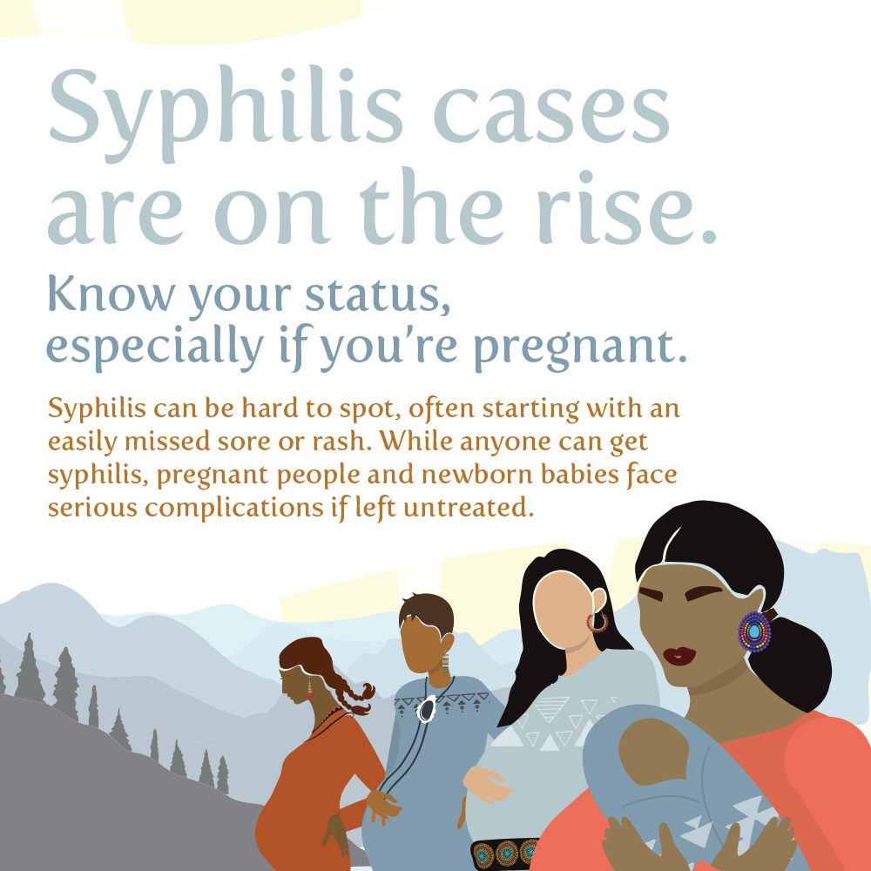
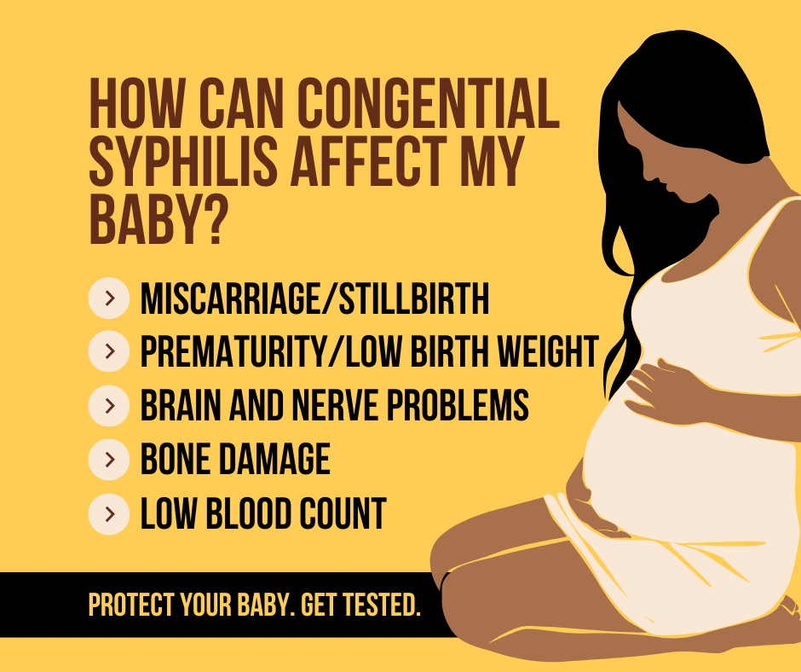
Think Syphilis

Slide 8
Who should be screened for syphilis? US Preventive Services Task Force Grade A Recommendations
“The USPSTF recommends early screening for syphilis infection in all pregnant women”.
All pregnant women are at risk. All pregnant women should be tested for syphilis as early as possible when they first present to care (including emergency and urgent Care). If a woman has not received prenatal care prior to delivery, she should be tested at the time she presents for delivery.
“The USPSTF continues to recommend screening for syphilis in nonpregnant persons who are at increased risk for infection”.
Population: Asymptomatic, nonpregnant adolescents and adults who are at increased risk for syphilis infection
Place: Per CDC and AMA, including emergency departments and urgent care centers
https://www.uspreventiveservicestaskforce.org/uspstf/recommendation/syphilis-infection-in-pregnancy-screening
https://www.uspreventiveservicestaskforce.org/uspstf/announcements/final-recommendation-statement-screening-syphilis-infection-nonpregnant-adolescents-and-adults
https://www.ama-assn.org/delivering-care/public-health/routinely-screen-hiv-stis-viral-hepatitis-and-latent-tb-infection

Slide 9
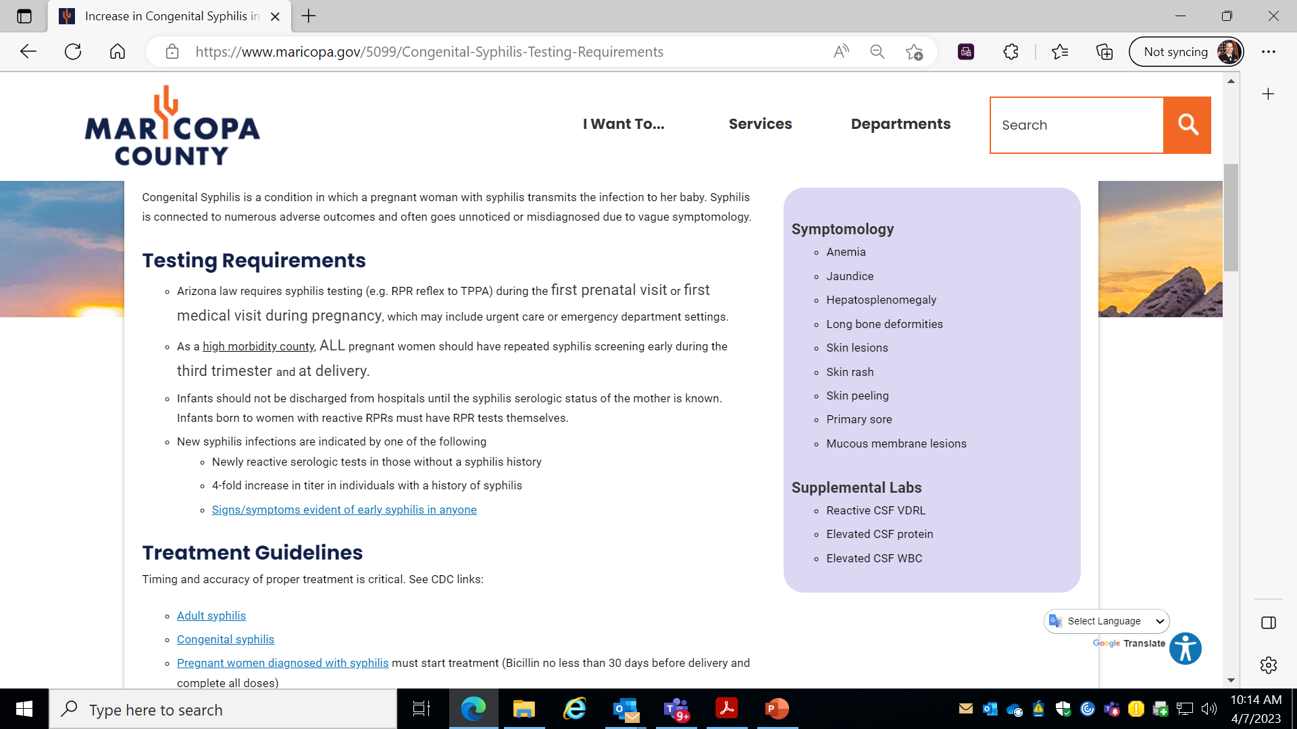
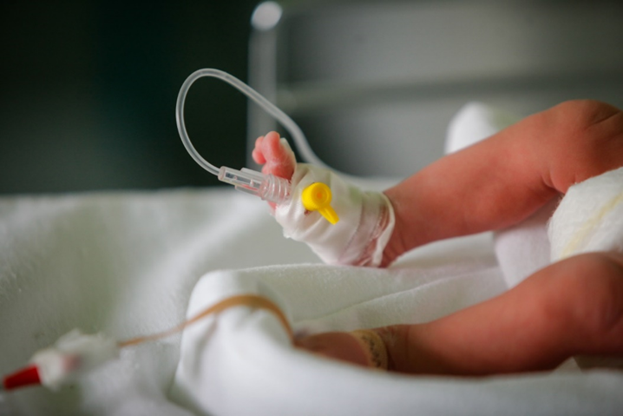
Maternal Screening for Syphilis
Maternal Screening for Syphilis
https://www.cdc.gov/std/statistics/2019/case-definitions.htm)

Slide 10
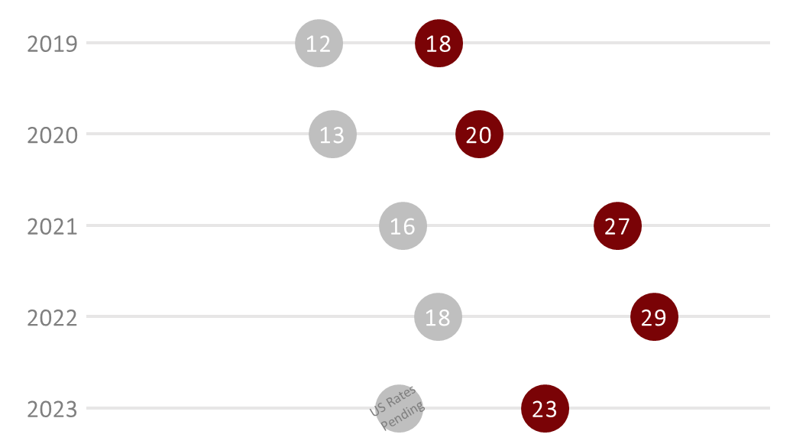
Primary and Secondary Syphilis —
Rates of Reported Cases, US vs Arizona, 2023*
*2023 rates are preliminary and are subject to change
**2022 and 2023 rates of syphilis in the U.S. are not yet available
***Rates are calculated per 100,000
Notes:
*2023 AZ rates calculated using 2022 AZ population (2023 denominators not available)
*2023 data are preliminary and subject to change

Slide 11
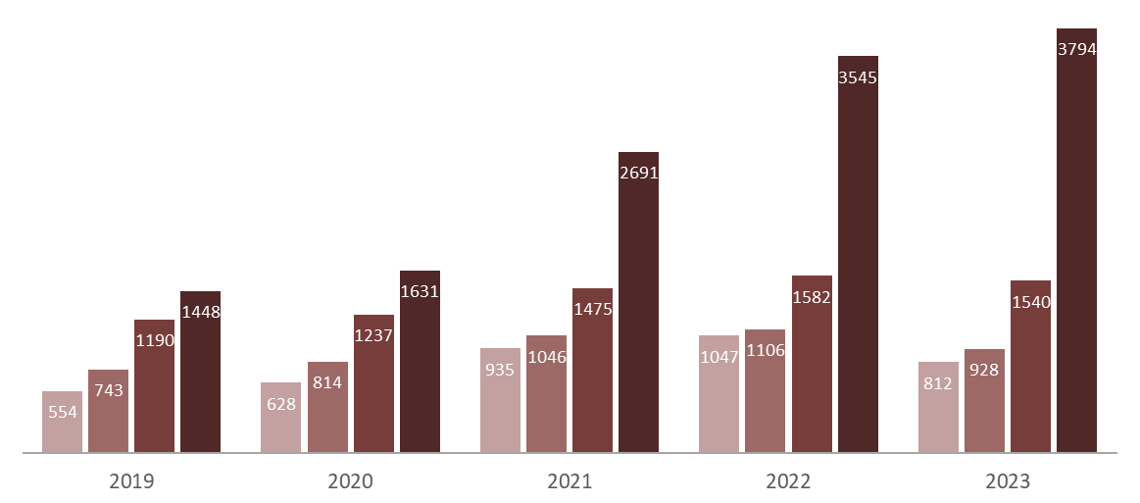
Adult Syphilis* —
Number of Reported Cases, Arizona, 2019- 2023**
Primary | Secondary | Early Latent | Late Latent/Unknown Duration
*Adult Syphilis counts are comprised of primary, secondary, early latent, and late latent syphilis
**2023 counts are preliminary and are subject to change

Slide 12
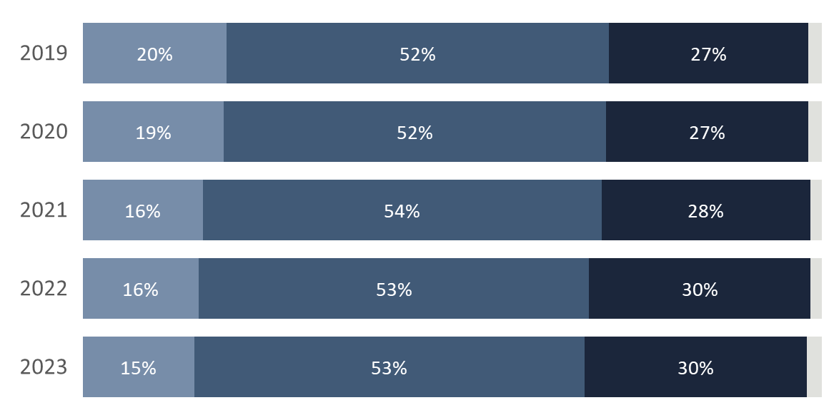
Adult Syphilis* by Age Group —
Arizona, 2019- 2023**
10-24 | 25-39 | 40-64| 65+
*Adult Syphilis counts are comprised of primary, secondary, early latent, and late latent syphilis
**2023 counts are preliminary and are subject to change
Notes:
65+ is 2% for every year

Slide 13
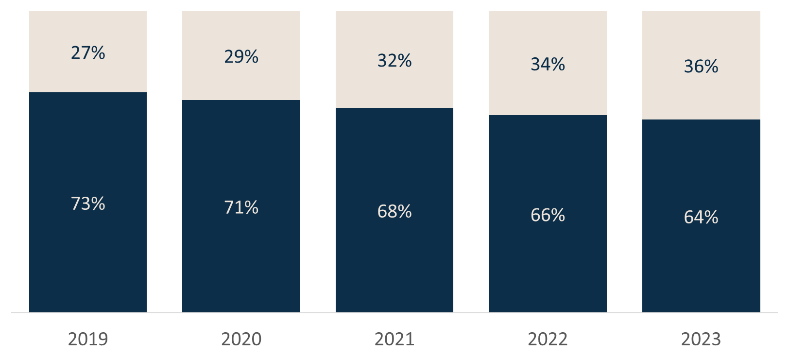
Adult Syphilis* by Sex at Birth —
Arizona, 2019- 2023**
Male | Female
*Adult Syphilis counts are comprised of primary, secondary, early latent, and late latent syphilis
**2023 counts are preliminary and are subject to change

Slide 14
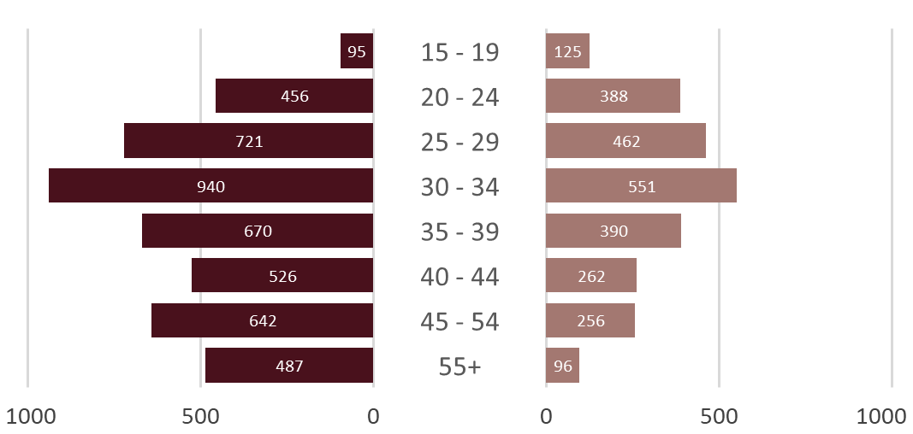
Adult Syphilis* — Number of Reported Cases by Age Group and Sex, Arizona, 2023**
Male | Female
*Adult Syphilis counts are comprised of primary, secondary, early latent, and late latent syphilis
**2023 counts are preliminary and are subject to change
Female Cases
Notes:
2023 Adult Syphilis (Including primary, secondary, early latent, and late latent/unknown duration) by Sex at Birth and Age Groups
*Please interpret data with caution; 2023 data are still preliminary.*

Slide 15
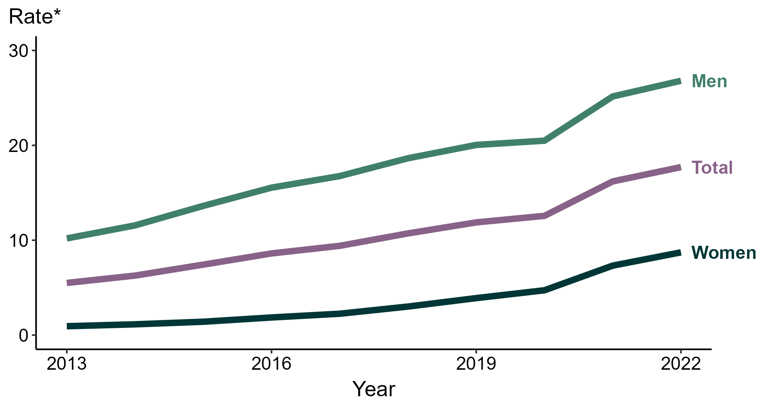
Primary and Secondary Syphilis — Rates of Reported Cases by Sex, United States, 2013–2022
* Per 100,000
https://www.cdc.gov/std/statistics/2022/figures.htm
Notes:
During 2021 to 2022, the rate of reported primary and secondary syphilis among women increased 19.2% (from 7.3 to 8.7 per 100,000) and the rate among men increased 6.3% (from 25.2 to 26.8 per 100,000).
Over the last five years, the rate of reported primary and secondary syphilis among women increased 190.0% (from 3.0 to 8.7 per 100,000) and the rate among men increased 44.1% (from 18.6 to 26.8 per 100,000). Over the last 10 years, the rate among women increased 866.7% (from 0.9 to 8.7 per 100,000) and the rate among men increased 162.7% (from 10.2 to 26.8 per 100,000).
This report includes data from years that coincide with the COVID-19 pandemic, which introduced uncertainty and difficulty in interpreting STI surveillance data. See Impact of COVID-19 on STIs for more information.
See Technical Notes (https://www.cdc.gov/std/statistics/2022/technical-notes.htm) for information on syphilis case reporting. Table A1 (https://www.cdc.gov/std/statistics/2022/tables/a1.htm) provides information on unknown, missing, or invalid values of select variables.
Data for all figures are available at https://www.cdc.gov/std/statistics/2022/data.zip. The file “PS Syphilis - Rates by Sex (US 2013-2022).xlsx” contains the data for the figure presented on this slide.

Slide 16
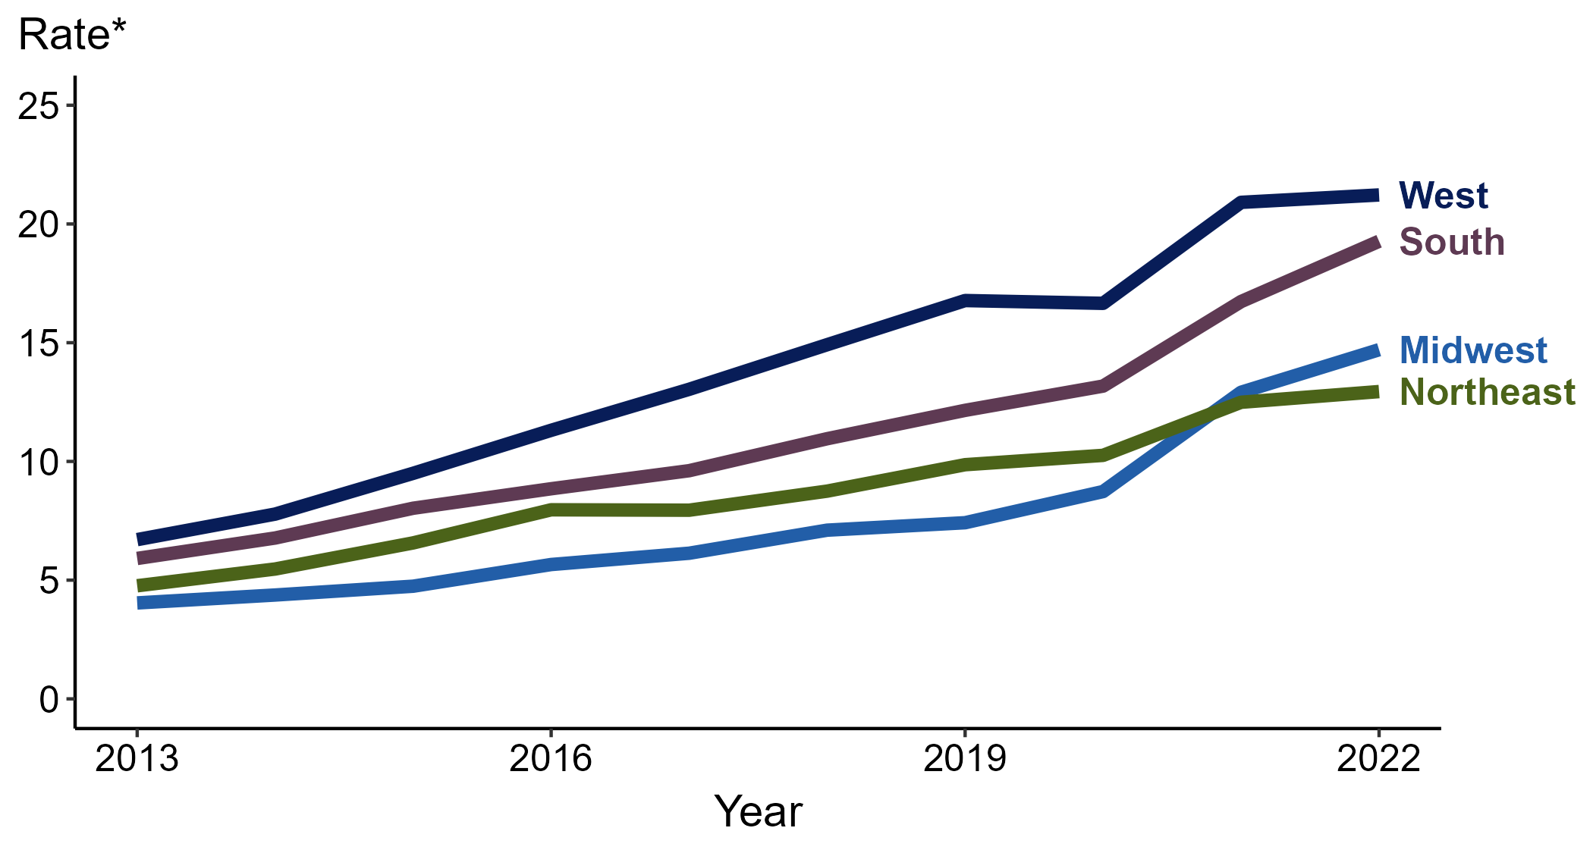
Primary and Secondary Syphilis — Rates of Reported Cases by Region, United States, 2013–2022
* Per 100,000
https://www.cdc.gov/std/statistics/2022/figures.htm
Notes:
In 2022, the West had the highest rate of reported primary and secondary (P&S) syphilis (21.2 cases per 100,000; 1.4% increase from 2021), followed by the South (19.3 cases per 100,000; 15.6% increase from 2021), the Midwest (14.7 cases per 100,000; 14.0% increase from 2021), and the Northeast (12.9 cases per 100,000; 3.2% increase from 2021).
The Midwest had the greatest five-year increase in rates of reported cases of P&S syphilis (7.1 to 14.7 per 100,000; 107.0% increase from 2018). The Midwest also had the greatest 10-year increase in rates of reported cases of P&S syphilis (4.0 to 14.7 per 100,000; 267.5% increase from 2013).
This report includes data from years that coincide with the COVID-19 pandemic, which introduced uncertainty and difficulty in interpreting STI surveillance data. See Impact of COVID-19 on STIs for more information.
See Technical Notes (https://www.cdc.gov/std/statistics/2022/technical-notes.htm) for information on syphilis case reporting.
Data for all figures are available at https://www.cdc.gov/std/statistics/2022/data.zip. The file “PS Syphilis - Rates by Region (US 2013-2022).xlsx” contains the data for the figure presented on this slide.

Slide 17
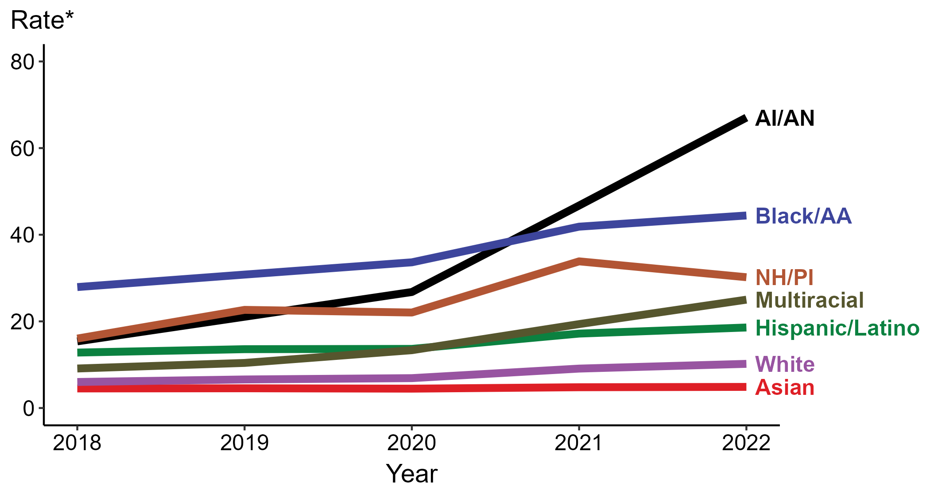
Primary and Secondary Syphilis — Rates of Reported Cases by Race/Hispanic Ethnicity, United States, 2018–2022
* Per 100,000
ACRONYMS: AI/AN = American Indian or Alaska Native; Black/AA = Black or African American; NH/PI = Native Hawaiian or other Pacific Islander
https://www.cdc.gov/std/statistics/2022/figures.htm
Notes:
In 2022, the highest rate of reported primary and secondary syphilis cases per 100,000 persons was among non-Hispanic American Indian or Alaska Native persons (67.0), followed by non-Hispanic Black or African American persons (44.4).
During 2021 to 2022, the greatest increase in rate of reported primary and secondary syphilis cases per 100,000 persons was among non-Hispanic American Indian or Alaska Native persons (46.7 to 67.0; 43.5% increase). Non-Hispanic American Indian or Alaska Native persons also had the greatest five-year increase in rate of reported primary and secondary syphilis (15.4 to 67.0; 335.1% increase from 2018).
During 2021 to 2022, the only decrease in rate of reported primary and secondary syphilis cases per 100,000 persons was among non-Hispanic Native Hawaiian or other Pacific Islander persons (33.9 to 30.2; 10.9% decrease). There were no decreases in the rate of reported primary and secondary syphilis among any race or Hispanic ethnicity group during 2018 to 2022.
This report includes data from years that coincide with the COVID-19 pandemic, which introduced uncertainty and difficulty in interpreting STI surveillance data. See Impact of COVID-19 on STIs for more information.
See Technical Notes (https://www.cdc.gov/std/statistics/2022/technical-notes.htm) for information on syphilis case reporting, race/Hispanic ethnicity categorization, and reporting of race/Hispanic ethnicity for STI cases. Table A1 (https://www.cdc.gov/std/statistics/2022/tables/a1.htm) provides information on unknown, missing, or invalid values of select variables.
Data for all figures are available at https://www.cdc.gov/std/statistics/2022/data.zip. The file “PS Syphilis - Rates by Race Hispanic Ethnicity (US 2018-2022).xlsx” contains the data for the figure presented on this slide.

Slide 18
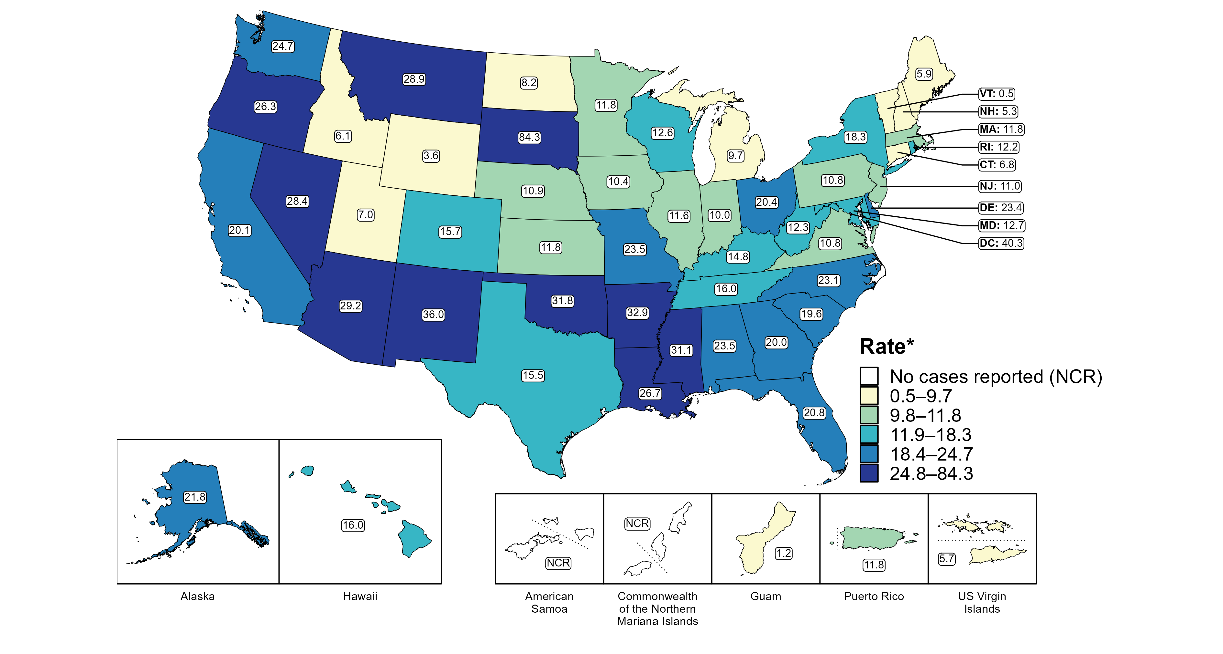
Primary and Secondary Syphilis — Rates of Reported Cases by Jurisdiction, United States and Territories, 2022
* Per 100,000
https://www.cdc.gov/std/statistics/2022/figures.htm
Notes:
In 2022, rates of reported primary and secondary (P&S) syphilis ranged by state from 0.5 cases per 100,000 population in Vermont to 84.3 cases per 100,000 population in South Dakota. The rate of reported P&S syphilis in the District of Columbia was 40.3 per 100,000 population.
Among US territories reporting any cases, rates of reported P&S syphilis ranged from 1.2 cases per 100,000 population in Guam to 11.8 cases per 100,000 population in Puerto Rico. No cases of P&S syphilis were reported in American Samoa and the Commonwealth of the Northern Mariana Islands.
This report includes data from years that coincide with the COVID-19 pandemic, which introduced uncertainty and difficulty in interpreting STI surveillance data. See Impact of COVID-19 on STIs for more information.
See Technical Notes (https://www.cdc.gov/std/statistics/2022/technical-notes.htm) for information on syphilis case reporting and on interpreting reported rates in US territories.
Data for all figures are available at https://www.cdc.gov/std/statistics/2022/data.zip. The file “PS Syphilis - Rates by Jurisdiction (US and Terr 2022).xlsx” contains the data for the figure presented on this slide.

Slide 19
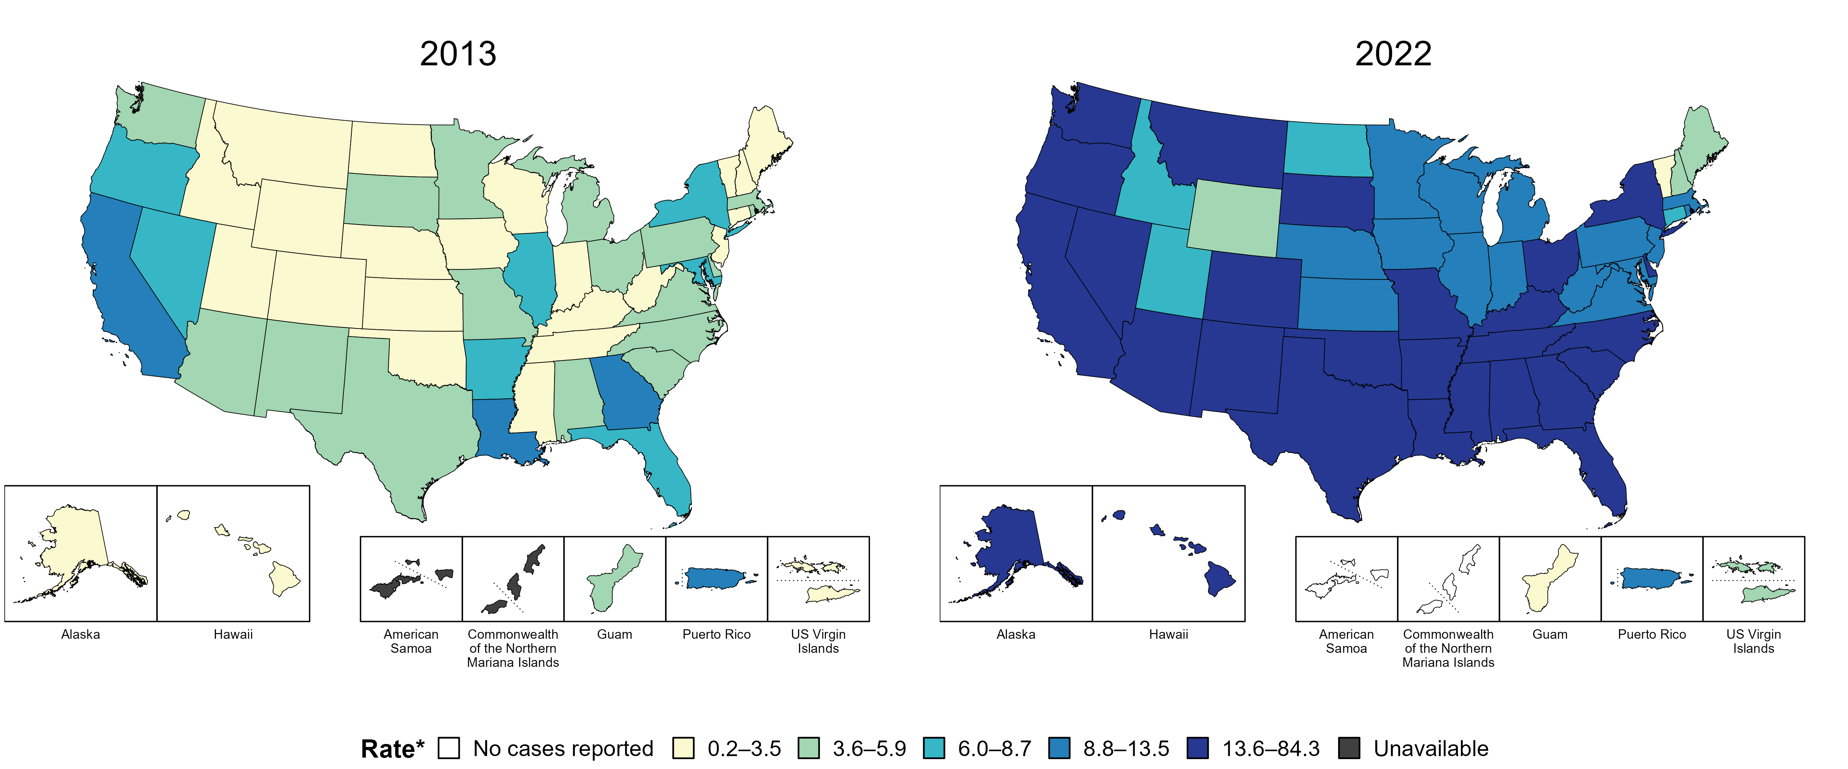
Primary and Secondary Syphilis — Rates of Reported Cases by Jurisdiction, United States and Territories, 2013 and 2022
* Per 100,000
https://www.cdc.gov/std/statistics/2022/figures.htm
Notes:
In 2013, three states, the District of Columbia (DC), and one US territory (9.3% of areas with available data) had a rate of reported primary and secondary syphilis greater than or equal to 8.8 cases per 100,000 population. This increased to 42 states, DC, and one US territory (78.6% of areas with available data) in 2022.
American Samoa and the Commonwealth of the Northern Mariana Islands began reporting data on primary and secondary syphilis cases to CDC in 2018; data are not available for those areas prior to that year.
This report includes data from years that coincide with the COVID-19 pandemic, which introduced uncertainty and difficulty in interpreting STI surveillance data. See Impact of COVID-19 on STIs for more information.
See Technical Notes (https://www.cdc.gov/std/statistics/2022/technical-notes.htm) for information on syphilis case reporting and on interpreting reported rates in US territories.
Data for all figures are available at https://www.cdc.gov/std/statistics/2022/data.zip. The file “PS Syphilis - Rates by Jurisdiction (US and Terr 2013 and 2022).xlsx” contains the data for the figure presented on this slide.

Slide 20
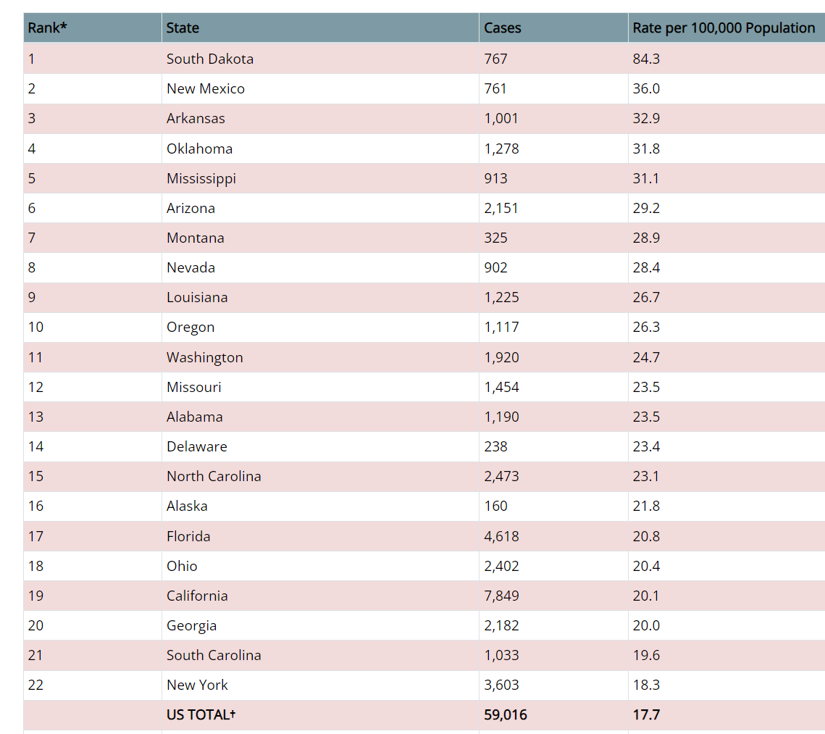
Primary and Secondary Syphilis — Reported Cases and Rates by State, United States, 2022
https://www.cdc.gov/std/statistics/2022/tables/21.htm

Slide 21
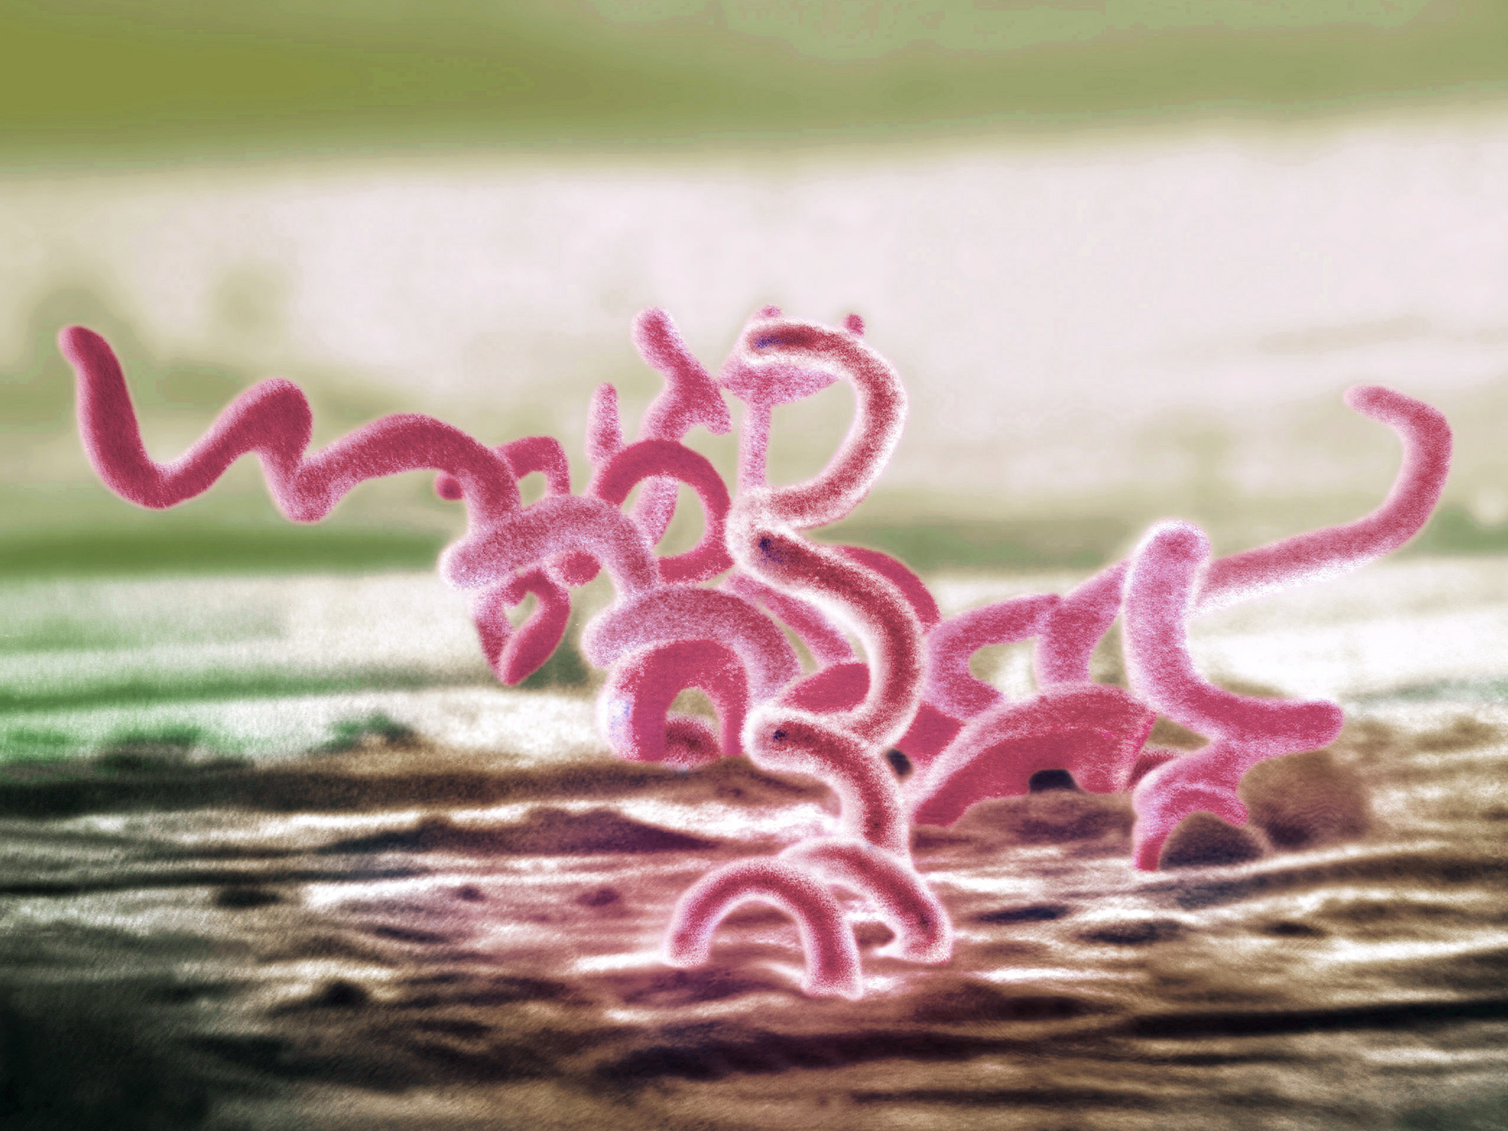
Syphilis
Syphilis
Treponema pallidum
Sexual, vertical, and horizontal transmission
Curable with penicillin
4 stages
Primary
Secondary
Early (non-primary, non-secondary)
Unknown duration or late
Notes:
Horizontal transmission is rare but can occur from blood transfusion or organ transplantation “Prior to the standard practice of using gloves by healthcare providers, there were reports of extragenital syphilitic lesions on the fingers and in the nose of physicians.^{12,39} In addition, the transmission of syphilis via human bite in both sexual and non-sexual circumstances has been reported,^{13–15} as well as transmission via mouth-to-mouth feeding of infants with pre-chewed food from infected relatives”
Stoltey JE, Cohen SE. Syphilis transmission: a review of the current evidence. Sex Health. 2015;12(2):103-109. doi:10.1071/SH14174
Tertiary syphilis is no longer consider a stage of syphilis rather the clinical signs are called “late”

Slide 22
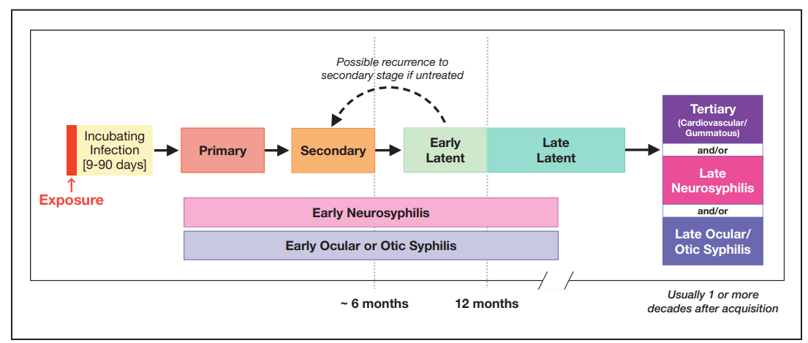
Natural History of Untreated Syphilis Infection
Transmission to fetus during pregnancy
The Diagnosis, Management and Prevention of Syphilis An Update and Review. New York City Department of Health and Mental Hygiene Bureau of
Sexually Transmitted Infections and the New York City STD Prevention Training Center . May 2019. https://www.nycptc.org/x/Syphilis_Monograph_2019_NYC_PTC_NYC_DOHMH.pdf

Slide 23
Case Definitions: Primary Syphilis
Clinical Description
Characterized by one or more ulcerative lesions (e.g. chancre), which might differ in clinical appearance.
Classic Presentation
Single painless ulcer or chancre at the site of infection
Atypical Presentation
Multiple, atypical, or painful lesions at the site of infection
Vaginal
Tongue
Penile
https://www.cdc.gov/std/syphilis/images.htm and https://www.cdc.gov/std/statistics/2019/case-definitions.htm
Notes:
Case Definitions in Effect During 2019 (cdc.gov)
“Syphilis, primary
Clinical description
A stage of infection with Treponema pallidum characterized by one or more ulcerative lesions (e.g., chancre), which might differ considerably in clinical appearance.
Laboratory criteria for diagnosis
Confirmatory:
Demonstration of T. pallidum by darkfield microscopy in a clinical specimen that was not obtained from the oropharynx and is not potentially contaminated by stool, OR
Demonstration of T. pallidum by polymerase chain reaction (PCR) or equivalent direct molecular methods in any clinical specimen.
Supportive:
A reactive nontreponemal serologic test (Venereal Disease Research Laboratory [VDRL], rapid plasma reagin [RPR], or equivalent serologic methods), OR
A reactive treponemal serologic test (T. pallidum particle agglutination [TP-PA], enzyme immunoassay [EIA], chemiluminescence immunoassay [CIA], or equivalent serologic methods).*
* These treponemal tests supersede older testing technologies, including microhemagglutination assay for antibody to T. pallidum [MHA-TP].
Case classification
Probable: a case that meets the clinical description of primary syphilis and the supportive laboratory criteria.
Confirmed: a case that meets the clinical description of primary syphilis and the supportive confirmatory criteria.”

Slide 24
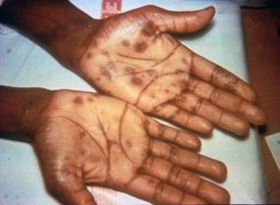
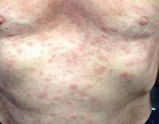
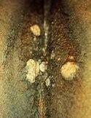
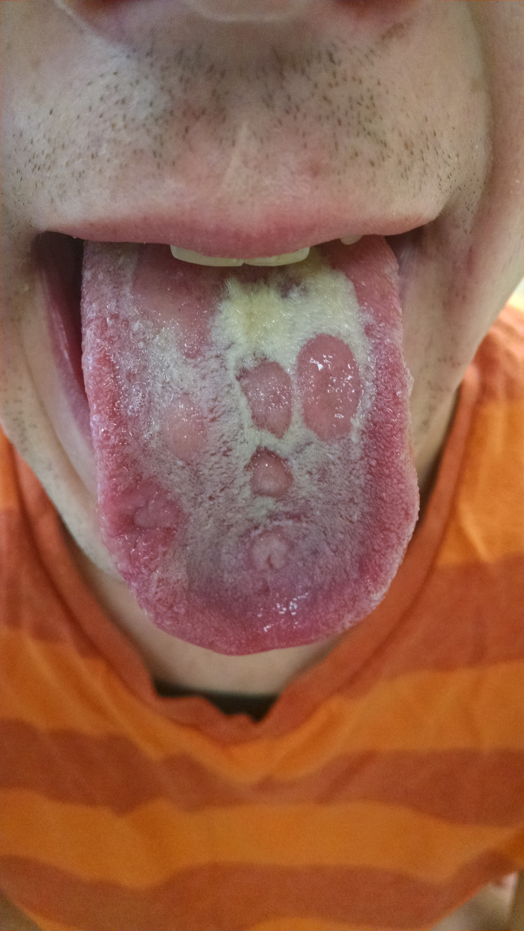
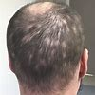
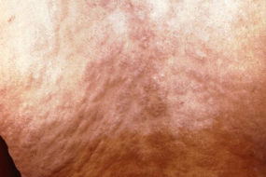
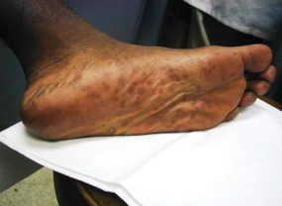
Case Definitions: Secondary Syphilis
Clinical Description
Characterized by localized or diffuse mucocutaneous lesions (e.g., rash – such as non-pruritic macular, maculopapular, papular, or pustular lesions), often with generalized lymphadenopathy. Other signs can include mucous patches, condyloma lata, and alopecia. The primary ulcerative lesion may still be present.
Torso/back rash
Palmar/plantar rash
Condyloma lata
Alopecia
Mucous patches
https://www.cdc.gov/std/syphilis/images.htm
https://www.cdc.gov/std/statistics/2019/case-definitions.htm
Notes:
Case Definitions in Effect During 2019 (cdc.gov)
“A stage of infection caused by T. pallidum characterized by localized or diffuse mucocutaneous lesions (e.g., rash – such as non-pruritic macular, maculopapular, papular, or pustular lesions), often with generalized lymphadenopathy. Other symptoms can include mucous patches, condyloma lata, and alopecia. The primary ulcerative lesion may still be present. Because of the wide array of symptoms and signs possibly indicating secondary syphilis, serologic tests for syphilis and a physical examination are crucial to determining if a case should be classified as secondary syphilis.
Laboratory criteria for diagnosis
Confirmatory:
Demonstration of T. pallidum by darkfield microscopy in a clinical specimen that was not obtained from the oropharynx and is not potentially contaminated by stool, OR
Demonstration of T. pallidum by polymerase chain reaction (PCR) or equivalent direct molecular methods in any clinical specimen.
Supportive:
A reactive nontreponemal serologic test (VDRL, RPR, or equivalent serologic methods), AND
A reactive treponemal serologic test (TP-PA, EIA, CIA, or equivalent serologic methods).”

Slide 25
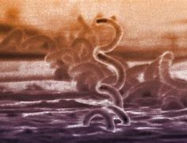
Case Definitions: Early (non-primary non-secondary)
Clinical Description
Stage of infection caused by T. pallidum in which initial infection has occurred within the previous 12 months, but there are no current signs or symptoms of primary or secondary syphilis.
Less than 12 months duration by (1) interval from prior negative syphilis test (or 4-fold titer increase) OR (2) report of symptoms consistent with syphilis within prior 12 months OR (3) sexual contact with a known case (or sexual debut) within prior 12 months
https://www.cdc.gov/std/statistics/2019/case-definitions.htm)
Notes:
Case Definitions in Effect During 2019 (cdc.gov)
“Case classification
Probable: a person with no clinical signs or symptoms of primary or secondary syphilis who has one of the following:
No prior history of syphilis, AND a current reactive nontreponemal test (e.g., VDRL, RPR, or equivalent serologic methods), AND a current reactive treponemal test (e.g., TP-PA, EIA, CIA, or equivalent serologic methods), OR
A prior history of syphilis and meets the supportive laboratory criteria.
AND evidence of having acquired the infection within the previous 12 months based on one or more of the following criteria:
Documented seroconversion or fourfold or greater increase in titer of a nontreponemal test during the previous 12 months, unless there is evidence that this increase was not sustained for >2 weeks
Documented seroconversion of a treponemal test during the previous 12 months
A history of symptoms consistent with primary or secondary syphilis during the previous 12 months
Meets epidemiologic criteria.
Epidemiological criteria:
A history of sexual exposure to a partner within the previous 12 months who had primary, secondary, or early non-primary non-secondary syphilis (documented independently as duration <12 months).
Only sexual contact (sexual debut) was within the previous 12 months.”

Slide 26
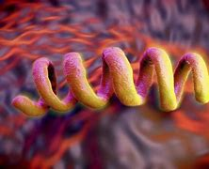
Case Definitions: Unknown duration or late
Clinical Description
Stage of infection caused by T. pallidum in which initial infection has occurred >12 months previously or in which there is insufficient evidence to conclude that infection was acquired during the previous 12 months.
Unknown or greater than 12 months duration by: (1) interval from prior negative syphilis test (or 4-fold titer increase) OR (2) report of symptoms consistent with syphilis occurring > 12 months ago OR (3) sexual contact with a known case > 12 months ago (4) Neurologic, ocular, otic signs without evidence of acquiring infection in prior 12 months.
Notes:
Case Definitions in Effect During 2019 (cdc.gov)
“Syphilis, unknown duration or late
Clinical description
A stage of infection caused by T. pallidum in which initial infection has occurred >12 months previously or in which there is insufficient evidence to conclude that infection was acquired during the previous 12 months.
Case classification
Probable: a person with no clinical signs or symptoms of primary or secondary syphilis who meets one of the following sets of criteria:
No prior history of syphilis, and a current reactive nontreponemal test (e.g., VDRL, RPR, or equivalent serologic methods), and a current reactive treponemal test (e.g., TP-PA, EIA, CIA, or equivalent serologic methods), OR
A prior history of syphilis, and a current nontreponemal test titer demonstrating fourfold or greater increase from the last nontreponemal test titer, unless there is evidence that this increase was not sustained for >2 weeks, OR
Clinical signs or symptoms and laboratory results that meet the likely or verified criteria for neurologic, ocular, otic, or late clinical manifestations syphilis (see below)
AND who has no evidence of having acquired the disease within the preceding 12 months (see Syphilis, early non-primary non-secondary).
Comments: Although cases of syphilis of unknown duration are grouped together with late syphilis for the purposes of surveillance, the conservative clinical and public health responses to these cases will differ when there is uncertainty about the duration of infection. When faced with uncertainty, clinicians should act conservatively and treat unknown duration syphilis as if it were late infection, with three doses of benzathine penicillin. In contrast, the most conservative approach for STD control programs would be to manage cases of syphilis of unknown duration as early non-primary non-secondary infections and search for partners who may have been recently infected. Because this would not be feasible for most STD control programs, programs should consider prioritizing cases of syphilis of unknown duration with higher nontreponemal titers (e.g., 1:32 or higher) for investigation and partner services. Although nontreponemal titers cannot reliably distinguish between early infection (<12 months duration) and late infection (>12 months duration), nontreponemal titers usually are higher early in the course of syphilis infection.

Slide 27
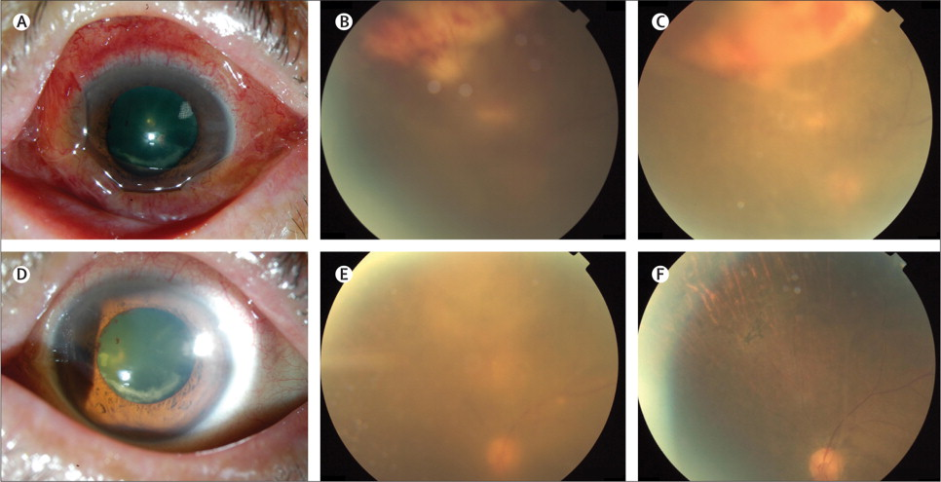
Neurologic manifestations can occur at any stage
Neurosyphilis | Ocular syphilis | Otosyphilis
Infection of the central nervous system with T. pallidum, as evidenced by manifestations including: Syphilitic meningitis, Meningovascular syphilis, General paresis, Dementia, Tabes dorsalis | Infection of any eye structure with T. pallidum. Manifestations can involve any structure in the anterior and posterior segment of the eye including: Conjunctivitis Anterior uveitis Posterior uveitis Panuveitis Posterior interstitial keratitis Optic neuropathy Retinal vasculitis Ocular syphilis may lead to decreased visual acuity including permanent blindness. | Infection of the cochleovestibular system with T. pallidum, as evidenced by manifestations including sensorineural hearing loss, tinnitus, and vertigo. Typically presents with cochleo-vestibular symptoms including Tinnitus Vertigo Sensorineural hearing loss Unilateral/Bilateral Have a sudden onset Progress Rapidly Otic syphilis can result in permanent hearing loss
https://www.thelancet.com/journals/laninf/article/PIIS1473-3099(13)70198-1/fulltext

Slide 28
Uncommon presentations of adult syphilis
Ocular syphilis (iritis, retinitis, vitreitis)
Otic syphilis
Seizures (tonic-clonic)
Meningovascular stroke
Unilateral paralysis/weakness
Gait/balance abnormalities
Primary syphilis lesions: tonsil, lip, buccal mucosa, fingers, ear, eyelid
Neurosyphilis
Extensive necrotic lesions/purulent secretion
Hepatosplenomegaly
Giant necrotic and phagedenic chancres
Hair loss
Membranous glomerulonephritis
Proteinuria
Thoracic aortic aneurysm
Erythema multiforme-type skin lesions

Slide 29
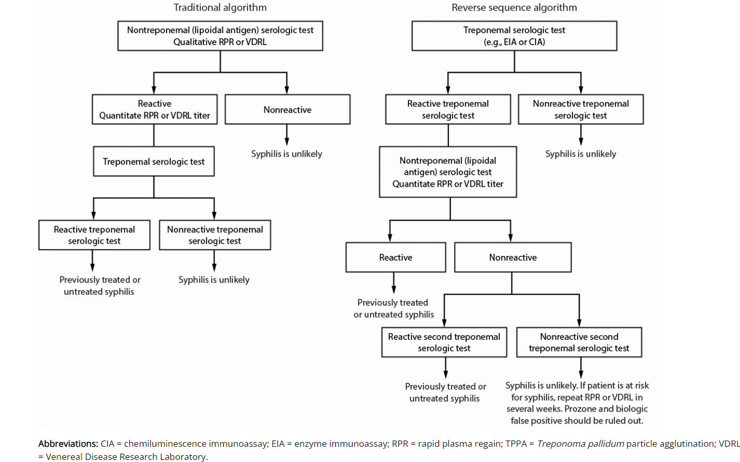
Serologic Diagnosis of Syphilis
Serologic Diagnosis of Syphilis
CDC Laboratory Recommendations for Syphilis Testing, United States, 2024 | MMWR

Slide 30
Serologic Diagnosis of Syphilis

Slide 31
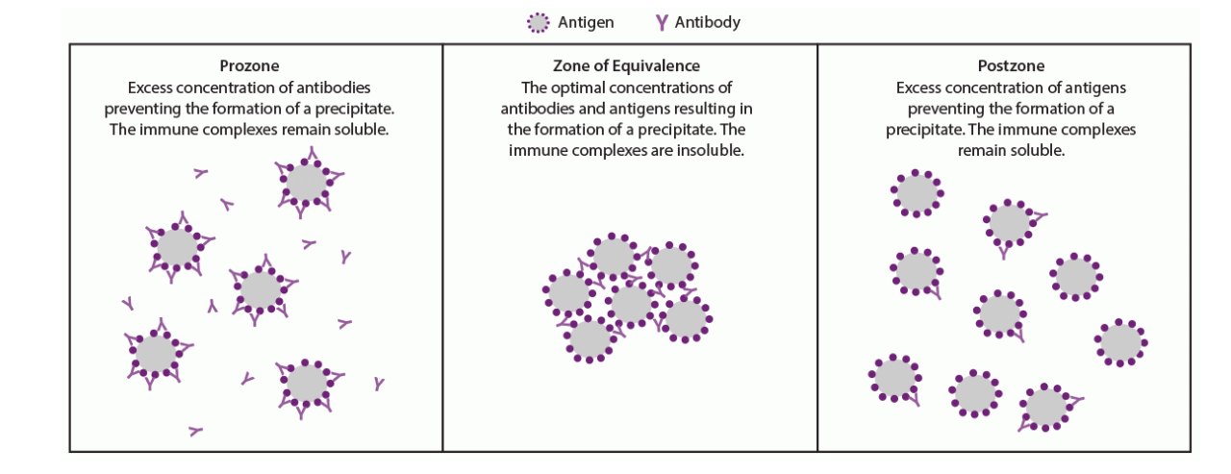
Prozone phenomena
CDC Laboratory Recommendations for Syphilis Testing, United States, 2024 | MMWR

Slide 32
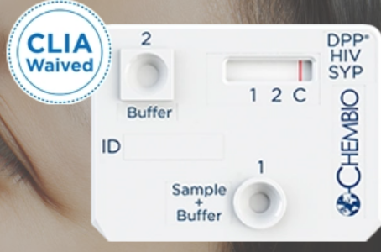
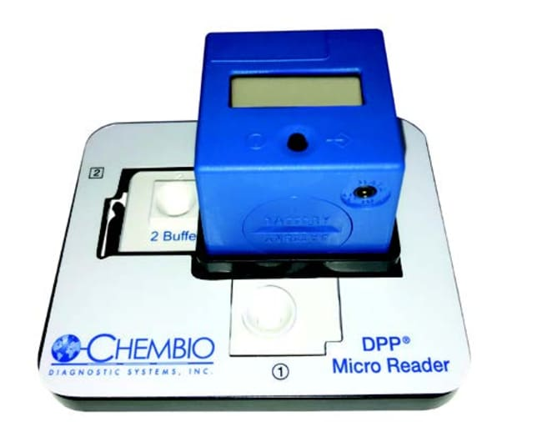
Rapid syphilis testing
Chembio
FDA-approved and CLIA-waived rapid dual HIV/syphilis test
Treponemal test component for syphilis
Sensitivity: >99% for HIV and >94% for T. pallidum
Sample volume: 10 μl
15-minute results for dual rapid test
Objective results using handheld
digital reader (DPP® Micro Reader)
DPP® HIV Syphilis USA – Chembio Diagnostics, Inc.

Slide 33
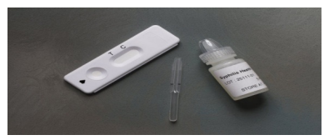
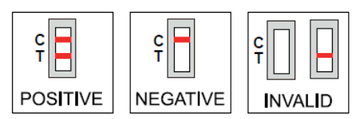
Rapid Syphilis Testing Continued
Syphilis Health Check
Treponemal test
FDA approved and CLIA waived
Results available in 10 minutes
About $10/test
Manufacturer: Diagnostics Direct
Syphilis point-of-care tests (cdc.gov)

Slide 34
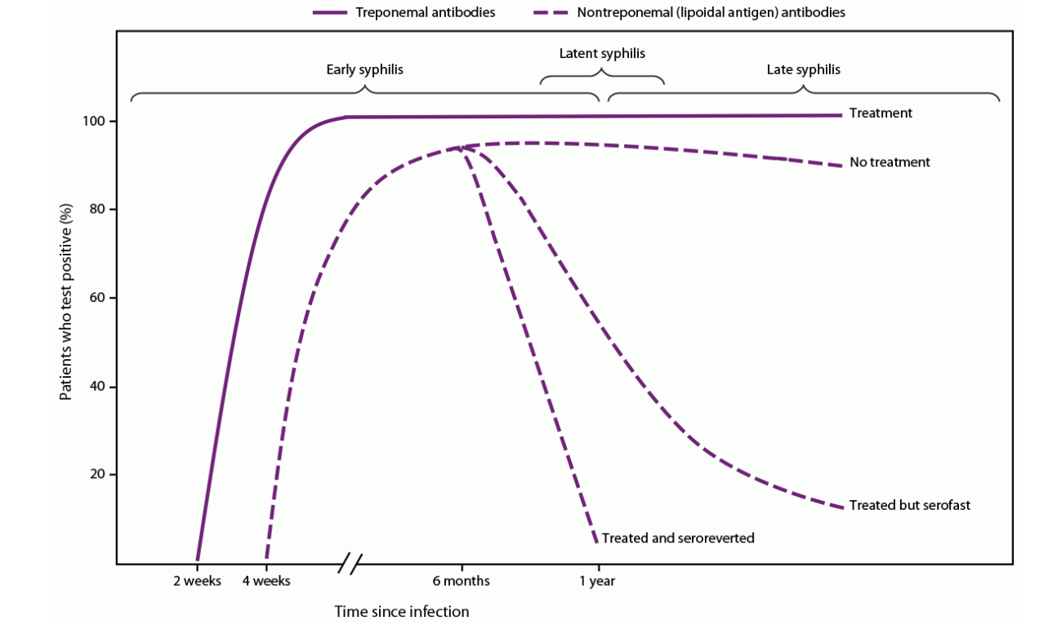
Expected serologic response after treatment
CDC Laboratory Recommendations for Syphilis Testing, United States, 2024 | MMWR
Adapted from Peeling RW, Mabey D, Kamb ML, Chen X-S, Radolf JD, Benzaken AS. Syphilis. Nat Rev Dis Primers 2017;3:17073.

Slide 35
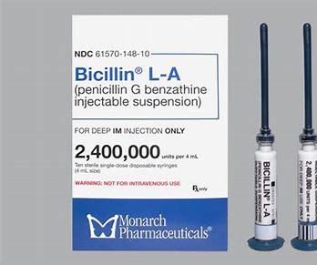
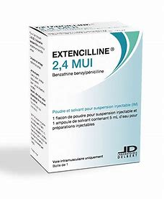
Secure the Supply of Benzathine Penicillin
https://www.cdc.gov/std/treatment-guidelines/default.htm
Notes:
Foundational to the syphilis response nationally is treatment with benzathine penicillin., the only recommended treatment for pregnant women. The national shortage of benzathine penicillin has affected the public health response to curbing the syphilis increases in the United States. The Indian Health Service has ensured that an adequate supply of benzathine penicillin is available for tribal members receiving care through I H S and tribal health facilities.

Slide 36
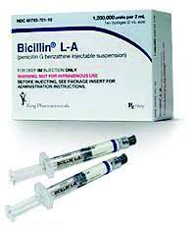
Treatment of syphilis with penicillin*: Overview
Stage
Primary | Secondary | Early non-primary, non secondary | Late Latent/ or Unknown Duration | Neurosyphilis, ocular syphilis and otic syphilis
Benzathine penicillin 2.4 million units IM in a single dose | Benzathine penicillin 2.4 million units IM in a single dose | Benzathine penicillin 2.4 million units IM in a single dose | Benzathine penicillin 2.4 million units total administered as 3 doses of 2.4 million units IM each at 1-week intervals | Aqueous crystalline penicillin G 18-24 million units per day, administered as 3-4 million units by IV every 4 hours or continuous infusion for 10-14 days Alternative: procaine penicillin G 2.4 million units IM 1x/day PLUS probenecid 500 mg orally 4x/day, both for 10-14 days
* Doxycycline is an alternative oral treatment for syphilis in non-pregnant patients
https://www.cdc.gov/std/treatment-guidelines/default.htm

Slide 37
Syphilis Treatment Compliance: Benzathine Penicillin Treatment Rates Among People with Late Latent and Unknown Duration Syphilis in Maricopa County, Arizona
Mangone et al. Sexually Transmitted Diseases. 2023 Jan 25. doi: 10.1097/OLQ.0000000000001775. PMID: 36693196.

Slide 38
Access to benzathine penicillin for syphilis patients, Maricopa County, AZ 2021 (n = 2977)
Mangone E, Bell J. Sexually Transmitted Diseases. In Press February 2024

Slide 39
Penicillin Allergy
Patients often are incorrectly labeled as allergic to penicillin
Evaluate what symptoms were experienced by patients with reported penicillin allergy
Penicillin allergy causing anaphylaxis is rare
In studies that have incorporated penicillin skin testing and graded oral challenge among persons with reported penicillin allergy, the true rates of allergy are low, ranging from 1.5% to 6.1%.
Allergies wane over time:
Approximately 80% of patients with a true IgE-mediated allergic reaction to penicillin have lost the sensitivity after 10 years
Desensitization is recommended for pregnant women diagnosed with syphilis followed by treatment with penicillin.
https://www.cdc.gov/std/treatment-guidelines/STI-Guidelines-2021.pdf . Page

Slide 40
Benzathine penicillin shortage
Shortage announced in March 2023, Supply expected to recover from U.S. sole-source, Pfizer in Q2 of 2024
January 2024, the U.S. Food and Drug Administration’s (FDA) announced the import of Extencilline (benzathine benzylpenicillin injection, powder, for suspension) from France.
CDC reports that Extencilline has been determined to be equivalent to Bicillin L-A® and is currently authorized and marketed in other countries.
To place an order, please contact Direct Success at Distribution@dsuccess.com or 1-877-404-3338.
https://www.cdc.gov/std/dstdp/dcl/2024-january-16-availability_of_extencilline.htm
DailyMed - EXTENCILLINE- benzathine benzylpenicillin kit EXTENCILLINE- benzathine benzylpenicillin injection, powder, for suspension (nih.gov)

Slide 41
Field Treatment
Field treatment can be offered for patients with syphilis or other STIs who cannot access care at a facility due to:
Transportation difficulties, childcare, privacy concerns, mental health issues, substance use, pregnancy
Necessary components to initiate treatment of syphilis in the field:
Standing orders, availability of public health nursing staff, coordination with pharmacy
PHN Syphilis Field-Based Treatment Policy - Indian Country ECHO

Slide 42
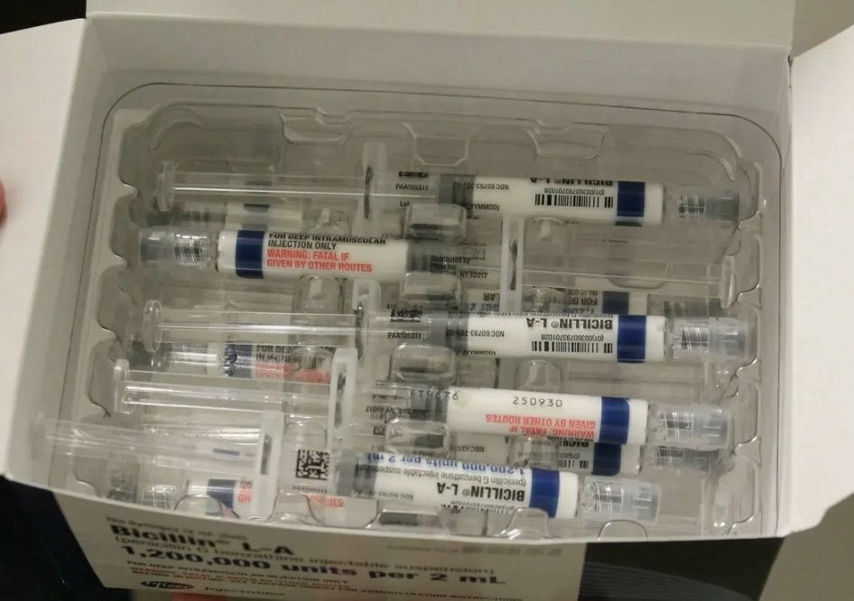
Presumptive Treatment
Presumptive treatment prior to receiving syphilis test results is recommended:
For patients with symptoms consistent with syphilis
For sexual contacts to syphilis cases
(For patients testing positive using rapid testing prior to confirmatory results)*
*Vital Signs: Missed Opportunities for Preventing Congenital Syphilis — United States, 2022 | MMWR (cdc.gov)

Slide 43
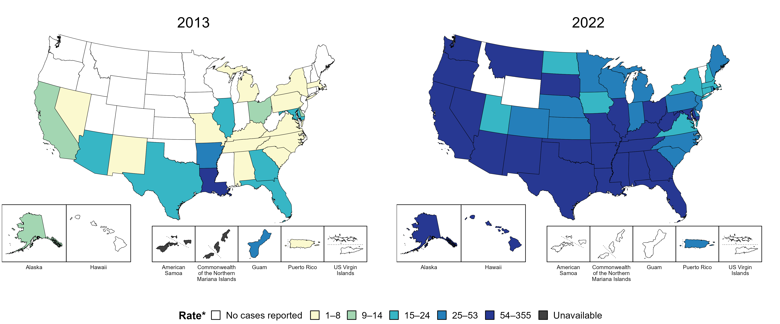
Congenital Syphilis — Rates of Reported Cases by Year of Birth and Jurisdiction, United States and Territories, 2013 and 2022
* Per 100,000 live births
Notes:
In 2022, there were a total of 3,755 cases of congenital syphilis reported among states and the District of Columbia (DC) for a rate of 102.5 per 100,000 live births. Including data from US territories, there were a total of 3,760 cases of congenital syphilis reported for a rate of 101.9 per 100,000 live births.
In 2013, two states and one US territory (5.6% of areas with available data) had a rate of reported congenital syphilis greater than or equal to 25 cases per 100,000 live births. This increased to 39 states, DC, and one US territory (73.2% of areas with available data) in 2022.
American Samoa and the Commonwealth of the Northern Mariana Islands began reporting data on congenital syphilis cases to CDC in 2018; data are not available for those areas prior to that year.
This report includes data from years that coincide with the COVID-19 pandemic, which introduced uncertainty and difficulty in interpreting STI surveillance data. See Impact of COVID-19 on STIs for more information.
See Technical Notes (https://www.cdc.gov/std/statistics/2022/technical-notes.htm) for information on syphilis case reporting and on interpreting reported rates in US territories.
Data for all figures are available at https://www.cdc.gov/std/statistics/2022/data.zip. The file “CS - Rates by Year of Birth and Jurisdiction (US and Terr 2013 and 2022).xlsx” contains the data for the figure presented on this slide.
Note: the interpretative text on this slide was updated on April 2, 2024 to correct a data error. No changes were made to the figure or the underlying data file.

Slide 44
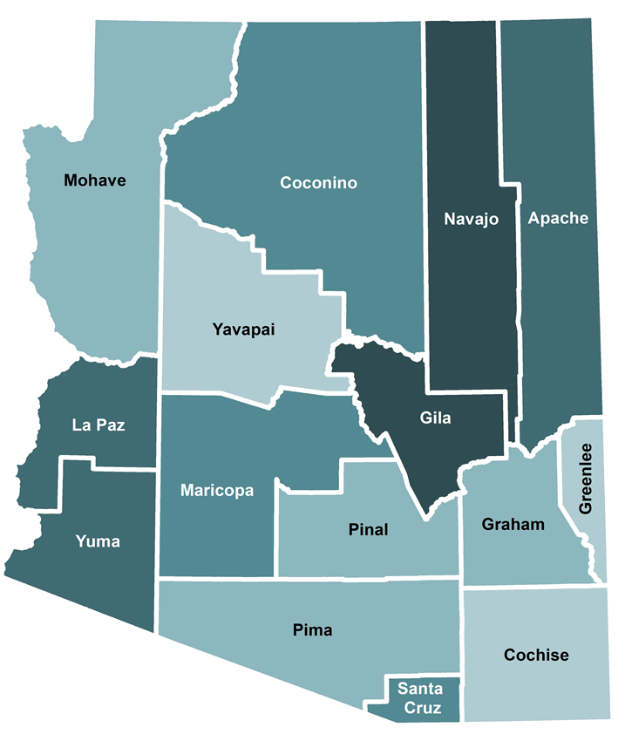
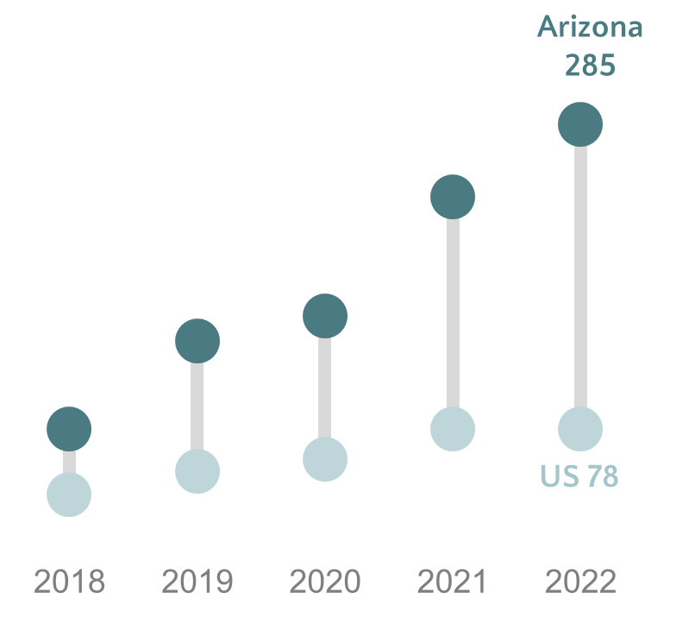
Congenital Syphilis — Arizona, 2018- 2022
Arizona has consistently had a higher incidence of congenital syphilis than the United States.
Notes:
Switching over to congenital syphilis quickly….Arizona has experienced a higher rate of congenital syphilis in comparison to the US for the last 5 years.
In 2022 in Arizona, 285 congenital cases were reported per 100,000 births. The 2022 US rate has yet to be released, but in 2021 the US had a rate of 78 cases per 100,000 births.
Congenital syphilis is present throughout the state, as shown by the map on the right. Gila county has the highest rate of congenital syphilis in the state. However, it’s important to keep in mind that rates can be high in areas with a very low population, where even a handful of cases can result in high rates. Ultimately, most congenital syphilis cases reported in Arizona occur in Maricopa county, where the majority of the Arizona population lives.
***2022 US rate not yet published – using 2021 US rate for comparison. 2022 Arizona rate calculated using 2020 birth population denominators, 2021 & 2022 birth population not released.***
Per the 2021 STD Surveillance Report by CDC - the national CS rate in 2021 was 78 per 100,000 live births - a 31% relative increase compared to the year prior.
To put this information in a national context – nationally, CS has increased over 200% in the last 5 years, with over 2,800 cases reported in 2021.

Slide 45
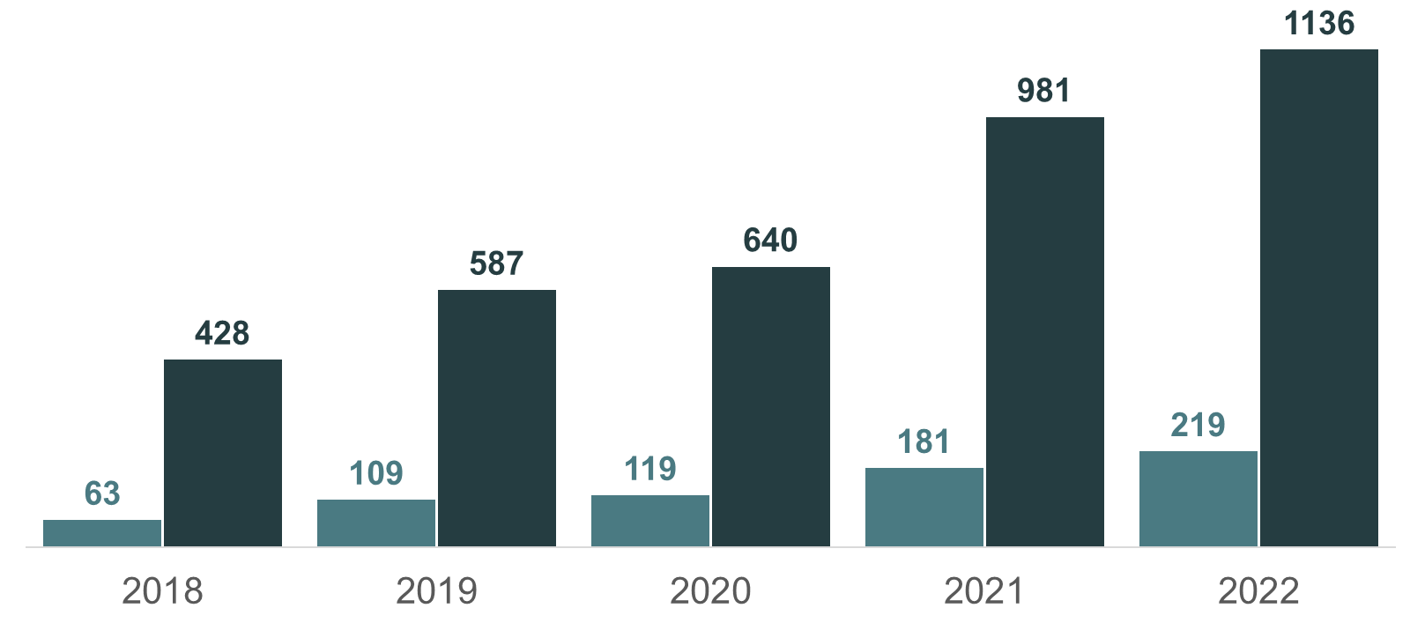
Early Syphilis* in Women & Infants — Arizona, 2018- 2022
Infants | Women
*Early Syphilis counts are comprised of primary, secondary, and early latent syphilis
Notes:
In Arizona in 2022, there were a total of 219 congenital cases reported.
The graph shown here includes congenital cases in the lighter blue, with female early syphilis cases in the darker blue. The increase of congenital cases over the past few years is a reflection of the increase of syphilis among reproductive-age women, which highlights the importance of ensuring pregnant persons are brought to treatment in a timely manner, especially for persons who may experience barriers when accessing care.
Additionally, nationally in 2021, 220 syphilis-related stillbirths and infant deaths were reported, 14 of which occurred in Arizona. In 2022, Arizona reported 32 infant deaths.

Slide 46
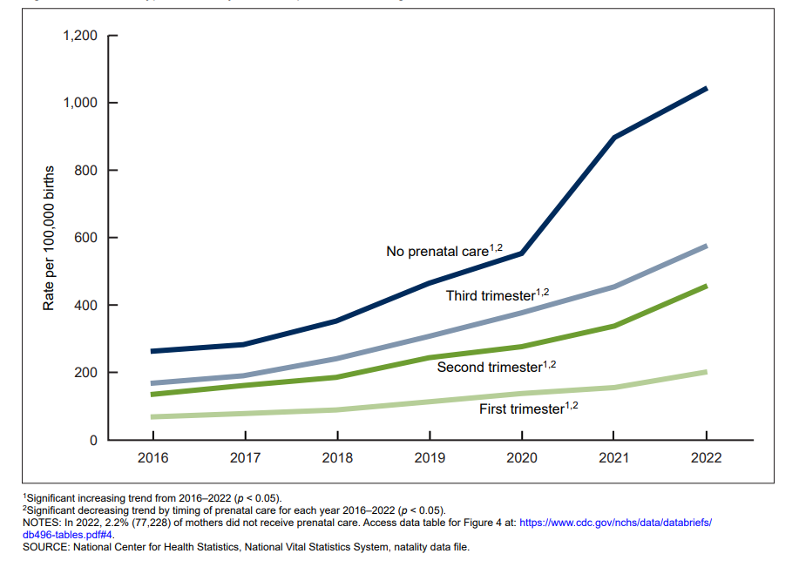
Maternal syphilis rate, by trimester prenatal care began: United States, 2016–2022

Slide 47
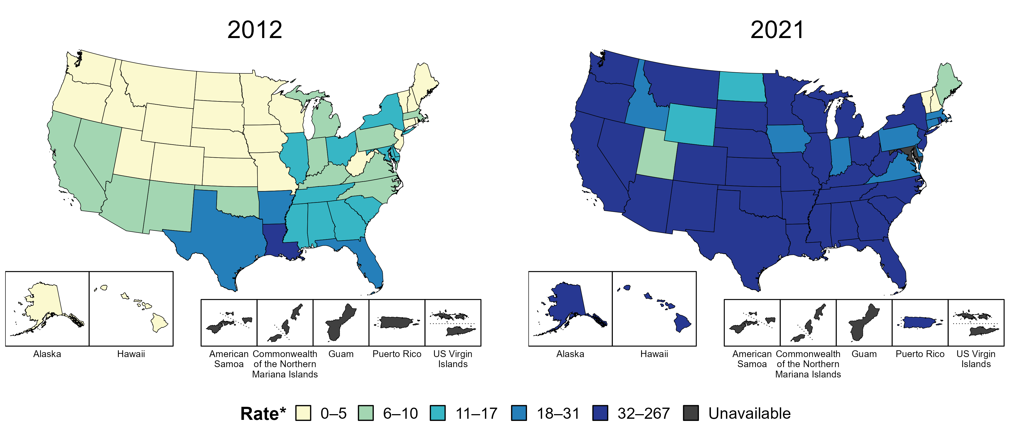
Syphilis (All Stages) — Rates of Reported Cases Among Women Aged 15–44 Years by State, United States and Territories, 2012 and 2021
* Per 100,000
https://www.cdc.gov/std/statistics/2021/figures.htm
Notes:
In 2012, four states and the District of Columbia (DC; 9.8% of areas with available data) had a rate of reported syphilis (all stages) greater than or equal to 18 cases per 100,000 women aged 15 to 44 years. This increased to 43 states, DC, and one US territory (88.2% of areas with available data) in 2021.
Data on reported cases of syphilis other than primary and secondary syphilis are not available by age and sex for American Samoa, the Commonwealth of the Northern Mariana Islands, Guam, and the US Virgin Islands. Additionally, population estimates by age and sex were not available in all territories in both years. Due to a network security incident in December 2021, the Maryland Department of Health could not finalize their 2021 STD case notification data. 2021 data from Maryland have been suppressed for this figure; however, they are included in national and regional case counts and rates displayed in other figures.
The COVID-19 pandemic has introduced uncertainty and difficulty in interpreting STD data collected during 2020 and 2021. See Impact of COVID-19 on STDs (https://www.cdc.gov/std/statistics/2021/impact.htm) for more information.
See Technical Notes (https://www.cdc.gov/std/statistics/2021/technical-notes.htm) for information on syphilis case reporting and on interpreting reported rates in US territories.
Data points are available at https://www.cdc.gov/std/statistics/2021/data.zip.

Slide 48
Congenital Syphilis — Reported Cases and Rates of Reported Cases by State, Ranked by Rates, United States, 2022
https://www.cdc.gov/std/statistics/2022/tables/31.htm

Slide 49
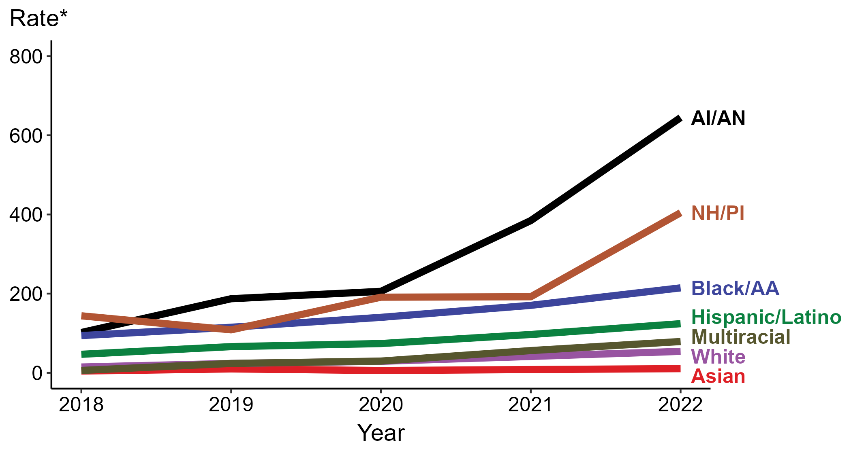
Congenital Syphilis — Rates of Reported Cases by Year of Birth, Race/Hispanic Ethnicity of Mother, United States, 2018–2022
* Per 100,000 live births
ACRONYMS: AI/AN = American Indian or Alaska Native; Black/AA = Black or African American; NH/PI = Native Hawaiian or other Pacific Islander
https://www.cdc.gov/std/statistics/2022/figures.htm
Notes:
In 2022, there were a total of 3,755 cases of congenital syphilis reported for a rate of 102.5 per 100,000 live births.
In 2022, the highest rate of reported cases of congenital syphilis per 100,000 live births was among mothers who were non-Hispanic American Indian or Alaska Native (644.7), followed by mothers who were non-Hispanic Native Hawaiian or other Pacific Islander (404.4).
During 2021 to 2022, the greatest increase in rate of reported cases of congenital syphilis per 100,000 live births was among mothers who were non-Hispanic Native Hawaiian or other Pacific Islander (192.1 to 404.4; 110.5% increase). Mothers who were non-Hispanic and of multiple races had the greatest five-year increase in rate of congenital syphilis (5.9 to 79.0; 1,239.0% increase from 2018).
There were no decreases in the rate of reported cases of congenital syphilis per 100,000 live births among any race or Hispanic ethnicity group during 2021 to 2022. There were also no decreases in the rate of congenital syphilis among any race or Hispanic ethnicity group during 2018 to 2022.
This report includes data from years that coincide with the COVID-19 pandemic, which introduced uncertainty and difficulty in interpreting STI surveillance data. See Impact of COVID-19 on STIs for more information.
See Technical Notes (https://www.cdc.gov/std/statistics/2022/technical-notes.htm) for information on syphilis case reporting, race/Hispanic ethnicity categorization, and reporting of race/Hispanic ethnicity for STI cases.
Data for all figures are available at https://www.cdc.gov/std/statistics/2022/data.zip. The file “CS - Rates by Race Hispanic Ethnicity of Mother (US 2022).xlsx” contains the data for the figure presented on this slide.

Slide 50
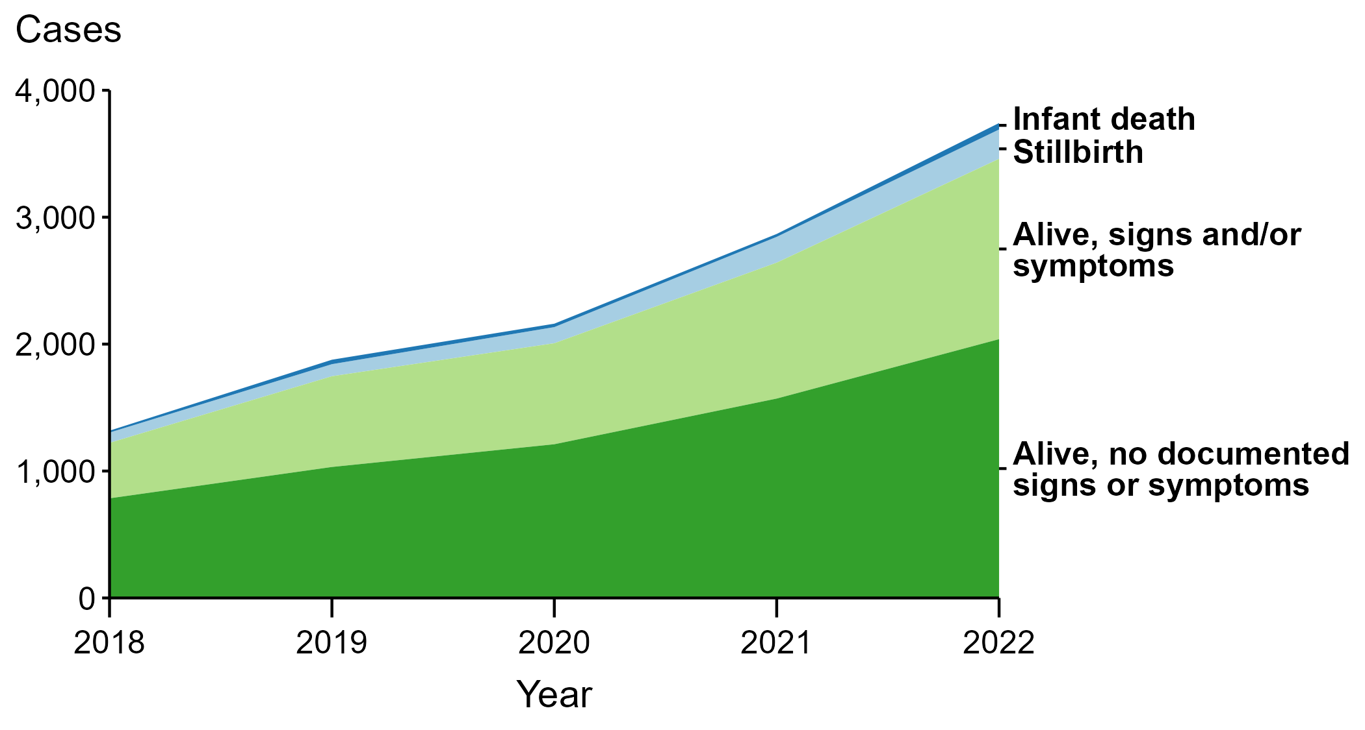
Congenital Syphilis — Reported Cases by Vital Status and Clinical Signs and Symptoms* of Infection, United States, 2018–2022
* Infants with signs and/or symptoms of congenital syphilis have documentation of at least one of the following: long bone changes consistent with congenital syphilis, snuffles, condylomata lata, syphilitic skin rash, pseudoparalysis, hepatosplenomegaly, edema, jaundice due to syphilitic hepatitis, reactive CSF-VDRL, elevated CSF WBC or protein values, or evidence of direct detection of T. pallidum.
NOTE: Of the 11,999 congenital syphilis cases reported during 2018 to 2022, 33 (0.3%) did not have sufficient information to be categorized.
https://www.cdc.gov/std/statistics/2022/figures.htm
Notes:
In 2022, there were a total of 3,755 cases of congenital syphilis reported for a rate of 102.5 per 100,000 live births.
In 2022, 51 congenital syphilis cases (1.4%) were infant deaths, 231 cases (6.2%) were stillbirths, 1,421 cases (37.8%) were born alive with congenital syphilis-related signs or symptoms, 2,039 cases (54.3%) were born alive with no documented congenital syphilis-related signs or symptoms, and 13 cases (0.3%) were missing information on vital status.
In 2022, there were 282 congenital syphilis-related deaths (231 stillbirths and 51 infant deaths), an increase of 24.8% from 2021 (226 in 2021 to 282 in 2022) and an increase of 193.8% from 2018 (96 in 2018 to 282 in 2022).
The number of infants reported with congenital syphilis who were born alive with congenital syphilis-related signs and symptoms increased 32.7% from 2021 to 2022 (1,071 in 2021 to 1,421 in 2022) and increased 225.2% from 2018 to 2022 (437 in 2018 to 1,421 in 2022).
This report includes data from years that coincide with the COVID-19 pandemic, which introduced uncertainty and difficulty in interpreting STI surveillance data. See Impact of COVID-19 on STIs for more information.
See Technical Notes (https://www.cdc.gov/std/statistics/2022/technical-notes.htm) for information on syphilis case reporting.
Data for all figures are available at https://www.cdc.gov/std/statistics/2022/data.zip. The file “CS - Cases by Vital Status and Clinical Signs and Symptoms (US 2018-2022).xlsx” contains the data for the figure presented on this slide.

Slide 51
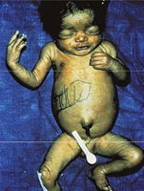
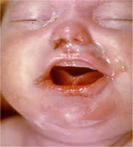
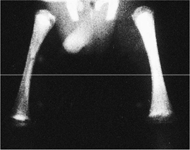
Clinical Manifestations of Congenital Syphilis (CS)
Centers for Disease Control and Prevention https://www.cdc.gov/ncbddd/birthdefects/surveillancemanual/quick-reference-handbook/congenital-syphilis.html
Centers for Disease Control and Prevention. Congenital syphilis case definition
World Health Organization. Birth defects surveillance: A manual for programme managers, 2nd Edition. December 2020. https://www.who.int/publications/i/item/9789240015395
World Health Organization. Global Guidance on Criteria and Processes for Validation: Elimination of Mother-to-Child Transmission of HIV, syphilis and hepatitis B. 9789240039360-eng.pdf (who.int). Page 18

Slide 52
Syphilitic Stillbirth
Syphilitic Stillbirth
Clinical case definition
A fetal death that occurs after a 20-week gestation OR in which the fetus weighs >500g AND the mother had untreated or inadequately treated* syphilis at delivery.
* Adequate treatment is defined as completion of a penicillin-based regimen, in accordance with CDC treatment guidelines, appropriate for stage of infection, initiated 30 or more days before delivery.
Comments: For reporting purposes, congenital syphilis includes:
cases of congenitally acquired syphilis among infants and children
syphilitic stillbirths
https://www.cdc.gov/std/statistics/2019/case-definitions.htm)

Slide 53
Syphilis Scenarios
Scenario 1: Confirmed, proven or highly probable congenital syphilis | Scenario 2: Possible congenital syphilis | Scenario 3: Congenital syphilis less likely | Scenario 4: Congenital syphilis unlikely
Neonate with: a physical exam consistent with CS serum quantitative nontreponemal serology 4-fold greater than mother’s or a positive darkfield or PCR test of placenta, body fluids or positive silver stain of placenta or cord | Neonate with a normal physical exam and a serum quantitative nontreponemal serologic titer equal to or < 4-fold of the maternal titer at delivery and one of the following: • The mother was not treated, was inadequately treated, or has no documentation of treatment. • The mother was treated with erythromycin or a regimen not recommended in these guidelines • The mother received recommended regimen but treatment was initiated <30 days before delivery. | Neonate with a normal physical examination and a serum quantitative nontreponemal serologic titer equal or <4-fold of the maternal titer at delivery and both of the following are true: • The mother was treated during pregnancy, treatment was appropriate for the infection stage, and the treatment regimen was initiated ≥30 days before delivery. • The mother has no evidence of reinfection or relapse | Neonate with: a normal physical exam serum quantitative nontreponemal serology equal to or less than 4-fold mother’s at delivery and Mother’s treatment was adequate before pregnancy Mother’s nontreponemal titer remained low and stable before and during pregnancy and at delivery
Evaluation: CSF with VDRL, cell ct, protein, CBC/diff, long bone radiographs, neurologic eval (eye, auditory, imaging) | CSF analysis for VDRL, cell count, and protein** CBC, differential, long-bone radiographs | No evaluation is recommended | No evaluation is recommended
Treatment: Aqueous crystalline penicillin G 100,000–150,000 units/kg/body wt./day, administered as 50,000 units/kg body wt./dose IV q 12 hours during the first 7 days of life and q 8 hours thereafter for a total of 10 days OR Procaine penicillin G 50,000 units/kg body weight/dose IM in a single daily dose for 10 days | Treatment: Aqueous crystalline penicillin G 100,000–150,000 units/kg/body wt./day, administered as 50,000 units/kg body wt./dose IV q 12 hours during the first 7 days of life and q 8 hours thereafter for a total of 10 days OR Procaine penicillin G 50,000 units/kg body weight/dose IM in a single daily dose for 10 days OR Benzathine penicillin 50,000 units/kg body wt. single IM injection | Treatment: Benzathine penicillin G 50,000 units/kg body weight/dose IM in a single dose * Another approach involves not treating the newborn if follow-up is certain but providing close serologic follow-up every 2–3 months for 6 months for infants whose mothers’ nontreponemal titers decreased at least fourfold after therapy for early syphilis or remained stable for low titer, latent syphilis (VDRL <1:2 or RPR <1:4). | No treatment recommended Benzathine penicillin 50,000 units/kg body weight as a single IM injection might be considered, if follow-up is uncertain and the neonate has a reactive nontreponemal test. Neonates should be followed serologically to ensure the nontreponemal test returns to negative
https://www.cdc.gov/std/treatment-guidelines/default.htm

Slide 54
Congenital Syphilis Case Classification for Disease Reporting
Demonstration of Treponema pallidum in any infant body fluid or discharge, umbilical cord, autopsy, or placenta by darkfield, immunohistochemistry, staining, or other molecular testing (PCR) OR
An infant whose mother had untreated or inadequately treated* syphilis at delivery, regardless of signs in the infant OR
An infant or child who has a reactive non-treponemal test for syphilis (Venereal Disease Research Laboratory [VDRL], rapid plasma reagin [RPR], or equivalent serologic methods) AND any one of the following:
Any evidence of congenital syphilis on physical examination
Any evidence of congenital syphilis on radiographs of long bones
A reactive cerebrospinal fluid (CSF) venereal disease research laboratory test (VDRL) test
In a non-traumatic lumbar puncture, an elevated CSF leukocyte (white blood cell, WBC) count or protein (without other cause):
Suggested parameters for abnormal CSF WBC and protein values:
During the first 30 days of life, a CSF WBC count of >15 WBC/mm3 or a CSF protein >120 mg/dl is abnormal.
After the first 30 days of life, a CSF WBC count of >5 WBC/mm3 or a CSF protein >40 mg/dl, regardless of CSF serology. The treating clinician should be consulted to interpret the CSF values for the specific patient.
*Adequate treatment is defined as completion of a penicillin-based regimen, in accordance with CDC treatment guidelines, appropriate for stage of infection, initiated 30 or more days before delivery.
https://ndc.services.cdc.gov/case-definitions/syphilis-congenital-2018/

Slide 55
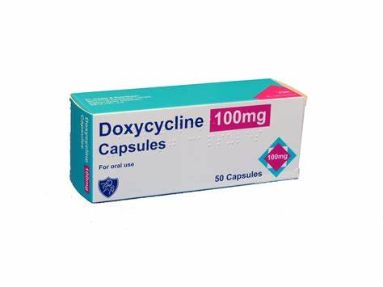
DoxyPEP
Take 1 dose of Doxycycline 200mg
< 72 hours after condomless sex
Prevention of chlamydia, gonorrhea, and syphilis
Who should receive DoxyPEP?
Men who have sex with men (MSM)/Trans Women (TGW) on HIV PrEP or living with HIV
If not on HIV PrEP, MSM/TGW with history of STIs within the past 12 months, sex work, chemsex (sex under the influence of drugs)
Guidelines for the Use of Doxycycline Post-Exposure Prophylaxis for Bacterial STI Prevention (cdc.gov)

Slide 56
Case Investigation and Contact Tracing
Importance of identifying and referring sexual contacts/partners to syphilis cases for presumptive treatment to stop community-level transmission
Partner services is an effective method to identify undiagnosed cases of syphilis and other STIs. It has a higher yield than screening.
Notes:
I cannot stress enough the Importance of contact tracing as a top level best practice for syphilis control. This public health practice is the most effective way to identify undiagnosed syphilis at a community level specifically…. identifying and referring sexual contacts/partners to syphilis cases for presumptive treatment to stop community-level transmission
Halting community level transmission is critical to stop outbreaks. Consistent and frequent communication with the clinical service unit to the state, county and/or tribal Disease Intervention Specialists (DIS) is important to relay case information to facilitate sexual partner identification and referral to care.

Slide 57
Train Public Health Staff for Disease Intervention/Partner Services
https://www.cdc.gov/std/training/courses.htm

Slide 58
HIV Pre Exposure Prophylaxis
US Public Health Service: PREEXPOSURE PROPHYLAXIS FOR THE PREVENTION OF HIV INFECTION IN THE UNITED STATES – 2021 UPDATE, A CLINICAL PRACTICE GUIDELINE (cdc.gov)

Slide 59
Provider Education Resources
CDC STD Treatment Guidelines: https://www.cdc.gov/std/treatment-guidelines/default.htm
CDC STD Surveillance: https://www.cdc.gov/std/statistics/2022/default.htm
Indian Country Infectious Disease ECHO: www.IndianCountryECHO.org
CDC STD Prevention Training Centers: https://www.cdc.gov/std/training/default.htm
University of Washington STD CME sessions: https://www.std.uw.edu/
California Prevention Training Center Online: https://www.stdhivtraining.org/online_courses.html
Johns Hopkins STD Prevention Training: https://www.stdpreventiontraining.com/
New York City STD/HIV Prevention Training Center: https://www.nycptc.org/

Slide 60
Summary and Best Practices
Broad screening of sexually active patients in primary and acute care, including emergency departments
3-time point syphilis screening in pregnancy
Symptom recognition and appropriated staging to guide treatment
Understanding lab algorithms within your clinical setting
Case reporting
Contact tracing and presumptive treatment of sexual partners
PrEP and doxyPEP

Slide 61
Think Syphilis Campaign
MDT7@cdc.gov

