Slide 1
Harm Reduction 101 for Health Care Providers
Presenters:
George Elias Jr., CDCA II - Kelsey Rider, CDCA
Health Educator Harm Reduction Coordinator

Slide 2
This conference is supported by the Health Resources and Services Administration (HRSA) of the U.S. Department of Health and Human Services (HHS) as part of an award totaling $4,036,482 with 0 percentage financed with nongovernmental sources. The contents are those of the author(s) and do not necessarily represent the official views of, nor an endorsement, by HRSA, HHS or the U.S. Government.

Slide 3
Disclosures
None to report

Slide 4
- Gain a clear understanding of the principles that guide harm reduction strategies and how these strategies can be incorporated into workflow to better serve patients. - Increase knowledge of how best to serve diverse populations in a way that builds relationships and leads to better health outcomes for populations experiencing dramatic disparities. - Increased understanding of how sexual health intersects with drug use and how this creates special considerations when developing risk reduction plans and behavior change. - Gain a basic knowledge of motivational interviewing (MI) and how this strategy can lead to better health outcomes while empowering your patients.
Today’s Objectives

Slide 5
We are Greater Cincinnati’s AIDS service organization, devoted to positively changing lives in the fight against HIV/AIDS through:
Prevention
Promoting health and well-being in at-risk communities through evidence-based approaches to prevent disease and reduce the spread of HIV
Housing
Offering a variety of permanent housing support to prevent homelessness and to stabilize individuals and families living with HIV
Care
Helping individuals living with HIV access the health care they need through medical case management and pharmacy services
Learn more: caracole.org

Slide 6
Our Mission
To positively changing lives in the fight against HIV/AIDS through prevention, housing and care
Our Vision
To be a relentless force for health equity

Slide 7
UNDERSTANDING HARM REDUCTION, VALUES, AND PRINCIPLES

Slide 8
Harm Reduction, what is it?
Understanding HARM REDUCTION, values and principles
Harm reduction is an evidence-based approach that seeks to minimize the negative consequences of risky behaviors without requiring abstinence.
Harm reduction, as an approach to problematic drug use and innovative health care methods, is the idea of providing drug users with the tools and education they need to make informed decisions about their substance use. It is an approach to addiction recovery that encourages safe habits when consuming drugs to minimize any adverse effects on the individual’s health.
The primary goal of harm reduction is to promote an atmosphere of compassion and acceptance for drug users. Harm reduction is a set of practices aimed at reducing the harmful effects of drug-related harm, as well as a social movement dedicated to destigmatizing drug addiction and promoting the respect and rights of people who are addicted to drugs. Harm reduction is about keeping drug users safe so that they have an opportunity to recover.

Slide 9
Understanding harm reduction, values and principles

Slide 10
Harm Reduction Values
Understanding harm reduction, values and principles
Client-Centered Approach – Tailors interventions to the needs and preferences of the individual
Collaboration/Community Involvement - Involves people from various sectors including healthcare providers, community organizations, and policymakers
Sociocultural Complexity – Recognizes the complex social factors that influence vulnerability to drug use and drug-related harm, including poverty, social inequality, discrimination and trauma.
Humanism – Values the dignity and worth of every individual.
Participant Leadership – The incorporation of MI (motivational interviewing) to allow clients to identify and meet their own goals.
Pragmatism and Realism – Simply acknowledges that certain high-risk behaviors may continue, despite efforts to discourage them.
Humanism
Client- Centered
Participant Leadership
Collaboration/ Community involvement
Pragmatism and Realism
Sociocultural Complexity

Slide 11
Harm Reduction Principles
Understanding harm reduction, values and principles.
Accepts that drug use is a common and enduring human practice and works to address and reduce related harms, rather than ignoring or condemning them.
Understands drug use as a complex, multi-faceted phenomenon that encompasses a continuum of behaviors from severe use to total abstinence and acknowledges that some ways of using drugs are clearly safer than others.
Establishes quality of individual and community life and well-being—not necessarily cessation of all drug use—as the criteria for successful interventions and policies.
Calls for the non-judgmental, non-coercive provision of services and resources to people who use drugs and the communities in which they live in, to assist them in reducing attendant harm.

Slide 12
Harm Reduction Principles
Ensures that people who use drugs and those with a history of drug use routinely have a real voice in the creation of programs and policies designed to serve them
Affirms people who use drugs (PWUD) themselves as the primary agents of reducing the harms of their drug use and seeks to empower PWUD to share information and support each other in strategies which meet their actual conditions of use
Recognizes that the realities of poverty, class, racism, social isolation, past trauma, sex-based discrimination, and other social inequalities affect both people’s vulnerability to and capacity for effectively dealing with drug-related harm
Does not attempt to minimize or ignore the real and tragic harm and danger that can be associated with illicit drug use

Slide 13
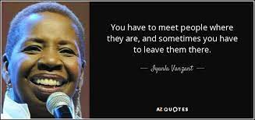
Meeting People Where They’re At
Common phrase in the harm reduction community
Means that everyone comes to us with different experiences and outlooks
Instead of laying out our own expectations of what one’s journey and outcome should look like we offer them compassionate support
We don’t leave them behind just because our goals for someone are not in line with that individual’s goals. Instead, we try to support them if possible and help them navigate how to be as safe as possible

Slide 14
Harm Reduction and Racial Justice
Historically oppressed populations less likely to engage with harm reduction services
Criminalization of drugs exacerbates existing distrust of healthcare community
Ethnic minorities are over-represented in U.S. criminal justice system
Black Americans died from overdose at the highest rate in 2021
Black, Indigenous, and People of Color less likely to be engaged in naloxone distribution
Minority communities often exposed to a highly variable and unpredictable illicit drug supply

Slide 15
Hepatitis C
Sharing needles and other drug injection equipment (like cookers and cotton)
Overall, the risk of sexual transmission is low for Hepatitis C, but sexual activities that involve blood, such as anal sex or rough vaginal sex.
From parent to baby at birth (about 5% risk; much higher if the birthing parent is also HIV+)
Body piercing or tattooing using unsterilized needles or shared inkwells – primarily seen in jail or prison settings
Possibly sharing things that may contain small traces of blood, like snorting straws, toothbrushes, razors, or manicure implements
Notes:
Most new hepatitis C infections are among people who inject drugs from sharing needles, syringes and injection equipment. Hepatitis C can also be transmitted through sharing cookers or spoons, cotton and filters, and water. If you shoot drugs, you can avoid transmission by using a new, sterile syringe for each injection (or, at least, a syringe that only you have used), along with your own injection cookers, cottons, water and ties. If you’re shooting up with someone else, make sure everyone is using their own sterile needle, and preferably, mix your shots in separate cookers using separate sources of water. Clean out used cookers and spoons.

Slide 16
HIV
Sharing needles, syringes, or other drug injection equipment—for example, cookers—puts people at risk for getting or transmitting HIV and other infections.
HIV is also transmitted through bodily fluids such as blood, semen, rectal fluid, and vaginal fluids
HIV transmission can be prevented by safer sex/safer injection practices and with the medications PrEP and PEP
By providing Harm Reduction tools like SSPs, HIV/HCV testing and condoms, this gives patients the autonomy to make their own choices about their health

Slide 17
Sexual Health and Harm Reduction
Substance use can affect sex in many ways and change the way the body responds to sex
Libido can be increased or decreased
Risk-taking behaviors can be heightened
In Sexual Health, Harm Reduction can be incorporated by:
Sex Education
Condoms
PrEP (Pre-Exposure Prophylaxisis)
STI testing and Treatment

Slide 18
Harm Reduction and Sex Work
Sex work is the consensual exchange of a sexual service between adults for something of value
Harms associated with sex work can be reduced by strategies like:
Barrier Methods
Working in pairs
Bad Date Sheets
“Sex workers and their communities were at the forefront of the harm reduction movement in the U.S. and globally, because there are a lot of similarities between drug use and sex work. Both are a stigmatized and criminalized activity, and, much like people who use drugs, people who engage in sex work are marginalized and criminalized for the choices they make about their bodies.” – National Harm Reduction Coalition

Slide 19
Risk Factor and Gender
Those who identify as female may start injecting drugs by having a partner or someone else inject them
This can create an unbalanced power dynamic
Increases the likelihood of injecting with a used syringe or other used equipment
Creates a lack of control over the amount being used
Gender based violence can deprioritize seeking out Harm Reduction services

Slide 20
Comprehensive Harm Reduction
First and foremost, treating all people with respect for their dignity and autonomy
Syringe access through SSPs, pharmacies, vending machines, and other sources
Flexible, low-barrier access to medications for opioid use disorder (MOUD)
911 Good Samaritan laws that protect people experiencing and responding to an overdose from criminal penalties
Drug-checking tools like fentanyl test strips and community naloxone trainings
Mental health crisis center and trauma-informed emergency response services
Wrap-around mobile services to improve connections to and retention in care

Slide 21
Comprehensive Harm Reduction
Peer leadership and support services
Housing First initiatives to increase low-barrier housing for people who use drugs
Community navigation for health insurance, medical and social service connections, long-term care, and other resources
Sharing honest, evidence-based information with people who use drugs and people who do sex work, without judgment
Co-located primary care, including wound care, reproductive health services, and vaccination

Slide 22
Harm Reduction Programs
Provide of services to people in active use, without the expectation that they stop using drugs
Provide supplies and resources to people who use drugs, so that they can use and live as safely as possible
Prioritize non-judgmental, non-stigmatizing, non-coercive, strengths-based, and mutually respectful engagement with people who use drugs
Acknowledge the harms associated with drug use, while presenting accurate and complete information about ways to reduce these harms much as possible

Slide 23
Syringe Service Programs (SSP)
Community-based public health programs that may provide comprehensive harm reduction services such as :
Sterile needles, syringes, and other injection equipment-cookers, cottons, tourniquets, bleach and alcohol pads
Collect and safely dispose of used syringes
HIV and Hepatitis testing and linkage to treatment- PrEP & PEP Education
Overdose education and prevention and safer injection practices
Naloxone distribution and education + fentanyl test strips
Referrals to medical, mental health and social services
Referral to substance use disorder treatment, including medication-assisted treatment
Tools to prevent HIV, STIs, and viral hepatitis including counseling, condoms, and vaccinations
A judgement free place

Slide 24
Syringe Programs and Disease Prevention
Sterile syringes can prevent infections, including:
Bacteremia
Cellulitis
Abscesses (staph, strep)
Endocarditis
Necrotizing fasciitis
Wound botulism
Infection resulting in sepsis
Viral infections (bloodborne diseases), including:
Hepatitis C virus (HCV)
Hepatitis B virus (HBV)
Hepatitis A virus (HAV)
HIV

Slide 26
Overdose Prevention
Raise public awareness and reduce stigma
Expand access to naloxone to reverse an opioid overdose, through pharmacies, co-prescribing, SSP and local health department distribution, public-access naloxone (like AEDs or fire extinguishers)
Provide training and education to people most like to be able to respond to an opioid overdose—namely people who use drugs
Support legal protections for people experiencing and responding to drug-related emergencies, including Good Samaritan laws
Improve health for incarcerated people, including MOUD treatment and naloxone training and access
Fentanyl test strips

Slide 27
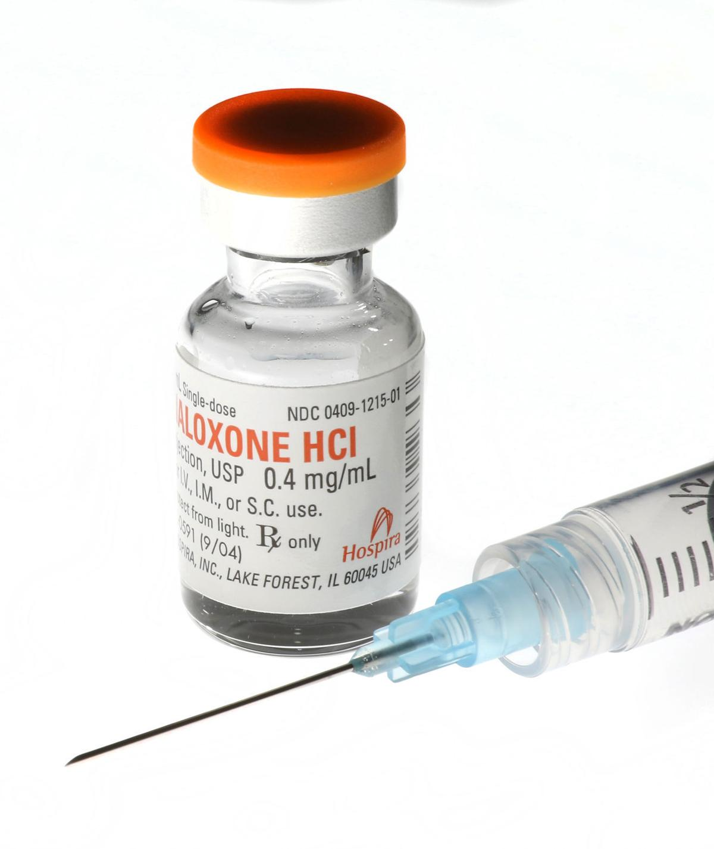
Always have Naloxone, never use alone
An illicit drug supply is an unregulated drug supply. Even when getting drugs from a trusted source, check your supply with fentanyl test strips or other drug-checking tools. Make sure naloxone is available and that someone is able to administer it in case of opioid poisoning.

Slide 28
Harm Reduction Vending Machine
A harm reduction vending machine:
Provides access to disease prevention tools
Many Syringe Service Programs (SSPs) were closed due to COVID
Fills gaps left by traditional service provision
Removes barriers for those who do not participate in local SSPs or other face to face harm reduction services
Allows for no or low contact supply delivery with the option of referrals, support, HIV/HCV testing, and other services
Notes:
Caracole’s SSP

Slide 29
Harm Reduction Vending Machine Cont.
Safer sex kits
Safer smoking kits that have Bubble or Stem
Safer injection kits
Fentanyl/ Xylazine test strips
IM and Nasal Naloxone
Pregnancy tests
Sharps containers
Wound Care kit
At-Home HIV test
Treatment and other community resources
Harm reduction/disease prevention education

Slide 30
Overview of
Motivational Interviewing

Slide 31
Motivational Interviewing
Motivational interviewing (MI) is a technique in which you become a helper in the change process and express acceptance of your client. It’s a way to interact with clients and a style of counseling that can help resolve the ambivalence that prevents clients from realizing personal goals. Motivational interviewing builds on optimistic and humanistic theories about people’s capabilities for exercising free choice and changing through a process of self-actualization.
Motivational interviewing is a counseling style based on the following assumptions:
Ambivalence about substance use (and change) is normal and constitutes an important motivational obstacle in recovery.
Ambivalence can be resolved by working with your client’s intrinsic motivations and values.
The alliance between you and your client is a collaborative partnership to which you each bring important expertise.
An empathic, supportive, yet directive, counseling style provides conditions under which change can occur. (Direct argument and aggressive confrontation may tend to increase client defensiveness and reduce the likelihood of behavioral change.)

Slide 32
The Guiding Principles of Motivational Interviewing
To resist the righting reflex: People who enter helping professions often have a powerful desire to set things right, to heal, to prevent harm, and promote well-being, which is called the “Righting Reflex”. Rolling with resistance prevents a breakdown in communication between clients and helpers and allows the clients to explore their views. Avoid arguing for change. Do not directly oppose resistance. New perspectives are offered but not imposed. The clients are a primary resource in finding answers and solutions. Resistance is a signal for the helpers to respond differently.
To understand and explore the clients’ own motivations: Developing discrepancy enables the clients to see that their present situation does not necessarily fit into their values and what they would like in the future. The clients rather than the helpers should present the arguments for change. Change is motivated by a perceived discrepancy between present behavior and important personal goals and values.
To listen with empathy: Expressing empathy towards the clients shows acceptance and increases the chance of developing a rapport. Acceptance enhances self-esteem and facilitates change. Skillful reflective listening is fundamental. Clients’ ambivalence is normal.
To empower the clients, encouraging hope and optimism: Self-efficacy is a crucial component to facilitating change. If the clients believe that they have the ability to change, the likelihood of change occurring is greatly increased. Beliefs in the possibility of change is an important motivator. The clients, not the helpers, are responsible for choosing and carrying out change. The helpers’ believe in the clients’ ability to change becomes a self-fulfilling prophecy.
These four principles fit the acronym RULE: Resist, Understand, Listen, and Empower
(Miller & Rollnick, 2013)

Slide 33
Four Processes in Motivational Interviewing
Engaging: is the process by which both parties establish a helpful connection and a working relationship. Therapeutic engagement is a prerequisite for everything that follows, and it involves developing a working alliance.
Focusing: is the process by which helpers and clients develop and maintain a specific direction in the conversation about change. In the course of helping relationships, a direction towards one or more change goals usually emerges.
Evoking: involves eliciting the clients’ own motivations for change, and it has always been at the heart of MI. It occurs when there is a focus on a particular change and the providers harness the clients’ own ideas and feelings about why and how they might do it. Evoking is having the clients voice the arguments for change.
Planning: encompasses both developing commitments to change and formulating a specific plan of action. It’s a conversation about action that can cover a range of topics, conducted with a sharp ear for eliciting clients’ own solutions, promoting their autonomy of decision making, and continuing to elicit and strengthen change talk as a plan emerges.
(Miller & Rollnick, 2013)

Slide 34
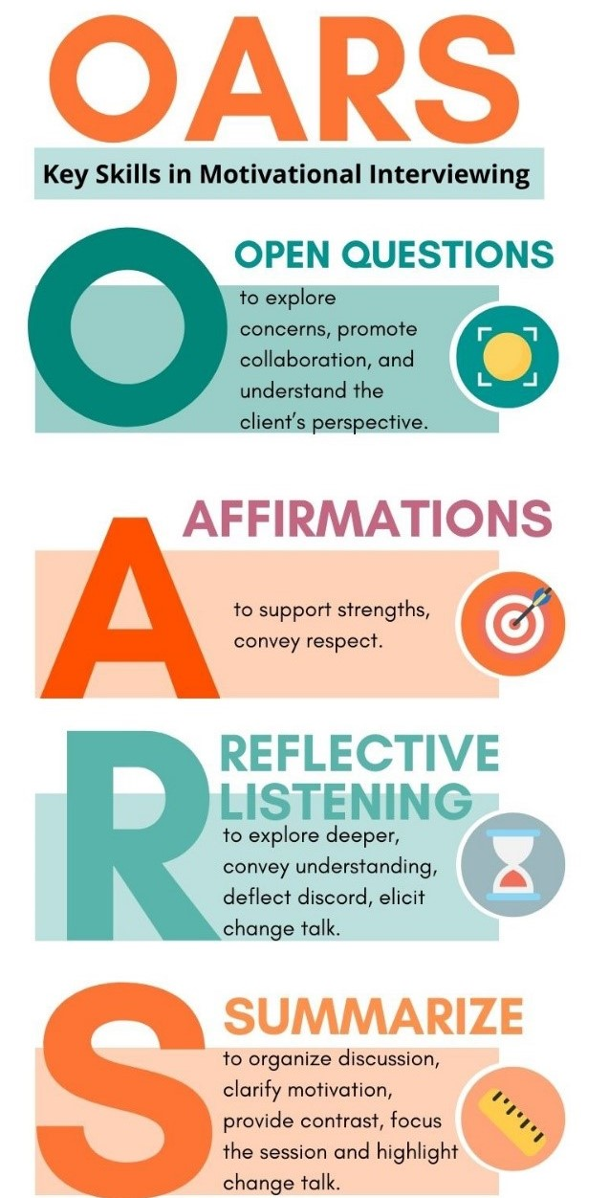

Slide 35
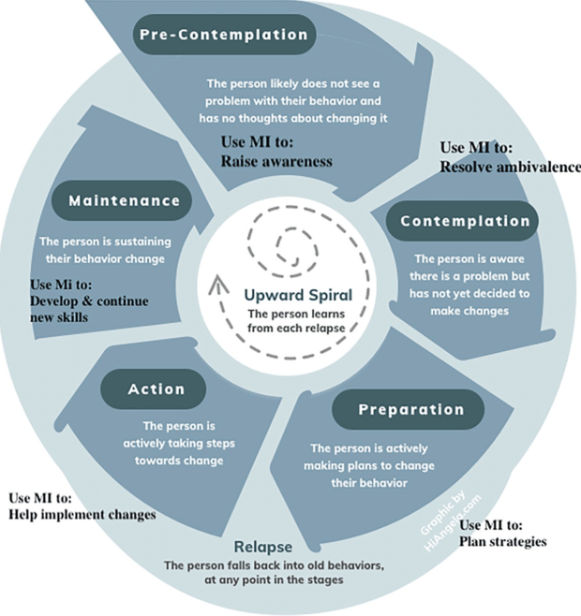
Change Talk
Change talk is defined as statements by the clients revealing consideration of, motivation for, or commitment to change. In Motivational Interviewing, the helpers seek to guide the clients to expressions of change talk as the pathway to change. Research indicates a clear correlation between clients’ statements about change and outcomes-client-reported levels of success in changing a behavior. The more clients talk about change, the more likely they are to change (Miller & Rollnick, 2013). Different types of change talk can be described using the mnemonic DARN-CAT:
Preparatory Change Talk
D – Desire (I want to change)
A – Ability (I can change)
R – Reason (It’s important to change)
N – Need (I should change)
And most predictive of a positive outcome:
Implementing Change Talk
C – Commitment (I will make changes)
A – Activation (I am ready, prepared, willing to change)
T – Taking Steps (I am taking specific actions to change)

Slide 36
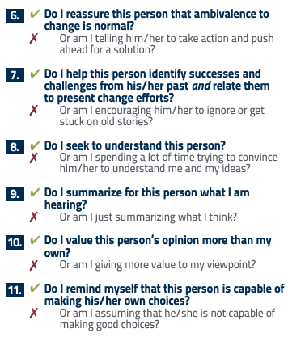
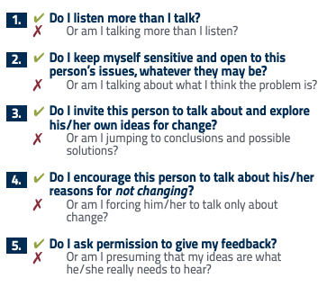

Slide 37
Resources
Syringe Services Program Info, CDC
https://www.cdc.gov/hiv/pdf/risk/cdchiv-fs-syringe-services.pdf?MERMIN0001
HIV.gov, Syringe Services Programs
https://www.hiv.gov/federal-response/policies-issues/syringe-services-programs
Harm Reduction Coalition https://harmreduction.org/
Stages of Change -https://store.samhsa.gov/system/files/sma12-4097.pdf
Caracole www.caracole.org

Slide 38
Resources
Canadian Mental Health Association Harm Reduction (cmha.ca)
HIV.gov Syringe Services Programs | HIV.gov
National Harm Reduction Coalition What is Hepatitis C? - National Harm Reduction Coalition

Slide 39
QUESTIONS?

Slide 40
MATEC Resources
National Clinician Consultation Center http://nccc.ucsf.edu/
HIV Management
Perinatal HIV
HIV PrEP
HIV PEP line
HCV Management
Substance Use Management
AETC National HIV Curriculum https://aidsetc.org/nhc
AETC National HIV-HCV Curriculum https://aidsetc.org/hivhcv
National PrEP Curriculum https://www.hivprep.uw.edu
Hepatitis B Online https://www.hepatitisb.uw.edu
Hepatitis C Online https://www.hepatitisc.uw.edu
AETC National Coordinating Resource Center https://aidsetc.org/
Additional Trainings https://matec.info

Slide 41
George Elias Jr., CDCA II
Health Educator, Caracole
gelias@caracole.org
Kelsey Rider, CDCA
Harm Reduction Service Coordinator
krider@caracole.org

