Slide 1
The HIV Treatment-Experienced Patient: Case Discussions
October 4, 2020
John J. Faragon, PharmD, BCPS, AAHIVP
Clinical Pharmacist
Regional Pharmacy Director
Northeast/Caribbean AIDS Education & Training Center
Albany Medical College
Albany, New York
Holly R. Murphy, PharmD, BCPS, AAHIVP
Clinical HIV/AIDS Pharmacist
Erie County Medical Center
Buffalo, New York

Slide 2
Disclosures
Holly Murphy, PharmD:
I have nothing to disclose.
John Faragon, PharmD:
Speakers Bureau
Gilead
Janssen
Merck
Advisory
ViiV

Slide 3
Disclosures
“This program is supported by the Health Resources and Services Administration (HRSA) of the U.S. Department of Health and Human Services (HHS) as part of an award totaling $3,879,101 with zero percentage financed with nongovernmental sources. The contents are those of the author(s) and do not necessarily represent the official views of, nor an endorsement, by HRSA, HHS or the U.S. Government.”

Slide 4
Slide Acknowledgements
Select Slides adapted from AETC National Resource Center
Select Slides from Stanford Database
Select Slides from actual resistance tests from clinic
Select Slides from data sets from medications being reviewed

Slide 5
Goals
Provide basic overview of resistance testing
List key aspects of medications used in treatment experienced patients
Review newer medications and discuss their role in HIV treatment
Using cases, provide examples of complex resistance cases and regimen selection

Slide 6
Virologic Suppression
Virologic suppression (VS):
Confirmed HIV RNA below lower limit of detection (eg,<50 copies/mL)
Patient attained
and has maintained an undetectable
viral load
Graphic: National HIV Curriculum, hiv.uw.edu
DHHS Guidelines, December 2019.

Slide 7
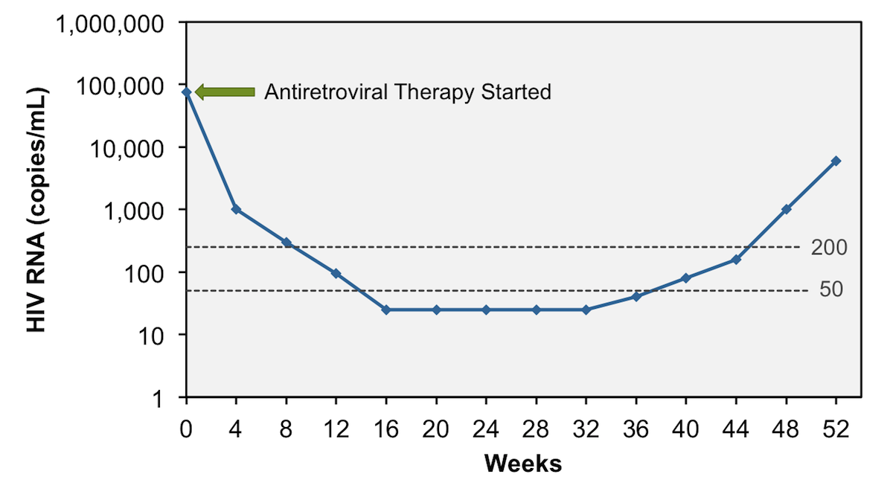
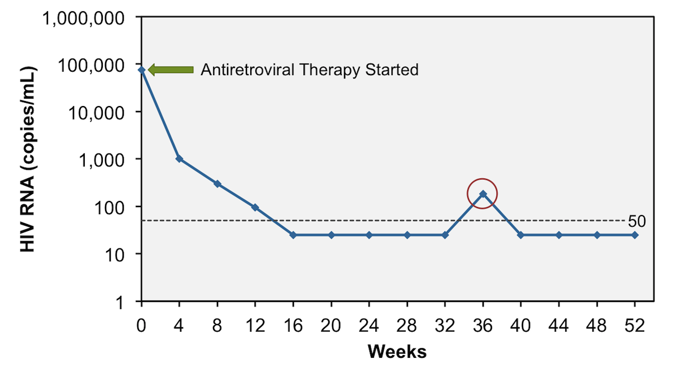
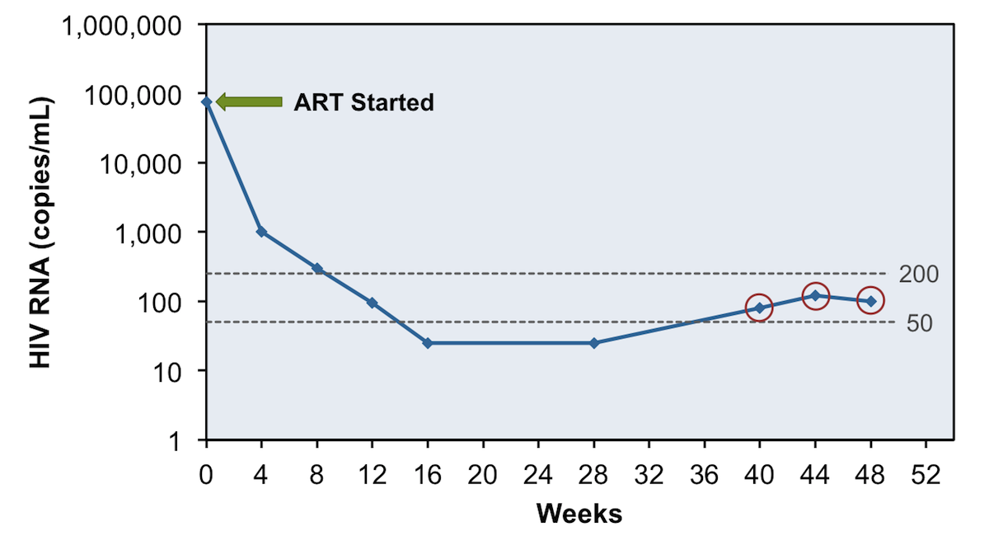
Virologic Response
Incomplete virologic response:
Lack of VS to <200 copies/mL after 24 weeks on ART
Virologic rebound:
Confirmed HIV RNA ≥200 copies/mL after VS
Virologic blip:
An isolated detectable HIV RNA level followed by a return to VS
Low-level viremia:
Detectable HIV RNA <200 copies/mL
Graphics: National HIV Curriculum, hiv.uw.edu
DHHS Guidelines, December 2019.

Slide 8
Managing Patients with Virologic Failure
Review HIV RNA, CD4 count, ARV history, prior and current ARV resistance test results, potential drug interactions
Resistance is cumulative; consider all past resistance tests
Ideally, resistance test should be done while patient is taking the failing regimen, or within 4 weeks of treatment discontinuation
If >4 weeks since ARV discontinuation, resistance test may provide useful information, but it may not detect previously selected mutations
DHHS Guidelines, December 2019.

Slide 9
Managing Patients with Virologic Failure
Goal of treatment: virologic suppression
New regimen should contain at least 2 (preferably 3) fully active agents
Some ARVs may have partial activity even if resistance mutations are present
Don’t add only one active drug to a failing regimen
If HIV/HBV coinfected – continue HBV-active agents to avoid HBV flare
DHHS Guidelines, December 2019.

Slide 10
Managing Virologic Failure – Based on Current Viral Load
For all levels
Confirm viral load, assess/address adherence, possible drug-drug and drug-food interactions
Viral Load <200 copies/ml
ART change not usually required. Development of resistance unlikely. No consensus re management. Check VL q 3 months.
Viral Load over 200 copies/ml but less than 1000 copies/ml
Treat as if they are failing their regimen, manage as if VL ≥1000.
DHHS Guidelines, December 2019.

Slide 11
Managing Virologic Failure – Based on Current Viral Load
Viral Load ≥1000, but no ARV resistance mutations identified:
Usually caused by suboptimal adherence: assess and address; consider changes, simplification
Double check for drug interactions, especially those that affect ARV medication absorption or drug levels
Viral Load ≥1000 AND ARV resistance mutations identified:
Modify regimen ASAP, to prevent additional resistance development and to prevent increasing viral load and decreased CD4 cell count
DHHS Guidelines, December 2019.

Slide 12
Managing Virologic Failure
Failure of 1st ART Regimen - INSTI + 2 NRTIs
Resistance Considerations | ART options
If resistance to 3TC/FTC but no INSTI resistance | Boosted PI + 2 NRTIs (at least 1 active) DTG + 2 NRTIs (include at least 1 active) Boosted PI + INSTI
If EVG or RAL resistance +/- 3TC/FTC resistance | Boosted PI + 2 NRTIs (at least 1 active) DTG BID (if HIV is sensitive to DTG) + 2 active NRTIs DTG BID (if HIV is sensitive to DTG) + boosted PI (BIC not recommended – no data)
DHHS Guidelines, December 2019.

Slide 13
Managing Virologic Failure
Failure of 1st ART Regimen - NNRTI + 2 NRTIs
Resistance considerations | ART options
Most likely: resistance to NNRTI +/- 3TC/FTC (M184V/I) Additional NRTI mutations may be present | Boosted PI + 2 NRTIs (at least 1 active) DTG + 2 NRTIs (at least 1 active) Boosted PI + INSTI
DHHS Guidelines, December 2019.

Slide 14
Managing Virologic Failure
Failure of 1st ART Regimen - Boosted PI + 2 NRTIs
Resistance considerations | ART options
Most likely: no resistance, or resistance only to 3TC/FTC (M184V/I) | Continue same regimen Another boosted PI + 2 NRTIs (at least 1 active) INSTI + 2 NRTIs (at least 1 active); DTG preferred if only 1 fully active NRTI Another boosted PI + INSTI
DHHS Guidelines, December 2019.

Slide 15
Managing Virologic Failure
Failure of 2nd (or subsequent) ART Regimen – ARV resistance but active ARV options
Resistance considerations | ART options
Consider past and current resistance test results and ART history to design new ART regimen | At least 2 (preferably 3) fully active ARVs Can use partially active ARVs if no other options Consider ARVs with different mechanisms of action
DHHS Guidelines, December 2019.

Slide 16
Managing Virologic Failure
Failure of 2nd (or subsequent) ART Regimen – Multiple or extensive resistance and few ARV options
Resistance considerations | ART options
Consider past and current resistance test results and ART history to design new ART regimen Consider tropism test (if MVC is being considered) Consult experts | Identify all active or partially active ARVs Consider ARVs with different mechanisms of action Consider investigational ARVs: clinical trial or expanded access program ART discontinuation is NOT recommended
DHHS Guidelines, December 2019.

Slide 17
Managing Virologic Failure
Suspected ARV Resistance but Limited/Incomplete ARV and Resistance History - Unknown
Resistance considerations | ART options
Obtain records, if possible Resistance testing: may identify mutations (if patient off ART, mutations may not be detected) | Consider restarting previous regimen and obtain VL and resistance test after 2-4 weeks Consider regimen with ARVs with high genetic barriers to resistance (eg, DTG and/or boosted DRV)
DHHS Guidelines, December 2019.

Slide 18
Resistance Tests
Genotype
Compares the HIV strain from the patient to the “wild type” or un-mutated virus from circulating HIV RNA
Reports out amino acid changes for NRTI, NNRTI, PI and INSTIs
Phenotype
Amplifies the patients HIV strain in different medications from circulating HIV RNA
Reports out a Fold-Change, which represents the change in drug concentration required to inhibit the patients virus
Archived Genotype
Analyzes extracted DNA from CD4 cells to determine mutations
Helpful if you have no HIV resistance records, or if person is undetectable
Reliability not completely established, but can be helpful
DHHS Guidelines, December 2019.

Slide 19
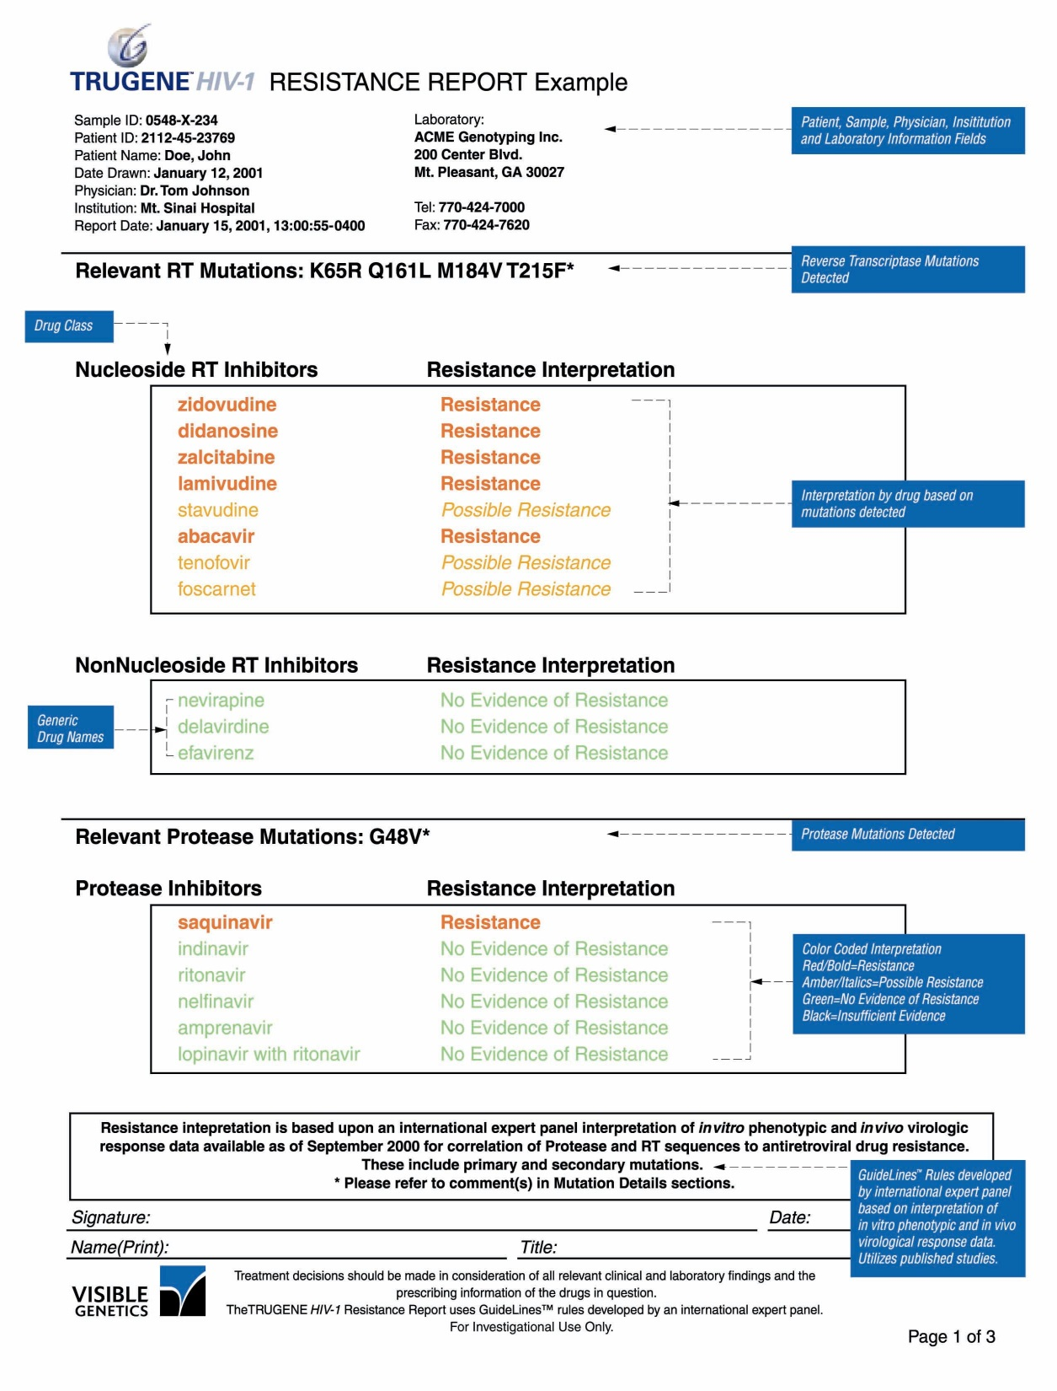
Genotype Example
0
M184V
M = Methionine
184 = the codon #
V = Valine
A mutation at codon #184 in the RT gene codes for a Valine in the resistant virus, where a Methionine should be there in the wild type virus
Notes:
The first page provides an at-a-glance color-coded resistance summary that includes
A listing of relevant mutations detected
A listing of ARVs by generic name
A resistance interpretations for each drug
Guidelines™ rules for interpretation are developed and updated by an international expert panel that convenes regularly to review new evidence and update rules accordingly

Slide 20
Genotype Example
0
Reports each medication out as resistant, possibly resistant, or sensitive (meaning no evidence of resistance)

Slide 21
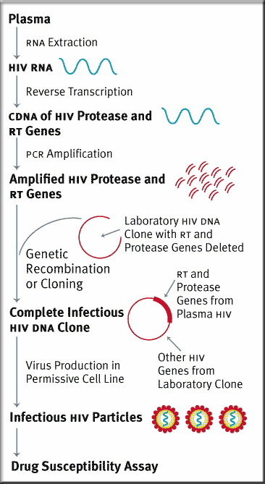
Phenotypic Resistance Testing
0
Tests viability the patient’s HIV in the presence of varying antiretroviral agents
Similar to traditional bacterial antibiotic susceptibility assays
Results reported as fold-change in susceptibility to antiretroviral agents

Slide 22
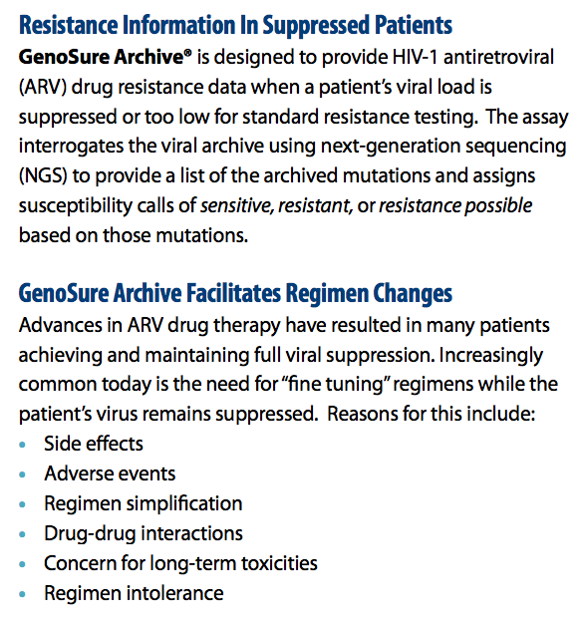
GenoSure Archive

Slide 23
Stanford Database – www.hivdb.stanford.edu
0
Provides a database of mutated virus sequences that can be searched to hep determine drug resistance or susceptibility
Click here to access database

Slide 24
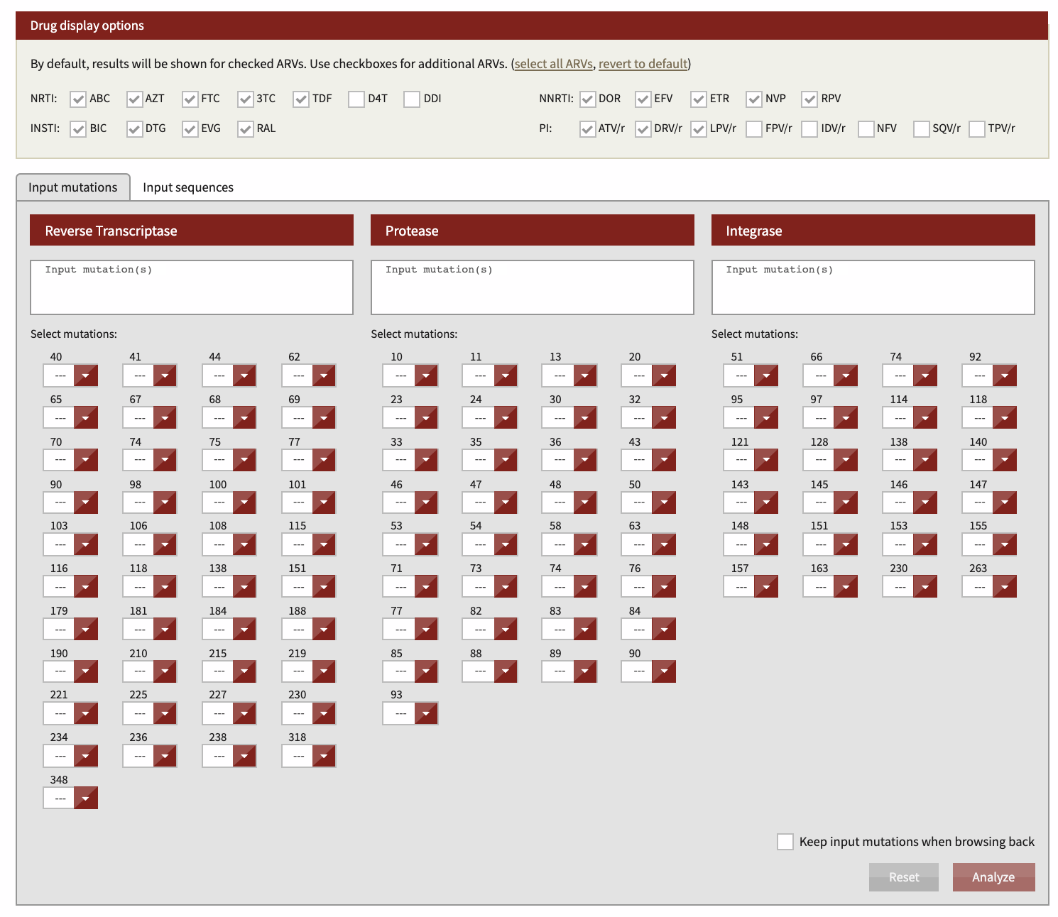
Stanford Database – www.hivdb.stanford.edu
0
Input all mutations from all available HIV Genotypes
Click analyze at bottom right

Slide 25
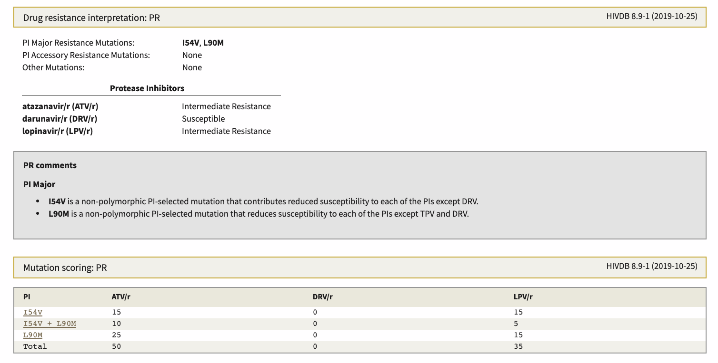
Stanford Database – www.hivdb.stanford.edu
0
Provides resistance analysis
Resistance/Susceptible
Clinical comments
Provides mutation score
Higher score is “worse” for that drug
Lowest number is likely best drug

Slide 26
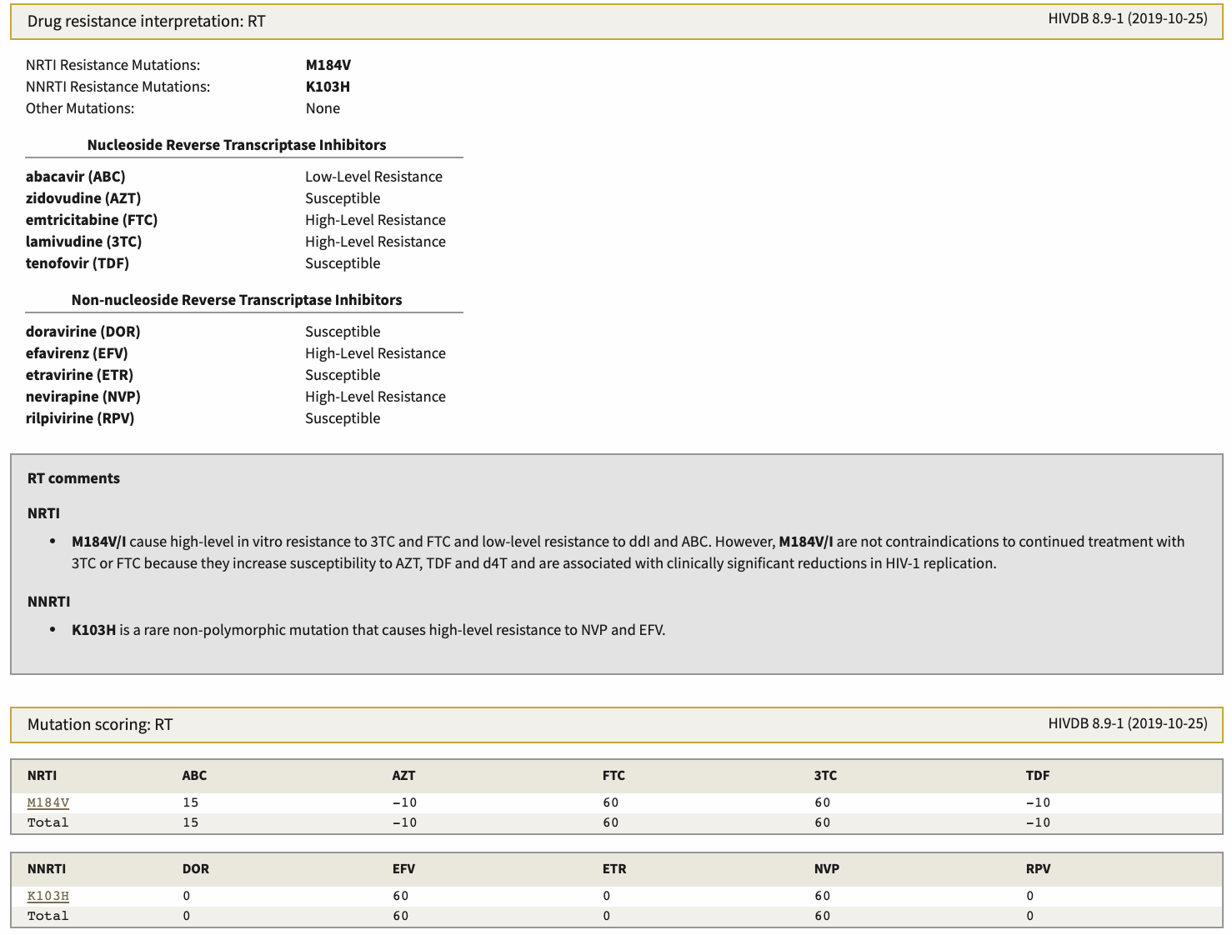
Stanford Database – www.hivdb.stanford.edu
0
Provides resistance analysis
Resistance/Susceptible
Clinical comments
Provides mutation score
Higher score is “worse” for that drug
Lowest number is likely best drug
Some caveats, ie M184V
often OK to maintain the mutation, ie use 3TC or FTC despite resistance

Slide 27
CASE #1

Slide 28
Case #1
54yr female, recurrent URI prompted HIV testing
Tested positive Jan 2017, likely through heterosexual transmission
Baseline HIV RNA 5,582,420 copies/mL, initial CD4 count was in the 20s.
Baseline GT, transmitted resistance to NNRTI: Y181C, N348I, E138K/R and V179E
Initial regimen in February 2017 was Raltegravir 400mg BID with Tenofovir alafenamide/emtricitabine.
Reports missing 4 days of treatment in 6months due to depression
August 2017 (6 month visit), HIV RNA 63,000 copies/ml, CD4 73
New resistance testing shows
NRTI, NNRTI - K65R, K70E, MI84V, N348I E138K, V179E, Y181C
INSTI - L74I, G140S, Q148M

Slide 29
Case #1
September 2017, She gets switched to
Darunavir/cobicistat + atazanavir + tenofovir alafenamide + emtricitabine
Provider requested me to review chart for ARV opinion
October 2017, Now HIV RNA 270 copies/ml, CD4 94 cells/mm³

Slide 30
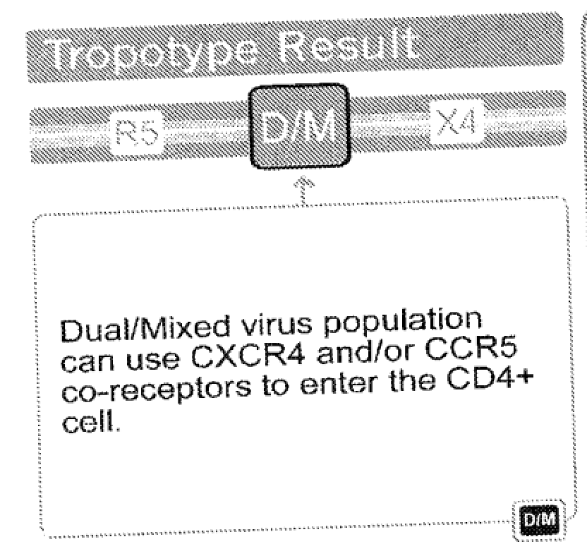
Case #1, prior to Ibalizumab, Fostemsavir availability
Trofile DNA dual/mixed
Fostemsavir expanded access explored. Wait listed as manufacturing issue and no current trial enrollment
Ibalizumab EAP- viral load >1000copies/ml (In NY, Chelsea, Jacobi and Yale, CT nearest sites)

Slide 31
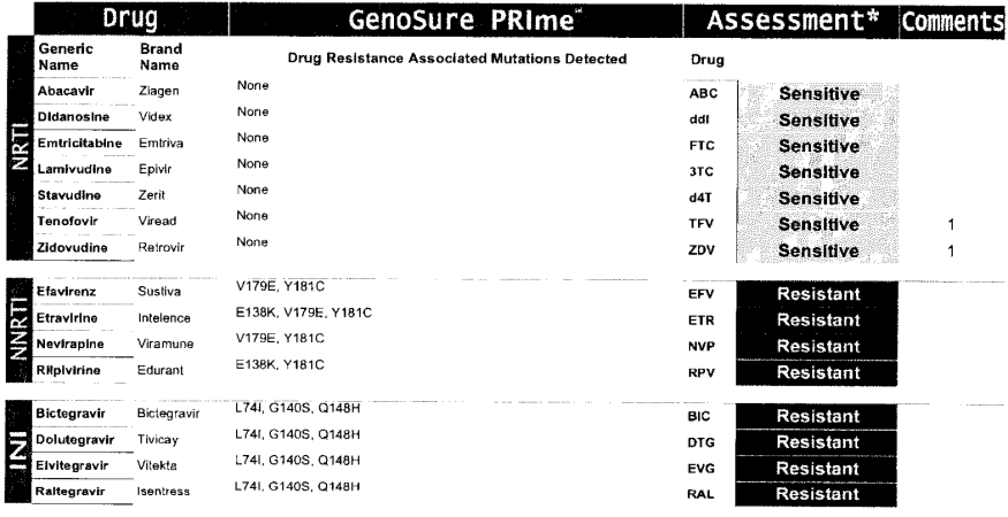
March 2018, New GT Records
Note NO mutations
On NRTIs – GREAT
Example of reviewing
Old records too

Slide 32
March 2018, GT Records
Never “failed” a PI, so this makes sense

Slide 33
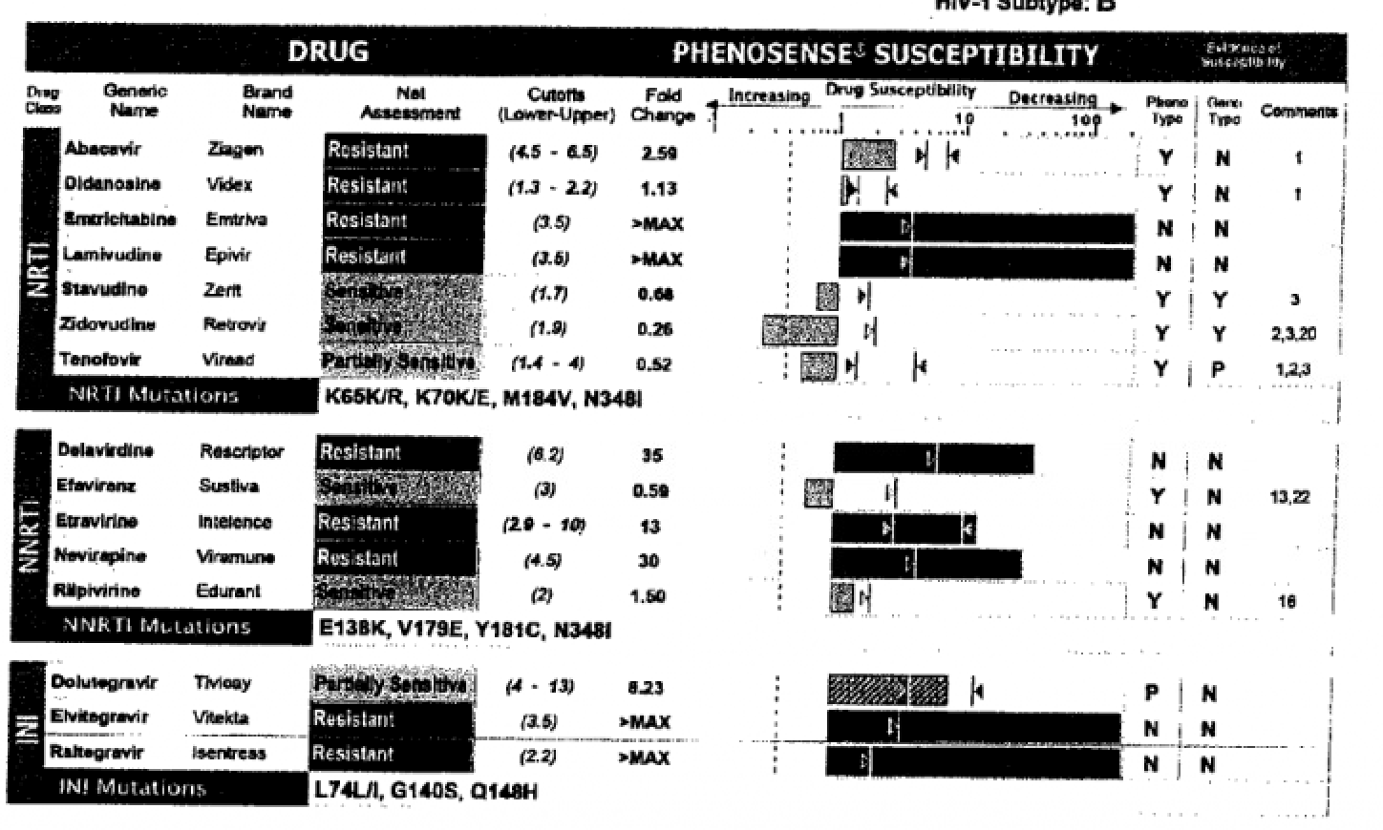
August 2017, old records
AZT active with K65R,
Note mixture K65K/R
RPV OK, DOR not
on GT at the time
DTG only partial

Slide 34
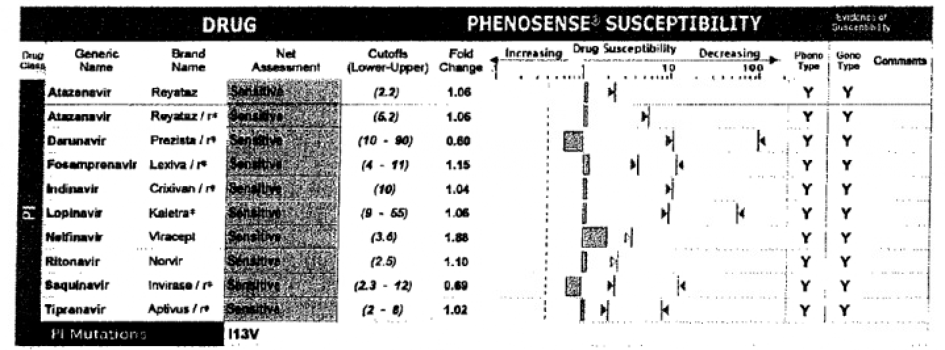
August 2017, old records

Slide 35
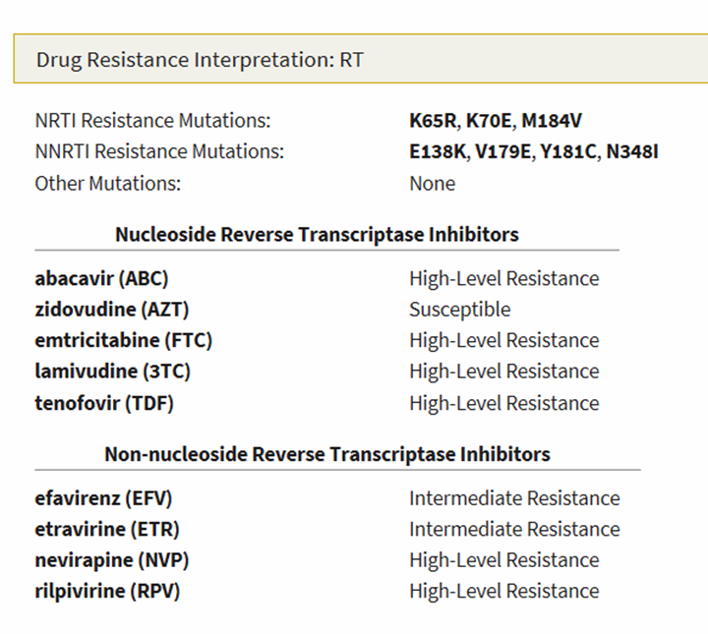
Stanford Database, April 2019

Slide 36
Ibalizumab, TMB-301 Study
CD4-directed post-attachment HIV-1 inhibitor
Efficacy outcomes of IBA with OBR in patients resistant and susceptible dolutegravir (DTG) and darunavir (DRV)
Study TMB-301
IBA, IV 2000 mg, followed by 800 mg doses every 2 weeks up to Week 25
OBR with at least 1 additional sensitive agent was added at day 7
Eligible patients continued to receive IBA for up to 96 weeks
IBA 2000mg
IV load
IBA maintenance, 800mg IV q 14 days, 25 weeks
BL
Add OBR, Day 7
Wk 25
Emu B, et al. N Engl J Med 2018;379:645-54. DOI: 10.1056/NEJMoa1711460

Slide 37
Ibalizumab, TMB-301
40 patients
18 (45%) had DTG resistance, of which 11 had major DTG resistance mutations (Q148 plus additional mutations)
10/18 received DTG in their OBR while
16 of 22 DTG susceptible patients received DTG as OBR
27 (68%) had DRV resistance
DRV was included as OBR in 26 patients: 18 with DRV resistance, 8 DRV susceptible
5 discontinuations, all non IBA related - Death (2), Consent withdrawal (2), Physician decision (1)
Emu B, et al. N Engl J Med 2018;379:645-54. DOI: 10.1056/NEJMoa1711460

Slide 38
Characteristic | Value | Characteristic | Value
Median age (range, year) | 53(23-65) | Total ARV received
Male sex – no (%) | 34 (85) | Mean | 11+/-5
Race – no (%) |  | Median (range) | 10 (3-12)
White | 22(55) | Resistance to > 1 drug in class – no (%)
Black | 13(33) | NRTI | 37(93)
Asian | 4(10) | NNRTI | 37(93)
Unknown | 1(3) | PI | 36(90)
Years since HIV Diagnosis |  | INSTI | 27(68)
Mean | 20+/-8 | Coreceptor Antagonist | 33(87)
Median (range) | 4.6(2.5-5.9) | Fusion Inhibitor | 9(24)
Viral load log₁₀ copies/ml |  | Resistance to all drugs in class – no (%)
Mean | 4.5+/-0.8 | NRTI | 26(65)
Median (range) | 23(2-30) | NNRTI | 26(65)
VL >100,000 – no (%) | 7(18) | PI | 25(63)
CD4 count (cells/mm³) |  | INSTI | 19(48)
Mean | 150+/-182 | Coreceptor Antagonist | 33(87)
Median (range) | 73(0-676) | Fusion Inhibitor | 9(24)
<10 | 12(30)
<50 | 17(43)
50-200 | 10(25)
>200 | 13(33)
Emu B, et al. N Engl J Med 2018;379:645-54. DOI: 10.1056/NEJMoa1711460

Slide 39
Ibalizumab, TMB-301, Results
Emu B, et al. N Engl J Med 2018;379:645-54. DOI: 10.1056/NEJMoa1711460

Slide 40
Adverse Events in 40 Study Patients
Adverse Event | No. of Patients (%)
Any adverse event | 32(80)
Assessed as related to IBA | 7(18)
Leading to D/C of IBA | 5(13)
Occurring in patients who died | 4(10)
Serious Adverse Event | 9(23)
Adverse Event Reported in >5%
Diarrhea | 8(20)
Dizziness | 5(13)
Fatigue | 5(13)
Nausea | 5(13)
Pyrexia | 5(13)
Rash | 5(13)
Vomiting | 4(10)
Lymphadenopathy | 4(10)
Nasopharyngitis | 3(8)
Deceased appetite | 3(8)
Excoriation | 3(8)
Headache | 3(8)
Upper Respiratory Infection | 3(8)
Emu B, et al. N Engl J Med 2018;379:645-54. DOI: 10.1056/NEJMoa1711460

Slide 41
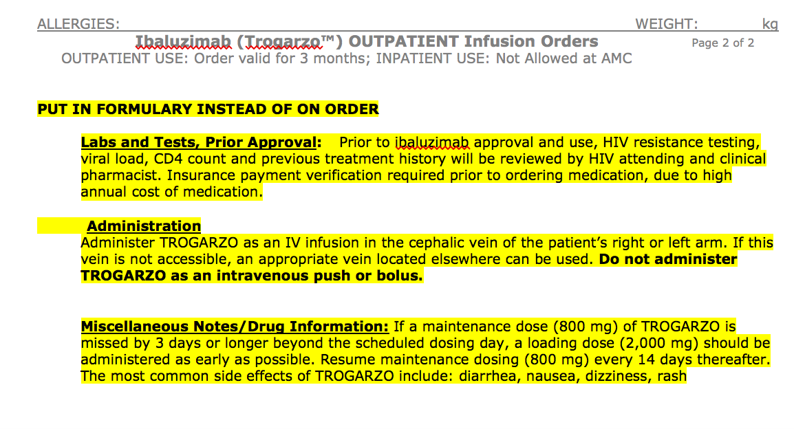

Slide 42
How did this happen?
Pharmacy fill report obtained. 2017 Feb, March, April, May both filled. June- no ARV filled. July- raltegravir alone and in August, FTC-TAF alone filled.
No drug-drug interaction identified.
Med dispensing through Pharmacy prefilled am - pm pouch with home delivery arranged.
On Cobicistat boosted darunavir once a day, dolutegravir BID and etravirine twice a day
Added Ibalizumab, no response

Slide 43
What’s next? Spring/Summer 2020
COVID complicated and continues to complicate numerous aspects of HIV care
Laboratory draws
Face to Face versus Virtual visits
Regimen changes/complexities
Prior Authorization timing
Even if on Ibalizumab, patient concerns about safety, etc

Slide 44
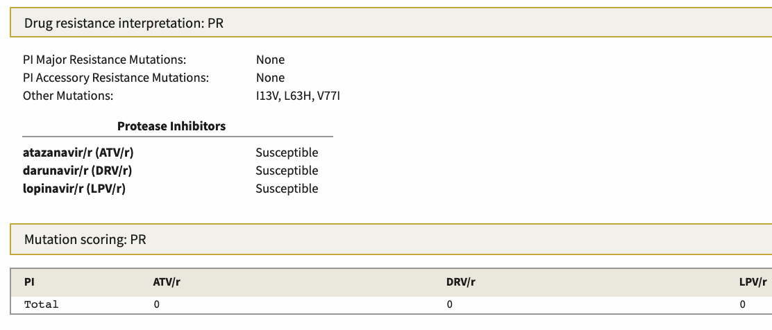
New Stanford Database Analysis, Summer 2020

Slide 45
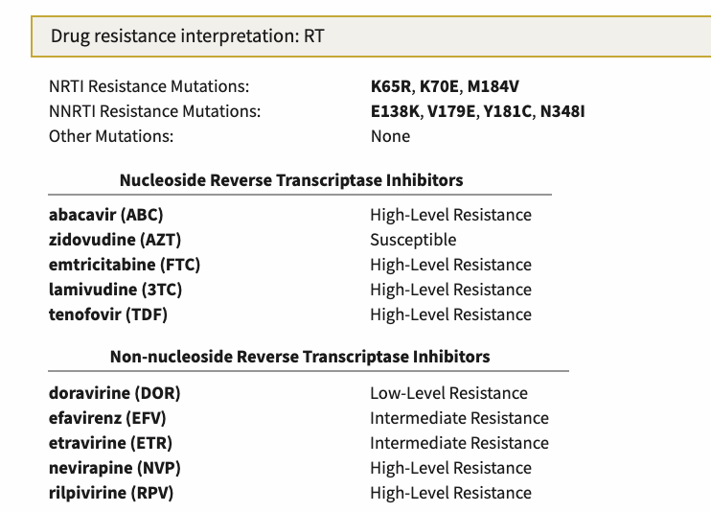
New Stanford Database Analysis Summer 2020
AZT active, patient had severe
Headaches when used in past
Mutation Score – Higher is worse, lower is better – Calculated for each medication

Slide 46
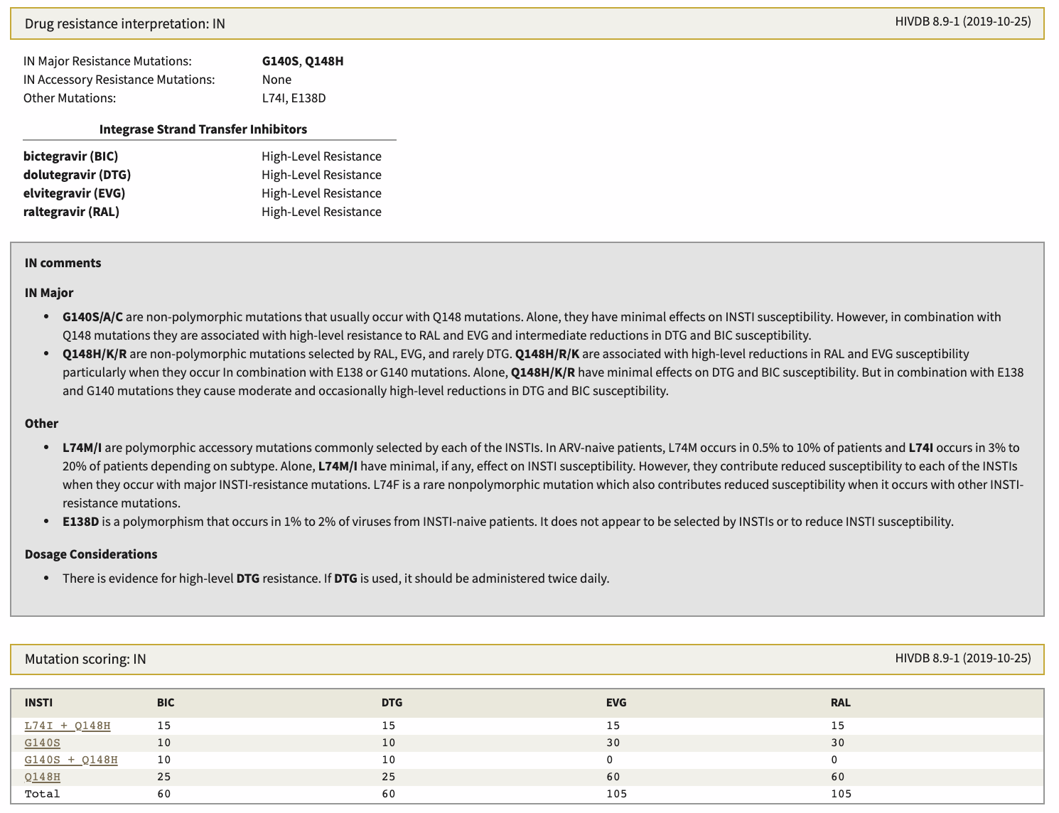
New Stanford Database Analysis Summer 2020
Note both DTG and BIC are equal for scoring, high level resistance

Slide 47
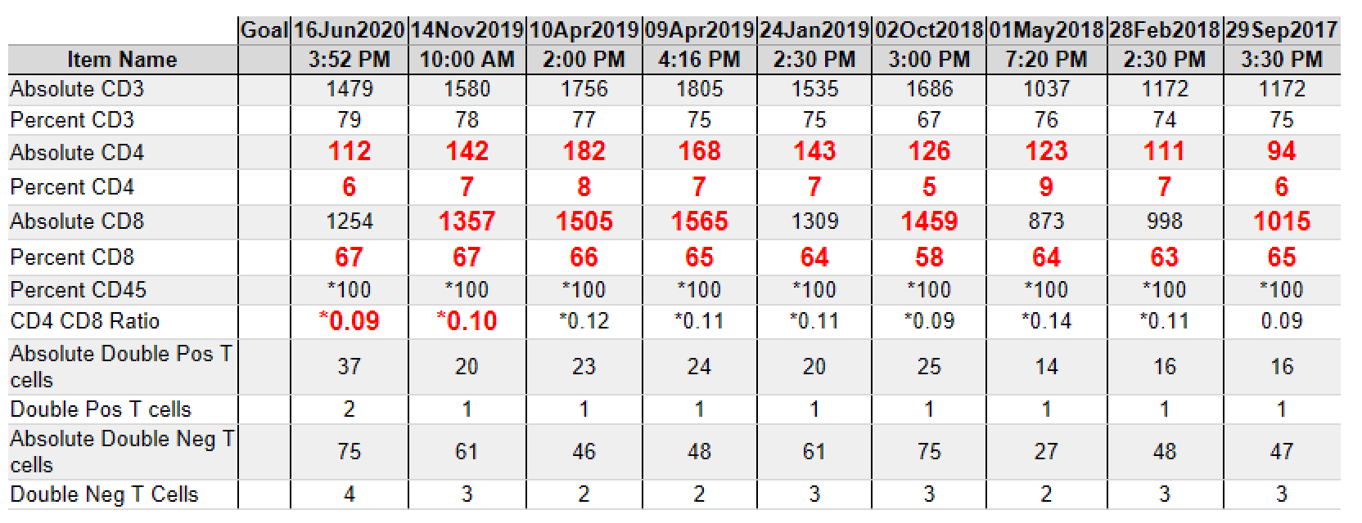

Slide 48
Is Fostemsavir an option?
Prodrug of temsavir
Gp120 directed attachment inhibitor
Indication
Use in combination with other antiretrovirals to treat HIV-1 infection in heavily treatment-experienced adults with multidrug-resistant HIV-1 infection failing their current ARV regimen due to resistance, intolerance, or safety considerations
Dosing
Extended Release 600mg tablets with or without food twice daily – DO NOT CRUSH
Rukobia Product Information. ViiV Healthcare, 2020

Slide 49
Fostemsavir, Adverse Events
Adverse Events
Most common, observed in ≥5% of subjects, was nausea (10%)
81% of ARDs were mild or moderate in severity
QTc Prolongation
At doses of 2,400 mg twice daily, fostemsavir has been shown to significantly prolong the QTc interval of the electrocardiogram
Caution in patients with a history of QTc interval prolongation or in patients with relevant pre-existing cardiac disease or who are taking drugs with a known risk of Torsade de Pointes
AST/ALT elevations in HBV or HCV co-infection
Monitoring AST/ALT
Maintain effective HBV therapy in patients co-infected HBV
Rukobia Product Information. ViiV Healthcare, 2020

Slide 50
Fostemsavir – Contraindicated Medications
Class | Medication | Clinical Comments
Contraindicated Medications
Androgen receptor inhibitor | Enzalutamide | Potential reduction in fostemsavir levels
Anticonvulsants | Carbamazepine, phenytoin | Potential reduction in fostemsavir levels
Antimycobacterial | Rifampin | Potential reduction in fostemsavir levels
Antineoplastic | Mitotane | Potential reduction in fostemsavir levels
Herbal product | St John’s wort (Hypericum) | Potential reduction in fostemsavir levels
Medications above are all inducers of CYP3A4 and will likely reduce drug levels of fostemsavir
Rukobia Product Information. ViiV Healthcare, 2020

Slide 51
Fostemsavir – Drug Interactions
Class | Medication | Clinical Comments
Medications to Used with Caution
HCV Protease Inhibitors | Grazoprevir and Voxilaprevir | HCV medication levels may be increased, use alternative
HMG-CoA Reductase Inhibitors | All Statins | Potential increase in statin drug levels, use lowest dose
Hormonal Contraception | Ethinyl Estradiol | Max daily dose 30 micrograms
Rukobia Product Information. ViiV Healthcare, 2020

Slide 52
Fostemsavir – Drug Interactions
Class | Medication | Clinical Comments
HIV Medications that CAN be used with Fostemsavir
Protease Inhibitors | Atazanavir or darunavir with either cobicistat or ritonavir | No interaction
NNRTI | etravirine | No interaction; rilpirivine and doravirine unlikely to interact
NRTI | Tenofovir disoproxil fumarate | No interaction; abacavir, tenofovir alafenamide unlikely to interact
INSTI | Dolutegravir, raltegravir | No interaction, bictegravir and elvitegravir/cobicistat unlikely to interact
Entry Inhibitors | Ibalizumab, maraviroc | Unlikely to interact
Other Medications that CAN be used with Fostemsavir
Buprenorphine/naloxone, famotidine, methadone, norethindrone, rifabutin
Rukobia Product Information. ViiV Healthcare, 2020

Slide 53
BRIGHTE Study, ongoing Phase 3
Design - Randomized, double-blind, placebo-controlled, 2 Cohorts
Randomized Cohort –Treatment experienced, failing regimen, HIV-1 RNA > 400 copies/ml AND
1 or 2 ARV classes remaining with >1 fully active agent per class
Unable to construct viable regimen from remaining agents
Non-randomized Cohort – Treatment experienced, failing current regimen, HIV-1 RNA > 400 copies/ml AND
0 ARV classes remaining and no remaining fully active approved agents
Blinded FTR 600mg BID + failing regimen
Randomized 3:1
Open-label FTR 600mg BID + OBT
Blinded placebo BID + failing regimen
Day1 Day 9 24wks 48wks 96wks
Non Randomized
Open-label FTR 600mg BID + OBT
Day 1 24wks 48wks 96wks
Lataillade M, et al. 10th IAS Conference on HIV Science, July 21-24, 2019, Mexico City.
Abstract MOAB0102.

Slide 54
BRIGHTE, Baseline Characteristics
Lataillade M, et al. 10th IAS Conference on HIV Science, July 21-24, 2019, Mexico City.
Abstract MOAB0102.

Slide 55
BRIGHTE, Baseline ARV Exposure and Resistance
Lataillade M, et al. 10th IAS Conference on HIV Science, July 21-24, 2019, Mexico City.
Abstract MOAB0102.

Slide 56
Most Common ARV in initial OBT
Lataillade M, et al. 10th IAS Conference on HIV Science, July 21-24, 2019, Mexico City.
Abstract MOAB0102.

Slide 57
BRIGHTE – HIV RNA <40 copies/ml, FDA Snapshot, ITT-E
Lataillade M, et al. 10th IAS Conference on HIV Science, July 21-24, 2019, Mexico City.
Abstract MOAB0102.

Slide 58
Mean Change from BL in CD4 Count
Lataillade M, et al. 10th IAS Conference on HIV Science, July 21-24, 2019, Mexico City.
Abstract MOAB0102.

Slide 59
Doravirine (Pifeltro®)
NNRTI dosed once daily with or without food that is approved for use in persons with no antiretroviral history and in switch
The non-nucleoside reverse transcriptase inhibitor (NNRTI) anchor drug in this regimen—doravirine—retains activity in the presence of common NNRTI drug-resistant mutations (e.g. K103N, Y181C, G190A) and thus may have clinical utility for individuals with resistance to other NNRTI’s.
No CD4 count or HIV RNA level restrictions
No proton pump inhibitor limitations
No dosage adjustment required in patients with mild, moderate, or severe renal impairment
No dosage adjustment CPT A or B, has not been studied in CPT C
Good PK with Darunavir/c, dolutegravir – minimal risk of drug interactions
Pifeltro Product Information, Merck, 2020.

Slide 60
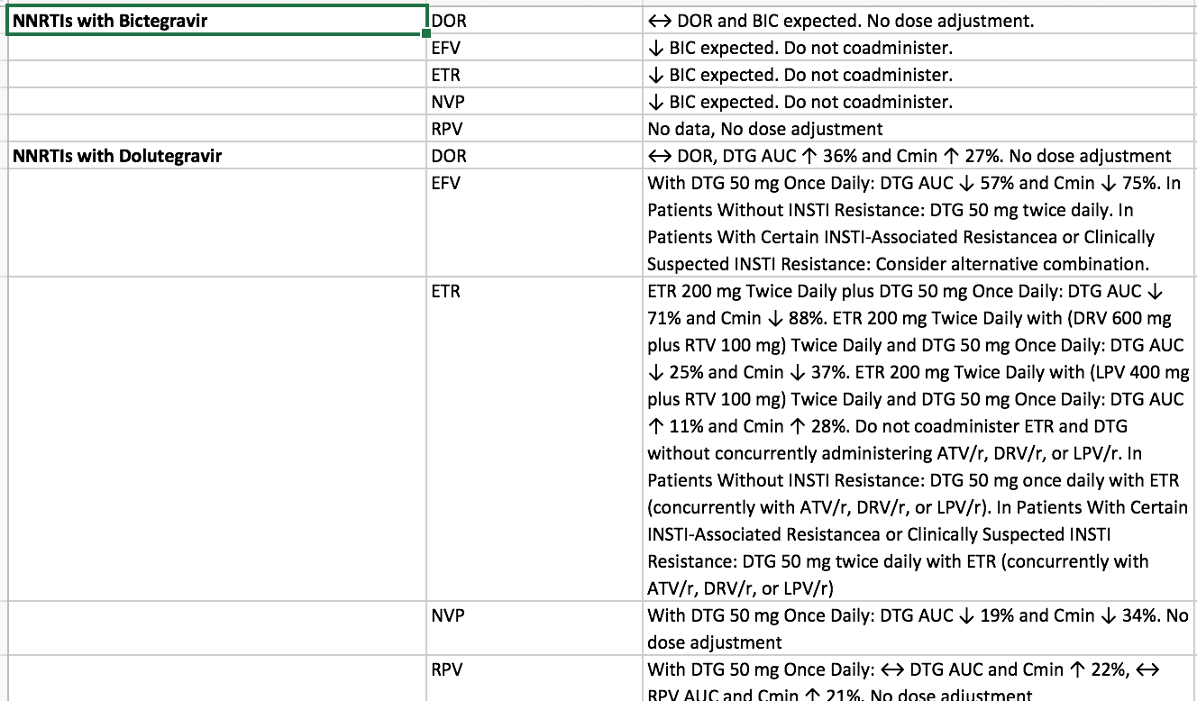
Select Combinations with Acceptable PK – DHHS
DHHS Guidelines, December 2019.

Slide 61
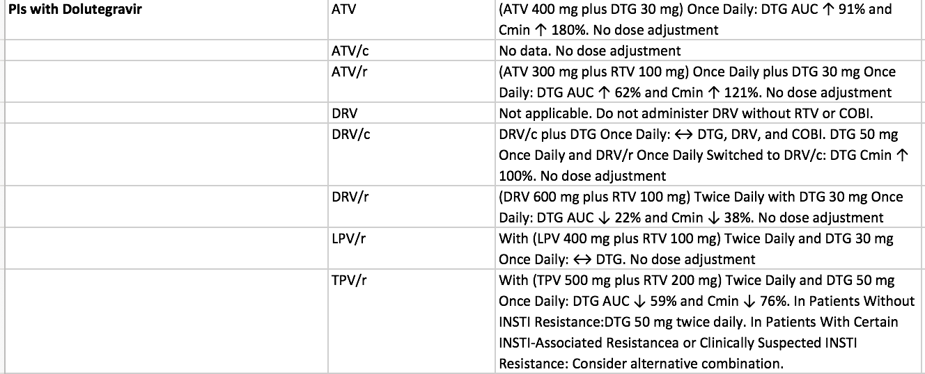
Select Combinations with Acceptable PK – DHHS
DHHS Guidelines, December 2019.

Slide 62
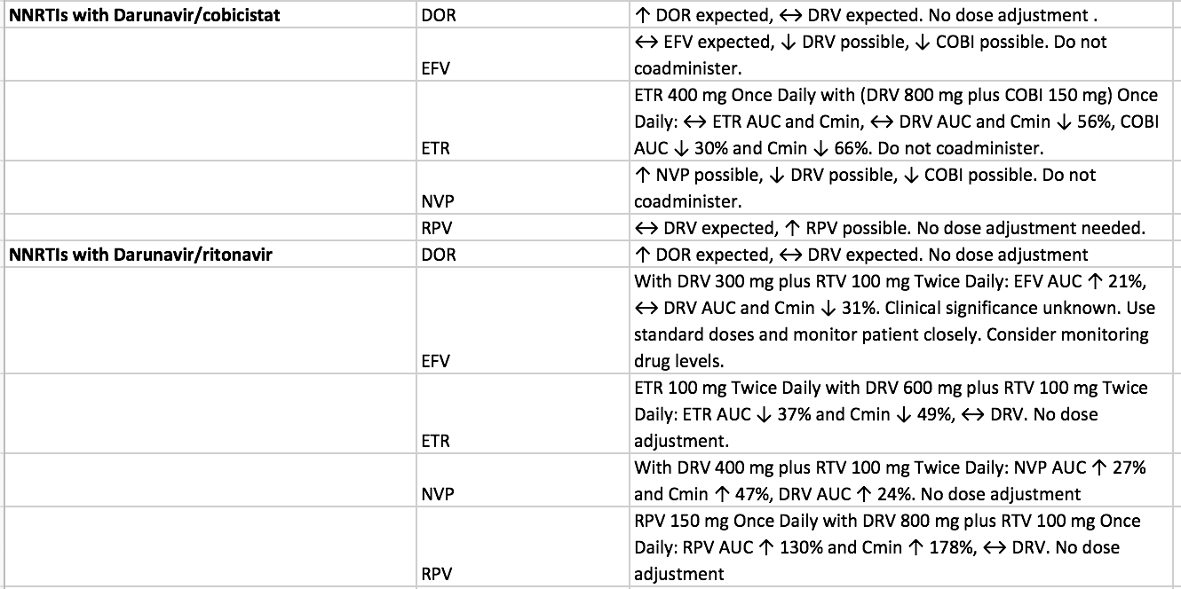
Select Combinations with Acceptable PK – DHHS
DHHS Guidelines, December 2019.

Slide 63
Fostemsavir – Drug Interactions
Class | Medication | Clinical Comments
HIV Medications that CAN be used with Fostemsavir
Protease Inhibitors | Atazanavir or darunavir with either cobicistat or ritonavir | No interaction
NNRTI | etravirine | No interaction; rilpirivine and doravirine unlikely to interact
NRTI | Tenofovir disoproxil fumarate | No interaction; abacavir, tenofovir alafenamide unlikely to interact
INSTI | Dolutegravir, raltegravir | No interaction, bictegravir and elvitegravir/cobicistat unlikely to interact
Entry Inhibitors | Ibalizumab, maraviroc | Unlikely to interact
Other Medications that CAN be used with Fostemsavir
Buprenorphine/naloxone, famotidine, methadone, norethindrone, rifabutin
Rukobia Product Information. ViiV Healthcare, 2020

Slide 64
Select Combinations with Acceptable PK – Pill Burden Minimization
NNRTI with INSTI
Biktarvy (BIC/FTC/TAF) + Pifeltro (doravirine)
Tivicay (Dolutegravir) + Pifeltro (doravirine)
Odefsey (RPV/TAF/FTC) + Tivicay (dolutegravir)
PI with INSTI
Symtuza (DRV/c/TAF/FTC) + Tivicay (dolutegravir)
Prezcobix (DRV/c) + Biktarvy (BIC/FTC/TAF)
Prezcobix (DRV/c) + Tivicay (Dolutegravir)
DHHS Guidelines, December 2019.

Slide 65
VL and CD4 Data, Updated

Slide 66
Regimen Change
From Darunvair/cobicistat, etravirine BID, dolutegravir BID + failed ibalizumab
To:
Darunavir/cobicistat 800mg/150mg daily – Fully active
Dolutegravir 50mg twice daily – Hopefully active
Doravirine 100mg once daily – Mostly Active
Fostemsavir 600mg twice daily – Fully active
Awaiting VL and CD results after change

Slide 67
CASE #2

Slide 68
Case #2
53 year old female diagnosed with HIV/AIDS in 2006 through heterosexual transmission
Pt was initially on Atripla, stopped after experiencing nightmares
Other meds she has been on: Tenofovir disoproxil/ emtricitabine, etravirine, stavudine, raltegravir, darunavir/ ritonavir
PMH history of PCP 2013
CD4 was 1 in June 2016
Most recent CD4 count July 2020 was 96(6.8%)
Patient was switched to bictegravir/tenofovir alafenamide/emtricitabine in October 2018

Slide 69
Case #2
Darunavir/cobicistat was added to B/F/TAF in August 2019 due to persistently high viral loads
Stopped darunavir/cobicistat in May 2020 due to concern of lipodystrophy and weight gain around her neck/shoulder area
Long history of non-adherence
Provider reviews recent genotype results and the importance of not missing medications
Provider inquires about potential regimen change
Also take omeprazole 20mg for GERD

Slide 70
Case #2 Viral Load History
Date (MO/YY) | VL (copies/ml) | Clinical Comments
7/2020 | 13,600
6/2020 | 152,000 | Reports missing BIC/TAF/FTC for first 3 months of 2020, every other day
12/2019 | 37 | First VL <200copies/ml
8/2019 | 18,100 | Added DRC/c to BIC/TAF/FTC
7/2019 | 39,600
3/2019 | 35,200
1/2019 | 46,500
10/2018 | 56,400 | Changed to BIC/TAF/FTC
7/2017 | 101,000
3/2017 | 62,032
11/2016 | 21,260
6/2016 | 9922
3/2016 | 80968 | DRV/r/RAL/TDF/FTC/EFV

Slide 71
Case #2

Slide 72
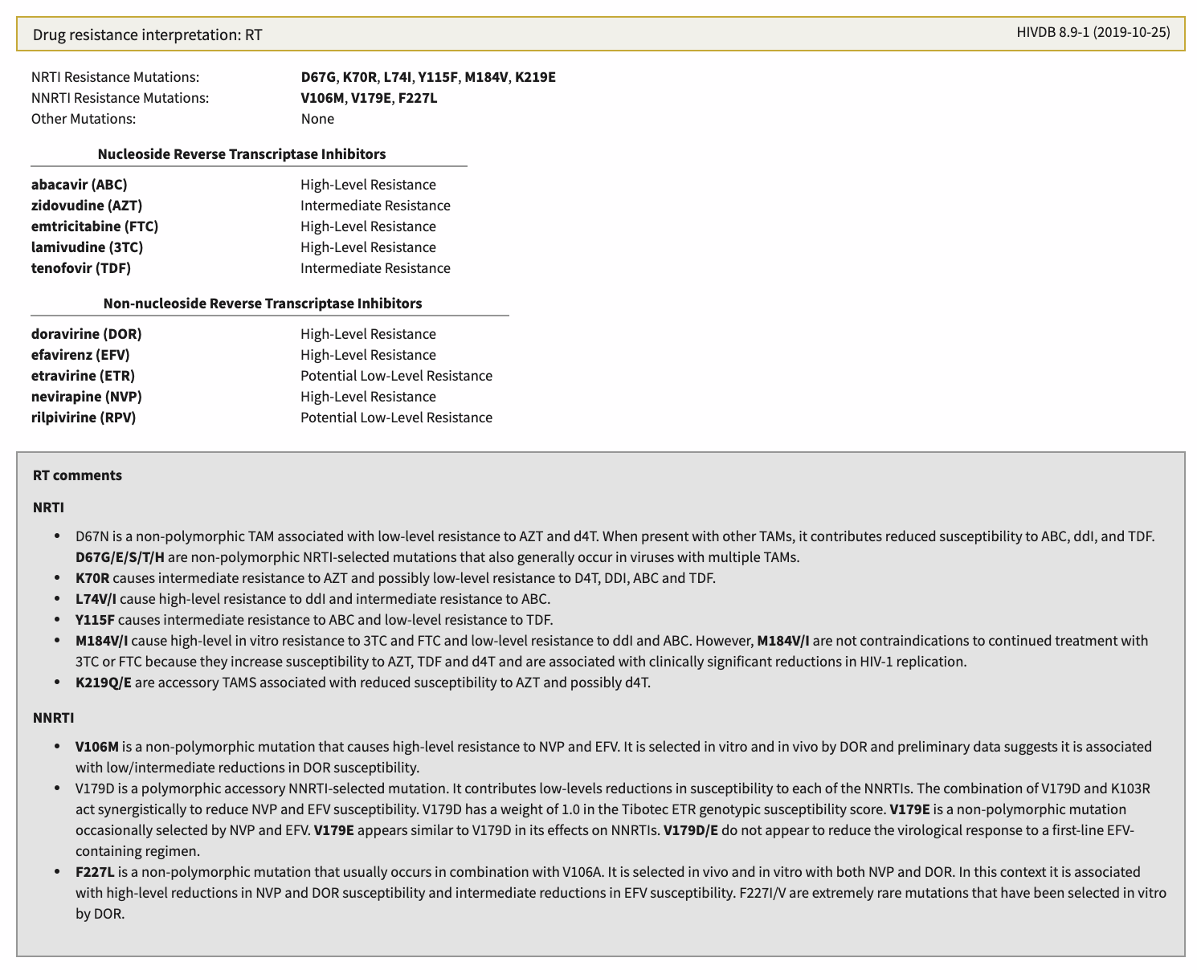
Case #2 – Stanford Database RT

Slide 73
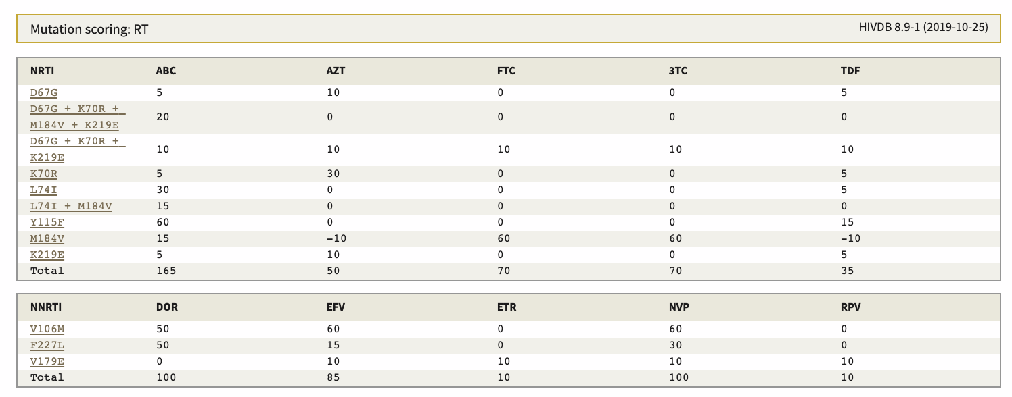
Case #2 – Stanford Database RT
Mutation Score – Higher is worse, lower is better – Calculated for each medication
Mutation Score – Higher is worse, lower is better – Calculated for each medication

Slide 74
Case #2 – Stanford Database PR

Slide 75
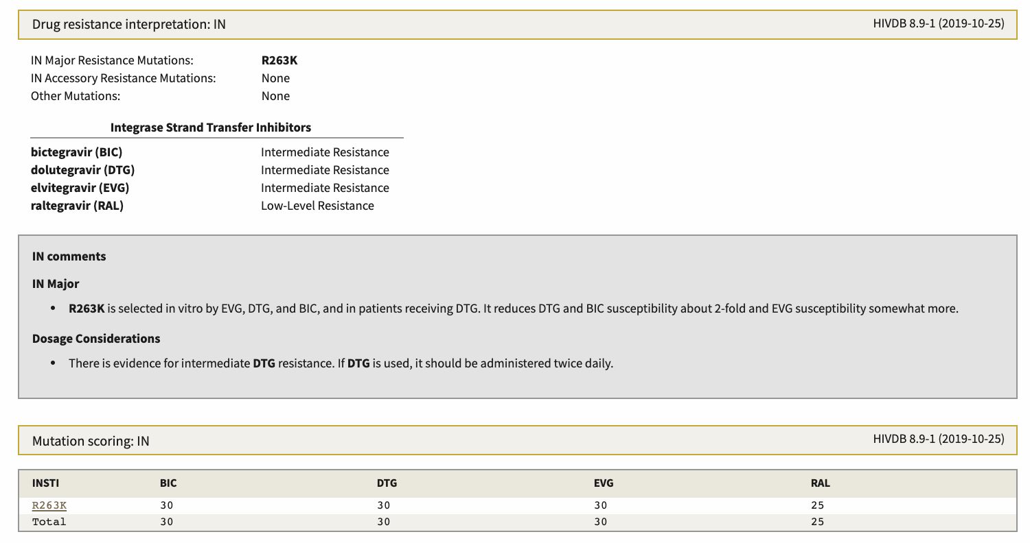
Case #2 – Stanford Database INSTI
Mutation Score – Higher is worse, lower is better – Calculated for each medication

Slide 76
Options/Questions/Concerns based upon Stanford Database
Symtuza +/- DTG twice daily
Issues with lipodystrophy, PK is acceptable
DTG twice daily + Fostemsavir + TAF/FTC or TDF/FTC
DTG twice daily + TAF/FTC or TDF/FTC +/- Rilpivirine
Concern about extensive NRTI mutations, but may be OK
On omeprazole, so rilpivirine not ok unless switched off
RAL HD + Descovy or Truvada
Concern about INSTI and NRTI mutations,
BIC/TAF/FTC alone again
Concern about INSTI and NRTI mutations
Can’t do BID dosing
Could also draw a Trofile to see if maraviroc will work

Slide 77
HIV Resources

Slide 78
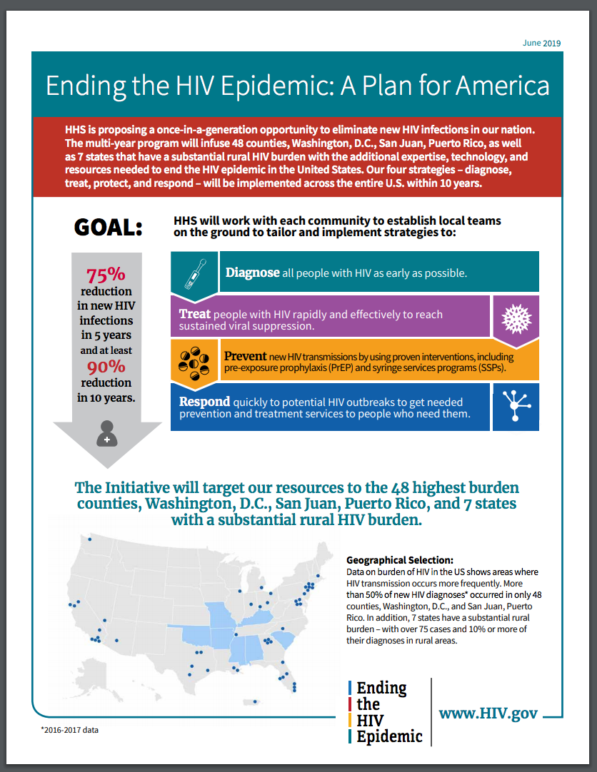
Ending the HIV Epidemic A Plan for America
Center for Disease Control. National Center for HIV/AIDS, Viral Hepatitis, STD, and TB Prevention Division of HIV/AIDS Prevention. Ending the HIV Epidemic: A Plan for America. Located at http://www.cdc.gov/endhiv/index.html Accessed March 21, 2020.

Slide 79
www.aidsetc.org

Slide 80
www.necaaetc.org

Slide 81
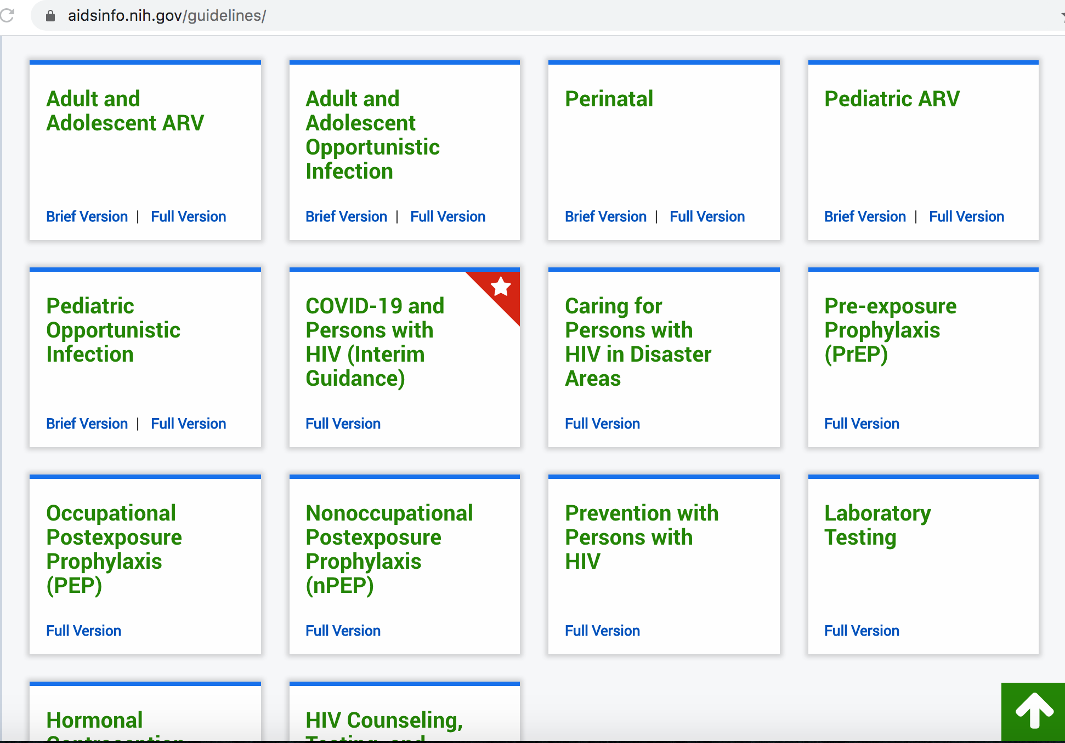
http://aidsinfo.nih.gov/guidelines/

Slide 82
National HIV Curriculum – hiv.uw.edu

Slide 83
Select National and International Resources for COVID-19
CDC – Cases and Latest Updates
www.cdc.gov/coronavirus/2019-ncov/cases-updates/index.html
CDC – Situation Summary
www.cdc.gov/coronavirus/2019-ncov/cases-updates/summary.html
CDC – Healthcare Professionals Information
www.cdc.gov/coronavirus/2019-nCoV/hcp/index.html
CDC – Interim Guidelines for Clinical Specimens
www.cdc.gov/coronavirus/2019-nCoV/lab/guidelines-clinical-specimens.html
CDC – Emergency Preparedness and Response, Clinician Outreach and Community Activity (COCA)
www.emergency.cdc.gov/coca/
WHO Coronavirus Website
www.who.int/emergencies/diseases/novel-coronavirus-2019/events-as-they-happen
JAMA – COVID-19 Summary and Insights, February 28, 2020
www.jamanetwork.com/journals/jama/fullarticle/2762510
HRSA COVID-19 FAQs
www.bphc.hrsa.gov/emergency-response/coronavirus-frequently-asked-questions.html

Slide 84
Local Resources for COVID-19 – NY, NJ, PR, USVI
NYSDOH Coronavirus Website
www.health.ny.gov/diseases/communicable/coronavirus/
NYSDOH Coronavirus Website Information for Providers
www.health.ny.gov/diseases/communicable/coronavirus/providers.htm
NJDOH Coronavirus Website
www.nj.gov/health/cd/topics/ncov.shtml
Puerto Rico Coronavirus Website
www.salud.gov.pr/Pages/coronavirus.aspx
USVI Coronavirus Website
www.doh.vi.gov/covid19usvi

Slide 85
COVID-19 Patient Care and Management Resources
CDC Mental Health and COVID-19
www.cdc.gov/coronavirus/2019-ncov/prepare/managing-stress-anxiety.html
CDC Patient Management
www.cdc.gov/coronavirus/2019-ncov/hcp/clinical-guidance-management-patients.html
Clinical Trials Portal (search COVID–19)
http://www.clinicaltrials.gov/
Toronto Information on Crushing/PT HIV Medication Use
https://www.hivclinic.ca/main/drugs_extra_files/Crushing%20and%20Liquid%20ARV%20Formulations.pdf
Liverpool Drug Interaction Guide for Treatment
http://www.covid19-druginteractions.org/
Liverpool Guide for Patients with Swallowing Difficulties
http://www.covid19-druginteractions.org/

Slide 86
Questions/Contact
John J. Faragon, PharmD, BCPS, AAHIVP
faragoj@amc.edu
Please contact me with questions

