Slide 1
Mpox:
An Update for North Carolina
Moderator:
Christopher Hurt, MD, FIDSA
Emma Doran, MD, MPH
Carrie Blanchard, PharmD, MPH
June 21, 2024

Slide 2
Epidemiology

Slide 3
Mpox
Mpox (formerly Monkeypox) is caused by the Monkeypox virus (MPXV) an orthopoxvirus that is in the same genus as variola (the causative agent of smallpox) and vaccinia viruses (the virus used in the smallpox vaccine).
Historically, most cases of mpox have occurred in Central and West Africa. However, since May 2022, there has been a global outbreak of mpox in many nonendemic countries.
Prior to 2022, most cases in nonendemic countries were reported in travelers who were returning from endemic regions. There was also an outbreak of human mpox in the United States in 2003 associated with infected prairie dogs who were exposed to imported animals from Africa.
https://www.cdc.gov/poxvirus/mpox/about/index.html

Slide 4
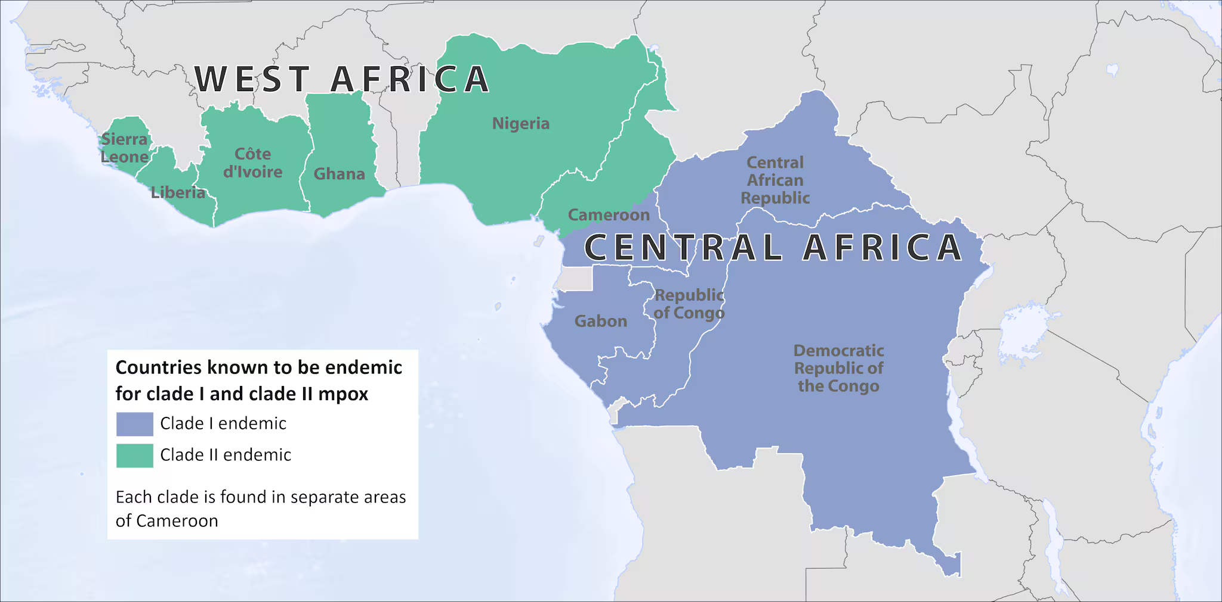
MPXV Clade I vs. II
MPXV has two distinct genetic clades, I and II, endemic to central and west Africa respectively.
A subclade of Clade II (Clade IIb) has been associated with the 2022 mpox outbreak.

Slide 5
MPXV Clade I
Clade I causes more severe illness and deaths.
Clade I outbreaks involving human-to-human transmission in the Democratic Republic of the Congo (DRC) with potential for international spread.
To date, no cases of clade I mpox have been detected outside of countries in Central Africa where the virus is endemic.
Treatments and vaccines that have been used during the ongoing Clade IIb outbreak, are expected to be effective for Clade I MPXV infections.
For individuals with suspected mpox infection and with travel to mpox-endemic regions of central Africa such as DRC in the 21 days preceding symptom onset or close contact with someone with such recent travel, clinicians should contact the Communicable Disease Branch epidemiologist on call at 919-733-3419 for consultation on clade-specific MPXV testing.
https://www.cdc.gov/mmwr/volumes/73/wr/mm7319a3.htm

Slide 6
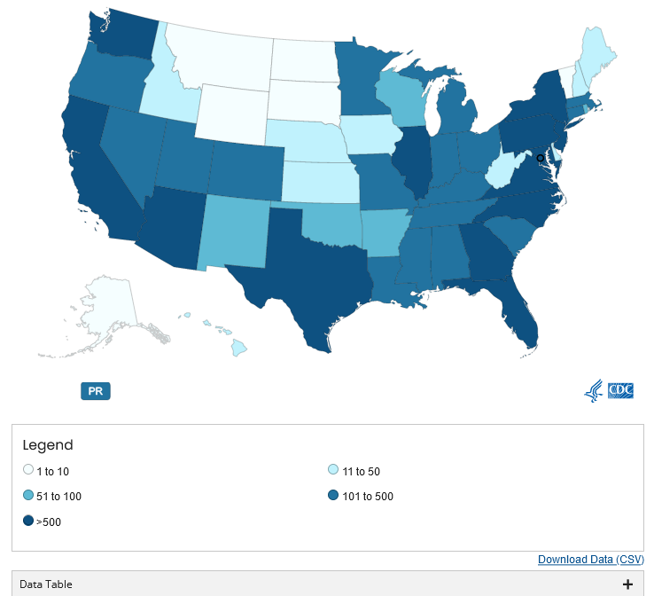
2022 Mpox Outbreak
32,063 U.S. cases as of June 2, 2024
767 North Carolina cases from 2022 to 2024 (data as of June X, 2024)
Main route of transmission has been through sexual contact.
https://www.cdc.gov/poxvirus/mpox/response/2022/us-map.html
Notes:
58 deaths in the US

Slide 7
North Carolina Mpox Demographics
Race | Number of Cases in the last 6 months (%) | Total Number of Cases (%)
American Indian/Alaskan Native | 0 | 3(<1)
Asian | 0 | 4 (1)
Black or African American | 25 (57) | 504 (67)
Native Hawaiian or Pacific Islander | 0 | 0
White | 13 (30) | 189 (25)
Multi-racial | 3 (7) | 27 (4)
Other | 2 (4) | 25 (3)
Unknown | 1 (2) | 2 (<1)
Ethnicity
Hispanic | 11 (25) | 112 (15)
Non-Hispanic | 26 (59) | 633 (84)
Unknown | 7 (16) | 41 (5)

Slide 8
North Carolina Mpox Demographics
Gender | Number of Cases in the last 6 months (%) | Total Number of Cases (%)
Male | 40 (91) | 720 (95)
Female | 4 (9) | 30 (4)
Other than sex assigned at birth | 0 | 4 (1)
Age
0-17 | 0 | 3 (<1)
18-29 | 19 (43) | 264 (35)
30-49 | 21 (48) | 427 (57)
50+ | 4 (9) | 60 (8)
HIV Coinfection | 25 (57) | 397 (53)
Total | 44 | 754
*Due to rounding, percentages may not total 100
North Carolina Electronic Disease Surveillance System
Notes:
Mpox has predominantly affected gay, bisexual, or other men who have sex with men (MSM).
North Carolina has seen coinfection with mpox, HIV, and other STIs

Slide 9
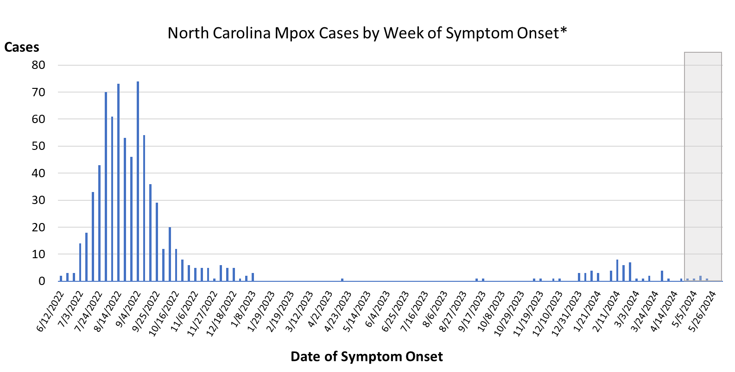
Mpox Epi Curve 2022-Present
https://www.ncdhhs.gov/2022-23-mpox-surveillance-data/open

Slide 10
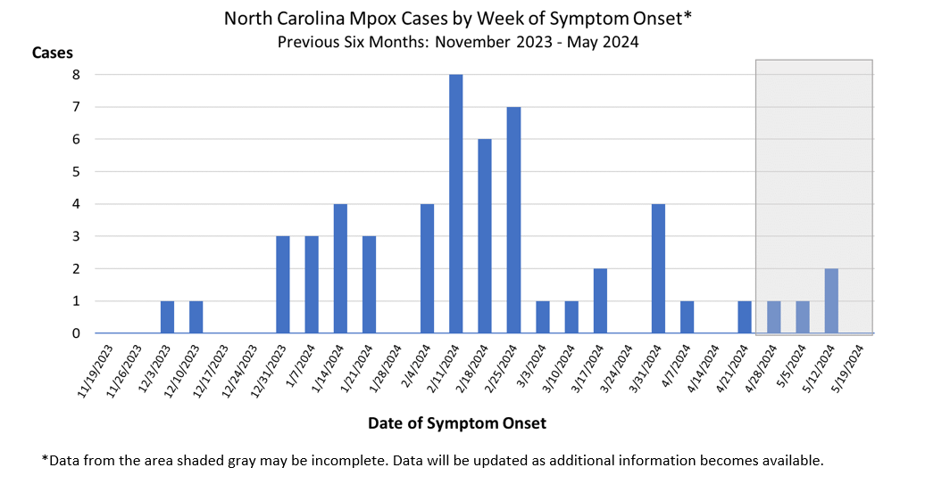
Mpox 6 Month Epi Curve
https://www.ncdhhs.gov/2022-23-mpox-surveillance-data/open

Slide 11
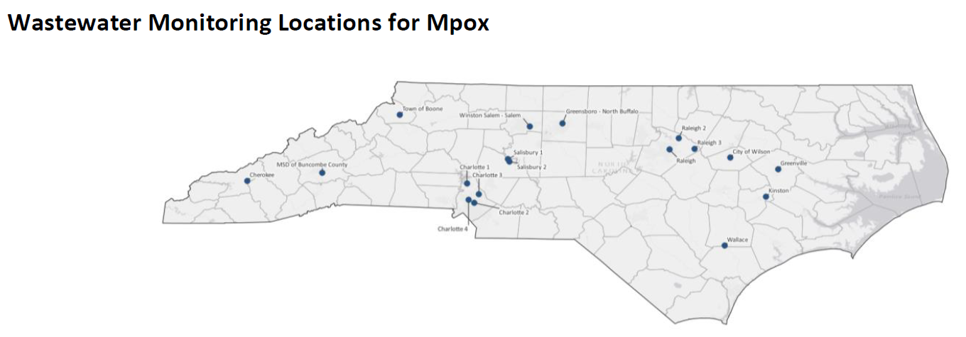
Mpox Wastewater Testing
Expanded wastewater testing to four Charlotte, three Raleigh, one Buncombe, one Greensboro, and one Greenville site in November 2023
Three WastewaterSCAN sites at Kinston (October 2022), Wilson (September 2023) and Winston-Salem (August 2022).
A partnership with CDC provides wastewater testing and results in Cherokee, Kinston, two sites in Salisbury, the Town of Boone, and Wallace.

Slide 12
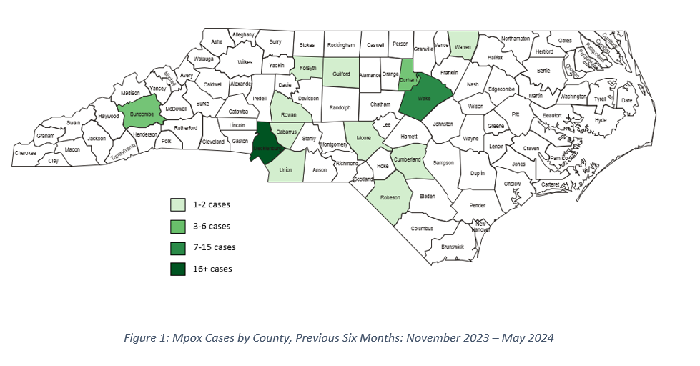
Mpox Map
https://www.ncdhhs.gov/2022-23-mpox-surveillance-data/open

Slide 13
Clinical

Slide 14
Mpox Disease Stages
Incubation Period: The incubation period is roughly 1-2 weeks. A person is not contagious during this period. Physicians are currently recommended to monitor patients up to 21 days.
Prodrome: Symptoms may include fever, malaise, headache, sore throat, or cough, and (in many cases) swollen lymph nodes. Lymphadenopathy is a characteristic feature of mpox, and lymph nodes may swell in the neck (submandibular & cervical), armpits (axillary), or groin (inguinal) and can occur on both sides of the body or just one. A person may be contagious during this period. Instruct patients to isolate if they develop symptoms.
Rash: Many of the recent cases have only had localized lesions and have not presented with diffuse rash often seen in figures. People with mpox infection develop lesions that typically progress from papules, macules, vesicles, pustules, and then scabs. A person is contagious until after all the scabs on the skin have fallen off and a fresh layer of intact skin has formed underneath. Decisions regarding discontinuation of isolation precautions at a healthcare facility and at home should be made in consultation with the local or state health department.
https://www.ncdhhs.gov/2022-23-mpox-surveillance-data/open
Notes:
Rectal symptoms (e.g., purulent or bloody stools, rectal pain, or rectal bleeding) have been frequently reported in the current outbreak.
Lesions are often described as painful until the healing phase when they become itchy (crusts).
Fever and other prodromal symptoms (e.g., chills, lymphadenopathy, malaise, myalgias, or headache) can occur before rash but may occur after rash or not be present at all​.
Respiratory symptoms (e.g. sore throat, nasal congestion, or cough) can occur.

Slide 15
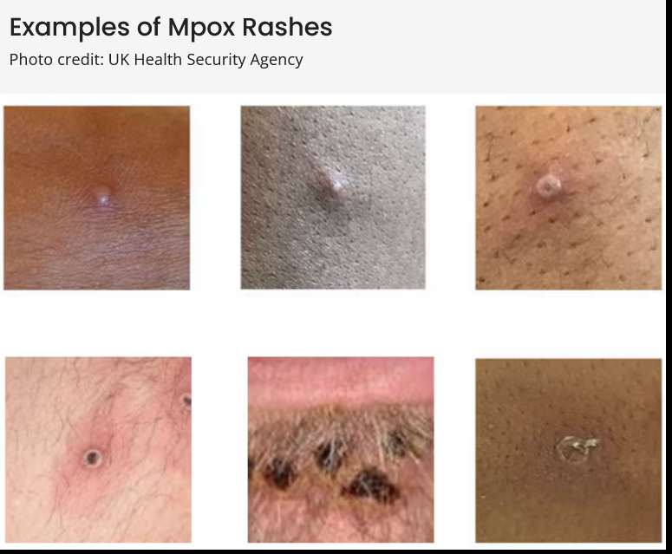
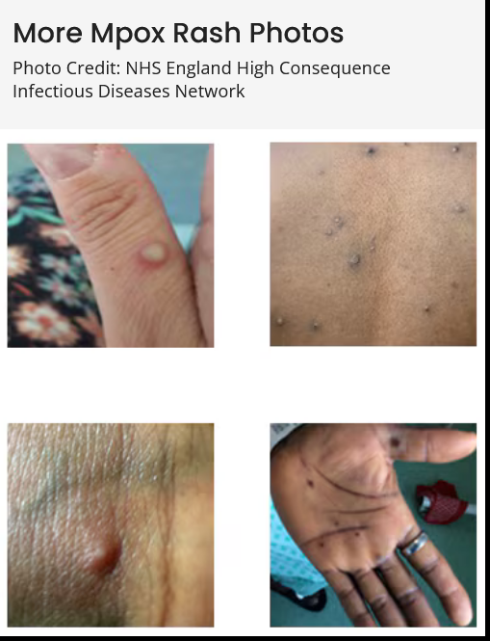
https://www.cdc.gov/poxvirus/mpox/clinicians/clinical-recognition.html

Slide 16
Complications
Proctitis which may or not be associated with visible vesicular or pustular lesions on the perianal area
Ulcerative pharyngitis or tonsillitis presenting with sore throat and difficulty swallowing that may limit or prevent oral intake. Ulcerative lesions may be seen on the palatine tonsils or the pharynx
Ocular manifestations can present as conjunctivitis, blepharitis, periocular cellulitis, keratitis, loss of vision, and subconjunctival nodules
Neurologic manifestations including encephalitis and encephalomyelitis
https://www.uptodate.com/contents/epidemiology-clinical-manifestations-and-diagnosis-of-mpox-monkeypox
Notes:
Necrotizing form of mpox, may be seen in the context of advanced HIV.
Bowel lesions that are exudative or cause significant tissue edema leading to obstruction. Preputial edema or gross edema of the penile glans resulting in paraphimosis has also been reported. Other complications include bronchopneumonia, sepsis, myocarditis, parotitis, epiglottitis, peritonsillar abscess, severe lymphadenopathy that can be necrotizing or obstructing, rectal wall perforation in patients with mpox proctitis, and hemophagocytic lymphohistiocytosis

Slide 17
Mpox in PLWH
People with HIV-associated immunosuppression (CD4 T lymphocyte [CD4] cell count <200 cells/mm3 and especially <50 cells/mm3) can be at increased risk of severe mpox.
Vaccination with JYNNEOS is considered safe for people who are immunocompromised, including those with HIV or primary immunodeficiency or from immunosuppressive therapies.
People with mpox and HIV not presently taking antiretroviral therapy (ART) should initiate ART as soon as possible to improve immune function; ART should ideally be started at the same time as mpox therapy.
Antiviral treatment(s) for mpox have minimal interaction with ART and with common immunosuppressive medications.
https://www.cdc.gov/poxvirus/mpox/clinicians/people-with-HIV.html

Slide 18
Mpox Transmission
Human-to-human transmission of monkeypox virus can occur through several routes. These include:
    Close contact with infectious skin lesions. The current global outbreak in nonendemic countries has been primarily associated with close intimate contact, such as during sexual activity.
    Indirect contact with infectious fluid (eg, on contaminated linens).
    Percutaneous inoculation via needlestick injuries from supplies used to collect cutaneous lesion samples.
    Large respiratory droplets. For this to occur, prolonged face-to-face contact may be required (eg, within a six-foot radius for ≥3 hours in the absence of PPE).
https://www.ncdhhs.gov/2022-23-mpox-surveillance-data/open
Notes:
Monkeypox virus can also been acquired through contact with an infected animal's bodily fluids or through a bite. Monkeys and humans are incidental hosts; the reservoir is likely to be certain rodents.

Slide 19
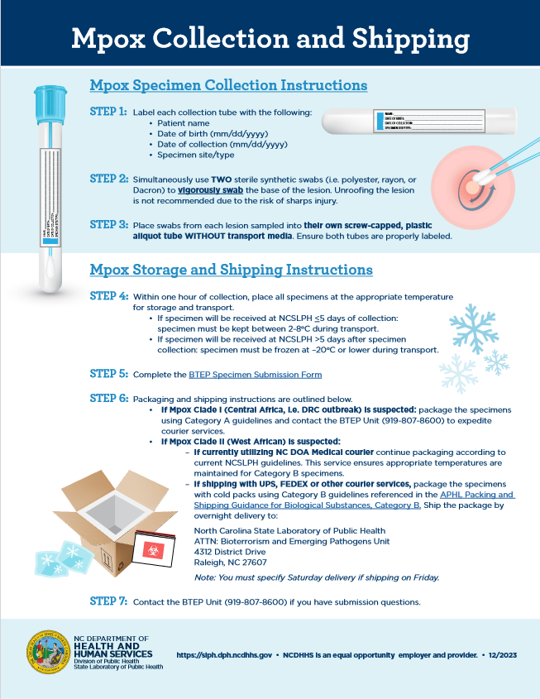
Mpox Testing
Mpox is diagnosed using real time PCR tests.
Clinicians should collect two swabs from each lesion (generally from 2-3 lesions) in case additional testing, such as clade-specific testing, is needed for these patients.
PPE used by healthcare personnel should include:
    Gown
    Gloves
    Eye protection
    NIOSH-approved particulate respirator equipped with N95 filters or higher
https://epi.dph.ncdhhs.gov/cd/lhds/manuals/cd/monkeypox/MonkeypoxCollectionandShippingInfographic.pdf

Slide 20
Mpox Treatment
No treatment approved specifically for MPXV infections.
Supportive care and pain control may not be enough for some patients such as those with weakened immune systems, people who have severe disease (ex hemorrhagic disease, necrotic lesions, sepsis) or involvement of anatomic areas which might results in serious sequelae including scarring and strictures. In these cases, treatment should be considered.
Medical countermeasures currently available from the Strategic National Stockpile (SNS) as options for the treatment of mpox include tecovirimat, brincidofovir, and vaccinia immune globulin (VIGIV). Cidofovir is also available commercially.
https://www.cdc.gov/poxvirus/mpox/clinicians/treatment.html?

Slide 21
Tecovirimat (TPOXX)
For Oral TPOXX:
Enrollment in the STOMP trial (1-855-876-9997) should always be considered first. With this option, patients/providers can self-enroll without state support.
If patient is not eligible for STOMP or does not want to participate, existing in-state supply of oral TPOXX can be prescribed and dispensed in accordance with CDC’s EIND Protocol. The Public Health Preparedness and Response (PHP&R) team can assist providers with finding in-state supply and facilitating transfer of product.
If in-state supply is not available, then a request can be made to CDC EOC on a patient specific basis. PHP&R team would place request on behalf of provider.
For IV TPOXX:
STOMP trial covers oral TPOXX only.
Existing in-state supply of IV TPOXX can be prescribed and dispensed in accordance with CDC’s EIND Protocol. The PHP&R team can assist providers with finding in-state supply and facilitating transfer of product.
If in-state supply is not available, then a request can be made to CDC EOC on a patient specific basis. PHP&R team would place request on behalf of provider.
Additional information on TPOXX process from CDC webpage: https://www.cdc.gov/poxvirus/mpox/clinicians/obtaining-tecovirimat.html
Notes:
Wake Forest Baptist and Duke are both STOMP trial sites.

Slide 22
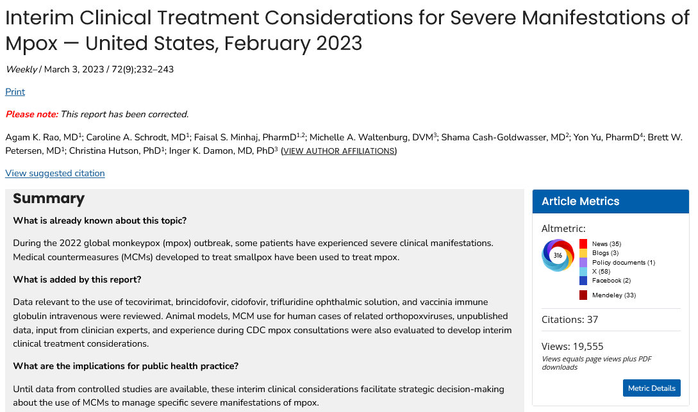
https://www.cdc.gov/mmwr/volumes/72/wr/mm7209a4.htm

Slide 23
Post-Exposure Prophylaxis
Mpox vaccine can be given as PEP both to people with known or presumed exposure to mpox virus.
As PEP, vaccine should be given as soon as possible, ideally within four days of exposure; administration 4 to 14 days after exposure may still provide some protection against mpox and should be offered.
Persons exposed to mpox through sexual contact who are asymptomatic should also be tested for HIV and other sexually transmitted infections.
Discuss and facilitate access to HIV pre-exposure prophylaxis (PrEP) for people who are HIV negative and at risk for HIV.
https://www.cdc.gov/poxvirus/mpox/clinicians/clinical-guidance-quick-reference.html

Slide 24
Vaccine Information

Slide 25
JYNNEOS Vaccine Interim Guidance
The JYNNEOS vaccine is administered in two doses 28 days (4 weeks) apart.
The standard regimen involves a subcutaneous (subcut) route of administration with an injection volume of 0.5mL. The standard regimen is the FDA-approved dosing regimen.
Since August 9, 2022, the standard regimen has also been authorized for people aged <18 years under an Emergency Use Authorization.
The authorized alternative regimen involves an intradermal (ID) route of administration with an injection volume of 0.1 mL.
The alternative regimen, when feasible, is preferred because this could increase the number of available JYNNEOS vaccine doses up to five-fold.
Both the standard regimen (subcut) and the alternative regimen (ID) produce similar immune responses that are effective at reducing the risk of mpox.
Providers should discuss both administration options with patients.

Slide 26
Mpox Vaccine
The 2-dose JYNNEOS vaccine series is recommended for persons aged 18 years and older at risk for mpox, including the following:
    Anyone who has or may have multiple or anonymous sex partners; or
    Anyone whose sex partners are eligible per the criteria above; or
    People who know or suspect they have been exposed to mpox in the last 14 days; or
    Anyone else who considers themselves to be at risk for mpox through sex or other intimate contact.
Vaccination can protect against mpox infection from both Clades I and II
Nationally, only one in four eligible people have received both doses of JYNNEOS.

Slide 27
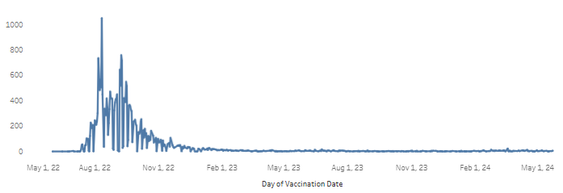
Total Jynneos Administrations
Administrations
Vaccination Date

Slide 28
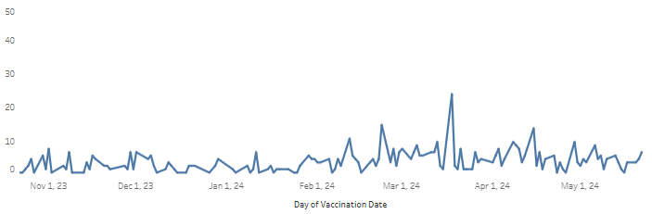
6-Month Jynneos Administrations
Previous 6 Months: November 2023 – May 2024
Administrations
Vaccination Date

Slide 29
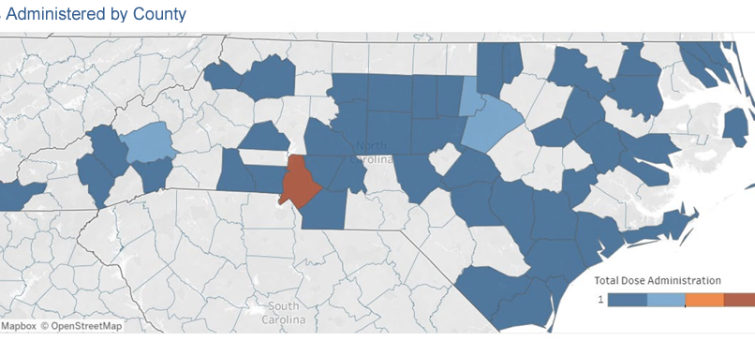
Mpox Doses Administered by County

Slide 30
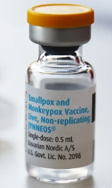
Commercialization
JYNNEOS (Bavarian Nordic) is now available commercially.
Providers are unable to order JYNNEOS vaccines from the US Government supply, as they have been.
State-supplied JYNNEOS is still available for a transfer if needed.
We anticipate JYNNEOS vaccines will be available through the Vaccines for Children (VFC) program for VFC-eligible 18-year-olds. We will provide updates as we receive them.
For assistance procuring JYNNEOS vaccine, email Kandice Oakley: kandice.oakley@dhhs.nc.gov

Slide 31
Storage and Handling
Frozen: Unpunctured vials may be stored in the freezer (between -25°C and -15°C) until the expiration date
Refrigerated: Unpunctured vials may be stored in the refrigerator (between 2°C and 8°C) for up to 8 weeks (allowed per the EUA Fact Sheet). Once thawed, vaccine cannot be refrozen
Punctured vials may be stored in the refrigerator (between 2°C to 8°C) for up to 8 hours after the first puncture

Slide 32
Resources and Reminders
The mpox vaccine locator is maintained by the CDC and National Prevention Information Network (NPIN). The vaccine locator can be used to search for mpox vaccine provider sites. You can register your organization here.
NCIR’s Reminder/Recall Report allows you to generate letters for patients who are due or overdue for vaccines. It can also be used to find eligible patients. You must be an Administrator in the NCIR to see the Reports menu and generate the report.
Additional Resources:
    Authorized distributor to order JYNNEOS Vaccines
    Full Prescribing Information
    Important Safety Information
    Mpox in NC Dashboard
    For medical inquiries about JYNNEOS, please contact Medical Information at (844) 422-8274 or medical.information_na@bavarian-nordic.com.

Slide 33

Mpox Outreach Efforts
Keeping communities informed about mpox outbreaks is at the forefront of our work. We currently have 42 Pride Events and Engagements noted on our NCDHHS website. We attended a pride event on June 1st, the start of Pride month, and plan to attend events through September 2024.
NCDHHS CDB and IB staff have conducted several focus groups with JYNNEOS vaccine providers​, NC LGBTQ Center staff and pride organizers​, NC A&T Public Health Ambassadors interns​, and LGBTQ community members to understand LGBTQ North Carolinians’ knowledge level of mpox, the JYNNEOS vaccine, and sexual health; understand barriers to JYNNEOS vaccination and sexual health care; and learn about successful sexual health and mpox outreach.
The insights and feedback from the focus groups helped us:
Develop a PRIDE-specific website, which contains a history of Pride month, LGBTQ health resources, STI testing locator, and more.
Develop captivating social media posts across our social media platforms to bring continued awareness of mpox.
Develop a Pride event blog that contains pictures from Pride events and resources.

Slide 34

Mpox Outreach Efforts
Mpox Outreach Efforts
NCDHHS staff, NCDHHS funded-agencies, and volunteers are actively engaging in Pride events where services such as (Rapid) HIV Testing, Syphilis Testing, Hepatitis C Testing, HIV/STI Education, Mpox Education, Tobacco Education and Cessation Resources, and NC LGBTQIA2S+ Health Needs Assessment are provided.
NCDHHS is committed to participating in several events in 2024:
Wilson Pride 6/1
New Bern Pride 6/8
Raleigh Pride 6/22
Fayetteville 6/29
Charlotte Black Pride 7/20
Charlotte Pride 8/17
Greensboro 9/22
Durham 9/28

Slide 35

Mpox Resources:
Provider Training Available
The North Carolina HIV Training & Education Center offers a series of trainings for providers working with, or interested in working with, LGBTQ+ communities. The series covers topics like how to take a sexual-health history, mpox, sexually transmitted infections, and serving LGBTQ+ communities using a supportive and affirming framework.
Registration is open for these provider trainings to be held over Zoom. Continuing Education Credits (CEUs) are available:
    6/11/2024
    9/10/2024
    11/12/2024
Sign up here to receive these and other training updates.

Slide 36
Neisseria meningitidis

Slide 37
Neisseria meningitidis
Different clinical syndromes
    Meningitis, meningococcemia (septicemia)
    Illness can be severe- patient condition can rapidly deteriorate
    Severe sequelae can occur
Responsible for sporadic cases as well as outbreaks
Serogroups: A, B, C, Y, W-135
Vaccines available
    Men ACWY: contains 4 serogroups. Recommended for all children 11–18 and adults at increased risk
    MenB vaccine: contains only serogroup B. Typically recommended for 16-18 year olds, considered at increased risk of serogroup B

Slide 38
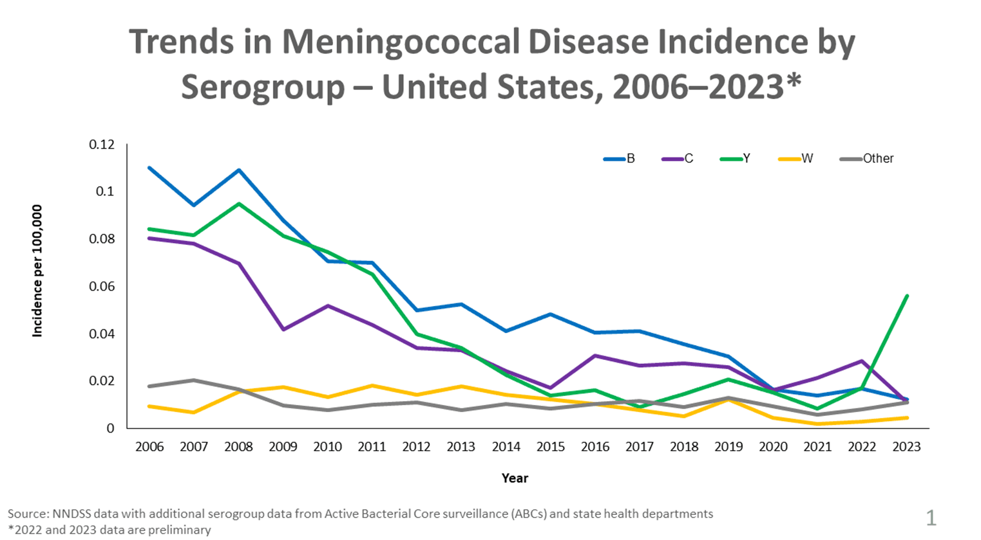
United States Meningococcal Disease Trends
https://www.cdc.gov/meningococcal/surveillance/index.html

Slide 39
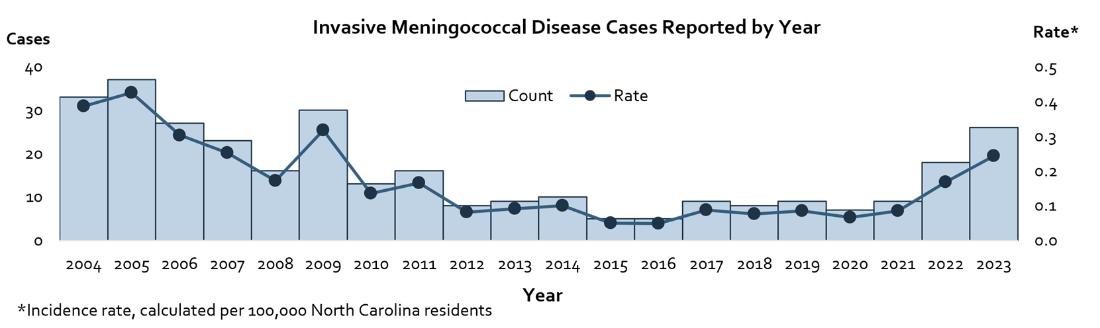
20-Year North Carolina Epi Curve
North Carolina Electronic Disease Surveillance System, 2004-2023
*2023 case data are provisional and subject to change
Notes:
There has been an increase in meningococcal cases in North Carolina since the beginning of 2022
44 cases reported during 2022-2023 (22 per year)
43 total cases reported in previous 5 years (9 per year)
No evident pattern or epi-link between cases has been found
We’re seeing an increase in serogroup Y, an increase in adults aged 50-74 and in Black/African Americans

Slide 40
Cases in MSM and PLWH
Six cases reported in men who have sex with men (MSM) since 2022, compared to four during the previous five years.
Eight cases since 2022 have been in persons living with HIV. Just two were reported among this population in the previous five years.
Persons living with HIV are recommended to receive the MenACWY vaccines due to increased risk for infection, and should receive a booster dose every five years.
North Carolina Electronic Disease Surveillance System, 2017-2023

Slide 41
Single Column Text and Bullets
Text
Bullet 1
    Bullet 2
      Bullet 3

Slide 42
Two Column Layout
Text
Bullet 1
    Bullet 2
      Bullet 3
Text
Bullet 1
    Bullet 2
      Bullet 3

Slide 43
Three Column Layout
Text
Bullet 1
    Bullet 2
      Bullet 3
Text
Bullet 1
    Bullet 2
      Bullet 3
Text
Bullet 1
    Bullet 2
      Bullet 3

Slide 44
Table Example
Resistance considerations | ART options
if resistance to 3TC/FTC but no INSTI resistance | Boosted PI + 2 NRTIs (at least 1 active) DTG + 2 NRTIs (include at least 1 active) Boosted PI + INSTI
if EVG or RAL resistance +/- 3TC/FTC resistance | Boosted PI + 2 NRTIs (at least 1 active) DTG BID (if HIV is sensitive to DTG) + 2 active NRTIs DTG BID (if HIV is sensitive to DTG) + boosted PI (BIC not recommended – no data)

