Slide 1


Congenital syphilis (CS)
Wyatt Hanft, MD MPH AAHIVS
STI Fellow
California Prevention Training Center
University of California, San Francisco

Slide 2
Conflict of Interest Disclosure Statement
Speaker has nothing to disclose
This program is supported by the Health Resources and Services Administration (HRSA) of the U.S. Department of Health and Human Services (HHS) as part of an award totaling $4,205,743 with 0% financed with non-governmental sources. The contents are those of the author(s) and do not necessarily represent the official views of, nor does mention of trade names, commercial practices, or organizations imply an endorsement by HRSA, HHS, or the U.S. Government. For more information, please visit HRSA.gov. Any trade/brand names for products mentioned during this presentation are for training and identification purposes only.

Slide 3
Use of Trade/Brand Names
This program is supported by the Health Resources and Services Administration (HRSA) of the U.S. Department of Health and Human Services (HHS) as part of an award totaling $4,205,743, with 0% financed with non-governmental sources.
The views expressed do not necessarily reflect the official policies of the Department of Health and Human Services, nor does mention of trade names, commercial practices, or organizations imply endorsement by the U.S. Government. Any trade/brand names for products mentioned during this presentation are for training and identification purposes only.
Notes:
NOTE: THIS SLIDE MUST BE INCLUDED IF TRADE AND/OR BRAND NAMES FOR MEDICATIONS ARE USED IN THE PRESENTATION.
IT MAY BE DELETED IF THERE IS NO REFERENCE TO TRADE NAMES, INCLUDING PRESENTATIONS IN WHICH ONLY GENERIC MEDICATION NAMES ARE MENTIONED.
TRADE NAMES MUST BE PUT IN PARENTHESES AFTER THE GENERIC NAME THE FIRST TIME IT IS MENTIONED - E.G., FLUOXETINE (PROZAC). TRADE NAMES SHOULD ONLY BE MENTIONED FOR THE INITIAL REFERENCE AND THE GENERIC NAME ONLY SHOULD BE USED AFTER THAT. THIS APPLIES EQUALLY TO ALL MEDICATIONS OR PRODUCTS MENTIONED IN THIS PRESENTATION.

Slide 4
Unconscious Bias Disclosure
SCAETC recognizes that language is constantly evolving, and while we make every effort to avoid bias and stigmatizing terms, we acknowledge that unintentional lapses may occur in our presentations.
We value your feedback and encourage you to share any concerns related to language, images, or concepts that may be offensive or stigmatizing.
Your input will help us refine and improve our presentations, ensuring they remain inclusive and respectful to participants.

Slide 5
Learning objectives
Understand how congenital syphilis (CS) epidemiology in the United States has changed over the previous 10 years
Recognize common manifestations of CS
Interpret CDC recommendations for CS testing and treatment based on infant and birthing parent labs and exam at the time of delivery
Apply current CDC syphilis screening guidelines to pregnant people in New Mexico

Slide 6
Epidemiology

Slide 7
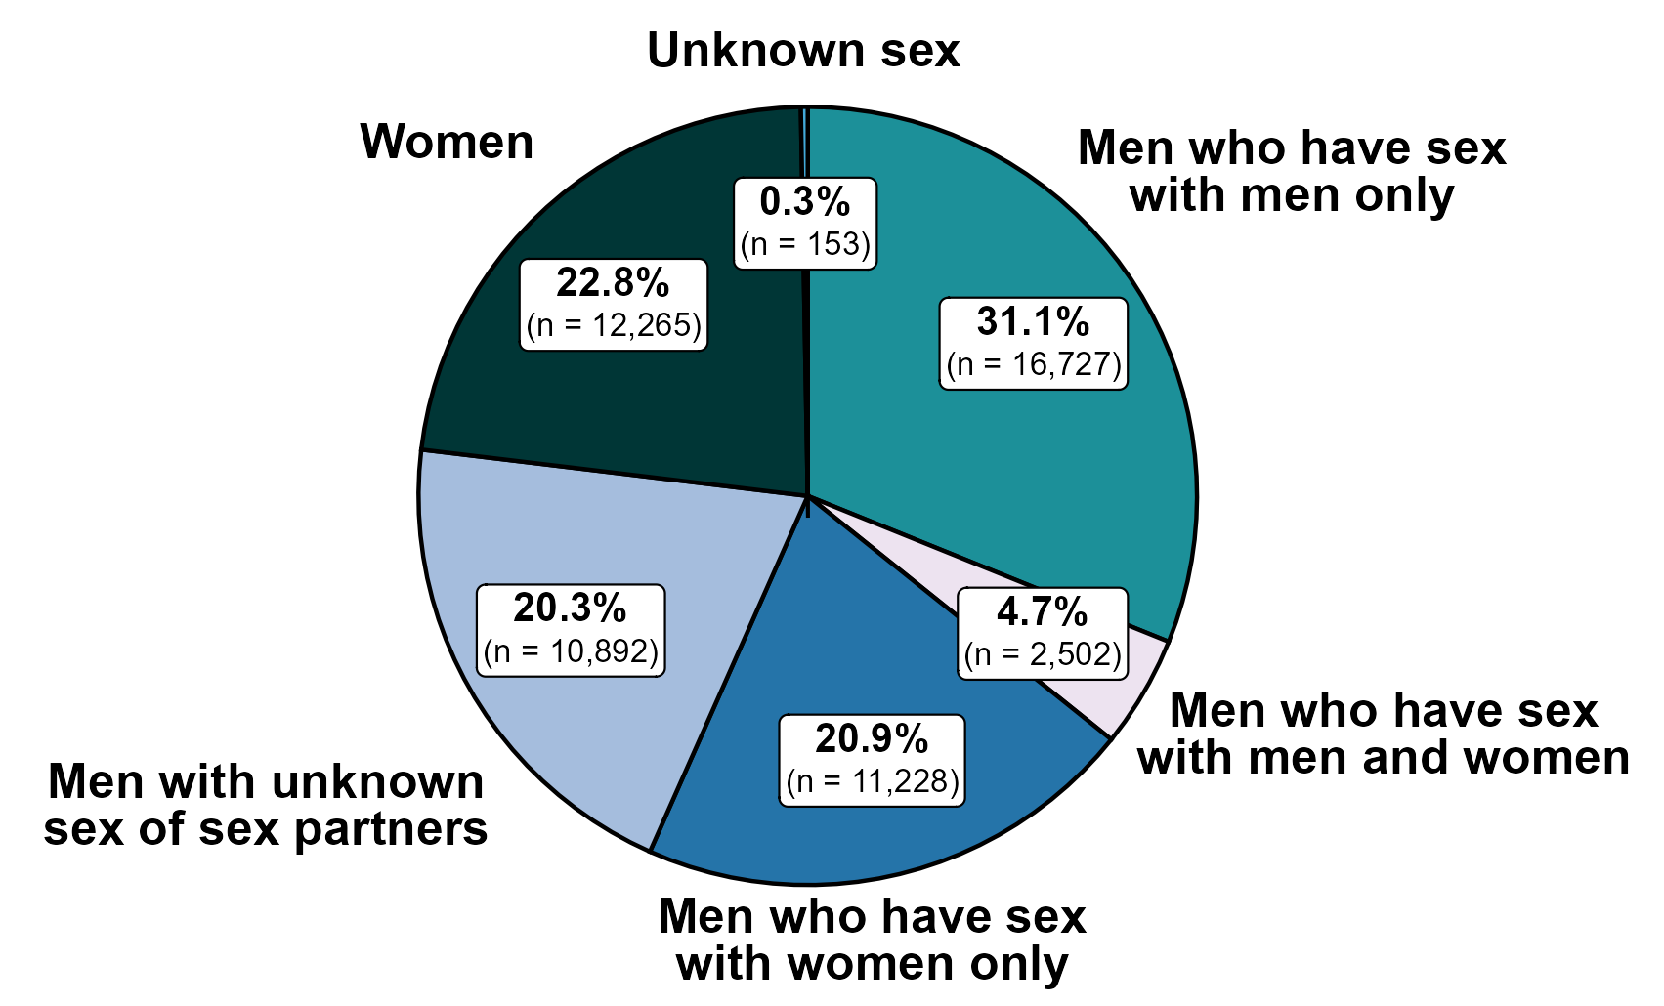
Primary and Secondary Syphilis — Distribution of Cases by Sex and Sex of Sex Partners, United States, 2022
Centers for Disease Control and Prevention, 2021

Slide 8
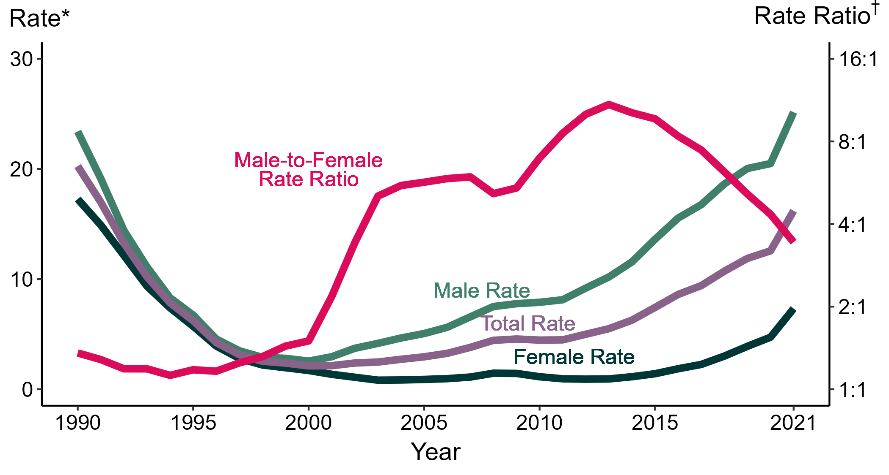
Primary and Secondary Syphilis — Rates of Reported Cases by Sex and Male-to-Female Rate Ratios, United States, 1990–2022
Centers for Disease Control and Prevention, 2022
Notes:
* Per 100,000
† Log scale

Slide 9
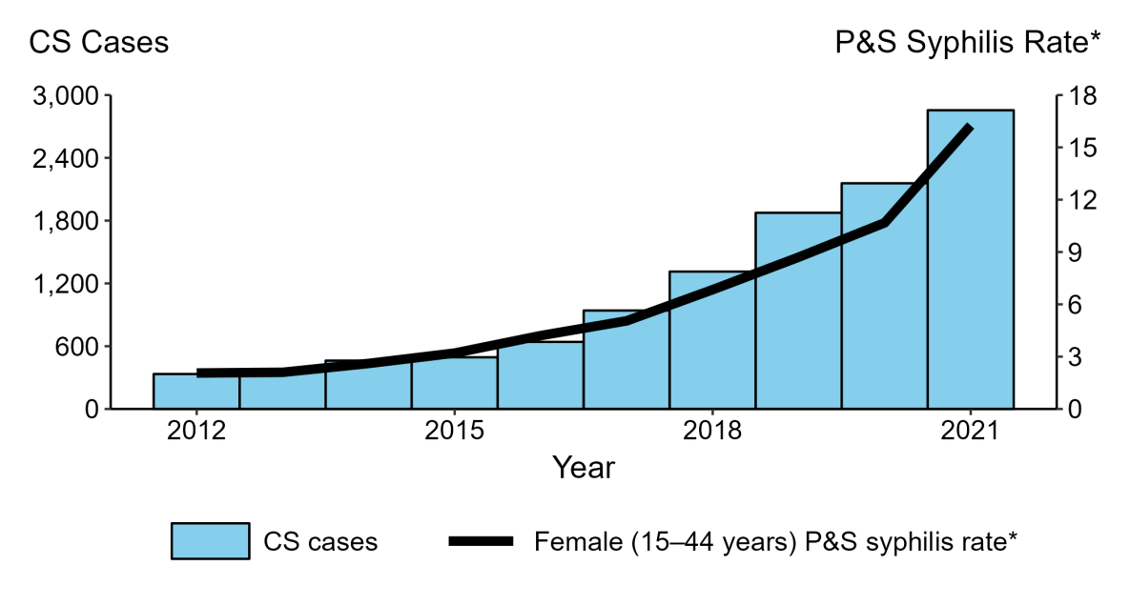
Congenital Syphilis — Reported Cases by Year of Birth and Rates of Reported Cases of Primary and Secondary Syphilis Among Females Aged 15–44 Years, United States, 2013–2022
Centers for Disease Control and Prevention, 2022
Notes:
* Per 100,000
ACRONYMS: CS = Congenital syphilis; P&S = Primary and secondary syphilis

Slide 10
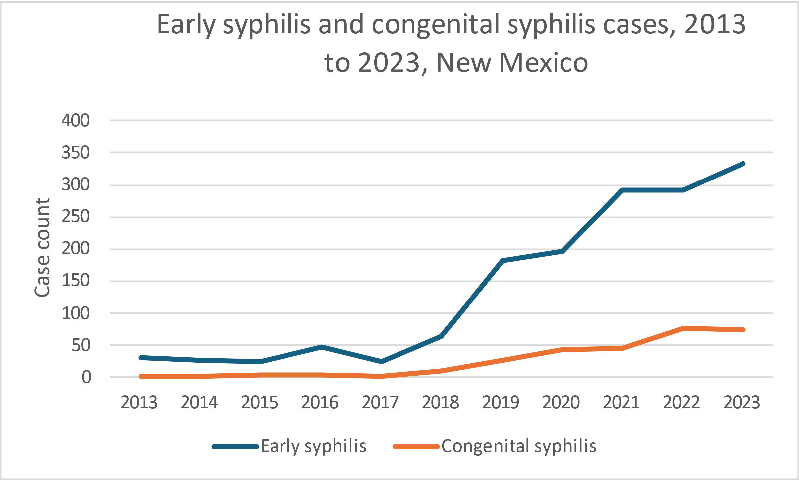
Early syphilis and CS in New Mexico
Early syphilis among females of reproductive age (15-44) and CS case counts, 2013 to 2023, New Mexico
New Mexico DOH, 2024
Notes:
Thank you to the epidemiology team at the New Mexico DOH for pulling together NM’s CS data for me to present as well.
Early syphilis – primary, secondary, and early latent

Slide 11
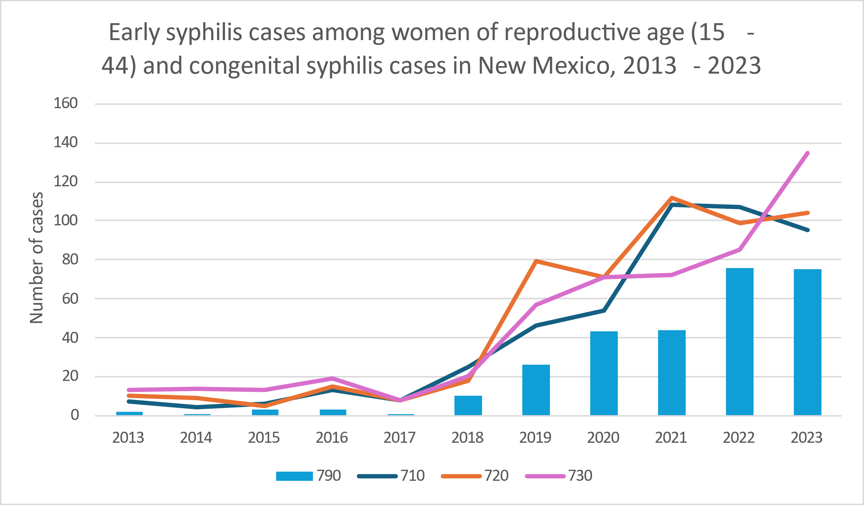
Early syphilis and CS in New Mexico
Early syphilis among females of reproductive age (15-44) and CS case counts, 2013 to 2023, New Mexico
New Mexico DOH, 2024
Notes:
710 = primary syphilis
720 = secondary syphilis
730 = early latent syphilis
790 = CS

Slide 12
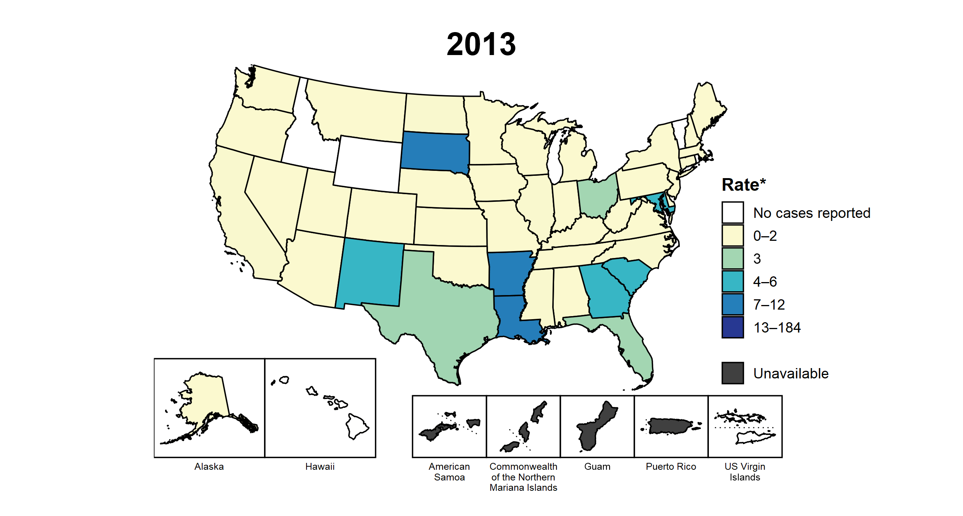
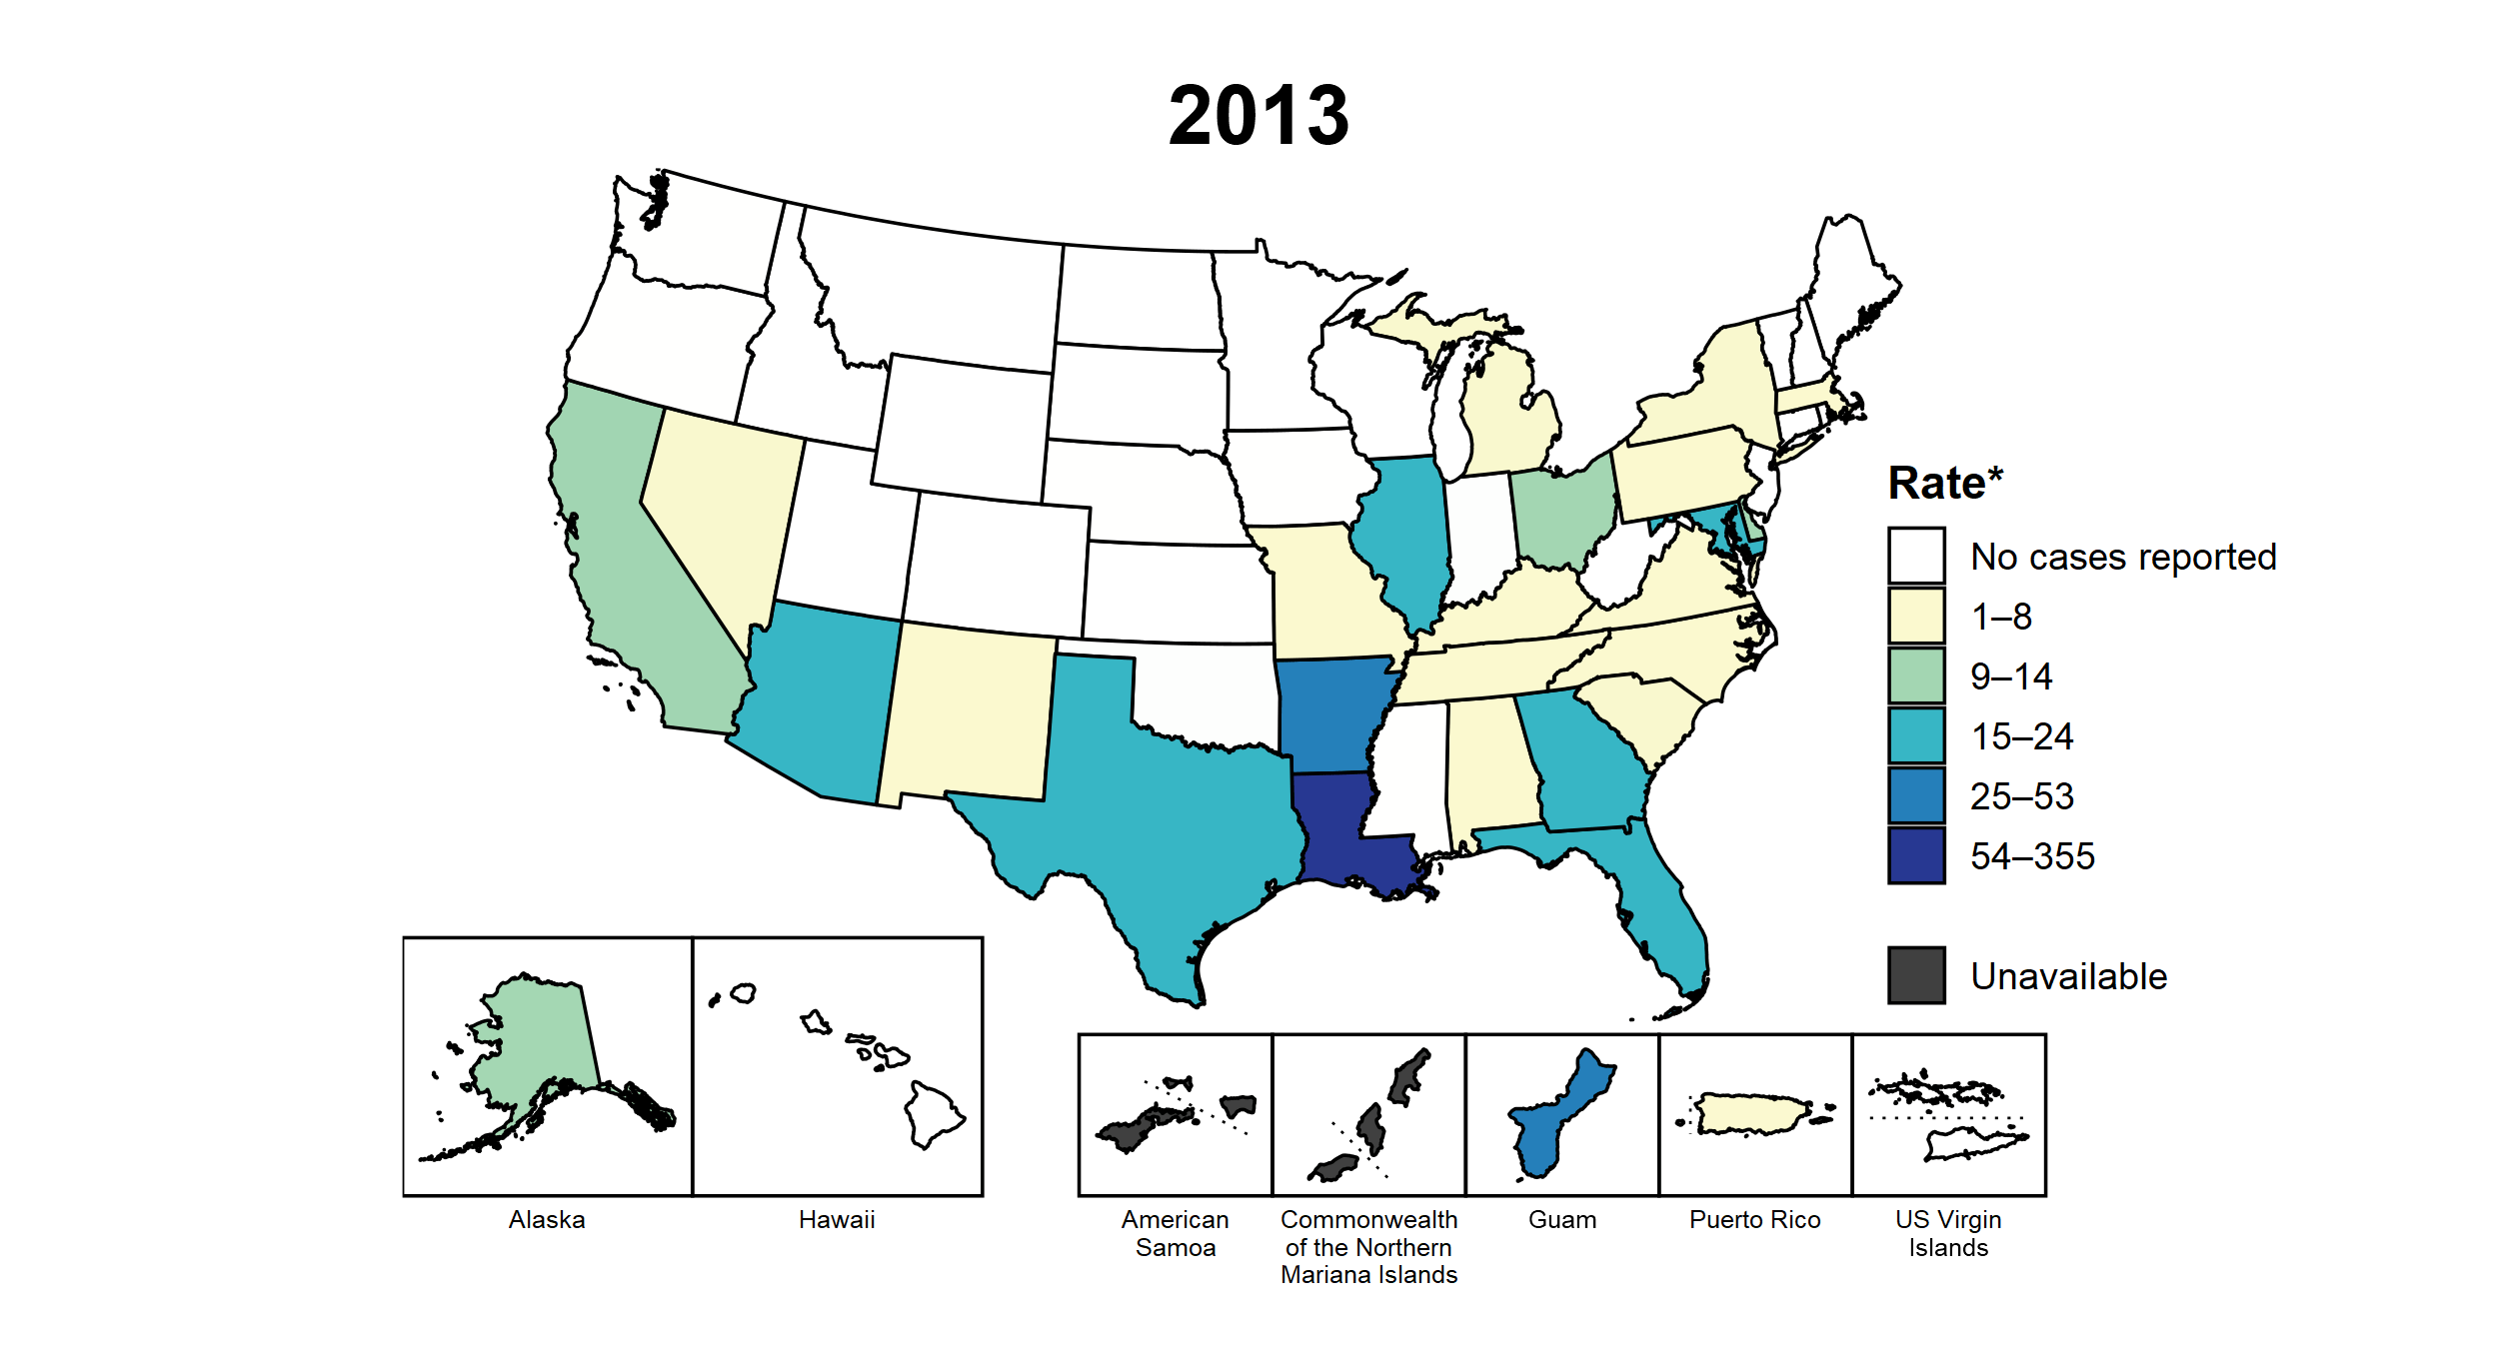
Rates of P&S syphilis among women 15-44 years old versus CS, by State and territories, 2013-2022
P&S Syphilis Rates Among Women 15–44 Years by State, United States and Territories, 2012–2021
Congenital Syphilis Rates by State,
United States and Territories, 2012–2021
Centers for Disease Control and Prevention, 2022

Slide 13
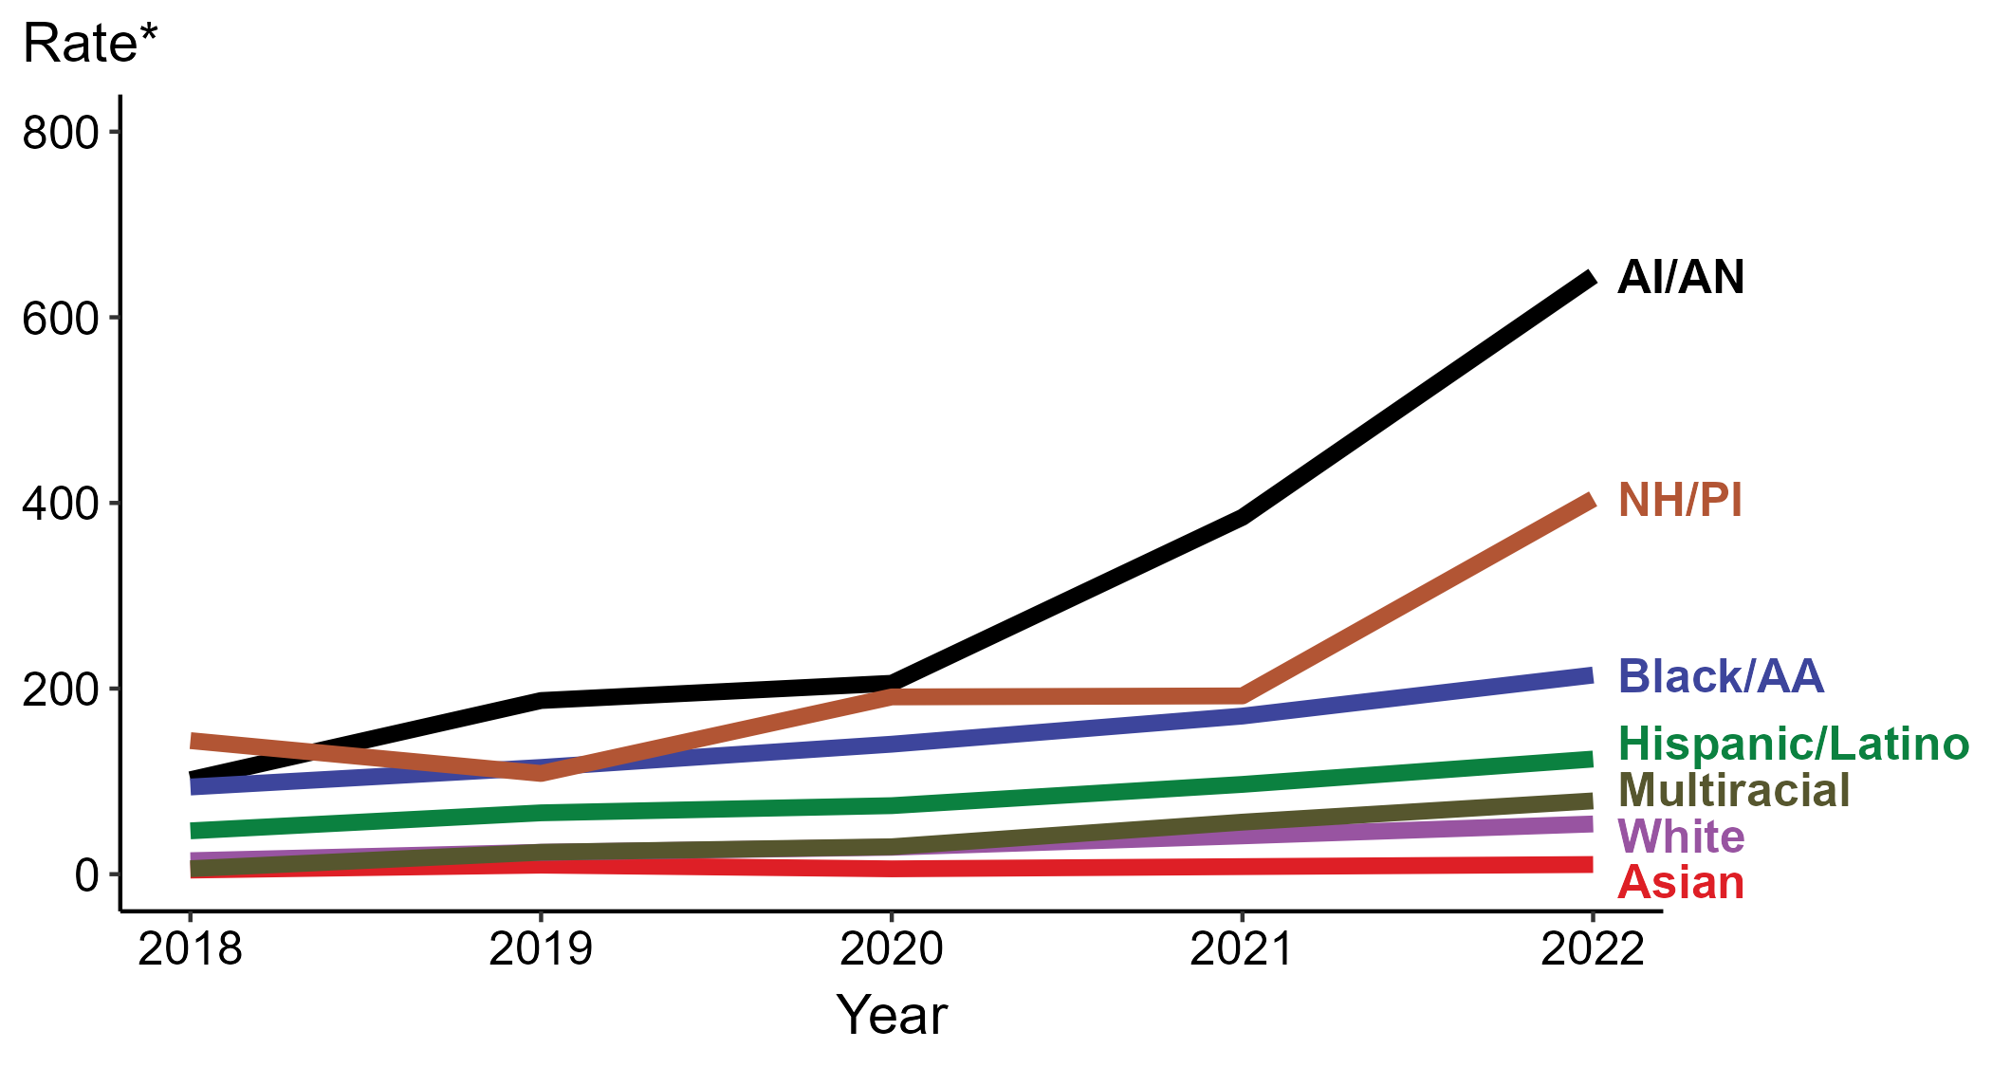
Congenital Syphilis — Rates of Reported Cases by Race/Hispanic Ethnicity, United States, 2018–2022
AI/AN = American Indians/Alaska Natives, NH/PI = Native Hawaiians/Other Pacific Islanders
Centers for Disease Control and Prevention, 2022
Notes:
* Per 100,000
ACRONYMS: AI/AN = American Indians/Alaska Natives; NHOPI = Native Hawaiians/Other Pacific Islanders

Slide 14
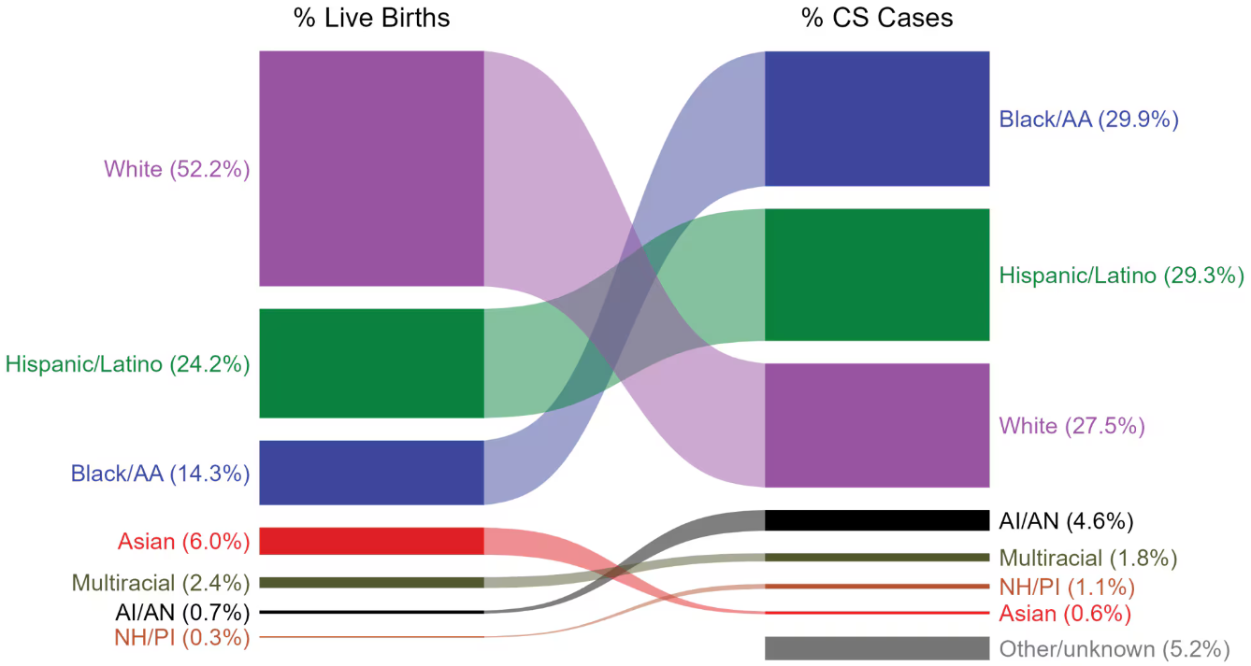
Congenital Syphilis — Total Live Births and Reported Cases by Race/Hispanic Ethnicity of Mother, United States, 2022
Centers for Disease Control and Prevention, 2022
Notes:
NOTE: In 2021, a total of 149 congenital syphilis cases (5.2%) had missing, unknown, or other race and were not reported to be of Hispanic ethnicity. These cases are included in the “other/unknown” category.
ACRONYMS: AI/AN = American Indian or Alaska Native; Black/AA = Black or African American; NH/PI = Native Hawaiian or other Pacific Islander

Slide 15
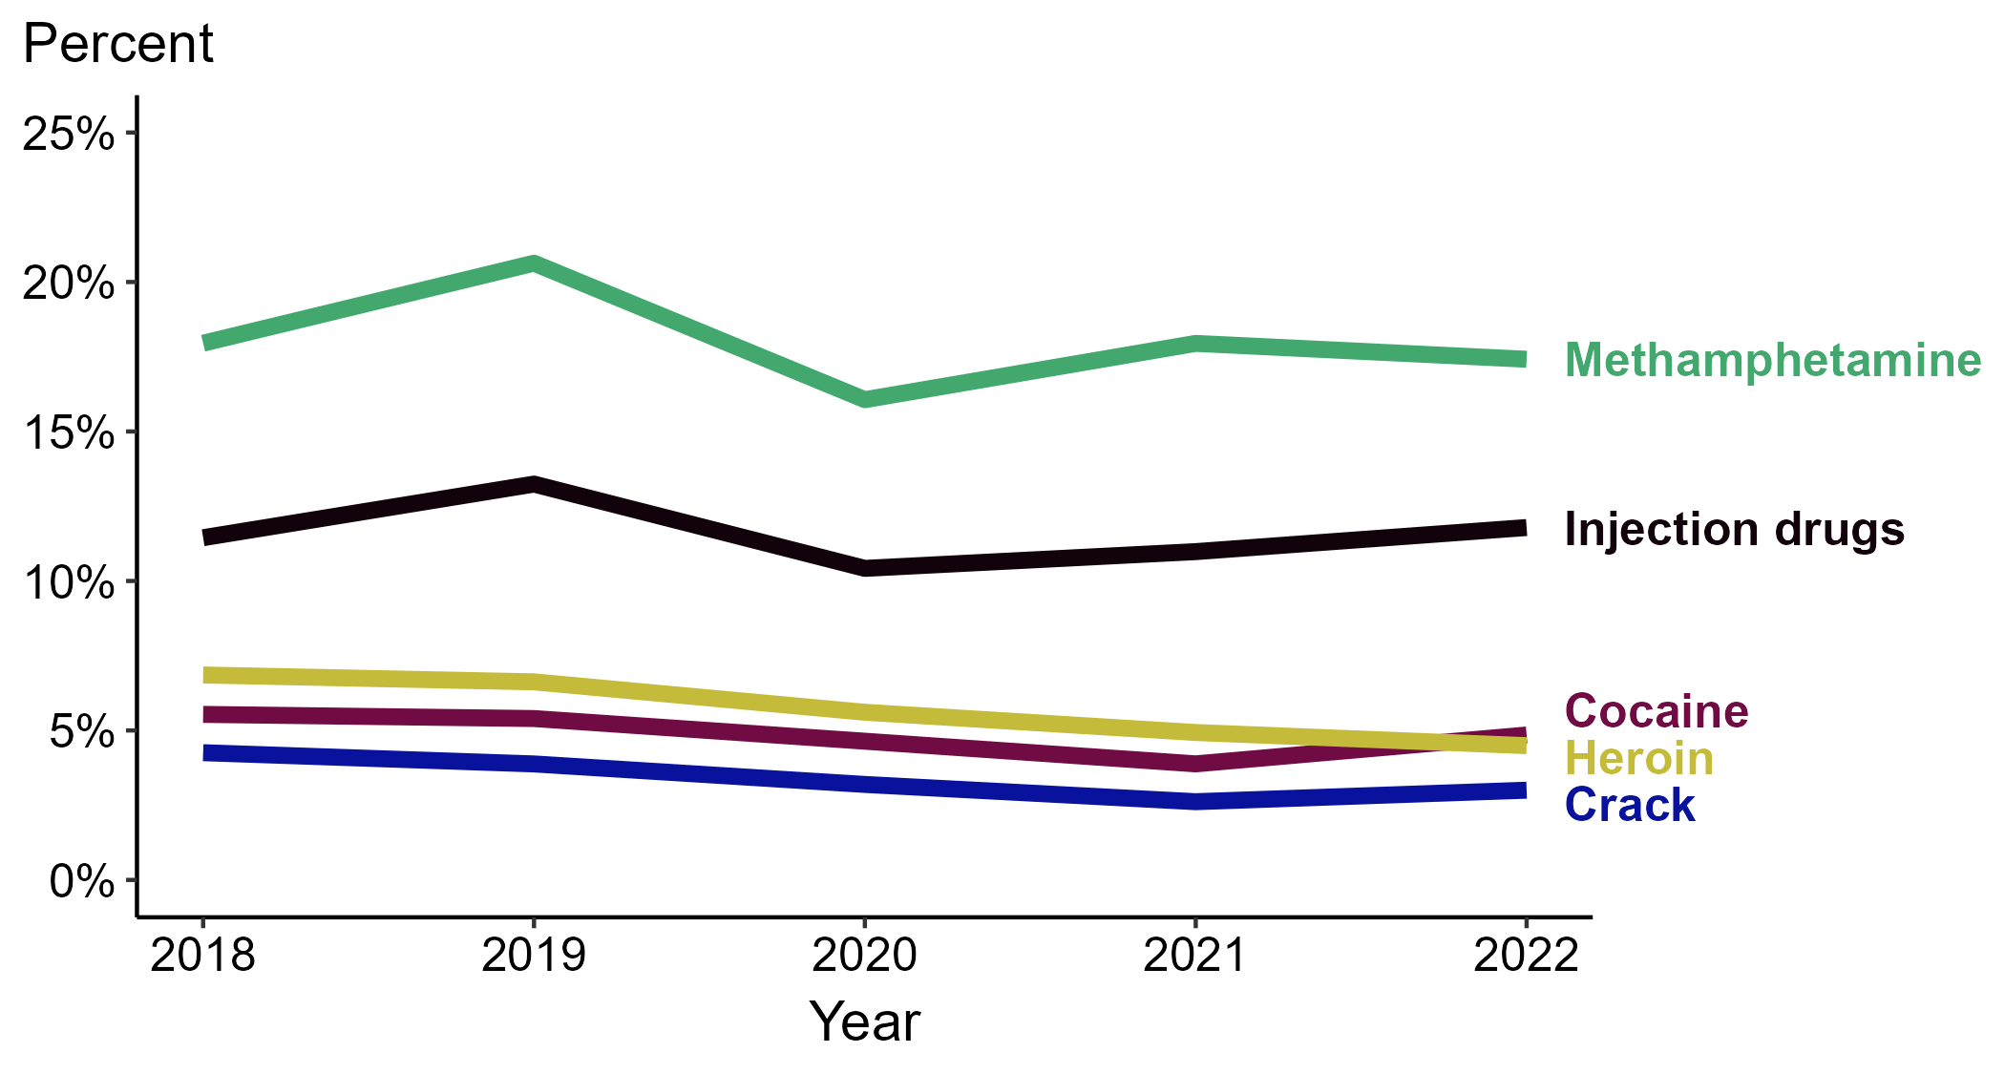
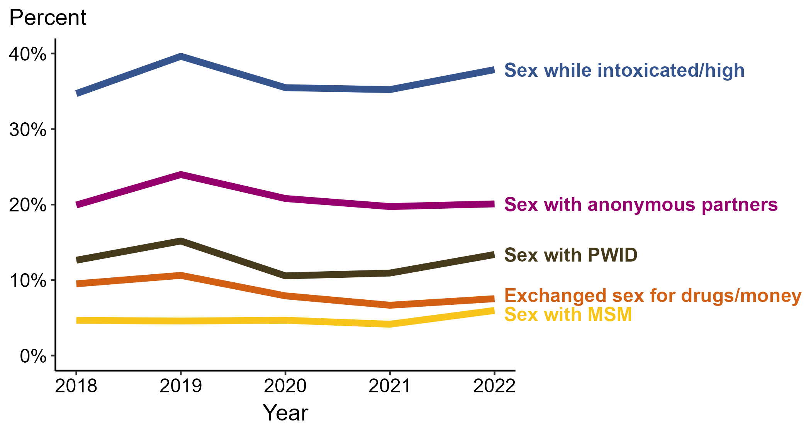
Primary and Secondary Syphilis — Percentage of Cases Reporting Selected Sexual Behaviors Among Women, United States, 2018–2022
Centers for Disease Control and Prevention, 2022

Slide 16
Reported Substance Use Among Women with Primary-Secondary Syphilis, US, 2018–2022
Centers for Disease Control and Prevention, 2022
Notes:
During 2018 to 2022, the proportion of P&S syphilis cases among women that reported injection drug use remained stable (11.4% to 11.8%), the proportion of P&S syphilis cases among women that reported methamphetamine use remained stable (18.0% to 17.4%), the proportion of P&S syphilis cases among women that reported cocaine use remained stable (5.5% to 4.8%), the proportion of P&S syphilis cases among women that reported crack use decreased (4.3% to 3.0%), and the proportion of P&S syphilis cases among women that reported heroin use decreased (6.9% to 4.5%).

Slide 17
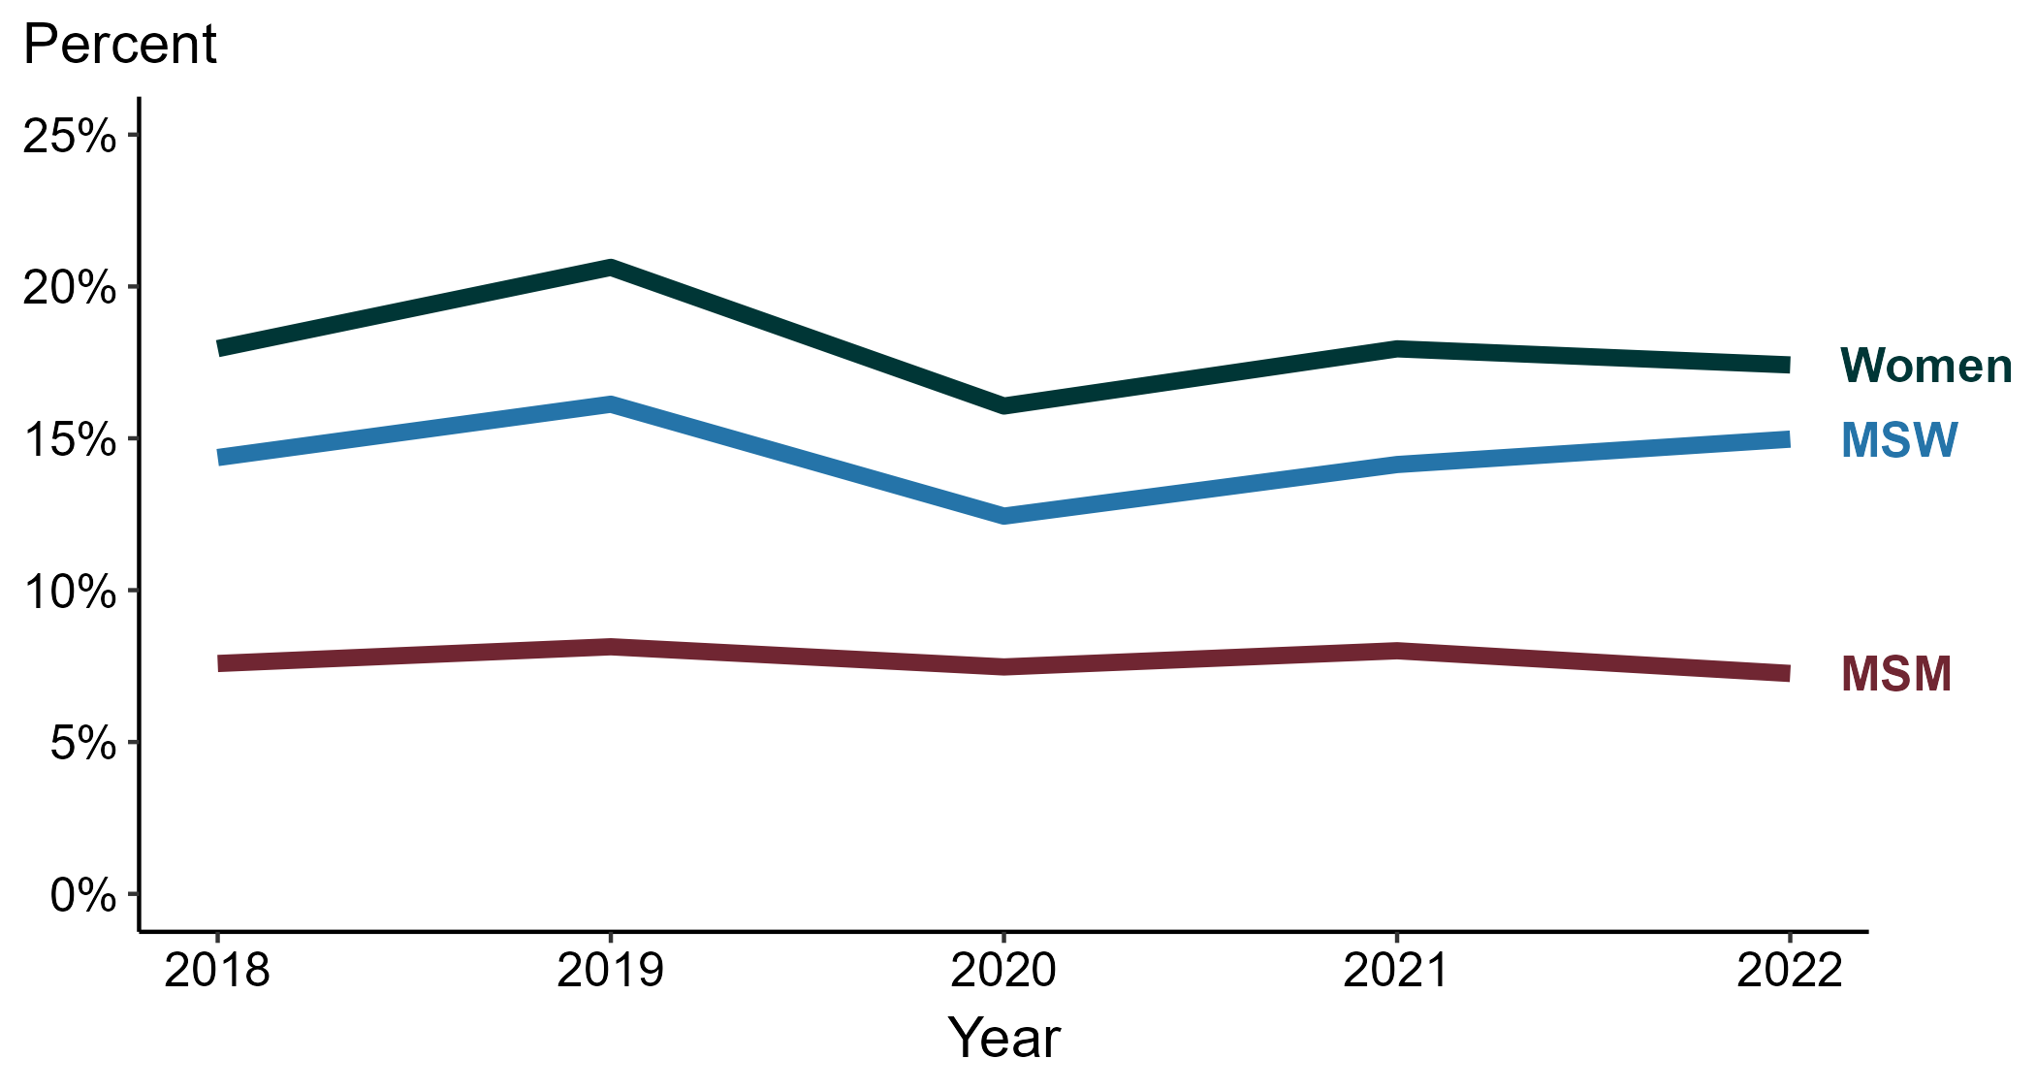
Reported Methamphetamine Use Among Primary-Secondary Syphilis Cases by Sex and Sex of Sex Partners, United States, 2014–2018
Centers for Disease Control and Prevention, 2022
Notes:
* Proportion reporting methamphetamine use within the last 12 months calculated among cases with known data (cases with missing or unknown responses were excluded from the denominator).
Abbreviations: MSM = gay, bisexual, or other men who have sex with men; MSW = men who have sex with women only.

Slide 18
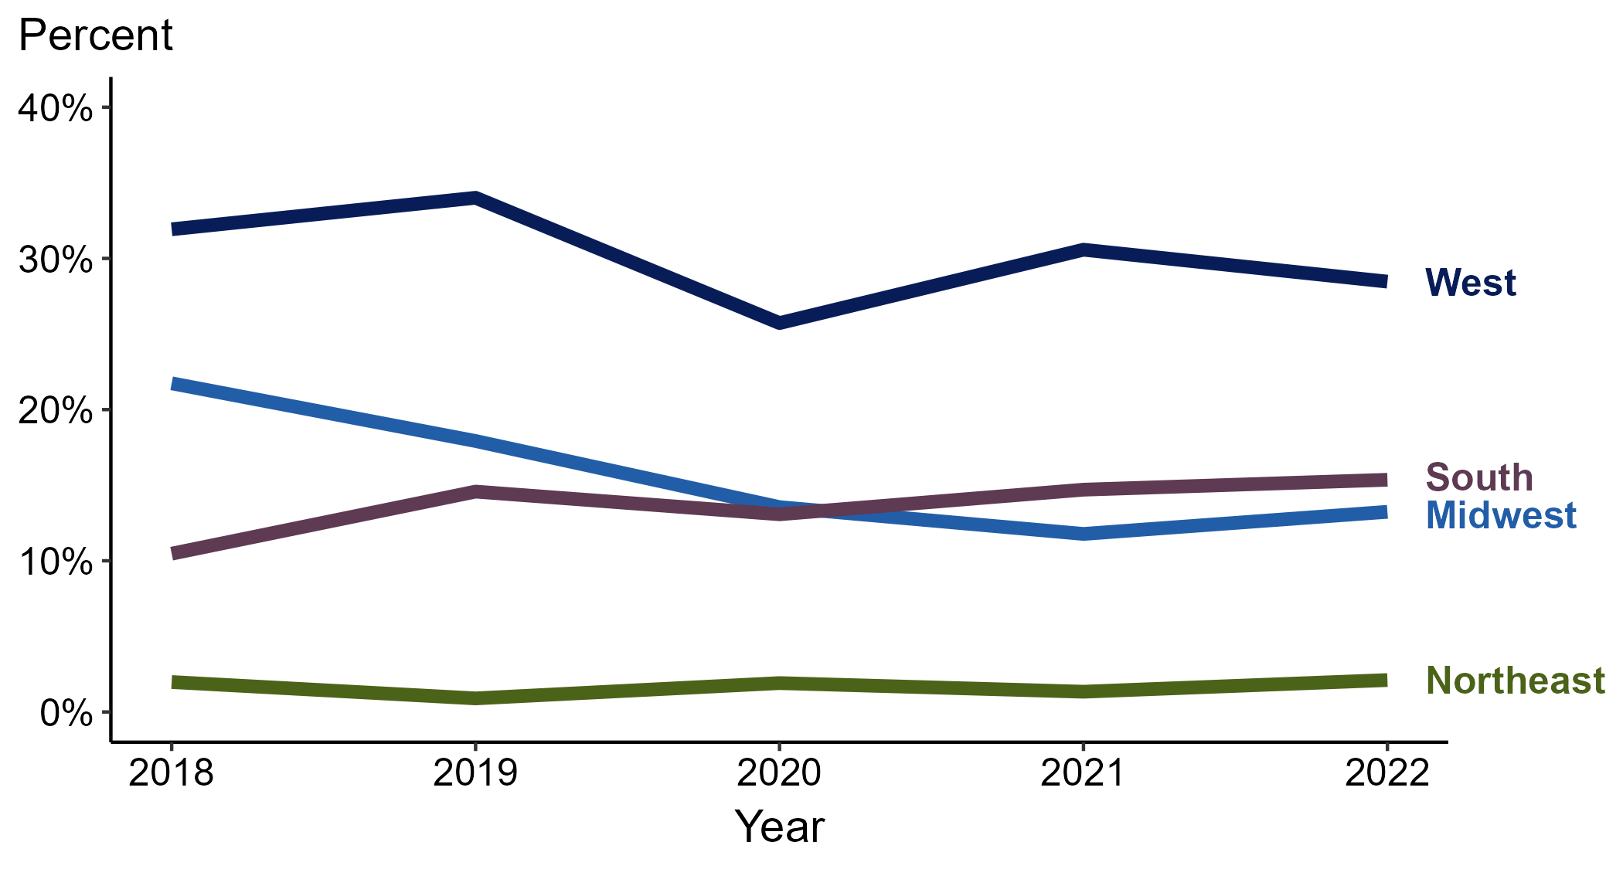
Reported Methamphetamine Use Among Women with Primary and Secondary Syphilis by Region, United States, 2014–2018
Centers for Disease Control and Prevention, 2022
Notes:
* Proportion reporting methamphetamine use within the last 12 months calculated among cases with known data (cases with missing or unknown responses were excluded from the denominator).

Slide 19
Pathophysiology and Manifestations

Slide 20
Natural History of syphilis
Incubation Period 10-90 days
Average 3-4 weeks
2-6 weeks
3-8 weeks
2-20 years
Exposure
Primary
Secondary
Latent
Tertiary
30-50%
30%
25%
Chancre (ulcer): Single, painless, indurated, clean-based lesion with rolled edge
Often goes unrecognized, especially in the rectal or vaginal area
May have associated regional lymphadenopathy
Rash (75-90%); often involves palms/soles (60%)
Generalized lymphadenopathy (70-90%)
Constitutional symptoms (50-80%)
Mucous patches (5-30%)
Condyloma lata (5-25%)
Patchy alopecia (10-15%)
Early latent: latent with evidence of infection within the past 12 months
Otherwise: considered late latent or unknown duration

Slide 21
Natural history of syphilis
Incubation Period 10-90 days
Average 3-4 weeks
2-6 weeks
3-8 weeks
2-20 years
Exposure
Primary
Secondary
Latent
Tertiary
30-50%
30%
25%
Neurosyphilis, ocular syphilis, and otosyphilis
can occur at any stage
80% if parent left untreated
Transmission from parent to fetus can occur at any stage

Slide 22
What is Evidence of Infection Within 1 Year?
Within the last year, has person had 1 or more of the following?
  Negative syphilis serology
  Known contact to an early syphilis case
  Signs/symptoms of primary/secondary syphilis
  A previously reactive RPR/VDRL and a 4-fold increase in titer
  Only one possible exposure and occurred within the last year
If yes to any of the above, then early syphilis
If no to all the above, then late latent syphilis or syphilis of unknown duration

Slide 23
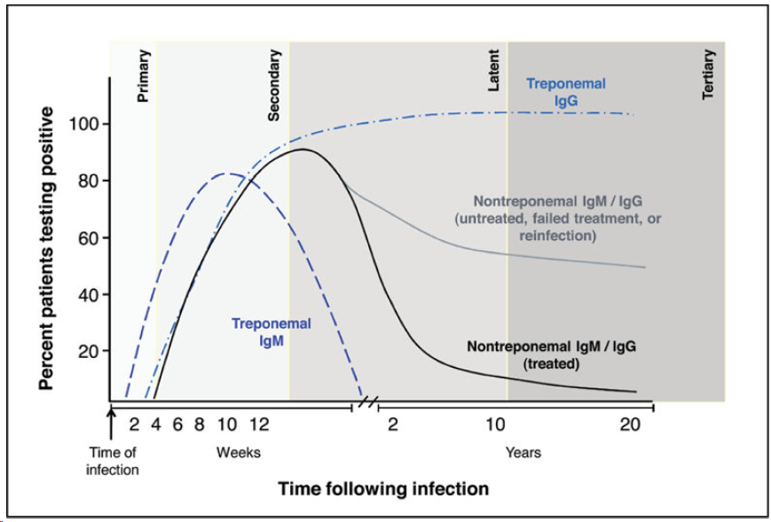
Syphilis Serology Timeline
Treponemal tests (e.g., EIA, CIA, TPA, TPPA, FTA-Abs) usually stay positive forever
  Used to identify a history of syphilis
Non-treponemal tests (e.g., Rapid Plasma Regain = RPR or Venereal Disease Research Labrotory = VDRL) decrease after treatment or over time
  Used to identify active infection and treatment success
Attribution: Soreng et al 2014.
Notes:
Something I find very helpful for understanding how to interpret titer is understanding who they change with infection and over time, with and without treatment. This is what this graph shows.
So again, starting with treponemal titers, remember these will stay positive forever after infection – look at graph. For this reason they are used to identify a history of syphilis, but cannot distinguish past or current infection, or treatment success.
And non-treponemal titers go up with infection, then decline over time, both with and without treatment – look at graph. For this reason they can be used to distinguish past or current infection, and treatment success.

Slide 24
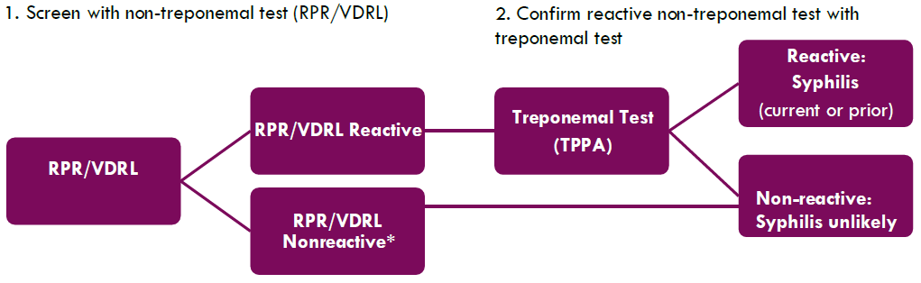
Traditional screening algorithm
Early primary syphilis and late untreated syphilis are possible if RPR/VDRL are nonreactive.

Slide 25
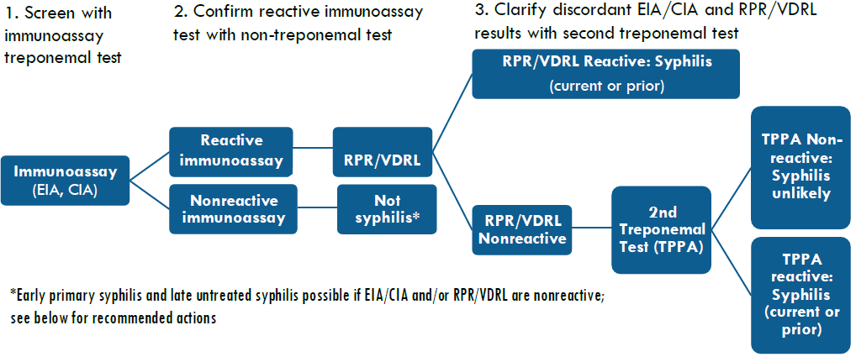
Reverse screening algorithm
Early primary syphilis and late untreated syphilis are possible if EIA/CIA and/or RPR/VDRL are nonreactive.

Slide 26
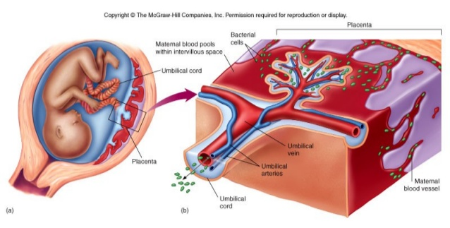
Vertical transmission of syphilis
Transplacental transmission
  Rarely via contact of infectious lesions at birth
Associated with…
  Earlier maternal stage of disease
  High maternal disease titers (VDRL, RPR)
Attribution: McGraw Hill Companies.

Slide 27
How Does T. pallidum Affect the Fetus?
It’s complicated….
  T. pallidum can vegetate in fetal tissues until appropriate biological conditions promote virulence and pathogenicity
    Includes late gestation infections, and post-partum CS cases
    Contributing to factor to why some neonates are asymptomatic at birth
    One reason treatment is important even late in pregnancy and in the post-partum period
  Hypothesis of protective apoptosis of infected cells at the maternal-fetal interface
  Virulence of T. pallidum may be modulated by maternal immune response, and/or the embryonic/fetal genetic background
Wicher et al. 2001; Kim et al. 2015; Salyers et al. 2009

Slide 28
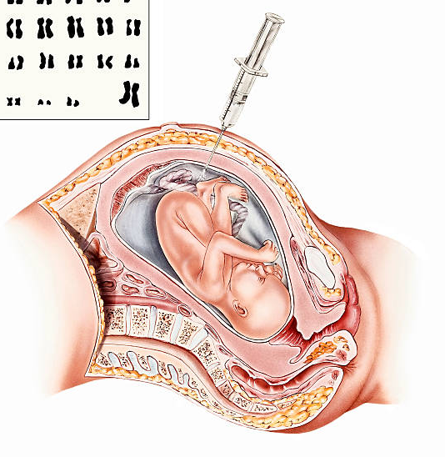
Prenatal Diagnosis of Fetal Infection?
Not routinely done
Isolation of T. pallidum from up to 74% of amniotic fluid specimens from pregnancies with early syphilis
Suggests organism can traverse fetal membranes, and result in fetal infection
Attribution: iStock Images.
Wendel et al. 1991; Nathan et al. 1993; Hollier et al. 2001

Slide 29
Sonography and CS
Only needed if syphilis diagnosis in pregnancy is after 20 weeks gestation. Getting ultrasound should not delay treatment.
Sonographic signs: hepatomegaly, thickened placenta, non-immune hydrops & ascites (image 1), fetal anemia, long bone abnormalities (image 2)
Cases accompanied by these signs should be managed in consultation with obstetric specialists. No specific regimens.
Johnson et al. 2018
Notes:
Image 1: Fetal nonimmune hydrops noted in the transverse plane with evidence of fetal ascites and skin edema.
Image 2: Bowing of fetal long bones visible on prenatal ultrasound.

Slide 30
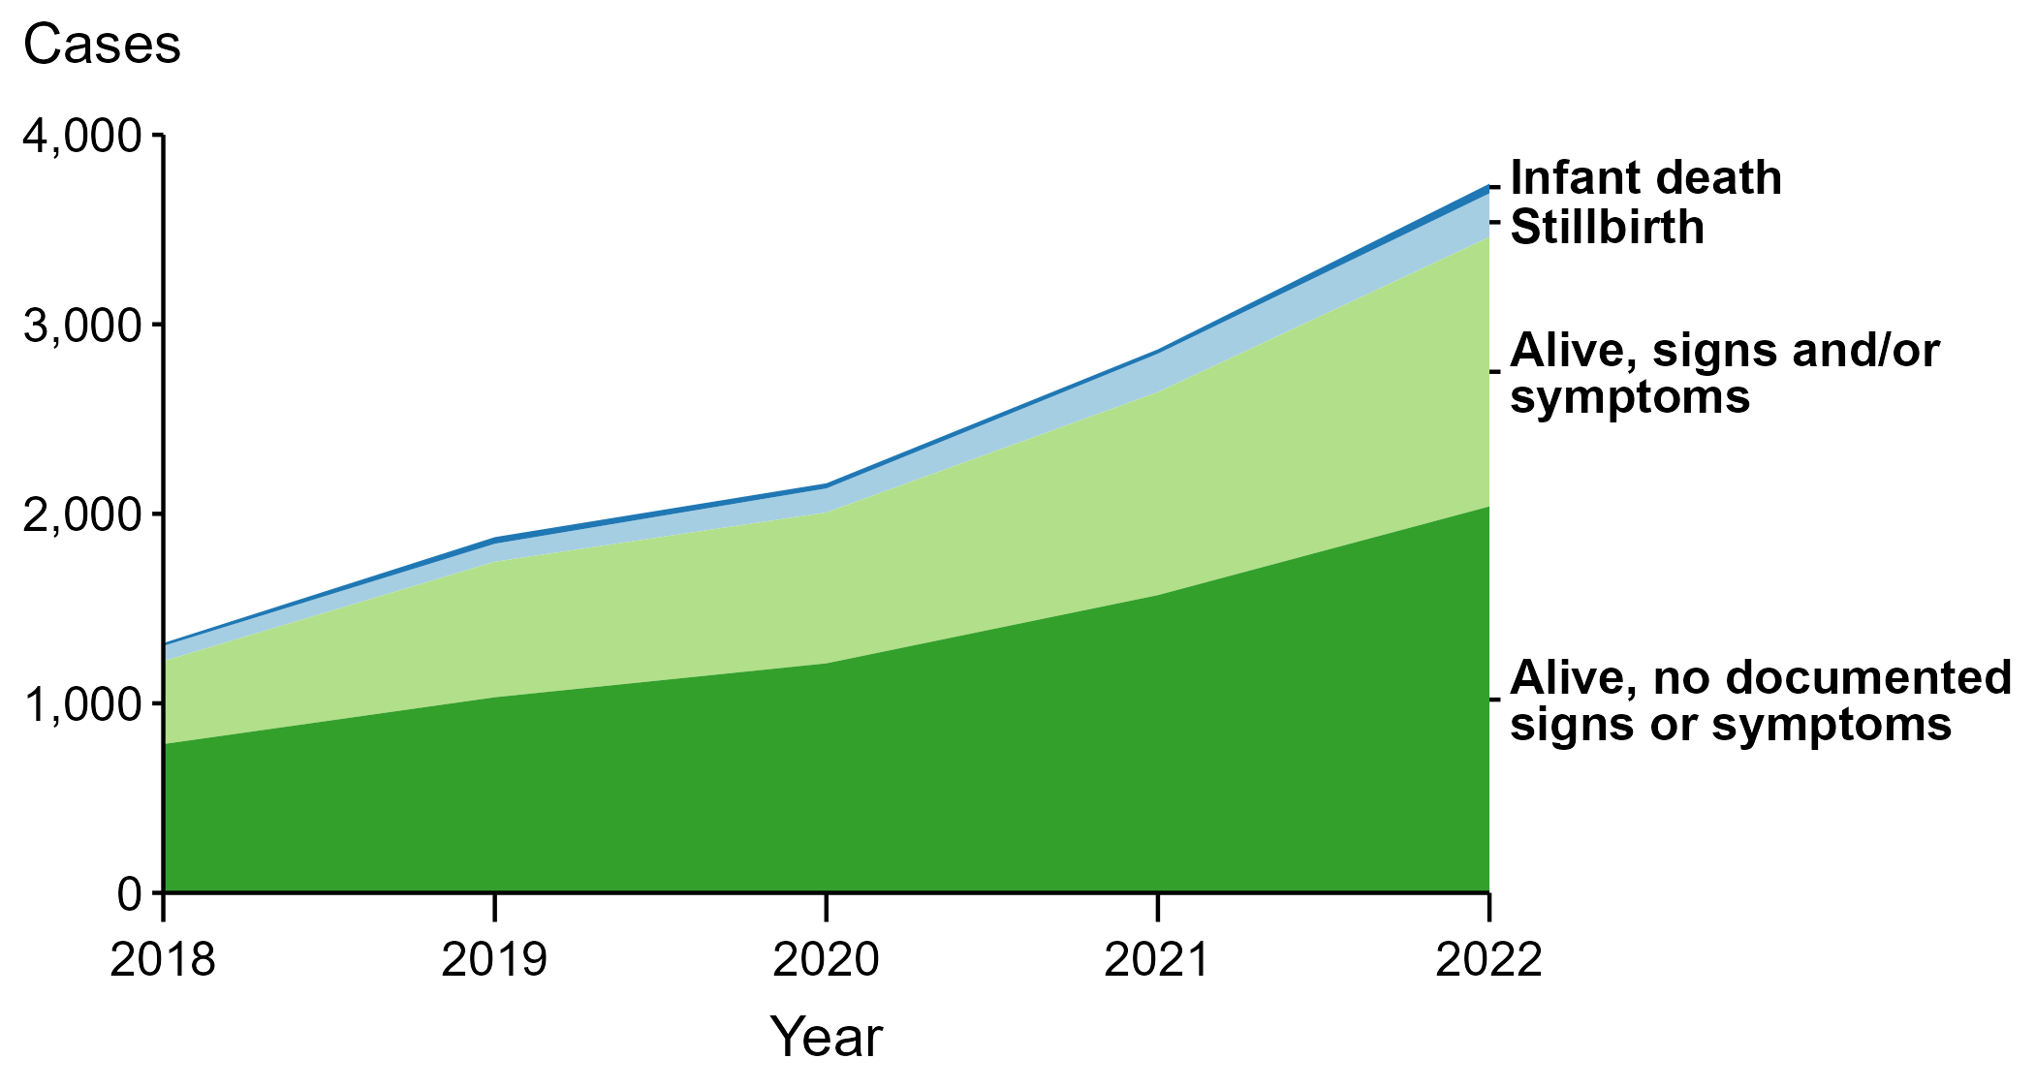
Congenital Syphilis — Reported Cases by Vital Status and Clinical Signs and Symptoms of Infection, United States, 2018–2022
(n = 51)
(n = 231)
(n = 1,421)
(n = 2,039)
Centers for Disease Control and Prevention, 2022
Notes:
In 2022, 51 congenital syphilis cases (1.4%) were infant deaths, 231 cases (6.2%) were stillbirths, 1,421 cases (37.8%) were born alive with congenital syphilis-related signs or symptoms, 2,039 cases (54.3%) were born alive with no documented congenital syphilis-related signs or symptoms, and 13 cases (0.3%) were missing information on vital status.

Slide 31
Manifestations of CS
Early manifestations
  < 2 years of age
  Due to hematogenous spread (via blood) of T. pallidum and the resultant inflammatory response in various organs and tissues
  Immune-mediated
Late manifestations
  > 2 years of age
  Scarring or stigmata from early disease
  Reaction to persistent inflammation
  Noninfectious

Slide 32
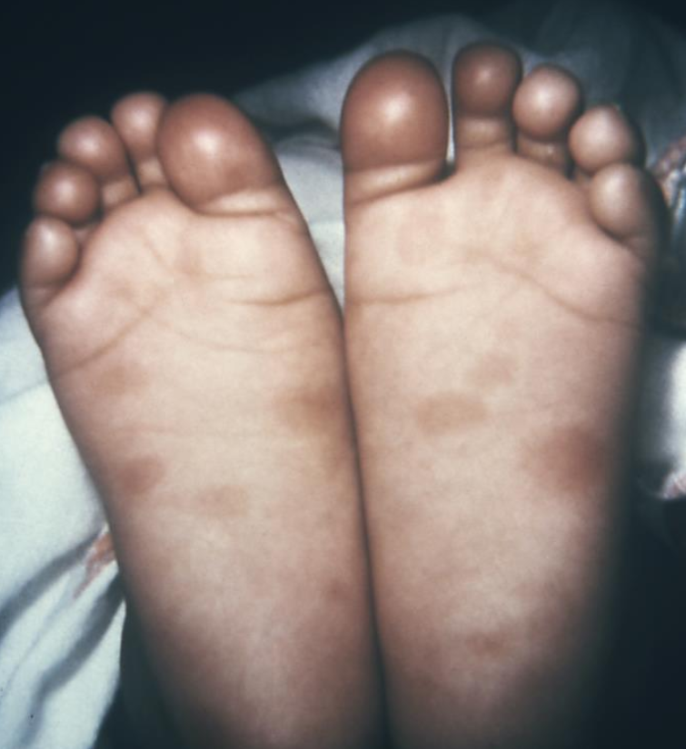
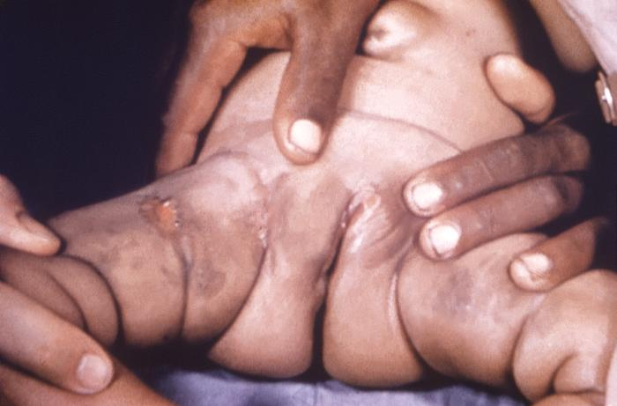
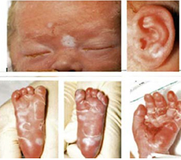
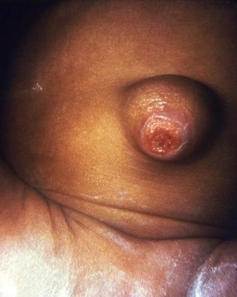
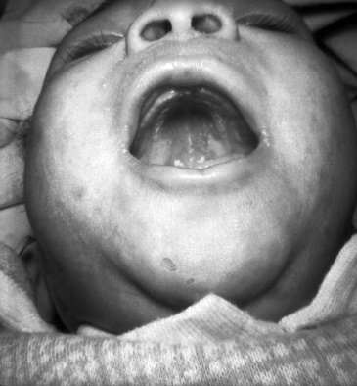
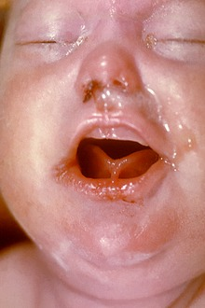
Early Manifestations (birth to age 2)
Sole rash
Desquamating rash
Gestation
  Placental thickening, hydrops fetalis, intrauterine growth restriction, preterm, and/or small for gestational age
Constitutional
  Fever and irritability
Skin and Mucosa
  Rash and lesions
  Nasal secretions (snuffles)
  Mucous patches
  Adenopathy
CDC PHIL
CDC PHIL
CDC PHIL
CDC PHIL
CDC PHIL
CDC PHIL
Mucous patches
Umbilical lesion
CDC PHIL
Nasal secretions
Remington et al. 2010
Notes:
Starting with early manifestations, ss early as 2nd trimester US screening, one may notice changes such as hydrops, IUGR, boney findings, hepatosplenomegaly. Infants may be born preterm and/or SGA as well.
After delivery, signs of CS may include… (read rest of slide)
Of note, lesions and nasal secretions are infectious.

Slide 33
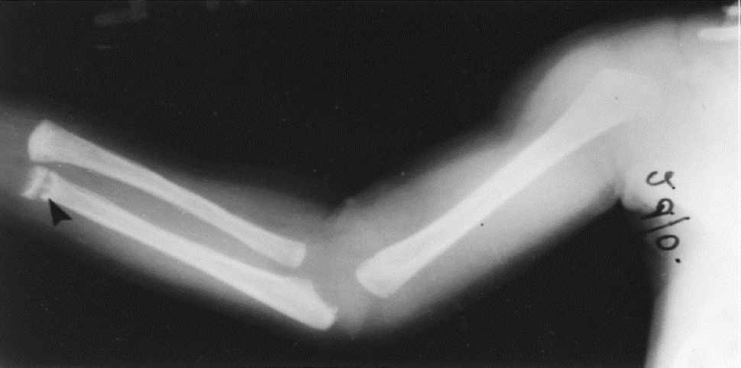
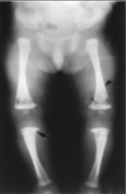
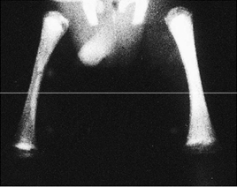
Early Manifestations (birth to age 2)
Periostitis
Neurologic:
  Abnormal reflexes or motor development
  Failed hearing screens
Musculoskeletal:
  Osteochondritis
  Periostitis
  Pseudoparalysis
Osteochondritis
CDC PHIL
CDC PHIL
CDC PHIL
Periostitis
Remington et al. 2010
Notes:
Furthermore, infants may have neurologic and bone findings including… (read slide)
Although pseudoparalysis may present like a neurologic disorder, it is actually due to pain from osteochondritis and periostitis.

Slide 34
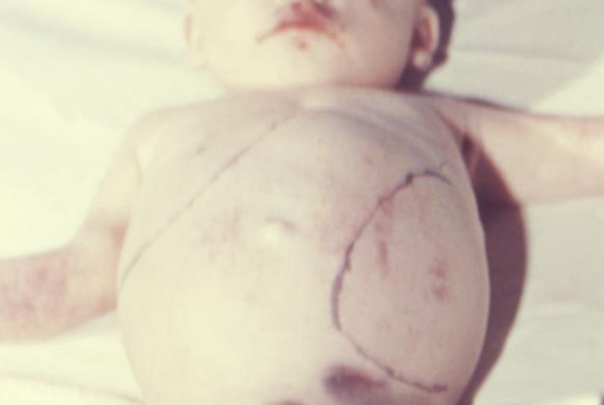
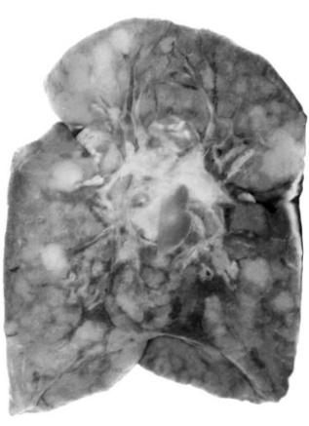
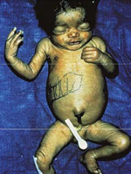
Early Manifestations (birth to age 2)
Pulmonary:
  Pneumonia alba
Cardiac:
  Myocarditis
Gastrointestinal (GI):
  Pancreatitis
  GI malabsorption
  Hepatomegaly (with or without jaundice)
  Splenomegaly
    Pneumonia alba
CDC PHIL
CDC PHIL
Hepatosplenomegaly
CDC PHIL
Remington et al. 2010
Notes:
Pulmonary, cardiac, and gastrointestinal findings may include… (read slide)
Pneumonia alba (or ‘white pneumonia’) refers to the white fibrotic tissue that forms in the lung as seen in this photo.
While not listed here, lab findings may include anemia, thrombocytopenia; hypoglycemia; liver transaminitis and direct hyperbilirubinemia; cerebrospinal fluid pleocytosis, elevated protein content, reactive VDRL test.

Slide 35
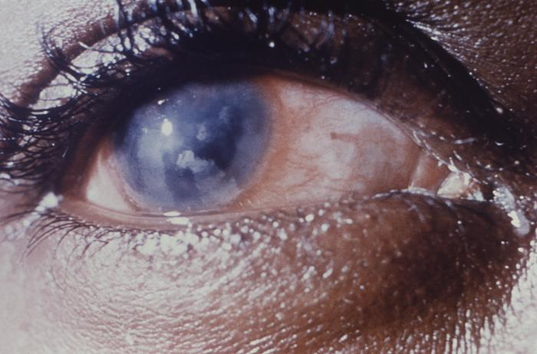
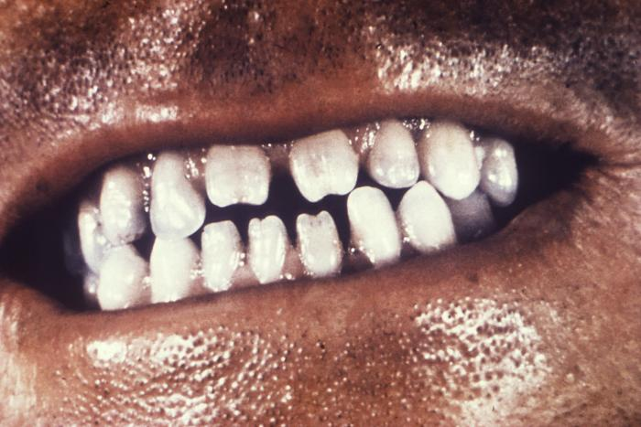
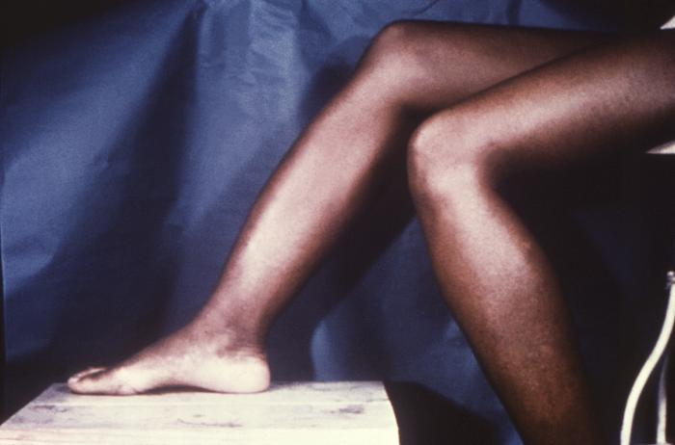
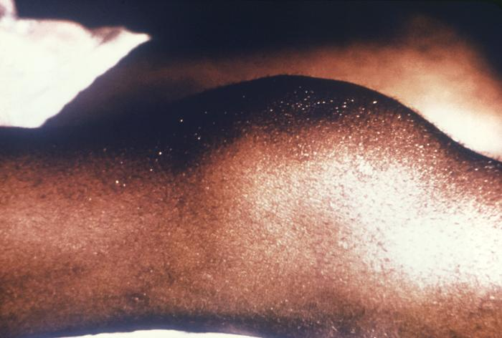
Late Manifestations (>2 years of age)
Neurologic
  Interstitial keratitis
  8th cranial nerve deafness
Dental
  Hutchinson teeth
  Mulberry molars
Skeletal
  Saber shins
  Frontal bossing
  Clutton joints
Facial
  Saddle nose
  Rhagades
Interstitial keratitis
Hutchinson teeth
CDC PHIL
CDC PHIL
Saber shins
Clutton joints
CDC PHIL
CDC PHIL
Remington et al. 2010
Notes:
I will not spend a lot of time discussing late manifestations of CS, as CS is often recognized before these occur.
There are many late manifestations of CN – these are just some of them.
Interstitial keratitis – corneal scarring due to chronic inflammation of the stroma; causes fogging of the cornea
8th CN deafness – due to osteochondritis affecting the otic capsule.
Dental – syphilic vasculitis around the time of birth affects the tooth buds causing these manifestations.
- Hutchinson teeth - Peg-shaped & notched central incisors
- Mulberry molars - Multicuspid first molars
Skeletal – due to prolonged periosteal reaction causing changes in bone shape.
- Saber shins - Anterior bowing of the shins
- Clutton - Symmetric painless swelling of the knees
Facial
- rhagades - Fissures and scaring around body orifices

Slide 36
Mortality of CS
Of 191 confirmed CS cases (by immunoblotting/PCR/RIT of specimen)….
  Mortality was found to be 31% (59/191)
    Stillbirths: 90% of deaths (53/59)
      Majority were <28 weeks gestation (74%, 39/53)
CDC surveillance case definition correctly identified all CS cases, but underestimated mortality at 10%
Wozniak et al. 2023
Notes:
Parkland Memorial Hospital and Children’s Medical Center from 1984 to 2002. Prospective, single site, cohort study of all cases of syphilis among mothers and their infants from 1984 to 2002. The diagnosis of congenital syphilis was determined using IgM immunoblotting, polymerase chain reaction, and RIT of fetal or infant specimens in addition to clinical, laboratory, and radiographic criteria. Data were retrospectively reviewed to ascertain fetal and neonatal mortality.

Slide 37
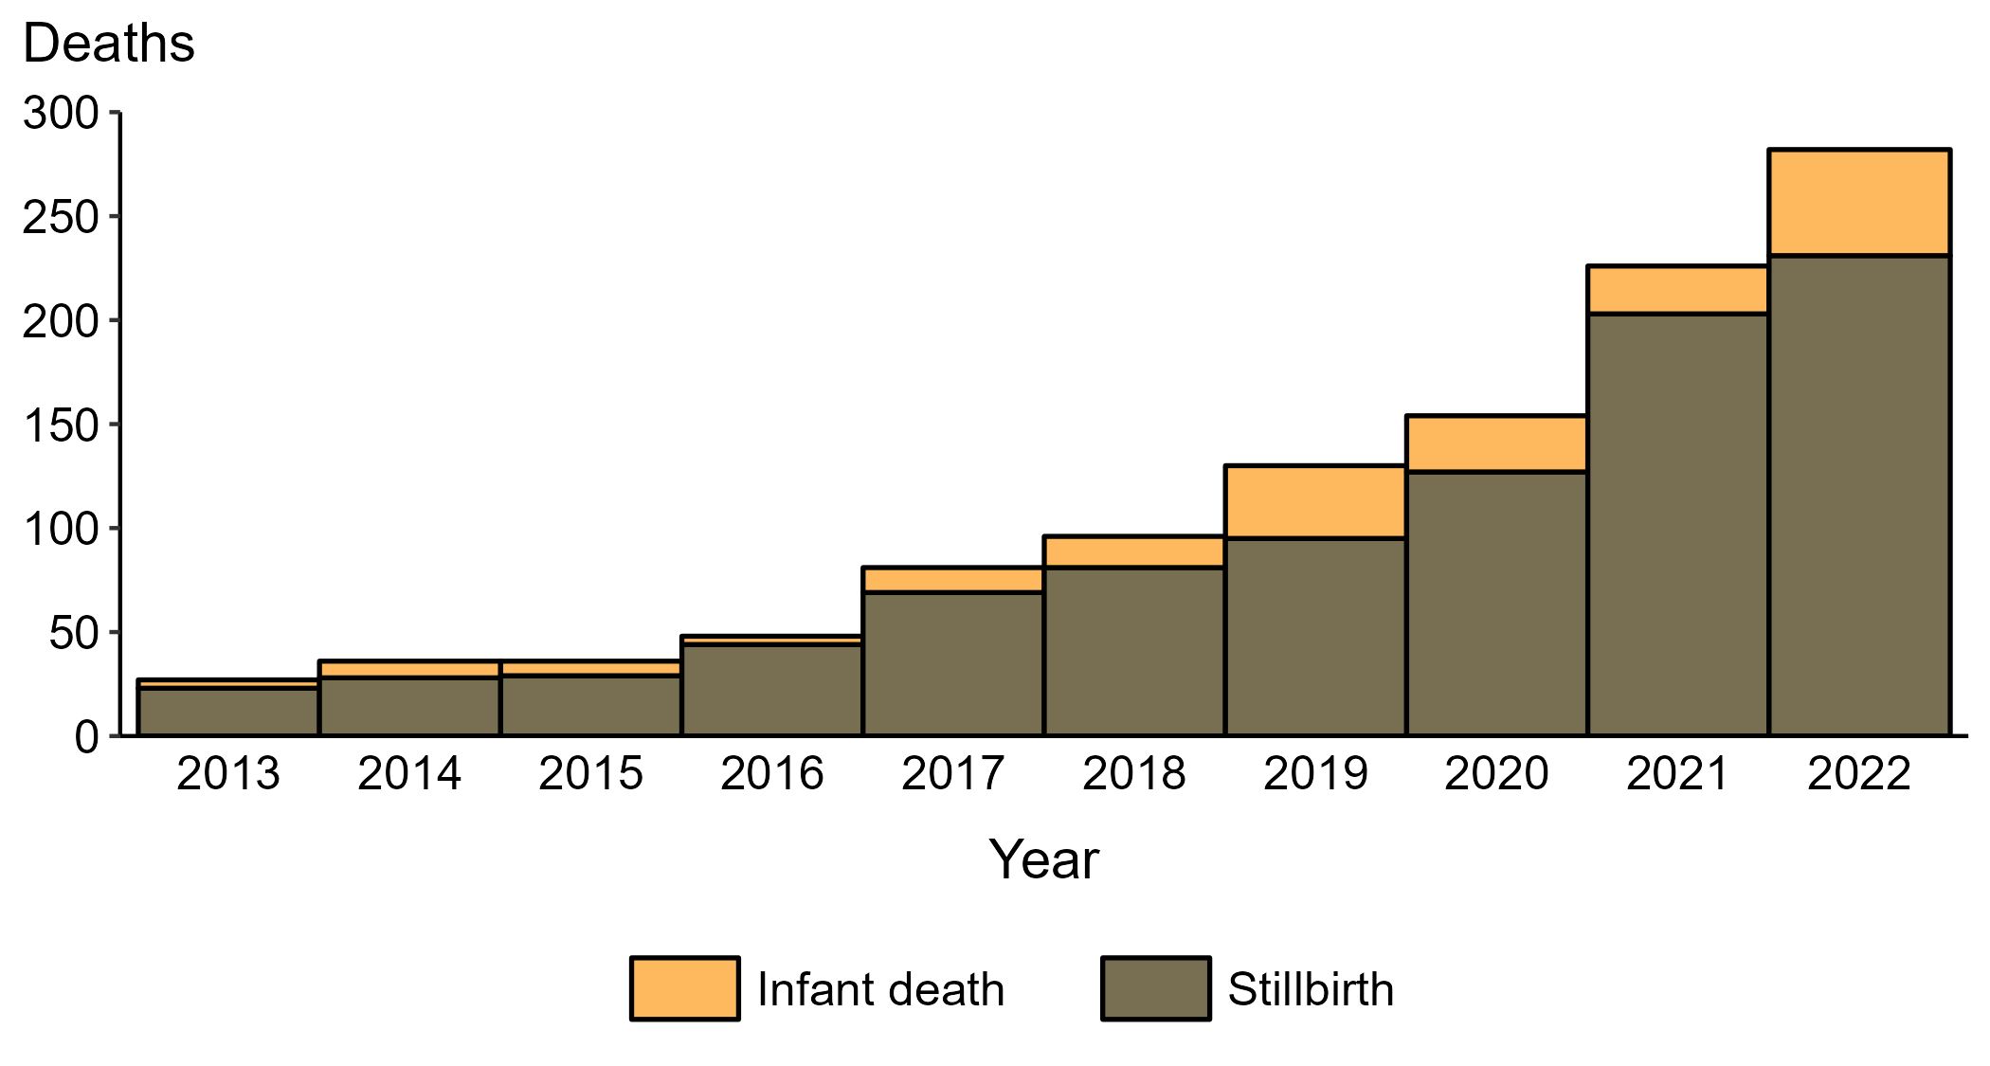
Congenital Syphilis — Reported Stillbirths and Infant Deaths, United States, 2013–2022

Slide 38
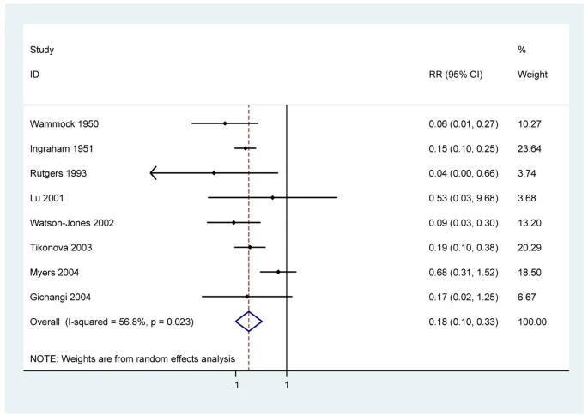
How Does Treatment Affect Risk of CS Mortality?
Meta analysis of 8 observational studies showing effect of penicillin on stillbirth in pregnant women with active syphilis
Prenatal treatment dramatically reduces the risk of CS stillbirth
  Adjusted risk ratio = 0.18 (95% CI: 0.10 - 0.33)
Blencowe et al. 2011

Slide 39
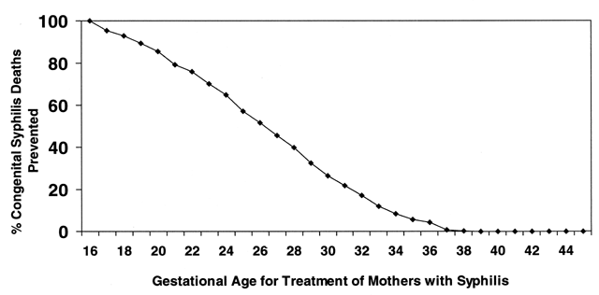
How Does Treatment Timing Affect Outcome?
Percentage of CS deaths potentially prevented by treating all pregnant women with syphilis at a given gestational age
Earlier treatment results in fewer CS infant deaths
About 70% of CS stillbirths are likely avoidable if treatment is provided by 21 weeks gestation
Gust et al. 2002

Slide 40
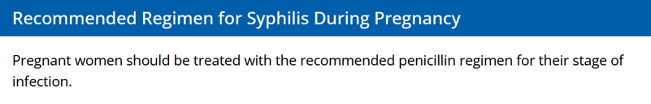

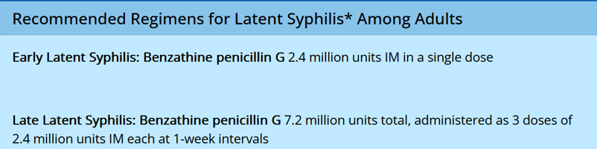
Treatment of Syphilis in Pregnancy
The only treatment for syphilis in pregnancy is penicillin
If type-1 penicillin allergy, desensitize in collaboration with an allergist in the hospital and treat with penicillin
https://www.cdc.gov/std/treatment-guidelines/syphilis-pregnancy.htm
Notes:
Pregnant patients should be treated with the penicillin regimen appropriate for their stage of infection (see images).
Type-1 allergy can be confirmed with skin testing; consult an allergist.
Some experts recommend a 2nd dose of benzathine penicillin G 2.4 mu IM ( 7 days after 1st dose in early syphilis for pregnant people) – for early syphilis. The is expert opinion and there are not great guidelines around it – some situations in which to consider include diagnosis after 28 weeks GA (due to changing pharmacokinetics) and/or in the presence of US findings of CS. It may also depend on where you are geographically and whether you have a Bicillin shortage.
Doxycycline is not an option in pregnancy (category D).

Slide 41
What about Extencilline?
In January of 2024, the US FDA started the temporary importation of Extencilline® (benzathine benzylpenicillin)
Benzathine benzylpenicillin is an alternative name for benzathine penicillin G (Bicillin® L-A), therefore Extencilline® and Bicillin® L-A are equivalent and can be used interchangeably for the treatment of syphilis
Extencilline® is safe for use in pregnancy
CDC Dear Colleague Letter January 2024
Notes:
Of note – injection volumes are higher for extencilline so consider splitting to give multiple smaller volume injections.

Slide 42
Syphilis Treatment Intervals in Pregnancy
The optimal interval between doses is 7 days for pregnant people
Intervals > 9 days between doses are not acceptable for treatment of pregnant people
If > 9 days lapse the full treatment course should be repeated
First Injection
Day 0
7-9 days
Second Injection
Day 7
7-9 days
Third Injection
Day 14
https://www.cdc.gov/std/treatment-guidelines/syphilis-pregnancy.htm
Notes:
For those being treated for late latent syphilis, 3 injections are required. Per CDC guidelines… (read slide)
If a pregnant person does not return for the next dose on day 7, every effort should be made to contact them and link them to care within 2 days
Just an FYI - CDC allows for up to 9 days between doses, but recent research suggests the risk of CS increases when 9 or more days lapse (Johnson et al, 2023). This has resulted in some states narrowing the treatment window to 8 days.

Slide 43
Jarisch-Herxheimer Reaction and CS
Jarisch-Herxheimer reactions may precipitate fetal distress and premature labor during treatment in the second trimester
If parent develops fevers, contractions, or decreased fetal movement after treatment they should present for evaluation
Concern for possibly causing Jarisch-Herxheimer reaction SHOULD NOT delay treatment
https://www.cdc.gov/std/treatment-guidelines/syphilis-pregnancy.htm

Slide 44
Prenatal Syphilis Treatment
Treatment Regimens in Pregnancy
Late latent or unknown duration
(asymptomatic; > 1 year)
Primary (chancre)
Secondary (rash, etc.)
Early latent
(asymptomatic; < 1 year)
Benzathine penicillin (PCN) G 2.4 million units IM once
Some experts recommend a 2nd dose 7 days after the initial dose
Benzathine penicillin (PCN) G 2.4 million units IM weekly for 3 weeks
Optimal dosing interval of 7 days
https://www.cdc.gov/std/treatment-guidelines/syphilis-pregnancy.htm

Slide 45
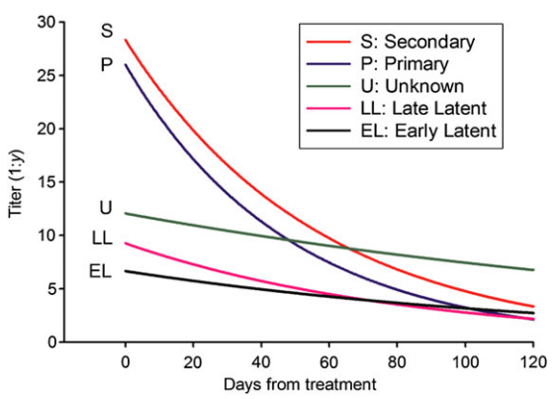
Follow-up After Treatment in Pregnancy
Repeat RPR 8 weeks after treatment unless signs of primary/secondary syphilis (reinfection concern)
  Syphilis diagnosed and treated at 24 weeks gestation-repeat serology at delivery
Repeat RPR at delivery if treated during pregnancy
Post-treatment serologic response during pregnancy varies widely
  Many don’t have a fourfold decline by delivery
If sustained fourfold increase occurs after treatment completion, evaluate for reinfection and neurosyphilis
Titer decline after adequate treatment of syphilis in pregnancy, by stage
Rac et al. 2014

Slide 46
Management of Infants Exposed to Syphilis in Utero

Slide 47
Syphilis serologies at delivery
Non-treponemal (RPR/VDRL)
  Need both birthing parent and infant titers at delivery
  Perform the same test on both (e.g. compare RPR with RPR) drawn at the same time
Treponemal (FTA-ABS/TP-PA EIA)
  TP-PA from a birthing parent can stay positive in Infant serum for up to 15 months.
  NOT NEEDED IN INFANT SCREENING

Slide 48
Evaluation & Treatment of Neonates (<30 days old) Exposed to Syphilis In Utero

Slide 49

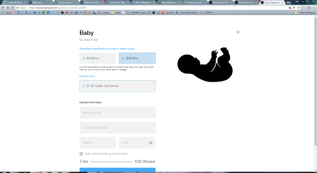
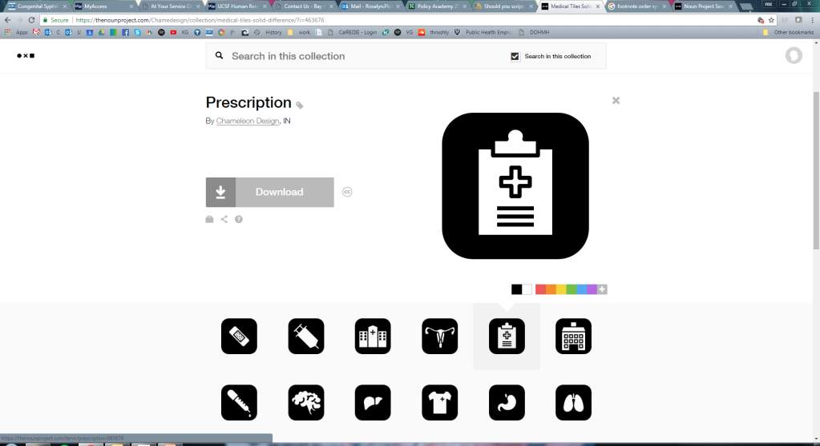
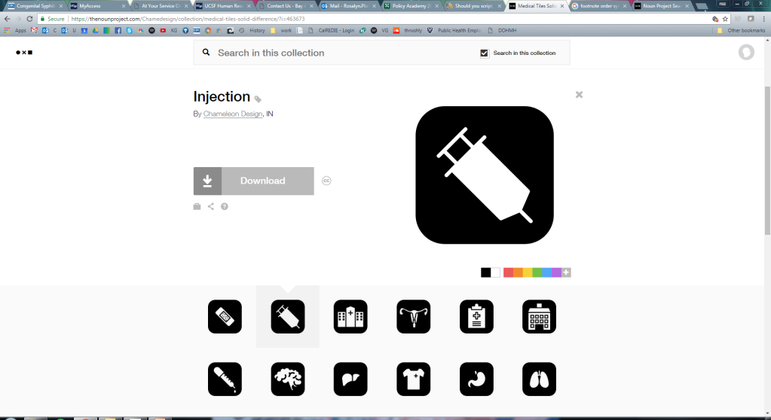
ALL INFANTS & BIRTHING PARENTS (e.g., mother): SERUM RPR OR VDRL TITER DRAWN AT DELIVERY
Infant Criteria:
CS findings on phys exam
titer ≥4-fold ↑ vs birthing pt’s
+ darkfield or PCR- placenta, cord lesion, or body fluid
+ silver stain- placenta or cord
No to all
Birthing Parent Criteria:
Inadequately/not txed§
Tx undocumented
Txed with non-benzathine PCN G
Initiated tx <30 days before delivery
No to all
Add’l Birthing Parent Criteria:
Adequately txed w/ benzathine PCN G appropriate for stage, initiated ≥30 d before delivery
AND
No concern for reinfxn or tx failure
Infant
Treatment
Infant &
Birthing Parent Criteria
Scenario 2:
Possible CS ^{II}
Scenario 3:
Less likely CS
Scenario 1: Proven or highly probable CS
Yes to any
Yes to both
Yes to any
No add’l infant eval
CSF † (VDRL, cell count, protein)
CBC, diff, platelet count
Long-bone radiographs
CSF † (VDRL, cell count, protein)
CBC, diff, platelet count
Long-bone radiographs
Tests as clinically indicated by signs on phys exam
Review birthing parent titers & stage:
≥4-fold ↓ in titer after tx for early syphilis
OR
Stable titer for low-titer, latent syphilis (RPR <1:4 or VDRL <1:2)
Infant
Evaluation
Any abnormalities, results not avail, OR follow-up¶ uncertain
No abnormalities AND
follow-up¶ certain
No to both OR
follow-up¶ uncertain
Yes to either AND follow-up¶ certain
Aqueous crystalline PCN G‡ 100,000–150,000 units/kg/day, admin as 50,000 units/kg/dose IV q12 hrs x first 7 days of life & q8 hrs thereafter x 10 days total
Benzathine PCN G
50,000 units/kg/dose IM in single dose
No treatment indicated
with close serologic follow-up of infant q 2-3 months for 6 months
Infant
Treatment
Infant
Treatment
Notes:
† Cerebrospinal Fluid (CSF) test results obtained during the neonatal period can be difficult to interpret; normal values differ by gestational age and are higher in preterm infants.
‡ Alternative: Procaine penicillin G 50,000 units/kg/dose IM in a single daily dose for 10 days
§ Benzathine Penicillin G (BPG or Bicillin-LA), administered according to stage of disease and initiated at least 30 days prior to delivery is the only adequate treatment for syphilis during pregnancy.
II Evaluation is not necessary if a 10-day course of parenteral therapy is administered, although such evaluations might be useful. If the neonate’s nontreponemal test is nonreactive and the mother’s risk for untreated syphilis is low, a single IM dose of BPG can be considered without evaluation.
¶ All neonates with reactive nontreponemal tests should receive careful follow-up examinations and serologic testing (i.e., a nontreponemal test) every 2–3 months until the test becomes nonreactive. Neonates with a negative nontreponemal test at birth whose mothers were seroreactive at delivery should be retested at 3 months to rule out serologically negative incubating congenital syphilis at the time of birth.
FOR MORE INFORMATION ABOUT SCENARIO 4 MANAGEMENT, TREATMENT OF SYPHILIS IN PREGNANCY, NEONATAL CSF INTERPRETATION, AND CS INFANT FOLLOW-UP, PLEASE REFER TO THE CDC 2021 STI TREATMENT GUIDELINES. `

Slide 50
ALL INFANTS & BIRTHING PARENTS (e.g., mother): SERUM RPR OR VDRL TITER DRAWN AT DELIVERY
Infant Criteria:
CS findings on phys exam
titer ≥4-fold ↑ vs birthing pt’s
+ darkfield or PCR- placenta, cord lesion, or body fluid
+ silver stain- placenta or cord
No to all
Birthing Parent Criteria:
Inadequately/not txed§
Tx undocumented
Txed with non-benzathine PCN G
Initiated tx <30 days before delivery
No to all
Add’l Birthing Parent Criteria:
Adequately txed w/ benzathine PCN G appropriate for stage, initiated ≥30 d before delivery
AND
No concern for reinfxn or tx failure
Infant
Treatment
Infant &
Birthing Parent Criteria
Scenario 2:
Possible CS ^{II}
Scenario 3:
Less likely CS
Scenario 1: Proven or highly probable CS
Yes to any
Yes to both
Yes to any
No add’l infant eval
What about Scenario 4?
CSF † (VDRL, cell count, protein)
CBC, diff, platelet count
Long-bone radiographs
CSF † (VDRL, cell count, protein)
CBC, diff, platelet count
Long-bone radiographs
Tests as clinically indicated by signs on phys exam
Review birthing parent titers & stage:
≥4-fold ↓ in titer after tx for early syphilis
OR
Stable titer for low-titer, latent syphilis (RPR <1:4 or VDRL <1:2)
Infant
Evaluation
Any abnormalities, results not avail, OR follow-up¶ uncertain
No abnormalities AND
follow-up¶ certain
No to both OR
follow-up¶ uncertain
Yes to either AND follow-up¶ certain
Aqueous crystalline PCN G‡ 100,000–150,000 units/kg/day, admin as 50,000 units/kg/dose IV q12 hrs x first 7 days of life & q8 hrs thereafter x 10 days total
Benzathine PCN G
50,000 units/kg/dose IM in single dose
No treatment indicated
with close serologic follow-up of infant q 2-3 months for 6 months
Infant
Treatment
Infant
Treatment
Notes:
† CSF test results obtained during the neonatal period can be difficult to interpret; normal values differ by gestational age and are higher in preterm infants.
‡ Alternative: Procaine penicillin G 50,000 units/kg/dose IM in a single daily dose for 10 days
§ Benzathine Penicillin G (BPG or Bicillin-LA), administered according to stage of disease and initiated at least 30 days prior to delivery is the only adequate treatment for syphilis during pregnancy.
II Evaluation is not necessary if a 10-day course of parenteral therapy is administered, although such evaluations might be useful. If the neonate’s nontreponemal test is nonreactive and the mother’s risk for untreated syphilis is low, a single IM dose of BPG can be considered without evaluation.
¶ All neonates with reactive nontreponemal tests should receive careful follow-up examinations and serologic testing (i.e., a nontreponemal test) every 2–3 months until the test becomes nonreactive. Neonates with a negative nontreponemal test at birth whose mothers were seroreactive at delivery should be retested at 3 months to rule out serologically negative incubating congenital syphilis at the time of birth.
FOR MORE INFORMATION ABOUT SCENARIO 4 MANAGEMENT, TREATMENT OF SYPHILIS IN PREGNANCY, NEONATAL CSF INTERPRETATION, AND CS INFANT FOLLOW-UP, PLEASE REFER TO THE CDC 2021 STI TREATMENT GUIDELINES. `

Slide 51
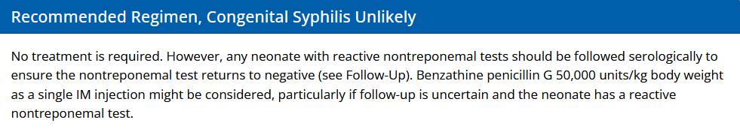
Scenario 4: Congenital Syphilis Unlikely
Neonate with normal physical examination and a titer ≤ 4-fold that of the birthing parent’s titer at delivery and BOTH of the following are true for the birthing parent:
  Treatment was adequate before pregnancy
  Nontreponemal serologic titer remained low and stable (i.e., serofast) before and during pregnancy and at delivery (e.g., VDRL ≤1:2 or RPR ≤1:4)
https://www.cdc.gov/std/treatment-guidelines/congenital-syphilis.htm
Notes:
No work-up or treatment needed.

Slide 52
Congenital Syphilis Treatment
Aqueous crystalline penicillin G 100,000–150,000 units/kg/day, administered as 50,000 units/kg/dose IV
  Every 12 hours during the first 7 days of life
  Every 8 hours thereafter for a total of 10 days
Alternative: Procaine penicillin G 50,000 units/kg/dose intramuscular (IM) in a single daily dose for 10 days, only for neonates; current drug shortage
Appropriate for:
  Scenario 1
  Scenario 2 with any abnormalities, results not available, or follow-up uncertain
CDC STI Treatment Guidelines, 2021

Slide 53
Congenital Syphilis Treatment
Benzathine penicillin G 50,000 units/kg/dose IM in a single dose
Appropriate for:
  Scenario 2 who do not meet criteria for IV aqueous crystalline penicillin G
  Scenario 3 with either:
    Birthing parent with early syphilis who did not achieve ≥4-fold decrease in titer post-treatment
or
    Birthing parent with latent syphilis who did not have a stable low titer (RPR < 1:4 or VDRL < 1:2) throughout pregnancy
CDC STI Treatment Guidelines, 2021

Slide 54
Infant Follow-up By Scenario
Reactive & Treated (Scenario 1 or 2)
RPR should decrease by 3 months and be non-reactive at 6-12 months
If reactive at 6-12 months, repeat CSF and re-treat
Reactive & Not Treated (Scenario 3 or 4)
RPR should be non-reactive by 6 months
If reactive at 6 months, repeat CSF examination and re-treat
Non-Reactive and Regardless of Treatment
Repeat RPR at 3 months to ensure neonate was not incubating syphilis
CDC STI Treatment Guidelines, 2021
Notes:
Similar to adults treated for syphilis, infants treated for CS should have close laboratory follow-up. The frequency and duration for RPR depends on the scenario the infant was categorized as, their RPR status at delivery, and their treatment received. Starting with infants who had a reactive RPR and were treated with BPG (scenario 1 or 2)… read slide.
Is the infant has a reactive titer and is not treated (Scenario 3 or 4) then… (read slide). The reason the cut off is more strict in this case is that any maternal RPR antibodies should not be in the infant at 6 months, so if they persist this would indicate an infection in the infant.
Sometimes infants have a non-reactive RPR, but there is still concern for CS due to maternal history. Even in these cases as repeat RPR should be done at 3 months to ensure the neonate was not incubating syphilis.

Slide 55
Newly Reactive RPR in Infants (>30 days age) and Children
Situations:
  RPR may become newly reactive after delivery even when maternal labs are negative in cases of very early incubating syphilis
  If new concern for missed CS at delivery – get an RPR
If RPR is reactive, work-up should include:
  CSF analysis for VDRL, cell count, and protein
  CBC, differential, and platelet count
  Other tests as clinically indicated (e.g., long-bone radiographs, chest radiograph, liver function tests, abdominal ultrasound, ophthalmologic examination, neuroimaging, and auditory brain-stem response)
CDC STI Treatment Guidelines, 2021
Notes:
As mentioned before, even when an infant’s RPR is non-reactive at delivery we want to retest at 3 months of age to rule out incubating syphilis. Very rarely, this may identify a case of congenital syphilis that was incubating at delivery. Additionally, there may be situations in which the concern for CS arises after the neonate is discharged from the hospital and > 30 days old – such as cases in which screening was not performed at delivery.
If RPR is newly reactive in either of these cases, work-up should include: (read slide starting at CSF analysis…)

Slide 56
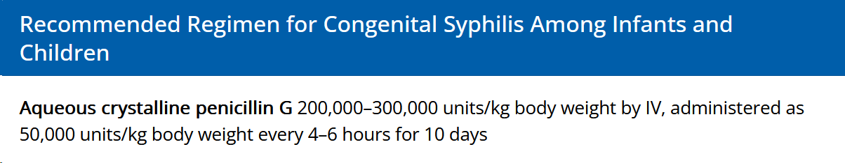
Treatment if Congenital Syphilis is Identified in an Infant or Child
For those WITH signs of CS on work-up or abnormal CSF examination:
For those WITHOUT signs of CS on work-up or abnormal CSF examination, 3 doses of benzathine penicillin G 50,000 units/kg body weight IM weekly can be considered
CDC STI Treatment Guidelines, 2021

Slide 57
Follow-up After Treatment for Syphilis in Infancy and Childhood
Repeat RPR every 3 months until the test becomes non-reactive or decreases 4-fold
If titers do not become non-reactive or decrease 4-fold by 12-18 months after treatment:
  Repeat CSF examination
  Repeat 10-day course of IV/IM penicillin G
CDC STI Treatment Guidelines, 2021
Notes:
If an infant or child is treated for syphilis after the neonatal period, they should have close follow-up. This follow-up should include: (read slide)

Slide 58
Congenital Syphilis Prevention

Slide 59
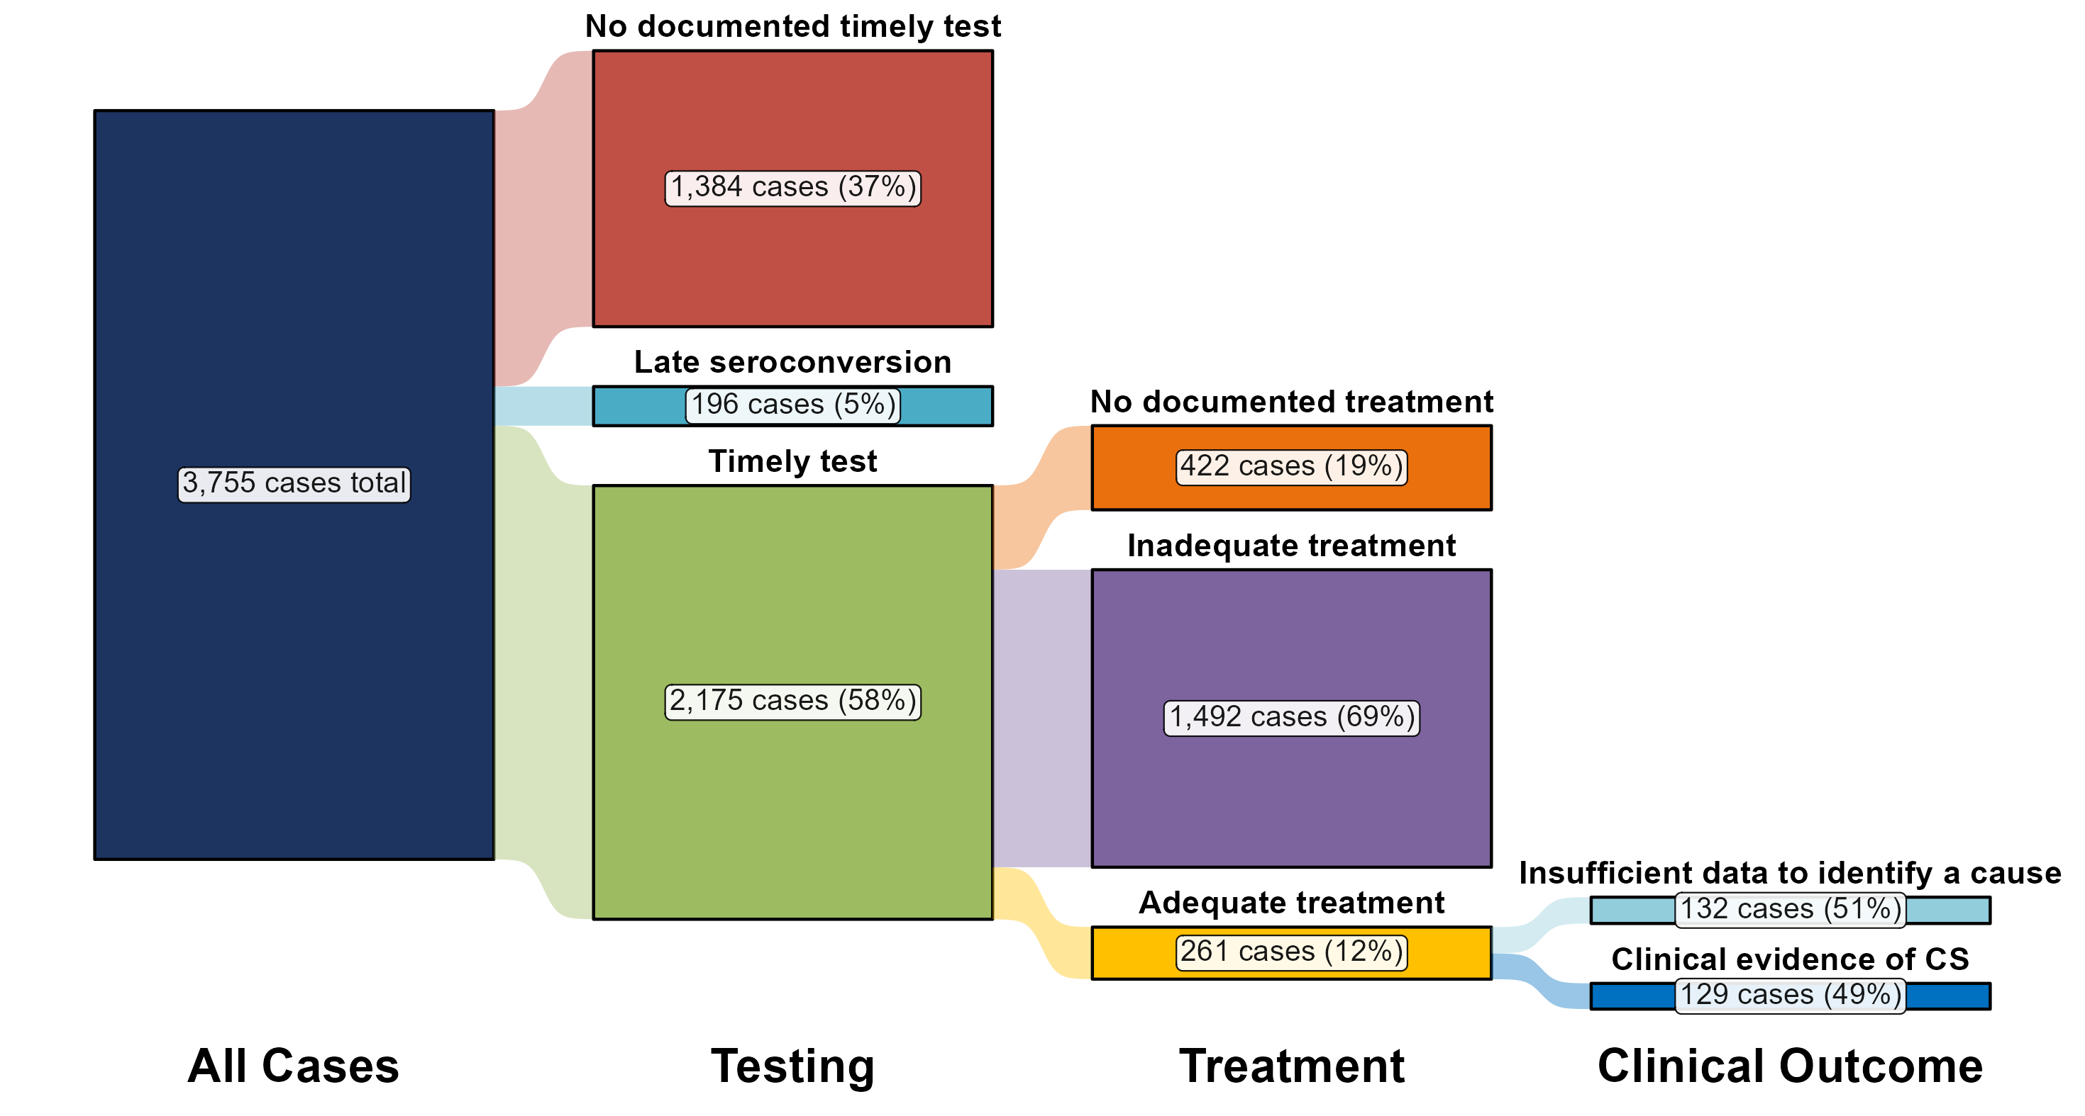
Distribution of Receipt of Testing and Treatment by Pregnant Persons with a Congenital Syphilis Outcome, United States, 2022
Centers for Disease Control and Prevention, 2022
Notes:
In 2022, there were a total of 3,755 cases of congenital syphilis reported for a rate of 102.5 per 100,000 live births.
In 2022, the most common missed prevention opportunity among birthing parents of infants with congenital syphilis was inadequate treatment (n = 1,492; 39.7%), followed by no documented timely test (n = 1,319; 35.1%).

Slide 60
Screening Prior to Pregnancy
CDC guidelines:
  Screen asymptomatic women at increased risk (e.g., history of incarceration, transactional sex, geography, race/ethnicity) for syphilis
  Among those who are living with HIV: for sexually active individuals, screen at first HIV evaluation, and at least annually thereafter
    More frequent screening might be appropriate depending on individual risk behaviors and the local epidemiology
https://www.cdc.gov/std/treatment-guidelines/congenital-syphilis.htm

Slide 61
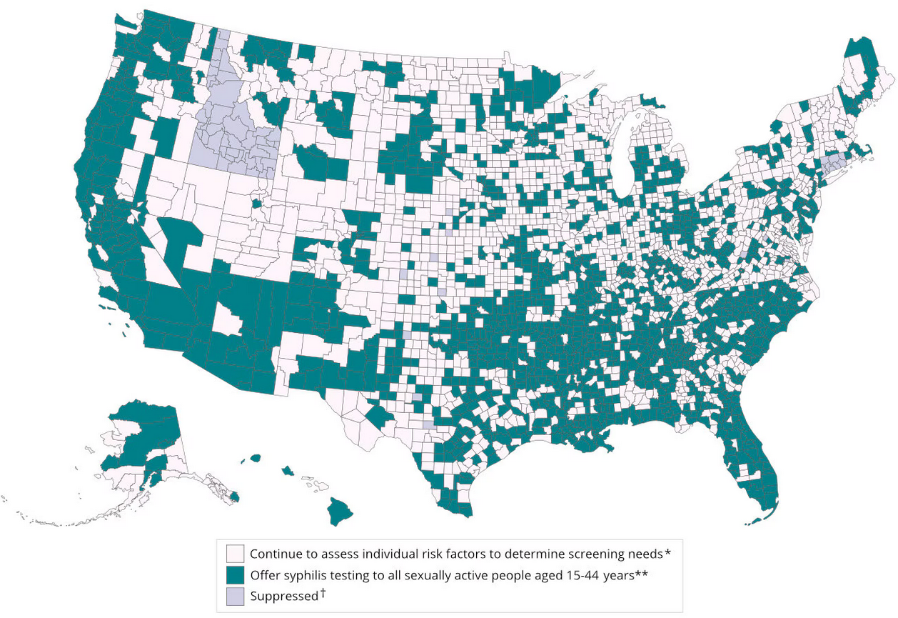
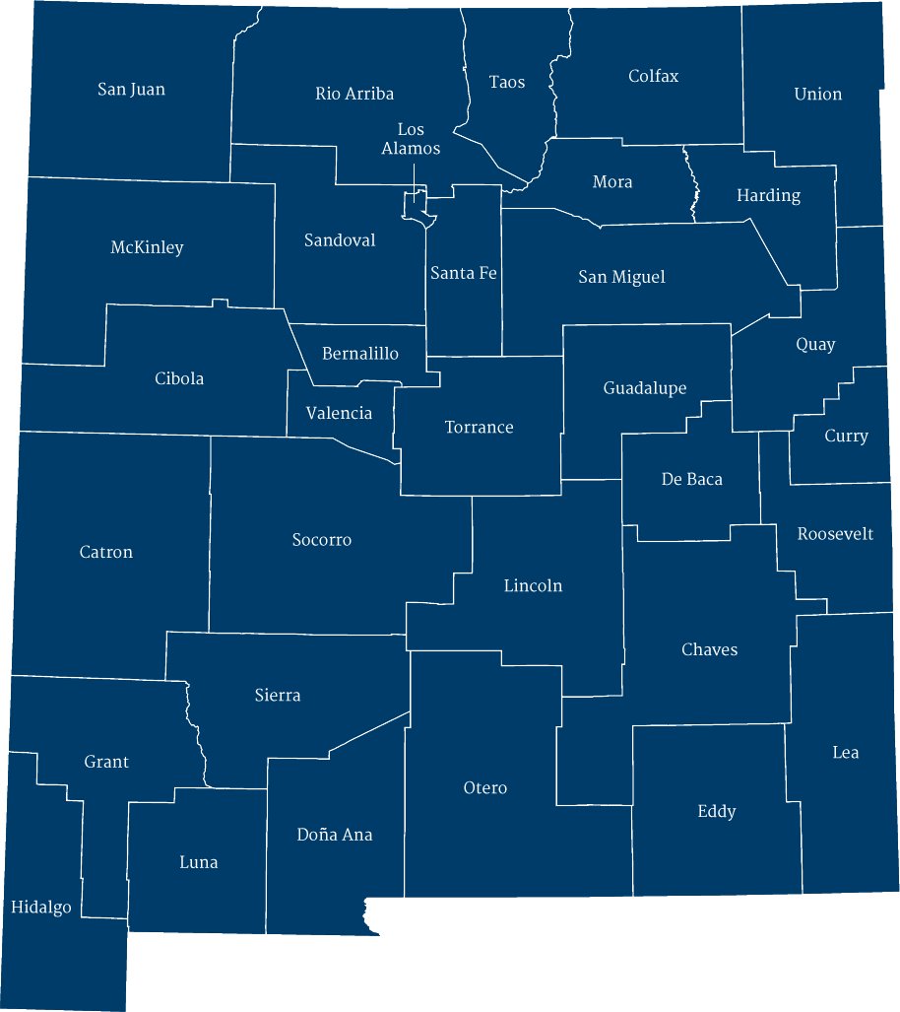






County Level Syphilis Rates Among Women of Reproductive Age in NM
Rate > Healthy People 2030 Goal
Rate > Healthy People 2030 Goal
Centers for Disease Control and Prevention, 2021
Notes:
The Healthy People 2030 goal for reducing the rate of primary and secondary syphilis among women aged 15–44 years is 4.6 per 100,000 people. This goal can provide a threshold for geography-based syphilis screening efforts for all sexually active people.
The county-level map below shows counties above and below this rate and can be an important tool for providers as they consider their syphilis screening efforts.
When zooming in on NM – this is what we see by county… (look at map)

Slide 62
Screening During Pregnancy
CDC guidelines:
  All pregnant people at the first prenatal visit
  Retest at 28 weeks gestation and at delivery if at increased risk due to geography or personal risk
    Risk factors: late or no prenatal care, incarceration, unstable housing, substance use (meth or opiates), sexually transmitted infections (STIs) during pregnancy, multiple partners, a new partner, partner with STIs
New Mexico policy: all pregnant people at first prenatal visit
Centers for Disease Control and Prevention, 2021

Slide 63

ACOG Update of Syphilis Screening Recommendations
Previously endorsed the CDC’s guidelines for universal screening at first visit and risk-based screening in the third trimester and at delivery
April 2024 – updated guidelines to universal screening at first visit, third trimester and at delivery
  All people should have syphilis screening 3-times during pregnancy
ACOG News Release April 18, 2024

Slide 64
High Priority Needs for CS Elimination
Testing
Third trimester and delivery screening in pregnancy
Expanding screening to corrections, drug treatment, and EDs
Treatment
On-site treatment and adequate treatment
Evaluation and treatment of exposed infants
Case Review
Routine in depth case review
Appropriate screening in family planning & primary care settings of people of reproductive age
Maximize 340B program
Public Health
Active surveillance
Outbreak response and disease intervention
Access to PNC
Housing, transportation, and social support
Substance use treatment
PNC = prenatal care

Slide 65
Summary
CS rates are increasing throughout the US, mirroring the increase in primary and secondary syphilis in people of reproductive age
Treatment of syphilis in pregnancy is based on stage of syphilis infection and 7-day intervals are essential
Treatment and follow-up for newborns affected by syphilis depends on infant and maternal criteria
Appropriate screening before and during pregnancy will be essential in addressing the current CS epidemic

Slide 66
Acknowledgements
Rosalyn Plotzker
Sharon Adler
Kelly Johnson
Ina Park
Questions?

Slide 67
Resources
National Clinician Consultation Center http://nccc.ucsf.edu/
  HIV Management
  Perinatal HIV
  HIV PrEP
  HIV PEP line
  HCV Management
  Substance Use Management
Present on ECHO
https://hsc.unm.edu/scaetc/programs-services/echo.html​
AETC National HIV Curriculum https://aidsetc.org/nhc
AETC National Coordinating Resource Center https://targethiv.org/library/aetc-national-coordinating-resource-center-0
HIVMA Resource Directory https://www.hivma.org/globalassets/ektron-import/hivma/hivma-resource-directory.pdf
Additional trainings scaetcecho@salud.unm.edu
www.scaetc.org
Notes:
IDEA Platform: Infectious Diseases Education & Assessment. https://idea.medicine.uw.edu/
AETC National HIV Curriculum: 6 core modules for self study; regularly updated; CME, CNE
Hepatitis C Online Curriculum: https://www.hepatitisc.uw.edu/
Hepatitis B Online Curriculum: https://www.hepatitisb.uw.edu/
National STD Curriculum: https://www.std.uw.edu/

Slide 68
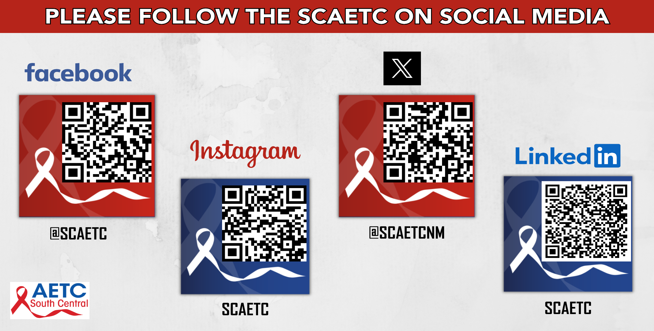
Notes:
Find an HIV-related topic TeleECHO in your area: https://echo.unm.edu/locations-2/echo-hubs-superhubs-united-states/
IDEA Platform: Infectious Diseases Education & Assessment. https://idea.medicine.uw.edu/
AETC National HIV Curriculum: 6 core modules for self study; regularly updated; CME, CNE
Hepatitis C Online Curriculum: https://www.hepatitisc.uw.edu/
Hepatitis B Online Curriculum: https://www.hepatitisb.uw.edu/
National STD Curriculum: https://www.std.uw.edu/

