Slide 1
Optimizing Health and Well-being: Applying the 4Ms Model to Enhance Aging with HIV Care
Chien-Wai Chiu MD
Geriatric Fellow PGY4
Baylor College of Medicine
Notes:
Version date: 4/23/24
Target participants: ID providers, fellows, residents, students & clinic staff
Director reviewed & approved: 4/29/24
Submitted to SCAETC CO: 5/10/24

Slide 2
Conflict of Interest Disclosure Statement
Speaker has nothing to disclose
This program is supported by the Health Resources and Services Administration (HRSA) of the U.S. Department of Health and Human Services (HHS) as part of an award totaling $4,205,743 with 0% financed with non-governmental sources. The contents are those of the author(s) and do not necessarily represent the official views of, nor does mention of trade names, commercial practices, or organizations imply an endorsement by HRSA, HHS, or the U.S. Government. For more information, please visit HRSA.gov. Any trade/brand names for products mentioned during this presentation are for training and identification purposes only.
Notes:
Please add presenter disclosures here if any exist.

Slide 3
Unconscious Bias Disclosure
SCAETC recognizes that language is constantly evolving, and while we make every effort to avoid bias and stigmatizing terms, we acknowledge that unintentional lapses may occur in our presentations.
We value your feedback and encourage you to share any concerns related to language, images, or concepts that may be offensive or stigmatizing.
Your input will help us refine and improve our presentations, ensuring they remain inclusive and respectful to participants.

Slide 4
Learning Objectives
Understand how 4Ms Framework create Age-Friendly Health Systems (AFHS)
Assess the patient aging with HIV
Apply the use of the 4Ms model to screen patient aging with HIV

Slide 5
Background
Advances in antiretroviral therapy (ART) have reduced mortality rates and transformed HIV into a manageable and chronic disease.
The life expectancy for people living with HIV who have had early and sustained access to ART is now similar to that of populations without HIV.
At the end of 2020, according to the CDC, more than 52% of people with HIV in the United States were ≥50 years old.

Slide 6
Understand how 4Ms Framework create Age-Friendly Health Systems (AFHS)

Slide 7
What is Age-Friendly Health Systems?
Age-Friendly Health Systems is an initiative of The John A. Hartford Foundation and the Institute for Healthcare Improvement (IHI), in partnership with the American Hospital Association (AHA) and the Catholic Health Association of the United States (CHA), designed to meet the challenge of increased older adult population.
Age-Friendly Health Systems aim to:
Follow an essential set of evidence-based practices
Cause no harm
Align with What Matters to the older adult and their family caregivers.
https://www.ihi.org/initiatives/age-friendly-health-systems
Notes:
https://www.ihi.org/initiatives/age-friendly-health-systems
This Improves health outcomes for older adults, reduces waste from low-quality services, and increases the utilization of cost effective services

Slide 8
4Ms Framework
Matters most: prioritize the older adult’s specific health outcome goals and care preferences across all settings of care.
Mobility: ensures the appropriate approach to assisting or encouraging older adults to move safely every day in order to maintain functional ability and do what matters.
https://www.ihi.org/initiatives/age-friendly-health-systems
Notes:
Becoming an Age-Friendly Health System means providing a set of four evidence-based elements of high-quality care, known as the “4Ms,” : What Matters, Mobility, mentation and medication

Slide 9
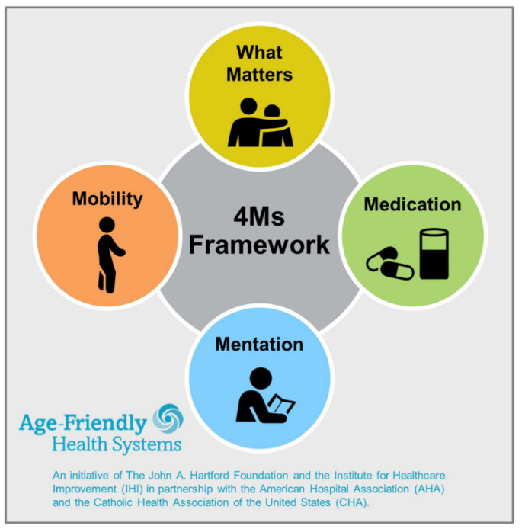
4Ms Framework
Mentation: referred to as mood and memory, focuses on the prevention, identification, treatment, and management of dementia, depression, and delirium.
Medication: means using age-friendly medication or dose adjusting if medication is needed, and avoiding or deprescribing high-risk medications that may interfere with what matters, mentation, or mobility.

Slide 10
Assess the patient aging with HIV

Slide 11
Patients Aging with HIV
Patients with HIV (PWH) age 10 years faster than those without HIV
Premature aging of the immune system: Chronic viral infections, such as HIV infection, often cause immune activation and inflammation and are linked to premature age-associated conditions, including cardiovascular disease, frailty, and bone loss, even in patients using ART.
Older adults with HIV have an increased risk of dementia, diabetes, frailty, depression, osteoporosis, and some cancers, compared to those without HIV.
Comorbidities commonly associated with aging (e.g., diabetes) have been found to increase the risk of opportunistic infections (e.g., HIV-related concerns) in older adults with HIV

Slide 12
Challenges faced by Patient Aging with HIV
Functional impairment
Falls: important to monitor and address because of the increased risk of osteoporosis and fractures among people with HIV.
Cognitive impairment, which may have multiple etiologies
HIV-associated neurocognitive disorder (HAND) affects 20 to 50 percent of PWH
Other associated causes: Cardiovascular risk factors, the presence of hepatitis C virus, substance use (alcohol and methamphetamine), female gender, and depression

Slide 13
Challenges faced by Patients Aging with HIV
Polypharmacy is especially challenging in people aging with HIV because they must take ART, in addition to other medications for comorbidities, as well as over-the-counter medications, vitamins, and supplements.

Slide 14
HIV-Associated Neurocognitive Disorder (HAND)
Although ART is effective at repressing circulating HIV, the central nervous system (CNS) may serve as a reservoir for HIV
Several ART medications are unable to cross the blood-brain barrier to target CNS-specific HIV, allowing the virus to continue to replicate. This replication may lead to neurocognitive disorders in People with HIV (PWH) as they age

Slide 15
Patients Aging with HIV: Other challenges
Sensory impairment: Hearing or vision decline or loss
Impaired oral health: caries and periodontal disease.
Decreased vaccine responses due to aging
Failure by providers to address sexual health, which may be less likely to be discussed because of competing comorbidities or the perception that older people are not sexually active
Stigma of HIV is associated with higher rates of loneliness, social isolation and depression in PWH
Insomnia, which is very common in the older adults, is both a symptom of and a risk factor for depression.

Slide 16
Apply the use of the 4Ms model to screen patients aging with HIV

Slide 17
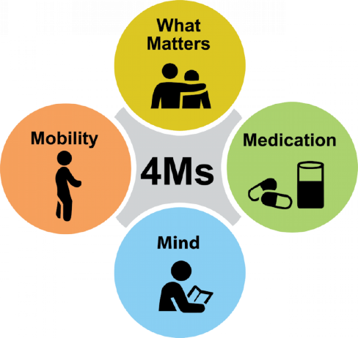
4Ms Frameworks: Matters Most
Establish the core values of the older adults
It is critical how we frame the question
1) Explore the older adult’s life context, priorities, and preferences and connect them to the impacts of care, self-management, and care decisions
“What is important to you today? “
2) Anchored to tangible health or care events in an older adult’s life.
“What is the one thing about your health care you most want to focus on so that you can do [desired activity] more often or more easily? “
https://www.ihi.org/initiatives/age-friendly-health-systems
Notes:
Current guideline-based clinical decision making may overrule personal preferences, resulting in treatment that is not holistic. Given the various complex implications of multiple comorbidities, integrated treatment that follows what matters allows the older adults and family to weigh in on the potential benefits and harms of various treatments to find out what is right for them

Slide 18
4Ms Frameworks: Matters Most (Continued)
Value
Goal
4 aspects of values:
Connection with others
Enjoy Life
Function independently
Managing health
Value will not change
SMART* tool is helpful to establish goals
More frequent conversations need to occur when there are changes in health status
*SMART: specific, measurable, actionable, realistic, and timely
Notes:
SMART: specific, measurable, actionable, realistic, and timely
“I want to know what is important to you since it is important for me”

Slide 19
4Ms Frameworks: Matters Most (Continued)
Advance directive: Living will and medical power of attorney
Code status (out-of-hospital do-not-resuscitate) / Life sustaining treatment (LST)

Slide 20
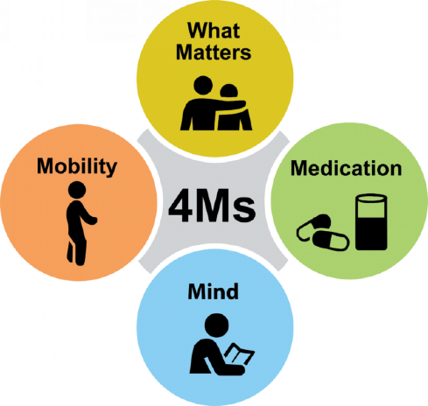
4Ms Frameworks: Mobility
Gait and Function
1) Gait- Timed Get Up and Go (TUG)
Using stopwatch. From position of sitting in the chair, walk 3 meter or 10 feet.
> 12sec: increased risk of fall
Correlates to a past history of falls; it is less effective to predict future falls and thus should not be used in isolation to identify older adults who are at high risk of falls
2) Function – activities of daily living (ADL) and instrumental ADLs (IADLS)
https://www.ihi.org/initiatives/age-friendly-health-systems
Notes:
TUG-manual; TUG cognitive
TUG time performance correlates to a past history of falls, it is less effective at predicting future falls and thus should not be used in isolation to identify older adults who are at high risk of falls. The TUG may be limited in its ability to predict falls due to additional risk factors that the test fails to account for, such as female gender, poor vision, fear of falling, lower limb proprioception, lifestyle, intake of neuroleptics, and dementia
Other method of assessing Gait: Johns Hopkins Highest Level of Mobility (JH-HLM), Tinetti Performance Oriented Mobility Assessment (POMA), and/or referral to physical therapy (PT)

Slide 21
4Ms Frameworks: Mobility- ADL and iADL
Basic ADLs- skills required to manage one’s basic physical needs
Personal hygiene: The ability to bathe and groom oneself and maintain dental hygiene, nail, and hair care.
Dressing: The ability to select appropriate clothes and to put the clothes on.
Toileting: The ability to get to and from the toilet, use it appropriately, and clean oneself.
Ambulating: The extent of an individual’s ability to move from one position to another and walk independently.
Continence: The ability to control bladder and bowel function
Feeding: The ability of a person to feed oneself.
Harder
Easier

Slide 22
4Ms Frameworks: Mobility- ADL and iADL
Instrumental ADLs- more complex activities related to the ability to live independently in the community
Managing communication with others: The ability to manage telephone and mail.
Transportation and shopping: Ability to do grocery shopping, attend events, and manage transportation, either via driving or public transportation.
Meal preparation: Plans, prepares and serves adequate meals independently
Housecleaning and home maintenance: Maintaining living areas reasonably clean and tidy, and keeping up with home maintenance, including laundry.
Managing medications: Ability to obtain medications and take them as directed.
Managing finances: Ability to pay bills and manage financial assets.
Notes:
Assessing function: Linkage to resources on home health, nursing homes, day programs, and wellness centers can be initiated from the outcome of these assessments.

Slide 23
4Ms Frameworks: Mobility- Frailty and Fall
Frailty is a clinically recognizable state of increased vulnerability resulting from an aging-associated decline in reserve and function across multiple physiologic systems, such that the ability to cope with everyday or acute stressors is compromised
Multiple underlying causes increase fall risk: such as functional impairment, frailty, gait instability, cognitive impairment, and adverse reactions to medications

Slide 24
Fall prevention
Avoid high risk medications.
Identify and set a daily mobility goal with older adult that supports what matters and then review and support progress toward a mobility goal.
Educate older adult and family caregivers.
Manage impairments that reduce mobility (pain, balance, gait, and strength, vision/hearing).
Refer to physical therapy (balance, gait, strength, and exercise program).
Create safe environment: keeping objects off steps, fixing loose or broken stairs, removing throw rugs, and storing frequently used objects on low shelves.
CDC: STEDI (Stopping Elderly Accidents, Deaths & Injuries)- Older Adult Fall Prevention: Algorithm and resources for clinician and patient/caregiver
Notes:
https://www.cdc.gov/steadi/pdf/check_for_safety_brochure-a.pdf
Safety checklist produced by the CDC can help find and fix hazards in the home to ensure safe home environment for mobility.

Slide 25
Mentation: Dementia
Screen older adults at least one time per year for cognitive impairment and, if screen is positive, refer for further evaluation and manage manifestations of cognitive impairment
Screening tools:
Mini-Cog
Saint Louis University Mental Status (SLUMS)
Montreal Cognitive Assessment (MoCA).
Mini-Mental Status Exam (MMSE)
Notes:
SLUMS and MoCA are more effective screening tool among diverse population
There is a fee associated with theMMSE and MoCA, whereas the Mini-Cog and SLUMS test are freely available
The PHQ-9 and PHQ-2 have lower specificities in older adults with cognitive impairment. GDS and GDS-15 have proven to be effective in assessing depression and are appropriate for culturally diverse populations and older adults with different levels of education
The Mini-Cog is a three-minute test consisting of two components: a three-item recall test and a clockDrawing
The SLUMS is an 11-item, 7-minute exam consisting of animal naming, clock drawing, figure differentiation, numeric calculation, and assessment of recall ability (Morley & Tumosa, 2002).
The MoCA is a 30- question, 10- to 15-minute test that measures visuospatial and executive functions, as well as various cognitive domains, such as naming, memory, attention, language, abstraction, delayed recall, and orientation.
The Mini-Mental Status Exam (MMSE) tests seven domains—orientation, registration, attention, calculation, recall, language, and visual construction—through a 30-item questionnaire

Slide 26
Mentation: Depression
Screening for depression is recommended annually or when symptoms arise.
Screening tools:
Patient Health Questionnaire- 2 (PHQ-2)
Patient Health Questionnaire-9 (PHQ-9)
Geriatric Depression Scale (GDS)
Geriatric Depression Scale - short form (GDS - 15)
Notes:
SLUMS and MoCA are more effective screening tool among diverse population
There is a fee associated with theMMSE and MoCA, whereas the Mini-Cog and SLUMS test are freely available
The PHQ-9 and PHQ-2 have lower specificities in older adults with cognitive impairment. GDS and GDS-15 have proven to be effective in assessing depression and are appropriate for culturally diverse populations and older adults with different levels of education
The Mini-Cog is a three-minute test consisting of two components: a three-item recall test and a clockDrawing
The SLUMS is an 11-item, 7-minute exam consisting of animal naming, clock drawing, figure differentiation, numeric calculation, and assessment of recall ability (Morley & Tumosa, 2002).
The MoCA is a 30- question, 10- to 15-minute test that measures visuospatial and executive functions, as well as various cognitive domains, such as naming, memory, attention, language, abstraction, delayed recall, and orientation.
The Mini-Mental Status Exam (MMSE) tests seven domains—orientation, registration, attention, calculation, recall, language, and visual construction—through a 30-item questionnaire

Slide 27
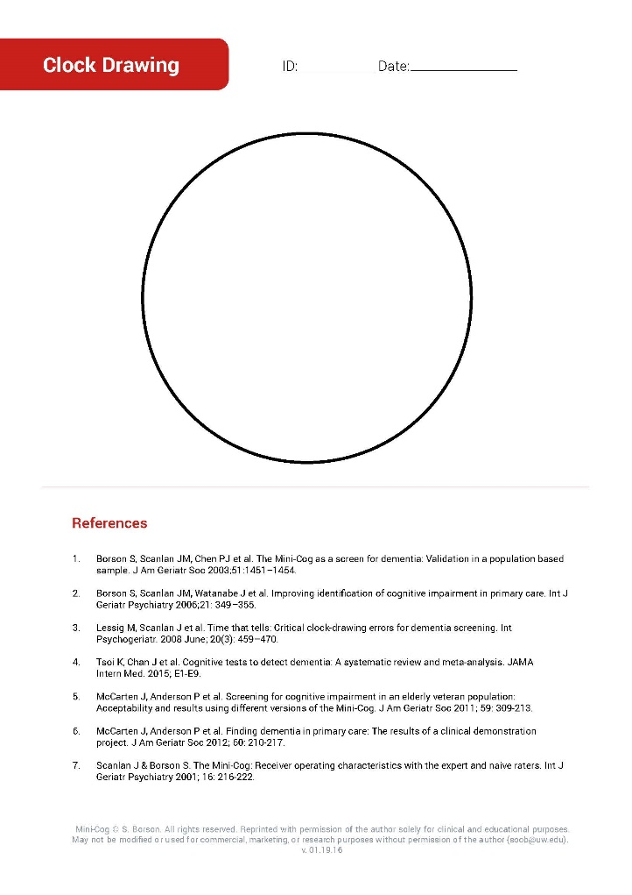
Mini Cog
https://mini-cog.com/

Slide 28
Mentation: Dementia- HIV-Associated Neurocognitive Disorder (HAND)
Screening and testing tools specific to HAND detection:
Montreal Cognitive Assessment (MoCA)
Frascati criteria classify HAND into:
ANI: asymptomatic neurocognitive impairment—Abnormality in 2 or more cognitive ability with no functional impairment
MND: mild neurocognitive disorder — Cognitive impairment with mild functional impairment
HAD: HIV-associated dementia — Marked cognitive impairment with marked functional impairment
HIV dementia scale
Notes:
In a recent study, prevalence estimates for HAND diagnoses were 33 percent for asymptomatic neurocognitive impairment (ANI), percent for mild neurocognitive disorder (MND), and 2 percent for HIV-associated dementia (HAD).
Although the incidence of HAD has been decreasing in recent years, the overall prevalence of all HAND diagnoses has remained high or has increased over the same period, despite widespread use of ART.

Slide 29
Mentation: Dementia
Although no robust treatment options exist for cognitive impairment and little evidence supports that early detection will improve the patient’s outcome, early detection of cognitive impairment can allow both patients and family members to start planning while the patient is still capable of making informed decisions.

Slide 30
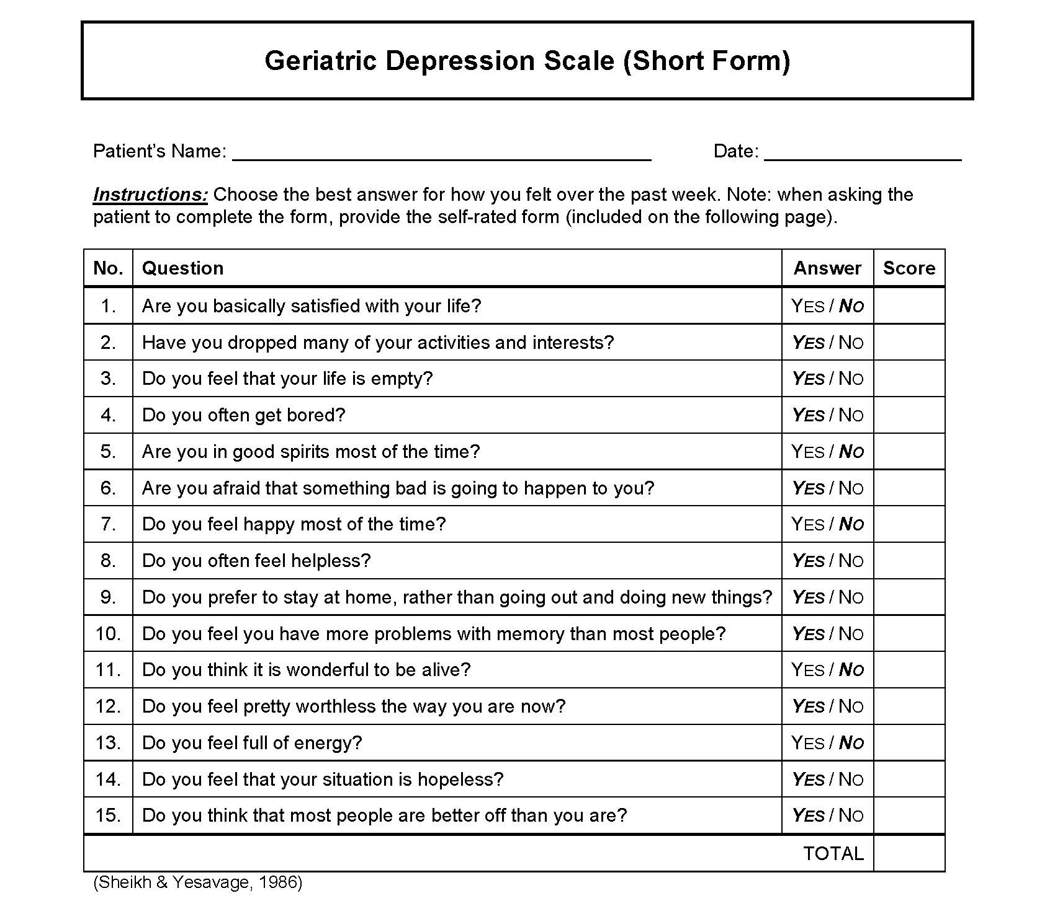
Mentation: Depression: PHQ 2 and GDS 15
https://www.hiv.uw.edu/page/mental-health-screening/phq-2
A score > 5 points is suggestive of depression
A score ≥ 10 points is almost always indicative of depression.
Both should warrant a follow-up comprehensive assessment.

Slide 31
Mentation: Delirium
Acute and fluctuating syndrome of impaired attention and awareness
Confusion Assessment Method (CAM)
Days of the weeks backward, Months of the years backwards
Confusion Assessment Method (CAM)
1. Acute change in mental status and fluctuating course
2. Inattention: Does the patient have difficulty focusing attention? Can use one of the following tests for attention: Digit span up to 5 forward, 4 backward “World” backward Days of the week backward, months of the year backwards
3. Disorganized thinking
4. Altered level of consciousness: Is the patient’s mental status anything other than alert (vigilant, lethargic, stuporous, comatose)?
Notes:
Other screening tools:
3-Minute Diagnostic Assessment for Delirium using the CAM algorithm (3D-CAM),
CAM for the Intensive Care Unit (CAM-ICU)
Brief CAM (bCAM)
Ultrabrief Two-Item Bedside Test for Delirium (UB-2)
Nursing Delirium Symptom Checklist (NuDESC).

Slide 32
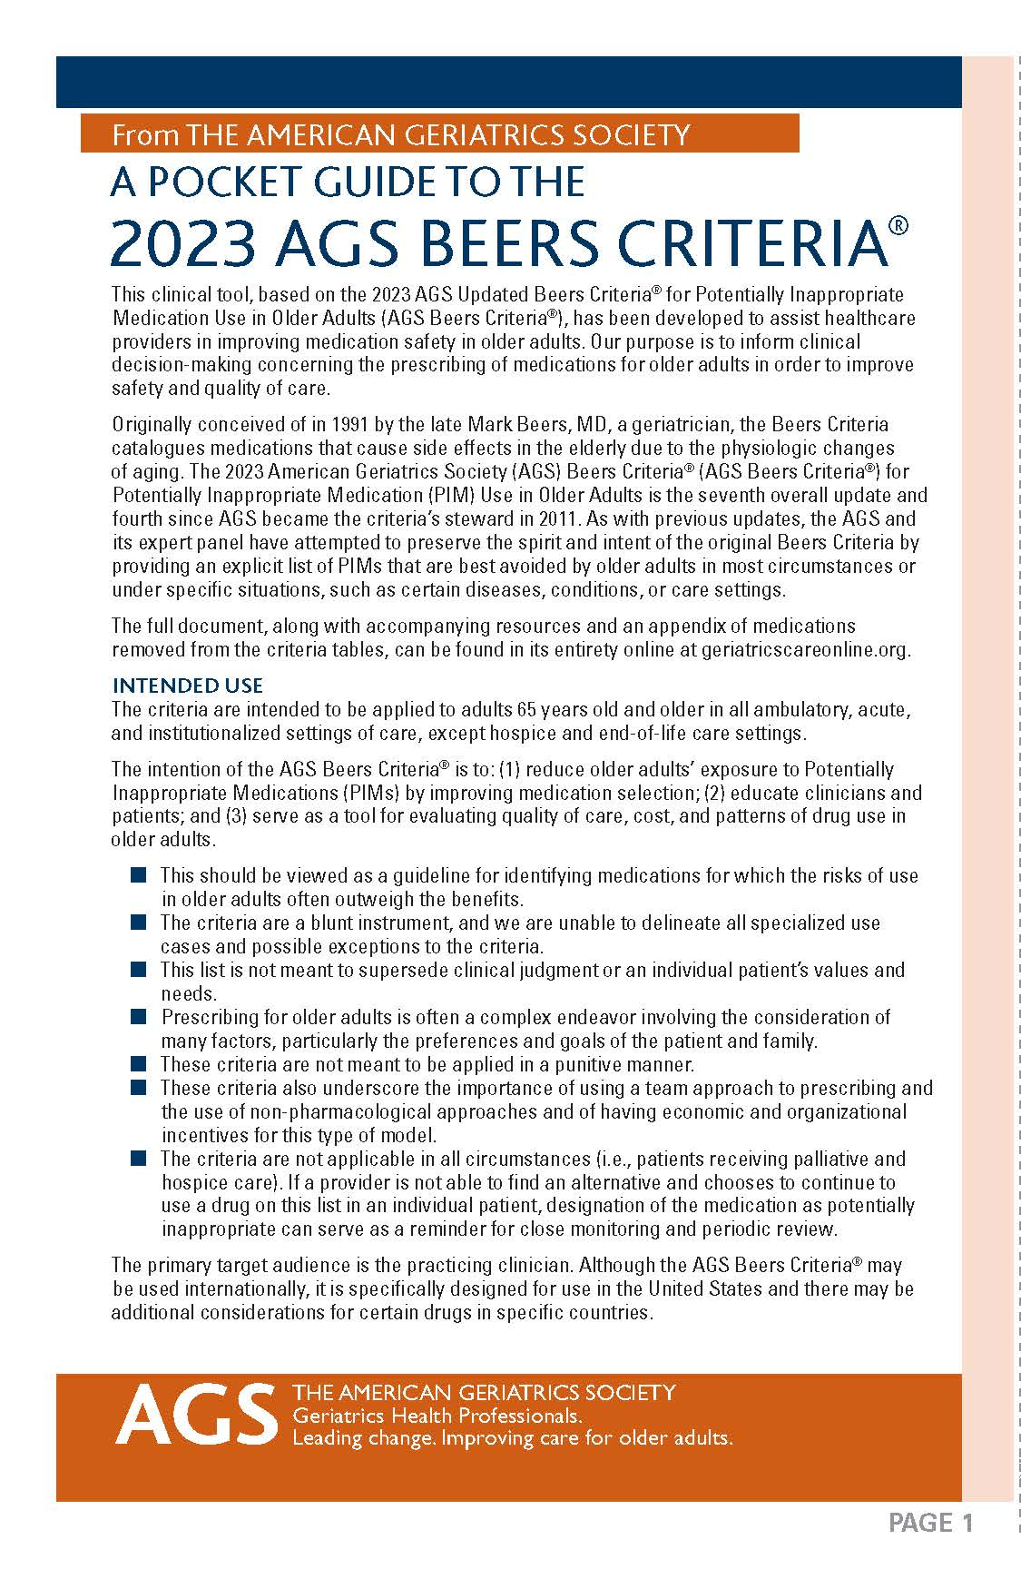
Medication
2023 Beers Criteria: reduce older adults' exposure to potentially inappropriate medications (PIMs) by improving medication selection
Table 1. Medications considered as potentially inappropriate
Table 2. Medications potentially inappropriate in patients with certain diseases or syndromes
Table 3. Medications to be used with caution
Table 4. Potentially inappropriate drug–drug interactions
Table 5. Medications whose dosages should be adjusted based on renal function
https://www.ihi.org/initiatives/age-friendly-health-systems
Notes:
(1) reduce older adults' exposure to potentially inappropriate medications (PIMs) by improving medication selection; (2) educate clinicians and patients; and (3) serve as a tool for evaluating the quality of care, cost, and patterns of drug use in older adults.
The Screening Tool of Older Person's Prescriptions (STOPP)/Screening Tool to Alert doctors to Right Treatment (START) criteria, is used in Europe to detect potentially inappropriate medications and treatment omissions

Slide 33
Medication (Continued)
The avoidance of high-risk medication and when medication is necessary, establishing a plan for it to be safely dose adjusted or deprescribed
When medication is necessary, the aim in any care setting is to ensure that what matters, mentation, and mobility are not negatively influenced by medication.
Screen for the 7 following drug categories:
Benzodiazepines
Opioids
Anticholinergic medications (e.g. oxybutynin or diphenhydramine) – tool : https://www.acbcalc.com/
All prescription and over-the-counter sedatives and sleep medications
Muscle relaxants
Tricyclic antidepressants
Antipsychotics

Slide 34
Medication- Polypharmacy
The condition of therapeutic duplication or medical inefficacy through the use of five or more drugs
shown in studies to be correlated with negative clinical outcomes
Increased risk of adverse drug events (ADEs), drug-drug interactions, medication nonadherence, reduced functional capacity, multiple geriatric syndromes, and higher costs
For example, studies showed an 88% increased risk of experiencing an ADE for outpatients taking five or more medications, compared to those who were taking fewer medications. For those taking between five and nine medications, the risk of a drug-drug interaction is 50%. If that number rises to more than 20 medications, the risk doubles to 100%

Slide 35
Deprescribing pathway
The process of tapering, withdrawing, discontinuing or stopping medicines to reduce potentially problematic polypharmacy, adverse drug effects and inappropriate or ineffective medicine use.
https://www.researchgate.net/figure/Deprescribing-Algorithm_fig5_297608391
Notes:
IF there is evidence base indication to use to medication with current dosing and frequency in this patient age group and disability level. And Benefit outweigh the adverse event

Slide 36
Apply the use of the 4Ms model to screen patients aging with HIV
Matters Most: Life context
Mentation: MoCA is widely used in detecting mild cognitive impairment, especially early HAND.
Mobility: Gait (TUG) and Function (ADL/iADL)
Medication: drug-drug interaction
University of Liverpool HIV Drug Interactions Checker
NYSDOH AI Resource: ART Drug-Drug Interactions.
Polypharmacy
https://www.ihi.org/initiatives/age-friendly-health-systems

Slide 37
Summary
Understand how 4Ms Framework create Age-Friendly Health Systems (AFHS): What Matters, Medication, Mentation, and Mobility.
Assess the patient aging with HIV: PWH have an increased risk of cardiovascular disease, diabetes, dementia, frailty, depression, osteoporosis
Apply the use of the 4Ms model to screen patients aging with HIV

Slide 38
References
Optimizing HIV Care for People Aging with HIV: Incorporating New Elements of Care. https://ryanwhite.hrsa.gov/sites/default/files/ryanwhite/grants/aging-guide-new-elements.pdf
Mate K, Fulmer T, Pelton L, Berman A, Bonner A, Huang W, Zhang J. Evidence for the 4Ms: Interactions and Outcomes across the Care Continuum. J Aging Health. 2021 Aug-Sep;33(7-8):469-481. doi: 10.1177/0898264321991658. Epub 2021 Feb 8. PMID: 33555233; PMCID: PMC8236661.
Kokorelias KM, Grosse A, Zhabokritsky A, Sirisegaram L. Understanding geriatric models of care for older adults living with HIV: a scoping review and qualitative analysis. BMC Geriatr. 2023 Jul 8;23(1):417. doi: 10.1186/s12877-023-04114-7. PMID: 37422631; PMCID: PMC10329351

Slide 39
Resources
Age-Friendly Health Systems Resources and News: https://www.ihi.org/initiatives/age-friendly-health-systems/resources-and-news
Guidance: Addressing the Needs of Older Patients in HIV Care https://www.hivguidelines.org/guideline/hiv-aging/
Notes:
You may also add your own organization-specific resource slide in addition to the SCAETC Resources slide.

Slide 40
Resources
National Clinician Consultation Center http://nccc.ucsf.edu/
HIV Management
Perinatal HIV
HIV PrEP
HIV PEP line
HCV Management
Substance Use Management
Present on ECHO
https://hsc.unm.edu/scaetc/programs-services/echo.html​
AETC National HIV Curriculum https://aidsetc.org/nhc
AETC National Coordinating Resource Center https://targethiv.org/library/aetc-national-coordinating-resource-center-0
HIVMA Resource Directory https://www.hivma.org/globalassets/ektron-import/hivma/hivma-resource-directory.pdf
Additional trainings scaetcecho@salud.unm.edu
www.scaetc.org
Notes:
IDEA Platform: Infectious Diseases Education & Assessment. https://idea.medicine.uw.edu/
AETC National HIV Curriculum: 6 core modules for self study; regularly updated; CME, CNE
Hepatitis C Online Curriculum: https://www.hepatitisc.uw.edu/
Hepatitis B Online Curriculum: https://www.hepatitisb.uw.edu/
National STD Curriculum: https://www.std.uw.edu/

