Slide 1
Understanding Health Disparities and Latines Trauma: What Can We Do
Image Reference: Metropolitan State University of Denver

Slide 2
Presenters
Gricel Arredondo, MA (she/her),
Vice President of Capacity Building
Miguel Chion MD, MPH
Vice President CAI West, NHCLC Program Director

Slide 3
Conflict of Interest Disclosure Statement
Speakers have nothing to disclose
This program is supported by the Health Resources and Services Administration (HRSA) of the U.S. Department of Health and Human Services (HHS) as part of an award totaling $4,205,743 with 0% financed with non-governmental sources. The contents are those of the author(s) and do not necessarily represent the official views of, nor does mention of trade names, commercial practices, or organizations imply an endorsement by HRSA, HHS, or the U.S. Government. For more information, please visit HRSA.gov. Any trade/brand names for products mentioned during this presentation are for training and identification purposes only.

Slide 4
Use of Trade/Brand Names
This program is supported by the Health Resources and Services Administration (HRSA) of the U.S. Department of Health and Human Services (HHS) as part of an award totaling $4,205,743, with 0% financed with non-governmental sources.
The views expressed do not necessarily reflect the official policies of the Department of Health and Human Services, nor does mention of trade names, commercial practices, or organizations imply endorsement by the U.S. Government. Any trade/brand names for products mentioned during this presentation are for training and identification purposes only.

Slide 5
Unconscious Bias Disclosure
SCAETC recognizes that language is constantly evolving, and while we make every effort to avoid bias and stigmatizing terms, we acknowledge that unintentional lapses may occur in our presentations.
We value your feedback and encourage you to share any concerns related to language, images, or concepts that may be offensive or stigmatizing.
Your input will help us refine and improve our presentations, ensuring they remain inclusive and respectful to participants.

Slide 6
Image Reference: Goodwin University. (n.d.). Criminal Justice
Image Reference: Orion Security. (n.d.).
Notes:
Picture of line of people and man in security guard outfit
I want you to imagine these are taken from the same place…what place is this? How many of you think this is a place you would want to go to or be at? How many of you guess this is a place you would NOT want to go to?
Lets keep this in mind as we look have our discussions today on...

Slide 7
Health Disparities…
18.9% of U.S. population are Latines, yet…
Latines accounted for ~30% of all HIV infection cases*.
Latine males 4x as likely to have HIV or AIDS as compared to white males.
Latine females 4x as likely to have AIDS* as compared to white females.
Latine men 2x as likely as white men to die of HIV infection.
Latine women 3x as likely as white women to die of HIV infection.
US Department of Health and Human Services. Office of Minority Health. (2021).; *2019

Slide 8
Other Examples
Suicide = 2nd leading cause of death for Latines, ages 15 to 34
In 2018, Latines were 50% less likely to have received mental health treatment as compared to whites.
Latine men and women ~2x to have, and die from, liver cancer than whites.
Latine mothers 80% as likely to receive late or no prenatal care as compared to white mothers.
Latine adults 70% more likely than white adults to be diagnosed with diabetes.
55% Latines were categorized as housing cost-burdened
US Department of Health and Human Services. Office of Minority Health (2021); UCLA Latino Policy and Politics Institute. Latino Data Hub. 2023.

Slide 9
What is the Response?
Food Bank
Transport Support
?
Social Service
Housing Service
Mental Health Service
HIV Prev. Service
Free Clinics
?
Notes:
Organizations around the country, like yours, have looked (or looking) for funding to put in place services that were “identify” as key in addressing some of these health disparities… but despite these services sometimes our communities do not come (or access), or do not follow the prescriptions, is there something that we are missing that our communities need, and may interact with other services?

Slide 10
How Common is Trauma?
Image Reference: Freepik.com
Notes:
how common is trauma?

Slide 11
Prevalence of Trauma
20%
38%
62%
80%
Traumatic Childhood Experiences of General Population
Traumatic Childhood Experience Among Latinx
Felitti, V., Anda, R., et.al., 1997.
Despres, 2017.
Notes:
What might attribute to this huge difference in experiences of trauma among
Brainstorm?
Let’s take a look at the prevalence of trauma within some identity groups of the people that we serve.
CLICK One study indicated that 81% of African Americans have a lifetime exposure to trauma. Additionally, estimates of hate crime victimization for African-Americans increased by 49% in 2020 compared to 2019.
CLICK Nearly 4/5 Latinx youth suffer at least one traumatic childhood experience.
In 2019, hate crimes against the Latinx population were at their highest level since 2010.

Slide 12
Higher Conditional Risks for Post Traumatic Stress Disorder (PTSD)
Image Reference: https://www.istockphoto.com/
Notes:
Latinos also have a higher conditional risks for ptsd…
You do not have to have PTSD to have long lasting trauma impact
Not everyone who has adverse/traumatic experiences develops PTSD
Conditional risk for Posttraumatic Stress Disorder (PTSD)—defined as the risk of developing a PTSD diagnosis or PTSD symptoms, of endorsing more severe PTSD symptoms, or of experiencing more persistent PTSD over time, once exposed to one or more traumatic event(s),
The prevalence, onset, persistence, or severity of PTSD after traumatic exposure
In 2012, a systematic review (28 journal articles) found Elevated rates of PTSD onset and severity among Latines vs non-Latines whites.

Slide 13
LATINES
Newly Arrived Immigrants
LGBTQIA+
Women
Other?
Notes:
And when we think of Latines, we have to remember that this is an umbrella term that includes a lot of people who traditionally have high prevalence of trauma…
Give examples of this and then ask them to think of what other folks ….
(gang members, indigenous folks,

Slide 14
How Might Trauma Impact an Individual?
Image Reference: IStock
Notes:
Lets think about the individuals you are serving or you want to serve….what are your goals, what do you want clients or patients to do?
We want them to adhere medication, come in for treatment and appt, we want them to be honest with us….

Slide 15
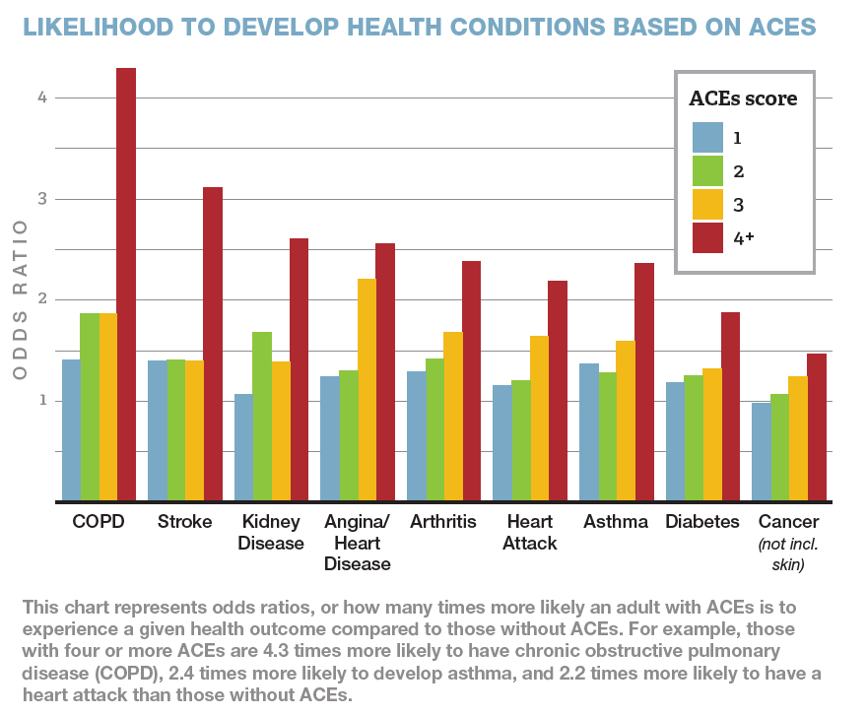
Trauma Increases Likelihood of Developing Health Conditions
Notes:
One of the things that the ACE study and other studies since have shown is that the greater number of trauma exposures, particularly during the sensitive childhood years, the greater the likelihood of developing a serious health condition….. (talk about the graph- point out the shark difference for folks who have had 4 or more ACEs)

Slide 16
High
Sensitivity
to Stress and Potential Threat
Image Reference: Getty Images/iStockphoto
Notes:
it means that your brain is extremely sensitive to stress and threat (which makes sense. Its your brains attempt to protect you).

Slide 17
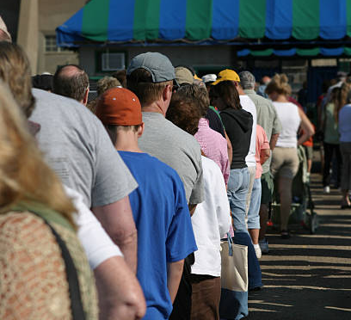
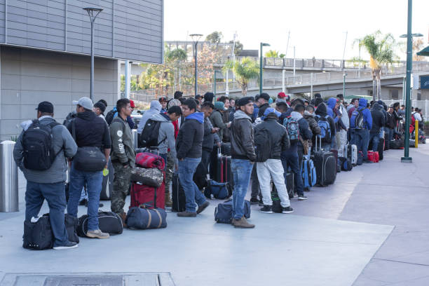
Trauma Reminder
Image Reference: Shore News Network. (2024, March 5)
Image Reference: Business 2 Community
Notes:
For example, a long line at

Slide 18
Trauma Impacts….How You Experience…
The World
Others
Yourself

Slide 19
How might this show up at your work?
Image Reference: OptimumAds
Notes:
So, how do you think this might be related to the health disparities we see?
looking at these facts, you can see how this can play a role in the health disparities we are seeing…

Slide 20
the risks of physical and mental ailments
the likelihood of utilizing healthcare services
Image Reference: OptimumAds
Notes:
In your clinic what are some of the behaviors you are seeing?
How does it look – lack of trust., etc....
Lack of sense of stability.

Slide 21
So, we can just refer them to mental health services, right?
Notes:
Traditionally, people have always thought that the answer is just to refer everyone who has unaddressed trauma to mental health services.

Slide 22
Mental Health Services and Latines
McGuire TG, Miranda J. New evidence regarding racial and ethnic disparities in mental health: policy implications. Health Aff (Millwood). 2008 Mar-Apr;27(2):393-403.
Notes:
https://www.ncbi.nlm.nih.gov/pmc/articles/PMC3928067/#:~:text=Among%20adults%20with%20diagnosis%2Dbased,of%20African%20Americans%2C%20receive%20treatment.
Among people who have been diagnosed with needing mental health services-
37.6 of whites receive services
25.% of African americans receive services
22.5% of Latinos receive services
https://namica.org/mental-health-challenges-in-latino-communities/
An estimated 33% of Latinx adults with mental illness receive treatment each year compared to the U.S. average of 43%.
Barriers To Mental Health Care
Hispanic/Latinx communities show similar vulnerability to mental illness as the general population, but they face disparities in both access to and quality of treatment. More than half of Hispanic young adults ages 18-25 with serious mental illness may not receive treatment. This inequality puts these communities at a higher risk for more severe and persistent forms of mental health conditions, because without treatment, mental health conditions often worsen.
35.1% of Hispanic/Latinx adults with mental illness receive treatment each year compared to the U.S. average of 46.2%. This is due to many unique barriers to care.
Source: National Alliance on Mental Illness
https://www.nami.org/Your-Journey/Identity-and-Cultural-Dimensions/Hispanic-Latinx#:~:text=This%20inequality%20puts%20these%20communities,the%20U.S.%20average%20of%2046.2%25.

Slide 23
Terapia?!!! Mijo, eso solo pa’ locos!!
Image Reference: iStock
Notes:
But we know there is a lot of stigma around using mental health services in general

Slide 24
“La ropa sucia se lava en la casa.”
Image Reference: iStock
Notes:
There is also the cultural norm of don’t air your dirty laundry…

Slide 25
“Ella sufre de los nervios.”
Image Reference: Getty Images/iStockphoto
Notes:
https://namica.org/mental-health-challenges-in-latino-communities/
Cultural differences may lead to a misunderstanding of what might be happening.
doctors to misdiagnose Latinos. For instance, Latinos may describe the symptoms of depression as “nervios” (nervousness), tiredness or a physical ailment. These symptoms are consistent with depression, but doctors who are not aware of how culture influences mental health may not recognize that these could be signs of depression
In addition, latines may not recognize that the symptoms they are experiencing are related to trauma and that mental health services might help. And may see the solution to be solely home remedies based on herbal or plant based options and/or spiritual practices

Slide 26
But What Can We Do?
“We are not mental health providers. What can we do?”
Image Reference: Getty Images
Notes:
This can leave us feeling helpless…afterall if you are not a mental health provider, it may feel like there is nothing you can do.

Slide 27
The 3 Phases of Trauma Intervention
Safety and Stabilization
Remembrance and Mourning
Reconnection
ISTSS, 2012; Herman, J., 1992; Ford, J., Courtois, C, et al, 2005, Saxe, G., Ellis, B.H., 2006, 2017
Notes:
The truth is, there are ways that everyone at the agency can support clients who have experienced trauma.
One way to understand how is by talking about the three phases of trauma intervention
​
CLICK First is Safety and stabilization, where the effort of the everyone on team is needed most. Then comes
CLICK Second is Remembrance, which is what we typically think of when we think of therapy (where you process past events) and finally,
[CLICK] Third is reconnection: the individual develops a renewed sense of self, with recognition of their growth. They can connect to meaningful people and future hopes. Trauma is still a part of their story but no longer the only story that defines them.​​
27

Slide 28
Image Reference: Goodwin University. (n.d.). Criminal Justice
Image Reference: iStockphoto
Notes:
What would happen if you were to change this image with this image…
This is an example of a trauma informed care approach and something several of the agencies we have worked with have made.

Slide 29
Trauma Informed Care (TIC)
A strengths-based organizational structure and intervention framework that:
Recognizes the prevalence and impact of trauma
Supports the creation of a healing environment that supports safety and stabilization for both consumers and staff
Image Reference: ALPublicHealth
Notes:
Trauma informed care is a strengths-based organizational structure and intervention framework that [CLICK] recognizes the prevalence of trauma and [CLICK] supports the creation of a healing environment for both consumers and staff.
29

Slide 30
Trauma Informed Care
Choice and
empowerment
Collaboration and
mutuality
Safety
Recognizing and responding to trauma
Recognizing cultural and historical context
Hopper, Bassuk, & Olivet, 2010.
Notes:
For example…where do you want to sit?
When you think of safety and stabilization, you can see how this already comes to life in the work you do. Let's see how TIC can help strengthen the supports for safety and stabilization.
TIC is a strengths-based organizational structure and intervention framework that is designed to help those impacted by trauma without asking them to share or tell their trauma story
It involves:
Empowering clients by providing choices
working collaboratively with clients, partnering with them
Ensuring all levels of safety for all
Recognizing traumas effects with skillful responses
Recognizing and building on the strengths inherent in people’s culture and histories, while also acknowledging the historic and systemic oppression that has shaped social biases against many groups of people

Slide 31
Okay…
How do you actually do that?
Image Reference: Getty Images
Notes:
Think of practical ways that an organization and staff can help support safety and stabilization in your work….

Slide 32
Choice and
Empowerment
Image References: Hollingsworth & Zivitz, P.C
Notes:
For example…Giivng a client options about where they want to sit
Empowering clients by providing choices For example- giving a client options about where they want to sit.

Slide 33
Collaboration and Mutuality
Image References: Hollingsworth & Zivitz, P.C
Notes:
working collaboratively with clients, partnering with them- so that might be emphasizing how you are working in partnership with them. so for example, I might sy, I want to provide you with some information and then uyou decide what workds for you.

Slide 34
Safety
Image References: Hollingsworth & Zivitz, P.C
Notes:
Ensuring all levels of safety for all- (this includes physical and emotional safety- for example, one agency did an assessment of their organization and nt0iced that they had staircases around the parking lot that was darkly lit. so they invested in getting new lightbulbs.

Slide 35
Recognizing and Responding to Trauma
Image References: Hollingsworth & Zivitz, P.C
Notes:
Recognizing traumas effects with skillful responses-being able to use a trauma informed lens…

Slide 36
Recognizing Cultural and Historical Context
Image References: Hollingsworth & Zivitz, P.C
Notes:
Recognizing and building on the strengths inherent in people’s culture and histories, while also acknowledging the historic and systemic oppression that has shaped social biases against many groups of people

Slide 37
Trauma Informed Care Helps the Helper!
Image References: Hollingsworth & Zivitz, P.C
Notes:
TIC IS NOT just about the clients. A huge part of TIC is the recognition that staff are human beings who may have experiences of their own past or current trauma, that this work is challenging and that it has an impact on those who work in human services.
Compassion fatigue is common. Up to 80% of helping professionals experience high rates of secondary trauma.
Healthcare Workers: Up to 85% report Compassion Fatigue & Vicarious Trauma

Slide 38
Benefits of Helping the Helper
Increased levels of competence
Decrease in burnout and vicarious trauma
Less staff turnover
Notes:
So what are the benefits of TIC?
We know TIC is designed to strengthen organizational support of staff's health and wellness proven to:
[CLICK] Increase levels of competence,
[CLICK] decrease burnout and vicarious trauma
[CLICK] And because staff who feel more effective and more incline to stay, resulting in less turnover

Slide 39
Measurable Benefits of TIC
Reduction in disparities
Reduction in alcohol and drug use
Decreased risk of hospitalization
Reduction in costs
Increased consumer engagement
Improved workforce participation
NASMHPD Quantitative Benefits of Trauma-Informed Care. (2017).
Notes:
It is such an important time to integrate TIC in to your agencies considering the health disparities clients face and the challenges the workforce is experiencing.
There have been proven benefits of reducing vulnerabilities and boosting resilience by:
Proven Reduction in disparities for people who are younger, homeless and had less formal education
Reduced alcohol and drug use, often associated with increased risk of hospitalization
- As well as increased consumer engagement also decreasing the demand for hospitalization
Agencies also saw benefits
Improved workforce participation, that includes increasing compassion in providers and addressing burnout and vicarious trauma
- lastly reduction of cost considering less client missed appointments and retention in staff

Slide 40
References
US Department of Health and Human Services. Office of Minority Health. (2021)
UCLA Latino Policy and Politics Institute. Latino Data Hub. 2023
McGuire TG, Miranda J. New evidence regarding racial and ethnic disparities in mental health: policy implications. Health Aff (Millwood). 2008 Mar-Apr;27(2):393-403.
Latinx/Hispanic Communities and Mental Health. Mental Health America: https://mhanational.org
Mental Health Challenges and Support: Latinx Communities: https://namica.org/mental-health-challenges-in-latino-communities/
Lehman, Mary, et al. “Politics, Pandemics, and Trauma: Understanding and Addressing Latino Health Needs Through a Culturally-Informed Lens.” Front. Public Health, 15 July 2022. Sec. Public Menal Health. Volume 10-2022.
Bucay-Harari, Linda. “Mental Health Needs of an Emerging Latino Community.” The Journal of Behavioral Health Services & Research. 47:3 July 2020.
NASMHPD Quantitative Benefits of Trauma-Informed Care. (2017).
Note: other references upon request

Slide 41
Resources
CAI: www.caiglobal.org/contact-us/
National HIV Classroom Learning Center: https://caiglobal.org/projects/national-hiv-classroom-learning-center-nhclc/
New York Trauma-Informed Care Initiative: https://caiglobal.org/projects/new-york-trauma-informed-care-initiative/

Slide 42
Resources
National Clinician Consultation Center http://nccc.ucsf.edu/
HIV Management
Perinatal HIV
HIV PrEP
HIV PEP line
HCV Management
Substance Use Management
Present on ECHO
https://hsc.unm.edu/scaetc/programs-services/echo.html​
AETC National HIV Curriculum https://aidsetc.org/nhc
AETC National Coordinating Resource Center https://targethiv.org/library/aetc-national-coordinating-resource-center-0
HIVMA Resource Directory https://www.hivma.org/globalassets/ektron-import/hivma/hivma-resource-directory.pdf
Additional trainings scaetcecho@salud.unm.edu
www.scaetc.org

Slide 43
SCAETC Social Media

Slide 44
THANK
YOU!
Gricel Arredondo
Garredondo@caiglobal.org
Miguel Chion
Mchion@caiglobal.org

