Slide 1

HIV & Bipolar Disorder
HIV ECHO Clinic
Gabrielle R. Marzani, MD, MBA
Professor of Psychiatry | University of Virginia
May 21, 2024
Notes:
Version_ 05/2024
UNMRP clinical director reviewed 05/21/2024

Slide 2
Conflict of Interest Disclosure Statement
Dr. Marzani has nothing to disclose.
This presentation was reviewed by UNMHSC and SCAETC faculty to ensure it meets Continuing Education guidelines.
This program is supported by the Health Resources and Services Administration (HRSA) of the U.S. Department of Health and Human Services (HHS) as part of an award totaling $4,205,743 with 0% financed with non-governmental sources. The contents are those of the author(s) and do not necessarily represent the official views of, nor does mention of trade names, commercial practices, or organizations imply an endorsement by HRSA, HHS, or the U.S. Government. For more information, please visit HRSA.gov. Any trade/brand names for products mentioned during this presentation are for training and identification purposes only.

Slide 3
Unconscious Bias Disclosure
SCAETC recognizes that language is constantly evolving, and while we make every effort to avoid bias and stigmatizing terms, we acknowledge that unintentional lapses may occur in our presentations.
We value your feedback and encourage you to share any concerns related to language, images, or concepts that may be offensive or stigmatizing.
Your input will help us refine and improve our presentations, ensuring they remain inclusive and respectful to participants.

Slide 4
Learning Objectives
Recognize differences between Bipolar Affective Disorder (BPAD) in people with HIV (PWH) compared to other populations
Identify distinction between BPAD I and II
For individuals with BPAD with a seasonal depression, recognize light intensity and recommendations on time of day for light therapy

Slide 5
BPAD and PWH vs. General Population
Overall prevalence 1.1-10.8% (rates vary in the literature)
Men are overrepresented (6-fold v. general population)
  Women appear to have same rate as those in general population
Individuals display poorer performance on neuropsychological tests of sustained attention and decreased global functioning than PWH without BPAD
BPAD also appears to impact adherence to medication
Douaihy et al., 2022, Lopes et al., 2012, Posada et al., 2012

Slide 6
Bipolar Affective Disorder (BPAD)
  Type I (mania +/- depression)
  Type II (hypomania/depression)
    highly prevalent in PWH
    often missed as people present depressed
  Some pearls:
    Depression is often atypical/seasonal/less responsive to antidepressants/impacted by changes in light
    Panic attacks can occur (alone or on antidepressants)

Slide 7
Baseline and Monitoring Screening Tests – PCP Can Assist
  Complete physical exam, including neurological– can rule out systemic illness
    get baseline BMI, BP, & waist circumference and monitor – also checks for extrapyramidal signs
    PWH tend towards weight gain just like rest of population, with meds often adding central weight
  Basic metabolic panel – baseline sodium + renal function
  Complete Blood Count (CBC) – baseline (anticonvulsants), rule out anemias
  Liver function – baseline (anticonvulsants, antipsychotics)
  Lipid panel – baseline (anticonvulsants, antipsychotics, lithium)
BMI = body mass index, BP = blood pressure. Marzani G, Price Neff A. Bipolar Disorders: Evaluation and Treatment. Am Fam Physician. 2021 Feb 15;103(4):227-239. PMID: 33587568
Notes:
“ Fasting glucose level/lipids. Rules out diabetes mellitus, hyperlipidemia, and Cushing disease and establishes baseline measurements in patients taking any medication that can cause weight gain or hyperglycemia” Marzani G, Price Neff A. Bipolar Disorders: Evaluation and Treatment. Am Fam Physician. 2021 Feb 15;103(4):227-239. PMID: 33587568.

Slide 8
Baseline and Monitoring Screening Tests – PCP Can Assist (cont’d)
  Fasting glucose - baseline (anticonvulsants, antipsychotics, lithium)
  Drugs of abuse – rule out substance-induced psychosis, check for co-morbid issues
  Pregnancy – if childbearing potential to avoid teratogenic medications
  TSH – rule out thyroid issues, also if lithium planned
  EKG (>40 years, in others if indicated) – meds can prolong QTc interval (can compound if other meds present
      Cardiovascular disease is double in individuals with BPAD; even higher in PWH
TSH = Thyroid Stimulating Syndrome, EKG = Electrocardiogram

Slide 9
Screening for PWH and BPAD
In additional to usual screening in general population, check
    TSH
    Vit D (deficiency)
    Testosterone deficiency – bioavailable testosterone not impacted by time of day tested – others can be
  Increased risk of renal and hepatic issues (HIV and other meds) – also check CBC and other chemistries.

Slide 10
New Onset Psychosis
Hospitalization is best
Always warrants a rule out of organic causes
Always check an EEG, MRI if possible or CT at least
    This rules out seizures, intracranial mass, autoimmune and infectious etiologies
Do the screening tests on the previous slide
If indicated, look for heavy metals, urine porphyrins, hepatitis C, and syphilis
EEG = electroencephalogram, MRI = magnetic resonance imaging, CT = computed tomography. Marzani G, Price Neff A. Bipolar Disorders: Evaluation and Treatment. Am Fam Physician. 2021 Feb 15;103(4):227-239. PMID: 33587568

Slide 11
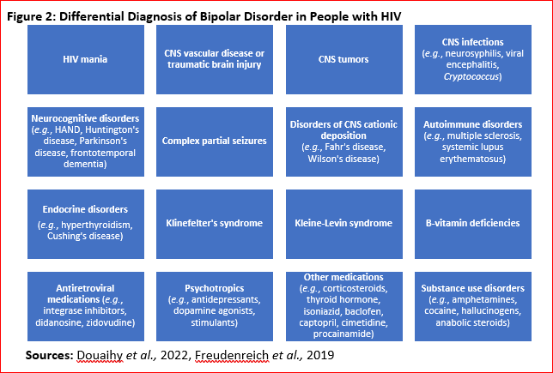
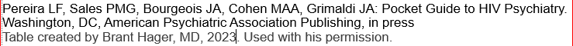

Slide 12
Co-morbidities for PWH
BPAD, in general:
¾ have history of 3 additional disorders including anxiety disorders, impulse control and attention deficit disorders, and substance use disorders.
higher rates of suicide attempts and completed suicide
Substance use disorders (SUD) – sometimes self-medicating
  With BPAD, PWH demonstrate ↑ risk of comorbid substance use and SUDs with stimulants, gamma-hydroxybutyric acid (GHB), & psychedelics possibly overrepresented
Attention Deficit Disorder (both hyperactive and inattentive types)
  Cognitive disorders – HIV-Associated Neurocognitive Disorder (HAND)
  Different stages, can be connected to CD4 count/viral load, but can also occur in individuals who are medically stable
Anxiety disorders – anxious features have ↑ risk of suicide, longer duration, and poorer med response
Marzani & Price, 2021. Douaihy et al., 2022. Yalin et al., 2021
Notes:
“People living HIV may develop a spectrum of cognitive, motor, and/or mood problems collectively known as HIV-Associated Neurocognitive Disorder (HAND). Typical symptoms include difficulties with attention, concentration, and memory; loss of motivation; irritability; depression; and slowed movements”. (From a Healthcare Provider’s Guide to HIV-Associated Disorder (HAND). Resource: https://memory.ucsf.edu/sites/memory.ucsf.edu/files/wysiwyg/UCSF_HIV%20Dementia_Providers_11-6-17.pdf

Slide 13

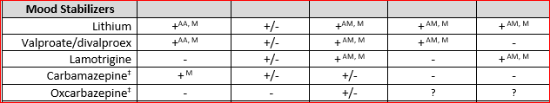
Notes: AA adjunct to antipsychotic, AM adjunct to mood stabilizer, LAI long-acting injectable, M monotherapy, OFC olanzapine fluoxetine combination
*first line maintenance: continuation of medication(s) successful in addressing the acute mood episode
†Combination antipsychotic + mood stabilizer generally first line for severe mania/mixed episode
‡Avoid use in PWH due to decreased antiretroviral therapy (ART) effectiveness from metabolic induction
§Caution use in PWH due to increase risk of extrapyramidal symptoms
Sources: Keck et al., 2017. Post 2023. Shelton et al., 2022. Stovall 2022.
Pereira LF, Sales PMG, Bourgeois JA, Cohen MAA, Grimaldi JA. Pocket Guide to HIV Psychiatry. Washington, DC, American Psychiatric Association Publishing, in press. Tablet created by Brand Hager, MD, 2023. Used with his permission.
Notes:
Notes: AA adjunct to antipsychotic, AM adjunct to mood stabilizer, LAI long-acting injectable, M monotherapy, OFC olanzapine fluoxetine combination
*first line maintenance: continuation of medication(s) successful in addressing the acute mood episode
†Combination antipsychotic + mood stabilizer generally first line for severe mania/mixed episode
‡Avoid use in PWH due to decreased antiretroviral therapy (ART) effectiveness from metabolic induction
§Caution use in PWH due to increase risk of extrapyramidal symptoms
Sources: Keck et al., 2017. Post 2023. Shelton et al., 2022. Stovall 2022.

Slide 14

Notes: AA adjunct to antipsychotic, AM adjunct to mood stabilizer, LAI long-acting injectable, M monotherapy, OFC olanzapine fluoxetine combination
*first line maintenance: continuation of medication(s) successful in addressing the acute mood episode
†Combination antipsychotic + mood stabilizer generally first line for severe mania/mixed episode
‡Avoid use in PWH due to decreased ART effectiveness from metabolic induction
§Caution use in PWH due to increase risk of extrapyramidal symptoms
Sources: Keck et al., 2017. Post 2023. Shelton et al., 2022. Stovall 2022.
Pereira LF, Sales PMG, Bourgeois JA, Cohen MAA, Grimaldi JA. Pocket Guide to HIV Psychiatry. Washington, DC, American Psychiatric Association Publishing, in press. Tablet created by Brand Hager, MD, 2023. Used with his permission.

Slide 15
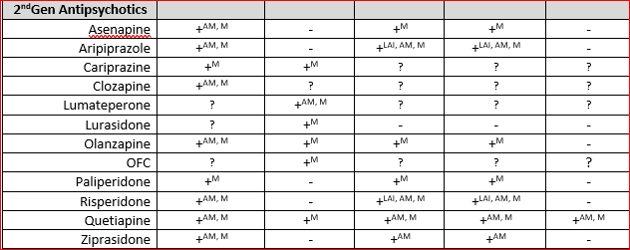
Pereira LF, Sales PMG, Bourgeois JA, Cohen MAA, Grimaldi JA. Pocket Guide to HIV Psychiatry. Washington, DC, American Psychiatric Association Publishing, in press. Tablet created by Brand Hager, MD, 2023. Used with his permission.
Notes:
Notes: AA adjunct to antipsychotic, AM adjunct to mood stabilizer, LAI long-acting injectable, M monotherapy, OFC olanzapine fluoxetine combination
*first line maintenance: continuation of medication(s) successful in addressing the acute mood episode
†Combination antipsychotic + mood stabilizer generally first line for severe mania/mixed episode
‡Avoid use in PWH due to decreased antiretroviral therapy (ART) effectiveness from metabolic induction
§Caution use in PWH due to increase risk of extrapyramidal symptoms
Sources: Keck et al., 2017. Post 2023. Shelton et al., 2022. Stovall 2022.

Slide 16
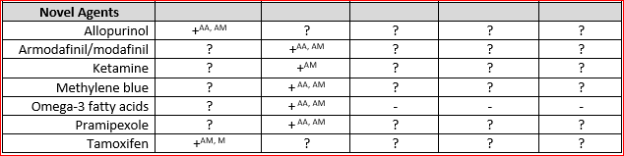
Notes: AA adjunct to antipsychotic, AM adjunct to mood stabilizer, LAI long-acting injectable, M monotherapy, OFC olanzapine fluoxetine combination
*first line maintenance: continuation of medication(s) successful in addressing the acute mood episode
†Combination antipsychotic + mood stabilizer generally first line for severe mania/mixed episode
‡Avoid use in PWH due to decreased ART effectiveness from metabolic induction
§Caution use in PWH due to increase risk of extrapyramidal symptoms
Sources: Keck et al., 2017. Post 2023. Shelton et al., 2022. Stovall 2022.
Pereira LF, Sales PMG, Bourgeois JA, Cohen MAA, Grimaldi JA. Pocket Guide to HIV Psychiatry. Washington, DC, American Psychiatric Association Publishing, in press. Tablet created by Brand Hager, MD, 2023. Used with his permission.

Slide 17
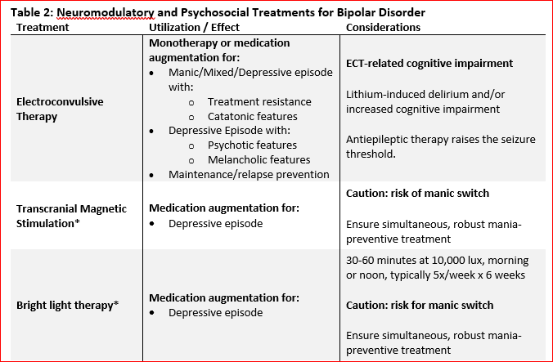
Pereira LF, Sales PMG, Bourgeois JA, Cohen MAA, Grimaldi JA. Pocket Guide to HIV Psychiatry. Washington, DC, American Psychiatric Association Publishing, in press. Tablet created by Brand Hager, MD, 2023. Used with his permission.

Slide 18
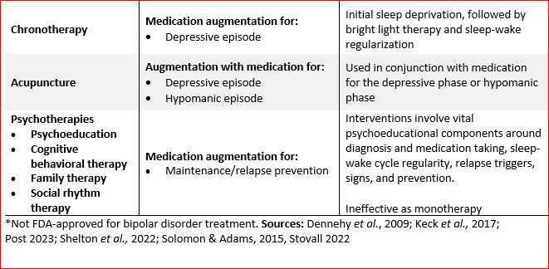
Pereira LF, Sales PMG, Bourgeois JA, Cohen MAA, Grimaldi JA. Pocket Guide to HIV Psychiatry. Washington, DC, American Psychiatric Association Publishing, in press. Tablet created by Brand Hager, MD, 2023. Used with his permission.

Slide 19
Use of Light for Seasonal Depression
Recommendations
Literature suggests it is helpful
But! at 7,000 LUX (10,000 LUX recommended for Seasonal Affective Disorder – not Bipolar).
And, midday (instead of early morning of SAD)
Risk greatest for switch if history of mania/mixed states or heading into mania
SAD = Seasonal Affect Disorder, LUX = Luminous Flux per Unit Area, Sit et al., 2018

Slide 20
Overall Pearls
Antipsychotics have a higher rate of extrapyramidal symptoms (EPS) in PWH
There are more side effects possible, including bone marrow suppression, liver/renal pancreatic, low sodium, other endocrine issues (prolactin, thyroid, lipids)
More potential QTC issues
The newest ones are more notable (e.g., aripiprazole)
Quetiapine seems to have a higher risk of cramps/restless legs, even at small doses – but is a “go to” option for many providers

Slide 21
Overall Pearls
Weight gain is a big concern in general – weight neutral options are ideal
Bupropion has been touted for less switch to mania – research is based on open label study with 11 individuals – so caution if not reading the original research! Also associated with panic attacks and irritability, although may be a helpful option for some.
Benzodiazepines are avoided, although sometimes can be necessary.
Integrase inhibitors have been associated with increased panic, depression, and should be considered as a cause if patient develops worsening symptoms within a year of switch. Can be very delayed and missed in retrospect.

Slide 22
Lamotrigine for BPAD II
Lamotrigine is preferred over lithium/valproic acid
This is weight neutral – biggest risk is rash – must follow guidelines exactly – rash is related to rate of increase>dose
If off for more than 3 days, have to start from scratch
PWH tend to have issues with weight gain, not weight loss - avoid meds which cause weight gain.=
No blood levels needed, but CBC should be checked periodically

Slide 23
Special Thanks To
Brant Hager, MD
Associate Professor
Psychiatry and Behavioral Sciences
Program Director
UNM/VANMHS Consultation-Liaison Fellowship
University of New Mexico
A total Rock Star and 1st author for a chapter we have written together on HIV and Bipolar Affective Disorder - in press!

Slide 24
References Used
Benedetti F, Avery DH, Bauer M, et al. Evidence for the Efficacy of Bright Light Therapy for Bipolar Depression. Am J Psychiatry. 2018;175(9):905-906. doi:10.1176/appi.ajp.2018.18020231
Dennehy EB, Schnyer R, Bernstein IH, et al.,. (2009). The safety, acceptability, and effectiveness of acupuncture as an adjunctive treatment for acute symptoms in bipolar disorder. J Clin Psychiatry. 70:897-905. doi 10.4088/JCP.08m04208.
Douaihy, A., Kang, G., Zhang, T. (2022). Bipolar Disorders. In: Bourgeois, J.A., Cohen, M.A.A., Makurumidze, G. (eds) HIV Psychiatry. Springer, Cham. https://doi.org/10.1007/978-3-030-80665-1_8
Keck, P.E., McElroy, S.L. (2017). Treatment of bipolar disorder. In Schatzberg, A.F., Nemeroff, C.B. (eds) The American Psychiatric Association Publishing Textbook of Psychopharmacology, 5th Ed. American Psychiatric Association Publishing. https://doi-org.libproxy.unm.edu/10.1176/appi.books.9781615371624.as47
Pereira LF, Sales PMG, Bourgeois JA, Cohen MAA, Grimaldi JA: Pocket Guide to HIV Psychiatry. Washington, DC, American Psychiatric Association Publishing, in press
Table created by Brant Hager, MD, 2023. Used with his permission.

Slide 25
References Used
Posada, C., Moore, D. J., Deutsch, R., Rooney, A., Gouaux, B., Letendre, S., Grant, I., Atkinson, J. H., & HIV Neurobehavioral Research Program Hnrp Group (2012). Sustained attention deficits among HIV-positive individuals with comorbid bipolar disorder. The Journal of Neuropsychiatry and Clinical Neurosciences, 24(1), 61–70. https://doi.org/10.1176/appi.neuropsych.11010028
Post, R.M. (2023). Bipolar disorder in adults: Choosing maintenance treatment. In Keck P., Solomon D. (eds) Up to Date. Retrieved August 21, 2023, from: https://www.uptodate.com/contents/bipolar-disorder-in-adults-choosing-maintenance-treatment
Shelton R.C., Bobo W.V. (2022). Bipolar major depression in adults: Choosing treatment. In Keck P., Solomon D. (eds) Up to Date. Retrieved August 21, 2023, from: https://www.uptodate.com/contents/bipolar-major-depression-in-adults-choosing-treatment
Sit DK, McGowan J, Wiltrout C, et al. Adjunctive Bright Light Therapy for Bipolar Depression: A Randomized Double-Blind Placebo-Controlled Trial. Am J Psychiatry. 2018;175(2):131-139. doi:10.1176/appi.ajp.2017.16101200
Solomon D., Adams J. (2015). The use of complementary and alternative medicine in adults with depressive disorders. A critical integrative review. J Affective Disord. 179:101-113. doi: 10.1016/j.jad.2015.03.031.

Slide 26
Resources
National Clinician Consultation Center http://nccc.ucsf.edu/
  HIV Management
  Perinatal HIV
  HIV PrEP
  HIV PEP line
  HCV Management
  Substance Use Management
Present your case on ECHO
http://echo.unm.edu hivecho@salud.unm.edu
AETC National HIV Curriculum https://aidsetc.org/nhc
AETC National Coordinating Resource Center https://targethiv.org/library/aetc-national-coordinating-resource-center-0
HIVMA Resource Directory https://www.hivma.org/globalassets/ektron-import/hivma/hivma-resource-directory.pdf
Additional trainings scaetcecho@salud.unm.edu
www.scaetc.org
Notes:
Find additional ECHO sessions in your area: https://echo.unm.edu/locations-2/echo-hubs-superhubs-united-states/
https://hsc.unm.edu/echo/get-involved/join-an-echo/
IDEA Platform: Infectious Diseases Education & Assessment. https://idea.medicine.uw.edu/
AETC National HIV Curriculum: 6 core modules for self study; regularly updated; CME, CNE
Hepatitis C Online Curriculum: https://www.hepatitisc.uw.edu/
Hepatitis B Online Curriculum: https://www.hepatitisb.uw.edu/
National STD Curriculum: https://www.std.uw.edu/

Slide 27
