Slide 1

Basics of Hepatitis B (HBV) Treatment
HIV ECHO Clinic
Karla Thornton, MD, MPH
Professor, Division of Infectious Diseases | UNM Health Science Center
Senior Associate Director | Project ECHO
Albuquerque, NM
14 May 2024
Notes:
Version_ 04/2024
UNMRP clinical director reviewed 5/13/2024

Slide 2
Conflict of Interest Disclosure Statement
Speaker has nothing to disclose.
This presentation was reviewed by UNMHSC and SCAETC faculty to ensure it meets Continuing Education guidelines.
This program is supported by the Health Resources and Services Administration (HRSA) of the U.S. Department of Health and Human Services (HHS) as part of an award totaling $4,205,743 with 0% financed with non-governmental sources. The contents are those of the author(s) and do not necessarily represent the official views of, nor does mention of trade names, commercial practices, or organizations imply an endorsement by HRSA, HHS, or the U.S. Government. For more information, please visit HRSA.gov. Any trade/brand names for products mentioned during this presentation are for training and identification purposes only.

Slide 3
Use of Trade/Brand Names
This program is supported by the Health Resources and Services Administration (HRSA) of the U.S. Department of Health and Human Services (HHS) as part of an award totaling $4,205,743, with 0% financed with non-governmental sources.
The views expressed do not necessarily reflect the official policies of the Department of Health and Human Services, nor does mention of trade names, commercial practices, or organizations imply endorsement by the U.S. Government. Any trade/brand names for products mentioned during this presentation are for training and identification purposes only.
Notes:
Note: this slide must be included if trade and/or brand names for medications are used in the presentation.
It may be deleted if there is no reference to trade names, including presentations in which only generic medication names are mentioned.
Trade names must be put in parentheses after the generic name the first time it is mentioned - e.g., fluoxetine (Prozac). Trade names should only be mentioned for the initial reference and the generic name only should be used after that. This applies equally to all medications or products mentioned in this presentation.

Slide 4
Unconscious Bias Disclosure
SCAETC recognizes that language is constantly evolving, and while we make every effort to avoid bias and stigmatizing terms, we acknowledge that unintentional lapses may occur in our presentations.
We value your feedback and encourage you to share any concerns related to language, images, or concepts that may be offensive or stigmatizing.
Your input will help us refine and improve our presentations, ensuring they remain inclusive and respectful to participants.

Slide 5
Learning Objectives
Identify appropriate baseline serologies for hepatitis B (HBV)
Identify who should be offered treatment for HBV
Recognize the current recommended medications for HBV treatment

Slide 6
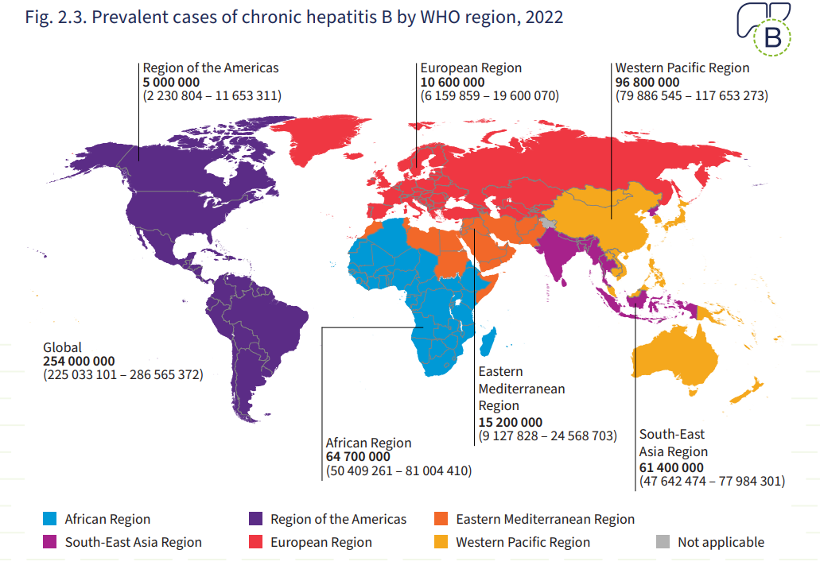
Hepatitis B: Global Burden
Global hepatitis report 2024: action for access in low- and middle-income countries. Geneva:World Health Organization; 2024. Licence: CC BY-NC-SA 3.0 IGO.
Notes:
Globally, an estimated 257 million people, or 3.5% of the world’s population, are living with chronic HBV infection. Of these 257 million, an estimated 68% are in the WHO-defined Africa and Western Pacific regions.
Globally, perinatal transmission remains the predominant mode of HBV transmission.
In 2017, there were an estimated 2.4 million persons living with chronic hepatitis B in the United States, which equates to 0.8% of the population. The HBV prevalence is highest among foreign-born persons and adults 18 years of age and older.
In the United States, from 2012-2019, approximately 20,000 new HBV infections have occurred each year, with a decline to 14,000 in 2020,
Higher rates of acute HBV infection were reported with higher rates in men than women and in persons 30 to 49 years of age.
Injection drug use and sexual exposure are the major risk factors for HBV acquisition in the United States, with injection drug use playing an increasingly important role in transmission as a result of the ongoing opioid epidemic.
Persons with chronic HBV in the United States die, on average, 14 years younger than persons in the general population.

Slide 7
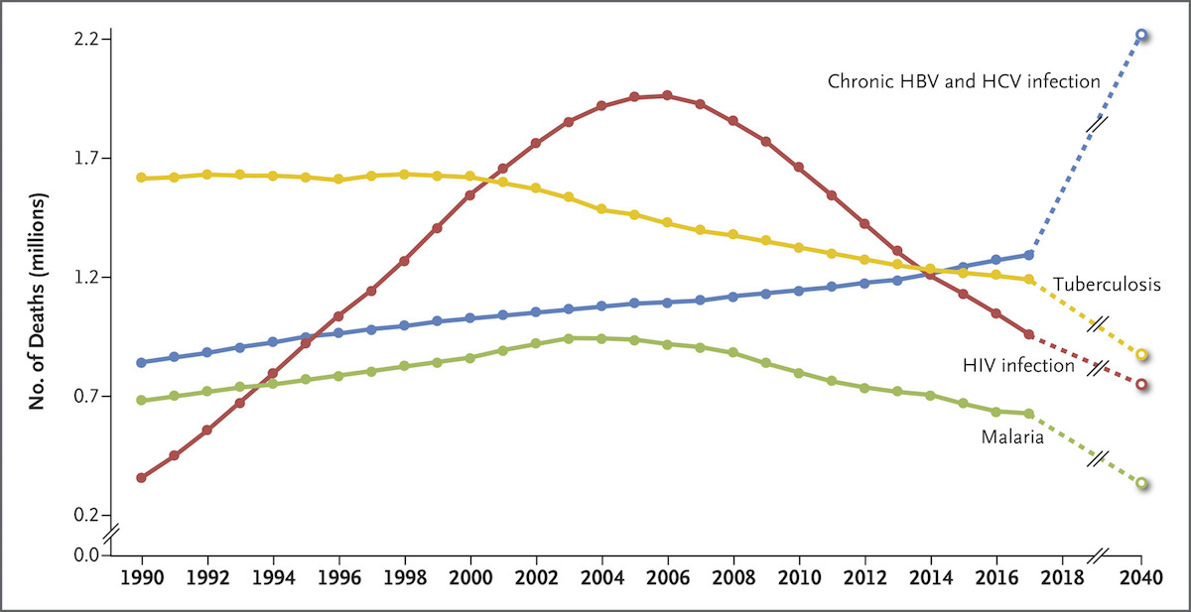
Global HBV-related Deaths
Thomas DL. Global Elimination of Chronic Hepatitis. N Engl J Med. 2019;380:2041-50.
Notes:
In 2015, viral hepatitis led to 1.34 million deaths worldwide and 884,000 (66%) of these were due to hepatitis B.[6] More recent data from the Institute for Health Metrics and Evaluation estimated that in 2017, deaths due to viral hepatitis outnumbered those of tuberculosis, HIV, and malaria, with deaths from viral hepatitis projected to exceed the combined mortality of tuberculosis, HIV, and malaria by 2040 (Figure 14).[23,58]. Globally, the majority of deaths due to HBV are from complications of cirrhosis and hepatocellular carcinoma, with a small minority from acute infection

Slide 8
HBV Awareness
A minority of persons living with chronic HBV are aware of their HBV infection status
NHANES data (2013 through 2016)
  33.9% of those with chronic infection were aware of their HBV status
  11.7% of persons with a past exposure to HBV (defined by the presence of HBcAb) were aware they had been exposed to HBV
Kim HS, Yang JD, El-Serag HB, Kanwal F. Awareness of chronic viral hepatitis in the United States: An update from the National Health and Nutrition Examination Survey. J Viral Hepat. 2019 May;26(5):596-602. doi: 10.1111/jvh.13060. Epub 2019 Mar 13. PMID: 30629790.

Slide 9
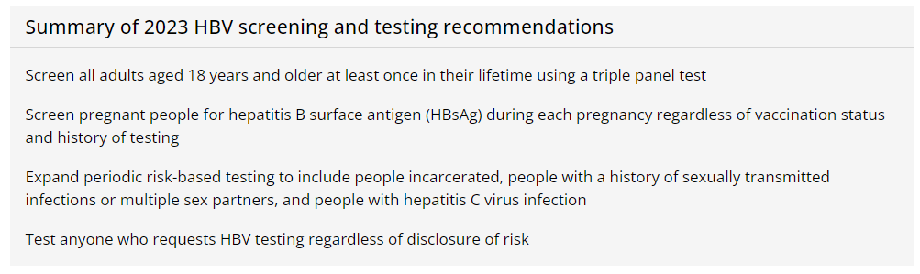
CDC Screening and Testing Recommendations for HBV
Morbidity and Motality Weekly Report (MMWR) March 10, 2023
https://www.cdc.gov/mmwr/volumes/72/rr/rr7201a1.htm?s_cid=rr7201a1_w –accessed 7_28_23

Slide 10
HBV Testing and Serology Interpretation

Slide 11
HBV Terminology
Name | Abbreviation | Interpretation
Hepatitis B Surface Antigen | HBsAg | Indicates active infection Indicates chronic infection if persistent >6 mos
Hepatitis B Surface Antibody | anti-HBs | Indicates immunity
Hepatitis B Core Antibody | anti-HBc (HBcAb) | Indicates exposure. NOT seen in those immune because of vaccine.

Slide 12
HBsAg | Anti-HBs | Anti-HBc | Interpretation
─ | ─ | ─ | Susceptible. Vaccinate!
+ | -/+ | + | Chronic infection
─ | + | ─ | Immune from prior vaccination
─ | + | + | Exposure with immune control, low risk of reactivation
─ | ─ | + | Exposure with minimal or no immune control, higher risk of reactivation

Slide 13
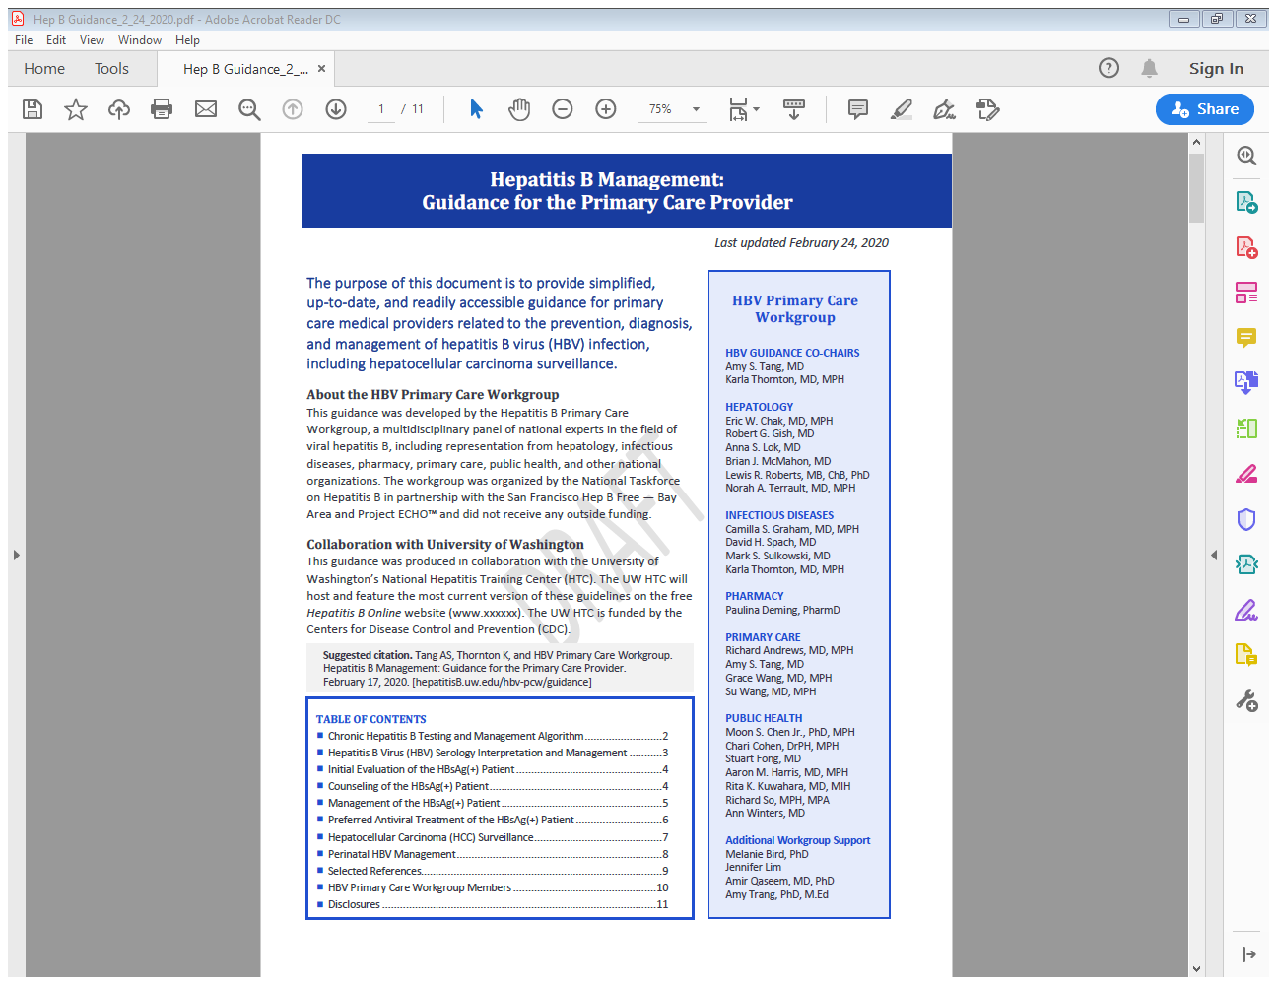

Hepatitis B Management: Guidance for the Primary Care Provider - HBV Primary Care Workgroup - Hepatitis B Online (uw.edu)
13

Slide 14
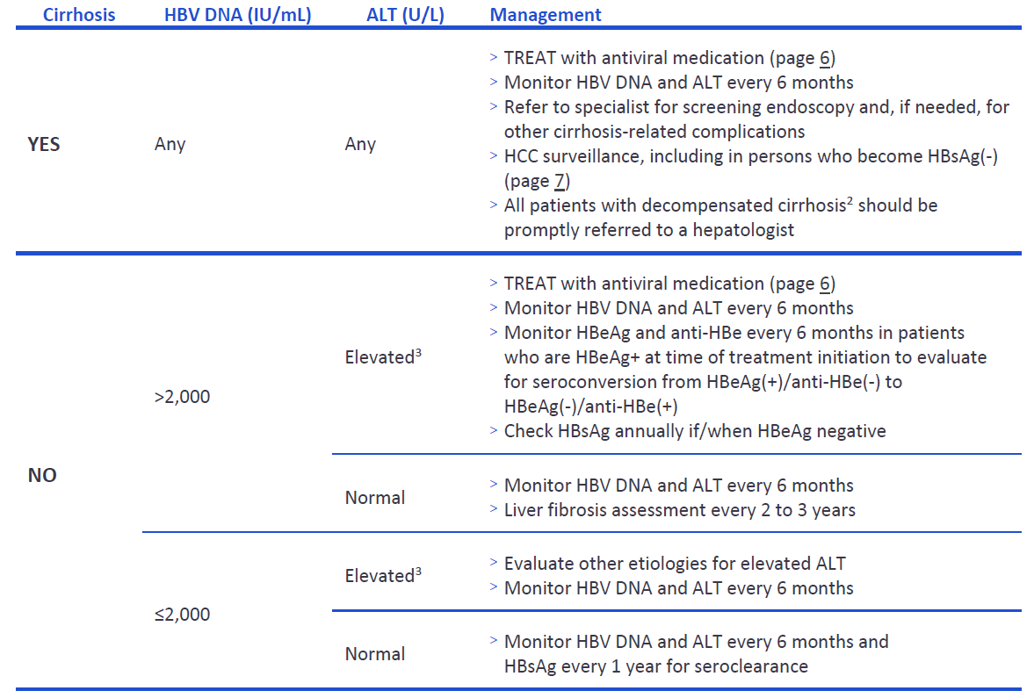
Management of the HBsAg (+) Person
Hepatitis B Management: Guidance for the Primary Care Provider - HBV Primary Care Workgroup - Hepatitis B Online (uw.edu)

Slide 15
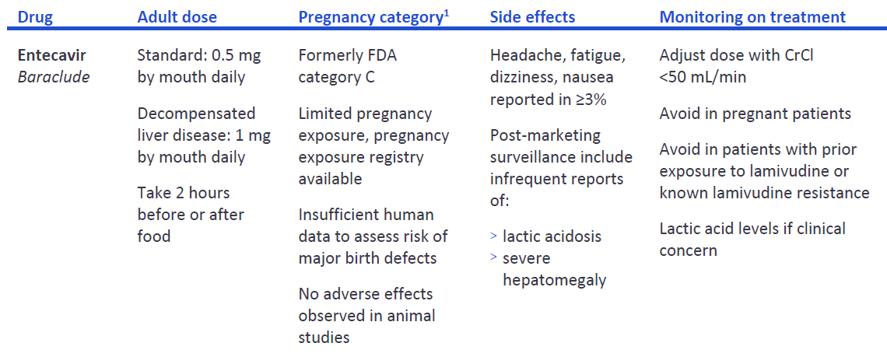
Preferred Antiviral Treatment of the HBsAg (+) Person
Hepatitis B Management: Guidance for the Primary Care Provider - HBV Primary Care Workgroup - Hepatitis B Online (uw.edu)

Slide 16
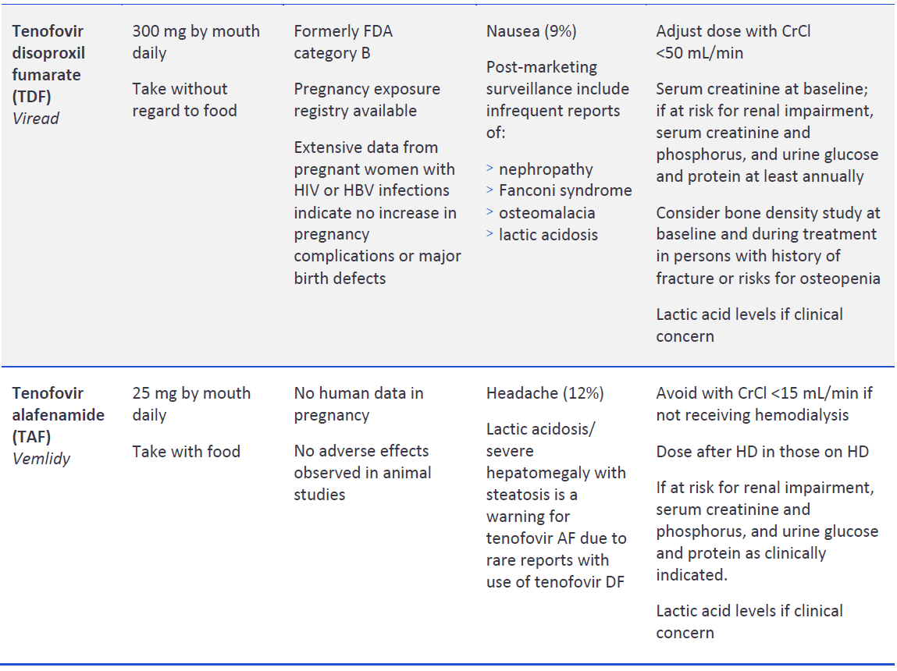
Preferred Antiviral Treatment of the HBsAg (+) Person
Hepatitis B Management: Guidance for the Primary Care Provider - HBV Primary Care Workgroup - Hepatitis B Online (uw.edu)

Slide 17
Key Points
HBV is a major global health problem
Screen all adults 18 years or older with the triple panel
HBcAb (anti-HBc) indicates exposure to HBV
HBsAg indicates active HBV infection
Decision to treat based on HBVDNA level and degree of liver inflammation
Treat all people with cirrhosis
Treat pregnant people in 3rd trimester at risk of transmission
HBV is not curable (with current treatment) but is controllable with improved patient outcomes

Slide 18
Questions?

Slide 19
References
https://www.cdc.gov/hepatitis/
https://www.hepatitisb.uw.edu/
Hepatitis B Management: Guidance for the Primary Care Provider - HBV Primary Care Workgroup - Hepatitis B Online (uw.edu)
WHO Global Hepatitis report: https://www.who.int/publications/i/item/9789240091672

Slide 20
Resources
National Clinician Consultation Center http://nccc.ucsf.edu/
  HIV Management
  Perinatal HIV
  HIV PrEP
  HIV PEP line
  HCV Management
  Substance Use Management
Present your case on ECHO
http://echo.unm.edu hivecho@salud.unm.edu
AETC National HIV Curriculum https://aidsetc.org/nhc
AETC National Coordinating Resource Center https://targethiv.org/library/aetc-national-coordinating-resource-center-0
HIVMA Resource Directory https://www.hivma.org/globalassets/ektron-import/hivma/hivma-resource-directory.pdf
www.scaetc.org
Notes:
Find additional ECHO sessions in your area: https://echo.unm.edu/locations-2/echo-hubs-superhubs-united-states/
https://hsc.unm.edu/echo/get-involved/join-an-echo/
IDEA Platform: Infectious Diseases Education & Assessment. https://idea.medicine.uw.edu/
AETC National HIV Curriculum: 6 core modules for self study; regularly updated; CME, CNE
Hepatitis C Online Curriculum: https://www.hepatitisc.uw.edu/
Hepatitis B Online Curriculum: https://www.hepatitisb.uw.edu/
National STD Curriculum: https://www.std.uw.edu/

Slide 21
