Slide 1
Hepatitis C : The Road to Cure
Kelli Williams MD, MPH, FIDSA
6/17/2024

Slide 2
This conference is supported by the Health Resources and Services Administration (HRSA) of the U.S. Department of Health and Human Services (HHS) as part of an award totaling $4,036,482 with 0 percentage financed with nongovernmental sources. The contents are those of the author(s) and do not necessarily represent the official views of, nor an endorsement, by HRSA, HHS or the U.S. Government.

Slide 3
Disclosures
None

Slide 4
Learning Objectives
Review the epidemiology of HCV in the US
Discuss HCV screening and diagnosis
Review Pre-treatment eval for HCV
Review treatment options for HCV
Describe how HIV may impact treatment
Discuss monitoring of HCV treatment and post treatment monitoring

Slide 5
PLANNER & SPEAKER DISCLOSURES
In accordance with the ACCME Standards for Integrity and Independence Integrity and Independence in Accredited Continuing Education and the University of Cincinnati policy, all faculty, planning committee members, and other individuals, who are in a position to control content, are required to disclose all relationships with ineligible companies* (commercial interests) within the last 24-months. All educational materials are reviewed for fair balance, scientific objectivity, and levels of evidence. The ACCME requires us to disqualify individuals who refuse to provide this information from involvement in the planning and implementation of accredited continuing education, or whose conflicts of interests cannot be mitigated.
*Companies that are ineligible to be accredited in the ACCME System (ineligible companies) are those whose primary business is producing, marketing, selling, re-selling, or distributing healthcare products used by or on patients.

Slide 6
All relevant relationships have been mitigated.
The following disclosures were made:
Planning Committee Members
Name | Activity Role | Relationship/Co. Name
T’Keyah Grier, PhD, MPH, CHES | Planning Committee | None to disclose
Pamposh Kaul, MD | Planning Committee | None to disclose
Kelli Williams, MD, MPH, FIDSA | Planning Committee | None to disclose
Bruce Gebhardt, MD | Planning Committee | None to disclose
Robert Ellis, MD | Planning Committee | None to disclose
Susan Tyler, PhD, CHCP, CMP | Planning Committee | None to disclose
Suzanne Matthey | Planning Committe | None to disclose

Slide 7
All relevant relationships have been mitigated.
The following disclosures were made:
Speakers
Name | Activity Role | Relationship/Co. Name
Kelli Williams, MD, MPH, FIDSA | Presenter | None to disclose

Slide 8
ACCREDITATION AND DESIGNATION STATEMENT
This activity has been planned and implemented in accordance with the accreditation requirements and policies of the Accreditation Council for Continuing Medical Education (ACCME) through the providership of the University of Cincinnati. The University of Cincinnati is accredited by the ACCME to provide continuing medical education for physicians..
The University of Cincinnati designates this live activity for a maximum of 1.0 AMA PRA Category 1 Credit(s) ™. Physicians should claim only the credits commensurate with the extent of their participation in the activity.
OFF-LABEL DISCLOSURE STATEMENT
Faculty members are required to inform the audience when they are discussing off-label, unapproved uses of devices and drugs. Physicians should consult full prescribing information before using any product mentioned during this educational activity.
DISCLAIMER STATEMENT
The opinions expressed during the live activity are those of the faculty and do not necessarily represent the views of the University of Cincinnati. The information is presented for the purpose of advancing the attendees’ professional development.

Slide 9
Notes:
Flavivirus
RNA virus; enveloped
Genotypes 1-6, 1-3 are the most common in the US
On October 5, 2020, it was announced that Harvey J. Alter, Michael Houghton, and Charles M. Rice had been awarded the 2020 Nobel Prize in Physiology or Medicine for the discovery of HCV

Slide 10
Liver Disease and Hepatitis Definitions
Liver disease is a major cause of morbidity and mortality in the US and worldwide (Alcohol, viral hepatitis, NAFLD)
Hepatitis: inflammation of the liver. Persistent inflammation leads to scar tissue buildup- cirrhosis
Cirrhosis- causes decrease in liver function, at risk for: liver failure and death without transplantation
HCC- hepatocellular carcinoma: MC primary liver cancer, occurs most often in people with chronic liver diseases, 3rd leading cause of cancer related deaths
HAV/HEV: can lead to acute death, does not cause chronic liver disease
HBV, HCV/HDV: "silent" diseases, chronic, causes extensive damage over time

Slide 11
Behaviors Associated with Increased Risk of HCV
AASLD-IDSA. Recommendations for testing, managing, and treating hepatitis C. http://www.hcvguidelines.org. [6/6/24].

Slide 12
Natural History of Hepatitis C Virus
Figure source: Lingala S, Ghany MG. Natural History of Hepatitis C. Gastroenterol Clin North Am. 2015;44:717-34.

Slide 13
Chronic Hep C Factors that Promote Progression or Severity
Increased alcohol intake
Age > 40 years old when infected
HIV co-infection
Other
Male sex
Chronic HBV coinfection

Slide 14
https://www.healthcentral.com/condition/hepatitis-c (accessed 6/6/24)

Slide 15
Epidemiology of HCV in the US
ThePhoto by PhotoAuthor is licensed under CCYYSA.

Slide 16
https://cdafound.org/dashboards/Polaris/dashboard.html accessed 6/4/2024
Notes:
The CDA "chronic disease analysis" has global estimates of HCV infections. We estimate that less than 50% have been diagnosed and less than 10% are being treated anually and which shows us where we have work still to do with critical first steps with getting patients diagnosed and treated.

Slide 17
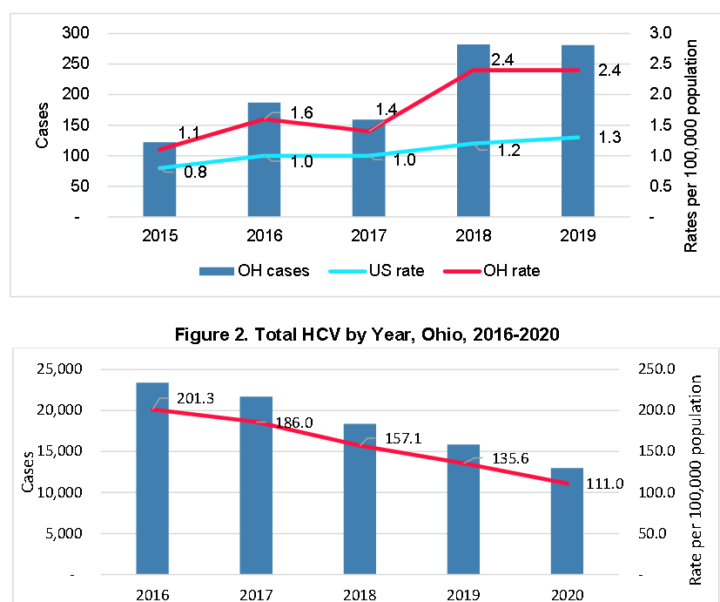
Ohio burden of HCV
https://odh.ohio.gov/know-our-programs/viral-hepatitis/data-statistics/hcv-5yr-report
Notes:
2022 data looking at hepatitis C case rates by county, lighter the color the less people living with Hep C, darker color with more hep c

Slide 18
CDC New HCV infections nearly tripled over five years Number of reported cases* and estimated infections† of acute hepatitis C — United States, 2015–2022
https://www.cdc.gov/hepatitis/statistics/2022surveillance/hepatitis-c/figure-3.1.htm
https://www.cdc.gov/hepatitis/statistics/2022surveillance/hepatitis-c/figure-3.1.htm​
Notes:
In the shadow of the opioid crisis, new hep C infections have increased. This has risen in parallell syndemics or epidemics meaning that 2 or more afflictions, interacting synergistically, contributing to excess burden of disease. WIth rise in HIV and Hep C as well as other infectious complications.

Slide 19
New reports of chronic hep c high in multiple generations Number of newly reported* chronic Hepatitis C virus infection cases† by sex and age — United States, 2021
Millennials
1981-1996
Baby Boomers 1945-1965
https://www.cdc.gov/hepatitis/statistics/2021surveillance/hepatitis-c/figure-3.8.htm
Notes:
We have seen a significant number of young people. For years we have had our eye on baby boomers with Hep C

Slide 20
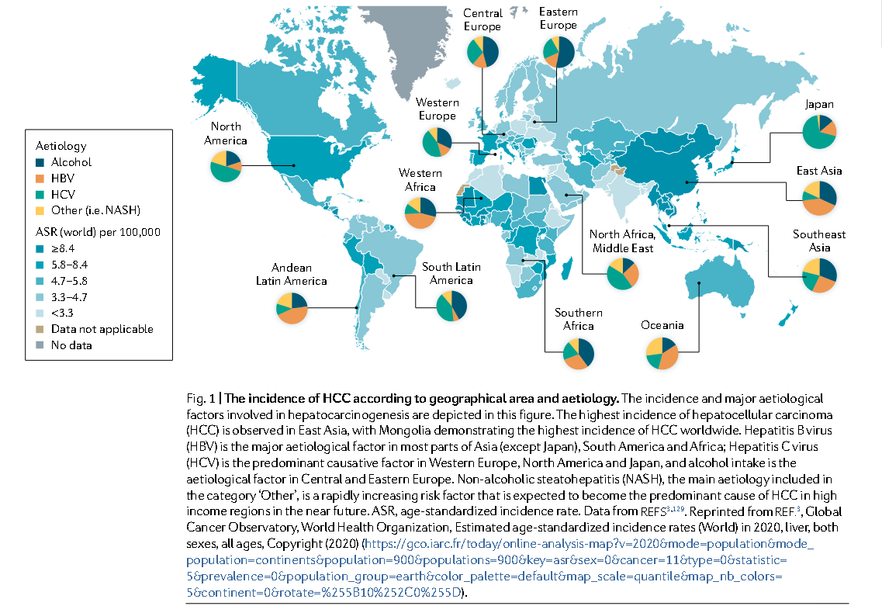
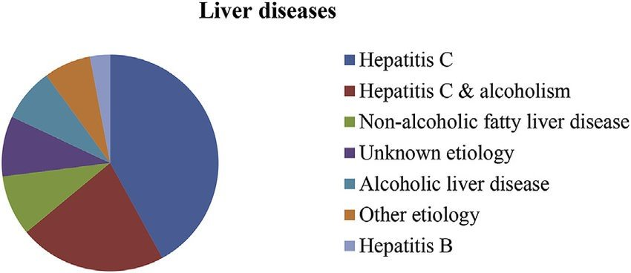
HCV Remains a Major Source of Mortality
Khatun, Mst. Shanta & Biswas, Md. Haider Ali. (2019). Optimal Control Strategies for Preventing Hepatitis B Infection and Reducing Chronic Liver Cirrhosis Incidence. Infectious Disease Modelling. 5. 10.1016/j.idm.2019.12.006.
Notes:
HCV is a major contributor to the development of cirrhosis and HCC.

Slide 21
HCV remains a major source of mortality
https://www.cdc.gov/hepatitis/statistics/2022surveillance/hepatitis-c/figure-3.9.htm

Slide 22
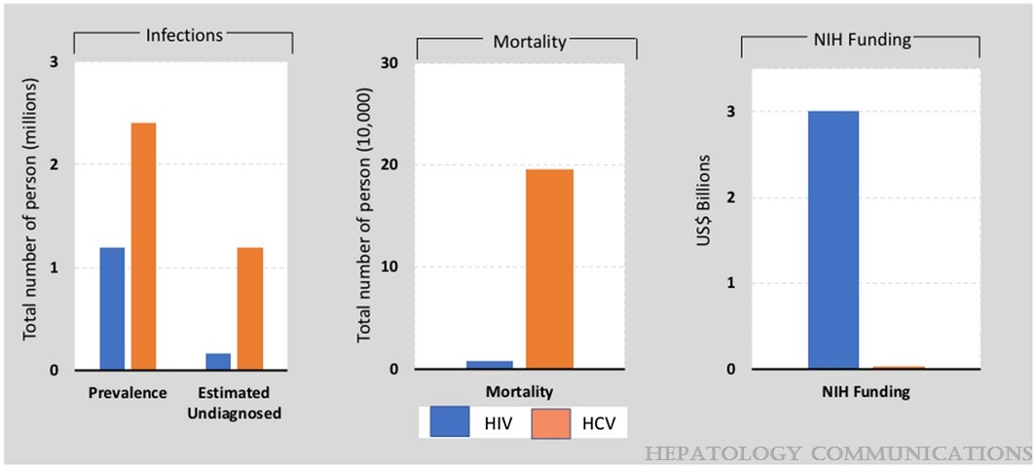
US Disproportionate Response to HIV and Hepatitis C
United States response to HIV and HCV epidemics.(108) While the US estimated prevalence of HCV may vary by study, Saab et al. demonstrated how HCV is severely underfunded from research and care standpoints.(108) This comparison shows the prevalence, undiagnosed infection, mortality, and National Institutes of Health research funding for HCV and HIV/AIDS in the United States. HCV is a more prevalent infection in the United States, with a substantial burden of undiagnosed cases and greater mortality compared with HIV.
Innovations in Hepatitis C Screening and Treatment
Patel, Arpan A.; Bui, Aileen; Prohl, Eian; Bhattacharya, Debika; Wang, Su; Branch, Andrea D.; Perumalswami, Ponni V.
Hepatology Communications5(3):371-386, March 2021.
doi: 10.1002/hep4.1646
Notes:
When we look at the US and the response to HIV as compared to HCV. We know that historically we have had a very disproportinate response, where we have made great strides with decreasing the prevelance of HIV infection and really reducing the number of patients with undiagnosed HIV as shown in blue here on the bars in terms of infection and on mortality and where we have devoted funding. Hep C in sharp contrast has had an increasing prevelence. Too many people are undiagnosed with this infection and many people living with this infection live silently until they develop a very late stage presentation. And Hep C has now become a significant contributor to mortality and federal funding still lags behind HIV.

Slide 23
Antiviral treatment is recommended for ALL adults with acute or chronic HCV infection, except those with a short life expectancy that cannot be remediated by HCV therapy, liver transplantation, or another directed therapy (I,A)
AASLD/IDSA HCV Guidance
https://aasldpubs.onlinelibrary.wiley.com/doi/pdf/10.1002/hep.31060#
Notes:
Hep C guidance that comes out of AASLD and IDSA. To say not who do we treat but how do we get everyone treated

Slide 24
We are in the Era of HCV Elimination
Approval of direct acting antivirals for HCV
In 2016, World Health Organization (WHO) adopted goal of viral hepatitis elimination by 2030 (193 countries)
In 2018, the US National Academy of Science, Engineering and Medicine convened committee for national strategy
https://www.health.ny.gov/diseases/communicable/hepatitis/hepatitis_c/docs/achieving_elimination.pdf [6.8.24]
Notes:
We are still getting outpaced by

Slide 25
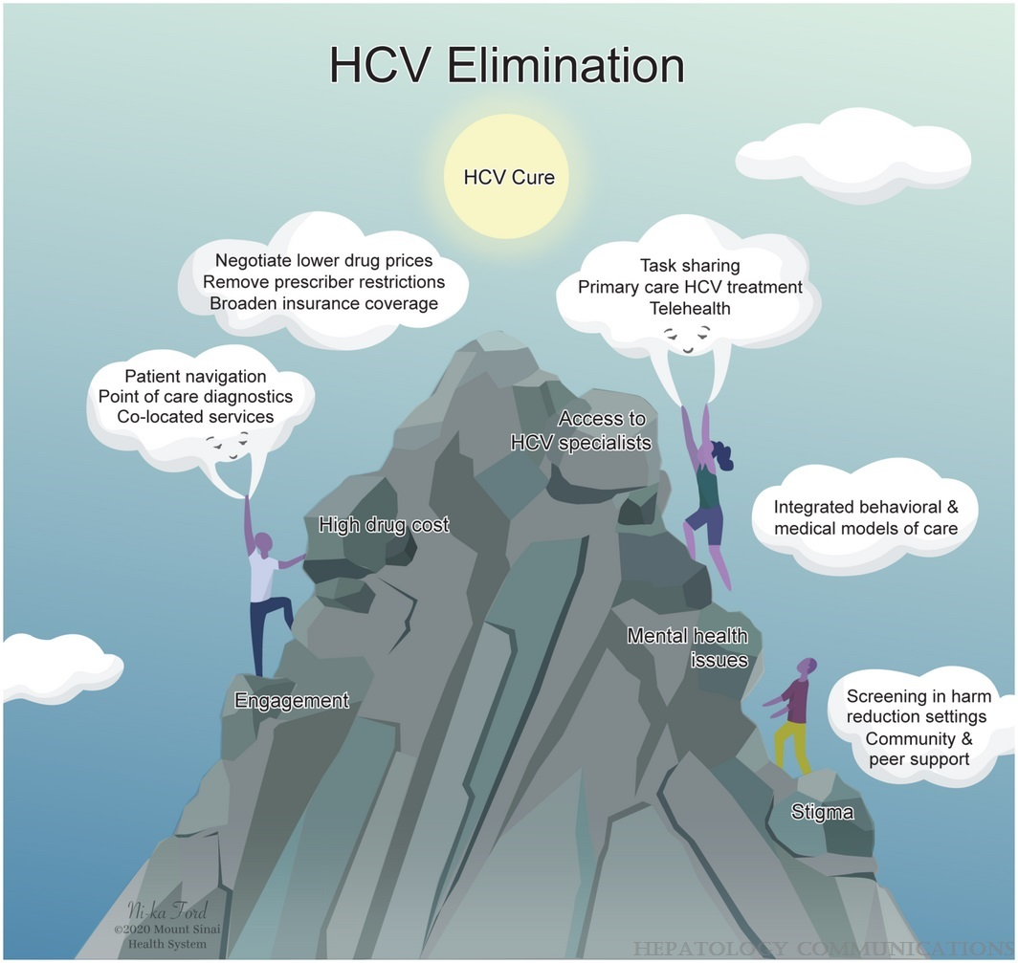
Fig. 2
Innovations in Hepatitis C Screening and Treatment
Patel, Arpan A.; Bui, Aileen; Prohl, Eian; Bhattacharya, Debika; Wang, Su; Branch, Andrea D.; Perumalswami, Ponni V.
Hepatology Communications5(3):371-386, March 2021.
doi: 10.1002/hep4.1646
Barriers to HCV elimination can be overcome by innovation. System‐level innovations of HCV care can overcome gaps in care from testing, linkage to care, treatment, and cure. Barriers such as access to HCV specialists can be overcome by task sharing with a multidisciplinary team–based approach to care, removal of specialist restrictions by payers, coupled with task shifting to primary care and use of telehealth. Printed with permission © Mount Sinai Health System.

Slide 26
Gaps in HCV Care
Interventions to optimise the care continuum for chronic viral hepatitis: a systematic review and meta-analyses
Kali Zhou, MD † Thomas Fitzpatrick, BA †Nick Walsh, et al.
The Lancet, Volume 16, ISSUE 12, P1409-1422, December 2016 Published:September 05, 2016DOI:https://doi.org/10.1016/S1473-3099(16)30208-0
Notes:
There are certainly a lot of gaps in care starting with improved access to testing, bringing testing to where target populations are engaged in is a very important first step followed by moving patients along, coordinating their care, integrating care into spaces where these patients are already engaged.

Slide 27
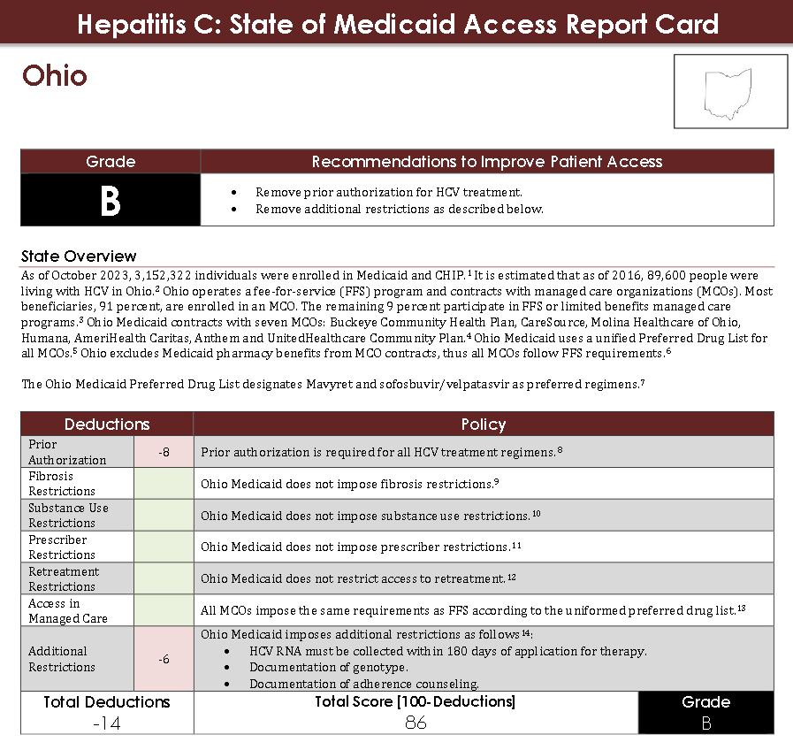
https://stateofhepc.org//wp-content/uploads/2021/05/Ohio-February-2024_clean.pdf

Slide 28
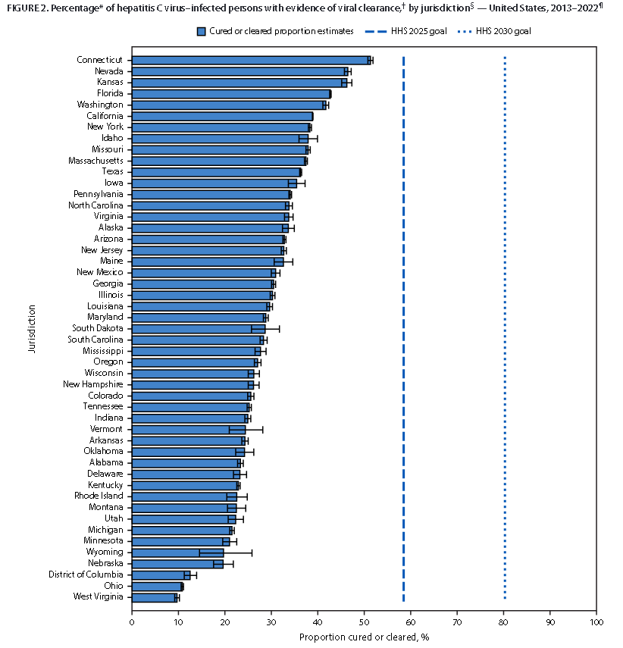
https://www.hhs.gov/hepatitis/programs-and-initiatives/mapping-hepatitis-elimination-in-action/index.html
HCV Prior Authorization
U.S. Department of Health and Human Services | Centers for Disease Control and Prevention | MMWR | May 30, 2024 | Vol. 73 | No. 21

Slide 29
HCV Screening & Diagnosis

Slide 31
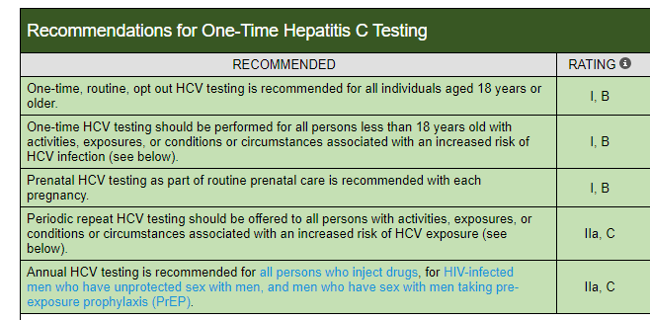
HCV screening
EACH
PREGNANCY
ANNUALLY
AASLD-IDSA. Recommendations for testing, managing, and treating hepatitis C. http://www.hcvguidelines.org. [6/6/24].

Slide 32
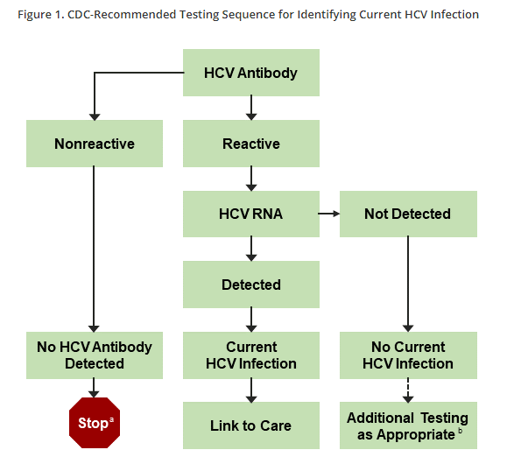
HCV Screening
A positive HCV-antibody test indicates:
1. current (active) HCV infection (acute or chronic)
2. a past resolved infection
3. rarely a false-positive result
Figure 1. CDC-Recommended Testing Sequence for Identifying Current HCV Infection
ª For persons who might have been exposed to HCV within the past 6 months, testing for HCV RNA or follow-up testing for HCV antibody should be performed. For persons who are immunocompromised, testing for HCV RNA should be performed. b To differentiate past, resolved HCV infection from biologic false positivity for HCV antibody, testing with another HCV-antibody assay can be considered. Repeat HCV-RNA testing if the person tested is suspected to have had HCV exposure within the past 6 months or has clinical evidence of HCV disease, or if there is concern regarding the handling or storage of the test specimen. Adapted from Centers for Disease Control and Prevention (CDC, 2013).
Notes:
Here in US antibody test is blood test. Antibody test can have 1 of 2 responses: Reactive/positive or nonreactive/negative, then should be reflexed to HCV RNA test which is the confirmatory test that tells you whether or not you have active infection. Hep C RNA measures the detection of virus in the blood. If the antibody test is positive it is recommended that a HCV RNA test is then done each time to tell whether HCV is detectable in the blood. The concept of reflex testing means that antibody and RNA testing should be one step process ideally rather than bringing patient back for a second blood test, ideal thing would be to do enough blood tests that if it's positive your lab can run RNA testing without bringing them back. I think the key here for us for improvement is the reflex testing, how can we make it a 1 step process so that patients and providers don’t get lost in the process

Slide 33
HCV Infection and Tests
HCV RNA/Viral Load:
typically becomes detectable 2-3 weeks after viral exposure
maybe transiently negative during acute HCV infection
viral fluctuations >1log10 IU/mL may indicate acute HCV infection
Presence of HCV RNA alone does not distinguish between acute and chronic infection
Presence after 6 months indicates chronic infection
Antibody:
HCV antibody occurs 2-3 months after exposure, on average
Test may be negative during the first 6 weeks after exposure
Presence of HCV antibody does not distinguish between acute and chronic infections
ALT:
Fluctuating ALT peaks (high then low then high) suggest acute infection
ALT may be normal during infection
May be elevated due to other liver insult

Slide 34
Pre-Treatment Evaluation for HCV

Slide 35
Goal of treatment : CURE
Cure is defined as sustained virological response (SVR12): negative HCV VL at 12 weeks after completion of therapy
Reduce liver inflammation
Reduce fibrosis and improve portal hypertension
Reduce mortality

Slide 36
Engagement around HCV treatment
Provide reassurance that HCV treatment is effective, easy, safe, and very well tolerated
1
Be aware of how difficult non-DAA treatment was as many patients not informed about new treatments
2
Patients previously treated
Friends/acquaintances treated previously
Myths and misconceptions exist about new treatment
Emphasize importance of adherence to treatment
3
Treatment failures are most likely when adherence is not optimal

Slide 37
Many Options…How Do You Choose the Right One?
Good news is they all work very well!
SVR rates consistently > 95% in clinical trials and real-world studies
Excellent safety/tolerability
For most patients, any of the recommended options are fine

Slide 38
Pretreatment guide to choosing a regimen
Fibrosis assessment: ALL patients
Genotype
Still necessary
Treatment history
Naïve
Experienced
Comorbidities
CKD
HIV
Drug-drug interactions

Slide 39
Why do we care about fibrosis assessment?
Don’t want to miss cirrhosis!
Presence of cirrhosis increases the urgency of therapy and may affect regimen, duration, use of ribavirin and risks of therapy
If cirrhosis:
Any history or signs of decompensation?
Need for post-SVR follow up
HCC screening
Need to exclude current or past liver decompensation
Affects regimen choice- No PIs, add RBV
Affects safety- warn patient and monitor closely
If patient has cirrhosis
Calculate Child Pugh Score- If > 5 pay attention!
Calculate MELD- if > 18 pay attention!
http://www.hepatitis.va.gov/hcv/liver-fibrosis.asp [6/7/24}

Slide 40
Fibrosis Assessment
APRI or FIB-4 can be done anywhere by all providers
Very good negative predictive value - rule out cirrhosis
Transient elastography
>12.5 KPa = cirrhosis
Serum tests with cutoffs indicating cirrhosis (eg, Fibrosure, Enhanced Liver Fibrosis Test, etc)
FibroTest (0.75 = cirrhosis)
Liver biopsy rarely needed
What about ultrasound?
Young patient, low risk of advanced fibrosis, not needed
Insensitive for cirrhosis – only needed if cirrhotic to exclude HCC before you start
Using 2 assessments increases your accuracy

Slide 41
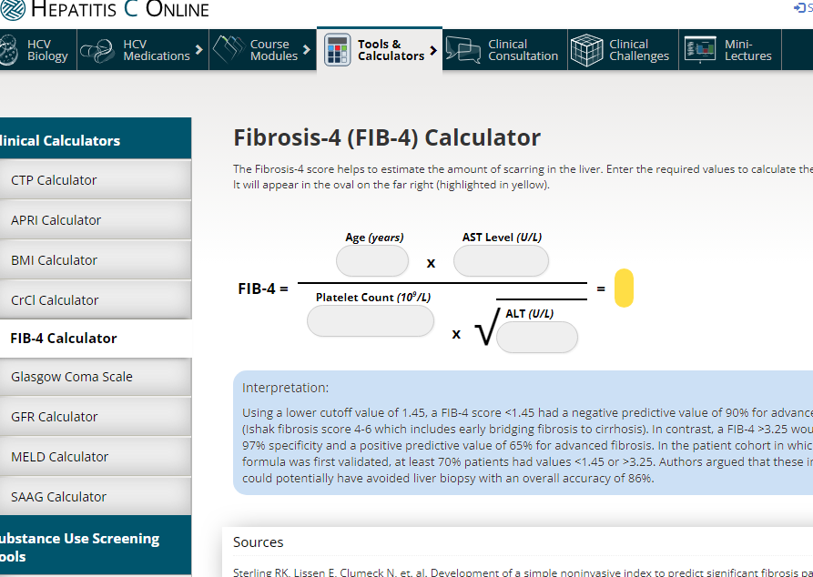
Fib 4 Assessment
Age, platelet count, AST, ALT
>3.25 suggests F3/4
Can perform on all patients
https://www.hepatitisc.uw.edu/page/clinical-calculator/fib-4 {6/7/24}

Slide 42
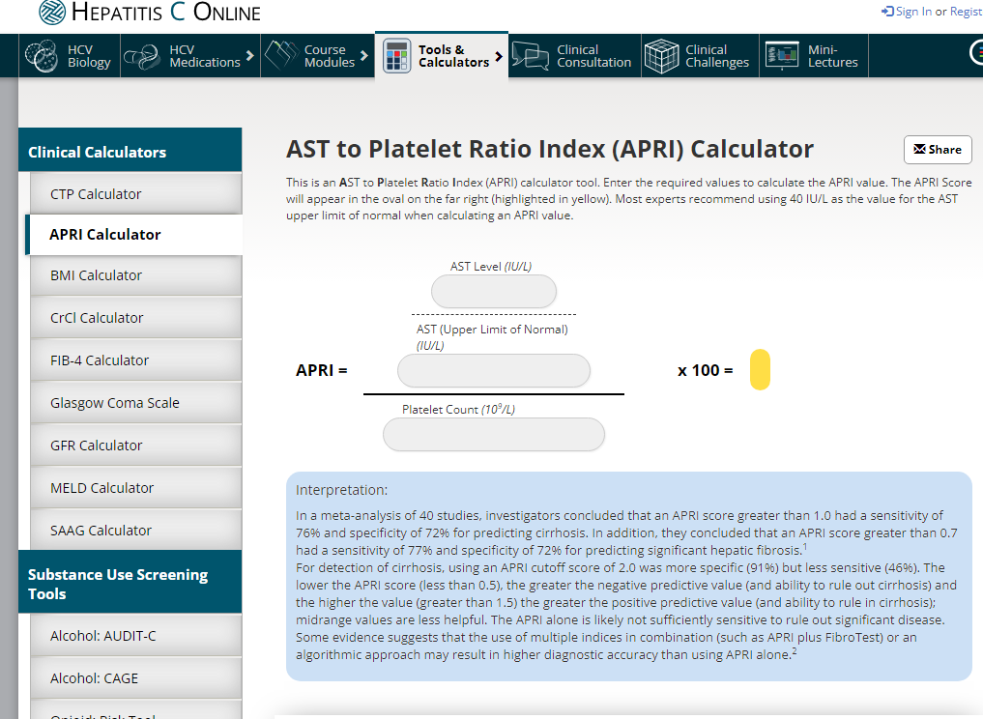
APRI Assessment
AST, ALT, platelet count
>1.0 suggests F3/4
Can perform on all patients
https://www.hepatitisc.uw.edu/page/clinical-calculator/apri {6/7/24}

Slide 43
Transient Elastography
Propagation of the mechanical shear wave through the skin and liver tissues is measured using ultrasound
Stiffness is computed from the shear wave propagation map
Number corresponds to fibrosis
Some considerations
Very reliable
Non-invasive
Requires 3 hours of fasting
Access issues
Obesity can be a problem
N. Frulio, H. Trillaud,
Ultrasound elastography in liver, Diagnostic and Interventional Imaging,
Volume 94, Issue 5, 2013, Pages 515-534,ISSN 2211-5684,
https://doi.org/10.1016/j.diii.2013.02.005.

Slide 44
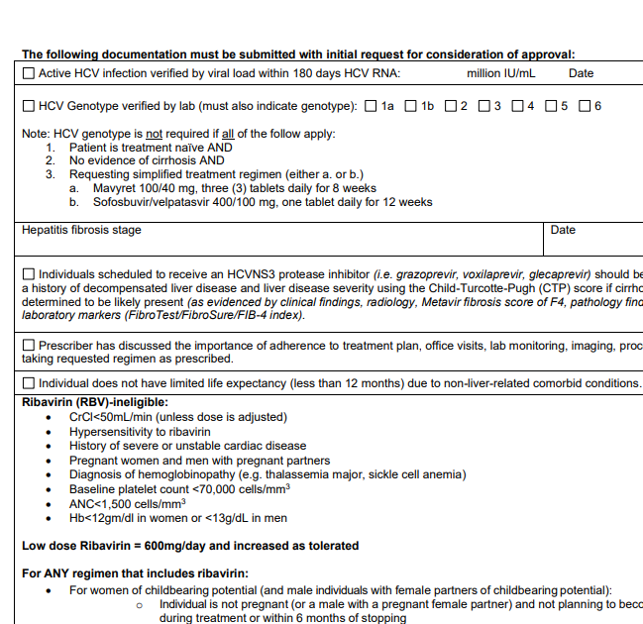
Can We Avoid Genotyping?
Currently in the US: No
Payers in many states including Ohio continue to require it on prior authorization forms
In Ohio, Medicaid still requires a prior authorization
Some states do not require genotypes or prior authorization
Hepatitis C PA Fillable Form (ohio.gov) [6/7/24]

Slide 45
Pre-Treatment Assessment Recommendations
Medication reconciliation: Record current medications, including over-the-counter drugs and herbal/dietary supplements.
Potential drug-drug interaction assessment: Drug-drug interactions can be assessed using the AASLD/IDSA guidance or the University of Liverpool drug interaction checker.
Drug-drug interactions are particularly important in HIV co-infection
In those with HIV, the simplified treatment approach should not be used in those on TDF containing regimens with eGFR <60 ml/min because of the need of additional monitoring.
Education: Educate the patient about proper administration of medications, adherence, and prevention of reinfection.
Pretreatment laboratory testing:
Within 6 months of initiating treatment:
Complete blood count (CBC)
Hepatic function panel (ie, albumin, total and direct bilirubin, alanine aminotransferase [ALT], aspartate aminotransferase [AST])
Calculated glomerular filtration rate (eGFR)
Any time prior to starting antiviral therapy:
Quantitative HCV RNA (HCV viral load)
HIV antigen/antibody test
Hepatitis B surface antigen
Before initiating antiviral therapy:
Serum pregnancy testing and counseling about pregnancy risks of HCV medication should be offered to women of childbearing age.
AASLD-IDSA. Recommendations for testing, managing, and treating hepatitis C. http://www.hcvguidelines.org. [6/6/24].

Slide 46
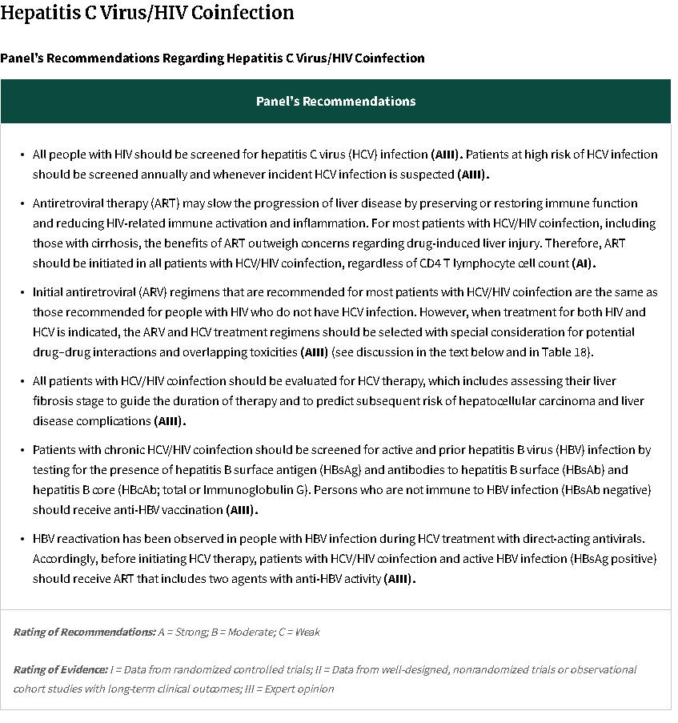

Slide 47
Treatment of HCV
ThePhoto by PhotoAuthor is licensed under CCYYSA.

Slide 48
This Photo by Unknown author is licensed under CC BY-NC-ND.
AASLD-IDSA. Recommendations for testing, managing, and treating hepatitis C. http://www.hcvguidelines.org. [6/6/24].

Slide 50
Simplified HCV Treatment for Treatment-Naïve Adults Without Cirrhosis
3 pills daily
1 pill daily
Common Side Effects >5%
Headache, fatigue, nausea
Headache, fatigue, nausea, asthenia, insomnia

Slide 51
Recommended Treatment Regimens
Genotype- specific
Elbasvir/Grazoprevir (Zepatier): GT 1,4
Ledipasvir/Sofosbuvir (Harvoni): GT 1,4,5,6
Pangenotypic
Sofosbuvir/Velpatasvir (Epclusa): GT 1-6
Glecaprevir/Pibrentasvir (Mavyret): GT 1-6
Sofosbuvir/Velpatasvir/voxilaprevir (Vosevi): GT 1-6
(Reserved for salvage therapy)
Notes:
Vosevi is used for retreatment

Slide 53
Comorbidities
HBV
HBsAg is important
Anti-HBc not very important (but very common!)
Risk of reactivation with HBsAg+ and/or HBcAb+
HIV
Important due to common risk factors and importance of diagnosis

Slide 54
Notes:
Look at OTC meds, supplements. If possible stop other meds if there is concern

Slide 55
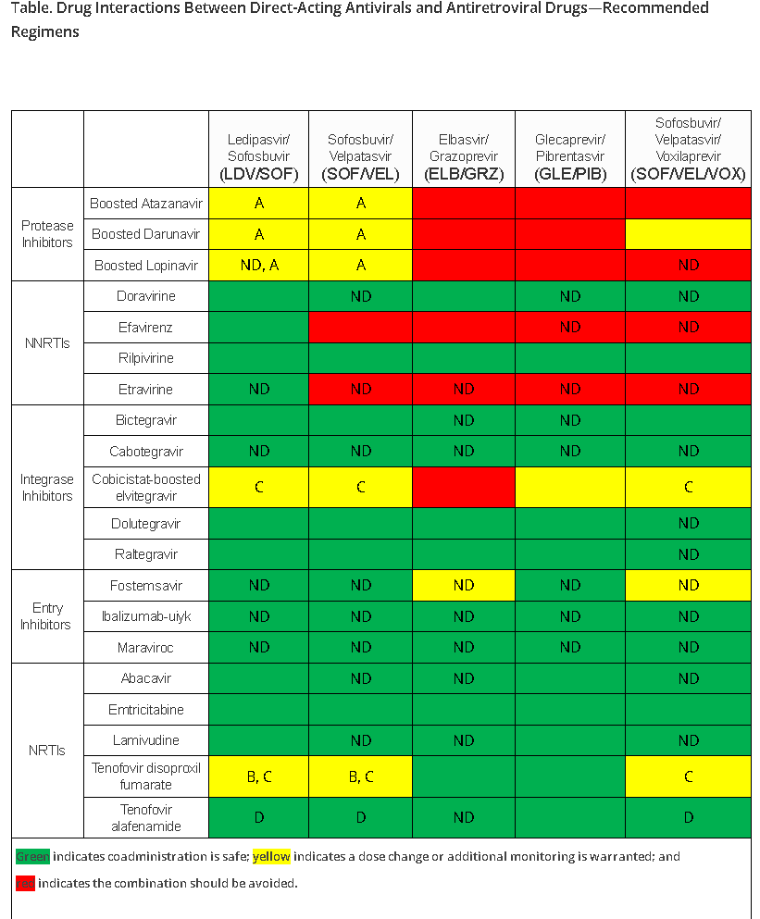
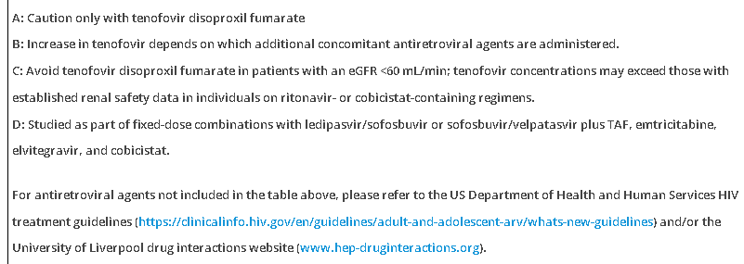
AASLD-IDSA. Recommendations for testing, managing, and treating hepatitis C. http://www.hcvguidelines.org. [6/6/24].

Slide 56
AASLD-IDSA. Recommendations for testing, managing, and treating hepatitis C. http://www.hcvguidelines.org. [6/6/24].

Slide 57
Drug-Drug Interactions
Check using web-based tools
Electronic health records may have DDI check built in
Talk to your pharmacist
https://www.hep-druginteractions.org/checker.%C2%A0 [6/10/24]

Slide 58
When to refer?
Cirrhosis
Co-existing active Hep B infections, HIV
Treatment failure to all oral HCV regimen or interruption
BOC/TEL +/- PegIFN RBV failures are now treated as treatment naïve
F3 or F4
HCC screening long term
Up to PCP

Slide 59
On Treatment Monitoring
Inform patients taking diabetes medication of the potential for symptomatic hypoglycemia
Monitoring for hypoglycemia is recommended.
Inform patients taking warfarin of the potential for changes in their anticoagulation status.
Monitoring INR for subtherapeutic anticoagulation is recommended
No laboratory monitoring is required for other patients
An in-person or telehealth /phone visit may be scheduled, if needed, for patient support/adherence, assessment of symptoms, and/or new medications
HCV antibody will remain positive for life
AASLD-IDSA. Recommendations for testing, managing, and treating hepatitis C. http://www.hcvguidelines.org. [6/6/24].

Slide 60
Monitoring Recommendations
Advise patients, particularly those with prior HBV infection, to contact their provider if they experience unexpected or severe symptoms
At least 12 weeks after treatment completion, confirm cure by assessing HCV RNA by PCR
Refer patients with detectable HCV RNA to a specialist
At least 12 weeks after treatment completion, obtain ALT level
If ALT remains abnormal on repeated measure, refer the patient to a specialist
Dietrich volume 12

Slide 61
Post Treatment Monitoring
ThePhoto by PhotoAuthor is licensed under CCYYSA.

Slide 62
Post Treatment
Check HCV RNA 12 weeks after ending treatment to determine cure
HCV RNA not detected-> CURED -> Monitor for re-infection if risk ongoing at least annually, REMEMBER HCV Ab positive life long
HCV RNA detected-> not cured -> Evaluate for Retreatment, Try to identify why not cured and address prior to retreatment (drug relapse, treatment not completed)

Slide 63
Post-cure Recommendations
Congratulate patients for their HCV cure
Inform patients who are cured that they are susceptible to reinfection if risks ongoing
Provide patients with appropriate HCV harm-reduction resources to minimize the possibility of reinfection
No liver-related follow-up is recommended for noncirrhotic/F3 patients who achieve cure
HCC surveillance with ultrasound +/- AFP every 6 months in patients who had advanced F3/F4 before HCV treatment lifelong
Advise patients to avoid excess alcohol use

Slide 64
Follow-Up for patients who do not achieve a Virologic Cure
Patients in whom initial HCV treatment fails to achieve cure (SVR) should be evaluated for retreatment by a specialist, in accordance with AASLD/IDSA guidance
Until retreatment occurs, assessment for disease progression every 6-12 months with a hepatic function panel, CBC, and INR is recommended
Advise patients to avoid excess alcohol use

Slide 65
Post Treatment Considerations
Consequences of liver disease
Cirrhosis (fibrosis assessment pretreatment!)
HCC risk
Liver function
HCV reinfection risk if ongoing exposures
HCV RNA testing every 6-12 months
No ongoing exposures
Annual ALT, promote liver health
HCV antibody positive life long

Slide 66
Patients with new CHC diagnosis:
Should be evaluated for:
Evidence of advanced chronic liver disease
Other blood-borne pathogens:
HBV and HIV
Candidacy for potential treatment:
Possible contraindications in patients with active IVDU or high risk of relapse or demonstrated medical noncompliance
Should be protected from additional hepatotoxicity:
Undergo hepatitis A and B vaccination if susceptible
Reduce or discontinue alcohol consumption
Avoid new medicines, including over-the-counter and herbal agents
Should be counseled to reduce risk of transmission:
Do not donate blood, tissue, or semen
Do not share appliances that may come in contact with blood, such as toothbrushes, dental appliances, razors, and nail clippers

Slide 67
HCC Screening
All patients with F3 and F4 pre treatment
Lifelong
US +/- AFP every 6 months
Can be done by nonspecialists
Many will refer to periodically see specialists to monitor for liver decompensation
Some patients may have fibrosis improvement post treatment
>60% will have histological changes that persist post cure
Current tools are not great at assessing regression of fibrosis post SVR to determine who can safely stop HCC screening

Slide 68
Summary of Key HCV Resources
Fibrosis Assessment
http://www.hepatitisc.uw.edu/page/clinical-calculators/fib-4
AASLD/IDSA HCV guidance:
http://hcvguidelines.org
Potential Drug Interactions:
http://hep-druginteractions.org

Slide 69
Summary
HCV assessment and treatment have been simplified
Treatment and screening are recommended for all
Fibrosis assessment is key
Genotyping still required by most payers
Pangenotypic regimens in most if not all settings
Post-SVR follow up limited to HCC surveillance for those with cirrhosis and HCV RNA for those with ongoing risk exposures
Ohio has room for improvement in the way we cure HCV

Slide 70
MATEC Resources
National Clinician Consultation Center http://nccc.ucsf.edu/
HIV Management
Perinatal HIV
HIV PrEP
HIV PEP line
HCV Management
Substance Use Management
AETC National HIV Curriculum https://aidsetc.org/nhc
AETC National HIV-HCV Curriculum https://aidsetc.org/hivhcv
National PrEP Curriculum https://www.hivprep.uw.edu
Hepatitis B Online https://www.hepatitisb.uw.edu
Hepatitis C Online https://www.hepatitisc.uw.edu
AETC National Coordinating Resource Center https://aidsetc.org/
Additional Trainings https://matec.info

Slide 71
Thank you! Questions? kelli.mccauley@uc.edu

