Slide 1
HIV Epidemic In Latinx
Jorge Mera, MD
SCAETC, UNM
Notes:
Version date_04 2024

Slide 2
Conflict of Interest Disclosure Statement
Speaker has nothing to disclose
This program is supported by the Health Resources and Services Administration (HRSA) of the U.S. Department of Health and Human Services (HHS) as part of an award totaling $4,205,743, with 0% financed with non-governmental sources. The contents are those of the author(s) and do not necessarily represent the official views of, nor an endorsement of, by HRSA, HHS, or the U.S. Government. For more information, please visit HRSA.gov.
Notes:
Find an HIV-related topic TeleECHO in your area: https://echo.unm.edu/locations-2/echo-hubs-superhubs-united-states/
IDEA Platform: Infectious Diseases Education & Assessment. https://idea.medicine.uw.edu/
AETC National HIV Curriculum: 6 core modules for self study; regularly updated; CME, CNE
Hepatitis C Online Curriculum: https://www.hepatitisc.uw.edu/
Hepatitis B Online Curriculum: https://www.hepatitisb.uw.edu/
National STD Curriculum: https://www.std.uw.edu/

Slide 3
Use of Trade/Brand Names
This program is supported by the Health Resources and Services Administration (HRSA) of the U.S. Department of Health and Human Services (HHS) as part of an award totaling $4,205,743, with 0% financed with non-governmental sources.
The views expressed do not necessarily reflect the official policies of the Department of Health and Human Services, nor does mention of trade names, commercial practices, or organizations imply endorsement by the U.S. Government. Any trade/brand names for products mentioned during this presentation are for training and identification purposes only.
Notes:
NOTE: THIS SLIDE MUST BE INCLUDED IF TRADE AND/OR BRAND NAMES FOR MEDICATIONS ARE USED IN THE PRESENTATION.
IT MAY BE DELETED IF THERE IS NO REFERENCE TO TRADE NAMES, INCLUDING PRESENTATIONS IN WHICH ONLY GENERIC MEDICATION NAMES ARE MENTIONED.
TRADE NAMES MUST BE PUT IN PARENTHESES AFTER THE GENERIC NAME THE FIRST TIME IT IS MENTIONED - E.G., FLUOXETINE (PROZAC). TRADE NAMES SHOULD ONLY BE MENTIONED FOR THE INITIAL REFERENCE AND THE GENERIC NAME ONLY SHOULD BE USED AFTER THAT. THIS APPLIES EQUALLY TO ALL MEDICATIONS OR PRODUCTS MENTIONED IN THIS PRESENTATION.

Slide 4
Unconscious Bias Disclosure
SCAETC recognizes that language is constantly evolving, and while we make every effort to avoid bias and stigmatizing terms, we acknowledge that unintentional lapses may occur in our presentations.
We value your feedback and encourage you to share any concerns related to language, images, or concepts that may be offensive or stigmatizing.
Your input will help us refine and improve our presentations, ensuring they remain inclusive and respectful to participants.

Slide 5
Session Description
This session will provide an overview of the current state we are in regarding HIV, Hepatitis C and Substance Use Disorders. Current data and statistics will be examined, and a conversation will be facilitated by a panel of experts. The panel will go over key factors that are driving these epidemics and facilitate a discussion on how to address them. Strategies will be discussed on how we can move forward as a community regardless of what our expertise is in. From innovative approaches to advocating at the local state and national level in order to achieve our Ending the HIV Epidemic (EHE) goals for our initiatives.

Slide 6
Learning Objectives
The Expert Panel: Moving towards addressing and ending the HIV, Hep C and Substance Use Disorder Epidemics.
Review the current state of HIV, Hepatitis C (HCV) and Substance Use Disorder (SUD) in the Latinx community.
Discuss what are the drivers of these epidemics that we must focus on in order to achieve our end goal.
Identify strategies that can be applied in our work that can facilitate ending the HIV, HCV and SUD epidemics.

Slide 7
HIV in Hispanic/Latino population in the US
CDC estimates that, as of 2019, about 1.2 million people in the U.S. have HIV.
In 2019, Hispanic/Latino people accounted for 18% of the U.S. population but 25% of people with HIV.
New HIV infections did not decline from 2015 to 2019 among Hispanic/Latino people.
https://www.cdc.gov/hiv/group/racialethnic/hispanic-latino/index.html

Slide 8
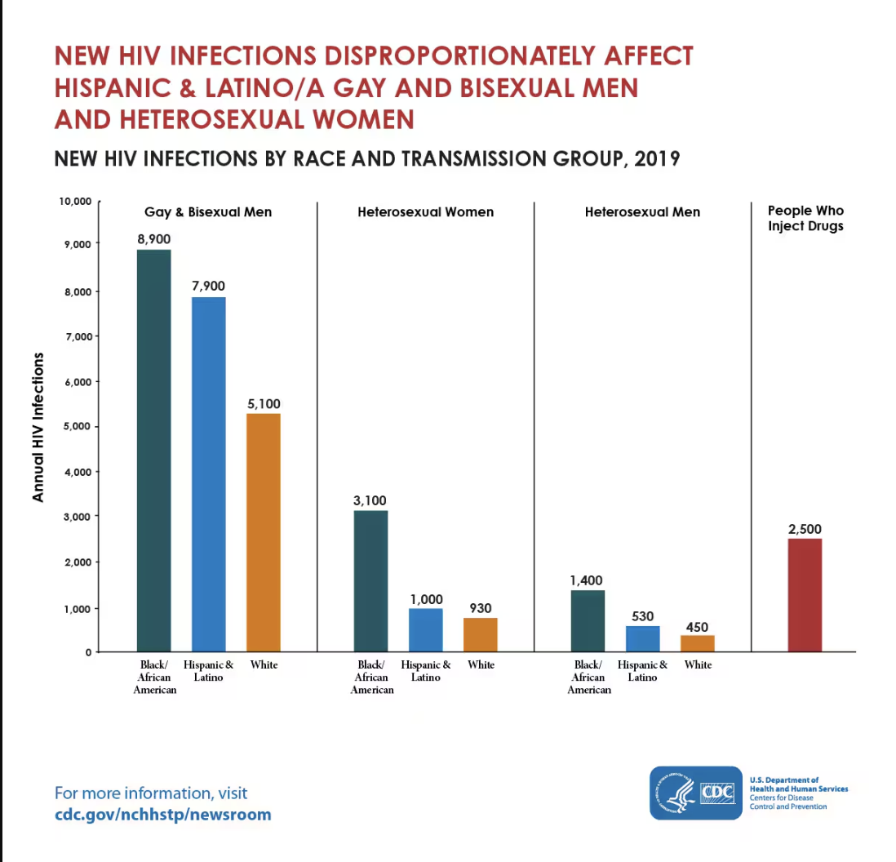
New HIV Infections Disproportionately Affect Hispanic/Latino Community in the US In 2019
Latino Men accounted for 89% of new HIV infections
With 87% of those infections attributed to Men who Have Sex with Men (MSM)
Hispanic/Latino gay and bisexual men were the least likely to:
Be aware of their HIV status
Use Pre-exposure Prophylaxis (PrEP)
Be virally suppressed.
Among Hispanic/Latina women:
91% of new HIV infections due to heterosexual contact
Hispanic/Latina Transgender Women (TGW) accounted for 35% of HIV infections among TGW with in seven major U.S. cities.
https://www.cdc.gov/hiv/group/racialethnic/hispanic-latino/index.html

Slide 9
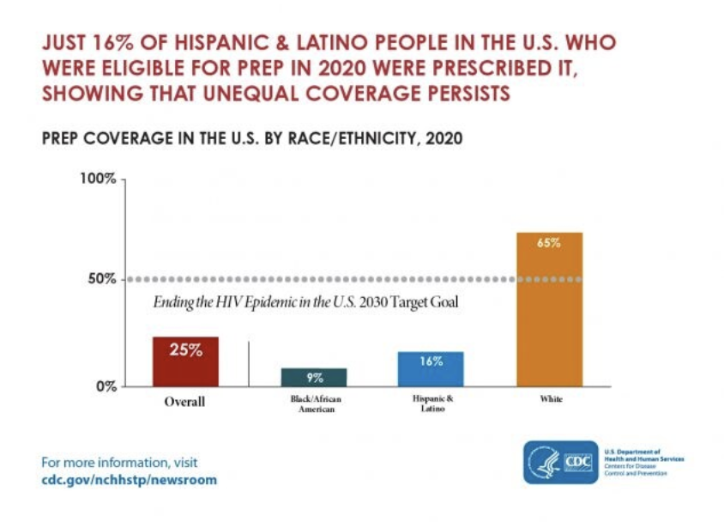
What do we need to end the HIV epidemic
The problem
Almost 16% of Hispanic/Latino people with HIV in the U.S. Still do not know their status
Only 71% with a recent diagnosis are virally suppressed
Only 16 % of those eligible for PrEP were prescribed it
The solution is to equitably ensure that all have equitable access to:
HIV testing
Care and treatment
HIV prevention, including PrEP
https://www.cdc.gov/hiv/group/racialethnic/hispanic-latino/index.html

Slide 10
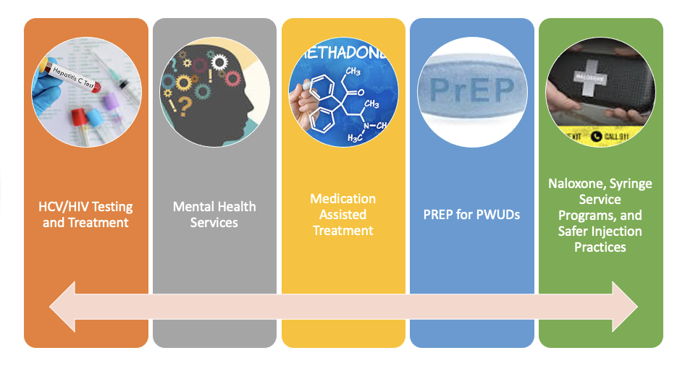
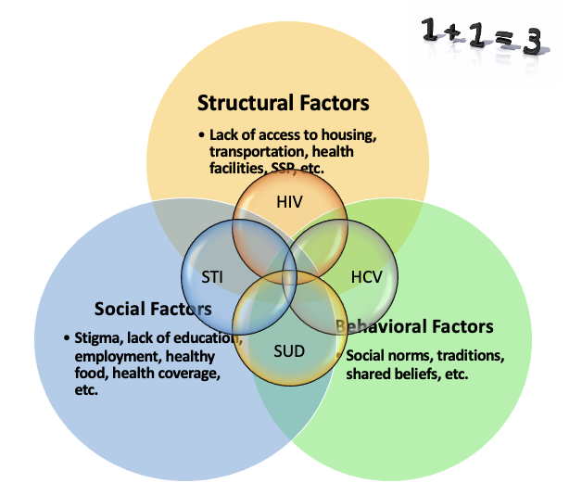
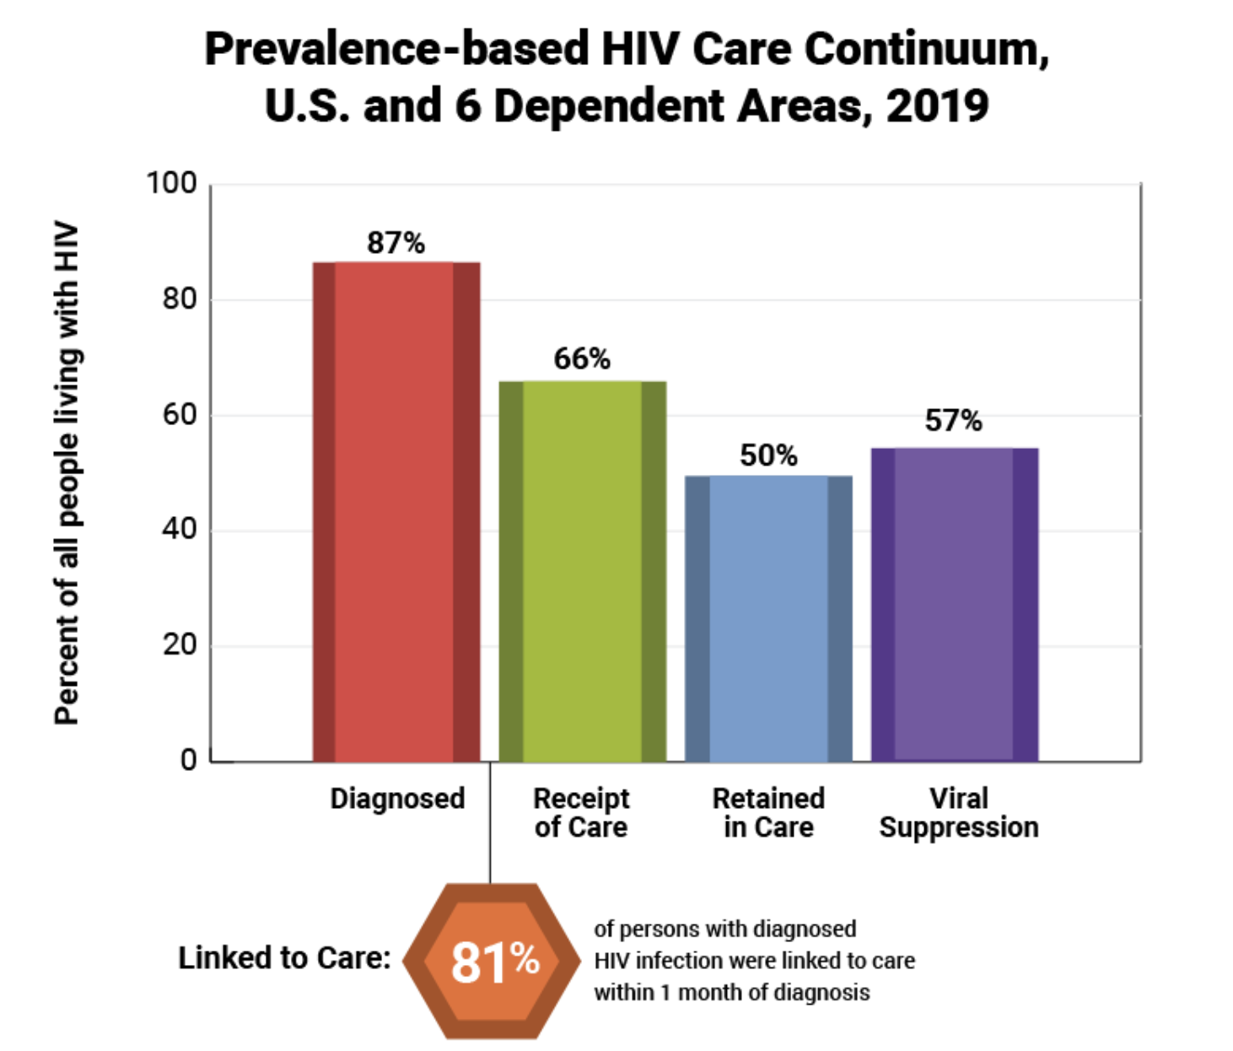
Approaches to EHE in Hispanic/Latino Population
Holistic Care
Syndemic Approach
Data Monitoring
HIV.Gov

Slide 11
HCV Elimination
Anthony Martinez, MD, AAHIVS, FAASLD Associate Professor of Medicine Jacobs School of Medicine University at Buffalo Medical Director, Hepatology Erie County Medical Center

Slide 12
HCV In 2024: 2.7-3.9 Million in the US
Baby Boomers (1945-1965) – STILL IMPORTANT!
People who use drugs
Justice Involved
WOCBA
Children born to HCV + mothers
Indigenous Communities
Unstable Housing
Injection Drug Use/ Opiate Crisis
WOCBA = Women of Childbearing Age
.

Slide 13
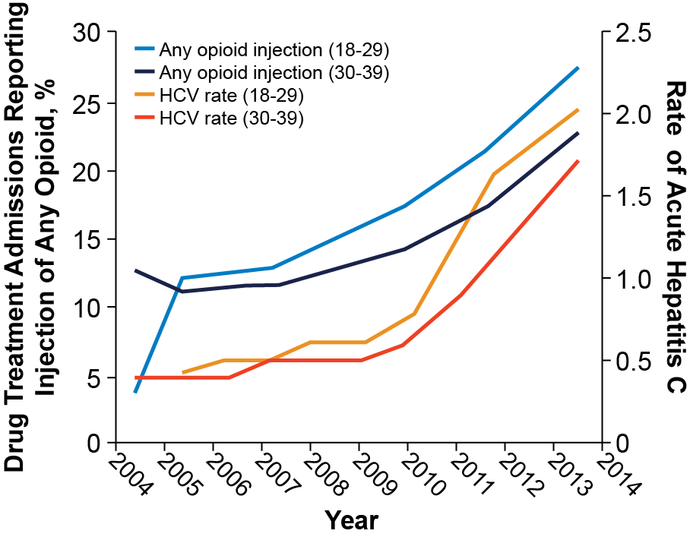
Increase in Hepatitis C Infections Linked to Worsening Opioid Crisis¹
Hepatitis C and Opioid Injection Rose Dramatically in
Younger Americans From 2004-2014
Among people ages 18-29, admission for injection opioid use increased by 622%
HCV incidence increased by 400% in the same cohort
As many as 1 in 2 patients have incomplete testing²
~7% of people who use drugs have received Tx
1. https://www.cdc.gov/nchhstp/newsroom/2017/hepatitis-c-and-opioid-injection-press-release.html.
2. Feld JJ. J Infect Dis. Published online October 13, 2023

Slide 14
Treatment As Prevention
Left untreated, one person actively injecting potentially will infect up to 20 others with HCV within the first 3 years of diagnosis^{1,2}
1. NIH National Institute on Drug Abuse. Heroin Research Report. Updated June 2021. Accessed November 2, 2021. https://www.drugabuse.gov/download/37596/heroin-research-report.pdf 2. NIH National Institute on Drug Abuse. Viral Hepatitis—A Very Real Consequence of Substance Use. Updated August 3, 2020. Accessed November 9, 2021. https://www.drugabuse.gov/drug-topics/viral-hepatitis-very-real-consequence-substance-use

Slide 15
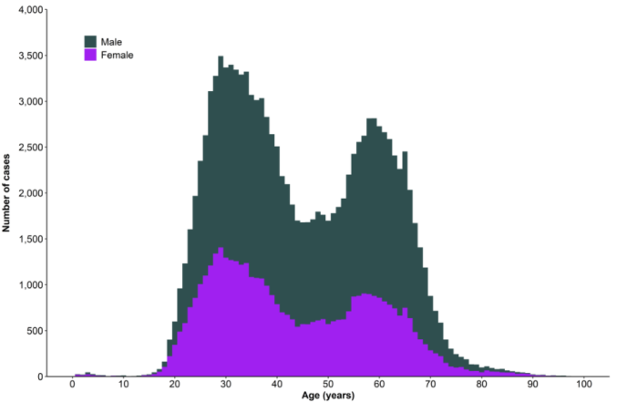
HCV and Women of Child-Bearing Age (WOCBA)
Changing HCV Prevalence Among Pregnant Women^{2,}
Number of newly reported chronic HCV infection cases, by sex and age — US, 2019¹
During 1998–2018, prevalence of HCV diagnosed during pregnancy increased 16 fold from .34/1000 to 5.3/1000
Prevalence increased 31-fold among ages 21-30
5.3 cases per 1000
Estimate 725 HCV + children born annually
Meta-analysis of 17 studies looked at HCV vertical transmission risk in women with chronic HCV: risk was 5.8% in HIV-negative women; risk doubled to 10.8% in HIV-positive women³
1. https://www.cdc.gov/hepatitis/statistics/2019surveillance/Figure3.8.htm. 2. Arditi et al Deliveries Among Patients With Maternal Hepatitis C OBSTETRICS & GYNECOLOGY VOL. 141, NO. 4, APRIL 2023
3. Society for Maternal-Fetal Medicine (SMFM). Am J Obstet Gynecol. 2017;217(5):B2-B12.
Notes:
cases per 100,0002009-20161% between fine

Slide 16
HCV In The LatinX Community
Screening for Hepatitis C Among Community Health Center Patients by Ethnicity and Language Preference²
N = 182,002 patients (adults 1945-1965)
60% non-Hispanic Whites, 29% Latino Spanish preferred, and 11% Latino English preferred.
9% received hepatitis C virus screening, and 2.4% were diagnosed with hepatitis C virus.
Latino English-preferred patients had lower rates of screening (5.5%) than both non-Hispanic Whites (9.4%) and Latino Spanish-preferred (9.6%)
2. Chan et al / AJPM Focus 2023;2(2):100077

Slide 17
The WHO HCV Elimination Target 2030: Where Do We Stand?
90% Diagnosing of the HCV-infected population
80% Treating of the eligible population
Reducing new HCV infections by 80%
World Health Organization. Global health sector strategy on viral hepatitis, 2016–2020. WHO REFERENCE NUMBER: WHO/HIV/2016.06
Sulkowski, M., Cheng, WH., Marx, S. et al. Estimating the Year Each State in the United States Will Achieve the World Health Organization’s Elimination Targets for Hepatitis C.Adv Ther 38, 423–440 (2021). https://doi.org/10.1007/s12325-020-01535-3

Slide 19
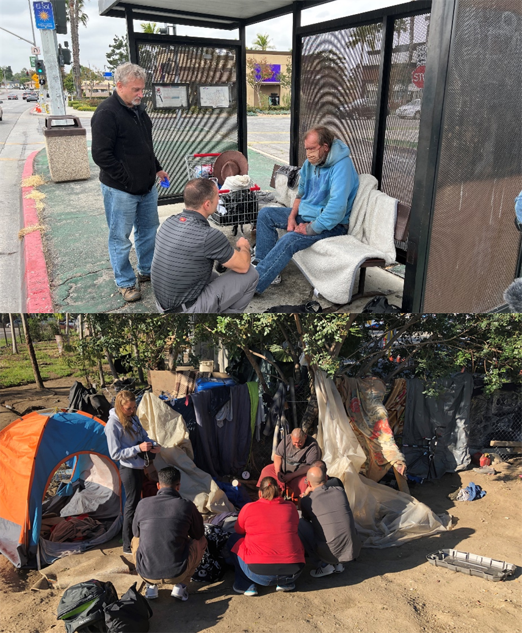
Homelessness: An Intractable Health Crisis?
80% People of Color, 40% Latinx
50% tri-morbid (physical, mental, and substance use disorder)
Age of death 42-52 years old
Overwhelming barricades to health care
>75% insured, but 7% with PCP
Image Reference: Taken by presenter

Slide 20
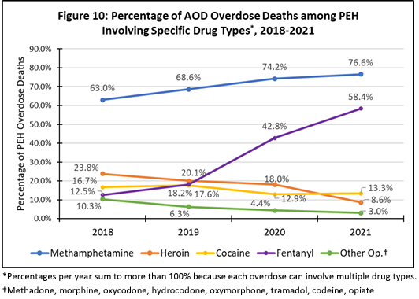
Death Rates in LA County

Slide 21
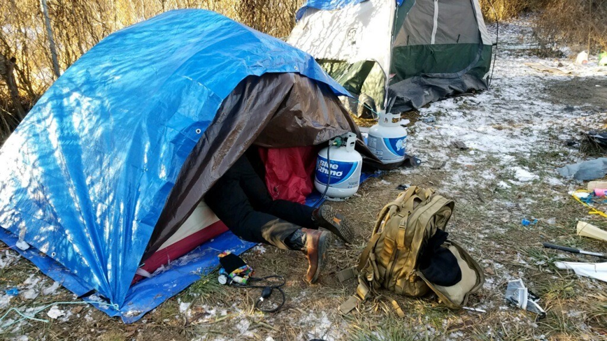
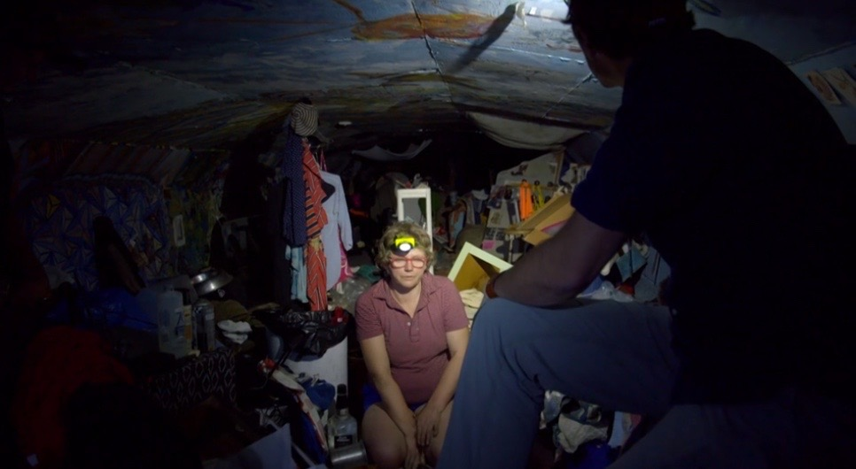
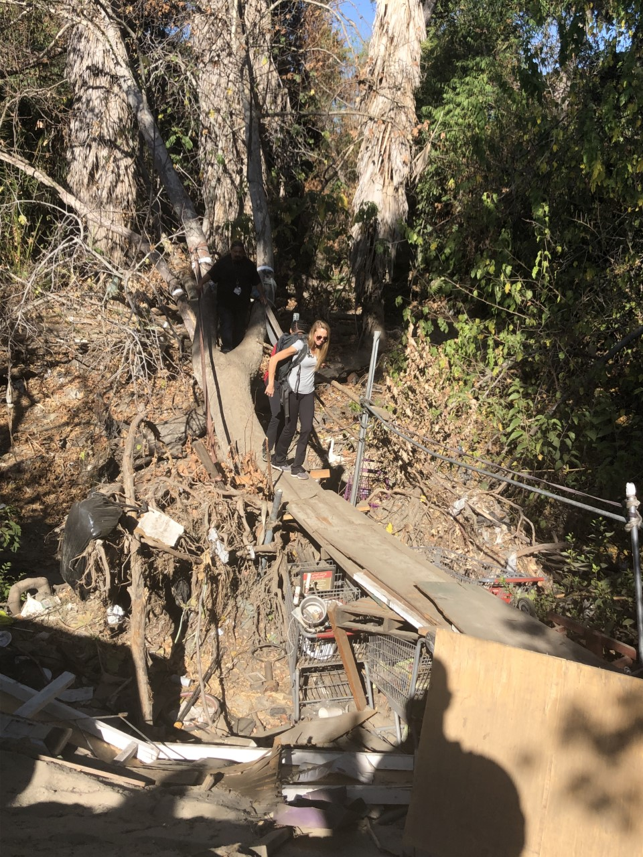
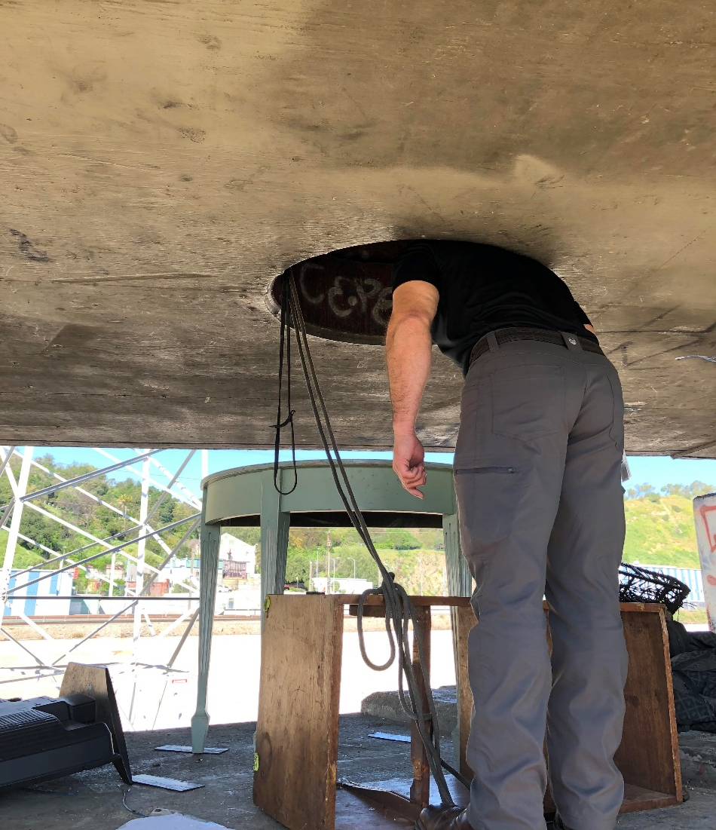
What is Street Medicine?
Provides healthcare to people experiencing homelessness where they are
Care performed on the street/ under bridges/parks
Done through walking rounds/backpack medicine
“Go to the People”
Image Reference: Taken by presenter

Slide 22
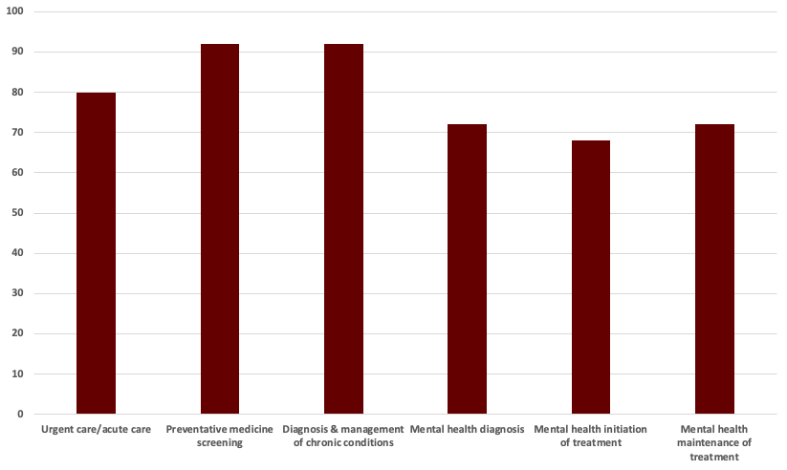
Wide Scope of Practice

Slide 23
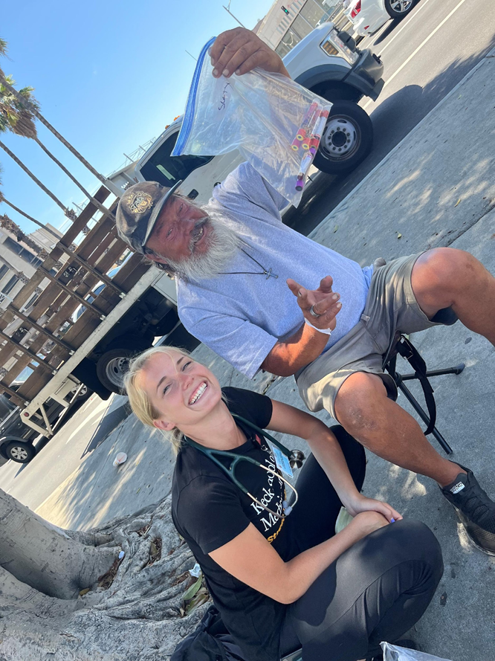
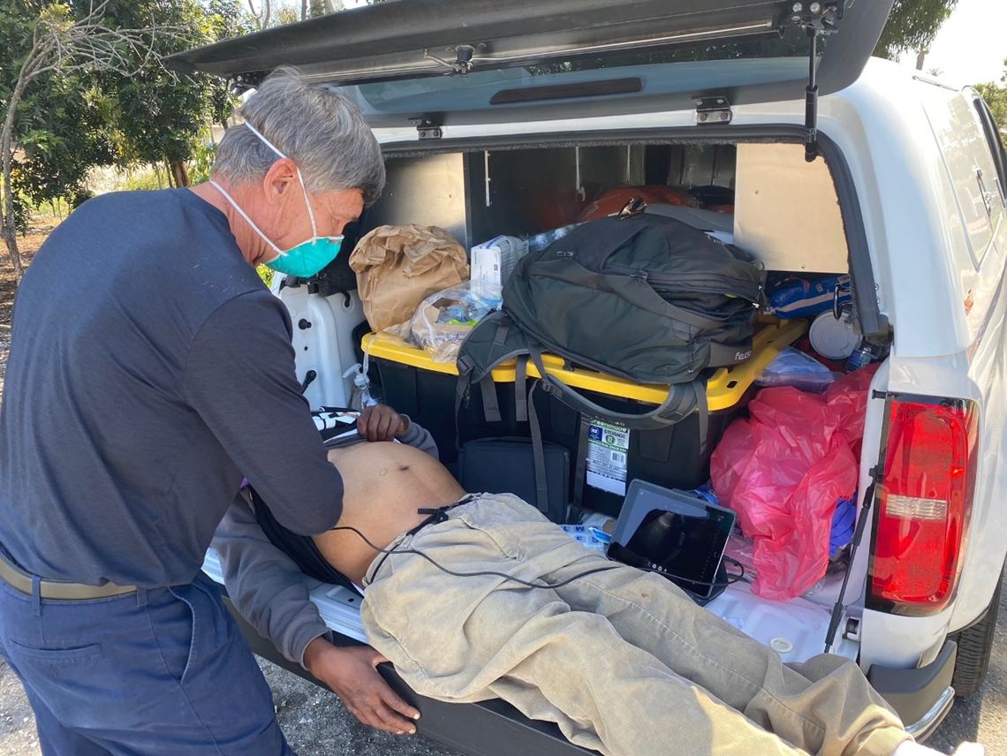
Image Reference: Taken by presenter

Slide 24
Resources
National Clinician Consultation Center http://nccc.ucsf.edu/
HIV Management
Perinatal HIV
HIV PrEP
HIV PEP line
HCV Management
Substance Use Management
Present on ECHO
https://hsc.unm.edu/scaetc/programs-services/echo.html​
AETC National HIV Curriculum https://aidsetc.org/nhc
AETC National Coordinating Resource Center https://targethiv.org/library/aetc-national-coordinating-resource-center-0
HIVMA Resource Directory https://www.hivma.org/globalassets/ektron-import/hivma/hivma-resource-directory.pdf
Additional trainings scaetcecho@salud.unm.edu
www.scaetc.org
Notes:
IDEA Platform: Infectious Diseases Education & Assessment. https://idea.medicine.uw.edu/
AETC National HIV Curriculum: 6 core modules for self study; regularly updated; CME, CNE
Hepatitis C Online Curriculum: https://www.hepatitisc.uw.edu/
Hepatitis B Online Curriculum: https://www.hepatitisb.uw.edu/
National STD Curriculum: https://www.std.uw.edu/

Slide 25
Notes:
Find an HIV-related topic TeleECHO in your area: https://echo.unm.edu/locations-2/echo-hubs-superhubs-united-states/
IDEA Platform: Infectious Diseases Education & Assessment. https://idea.medicine.uw.edu/
AETC National HIV Curriculum: 6 core modules for self study; regularly updated; CME, CNE
Hepatitis C Online Curriculum: https://www.hepatitisc.uw.edu/
Hepatitis B Online Curriculum: https://www.hepatitisb.uw.edu/
National STD Curriculum: https://www.std.uw.edu/

