Slide 1
HIV Management - Review of DHHS Guidelines
Allison Cormier, M.D.
Infectious Diseases Staff Physician
South Louisiana Medical Associates
Houma, Louisiana
Notes:
Version date

Slide 2
Conflict of Interest Disclosure Statement
No financial conflicts of interest for Allison Cormier
Opinions do not reflect those of my employer
Includes slides originally developed by:
  Emmanuel Guajardo, MD
    Medicine, Infectious Disease, Tulane School of Medicine
  Shital M. Patel, MD, MSc and Melanie Goebel, MD
    Medicine, Infectious Diseases, Baylor College of Medicine
    Houston AETC
This program is supported by the Health Resources and Services Administration (HRSA) of the U.S. Department of Health and Human Services (HHS) as part of an award totaling $4,205,743 with 0% financed with non-governmental sources. The contents are those of the author(s) and do not necessarily represent the official views of, nor does mention of trade names, commercial practices, or organizations imply an endorsement by HRSA, HHS, or the U.S. Government. For more information, please visit HRSA.gov. Any trade/brand names for products mentioned during this presentation are for training and identification purposes only.

Slide 3
Use of Trade/Brand Names
This program is supported by the Health Resources and Services Administration (HRSA) of the U.S. Department of Health and Human Services (HHS) as part of an award totaling $4,205,743, with 0% financed with non-governmental sources.
The views expressed do not necessarily reflect the official policies of the Department of Health and Human Services, nor does mention of trade names, commercial practices, or organizations imply endorsement by the U.S. Government. Any trade/brand names for products mentioned during this presentation are for training and identification purposes only.

Slide 4
Unconscious Bias Disclosure
SCAETC recognizes that language is constantly evolving, and while we make every effort to avoid bias and stigmatizing terms, we acknowledge that unintentional lapses may occur in our presentations.
We value your feedback and encourage you to share any concerns related to language, images, or concepts that may be offensive or stigmatizing.
Your input will help us refine and improve our presentations, ensuring they remain inclusive and respectful to participants.

Slide 5
Sharing Slides Statement
These slides may not be published, posted online, or used in commercial presentations without permission.

Slide 6
Learning Objectives
Understand baseline and periodic laboratory testing for people with HIV (PWH)
Describe the recommended antiretroviral regimens for initial therapy
Understand principles of management of treatment-experienced patients
Notes:
PLWH now PWH per HRSA guidance

Slide 7
Learning Objectives
Understand baseline and periodic laboratory testing for people with HIV (PWH)
Describe the recommended antiretroviral regimens for initial therapy
Understand principles of management of treatment-experienced patients
Notes:
PLWH now PWH per HRSA guidance

Slide 8
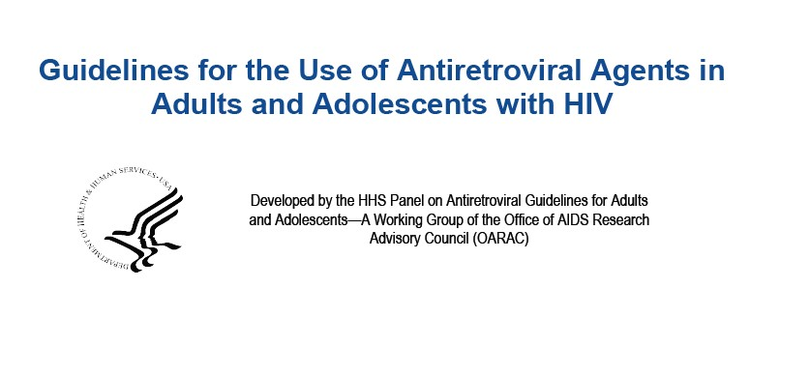
HIV Guidelines
Panel on Antiretroviral Guidelines for Adults and Adolescents. Guidelines for the Use of Antiretroviral Agents in Adults and Adolescents with HIV. Department of Health and Human Services. Available at https://clinicalinfo.hiv.gov/en/guidelines/adult-and-adolescent-arv
Notes:
Guiding document and primary reference for this presentation (if no reference listed at the bottom of slide, assume it’s from this document)
Huge document (585 pages) – we will focus on a few key sections

Slide 9
Case Presentation
John is a 34-year-old man who presents to clinic with new diagnosis of HIV
Reports no Past Medical History (PMHx) and no symptoms
Reports multiple condomless sexual encounters with male and female partners
What lab and imaging tests would you order?
Notes:
Representative case to guide us through these slides
For this case, assume the diagnosis has been confirmed (we’ll discuss screening and diagnosing in later talk)

Slide 10
Initial Labs
HIV Labs
Non-HIV Labs
CD4 count and %
HIV viral load (VL)
Genotype
Drug reaction risk
General
Coinfection screens
Malignancy screens
Metabolic screens
CD4 = Clusters of Differentiation
Notes:
- “Buckets” of labs

Slide 11
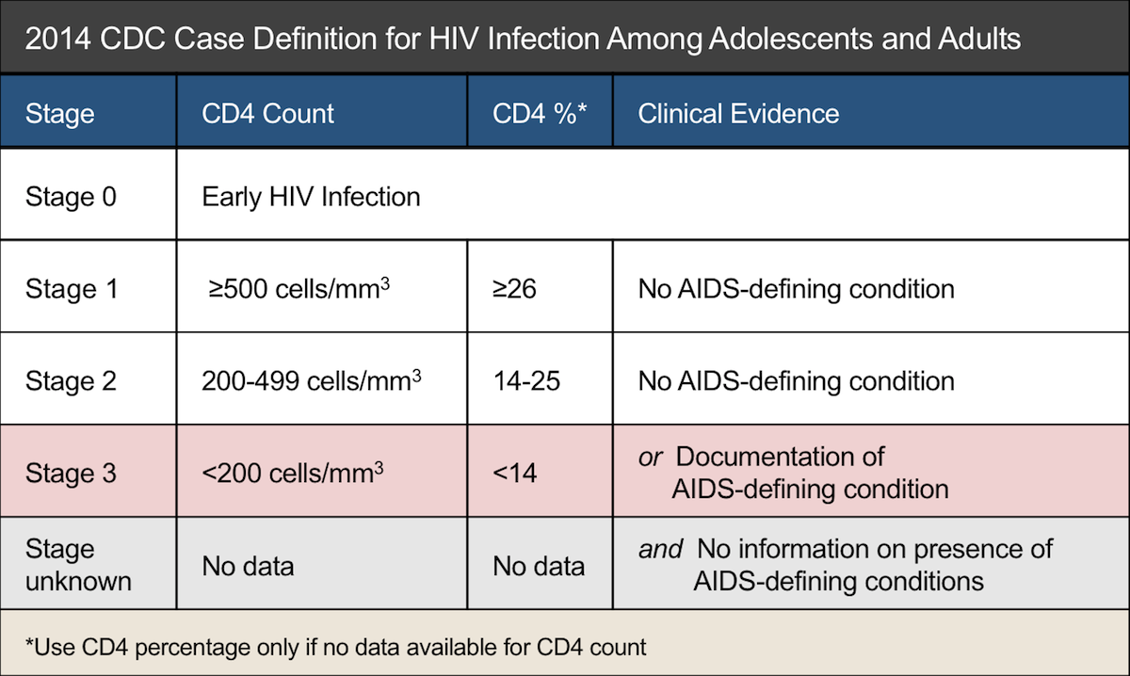
HIV-Specific Labs: CD4 & VL
CD4 count:
  Used to stage disease
HIV VL:
  HIV RNA quantitative PCR
  Used to monitor response to treatment
PCR = Polymerase Chain Reaction
Source: Centers for Disease Control and Prevention. Revised surveillance case definition for HIV infection—United States, 2014. MMWR Recomm Rep. 2014;63(RR-03):1-10.
Notes:
-Here’s how we interpret the key labs: CD4 and HIV VL
-CD4 helps to stage disease and determine need for OI prophylaxis
-If CD4 is <200, or patient has an AIDS-defining condition, then their HIV disease has progressed to AIDS
In the most recent 2014 CDC case definition for HIV, there is a 5-stage system. A patient’s status can change in either direction after diagnosis.
Stage 0 is early infection
Stage 1 is defined as a CD4 > 500
Stage 2 is a CD4 of 200-499
Stage 3 is a CD4 < 200 or the presence of an AIDS-defining condition
We aren’t going to go into detail about AIDS-defining conditions. This includes conditions such as opportunistic infections and HIV-related malignancies

Slide 12
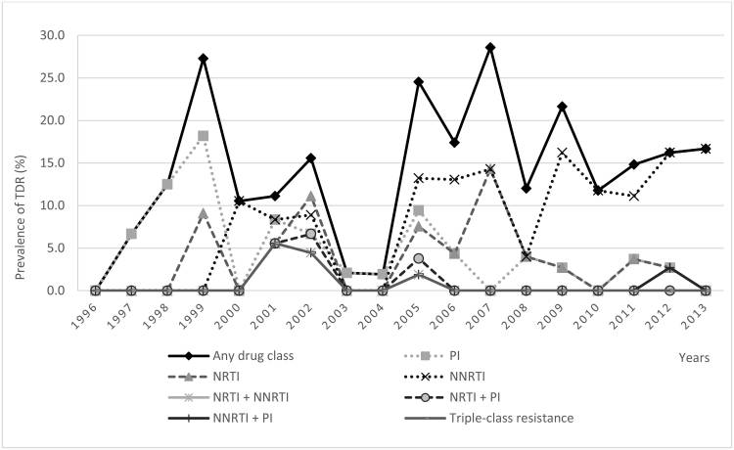
HIV-Specific Labs: Baseline Genotype
USA: transmitted resistance rate for treatment naïve 16%
NNRTI > NRTI & PI > INSTI
(NNRTI = Non-nucleoside Reverse Transcriptase Inhibitor, NRTI = Non-nucleoside Reverse Transcriptase Inhibitor, PI = Protease Inhibitor, INSTI=Integrase Strand Inhibitors)
https://www.ncbi.nlm.nih.gov/pmc/articles/PMC4712087/
Notes:
K103N is most commonly transmitted DRM (NVP and EFV)
Transmitted INSTI resistance is still rare – routine resistance testing NOT recommended (e.g. GenoSure)
Caveats: patient was on Cabotegravir for PrEP; source patient was on an INSTI
Generally need >1000 copies to run a genotype. Try to run it at baseline even if they have low VL

Slide 13
HIV-Specific Labs: Risk for Adverse Drug Reaction
HLA-B*57:01 = if positive, high risk for abacavir hypersensitivity (avoid)
G6PD = if deficient, avoid dapsone, primaquine, +/- sulfa
Do not need to test all PWH for these
HLA-B = Histocompatability Complex class B, G6PD = Glucose 6 Phosphate Dehydrogenase
Notes:
Don’t need to check HLA unless you’re considering using ABC in your regimen
Abacavir binds to his HLA on CD8 cells and leads to inflammatory cytokine release
Flu-like syndrome + GI symptoms (N/V/D) +/- Resp symptoms +/- Rash (w/in few days to few weeks)
DON’T RECHALLENGE -> shock and death
Glucose-6-phosphate dehydrogenase deficiency: can check in appropriate ethnic groups or if considering one of these medications
Areas where malaria was/is endemic. X-linked
Acute hemolytic anemia 2/2 oxidative stress
Bactrim is usually well-tolerated in G6PDD

Slide 14
Non-HIV Labs: General
Complete Blood Count (CBC)
Complete Metabolic Panel
  Baseline kidney & liver function, glucose, electrolytes
Urinalysis
  Baseline protein and glucose
Pregnancy Test
Notes:
Modern ART drugs are generally safe, but can have renal or hepatic side effects – need baseline levels
Not applicable to John, but for Women of Childbearing Age, check Urine Pregnancy Test -> If pos, can guide choice of ART, and if neg, can guide discussion of contraception plans

Slide 15
Back to John’s Case
CD4: 42 cells/µL, 7%
Viral load: 106,000 copies/mL
Genotype: Wild Type
Which opportunistic infection(s) would you screen for in this asymptomatic patient?
Notes:
- Assume his CBC and CMP were completely normal

Slide 16
Opportunistic Infections in PWH
Fungi
  Pneumocystis pneumonia
  Cryptococcosis
  Candidiasis
  Histoplasmosis
  Coccidioidomycosis
  Talaromycosis
Bacteria
  Tuberculosis
  Disseminated Mycobacterium avium
  Bartonella
Protozoa
  Toxoplasmosis
  Cryptosporidiosis
  Microsporidiosis
  Cystoisosporiasis
  Leishmaniasis
  Chagas disease
Viruses
  Cytomegalovirus disease
  Progressive multifocal leukoencephalopathy (JC virus)
  Varicella-zoster virus
  Human papilloma virus
  Herpes simplex virus
  Human herpesvirus-8 disease
National HIV Curriculum: https://www.hiv.uw.edu/
OI Treatment Guidelines (clinicalinfo.hiv.gov)
Notes:
- Opportunistic infections are defined as infections that are more frequent or more severe because of HIV-mediated immunosuppression (can be AIDS-defining illnesses)
These infections can be categorized by type of organism, including fungi, bacteria, protozoa, and viruses.
Cryptococcus: Asymptomatic antingenemia seen in 4.3% of PWH when CD4 < 50 -> check serum Crypto Ag if CD4 < 100, and certainly if < 50
For other OIs, evaluation should be directed by symptoms/clinical assessment (whole separate lecture)

Slide 17
Initial Labs
HIV Labs
Non-HIV Labs
CD4 count and %
HIV viral load (VL)
Genotype
Drug reaction risk
General
Coinfection screens
Malignancy screens
Metabolic screens
Notes:
- Back to our “Buckets” of labs

Slide 18

Non-HIV Labs: Coinfections
Syphilis (Treponemal Ab or RPR)
Gonorrhea & Chlamydia (urine, rectal, and/or pharyngeal NAAT)
TB (TST or IGRA)
Viral Hepatitis (A/B/C)
Toxoplasma Immunoglobulin G (IgG)?
Herpes Viruses?
https://www.cdc.gov/std/saw/talktesttreat/default.htm Ab = Antibodies, RPR = Rapid Plasma Regain, NAAT = Nucleic Acid Amplification Test, TST = Tuberculin Skin Test, IGRA = Interferon Gamma Release Assay
Notes:
STI’s travel together – if positive for one, can be positive for another!
GC/C NAAT should be screened at all sites based on exposure history
Trichomonas (annual screening for women, no recommendation for men)
Do not need to routinely screen for Toxo or HSV or CMV in asymptomatic patients
STI Awareness Week Apr 9-15

Slide 19
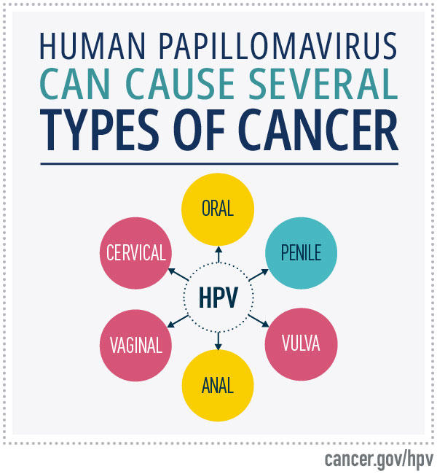
Non-HIV Labs: Malignancy Screens
Age-appropriate cancer screenings
Caveats
  Cervical cancer
  Anal cancer
https://www.cancer.gov/about-cancer/causes-prevention/risk/infectious-agents/hpv-and-cancer
Notes:
HIV increases incidence of HPV-related cancers, including cervical and anal CA
Cervical CA algorithm is different in PWH: still start at age 21, but don’t stop at age 65, and screening frequency more aggressive
Anal CA screening guidelines are evolving as we get more data. Can consider screening with anal pap for high-risk groups (especially MSM who practice anoreceptive sex and/or have Hx of anogenital warts) – CAVEAT: need to have local expertise for interpretation of screening and referral infrastructure for HRA

Slide 20

Non-HIV Labs: Metabolic Screens
Hemoglobin A1c
Lipid profile
Vitamin D?
https://www.nebraskamed.com/primary-care/9-vitamin-d-deficiency-symptoms-and-11-high-vitamin-d-foods
Notes:
HgbA1c should ideally be checked BEFORE starting ART (once on ART, it tends to underestimate BG levels)
If random blood glucose from CMP abnormal -> repeat fasting (generally use FGB to make diagnosis of DM in PWH)
If random lipids abnormal -> repeat fasting
Consider rechecking lipids ~3 months after switching ART
Routine screening of Vit D is not recommended. Bone mineral density testing, however…

Slide 21
Initial Imaging
Bone Mineral Density Screening (DEXA)?
  All men & postmenopausal women > age 50
Chest X-ray?
https://academic.oup.com/cid/article/52/8/1061/286563?login=false
Notes:
Mechanism: HIV T-cell activation -> proinflammatory cytokines & RANKL expression -> more osteoclast activity & osteoblast apoptosis
Some ART (TDF) can also lower bone mineral density
If osteopenia or osteoporosis, check Vit D level -> treat with Ca + Vit D +/- Bisphosphonates as appropriate
CXR is not strong universal recommendation. Mostly recommended for patient with +LTBI screen or Hx of TB
Good practice to get a baseline though that you can later compare to

Slide 22
Periodic Lab Testing
HIV VL
  Repeat 4-8 weeks after starting a new regimen
  Once suppressed, repeat every 3-4 months
  Once controlled for > 1 year, repeat 6 months
CD4
  Repeat every 3 months for first 2 years
CBC & CMP
CMP = Comprehensive Metabolic Panel
Notes:
Need to ensure the new regimen is suppressing the virus / that VL is going down
Repeat VL in 4-8 week intervals until it becomes undetectable
CD4 count is much more variable, and generally needs to be checked less often
CD4 increases by 50-150 in the first year (especially 1st 3 months), then by 50-100/year until steady state is reached
If CD4 > 300, can check CD4 every 6 months
Can check CBC and CMP every 6 months (every 3 months CBC if you’re following the CD4)

Slide 23
Learning Objectives
Understand baseline and periodic laboratory testing for people with HIV (PWH)
Describe the recommended antiretroviral regimens for initial therapy
Understand principles of management of treatment-experienced patients
Notes:
- Pause for questions

Slide 24
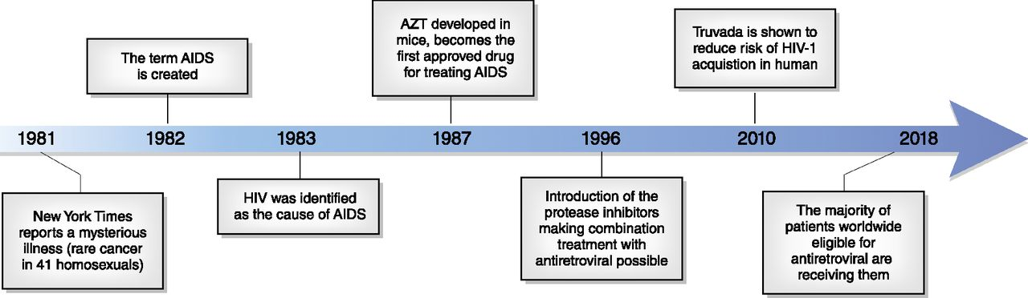
Milestones in HIV Therapy
CJASN March 2019, 14 (3) 435-444; DOI: https://doi.org/10.2215/CJN.02240218
Notes:
- Start with a history lesson
- I include this slide to emphasize that we have come a long way in the HIV epidemic in the last 40 years
- In 1987, AZT or zidovudine, became the first approved drug for treating HIV (37 years ago)
- Combination antiretroviral therapy was introduced in 1996 (“HAART”)
- And in the modern era, the majority of people eligible for antiretroviral therapy are receiving them, but we still have a ways to go to end the epidemic

Slide 25
Initiating Antiretroviral Therapy (ART)
Who should start ART?
  Everyone! ART is recommended for all persons with HIV
When should you start ART?
  Immediately! Initiate ART as soon as possible after HIV diagnosis
  Prompt initiation is critical for:
    Pregnant women with HIV
    Certain comorbidities
      HIV-associated nephropathy
      Co-infection with hepatitis B
      HIV-associated immune thrombocytopenia (ITP)
      Lymphoma
Notes:
-Although we don’t yet have a cure, we do have excellent treatments for HIV
-You may recall that years ago it was recommended to wait to initiate ART until the CD4 dropped below a certain threshold
-Current guidelines recommend to initiate ART for all people with HIV as soon as possible after HIV diagnosis.
-Early initiation of ART improves linkage to care, decreases the time to viral suppression, and improves the rate of virologic suppression among people with HIV
- Reasons to delay: Crypto Meningitis, new TB diagnosis (especially TB meningitis)

Slide 26
ART Treatment Goals
Maximally and durably suppress plasma HIV RNA
Restore and preserve immunologic function
Reduce HIV-associated morbidity and prolong the duration and quality of survival
Prevent HIV transmission (Treatment as Prevention)

Slide 27
ART Guidelines: Preferred Initial Regimen
ART Regimen | Rating | Notes
Bictegravir-Tenofovir AF-Emtricitabine (Biktarvy) | AI
Dolutegravir-Abacavir-Lamivudine (Triumeq) | AI | If HLA-B*5701 negative and patient without chronic HBV
Dolutegravir + Tenofovir + Emtricitabine (Descovy or Truvada) | AI | Tenofovir AF or DF formulation
Dolutegravir-Lamivudine (Dovato) | AI | Avoid if VL>500,000, HBV co-infection, or resistance test results not available
Many single tablet regimens now available
https://clinicalinfo.hiv.gov/en/guidelines/adult-and-adolescent-arv/what-start-initial-combination-regimens-antiretroviral-naive?view=full
Notes:
-Currently there are more than 30 FDA-approved antiretroviral medications, starting with zidovudine in 1987, to most recently injectable cabotegravir. Many of them we use seldomly
-These are the recommended initial regimens for most people with HIV
-All of these regimens include an Integrase Inhibitor with either 1 or 2 “Nukes”
-Several of these regimens are available as a single-tablet co-formulated regimen (“STR”)
-Current regimens are easier to take, more effective, and safer than older regimens.
Rating Recommendation: A=strong, B=moderate, C=optional
Rating Evidence: I=data from RCTs; II= data from well-designed nonrandomized traials, observational cohort studies with long-term clinical outcomes, relative bioavailability/bioequivalence studies, or regimen comparisons from randomized switch studies; III=expert opinion
Top 3 options in recommended list by IAS-USA 2018 guidance & are the recommended regimens if ART started prior to having baseline HIV VL or CD4 or resistance testing available. https://www.iasusa.org/2018/07/24/antiretroviral-drugs-treatment-prevention-hiv-infection-adults-2018-recommendations-of-the-international-antiviral-society-usa-panel/

Slide 28
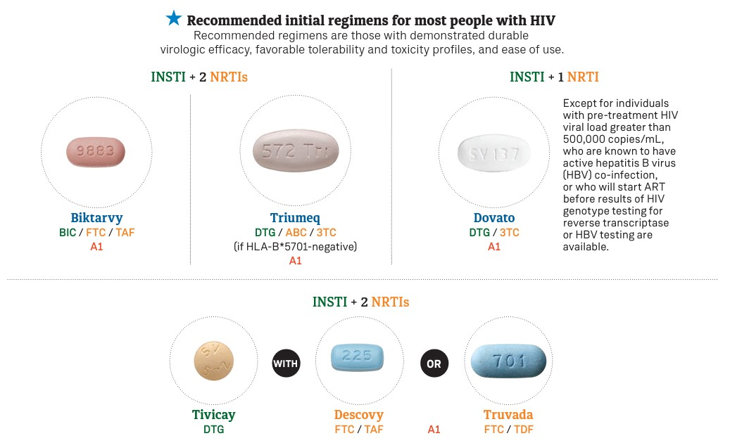
https://www.positivelyaware.com/2022-hiv-drug-guide
Notes:
- Same recommended regimens but with photos
- Positively Aware HIV Drug Guide: user friendly, targeted at patients as well as providers

Slide 29
ART Guidelines: Alternate Regimens
ART Regimen | Rating | Notes
Raltegravir + Tenofovir + (Emtricitabine or Lamivudine) | BI/BII
Elvitegravir-cobicistat-Tenofovir -Emtricitabine | BI
Darunavir+ritonavir/cobicistat + Tenofovir + Emtricitabine | AI
Atazanavir + ritonavir/cobi + Tenofovir + Emtricitabine | BI
Daruvavir + ritonavir/cobi + Abacavir + Lamivudine | BII | If HLAB5701 negative
Doravirine + Tenofovir + Lamivudine | BI/BIII
Efavirenz + Tenofovir + Emtricitabine | BI/BII | Several formulations
Rilpivirine + Tenofovir + Emtricitabine | BI/BII | If VL<100,000 & CD4>200
Darunavir + Ritonavir + Raltegravir | CI | BID dosing; if VL<100,000 & CD4 >200
Darunavir + Ritonavir + Lamivudine | CI
https://clinicalinfo.hiv.gov/en/guidelines/adult-and-adolescent-arv/what-start-initial-combination-regimens-antiretroviral-naive?view=full
Notes:
- These alternative regimens are recommended in certain clinical situations. They are effective and tolerable but have some disadvantages compared to the preferred regimens
- Notice that all of these regimens include 2 NRTIs plus a third class of medication, or a boosted PI plus NRTI or INSTI
-The key is having at least 2 drugs from different classes
Rating Recommendation: A=strong, B=moderate, C=optional
Rating Evidence: I=data from RCTs; II= data from well-designed nonrandomized traials, observational cohort studies with long-term clinical outcomes, relative bioavailability/bioequivalence studies, or regimen comparisons from randomized switch studies; III=expert opinion
Top 3 options in recommended list by IAS-USA 2018 guidance. https://www.iasusa.org/2018/07/24/antiretroviral-drugs-treatment-prevention-hiv-infection-adults-2018-recommendations-of-the-international-antiviral-society-usa-panel/
Lamivudine may be substituted for emtricitabine

Slide 30
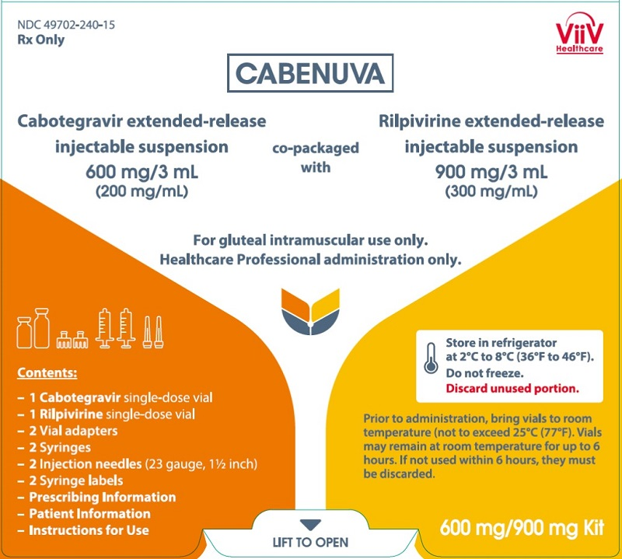
The Future of ART: Injectables
Injectable long-acting cabotegravir and rilpivirine (Cabenuva)
Administered once every month or once every 2 months
Most frequent adverse event: injection site reaction (pain)
https://www.hiv.uw.edu/page/treatment/drugs/cabotegravir-rilpivirine-long-acting-injectable
Notes:
In January 2021 the FDA approved the first injectable, complete regimen for HIV
This regimen is for patients who are virologically suppressed on a stable regimen with no history of treatment failure and no known or suspected resistance to cabotegravir or rilpivirine
Clinical trials published in 2020 showed that virologic suppression was similar for long-acting cabotegravir plus rilpivirine administered every 8 weeks vs every 4 weeks
FDA approval allows for every 4 or every 8 week dosing
Note that oral cabotegravir can be taken in combination with oral rilpivirine for one month prior to switching to the injectable formulation to ensure the medications well-tolerated

Slide 31
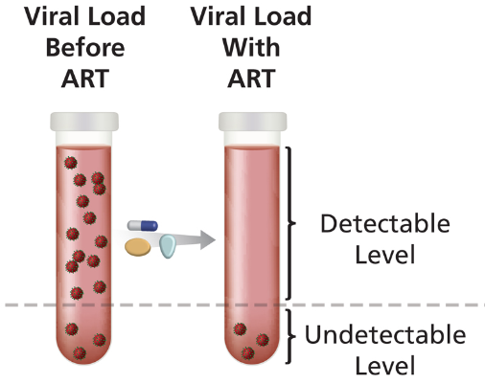
Virologic Success
Virologic suppression: HIV RNA level < lower limit of detection (<20 copies in VA)
After initiation of effective ART, virologic suppression usually occurs within the first 12 to 24 weeks of therapy.
Predictors of virologic success:
  Low baseline viremia
  High potency of the ART regimen
  Tolerability of the regimen
  Convenience of the regimen
  Excellent adherence
<20
Notes:
Once we have linked a patient and care and initiated ART, how do we define success?

Slide 32
Virologic Success
You start John on Biktarvy, and within a couple months, his viral load is undetectable!

Slide 33
Learning Objectives
Understand baseline and periodic laboratory testing for people with HIV (PWH)
Describe the recommended antiretroviral regimens for initial therapy
Understand principles of management of treatment-experienced patients
Notes:
- GENERAL Principles – do not hesitate to reach out to an HIV expert for consultation if any doubts

Slide 34
Case Presentation
Tom is a 45-year-old man who presents to clinic for follow up
Well-established in your practice
Current ART: Odefsey
Works irregular hours, struggled with adherence
Most recent CD4 460, VL 2.3k (this week)
Notes:
Representative case to guide us through these slides
Patient reports his adherence is much better these past few months, and was not missing ART doses when he drew these labs

Slide 35
HIV History
Diagnosed in 2015
  MSM, no IVDU
  Nadir CD4 290, no history of OI
Treatment History
  Atripla from diagnosis to 2017 (EFV/TDF/FTC)
  Odefsey since 2017 (RPV/TAF/FTC)
No known Drug Resistance Mutations
MSM = Men who have Sex with Men, IVDU = Intravenous Drug Use
Notes:
In PWH whose viral load is elevated – first confirm adherence & risk of DDI or Drug-Food Interactions
Patient reaffirms adherence & they are NOT taking any medications that can interfere with Odefsey (PPI)
Next step: need to check genotype. However, the patient can’t go back to the lab until next week!
You instruct the patient to keep taking the failing regimen while you check the genotype. Why?

Slide 36
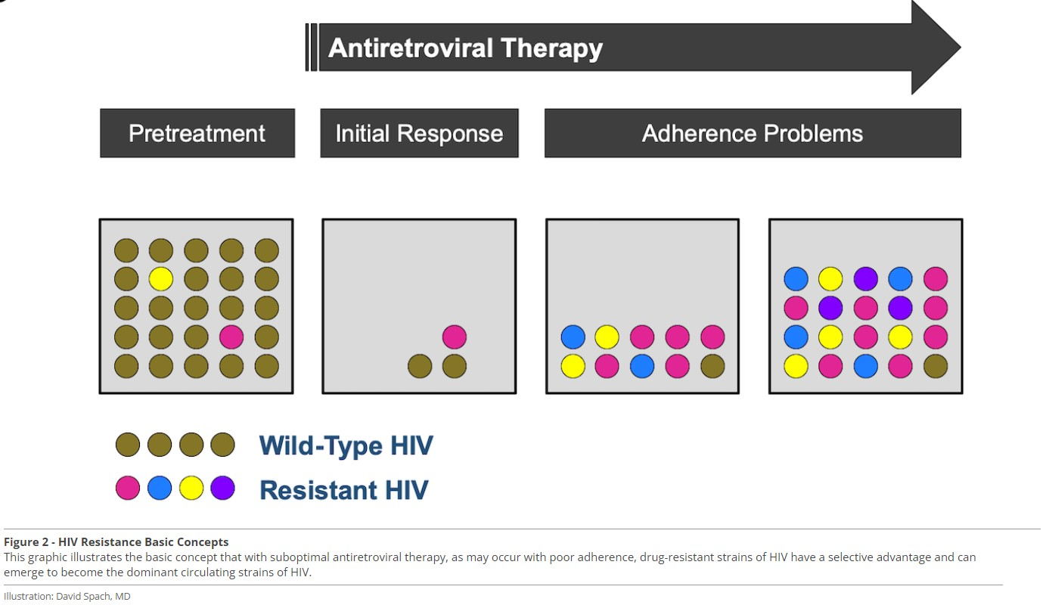
https://www.hiv.uw.edu/go/antiretroviral-therapy/evaluation-management-virologic-failure/core-concept/all
Notes:
HIV replicates at a high-rate, and reverse transcriptase (RT) enzyme is error-prone, leading to mutations
Box A, Pretreatment: Mutations come w/ fitness cost. Wild type (WT) virus predominates (in the absence of selective pressures such as ART)
Box B, Initial Response: ART causes viral suppression. With good adherence, there is too little replication for mutations to occur at a significant frequency. Virus remains suppressed
Box C and D, Adherence Problems: viral strains that develop mutations w/resistance to ART have fitness advantage & become dominant quasi-species. This leads to virologic failure
If/when ART is subsequently held, fitness advantage of mutated quasi-species is decreased, & WT strain dominates again. This is why genotype should be checked while patient is on the failing regimen, or w/in 4 weeks of stopping it!

Slide 37
Drug Resistance Mutations
Tom’s Genotype: K103N, V108I, E138K
No prior genotypes available
Now what?
Notes:
Important before making a switch in ART to know all their past regimens and review all available genotypes

Slide 38
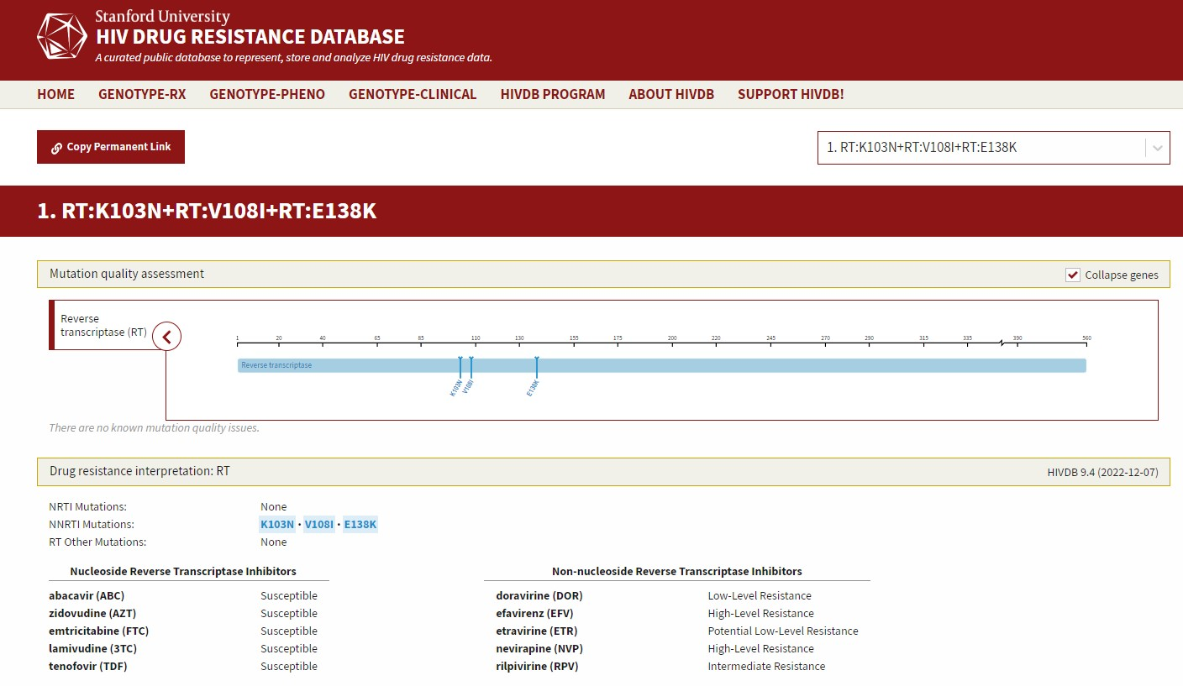
Drug Resistance Mutations
https://hivdb.stanford.edu/
Notes:
Use a DRM database to check which ART drugs you can use to treat the patient
Details of this particular analysis are superfluous
Takeaway points: availability of Stanford HIV DRB (free)
Importance of using ALL known genotypes
Want at least 2 fully active drugs (if one has high barrier to resistance); otherwise, need 3 drugs
Generally don’t want to add 1 drug to a failing regimen
K103N selected by EFV, decreases viral susceptibility to EFV and NVP
V108I is an accessory mutation – doesn’t do much on its own, but does lower EFV and NVP susceptibility a bit
E138K selected by RPV, decreases susceptibility to RVP a bit on its own

Slide 39
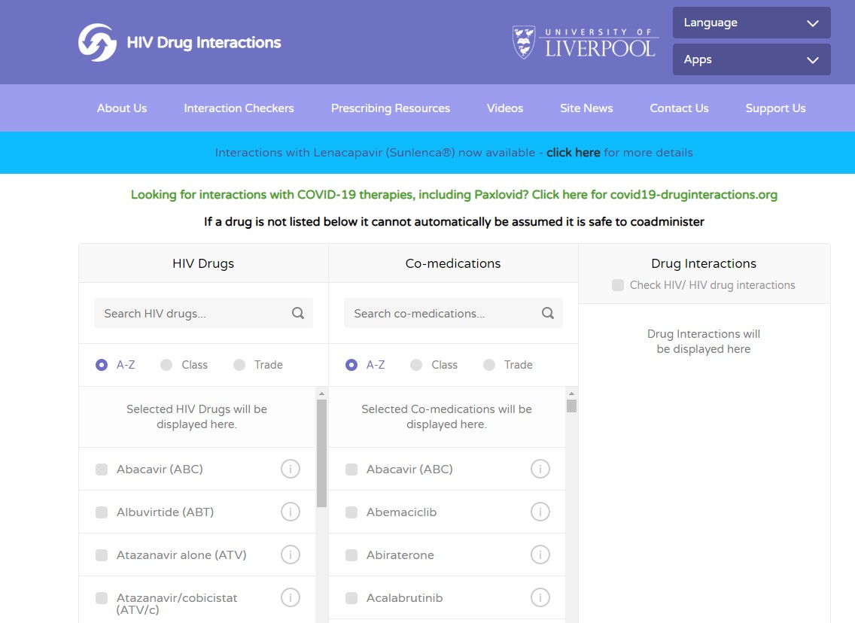
Check for Drug Interactions
https://www.hiv-druginteractions.org/checker
Notes:
Once you have a candidate regimen to switch to, you need to check for possible drug interactions
If DDI – either make a change in the co-medication, or choose a different ART
Tool is also useful to check for DDI that might explain why their regimen is failing in the first place

Slide 40
Tom’s New Regimen
Biktarvy (BIC/TAF/FTC)
Adherence Counseling
Repeat VL in 4 weeks: undetectable!
Notes:
You start Tom on Biktarvy and provide counseling and support for adherence
You recheck VL in 4 weeks

Slide 41
If you are interested in other training opportunities, contact:
Dana Gray, SCAETC Program Director
LSU Health – New Orleans, School of Public Health
dgray@lsuhsc.edu or (504) 568-5647
Visit us at: https://hsc.unm.edu/scaetc/ or
https://sph.lsuhsc.edu/service/south-central-aetc/scaetc-events/

Slide 42
Resources
National Clinician Consultation Center http://nccc.ucsf.edu/
  HIV Management
  Perinatal HIV
  HIV PrEP
  HIV PEP line
  HCV Management
  Substance Use Management
Present on ECHO
https://hsc.unm.edu/scaetc/programs-services/echo.html​
AETC National HIV Curriculum https://aidsetc.org/nhc
AETC National Coordinating Resource Center https://targethiv.org/library/aetc-national-coordinating-resource-center-0
HIVMA Resource Directory https://www.hivma.org/globalassets/ektron-import/hivma/hivma-resource-directory.pdf
Additional trainings scaetcecho@salud.unm.edu
www.scaetc.org
Notes:
IDEA Platform: Infectious Diseases Education & Assessment. https://idea.medicine.uw.edu/
AETC National HIV Curriculum: 6 core modules for self study; regularly updated; CME, CNE
Hepatitis C Online Curriculum: https://www.hepatitisc.uw.edu/
Hepatitis B Online Curriculum: https://www.hepatitisb.uw.edu/
National STD Curriculum: https://www.std.uw.edu/

Slide 43
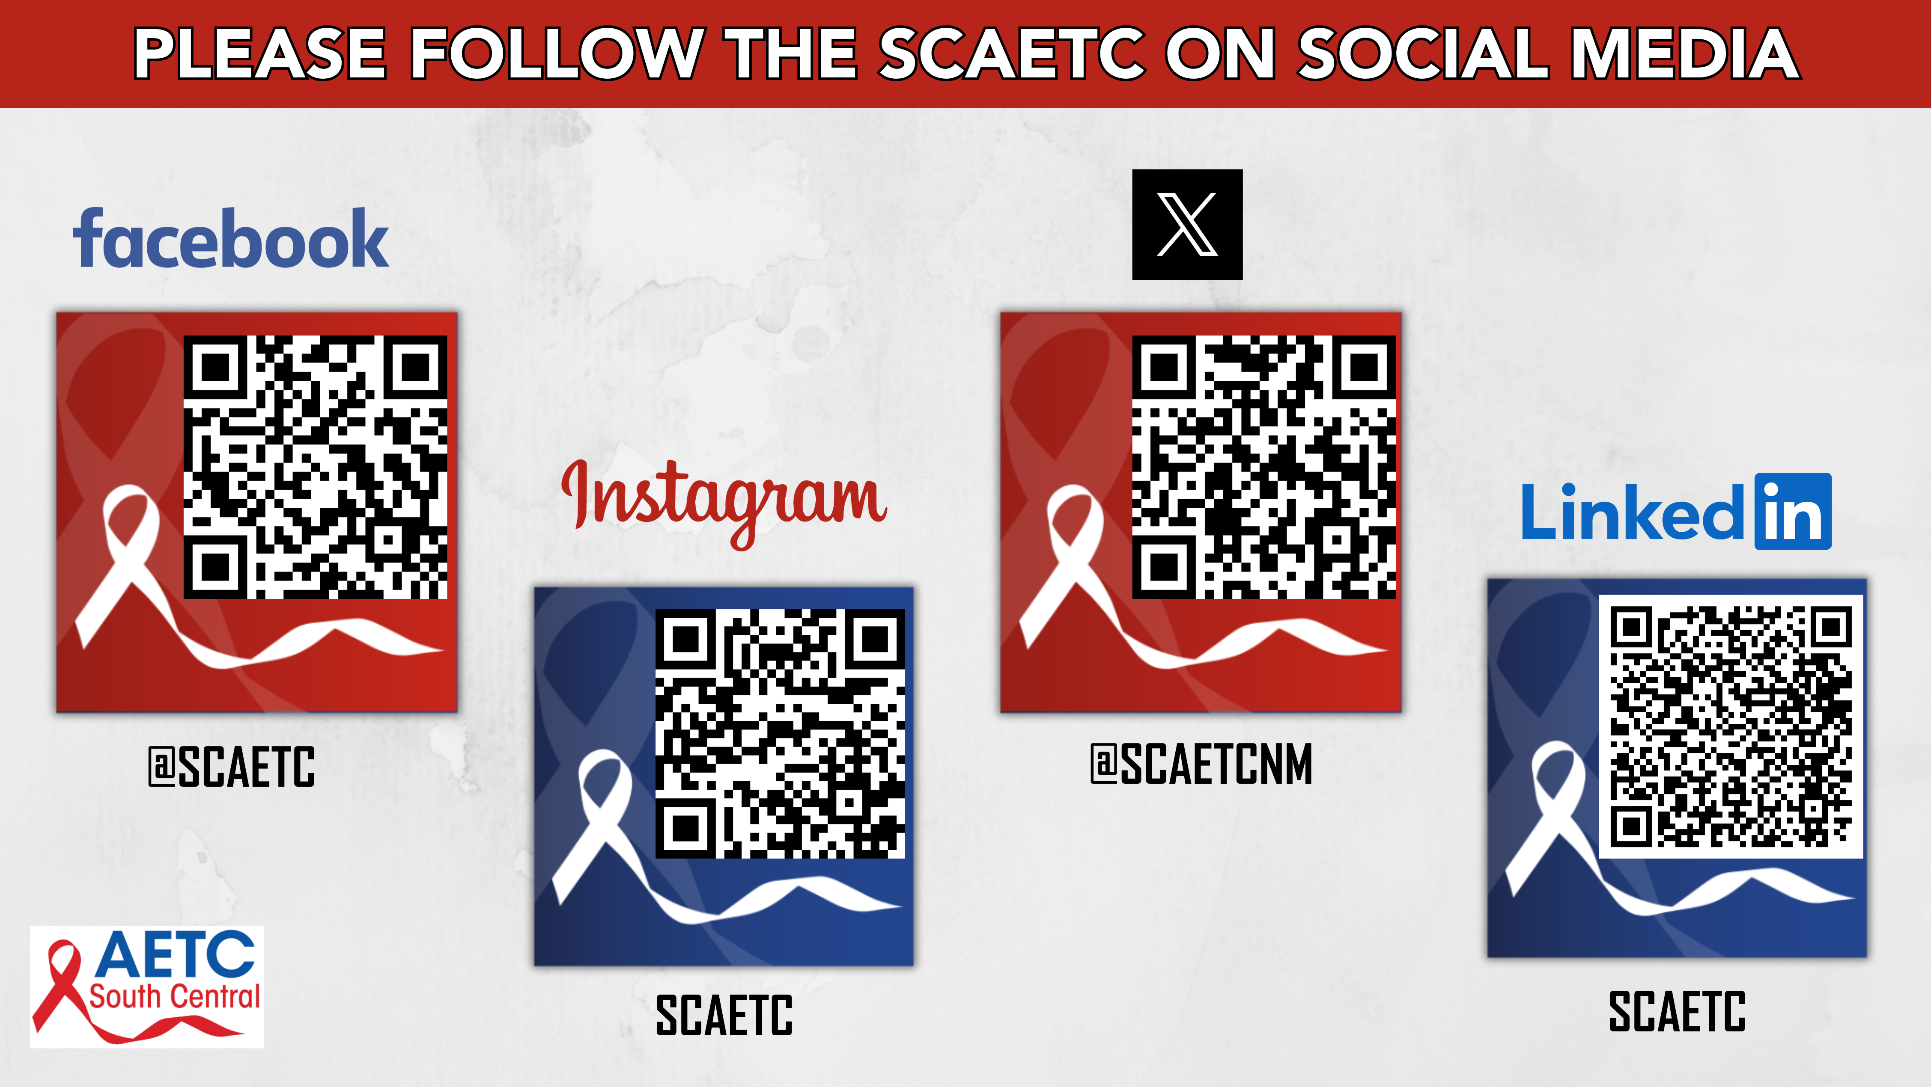

Slide 44
Thank You!
Allison Cormier
acormier@slma.cc
Instagram and TikTok: @iddoctorallison

Slide 45
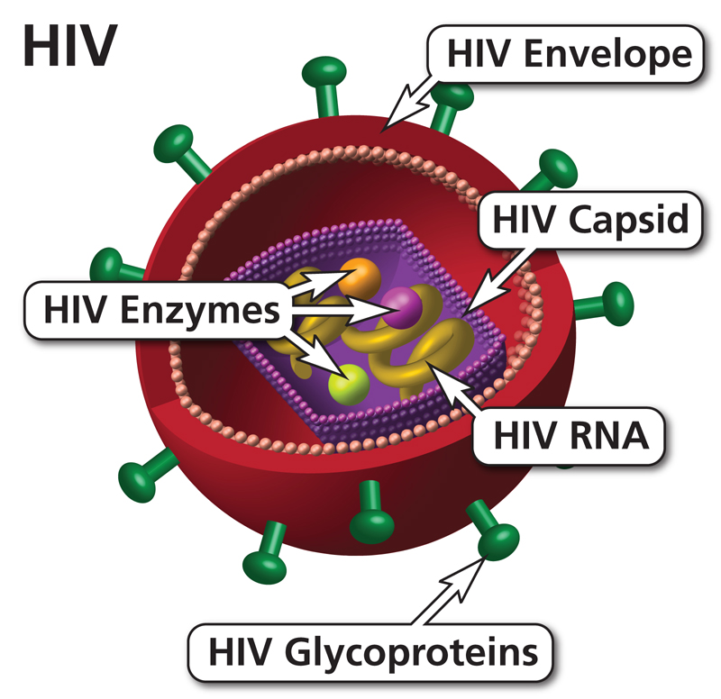
Human Immunodeficiency Virus
Retrovirus
Targets CD4+ T-cells and macrophages
Lives and multiplies inside of cells
  Latent (dormant) in resting cells
  Destroys active cells
https://clinicalinfo.hiv.gov/en

Slide 46
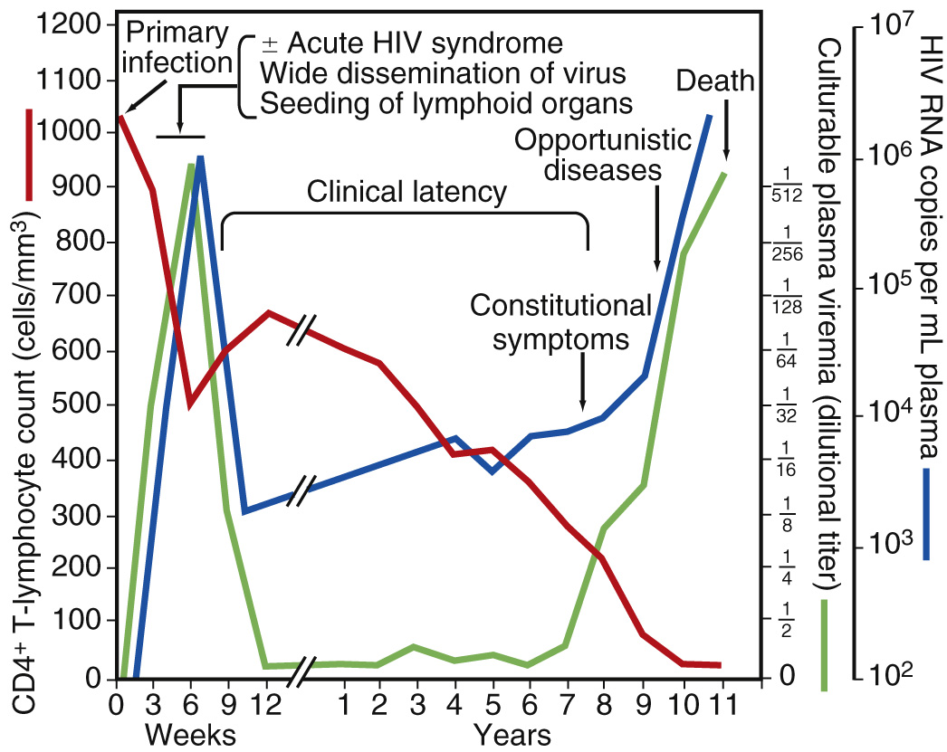
Natural History of Untreated HIV
Steady decline in the number of CD4 cells
Increased risk of opportunistic infections
Increased inflammation
Increased mortality
Increased risk of transmission
https://www.hiv.uw.edu/
Mandell, Douglas, and Bennett's Principles and Practice of Infectious Diseases, 2019.
Notes:
Following acquisition of HIV, people who are untreated typically develop a steady decline in CD4 cell count that is inversely related to the HIV viral load. As the HIV viral load increases, the CD4 count declines.
People with HIV typically progress to AIDS, or stage 3 HIV, within 10 years of the initial infection.
As the CD4 count declines, the patient’s risk for constitutional symptoms, opportunistic infections and death increases.

Slide 47
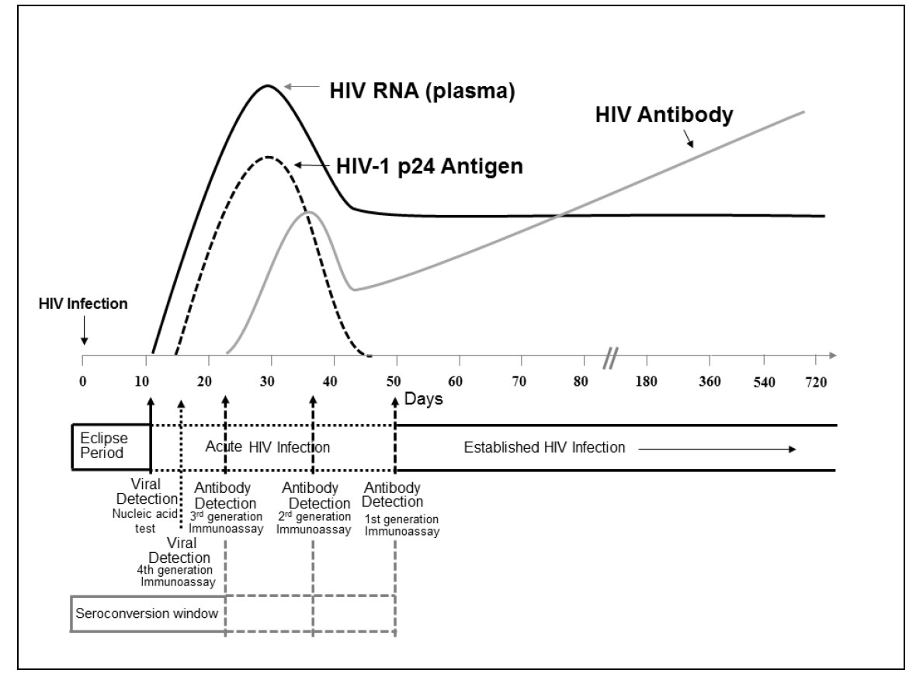
Laboratory markers for HIV-1 infection
https://stacks.cdc.gov/view/cdc/23447
Notes:
Immediately after HIV infection, no viral markers will be positive. The time during which no existing diagnostic test is capable of detecting HIV is called the eclipse period.
The seroconversion window period is the time between infection with HIV and first detection of antibodies
10 days after infection, HIV-1 RNA is detectable by nucleic acid test or PCR
P24 antigen, which is part of the combination tests, can be detected by 4th generation immunoassays within 4-10 days later (after initial detection of RNA)
Antibodies will become positive 3 to 5 days after that (10-13 days after appearance of viral RNA, ~ 3 weeks after infection)

Slide 48
Initiation of ART in Asymptomatic HIV
START study
Multicenter international randomized controlled trial
Patients with asymptomatic HIV and CD4 > 350
Randomized to start ART immediately or defer until CD4 < 350 or development of AIDS
N Engl J Med 2015; 373:795-807
Notes:
The Strategic Timing of Antiretroviral Therapy (START) study was a multicenter international trial that evaluated the risks and benefits of initiating ART in asymptomatic patients with HIV who had a CD4 count greater than 350 cells/mm³.^{[1]} They randomized 4,685 adults with HIV to one of two arms: 1) start antiretroviral therapy immediately (immediate-initiation group) or 2) defer antiretroviral therapy until the CD4 count decreased to 350 cells/mm³ or development of an AIDS-related condition
Primary composite endpoint was any serious AIDS related event, serious non-AIDS related event, or death from any cause
The primary endpoint occurred in 1.8% of patients in the immediate initiation group vs 4.1% in the deferred initiation group
This was one of several landmark trials that showed a clear benefit of starting ART earlier in the course of HIV disease progression

Slide 49
ART Guidelines: Initial Regimen
Current guidelines
  2 NRTI + INSTI
  1 NRTI + INSTI
Alternatives:
  2 NRTIs + 3rd Class (INSTI, boosted-PI, or NNRTI)
Current regimens are easier to take, more effective, and safer than older regimens.
Many single-tablet once-daily regimens are currently FDA approved.
https://clinicalinfo.hiv.gov/en/guidelines/adult-and-adolescent-arv/whats-new-guidelines
Notes:
Now that we have discussed some of the details of how ART works, we will review the currently recommended regimens for treatment-naïve patients with HIV
DHHS Guidelines for the Use of Antiretroviral Agents in HIV-1 Infected Adults and Adolescents.
https://aidsinfo.nih.gov/guidelines/html/1/adult-and-adolescent-arv/0
Saag, Benson, Gandhi, et al, JAMA, 2018. 2018 Recommendations of the International Antiviral Society-USA Panel. Antiretroviral Drugs for Treatment and Prevention of HIV Infection in Adults. https://www.iasusa.org/2018/07/24/antiretroviral-drugs-treatment-prevention-hiv-infection-adults-2018-recommendations-of-the-international-antiviral-society-usa-panel/
Initial 2-drug regimens are only recommended in the rare situations in which a patient cannot take abacavir, TAF, or TDF

