Slide 1


The US/Mexico Border AETC Steering Team (UMBAST)
Saturday, May 4th 2:45 p.m. – 4:00 p.m.
El Paso Room B

Slide 2
Disclaimer 1
The views and opinions expressed in this presentation are not necessarily those of the Pacific AIDS Education & Training Center (Pacific AETC) or its eight local partner sites in HRSA Region 9, the Regents of the University of California or its San Francisco campus (UCSF or collectively, University) nor of our funder the Health Resources and Services Administration (HRSA). Neither Pacific AETC, University, HRSA nor any of their officers, board members, agents, employees, students or volunteers make any warranty, express or implied, including the warranties of merchantability and fitness for a particular purpose; nor assume any legal liability or responsibility for the accuracy, completeness or usefulness of information, product or process assessed or described; nor represent that its use would not infringe privately owned rights.​
HRSA Acknowledgement Statement
The Pacific AETC is supported by the Health Resources and Services Administration (HRSA) of the U.S. Department of Health and Human Services (HHS) as part of an award totaling $4,377,449. The contents are those of the author(s) and do not necessarily represent the official views of, nor an endorsement, by HRSA, HHS, or the U.S. Government. For more information, please visit HRSA.gov.
Trade Name Disclosure Statement
Funding for this presentation was made possible by 5 U1OHA29292‐08‐00 from the Human Resources and Services Administration HIV/AIDS Bureau. The views expressed do not necessarily reflect the official policies of the Department of Health and Human Services nor does mention of trade names, commercial practices, or organizations imply endorsement by the U.S. Government. Any trade/brand names for products mentioned during this presentation are for training and identification purposes only.

Slide 3
Disclaimer 2
This program is supported by the Health Resources and Services Administration (HRSA) of the U.S. Department of Health and Human Services (HHS) as part of an award totaling $4,205,743, with 0% financed by non-governmental sources.
The views expressed do not necessarily reflect the official policies of the Department of Health and Human Services, nor does mention of trade names, commercial practices, or organizations imply endorsement by the U.S. Government. Any trade/brand names for products mentioned during this presentation are for training and identification purposes only.

Slide 4
Unconscious Bias Disclosure
SCAETC recognizes that language is constantly evolving. While we make every effort to avoid bias and stigmatizing terms, we acknowledge that unintentional lapses may occur in our presentations.
We value your feedback and encourage you to share any concerns about language, images, or concepts that may be offensive or stigmatizing.
Your input will help us refine and improve our presentations, ensuring they remain inclusive and respectful to participants.

Slide 5
Disclosures
All presenters of this continuing medical education activity have indicated that neither they nor their spouse/legally recognized domestic partner has any financial relationships with commercial interests related to the content of this activity.

Slide 6
Learning Objectives
At the completion of this presentation, participants will be able to:
  Explain US/Mexico Border health disparities, including for HIV and other Sexually Transmitted Infections (STIs)
  Discuss how the US and Mexico organize HIV resources, including prevention resources
  Refer a client/patient to HIV/STI prevention and treatment resources in both countries

Slide 7
Case: Maria
Maria is 28 years old and living with HIV but does not know it. She crossed the border last year from Honduras and made her way to family in a US city after passing through the border. Through a health fair she was given a wellness check up that included a pregnancy test and an HIV test. The HIV test came back positive. Maria is in a state of shock and afraid for the future.
What additional information would you like about Maria? Why?
What can you/your agency do for Maria?

Slide 8
Case: Jose
Jose, 55, is a LGBT/HIV activist from Mexico who crossed the US Border three years ago and is doing very well in a HIV clinic in his new town in the US South. He has to move to California for work and is wondering how to get HIV care there.
What other info would you like to have about Jose?
What can you/your agency do for Jose?
Can you help Jose if he decides he wants to retire in Mexico? How?

Slide 9
Presenters
Thomas Donohoe and Sandra Cuevas
Pacific AETC—Los Angeles Area (California)
Alyssa Guido and Kassandra Rios
Pacific AETC—Arizona
Pedro Coronado
South Central AETC (Texas and New Mexico)

Slide 10
Agenda
The United States/Mexico Border Region
What Is UMBAST? Who Is UMBAST?
Federal and Other Training/Technical Assistance Partnerships
Border State Highlights/Best Practices
UMBAST Online
Recognitions
Plans for the Future
Questions and Answers

Slide 11
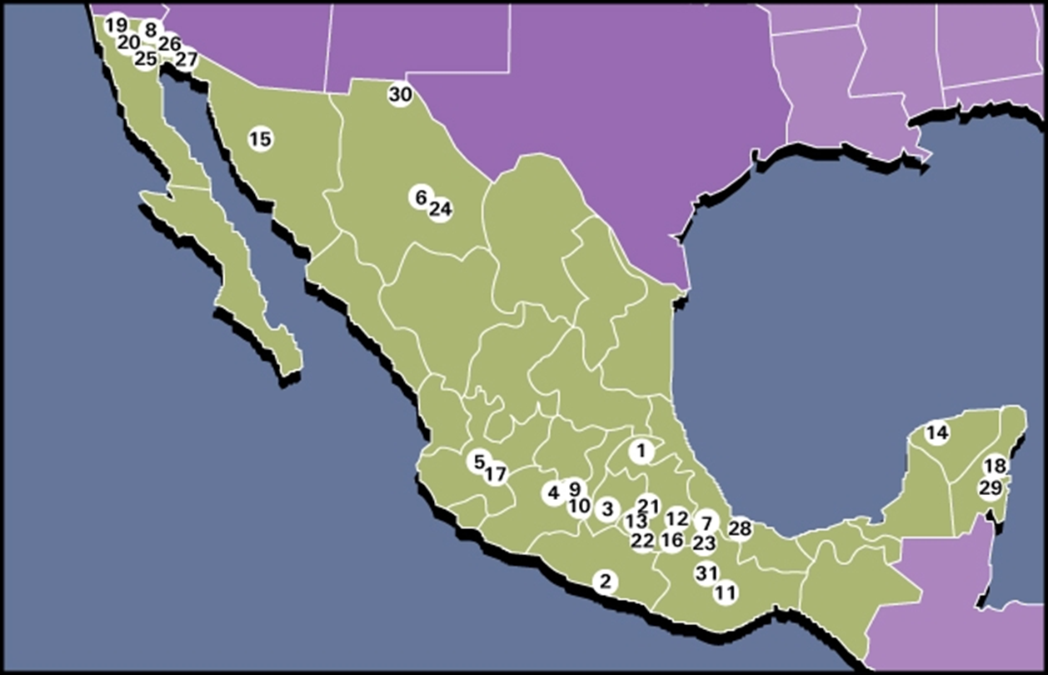
UCLA Center for Health Policy Research (CHPDP) HIV/AIDS Training Programs Delivered in Mexico: 1995- 2005
Notes:
Image Citation: UCLA CHPDP HIV/AIDS Training Programs Delivered in Mexico: 1995- 2005

Slide 12
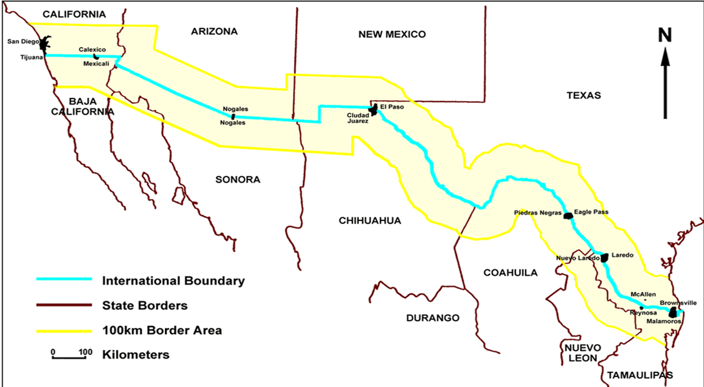
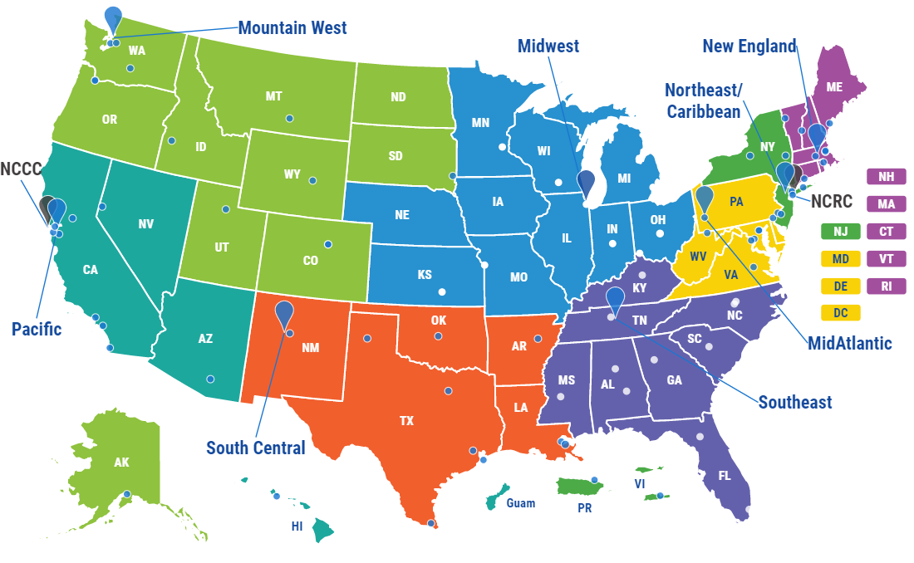
U.S./Mexico Border Region
Image: Map AIDS Education and Training Center. https://aidsetc.org/directory
Notes:
Citation Images
Image 1: Map
Image 2: Map AIDS Education and Training Center. https://aidsetc.org/directory

Slide 13
Border Challenges
Health Professional Shortage Area (HPSA)
Higher incidence of infections diseases compared with the U.S. average
If made a state, the border region would rank:
  1st in number of uninsured school children
  2nd in death rates due to hepatitis
  3rd in deaths related to diabetes
  Last in access to health care
  Last in per capita income
Source: Moya EM, Chávez-Baray SM, Wood WW, Martinez O. Nuestra Casa: An advocacy initiative to reduce inequalities and tuberculosis
along the US-Mexico border. Int Public Health J. 2016 Apr-Jun;8(2):107-119. PMID: 30245778; PMCID: PMC6150456.
Notes:
Source: Moya EM, Chávez-Baray SM, Wood WW, Martinez O. Nuestra Casa: An advocacy initiative to reduce inequalities and tuberculosis
along the US-Mexico border. Int Public Health J. 2016 Apr-Jun;8(2):107-119. PMID: 30245778; PMCID: PMC6150456.

Slide 14
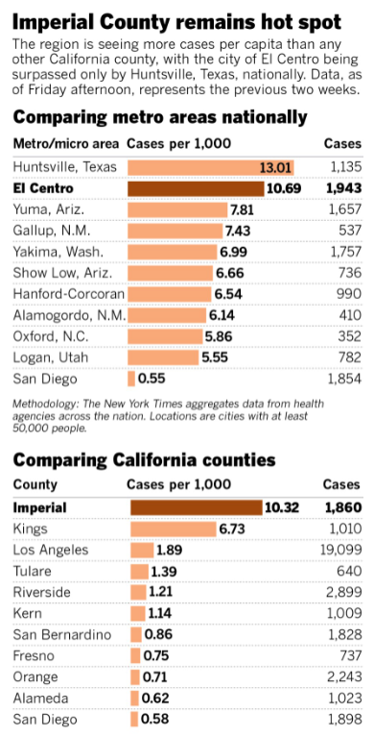
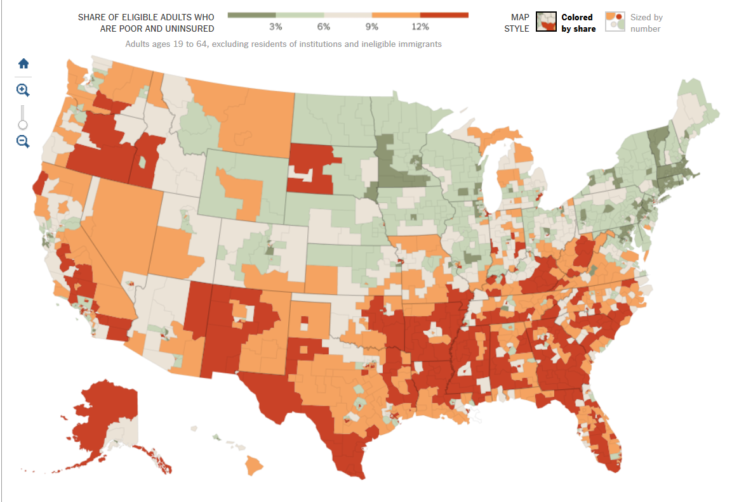
Poor and Uninsured in the U.S.
Source: Where Poor and Uninsured Americans Live, NYT Interactive Map, Archived page 2016,
By Robert Gebeloff, Haeyoun Park, and Matthew Ericson)
Notes:
Source: Where Poor and Uninsured Americans Live, NYT Interactive Map, Archived page 2016, By ROBERT GEBELOFF, HAEYOUN PARK, MATTHEW BLOCH and MATTHEW ERICSON)

Slide 15

USMBHC & First Needs Assessments
Early Border Provider Needs Assessments:
  2002 “Monarch” report sent to HRSA
Recommendations/Themes from Border Providers:
  Expand Training Targets (interpreters, promotores/volunteers, etc)
  Coordinate Activities across local, state, federal, and other agencies
  Maintain Binational Perspective wherever possible
  More Convenient Trainings (online, local, etc.)
  More Trainings on Cultural Sensitivity
Notes:
Source: US and Mexico Border Health Commission. 2002. “Monarch” Border Provider Needs Assessment.

Slide 16


What/Who Is UMBAST?
U.S.-
Mexico
Border
AETC
Steering
Team
Promote high-quality, culturally sensitive education & capacity building programs
Provide focused collaboration through joint planning, resource sharing, & evaluation
Maintain efforts and sustain efforts even when specific funding is not available

Slide 17

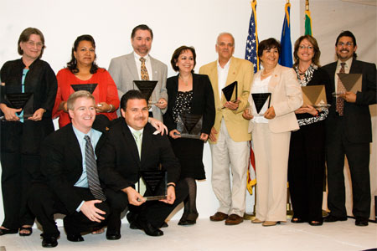
2008 UMBAST IAC Border Scholarships
Casa California, Mexico City August 2008
HIV Clinician UMBAST “Border Heroes”
IAC = International Accreditation Commission

Slide 18

Human Rights Watch
Returned to Risk: Deportation of HIV-Positive Migrants
Human Rights Watch 2009
Initiatives to provide cross-border treatment between the United States and Mexico could serve as an example. Programs such as the U.S.-Mexico Border AIDS Steering Team…serve as a model for how treatment can be coordinated for deportees across borders and should be expanded where feasible.
Notes:
Source: Human Rights Watch. 2009. Returned to Risk: Deportation of HIV-positive Migrants. https://www.hrw.org/report/2009/09/23/returned-risk/deportation-hiv-positive-migrants#:~:text=National%20governments%20need%20to%20broadly,where%20treatment%20and%20social%20support
Note: In Sept. 2009 Human Rights Watch recognized the work of UMBAST throughout their report, including their recommendations (read). Now let’s hear how UMBAST got started.

Slide 19
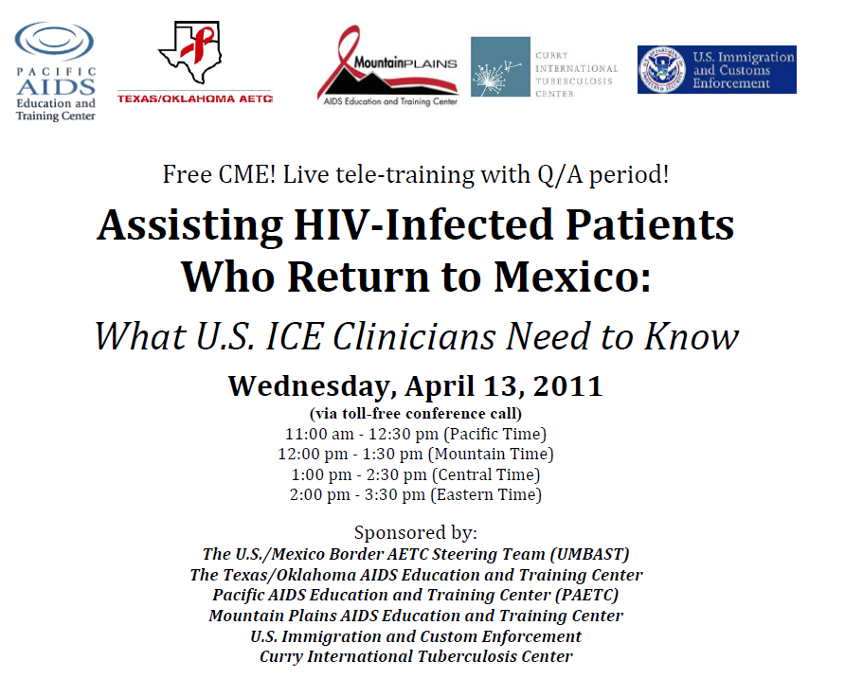
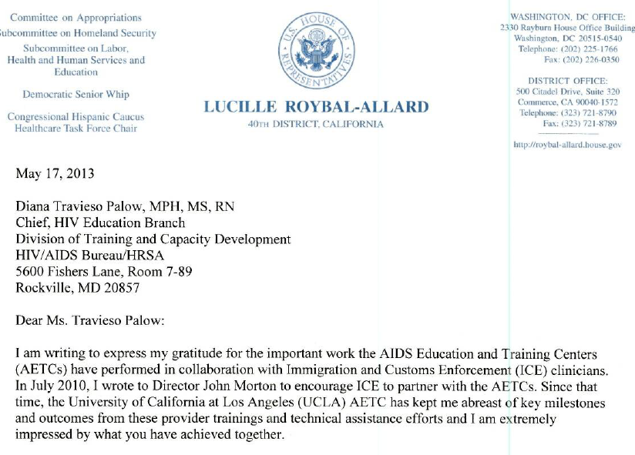
U.S. Immigration and Customs Enforcement (ICE) Clinician Trainings

Slide 20
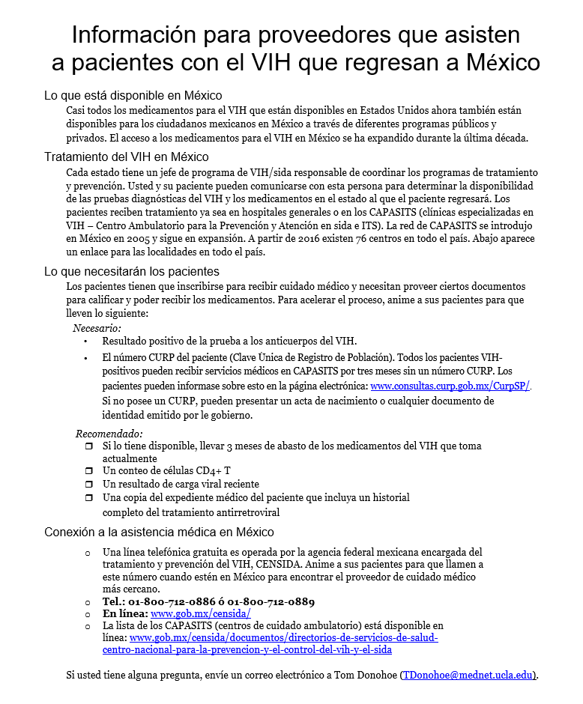
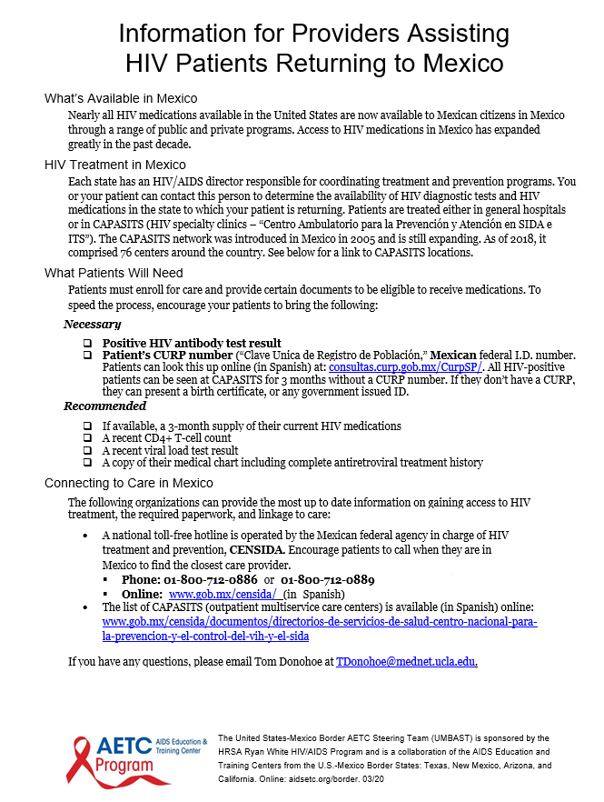
Continuity of Care Fact Sheets
1-page, practical tips for providers and patients
9 countries:
  Mexico, Honduras, Guatemala, Costa Rica, El Salvador, Nicaragua, Panama, Belize, Dominican Republic
Overview of HIV care in the country
Anti-retroviral (ARV) availability
Requirements for enrolling in care
Contact numbers and websites
Notes:
Source: UMBAST. 2020. Assisting HIV Patients Returning to Mexico and Central America. https://aidsetc.org/resource/umbast-factsheets

Slide 21

State Highlights: California
Thomas Donohoe and Sandra Cuevas
Pacific AETC—Los Angeles Area

Slide 22
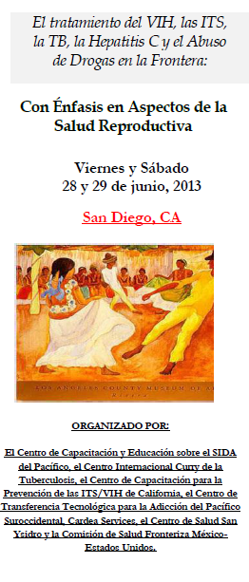
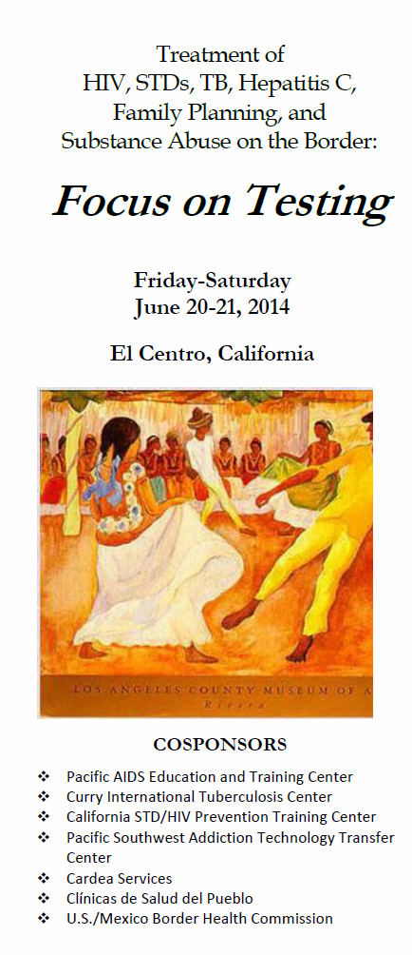
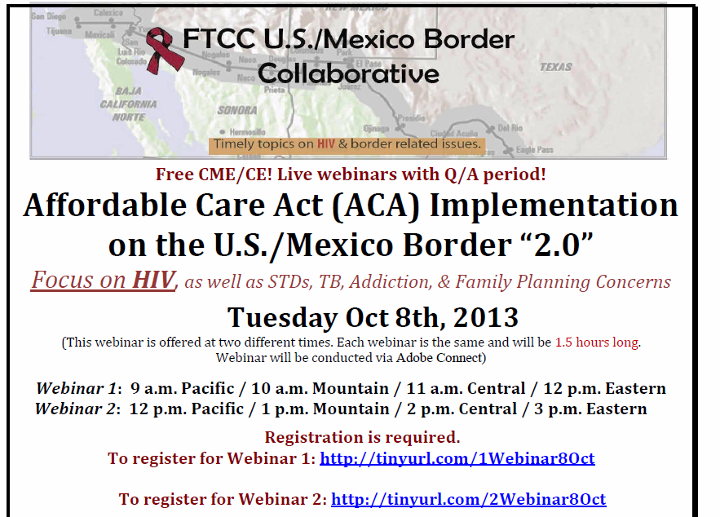
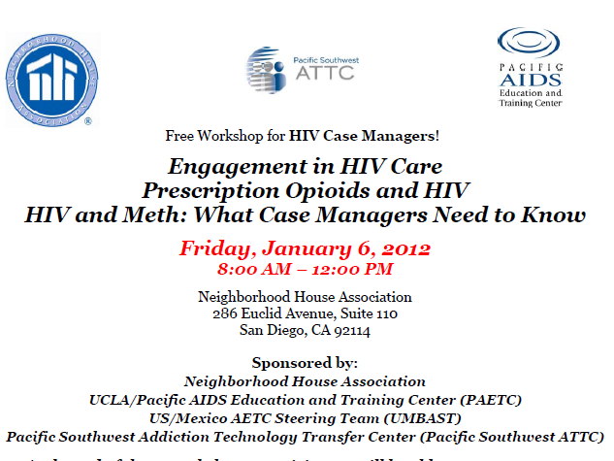
Federal Training Centers Border Collaborative FTCC (2010-2014)
AIDS Education and Training Center (AETCs - HRSA)
Prevention Training Centers (CDC)
TB Training Centers (CDC)
Addiction Technology Transfer Centers (SAMHSA)
CARDEA Services (Office of Population Affairs)

Slide 23
State Highlights: Arizona
Alyssa Guido and Kassandra Rios Lizarraga
Pacific AETC—Arizona

Slide 24
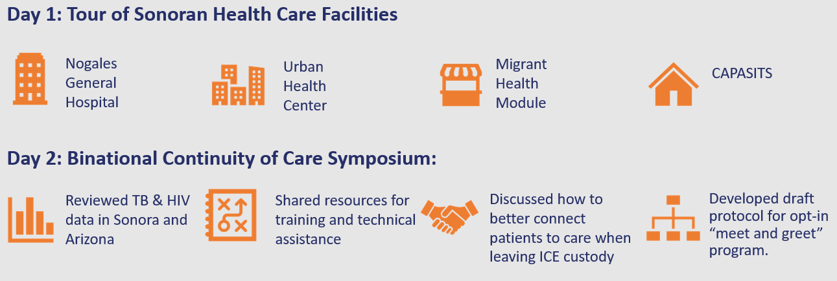
Enhancing Continuity of Care in Arizona and Sonora
Participating organizations:
Sonoran health department, CAPASITS, Nogales General Hospital, AZ state health department, county health departments, HIV prevention, HIV surveillance, Ryan White Parts A, B, C, TB Control Program, Curry TB Center, PAETC.
CAPASITS = Outpatient Centers for Prevention and Care of HIV and STI’s in Mexico
Notes:
Note: Review TB & HIV epi data in Sonora and Arizona, share resources for training and technical assistance, discussion on how to better connect patients to care when leaving ICE custody and development of draft protocol for opt-in “meet and greet” program.

Slide 25
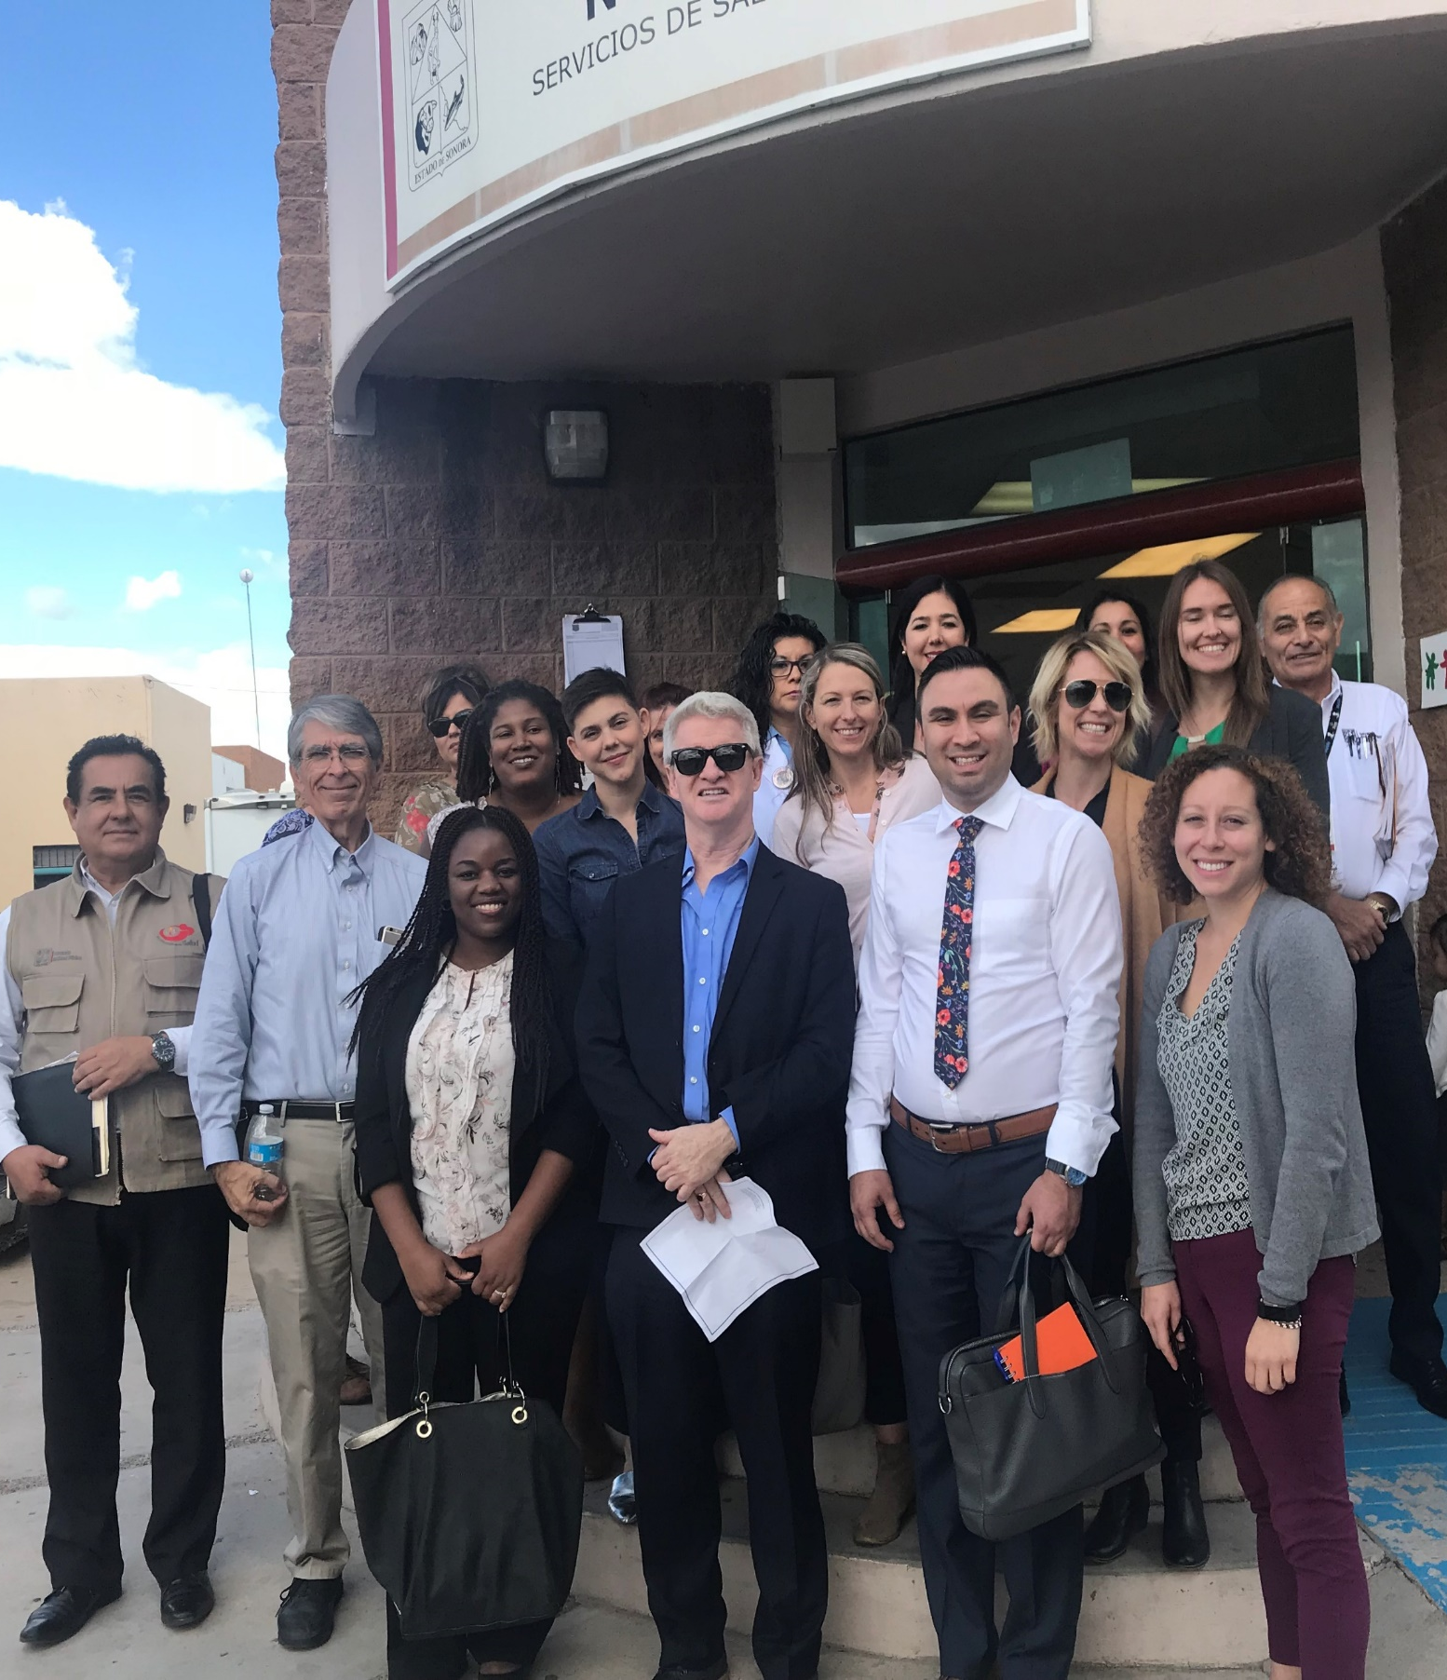
Enhancing Continuity of Care in Arizona and Sonora: Outcomes
Representatives from the Arizona Department of Health Services and Sonoran Ministry of Health created together:
A plan of action to develop an HIV continuity of care pilot program based on the framework of the established tuberculosis Meet & Greet Protocol currently in use.
A draft protocol to be used in the Meet & Greet pilot program for the continuity of HIV care for patients returning to Mexico.
A directory to share contact information for all symposium attendees involved in this work so that partners can build upon collaborative efforts and maintain communication moving forward
“Both days were an incredible learning experience. The direct observation and visitation of the Nogales hospital, clinic and CAPASITS were invaluable and critical to having a greater understanding of the continuity of HIV/TB care issues on Day 2.”

Slide 26

HIV Training for Promotoras de Salud & Mexican Consulate Staff
May 18, 2018: Promotoras de Salud
20 participants from:
Two community health centers
A local mobile health program
The Southern Arizona Community Food Bank
Pima Community College
University of Arizona’s Cancer Center
Response to, “how will you apply this information to your work?”
Share information related to the theme of HIV prevention and risk with the people I attend to every day.
Share information that there is help for everyone.
Refer people to their doctor for testing if it’s possible for everyone.
Share the information and education with patient and the community.

Slide 27
HIV Training for Promotoras de Salud & Mexican Consulate Staff
9 consulate staff:
  7 information assistants/phone operators
  1 program coordinator from local community health center
  1 program coordinator from Head Start program.
Responses to, “How will you apply this information to your work?”
  Educate the population, explaining what HIV is and how to prevent and treat cases of the virus.
  With better management of situations involving HIV/AIDS.
  Share information about healthcare services in Mexico and the U.S. for people with HIV

Slide 28

State Highlights: Texas
Pedro Coronado
South Central AETC

Slide 29
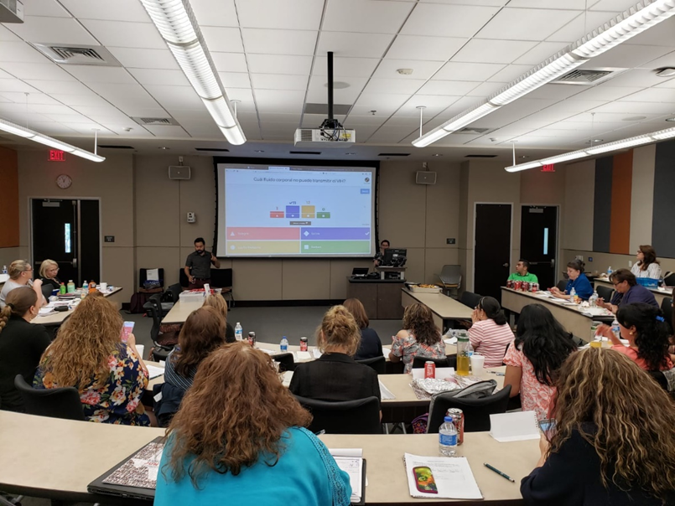
State Highlights: Texas
Promotor de Salud/Community Health Worker Training Curriculum
UT El Paso Training
Utilize the Telenovela Sin Verguenza as a training modality
Audience: CHW/Promotores de Salud
  Laredo, TX
  Rio Grande Valley, TX
  El Paso, TX
  La Cruces, NM

Slide 30

State Highlights: Texas
Bi-National Border Work – Texas & Tamaulipas
National Latinx Conference on HIV/HCV/SUD
Bi-National World AIDS Day Event
Audience: CAPASITS Tamaulipas Mexico; Texas DSHS Region 11; Governmental and Non-Governmental Organizations
Continuity of care for PWH; Data Presentations; ART Formularies
Partnerships with:
  Mexican Consulates
  Migrant Clinicians Network (Medical Record Sharing)
  CAPASITS (Centros Ambulatorios para la Prevencion y Atencion en SIDA e Infecciones de Transmision Sexual)
2 ½ Day Conference
Focus on Latinx Health Disparities
Audience:
  Clinicians
  Case Workers
  CHW’s
500 participants

Slide 31
State Highlights: New Mexico
Pedro Coronado
South Central AETC

Slide 32
State Highlights: New Mexico
University of New Mexico – AIDS Education and Training Center (UNM-AETC) Practice Transformation site Centro San Vicente in El Paso, Texas
Practice Transformation refers to a process of change in the organization and delivery of primary care to advance quality improvement, patient-centered care, and characteristics of high performing primary care.
The AETC Program implements projects to support and facilitate practice transformation in selected clinics in order to improve patient outcomes along the HIV care continuum by integrating principles of the patient-centered medical home model and integrated HIV care and behavioral health services.
The practice transformation process involves goal-setting, leadership, practice facilitation, workflow changes, quality improvement and outcomes measurement, and adapting organizational tools and processes to support advances in models of team-based care.

Slide 33
ID CHW Curriculum Development
Infectious Disease Community Health Worker Curriculum Development
UNM-AETC is working with regional South Central AIDS Education and Training Center (SCAETC) partners, UNM Project ECHO and UNM Office for Community Health to develop an infectious disease curriculum for Community Health Workers (CHW), Promotores/as de Salud, and Tribal Community Health Representatives (CHR).
Curriculum will contribute to the certification efforts for CHWs, CHRs and Promotores/as de Salud by providing additional competencies in infectious disease.
UNM-AETC will work with the New Mexico Department of Health Office of Community Health Workers to have infectious disease competencies endorsed for statewide certification purposes and work with SCAETC regional partners to provide similar endorsements pertinent in their states.
This work will add to current HIV / infectious disease initiatives in the U.S. – Mexico Border region.

Slide 34

Finding Resources Online
Nicole Mandel, AETC National Coordinating Resource Center

Slide 35
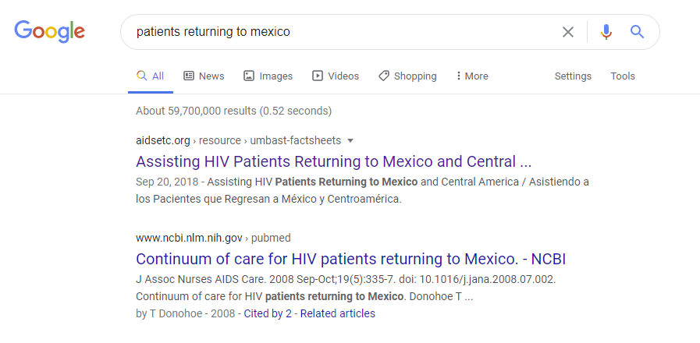
Google “Patients Returning to…”

Slide 36
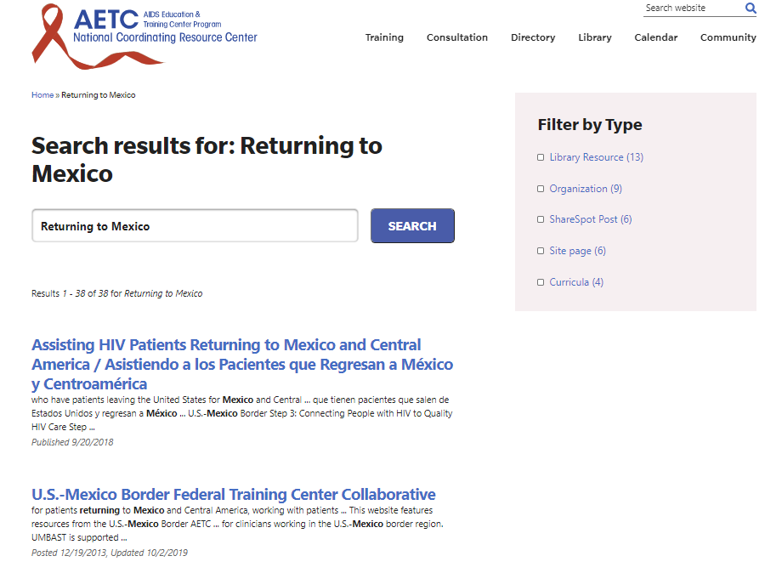
Search on AIDSETC.org

Slide 37
Fact Sheet Timeline
Mexico launched August 2011
Central America added 2013
Belize added 2015
ICE Tip Sheet added 2017
Dominican Republic added 2020
Notes:
Source: UMBAST. 2020. Assisting HIV Patients Returning to Mexico and Central America. https://aidsetc.org/resource/umbast-factsheets

Slide 38
Fact Sheet Traffic
22,000 Page Views/Downloads
Top Cities
Top Countries
United States
Mexico
Brazil
Canada
El Paso
Los Angeles
New York
San Diego
Houston
Dallas
Phoenix
Tucson
San Francisco
Albuquerque
Chicago
Austin
San Antonio
Ashburn
Washington
Beijing
Coffeyville
McAllen
Seattle
Denver
Yuma
Boston
El Centro
Eagle Pass

Slide 39


Recognitions
2006 Ryan White AETC Leadership Award
2008 Border Heroes Mexico City IAC
2009 Human Rights Watch International “Best Practice”
2012 Border Heroes Washington DC IAC
Scores of UMBAST-related OpEDs, profiles and stories in ICE, TB, ATTC, ANAC, and border/binational journals

Slide 40
Plans for Future
Longer term continuity of care and other border/migrant themes that support EHE
Continued collaborations with our federal and other training/TA/policy partners
Maintaining a binational perspective, leveraging successes of both countries with regard to HIV and shared populations
Discussions Thursday at Latinx conference satellite sessions

Slide 41
Other Resources
National Clinician Consultation Center
http://nccc.ucsf.edu/
  HIV Management
  Perinatal HIV
  HIV PrEP
  HIV PEP line
  HCV Management
  Substance Use Management
Present on ECHO
https://hsc.unm.edu/scaetc/programs-services/echo.html​
AETC National HIV Curriculum https://aidsetc.org/nhc
AETC National Coordinating Resource Center https://targethiv.org/library/aetc-national-coordinating-resource-center-0
HIVMA Resource Directory https://www.hivma.org/globalassets/ektron-import/hivma/hivma-resource-directory.pdf
Additional trainings scaetcecho@salud.unm.edu
www.scaetc.org

Slide 42
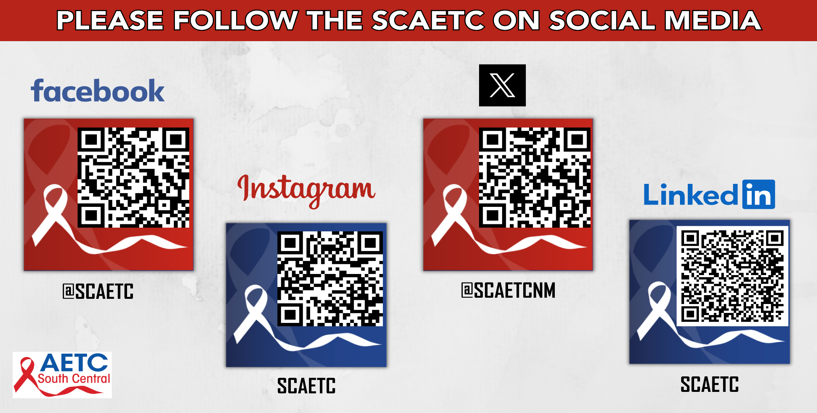
SCAETC Social Media

Slide 43
References
Moya EM, Chávez-Baray SM, Wood WW, Martinez O. Nuestra Casa: An advocacy initiative to reduce inequalities and tuberculosis along the US-Mexico border. Int Public Health J. 2016 Apr-Jun;8(2):107-119. PMID: 30245778; PMCID: PMC6150456
Where Poor and Uninsured Americans Live, NYT Interactive Map, Archived page 2016, By Robert Gebeloff, Haeyoun Park, and Matthew Ericson)
Human Rights Watch. 2009. Returned to Risk: Deportation of HIV-positive Migrants. https://www.hrw.org/report/2009/09/23/returned-risk/deportation-hiv-positive-migrants#:~:text=National%20governments%20need%20to%20broadly,where%20treatment%20and%20social%20support
UMBAST. 2020. Assisting HIV Patients Returning to Mexico and Central America. https://aidsetc.org/resource/umbast-factsheets
US and Mexico Border Health Commission. 2002. “Monarch” Border Provider Needs Assessment.

Slide 44
Contact Information
Thomas Donohoe---tdonohoe@mednet.ucla.edu
Sandra Cuevas---smcuevas@mednet.ucla.edu
Pacific AETC - Los Angeles Area (California)
Moira Mar Tang --- mmartang@health.ucsd.edu
Aaron Willcott---awillcott@health.ucsd.edu
Pacific AETC – San Diego (California)
Alyssa Guido---alyssa1@deptofmed.Arizona.edu
Kassandra Rios---rioslizarraga@arizona.edu
Pacific AETC - Arizona
Pedro Coronado---peterc@westbrookclinic.org
South Central AETC (Texas and New Mexico)

