Slide 1
Project ECHO® - UNM
Indian Country HIV ECHO Clinic
Gender-Affirming Care in Persons with HIV
12 June 2024
Jennie Wei, MD, MPH
Gallup Indian Medical Center, Gallup, NM
Chief Clinical Consultant, Indian Health Service
Asst. Clinical Professor of Medicine | University of California, San Francisco
Notes:
Version_ 06/2024
Target audience: clinicians and healthcare team members, pharmacists, pharmacy technicians

Slide 2
Conflict of Interest Disclosure Statement
Speaker has nothing to disclose.
This presentation was reviewed by UNMHSC and SCAETC faculty to ensure it meets Continuing Education guidelines.
This program is supported by the Health Resources and Services Administration (HRSA) of the U.S. Department of Health and Human Services (HHS) as part of an award totaling $4,205,743 with 0% financed with non-governmental sources. The contents are those of the author(s) and do not necessarily represent the official views of, nor does mention of trade names, commercial practices, or organizations imply an endorsement by HRSA, HHS, or the U.S. Government. For more information, please visit HRSA.gov. Any trade/brand names for products mentioned during this presentation are for training and identification purposes only.

Slide 3
Use of Trade/Brand Names
This program is supported by the Health Resources and Services Administration (HRSA) of the U.S. Department of Health and Human Services (HHS) as part of an award totaling $4,205,743, with 0% financed with non-governmental sources.
The views expressed do not necessarily reflect the official policies of the Department of Health and Human Services, nor does mention of trade names, commercial practices, or organizations imply endorsement by the U.S. Government. Any trade/brand names for products mentioned during this presentation are for training and identification purposes only.
Notes:
NOTE: THIS SLIDE MUST BE INCLUDED IF TRADE AND/OR BRAND NAMES FOR MEDICATIONS ARE USED IN THE PRESENTATION.
IT MAY BE DELETED IF THERE IS NO REFERENCE TO TRADE NAMES, INCLUDING PRESENTATIONS IN WHICH ONLY GENERIC MEDICATION NAMES ARE MENTIONED.
TRADE NAMES MUST BE PUT IN PARENTHESES AFTER THE GENERIC NAME THE FIRST TIME IT IS MENTIONED - E.G., FLUOXETINE (PROZAC). TRADE NAMES SHOULD ONLY BE MENTIONED FOR THE INITIAL REFERENCE AND THE GENERIC NAME ONLY SHOULD BE USED AFTER THAT. THIS APPLIES EQUALLY TO ALL MEDICATIONS OR PRODUCTS MENTIONED IN THIS PRESENTATION.

Slide 4
Unconscious Bias Disclosure
SCAETC recognizes that language is constantly evolving, and while we make every effort to avoid bias and stigmatizing terms, we acknowledge that unintentional lapses may occur in our presentations.
We value your feedback and encourage you to share any concerns related to language, images, or concepts that may be offensive or stigmatizing.
Your input will help us refine and improve our presentations, ensuring they remain inclusive and respectful to participants.

Slide 5
Learning Objectives
Recognize health disparities in HIV infection and treatment among transgender/gender diverse individuals
Understand barriers to care for transgender people
Discuss ways to provide gender affirming care in our clinic settings including offering hormone therapy

Slide 6
Health Disparities
HIV prevalence: 14% among transgender women and 2% among transgender men
Transgender women (TGW) with HIV are less likely than cisgender men to receive antiretroviral therapy (ART), be adherent, and achieve viral suppression
Becasen JS, Denard CL, Mullins MM, Higa DH, Sipe TA. Estimating the prevalence of HIV and sexual behaviors among the US transgender population: a systematic review and meta-analysis, 2006–2017. Am J Public Health. 2018:e1-e8.
Poteat T, Hanna DB, Rebeiro PF, et al. Characterizing the HIV care continuum among transgender women and cisgender women and men in clinical care: a retrospective time-series analysis. Clinical Infectious Diseases. 2019. Available at: https://doi.org/10.1093/cid/ciz322.

Slide 7
Barriers to Care and Treatment
Transgender people may avoid the healthcare system due to stigma, past negative experiences
For many people who are transgender, gender-affirming therapy is a greater priority than HIV treatment
Concerns about interactions with hormone therapy and ART is common
One study found that 40% of transgender women with HIV (TGWWH) do not take their ART due to concerns about interactions, but less than half discussed with their providers
James SE, Herman JL, Rankin S, et al. The report of the 2015 U.S. transgender survey. 2016
Sevelius JM, Patouhas E, Keatley JG, Johnson MO. Barriers and facilitators to engagement and retention in care among transgender women living with human immunodeficiency virus. Ann Behav Med. 2014;47(1):5-16.
Braun HM, Candelario J, Hanlon CL, et al. Transgender women living with HIV frequently take antiretroviral therapy and/or feminizing hormone therapy differently than prescribed due to drug-drug interaction concerns. LGBT Health. 2017;4(5):371-375.

Slide 8
Gender Affirmation Improves HIV Outcomes
Individuals are more likely to engage in HIV care when their gender is affirmed
Transgender people with HIV who work with providers who affirm their gender more likely to be virally suppressed
Rates of viral suppression are significantly greater among TGWWH receiving gender-affirming hormone therapy (GAHT) compared to TGWWH who were not
Dowshen N, Lee S, Franklin J, Castillo M, Barg F. Access to medical and mental health services across the HIV care continuum among young transgender women: a qualitative study. Transgend Health. 2017;2(1):81-90.
Chung C, Kalra A, McBride B, Roebuck C, Sprague L, Center TL. Some kind of strength: findings on health care and economic wellbeing from a national needs assessment of transgender and gender non-conforming people living with HIV. 2016.
Summers et al. Effects of Gender-affirming Hormone Therapy on Progression Along with HIV Care Continuum in Transgender Women. Open Forum Infec Dis July 2021.

Slide 9
Welcoming Environment
Gender neutral bathrooms
Prominently display office policies that prohibit discrimination based on sexual orientation or gender identity
Train all staff (receptionists, medical assistants, emergency room (ER), urgent care center (UCC), lab, radiology) to honor presenting gender identity, names, and pronouns
Make in-take forms and electronic health record (EHR) trans-friendly, i.e., include “name used” not just legal name; include more than male or female (M/F)

Slide 10
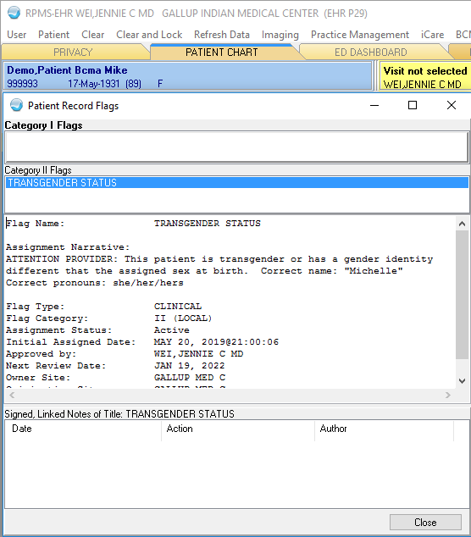
Transgender Flag in EHR

Slide 11
How to Improve Therapeutic Alliance with Trans People
If patients introduce themselves with a name different than their given (dead) name, use that name they used
“I’m Jennie Wei, I use she/her pronouns, what is your name? What pronouns do you use?”
If you use the wrong pronoun or name, an apology can be healing

Slide 12
Gender-Affirming Care
Mental health counselling
Phenotypic interventions
Legal transition

Slide 13
Treatment Options for Gender Dysphoria
Mental health counselling
Phenotypic interventions
Legal transition
Partially reversible:
Hormone therapy
Irreversible:
Surgical interventions

Slide 14
Efficacy of Hormone Therapy
Systematic review and meta-analysis of 28 eligible studies, 1833 participants with gender identity disorder (GID)
80% of individuals reported significant improvement in gender dysphoria
78% reported significant improvement in psychological symptoms
80% reported significant improvement in quality of life
72% reported significant improvement in sexual function
Murad, MH. Elamin MB. Et al. Hormonal therapy and sex reassignment: a systemetic review and meta-analysis of quality of life and psychosocial outcomes. Clin Endocrinol. 2010; 72(2): 214.

Slide 15
Gender-Affirming Feminizing Hormones and Surgical Options

Slide 16
Effects of Hormone Therapy – Estrogen Transfeminine
Effects of estrogen
breast growth
redistribution of body fat
decreased upper body strength
softening of skin
decrease in body hair
decreased fertility and testicular size
less frequent, less firm erections
May have increased risk of:
Venous thrombosis, pulmonary embolism
Hypertriglyceridemia
Benign pituitary prolactinomas
Emotional lability
Hypertension
Liver disease
** Data does NOT suggest increased risk of breast cancer compared to biological females

Slide 17
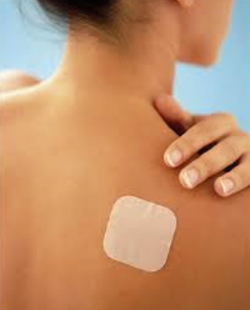
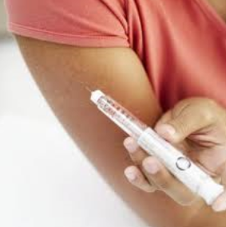
Forms of Estrogen
Oral pill
Transdermal patch
Estrogen injection
Images source: Stock Image

Slide 18
Use of Anti-Androgen (Anti-Testosterone) Therapy
Suppress testosterone production and aid in feminization
Decreased facial hair and body hair, mild breast growth
Spironolactone first-line
GnRH agonists (goserelin)
finasteride

Slide 19
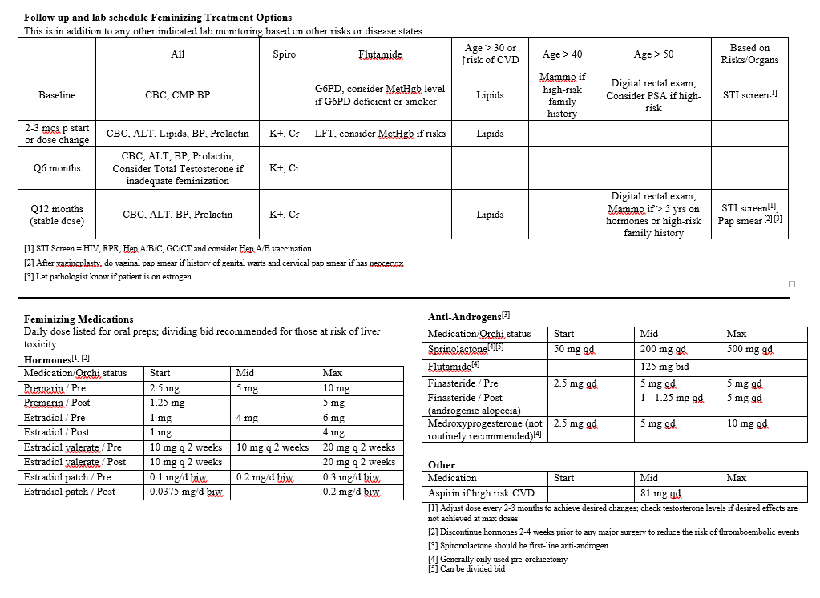
Feminizing Hormone Protocols
Image source: Project Health

Slide 20
Gender Affirming Feminizing Surgical Options
Male to female (MTF)
Breast implants
Vaginoplasty
Plastic surgery to create a vagina
Orchiectomy
Surgery to remove the testicles
Vocal cord surgery
Facial feminization
Tracheal shave

Slide 21
Gender-Affirming Masculinizing Hormones and Surgical Options

Slide 22
Effects of Hormone Therapy – Testosterone Transmasculine
Effects of testosterone
Deepening of the voice
Decrease in breast size
Increased facial and body hair
Increased upper body strength
Weight gain
Decreased hip fat
Increased sex drive
May have increased risk of:
Infertility
Acne
Shift of lipid profiles which may increase risk of cardiovascular (CV) disease
Hepatic dysfunction

Slide 23
Forms of Testosterone
Intramuscular injection
Transdermal patch
Transdermal gel/ointment

Slide 24
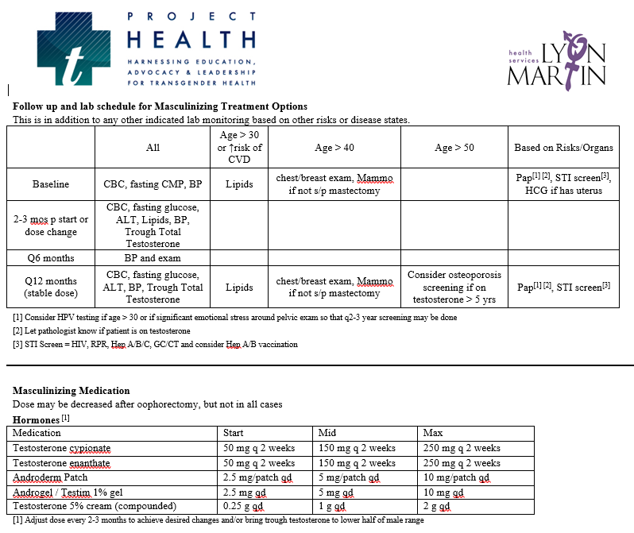
Masculinizing Hormone Protocols
Image source: Project Health

Slide 25
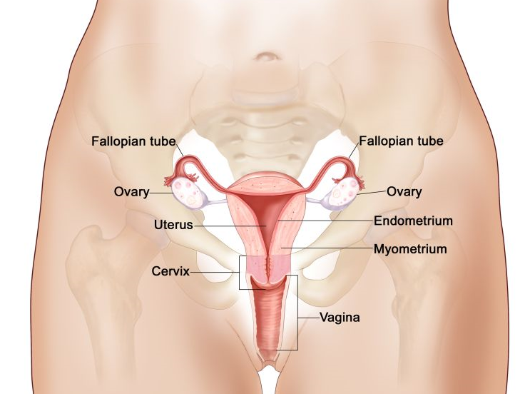
Gender Affirming Masculinizing Surgical Options
Female to male (FTM)
Mastectomy
Removal of the breasts
Hysterectomy
Removal of the uterus
Salpingectomy
Removal of fallopian tubes
Oophorectomy
Removal of the ovaries
Metoidioplasty
Creation of a penis using existing genital tissue
Phalloplasty
Construction of a penis from tissue from remote sites
Image source: Stock Image

Slide 26
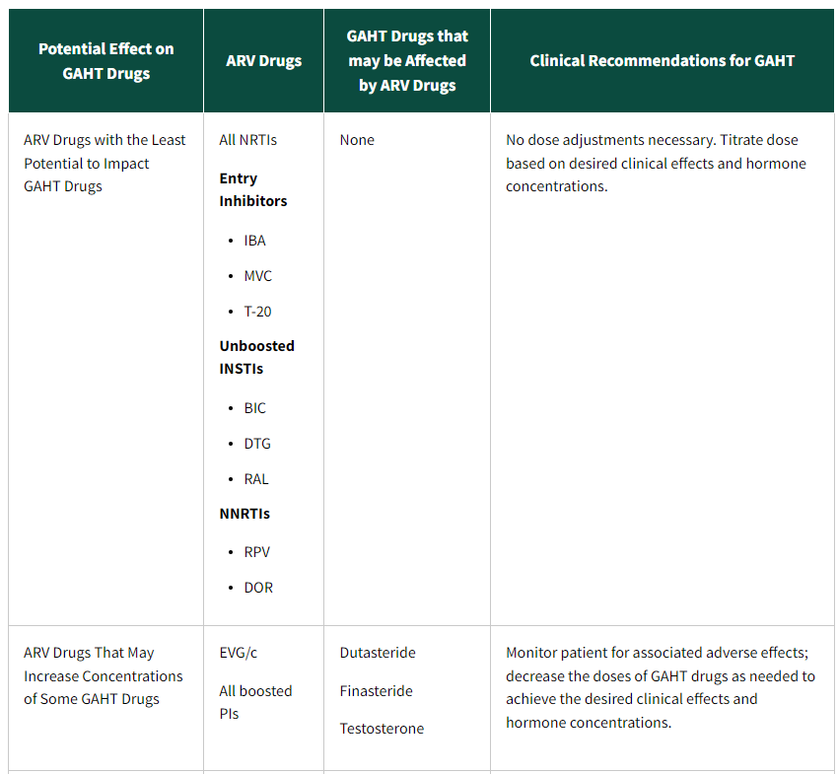
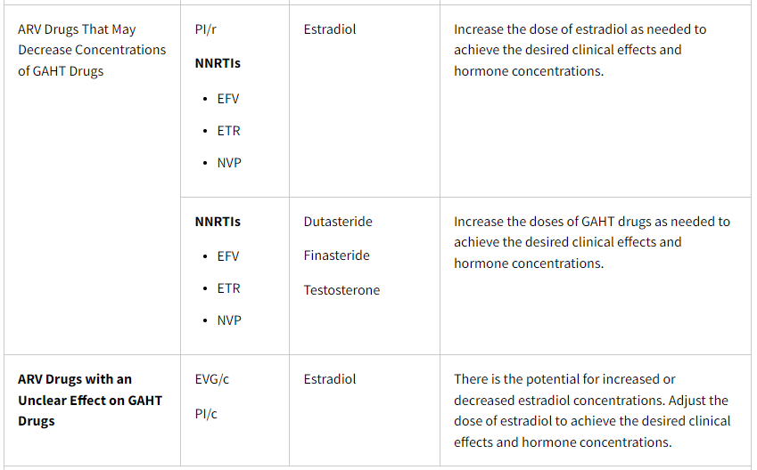
Hormones and ART Interactions
https://clinicalinfo.hiv.gov/en/guidelines/hiv-clinical-guidelines-adult-and-adolescent-arv/special-populations-transgender-people
Notes:
Only med that is used at times is boosted PIs, more cautious with checking hormone levels

Slide 27
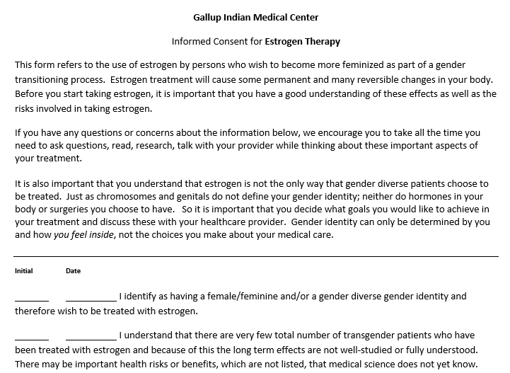
Gallup Indian Medical Center Consent Form

Slide 28
Referral For Transgender Care
Transgender Clinic at Gallup Indian Medical Center
Fax referral to 505 726 8557
Email jennie.wei@ihs.gov
Trans-friendly plastic surgeons:
Albuquerque: Dr. Jeff Morehouse, (505) 262-7777
Scottsdale: Dr. Toby Meltzer, (480) 657-7006
Transgender Resource Center of New Mexico: http://www.tgrcnm.org/
https://www.indiancountryecho.org/program/trans-and-gender-affirming-care/

Slide 29
References
Becasen JS, Denard CL, Mullins MM, Higa DH, Sipe TA. Estimating the prevalence of HIV and sexual behaviors among the US transgender population: a systematic review and meta-analysis, 2006–2017. Am J Public Health. 2018:e1-e8.
Poteat T, Hanna DB, Rebeiro PF, et al. Characterizing the HIV care continuum among transgender women and cisgender women and men in clinical care: a retrospective time-series analysis. Clinical Infectious Diseases. 2019. Available at: https://doi.org/10.1093/cid/ciz322.
James SE, Herman JL, Rankin S, et al. The report of the 2015 U.S. transgender survey. 2016
Sevelius JM, Patouhas E, Keatley JG, Johnson MO. Barriers and facilitators to engagement and retention in care among transgender women living with human immunodeficiency virus. Ann Behav Med. 2014;47(1):5-16.
Braun HM, Candelario J, Hanlon CL, et al. Transgender women living with HIV frequently take antiretroviral therapy and/or feminizing hormone therapy differently than prescribed due to drug-drug interaction concerns. LGBT Health. 2017;4(5):371-375.
Dowshen N, Lee S, Franklin J, Castillo M, Barg F. Access to medical and mental health services across the HIV care continuum among young transgender women: a qualitative study. Transgend Health. 2017;2(1):81-90.
Chung C, Kalra A, McBride B, et al. Some kind of strength: findings on health care and economic wellbeing from a national needs assessment of transgender and gender non-conforming people living with HIV. 2016.
Summers et al. Effects of Gender-affirming Hormone Therapy on Progression Along with HIV Care Continuum in Transgender Women. Open Forum Infec Dis July 2021.
Murad, MH. Elamin MB. Et al. Hormonal therapy and sex reassignment: a systemetic review and meta-analysis of quality of life and psychosocial outcomes. Clin Endocrinol. 2010; 72(2): 214.
HIV Guidelines: Considerations for Antiretroviral Use in Special Patient Populations- Transgender People with HIV https://clinicalinfo.hiv.gov/en/guidelines/hiv-clinical-guidelines-adult-and-adolescent-arv/special-populations-transgender-people

Slide 30
Resources
National Clinician Consultation Center http://nccc.ucsf.edu/
HIV Management
Perinatal HIV
HIV PrEP
HIV PEP line
HCV Management
Substance Use Management
Present case on ECHO http://echo.unm.edu hivecho@salud.unm.edu
AETC National HIV Curriculum https://aidsetc.org/nhc
AETC National Coordinating Resource Center https://targethiv.org/library/aetc-national-coordinating-resource-center-0
Additional trainings scaetcecho@salud.unm.edu
www.scaetc.org
Notes:
Find additional TeleECHO sessions in your area: https://echo.unm.edu/locations-2/echo-hubs-superhubs-united-states/
https://hsc.unm.edu/echo/get-involved/join-an-echo/
IDEA Platform: Infectious Diseases Education & Assessment. https://idea.medicine.uw.edu/
AETC National HIV Curriculum: 6 core modules for self study; regularly updated; CME, CNE
Hepatitis C Online Curriculum: https://www.hepatitisc.uw.edu/
Hepatitis B Online Curriculum: https://www.hepatitisb.uw.edu/
National STD Curriculum: https://www.std.uw.edu/

Slide 32
Thank you! Questions? Jennie.wei@ihs.gov

