Slide 1

HIV and Psychosis
HIV ECHO Clinic
Oliver Freudenreich, MD
Co-Director, MGH Psychosis Program | Massachusetts General Hospital
May 28, 2024
Notes:
Version_ 08 2023
UNMRP clinical director reviewed MM/DD/YY

Slide 2
Conflict of Interest Disclosure Statement
Speaker reports the following financial relationships with ineligible companies:
  American Psychiatric Association (Consultant)
  UpToDate (Royalties)
  Otsuka (Researcher)
  Karuna (Researcher, Consultant)
  Vida (Consultant)
  Wolters-Kluwer (Royalties)
This presentation was reviewed by UNMHSC and SCAETC faculty to ensure it meets Continuing Education guidelines.
This program is supported by the Health Resources and Services Administration (HRSA) of the U.S. Department of Health and Human Services (HHS) as part of an award totaling $4,205,743 with 0% financed with non-governmental sources. The contents are those of the author(s) and do not necessarily represent the official views of, nor does mention of trade names, commercial practices, or organizations imply an endorsement by HRSA, HHS, or the U.S. Government. For more information, please visit HRSA.gov. Any trade/brand names for products mentioned during this presentation are for training and identification purposes only.

Slide 3
Use of Trade/Brand Names
This program is supported by the Health Resources and Services Administration (HRSA) of the U.S. Department of Health and Human Services (HHS) as part of an award totaling $4,205,743, with 0% financed with non-governmental sources.
The views expressed do not necessarily reflect the official policies of the Department of Health and Human Services, nor does mention of trade names, commercial practices, or organizations imply endorsement by the U.S. Government. Any trade/brand names for products mentioned during this presentation are for training and identification purposes only.
Notes:
Note: this slide must be included if trade and/or brand names for medications are used in the presentation.
It may be deleted if there is no reference to trade names, including presentations in which only generic medication names are mentioned.
Trade names must be put in parentheses after the generic name the first time it is mentioned - e.g., fluoxetine (Prozac). Trade names should only be mentioned for the initial reference and the generic name only should be used after that. This applies equally to all medications or products mentioned in this presentation.

Slide 4
Unconscious Bias Disclosure
SCAETC recognizes that language is constantly evolving, and while we make every effort to avoid bias and stigmatizing terms, we acknowledge that unintentional lapses may occur in our presentations.
We value your feedback and encourage you to share any concerns related to language, images, or concepts that may be offensive or stigmatizing.
Your input will help us refine and improve our presentations, ensuring they remain inclusive and respectful to participants.

Slide 5
Learning Objectives
Recognize signs and symptoms of psychosis
Draw a diagnostic decision tree for people with HIV (PWH) presenting with psychosis
Describe a work-up for psychosis in PWH

Slide 6

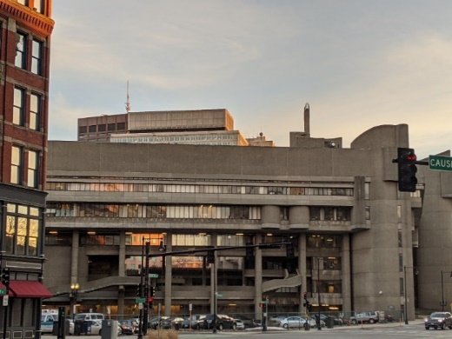
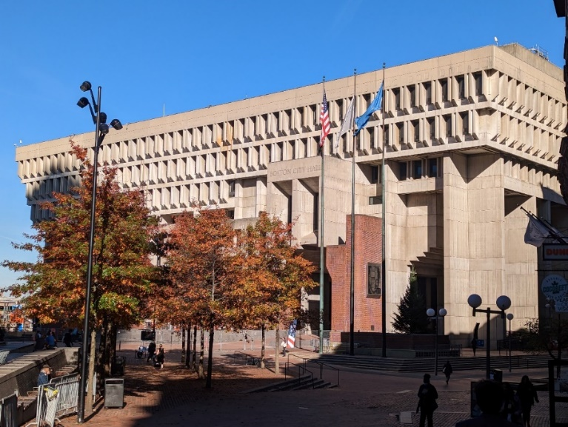

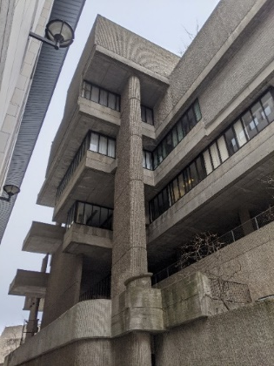
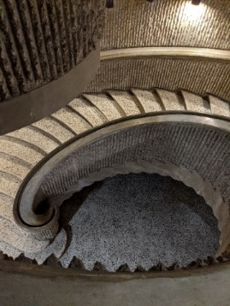
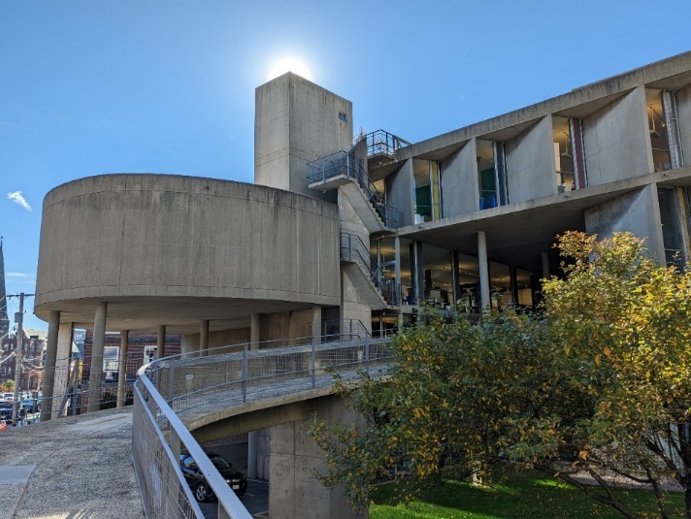

Heroic Boston
Erich Lindemann Mental Health Center
Boston, Massachusetts
Massachusetts General Hospital
Boston, Massachusetts
MGH Psychosis Clinical and Research Program
Photos courtesy of Oliver Freudenreich

Slide 7

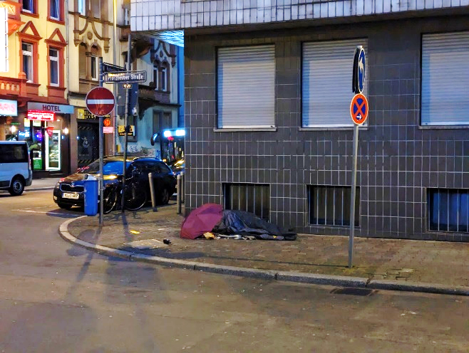



You cannot diagnose just by looking
12.4%
Schizophrenia¹
30%
Psychosis²
¹Gutwinski S et al. PLoS Med. 2021;18(8):e1003750.
²Ayano G et al. BMC Psychiatry. 2019;19:370.

Slide 8
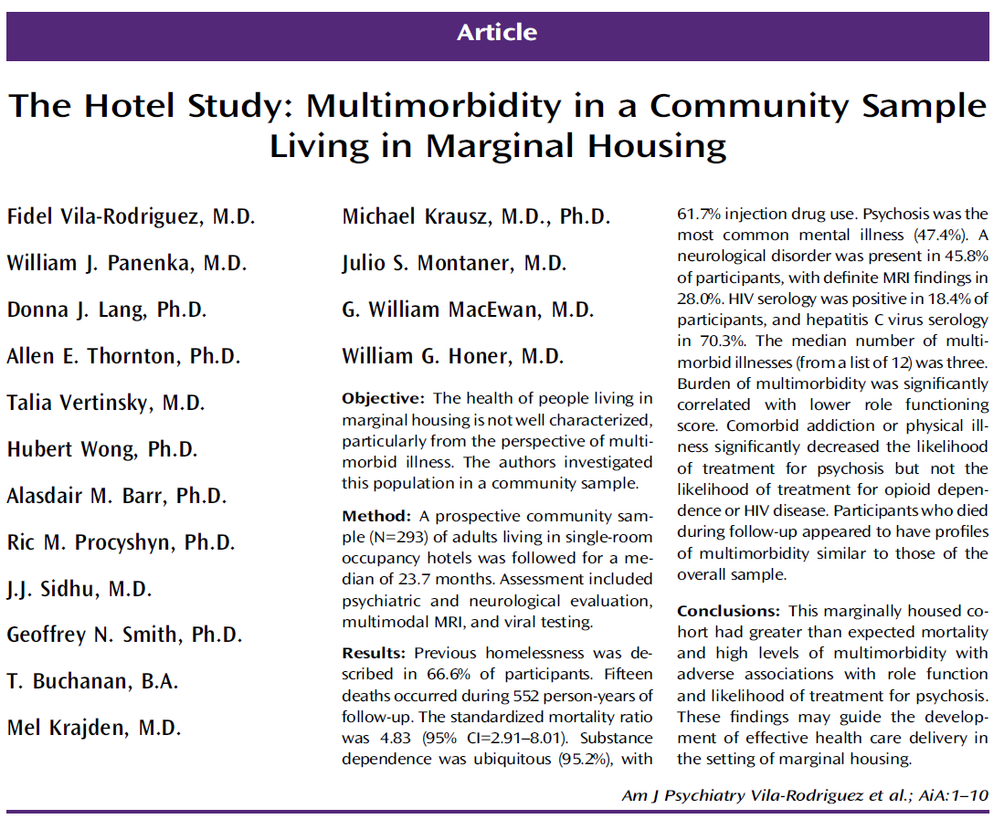
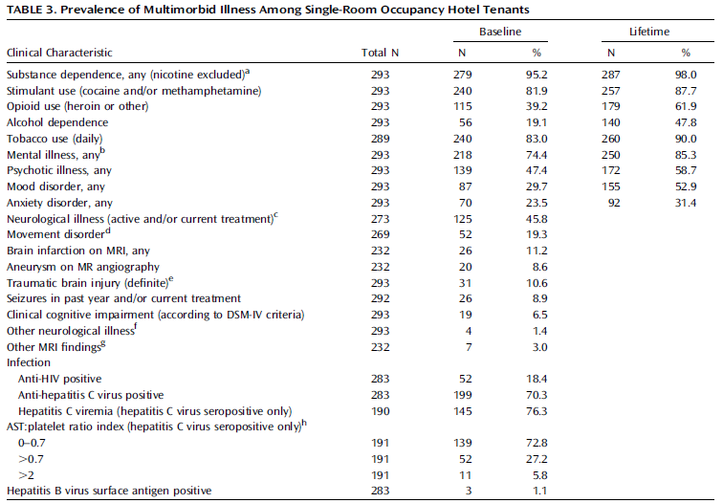
(SRO) Hotel study
High rate of psychosis:
47.4%
High rate of HAART use in HIV:
89%
Vila-Rodriguez F et al. Am J Psychiatry 2013;170(12):1413-22.

Slide 9
Psychosis
conceptual
Signs and symptoms
Psychosis refers to a collection of symptoms that affect the mind, where there has been some loss of contact with reality
During an episode of psychosis, a person’s thoughts and perceptions are disrupted and they may have difficulty recognizing what is real and what is not
  Delusions
  Hallucinations
  Disorganized speech
  Grossly disorganized or catatonic behavior
https://www.nimh.nih.gov/health/publications/understanding-psychosis
Based on DSM-5-TR

Slide 10
Karl Bonhoeffer (1868–1948)
Father of “organic psychiatry”
  “Crude exogenous organic damage of the most varying kind can produce acute psychotic clinical pictures of a basically uniform kind.”
  -Bonhoeffer, 1909
No help from phenomenology!
  No pathognomonic signs
  No etiologic specificity
Strohle A et al. Am J Psychiatry 2008;165:575.

Slide 11
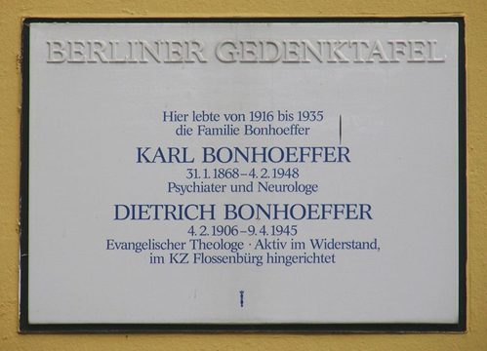

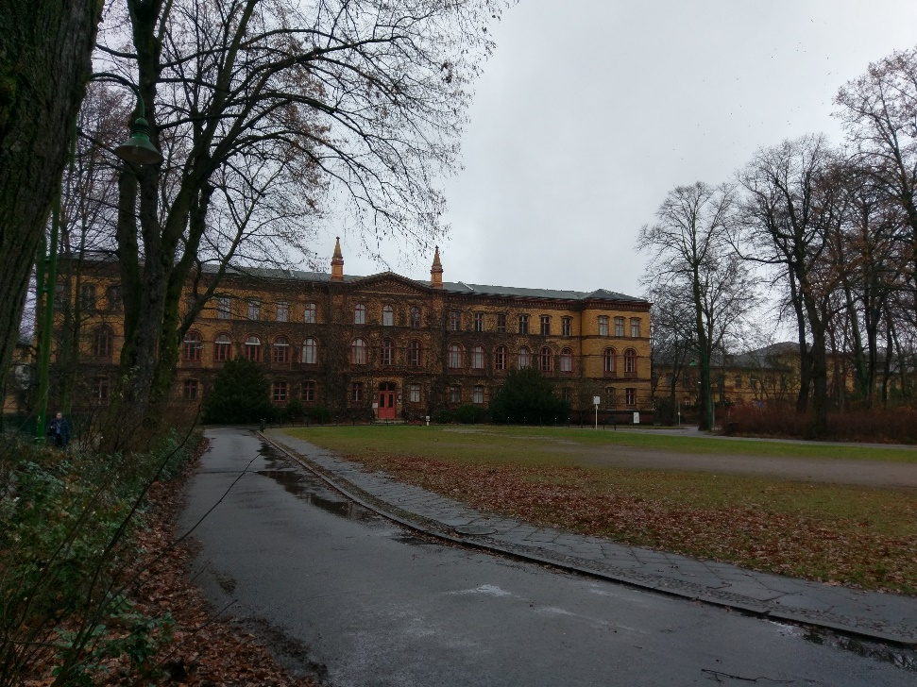
Bonnie’s Ranch in Berlin
https://www.exberliner.com/politics/bonnies-ranch/

Slide 12
New-onset psychosis
ICD-11 Primary vs. secondary
Primary
Secondary
Schizophrenia spectrum
Other
psychiatric
Illnesses
Delirium
Dementia
2nd GMC
Substance
Induced
“Psychiatric”
“ORGANIC”
GMC = General Medical Condition
Based on: Freudenreich O. Psychiatric Times Dec 2010
Notes:
One organizing principle separates etiology into primary psychiatric and secondary causes (“organic”), the latter including delirium, dementia, medical illnesses and substances (see FIGURE YY).. Psychosis could be attributable to a combination of factors (like a delirium which is often multifactorial) and all of them must be systematically examined.

Slide 13
Goals of First-Episode Psychosis (FEP) Medical Work-Up
Make a positive (working) diagnosis of schizophrenia
  Diagnosis of exclusion
Avoid missing easily treatable medical conditions
Establish medical baseline for planned treatment with antipsychotic
Assure patients and families (and yourself) that the etiology is not medical/neurological

Slide 14
New-onset Psychosis Work-up
Screen broadly
  CBC, glucose, full chemistry, liver function tests (LFTs), ESR, ANA, urinalysis, urine drug screen
  Imaging (low yield in “healthy”)*
Test specifically
  TSH, B12 & folate, ceruloplasmin (?), HIV, FTA-Abs
Test more as clinically indicated
  Electroencephalogram (EEG)
  Karyotype (early onset schizophrenia!)
  Chest x-ray (CXR), lumbar puncture, blood cultures, arterial blood gas
  Serum cortisol
  Toxin search
  Autoantibodies (cerebrospinal fluid [CSF]!)
  Drug levels
  Neurocognitive testing (?)
Epidemiology counts!
Consider immune status – CD4 count, HIV viral load
FES
Delirium
CBC = complete blood count, ESR = erythrocyte sedimentation rate, ANA = antinuclear antibody, TSH = thyroid stimulating hormone. Adapted from Freudenreich et al. Harv Rev Psychiatry 2007;15:189.

Slide 15
Comorbidity and Causality Problem
  We lack knowledge about etiology and pathophysiology of schizophrenia
  Is the identified problem
    An incidental finding? (Slater: “fortuitous”)
    Relevant at some level? (Slater: precipitate “true” schizophrenia)
    Solely responsible for the psychopathology? (If you removed it, psychosis would resolve)
  Use ATYPICALITY and TEMPORALITY and BIOLOGICAL PLAUSABILITY as criteria
Notes:
Examples: drug use, cytogenetic abnormality, many MRI finding

Slide 16
Comorbidities
Schizophrenia + HIV
HIV + psychosis
People with schizophrenia who have co-occurring HIV
    Patients with schizophrenia have higher risk of contracting HIV
    May have better viral suppression outcome (!)
PWH who have psychotic symptoms
  Substance use is most common cause of substance-related psychosis
  Vulnerable brain as risk factor for psychosis
  HIV treatment (efavirenz)
Cournos F, et al. J Clin Psychiatry. 2005:66 Suppl 6:27-33. Riano NS, et al. J Health Care Poor Underserved. 2024;35:1-7. Ebuenyi I, et al. AIDS Care. 2018;30(12):1586-1594. Eur Rev Med Pharmacol Sci. 2020 Oct;24(20):10729-10735.

Slide 17
Methamphetamine and Psychosis
MATES = Methamphetamine Treatment Evaluation Study
MATES cohort subsample N=278
  Methamphetamine dependence
  Prospective: BL, 3 % 12 mos, 3 yrs
  BPRS >= 4 on any of 3 items in past month: suspiciousness, unusual thought content, hallucinations
Fixed-effects analysis
  Meth use compared to not
Age 32; 72% male
58% use in observed month
  Median use 8 days
  79% injection
25% psychosis in observed month
  71% SUSP; 35% D; 51% H
5-fold ↑ in likelihood of psychosis when using; dose effect
 | Use | Odds Ratio | Psychosis
No use |  |  | 7%
Meth | 1-15 d | 4.0 | 27%
 | 16-28 d | 11.2 | 48%
Cannabis | 16-28 d | 2.0 | 61%
Alcohol | 16-28 d | 2.1 | 63%
Both |  |  | 69%
BPRS = Brief Psychiatric Rating Scale
McKetin R et al. JAMA Psychiatry 2013;70:319.

Slide 18
Substance-induced Psychosis
Danish population-based registry study
  20-year follow-up
  N=6,778
  Majority alcohol, cannabis, amphetamines
  32.2% of patients converted to schizophrenia or bipolar disorder
    Substantial differences in conversion rates between substances
      Almost 50% if cannabis-induced psychosis
    Half converted within 3 years to schizophrenia
    The younger the patient, the higher the conversion risk
Implications
  50% of cannabis induced psychosis will become schizophrenia
  Longer-term follow-up and treatment needed to prevent schizophrenia?
  Will legalization of cannabis increase psychosis incidence?
“…drug-precipitated disorder in highly vulnerable individuals”
Starzer MSK et al. Am J Psychiatry. 2018;175(4):343-50. Ghose S. Am J Psychiatry. 2018;175(4):303-4. Murray RM and Hall W. JAMA Psychiatry. 2020;77(8):777-8. Kendler KS et al. Am J Psychiatry. 2019;176(9):711-9. Tandon R and Shariff SM. Am J Psychiatry. 2019;176(9);683-4.

Slide 19
HIV and the Brain
Growing number of aging PWH
  Early CNS infection; subcortical
  More HIV-associated neurocognitive disorders (HAND)
Prevention
  HIV screening (early diagnosis and early treatment)
  Appropriate neurocognitive screening?
Treatment
  Early (i.e., screening!)
  Use CNS Penetration-Effectiveness (CPE) rank?
  Routine lumbar puncture for CNS viral load?
Psychosis as first sign of HIV dementia.
Valcour V et al. Curr HIV/AIDS Rep 2011;8:54. Valcour V et al. CID 2011;53:836. Letendre S et al. Arch Neurol 2008;65:65. Lin SP et al. Curr Top Behav Neurosci. 2021:50:517. Owe-Larsson B et al. Afr J Psychiatry 2009;12:115.

Slide 20
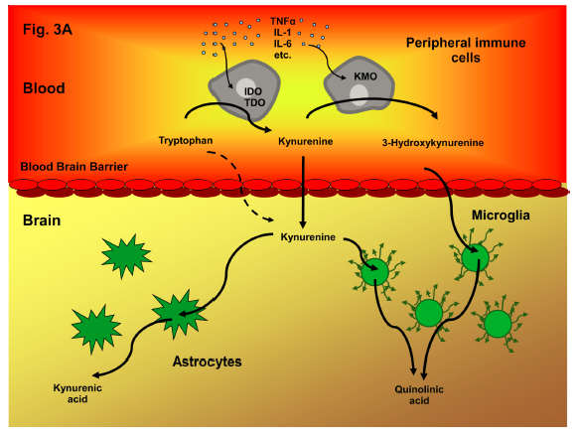
Kynurenic Acid in CSF
Nilsson 2005; Atlas 2007.
Review: Schwarcz et al. Nat Rev Neurosci 2012;13:465.
Notes:
However, there has been one interesting finding about a possible pathophysiology of HIV-associated psychosis, suggesting that an entity like psychosis due to HIV exists.
One theory of schizophrenia posits an NMDA receptor hypofunction as contributor to the symptoms of schizophrenia {Goff, 2001 #428}. PCP or ketamine which can cause psychosis are exogenous NMDA antagonists. Kynurenic acid is an endogenous NMDA antagonist that is increased in the brain {Schwarcz, 2001 #973} and CSF of patients with schizophrenia {Nilsson, 2005 #1252}. Some HIV strains can increase the activity of a key enzyme of tryptophan metabolism, indolamine 2,3-dioxygenase {Grant, 2000 #1859} which leads to an increase in catabolic products that include kynurenic acid and the neurotoxic quinolinic acid. Atlas and colleagues {Atlas, 2007 #1015} found increased CSF levels of kynurenic acid in patients with HIV compared to normal controls. In addition, patients with HIV and psychosis had higher levels compared to patients with HIV alone. Quinolinic acid levels in CSF have been found to correlate with brain atrophy in HIV patients {Heyes, 2001 #1862}. Such a model is consistent with a recent case report of psychosis emerging in an HIV patient following HAART discontinuation and resulting rise in viral load and decline in CD4 cells {Alvarez-Segura, 2008 #1864}.

Slide 21
Secondary Psychosis Due to COVID-19
Neuropsychiatric syndromes often seen in pandemics
Direct COVID-19 effects on the brain
  Anosmia and ageusia
  Neurologic manifestations in 214 Wuhan patients
    36.4% with CNS, PNS, and skeletal muscle involvement
    Acute cerebrovascular disease, impaired consciousness
  Psychosis due to COVID-19? Autoimmune trigger?
Differential diagnosis
  Delirium
  Triggered psychiatric illnesses due to stress: brief psychotic disorder
Management
  Evolving
  Antipsychotics safe (cardiology) and/or effective?
https://www.vice.com/en_us/article/g5x3gq/link-between-pandemics-and-psychosis-spanish-influenza-and-psychotic-disorders Troyer EA et al. Brain Behav Immu. April 13, 2020. Mao L et al. JAMA Neurol. April 10, 2020. Ferrando SJ et al. Psychosomatics. 2020;61(5):551-5. Smith CM et al. Gen Hosp Psychiatry 2021;73:84-100. https://www.psychiatrictimes.com/coronavirus/brief-psychotic-disorder-triggered-fear-coronavirus-small-case-series Kochi AN et al. J Cardiovasc Electrophysiol. 2020 Apr 9. doi: 10.1111/jce.14479.

Slide 22


Slide 23
Clinical Pearls – Secondary Psychosis
Psychosis = delirium until proven otherwise
  Can usually be quickly disproven
  BUT: acute and transient psychotic disorders may appear “organic”
Avoid unnecessary hierarchical/etiological thinking
  List all possible contributions agnostically
  Unfortunately, we lost “multi-axial” system
Keep high index of suspicion for new or uncommon etiologies
  Designer drugs, autoantibodies, COVID-19
  In HIV, viral an immune status matters!
Expand search for etiologies if poor response
Legesse B et al. Psychosomatics 2011;52:468-471.

Slide 24
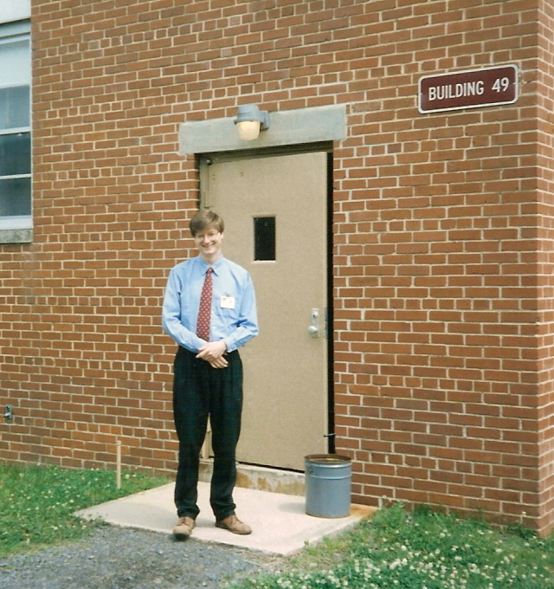

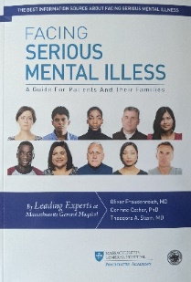
Thank you!
Articles
Freudenreich O. Differential diagnosis of psychotic symptoms: medical “mimics.” Psychiatric Times. 2010;27(12):56-61. https://www.psychiatrictimes.com/view/differential-diagnosis-psychotic-symptoms-medical-mimics
Freudenreich O et al. Initial medical work-up of first-episode psychosis: a conceptual review. Early Interv Psychiatry. 2009;3(1):10-8.
Book
Freudenreich, O. (2020). Psychotic disorders. A practical guide (2nd edition). Humana Press/Springer Verlag.
John Umstead Hospital, Butner, NC, ca. 1995
freudenreich.oliver@mgh.harvard.edu

Slide 25
Resources
National Clinician Consultation Center http://nccc.ucsf.edu/
  HIV Management
  Perinatal HIV
  HIV PrEP
  HIV PEP line
  HCV Management
  Substance Use Management
Present your case on ECHO
http://echo.unm.edu hivecho@salud.unm.edu
AETC National HIV Curriculum https://aidsetc.org/nhc
AETC National Coordinating Resource Center https://targethiv.org/library/aetc-national-coordinating-resource-center-0
Additional trainings scaetcecho@salud.unm.edu
www.scaetc.org
Notes:
Find additional ECHO sessions in your area: https://echo.unm.edu/locations-2/echo-hubs-superhubs-united-states/
https://hsc.unm.edu/echo/get-involved/join-an-echo/
IDEA Platform: Infectious Diseases Education & Assessment. https://idea.medicine.uw.edu/
AETC National HIV Curriculum: 6 core modules for self study; regularly updated; CME, CNE
Hepatitis C Online Curriculum: https://www.hepatitisc.uw.edu/
Hepatitis B Online Curriculum: https://www.hepatitisb.uw.edu/
National STD Curriculum: https://www.std.uw.edu/

Slide 26
