Slide 1
Human Immunodeficiency Virus (HIV 101)
Louie Mar Gangcuangco, MD, MSc, AAHIVS
Assistant Professor of Medicine, JABSOM
Principal Investigator, Pacific AIDS Education & Training Center – Hawaii and US-affiliated Pacific Islands
July 17, 2024

Slide 2
Disclaimer
The views and opinions expressed in this presentation are not necessarily those of the Pacific AIDS Education & Training Center (Pacific AETC) or its eight local partner sites in HRSA Region 9, the Regents of the University of California or its San Francisco campus (UCSF or collectively, University) nor of our funder the Health Resources and Services Administration (HRSA). Neither Pacific AETC, University, HRSA nor any of their officers, board members, agents, employees, students, or volunteers make any warranty, express or implied, including the warranties of merchantability and fitness for a particular purpose; nor assume any legal liability or responsibility for the accuracy, completeness or usefulness of information, product or process assessed or described; nor represent that its use would not infringe privately owned rights.
​
HRSA Acknowledgement Statement​ The Pacific AETC is supported by the Health Resources and Services Administration (HRSA) of the U.S. Department of Health and Human Services (HHS) as part of an award totaling $4,377,449. The contents are those of the author(s) and do not necessarily represent the official views of, nor an endorsement, by HRSA, HHS, or the U.S. Government. For more information, please visit HRSA.gov.
​
Trade Name Disclosure Statement​ Funding for this presentation was made possible by 5 U1OHA29292‐08‐00 from the Human Resources and Services Administration HIV/AIDS Bureau. The views expressed do not necessarily reflect the official policies of the Department of Health and Human Services nor does mention of trade names, commercial practices, or organizations imply endorsement by the U.S. Government. Any trade/brand names for products mentioned during this presentation are for training and identification purposes only.

Slide 3
Learning Objectives
By the end of this training participants will be able to…
Explain why someone should get tested for HIV
Discuss the HIV life cycle in relation to how the available therapies work.
Describe the importance of linkage to care when someone tests positive for HIV
Notes:
By the end of this training, participants should be able to…
Explain why someone should get tested for HIV
Describe the importance of linkage to care when someone is tested HIV+
Identify the benefits case management provides to People with HIV
If you have questions during the training, you can either put them in the chat or you can also use the “raise hand” feature on Zoom. I will do my best to address questions as the training goes along and Judy is helping me field questions as they come in.
If I don’t have an answer right away, I’ll do my best to get you one after the training is over.

Slide 4
HIV and AIDS Statistics

Slide 5
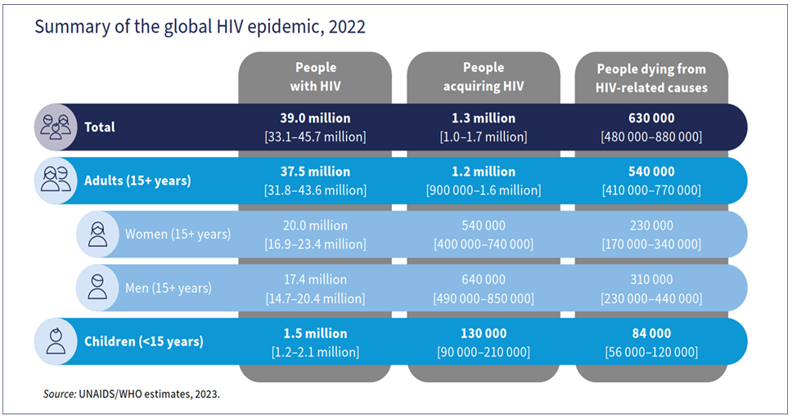
WHO HIV Epidemic 2023 estimates
World Health Organization. HIV data and statistics. Accessed Feb 19, 2024.

Slide 6
HIV Statistics
At year-end 2021, an estimated 1.2 million people in the United States aged 13 and older had HIV in the U.S.
Estimated new HIV infections in the U.S.: 32,100
Lifetime treatment cost of an HIV infection is currently estimated at $379,668 in 2010 dollars.
World Health Organization & CDC data

Slide 7
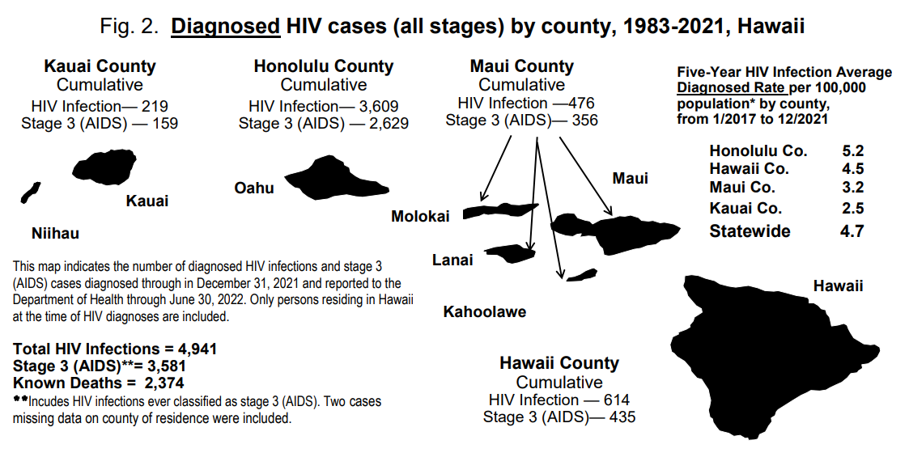
Diagnosed HIV cases (all stages) by county, 1983-2021
Hawaii State Dept of Health https://health.hawaii.gov/harmreduction/files/2022/12/HIV-surveillance-annual-report-year-ending-2021.pdf Accessed May 2023

Slide 8
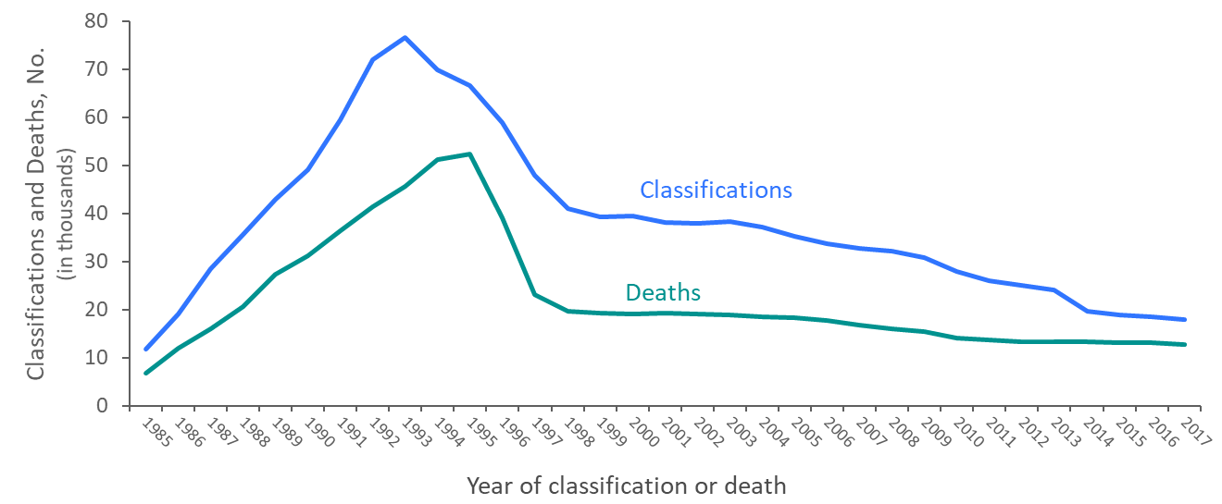
Stage 3 (AIDS) Classifications and Deaths of Persons with Diagnosed HIV Infection Ever Classified as Stage 3 (AIDS), among Adults and Adolescents, 1985–2017 United States and 6 Dependent Areas
HIV Cases Peaked 1992-1993
Decline in Cases due in part to
Highly Active Anti-Retroviral
Therapy Available since 1996
CDC HIV Surveillance 2018
National Center for HIV/AIDS, Viral Hepatitis, STD, and TB Prevention
Division of HIV/AIDS Prevention
Note:Deaths of persons with HIV infection, stage 3 (AIDS) may be due to any cause.
Notes:
The upper curve on the line graph represents the number of stage 3 (AIDS) classifications among adults and adolescents with diagnosed HIV infection in the United States and dependent areas, by year of classification from 1985 through 2017; the lower curve represents the number of deaths of adults and adolescents with diagnosed HIV infection ever classified with stage 3 (AIDS), by year of death from 1985 through 2017. The peak in stage 3 (AIDS) in 1993 can be associated with the expansion of the HIV surveillance case definition implemented in January 1993. The overall declines in stage 3 (AIDS) and deaths of persons with stage 3 (AIDS) are due in part to the success of highly active antiretroviral therapies, introduced in 1996.
In recent years, stage 3 (AIDS) classifications and deaths of persons with stage 3 (AIDS) have continued to decline.
Deaths of persons with stage 3 (AIDS) may be due to any cause (may not be HIV-related). Deaths of persons with stage 3 (AIDS) are classified as adult or adolescent based on age at death.

Slide 9
HIV and AIDS: Overview of the Immune System

Slide 10
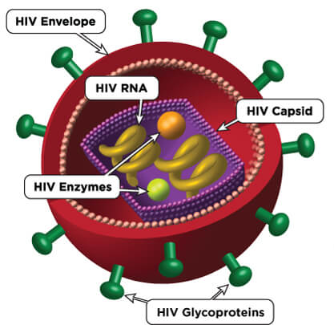
Human Immunodeficiency Virus (HIV) (1)
HIV causes Acquired Immune Deficiency Syndrome (AIDS)
HIV attacks the immune system, making it difficult for the body to fight infections
Without treatment, people with HIV (PWH) will develop AIDS
Treatment greatly delays disease progression and prevents HIV transmission
Notes:
Starting with the basics
Here, you see an illustration of the Human Immunodeficiency Virus, HIV.
This is the virus that causes AIDS, the Acquired Immune Deficiency Syndrome. You might hear people use the term “Advanced HIV” because the term AIDS is being used less and less these days in medical settings.
Without treatment, HIV breaks down the immune systems and leaves it unable to fight infections.
With consistent treatment, however, someone newly diagnosed with HIV should expect to never be given an AIDS diagnosis nor even to transmit the virus to their sexual partners.
A really important teaching point to keep in mind when working with clients is that HIV and AIDS are not the same thing. HIV is the virus. AIDS is the disease state that happens over a number of years if HIV is left untreated. AIDS or Advanced HIV, is the a clinical definition of what happens when HIV goes untreated.
In my work, I find that it can give people a sense of control over their diagnosis as HIV+ to know that by taking medications to treat HIV, they are proactively keeping themselves healthy, keeping Advanced HIV at bay, and they are protecting their sex partners. My taking medications, they are taking action to keep themselves healthy…taking control and exerting their power over the diagnosis.
So, in respect to the question of why should someone get tested? Well, to know their status and if HIV-, take the proper steps to protect themselves from getting HIV such as taking PrEP, using condoms, or other prevention methods. And if HIV+, to engage in medical care and get on treatment to maintain their long-term health and protect their partners.

Slide 11
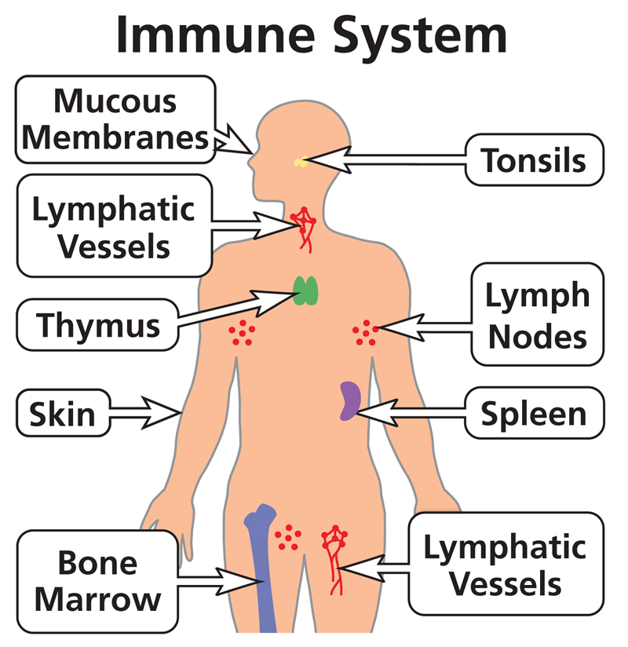
The immune system: body’s defense against infections
Image source: HIVinfo.NIH.gov

Slide 12
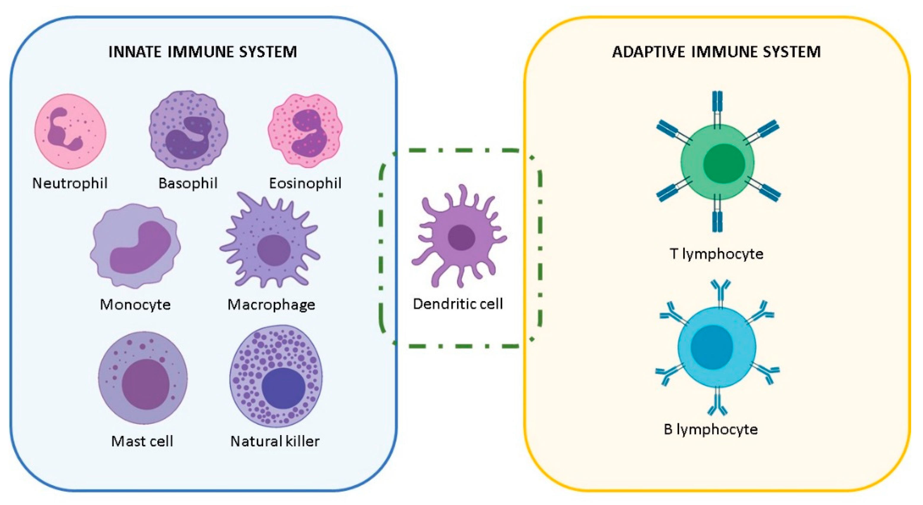
Cells of the immune system
CD4
T cells

Slide 13
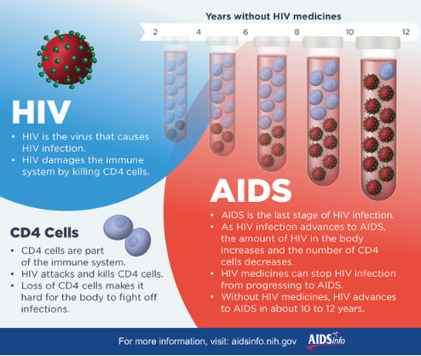
HIV and AIDS: what is the difference?

Slide 14
How is HIV transmitted?
Transmitted via certain body fluid(s)
Blood
Semen
Vaginal Secretions
Breast Milk
These body fluids enter into the body via…
Mucous Membrane in anus or vagina
Blood-to-blood (Intravenous drug use; needlestick injury)
Perinatal (In utero, during birth, breastfeeding)
Notes:
HIV is spread most commonly through unprotected sex with an infected partner. The virus can enter the body through the lining of the vagina, vulva, penis, or the rectum, during high-risk sex.
When I say “high risk” I want you to not only consider sex without a barrier (e.g. condom) but also without PrEP or without the PWH having an undetectable viral load.
HIV is also spread through contact with infected blood, especially among injecting drug users who share contaminated needles and other drug paraphernalia.
Women can transmit HIV to their babies during pregnancy, birth and via breastfeeding

Slide 15
How is HIV not transmitted?
HIV+ people do NOT transmit the virus via…
Saliva
Sweat
Tears
Urine
Feces
Vomit
Notes:
The body fluids you see on the screen do not transmit HIV.
HIV does not survive well outside the body. Therefore, HIV cannot be spread through casual contact such as:
Sharing drinking glasses
Casual kissing
Contact with saliva, sweat, tears, urine or feces
Insect bites

Slide 16
HIV Life Cycle
Notes:
This is a depiction of the HIV Life cycle from infection to the production of new virus. The cycle will be broken down into sections to describe the targets of HIV treatment.

Slide 17
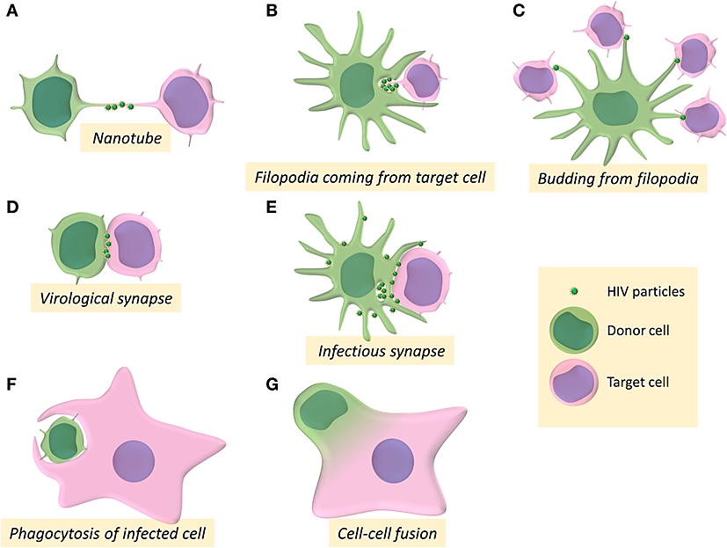
Cell to cell transmission of HIV

Slide 18
There is no cure for HIV due to anatomical and cellular reservoirs

Slide 19
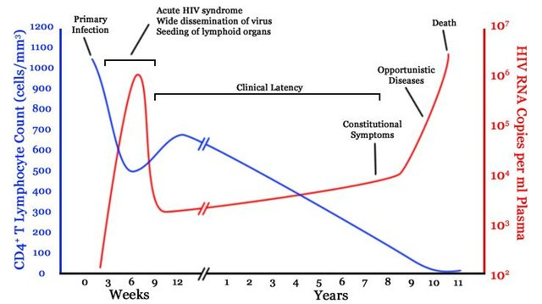
Natural History of untreated HIV infection
Popoola and Awodele. Afr. J. Med. med. Sci. (2016) 45, 5 - 21
Notes:
This is a figure presenting the natural history of untreated HIV infection. The blue line shows the level of CD4 T lymphocytes while the red line shows the HIV viral load. HIV is a virus that destroys the immune system, primarily infecting CD4 lymphocytes. During the first few years of HIV infection, the body is able to control the virus but after several years, the CD4 lymphocytes get depleted and viral load increases significantly. At this point, the patient would be susceptible to various bacterial, viral, and fungal infections.

Slide 20
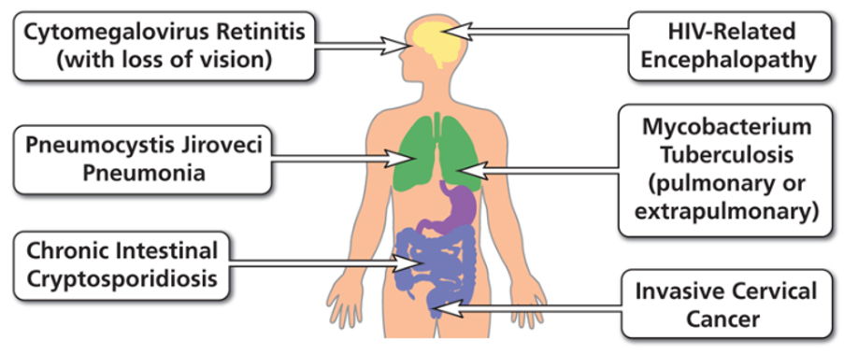
Examples of AIDS-Defining Conditions
Source: AIDS Defining Conditions | NIH

Slide 21
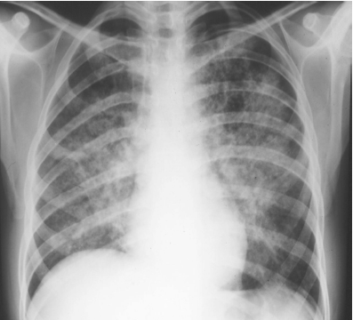
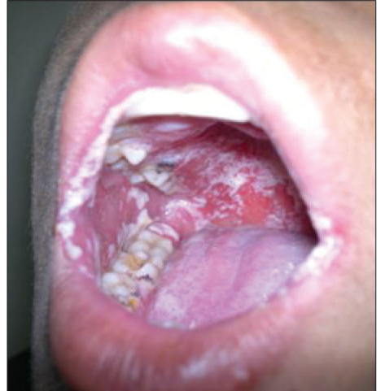
Clinical Manifestations of HIV
Pneumocystis pneumonia
Candidiasis
Tomar et al. Int J of Oral Care and Research, January-March (Suppl) 2018;6(1):31-35
Clin Med 2008;8:539–43

Slide 22
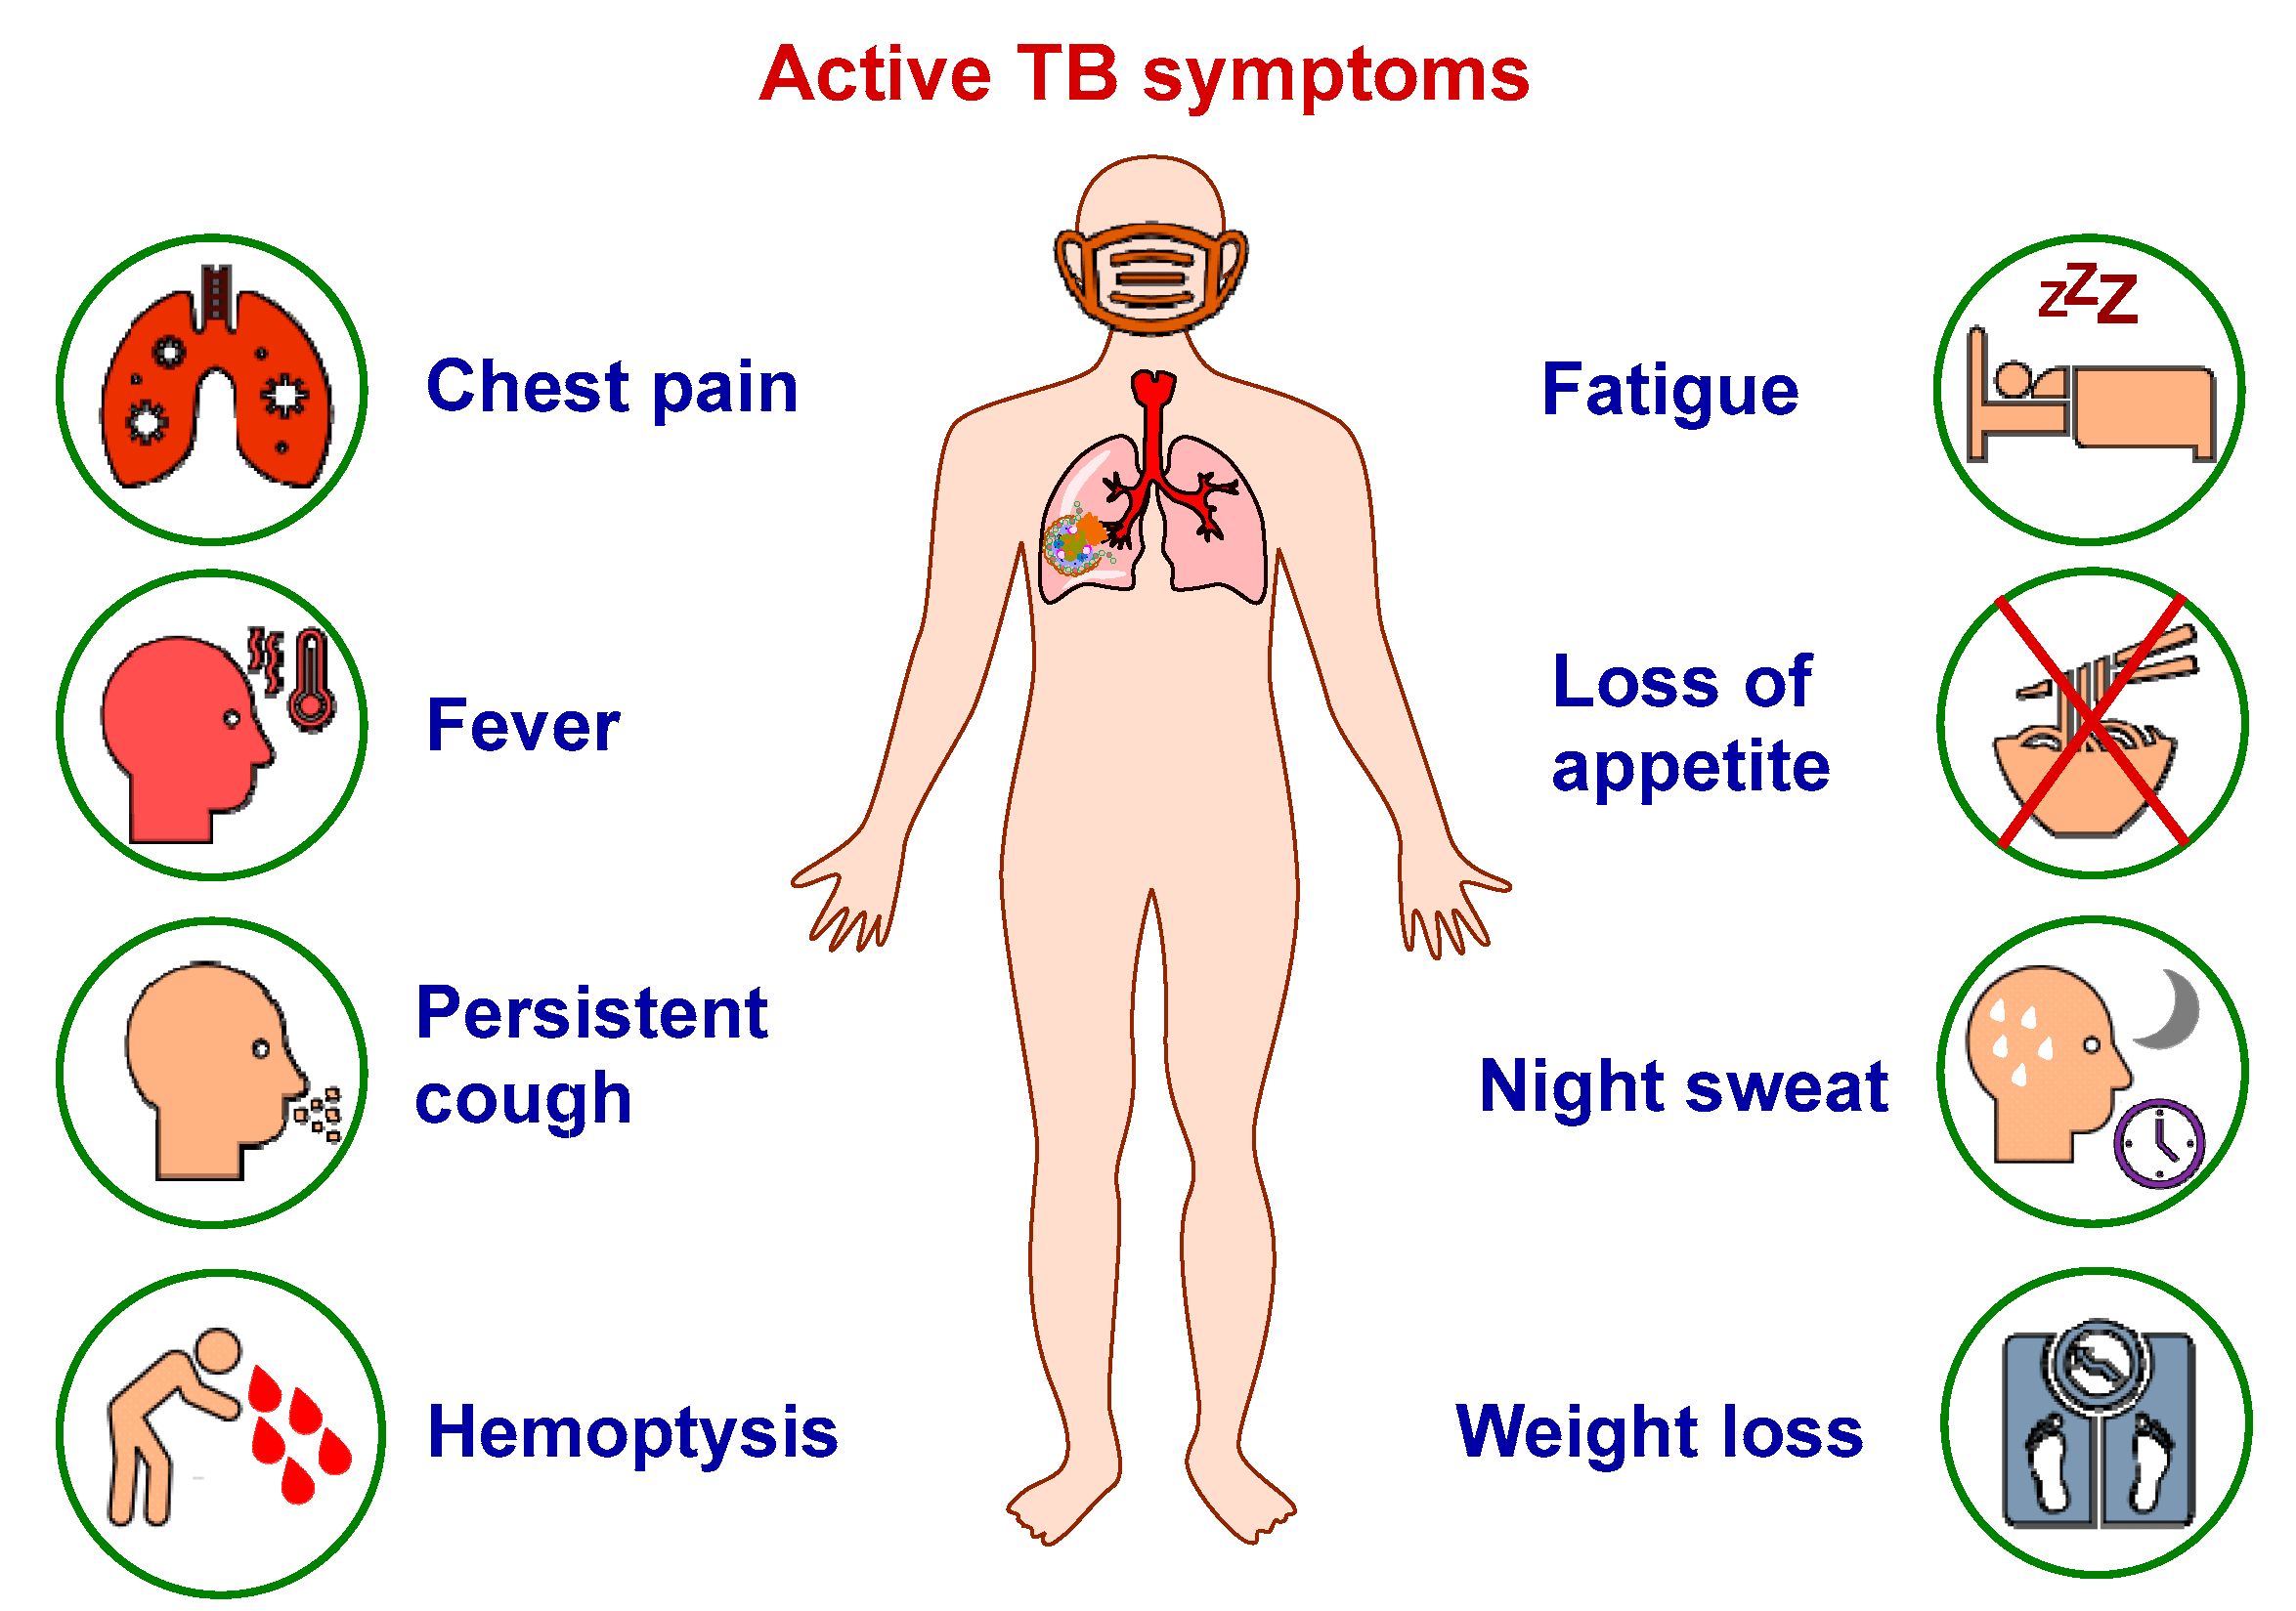
Clinical manifestations of tuberculosis

Slide 23
HIV Testing

Slide 24
Natural progression of untreated HIV infection
Popoola and Awodele. Afr. J. Med. med. Sci. (2016) 45, 5 - 21
Notes:
This is a figure presenting the natural history of untreated HIV infection. The blue line shows the level of CD4 T lymphocytes while the red line shows the HIV viral load. HIV is a virus that destroys the immune system, primarily infecting CD4 lymphocytes. During the first few years of HIV infection, the body is able to control the virus but after several years, the CD4 lymphocytes get depleted and viral load increases significantly. At this point, the patient would be susceptible to various bacterial, viral, and fungal infections.

Slide 25
USPSTF HIV Screening Recommendations*
Population | Recommendation | Grade
Pregnant persons | The USPSTF recommends that clinicians screen for HIV infection in all pregnant persons, including those who present in labor or at delivery whose HIV status is unknown. | A
Adolescents and adults aged 15 to 65 years | The USPSTF recommends that clinicians screen for HIV infection in adolescents and adults aged 15 to 65 years. Younger adolescents and older adults who are at increased risk of infection should also be screened. | A
*current as of May 2024; Topic is being updated.
USPSTF. Final recommendation statement on HIV Screening. Available at: https://www.uspreventiveservicestaskforce.org/uspstf/recommendation/human-immunodeficiency-virus-hiv-infection-screening Accessed December 17, 2023.

Slide 26
Window period of various HIV tests
Notes:
Nucleic Acid Test (NAT)—A NAT can usually tell if you have HIV infection 10 to 33 days after exposure. It is performed by a lab on blood from your vein.
Antigen/Antibody Test—An antigen/antibody test performed by a laboratory on blood from your vein can usually detect HIV infection 18 to 45 days after exposure. An antigen/antibody test done with blood from a finger prick takes longer to detect HIV (18 to 90 days after an exposure).
Antibody Test—An antibody test can usually detect HIV infection 23 to 90 days after an exposure. Most rapid tests and self-tests are antibody tests. In general, antibody tests that use blood from a vein detect HIV sooner after infection than tests done with blood from a finger prick or with oral fluid.

Slide 27
HIV Seroconversion Window Period
Different types of tests diagnose HIV at different intervals post-infection
Antibody tests – as early as 3 weeks; most by 12 weeks via oral fluid or blood
Antigen test – as early as 2 weeks; most by 6 weeks via blood
Viral Detection (HIV RNA) – as early as 7 days; up to 28 days via blood
Notes:
The HIV Seroconversiton Window Period is the time between when an HIV infection occurs and when that infection shows up on a test.
Different types of tests diagnose HIV at different intervals after an infection occurs.
Additionally, everyone’s bodies produce the markers some of these tests are looking for at different times so we cannot say with 100% precision when each test is going to diagnose HIV
Antibody tests via saliva or blood, may pick up an HIV+ result as early as three (3) weeks after infection
Antigen blood tests can give results as early as two (2) weeks after infection
Viral Detection—done through a Nucleic Acid Amplification Test which examines the actual virus in the blood—can diagnose HIV as early as seven (7) days after an infection
Of course, these are the earliest times that a certain test can detect HIV infection and in many instances, they require longer to pick up a positive result if there is one.
So, because the virus can be present in someone’s body but not register on a test—that is, they are in the Window Period—we ask them to get another HIV test after a prescribed duration of time

Slide 28
Case 1
A 25-year-old cisgender male comes in the clinic for routine HIV testing. His last unprotected (condomless) sexual encounter was 1 week ago. The HIV status of the partner is unknown. His HIV screening test comes back negative. The patient does not have any symptoms and is feeling well. Aside from counseling the patient on safe sex practices, what is the best advice?
Your HIV test is non-reactive (negative) and there is no further follow-up needed
Your HIV test is negative and you need a repeat HIV test tomorrow
Your HIV test is negative and you need a repeat HIV test in a few weeks
Any of the above

Slide 29
Acute HIV Syndrome
Common Symptoms fever, fatigue, and rash
Less Common Symptoms headache, swollen lymph glands, sore throat, feeling achy, nausea, vomiting, diarrhea, and night sweats
Similar to other illnesses (e.g. flu, COVID-19)
Only experienced by about ½ of the people newly infected
Only an HIV test can diagnose HIV
Notes:
Some people, during seroconversion, experience something called Acute HIV Syndrome
You’ll see the common and less common symptoms listed here on the screen
Only about half of the people newly infected with HIV have this experience and it mimics other illnesses
Of course, you can’t tell someone has HIV just by looking at them or by an anecdotal symptom review. The only way to know is to get a test
As a side note: There are many people infected with HIV who are not aware of it—1 out of 7 nationally* (155,000 per 2016 estimates)
Research has shown that PLWH who are not diagnosed and in care are linked to 9/10 new HIV transmissions so knowing your status matters not only to the individual but also to the community

Slide 30
Antiretroviral Therapy

Slide 31
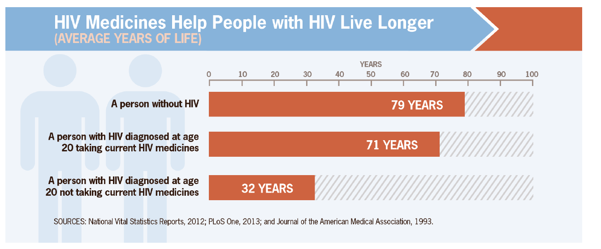
Effective Treatment Saves Lives

Slide 32
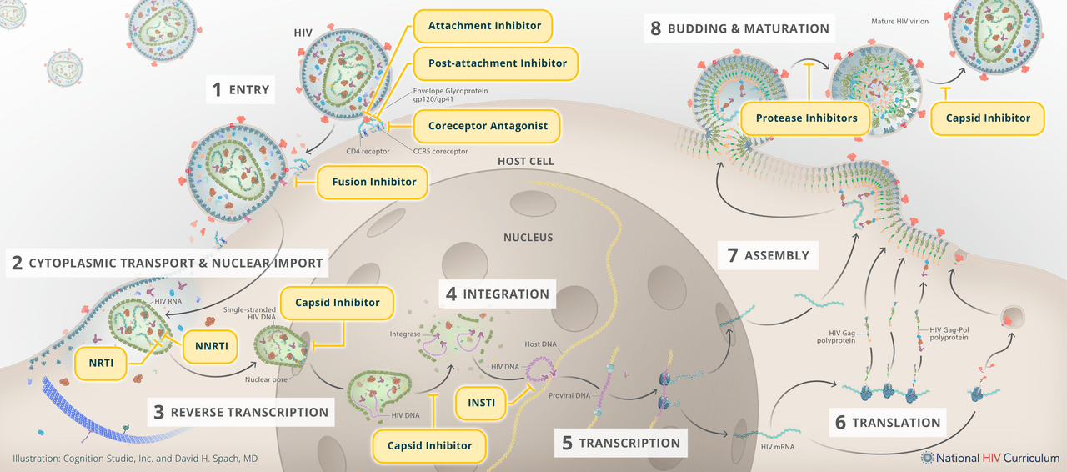
HIV life cycle and targets of antiretroviral therapy
Illustration: Cognition Studio, Inc. and David H. Spach, MD. Available at: https://www.hiv.uw.edu/go/antiretroviral-therapy/general-information/core-concept/all Accessed March 5, 2024.

Slide 33
Antiretroviral Therapy (ART)
*Long-acting injectable ART is now available
Notes:
Once linked to care, medical clinicians will do a full panel of baseline labs and then start patients on Antiretroviral Treatment or ART with the clinical goals of:
Reducing HIV viral load to undetectable and keeping it that way
Increasing CD4 cell count and maintaining it in the normal range between 500 and 1600
Ensuring ART adherence on simple first line regimens such as one-pill-once-a-day meds
Preserving a patient’s quality of life
And reducing HIV transmission
Just to re-emphasize, a really empowering point for PWH is that when someone achieves an undetectable viral load and sustains it for longer than six months, research has shown that they cannot transmit HIV to their sexual partners.

Slide 34
HIV Attachment to CD4 Cells
(GP -120)
(GP-120 Direct
Attachment Inhib.)
(Capsid)
(CD4 Directed Post-
Attachment Inhib.)
Source: Clinical Info HIV.gov
Notes:
This part of the viral lifecycle focuses on the phase from attachment of the virus to the CD4 cell, which is the target of infection and fusion of the virus with the cell. The slide shows various areas on the surface of the CD4 cell and the virus that are targets for antiviral treatment.

Slide 35
Entry Inhibitors
Source: Clinical Info HIV.gov
Notes:
This slide goes into further details of where entry occurs and fusion begins.

Slide 36
HIV Reverse Transcription
Source: Clinical Info HIV.gov
Notes:
This slide depicts the reverse transcription phase of the viral life cycle where viral RNA in yellow is made into viral DNA in red by a viral enzyme called reverse transcriptase. The right panel shows where antiviral reverse transpriptase inhibitors (NNRTI = non-nucleoside reverse transcriptase inhibitor or NRTI = Nucleoside reverse transcriptase inhibitors) work.

Slide 37
HIV Integration
Notes:
This part of the lifecycle call integration is where the virus uses it's own enzyme, integrase, to incorporate the viral DNA in red into the CD4 cells DNA in blue so that it causes the CD4 cell to make more viruses. The panel on the right depicts a medication called an integrase inhibitor to block this process.

Slide 38
Protease Inhibition
Notes:
This slide of the life cycle depicts another step that medications can prevent new virus. It is with the use of medications call protest inhibitors that blocks where viral protein is made and modified.

Slide 39
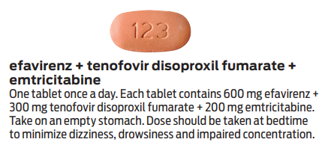
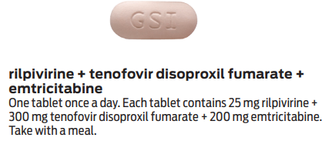
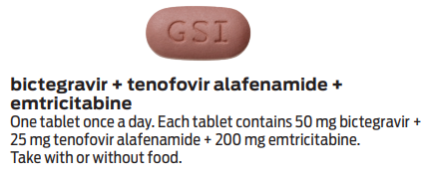
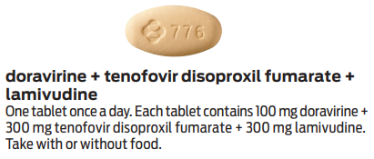
Examples of one pill once a day antiretroviral regimen for HIV (1)
Source:2022 HIV Drug Chart. https://www.poz.com/pdfs/POZ_2022_HIV_Drug_Chart_high.pdf
Notes:
Shown here are examples of one pill once a day regimens for HIV

Slide 40
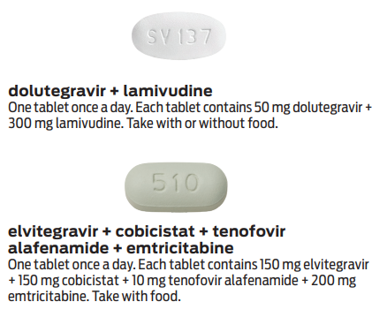
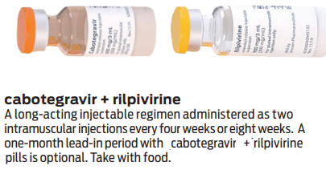
Examples of antiretroviral therapy options for HIV
Long-acting injectable
Source:2022 HIV Drug Chart. https://www.poz.com/pdfs/POZ_2022_HIV_Drug_Chart_high.pdf
Notes:
Shown here are examples of one pill once a day regimens for HIV. Also shown is the long-acting injectable cabotegravir-rilpivirine combination

Slide 41
Recommended Initial Regimens for Most People with HIV (in alphabetical order)
bictegravir/tenofovir alafenamide/emtricitabine (fixed-dose combination)
dolutegravir/abacavir/lamivudine (fixed-dose combination)
only for individuals who are HLA-B*5701 negative and without chronic hepatitis B virus (HBV) coinfection
dolutegravir + (tenofovir alafenamide or tenofovir disoproxil fumarate) + (emtricitabine or lamivudine)
dolutegravir/lamivudine (fixed-dose combination)
except for individuals with HIV RNA >500,000 copies/mL, HBV coinfection, or when ART is to be started before the results of HIV genotypic resistance testing for reverse transcriptase or HBV testing are available.
AIDS Panel on Antiretroviral Guidelines for Adults and Adolescents. Guidelines for the Use of Antiretroviral Agents in Adults and Adolescents with HIV. Department of Health and Human Services. Available at https://clinicalinfo.hiv.gov/en/guidelines/adult-and-adolescent-arv. Accessed December 2023
Notes:
Note: For people with a history of using cabotegravir as PrEP: INSTI genotypic resistance testing should be done before the start of ART. If treatment is begun prior to results of genotypic testing, the following regimen is recommended: Boosted darunavir plus (TAF or TDF) plus (FTC or 3TC) — pending the results of the genotype test (AIII)

Slide 42
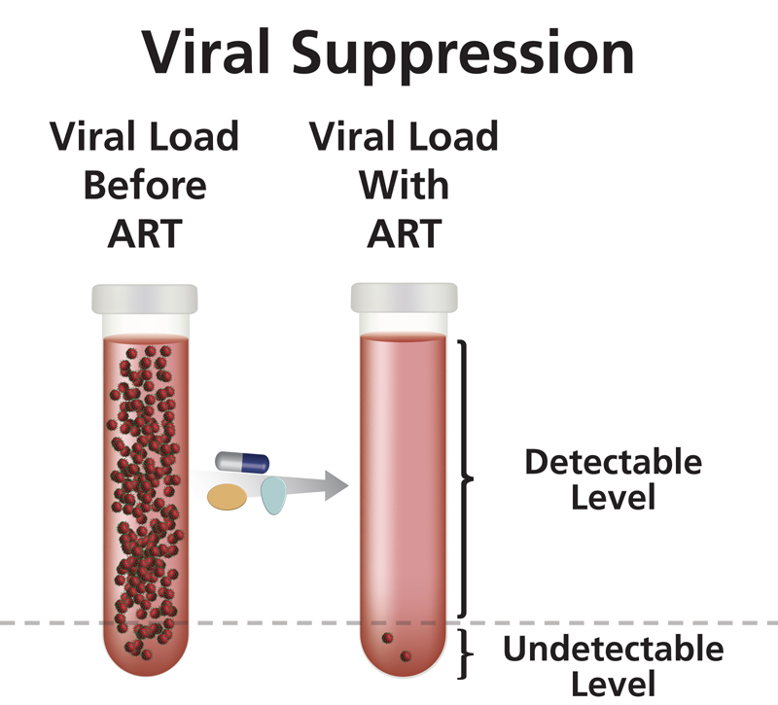
Antiretroviral Treatment (ART)
Clinical Goals
Reduce viral load as much as possible for as long as possible
Increase CD4 cell count
Ensure medication adherence to preserve ART options
Preserve quality of life
Reduce HIV transmission
https://clinicalinfo.hiv.gov/en/glossary/viral-suppression
Notes:
Once linked to care, medical clinicians will do a full panel of baseline labs and then start patients on Antiretroviral Treatment or ART with the clinical goals of:
Reducing HIV viral load to undetectable and keeping it that way
Increasing CD4 cell count and maintaining it in the normal range between 500 and 1600
Ensuring ART adherence on simple first line regimens such as one-pill-once-a-day meds
Preserving a patient’s quality of life
And reducing HIV transmission
Just to re-emphasize, a really empowering point for PWH is that when someone achieves an undetectable viral load and sustains it for longer than six months, research has shown that they cannot transmit HIV to their sexual partners.

Slide 43
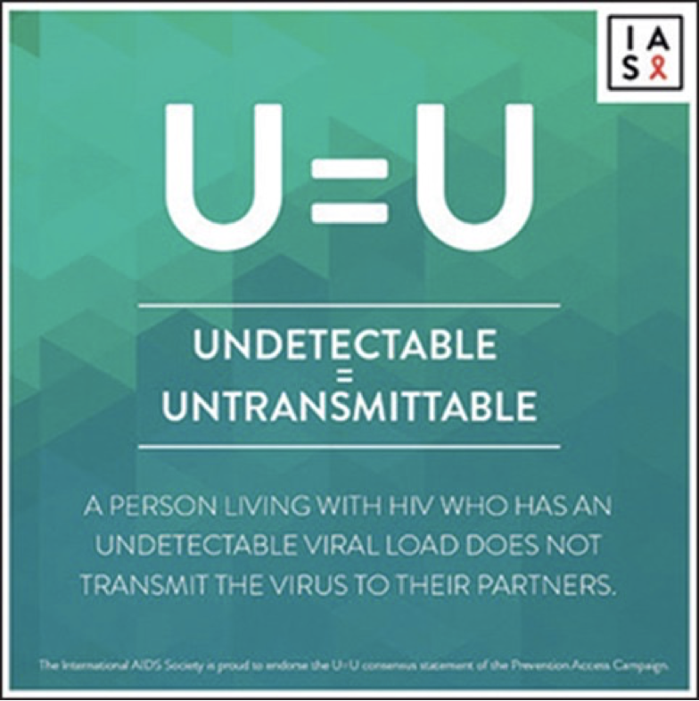
U=U and "Treatment as Prevention" has revolutionized HIV prevention and care
Sexual partners
(does not apply to injecting drug use)
Notes:
U=U and "Treatment as Prevention" has revolutionized HIV prevention and care

Slide 44
Case 2
A 40-year-old cisgender female comes to the clinic to establish primary care. She feels well and does not have any symptoms.
During the social history-taking, you learned that she has had multiple sex partners in the past. She has never been tested for HIV. Physical exam is unremarkable.
What is the most appropriate advice for the patient?
It is appropriate to screen you for HIV
You should not worry about HIV because you only had a few sexual partners in the past
You should not worry about HIV because you are a cisgender female
You should not worry about HIV because your physical exam is normal

Slide 45
Case 2 (continued)
HIV antibody test is reactive (positive)
HIV RNA is 200,000 copies/ml
CD4 T cell count is 450 cells/uL
What is the appropriate next step?
HIV treatment (antiretroviral therapy) is not necessary because her CD4 is above 200 cells/uL
HIV treatment is appropriate and antiretroviral therapy options should be discussed
It is a false positive result. Repeat HIV testing in 3 months.

Slide 46
Key Concepts in HIV Antiretroviral Therapy [1]
Antiretroviral therapy (ART) is recommended for all persons with HIV to reduce morbidity and mortality and to prevent transmission to others
Initiate ART immediately (or as soon as possible) after HIV diagnosis to increase the uptake of ART and linkage to care, decrease the time to viral suppression, and to improve the rate of virologic suppression
When initiating ART, it is important to educate patients regarding the benefits of ART
AIDS Panel on Antiretroviral Guidelines for Adults and Adolescents. Guidelines for the Use of Antiretroviral Agents in Adults and Adolescents with HIV. Department of Health and Human Services. Available at https://clinicalinfo.hiv.gov/en/guidelines/adult-and-adolescent-arv. Accessed December 2023

Slide 47
Key Concepts in HIV Antiretroviral Therapy [2]
Medications from at least 2 different classes are combined to construct an antiretroviral regimen.
Never give only one medication as it promotes HIV resistance.
HIV drug resistance testing is recommended at entry into care for people with HIV to guide selection of antiretroviral regimen.
Treat all patients with hepatitis B.
Selection of a regimen should be individualized:
based on virologic efficacy, potential adverse effects, childbearing potential and use of effective contraception, pill burden, dosing frequency, drug–drug interaction potential, comorbid conditions, cost, access, and resistance-test results
AIDS Panel on Antiretroviral Guidelines for Adults and Adolescents. Guidelines for the Use of Antiretroviral Agents in Adults and Adolescents with HIV. Department of Health and Human Services. Available at https://clinicalinfo.hiv.gov/en/guidelines/adult-and-adolescent-arv. Accessed December 2023

Slide 48
HIV Care Continuum

Slide 49
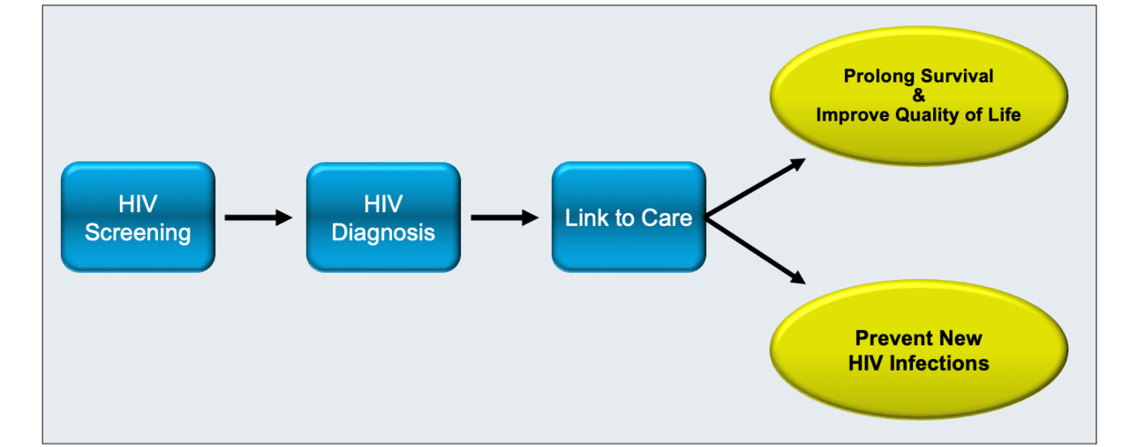
Linkage to HIV Care: Main Goals
Budak JZ. Linkage to HIV Care. Available from the National HIV Curriculum (online). Accessed Feb 19, 2024

Slide 50
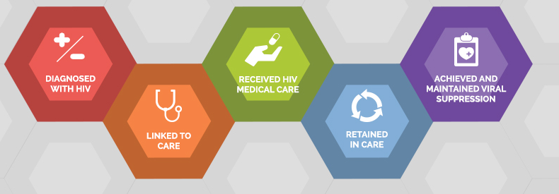
The HIV Care Continuum
The HIV care continuum is a public health model that outlines the steps or stages that people with HIV go through from diagnosis to achieving and maintaining viral suppression
U.S. DHHS https://www.hiv.gov/federal-response/policies-issues/hiv-aids-care-continuum/ Accessed May 2023

Slide 51
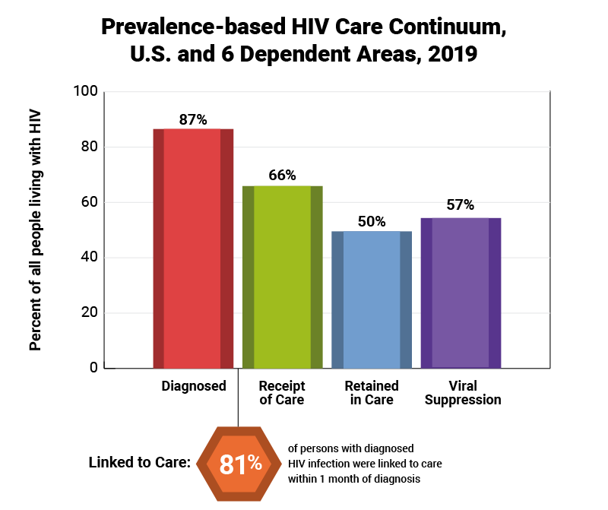
US HIV Care Continuum, 2019
U.S. DHHS https://www.hiv.gov/federal-response/policies-issues/hiv-aids-care-continuum/ Accessed May 2023
Notes:
This graphic is from HIV.gov and you can find in depth information about the HIV Care Continuum, also known as the Treatment Cascade, on that website
Basically, this is an overview of the engagement in testing, care and treatment by PLWH in the US
We start with 86% knowing that they are HIV+
After diagnosis, 78% are then linked to care
64% actually receive care
49% meet the clinical definition of being retained in care (CDC says: two or more CD4 or viral load tests, performed at least three months apart)
and 53% are virally suppressed, or undetectable
Frontline workers play a vital role in helping to improve this treatment cascade and as you can see, there is a lot of work to be done to ensure that PLWH in the US get tested, engaged in care and stay healthy. It all starts with the very important step of linking someone to care after they are diagnosed

Slide 52
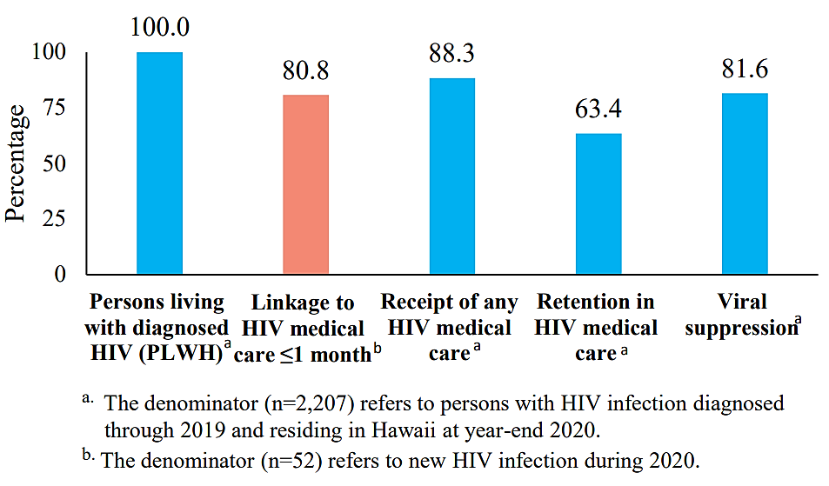
HIV Care Continuum in Hawaii (Year 2020)
Hawaii State Dept of Health https://health.hawaii.gov/harmreduction/files/2022/12/HIV-surveillance-annual-report-year-ending-2021.pdf Accessed May 2023

Slide 53
The 95-95-95 Targets to end the HIV Epidemic
Image from: Together! Act Now | UNAIDS
Notes:
In December 2020, UNAIDS released a new set of ambitious targets calling for 95% of all people with HIV to know their HIV status, 95% of all people with diagnosed HIV infection to receive sustained antiretroviral therapy, and 95% of all people receiving antiretroviral therapy to have viral suppression by 2025

Slide 54
Delayed Linkage to Care: Key Factors
substance use
lack of medical insurance
lack of access to primary care prior to HIV diagnosis
residence in a high-poverty area
Budak JZ. Linkage to HIV Care. Available from the National HIV Curriculum (online). Accessed Feb 19, 2024

Slide 55
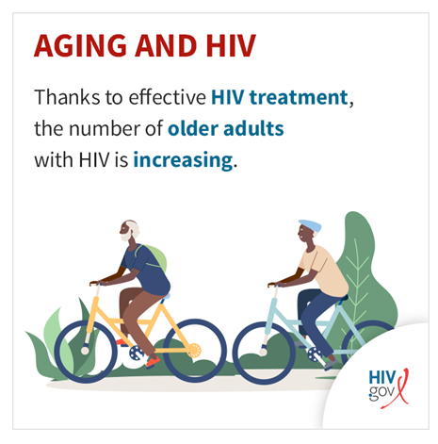
Aging with HIV (2021 Data)
According to the Centers for Disease Control and Prevention, in 2021, of the nearly 1.1 million people with diagnosed HIV in the United States and dependent areas, over 53% were aged 50 and up.
People aged 50 and older accounted for 16% of the 36,136 new HIV diagnoses in 2021 among people ages 13 and older in the United States and dependent areas.
HIV.gov ‘Aging with HIV’ website Accessed April 2024

Slide 56
Aging & HIV
ART Cohort Collaboration. Lancet HIV 2017:4 e354.

Slide 57
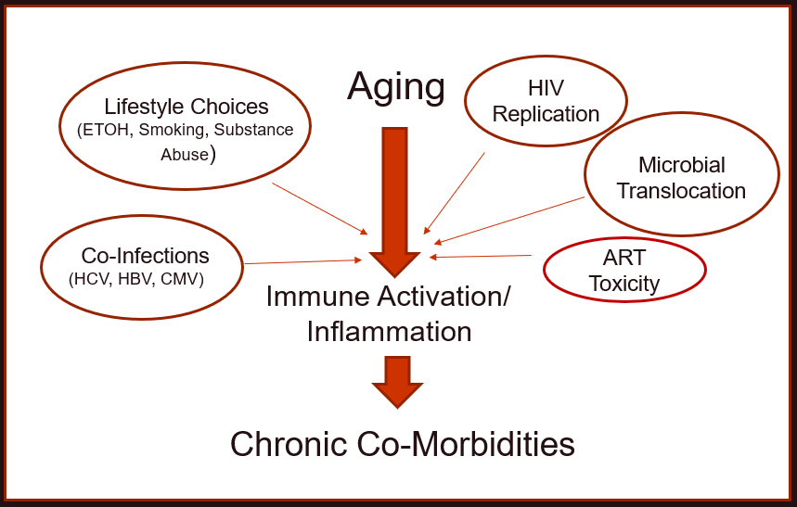
Factors Contributing to Immune Activation & Inflammation
Abbreviations: ART, antiretroviral therapy; CMV: cytomegalovirus; ETOH, ethanol/alcohol; HBV, hepatitis B virus; HCV, hepatitis C virus;
Babu H, et al. Front. Immunol., 26 August 2019
Notes:
Aging is associated with Low grade Inflammation and Immune Activation which then contributes to chronic co-morbidities.
Co-factors surrounding HIV makes this that much worse – HIV replication despite suppressive ART, microbial translocation with seepage of bacterial components thru a disrupted gut mucosa, and some ART toxicity such as increase in obesity due to integrase inhibitor contribute to immune activation;
As well as lifestyle choice such as alcohol, smoking and substance abuse and high rates among PWH of HCV, HBV and CMV co-infection

Slide 58
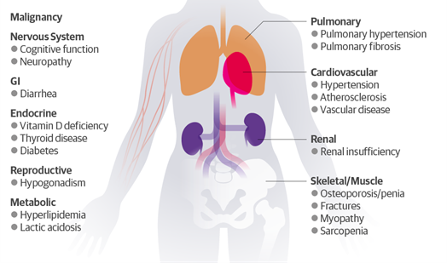
Spectrum of HIV Complications

Slide 59
Summary
HIV is a virus that attacks the immune system, causing a decrease in CD4 T helper cells.
There is currently no cure for HIV but effective treatment with combination antiretroviral therapy saves lives
U=U means that people with HIV who achieve and maintain an undetectable viral load—the amount of HIV in the blood—by taking antiretroviral therapy (ART) daily as prescribed cannot sexually transmit the virus to others.
Multidisciplinary approach is needed to strengthen the HIV care continuum

Slide 60
Resources for Further Learning
HIVInfo - an online resource offering up-to-date HIV/AIDS information to the general consumer, people with HIV/AIDS, people recently diagnosed and those who care for them.
The Body – basics on HIV, especially helpful for newly diagnoses
POZ – breaking down stigma and empowering HIV+ people
Positively Aware drug guide - HIV Medication Guide, updated yearly
HIV.gov – general info about HIV from the US federal government including national strategies and initiatives
HIVE – safe conception and sero-discordant relationship information
Please PrEP Me – information on staying HIV negative
Notes:
These are not only resources for you as frontline workers, but also ones that you can share with your clients.

Slide 61
Questions?
Presenter: Louie Mar Gangcuangco, MD
louiemag@hawaii.edu

