Slide 1
PERINATAL HIV UPDATE
Danielle Avila, MD, MS​
University of Arizona Division of Infectious Diseases ​

Slide 2
Disclaimer
The views and opinions expressed in this presentation are not necessarily those of the Pacific AIDS Education & Training Center (Pacific AETC) or its eight local partner sites in HRSA Region 9, the Regents of the University of California or its San Francisco campus (UCSF or collectively, University) nor of our funder the Health Resources and Services Administration (HRSA). Neither Pacific AETC, University, HRSA nor any of their officers, board members, agents, employees, students, or volunteers make any warranty, express or implied, including the warranties of merchantability and fitness for a particular purpose; nor assume any legal liability or responsibility for the accuracy, completeness or usefulness of information, product or process assessed or described; nor represent that its use would not infringe privately owned rights.
HRSA Acknowledgement Statement The Pacific AETC is supported by the Health Resources and Services Administration (HRSA) of the U.S. Department of Health and Human Services (HHS) as part of an award totaling $4,377,449. The contents are those of the author(s) and do not necessarily represent the official views of, nor an endorsement, by HRSA, HHS, or the U.S. Government. For more information, please visit HRSA.gov.
Trade Name Disclosure Statement Funding for this presentation was made possible by 5 U1OHA29292‐08‐00 from the Human Resources and Services Administration HIV/AIDS Bureau. The views expressed do not necessarily reflect the official policies of the Department of Health and Human Services nor does mention of trade names, commercial practices, or organizations imply endorsement by the U.S. Government. Any trade/brand names for products mentioned during this presentation are for training and identification purposes only.

Slide 3
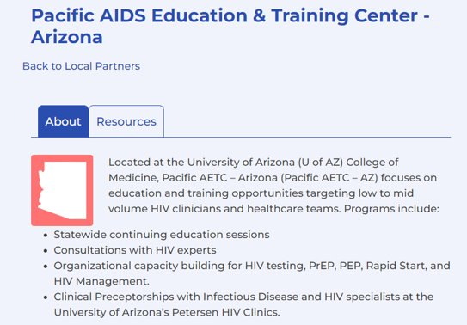
Pacific AIDS Education and Training Center - Arizona
https://paetc.org/about/local-partners/arizona/​

Slide 4
Disclosure Statement ​
No relevant financial disclosures today ​
https://www.nps.gov/orpi/learn/nature/cacti.htm

Slide 5
Outline of today’s talk
1. Epidemiology of perinatal HIV in US
2. Pre-Exposure Prophylaxis (PrEP) in the perinatal period
3. HIV management & transmission prevention through the pregnancy timeline:
Pre-conception
Pregnancy (ART Update)
Labor & Delivery
Infant prophylaxis
Infant feeding

Slide 6
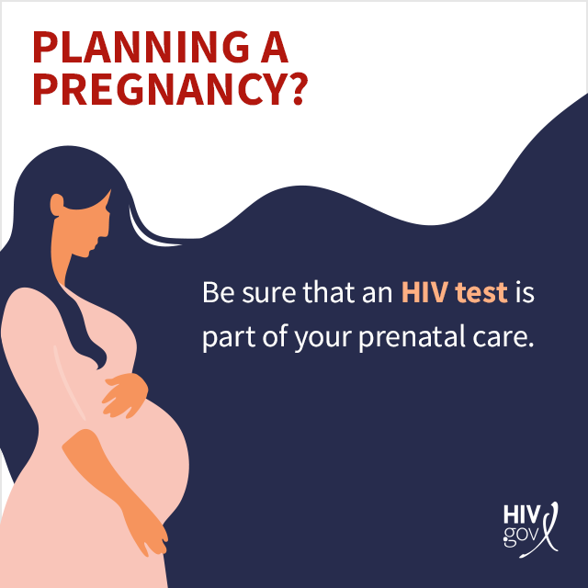
Learning Objectives
By the end of this presentation, participants will be able to:
Explain the concept and significance of Pre-exposure Prophylaxis (PrEP) in perinatal HIV prevention.
Determine appropriate antiretroviral therapies to be used during pregnancy, as outlined in the 2024 Perinatal HIV Guidelines
Counsel pregnant patients in accordance with the updated infant feeding recommendations in the 2024 perinatal HIV guidelines.

Slide 7
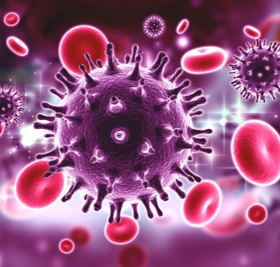
Epidemiology of Perinatal HIV transmission​ in US
~5,000 people with HIV give birth each year ​
2019: 1% of people with HIV were identified as cases of perinatal transmission
https://www.aidsmap.com/about-hiv/hiv-lifecycle

Slide 8
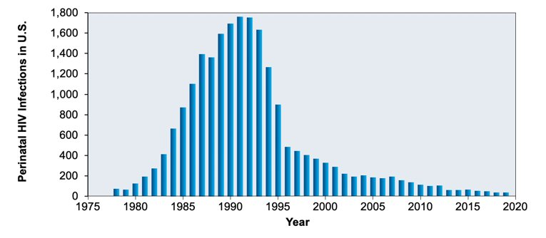
Success! Decreasing perinatal HIV transmission in the U.S.
Notes:
CDC considers perinatal HIV effectively eliminated in the US <1 baby for every 100,000 live births since 2019
Not that perinatal transmission doesn’t occur – just considered a very rare event

Slide 9
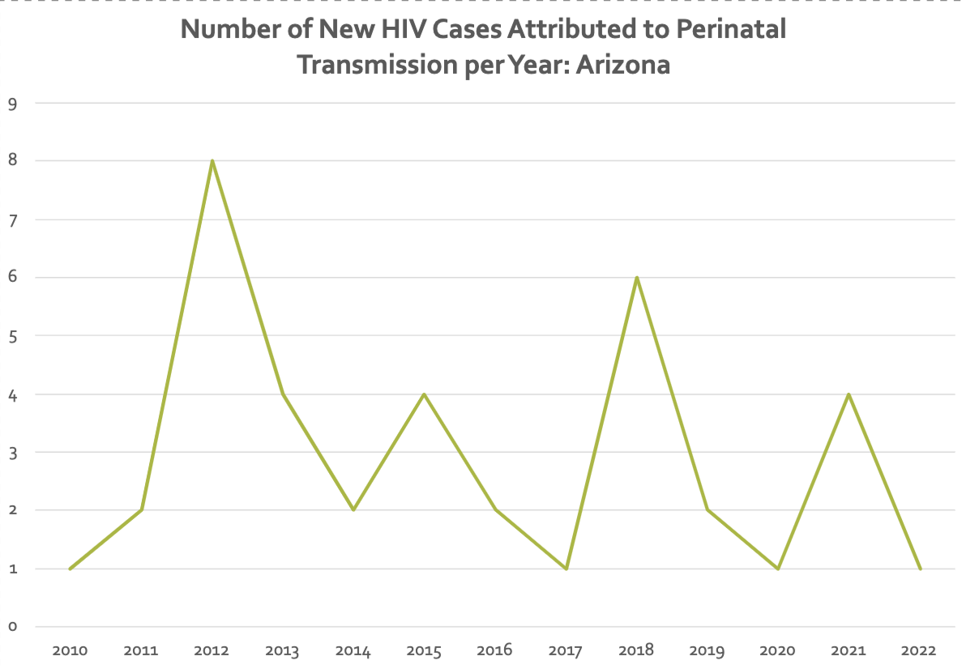
Number of New HIV Cases Attributed to Perinatal Transmission
Data from​
Arizona Dept of Health Services Epidemiology team
Notes:
Unpublished data and no detail on specifics of cases
Suspect 2021 increased cases is due to effects of lack of perinatal care during COVID-19 pandemic

Slide 10
Identified risk factors for perinatal HIV transmission
179 infants with perinatally acquired HIV
Odds of transmission increase with:
Late HIV testing
Did not receive ART
Low CD4 count
Substance use disorder
Whitmore SK, Taylor AW, Espinoza L, Shouse RL, Lampe MA, Nesheim S. Correlates of mother-to-child transmission of HIV in the United States and Puerto Rico. Pediatrics. 2012 Jan;129(1):e74-81. doi: 10.1542/peds.2010-3691. Epub 2011 Dec 5. PMID: 22144694.

Slide 11
Barriers to preventing perinatal HIV transmission
HIV risk for women often underestimated
Lack of HIV testing of partners
Underutilization of PrEP among women
Especially during pregnancy and breastfeeding
Pollock L, Warren M, Levison J. Missed Opportunities for HIV Prevention in Perinatal Care Settings in the United States. Front Reprod Health. 2021 Jun 14;3:680046. doi: 10.3389/frph.2021.680046. PMID: 36304042; PMCID: PMC9580717.

Slide 12
Work to do: New Perinatal HIV Diagnoses disproportionately affect certain racial & ethnic groups
Notes:
Mirrors new diagnoses of HIV in women: occurring in the South and affecting Black & Brown populations
Associated with states where Medicaid expansion NOT occurring

Slide 13
Absence of Prevention Intervention
In the absence of any prevention intervention, the rate of perinatal HIV transmission is approx. 25%
Connor EM, Sperling RS, Gelber R, Kiselev P, Scott G, O'Sullivan MJ, VanDyke R, Bey M, Shearer W, Jacobson RL, et al. Reduction of maternal-infant transmission of human immunodeficiency virus type 1 with zidovudine treatment. Pediatric AIDS Clinical Trials Group Protocol 076 Study Group. N Engl J Med. 1994 Nov 3;331(18):1173-80. doi: 10.1056/NEJM199411033311801. PMID: 7935654.

Slide 14
Timing of HIV Transmission to Infant
~20% before 36 weeks gestation
~50% between 36 weeks and delivery
~30% during active labor and delivery
Kourtis AP, Bulterys M, Nesheim SR, Lee FK. Understanding the timing of HIV transmission from mother to infant. JAMA. 2001 Feb 14;285(6):709-12. doi: 10.1001/jama.285.6.709. PMID: 11176886.

Slide 15
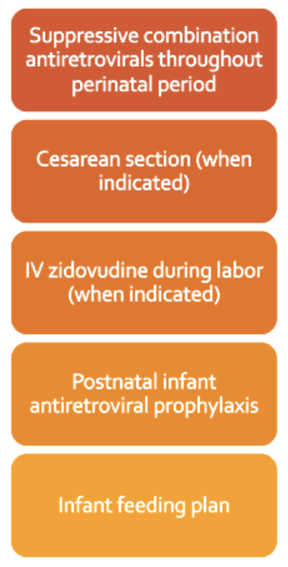
How to prevent Perinatal HIV?​ ​
1. Prevent HIV acquisition (use PrEP)
2. TEST for HIV during pregnancy
Notes:
f

Slide 16
HIV Testing in Pregnancy ​
Test as early in pregnancy as possible and repeat if: ​
STI ​
Symptoms of acute HIV infection (check HIV RNA quant)
High incidence facility or jurisdiction
Some states mandate 3rd trimester testing ​
- Expediated testing in labor if HIV status unknown or high risk

Slide 17
Case
18 yo F from rural AZ ​
Hx latent syphilis, treated 1 year ago​
Methamphetamine & fentanyl use disorder ​
Multiple male partners, at least one with HIV diagnosed approx. 5 months ago​
Tests positive for HIV and pregnancy​
Never informed about PrEP or PEP

Slide 18
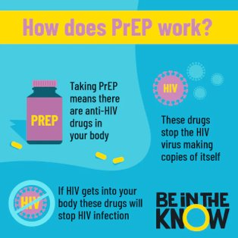
Intro to Pre-Exposure Prophylaxis (PrEP) in the perinatal period
CDC guidance recommends discussion about PrEP with all sexually active people without HIV​
Special focus on: ​
Hx of bacterial STI ​
Transactional sex​
Substance use disorder ​
Intimate partner violence
https://www.beintheknow.org/hiv-and-stis/hiv-prevention/pre-exposure-prophylaxis-prep
Notes:
Tie in with conversation about contraception

Slide 19
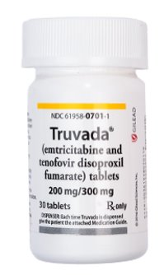
PrEP options during perinatal period
Truvada (fixed dose TDF/FTC)​
Not Currently Recommended:
Descovy (fixed dose TAF/FTC)
Apretude (IM cabotegravir)
https://www.nurx.com/hiv-prevention/truvada/

Slide 20
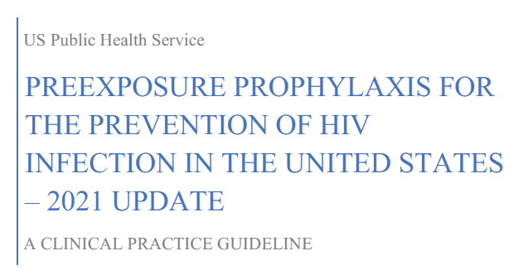
PrEP Care
Q3 month follow-up with labs ​
Counseling for symptoms of acute retroviral syndrome ​

Slide 21
Pre-pregnancy counseling for PWH​
https://clinicalinfo.hiv.gov/en/guidelines/perinatal/prepregnancy-counseling-childbearing-age-overview
Notes:
Treatment as prevention: U=U

Slide 22
Antiretroviral Drugs in Pregnancy ​
All pregnant people should start ART as soon as possible (regardless of viral load or CD4 count) and those already on ART should continue same regimen if suppressed*​
Maximizes maternal health​
Prevents perinatal and secondary sexual transmission ​
Decreases need to consider elective cesarean ​
*Many newer drugs have limited data in pregnancy

Slide 23
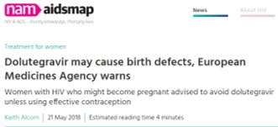
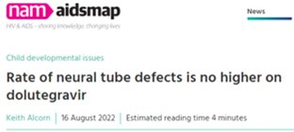
Safety of Antiretrovirals in Pregnancy?​
Source: https://www.aidsmap.com/​

Slide 24
History of Dolutegravir ​
Early safety signal from preliminary analysis of Tsepamo study​ in Botswana Suggested increased risk of neural tube defects (NTDs) with dolutegravir use​
More recent data from this study group did not find a statistically significant increase in NTDs​
Date​ | NTD n, (%) dolutegravir at conception​ | NTD n, (%) other antiretrovirals at conception​
5/2018​ | 4/426 (0.9%)​ | 14/11173 (0.1%)​
3/2019​ | 5/1683 (0.3%)​ | 15/14792 (0.1%)​
3/2022​ | 10/9460 (0.11%)​ | 25/23664 (0.11%)​
NTDs among women without HIV in the study:​
108/170,723 (0.07%)
Sources: Zash, et al. NEJM 2019. ​
Zash, et al. AIDS 2022 abstract 12759. ​
Notes:
This combined with additional surveillance data from South Africa showing similar rates of NTD → Dolutegravir is now recommended as a preferred antiretroviral for pregnant people by the Perinatal HIV Guidelines

Slide 25
The Antiretroviral Pregnancy Registry
www.apregistry.com
Notes:
Reporting is voluntary
Ideally, all exposures in pregnancy are reported!

Slide 26
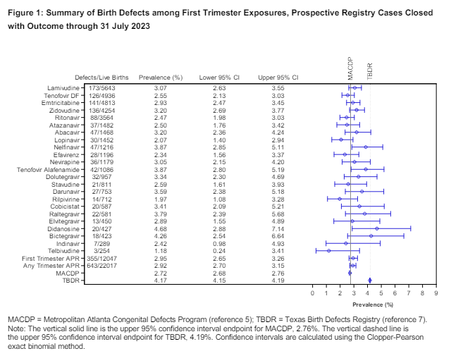
Antiretroviral ​Pregnancy ​Registry (APR)
Source: https://www.apregistry.com/forms/interim_report.pdf
Notes:
Data is shared twice per year

Slide 27
DHHS Recommendations: Pregnant PWH who are ARV naïve Option 1
Dolutegravir (DTG) +
Tenofovir (either TAF or TDF) +
Emtricitabine (FTC) OR Lamivudine (3TC)
Example: DTG + TXF/FTC

Slide 28
DHHS Recommendations: Pregnant PWH who are ARV naïve Option 2*
Dolutegravir (DTG) + Abacavir (ABC) + Lamivudine (3TC)
* Only if HLA-B5701 negative AND no chronic HBV

Slide 29
Back to Case
Started on DTG + TAF/FTC
Started perinatal vitamin
Referral to High-risk OB
VL <20 copies at 1 month f/u, maintained
Vaginal delivery of healthy HIV negative infant at 39w
Infant prophylaxis
Formula feeding

Slide 30
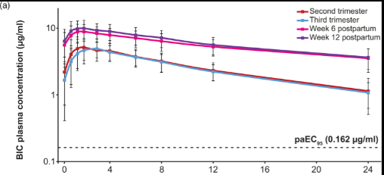
What about Biktarvy (BIC/TAF/FTC) in Pregnancy?
Now listed as Alternative regimen
BIC Drug levels lower in 2nd and 3rd trimesters
Remained above 95% maximal effective concentration
Viral suppression generally maintained
Zhang H, Hindman JT, Lin L, Davis M, Shang J, Xiao D, Avihingsanon A, Arora P, Palaparthy R, Girish S, Marathe DD. A study of the pharmacokinetics, safety, and efficacy of bictegravir/emtricitabine/tenofovir alafenamide in virologically suppressed pregnant women with HIV. AIDS. 2024 Jan 1;38(1):F1-F9. doi: 10.1097/QAD.0000000000003783. Epub 2023 Nov 22. PMID: 37939141; PMCID: PMC10715703.
Notes:
PK data now available for two clinical studies and a case series with good results
No significant safety signals

Slide 31
And Cabenuva (LA-CAB/RPV) in Pregnancy?
Data collection actively occurring
Little known at this time about PK in pregnancy
Long “tail”

Slide 32
DHHS Guidelines for Pregnant PWH who are taking ART when they become pregnant
Continue current regimen if viral load suppressed and no significant toxicity concerns
Two-drug regimens (DTG/3TC, DTG/RPV) can be continued with VL monitoring every 1-2 months
LA CAB/RPV: Shared decision-making
Cobicistat-containing regimens: Shared decision-making

Slide 33
Situation-Specific Recommendations
Source: https://clinicalinfo.hiv.gov/en/guidelines/perinatal/recommendations-arv-drugs-pregnancy-situation-specific-conceive-full

Slide 34
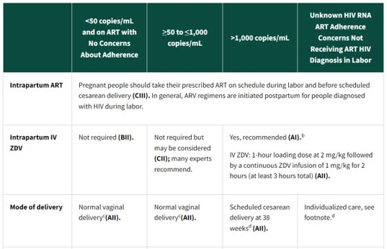
Labor and Delivery
Source: https://clinicalinfo.hiv.gov/en/guidelines/perinatal/intrapartum-care?view=full
Notes:
Great tables in DHHS Guidelines

Slide 35
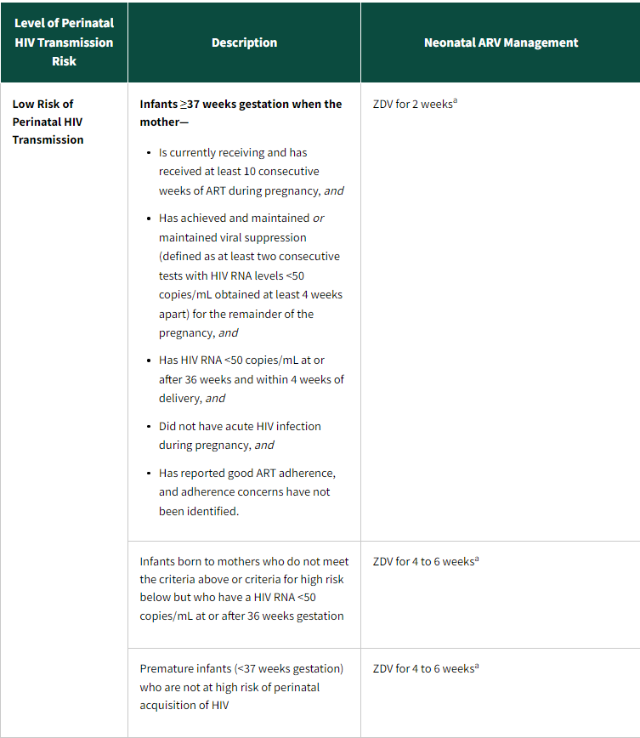
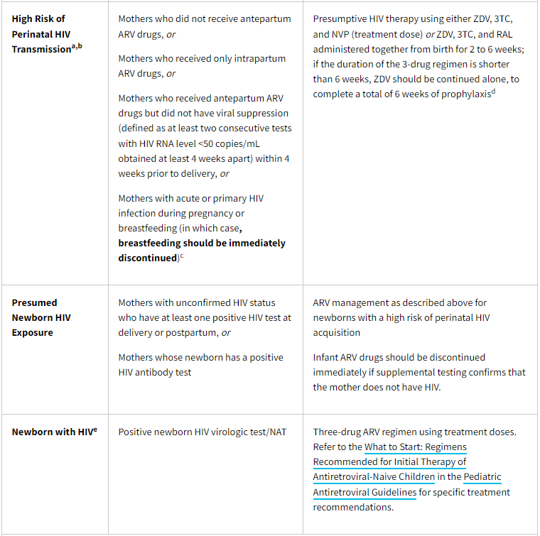
Infant prophylaxis Neonatal ARV management ​
Source: https://clinicalinfo.hiv.gov/en/guidelines/perinatal/management-infants-arv-hiv-exposure-infection?
Notes:
All infants with HIV+ pregnant parent receive SOME duration of prophylaxis – stratified by risk of acquisition.
Full table in DHHS guideline
Note shortened ppx to 2 weeks ZDV for low risk

Slide 36
Why give infant prophylaxis if undetectable status is maintained?​
Transmission occurs: ​
Via placenta​
Vaginal mucosa/secretions during L&D​
Breast milk
Cell-associated HIV: latent reservoir in CD4+ cells of the vaginal mucosa and breast milk
Antiretrovirals act as post-exposure prophylaxis ​
Notes:
What happened to U=U?

Slide 37
HIV transmission in Breast Milk
Cell-associated HIV: latent reservoir in
T-lymphocytes, measured by HIV DNA.
Cells become activated during extravasation or transepithelial migration into breast milk → viral replication and transmission to infant
Source: Moseholm E. J Intern Med. 2020; 287:19-31
Notes:
Both cell free RNA and cell-associated DNA virus in breast milk are associated with HIV transmission
Unknown if this mechanism occurs with newer ART

Slide 38
Infant feeding guideline update​ Example Case:​
26-year-old female, depression/anxiety/PTSD, obesity ​
HIV diagnosed May 2020. Started ART at time of diagnosis​
Has had undetectable viral load (<20 copies/mL) since 1 month after diagnosis, denies ever missing a dose ​
Planned pregnancy. G1PO. Maintained viremic suppression on dolutegravir + TAF/FTC throughout pregnancy and at 36 weeks gestation ​
Infant delivered via cesarean (failure to progress) at 40 weeks ​
She wants to breastfeed –what do we advise?

Slide 39
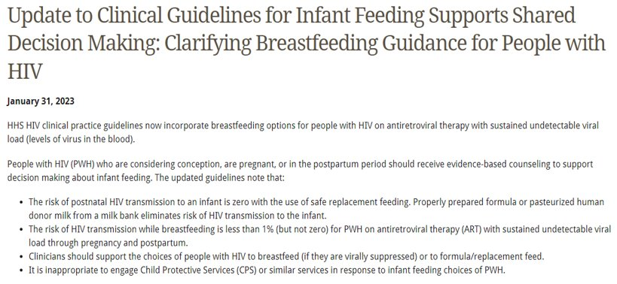
Update to Clinical Guidelines

Slide 40
Potential benefits of Breastfeeding ​
​Decreases risk of obesity, diabetes, reproductive cancers​
Bonding, immunologic support and nutritional value​
Access to formula ($$$) and clean water not required ​
Cultural, community norms and traditions
Notes:
PWH may PARTICULARLY benefit from these
MANY women breastfeeding despite provider recommendations not to do so according to survey data
Guidelines also change likely d/t conflict with WHO recommendation & formula shortage/contamination

Slide 41
Data to support breast/chest feeding in WLH with viremic control ?
Notes:
Most data comes from low and middle-income countries

Slide 42
Promoting Maternal Infant Survival Everywhere (PROMISE) trial data (n =2431)​
Compared maternal ART to infant prophylaxis with nevirapine during breastfeeding​
Median maternal viral load (MVL): mART 6,627 copies/mL vs. iNVP 59,816 copies/mL
Transmission rates 0.6% at 12 months in both arms​ (7 infant infections in each)
Two infants in maternal ART arm acquired HIV despite maternal HIV RNA < 40 on day of positive infant screening​
Source: JAIDS. 2018 Apr 1;77(4):383-392.
Notes:
14 sites in sub-Saharan Africa & India
Preferred maternal regimen TDF/FTC + LPV/r
No toxicities requiring regimen cessation/change in infant NVP arm

Slide 43
Case series from higher-resource countries (All mothers on ART and almost all virally suppressed)
Toronto, Canada: 3 breast fed infants with no transmission via breastfeeding
9 women with 10 pregnancies successfully breastfed at one site in the US
8 women breastfed at a U.S. second site
Italy: 13 women
Germany: 30 women
Source: https://clinicalinfo.hiv.gov/en/guidelines/perinatal/infant-feeding-individuals-hiv-united-states?view=full
Notes:
Various infant prophylaxis regimens were used
No transmissions via BF
Germany: some women were not optimally suppressed VL, still no transmission

Slide 44
Data to support breast/chest feeding in WLH with viremic control ​
No studies have systematically evaluated HIV transmission through breastfeeding when maternal ART is started before pregnancy and continued throughout breastfeeding, especially in higher-resource settings​
With guideline update, expect more data in higher-resource settings soon

Slide 45
Infant Prophylaxis while Breastfeeding?​
DHHS Panel could not reach a consensus ​
Majority vote: ZDV x 2 weeks (British HIV Association endorses) ​
Alternatives: ​
ZDV x 4-6 weeks ​
NVP x 6 weeks (Endorsed by WHO for low-risk infants) ​
NVP throughout breastfeeding

Slide 46
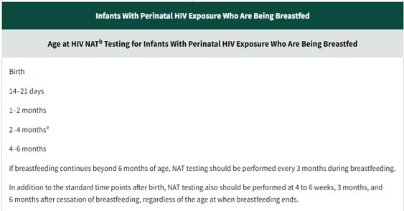
Lab monitoring: Table 13 ​
BF parent: No formal recommendation. ​
“One approach is viral load every 1-2 months” ​
Source: https://clinicalinfo.hiv.gov/en/guidelines/perinatal/intrapartum-care?view=full
Notes:
More frequent testing than if infant otherwise at low risk (would be just 14-21d, 1-2mo, 4-6mo) including after cessation of BF
Prompt testing of infant if maternal VL becomes detectable (>50 copies) during breastfeeding – consult perinatal hotline guidance (stop BF, or pump)
If mom has detectable VL and continues to BF, some panel members rec monthly testing of infant to detect infection as early as possible

Slide 47
Counseling WLH about Breast/Chest feeding
Start early
“Have you thought about how you’d like to feed your baby?”
Risk of HIV transmission is low, <1%, but not zero.
Shared decision-making

Slide 48
Back to our patient
Chose to breastfeed after discussion with pediatric ID team ​
Mother remains undetectable ​
Checking VL every 1-2 months ​
Infant prophylaxis: ZDV x 6 weeks​
Infant lab monitoring: standard low-risk protocol, remains negative for HIV at 5 months

Slide 49
Additional counseling points ​
Lactation consultants -- may need education ​
Guidance on breast care: mastitis, thrush, cracked nipples can increase risk of HIV transmission​
Exclusive BF safer than mixed feeding. Start solids at 6 mo. ​
Rapid weaning associated with increased HIV transmission ​
Postpartum life is hard! Parents need support taking their ART, coming to appointments, getting labs, taking care of mental health

Slide 50
Perinatal HIV resources
Most recent update: January 31, 2024
https://clinicalinfo.hiv.gov/en/guidelines/perinatal/whats-new

Slide 51
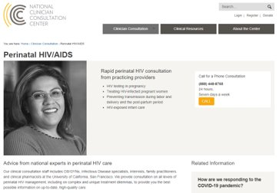
Perinatal HIV resources ​
National (UCSF) Hotline: (888)-448-8765​
Source: https://nccc.ucsf.edu/clinician-consultation/perinatal-hiv-aids/

Slide 52
In Memory: Hydeia Broadbent

Slide 53
Thank you!
Kristen Ellis, PharmD, BCPS, AAHIVP
danielledavila@arizona.edu

