Slide 1
STI, HIV and Hepatitis C Epidemiology in Stanislaus County
Erin Gustafson, MD, MPH
Assistant Public Health Officer/Stanislaus County Health Services Agency
June 18, 2024

Slide 2
Disclaimer
The views and opinions expressed in this presentation are not necessarily those of the Pacific AIDS Education & Training Center (Pacific AETC) or its eight local partner sites in HRSA Region 9, the Regents of the University of California or its San Francisco campus (UCSF or collectively, University) nor of our funder the Health Resources and Services Administration (HRSA). Neither Pacific AETC, University, HRSA nor any of their officers, board members, agents, employees, students, or volunteers make any warranty, express or implied, including the warranties of merchantability and fitness for a particular purpose; nor assume any legal liability or responsibility for the accuracy, completeness or usefulness of information, product or process assessed or described; nor represent that its use would not infringe privately owned rights.
HRSA Acknowledgement Statement The Pacific AETC is supported by the Health Resources and Services Administration (HRSA) of the U.S. Department of Health and Human Services (HHS) as part of an award totaling $4,377,449. The contents are those of the author(s) and do not necessarily represent the official views of, nor an endorsement, by HRSA, HHS, or the U.S. Government. For more information, please visit HRSA.gov.
Trade Name Disclosure Statement Funding for this presentation was made possible by 5 U1OHA29292‐08‐00 from the Human Resources and Services Administration HIV/AIDS Bureau. The views expressed do not necessarily reflect the official policies of the Department of Health and Human Services nor does mention of trade names, commercial practices, or organizations imply endorsement by the U.S. Government. Any trade/brand names for products mentioned during this presentation are for training and identification purposes only.

Slide 3
Disclosures
All presenters of this continuing medical education activity have indicated that neither they nor their spouse/legally recognized domestic partner has any financial relationships with commercial interests related to the content of this activity.

Slide 4
Learning Objectives
At the completion of this presentation, participants will be able to:
Describe the epidemiology of STIs, Hepatitis C and HIV
Discuss challenges in addressing the syndemic
Identify next steps

Slide 5
The Syndemic Model Dixon and Mendenhall, 2023
Source: Nature (2023)
Notes:
Image: https://www.nature.com/articles/s41572-023-00437-2
The concept of syndemics specifies which, where and how disease concentrations and interactions emerge and persist. Recognizing multimorbidity within a population or region is fundamental to syndemics because multimorbid conditions often share upstream drivers, including social inequalities. Applying syndemics to health care can inform clinical and policy interventions.
Overdoses, STIs, viral hepatitis, and HIV are closely intertwined in the U.S. Some of this overlap is due to shared risk factors. Sexual activity spreads STIs, including HIV and hepatitis B and C. Substance use, in particular injection drug use, spreads HIV and hepatitis B and C, and is the cause of overdose. These activities may also contribute to one another—use of certain substances can increase libido and reduce sexual inhibitions. However, another leading reason for the emergence of a syndemic has to do with the broader social context: HIV, STIs, hepatitis, and overdose inequitably impact many of the same populations and have shared root causes and risk factors. Poverty, unemployment, unstable housing, and poor access to healthcare are key risk factors for each of these diseases and conditions. Additionally, stigma and discrimination related to these diseases, conditions, and associated behaviors (e.g., substance use and sexual activity) can deter people from seeking and accessing health services. In addition to, and because of these shared risk factors, HIV, STIs, viral hepatitis, and overdose disproportionately impact many of the same populations. As demonstrated above, PWUD face heightened risk for HIV, STIs, and viral hepatitis, but so do Black, Indigenous, and People of Color, LGBTQ+ populations, young people, and people who have been involved with the criminal justice system.

Slide 6
The Syndemic of HIV, STIs, Viral Hepatitis and Overdose NACCHO 2023
HIV outbreaks among people who use drugs have been reported in at least 10 jurisdictions in the United States since 2015
STI case rates are at record high levels, as are negative outcomes of untreated STIs, such as congenital syphilis
Hepatitis C cases increased 5-fold since 2010
More than 100,000 fatal overdoses occurred over the course of the year ending in April 2021
Source: National Association of County & City Health Officials (2023)
Notes:
https://www.naccho.org/blog/articles/the-syndemic-approach-to-hiv-sti-hepatitis-and-harm-reduction

Slide 7
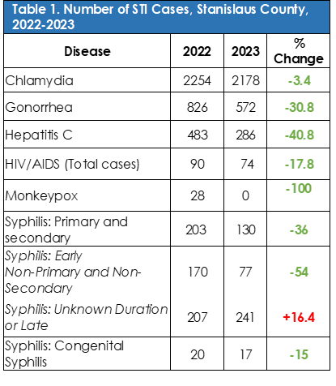
2022-2023 Stanislaus County Sexually Transmitted Infections Snapshot
Source: Stanislaus County Health Services Agency Data, CalREDIE

Slide 8
Overview of Trends in STIs in Stanislaus County, 2022-2023
Sexually transmitted infections (STIs) accounted for about 2/3 of all notifiable disease cases reported to Stanislaus County Health Services Agency in 2023
In 2023, there has been a decline in cases of STDs except Syphilis of Unknown Duration or Late compared to 2022.
Source: Stanislaus County Health Services Agency, CalREDIE

Slide 9
Chlamydia in Stanislaus County, 2023
Chlamydia is the most frequently reported notifiable disease in Stanislaus County, with 2,178 cases reported in 2023.
Infection is highest among women aged 20-24 years.
Source: Stanislaus County Health Services Agency, CalREDIE

Slide 10
Chlamydia Case Rates per 100,000 Population, Stanislaus County and California, 2021
Source: CDPH 2021 Sexually Transmitted Infection Data (2024)

Slide 11
Chlamydia Ranking of California County Rates-2021
Source: CDPH 2021 Sexually Transmitted Infection Data (2024)

Slide 12
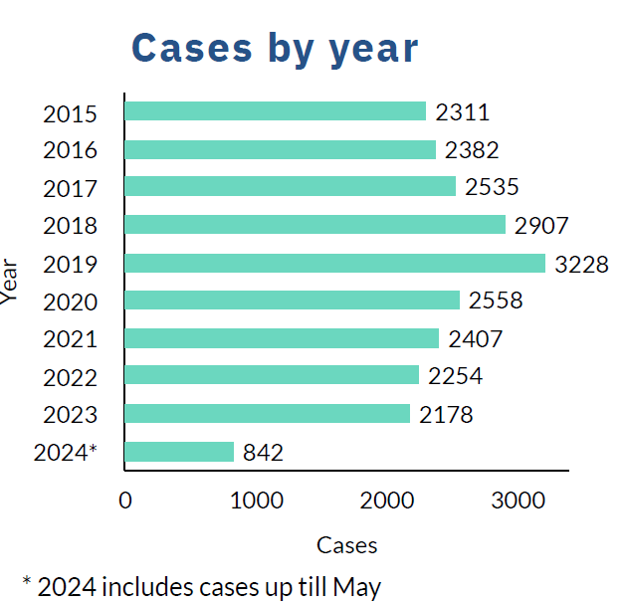
Chlamydia Case Numbers by Year, Stanislaus County, 2015-2024
Source: Stanislaus County Health Services Agency Data, CalREDIE

Slide 13
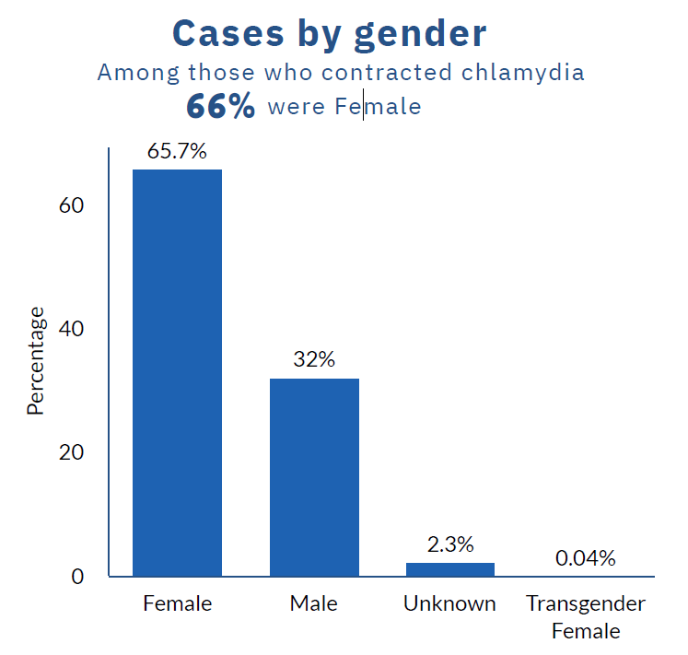
Chlamydia Cases by Gender in Stanislaus County, 2022-2023
Source: Stanislaus County Health Services Agency Data, CalREDIE

Slide 14
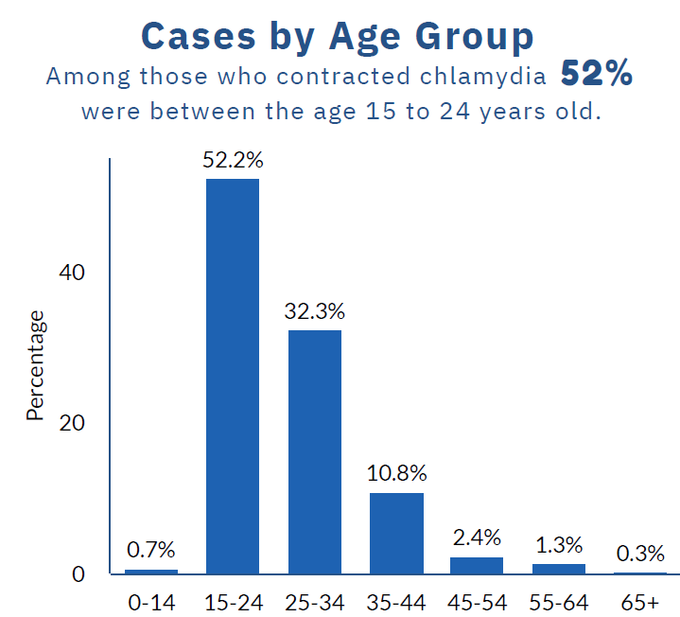
Chlamydia Cases by Age Group, Stanislaus County, 2022-2023
Source: Stanislaus County Health Services Agency Data, CalREDIE

Slide 15
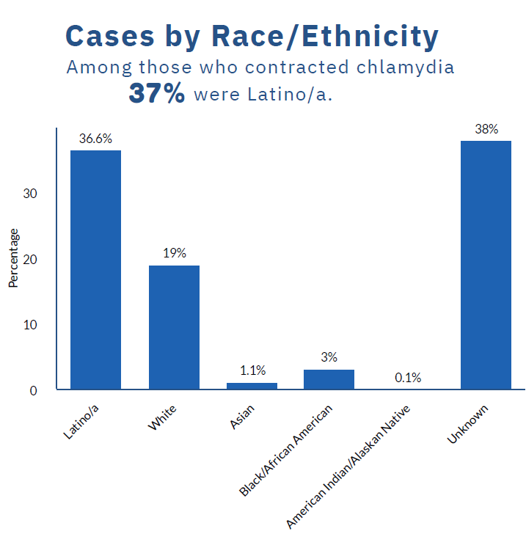
Chlamydia Cases by Race/Ethnicity, Stanislaus County, 2022-2023
Source: Stanislaus County Health Services Agency Data, CalREDIE

Slide 16
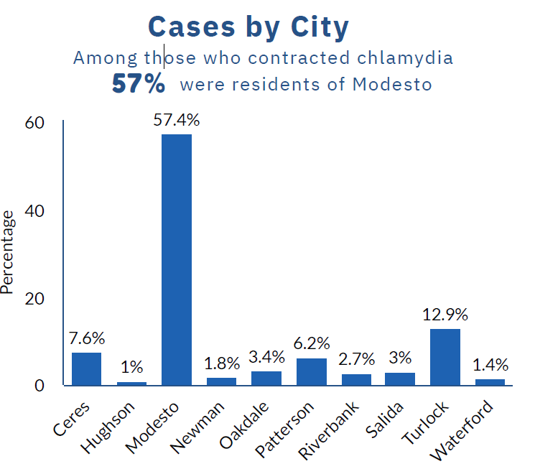
Chlamydia Cases by City Stanislaus County, 2022-2023
*48% of the 2022 total Stanislaus County population was Hispanic
Source: Stanislaus County Health Services Agency Data, CalREDIE

Slide 17
Gonorrhea in Stanislaus County, 2023
Gonorrhea infection rates are highest among males and females aged 25-34 years.
Males have higher gonococcal infection rates compared to females.
Gonorrhea rates in 2021 for males in Stanislaus County are less than California, while females in Stanislaus County have rates similar to California female rates.
Source: Stanislaus County Health Services Agency Data, CalREDIE
Notes:
*48% of the 2022 total Stanislaus County population was Hispanic

Slide 18
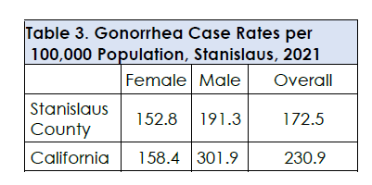
Gonorrhea Case Rates in Stanislaus County, 2021
Source: CDPH 2021 Sexually Transmitted Infection Data (2024)

Slide 19
Gonorrhea Ranking of California County Rates for 2021
Source: CDPH 2021 Sexually Transmitted Infection Data (2024)

Slide 20
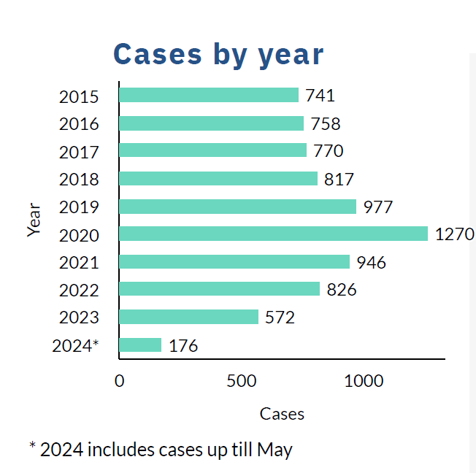
Gonorrhea Cases by Year, Stanislaus County, 2015-2024
Source: Stanislaus County Health Services Agency Data, CalREDIE

Slide 21
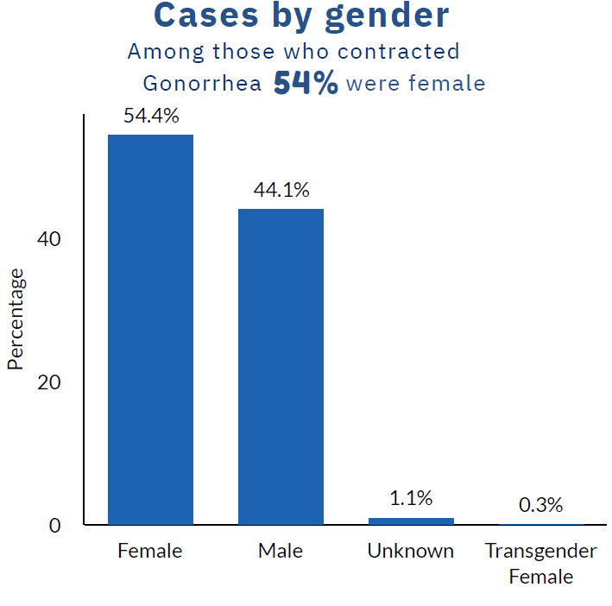
Gonorrhea Cases by Gender, Stanislaus County, 2022-2023
Source: Stanislaus County Health Services Agency Data, CalREDIE

Slide 22
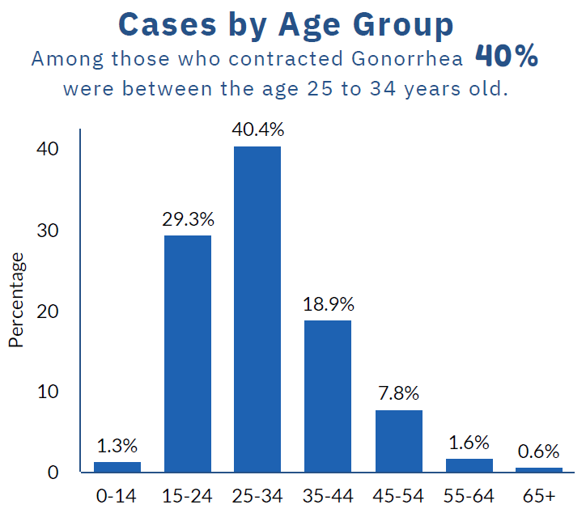
Gonorrhea Cases by Age, Stanislaus County, 2022-2023
Source: Stanislaus County Health Services Agency Data, CalREDIE

Slide 23
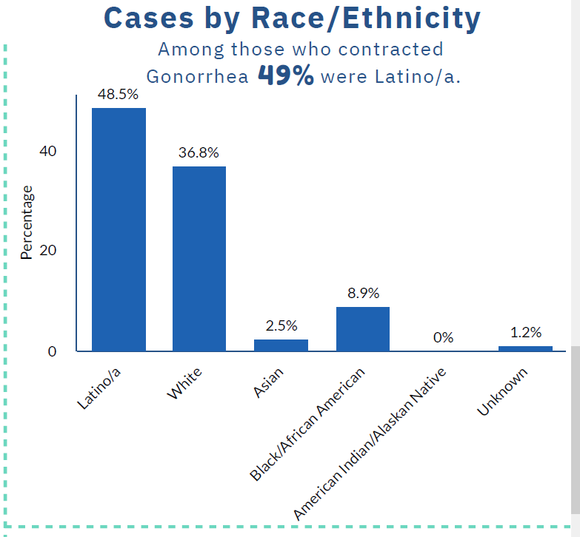
Gonorrhea Cases by Race/Ethnicity, Stanislaus County, 2022-2023
Source: Stanislaus County Health Services Agency Data, CalREDIE

Slide 24
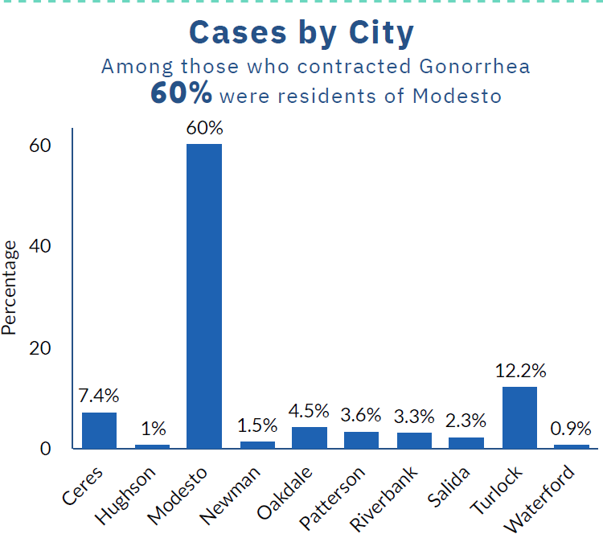
Gonorrhea Rates by City, 2022-2023
Source: Stanislaus County Health Services Agency Data, CalREDIE

Slide 25
HIV/AIDS in Stanislaus County, 2023
In 2023, Stanislaus County had 74 newly diagnosed HIV infections. The stage at diagnosis for new infections: 62 were Stage 1-2 and 12 were AIDS (Stage 3)
Females saw a bigger percent increase in new diagnoses compared to 2022 diagnoses.
Hispanics saw the biggest percent increase in new diagnoses of HIV.
MSM (Men Who Have Sex with Men) were the population most affected by HIV in Stanislaus in 2023.
Source: Stanislaus County Health Services Agency, CalREDIE
Notes:
In 2022, Stanislaus County had 53 newly diagnosed HIV infections. Stage at diagnosis for new infections: 44 were Stage 1-2 and 9 were AIDS (Stage 3)

Slide 26
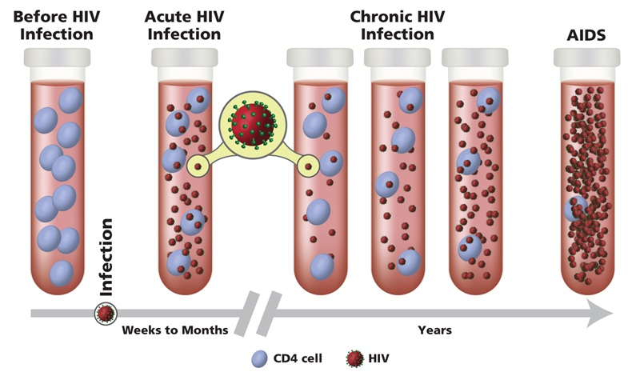
Stages of HIV Infection NIH, 2021
Source: National Institutes of Health (2021)
Notes:
Image: https://hivinfo.nih.gov/understanding-hiv/fact-sheets/stages-hiv-infection
Acute HIV infection is the earliest stage of HIV infection, and it generally develops within 2 to 4 weeks after infection with HIV. During this time, some people have flu-like symptoms, such as fever, headache, and rash. In the acute stage of infection, HIV multiplies rapidly and spreads throughout the body. The virus attacks and destroys the infection-fighting CD4 cells (CD4 T lymphocyte) of the immune system. During the acute HIV infection stage, the level of HIV in the blood is very high, which greatly increases the risk of HIV transmission. A person may experience significant health benefits if they start ART during this stage.
The second stage of HIV infection is chronic HIV infection (also called asymptomatic HIV infection or clinical latency). During this stage, HIV continues to multiply in the body but at very low levels. People with chronic HIV infection may not have any HIV-related symptoms. Without ART, chronic HIV infection usually advances to AIDS in 10 years or longer, though in some people it may advance faster. People who are taking ART may be in this stage for several decades. While it is still possible to transmit HIV to others during this stage, people who take ART exactly as prescribed and maintain an undetectable viral load have effectively no risk of transmitting HIV to an HIV-negative partner through sex.
AIDS is the final, most severe stage of HIV infection. Because HIV has severely damaged the immune system, the body cannot fight off opportunistic infections. (Opportunistic infections are infections and infection-related cancers that occur more frequently or are more severe in people with weakened immune systems than in people with healthy immune systems.) People with HIV are diagnosed with AIDS if they have a CD4 count of less than 200 cells/mm3 or if they have certain opportunistic infections. Once a person is diagnosed with AIDS, they can have a high viral load and are able to transmit HIV to others very easily. Without treatment, people with AIDS typically survive about 3 years.

Slide 27
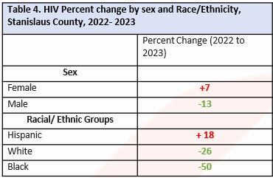
HIV/AIDS Percent Change by Sex and Race/Ethnicity, Stanislaus County, 2022-2023
Source: Stanislaus County Health Services Agency Data, CalREDIE

Slide 28
Transmission Category, New HIV Infections, Stanislaus County, 2023
Source: Stanislaus County Health Services Agency Data, CalREDIE

Slide 29
Percent of Persons with HIV Whose Infection is Attributed to Injection Drug Use (IDU)
Source: Stanislaus County Health Services Agency Data, CalREDIE

Slide 30
Newly Diagnosed with HIV in Stanislaus County, Continuum of Care, 2022
Source: Stanislaus County Health Services Agency Data, CalREDIE

Slide 31
Stanislaus County Continuum of Care, 2022 (all living cases)
Source: Stanislaus County Health Services Agency Data, CalREDIE

Slide 32
Syphilis: Background
Syphilis is divided into stages (primary, secondary, latent, and tertiary). Early syphilis is syphilis acquired within the past year, and includes primary, secondary, early non-primary, non-secondary and early latent stages.
Syphilis is transmissible during its primary and secondary (P&S) stages.
Pregnant women with any stage of untreated syphilis can transmit the infection to their baby, leading to congenital syphilis.
Source: CDPH 2021 Sexually Transmitted Infection Data (2024)

Slide 33
Early Syphilis (Primary, Secondary, Non-Primary and Non-Secondary)
Early syphilis (syphilis infection in 2023) cases made up 206 (63%) out of 481 of all syphilis cases in 2023.
Early syphilis was more commonly reported among males (67%) than females.
People aged 35-44 years have the highest case rate of 97.7 per 100,000 population.
Blacks/African Americans had the highest case rate of 120.3 per 100,000.
Source: Stanislaus County Health Services Agency Data, CalREDIE

Slide 34
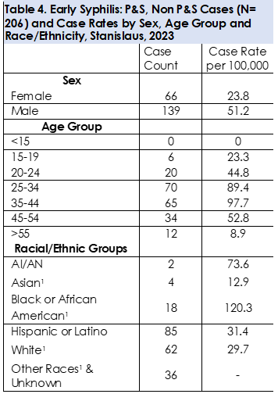
Early Syphilis Cases and Case Rates by Sex, Age Group and Race/Ethnicity, Stanislaus, 2023
Source: Stanislaus County Health Services Agency Data, CalREDIE

Slide 35
Early Syphilis Ranking of County Rates for 2021
Source: CDPH 2021 Sexually Transmitted Infection Data (2024)

Slide 36
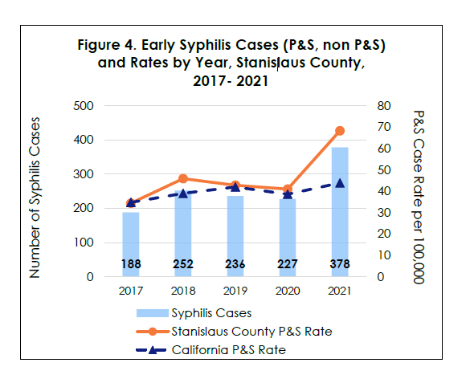
Early Syphilis infection rates have been increasing
Early syphilis rates for Stanislaus County are increasing, indicating active spread of syphilis (Figure 4).
Stanislaus County ranked 4th out of all CA counties for Early syphilis rates in 2021.
Source: Stanislaus County Health Services Agency Data, CalREDIE

Slide 37
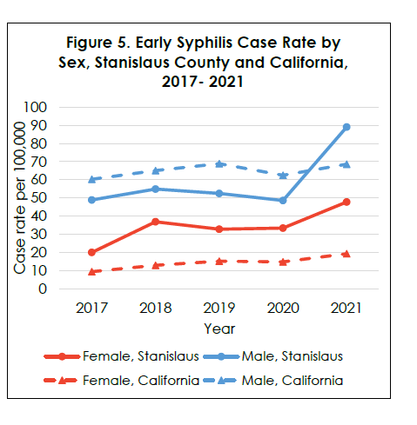
Females in Stanislaus County have a higher burden of syphilis compared with California
Early syphilis rates among females in Stanislaus County have increased in the past year (Figure 5).
Early syphilis rates among females in Stanislaus County (47.8 per 100,000) are higher than California rates (19.3/ 100,000) (Figure 5).
Early syphilis rates in males have also increased in the past year (Figure 5).
Source: Stanislaus County Health Services Agency Data, CalREDIE

Slide 38
Congenital Syphilis
Congenital syphilis can have devastating effects on babies. Syphilis treatment before and during pregnancy can prevent syphilis infection in babies.
The increase in syphilis in females is associated with an increase in congenital syphilis (Figure 6).
The congenital syphilis rate for Stanislaus County was 288.9 per 100,000 live births in 2021, ranking 3rd highest out of all California counties.
21 cases of congenital syphilis were reported in 2021, 20 cases in 2022, and 17 cases in 2023.
Source: Stanislaus County Health Services Agency Data, CalREDIE
Notes:
17 CS case in 2023

Slide 39
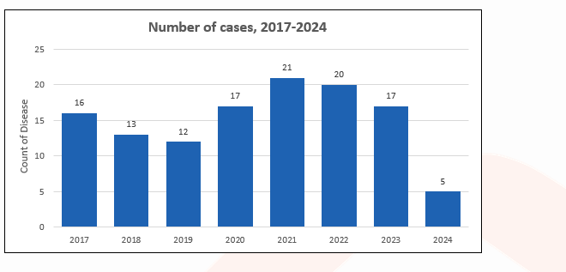
Congenital Syphilis Case Counts by Year, Stanislaus County
*2024 case count to date as of 6/7/24
Source: Stanislaus County Health Services Agency Data, CalREDIE

Slide 40
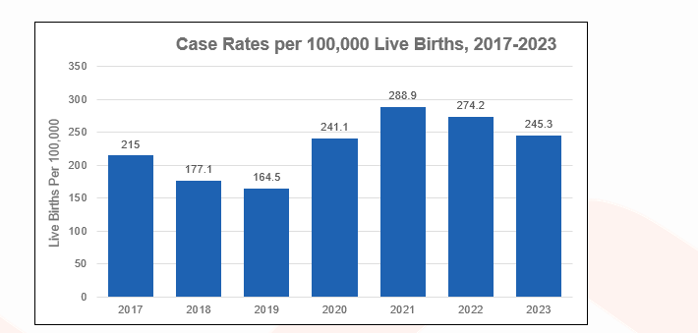
Congenital Syphilis Case Rates by Year, Stanislaus County
*2023 live birth data is extracted from the State of California Department of Finance Birth Projections. The number of births is calculated based on Historical trends from 1990 through 2022.
Source: Stanislaus County Health Services Agency Data, CalREDIE

Slide 41
Congenital Syphilis Case Rates by Year, Stanislaus County compared with CA and the US, 2018-2022
 | 2018 | 2019 | 2020 | 2021 | 2022
Stanislaus CS Case Rate | 177.1 | 164.5 | 241.1 | 288.9 | 274.2
California CS Case Rate | 72.3 | 99.4 | 114.5 | 124.1 | 146.5
United States CS Case Rate | 34.9 | 50.2 | 59.8 | 78.5 | 102.5
Source: Stanislaus County Health Services Agency Data, CalREDIE

Slide 42
Congenital Syphilis, Ranked Incidence Rates by County, California, 2021
This figure excludes counties with zero cases (24 counties had zero cases in 2021)
Prepared by CDPH-STD Control Branch

Slide 43
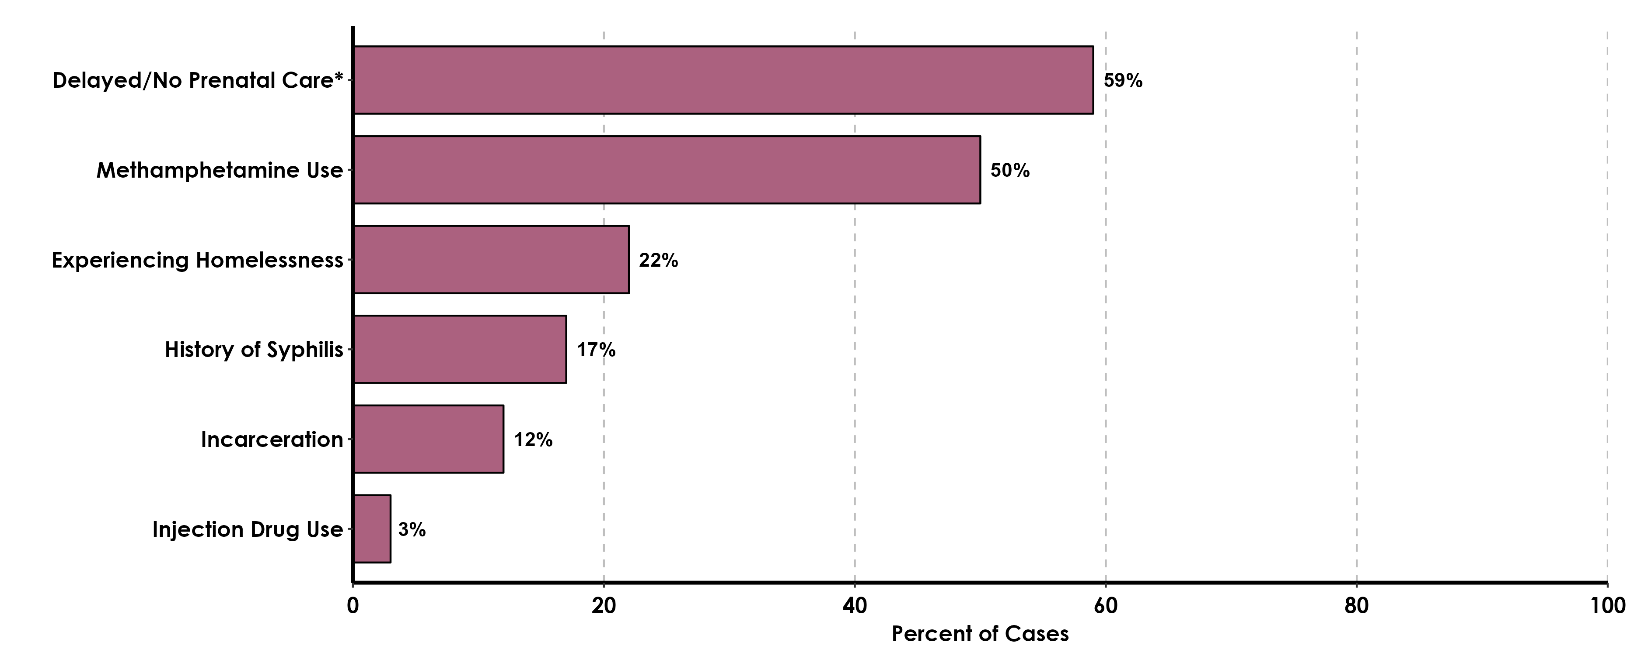
Risk Factors Reported by Mothers of CS Infants, California Project Area (CPA), 2021
These data do not include Los Angeles or San Francisco local health jurisdictions. *Prenatal care information was collected from CS cases in the CPA (N=405). Additional risk information were collected through CS quality assurance review of case interview records (N=175 interviewed/405 (43.2) total CS cases in CPA).
Source: CDPH 2021 Sexually Transmitted Infection Data (2024)
Notes:
CDPH 2021 Sexually Transmitted Infection Data. 8 Jan 2024. https://www.cdph.ca.gov/Programs/CID/DCDC/Pages/STD-Data.aspx

Slide 44
Mpox
Stanislaus County reported its first Mpox case on July 6, 2022
Among cases with available sex related data, 87% are MSM between 18 and 44 years.
Stanislaus County administered 563 doses of vaccine (JYNNEOS) to protect against Mpox.
Source: Stanislaus County Health Services Agency Data, CalREDIE

Slide 45
World Health Organization 2024 Global Hepatitis Report
According to the WHO 2024 Global Hepatitis Report, the number of lives lost due to viral hepatitis is increasing.
The disease is the second leading infectious cause of death globally-with 1.3 million deaths per year, the same as tuberculosis, a top infectious killer.
Source: Vital Signs: Hepatitis C Treatment Among Insured Adults – United States, 2019-2020 (2022)
Notes:
Thompson WW, Symum H, Sandul A, et al. Vital Signs: Hepatitis C Treatment Among Insured Adults — United States, 2019–2020. MMWR Morb Mortal Wkly Rep 2022;71:1011-1017. DOI: http://dx.doi.org/10.15585/mmwr.mm7132e1

Slide 46
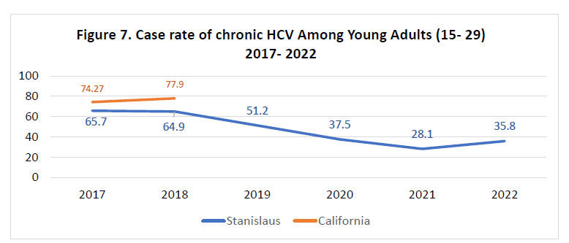
HCV
Chronic hepatitis is one of the most frequently reported communicable diseases in California.
Ages 45+ had the highest rates of newly reported chronic hepatitis C infection in 2022 and made-up 70% of newly reported cases.
50% of HIV/HCV cases in Stanislaus County were associated with injection drug use.
Source: Stanislaus County Health Services Agency Data, CalREDIE
Notes:
Hepatitis B cases plateaued after 2 decades of progress.

Slide 47
Hepatitis C Thompson et al, 2022
Only about 1 in 3 people with insurance receive timely treatment for Hepatitis C
People with Medicaid were 46% less likely to receive treatment than those with private insurance.
Medicaid recipients of other races were up to 2% less likely to get timely treatment than White Medicaid recipients.
Source: Vital Signs: Hepatitis C Treatment Among Insured Adults – United States, 2019-2020 (2022)
Notes:
Global hepatitis report 2024: action for access in low- and middle-income countries. Geneva: World Health Organization; 2024. Licence: CC BY-NC-SA 3.0 IGO.

Slide 48
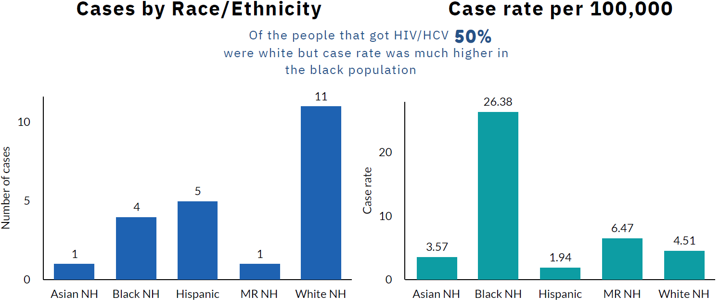
HIV/HCV Co-Infection Number of Cases and Case Rate per 100,000 by Race/Ethnicity, Stan. Co., 2022
Source: Stanislaus County Health Services Agency Data, CalREDIE

Slide 49
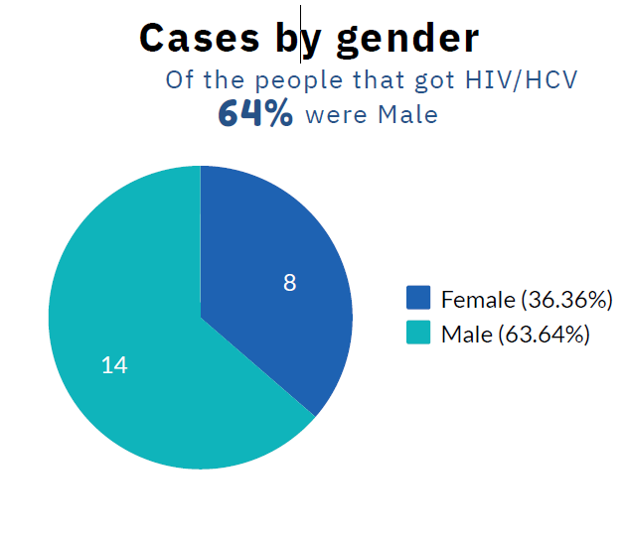
HIV/HCV Co-Infection Cases by Gender, Stan. Co., 2022
Source: Stanislaus County Health Services Agency Data, CalREDIE

Slide 50
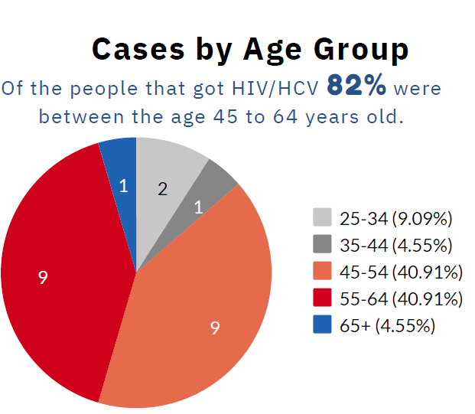
HIV/HCV Co-Infection, Cases by Age Group, Stan. Co., 2022
Source: Stanislaus County Health Services Agency Data, CalREDIE

Slide 51
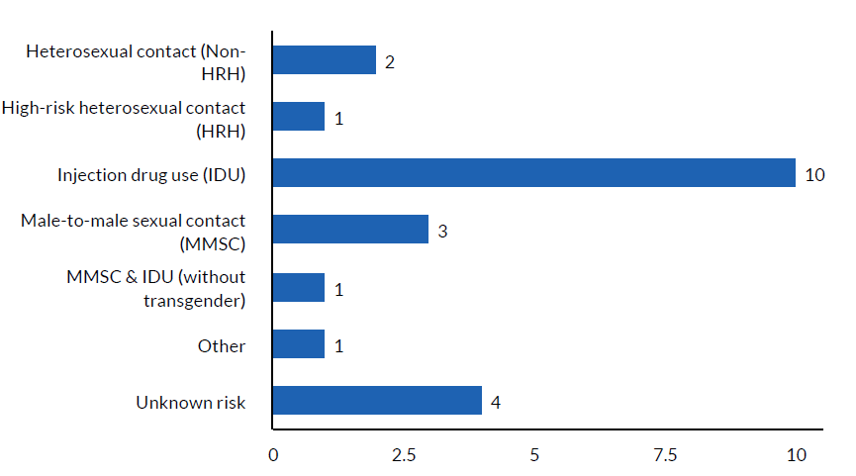
HIV/HCV Co-Infections, Cases by Risk Category, Stan. Co., 2022
Source: Stanislaus County Health Services Agency Data, CalREDIE

Slide 52
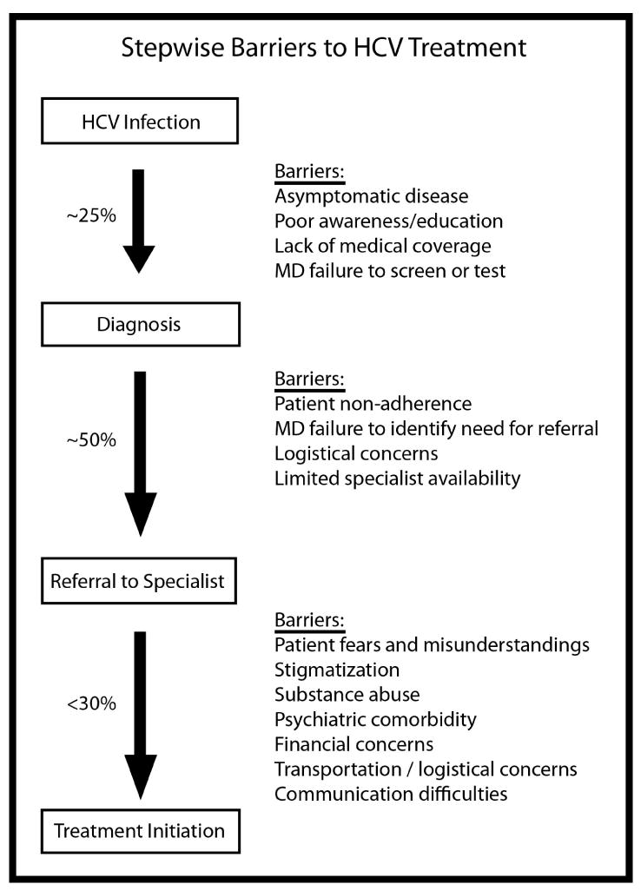
HCV Barriers to Treatment McGowan and Fried, 2012
Source: National Institutes of Health (2012)
Notes:
Image: https://www.ncbi.nlm.nih.gov/pmc/articles/PMC3955982/#:~:text=Barriers%20to%20hepatitis%20C%20treatment%20may%20arise%20at%20the%20provider,of%20referral%2C%20and%20communication%20issues.
McGowan CE, Fried MW. Barriers to hepatitis C treatment. Liver Int. 2012 Feb;32 Suppl 1(0 1):151-6. doi: 10.1111/j.1478-3231.2011.02706.x. PMID: 22212587; PMCID: PMC3955982.

Slide 53
HCV in Corrections Strick and Corcorran, 2024
In the United States, the prevalence of hepatitis C virus (HCV) infection is much higher in correctional settings as compared to the general community. Between 2011 and 2012, estimates based on 12 state prisons in the United States showed an HCV seroprevalence of 9.6% to 41.1%
It is estimated that approximately 30% of all individuals with HCV infection in the United States pass through a correctional system in a given year.
The AASLD-IDSA HCV Guidance recommends performing one-time opt-out testing for all individuals ages 18 year or older, including those with risk exposures such as incarceration.
Most prisons offer HCV treatment, but historically only a small fraction of patients with HCV infection have received HCV treatment, often due to time constraints (e.g., inability to complete treatment before release) and individual clinical factors.
Source: Treatment of HCV in a Correctional Setting (2024)
Notes:
Regardless of which data is examined, the HCV prevalence in prisons is markedly higher than in the overall United States population, which has an estimated prevalence of current HCV infection of 0.9%.
More recently, with the availability of DAAs, many of the clinical and time-based barriers to treatment have been eliminated, but some significant barriers to care remain, including the cost of therapy, limited clinician capacity, and lack of perceived expertise among clinicians.
Treatment of HCV in a Correctional Setting. https://www.hepatitisc.uw.edu/go/key-populations-situations/treatment-corrections/core-concept/all
AASLD: American Association for the study of liver diseases
Lara B. Strick, MD, MS
, Maria A. Corcorran, MD, MPH

Slide 54
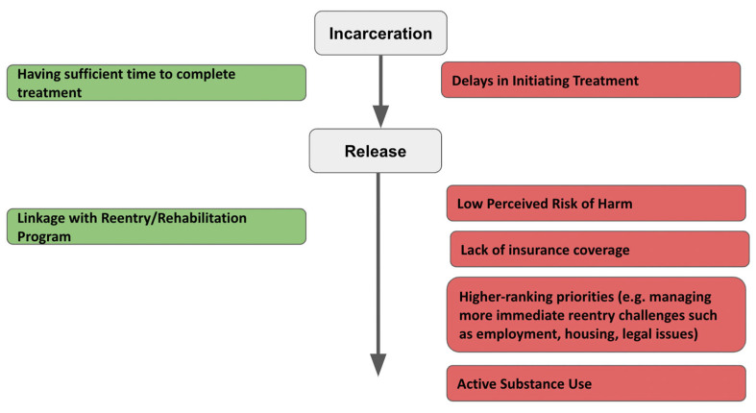
Facilitators and Barriers to Accessing HCV Care During and Following Incarceration Kamat et al, 2023
Source: PubMed (2023)
Notes:
Image: https://pubmed.ncbi.nlm.nih.gov/37109562/
Kamat S, Kondapalli S, Syed S, Price G, Danias G, Gorbenko K, Cantor J, Valera P, Shah AK, Akiyama MJ. Access to Hepatitis C Treatment during and after Incarceration in New Jersey, United States: A Qualitative Study. Life (Basel). 2023 Apr 17;13(4):1033. doi: 10.3390/life13041033. PMID: 37109562; PMCID: PMC10146294.

Slide 55
Key Points HCV in Corrections Strick and Corcorran, 2024
Screening for HCV in jails plays an important role in identifying individuals with HCV infection.
Incarceration can be an ideal time to treat HCV infection, given the high level of structure and oversight that enhances high treatment completion and SVR rates.
The high cost of HCV therapy and limited workforce capacity has forced most correctional facilities to prioritize treatment based on disease severity, but many facilities are expanding the population receiving treatment based on changing standards and external pressures.
Because the risk for reinfection exists, education and prevention services should be part of any HCV treatment program and should continue long after a sustained virologic response has been achieved.
To achieve the goal of HCV eradication in the United States, jail and prison populations will need to be included as a high-priority group for treatment; as such, it will become increasingly important for correctional systems to partner with public health systems.
Source: Treatment of HCV in a Correctional Setting (2024)
Notes:
Regardless of which data is examined, the HCV prevalence in prisons is markedly higher than in the overall United States population, which has an estimated prevalence of current HCV infection of 0.9%.
More recently, with the availability of DAAs, many of the clinical and time-based barriers to treatment have been eliminated, but some significant barriers to care remain, including the cost of therapy, limited clinician capacity, and lack of perceived expertise among clinicians.
Treatment of HCV in a Correctional Setting. https://www.hepatitisc.uw.edu/go/key-populations-situations/treatment-corrections/core-concept/all
Lara B. Strick, MD, MS
, Maria A. Corcorran, MD, MPH
Screening for HCV in jails plays an important role in identifying individuals with HCV infection.
Incarceration can be an ideal time to treat HCV infection, given the high level of structure and oversight that enhances high treatment completion and SVR rates.
The high cost of HCV therapy and limited workforce capacity has forced most correctional facilities to prioritize treatment based on disease severity, but many facilities are expanding the population receiving treatment based on changing standards and external pressures.
Because the risk for reinfection exists, education and prevention services should be part of any HCV treatment program and should continue long after a sustained virologic response has been achieved. Services should include effective harm reduction strategies, such as mechanisms for safe tattooing, needle exchange programs, medications for substance use disorder, and access to condoms.
All persons with HCV-related cirrhosis, even those successfully treated for HCV, need ongoing medical surveillance and care.
To achieve the goal of HCV eradication in the United States, jail and prison populations will need to be included as a high-priority group for treatment; as such, it will become increasingly important for correctional systems to partner with public health systems.

Slide 56
Challenges NACCHO, 2023
Stigma and discrimination deter people from seeking and accessing health services
Poverty, unemployment, unstable housing
Poor access to healthcare
Source: National Association of County & City Health Officials (2023)
Notes:
HIV, STIs, hepatitis, and overdose inequitably impact many of the same populations and have shared root causes and risk factors. Poverty, unemployment, unstable housing, and poor access to healthcare are key risk factors for each of these diseases and conditions. Additionally, stigma and discrimination related to these diseases, conditions, and associated behaviors (e.g., substance use and sexual activity) can deter people from seeking and accessing health services. In addition to, and because of these shared risk factors, HIV, STIs, viral hepatitis, and overdose disproportionately impact many of the same populations. As demonstrated above, PWUD face heightened risk for HIV, STIs, and viral hepatitis, but so do Black, Indigenous, and People of Color, LGBTQ+ populations, young people, and people who have been involved with the criminal justice system.
https://www.naccho.org/blog/articles/centering-people-who-use-drugs-to-address-the-syndemic-of-hiv-stis-hepatitis-and-overdose

Slide 57
Next Steps Kelley, NACCHO 2023
Prioritize populations that are inequitably impacted by the syndemic when designing public health services and interventions
Address the shared social determinants of health (poverty, housing, employment, involvement with the criminal justice system) and shared barriers to accessing health services (affordability, transportation, stigma and discrimination)
Collaborate with emergency departments and correctional institutions to increase screening
Source: National Association of County & City Health Officials (2023)
Notes:
https://www.naccho.org/blog/articles/the-syndemic-approach-to-hiv-sti-hepatitis-and-harm-reduction
The epidemics of HIV, STIs, viral hepatitis, and overdoses have merged into a syndemic in the U.S., inequitably impacting people who use drugs. A harm reduction approach that centers PWUD is critical to combating the syndemic, as harm reduction strategies directly prevent HIV and hepatitis and treat overdose, and as harm reduction programs are uniquely positioned to reach PWUD, offering a range of integrated health services. LHDs face myriad barriers in implementing harm reduction strategies and integrating HIV, STI, hepatitis, and harm reduction programs. These services are often underfunded and supported by different funding mechanisms; key harm reduction services are legally restricted in many jurisdictions; and building relationships and trust with PWUD and harm reduction providers requires intentional, dedicated efforts. However, harm reduction strategies and integration approaches are effective—overall and at addressing gaps and inequities in the public health and healthcare systems—allowing LHDs to maximize limited resources.

Slide 58
References
Dixon, J., & Mendenhall, E. (2023). Syndemic thinking to address multimorbidity and its structural determinants. Nature Reviews Disease Primers, 9, 23. doi:https://doi.org/10.1038/s41572-023-00437-2.
Kamat, S., Kondapalli, S., Syed, S., Price, G., Danias, G., Gorbenko, K., Cantor, J., Valera, P., Shah, A.K., & Akiyama, M.J. (2023). Access to Hepatitis C Treatment during and after Incarceration in New Jersey, United States: A Qualitative Study. Life (Basel), 13(4), 1033. doi:10.3390/life13041033
Kelley, K. (2023, January 31). Centering People Who Use Drugs to Address the Syndemic of HIV, STIs, Hepatitis, and Overdose: Winter Exchange Article. NAACHO Voice.
McGowan, C.E., & Fried, M.W. (2012). Barriers to hepatitis C treatment. Liver International, 32(S1),151-156. doi:10.1111/j.1478-3231.2011.02706.x
National Association of County & City Health Officials. (2023, April 19). The Syndemic Approach to HIV, STI, Hepatitis, and Harm Reduction. NAACHO Voice.
National Institutes of Health. (2021, August 20). The Stages of HIV Infection. HIVinfo.NIH.gov
Sexually Transmitted Diseases Control Branch. (2024, January 8). Sexually Transmitted Infection Data. California Department of Public Health.
Strick, L.B., & Corcorran, M.A. (2024, January 25). Treatment of HCV in a Correctional Setting. Hepatitis C Online.
Thompson, W.W., Symum, H., Sandul, A., Gupta, N., Patel, P., Nelson, N., Mermin, J., & Wester, C. (2022). Vital Signs: Hepatitis C Treatment Among Insured Adults — United States, 2019–2020. MMWR Morbidity and Mortality Weekly Report, 71(32), 1011-1017. doi:http://dx.doi.org/10.15585/mmwr.mm7132e1
World Health Organization. (2024, April 9). Global hepatitis report 2024: action for access in low- and middle-income countries. World Health Organization.

