Slide 1
This conference is supported by the Health Resources and Services Administration (HRSA) of the U.S. Department of Health and Human Services (HHS) as part of an award totaling $4,036,482 with 0 percentage financed with nongovernmental sources. The contents are those of the author(s) and do not necessarily represent the official views of, nor an endorsement, by HRSA, HHS or the U.S. Government.

Slide 2
Engaging and Retaining in Care Adolescents and Youth Newly Diagnosed with HIV Infection
Natella Rakhmanina, MD, PhD
Professor of Pediatrics
The George Washington University Director HIV Program
Children’s National Hospital, Senior Technical Advisor
Elizabeth Glaser Pediatric AIDS Foundation

Slide 3
Disclosures
Site Investigator for clinical trials by Gilead, ViiV and GSK under clinical research contract managed through Children's Research Institute, Washington, DC
Project Technical Lead, New Horizons Collaborative by Johnson & Johnson under contract managed through Elizabeth Glaser Pediatric AIDS Foundation
Invited expert/participant of the advisory panels and consultations for ViiV, Johnson & Johnson, Merck, Academic Medical Education

Slide 4
Objectives
Review current epidemiological data on HIV infection among adolescents and youth in the US
Identify unique challenges in the diagnosis of HIV infection and linkage to care for adolescents and youth
Differentiate key steps in the initiation of treatment and management of HIV infection with focus on youth
Describe barriers and facilitators to achieving and sustaining virologic suppression and improving health outcomes among youth with HIV

Slide 5
Adolescents and Youth
Adolescents 13-19 years Young people 20-24 years
Period of major changes
physical
physiological
educational
psychological
financial
sexual
cultural
social
emotional
behavioral

Slide 6
EPIDEMIOLOGY OF HIV INFECTION AMONG ADOLESCENTS AND YOUTH IN THE US

Slide 7
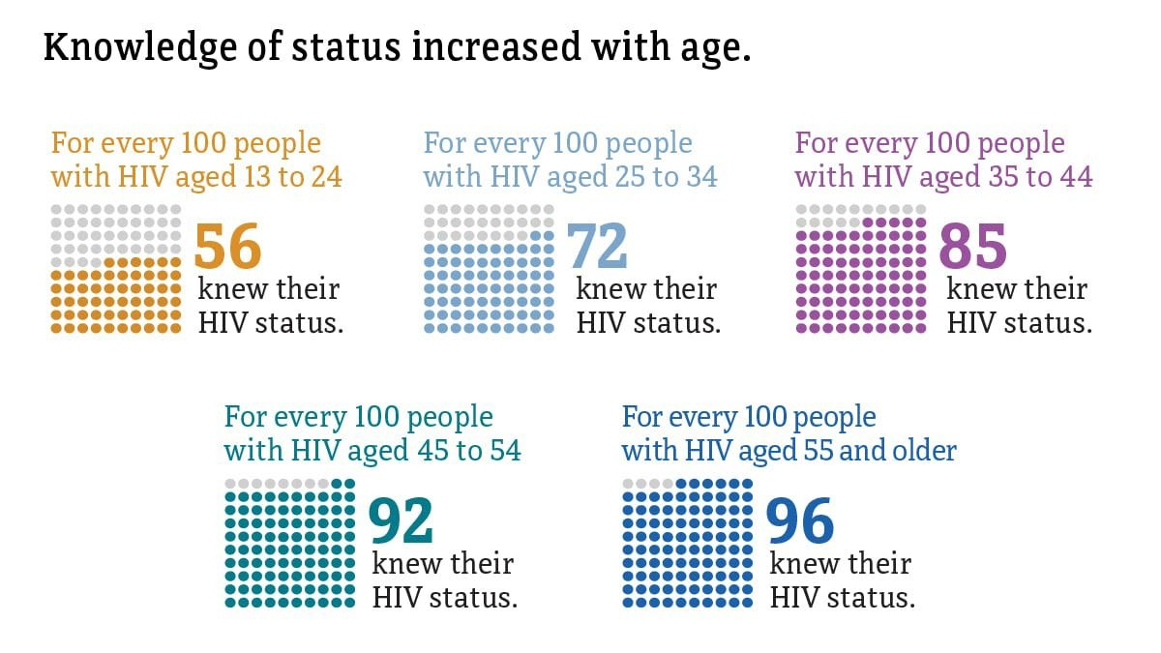
Knowledge of HIV Status in the US by Age,
2021
Source: CDC. Estimated HIV incidence and prevalence in the United States, 2017–2021.HIV Surveillance Supplemental Report, 2023; 28(3).

Slide 8
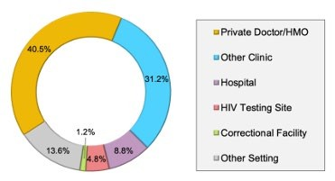
Why Low Rates of HIV Status Knowledge among Youth?
Patient factors: lack of knowledge about HIV risk, lack of perceived risk, sense of invulnerability to disease, lack of awareness of and/or access to free and confidential HIV testing sites, stigma, and misconception that parental consent requirements
HIV test setting for young adults ever tested for HIV.
Provider factors: lack of medical provider awareness of the testing guidelines, limited assessment of sexual and reproductive health history, health insurance barriers
National Youth Risk Behavior Survey and Behavioral Risk Factor Surveillance System.
Hsu KK, Rakhmanina, N.
Pediatrics. 2022 Jan 1;149(1):e2021055207;
Van Handel M, et al., pediatrics. 2016;137:e20152700.

Slide 9
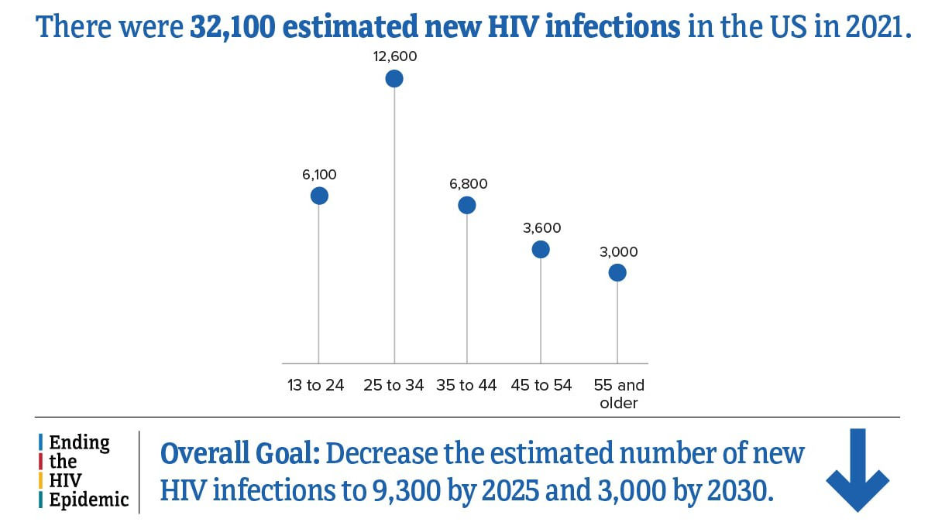
Estimated New HIV Infections by Age, US, 2021
Source: CDC. Estimated HIV incidence and prevalence in the United States, 2017–2021.HIV Surveillance Supplemental Report, 2023; 28(3).

Slide 10
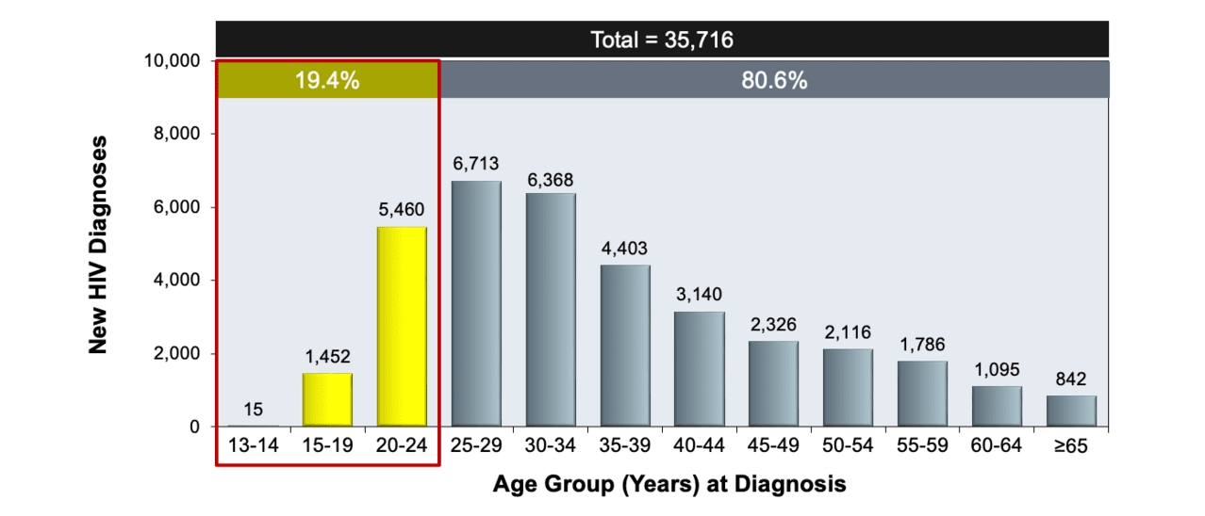
HIV Diagnoses, US and Dependent Areas by Age, 2021
Source: Centers for Disease Control and Prevention. Diagnoses of HIV infection in the United States and dependent areas, 2021.
HIV Surveillance Report, 2021; vol. 34. Published May 2023

Slide 11
Trends in HIV Diagnoses in the US and Dependent Areas by Age, 2017-2021
Source: CDC. Diagnoses of HIV infection in the United States and dependent areas, 2021.HIV Surveillance Report 2023;34.

Slide 12
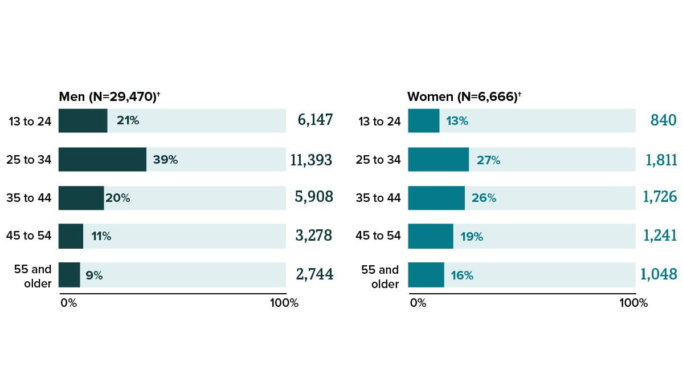
HIV Diagnoses by Sex and Age, US and Dependent Areas, 2021
Source: CDC. Diagnoses of HIV infection in the United States and dependent areas, 2021.HIV Surveillance Report 2023;34

Slide 13
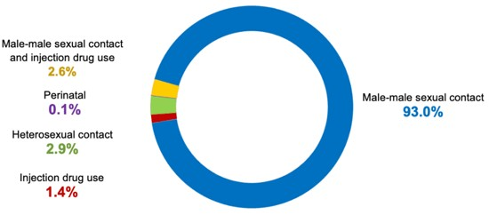
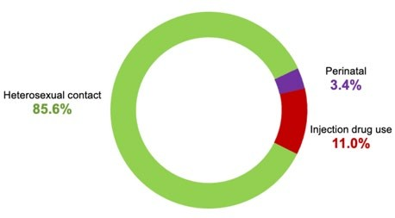
Youth Aged 13-24 years Newly Diagnosed with HIV by Transmission, US and Dependent Areas, 2021
93% acquired HIV through MSM contact
Males
Females
86% acquired HIV through heterosexual contact
Source: Centers for Disease Control and Prevention. Diagnoses of HIV infection in the United States and dependent areas, 2021.
HIV Surveillance Report, 2021; vol. 34. Published May 2023.

Slide 14
Injection Behaviors among People who Inject Drugs (PWID) in 23 US Cities by Age, 2018
Source: CDC. HIV infection risk, prevention, and testing behaviors among persons who inject drugs—
National HIV Behavioral Surveillance: injection drug use, 23 U.S. Cities, 2018. HIV Surveillance Special Report 2020;24.

Slide 15
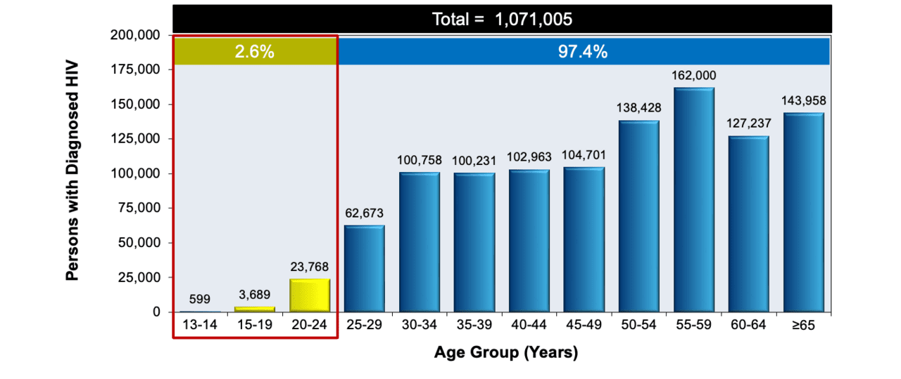
Persons with HIV by Age Group, US and Dependent Areas, 2021
Source: Centers for Disease Control and Prevention. Diagnoses of HIV infection in the United States and dependent areas, 2021.
HIV Surveillance Report, 2021; vol. 34. Published May 2023.

Slide 16
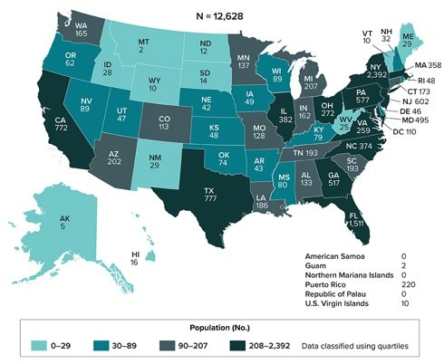
Heterogenous Populations of Youth with HIV
Persons Living with the HIV Diagnosed Perinatally, 2021, US
~50% are 13-24 years

Slide 17
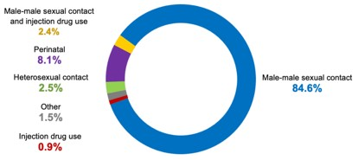
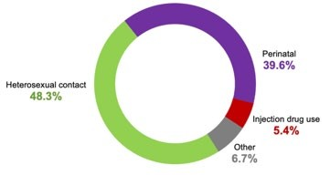
Youth Aged 13-24 years with HIV by Gender and Transmission Groups, US and Dependent Areas, 2021
85% acquired HIV through MSM contact
8% with perinatally acquired HIV
Males
Females
48 % acquired HIV through heterosexual contact
40% with perinatally acquired HIV
Source: Centers for Disease Control and Prevention. Diagnoses of HIV infection in the United States and dependent areas, 2021.
HIV Surveillance Report, 2021; vol. 34. Published May 2023.

Slide 18
UNIQUE CHALLENGES IN THE DIAGNOSIS OF HIV INFECTION AND LINKAGE TO CARE FOR ADOLESCENTS AND YOUTH
18

Slide 19
Linkage to HIV Care
For persons diagnosed with HIV, linkage to care within 30 days of diagnosis and retention in HIV clinical care are associated with improved clinical outcomes, decreased mortality, and decreased HIV transmission to sex and injecting drug partners (few adolescents included)
Individual and structural barriers for linkage to care and engagement in HIV care that are unique to adolescents and young adults remain poorly defined
Adolescents and young adults with HIV struggle to navigate complex medical systems
Adolescents and youth frequently lack full autonomy and are dependent on their families for health insurance, transportation, housing, and other needs
Adolescents and youth diagnosed with HIV while on a parental insurance plan face the risks of inadvertent disclosure of their HIV status
LGBTQ+ youth face additional barriers to linkage to care for HIV and their reproductive health/sexual health needs

Slide 20
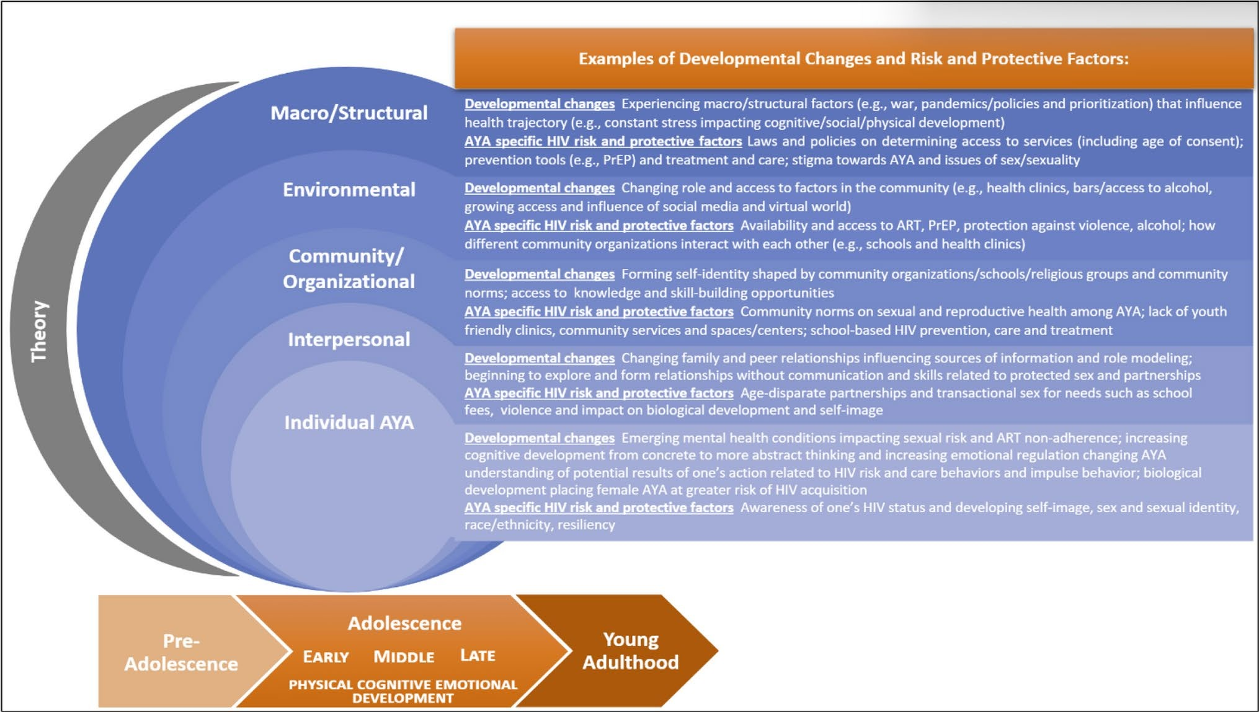
Development Changes – Risk and Protective Factors
Pre-adolescent - 9-11 years Early adolescence - 12-14 years
Middle adolescence - 15-17 years Late adolescence - 18-20 years Young adult - 21-24 years
Denison JA , et al. AIDS Behav. 2024. 28, 1694–1707

Slide 21
Caring for Adolescents with HIV
Crosscutting Challenges:
Youth with Perinatally Acquired HIV:
Growth and maturation delay – more prominent with delayed HIV diagnosis
Fatigue from long-term use of ART
Limited ART options with HIV resistance
Attachment to the pediatric medical
Limited legal and economic independence
Multiple adherence barriers
Stigma
Disclosure of HIV status to friends/peers/partners
Peer pressure
Risk-taking behavior
• Substance abuse ^{home}
_{• Mental health issues} • Frequent lack of one or both
• Multiple life priorities ^{parent(s)/caregiver(s)}
_{• Irrelevance of long-term} • Less functional autonomy
_{consequences} • Higher comorbidities and mortality risk
Racial Health Disparities, Transportation Barriers, Food Insecurity, Limited Educational & Employment Opportunities, History of Trauma
A statistically higher percentage of youth with newly acquired HIV report experiencing an even more extensive number of negative life experiences compared to those who acquired HIV early in life (38.8% versus 16.3%)
Frequent decline in medical adherence even in those who were virally suppressed for years

Slide 22
Median HIV Stigma Score among People with Diagnosed HIV in the US by Age, 2020
6,927 adolescents and young adults with a new HIV diagnosis, US, 2021: 3,697 (53%) Black youth, 1,854 (27%)
Hispanic youth and 971 (14%) were White youth
28,051 adolescents and youth living with HIV, US, 2021:
Youth experience highest HIV stigma compared to older people
HIV disproportionally affects people of color adding racial stigma burden to HIV stigma
15,733 (56%) Black youth
6,756 (24%) Hispanic youth
3,623 (13%) White youth
Source: CDC. Behavioral and clinical characteristics of persons with diagnosed HIV infection—Medical Monitoring Project, United States 2020 cycle (June 2020–May 2021). HIV Surveillance Special Report 2022;29.
Centers for Disease Control and Prevention. Diagnoses of HIV infection in the United States and dependent areas, 2021. HIV
Surveillance Report, 2021; vol. 34. Published May 2023.

Slide 23
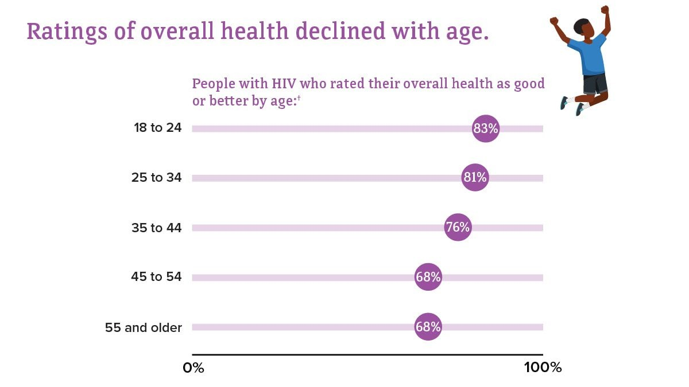
Self-rated Health Among People with Diagnosed HIV in the US by Age, 2020
Feeling Invincible!
Source: CDC. Quality of life and HIV stigma—Indicators for the National HIV/AIDS Strategy, 2022–2025,
CDC Medical Monitoring Project, 2017–2020 cycles. HIV Surveillance Special Report 2022;30.

Slide 24
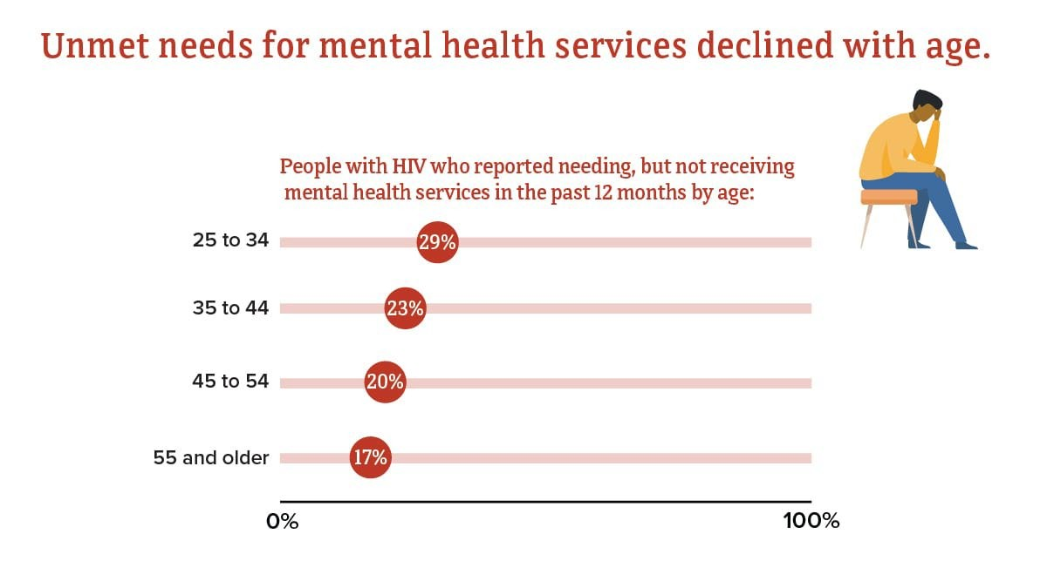
Unmet Need for Services from a Mental Health Professional among People with Diagnosed HIV, US by age, 2020
Source: CDC. Quality of life and HIV stigma—Indicators for the National HIV/AIDS Strategy, 2022–2025, CDC Medical Monitoring Project, 2017–2020 cycles. HIV Surveillance Special Report 2022;30.

Slide 25
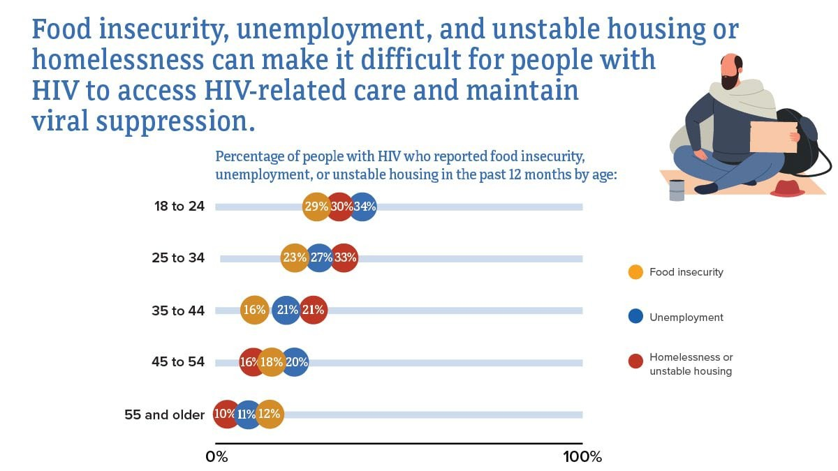
Food insecurity, unemployment, and unstable housing among people with diagnosed HIV in the US by age, 2020
Source: CDC. Quality of life and HIV stigma—Indicators for the National HIV/AIDS Strategy, 2022–2025, CDC Medical Monitoring Project, 2017–2020 cycles. HIV Surveillance Special Report 2022;30.

Slide 26
Focus on LGBTQ Youth
~1/3new HIV diagnoses among transgender individuals are among those aged 13 to 24 years
Transgender youth with HIV report high rates of stigma and other structural and logistical barriers that affect their access to gender- affirming and HIV prevention and treatment services
Substance abuse is frequent with young MSM having higher odds of each substance use behavior, and transgender women having increased odds of marijuana and other illicit drugs
LGBTQ are disproportionately represented among homeless youth
Homeless and unstably housed AYA with HIV have greater difficulties securing and sustaining resources and engaging in and being retained in care and treatment
Delany-Moretlwe S, J Int AIDS Soc. 2015;18:19833.
McCann E, Brown M. J Clin Nurs. 2019; 28: 2061–2072.

Slide 27
Engaging in Care Newly Diagnosed Adolescents and Youth
Establishing rapport and trust
Addressing confidentiality concerns and stigma
Addressing insurance coverage
Addressing transportation needs
Coordinating access to supporting services
Avoiding overwhelming amount of information
Inviting care/treatment supporters when desired
Informing of the patient rights and responsibilities

Slide 28
KEY STEPS IN THE INITIATION OF TREATMENT AND MANAGEMENT OF HIV INFECTION FOR ADOLESCENTS AND YOUTH

Slide 29
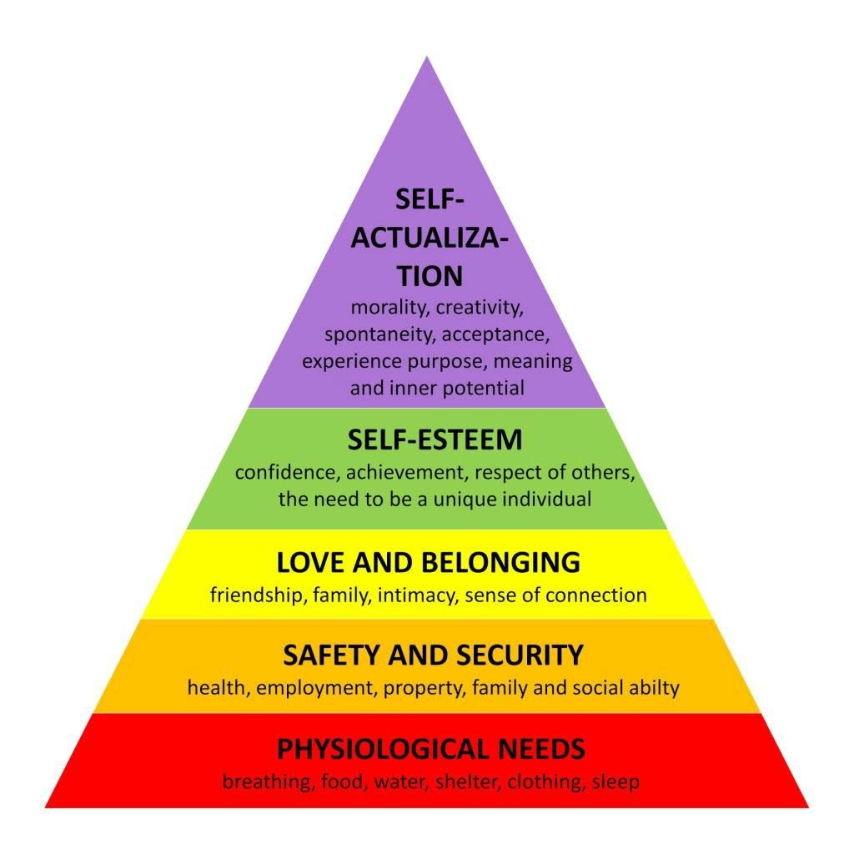
Maslow’s Hierarchy of Needs Affected by HIV through Adolescence
Cognitive development
Physical development
concrete thinking processes
preoccupation with self-image
need to fit in with their peers
high risk for neurocognitive impairment
mental health comorbidities
substance use disorders
rapid physiologic changes (e.g., puberty, rapid growth)
high risk for risk for impaired physical development
increased stigma with delayed maturation and short stature
https://www.simplypsychology.org/maslow.html

Slide 30
Key Principles of HIV Care for Adolescents and Youth
Integrated treatment patient-focused approach - psychological, medical and ancillary services
Addressing need for independent care - transportation,
housing, employment, food security
Meaningful peer engagement into the design of clinical services and research among adolescents is critically important
Optimizing ART modalities with simplified convenient ART
regimens and long-acting ARVs
Behavioral interventions to optimize engagement and retention in care
Education and engagement in HIV research

Slide 31
Baseline Evaluation
Confirming the diagnosis of HIV, obtaining a complete medical history and performing physical examination
Obtaining relevant laboratory tests and screening for sexually transmitted infections (at genital and extragenital sites of exposure)
Screening for mental health and substance use disorders
Providing education about HIV and addressing reproductive health concerns
Linking to appropriate primary care resources if necessary
For younger adolescents, additional psychosocial intervention and additional education may be necessary
Involving parents or guardians when necessary, depending on the state law, institutional policy, maturity of the adolescent,
and social situation

Slide 32
Discussing HIV Treatment
All adolescents and youth with HIV should receive ART regardless of their CD4 cell count or HIV RNA level
Rapid initiation of ART is recommended in the US and has been proven to effective in adolescents
Prior to initiating antiretroviral therapy assess for adherence issues including pill swallowing experience
Review any other medications used and potential for the drug-drug interactions with ART
For eligible youth, discuss pregnancy intention or planning
Discuss preexposure prophylaxis for seronegative partners and safe sex techniques to prevent transmission of HIV/STIs
Standard baseline laboratory testing, including an HIV drug resistance genotype, should be ordered prior to starting antiretroviral therapy
https://clinicalinfo.hiv.gov/en/guidelines/hiv-clinical-guidelines-adult-and-adolescent-arv/what-start-initial-antiretroviral?view=full
Patel ND, et al. Pediatr Infect Dis J. 2021 Feb 1;40(2):147-150.

Slide 33
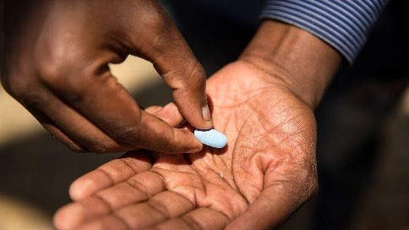
ART for Adolescents and Youth
Rapid initiation of ART simplest regimen possible
Fixed dose combination once a day ART – one pill!
Simplification strategies including eliminating food requirements and switching promptly to long-acting injectable ARVs
Looking into drug-drug interactions
Choosing regiment with a high resistance barrier

Slide 34
How about Long-Acting ART?
January 2021 – long-acting injectable (LAI) formulations of cabotegravir (CAB) and rilpivirine (RPV) approved for virologically suppressed HIV-infected patients ≥18 years of age with oral lead-in and monthly injections
February 2022 – LAI CAB/RPV approved for ages ≥12 years with a weight >35 kg
with optional oral lead-in and option for bi-monthly injections
Main eligibility criteria:
No history of treatment failure - viral load <200 copies/mL for sustained period (≥6 months)
No known or suspected resistance to either CAB or RPV
No HBV co-infection
Accepting intramuscular injections
Agreeing to schedule for injection visits every 1-2 months within 2 weeks window for each visit
December 2022 –LAI lenacapavir (LEN) approved for adults with multi-drug resistant HIV
Ongoing Clinical Trails of LA ART in Adolescents <18 years of age
Open label, non-inferiority study of virologically suppressed youth 12-19 years on first- line ART of LA CAB/RPV vs oral DTG/3TC/TDF (230 participants/arm), enrolling 2022
Phase I/II, multi‐center, open‐label, non‐comparative study to evaluate the safety, tolerability, acceptability, and PK of oral CAB, LA injectable CAB and RPV among up virologically suppressed HIV‐1 infected children and youth 12 to <18 years – fully recruited (155 participants), 24 weeks results encouraging

Slide 35
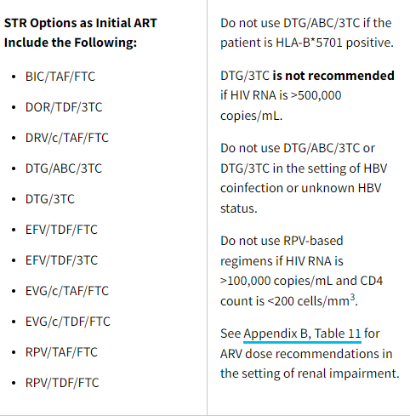
Initial ART Choices
Baseline CD4 count, viral load, prior exposure to long- acting PrEP and HBV status are important for the selection of the dual regimen
▪
ART regimen should
be started before HIV
drug resistance results
are available
https://clinicalinfo.hiv.gov/en/guidelines/hiv-clinical-guidelines-adult-and-adolescent-arv/what-start-initial-antiretroviral?view=full

Slide 36
Setting Up Care and Treatment Plans
Identify mutually acceptable goals for care
Identify support network - family, friends, partners, health team members and others
Educate patient and family about the importance of adherence
Develop a treatment plan that the adolescent and youth understand and to which they can be committed
Identify barriers to accessing care and treatment – any insurance, co-pay challenges, accessing pharmacy, delivering meds to home address
Establish capacity to take medication through in clinic practice sessions when indicated – offer pill swallowing training
Schedule a home or telemedicine visit to review medications and determine how they will be administered in the home setting

Slide 37
Supporting ART Adherence
▪
Patient education aids, including pictures, calendars, and
stickers
Reminder systems, such as cell phone calls, alerts, and text messaging, have been found to be particularly effective for adolescents and youth
Mixed results from the studies evaluating the usage of cell phone and text messaging interventions for adherence
Two-way communication yields better ART adherence outcomes compared to stand-alone reminders
A multidisciplinary approach with individualized case management that combines adherence tactics with supportive, emotional, or behavioral strategies for youth with HIV
Amankwaa A, et al.
PLoS One. 2018;13:e0204091.
https://clinicalinfo.hiv.gov/en/guidelines/pediatric-arv/adherence-antiretroviral-therapy-children-and-adolescents-living-hiv https://www.cdc.gov/hiv/research/interventionresearch/compendium/ma/complete.html

Slide 38
BARRIERS AND FACILITATORS TO ACHIEVING AND SUSTAINING VIROLOGIC SUPPRESSION AMONG YOUTH WITH HIV

Slide 39
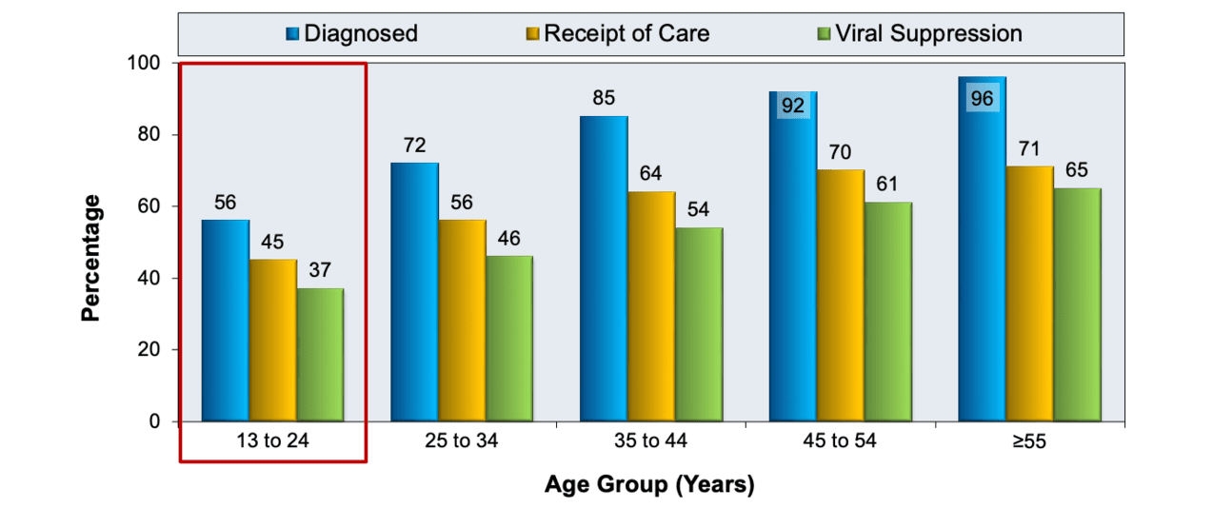
HIV Care Cascade/Continuum among People, US and Dependent Areas, 2021
Source: Centers for Disease Control and Prevention. Monitoring Selected National HIV Prevention and Care Objectives by Using HIV Surveillance Data—United States and 6 Dependent Areas, 2021. HIV Surveillance Supplemental Report. 2023;28(No. 4). Published May 2023.

Slide 40
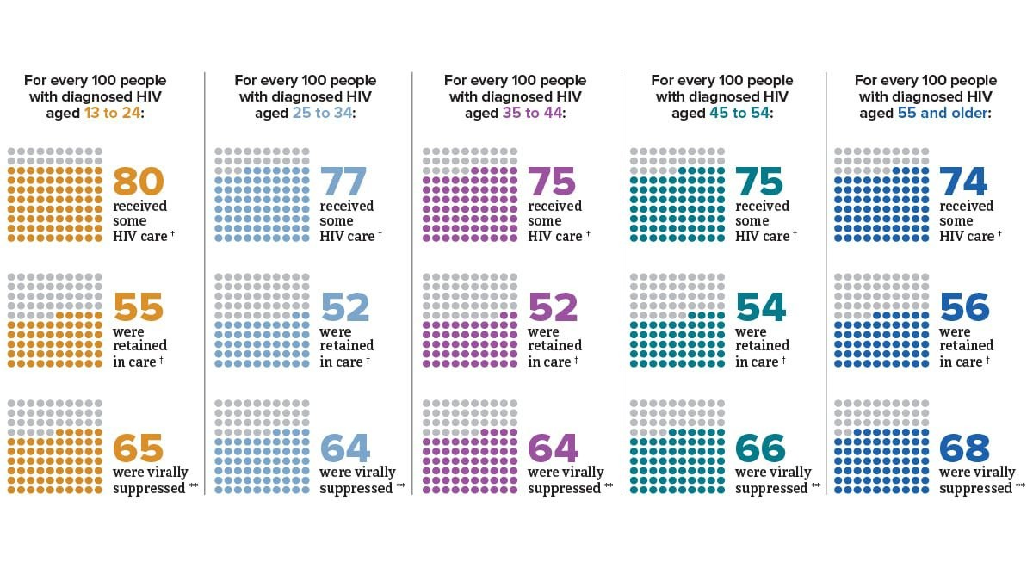
HIV Care Continuum among People with Diagnosed HIV in 47 States and DC by Age, 2021
Source: CDC. Monitoring selected national HIV prevention and care objectives by using HIV surveillance data— United States and 6 dependent areas, 2021. HIV Surveillance Supplemental Report 2023;28(4).

Slide 41
Retention in Care Challenges
Compared to 24% of overall adults with HIV 38% of young people 18-24 years old missed at least 1 medical appointment in the past 12 months

Slide 42
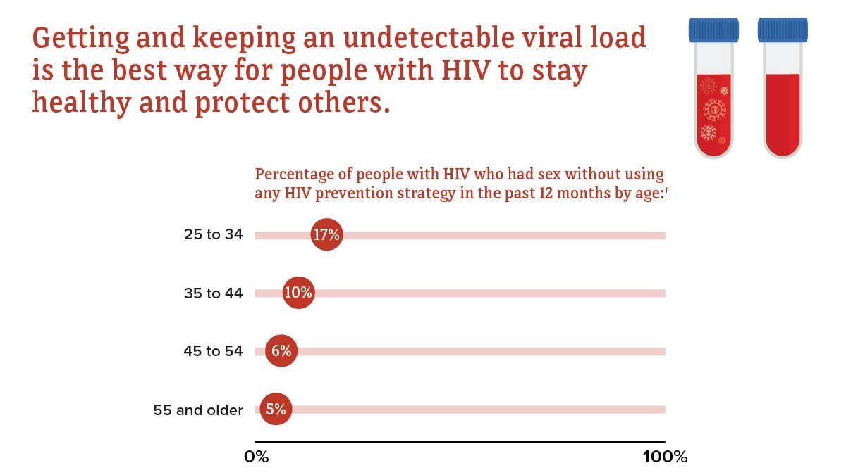
Sexual Behaviors among People with Diagnosed HIV in the US by Age, 2020
Source: CDC. Behavioral and clinical characteristics of persons with diagnosed HIV infection—Medical Monitoring Project, United States 2020 cycle (June 2020–May 2021). HIV Surveillance Special Report 2022;29.
42

Slide 43
Psychiatric Disorders in Adolescents and Youth with HIV,US
25% of ALHIV have clinical- level mental health
distress (4 systematic reviews)
10% current suicidal ideation (meta-analysis)
Neurocognitive impacts 2022 systematic review: impacted cognitive function, learning, processing, memory – closely linked to socioeconomic challenges
Higher percentage of youth with newly acquired HIV reported experiencing an even more extensive number of negative life experiences compared to those who acquired HIV early in life
(38.8% vs 16.3%)
69 %
diagnosed with
any non-
s ubs t a nc e use psychiatric
disorder
at least 1x
83%
diagnosed with
a ny disorder
at least 1x
41%
diagnosed with any substan ce us e disorder at least 1x
53%
diagnosed
≥ 2x
39%
diagnosed
≥ 2x
21%
diagnosed
> 2x
60%
diagnosed with
a ny anxiety disorder
at least 1x
31%
diagnosed
≥ 2x
18%
diagnosed with
any
behavior disorder
at least 1x
7%
diagnosed
≥ 2x
26%
diagnosed with
a ny m ood disorder
at least 1x
8%
diagnosed
≥ 2x
Cluver, Sherr et al (2022). Lancet Child & Adolescent Health; Anabwani-Richter et al (2022) Curr Trop Med Rep;
Tsegay & Agano, 2020
Slide: courtesy Dr. Lucy Cluver, modified
Child &Adolescent Self-Awareness and Health Study (CASAH) NIMH R01-MH069133, PI: Claude A. Mellins https://www.hivcenternyc.org/casah

Slide 44
Adherence to ART Challenges
Compared to 61% of overall adults with HIV, 38% of young people 18-24 years old took all their doses of HIV medicine over the last 30 days

Slide 45
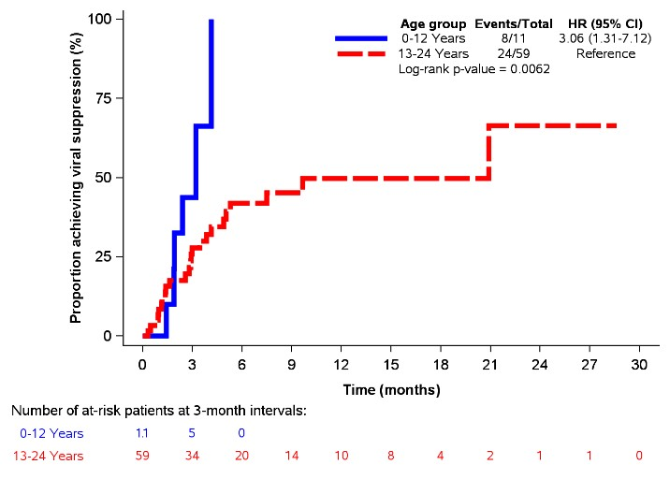
Outcomes in Treatment-Experienced Children and Youth
141 highly treatment-experienced pediatric and
youth patients newly prescribed INSTI-based ART
Median age=19.9 years (IQR 16.3-22.4):
14.9%≤12 yrs, 21.3% 13-17 yrs, 63.8% 18-24 yrs
40.4% female; 89.1% Black; 62.4% perinatally infected
Median time since HIV diagnosis = 7.6 yrs (IQR 3.4-16.3)
65.2% had non-suppressed VL (>20 copies/mL HIV RNA) at the start of INSTIs and were on PI-based ART
Kaplan-Meier curves for achieving Viral Suppression among non-suppressed patients at baseline (n=70)
DTG was the most commonly prescribed INSTI (55.3%), followed by EVG/C (36.9%) and RAL (7.8%)
More than half of patients with detectable viremia at baseline did not achieve VS
Among non-suppressed patients at baseline, patients <13 (vs. 13-24) years old were more likely to achieve VS (p=0.0062)
Levy ME, et al. Pediatr Infect Dis J. 2020

Slide 46
It Takes a Village to Support Adherence
Barriers to ART adherence include disruption of daily routine, poor understanding of the importance of adherence, denial and fear, forgetfulness, comorbid mental health diagnoses, substance use, lack of family and social support, and structural barriers
Solutions to improve adherence include encouragement and understanding of the barriers, peer support, treatment buddy (mentorship model), pharmacy innovations (auto refills, blister packs, home/clinic drug delivery), directly observed therapy, potentially brief hospitalization,

Slide 47
Comprehensive Multidisciplinary Care Team
- Summary of Ambulatory Services, CNH
Flexible in-person and telehealth appointments
Rapid ART and PrEP initiation - within 7 days
Injectional ART/PrEP program
Youth Sexual Health Clinic: STI prevention and diagnosis, treatment, contraception, Pap smears
Enhanced Treatment Adherence Counseling
Youth focused sexual health and risk reduction education
Vaccines (including yearly flu vaccination) and coordination with PCP for vaccines
TB screening and treatment
Mental health assessment and support (including disclosure of HIV status support)
Substance abuse program
Peer support
Extensive subspecialty referrals on campus
Housing, food needs support

Slide 48
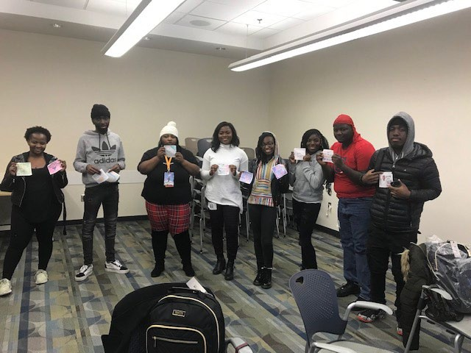
Peer Support Groups
What improvements you think need to be made to improve the group experience
“Longer time to discuss more topics.”
“More games – More gift cards, more prizes. Chipotle!!”
“Bring more people into the group.”
“Nothing I luv the group.”

Slide 49
Diversifying Peer Support
RD and PSS staff co-facilitate groups
Peer discussion and cooking session

Slide 50
Cooking Classes for Adolescents and Youth, CNH
Goals of cooking classes for AYHIV:
Exposure to new foods
Learning cooking techniques
Building sense of community
Increased self-confidence
Launched in 2018 & holding one cooking class per month
Partnered with mental health for collaborative approach
Biannual special cooking lessons for young adult peer support group
Monthly teen group:
“HerStory” Summer Series & “Super Saturdays”
Take home groceries assembled to use/recreate recipes

Slide 51
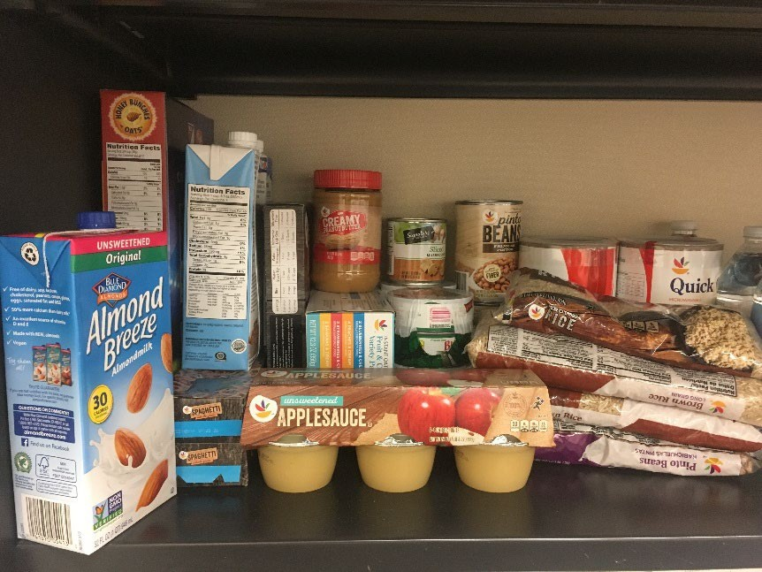
Addressing Food Insecurity
 | 3/2020 – 2/2021 | 3/2021 – 2/2022
Screene d | 200 | 196
Positive | 49 (24.5%) | 38 (19.4%)
Negative | 146 (73.0%) | 100 (78.6%)
N/A | 5 (2.5%) | 4 (2.0%)
Connecting youth with resources in county/zip code
Signing patients up for Food & Friends
In-clinic produce distribution

Slide 52
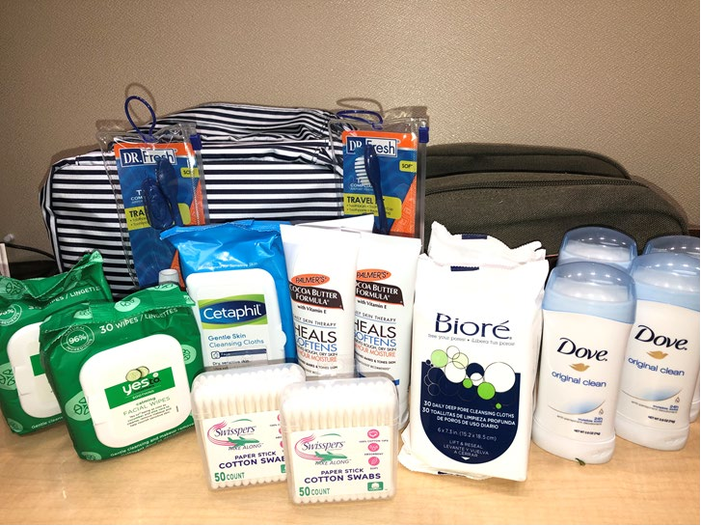
Wellbeing and Health Promotion
Personal Hygiene Kits:
Promotes sexual & reproductive health education
Part of condom distribution program
Budding healthy body habits
Raising self-management skills
Wellness & Physical Activity Kits:
Promotes physical health and conditioning
Part of mental health program
Budding healthy body habits
Raising self-management skills

Slide 53
Conclusions
HIV testing rates are low among adolescents and young adults with only 2 out of 5 youth with HIV know their status
Adolescents and youth comprise 19% of adolescents and adults newly diagnosed with HIV
Male youth predominantly acquire HIV via male-to-male sexual contact and female youth acquire HIV mostly through heterosexual contact
Adolescents and youth with HIV have worse health outcomes compared to other populations with HIV in the US
Multidisciplinary team approach with extensive support and two-way communication based on trust are key steps for engaging newly diagnosed adolescents and youth into care

Slide 54
Acknowledgements
Patients and their families
HIV Prevention and Treatment Services/Special Immunology Team at Children’s National
Regional DOH partners
HRSA Ryan White funding support
DC CFAR Partners
Trainees and diverse faculty

Slide 55
MATEC Resources
National Clinician Consultation Center http://nccc.ucsf.edu/
HIV Management
Perinatal HIV
HIV PrEP
HIV PEP line
HCV Management
Substance Use Management
AETC National HIV Curriculum https://aidsetc.org/nhc
AETC National HIV-HCV Curriculum https://aidsetc.org/hivhcv
National PrEP Curriculum https://www.hivprep.uw.edu
Hepatitis B Online https://www.hepatitisb.uw.edu
Hepatitis C Online https://www.hepatitisc.uw.edu
AETC National Coordinating Resource Center https://aidsetc.org/
Additional Trainings https://matec.info

