Slide 1
Sexually Transmitted Infections: Challenges in Management and Prevention
Frank J. Palella Jr MD
Potocsnak Family Professor of Medicine
Division of Infectious
Feinberg School of Medicine
Northwestern University Chicago

Slide 2
MATEC Statement on Equity and Inclusion
MATEC has a strong commitment to fair, respectful and unbiased representation of humankind. We strive to be anti-racist, gender affirming and honor all people in an authentic way. This is our goal in all of our work, including this presentation.
Our commitment to you is that we take this stance seriously and invite you to do the same. We ask that if you find something offensive, off-putting, or inaccurate to please let us know.
We continue to grow and evolve and welcome you on our journey.

Slide 3
Disclaimer
This program is supported by the Health Resources and Services Administration (HRSA) of the U.S. Department of Health and Human Services (HHS) as part of an award totaling $4,036,482.00 with 0 percentage financed with nongovernmental sources. The contents are those of the author(s) and do not necessarily represent the official views of, nor an endorsement, by HRSA, HHS or the U.S. Government.

Slide 4
Disclaimer
Funding for this presentation was made possible by grant number U1OHA29293 from the Human Resources and Services Administration HIV/AIDS Bureau. The views expressed do not necessarily reflect the official policies of the Department of Health and Human Services nor does mention of trade names, commercial practices, or organizations imply endorsement by the U.S. Government.
Any trade/brand names for products mentioned during this presentation are for training and identification purposes only.

Slide 5
Speaker Disclosures
Financial Relationships With Ineligible Companies (Formerly Described as Commercial Interests by the ACCME) Within the Last 2 Years

Slide 6
Learning Objectives
Describe bacterial sexually transmitted infection (STI) epidemiologic trends
Discuss STI prevention strategies
Describe management and antimicrobial resistance challenges

Slide 7
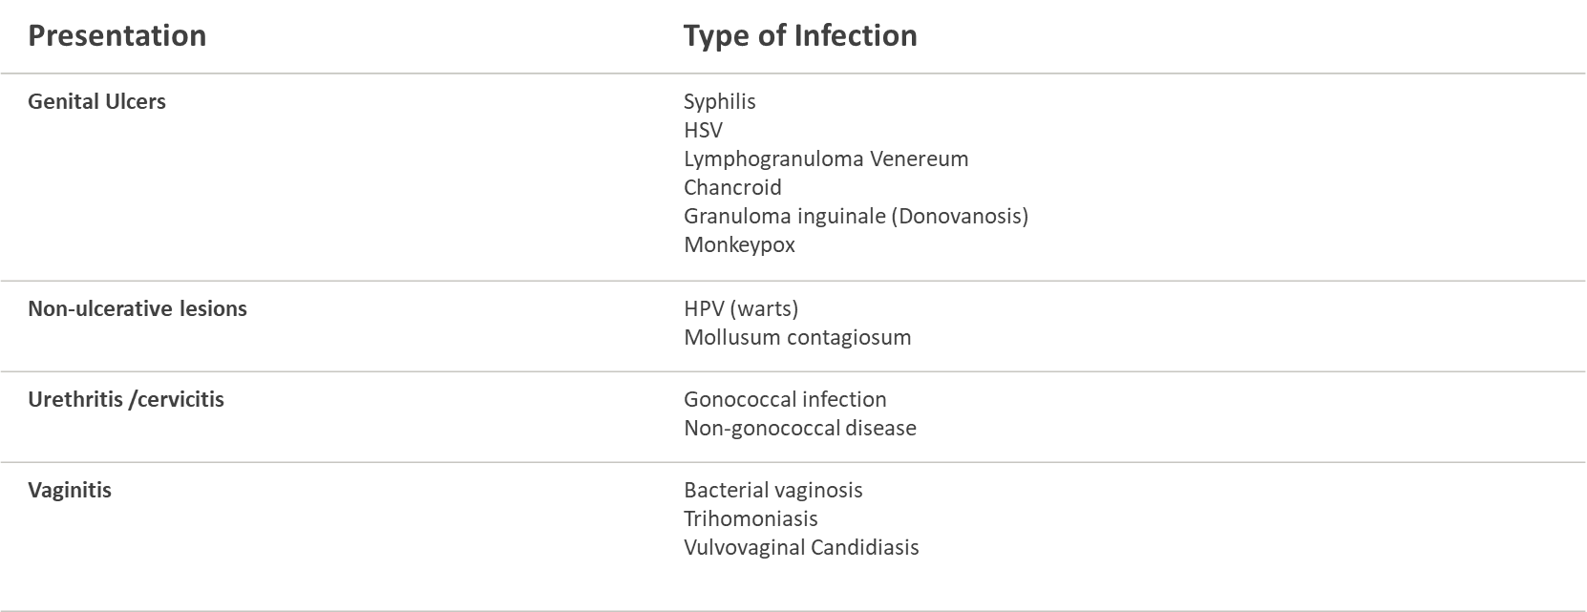
Types of Infections
Viral STDs not typically associated with any of the above syndromes but very important to screen for: HIV, HBV HCV.
Viral STDs not typically associated with any of the above syndromes but very important to screen for: HIV, HBV HCV.​

Slide 8
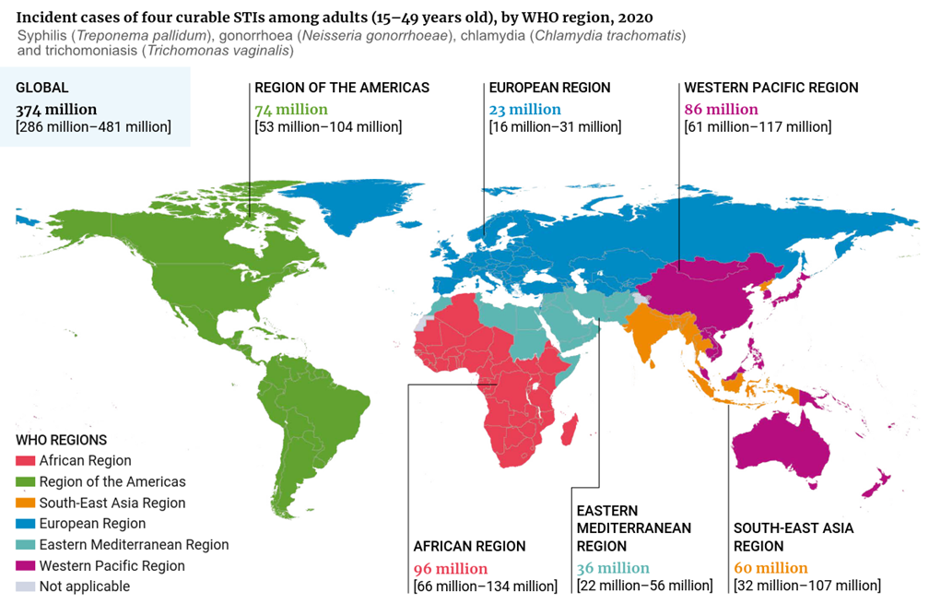
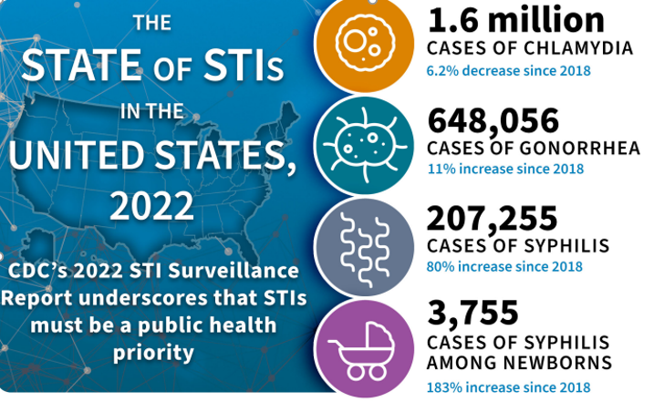
Objectives
Bacterial STI epidemiologic trends
Discuss STI prevention strategies
Management and antimicrobial
resistance challenges
Disclosures-Medical Consultant, CDC, Division of STD Prevention

Slide 9
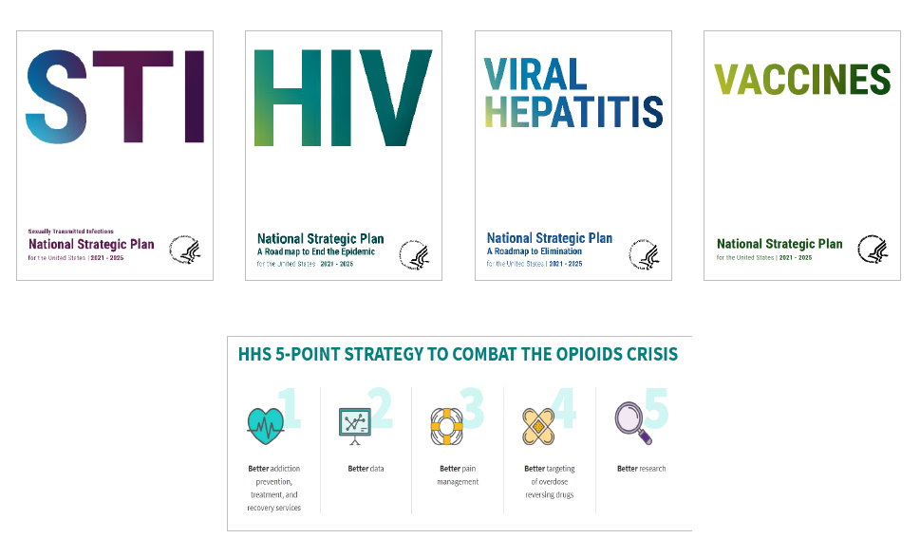
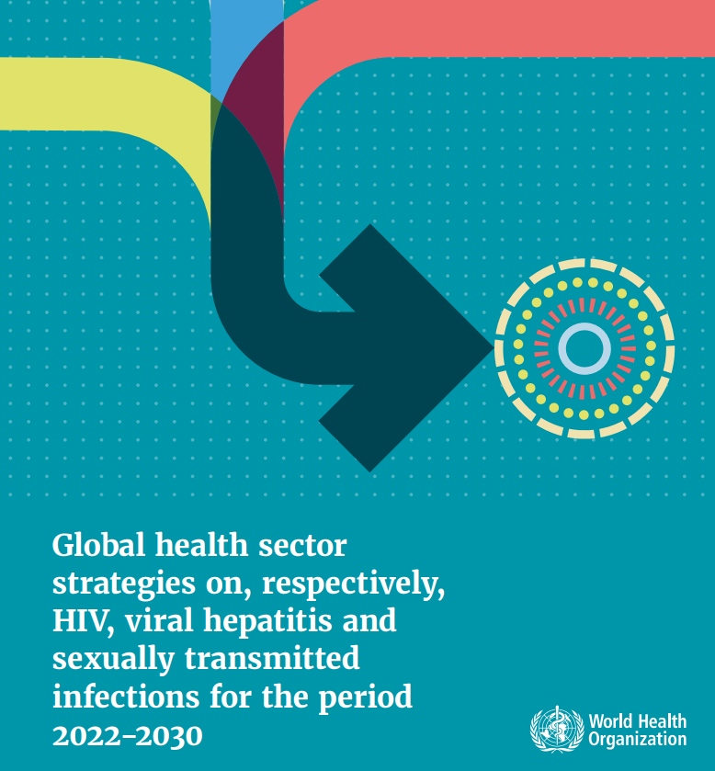
Challenges to STI Prevention
STI, HIV, viral hepatitis, substance use disorder syndemic
Asymptomatic/atypical/concurrent infection
Antimicrobial resistance
Reduced program capacity, diverted workforce, medication shortages
Limited point of care diagnostics (Kersh, STD 2022)
CT/GC/TV; single use; vaginal; CLIA waived (Visby)
CT/GC; requires device; vaginal, urine; CLIA waived (binx)
CT/GC; requires device; vaginal, urine; not CLIA waived (Cepheid)
Syphilis Health Check antibody (CLIA); DPP HIV Syphilis (CLIA)

Slide 10
STI Prevention
Health assessment
Substance use, tobacco, depression, partner violence
Sexual health 5Ps
partners, practices, protection, past history, pregnancy
Screen
STI (biologic assessment per guidelines)
USPSTF (STI counseling, GC, CT, syphilis, neonatal ocular prophylaxis, HIV, HBV, HCV, HSV, BV in pregnancy)
CDC STI Treatment Guidelines (population)
Vaccinate (HPV, hepatitis A, B, MPX)
Partner management
Prevention methods
Condoms, HIV PrEP, HIV/STI PEP

Slide 12
Luetkemeyer NEJM 2023;388:14

Slide 13
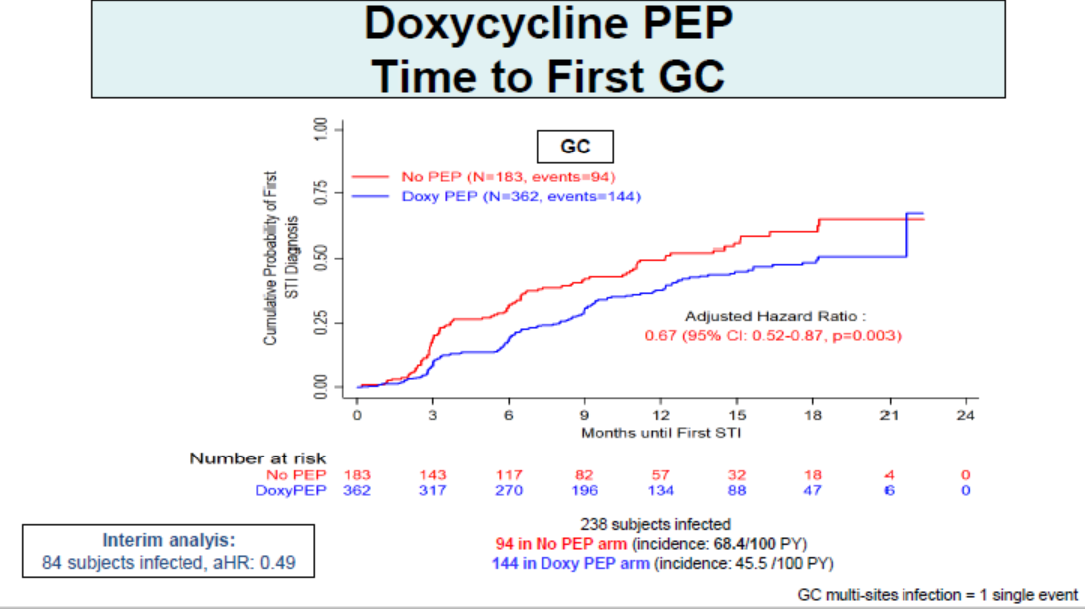
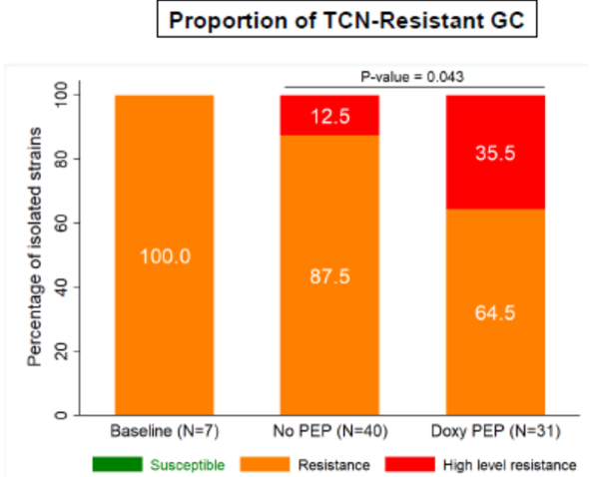
Molina, CROI 2024

Slide 14
Impact of Doxy PEP on STI Rates San Francisco
STI | Change in Cases Post–Doxy-PEP, % per Mo | P Value | Change in Cases in November 2023, % (95% CI)
Chlamydia | -6.6 | < .0001 | -50 (38-59)
Early syphilis | -2.7 | < .0001 | -51 (43-58)
Gonorrhea | +1.8 | < .0001 | Not reported
In post–doxy-PEP period, statistically significant decreases in observed cases of chlamydia and early syphilis vs model predictions
Approximate 50% decrease during the 13 mo after SF Department of Public Health guideline implementation
In post–doxy-PEP period, statistically significant increase in observed gonorrhea cases vs model predictions
In pre–doxy-PEP period, 1.8% per mo decrease vs model predictions

Slide 15
Doxy PEP Implementation
Restrictive vs broad, eligibility (MSM, TGW)
Current guidelines inconsistent
Population vs individual
Antimicrobial stewardship
Education of patients, providers
# Pills, syphilis serology, management of contacts to STI, women
Comprehensive sexual health services (primary prevention, vaccines, syndemic)
Impact on microbiome
Surveillance systems
Staph aureus colonization resistance
GC resistance
Clinical failure, culture for monitoring, alert for MIC >0.125 mg/ml, WGS

Slide 16
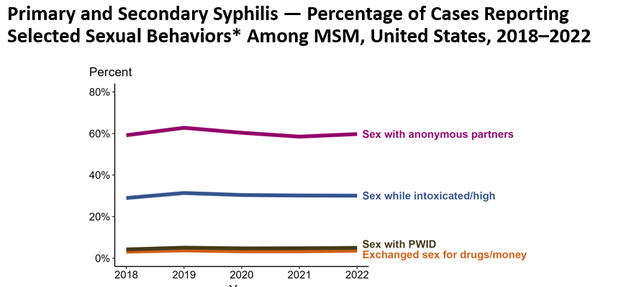
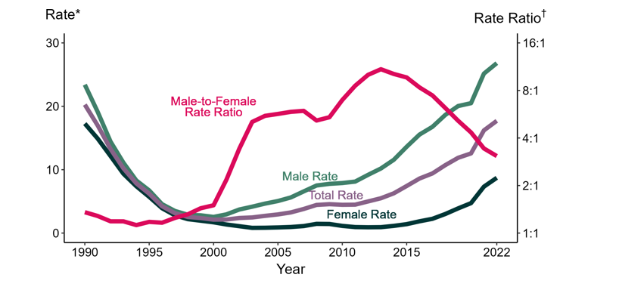
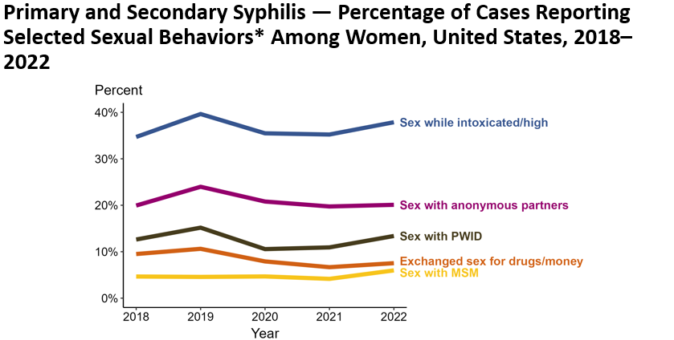
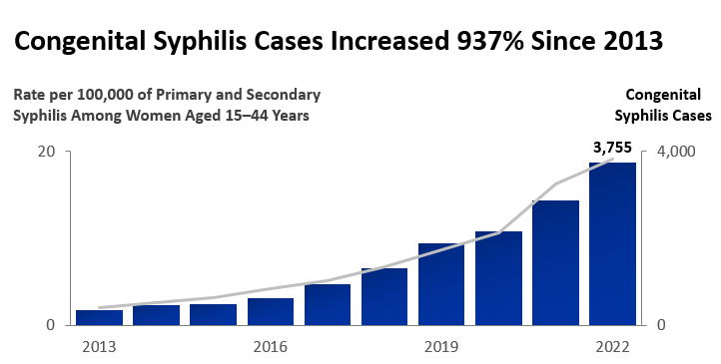
Primary and Secondary Syphilis — Rates of Reported Cases by Sex and Male-to-Female Rate Ratios, United States, 1990–2022

Slide 17
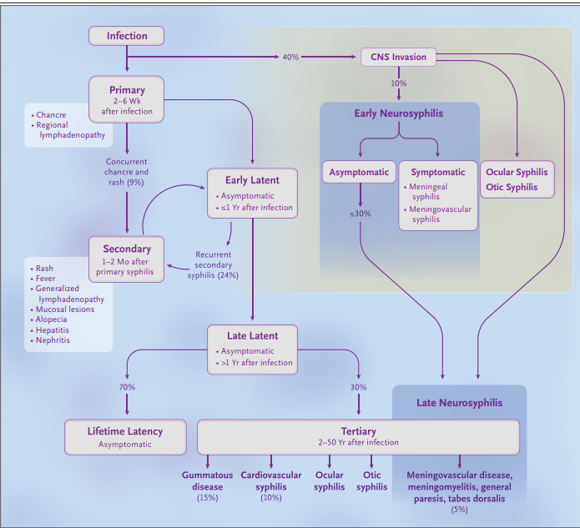
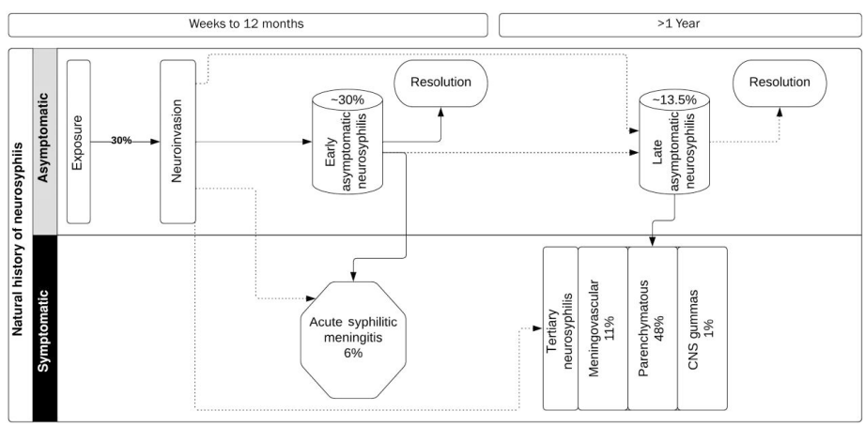
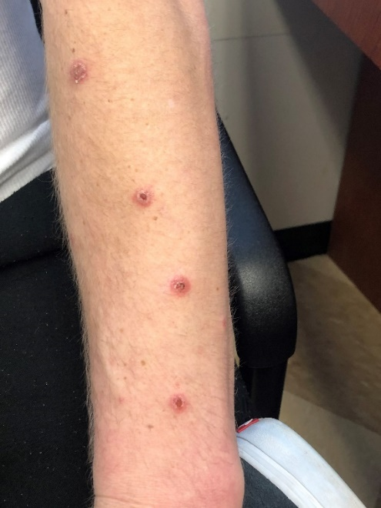
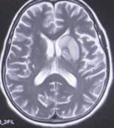
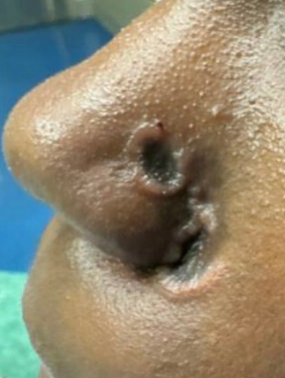
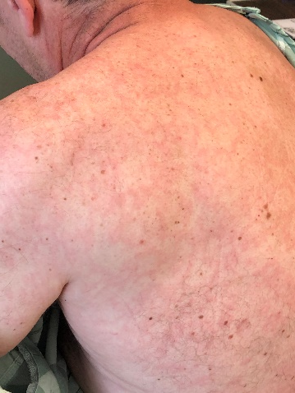
Natural History of Neurosyphilis
Hamill CID 2023
Ghanem 2020
Graciaa OFID 2017, Zhang Front Neuro 2023

Slide 18
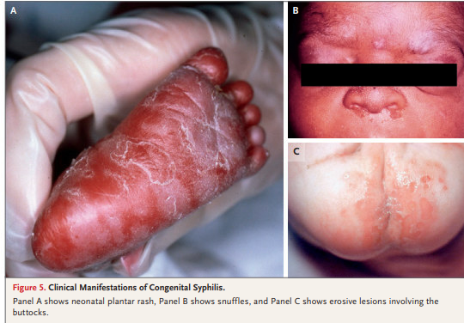
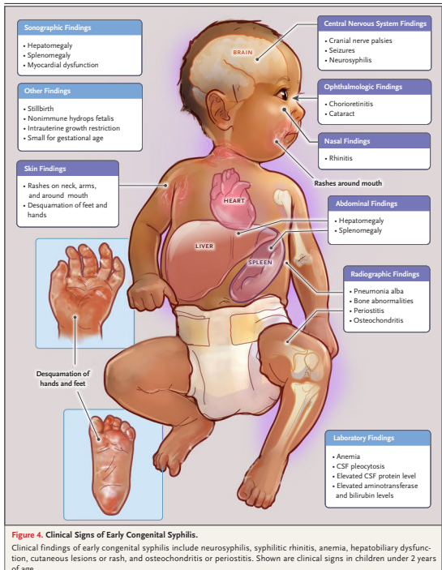
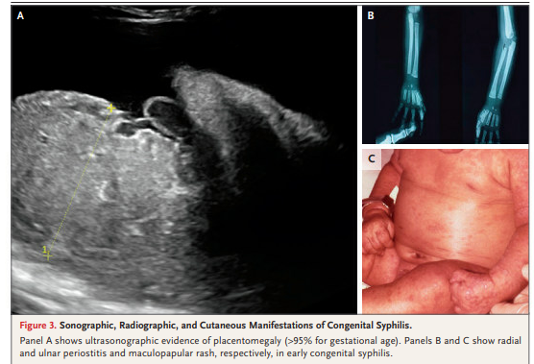

Slide 20
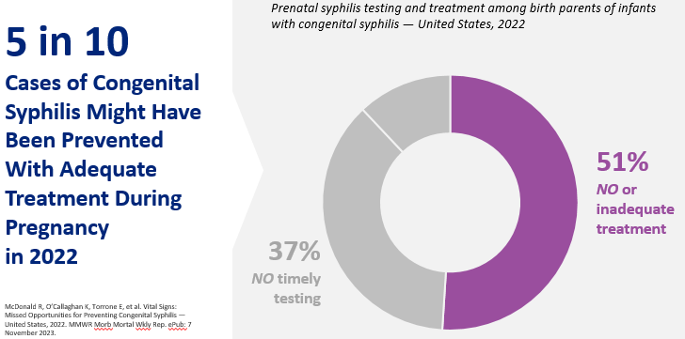
www.hhs.gov/about/news/2024/01/30/hhs-announces-department-actions-slow-surging-syphilis-epidemic.html

Slide 21
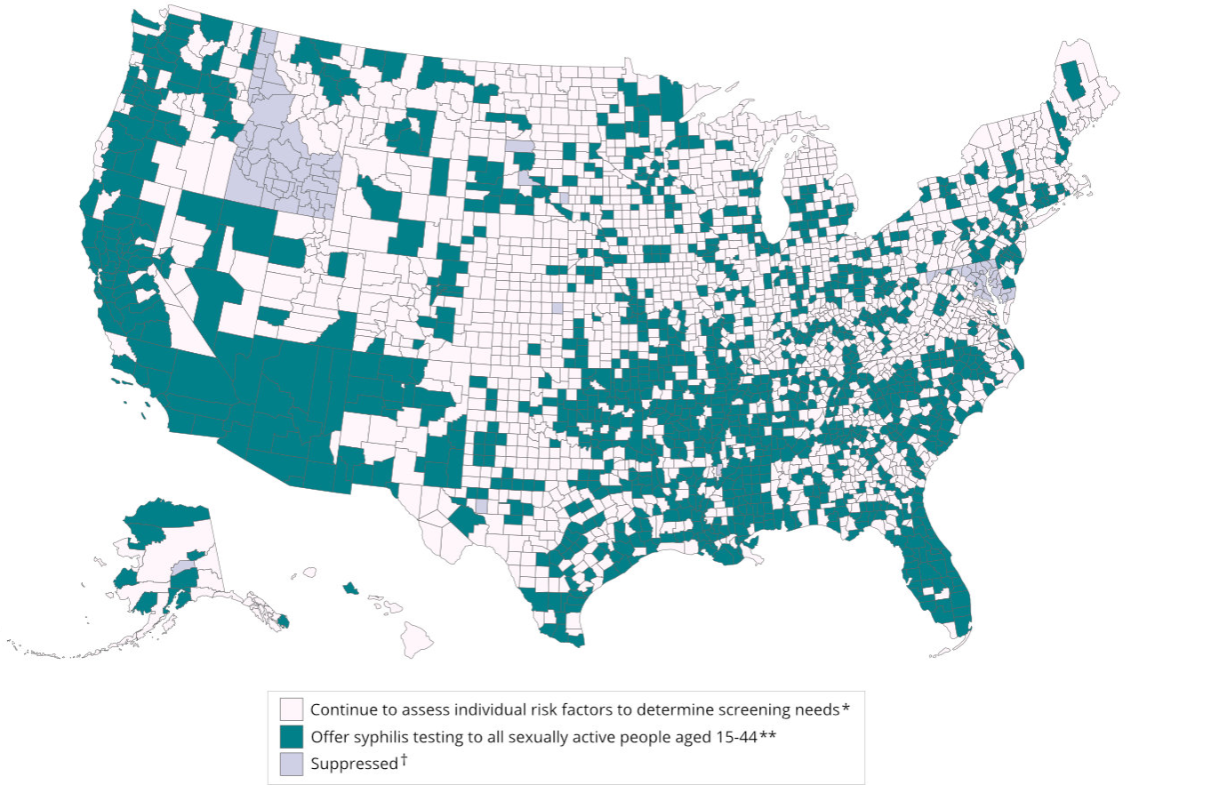
Syphilis Screening
Men who have sex with men
HIV
HIV PrEP
Pregnancy
Sexually active 15-44 in counties with prevalence > 4.6 cases/100K women
38% of US counties are high prevalence
72% of the US population
www.cdc.gov/nchhstp/atlas/syphilis/index.html

Slide 22
Syphilis serologic screening algorithms
Traditional
Reverse sequence
RPR
RPR+
RPR-
TP-PA or other trep. test
TP-PA+
Syphilis
(past or present)
TP-PA-
Syphilis unlikely
EIA or CIA
EIA/CIA+
EIA/CIA-
Quantitative RPR
RPR+
Syphilis
(past or present)
RPR-
TP-PA
TP-PA+
Syphilis
(past or present)
TP-PA-
Syphilis unlikely
RPR (Sensitivity)
Primary 62-78%
Secondary 97-100%
Early Latent 82-100%
Tertiary 47-64%
Early primary, requires RPR (active), false +
Active infection, F+, miss early
Never interpret syphilis serology in the absence
of a clinical history

Slide 23
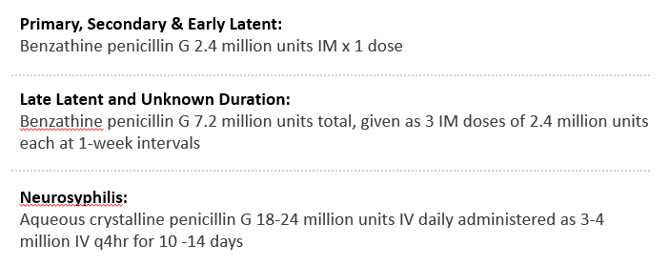
Syphilis Treatment
One vs Three BPG Weekly BPG for Early Syphilis
Amorphous PCN/Pen G q3 hours ~60 doses (8 days )
impractical due to short half life
Formulations to modify drug half life
POB (penicillin G in peanut oil and beeswax; 1946)
Procaine penicillin G (1948)
PAM (procaine penicillin G with aluminum monostearate; 1948)
Benzathine penicillin (1952)
Cumulative 6 Month Response by HIV Status
Persons with HIV (N=153)
BPG x1 (N=70) 76% (53)
BPG x 3 (N=83) 71% (59)
Difference in proportion with serological response: -0.05 (-0.17, 0.07)
Persons without HIV (N=91)
BPG x1 (N=51) 76% (39)
BPG x 3 (N=40) 70% ((28)
Difference in proportion with serological response: -0.06 (-0.22, 0.09)
Frequent coinfection (865 screened)
Gonorrhea 29%, Chlamydia 22%, GC+CT 23%
2021 CDC STI Guidelines
Dionne-Odom STD 2022; Dionne ID Wk 2023
Dionne ID Wk 2023

Slide 24
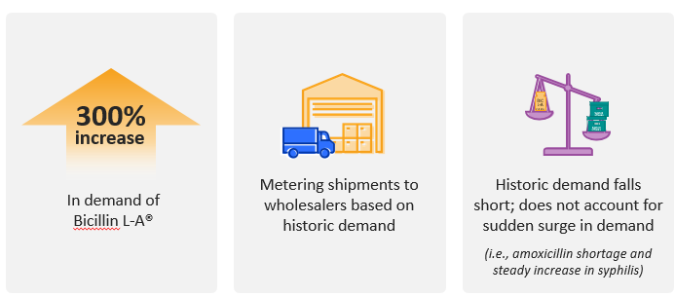
Extencilline – Benzathine Benzyl Penicillin Importation
CDC Dear Colleague Letter sent January 16, 2024
https://courses.nnptc.org/resource_detail.html?id=2032

Slide 25
Alternative Regimens
Early Syphilis Neurosyphilis
Amoxicillin Ceftriaxone*
Cefixime (Stafylis, CID 2021) Doxycycline
Ceftriaxone* Linezolid
1 gm IV x 10-14 d Procaine PCN*
Dalbavancin
Doxycycline*
doxy vs BPG (France)
Linezolid (Ubals, Lan Inf Dis 2024)
*CDC STI Guidelines
NIH Syphilis Workshop 2/24

Slide 26
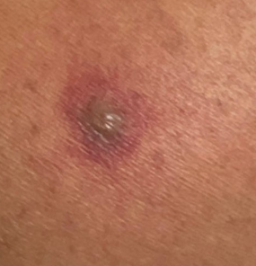
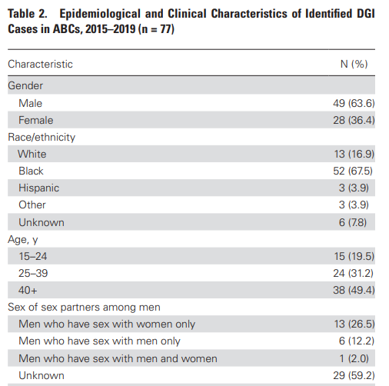
Disseminated GC
0.5-3% of gonococcal infections
Changing epidemiology
Increase in men, older age, illicit drug
Clinical presentation
Monoarticular arthritis
Skin lesions (petechial or pustular) + tenosynovitis + polyarthralgia
Endocarditis
17 yo male, fever, chills, hepatomegaly; brachial artery thrombus, myositis, AV root abscess, +16sRNA
65 yo male, CAD, RA; AV endocarditis, +blood cx
17 yo female, PID, trichomonas, AV root abscess, +16sRNA
Asymptomatic mucosal site
Associated with eculizumab
FDA adverse event reporting system (Crew 2018)

Slide 27
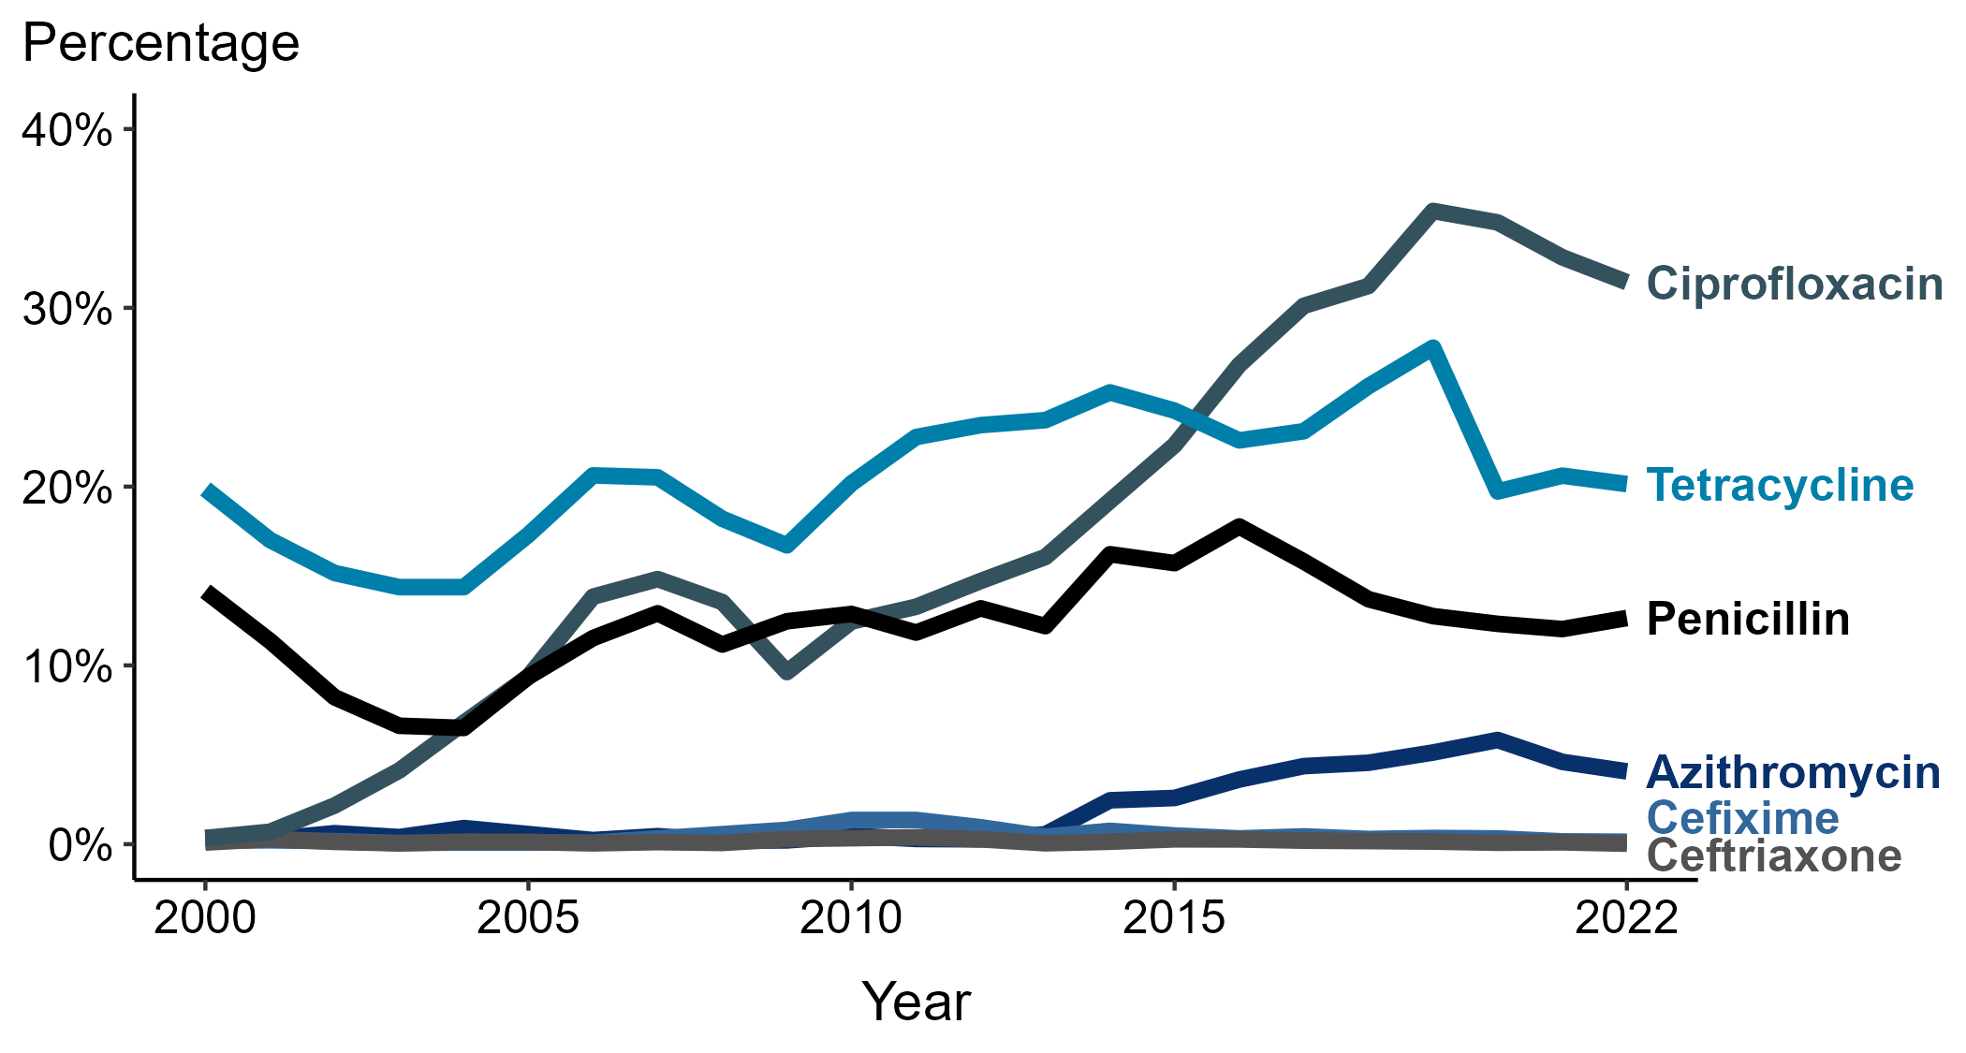
Neisseria gonorrhoeae — Prevalence of Tetracycline, Penicillin, or Ciprofloxacin Resistance* or Elevated Cefixime, Ceftriaxone, or Azithromycin Minimum Inhibitory Concentrations (MICs)†, by Year — Gonococcal Isolate Surveillance Project (GISP), 2000–2022

Slide 28
Gonorrhea Treatment
Evidence and Rationale
Microbiome impact (azithromycin)
Antimicrobial Stewardship
Azithromycin susceptibility (GISP)
Azithromycin resistance co-pathogens
PK/PD considerations
azithromycin, ceftriaxone variability
Wt based dosing (murine model) of unbound drug/MIC
Ceftriaxone 500* mg IM
plus
Doxycycline 100 mg orally 2 times/day for 7 days, if chlamydia has not been excluded
*For persons weighing ≥150 kg, 1 gm ceftriaxone

Slide 29
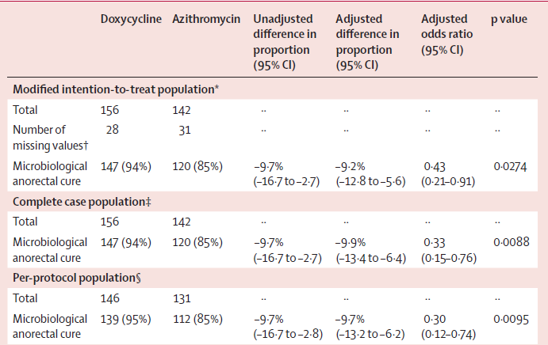
Doxycycline Versus Azithromycin for the Treatment of Rectal Chlamydia in Men Who Have Sex With Men: A Randomized Controlled Trial
Dombrowski, CID 2021
Lau, NEJM 2021

Slide 30
Chlamydia Treatment
Minimum doxycycline duration not defined
Single dose minocycline highly effective (Taylor-Robinson D. 1986)
RCT - 73 women 94% cure with 3d vs 94.7% cure with 7d (Reddy, 1997)
Measured vs self report compliance MEMS caps (Bachmann, 1999)
16% (n=221) adherent; Despite poor compliance, few treatment failures
The Compliance Paradox (Schachter, 1999)
Need definitive evidence of impact guidelines and change practice
NCT05840159

Slide 31
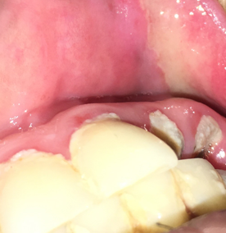
Summary
Behavioral and biologic sexual health assessment
Screening and timely treatment per guidelines
Variable clinical presentations, profound consequences
Syndemic -biomedical/partnership optimization
STI control historically focused individual risk factors (behavior/organism)
Address structural factors contributing to health inequity
Individual vs population benefit
Innovation
diagnostics, alternative treatment, prevention, care delivery
Targeted interventions to affected population

Slide 32
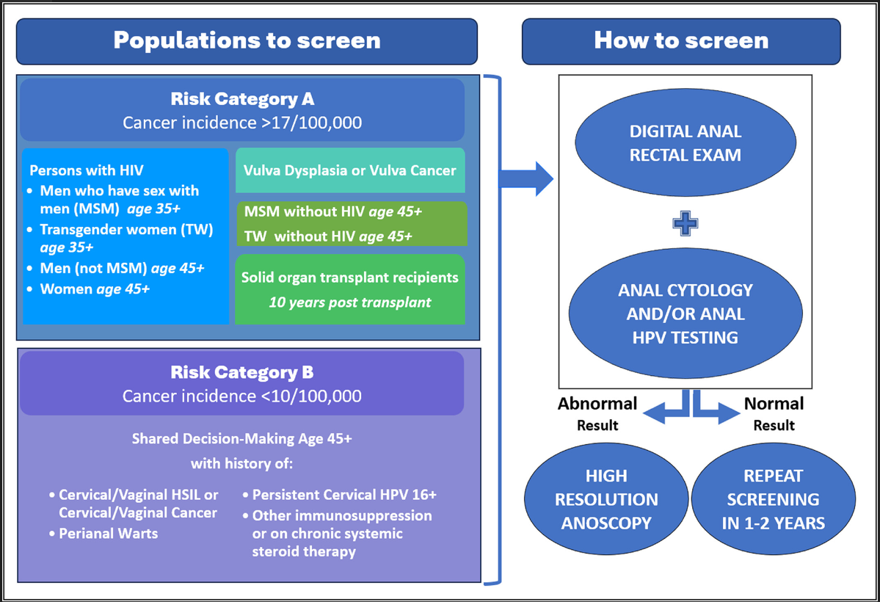
Anal Cancer Screening-International Anal Neoplasia Society
Stier, I J Can 2024

Slide 33
HPV Vaccination
Highly effective against incident and persistent infection
Women between the ages of 9 to 26
Men between the ages of 9 to 26)
Controversy on benefit of vaccination in persons >26 years

Slide 34
HPV Vaccination

Slide 35
HPV Vaccination update
Vaccination against human papillomavirus (HPV) is routinely recommended at age 11 or 12 years. Catch-up recommendations apply to persons not vaccinated at age 11 or 12 years.
What was added by this report?
After reviewing new evidence, CDC updated HPV vaccination recommendations for U.S. adults.
Routine recommendations for HPV vaccination of adolescents have not changed.
Catch-up HPV vaccination is now recommended for all persons through age 26 years. For adults aged 27 through 45 years, public health benefit of HPV vaccination in this age range is minimal; shared clinical decision-making is recommended because some persons who are not adequately vaccinated might benefit.

Slide 36
Topics updated in the most recent 3 versions of CDC
STD Treatment Guidelines
alternative treatment regimens for Neisseria gonorrhoeae;
the use of nucleic acid amplification tests for the diagnosis of trichomoniasis;
the role of Mycoplasma genitalium in urethritis/cervicitis and treatment-related implications;
updated HPV vaccine recommendations and counseling messages;
the management of persons who are transgender;
annual testing for hepatitis C virus in persons with HIV infection

Slide 37
MATEC Resources
AETC National HIV-HCV Curriculum https://aidsetc.org/hivhcv
Hepatitis C Online https://www.hepatitisc.uw.edu
AETC National Coordinating Resource Center https://aidsetc.org/
Additional Trainings https://matec.info
National PrEP Curriculum https://www.hivprep.uw.edu/
Hepatitis B Online https://www.hepatitisb.uw.edu/
National Clinician Consultation Center http://nccc.ucsf.edu/
HIV Management
Perinatal HIV
HIV PrEP
HIV PEP line
HCV Management
Substance Use Management
AETC National HIV Curriculum https://aidsetc.org/nhc

