Slide 1
Black Men’s HIV Leadership Capacity Building Initiative
Foundations Of Progress: Exploring The Historical Landscape Of HIV Activism Through Black Men’s Perspectives
June 18, 2024

Slide 2
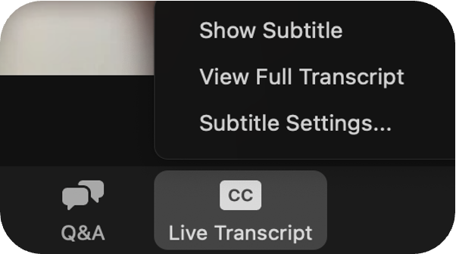
We are using Zoom's live transcription function today
Click on the “CC - Live Transcript”
button on your zoom action bar.
When the menu window appears, click “Show Subtitles”
to turn on closed captioning.

Slide 3
Tips to Maximize our Time Together
Please mute if you're not speaking
Freely use the chat!
Share ideas and support colleagues
Turn on your camera if you are able

Slide 4
This meeting is being recorded
Your voice, name, and video may be included
It is ok to keep your video off and/or change your zoom name
Breakout rooms will not be recorded

Slide 5
Training & Health Equity Collaborative (THE Collaborative)
Who we are
A provider-focused capacity building assistance unit
Within the Department of Family & Community Medicine @ UCSF
Our Mission:
Our goal is to provide capacity building services that support local priorities to improve systems of care.
Our Vision:
We envision a healthcare system that is accessible, responsive, culturally affirmative, centered in social justice and health equity, where the lessons of HIV and chronic care are fully integrated into patient- and community-centered models. A system where providers have access to the most relevant, current and accurate information and the skills to implement change that meet the needs of their patient populations.

Slide 6
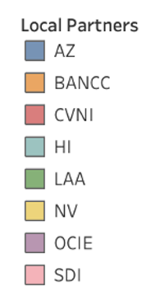
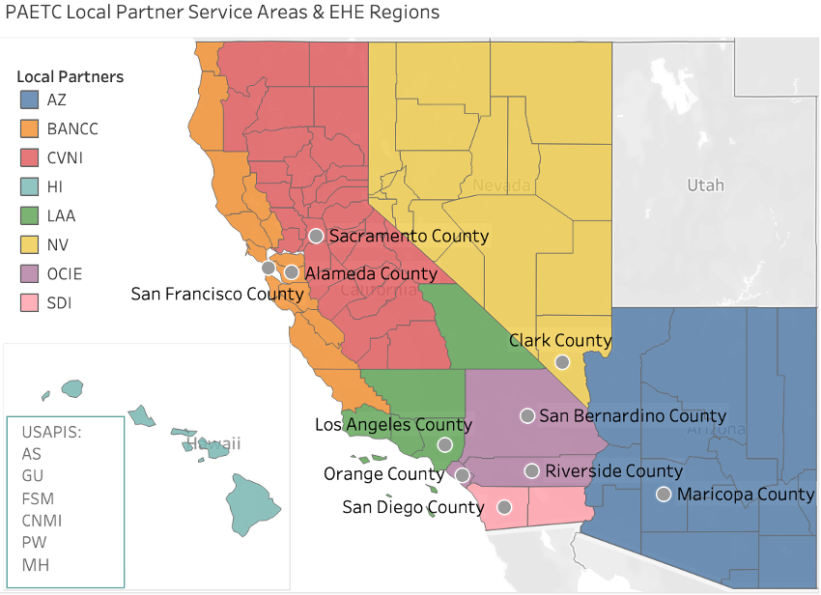
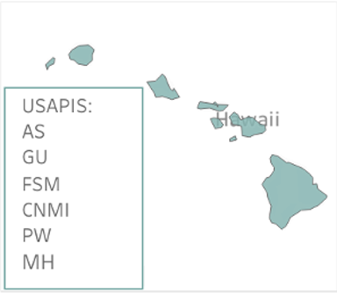
Pacific AETC Local Partner regions

Slide 7
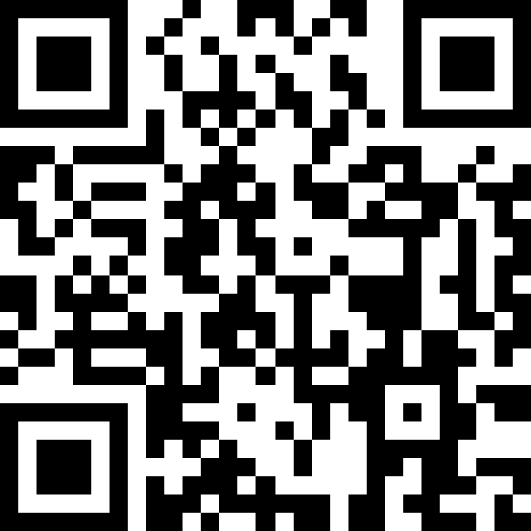
What is the Black Men’s HIV Leadership Capacity Building Initiative?
We are cultivating a vibrant community of practice dedicated to enhancing leadership skills and fostering the professional growth of Black men within the HIV workforce. Through online and in-person engagements, we aim to empower Black men to drive social change and advance health equity in the HIV service delivery system. Join us in co-creating a supportive and inclusive environment where Black men can thrive as leaders in a holistic approach to men’s sexual health.
Apply to join the initiative!
Learn more about the Black Men’s HIV Leadership Capacity Building Initiative:
https://paetc.org/our-programs/black-mens-hiv-leadership-capacity-building-initiative/
Scan the QR code to apply

Slide 8
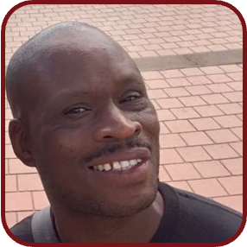
Meet Our Steering Committee and Program Team
Aunsha Hall-Everett, EdD, MA
Tai Edward Few, M.Div
Antoine S. Johnson, PhD
Cristian Chandler, PhD, MPH
Dr. James Q Simmons, DNP, MSN, RN,
AGACNP-BC, BJMC
Mikeal Mitchell
Andre J. Molette, MPH
Wayne Rafus
JaDawn Wright Morgan, MA
Ben Ignalino
Julie Whitfield

Slide 9
Community Agreements
Respect
Take Space, Make Space
Practice Self-Compassion
Reflect and Connect

Slide 10
Agenda
1:00 pm – 1:05 pm: Welcome, Introductions, Setting the Context
1:05 pm – 1:35 pm: Presentation by Antoine S. Johnson, PhD
1:35 pm – 1:45 pm: Q&A
1:45 pm – 2:25 pm: Breakout Group Activity and Debrief
2:25 pm – 2:30 pm: Closing

Slide 11
Learning Objectives
At the completion of this presentation, participants will be able to:
Identify key historical events or movements that are significant for understanding HIV work.
Describe two ways in which the historical legacy of HIV/AIDS shapes current efforts in the HIV workforce.
List strategies that can help address historical inequities and disparities in HIV work.
Explain how a deeper understanding of historical context can empower Black men within the HIV workforce.

Slide 12
Foundations of Progress: Exploring the Historical Landscape of HIV Activism Through Black Men's Perspectives
Antoine S. Johnson, PhD
Johns Hopkins University
Antoine S. Johnson, Ph.D.
June 18, 2024
Antoine.s.johnson@gmail.com

Slide 13
Approaches to Care
BIOMEDICAL
BEHAVIORAL
STRUCTURAL

Slide 14
June 5th, 1981
First Documented Report of AIDS
https://www.pbs.org/video/frontline-aids-black-america/
Notes:
Michael S. Gottlieb et al., “Pneumocystis Pneumonia—Los Angeles.” MMWR 30 (1981): 250-252.

Slide 15
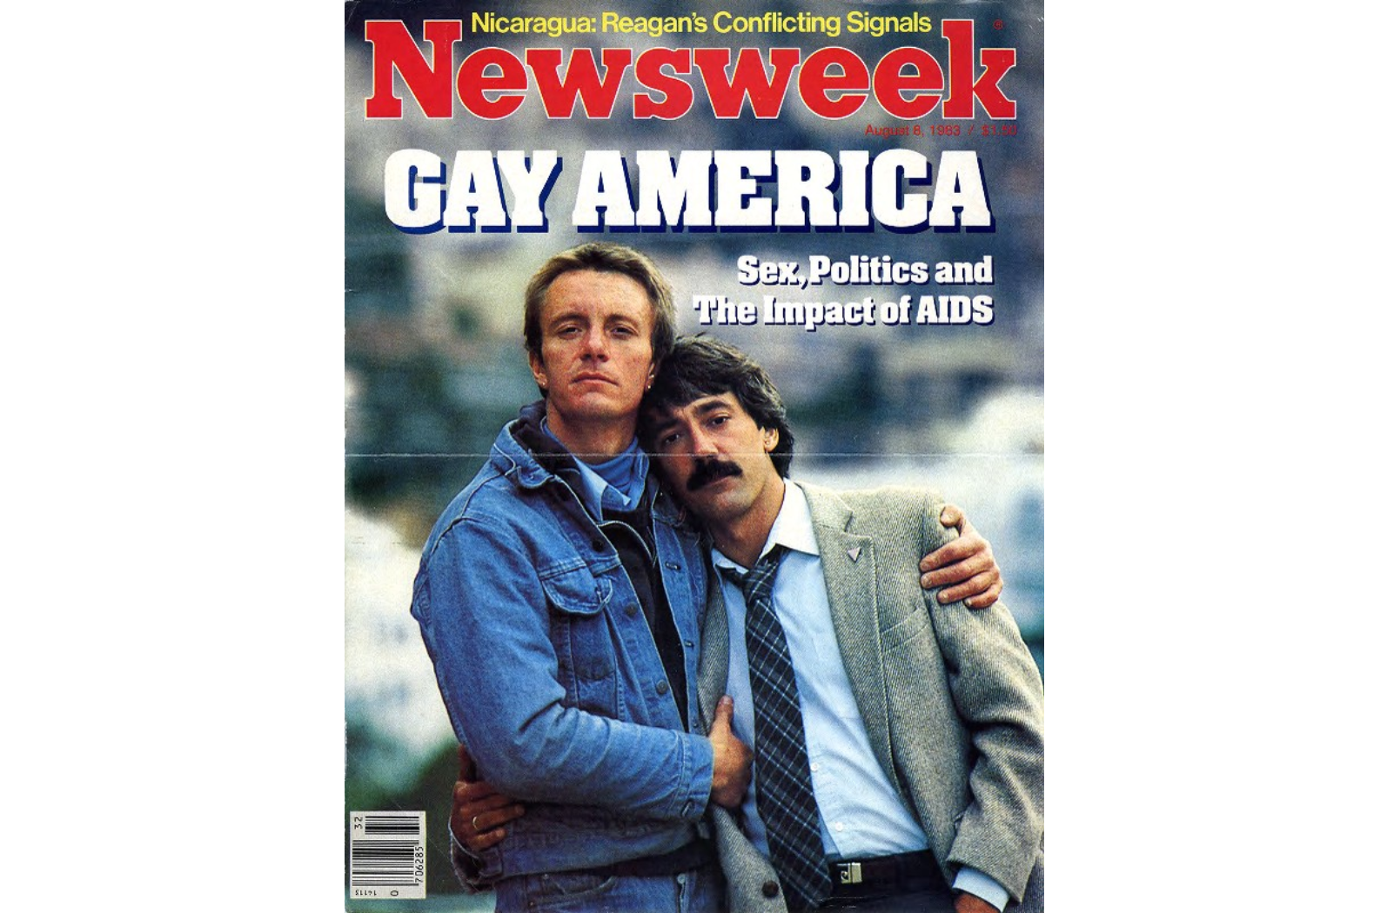
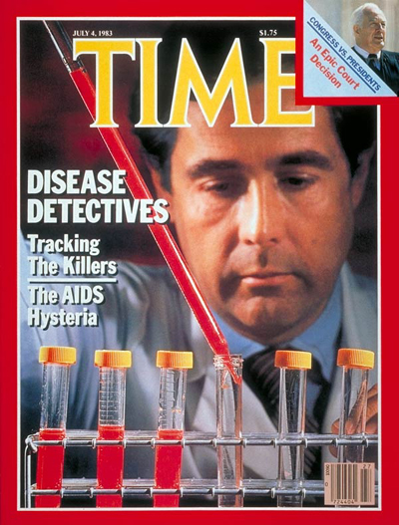
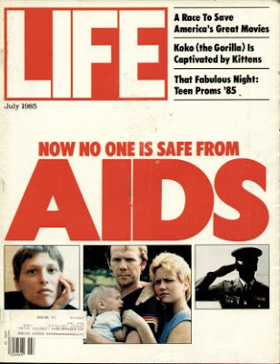
Creating a “Gay White Disease”
“Those prominent articles about AIDS in Time, Newsweek, & on network TV never showed any black AIDS victims or health professionals.”
– Wesley Anderson, co-founder of BEBASHI (Philadelphia Inquirer, 11 March 1986
Notes:
Google images of early magazine covers and a quote from Black physician and organizer, Dr. Wesley Anderson. Philadelphia Inquirer, March 11, 1986.

Slide 16
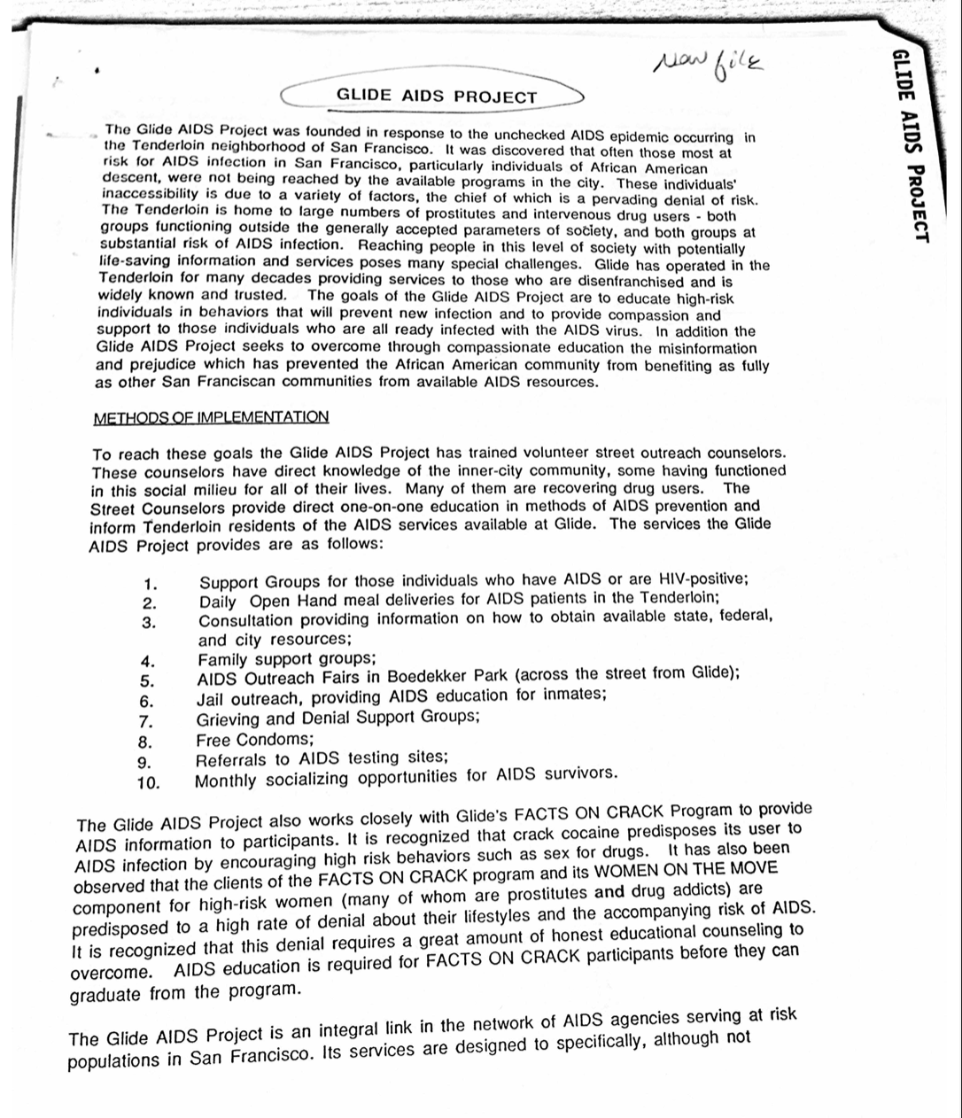
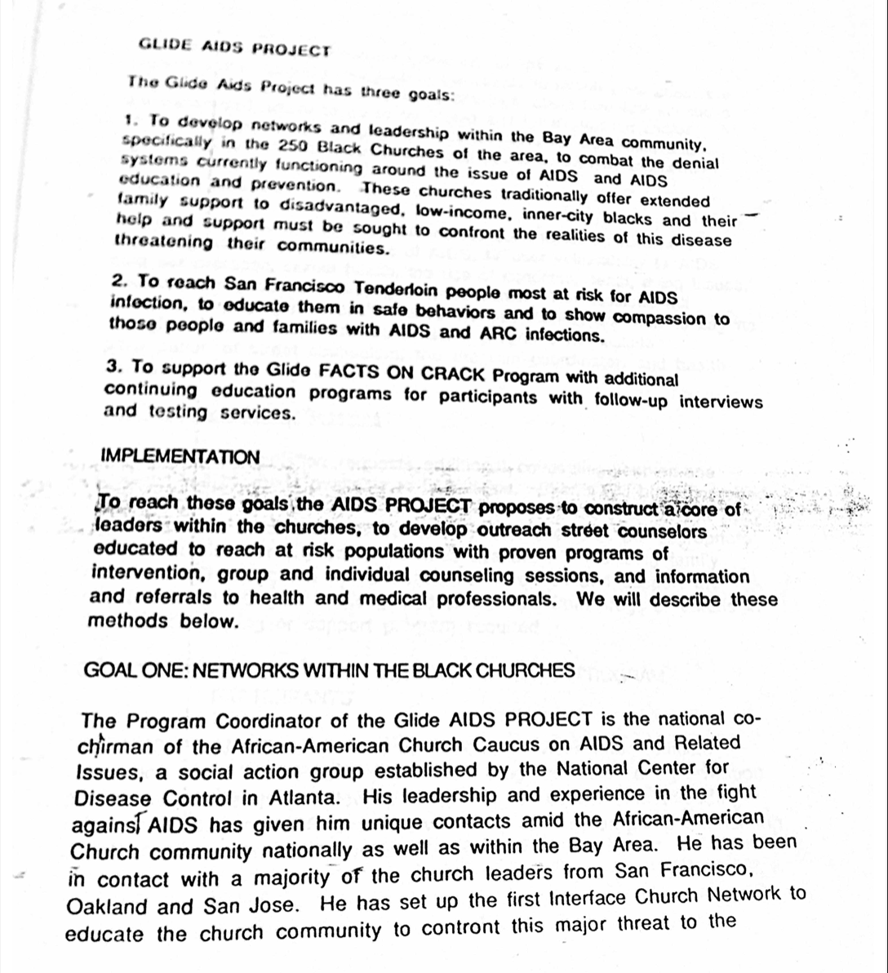
Cecil Williams and GLIDE
Notes:
Records of Glide Memorial Church’s AIDS Project. GLIDE AIDS Project, Box 7, Folder 23, SFH 4, San Francisco Department of Public Health Records, San Francisco Public Library, San Francisco, California

Slide 17
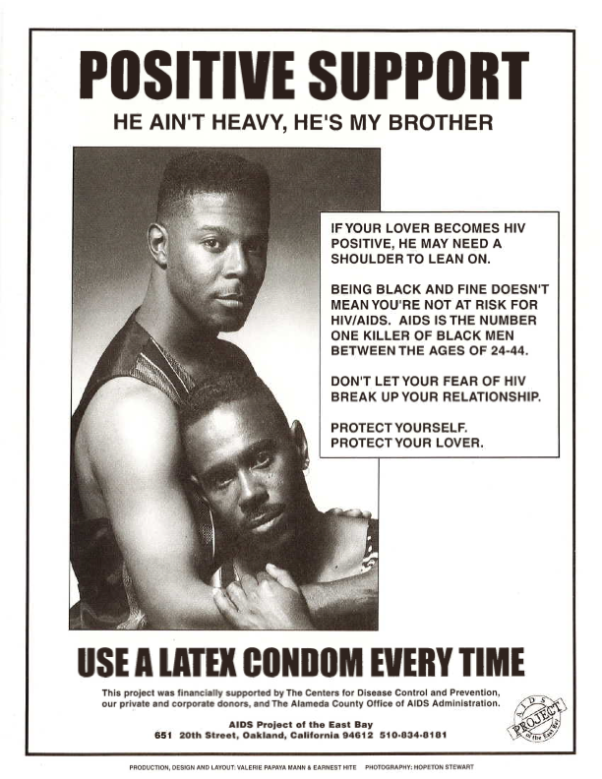
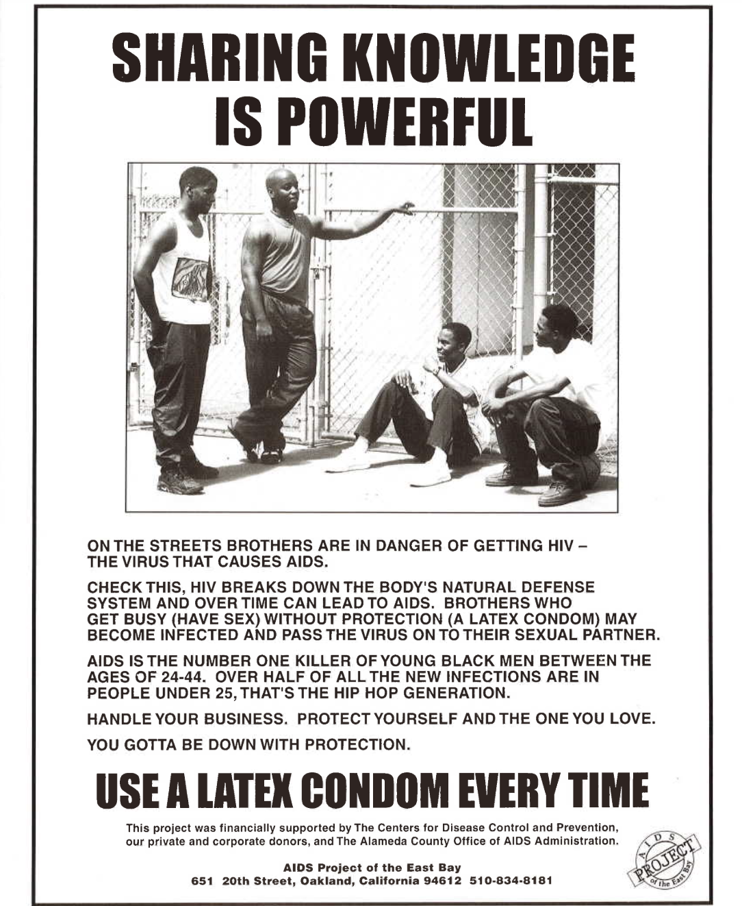
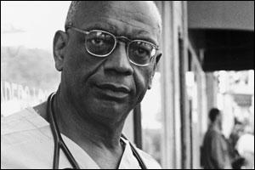
Dr. Robert C. Scott & APEB
Notes:
“AIDS Project of the East Bay Flyers circa 1990s,” Box 9, Folder 7, African American Museum & Library at Oakland Vertical File Collection, MS 179, African American Museum & Library at Oakland, Oakland Public Library, Oakland, California.

Slide 18
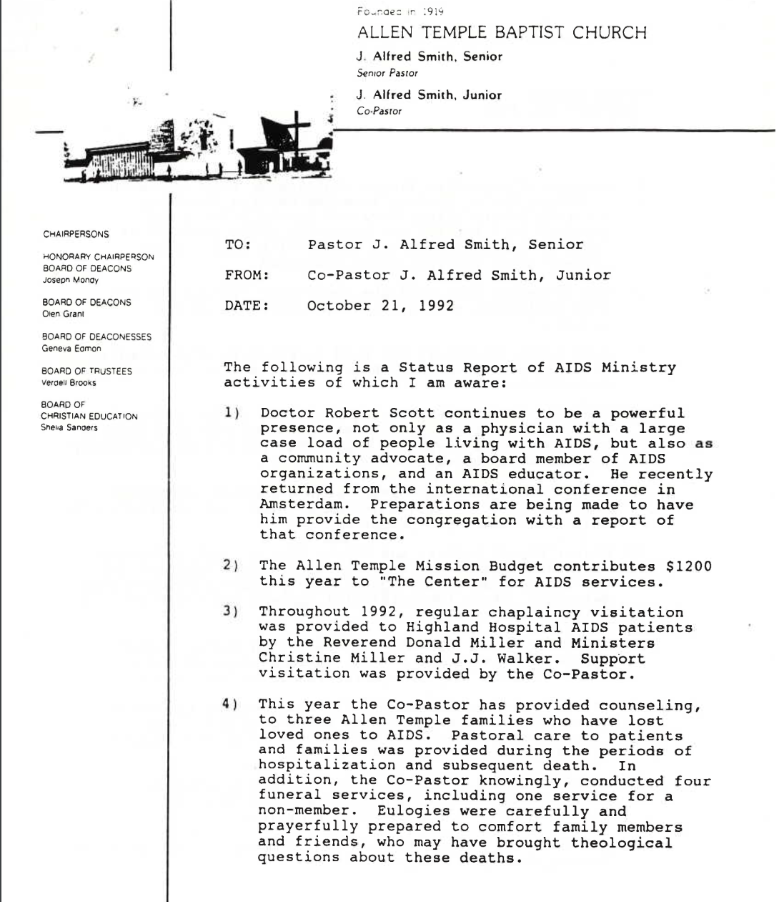
Allen Temple Baptist Church AIDS Ministry
Notes:
“Memorandum from J. Alfred Smith Jr. to J. Alfred Smith Sr. re: Status Report of AIDS Ministry Activities 1992-10-21,” Box 14, Folder 4, African American Museum & Library at Oakland Vertical File Collection, MS 179, African American Museum & Library at Oakland, Oakland Public Library, Oakland, California.

Slide 19
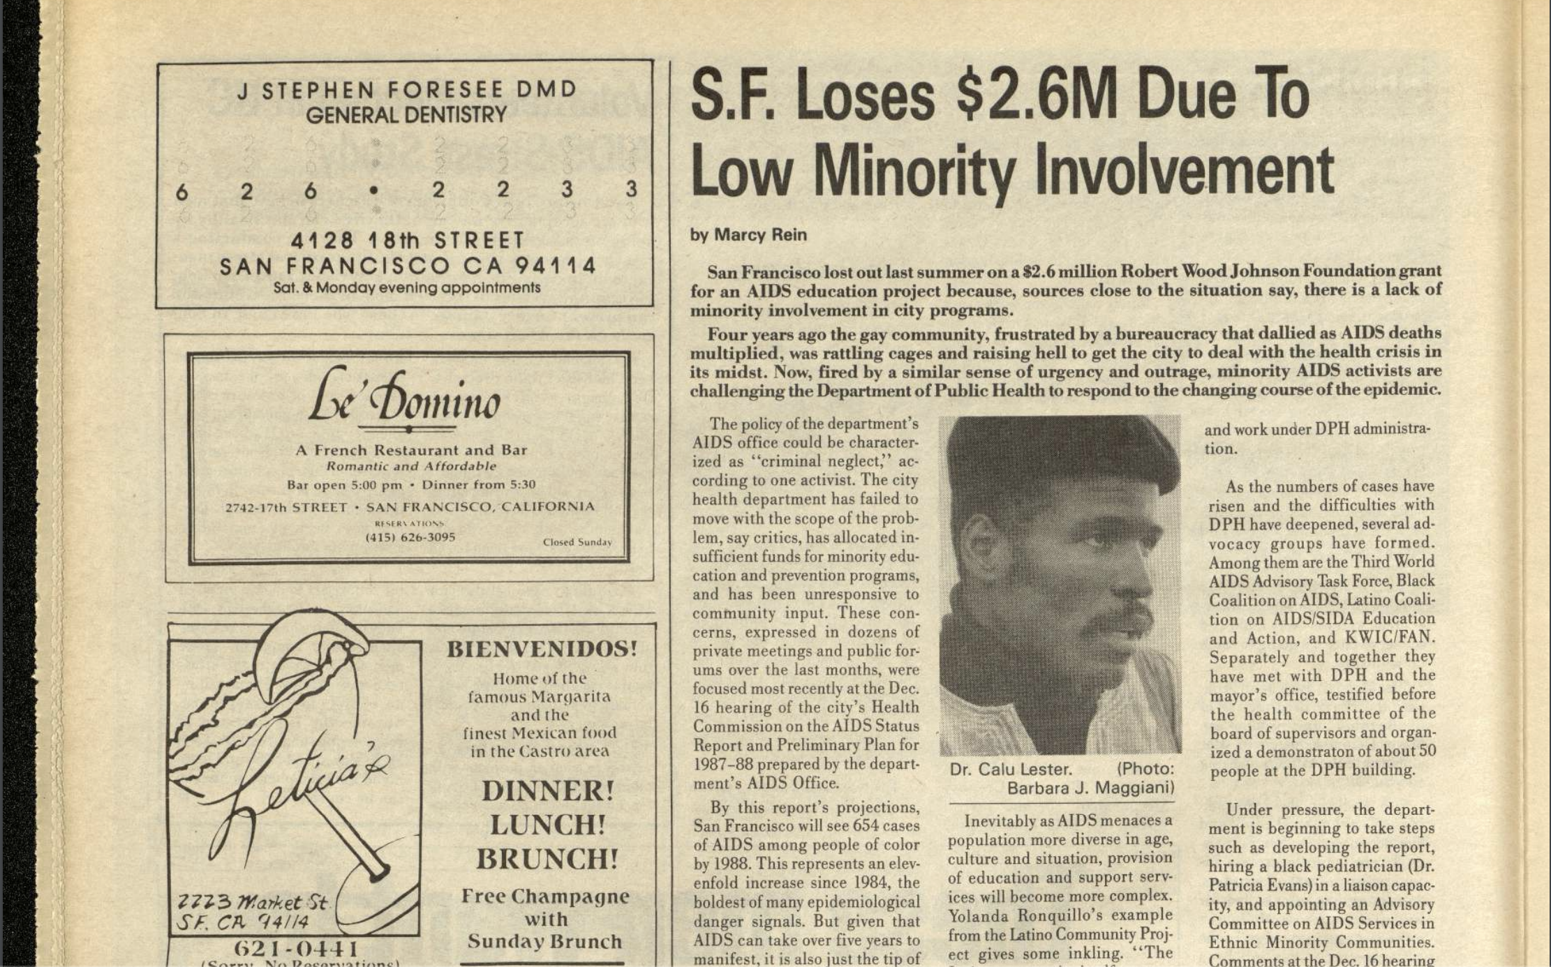
Dr. Calu Lester
“Many [Black] gay men are isolated in the impoverished inner city and have not been provided with the basics about how to keep from being exposed to the virus or spreading it. Also, many in this group are the victims of ignorance, denial, drug abuse, and rejection by black and brown leaders. This homophobic reaction… further alienates and isolates those persons of color at risk, as well as those already infected with the virus.
Notes:
198 Newspaper clipping explaining how the city of San Francisco failed to create programs for people of color Bay Area Reporter, September 11, 1986.

Slide 20
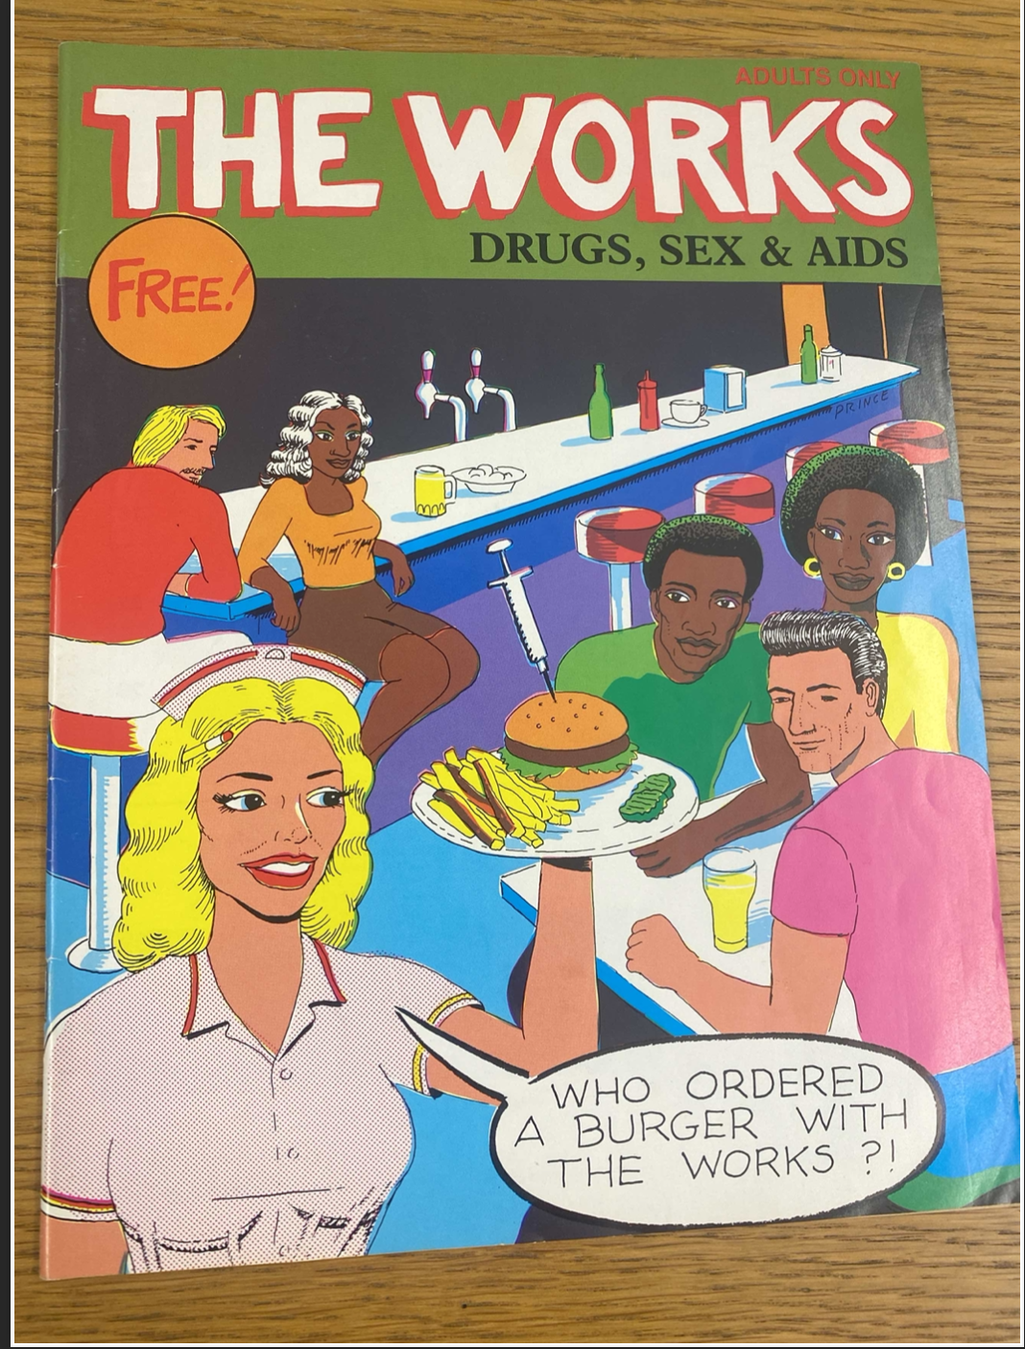
“The Works: Drugs, Sex & AIDS”
Created by KWIC-FAN
“The principal methods for prevention strategies will involve door-to-door educational/public information campaigns, mobile health prevention campaigns, public lectures, presentations, and special benefits… culturally sensitive health education literature using illustrations and cartoons; culturally relevant media shows (i.e., videos that can be shown at church…)
Notes:
The cover of KWIC-FAN’s comic “The Works,” created to hold conversations about AIDS at schools, churches, and other public venues for people of all ages. K-F History, Proposals, Work, Box 1, 2005-4, John E. Teamer Records, GLBT Historical Society, San Francisco, California.

Slide 21
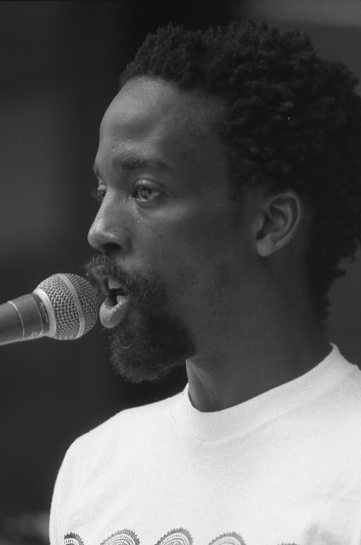
Essex Hemphill – “Vital Signs”(1994)
“Some of the T cells I am without are not here through my own fault. I didn’t lose all of them foolishly and I didn’t lose all of them erotically. Some of the missing T cells were lost to racism, a well-known transmittable disease. Some were lost to poverty… Homophobia killed quite a few, but so did my rage and my pointed furies, so did the wars at home and the wars within, so did the drugs I took to remain calm, cool and collected… there are T cells scattered all about me, at doorways where I was denied entrance because I was… too poor or too Black.”
Notes:
Excerpt from Essex Hemphill’s poem “Vital Signs”

Slide 22
References
Michael S. Gottlieb et al., “Pneumocystis Pneumonia—Los Angeles.” MMWR 30 (1981): 250-252.
Philadelphia Inquirer, 11 March 1986.
GLIDE AIDS Project, Box 7, Folder 23, SFH 4, San Francisco Department of Public Health Records, San Francisco Public Library, San Francisco, California.
“AIDS Project of the East Bay Flyers circa 1990s,” Box 9, Folder 7, African American Museum & Library at Oakland Vertical File Collection, MS 179, African American Museum & Library at Oakland, Oakland Public Library, Oakland, California.
“Memorandum from J. Alfred Smith Jr. to J. Alfred Smith Sr. re: Status Report of AIDS Ministry Activities 1992-10-21,” Box 14, Folder 4, African American Museum & Library at Oakland Vertical File Collection, MS 179, African American Museum & Library at Oakland, Oakland Public Library, Oakland, California.
Bay Area Reporter, September 11, 1986.
K-F History, Proposals, Work, Box 1, 2005-4, John E. Teamer Records, GLBT Historical Society, San Francisco, California.
Sample: Grady, J. S., Her, M., Moreno, G., Perez, C., & Yelinek, J. (2019). Emotions in storybooks: A comparison of storybooks that represent ethnic and racial groups in the United States. Psychology of Popular Media Culture, 8(3), 207–217. https://doi.org/10.1037/ppm0000185

Slide 23
Q&A

Slide 24
Breakout Room Activity
Breakout rooms will last 30 minutes

Slide 25
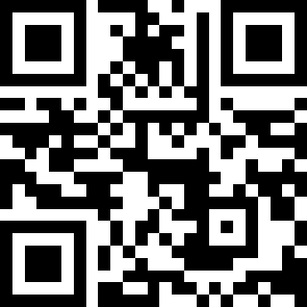
Announcements/Closing
Upcoming session:
Unity in Action: Cultivating Collective Power as Black Men in the HIV Workforce
July 31st, 1pm-2:30pm Pacific
Apply to join the initiative!
Scan QR Code to fill out our evaluation:

Slide 26
What is the Black Men’s HIV Leadership Capacity Building Initiative?
We are cultivating a vibrant community of practice dedicated to enhancing leadership skills and fostering the professional growth of Black men within the HIV workforce. Through online and in-person engagements, we aim to empower Black men to drive social change and advance health equity in the HIV service delivery system. Join us in co-creating a supportive and inclusive environment where Black men can thrive as leaders in a holistic approach to men’s sexual health.
Apply to join the initiative!
Learn more about the Black Men’s HIV Leadership Capacity Building Initiative:
https://paetc.org/our-programs/black-mens-hiv-leadership-capacity-building-initiative/
Scan the QR code to apply

Slide 27
Thank you for joining us!
Antoine.s.johnson@gmail.com - for questions about the presentation
Julie.whitfield@ucsf.edu - for questions about the initiative

