Slide 1



Fall Risk Evaluation & Management
Jenny Roraback-Carson, MD
Gerontology & Geriatric Medicine
University of Washington
Last Updated: July 14, 2021

Slide 2

Disclosures
No conflicts of interest or relationships to disclose

Slide 3
Learning Objectives / Outline
Understand the prevalence and financial burden of falls and fall-related injuries.
Appreciate the comorbidities and factors that raise the fall risk among those aging with HIV.
Learn how fall risk is assessed and managed in a Fall Prevention Clinic and how to apply those elements to your practice.
Drop the idea that a “mechanical ground level fall” is “non-medical” or not worthy
of further evaluation or preventative efforts.
Identify the common extrinsic and intrinsic factors that cause falls and how to
address those that are modifiable.

Slide 4
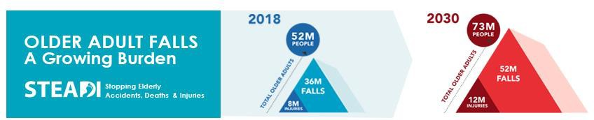
Falls: Magnitude of the Problem
Approximately 1 in 4 older adults (>65yo) report falling each year.
Older Adult Falls Data (cdc.gov)
Moreland B, Kakara R, Henry A. Trends in Nonfatal Falls and Fall-Related Injuries Among Adults Aged ≥65 Years —
United States, 2012–2018. MMWR Morb Mortal Wkly Rep 2020;69:875–881.

Slide 5
Falls: Magnitude of the Problem
1 out of 5 falls causes a serious injury (broken bones or head injury).
3 million older people are treated in ERs for fall injuries annually.
>800,000 patients per year are hospitalized because of a fall injury, most often head injury or hip fracture.
Older Adult Falls Data (cdc.gov)

Slide 6
Financial Burden of Falls
$50 billion per year is spent on medical costs related to non-fatal fall injuries
$754 million is spent related to fatal falls
Medicare and Medicaid shoulder 75% of these costs
Florence CS, Bergen G, Atherly A, Burns ER, Stevens JA, Drake C. Medical Costs of Fatal and Nonfatal Falls in Older
Adults. Journal of the American Geriatrics Society, 2018 March, DOI:10.1111/jgs.15304external icon

Slide 7
Aging with HIV Increases Fall Risk
Persons aging with HIV manifest “accelerated aging” with an earlier than
expected occurrence of many diseases of aging.
Patients with HIV have a high prevalence of several comorbidities and
physical impairments associated with an elevated fall risk:
Frailty
Sarcopenia
Low BMI
Neuropathy
Cognitive Impairment
Approx 75% of patients with HIV take at least 1 other Rx in addition to ART, and the most common of these are in the high fall risk category (cardiovascular and psychoactive meds).
Effros RB, Fletcher CV, Gebo K, et al. Aging and infectious diseases: workshop on HIV infection and aging: what is known and future research directions. Clin Infect Dis. 2008;47:542–553.

Slide 8



Guidelines for Fall Prevention
All persons aged 65+ should be screened for falls and fall risk at least once a year.
  ➔ 50+ for those with HIV:
“Assessment of mobility and frailty is recommended for patients
aged 50 years or older…”
- 2020 Recommendations of the International Antiviral Society–USA Panel
Anyone with gait or balance difficulty, 2 or more falls in prior 12 months, or history of seeking medical attention for a fall needs further assessment.

Slide 9
Fall Prevention in Clinical Practice
History of falls rarely elicited
Fall risk factors not identified
Most elders seen in ED for falls had no recommendation or appointment for follow-up beyond acute injury
Paniagua MA, et al. Am J Emerg Med, 2006.

Slide 10
Why do people fall?
Interaction between an individual’s risk factors and the environment
  A combination of intrinsic & extrinsic factors
Intrinsic Factors
Age-related changes
Chronic conditions
Leg weakness
Balance impairment
Extrinsic Factors
Medications, Alcohol
Footwear
Environmental Factors
Assistive device

Slide 11
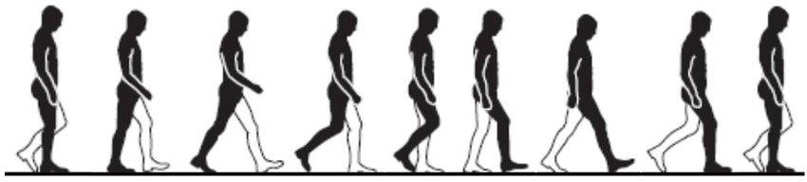
Intrinsic Factors: Age-Related Changes
Gait & balance
  Decreased step height
  Decreased proprioception
  Slowed righting reflexes
Vision
  Reduced pupillary response to light variation
  Thickening and loss of elasticity of lens

Slide 12
Intrinsic Factors: Chronic Conditions
Diseases of the eye (cataracts, macular degeneration, glaucoma)
Cardiovascular (orthostasis, aortic stenosis, bradyarrhythmias)
Musculoskeletal (arthritis, foot deformities, chronic pain, spinal stenosis)
Urological (incontinence, nocturia)
Insomnia, sleep deprivation
Neurological (CVA, dementia, peripheral neuropathy, Parkinson’s disease*)

Slide 13
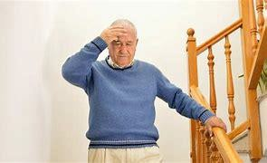
Orthostasis and Postural Dizziness
Affects 30% of community-dwelling elders
Causes can be intrinsic or extrinsic:
  Neurogenic (Parkinson’s disease, autonomic neuropathy)
  Non-neurogenic (aortic stenosis, volume depletion, vasodilation,
deconditioning, postprandial)
  Common med classes:
    Diuretics
    Antihypertensives
    Alpha blockers: doxazosin, prazosin
    Antidepressants: paxil, effexor, trazodone
    Antipsychotics: seroquel

Slide 14
Extrinsic factors: Polypharmacy, High-Risk Meds
≥4 meds = fall risk
Certain classes of meds:
  Psychoactive meds (benzos, high-dose SSRIs, sedative-hypnotics,
Trazodone, TCAs)
  BP meds (esp vasodilators, any BP med in high dose)
  Anticonvulsants (esp Gabapentin)
  Anticholinergics (Meclizine, Oxybutynin, …and ask about OTCs – Benadryl,
Tylenol PM, & Dramamine)
  Muscle relaxants
  Opioids (in high doses), Tramadol aka “Trama-don’t”

Slide 15
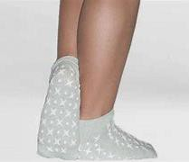
Extrinsic factors: Footwear
The enemies:
  Sandals
  Bare feet
  High Heels
  Open-backed slippers
  Smashed heels
Open-backed shoes (mules/slides)
Stocking Feet
Flip-Flops
Big shoes
The allies:
  Shoes with good sole contact area, closed-toe, covered heel are best
  Athletic/canvas shoes associated with lowest risk.

Slide 16
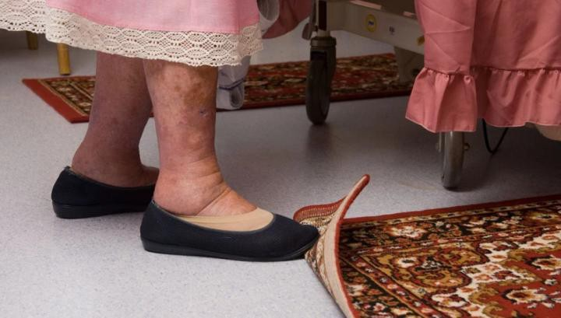
Extrinsic factors: Environmental Factors
Inadequate lighting
Loose objects on floor
(throw rugs, cords, junk, etc.)
Unsafe steps (broken, no railings)
Items in hard to reach places
Slippery tub/shower, lack of grab bars by toilet/shower
Step stools, ladders
Pets underfoot

Slide 17

Putting this all together…

Slide 18
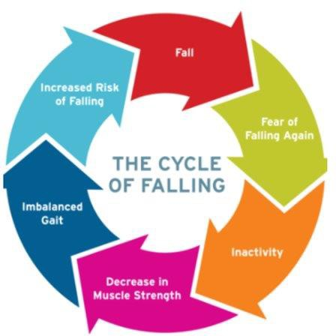
Harborview Fall Prevention Clinic
Comprehensive fall risk assessment and management for those who have fallen or have gait and balance problems
  Aged 65+ and <65 with referral review
  Outpatients (or nearing SNF discharge)
Interdisciplinary approach
  Physical therapy
  Geriatric medicine
  Social work
  Pharmacy
  Nutrition
Dedicated medical assistant
In-person or telephonic interpreter services

Slide 19
Harborview Fall Prevention Clinic
Comprehensive identification of fall risk factors
Gait and balance assessments
Assistive device assessment, fitting, and recommendations
Medication adjustment recommendations
Patient/caregiver education, including written materials
Targeted laboratory tests and imaging
…MOST of these elements can be done in the office of any PCP

Slide 20

After the Fall: A Practical Approach
History: Think SPLAT!
(S) Symptoms preceding the fall
  Dizziness, lightheadedness, vertigo, knee laxity, etc.
(P) Previous falls or near falls
  How frequent, in what setting, do they have a fear of falling
(L) Location to identify environmental factors
  At home or in community, on what surface, lighting, tripping hazards, on stairs, etc.
  (A) Activity at the time
  Multitasking? Hurrying? Turning? Reaching? Just stood up? Using walker/cane?
(T) Time of fall
  Time of day, ?cocktail hour, relationship to meds taken, meal eaten, etc.
  How much time needed to get up from fall? >5min or required assistance ➔ risk of long lie

Slide 21
After the Fall: A Practical Approach
Key Physical Exam Components:
  Orthostatics (can abbreviate to lying➔standing, note postural dizziness regardless of BP)
  Gait & balance evaluation:
    Width of base
    Step height, foot dorsiflexion, stride length
    Truncal rotation, arm swing
    Observe balance with turning
    Assistive device: proper fit, proper use, adequate support
  LE strength (“Can you stand up from this chair without pushing off with your arms?” – don’t worry about the TUG)
  Feet sensation, proprioception, deformities
  Look for tremor, rigidity, Parkinsonism (especially for backwards falls)

Slide 22
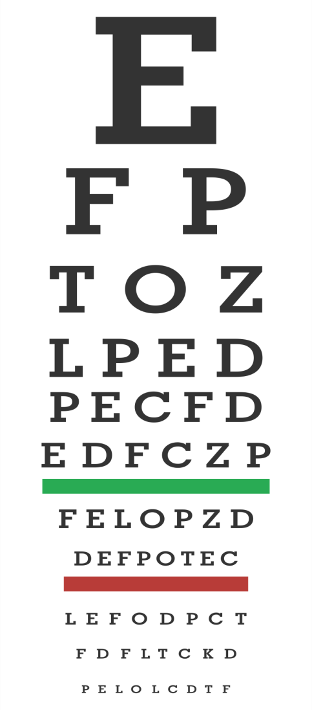
After the Fall: A Practical Approach
Additional Physical Exam Components:
  Visual acuity check if not done w/in 1yr
    20/40 or worse = fall risk
    Bifocals/multifocal/transition lenses are a fall risk
  Cardiac exam
  Static balance testing
Common lab studies, imaging:
  B12 level, Vit D level, CK, TSH, Hct, BUN/Cr, DEXA

Slide 23







Go After the Modifiable Fall Risk Factors
Gait abnormality
Lower extremity weakness
Impaired balance
Medications
Orthostatic hypotension
Vision
Feet / footwear
Assistive device
Home environment

Slide 24
Treatment Plan – Frequent Components
Exercise – strength and balance
Medication reduction (“de-prescribing”)
- Stop, taper with goal to stop, lower dose
Home / environmental modifications (clutter, rugs, lighting, adaptive equipment)
Behavioral modifications (avoid hurrying to answer phone / doorbell, no more step stools, arranging caregiver assistance for some tasks)
Self-management of postural hypotension
Footwear modification
Vitamin D supplementation

Slide 25
Treatment Plan – Referrals
Other healthcare providers:
  Physical therapy
  Cardiology
  Memory and Brain Wellness Clinic
Community-based programs:
  Exercise:
    Enhance Fitness®
Ophthalmology
Neurology
Geriatric Medicine / SeniorCare
Tai Chi – Tai Ji Quan: Moving for Better Balance®
Adult Day Health
Home Safety Evaluation:
  One Step Ahead (King County) – other programs available via AAA
  Home Health

Slide 26
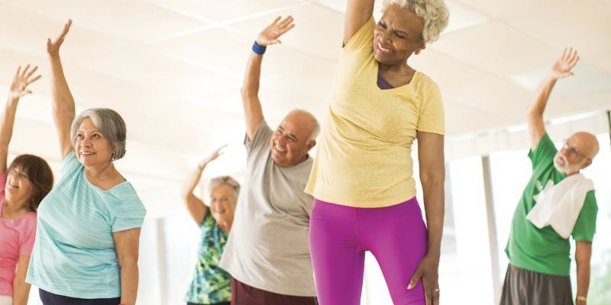
Thank you
Thank you to Elizabeth Phelan, MD – for slide sharing ☺
Questions? jenny5@uw.edu

Slide 27
Acknowledgment
The Mountain West AIDS Education and Training (MWAETC) program is supported by the Health Resources and Services Administration (HRSA) of the U.S. Department of Health and Human Services (HHS) as part of an award totaling $2,886,754 with 0% financed with non-governmental sources.
The content in this presentation are those of the author(s) and do not necessarily represent the official views of, nor an endorsement by, HRSA, HHS, or the U.S. Government.

