Slide 1
Use of Multi-disciplinary Teams to Identify and Address Special Cause Variation in Patient Outcomes
Adam Thompson, Regional Partner Director, South Jersey AETC
Cindy Hou, DO, MDA, FACOI, Infectious Diseases Physician, Jefferson Health New Jersey
Nikunj Vyas, PharmD, Clinical Pharmacist, Jefferson Health New Jersey
Erin Torpeye, DO, Resident Physician, University of Pennsylvania

Slide 2
Disclosures
“This [project/publication/program/website] [is/was] supported by the Health Resources and Services Administration (HRSA) of the U.S. Department of Health and Human Services (HHS) as part of an award totaling $3,879,101 with xx percentage financed with nongovernmental sources. The contents are those of the author(s) and do not necessarily represent the official views of, nor an endorsement, by HRSA, HHS or the U.S. Government.”

Slide 3
Objectives
Share a systems-level intervention to address special cause variation in patient and client outcomes
Discuss innovative care solutions for hardly reached and marginalized patients and clients
Demonstrate the value of systematic, iterative multi-disciplinary case review
Notes:
Ryan White HIV/AIDS Programs (RWHAP) have long leveraged multi-disciplinary teams to provide comprehensive care to Persons Living with HIV. These teams have been able to improve the quality of care and increase viral load suppression (VLS) nationwide. Despite these gains, some patients face barriers that are unique to their lives and experiences. Using quality improvement methods, multi-disciplinary teams can optimize their efforts by examining the special causes leading to disparate patient outcomes. Jefferson Health New Jersey Infectious Diseases (JHNJ) is a team-based care model using daily briefings, debriefings, huddles, and pre-visit planning to more effectively coordinate care. Through the adoption of a systems-level intervention to address special cause variations the JHNJ team has achieved and sustained a 91% VLS rate achieving the highest regional performance for a RWHAP.
The clinical quality management team, leveraging service data, review non-suppressed patients to identify potential barriers to care and develop individualized care plans. The multi-disciplinary review includes the patient’s care team as well as additional clinicians, pharmacists, and systems administrators. Preparation for the review includes a comprehensive chart abstraction with a special attention to social determinants of health. During the case review the team engages in a discussion on what is possible, often “bending the frame” of traditional healthcare services to achieve treatment goals. This workshop will present a systems-level iterative process aimed at ending the epidemic through personalized medicine and care. Team members will present on their experience with the process and how they have leveraged this systems-level intervention to improve care.

Slide 4
Agenda
Welcome and Overview
Learning to Drill Down the Data
Transformation Activities
Special Cause Variation and Drilling Down 2.0
Case Study
Panel Discussion
Closing

Slide 5
Garden State Infectious Diseases Associates, PA
Private Specialty Practice
Infectious Diseases; including HIV treatment
Travel Health Clinic
Onsite pharmacy, pain management, nutrition therapy, psychiatry, and medical case management
Physician-led, consensus-based decision-making leadership model
Physician-nurse care delivery model with medical case management support
Funded through patient self-pay, billing, and Ryan White HIV/AIDS Program Part A and New Jersey State HIV Care & Treatment

Slide 6
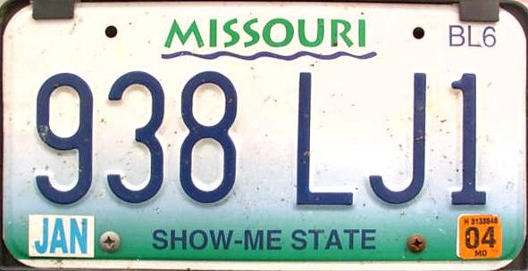
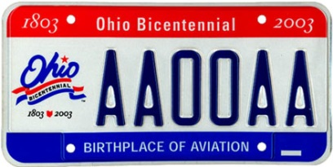
HIV Cross-Part Care Continuum Collaborative (H4C)
Five-State 18-month collaborative aimed at improving viral load suppression rates in Ryan White-funded agencies
A static cohort of non-suppressed patients was developed at the clinic level and used in “drill-down” sessions aimed at identifying key drivers of non-adherence
New Jersey and GSIDA participated and developed a QI Team to address non-suppression in the GSIDA EIP Program

Slide 7
Drilling Down the Data
The catalyst for transformation …

Slide 8
Building on a Process
“Drilling Down the Data” Tool from The AIDS Institute
Implemented specifically to address non-suppression in a population of PWH

Slide 9
Denominator Development
Measurement Period: 09/01/14 to 08/31/15
Patient: Any person with at least one medical visit in the measurement period
Suppressed: <200 copies per ml
Denominator Exclusions: Incarcerated, Transferred Care, Deceased, Moved

Slide 10
Team-Based Care and Disparity Analysis

Slide 11
Drill Down Discoveries …
No Medical Visit Scheduled
Missing Documentation in HER
Insurance
Mental Health
Substance Use
ART Treatment
Multi-drug Resistant Virus
Long-Term Non-Progressors
Declined Treatment

Slide 12
Improvements
Fix
Prevent
Create “not-in-numerator” report of patients with no next medical visit
Refer patients to Linkage to Care Coordinator (LTCC)
LTCC schedules visits for patients
LTCC supports or refers as appropriate
Quality Team will review Not-in-Numerator Report bi-monthly

Slide 13
Awareness
The current system relied on a care model that did not leverage all staff
The current procedures did not account for individual, intersectional barriers
The current experience with the electronic health record was a burden not a benefit
There was no systematic way to address individual patient barriers

Slide 14
Transformation
Change the system to change the outcome …

Slide 15
Practice Transformation
Practice transformation refers to a process of change in the organization and delivery of primary care to advance quality improvement, patient-centered care, and characteristics of high performing primary care.

Slide 16
Establishment of Teams

Slide 17
Empanelment
Empanelment is the act of assigning individual patients to individual primary care providers and care teams with sensitivity to patient and family preference

Slide 18
Care Coordination Practices
Briefings are a way to ensure today’s tasks happen today; no rework is created
Debriefings are a way to ensure that any care or care management concern is assigned to a care team member
Huddles are mechanisms to address immediate concerns around care

Slide 19
Community Health Worker
Ryan White-funded Community Health Worker Program
Persons with a shared lived experience
Provides an array of emotional and other supportive services
Allowed for a different engagement with patients and clients

Slide 20
Drilling Down the Data 2.0
The product of transformation …

Slide 21
Jefferson Health New Jersey – Infectious Diseases
Specialty practice inside a large health enterprise
Infectious Diseases; including HIV treatment
Travel Health Clinic
Onsite pharmacy, nutrition therapy, psychiatry, some MAT, medical and non-medical case management, and select gynecology services
Physicians practicing team-based care
Nurse-led care coordination teams with integrated social work and peer support
Funded through patient self-pay, billing, and Ryan White HIV/AIDS Program Part A and New Jersey State HIV Care & Treatment

Slide 22
Motivation to Continue
Overall clinic viral load suppression rate was high (88%) but staff wanted to do more
Desire to provide personalized care in the era of standardization and metrics
Leverage Agency experience in Not-In-Numerator Reporting as a Quality Tool
Manage differential experiences leading to special cause variations
Align and reinforce treatment message across the team
Expand the pool of interventions

Slide 23
Clinic Viral Load Suppression

Slide 24
Panel Suppression Rates

Slide 25
Variation in Patient Outcomes
Common Cause
Special Cause
Causes that are known or unknown to the system
The effect the cause has on your output is predictable and controllable
If you can identify the root cause, address
It is the noise in the system
Causes that were previously unknown to the system
Occurs when something out of the ordinary happens in a process
Refers to unexpected “glitches” in the system
It is the signal in the system

Slide 26
Panel Comparison
Intervention Panel
All Other Provider Panels
More likely to be African American (67%)
Higher percentage of female clients (37%)
Higher percentage below 100%FPL (46%)
Twice as likely to have unstable housing (14%)
Less likely to be Gay, Bisexual, or other Men who have Sex with Men (36%)
Less likely to be African American (43%)
Lower percentage of female clients (24%)
Lower percentage below 100% FPL (33%)
Predominantly stable housing (92%)
More likely to be Gay, Bisexual, or other Men who have Sex with Men (51%)

Slide 27
Drilling Down the Data 2.0
Identify Area of Interest
Determine Measure(s)
Convene Multi-disciplinary Team
Hypothesize about Key Drivers of Outcome
Create a List of Potential Interventions
Prioritize and Select Intervention
Implement Intervention
Evaluate Outcome
Additional or Different Strategies

Slide 28
Clinic Care Teams
Clinical Teamlet
Infectious Disease Specialist
Certified Medical Assistant
Behavioral Health Teamlet
Licensed Clinical Social Worker
Psychiatrist
Physician Assistant
Supportive Teamlet
Medical Care Coordinators (Registered Nurse)
Medical Case Manager
Non-Medical Case Manager
Community Health Worker

Slide 29
Case Conferencing Team
Facilitation Team
Intervention Panel Team
Infectious Disease Specialist
Clinical Pharmacist
Medical Student
Person with HIV
HIV Primary Care Provider
Community Health Worker
Nurse Care Manager
Medical Case Manager
Nonmedical Case Manager
Medical Assistant
Clinical Director

Slide 30
Viral Load Suppression for Intervention Panel

Slide 31
Change in Viral Load Suppression Rates
Controlled Performance
COVID-19

Slide 32
Case Study
Radical Autonomy

Slide 33
Honoring Autonomy
Patient Challenge
Considerations
Older African-American Woman with intermittent adherence that was affecting her CD4 count
The patent had received multiple adherence interventions and “talks” with the care team
The team had resolved that she was set in her ways and when she got sick then she might change
The clinic has historical knowledge of the types of care needed for people with advanced HIV disease
Raising awareness and offering a patient all the options that respect her autonomy might yield a different outcome

Slide 34
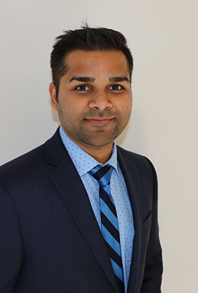
Panel Discussion
Cindy Hou, DO, MDA, FACOI, Infectious Diseases Physician, Jefferson Health New Jersey
Nikunj Vyas, PharmD, Clinical Pharmacist, Jefferson Health New Jersey

Slide 35
Critical Elements
Dedication and Commitment to the Process
Preparation for the Drill Down Sessions
Representative Staff
Integration of Clinical Pharmacy and Persons with HIV
Physician Champion
External Facilitation by Peers

Slide 36
Lessons Learned
Trust had to be built for the process to work between the Facilitation Team and the Intervention Panel Team
Coordination of staff was relatively easy with the support of clinical leadership, leveraged by the Physician Champion
The lens of Clinical Pharmacy allowed for deeper discussions about how medications and regimens may be affecting outcomes
The integration of Persons with HIV allowed the team to navigate “risky” conversations and generate “out-of-the-box” ideas
A good abstraction tool can save your team a lot of time by being prepared with the right data at the right time

Slide 37
Next Steps …

Slide 39
Contact
Adam Thompson, Regional Partner Director
Adam.Thompson@jefferson.edu
Jefferson Health Foundation – New Jersey
South Jersey Regional Partner
Northeast-Caribbean AIDS Education and Training Centers

