Slide 1
COVID-19 Update for Patients with HIV
Section 2:
Antiretroviral Therapy, Medication Access, Drug-interactions
Notes:
V_04032020

Slide 2
Slide Set Contributors
Avenue 360, Houston: C.Mark Nichols, DDS
Baylor College of Medicine: Shital Patel, MD; Melanie Goebel, MD
Gallup IHS: Jonathan Iralu, MD, FACP
LSUHSC: Paula Seal, MD MPH
PHNT: Deborah Morris-Harris, MD, EMBA
UNMHSC: Carly Floyd, Pharm D PhC AAHIVM; Nestor Sosa, MD; Meghan Brett, MD; Michelle Iandiorio, MD
Valley AIDS Council: Pedro Coronado

Slide 3
Learning Objectives
Recognize the importance of continued antiretroviral therapy (ART) during the COVID-19 pandemic.
Recognize potential drug-drug interactions between ART and experimental and over-the-counter therapies for the treatment of COVID-19.
Notes:
Speaker has no potential COI to disclose.
This presentation was reviewed by South Central AETC faculty to ensure it meets CME guidelines.
PLWH now PWH per HRSA guidance

Slide 4
Covid-19 in people with hiv
Melanie Goebel, MD; Infectious Disease Fellow, BCM
Shital M. Patel, MD;
Assistant Professor, Infectious Disease; Clinical Director BCM AETC
Baylor College of Medicine

Slide 5
Antiretroviral Therapy
There is ongoing discussion and research around some HIV ARTs which may have activity against COVID-19
The first randomized clinical trials with lopinavir/ritonavir demonstrated no benefit over standard care in 199 hospitalized adults with severe COVID-19 (Cao, B et al. NEJM 2020)
There is no evidence to support the use of other ARTs, including protease inhibitors
COVID-19 drug interactions website: www.covid19-druginteractions.org
*Cao, et al. N Engl J Med doi:10.1056/NEJMoa2001282.
Notes:
During SARS epidemic (2002-2003)
Combination ART was proposed to prevent and treat SARS
Limited studies showed activity of lopinavir-ritonavir against SARS
Do not change ART regimen to include a PI to treat or prevent COVID-19
Randomized, controlled, open-label trial of hospitalized patients with severe COVID-19*
199 patients randomized (99 lopinavir-ritonavir, 100 standard-care)
No difference between groups in time to clinical improvement, mortality, or detectable viral RNA

Slide 6
Guidance for all PWH
Maintain adequate (> 30-day, ideally > 90-day) supply of ART and other chronic medications
Mail order delivery if possible
Delay switching ART regimens if feasible
Keep vaccinations (influenza, pneumococcal) up to date
Follow CDC recommendations for travel recommendations, social distancing and hand hygiene

Slide 7
ADAP Updates During COVID-19
Carly Floyd, Pharm D, PhC, AAHIVP
Clinical Pharmacist, Southwest CARE Center
Clinical Director, UNMHSC AETC

Slide 8
ADAP Updates During COVID-19
Arkansas
Oklahoma
Full ADAP (no insurance)
Mail out 60d supply at a time (if enough refills to cover)
If insufficient refills, pharmacy will contact provider
Insured but using ADAP pharmacy:
Attempting to mail out 60d supply if permitted by insurance
All approved prescriptions are being filled for a 90d supply
Notes:
v033020

Slide 9
ADAP Updates During COVID-19
New Mexico
Rapid enrollment process implemented
Bridges & IAP are being approved with a quicker turnaround time
ADAP extensions are being granted more easily than normal
Notes:
v033020

Slide 10
ADAP Updates During COVID-19
Texas
Medication refill request
Expanded to allow refill request 20 days prior to next refill due
Emergency application
Valid 3/13/2020-5/31/2020
Used for New, Renewal (Recertification), and Self-Report (Self-Attestation) applications
**New Applications will need MCF
Medication refills
60 day supply: THMP is now sending out an extra month of medications for many medications that are currently 30-day refills
90 day supply: some medications are available as 90 day supplies for stable/controlled patients - update Medical Certification Form (MCF) & prescription
Some pharmacies are offering mail-order & delivery
https://dshs.texas.gov/hivstd/meds/default.shtm
https://dshs.texas.gov/hivstd/meds/document.shtm
Notes:
V033020
Medications through an insurance plan or Medicare: patient should contact their plan for refill information

Slide 11
ADAP Updates During COVID-19
Louisiana
Early refills for non-opioid prescriptions, consistent with approval from providers/pharmacists through 4/30/20
Application requirement modifications
Client unable to sign, note “client verified information correct via phone on date/time”
Okay to write, sign, date letter self-attesting client’s income and specify why documentation not available (e.g. office closed due to COVID-19)
Extended Core Eligibility End Date (CEED)
If CEED was 3/31/20, extended automatically to 4/30/20
Still submit applications when able
Uninsured: 90d fills now allowed (previously 30d)
Permanent change, was in process prior to COVID-19
https://www.lahap.org/covid19/
Notes:
v033020

Slide 12
Hospitalized patients with HIV and COVID-19
Continue ART
Avoid drug substitutions
For critically ill patients requiring tube feeding
Consult HIV specialist or pharmacist for ART options that can be crushed
Off-label or investigational treatment of COVID-19
PWH should be included in clinical trials for treatment of COVID-19 (https://clinicaltrials.gov/)
Notes:
Original slide: Melanie Goebel, MD
Gilead is allowing compassionate use again https://www.gilead.com/news-and-press/company-statements/gilead-sciences-statement-on-access-to-remdesivir-outside-of-clinical-trials
https://www.gilead.com/science-and-medicine/research/compassionate-use
Clinical trials of remdesivir for COVID-19
https://www.clinicaltrials.gov/ct2/results?cond=covid-19&term=remdesivir&cntry=&state=&city=&dist=&Search=Search

Slide 13
Art drug interactions with potential covid-19 treatments
Carly Floyd, Pharm D, PhC, AAHIVP
Clinical Pharmacist, Southwest CARE Center
Clinical Director, UNMHSC AETC

Slide 14
https://www.covid19-druginteractions.org
Notes:
Liverpool now has a dedicated page for COVID-19 drug interactions with HIV medications. This is not a searchable database, but there are documents with tables of interactions and current evidence.

Slide 15
Liverpool Evaluation of Evidence
Usual criteria (Seden et al, 2017) PLUS
Consideration of the following:
The likely critical condition of any patient requiring these therapies
The relatively short duration of co-administration
The incremental risks to health workers from additional monitoring
The available, safer alternatives
The option of pausing the co-medication whilst COVID therapy is administered
All quality of evidence for unpublished data should be considered LOW
Liverpool evaluation document, accessed online 3/31/2020

Slide 16
Experimental covid-19 treatments

Slide 17
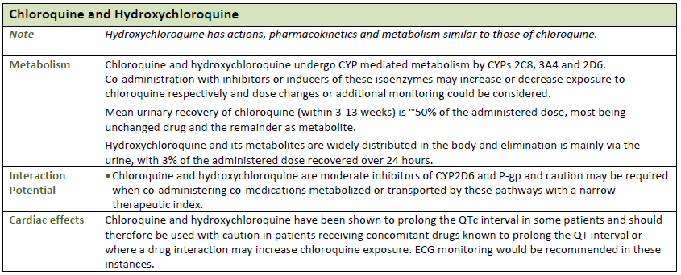
Chloroquine & Hydroxychloroquine
Reference: Liverpool evaluation document, accessed online 3/31/2020

Slide 18
Atazanavir
Reference: Liverpool evaluation document, accessed online 3/31/2020

Slide 19
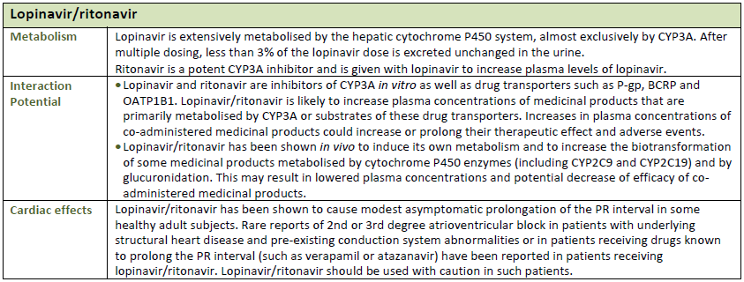
Lopinavir/ritonavir No benefit over standard care
B. Cao, et al. Trial of Lopinavir-Ritonavir in Adults Hospitalized with Severe Covid-19. DOI: 10.1056/NEJMoa2001282
Reference: Liverpool evaluation document, accessed online 3/31/2020

Slide 20
Remdesivir
Reference: Liverpool evaluation document, accessed online 3/31/2020

Slide 21
Favipravir
Reference: Liverpool evaluation document, accessed online 3/31/2020

Slide 22
Natazoxanide
Reference: Liverpool evaluation document, accessed online 3/31/2020

Slide 23
Ribavirin
Reference: Liverpool evaluation document, accessed online 3/31/2020

Slide 24
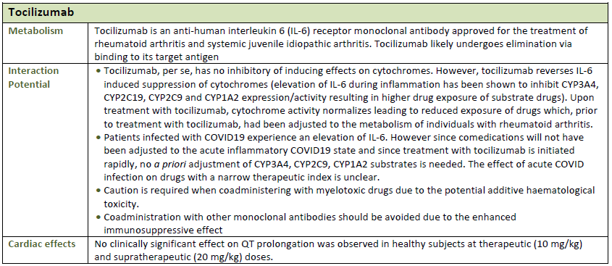
Tocilizumab
Reference: Liverpool evaluation document, accessed online 3/31/2020

Slide 25
Complementary & otc therapies
Note: Only evaluating the safety with ART, not efficacy of therapies
OTC=over the counter; ART=antiretroviral therapy
Notes:
People may ask about the following therapies. There are many websites suggesting people use any combination of these therapies, so it is important to be aware of what people might be using to prevent or treat COVID-19. This list is not all-inclusive, but should cover the most common herbal remedies or supplements. The efficacy of each therapy is not discussed in these slides.

Slide 26
Natural Medicine Database Levels of Evidence
A
High-quality randomized controlled trial (RCT)
High-quality meta-analysis (quantitative systematic review)
B
Nonrandomized clinical trial
Nonquantitative systematic review
Lower-quality RCT
Clinical cohort study
Case-control study
Historical control
Epidemiologic study
C
Consensus
Expert Opinion
D
Anecdotal evidence
In vitro or animal study
Theoretical based on pharmacology
Notes:
Refer to this slide when looking at the levels of evidence

Slide 27
Natural Medicine Database
Notes:
Refer to this slide when looking at the level of significance, likelihood of occurrence, and severity of interaction

Slide 28
Vitamins – Individual Formulations
No known interactions with the following:
Vitamin B Complex
Vitamin C
Vitamin D
Recommendation: likely safe to use individual agents (not in multivitamin formulations)
Reference: Liverpool evaluation document, accessed online 3/31/2020

Slide 29
Chinese Herbs
Astragalus
Common herb used to improve immune response
Theoretical reduction in all ART drug absorption due to hydrocolloidal fiber
Interaction rating moderate; moderate severity; occurrence: possible; level of evidence: D
Recommendation: be cautious with use
Andrographis
A terpenoid compound, antivral effects against respiratory disease-causing viruses, including enterovirus D68 & influenza A
No known interactions
Recommendation: likely safe

Slide 30
Curcumin
Main active ingredient in turmeric
No known interactions with ART
Recommendation: likely safe
Reference: Liverpool evaluation document, accessed online 3/31/2020

Slide 31
Echinacea
Flower from daisy family, immune booster with possible respiratory antiviral effects
Possible induction of CYP3A4, varying effects on intestinal vs. hepatic enzymes
Interaction rating moderate; moderate severity; occurrence = possible; level of evidence = B
INSTIs- bictegravir, elvitegravir, dolutegravir
PIs- darunavir, atazanavir
NNRTIs- doravirine, rilpivirine, etravirine, efavirenz, nevirapine
Boosters- cobicistat, ritonavir
CCR5 inhibitor- maraviroc
Recommendation: be cautious with use
Reference: Natural Medicines Database Interaction Checker accessed 3/31/20

Slide 32
Elderberry
Used to treat infections, being researched for effects on immune health
Possible inhibition of CYP3A4, but mostly in combo with echinacea
Interaction rating minor; moderate severity; occurrence = unlikely; level of evidence = D
INSTIs- bictegravir, elvitegravir, dolutegravir
PIs- darunavir, atazanavir
NNRTIs- doravirine, rilpivirine, etravirine, efavirenz, nevirapine
Boosters- cobicistat, ritonavir
CCR5 inhibitor- maraviroc
Recommendation: be watchful with use
Reference: Natural Medicines Database Interaction Checker accessed 3/31/20

Slide 33
Garlic
Anti-inflammatory & antiviral properties
Possible induction of CYP3A4
Interaction rating moderate; moderate severity; occurrence = possible; level of evidence = B
INSTIs- bictegravir, elvitegravir, dolutegravir
PIs- darunavir, atazanavir
NNRTIs- doravirine, rilpivirine, etravirine, efavirenz, nevirapine
Boosters- cobicistat, ritonavir
CCR5 inhibitor- maraviroc
Recommendation: be cautious with use
Reference: Natural Medicines Database Interaction Checker accessed 3/31/20

Slide 34
Licorice
Root may help protect against viral infections
Contains glycyrrhizin which might have antiviral activity against severe acute respiratory syndrome
Possible induction of CYP3A4
Interaction rating moderate; moderate severity; occurrence = possible; level of evidence = B
INSTIs- bictegravir, elvitegravir, dolutegravir
PIs- darunavir, atazanavir
NNRTIs- doravirine, rilpivirine, etravirine, efavirenz, nevirapine
Boosters- cobicistat, ritonavir
CCR5 inhibitor- maraviroc
Recommendation: be cautious with use
Reference: Natural Medicines Database Interaction Checker accessed 3/31/20

Slide 35
Medicinal Mushrooms
Used to prevent and treat infections
Studied for immune boosting potential
No interactions known
Recommendation: likely safe
Reference: Natural Medicines Database Interaction Checker accessed 3/31/20

Slide 36
Pelargonium sidoides
South African medicinal plant
Possibly alleviates symptoms of acute viral respiratory symptoms
No interactions known
Recommendation: likely safe
Reference: Natural Medicines Database Interaction Checker accessed 3/31/20

Slide 37
Propolis
Resin-like material, immune-enhancing effects, possible antiviral activity
Possible inhibition of CYP3A4
Interaction rating moderate; moderate severity; occurrence = possible; level of evidence = D
INSTIs- bictegravir, elvitegravir, dolutegravir
PIs- darunavir, atazanavir
NNRTIs- doravirine, rilpivirine, etravirine, efavirenz, nevirapine
Boosters- cobicistat, ritonavir
CCR5 inhibitor- maraviroc
Recommendation: be cautious with use
Reference: Natural Medicines Database Interaction Checker accessed 3/31/20

Slide 38
Selenium
Mineral and antioxidant
May enhance antiviral defense against influenza strains
No interactions known
Recommendation: likely safe
Reference: Natural Medicines Database Interaction Checker accessed 3/31/20

Slide 39
Zinc
Mineral needed for immune cell development
May protect against respiratory track infections like the common cold
Possible chelation and prevention of absorption
Atazanavir
Divalent cation, can bind and decrease levels and efficacy
INSTIs- bictegravir, elvitegravir, dolutegravir
Recommendation: be cautious with use
Reference: Natural Medicines Database Interaction Checker accessed 3/31/20

Slide 40
References
www.hiv-druginteractions.org
https://www.covid19-druginteractions.org
Natural Medicines Interaction Checker at www.naturalmedicines.therapeuticresearch.com
https://www.healthline.com/nutrition/immune-boosting-supplements
https://www.discovermagazine.com/health/can-natural-remedies-really-help-you-fight-the-coronavirus
https://www.pharmacytimes.com/news/what-are-drug-prevention-and-treatment-options-for-covid-19

