Slide 1
Anticoagulation Medication Update: A Focus on Patients Living with HIV
October 4, 2020
Erica Maceira, PharmD, BCPS
Associate Director of Pharmacy – Clinical Services
Renal/Pancreas Transplant Pharmacist
Pharmacy Residency Director
Intern Coordinator
Albany Medical Center Hospital

Slide 2
Disclosures
“This program is supported by the Health Resources and Services Administration (HRSA) of the U.S. Department of Health and Human Services (HHS) as part of an award totaling $3,879,101 with zero percentage financed with nongovernmental sources. The contents are those of the author(s) and do not necessarily represent the official views of, nor an endorsement, by HRSA, HHS or the U.S. Government.”

Slide 3
Albany Medical College endorses the standards of the Accreditation Council for Continuing Medical Education (ACCME) and the guidelines of the Association of American Medical Colleges (AAMC) that the sponsors of continuing medical education activities, speakers and planning committee members of these activities disclose relationships with commercial interests. Commercial interests are defined as any entity producing, marketing, reselling or distributing health care goods or services consumed by, or used on patients. Relationships include receiving from a commercial company research grants, consultancies, honoraria and travel, or other benefits or have a self-managed equity interest in a company.
Albany Medical College has implemented a mechanism to identify and resolve all conflicts of interest prior to the educational activity being delivered to learners.
Disclosure of a relationship is not intended to suggest or condone bias in any presentation but is made to provide participants with information that might be of potential importance to their evaluation of a presentation.

Slide 4
Disclosures
I have no financial relationships to disclose
This presentation may include off-label use of medications

Slide 5
The following planning members have no financial relationships to disclose: Cynthia Miller, MD, Sarah Walker, MS and Jennifer Price.

Slide 6
Learning Objectives
Discuss the role of direct oral anticoagulants in the management of atrial fibrillation and venous thromboembolism
Discuss consensus guidelines on anticoagulation management
Review common pitfalls in prescribing oral anticoagulants including drug interactions and dosing errors
List 5 HIV medications likely to interact with oral anticoagulants

Slide 7
Pre-test Question
True/False

Slide 8
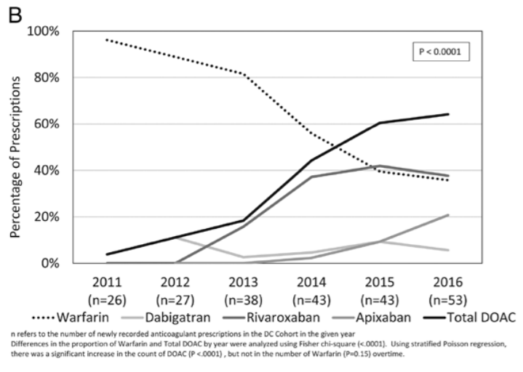
Anticoagulation With DOACs
Anticoagulation management is a dynamic field
Extensive clinical evidence and experience using the direct acting oral anticoagulants (DOACs) in a vast array of clinical scenarios
George JM et al. CID 2020

Slide 9
Medication | FDA Approval | Mechanism | FDA Approved Indications
Dabigatran (Pradaxa) | 2010 | Direct Thrombin Inhibitor (DTI) | Treatment of venous thromboembolism (VTE) Atrial fibrillation (AF) Prophylaxis s/p hip/knee arthroplasty
Rivaroxaban (Xarelto) | 2011 | Direct Xa Inhibitor | Treatment of VTE + secondary prophylaxis AF Prophylaxis s/p hip/knee arthroplasty VTE prophylaxis for the medically ill Cardiovascular risk reduction – CAD, PAD
Apixaban (Eliquis) | 2012 | Direct Xa Inhibitor | Treatment of VTE + secondary prophylaxis AF Prophylaxis s/p hip/knee arthroplasty
Edoxaban (Savasya) | 2015 | Direct Xa Inhibitor | Treatment of VTE AF

Slide 10
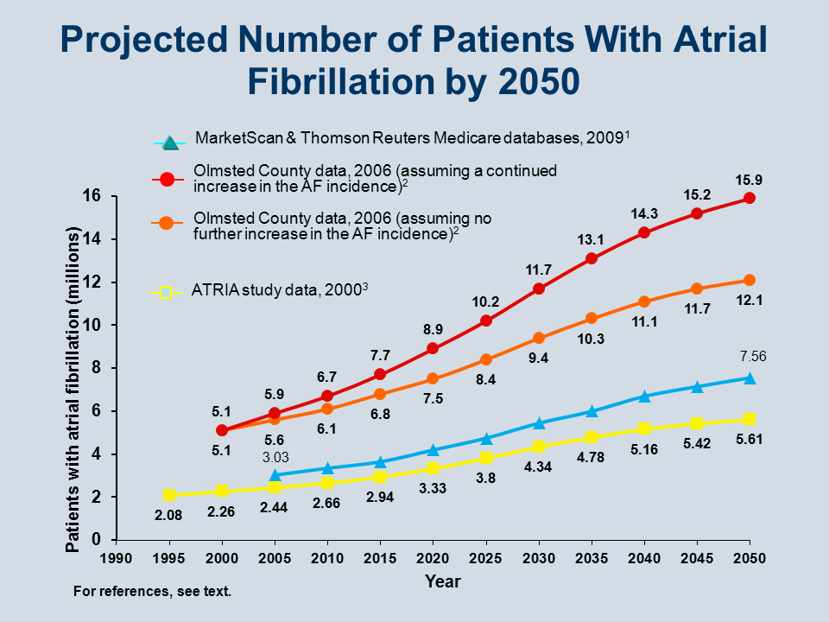
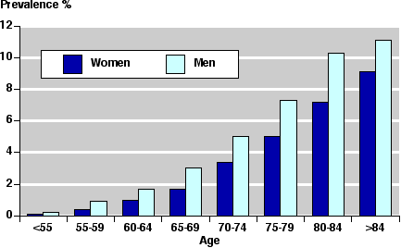
Atrial Fibrillation (AF)
AF is the most common type of arrhythmia
Estimated to affect 2.7 – 6.1 million people in the US
Prevalence increases with age
Am J Cardiol. 2009;104: 1534-1539
Circulation. 2006; 114: 119-125
JAMA. 2001;285:2370-2375

Slide 11
AF and Stroke
AF is one of the most common causes of stroke
Increases risk by ~5 times
Dependent on risk factors
Classic risk factors
Hypertension, diabetes, heart failure, history of stroke/TIA, cardiac surgery, hyperthyroidism
Initiating anticoagulation therapy needs to take into account thrombotic risk and bleeding risk
ESC Guidelines. European Heart Journal. 2020;00:1-125
AHA/ACC/HRS Guidelines. JACC;2019;74(1):104-32
Notes:
Main clinical stroke risk factors have been identified from non-anticoagulated arms of historical RCT conducted > 20 years ago
Thrombotic risk and bleeding risk are not mutually exclusive

Slide 12
HIV and AF
Data suggests at least 2% of patients with HIV also have AF
Risk increases with lower CD4 cell counts and higher viral loads
40% increase with CD4 count < 200 cell/mm³
70% increase with HIV viral load > 100,000 copies/mL
HIV is an independent risk factor for stroke
Stroke is common cause of morbidity and mortality
Unadjusted hazard ratio of 1.2
BMJ Case Rep 2015 doi:10.1136/bcr-2015-211651

Slide 13
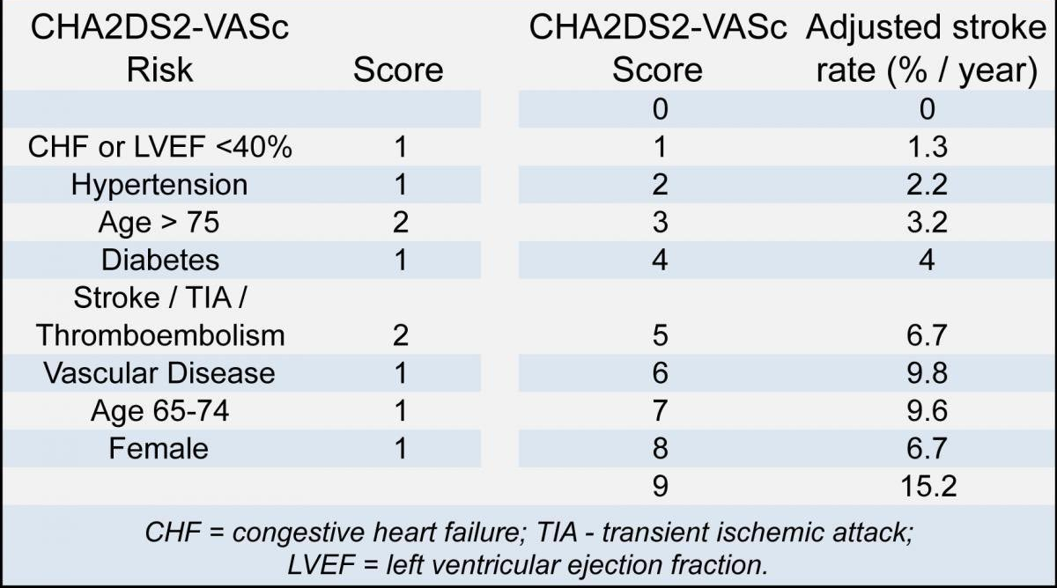
Stroke Risk – CHA₂DS₂-VaSC Score
Notes:
Stroke risk scores have to balance simplicity and practicality against precision. As any clinical risk factor based score, chads-vasc performs only modestly in predicting high risk patients who will sustain a thromboembolic event but is consistent in identifying those that are at low risk

Slide 14
Bleeding Risk – HAS-BLED Score
Notes:
Note – history of falls is not an independent risk factor for bleeding on a DOAC – modelling studies estimate that a person would have to fall 295 times per year for the benefit of ischemic stroke risk reduction to be outweighed by the potential for a serious bleed

Slide 15
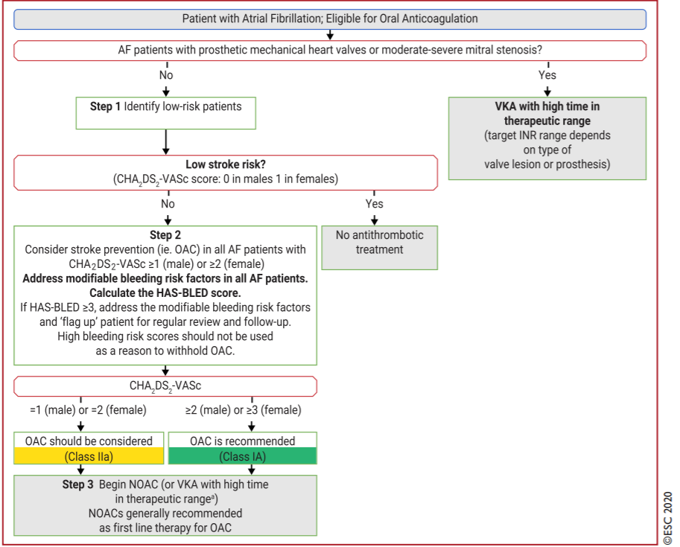
ESC GUIDELINES
ESC Guidelines. European Heart Journal. 2020;00:1-125
Notes:
Post-marketing observational data on the effectiveness and safety of the DOACs vs warfarin show general consistency with the respective RCTs.

Slide 16
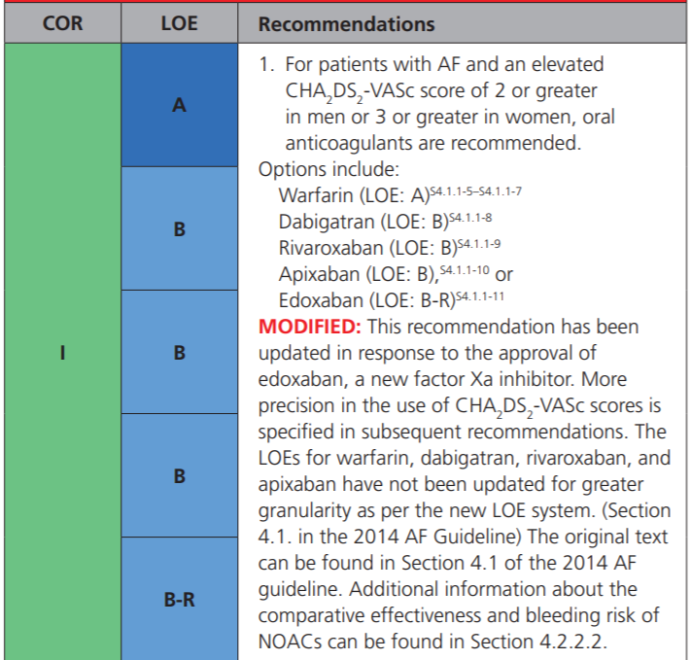
AHA/ACC/HRS GUIDELINES
AHA/ACC/HRS Guidelines. JACC;2019;74(1):104-32

Slide 17
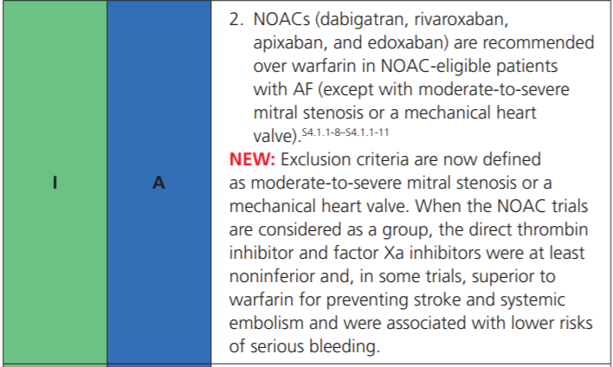
AHA/ACC/HRS 2019 Update
AHA/ACC/HRS Guidelines. JACC;2019;74(1):104-32

Slide 18
DOACs and AF Dosing
 | Dabigatran* | Rivaroxaban | Apixaban
Usual Dose | 150mg BID | 20mg DAILY | 5mg BID
Reduced Dose | 75mg BID | 15mg DAILY | 2.5mg BID
Indication for Dose Reduction | CrCl 15-30 mL/min | CrCl ≤50 mL/min | If 2 of 3 factors present: Age ≥80 years SCr ≥1.5 mg/dL Weight ≤60 kg
 | CrCl 30-50 mL/min with concomitant dronedarone or ketoconazole
 |  |  | Specific drug interactions (will discuss in later slides)
*inactive prodrug
Notes:
Those with CrCl <30 mL/min excluded from RE-LY trial†
Those with CrCl <30 mL/min excluded from ROCKET-AF trial†
Those with SCr >2.5 or CrCl <25 mL/min excluded from ARISTOTLE trial†

Slide 19
Comparative Data
No head-to-head studies
Evidence is limited to observational data
Similar efficacy between dabigatran, rivaroxaban and apixaban
Apixaban has the most favorable safety profile
Chest. 2016;150:1302–12
Eur J Epidemiol 2019 Feb;34(2):173-190
Notes:
There is no direct evidence comparing the 2 most commonly prescribed direct oral anticoagulants, apixaban and rivaroxaban, used for stroke prevention in nonvalvular atrial fibrillation (NVAF). A number of network meta-analyses (NMAs) of randomized control trials and real-world evidence (RWE) studies comparing the efficacy, effectiveness, and safety of apixaban and rivaroxaban have been published; however, a comprehensive evidence review across the available body of evidence is lacking. In this study, we aimed to systematically review and evaluate the clinical outcomes of apixaban and rivaroxaban using a combination of data gleaned from both NMAs and RWE studies. The review identified 21 NMAs and 5 RWE studies. The data demonstrated that apixaban was associated with fewer major bleeding events compared to rivaroxaban. There was no difference in the efficacy/effectiveness profiles between these treatments. Bleeding is a serious complication of anticoagulation therapy for the management of NVAF, and is associated with increased rates of hospitalization, morbidity, mortality, and health-care expenditure. The majority of studies in this comprehensive evidence review suggests that apixaban has a lower risk of major bleeding events compared to rivaroxaban in patients with NVAF.

Slide 20
United States Claims Data
CHEST 2016; 150(6):1302-1312

Slide 21
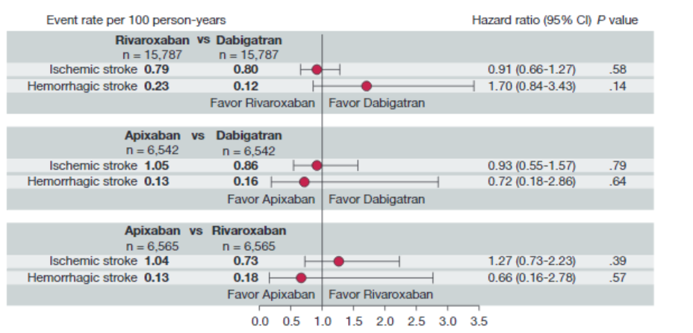
United States Claims Data
CHEST 2016; 150(6):1302-1312

Slide 22
Venous Thromboembolism (VTE)
Precise number of patients affected is unknown
Estimates suggest that 60,000-100,000 patients per year
10 to 30% of people will die within one month of diagnosis
Sudden death is the first symptom in about 25% of patients with a PE
Among people who have had a DVT, one third to one half will have long-term complications
Post-thrombotic syndrome
About 33% of people with DVT/PE will have a recurrence within 10 years
Data and Statistics on VTE. Available: https://www.cdc.gov/ncbddd/dvt/data.html Accessed 9/21/20

Slide 23
VTE in HIV
Data indicate that HIV-infected patients are at a 2- to 10-fold greater risk for a VTE event
Higher risk of recurrent event compared to uninfected controls (5.2 versus 3.1 per 100 person-years of follow-up)
Mechanisms are not fully elucidated
Chronic immune activation and inflammation
These don’t often normalize after suppressive antiretroviral therapy (ART)
Coagulation
Inflammation
Thromb Res 2014;133(0 1):S21-24 PLoS Med 2020;17(5):e1003101
Thromb Res 2013;132(5):495-499
Agrati et al. Translational Research 2020
Notes:
Recurrence most common in men and in the first year after withdrawing anticoagulation
Growing recognition that the relationship between coagulation and inflammation is bidirectional, with clotting a recognized consequence if inflammation and coagulation directly amplifying the inflammatory response.
Alterations in the coagulation are thought to be due to:
Persistent systemic immune activation
Micro and macro-vascular disease
Potentially, impaired hepatic synthesis of coagulation factors

Slide 24
Chest - Guideline Recommendations
Drug of choice:
Choice of long-term anticoagulant in VTE, no cancer
Suggest DOAC over warfarin therapy (Grade 2B)
Choice of long-term anticoagulant in VTE, with cancer
Low molecular weight heparin (LMWH) suggested as first-line (Grade 2B)
Duration of treatment
Provoked VTE
Recommend 3 months of treatment (Grade 1B)
Unprovoked VTE
Recommend at least 3 months of treatment (Grade 2B)
Unprovoked, low risk of bleed
Suggest extended anticoagulation therapy (Grade 2B)
Chest 2016;149(2):315-352
Blood Advances 2018;2(22):3257-3291

Slide 25
Factor | Preferred Anticoagulant | Comments
Cancer | LMWH
Avoidance of parenteral therapy | Rivaroxaban, apixaban | Other DOACs all studied with initial parenteral therapy for 5 – 7 days
Liver disease, coagulopathy | LMWH
Renal disease or CrCl < 30ml/min | Warfarin | Limited data to support use in renal impairment
Coronary artery disease | Warfarin, rivaroxaban, apixaban, edoxaban | CAD events appear to occur more often with dabigatran compared to warfarin. Other DOACs have demonstrated efficacy in CAD
Dyspepsia or history of GI bleed | Apixaban, warfarin | Dabigatran increases dyspepsia Other DOACs have higher GI bleeds compared to warfarin
Poor compliance | Warfarin | INR monitoring is available
Chest 2016;149(2):315-352

Slide 26
DOAC Dosing for VTE
 | Dabigatran | Rivaroxaban | Apixaban
Usual Dose | 150mg BID | 15mg BID for 21 days, followed by 20mg DAILY | 10mg BID for 10 days, followed by 5mg BID
Parenteral Therapy | 5 – 10 day | N/A | N/A
 | Excluded: CrCl < 30 ml/min | Excluded: CrCl < 30 ml/min | Excluded: SCr > 2.5 mg/dL eGFR < 25 ml/min

Slide 27
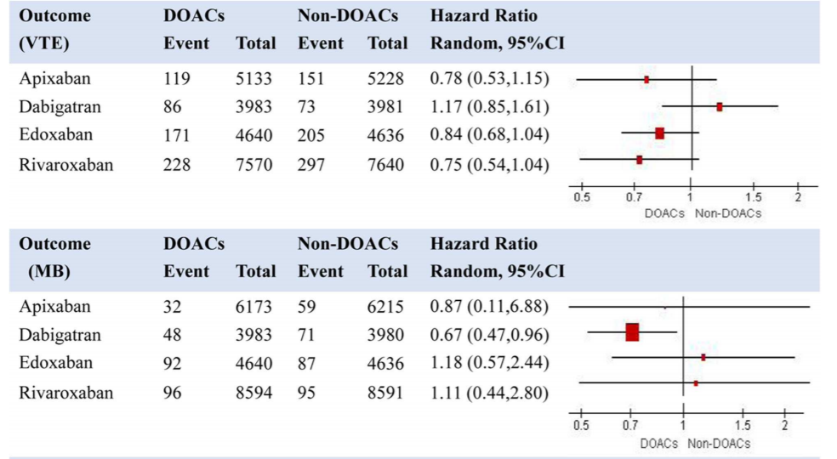
DOAC Equivalent Efficacy in VTE
Front Med (Lausanne). 2020; 7: 280.

Slide 28
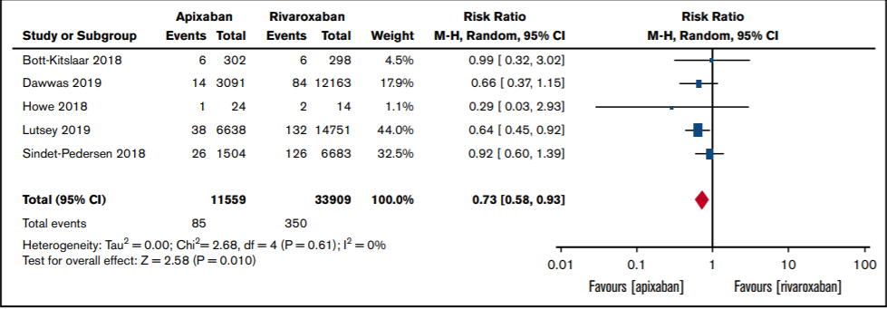
Rivaroxaban Compared to Apixaban
VTE Events
Major Bleeding
Blood Adv. 2019 Aug 13; 3(15): 2381–2387
Notes:
Meta-analysis – real world data
Clinically relevant non-major bleeding favored apixaban

Slide 29
Nuances of management - Appropriate dosing - drug interactions

Slide 30
DOAC Dosing
Dosing regimens depends on indication
Loading doses for treatment of VTE
Dabigatran package insert specifies the 5 – 10 day parenteral therapy initially
Dose adjustments for VTE ≠ AF
VTE doesn’t have the criteria for dose reduction for apixaban
Different drug interaction and different renal function cutoffs for dose adjustments

Slide 31
Dosing Errors
Intentional versus Unintentional
Most common dosing error is under-dosing
Frontiers in Pharmacology 2018;9:1220
Notes:
No class of medications is immune to dosing errors
Yao X, et al. Non-vitamin K antagonist oral anticoagulant dosing in patients with atrial fibrillation and renal dysfunction. J Am Coll Cardiol 2017;69:2779-90.
Bottom line:
Many patients with non-valvular AF receiving a DOAC receive inappropriate doses.
In patients with an indication to reduced the DOAC dose, "overdosing" (using regular doses) is associated with a 2-fold higher risk of major bleeding vs using appropriate reduced doses.
In patients taking apixaban without an indication to reduce the dose, "underdosing" (using reduced doses) apixaban is associated with a ~5-fold increased risk of stroke/systemic embolism.
: For the 772 included patients, inappropriate dosing occurred in 25.0% of hospitalizations with 23.4, 21.9, and 29.7% for dabigatran, rivaroxaban, and apixaban, respectively (p = 0.084). Underdosing was most prevalent for apixaban (24.5%) compared to dabigatran (14.0%) and rivaroxaban (12.8%), p < 0.001.

Slide 32
Under-dosing Consequences
Off-label lower dose DOAC use is associated with higher risk of mortality, stroke and MI and is not associated with a reduced bleeding rate
Adjusted HR for the composite of mortality, stroke and MI in patients treated with off-label lower dose was 1.38
95% CI: 1.13- 1.69, P=0.001
Adjusted HR for bleeding 1.34
95% CI: 0.92-1.95, P=NS
Stroke 2019;50:A36 https://doi.org/10.1161/str.50.suppl_1.36

Slide 33
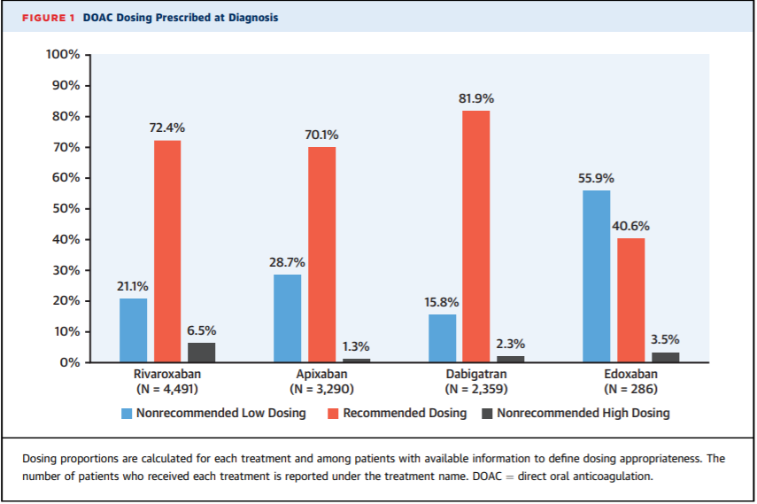
GARFIELD-AF. JACC. 2020;76(12):1425-36
Notes:
Mortality in Patients With Atrial
Fibrillation Receiving Nonrecommended
Doses of Direct Oral Anticoagulants

Slide 34
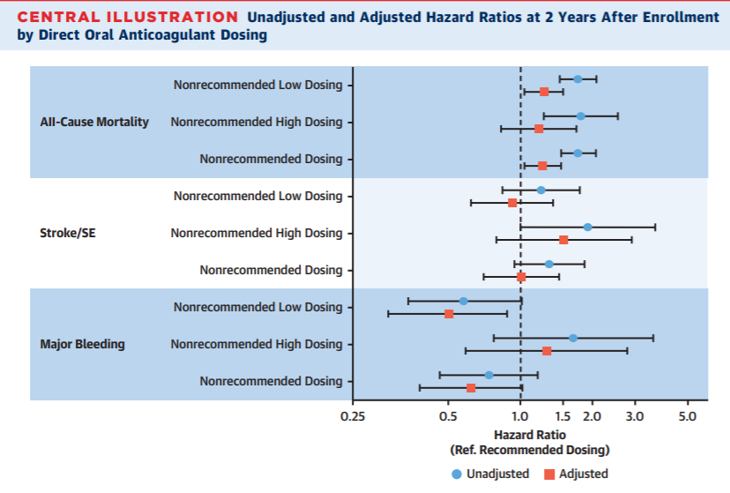
GARFIELD-AF. JACC. 2020;76(12):1425-36

Slide 35
Drug Interactions
Although not as cumbersome as warfarin, the potential for drug-drug interactions (DDIs) still exist with the DOACs
Whereas warfarin has higher number of DDIs than DOACs, warfarin at least has the monitoring option
DOAC absorption is mediated by p-glycoproteins (P-gp)
DOAC metabolism is mediated by CYP3A4
Varies based on the agent

Slide 36
Dabigatran Recommendations P-gp impact, no impact for 3A4
P-glycoprotein inhibitors
E.g. Verapamil, amiodarone, quinidine, clarithromycin
No dose adjustments are necessary
Avoid if CrCl < 30 ml/min
Ketoconazole and dronadarone
CrCl 30 – 50 ml/min
Dabigatran 75mg PO twice a day
P-glycoprotein inducers
E.g. Rifampin, carbamazepine
Inducers should be avoided

Slide 37
Rivaroxaban Recommendations P-gp and 3A4 impact (including weaker 3A4 inhibitors)
P-glycoprotein /Strong 3A4 inhibitors | Less potent P-glycoprotein /3A4 inhibitors | P-glycoprotein /Strong 3A4 inducers
Agents: Conivaptan, itraconazole, ketoconazole, lopinavir/ritonavir, ritonavir | Agents: Azithromycin, clarithromycin, diltiazem, dronaderone, erythromycin, verapamil | Agents: Carbamazepine, phenytoin, rifampin, St. John’s Wort
Management: - Avoid combination | Management: - Do not use combination in mild renal impairment (CrCl 30 – 60ml/min) | Management: - Avoid combination if possible

Slide 38
Apixaban Recommendations P-gp and 3A4 impact
Combined P-gp AND strong CYP3A4 inhibitors (e.g., ketoconazole, itraconazole) :
On 5 mg or 10 mg BID, reduce the dose by 50%
On 2.5mg BID, do not use
Combined P-gp AND strong CYP3A4 inducers
Avoid use

Slide 39
Managing Drug Interaction
American Society of Hematology (VTE treatment)
In patients with VTE on strong inducers or inhibitors of p-glycoprotein or CYP enzymes – suggest using alternative to DOAC (warfarin or LMWH)
Theoretical risk
Unable to estimate the real clinical magnitude of the interactions
Patient preference
Blood Advances 2018;2(22):3257-3291

Slide 40
HIV Specific Drug Interactions (only noting ones with expected interaction)
Anticoagulant | Antiretroviral | Expected Impact | Management
Dabigatran | Elvitegravir-cobicistat | ↑ dabigatran | AF: CrCl 30 – 50: 75mg BID CrCl < 30: Do not use VTE: CrCl < 50: Do not use
 | Atazanavir | No data | Consider alternative ARV or anticoagulant.
 | Atazanavir/r Atazanavir/c Lopinavir/r | ↑ dabigatran | AF: CrCl 30 – 50: 75mg BID CrCl < 30: Do not use VTE: CrCl < 50: Do not use
 | Darunavir/r Darunavir/c Tipranavir/r | ↑ dabigatran | Consider alternative ARV or anticoagulant.
https://clinicalinfo.hiv.gov/en/guidelines/adult-and-adolescent-arv/whats-new-guidelines
Accessed: Sept 22, 2020
Notes:
With COBI 150 mg Alone: Dabigatran AUC ↑ 110% to 127%

Slide 41
Dabigatran
Dabigatran etexilate is a prodrug
Rapidly and completely hydrolyzed to dabigatran moiety by esterases
Advantage – no CYP450 interactions
Highly sensitive to the P-gp efflux transporters in the intestinal lumen
Cobicistat
Less “collateral” drug interactions – more selective for 3A4 inhibition
Increased dabigatran AUC by 2-fold
Ritonavir
If given within 2hr after dabigatran – AUC was reduced by 29%
If dabigatran is to be used in combination with ritonavir – they should be given simultaneously
Antimicrob Agents Chemother 2017;61(11):e01201-17

Slide 42
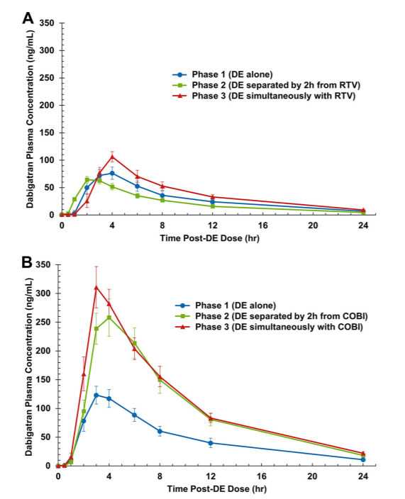

Slide 43
HIV Specific Drug Interactions (only noting ones with expected interaction)
Anticoagulant | Antiretroviral | Expected Impact | Management
Rivaroxaban | Elvitegravir-cobicistat | ↑ rivaroxaban | Do not use
 | Efavirenz Etravirine Nevirapine | ↓ rivaroxaban | Consider alternative ARV or anticoagulant therapy.
 | Atazanavir | No data | Consider alternative ARV or anticoagulant.
 | Any boosted PI Ritonovir Cobisistat | ↑ rivaroxaban | Do not use
https://clinicalinfo.hiv.gov/en/guidelines/adult-and-adolescent-arv/whats-new-guidelines
Accessed: Sept 22, 2020

Slide 44
HIV Specific Drug Interactions (only noting ones with expected interaction)
Anticoagulant | Antiretroviral | Expected Impact | Management
Apixaban | Elvitegravir-cobicistat | ↑ apixaban | Decrease apixaban by 50% If on 2.5mg – do not use
 | Efavirenz Etravirine Nevirapine | ↓ apixaban | Consider alternative ARV or anticoagulant therapy
 | Atazanavir | No data | Consider alternative ARV or anticoagulant.
 | Any boosted PI Ritonovir Cobisistat | ↑ apixaban | Decrease apixaban by 50% If on 2.5mg – do not use
https://clinicalinfo.hiv.gov/en/guidelines/adult-and-adolescent-arv/whats-new-guidelines
Accessed: Sept 22, 2020

Slide 45
Real World Experience
Rivaroxaban and nevirapine
Started on rivaroxaban 10mg daily POD3 after total knee replacement and discharged
Returned POD4 – shortness of breath, chest pain, pain in calf
Diagnosed with DVT, CT non-diagnostic for PE
Rivaroxaban
Darunavir/r, lamivudine, tenofovir, etravirine, raltegravir
S/p orthopedic surgery after snowmobile accident
Rivaroxaban 10mg daily – peak drug levels drawn and they were double what was expected
Rivaroxaban 5mg daily initiated
Presented to hospital with GI bleed about a month later
CMJ 2013;66(2):125-129
Swiss Med Wkly 2014;144:w13906

Slide 46
Real World Experience
Dabigatran
New diagnosis of AF, refused warfarin
Abacavir, lamivudine, atazanavir/r, tenofovir
Initiated on dabigatran 110mg daily & monitored trough drug plasma levels
Dabigatran increased to 110mg BID then to 150mg BID with no bleeding or thrombotic complication
Dabigatran
Darunavir/r, rilpivirine, emtricitabine/TAF, raltegravir
Darunavir/c was switched to darunavir/r due to suspected DDI
150mg BID
No reported thrombotic or bleeding events
Apixaban
Presented with new PE while on apixaban for recent DVT
Efavirenz, abacavir/lamivudine
BMJ Case Rep 2015 doi:10.1136/bcr-2015-211651
Am J Respir Crit Care Med 2018;197:A3451
Antimicrob Agents Chemother 2018;62(2):e02275-17

Slide 47
Conclusions
Real world data for DOACs is similar to findings from RCT in regards to efficacy and safety
Current guidelines recommend DOAC usage over warfarin therapy in patients who have no contraindication
Appropriate dosing is imperative to assure efficacy for our patients
Drug interactions pose unique challenges that need to be handled on an individual patient basis
Co-administration of DOACs with boosted-PI therapy, dabigatran has the most data to guide use

Slide 48
Post-test Question
True/False

Slide 49
Additional References
Curr Atheroscler Rep 2017;19:20
J Acquir Immune Defic Syndr 2017;76(1):90-97
Nig J Cardiol 2020;17:1-10
CID 2020;XX(X):1-10
Curr Opin HIV AIDS 2017;12:556-560
Dube G. Pharmacy Times 2020 July 14
PLoS Med 2020;17(5):e1003101
FDA listserv 15 August 2018
Antimicrob Agents Chemother doi:10.1122/AAC.01201-17
Antimicrob Agents Chemother 2018;62(2):e02275-17
HIV Medicine 2019;20:344-346
Antimicrob Agents Chemother 2017;61(11):e01201-17
National HIV Curriculum. Drug Interactions with Antiretroviral Medications. Access 18 Sept 2020

Slide 50
HIV - HCV - PrEP - PEP
Clinical Consultations
For Providers in Upstate NY
Call or E-mail for a consultation:
518-262-6864
Monday – Friday 8:00 a.m. – 4:30 p.m.
prokopw@amc.edu
If you have experienced an occupational exposure such as a needle stick, please call 518-262-4043. You will be given an opportunity on the telephone menu to speak to a physician 24 hours a day.
www.amc.edu/hiv

