Slide 1
Project ECHO® - UNM
HIV TeleECHO Clinic
Diabetes Mellitus Screening in People with HIV
Mark Cinquegrani, PharmD
PGY2 Ambulatory Care Pharmacy Resident
mcinquegrani@salud.unm.edu
Notes:
Version_12 2020

Slide 2
Conflict of Interest Disclosure Statement
Speaker has no financial conflicts of interest to disclose
This presentation was reviewed by UNMHSC and SCAETC faculty to ensure it meets CME guidelines.
This project is supported by the Health Resources and Services Administration (HRSA) of the U.S. Department of Health and Human Services (HHS). Under grant number U1OHA33225 (South Central AIDS Education and Training Center). It was awarded to the University of New Mexico. No percentage of this project was financed with non-governmental sources. This information or content and conclusions are those of the authors and should not be construed as the official position or policy of, nor should any endorsements be inferred by HRSA, HHS, or the U.S. Government

Slide 3
Learning Objectives
Recognize the different methods of diagnosing diabetes (DM).
Describe how these methods may not be accurate in people with HIV (PWH).
Identify other screening methods and monitoring important for patients at risk of diabetes.

Slide 4
A Review of Diabetes Mellitus
In Type II Diabetes
Insulin is still produced by the pancreas
High levels of glucose lead to high levels of insulin
Cells become resistant to circulating insulin
Blood glucose in the blood is elevated
https://www.health.harvard.edu/a_to_z/diabetes-mellitus-overview-a-to-z

Slide 5
http://www.oasishhi.com/oasis-blog/are-you-a-diabetic-know-your-risk-factors-for-diabetes

Slide 6
Screening for DM: Blood Glucose
Fasting Plasma Glucose
No caloric intake for at least 8 hours
Glucose ≥126mg/dL
2-Hour Plasma Glucose
Utilizing oral glucose tolerance test (75g of glucose dissolved in water)
Glucose ≥200mg/dL
Random Plasma Glucose
Any glucose reading over 200mg/dL with symptoms of hyperglycemia
https://care.diabetesjournals.org/content/43/Supplement_1/S14

Slide 7
Screening for DM: Hemoglobin A1c
Both point-of-care and laboratory blood tests are available
Does not require fasting
Reflects blood glucose control over three months
HbA1c ≥ 6.5%
Independently identifies 30% of diabetes cases
https://t1dtoolkit.org/basic-knowledge/understanding-hba1c/
https://care.diabetesjournals.org/content/43/Supplement_1/S14

Slide 8
https://www.randeye.com/hemoglobin-a1c-test/

Slide 9
HIVMA Primary Care Guidelines 2020
Random or fasting blood glucose and HbA1c should be obtained prior to starting antiretroviral therapy (ART)
If random blood glucose is abnormal, obtain fasting
HbA1c is no longer the recommended test for diagnosing diabetes in people with HIV on ART
For measurements that do not align, repeat the tests
https://academic.oup.com/cid/advance-article/doi/10.1093/cid/ciaa1391/5956736#214804158

Slide 10
HIVMA Primary Care Guidelines 2020
National Health and Nutrition Examination Survey recommend HbA1c cutoff of 5.8% for people with HIV on ART
No evidence to suggest switching antiretrovirals is beneficial
https://academic.oup.com/cid/advance-article/doi/10.1093/cid/ciaa1391/5956736#214804158

Slide 11
Inappropriately low glycated hemoglobin values and hemolysis in PWH
 | Non-HIV infected patients | HIV-infected patients | p
Number of patients | 1238 | 112
Age of patients (years) | 57 ± 15 | 49 ± 10 | < 0.05
Sex (M/F) (n) | 736/502 | 88/24 | < 0.0001
Sex (M/F) (%) | 59.5/40.5 | 78.6/21.4
HbA1c (%) | 6.52 ± 1.85 | 5.98 ± 1.55 | < 0.005
Measured-Gly (mM) | 6.95 ± 3.23 | 6.62 ± 2.42 | 0.28
HbA1c-Gly (mM) | 7.29 ± 3.41* | 6.29 ± 2.87† | < 0.005
Characteristics of patients included in the initial retrospective study
Values are expressed as mean ± SD.
Measured-Gly was significantly different from HbA1c-Gly in the non-HIV (*, p< 0.0001) and in the HIV-infected (†, p<0.0001) patients.
Diop ME, et al. AIDS Res Hum Retroviruses 2006
Notes:
Diop ME, et al. Inappropriately low glycated hemoglobin values and hemolysis in HIV-infected patients. AIDS Res Hum Retroviruses 2006
The difference between HbA1c-Gly and Measured-Gly is correlated with red blood cell volume, which may be affected by antiretroviral therapy

Slide 12
Inappropriately low glycated hemoglobin values and hemolysis in PWH
Drugs used by more than 10 patients | p (χ²) | Logistic regression analysis
NRTI : any | 0.006 | Odds ratio | Range | p
zidovudine (ZDV) | 0.10 | 0.90 | 0.4–2.1 | 0.81
stavudine (d4T) | 0.76 | 0.66 | 0.2–2.4 | 0.52
lamivudine (3TC) | 0.0003 | 3.97 | 1.7–9.2 | 0.001
didanosine (ddI) | 0.70 | 1.2 | 0.5–3.1 | 0.72
abacavir | 0.37 | 1.2 | 0.6–2.3 | 0.64
tenofovir | 0.99 | 1.2 | 0.5–2.6 | 0.73
Protease inhibitors : any | 0.12
ritonavir | 0.08
ritonavir/lopinavir | 0.34
atazanavir | 0.94
NNRTI : any | 0.94
efavirenz | 0.93
viramune | 0.77
Trimethoprim-sulfamethoxazole | 0.20
Associations between hemolysis and treatments in the group of 249 HIV-infected patients
Hemolysis was defined by serum haptoglobin values<0.5 g/l.
NRTI : Nucleoside reverse transcriptase inhibitors ; NNRTI : Non nucleoside reverse transcriptase inhibitors..
Diop ME, et al. AIDS Res Hum Retroviruses 2006
Notes:
Diop ME, et al. Inappropriately low glycated hemoglobin values and hemolysis in HIV-infected patients. AIDS Res Hum Retroviruses 2006
The difference between HbA1c-Gly and Measured-Gly is correlated with red blood cell volume, which may be affected by antiretroviral therapy

Slide 13
A1C Underestimates Glycemia in HIV Infection
Increased mean corpuscular volume (MCV) as a result of NRTIs is an important factor in the relationship between A1c and glycemia
Abacavir was additionally found to be associated with A1c-glucose discordance, but is not considered hemotoxic
NRTI= nucleoside/nucleotide reverse transcriptase inhibitors
Kim PS, Woods C, Georgoff P, et al. Diabetes Care 2009; 32:1591–3.
Notes:
Kim PS, Woods C, Georgoff P, et al. A1C underestimates glycemia in HIV infection. Diabetes Care 2009; 32:1591–3

Slide 14
Glycated Hemoglobin in Women with Diabetes and
With and Without HIV Infection
Data from the Women's Interagency HIV Study
Slightly lower HbA1c values in women with HIV after adjustment for fasting glucose
Difference was largely accounted for by MCV
Possibly greater red blood cell turnover
Higher proportion of younger cells that have not been glycated
Conclusion: A1c modestly underestimated glycemic control, but was not significant after adjusting for MCV
Glesby MJ, Hoover DR, Shi Q, et al. Antivir Ther 2010; 15:571–7.
Notes:
MCV may be increased in HIV-infected women on zidovudine
Glesby MJ, Hoover DR, Shi Q, et al. Glycated haemoglobin in diabetic women with and without HIV infection: data from the Women’s Interagency HIV Study. Antivir Ther 2010; 15:571–7
Authors commented that “non-black women had lower A1c relative to black women” but didn’t explain rationale or influence of social determinants of disease so unclear the significane

Slide 15
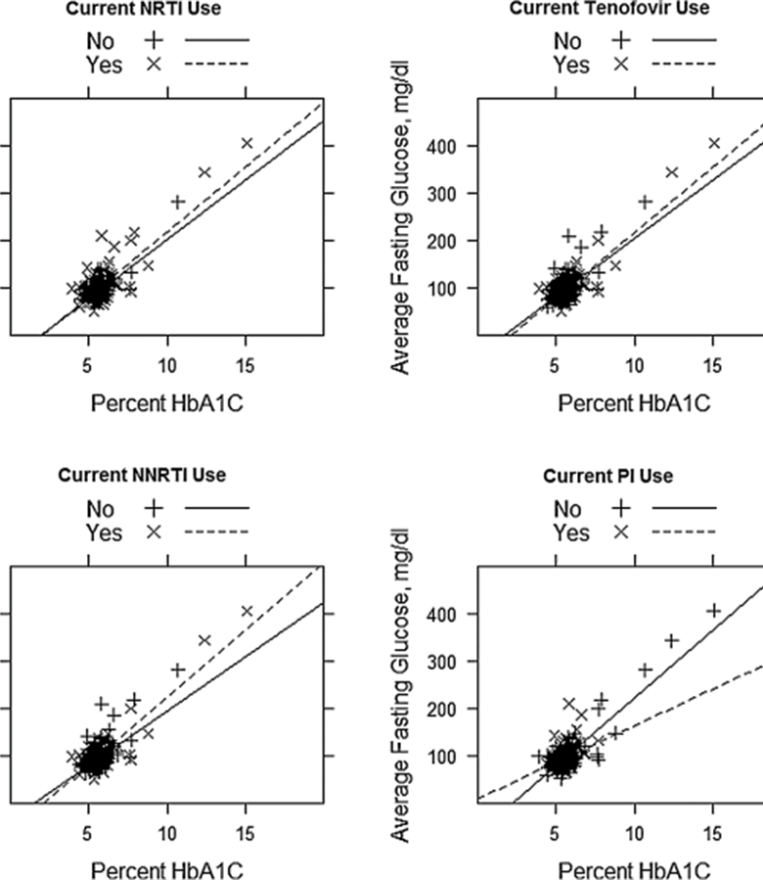
Glycated Hemoglobin A(1c) as screening for DM in PWH
Few patients were on zidovudine or stavudine
Did not find that race had an effect
PIs may cause HbA1c to overestimate glycemia
NNRTIs may cause HbA1c to underestimate glycemia
Tenofovir did not appear to have an effect
Eckhardt BJ, et al. AIDS Patient Care STDS 2012; 26:197–201.
Notes:
Eckhardt BJ, Holzman RS, Kwan CK, Baghdadi J, Aberg JA. Glycated hemoglobin A(1c) as screening for diabetes mellitus in HIV-infected individuals. AIDS Patient Care STDS 2012; 26:197–201.
Scatter plot and regression curves of fasting blood glucose and hemoglobin A_{1c} (HbA_{1c}) adjusted for current antiretroviral use. NRTI, nucleoside reverse transcriptase inhibitor; NNTRI, non-nucleoside reverse transcriptase inhibitor; PI, protease inhibitor.
PI=protease inhibitor

Slide 16
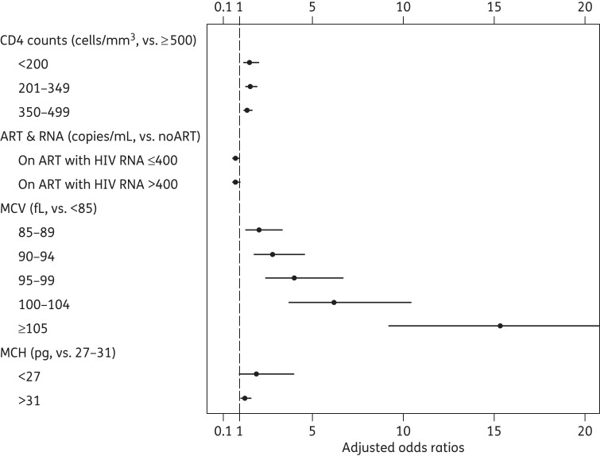
Inaccuracy of HbA1c among Men with HIV
PI use and zidovudine use were independently associated with discordance
Emtricitabine, abacavir, and lamivudine may be protective
Factors associated with HbA1c discordance (observed − expected HbA1c) ≤−0.5% among HIV-infected patients in the MACS. Other factors included age, race, BMI, HCV infection, AIDS and haemoglobin. The upper 95% CI for the OR of MCV ≥105 fL was 25.8.
Eckhardt BJ, et al. AIDS Patient Care STDS 2012; 26:197–201.
Notes:
Slama L, Palella FJ Jr, Abraham AG, et al. Inaccuracy of haemoglobin A1c among HIV-infected men: effects of CD4 cell count, antiretroviral therapies and haematological parameters. J Antimicrob Chemother 2014; 69:3360–7.

Slide 17
Summary: ART Medication Effects on HbA1c
Increased MCV is associated with discordant HbA1c and fasting blood glucose, this may be a medication effect
HbA1c and glycemia was discordant most often for patients on protease inhibitors, non-nucleoside reverse transcriptase inhibitors, and zidovudine
Integrase inhibitors have not been studied

Slide 18
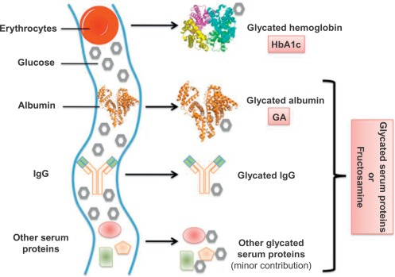
Alternate Screening Methods
Fructosamine has been indicated as a more accurate measure of glycemia levels as it was not significantly affected by antiretroviral class¹
May be affected by glycated lipoproteins, bilirubin, uric acid, ascorbic acid, and vitamin E²
Measures the glycemia levels over the previous 2-3 weeks³
Diabetes cut-off at 287.5mmol/L³
https://www.ncbi.nlm.nih.gov/pmc/articles/PMC2732167/
https://doi.org/10.1016/bs.acc.2015.07.005
http://amj.amegroups.com/article/view/4404/5139

Slide 19
Prediabetes in Patients without HIV
Fasting blood glucose 100-125mg/dL
2-hour fasting glucose 140-199mg/dL
HbA1c 5.8-6.4%
ADA recommends at least annual monitoring
https://care.diabetesjournals.org/content/43/Supplement_1/S32

Slide 20
Reducing Risk for Developing Diabetes
Achieve and maintain 7% total weight loss
Increase moderate-intensity exercise to at least 150 minutes per week
Nutrition should emphasize whole grains, legumes, nuts, fruits, and vegetables with minimal refined or processed foods
Smoking may increase the risk diabetes, consider cessation
https://care.diabetesjournals.org/content/43/Supplement_1/S32

Slide 21
So what about monitoring?
HbA1c is still effective for monitoring diabetes
Should be monitored every 6 months
Goal should be less than 7% in accordance with ADA guidelines, though can be adjusted based on patient factors
Fasting blood glucose can be used in conjunction with HbA1c to confirm glycemic level
https://academic.oup.com/cid/advance-article/doi/10.1093/cid/ciaa1391/5956736#214804158

Slide 22
References
Thompson, MA, et al. Primary Care Guidance for PWH: 2020 Update by HIVMA of IDSA.CID. 2020. https://academic.oup.com/cid/advance-article/doi/10.1093/cid/ciaa1391/5956736
ADA. Standards of medical Care in Diabetes-2020 Abridged for Primary Care Providers. Clinical Diabetes. 2020;38(1):10-38. https://clinical.diabetesjournals.org/content/38/1/10

Slide 23
Resources
AETC National Clinical Consultation Center http://nccc.ucsf.edu/
HIV Management
Perinatal HIV
HIV PrEP
HIV PEP line
HCV Management
Substance Use Management
Present case on ECHO http://echo.unm.edu hivecho@salud.unm.edu
scaetcecho@salud.unm.edu
AETC National HIV Curriculum https://aidsetc.org/nhc
AETC National HIV-HCV Curriculum https://aidsetc.org/hivhcv
Hepatitis C Online https://www.hepatitisc.uw.edu/
AETC National Coordinating Resource Center https://targethiv.org/library/aetc-national-coordinating-resource-center-0

