Slide 1

Understanding and Addressing Stigma in Healthcare Settings
Janet M. Turan, PhD MPH
School of Public Health
Center for AIDS Research (CFAR)
University of Alabama at Birmingham
AETC SHARE Project

Slide 2
Session Objectives
At the end of the session, participants should be able to:
  Define types and dimensions of stigma.
  Explain how HIV-related and intersectional stigma experienced by clients can affect HIV prevention and treatment behaviors, as well as health outcomes.
  Identify the variety of interventions and tools that can be used in healthcare settings to reduce stigma.
  Describe the Finding Respect and Ending Stigma around HIV (FRESH) intervention methods and pilot results.

Slide 3
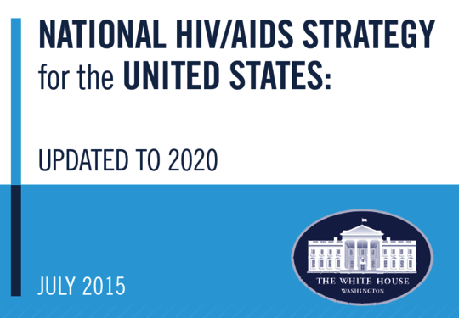
Vision
The United States will become a place where new HIV infections are rare, and when they do occur, every person, regardless of age, gender, race/ethnicity, sexual orientation, gender identity, or socio-economic circumstance, will have unfettered access to high quality, life-extending care, free from stigma and discrimination.

Slide 4
Stigma Definitions and Dimensions

Slide 5

What is Stigma?
Attributes or behaviors that can cause individuals to lose social value
an attribute that is “deeply discrediting”
Reduces a person from being a whole and usual person to a “tainted, discounted one”

Slide 6
Health-related Stigma
“a social process or related personal experience characterized by exclusion, rejection, blame, or devaluation that results from experience or reasonable anticipation of an adverse social judgment about a person or group identified with a particular health problem”
(Weiss and Ramakrishna, Lancet, 2006)

Slide 7
Examples of stigmatized health conditions/behaviors
HIV
Tuberculosis
Obesity
Mental illness
Substance abuse disorders
Smoking
Sex work

Slide 8
Dimensions/types of stigma
Anticipated stigma (fears)
Normative stigma (perceptions of community norms)
Experienced or enacted stigma (discrimination)
Internalized or self stigma
Notes:
EXPLAIN EACH IN SOME DETAIL.

Slide 9
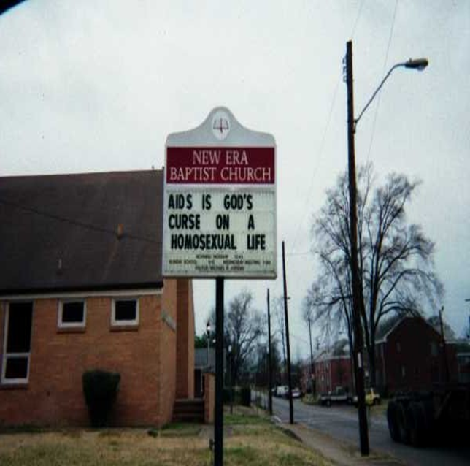
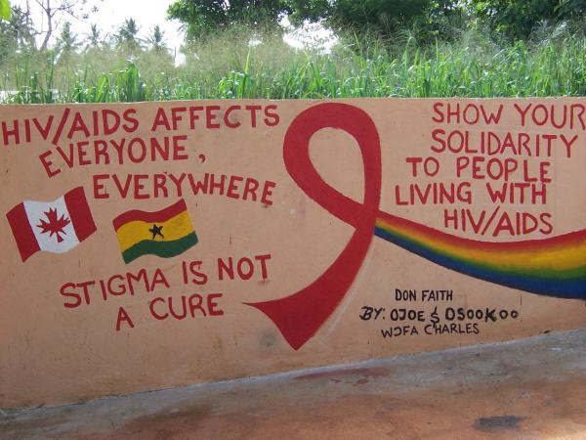
HIV-Related Stigma and Discrimination Persist Globally and Locally
* Photo courtesy of Dr. Bronwen Lichtenstein, UA

Slide 10
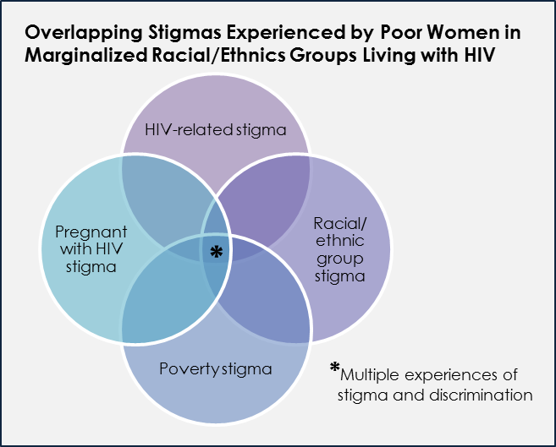
Intersectional Stigma

Slide 11
How Stigma Affects Health

Slide 12
How can stigma affect health?
Stigma adversely affects quality of life and physical and mental health of persons with stigmatized conditions
Stigma and fears of stigma make people less likely to practice preventive behaviors and/or utilize needed health services
Stigma can lead to discrimination and violence, with adverse consequences for health

Slide 13
A framework for the effects of stigma on health
Stigma
Psycho-social effects:
Behavioral Consequences:
Silence
Negative attitudes
Effects on health:
Delay in care
Avoidance of services
Not taking meds
Poor mental health
Mortality and morbidity
Adverse health consequences of violence
Shame
Transmission of infections
Lack of disclosure
Violence
Blame
Secrecy
Discrimination
Guilt
Fear
Denial
Not practicing prevention
*Adapted from Kumar et al., Culture, Health and Sexuality, 2009.
Notes:
DIRECT EFFECTS TOO!

Slide 14

What is known about the effects of HIV-Related Stigma?
Qualitative and mainly cross-sectional studies have found that HIV-related stigma is associated with poor engagement in HIV care and ART adherence*, including:
  Lower acceptance of HIV testing
  Lower access to medical care
  Poorer ART adherence
  Lower utilization of HIV care
*Katz et al., JIAS, 2013; Sweeney and Vanable, AIDS Behav, 2016.

Slide 15
Disparities and HIV-Related Stigma
Could differences in experiences and effects of stigma (including intersectional stigma) help explain disparities in HIV outcomes by gender, sexual orientation, and race/ethnicity?
  Women of color are at particularly high risk of acquiring HIV, and have worse health outcomes once infected compared to White women.
  HIV-infected women have lower ART adherence, lower retention, and higher mortality compared to men.
  Young black MSM have the highest rates of new HIV infections and worst outcomes in the US.
Notes:
Moderation and mediation effects.

Slide 16
A Conceptual Framework*
*B. Turan et al., Framing Mechanisms Linking HIV-Related Stigma, Adherence to Treatment, and Health Outcomes, American Journal of Public Health, 2017.

Slide 17
Experienced Stigma and Stress
Experienced stigma may lead to chronic stress, which may affect physical health of PLWH (e.g., CD4 counts and viral load)
Mechanism: stress-responsive biological systems (e.g., the hypothalamic–pituitary–adrenal axis, sympathetic nervous system)

Slide 18
HIV-Related and Intersectional Stigma in the US

Slide 19

What do we know about HIV-related stigma in the United States and specifically in the South?

Slide 20
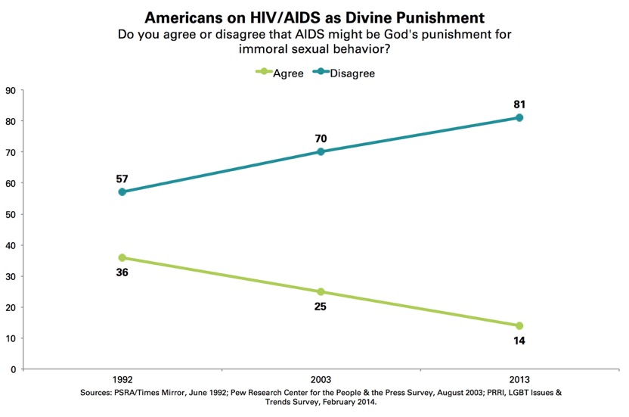
HIV STIGMA IN THE US
Less stigma?
HIV stigma has declined over the past 20 years. That’s good news, right?
Not quite
HIV has lost some of its power to instill fear, because it is no longer seen as a potential threat to everyone.
However, stigma still serves as a barrier to HIV diagnosis, prevention, and access to care.
* Slide adapted from Dr. Bronwen Lichtenstein, UA
Notes:
Can it be overcome?

Slide 21
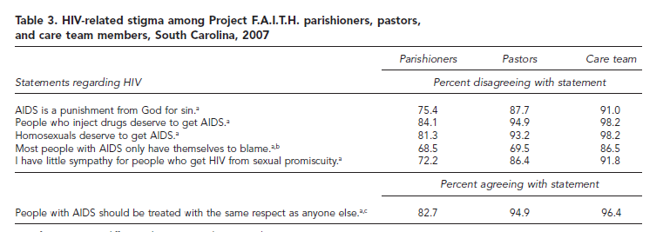
Stigmatizing Attitudes at Project
F.A.I.T.H. Churches in South Carolina
(Lindley et al., Public Health Reports, 2010)

Slide 22
Silent Endurance and Profound Loneliness in the Rural South
(Miles, et al., Qual Health Research, 2010)
“They don’t want [people with HIV] to come in their house . . . don’t want to touch them . . . don’t want to sit beside them. Hearing comments like that . . . I want to explain to them and tell them what’s going on, but I don’t. I just back down because I think that they’re going to say the same thing about me”.
“They talk about you like a dog. People are just uncaring, insensitive . . . point their fingers and look down on PLWH [like] modern day leprosy.”
“They’re stigmatized because of the fact that they got HIV . . . people look down . . . I guess they figure we’re, how do you say it, degenerates.”

Slide 23
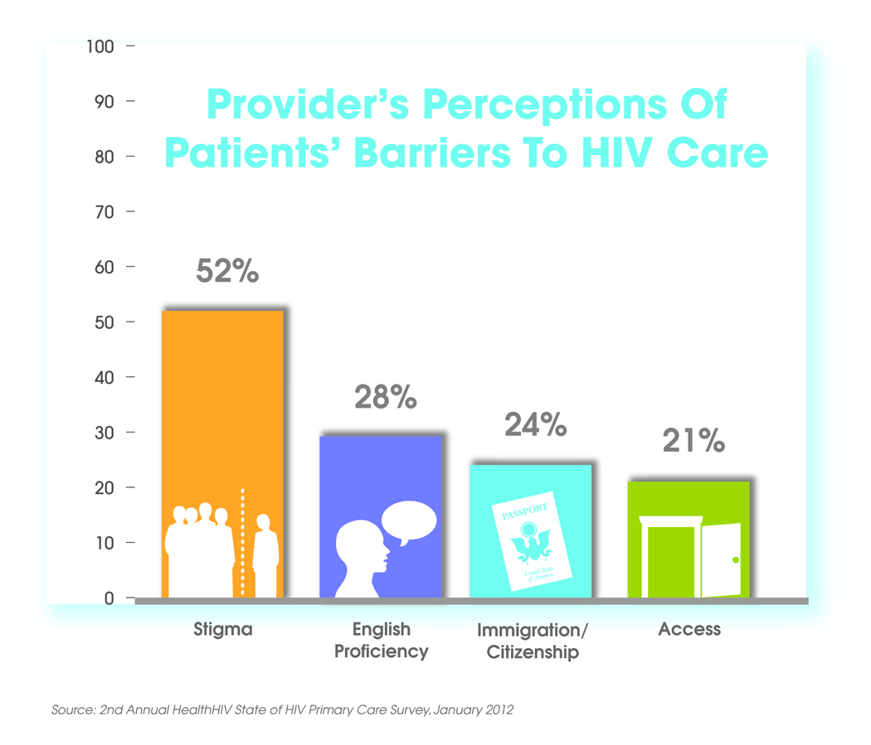

Slide 24
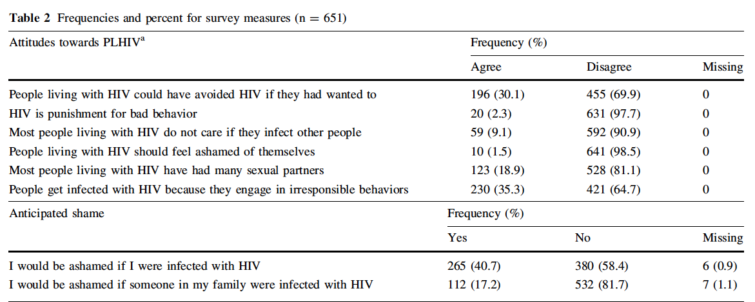
Survey of Public Health and Primary Health Care Workers in the South*
*Stringer et al., AIDS & Behavior, 2015.

Slide 25
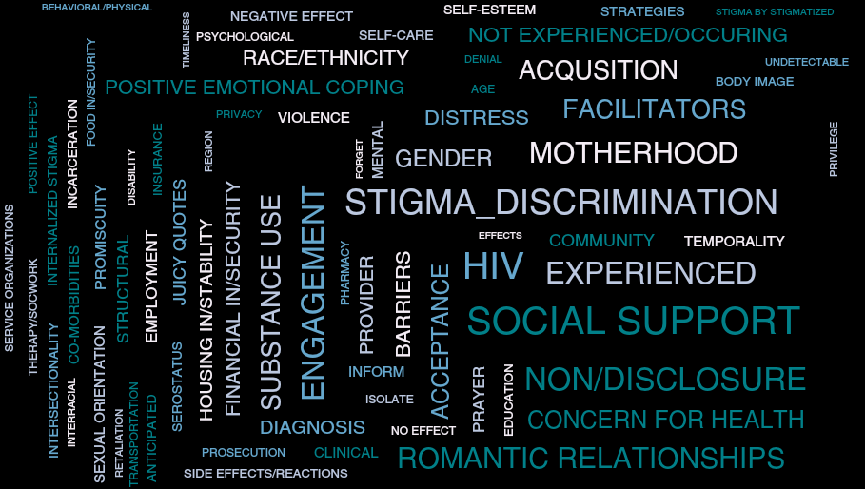
Qualitative Research on
Intersectional Stigma
In-depth interviews with 76 diverse women living with HIV in Alabama, Mississippi, George, and California
* Rice et al., Social Science & Medicine, 2018

Slide 26
Intersecting stigmas experienced by diverse women living with HIV in the US
Most commonly:
  Gender
  Race
  Poverty
But also:
  Incarceration
  Age
  Body image
“All my life I've always wondered what people discriminated against me for. Is it because I was Black? Is it because I was biracial? I never knew if people were discriminating against me because I was HIV-positive, because I was a woman. Honestly, I don't know what. I can't like really pinpoint. I just know that something. I guess it is like a gut feeling. Something just didn't feel right. Like somebody insulted me and like later I'm like what was that for?”

Slide 27
PrEP Stigma as perceived by young Black MSM in the South*
“I’ve heard the term Truvada whore. Like shaming people who take it. It’s like in the gay community, it’s like gay shaming. People think that guys who are on PrEP are overly promiscuous and all they want to do is have all this unprotected sex, these orgies and all this stuff.’’
‘‘Okay. this is what it is. Other people are like, ‘Okay, well, if you’re doing PrEP, then what else are you doing? Are you just out here spreading it low, spreading it wide.”
* Elopre et al., AIDS Pt Care and STDs, 2018

Slide 28
Stigma in Healthcare Settings

Slide 29
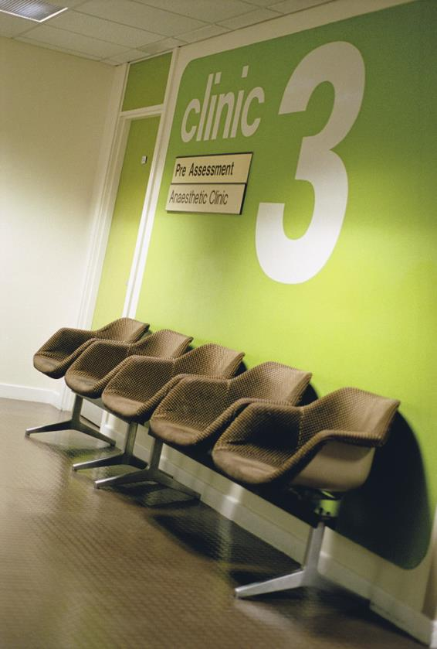
Why Addressing Stigma and Discrimination in Healthcare Settings is Important
Persons affected by HIV may have frequent contact with healthcare providers
Fears of stigma, discrimination, and lack of confidentiality in health facilities can discourage people from:
  accepting HIV testing / PrEP
  linking to HIV care after receiving an HIV-positive test result
  adhering to HIV visits and treatment, or to PrEP
  Getting other kinds of healthcare that they need

Slide 30

Rebecca’s story from the International Conference on Stigma*
"Once they found out I had HIV, nobody wanted to do my C-section.”
Rebecca's surgery was scheduled at 8 am. At 7 am she got the positive results of her HIV test. But then it was 9 am. And then 11 am. There was no one willing to operate on an HIV positive patient.
"And now, every time I go to a hospital or a doctor, I get a panic attack. The feelings of being treated as untouchable come back.”
*http://www.whocanyoutell.org/2017-conference/

Slide 31
Stigma in HC Settings
Fears and experiences of stigma in healthcare settings can both cause internalized stigma and erode trust in healthcare workers, resulting in detrimental effects for the mental and physical health of PLWH.
Internalized HIV stigma is associated with lower antiretroviral therapy (ART) adherence.
This association may be stronger for PLWH in racial/ethnic minority groups as compared to whites.

Slide 32
Intersection of HIV Stigma and Substance Use Stigma for PLWH who use Drugs
Quantitative findings*
Qualitative findings
HIV stigma did not predict retention in care or ART adherence
Anticipated drug use related stigma predicted less adherence to ART
Anticipated drug use stigma remained a significant predictor of ART adherence when controlling for HIV-related stigma
HIV related stigma impacts medication adherence and retention in care through stigma avoidance strategies
  hiding medications
  avoiding being seen at the HIV clinic
Drug use related stigma impacts the patient provider relationship
  Occurred inside and outside the specially care environments
  Limiting communication
  Provision of sub-optimal care
* Stringer KL, et al., AIDS Pt Care & STDs, 2019

Slide 33
Key Principles for HIV Stigma-Reduction Interventions*
Address immediately actionable drivers
Raise awareness
Discuss and challenge the shame and blame
Address HIV transmission fears and misconceptions
Affected groups at the center of the response
Develop and strengthen networks
Empower and strengthen capacity
Address self-stigma
Create partnerships between affected groups and opinion leaders
Contact strategies
Build empathy
Model desirable behaviors
Recognize and reward role models
*Nyblade L, Stangl A, Weiss E, et al. Combating HIV stigma in health care settings: What works? J Int AIDS Soc 2009;12:15.

Slide 34
Interventions that address HIV-related and intersectional stigma in HC settings
Interventions that work with health workers
  Medical/nursing students, current service providers, all levels of staff in a facility
  In-person workshops, seminars, videos, tablets
  See Nyblade et al., BMC Medicine, 2019.
Interventions that work with PLWH/community members
  AA women, Black MSM, Transgender groups, faith-based organizations
  Group-based and individual interventions
  See for example Bogart et al. in Cultur Divers Ethnic Minor Psychol, 2018
Interventions that work with both
  Multi-Country African Study (Uys et al. AIDS Pt Care STDS, 2009)
  FRESH adaptation for the US (Batey et al. AIDS Pt Care STDs, 2016)

Slide 35
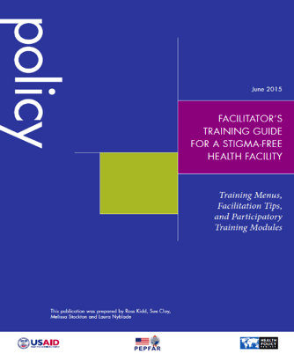
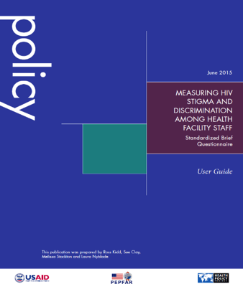
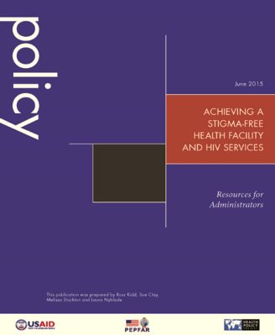
Core components
HPP Stigma-Reduction Package Core Components
  Assess: Two tools and a user’s guide for implementation
  Train: Training menus and material for health workers
  Sustain: Facility assessments, action planning, examples for developing codes of conduct and facility policies
Source: http://www.healthpoliccyproject.com/index.cfm?id=stigmapackage

Slide 36
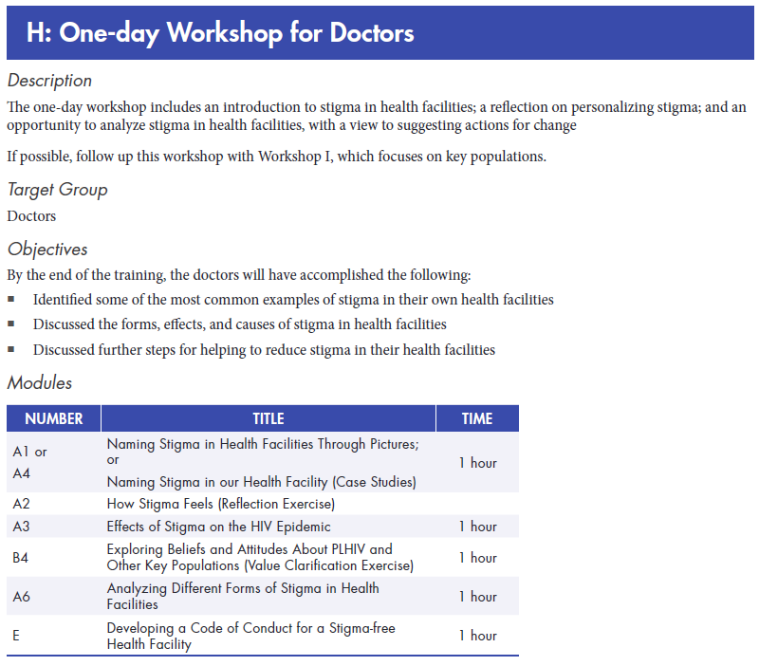
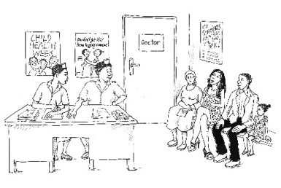
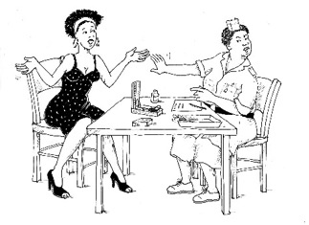
Training Package
Based on field application in 9 countries
Can be tailored for different health worker audiences and timeframes
Includes 17 sample workshops and 1 refresher
Sample S&D Training Programs
Half-day workshop for health facility managers
Three-day work shops for medical health workers
Ten-week modular course for medical health workers
Three-hour workshop for doctors on stigma toward key populations

Slide 37
Example Healthcare Setting Stigma-Reduction Intervention in the United States

Slide 38
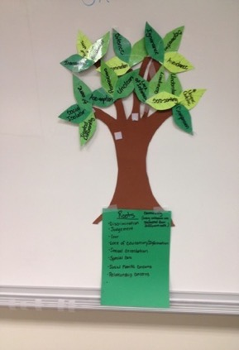
The FRESH Intervention (Finding Respect and Ending Stigma around HIV)
An intervention to reduce HIV-related stigma and discrimination in healthcare settings

Slide 39

Adapted from a Health Setting-Based Stigma Reduction Intervention in Five African Countries*
Based on interpersonal contact theory and social cognitive theory
Sharing information
  sharing the results of local data collection on HIV-related stigma and giving general information about the impact of stigma on persons living with HIV
Increasing contact with the affected group
  bringing together a group of health workers and people living with HIV to plan stigma-reduction activities together
Improving coping through empowerment
  engaging clients in an activity in which they can address stigma directly, not just accept or live with it
*PI: Holzemer; Uys et al., 2009

Slide 40

Importance of Context
The idea of bringing clients and providers together to address stigma in healthcare settings seemed transferable
When adapting for Alabama, we realized the importance of taking into account the very different context in the US South
  Health system characteristics
  Client characteristics
  Social-cultural context of communities
  Socio-economic factors
  Intersectional stigma

Slide 41
To Inform Intervention Adaptation
Data initially collected and analyzed from:
  At-risk populations in AL
    Questions on fears of stigma and values/attitudes added to baseline data collection for 3 HIV prevention projects implemented by the Health Services Center in NE Alabama
  Online survey of public health and primary health care workers in AL and MS*
    Online surveys including validated stigma scales were completed by 651 health workers
  Focus groups with persons living with HIV in Birmingham**
*Stringer et al., AIDS & Behavior, 2016.
**Batey et al., AIDS Patient Care and STDs, 2016.

Slide 42
FRESH Workshop Intervention for AL
10-15 health workers
  Doctors, nurses, receptionists, counselors, social workers, outreach workers, etc.
10-15 consumers (persons living with HIV)
Jointly facilitated by one health worker (social worker) and one consumer (PLWH)
1.5 days (full day followed by half day 1-2 weeks later)
In a neutral location (UAB School of Public Health)

Slide 43

FRESH AL Workshop Agenda
Understanding Stigma
  Local data on stigma and discrimination in AL
  Exercise: Roots and Leaves
Intersecting Stigmas
  Exercise: Stigma stories
Outcomes of Stigma
HIV Knowledge Update (over lunch)
Challenging and Coping with Stigma
  Exercise: Why is Stigma Hard to Change
Stigma Reduction Strategies
  Intervention examples to reduce stigma
  Activity: Working together to come up with ideas for activities to reduce stigma in the healthcare setting in our community

Slide 44

Main Modifications Made:
  including participants from across the city, not from specific health facilities
  neutral, non health facility location
  making the workshop shorter to accommodate busy schedules
  addition of a module on other intersecting stigmas and discrimination (e.g., racism, homophobia)
  targeting group projects to focus on ideas for reaching the larger population of health workers in the region

Slide 45
FRESH AL pilot results*
Satisfaction with the workshop experience was high
  87% PLWH and 89% HW rated the workshop “excellent”
Content analysis of open-ended items revealed that participants felt that the workshop:
  Was informative, interactive, well-organized, understandable, fun, and inclusive
  Addressed real and prevalent issues
Although sample sizes were small, positive trends in pre-post test measures were observed:
  increased awareness of stigma in the health facility among HWs (p=.047)
  decreased uncertainty about HIV treatment among PLWH (p=.017)
*Batey et al., AIDS Patient Care and STDs, 2016.

Slide 46
FRESH Continues….
CFAR Supplement funded to collect baseline data from clients and providers at 6 HIV clinics across Alabama and Tennessee, with plans to further adapt and test the intervention at more clinics across the US South
NIH Fogarty supported R21 to adapt and pilot FRESH for the Dominican Republic with a focus on MSM and Transgender clients (R21TW011761)

Slide 47
FRESH Acknowledgements
Collaborating partners
  ADPH & JCDH
  Health Services Center
  Birmingham AIDS Outreach
  The Health Policy Project
  Chattanooga Cares (Chattanooga)
  Medical AIDS Outreach (Montgomery and Dothan)
  Thrive Alabama (Huntsville)
  Unity Wellness (Opelika)
  USA Family Specialty Clinic (Mobile)
  Whatley Health Services (Tuscaloosa)
  UNIBE, Dominican Republic
  Caribbean Vulnerable Communities Coalition
Funders
  UAB CFAR, National CFAR
  AL PHTC
  UAB SOPH BOTE
  NIH Fogarty International Center
Stigma experts
  Laura Nyblade
  Pamela Payne-Foster
  William Holzemer
  Bronwen Lichtenstein
  Nelson Varas-Diaz
Research participants!
FRESH Study Team at UAB
  D. Scott Batey
  Janet Turan
  Bulent Turan
  Kristine Hauenstein
  Samantha Whitfield
  Emma Sophia Kay
  Kaylee Crockett
  Henna Budhwani
  Murray Ladner
  Joshua Sewell
  Matt Fifolt
  Ruth DeRamus
  Lisa McCormick
  Mirjam-Colette Kempf
  Modupe Durojaiye
  Maz Mulla
  Jason Leger
  Kristi Stringer
  Cathy Simpson
  Melonie Walcott
  Katie Adams
  Frau Lieb

Slide 48
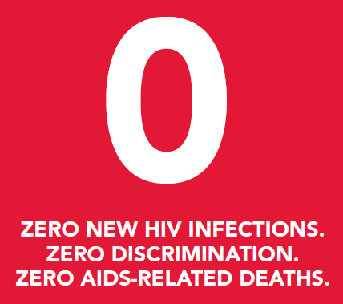
Getting to Zero

