Slide 1
HIV and Pregnancy
Jessica Yager, MD, MPH
Clinical Associate Professor of Medicine
Division of Infectious Diseases
SUNY Downstate Health Sciences University

Slide 2
Disclosures
“This program is supported by the Health Resources and Services Administration (HRSA) of the U.S. Department of Health and Human Services (HHS) as part of an award totaling $3,879,101 with zero percentage financed with nongovernmental sources. The contents are those of the author(s) and do not necessarily represent the official views of, nor an endorsement, by HRSA, HHS or the U.S. Government.”

Slide 3
Albany Medical College endorses the standards of the Accreditation Council for Continuing Medical Education (ACCME) and the guidelines of the Association of American Medical Colleges (AAMC) that the sponsors of continuing medical education activities, speakers and planning committee members of these activities disclose relationships with commercial interests. Commercial interests are defined as any entity producing, marketing, reselling or distributing health care goods or services consumed by, or used on patients. Relationships include receiving from a commercial company research grants, consultancies, honoraria and travel, or other benefits or have a self-managed equity interest in a company.
Albany Medical College has implemented a mechanism to identify and resolve all conflicts of interest prior to the educational activity being delivered to learners.
Disclosure of a relationship is not intended to suggest or condone bias in any presentation, but is made to provide participants with information that might be of potential importance to their evaluation of a presentation.

Slide 4
Disclosures
None.

Slide 5
The following planning members have no financial relationships to disclose: Cynthia Miller, MD, Sarah Walker, MS and Jennifer Price.

Slide 6
Learning Objectives
Discuss factors influencing perinatal HIV transmission
Describe strategies for reducing the risk of perinatal HIV, based on the U.S. Department of Health and Human Service’s Guidelines
List at least two recommendations for postpartum follow-up of women living with HIV
Describe when and how to consult with and refer patients to providers for more specialized care

Slide 7
Pre-test Question
A 28 yo woman is newly diagnosed with HIV and comes to see you for an initial medical visit. She previously used IV heroin, and both shared needles and exchanged sex for heroin; she believes she was infected through shared needles or heterosexual sex. She has now been sober for 4 years, but had delayed getting an HIV test out of fear of the results. She is newly married and would like to start a family though not immediately. Her husband has been tested and is HIV negative. All of the below are true EXCEPT:
She should start on ART and achieve a suppressed viral load prior to attempting to conceive
You fully anticipate that she will deliver an HIV-negative baby if her viral load remains suppressed throughout her pregnancy and delivery.
She should be screened for Hepatitis C.
DTG is absolutely contraindicated as part of her ART regimen.
Even if her viral load is suppressed at the time of delivery, it is recommended that she not breastfeed if she can exclusively formula feed.

Slide 8
Question:
Prior to the routine use of combination antiretroviral therapy (cART), what percentage of pregnant woman living with HIV delivered babies who were HIV positive?
10%
25%
50%
75%
100%

Slide 9
Background:
Why significant?
Similar route of transmission of HIV and pregnancy!
Historic rates of MTCT 25-35% without intervention
Acute HIV infection during pregnancy particularly dangerous to fetus
Routes of mother-to-child transmission
In utero
During labor
breastfeeding

Slide 10
HIV Natural history:
An P, Winkler CA. Trends in Genetics 2010;26:119-131.

Slide 11
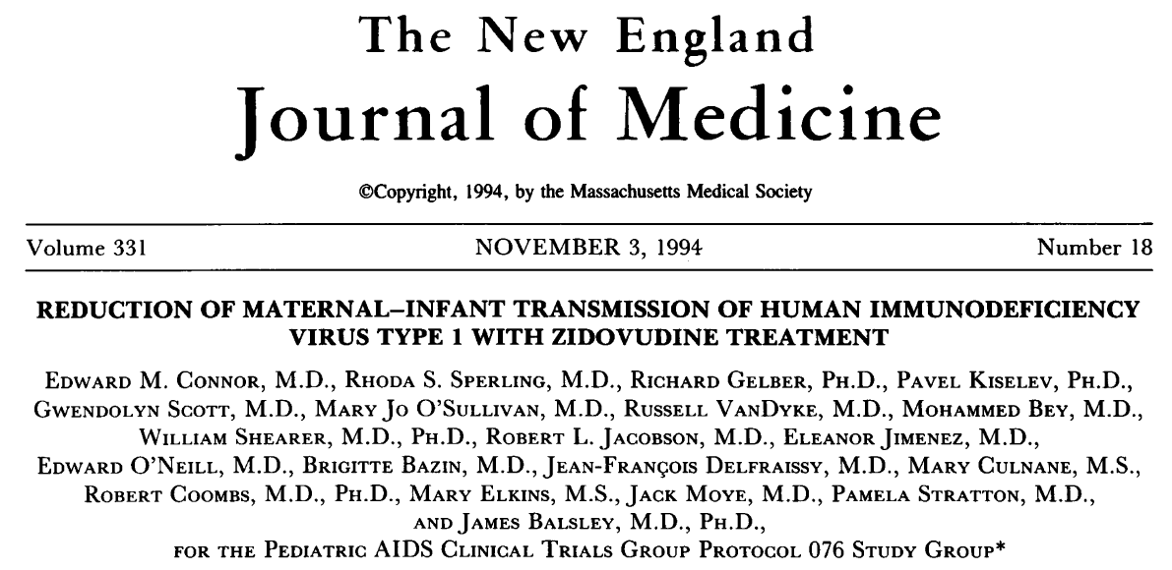

Slide 12
Background: ACTG 076
67.5% relative risk reduction
Connor EM, Sperling RS, Gelber R et al. N Engl J Med 1994;331:1173-1180

Slide 13
Background: ACTG 076

Slide 14
Garcia PM, Kalish LA, Pitt J et al. NEJM 1999;341:394-402.

Slide 15
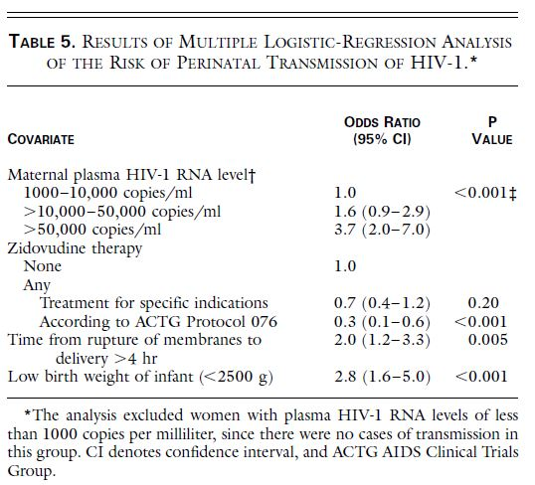
Garcia PM, Kalish LA, Pitt J et al. NEJM 1999;341:394-402.

Slide 16
Garcia PM, Kalish LA, Pitt J et al. NEJM 1999;341:394-402.

Slide 17
Background: ACTG 076

Slide 18
Planning Pregnancy:
Working with an HIV-positive female:
Ensuring VL<20
Ensuring she is on a tolerated ART regimen without known teratogenicity
General pre-natal counseling: etoh, tob reduction/cessation and prenatal vitamins!
Working with an HIV-negative partner:
Opportunity for PrEP

Slide 19
Planning Pregnancy:
Serodiscordant family planning: HIV-negative female with an HIV-positive male
U=U: Ensure positive male has HIV VL<20 copies/mL
PrEP!

Slide 20
Care of the Pregnant woman with HIV: ART naïve
ART indicated for all pregnant women
Test and counsel as you would any other HIV+ patient
Baseline genotype as with any other patient

Slide 21
Initiating ART in an ART-Naïve Pregnant Woman
https://clinicalinfo.hiv.gov/sites/default/files/guidelines/documents/Peri_Tables.pdf (Updated April 2020)

Slide 22
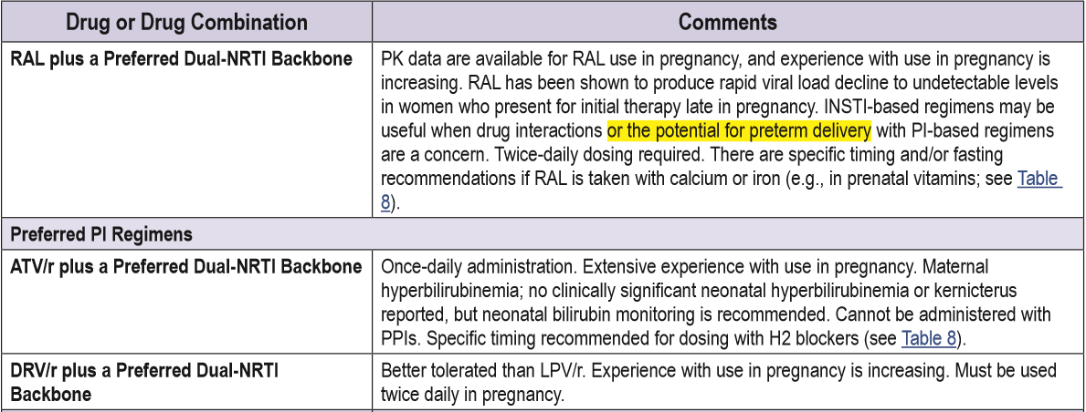
Initiating ART in an ART-Naïve Pregnant Woman
https://clinicalinfo.hiv.gov/sites/default/files/guidelines/documents/Peri_Tables.pdf (Updated April 2020)

Slide 23
Dolutegravir and Pregnancy
https://aidsinfo.nih.gov/news/2109/recommendations-regarding-the-use-of-dolutegravir-in-adults-and-adolescents-with-hiv-who-are-pregnant-or-of-child-bearing-potential

Slide 24
Dolutegravir in Pregnancy
https://aidsinfo.nih.gov/news/2109/recommendations-regarding-the-use-of-dolutegravir-in-adults-and-adolescents-with-hiv-who-are-pregnant-or-of-child-bearing-potential

Slide 25
Dolutegravir in Pregnancy
Zash R, Holmes L, Diseko M et al. N Eng J Med 2019; 381:827-840.

Slide 26
https://www.niaid.nih.gov/news-events/newer-anti-hiv-drugs-safest-most-effective-during-pregnancy

Slide 27
Darunavir concentrations in pregnancy:
AUC reduced 38-39%
AUC reduced 26%
Stek A, Best BM, Wang J et al. J Acquir Immune Defic Syndr. 2015 September 1; 70(1): 33–41.

Slide 28
Raltegravir in Pregnancy
Figure 1. Median raltegravir concentration-time curves
Highly variable raltegravir pharmacokinetic parameters during pregnancy, including trough levels
However, persistent virologic suppression: 92% had VL<400 copies/mL at delivery
High placental transfer, with median cord blood RAL levels higher than maternal levels at delivery
Watts DH, Stek A, Best BM. J Acquir Immune Defic Syndr. 2014 December 1; 67(4): 375–381.

Slide 29
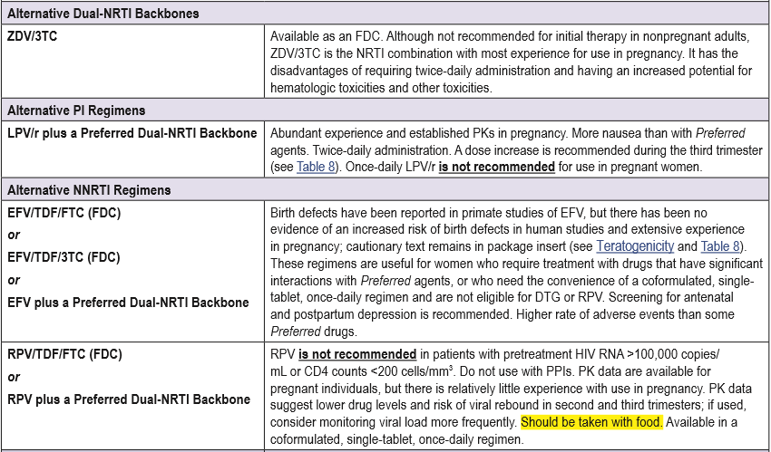
Initiating ART in an ART-Naïve Pregnant Woman
https://clinicalinfo.hiv.gov/sites/default/files/guidelines/documents/Peri_Tables.pdf

Slide 30
Initiating ART in an ART-Naïve Pregnant Woman
https://clinicalinfo.hiv.gov/sites/default/files/guidelines/documents/Peri_Tables.pdf

Slide 31
Women trying to conceive:
https://clinicalinfo.hiv.gov/sites/default/files/guidelines/documents/Peri_Tables.pdf

Slide 32
Considerations when initiating a regimen:
Pill burden and dosing schedule – can patient tolerate BID dosing?
Gestational age – urgency of achieving virologic suppression
Side effects – fatigue, nausea/vomiting
Hypotheses about potential resistance – partner’s regimen/resistance known?
Drug-drug interactions

Slide 33
A Pregnant woman already on ART
https://aidsinfo.nih.gov/guidelines/html/3/perinatal/157/pregnant-women-living-with-hiv-who-are-currently-receiving-antiretroviral-therapy

Slide 34
Monitoring pregnant women with HIV
Monitor CD4 and VL at initial pregnancy visit
At least every 3 months (once every trimester), though can consider every 6 months for CD4 if individual has robust immune system and has been stable on regimen for prolonged period
At 34-36 weeks to inform decisions about delivery
Perform genotype prior to initiating therapy if ART-naïve and no prior, and if failing therapy
Glucose tolerance test as normal (can consider earlier if on PI)
Early US to determine/confirm gestational age and assist in planning possible c-sxn
Perform amnio only after stable on ART

Slide 35
Question:
Based on current guidelines, a woman and her provider should plan for a c-sxn delivery if her HIV viral load is:
1. At all detectable (>20 copies/mL)
2. >500 copies/mL
3. >1000 copies/mL
4. >10,000 copies/mL

Slide 36
Intrapartum and neonatal care
If VL>1,000 near delivery:
Plan for c-sxn at 38 weeks
Administer IV AZT
If a woman presents in labor with unknown HIV-status:
Conduct a rapid test
If positive: send confirmatory and initiate therapy with IV AZT (mother) and combination ART (infant), to continue for at least 6 weeks

Slide 37
Postpartum care: mother
Continue ART!
Breastfeeding – contraindicated
Counseling on birth control, family planning
Ensure ongoing linkage to care – difficult transition period
Close ongoing care coordination between HIV, OB, and pediatric providers

Slide 38
Hepatitis B
Consideration of HBV coinfection:
Ensure all pregnant women screened for HBV
If negative: vaccinate!
If positive:
Ongoing screening for liver toxicity
Ensure on double treatment (NRTI backbone)
Test and vaccinate as needed against HAV
Baby to receive HBIG and vaccination upon delivery (within 12 hrs)

Slide 39
Hepatitis C
MTCT 5-15%. Higher rates in co-infected women with uncontrolled HIV
If possible: treat HCV prior to pregnancy
Treatment for HCV not recommended during pregnancy
Impact of pregnancy on HCV: higher incidence of intrahepatic cholestasis of pregnancy (Wijarnpreecha K et al. Clin Res Hepatol Gastroenterol. 2017;41(1):39-45.)
Test and vaccinate against HAV and HBV
Screen for liver toxicity
Breastfeeding is not contraindicated if mono-HCV infection
Infants born to HIV/HCV+ mothers should be Ab screened at 18mos old; need 2 HCV RNA tests if positive

Slide 40
When to refer?
Patients with a complicated history of ART resistance, non-adherence
Significant psycho-social barriers to care
Significant side effects to medications
Inability to assist with close coordination of care
Assistance of OB and/or pediatric ID specialist

Slide 41
Post-test Question
A 28 yo woman is newly diagnosed with HIV and comes to see you for an initial medical visit. She previously used IV heroin, and both shared needles and exchanged sex for heroin; she believes she was infected through shared needles or heterosexual sex. She has now been sober for 4 years, but had delayed getting an HIV test out of fear of the results. She is newly married and would like to start a family though not immediately. Her husband has been tested and is HIV negative. All of the below are true EXCEPT:
She should start on ART and achieve a suppressed viral load prior to attempting to conceive
You fully anticipate that she will deliver an HIV-negative baby if her viral load remains suppressed throughout her pregnancy and delivery.
She should be screened for Hepatitis C.
DTG is absolutely contraindicated as part of her ART regimen.
Even if her viral load is suppressed at the time of delivery, it is recommended that she not breastfeed if she can exclusively formula feed.

Slide 42
HIV - HCV - PrEP - PEP
Clinical Consultations
For Providers in Upstate NY
Call or E-mail for a consultation:
518-262-6864
Monday – Friday 8:00 a.m. – 4:30 p.m.
prokopw@amc.edu
If you have experienced an occupational exposure such as a needle stick, please call 518-262-4043. You will be given an opportunity on the telephone menu to speak to a physician 24 hours a day.
www.amc.edu/hiv

