Slide 1
The Intersection of Intimate Partner Violence, Sexual Assault, Trafficking and STI/HIV Risk in Indigenous Women
Providing Survivor Led, Advocacy Driven, and Culturally Safe Care
Content developed December 2020
Notes:
Welcome everyone! Thank you for joining this webinar, “The Intersection of Intimate Partner Violence, Sexual Assault, Trafficking and STI Risk in American Indian Women: Providing Survivor Led, Advocacy Driven and Culturally Safe Care.”

Slide 2
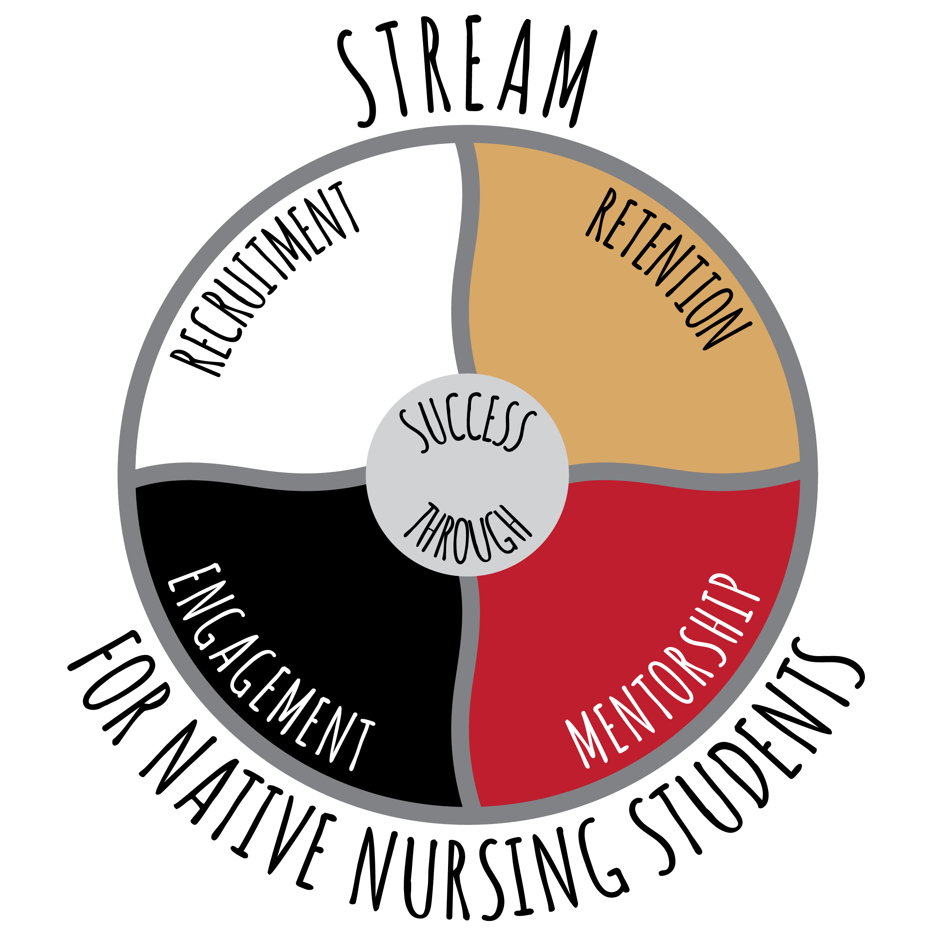
Thank You To Our Co-Sponsors
Notes:
We are honored to co-sponsor this event with the UW School of Nursing STREAM Program, Native American Center for Health Professions and UW Milwaukee’s School of Nursing and Women’s and Gender Studies program. And, we are very excited to have you all join us today for this webinar. And, thank you to everyone who also joined last week's program that provided foundational knowledge for this event.

Slide 3
Disclaimer
Funding:
This presentation is supported by the Health Resources and Services Administration (HRSA) of the U.S. Department of Health and Human Services (HHS) as part of an award totaling $3,994,961 with no percentage financed with nongovernmental sources. The contents are those of the author(s) and do not necessarily represent the official views of, nor an endorsement, by HRSA, HHS or the U.S. Government.
The research study referenced in this presentation was supported by a generous gift from the Forest Country Potawatomi Foundation.
Terminology:
We are committed to using terminology that respects and honors the individuals to whom this research is concerned. Currently, there are over 560 federally recognized American Indian and Alaskan Native Indian tribes in the U.S. While no single term is universally accepted by all indigenous peoples in the U.S., the terms “American Indian, Alaskan Native, Indigenous, and Native American,” are used for data reporting purposes only, and appear in the form the terminology was originally published. It is not meant to minimize, exclude or generalize the individuals involved nor endorse one form of terminology over the other.
Notes:
I'd also like to acknowledge that this program is funded by HRSA.

Slide 4
Land Acknowledgement
Notes:
Before we begin the presentation I would just like to acknowledge that the University of Wisconsin Madison campus is located on the ancestral lands of the Ho-Chunk nation.

Slide 5
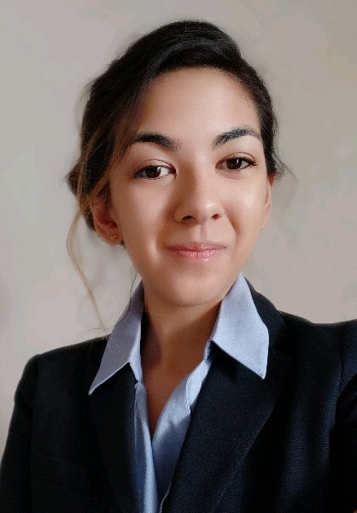
Presenters
Jeneile Luebke, PhD, RN │ she/her
Post-doctoral Nurse Research Associate
UW-Madison School of Nursing
Ashley Ruiz, RN, BSN, PhD(c)│ she/they
Sexual Assault Nurse Examiner, Aurora Sinai
University of Wisconsin – Milwaukee
Katie Klein, BA │ she/they​
MA Student & Instructor​
Women’s & Gender Studies, UW-Milwaukee​
Notes:
This presentation was prepared by Dr. Jeneile Luebke, Ashley Ruiz and Katie Klein.
Jeneile Luebke PhD, RN is a post-doctoral nurse research associate at University of Wisconsin-Madison. She received her early nursing degrees (LPN and ADN) in Bemidji, MN, and her BS and MS Nursing from the University of Wisconsin- Madison, and her PhD at UW-Milwaukee. She in an enrolled member of Bad River Band of Lake Superior Chippewa Indians. Her area of research and expertise include intimate partner violence in the lives of American Indian women, community health nursing and utilization and application of postcolonial and indigenous feminist methodologies. She is a survivor of intimate partner violence and is passionate about sharing her knowledge and personal experiences to help to support and empower other women to transition to survivorhood.
Ashley is a sexual assault nurse examiner at Aurora Sinai, and nursing scholar studying at the University of Wisconsin Milwaukee. Her expertise focuses on nurse-patient interactions following experiences of sexual violence. Through this expertise, Ashley offers insight into available resources and healthcare service available to survivors of sexual violence in Wisconsin.
Katie Klein (she/they) is a master's student and instructor in Women's & Gender Studies at UW-Milwaukee, and a 2020 Graduate Student Excellence Fellow. Katie's praxis is rooted in intersectional feminism and centered on eliminating gender-based violence. Their thesis research & activism focuses on the racialized, gendered, and sexualized precarity experienced by workers in the US service industry.

Slide 6
Learning Objectives
Recognize how gender-based violence (GBV) such as intimate partner violence (IPV), sexual assault (SA), and trafficking increases American Indian (AI) women’s risk for contracting sexually transmitted infections (STIs) or HIV
Describe three strategies for delivering culturally safe care to survivors of GBV
Identify two resources to support STI screening, pre-exposure prophylaxis (PrEP), and immediate access to HIV post-exposure prophylaxis (PEP)

Slide 7
Review
GBV such as IPV, SA, and human trafficking impacts women globally
Violence impacts AI women disproportionately (crisis)
GBV is a global human rights and public health issue (PREVENTABLE!)
GBV the most common killer of women around the world
SILENT EPIDEMIC—prevalence rates MUCH higher than reported
Devastating impacts to health and well-being
Impacts future generations

Slide 8
Polling Question!
Of the 574 Federally recognized tribes in the US, how many tribally-created or Native-centered domestic violence shelters are there?
Notes:
Answer: Less than 60 (National Indigenous Women's Resources Center)

Slide 9
violence and risk of STI & HIV
What are the connections?

Slide 10
Intersection of GBV and STI/HIV Risk
There are many commonalities between GBV such as IPV, SA, and trafficking
Many survivors have experienced multiple forms of abuse by more than one partner
IPV, SA, and trafficking survivors are vulnerable to many STIs, including HIV
The risk of HIV acquisition increases exponentially in certain circumstances

Slide 11
Prevalence of Violence Against AI Women
Crisis of violence against AI women (SA/ IPV/ trafficking) in both urban and reservation areas (Burnette, 2016; Casselman, 2016)
AI women disproportionately impacted by IPV, SA, and trafficking
Gap in the data: qualitative study addresses this gap
No studies published about IPV with AI women in Wisconsin previously
AI women at risk for STI/ HIV transmission during SA and trafficking

Slide 12
Rates of STIs
Kaiser Family Foundation. (2020, February 18). Sexually Transmitted Infections (STIs): An Overview, Payment, and Coverage. https://www.kff.org/womens-health-policy/fact-sheet/sexually-transmitted-infections-stis-an-overview-payment-and-coverage/
Notes:
The rate of reported chlamydia cases among AI's in the United States as 3.7 times the rate among Whites
In 2018, the rate of reported gonorrhea among AI's (329.5 cases per 100,000 population) was 4.6 times the rate among Whites, and a bigger disparity among AI women at 6.3 times the rate among White females than for AI/AN males (3.3 times the rate among White males).
In 2018, the rate of reported P&S syphilis cases among AI/AN was 2.6 times the rate among Whites (15.5 versus 6.0 cases per 100,000 population, respectively). This disparity was greater for AI/AN females (5.4 times the rate among White females) than for AI/AN males (2.1 times the rate among White males)

Slide 13
Rates of HIV: Wisconsin
HIV disproportionately affects people of color (POC)
New HIV diagnoses affecting POC rose from 20% in 1982 to 68% in 2019
During 2019, racial and ethnic minorities made up just 18% of WI's population, but accounted for 68% of new HIV diagnoses
During 2010–2019, 15 AI people were diagnosed with HIV infection
WI Department of Health Services, Division of Public Health. (2020). Wisconsin HIV surveillance annual report, 2019. https://www.dhs.wisconsin.gov/publications/p00484.pdf-0
Notes:
Three out of four of these recent diagnoses were male.
Forty-seven percent were under 30 at the time of diagnosis.
All but two were diagnosed in either the southeastern (53%) or northeastern (33%) regions.
Nine diagnoses were attributed to male-male sexual contact (60%), two were attributed to injection drug use (13%), and four had an unknown transmission category (27%).

Slide 14
2020 Ethnographic Study Data
Qualitative study conducted in the spring of 2020 to better understand how IPV manifests in the lives of urban WI AI women (N=34)
Two major themes were chosen to focus upon due to the urgency related to the COVID pandemic:
Structural barriers to help seeking after an experience with IPV
IPV experienced during the pregnancy period
Reported linkages between IPV, SA, and contraction of STIs
(Luebke, 2020)
Notes:
This major theme reveals the complexity of IPV experienced within the local context and how colonialism has contributed to the present-day IPV experiences of urban AI women in Wisconsin.
•The COVID-19 pandemic served to exacerbate barriers to help seeking (job loss, housing, etc).
•Of the 34 survivors interviewed:
•67.6% (N=23) refused/ unable to seek medical attention after IPV experience regardless of injury
•24% (N=8) of survivors received medical care only because the IPV was witnessed and a call to 911 was placed on their behalf
•17% (N=7) sought other types of help such as a domestic violence shelter, counseling, or a call to the police.

Slide 15
Study: Participant Stories
Laurie's* story demonstrates the connections between exposure to violence and STI risk
Laurie* experienced IPV, SA and was trafficked
This resulted in her contracting STIs and severe physical injuries
She sought medical care for her injuries, but was not screened for IPV
It is vital that we heed her advice to medical professionals and fellow survivors
(Luebke, 2020)
Notes:
Laurie's* story reflects the need for screening:
"I wish doctors would notice the signs so that they can help us before we get damaged."
Laurie's* advice to nurses & allied health professionals:
"Let us know we're safe. Take us to a safe place. If they see what's happening, bring us somewhere. Try to get us away from the abuser, even if they're sitting right outside. Let them know that it's okay, we can get you out safely."
Laurie* share what would be helpful for other women:
"Safe testing for us and let them know that it's okay to open up. It took me years. This is actually the first time opening up."

Slide 16
Medical Management of Sexual Assault
What should happen?

Slide 17
Polling Questions!
Have you ever recommended or prescribed post-exposure prophylaxis (PEP) or pre-exposure prophylaxis (PrEP) for a patient?
Do you know where the closest SANE nurse to you is?
Do you know where to find this information?

Slide 18
Management
The medical management of SA survivors should include the evaluation, treatment, and prevention of STIs if indicated, and the evaluation for prevention of pregnancy
Contracting an STI from an assailant is a risk, and significant concern of SA survivors
Adolescent and adult survivors of SA potentially exposed to STIs should be offered and given all recommended prophylactic medications, if indicated

Slide 19
Post-Exposure Prophylaxis (PEP)
Use of antiretroviral (ARV) medication to prevent HIV infection in an HIV-negative individual who has had a specific high-risk exposure to HIV
Exposure to HIV is a medical emergency, because HIV establishes infection very quickly (often within 24 to 36 hours after exposure)
The use of PEP is recommended as soon as possible in the first 72 hours [of a SA encounter]
The Wisconsin SAFE Fund now covers the entirety of HIV PEP medication for victims if prescribed during a SA forensic exam (up to $1,290. Per 21 79.05(1)(am) Stats. and certified by the department of revenue under s. 79.05(2m), Stats.

Slide 20
Pre-Exposure Prophylaxis (PrEP)
When a person who does not have HIV takes daily antiretroviral medication to prevent HIV acquisition in the event of an exposure to HIV through sexual contact or injection drug use
Practitioners may want to consider PrEP for women who experience repeat violence, sex work, and other behavioral risk factors for HIV
PrEP recommendation for treatment will be determined by provider on an individual basis
Survivor ability to comply with medication directions, status of kidney/liver function, etc.

Slide 21
Providing Survivor Led, Advocacy Driven, and Culturally Safe Care
How Can We Provide Safe Care?

Slide 22
Mistakes of Providers
Invalidating her experience
Paternalistic attitude
Victim shaming/blaming
Ignoring her need for safety
Not respecting her autonomy/self-sovereignty
Trivializing and minimizing abuse
Missed opportunities for screening
Missed opportunities to provide resources
Notes:
Building on some of the things that were just discussed

Slide 23
Trauma-Informed Care (TIC)
A strength-based framework that recognizes the impact that trauma can have on health and well-being
TIC is a patient-centered approach to providing care. TIC shifts the focus from “What’s wrong with you?” to “What happened to you?” by:
Realizing the widespread impact of trauma (including historical and intergenerational trauma) and understanding potential paths for recovery
Recognizing the s/s of trauma in survivors, families, and staff
Integrating knowledge about trauma into policies, procedures, and practices
Always seeking to actively resist re-traumatization
Notes:
TIC it places the survivor at the center of all healthcare decisions.
The survivor knows what is best for her- not the practitioner!.
TIC fosters the relationship with the patient based on respect, trust, and safety, allowing the patient to feel empowered. This also fosters the patient’s ability to make decisions about reporting and the criminal justice process.

Slide 24
What Can I Do?
Humanistic care (respect and non-judgement)
Listen attentively
Respect confidentiality
Promote access to services
Help in safety planning
Respect autonomy (self-sovereignty)
Believe and validate experiences
Acknowledge the injustice
Notes:
Normalize the topic of violence and screen EVERY woman at every point of care- will discuss more in detail in the next few slides
Respect survivors' decisions that they make for themselves. They are the experts in their own care.
Use your intuition. A survivor may decline the "violence screener". Make them aware of the resources available to them and you may frame it around having them share the information to anyone that they may know. The more times that they hear that there IS help, and that help is safe and accessible, the more likely she will be open to getting help.

Slide 25
TIC/Strength-Based Care con't
We always want to highlight the things that she is doing RIGHT.
Emphasize that IPV and SA is NOT her fault.
Check your social attitudes, practice self-reflection.
Never shame a victim. She will make mistakes. We all do because we are human.
Empower by creating a plan with her and letting her take charge of it (self-sovereignty!).
Remind her that she is not alone. There is hope!
Notes:
(how could you ever put up with that! OR why don’t you just leave?!?).

Slide 26
Culturally Safe Care
Cultural safety creates environment that is spiritually, emotionally, and socially SAFE where there is no assault, challenge, or denial of their identity and needs
Cultural safety ensures that we don’t replicate oppressive practices that put survivors “in a box”, that can lead to “othering”
Offer culturally specific resources when available, especially advocacy services
Don't be afraid to ask questions
"How can I best support you?"
"Is there anything I need to know about your cultural preferences?"

Slide 27
Mandated Reporting
Generally, we are mandated to report assault to authorities for survivors aged 16 and younger
Survivors know what’s best for them
Mistakes in reporting to authorities can cost survivors their lives
Always consult with a nurse manager, social worker, or advocacy service if you’re unsure how to proceed
Referral to advocacy services and SANE nursing services
Notes:
Under Chapter 48 of the Wisconsin Statutes or Executive Order 54, nurses are we are mandated reporters. Meaning if a survivor is below the age of 16, and has experienced violence, we are required to report this to child protective services or CPS. This is typically explained by sane nurses before a report is filed. This is one difference between SANE nurses and advocates, is that advocates are not mandated reporters. If you ever have any questions about mandated reporting consulting with you’re a nurse manager, social worker, or advocacy service is a great way to address these questions.

Slide 28
Examples of Advocacy driven care
What is being done?

Slide 29
Tracking Our Truth
Exemplar of an academic community partnership to provide survivor led and advocacy driven care to AI women
$2 million service grant from the DOJ (OVAW)
Development of SANE Programs with paired SANE RN/ Advocates
International Association of Forensic Nurses (IAFN) trainings in Milwaukee and Northern Wisconsin
Community partners to engage in culturally specific 40-hour SA advocacy training program
Development of Tribal Sexual Assault Response Team
Notes:
addresses a gap in care

Slide 30
Tracking Our Truth (cont)
Development of two new SANE programs in Milwaukee and one in Rice Lake
Partnership and provisions of care to St Croix Chippewa Indian Tribe and Lac Courtes Oreilles (LCO) Band of Lake Superior Chippewa Indians
(Embrace) will provide 24/7 advocacy-driven medical forensic care
Culturally tailored SA advocacy training program for those who assist survivors
Support from Great Lakes Inter-Tribal Council (GLITC), Red Wind, and American Indians Against Abuse (AIAA)
Notes:
Academic Community partnerships!

Slide 31
Other Indigenous Led Advocacy
Women's Leadership Cohort (Menominee)
Wise Women Gathering
HIR Wellness Institute
Gerald Ignace Indian Health Care Center (IHCC) (SANE services/Circles of Strength)
Many individuals!

Slide 32
Culturally Specific Resources
Wisconsin tribal health clinics:
https://www.dhs.wisconsin.gov/lh-depts/tribal.htm
Milwaukee:
Gerald Ignace Indian Health Care Center (Urban/ SANE): 1-414-383-9526
HIR Wellness Institute (Advocacy/ no SANE): 1-414-748-2592 (CARES Line)
Green Bay:
Wise Women Gathering: 1-920-490-0627
Other Areas:
Embrace Services, Inc: 1-800-924-0556/ 1-715-532-6976 (text) (24/7)
St. Croix Valley SART: 1-715-425-6443 (24/7 Support Line)
Strong Hearts Native Helpline: 1-844-7NATIVE (1-844-762-8483) www.strongheartshelpline.org

Slide 33
Other Resources
IPV, SA and Trafficking
Domestic Abuse Intervention Services: 608-251-4445 (helpline)
Rape Crisis Center: 608-251-7273 (24/7 help line)
RAINN's (Rape, Abuse & Incest National Network): 1-800-656-4673 (helpline) | www.rainn.org/
National Domestic Violence Hotline: 1-800-799-723
www.thehotline.org (live chat available online)
National Human Trafficking Hotline: 1-888-373-7888 (TTY: 711)
Text 233733 | https://humantraffickinghotline.org (live chat available online)
For clinical care teams
National Clinician Consultation Center (NCCC): nccc.ucsf.edu/
AETC NCRC nPEP Toolkit: https://aidsetc.org/resource/non-occupational-post-exposure-prophylaxis-npep-toolkit
Sexual Assault: PEP is an Urgent Health Need: https://aidsetc.org/blog/sexual-assault-pep-urgent-health-need

Slide 34
Review: How Can I Help? What Can I Do?
Know where the closest SANE provider is located
Identify the closest pharmacy that carries PEP/ PrEP/emergency contraception
Increase your understanding and awareness of the injustices AI women experience
Create safe spaces through examining violence within context
Practice self-reflection and acknowledge bias
Promote self-sovereignty
Notes:
Nurses and allied care professional have a unique opportunity to help STOP the cycle of abuse through an increased understanding and awareness of the injustice experienced by AI women!
When you think about saving someone versus empowering them, when we break that down, that’s a system of colonization
Self-sovereignty is self-love and self-care. My body= my rules.
As healers, one of the most important things we can do is encourage and support self-healing of survivors

Slide 35
References
Centers for Disease Control and Prevention. 2015 STD Treatment Guidelines. https://www.cdc.gov/violenceprevention/pdf/ipv/13_243567_Green_AAG-a.pdf.
Dawson, L., Kates, J., Ramaswamy, A. (2019). HIV, Intimate Partner Violence (IPV), and Women: An Emerging Policy Landscape. Kaiser Family Foundation. https://www.kff.org/hivaids/issue-brief/hiv-intimate-partner-violence-ipv-and-women-an-emerging-policy-landscape/.
Draughon, J. E. Sexual assault injuries and increased risk of HIV Transmission. Adv Emerg Nurs J. 2012 Jan-Mar; 34(1): 82–87. doi: 10.1097/TME.0b013e3182439e1a.
Office on Women’s Health. Violence against women and HIV risk. US DHHS. https://www.womenshealth.gov/hiv-and-aids/women-and-hiv/violence-against-women-and-hiv-risk.
Robinson, J. C. (2020). IAFN Sexual Assault Nurse Examiner Certification: A Review for the SANE-A® and SANE-P® Exams: Springer Publishing Company.

Slide 36
Discussion, Questions & Answers!
Miigwech (thank you) for joining us today!
Please feel free to ask any questions or share any feedback with us at this time!

Slide 37
Videos and Movies- Learn More!
The Search- MMIW: https://youtu.be/mdPv0NDfMbA
Our Sisters in Spirit: https://youtu.be/zdzM6krfaKY
Peace River Rising: https://youtu.be/6GbGL7dmEwA
A Broken Trust- Sexual Assault on Tribal Lands: https://youtu.be/-slFVM4ECUk
Silent No More: https://youtu.be/DdjXyUPXtZs
Between the Lines: https://youtu.be/hOXyGJuRMmo
Highway of Tears: https://youtu.be/xz63Vppw3gE

