Slide 1
The Intersection of Intimate Partner Violence, Sexual Assault, Trafficking and STI Risk in Indigenous Women Identifying Root Causes to Improve Care and Seek Social Justice
Content developed December 2020

Slide 2
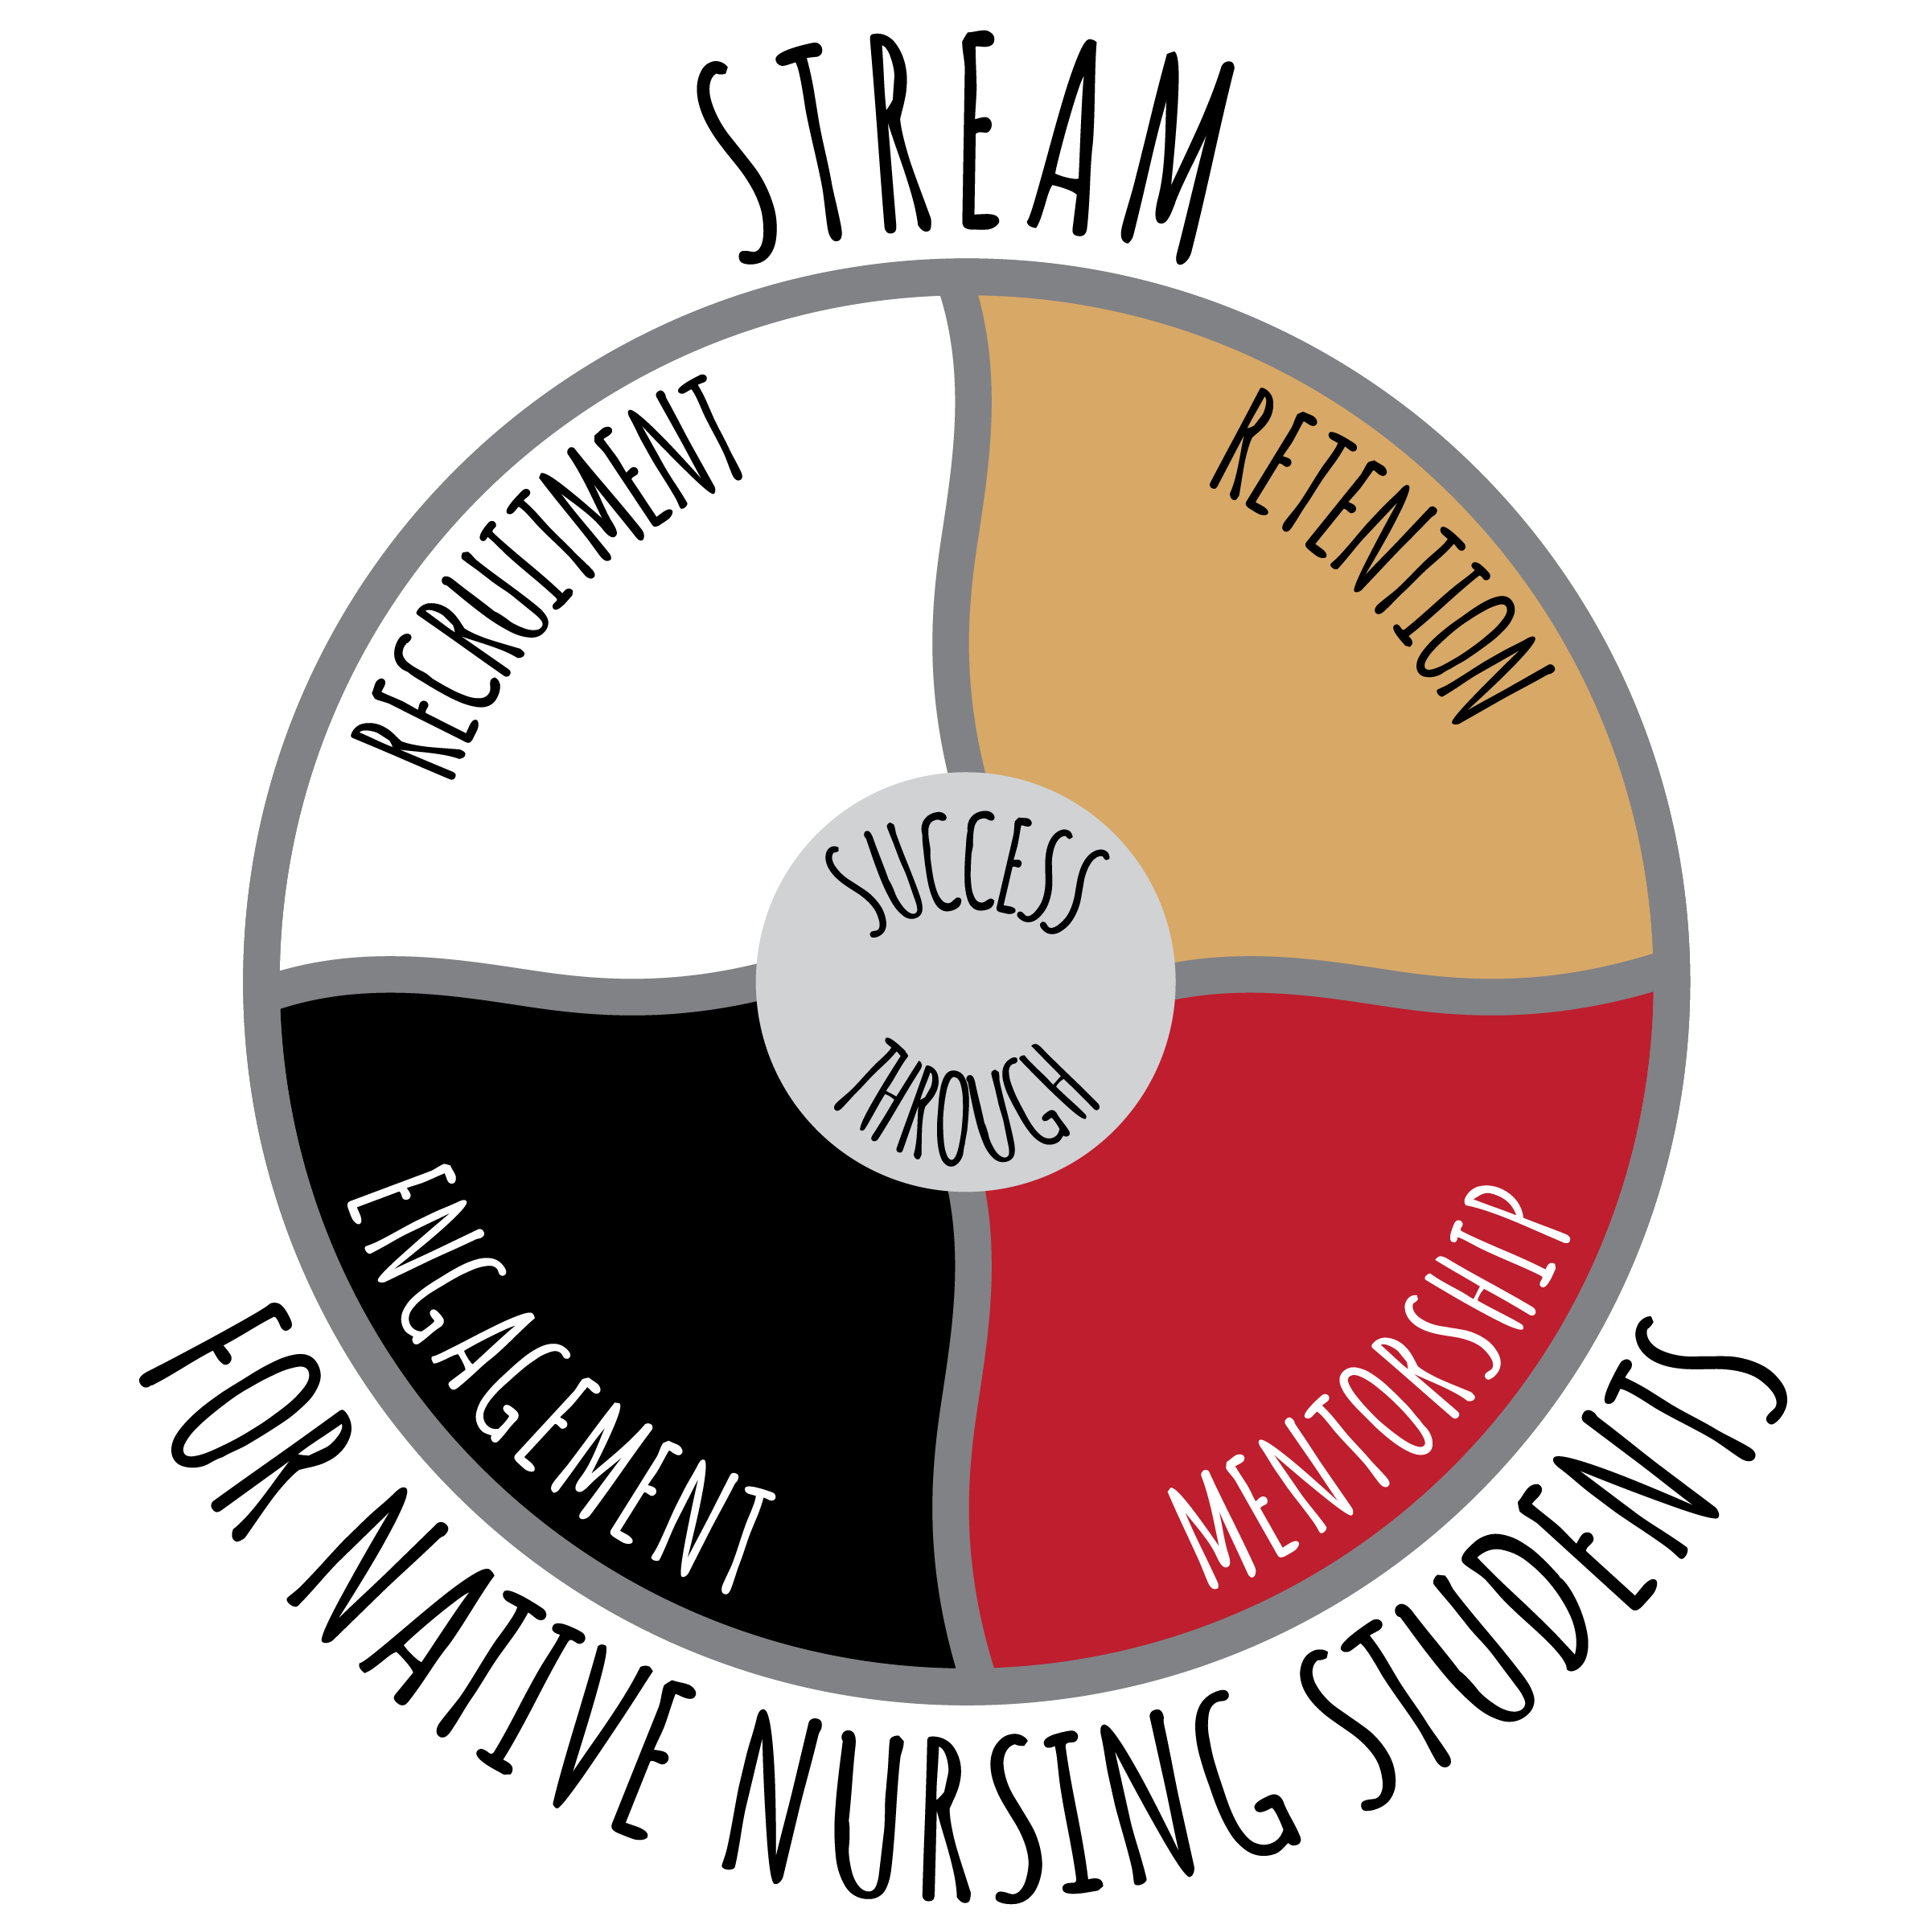
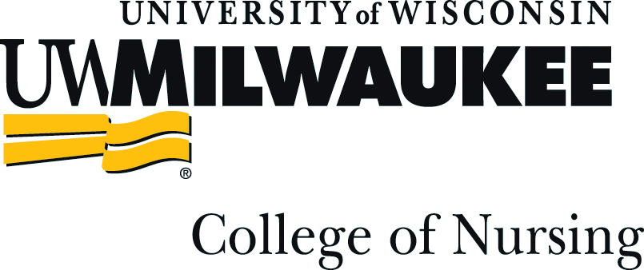
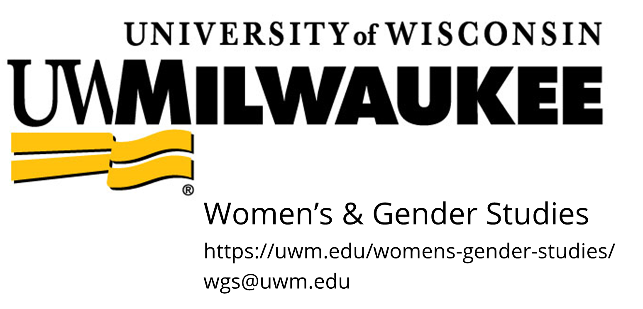
Thank You To Our Co-Sponsors
Notes:
We are honored to co-sponsor this event with the UW School of Nursing STREAM Program, Native American Center for Health Professions and UW Milwaukee’s School of Nursing and Women’s and Gender Studies program. And, we are very excited to have you all join us today for this webinar.

Slide 3
Disclaimer
Funding:
This presentation is supported by the Health Resources and Services Administration (HRSA) of the U.S. Department of Health and Human Services (HHS) as part of an award totaling $3,994,961 with no percentage financed with nongovernmental sources. The contents are those of the author(s) and do not necessarily represent the official views of, nor an endorsement, by HRSA, HHS or the U.S. Government.
The research study referenced in this presentation was supported by a generous gift from the Forest Country Potawatomi Foundation.
Terminology:
We are committed to using terminology that respects and honors the individuals to whom this research is concerned. Currently, there are over 560 federally recognized American Indian and Alaskan Native Indian tribes in the U.S. While no single term is universally accepted by all indigenous peoples in the U.S., the terms “American Indian, Alaskan Native, Indigenous, and Native American,” are used for data reporting purposes only, and appear in the form the terminology was originally published. It is not meant to minimize, exclude or generalize the individuals involved nor endorse one form of terminology over the other.

Slide 4
Land Acknowledgement
Notes:
Before we begin the presentation I would just like to acknowledge that the University of Wisconsin Madison campus is located on the ancestral lands of the Ho-Chunk nation.

Slide 5
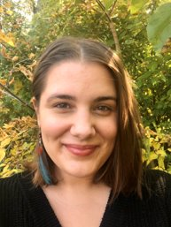
Presenters
Jeneile Luebke, PhD, RN │ her/hers
Ogimaakwe (Bad River Band Chippewa)
Post-doctoral Nurse Research Associate
UW-Madison School of Nursing
Katie Klein, BA │ she/they​
MA Student & Instructor​
Women’s & Gender Studies, UW-Milwaukee​
Notes:
This presentation was prepared by Dr. Jeneile Luebke and Katie Klein from in December 2020.

Slide 6
Learning Objectives
Recognize how intimate partner violence (IPV), sexual assault (SA) and trafficking disproportionately impact Indigenous women in Wisconsin
Discuss how intersecting systems of oppression contributes to high rates of IPV/ SA/ trafficking among Indigenous women
Recall how identity shapes experience and care for SA survivors
Describe how stigma plays a role in successful identification and intervention of survivors of IPV

Slide 7
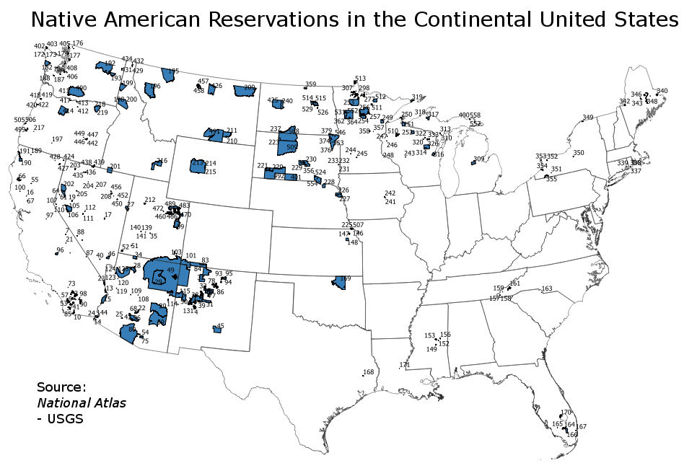
US Indigenous Population
Image created by "Presidentman"
Notes:
The ancestors of living Native Americans arrived in what is now the United States at least 15,000 years ago, possibly much earlier
In 2010, the U.S. Census Bureau estimated that about 0.8% of the U.S. population was of American Indian or Alaska Native descent. This population is unevenly distributed across the country. According to 2003 United States Census Bureau estimates, a little over one-third of the 2,786,652 Native Americans in the United States live in three states: California (413,382), Arizona (294,137) and Oklahoma(279,559)
As of 2012, 70% of Native Americans live in urban areas, up from 45% in 1970 and 8% in 1940. Urban areas with significant Native American populations include Minneapolis, Denver, Phoenix, Tucson, Chicago, Oklahoma City, Houston, New York City, and Los Angeles.
The ancestors of living Native Americans arrived in what is now the United States at least 15,000 years ago, possibly much earlier
In 2010, the U.S. Census Bureau estimated that about 0.8% of the U.S. population was of American Indian or Alaska Native descent. This population is unevenly distributed across the country. According to 2003 United States Census Bureau estimates, a little over one-third of the 2,786,652 Native Americans in the United States live in three states: California (413,382), Arizona (294,137) and Oklahoma(279,559)
As of 2012, 70% of Native Americans live in urban areas, up from 45% in 1970 and 8% in 1940. Urban areas with significant Native American populations include Minneapolis, Denver, Phoenix, Tucson, Chicago, Oklahoma City, Houston, New York City, and Los Angeles.

Slide 8
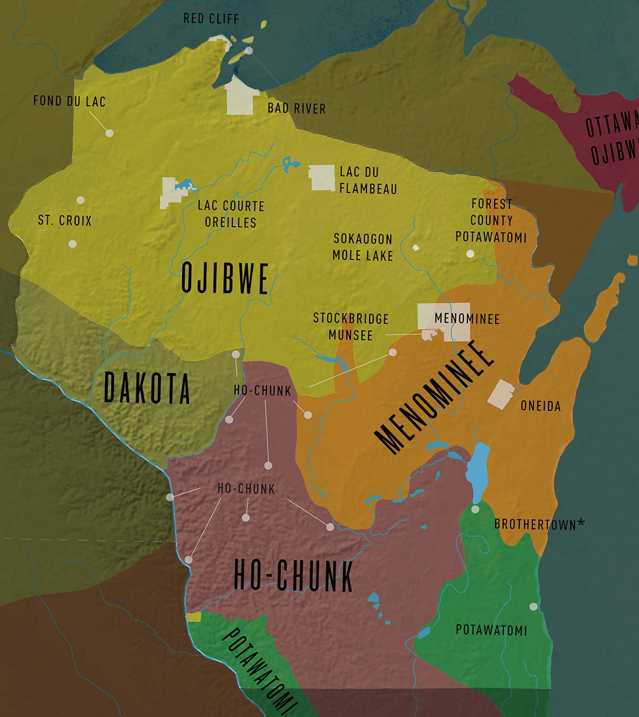
Wisconsin Tribes
Wisconsin: 11 federally recognized tribes: Bad River Band of Lake Superior Chippewa, Ho-Chunk Nation, Lac Courte Oreilles Band of Lake Superior Chippewa, Lac du Flambeau Band of Lake Superior Chippewa, Menominee Tribe of Wisconsin, Oneida Nation, Forest County Potawatomi, Red Cliff Band of Lake Superior Chippewa, St. Croix Chippewa, Sokaogon Chippewa (Mole Lake), and Stockbridge-Munsee, in addition to a non-federally-recognized tribe (Brothertown Nation).
Adapted Native Nations Map. Adapted from "Interactive Map from the Ways: Great Lakes Native Culture and Language," by Art & Sons. Retrieved from https://wisconsinfirstnations.org/map/. 2019 by Wisconsin Educational Communications Board.
Notes:
There are approximately 53,585 American Indians living in Wisconsin (WDHS, 2017). The distribution of American Indian populations in Wisconsin included over 60% in the counties of Milwaukee, Brown, Menominee, Shawano, Sawyer, Outagamie, Vilas, Dane, Ashland, and Bayfield. About 45% of Wisconsin's American Indian population resided in metropolitan areas, including 7,313 American Indians in Milwaukee County alone.

Slide 9
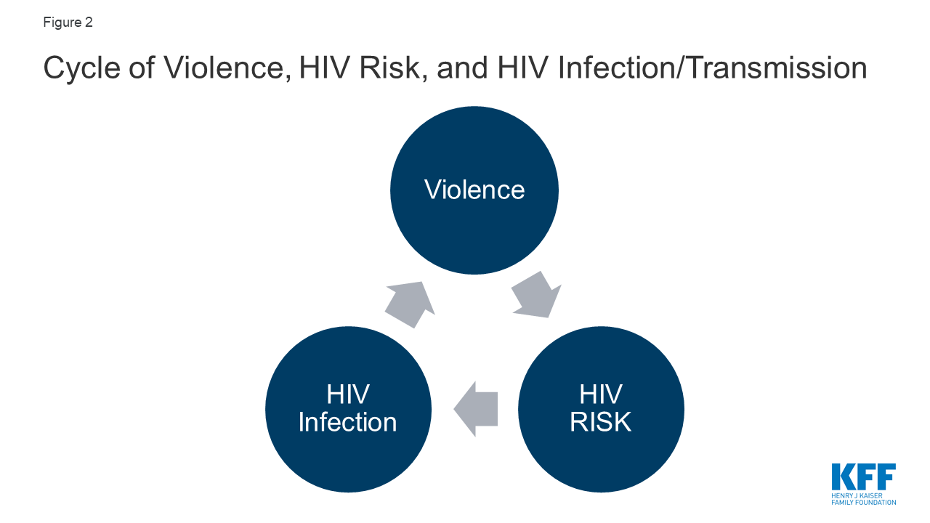
Intersections of IPV, SA, Trafficking & Sexually Transmitted Infection (STI) Risk
What do we mean by each of these?
How do disproportionate risks intersect? What are the relationships?
Dawson, L., Kates, J., & Ramaswamy, A. (2019, December 2). HIV, intimate partner violence (IPV), and women: An emerging policy landscape. https://www.kff.org/hivaids/issue-brief/hiv-intimate-partner-violence-ipv-and-women-an-emerging-policy-landscape/
Notes:
IPV:
SA:
Trafficking:
Define each and why we're talking about this
Relationship among all types of violence:
In many cases, the factors that put women at risk for contracting HIV are similar to those that make them vulnerable to experiencing trauma and IPV. Women in violent relationships are at a four times greater risk for contracting STIs, including HIV, than women in non-violent relationships and women who experience IPV are more likely to report risk factors for HIV.17 A nationally representative study found 20% of HIV positive women had experienced violence by a partner or someone important to them since their diagnosis and of these, with half perceiving that violence to be directly related to their HIV serostatus.18 Indeed, these experiences are interrelated and can become a cycle of violence, HIV risk, and HIV infection (see Figure 2). In this cycle, women who experience IPV are at increased susceptibility for contracting HIV and HIV positive women are at greater risk of experiencing IPV.19,20

Slide 10
Why is this important? Impacts of gender-based violence (GBV)
Physical injury (including strangulation)
Death: Homicide, suicide, or maternal
mortality related to high-risk pregnancy
Risk of STIs and HIV
Chronic pain or frequent illness
Psychological: depression, PTSD, drug and alcohol abuse, eating disorders, sleep disturbances
Decreased productivity/ missed work and school
Notes:
Share an experience that explains why this important to you, whether it be a personal or professional experience.

Slide 11
Disproportionate Impacts
Historical & Contemporary Context

Slide 12
Gender-based Violence
GBV is one of the most serious public health issues occurring in Native American communities today
Violence against women is greatest among AI than any other racially defined group: up to 84.3% of AI/AN women have experienced violence in their lifetime (NIJ, 2016)
AI women also experience one of the highest rates of homicide in the US. Nearly half, or 46.6% of AI women who were murdered were victims of IPV (Petrosky, Blair, Betz, Fowler, Jack, & Lyons, 2017)
AI women disproportionately impacted by IPV, SA, and trafficking
AI women at risk for STI/ HIV transmission during SA and trafficking
Notes:
Native Americans (American Indian/ Alaskan Natives)
NA represent about 1% of the US population
Women of all ages, ethnicities, and socioeconomic backgrounds can become victims of violence, however, the incidence of violence against women is greatest among Native Americans than any other racially defined group.

Slide 13
Crisis of Human Trafficking
In large urban areas such as Milwaukee, trafficking is a major issue, and underreported
Over the past four years, Milwaukee has consistently ranked among the top five cities in the nation for the recovery of trafficked adolescents
Milwaukee (tied with Las Vegas) for third largest trafficking hub in US, behind Denver and Detroit
Many of the victims of trafficking are minors (as young as 12 have been recovered)
In 2019, there were 48,326 contacts to the US National Trafficking hotline
Notes:
Milwaukee repeatedly ranks among the top cities for human trafficking. In 2015, an annual nationwide FBI sting, called Operation Cross Country rescued nine adolescents from commercial sexual exploitation, which ties Milwaukee with Las Vegas for the third highest number of young people rescued during the FBI raids across the US. Denver tops the list, with 20 young people rescued, and Detroit was next with 19.

Slide 14
Missing and Murdered Indigenous Women (MMIW)
The voices of Indigenous people have united to raise awareness of missing and murdered Indigenous woman and girls (MMIWG)
Impacts Indigenous peoples in Canada, New Zealand, Australia and the US (and in other indigenous populations globally)
The National Crime Information Center reported that as of 2016 there were 5,712 reports of missing AI/AN women and girls in the US
NamUs only logged 116 of these 5,702 cases (Department of Justice, 2018)
Indigenous women living on tribal lands are murdered at 10x the national average (NIJ)
This is a crisis that has been happening for hundreds of years with deep roots of historical and contemporary settler colonial influence and injustice
Notes:
Indigenous women don’t just “disappear like a magic trick”. Tied to historical roots of dispossession and violence.
NamUS is currently defunded (see news report)

Slide 15
STI Stats
Dawson, L., Kates, J., & Ramaswamy, A. (2019, December 2). HIV, intimate partner violence (IPV), and women: An emerging policy landscape. https://www.kff.org/hivaids/issue-brief/hiv-intimate-partner-violence-ipv-and-women-an-emerging-policy-landscape/

Slide 16
Intersecting Systems Of Oppression

Slide 17
Overlapping and Intersecting Oppressive Systems
Violence Against AI Women
Environmental and economic policies
High levels of incarceration
Tensions with law enforcement
Jurisdiction and sovereignty
Historical trauma
Distrust of healthcare and social service agencies
Barriers to seeking or receiving care
Underfunded IHS facilities

Slide 18
Settler Colonialism: Origins of Violence
High rates of violence are deeply intertwined in the history of colonization and sociopolitical contexts
Colonization and forced assimilation
Termination policies, creation of reservations, land dispossession, boarding schools
Loss of culture, language, kinship, and ways of life
historic racism, discrimination, exclusion, and marginalization.
Centuries of sexual violence that starting during colonial times (origins of "trafficking")
Harmful assumptions and stereotypes of American Indians

Slide 19
Contemporary Forms of Oppression
Indian Relocation Act (1956)
Oliphant vs. Suquamish (1978)
Public Law 280 (1953)
State foster care systems (Indian Child Welfare Act-1978)
Forced sterilization (1970’s)
Energy and economic policies
Fossil fuel extraction
Lack of funding for Indian Health Service
Notes:
Public Law 280
Public Law 83- 280 (commonly referred to as Public Law 280 or PL 280) was a transfer of legal authority (jurisdiction) from the federal government to state governments which significantly changed the division of legal authority among tribal, federal, and state governments. Congress gave six states (five states initially - California, Minnesota, Nebraska, Oregon, and Wisconsin; and then Alaska upon statehood) extensive criminal and civil jurisdiction over tribal lands within the affected states (the so-called "mandatory states"). Public Law 280 also permitted the other states to acquire jurisdiction at their option. Public Law 280 has generally brought about:
an increased role for state criminal justice systems in "Indian country" (a term which is specifically defined in federal statutes),
a virtual elimination of the special federal criminal justice role (and a consequent diminishment of the special relationship between Indian Nations and the federal government),
numerous obstacles to individual Nations in their development of tribal criminal justice systems, and
an increased and confusing state role in civil related matters

Slide 20
Jurisdiction, Sovereignty, and Criminal Justice System
Indian Law and Order Commission. (2013). A roadmap for making Native America safer (Report No. NCJ 244155). Indian Law and Order Commisssion. https://www.aisc.ucla.edu/iloc/report/
Notes:
Wisconsin is one of eight PL-280 states in the US

Slide 21
Intimate Partner Violence In The Lives Of Urban American Indian Women: A Continuation Of Colonial Injustice
Critical ethnography study insights

Slide 22
Dissertation Research
Understand how IPV manifests in the lives of urban AI women by centering their voices and their individual lived experiences in the local context
Crisis of violence against AI women, including IPV, in both urban and reservation areas (NSVIS, 2016)
Addresses a gap in the literature: currently no studies published about IPV with AI women in Wisconsin
Exemplar of Indigenous feminist activism through a study led by an AI nurse researcher and survivor of IPV
Notes:
Critical ethnography: a qualitative research approach that sets out to challenge racism, colonialism, and oppression to foster social change (Madison, 2011)
Is it worthwhile here to discuss terminology? Why you use American Indian and also Native & Indigenous?
Also, acknowledging you specifically interviewed women, but recognizing that trans and nonbinary/genderqueer folks and femmes who may or may not identify as women are also subject to disproportionate IPV?
I can definitely clarify that I used cis women in my study for simplicity

Slide 23
Findings and Significance
Many barriers exist that prevent AI women from the help that they need and deserve after IPV/ SA
68.8% (N=22) reported physical and/ or emotional IPV during the pregnancy period, and 3/4 (72%) experiencing IPV in more than one pregnancy (N=16)
Survivors spoke of linkages between their experiences and adverse health and pregnancy related outcomes
The COVID-19 pandemic served to exacerbate barriers to help seeking (job loss, housing, etc.)
Many of the participants experienced sexual assault within their intimate partnerships, some experiencing STIs as a result
Notes:
Survivors spoke of linkages between their experiences and adverse health outcomes:
negative pregnancy experience
Lack of or delays in prenatal care
Pregnancy & birth outcomes birth outcomes
Lack of informal supports and perpetuation of violence through generations
Of the 34 survivors interviewed:
67.6% (N=23) refused/ unable to seek medical attention after IPV experience regardless of injury
24% (N=8) of survivors received medical care only because the IPV was witnessed and a call to 911 was placed on their behalf
17% (N=7) sought other types of help such as a domestic violence shelter, counseling, or a call to the police.

Slide 24
Barriers To Seeking Care
What do you think are barriers to seeking care after an experience of SA, IPV and/or trafficking?

Slide 25
Barriers
Women of color are more reluctant to seek help after an experience of violence
Silence is a trauma response. Voices have been silenced for centuries.
Milwaukee: 2/3 of AI women interviewed for qualitative study did NOT seek help (regardless of injury)
Lack of resources (poverty/ insurance/ transportation)
Lack of SA advocacy
Geographic barriers (few DV shelters in rural areas)
Fear of retaliation by perpetrator or partner
Lack of culturally specific resources
Notes:
Understanding the barriers to help seeking is crucial
To remove barriers, we have to understand them first

Slide 26
COVID-19
COVID-19 is greatly exacerbating all types of violence!
Not safer at home/ limitations of shelters and other resources/ job loss
DV-related homicides are increasing in Wisconsin during COVID:
47 domestic violence related homicide deaths in 2018, and 72 in 2019
As of September 29, 2020, 69 Wisconsin lives lost to DV related homicide so far in 2020
22% of the victims were age 18 or under
Notes:
According to End Abuse Wisconsin’s Domestic Violence Homicide Report (2020)
If this pattern continues, it is estimated that 93 lives will be lost this year.

Slide 27
How Identity Shapes Experience
How anti-oppressive theories and frameworks help us to understand

Slide 28
CHAT TIME: Why it Matters
Why does it matter that we understand the roots of these systems in order to improve care for Indigenous women experiencing violence?
Notes:
We are trying to remove barriers; to remove them we have to understand them; Understanding barriers means understanding systemic oppression
Both the prevalence of violence against AI women, especially the high rates of interracial perpetrators, and the difficulty accessing services are directly tied to colonization and the intersections of racism, sexism, poverty and an absence of tribal sovereignty. Any response must both acknowledge this and center Indigenous ways of knowing and the voices of Indigenous feminists and AI women who have lived this experience.
Add further
Barriers to care are unique to each individual survivor and affected by multiple factors.
Barriers may be structural, cultural, contextual, or a combination.

Slide 29
Why it Matters
We are seeking to minimize and eliminate barriers to care for victim survivors
To understand barriers, we must understand systemic oppression
Women experiencing violence are the experts in what they need in terms of interventions
Creation of survivor-led interventions will better serve victims and survivors
Notes:
We are trying to remove barriers; to remove them we have to understand them; Understanding barriers means understanding systemic oppression
Both the prevalence of violence against AI women, especially the high rates of interracial perpetrators, and the difficulty accessing services are directly tied to colonization and the intersections of racism, sexism, poverty and an absence of tribal sovereignty. Any response must both acknowledge this and center Indigenous ways of knowing and the voices of Indigenous feminists and AI women who have lived this experience.
Add further
Barriers to care are unique to each individual survivor and affected by multiple factors.
Barriers may be structural, cultural, contextual, or a combination.

Slide 30
Critical Theoretical Frameworks
Indigenous feminism, Postcolonial theory, and Intersectionality
Analytical lens(es) to better understand the complexities within sociopolitical and historical locations of vulnerable populations (Mkandawire-Valhmu, 2018)
Self-sovereignty is self-governance. My body, my rules!
Notes:
Theory and analytical tool rooted in Black Feminism and connected to Woman of Color feminisms & activism
Crenshaw (1991) utilizes intersectionality to explore how experiences of violence that women of color face are often the result of intersecting racism and sexism.
This helps us to understand the complex, interacting and overlapping systems of oppression which shape Indigenous women's experiences of violence and their experiences seeking care.
Intersectionality is particularly salient in recognizing how race and influence the effectiveness of interventions.
Poll: Who feels they know what intersectionality is? Answer yes or no in the poll!
Also, feel free to add a comment in the chat box to share your understanding of intersectionality.
"Intersectionality is a way of understanding and analyzing the complexity in the world, in people, and in human experiences....When it comes to social inequality, people's lives and the organization of power in a given society are better understood as being shaped not by a single axis of social division, be it race or gender or class, but by many axes that work together and influence each other." (Collins & Bilge, 2016, p. 2)
How is this a useful tool and lens?

Slide 31
How has identity shaped the experience of violence and care?
“I tried to go to counseling once at my university, and I just... I see now what was wrong with our counselor, but I didn't like it. Now I see she just had no cultural understanding and really struggled with the way that I had relationships in my life. I went to see the counselor when I was a few years out and was raising my sister, who was a teenager, my mom was living with us and... Raising is a strong word, she was already a teenager. She was living with me and I was just kind of helping her get through high school. And my mom had moved in with me too, and I had a lot going on. And the counselor basically was like, "You're 26, why don't you just go out and get your own apartment and let them deal with what they have going on?" ... No understandings around kinship and relationships and family.... She had a very individualistic sense of what was right, and it did not fit very well and made me feel ashamed. So, never went back to counseling there, anywhere”
- Hailey*
Notes:
(make sure to highlight that the names are pseudonyms to protect participant identity)

Slide 32
Learned Social Practices
Dominant social norms facilitates the dismissal of SA experienced by ethnic minority women
This happens through the justification of racism and sexism
Learned social practices
Assumed as truth
Imbedded into policies and interventions
Impact women’s access to healthcare following an experience of SA
Notes:
Postcolonial, Indigenous Feminist and Intersectional theories contribute to an understanding of hegemonic masculinities
Hegemonic masculinities are learned social practices assumed as truth that have been imbedded into policies and interventions that impact women’s access to healthcare following an experience of sexual assault.
Hegemonic masculinities serve to facilitate the overlooking or dismissal of the sexual assault experienced specifically by ethnic minority women through the justification of racism and sexism.
the justification of racism and sexism (whether implicit or explicit, individual or institutional) facilitates the dismissal of SA experienced by ethnic minority women

Slide 33
How has identity shaped the experience of violence and care? (cont.)
"Talking about how the medical system treated you. The doctor that I saw, and it was an OBGYN, he... Oh my God, he just had nothing to say to me. He was just like, "You have HPV and there are pre-cancer cells here in your cervix and we gotta freeze those out." But his overall attitude was like, "You're a slut." [laughter] It's like, "No." And I was like, "Well, I guess he's got certain attitudes about sexuality and whatever." [chuckle] But yeah, I was like, to be in that position and that level of power with your patients, it just really blew me away that he would be so blatant about his disgust."- Ivy*
"So just, to me, being Native American is so different, and especially being in the system, and I don't even feel like we're considered as humans sometimes."- Laurie*

Slide 34
Breaking Down Stigma
Identifying and Intervening to Support Victim-Survivors of IPV, SA and Trafficking and Address STI Risk
Notes:
Katie

Slide 35
Stigma as a Barrier to Care
Screening for IPV, SA & Trafficking & STI risk must be interconnected
Shame was a major barrier to care, as was unsupportive and sometimes unsafe experiences with care
Normalizing screening for IPV, SA & Trafficking is key to supporting victim-survivors
Reduce stigma through the promotion of self-sovereignty
More specific and approaches for culturally safe care and effective interventions will be shared in another webinar
Notes:
Katie

Slide 36
What happens without screening?
Laurie's* story reflects the need for screening:
"I wish doctors would notice the signs so that they can help us before we get damaged."
Laurie's* advice to nurses & allied health professionals:
"Let us know we're safe. Take us to a safe place. If they see what's happening, bring us somewhere. Try to get us away from the abuser, even if they're sitting right outside. Let them know that it's okay, we can get you out safely."
Laurie* shares what would be helpful for other women:
"Safe testing for us and let them know that it's okay to open up. It took me years. This is actually the first time opening up."
Notes:
S1: Okay, okay, okay. I'm just trying to figure out, as a nurse and maybe coming into contact with people who may have been in a similar situation, like what we can do to try to...
S2: Let us know we're safe. Take us to a safe place. If they see what's happening, bring us somewhere. Try to get us away from the abuser, even if they're sitting right outside. Let them know that it's okay, we can get you out safely. S1: Okay. Had someone, if someone would have said that, if they would have somehow maybe read your body language and figured out about alerting whoever waiting, would you have taken that help? S2: Yeah.S1: Yeah. Okay.S2: Because I was tired of getting beaten.
S2: Just if they can get us out earlier, it would help us, that we wouldn't go with that because that's what we're used to. [identity being as a victim/survivor]
S2: I wish doctors would notice the signs so that they can help us before we get damaged.
S2: Safe testing for us and let them know that it's okay to open up. It took me years. This is actually the first time opening up.

Slide 37
Breaking Free, Resilience & Finding Support
To other survivors:
"I know that they aren't feeling pretty or beautiful or strong, but that deep down inside of them, they are walking with hundreds of years of beautiful ancestors that are inside of them, that can and will help them through, whatever it is that they're going through“ - Willow*
"I think that people just want to be believed.“ - Shelley*

Slide 38
Breaking Free...
“There’s hope. There is hope you can get out. …it's almost like you're tangled up in a spider web because of shared housing, children, and love … it seems hard to leave. But there's still hope. There are ways out, you can find scissors and cut those webs. I know, because I did”. – Hailey*

Slide 39
Next Steps and Call to Action
Check out Part II: Providing Survivor Led, Advocacy Driven, and Culturally Safe Care
Print pamphlets
Post information
Write to your legislators. Encourage them to support and pass the Violence Against Women’s Act.
Help on the frontlines! Oppose energy policies that destroy Native lands and communities!
Non-Native allies and advocates are needed. We can’t do this alone!
Notes:
Check out Part II: Providing Survivor Led, Advocacy Driven, and Culturally Safe Care. In part II, we will focus on the connections between IPV & STI/HIV risk and discuss strategies and resources for providing care
Learning Objectives:
Recognize how exposure to intimate partner violence increases a women’s risk for contracting sexually transmitted infections.
Describe three strategies for delivering culturally safe care to survivors of sexual assault and intimate partner violence.
Identify two resources to support sexual transmitted infection screening and immediate access to HIV post-exposure prophylaxis.

Slide 40
Questions?
Notes:
Thank Jeneile and Katie for working on this for
And thank you to all of the research participants for their courage and for empowering us to do better

Slide 41
Resources for Patients and Providers
IPV, SA and Trafficking
Stronghearts Native Helpline: https://www.strongheartshelpline.org (1-844-762-8483)
Domestic Abuse Intervention Services: 608-251-4445 (helpline)
Rape Crisis Center: 608-251-7273 (24/7 help line)
RAINN's (Rape, Abuse & Incest National Network): 1-800-656-4673 (helpline) | www.rainn.org/
National Domestic Violence Hotline: 1-800-799-723 www.thehotline.org (live chat available online)
National Human Trafficking Hotline: 1-888-373-7888 (TTY: 711); Text 233733 https://humantraffickinghotline.org (live chat available online)
For clinical care teams
Midwest AETC: www.matec.info
National Clinician Consultation Center (NCCC): nccc.ucsf.edu/
AETC NCRC nPEP Toolkit: https://aidsetc.org/resource/non-occupational-post-exposure-prophylaxis-npep-toolkit
Sexual Assault: PEP is an Urgent Health Need: https://aidsetc.org/blog/sexual-assault-pep-urgent-health-need

Slide 42
References
Crenshaw, K. (1991). Mapping the margins: Intersectionality, identity politics, and violence against women of color. Stanford Law Review, 43(6), 1241.
Collins, P., & Bilge, S. (2016). Intersectionality. Cambridge, UK ; Malden, MA: Polity Press.
Department of Justice (2018). NamUs. Retrieved from https://www.namus.gov/MissingPersons/Search.
Luebke J. Intimate Partner Violence in the Lives of Urban American Indian Women: A Continuation of Colonial Injustice. (Unpublished doctoral dissertation). University of Wisconsin-Milwaukee. 2020.
National Crime Information Center (2018). Federal Bureau of Investigation.

