Slide 1
Prevention and Treatment of Hepatitis C Infection Among People Who Use Drugs
Jocelyn James, MD
Assistant Professor
Division of General Internal Medicine
University of Washington School of Medicine
April 6, 2021

Slide 2
Panel Discussants
James Darnton, MD
Clinical Instructor
Division of General Internal Medicine
University of Washington School of Medicine
Jared Klein, MD, MPH
Assistant Professor
Division of General Internal Medicine
University of Washington School of Medicine

Slide 3
Slides adapted from talk developed by Dr. James and Dr. Judith Tsui in collaboration with the Washington State Department of Health.

Slide 4
Session Objectives
Describe epidemic of hepatitis C (HCV) infection among people who use drugs and importance of treating this population in order to eliminate hepatitis C as a public health threat
Address common myths about HCV treatment among people use drugs
Describe key features of a typical treatment course for HCV infection

Slide 5
Outline
Background
Changing epidemiology of HCV associated with opioid use epidemic
Health consequences of chronic HCV
Health benefits of cure of HCV
Treatment as prevention for people who use substances
Basics of HCV treatment
Screening and prevention of HCV

Slide 6
Which of the following best describes your professional role?
Administrator
Counselor / case worker / social worker
Nurse
Physician or other prescribing provider
Other

Slide 7
Patient Case
51 yo woman with opioid use disorder on methadone maintenance, chronic hepatitis C, tobacco use, presenting to establish care. Due to severe L hip pain, her substance use has escalated in the last month. She now muscles heroin and smokes methamphetamine daily.
She has heard there are great medications for hepatitis C now, but her priority is to get control over her heroin use.
How would you approach the topic of hepatitis C treatment? What would you recommend? What other information would you most want to know?

Slide 8
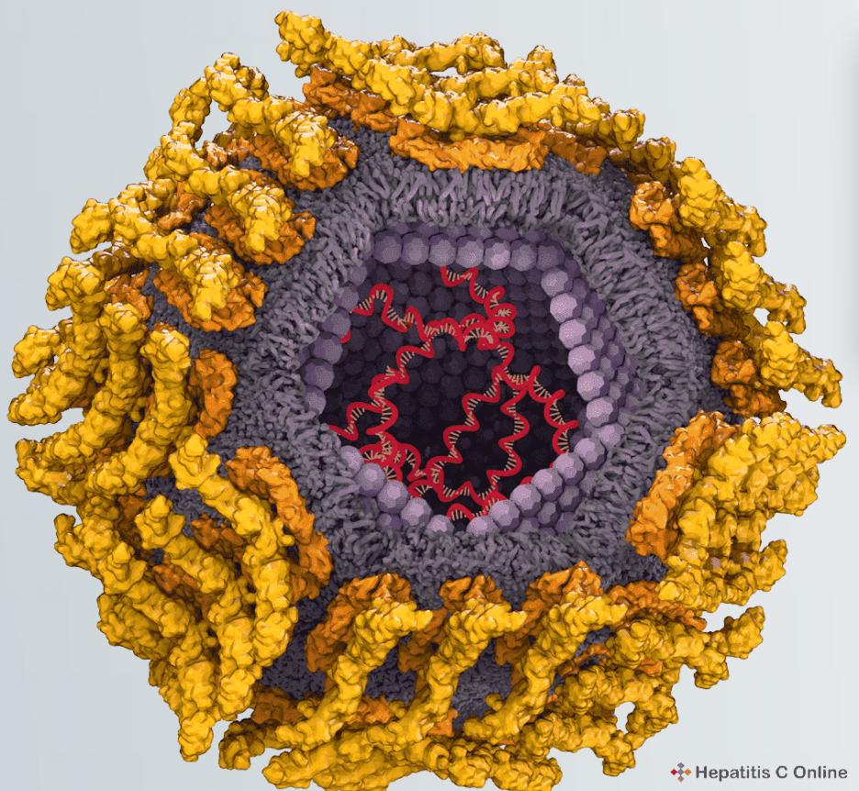
Background and Epidemiology of HCV
RNA virus identified in 1988
Most common blood-borne infection in US: 2.4 million chronically infected¹
56% aware of infection²
Not vaccine preventable
Most people exposed to hepatitis C virus will develop chronic infection
¹Hofmeister MG et al, Hepatology 2018; ²Kim HS et al, J Viral Hepat 2019 May; 26(5): 596-602

Slide 9
HCV in the US: Routes of Transmission
Injection drug use: 60% of cases
Blood transfusion prior to 7/1992
Receipt of solid organ transplantation or factor concentrates made before 1987
Male-to-male sex
Body tattoos
Intranasal cocaine use
Highest risk: sharing needles and syringes
Can also occur with sharing injection paraphernalia such as water, cookers, and cotton filters
Notes:
IDU accounts for 70% of new infections

Slide 10
Opioid Epidemic and HCV
Emerging epidemic of HCV infections among young people who inject drugs
Closely related to opioid epidemic
Figure source: modified from hepatitisc.uw.edu from Klevens et al, Am J Public Health 2014
Rates of reported acute hepatitis C by age group, US, 2002-2017 (CDC Viral Hepatitis Surveillance Data)

Slide 11
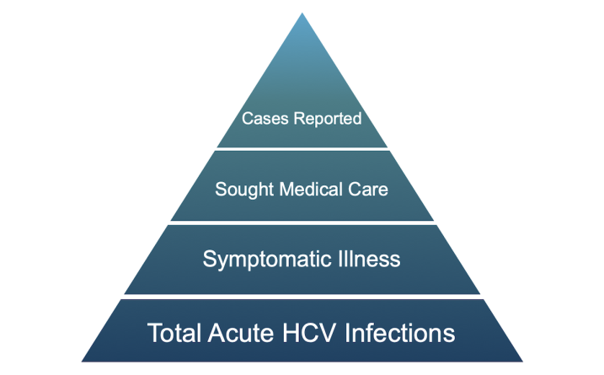
Opioid Epidemic and HCV
Reported acute infections are only the tip of the iceberg
3,621 acute cases reported in U.S. in 2018 ¹
Estimated 50,300 actual new cases¹
Figure source: modified from hepatitisc.uw.edu from Klevens et al, Am J Public Health 2014. ¹ Centers for Disease Control

Slide 12
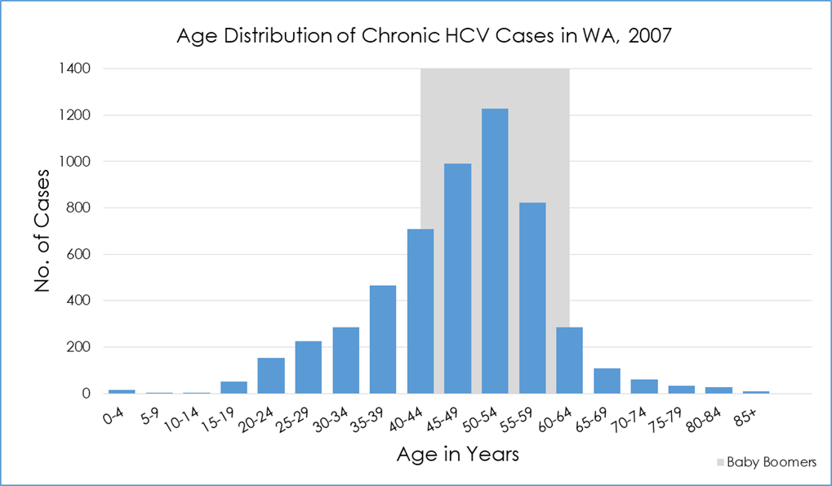
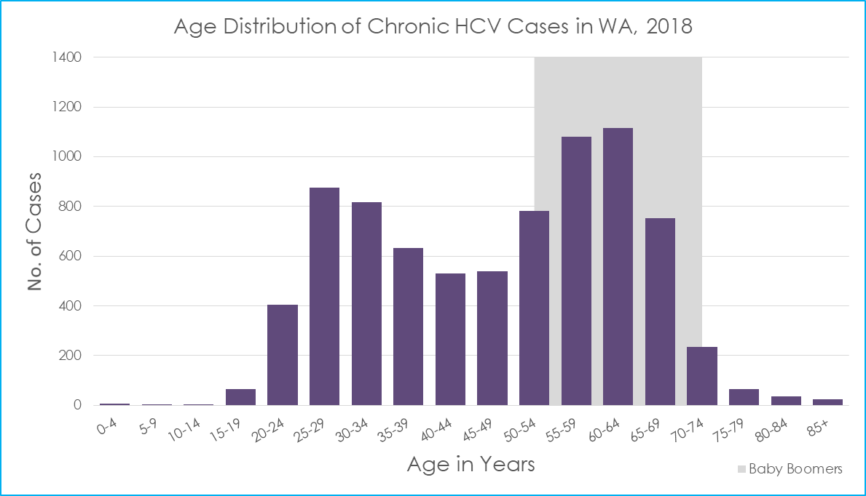
Example from Washington State
As throughout US, there are now two epidemics: baby boomers and young people who inject drugs
In 2018 there were 118 new reports of acute HCV, the highest in 20 years
Chronic HCV in WA State
2007
2018
Source: Washington State Department of Health

Slide 13
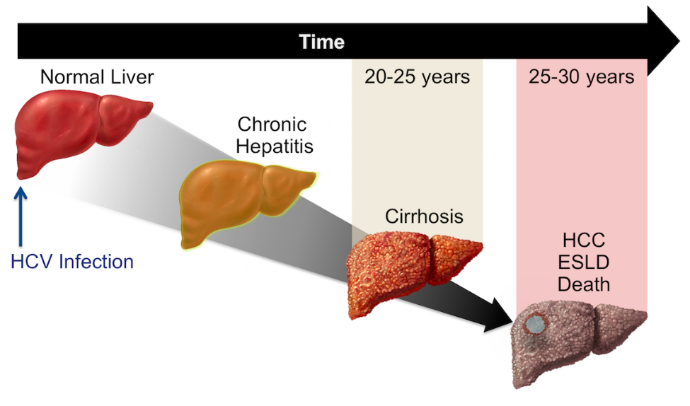
Health Consequences of Chronic HCV
15-30% of those with chronic HCV will develop cirrhosis, which can lead to
Liver failure
Hepatocellular carcinoma: 3-5% per year
Death: since 2017, deaths from HCV > deaths from HIV
Alcohol use increases each of these risks AND affects transplant candidacy
Figure: Hepatitisc.uw.edu, illustration by David Spach, MD

Slide 14
Worse Outcomes in People Co-infected with HIV and HCV
Image credit: Hepatitis C Online: hepatitisc.uw.edu
Image from Hepatitis C Online (hepatitisc.uw.ed). Di Martino et al, Hepatology. 2001;34:1193-9

Slide 15
Definitions
Cure of HCV = SVR 12
No detectable HCV virus (HCV RNA) at 12 or more weeks after completion of treatment
DAA= direct-acting antiviral medication (to treat hepatitis C infection)
Notes:
Add pictures

Slide 16
Benefits of Cure of HCV
Reduced all-cause mortality
Positive psychosocial effects and improved quality of life
Reduction in liver fibrosis and liver complications
Reduced transmission to others
Reduced incidence of liver cancer
Decreased inflammation and non-hepatic comorbidities

Slide 17
Psychosocial Benefits
Improved self-efficacy and empowerment
Relief from stigma and illness-related uncertainty/stress
Positive impacts on substance use
“Clearing HCV will help in defeating the bigger problems, because it’s like trying to get up when you’ve got 100 bricks on ya. But then if I took half the bricks off from the Hep C, then now I’ve got a bit more movement and I can start taking the bricks off.” ¹
“Everything changed. I stopped drug use. I stopped everything because I said if I beat the Hep C, I could beat that too. Praise God up to today, I feel so good.” ²
¹Goutzamanis et al, BMC Infectious Diseases 2018; ²Batchelder et al, Drug and Alcohol Depend 2015

Slide 18
Which People with HCV Should Be Treated?
Nearly everyone:
What about people who use drugs?
Treating people who use drugs is critical to achieving elimination of HCV
HCVguidelines.org (IDSA/AASLD)

Slide 19
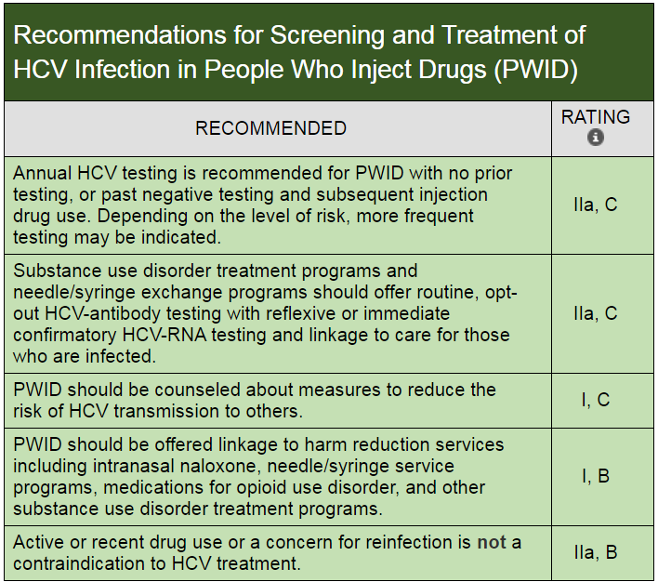
IDSA/AASLD Guideline Update

Slide 20
Treatment as Prevention in HCV
Treating populations that actively transmit HCV
Reduces new infections
Reduces prevalence over time

Slide 21
Common Myths
#1 People who use substances can’t be effectively treated / cured
#2 People who use substances are likely to get reinfected anyway
Though previously assumed true and incorporated into guidelines and coverage requirements, these myths have been debunked…

Slide 22
Countering Myth #1
Studies from various settings show good adherence and high cure rates among people who use drugs, including those with injection drug use
There are NO data to support pretreatment screening for illicit drug or alcohol use to select a population more likely to be successful with hepatitis C treatment
HCVguidelines.org

Slide 23
Randomized, double-blind, placebo-controlled trial of elbasvir/grazoprevir for treatment-naïve patients with genotype 1, 4, or 6 enrolled in opioid agonist treatment
Participants had to be at least 80% adherent to OAT visits
Primary outcome: proportion of patients with SVR12
Results:
301 patients, 76% men, 80% white, 7% coinfected with HIV, >46% with positive urine screens
91.5% had SVR 12
¹Dore G Ann Int Med 2016
Notes:
eligible patients had been in tx at least 3 months; randomized 2:1 to immediate vs delayed treatment; ~80% methadone, 20% buprenorphine; frequent monitoring, adherence support not described; 7% coinfected with HIV; mostly men, mostly white, mostly between 35-64; 25% IDU within prior 6 months

Slide 24
Open-label international trial of sofosbuvir/velpatasvir among people with hepatitis C, genotypes 1-6, and with injection drug use within 6 months
Therapy was given in one-week electronic blister packs
Primary outcome: proportion of patients with SVR12
Results:
103 patients, mostly male, 59% of whom were receiving opioid agonist treatment, 74% of whom had injected in last month
97% completed treatment, 94% had SVR 12, drug use did not affect SVR
Grebely Lancet Gastroenterol Hepat 2018
Notes:
Self-reported IDU w/in 6 months; recruited from drug tx clinics, hospital clinics, community clinics, etc; HIV excluded
Attended 4 visits during treatment, plus weekly to pick up blister packs
There is also real-world data with comparable outcomes

Slide 25
Countering Myth #2
Rate of reinfection among people who use drugs is low
Compared to rates of first infection: hepatitis C treatment has been associated with reduced needle sharing
Rates of reinfection are decreased…
When people receive medications for opioid use disorder
When people use syringe service programs
Some degree of reinfection suggests you are treating the right population
Notes:
Add references

Slide 26
Meta-Analysis of Rate of HCV Reinfection
Studied 1) people who recently used drugs, and 2) those on opioid agonist treatment
36 studies; 6,311 person-years follow up
Population | # Studies | Rates of reinfection per 100 person-years
Any drug use | 33 | 5.9 (95% CI 4.1-8.5)
Injecting drug use | 31 | 6.2 (95% CI 4.3-9.0)
Opioid agonist treatment | 25 | 3.8 (95% CI 2.5-5.8)
Notes:
19 studies were DAA

Slide 27
The Future of HCV
2016: the World Health Organization announces plan for elimination of HCV by 2030
80% reduction in incidence
65% reduction in mortality
2018: Gov. Inslee announces first state initiative to eliminate HCV: “Hep C Free WA”
Identifies people who inject drugs as priority population for treatment
Removes prescriber restrictions

Slide 28
HCV Restrictions/Requirements
Screening and referral if active alcohol or substance use
None
Consider SUD in adherence counseling
Screening and counseling for alcohol and drug use
Prescriber restrictions: decompensated cirrhosis
-->specialist
Drug screening within 30 days of treatment
https://stateofhepc.org/report/

Slide 29
How Are We Doing?
There is still a large cliff from screening to treatment among people who inject drugs
This 2018 Seattle, WA, data from National HIV Behavioral Surveillance Survey mirrors the region and nation
Corcorran et al, Drug and Alcohol Dependence, Volume 220, 2021

Slide 30
Interest in HCV Treatment is High in PWID
58% of respondents to a state syringe exchange survey from 2019 reported HCV testing in the last year
Of those diagnosed with HCV,
28% had received any treatment
68% reported interest in treatment
Photo: Hepatitis Education Project
Alcohol and Drug Abuse Institute (ADAI): https://adai.uw.edu/wa-state-syringe-exchange-health-survey-2019-results

Slide 31
Hepatitis C Treatment: The Big Picture
In most patients with hepatitis C, treatment is straight-forward and simple and can be done by PCPs/pharmacists
In people with advanced liver disease or certain other conditions (transplant, liver cancer), treatment is more complicated and should be done by or in consultation with specialists
Distinguishing these two groups is an important task and starts with a good clinical history

Slide 32
Direct-Acting Antivirals (DAAs) for HCV
Typical treatment duration | 8-12 weeks
Usual pill burden | 1-3 pills taken once daily
Tolerability | Very well-tolerated overall Headache, fatigue, and nausea are relatively common but rarely interfere with treatment course
Effectiveness | >95% rate of cure Comparable effectiveness in those with substance use
Examples (pan-genotypic) | Glecaprevir/pibrentasvir (Mavyret®) Sofosbuvir/velpatasvir (Epclusa®)
HCVguildelines.org

Slide 33
Pretreatment Assessment
Required | *Complete blood count (CBC), *Comprehensive metabolic panel (CMP), HCV RNA, HIV, HBsAg
Consider based on level of clinical concern for cirrhosis, based on… Review of existing data (likely) duration of infection cumulative alcohol exposure signs/symptoms of cirrhosis | International normalized ratio (INR) FibroTest/FibroSure®, ActiTest Transient elastography (FibroScan) Abdominal ultrasound
Treat as cirrhosis if any of the following | FIB-4 > 3.25 Platelet count < 150,000/mm³ FibroScan > 12.5 kPa Liver nodularity and/or splenomegaly on imaging Prior liver biopsy showing cirrhosis
HCVguidelines.org

Slide 34
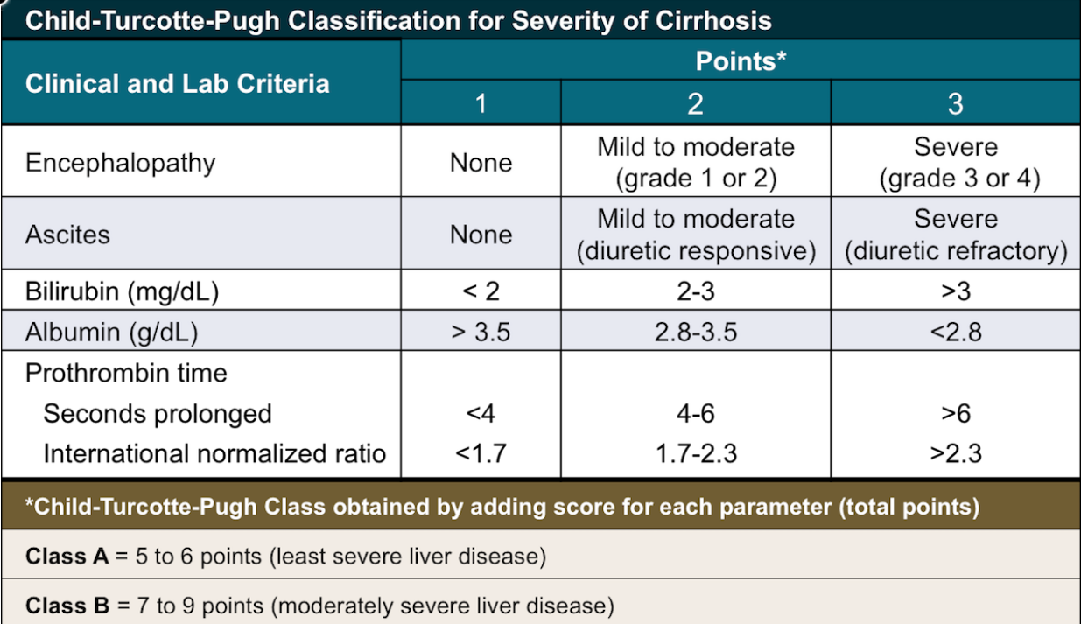
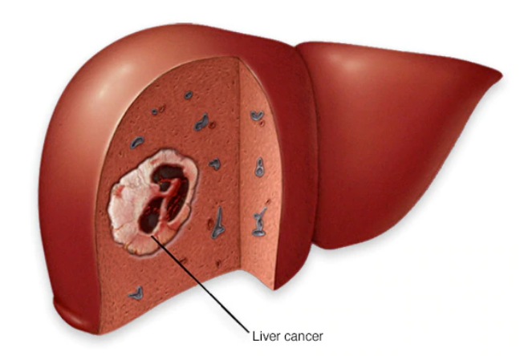
Know When to Refer
Definite:
Decompensated cirrhosis
Hepatocellular carcinoma
Post-transplant
Relative:
Hepatitis B and/or HIV
Prior treatment with DAAs
Image credit: Hepatitis C Online: hepatitisc.uw.edu
Image credit: Mayo Clinic
HCVguidelines.org

Slide 35
Simplified HCV Treatment: No Cirrhosis
Key Steps:
Review medications, drug-drug interactions
Update labs
Educate re: medication administration, adherence, and preventing reinfection
Treatment:
Glecapresvir/pibrentasvir for 8 wks (3 pills daily), or
Sofosbuvir/velpatasvir for 12 wks (1 pill daily)
Monitoring:
No lab monitoring required
Offer visits for support, assessment of symptoms
Hcvguidelines.org

Slide 36
Treating Patients with Compensated Cirrhosis
There is also a simplified algorithm, with some key differences:
Check liver ultrasound to exclude liver cancer prior to treatment
Basic labs within 3 months
Check genotype*
Monitor for decompensation**
*If treating with sofosbuvir/velpatasvir.
**Hepatic panel every 4 weeks; monitor for jaundice, ascites, encephalopathy.

Slide 37
Post-Treatment
If RNA detectable, refer to specialist for retreatment
If elevated despite undetectable RNA, assess for other causes of liver disease
Test for cure! Check HCV RNA 12 or more weeks after completing treatment
Avoid excessive alcohol
Cure does not prevent reinfection: screen annually if ongoing risk factors
Check AST and ALT
Provide Counseling
HCVguidelines.org

Slide 38
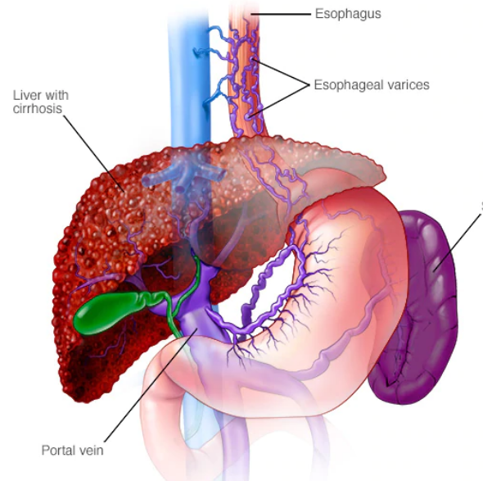
Patients with Cirrhosis Require Follow Up
Images: Mayo Clinic

Slide 39
Coinfection with HCV and HIV
Co-infection leads to accelerated rates of fibrosis
Rates of cure are comparable in those with coinfection vs monoinfection
Treatment regimens are generally equivalent, though in some circumstances, 8-week regimens should be extended to 12 weeks
Drug-drug interactions are key
IDSA/AASLD guideline provides examples of HIV and hepatitis C medications that can be used together
If considering other combinations, expert consultation is needed
Resources: hcvguidelines.org, https://aidsinfo.nih.gov/guidelines, www.hep-druginteractions.org
HCVguidelines.org
Notes:
For persons with HIV-HCV coinfection who are not on antiretroviral therapy and have a CD4 cell count less than 200 cells/mm3, it may be advisable to initiate HIV antiretroviral therapy first and defer HCV treatment until undetectable HIV RNA levels have been obtained.

Slide 40
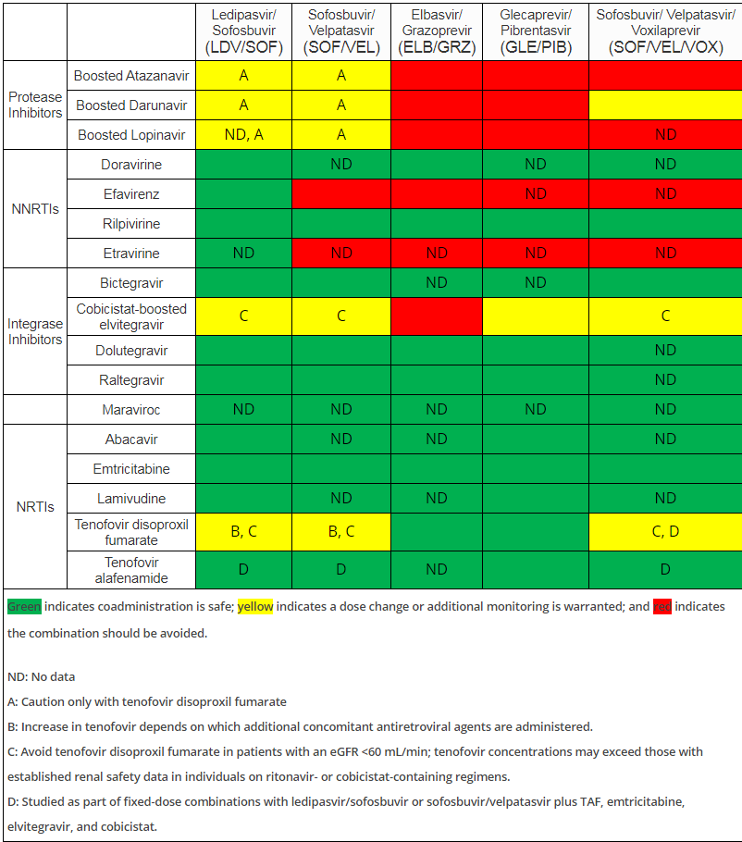
DAAs and Antiretroviral Medications
HCVguidelines.org

Slide 41
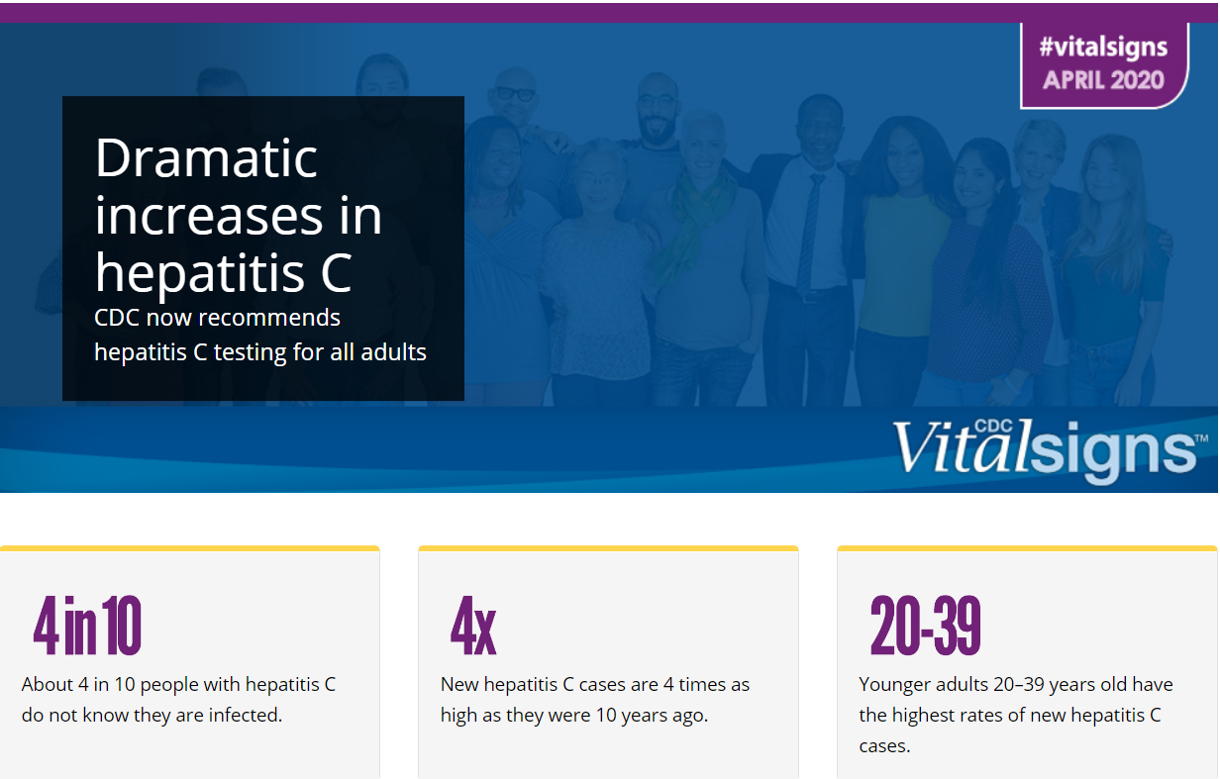
New Recommendation for Universal Screening
New USPSTF recommendation to screen all asymptomatic adults age 18-79 for hepatitis C
Those at high risk should be periodically rescreened
Notes:
Consider screening those younger than 18 and older than 79

Slide 42
HCV Prevention
Treatment as prevention
Medications for opioid use disorder
Education/harm reduction
Syringe service programs

Slide 43
Patient Case: Considerations
How concerned are you for advanced fibrosis?
Duration infection, alcohol history, symptoms and data
How relevant is the public health argument to treat ASAP to reduce transmission?
How does hepatitis C treatment fit with her goals?
It may improve quality of life/symptoms
It may increase self-efficacy, reduce risk behavior, improve SUD
Important to treat when she feels she can be successful, but also keep in mind, DAAs are forgiving of imperfect adherence

Slide 44
Key Resources
HCVguidelines.org: IDSA/AASLD guideline
Hepatitisc.uw.edu: excellent free online training
Project ECHO, weekly videoconferences : contact Pam Landinez at landinez@uw.edu
UCSF phone consultation, 9 am-8 pm ET: (844) HEP-INFO or (844) 437-4636
U. of Liverpool medication interaction checker: hep-druginteractions.org

Slide 45
Panel Discussion
What do you find most rewarding about providing hepatitis C treatment?
What challenges have you encountered while treating hepatitis C among people who use drugs?
What advice would you offer others interested in treating hepatitis C?

