Slide 1

HIV Basics
Mary Beth Donica, MD
Program Director, MATEC at University of Cincinnati
March 2021

Slide 2


This conference is supported by the Health Resources and Services Administration (HRSA) of the U.S. Department of Health and Human Services (HHS) as part of an award totaling $3,139,511.00 with 0 percentage financed with nongovernmental sources. The contents are those of the author(s) and do not necessarily represent the official views of, nor an endorsement, by HRSA, HHS or the U.S. Government.

Slide 3
Disclosures
I have no disclosures to report.

Slide 4
LEARNING OBJECTIVES
Review the epidemiology of HIV in Ohio and the USA.
Discuss stigma around HIV and LGBTQ+.
Describe the basic biology and transmission of HIV.
Describe clinical manifestations of HIV infection.
List tests used to monitor chronic HIV infection.
Review basics of outpatient care for PLWHA.

Slide 5
Epidemiology

Slide 6
HIV Epidemiology in US: 2018
1.1 million people in the USA have HIV
15% of people with HIV are unaware of their HIV status.
37,968 people were newly diagnosed with HIV in 2018
From 2014-2018, new HIV diagnoses decreased by 7%, although the incidence increased in some groups.
Men who have sex with men (MSM), particularly black/African American MSM, are most affected by the HIV epidemic.
In 2018, there were 15,280 deaths in people with HIV.

Slide 7
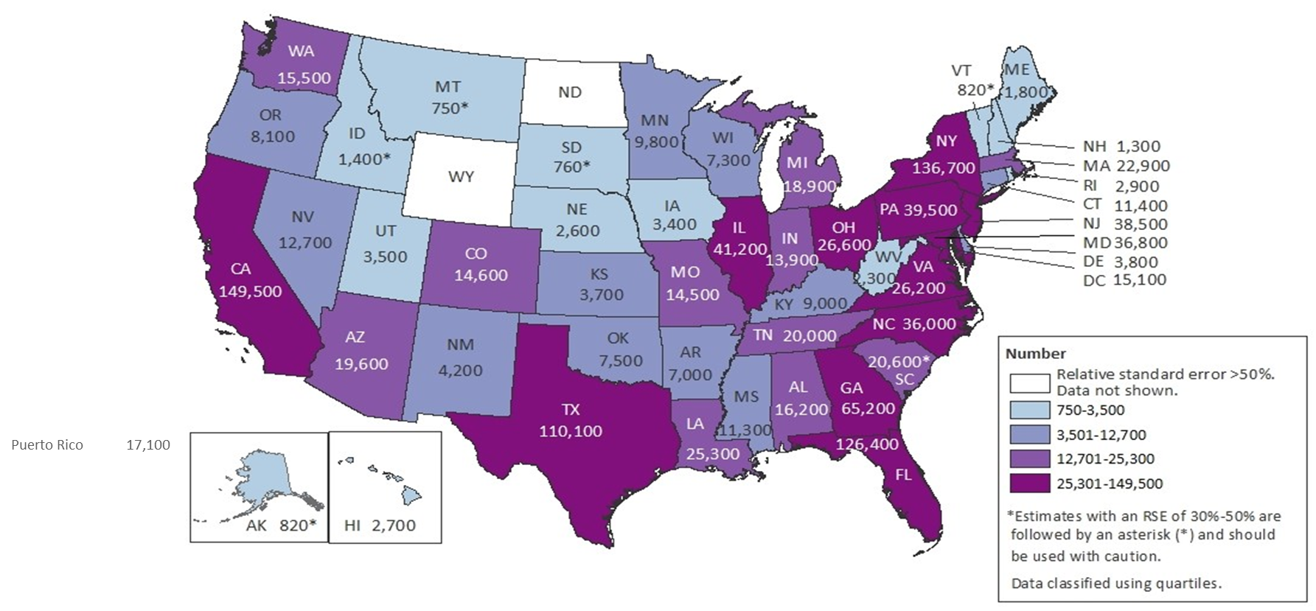
Estimated HIV Prevalence among Persons Aged ≥13 years, by Area of Residence 2018—United States
Total = 1,173,900†
Note. Estimates were derived from a CD4 depletion model using HIV surveillance data. Estimates rounded to the nearest 100 for estimates >1,000 and to the nearest 10 for estimates ≤1,000 to reflect model uncertainty. Estimates for the year 2018 are preliminary and based on deaths reported to CDC through December 2019. Estimates for Alabama, Oklahoma, and South Carolina should be interpreted with caution due to incomplete death ascertainment.
†Total estimate for the United States does not include data for Puerto Rico.
Notes:
This map presents estimates of HIV prevalence for persons aged ≥13 years in the United States for 2018. HIV prevalence was highest in California, Florida, Georgia, Illinois, Maryland, New York, New Jersey, North Carolina, Pennsylvania, Texas, Ohio, and Virginia.
Five states accounted for 50% of persons living with HIV infection: California, Florida, Georgia, New York, and Texas.
Estimates for the year 2018 are preliminary and based on deaths reported to CDC through December 2019. Estimates for Alabama, Oklahoma, and South Carolina should be interpreted with caution due to incomplete death ascertainment.
Estimates were derived from a CD4 depletion model using HIV surveillance data. Estimates were rounded to the nearest 100 for estimates >1,000 and to the nearest 10 for estimates ≤1,000 to reflect model uncertainty. Estimates with a relative standard error of 30%–50% are preceded by an asterisk (*) and should be used with caution.
Estimates for the following jurisdictions should be interpreted with caution because they do not have laws requiring complete reporting of laboratory data or have incomplete reporting. Areas without laws: Idaho, New Jersey, and Pennsylvania. Areas with incomplete reporting: Arizona, Arkansas, Connecticut (2018 only), Kansas, Kentucky, Nevada (2017 only), Vermont, and Puerto Rico.
All data presented in this slide set are from the same dataset (reported to CDC through December 2019) and CD4 model used for the HIV Supplemental Surveillance Report “Estimated HIV Incidence and Prevalence in the United States 2014–2018”. Please see the Commentary and Technical Notes for information on the methods used to produce the estimates. The report can be found at: https://www.cdc.gov/hiv/library/reports/hiv-surveillance.html

Slide 8
HIV in Ohio 2019
There are 24,558 people with HIV in Ohio.
In 2019, there were 973 new diagnoses of HIV.
The rates of new diagnoses were over 7 times higher for black/African American people when compared to white people.
Over half of the new diagnoses are in people between the ages of 20 and 34.
Male to male sexual contact is the risk factor for 58% of males newly diagnosed.
Heterosexual contact is the risk factor for 68% of females.

Slide 9
HIV in Selected Ohio Counties 2019
County | Rate per 100,000 | New Infection Rate per 100,000
Butler | 127.6 | 6.5
Clermont | 83.3 | 5.8
Cuyahoga | 410.1 | 16.1
Franklin | 405 | 16.4
Hamilton | 402.8 | 20.6
Montgomery | 294.9 | 17.9
odh.oh.gov accessed 9/28/2020
Notes:
Counties in Ohio with the highest rate of HIV. These are all urban areas. People with HIV/AIDS live in EVERY county in Ohio. However, not all counties in Ohio reported new HIV infections in 2014.

Slide 10


Slide 11
What is Stigma?
A process of devaluation of people either living with or associated with HIV and AIDS
Stigma is perpetuated by myths about what HIV is, how it’s transmitted, and who people living with HIV are
Types of stigma include:
  Enacted stigma
  Internalized stigma
  Institutional stigma
Notes:
Before we get started talking about HIV, we need to unpack what makes HIV unique. Thanks to advances in treatment and prevention, there is nothing about HIV that should uniquely disadvantage people living with it, compared to people living with, say, diabetes. But people living with HIV face…
The main causes of stigma include: (https://www.icrw.org/wp-content/uploads/2016/10/Understanding-and-Challenging-HIV-Stigma-Toolkit-for-Action.pdf)
Insufficient knowledge, misbeliefs and fears about how HIV is transmitted and the life potential/capacity of PLWH
Moral judgments about people who we assume have been sexually promiscuous
Fears about death and disease
Lack of recognition and stigma
The main forms of stigma include:
Physical and social isolation from family, friends, and community
Gossip, name calling, and condemnation
Loss of rights and decision-making power
Self-stigma – blaming and isolating themselves
Stigma by association
Stigma by looks/appearance/type of occupation
Stigma may arise from two sources, stigma enacted by society, and stigma arising from within the individual who is part of a stigmatized group.
Enacted stigma is the stigma that one experiences from external sources such as individuals and organizations. It is manifest in the interactions one has with others. It is stigma that emanates from, and is applied to, an individual who is part of the stigmatized group.
Internalized stigma occurs when a member of the stigmatized group comes to believe and integrate the stigma that is held by society. The messages that are conveyed by the dominant culture are absorbed by the individual and then become a part of how that individual sees themselves and their place within the greater society.
Institutional stigma occurs when institutions such as hospitals, community based organizations, schools, and courts come to believe and integrate into their policies and procedures the messages about the stigmatized group. It is the stigmatization of a particular group through the use of formal and informal policies and procedures enacted by those within the organization.

Slide 12
Impact of Stigma
Major barrier to HIV screening and testing
Negative impact on health of PLWH
Poor access to healthcare
Treatment interruptions
Failure to disclose status
(Dowshen et al., 2009; Eaton, et al, 2015; Fontenberry, et al., 2002; Halkitis, Wolitski, & Millett, 2013; Overstreet et al., 2012; Sayles et al., 2009)
Notes:
Healthcare providers and staff can hold outdated beliefs about HIV. Despite advances in treatment and knowledge about HIV, stigmatizing attitudes and behaviors persist and present barriers to testing, treatment adherence, and retention in care (Stringer, Turan, McCormick, Durojaiye, Nyblade, Kempf, Lichtenstein, & Turan, 2016). A study conducted in 2008 found that over 50% of nursing staff, 25% of cosmetic surgeons, and nearly half of all obstetricians surveyed refused to provide services to patients living with HIV (Sears, 2008). Other surveys and studies have found, time and time again, that people living with HIV report experiencing stigma from their healthcare providers (Stringer, et al., 2016). This can take the form of patient avoidance, taking extreme precautionary measures, refusing to do a physical exam, violating confidentiality, or refusing treatment altogether (Stringer, et al., 2016).
In the context of HIV testing, stigma can contribute to failing to recommend testing for everyone, based on the provider’s perception of how a person with HIV looks or behaves. For example, a nurse may not offer an older married woman an HIV test, because it is assumed she is in a safe, monogamous sexual relationship.
On the other hand, the fear of judgment and stigma can lead to the patient having anxiety and refusing to receive an HIV test, as well as ignoring their risk factors and not being honest with their provider (Nyblade, Stangl, Weiss, & Ashburn, 2009). Patients may feel that accepting an HIV test, or being honest about their risk factors, may negatively impact how the provider perceives them or interacts with them. (Young, Monin, & Owens, 2009). This can stem from an unconscious desire many patients feel to please their providers, since they see them as authority figures. This feeling can be heightened especially with providers who make value judgements and say things like, “good for you!” when a patient says they only have one sex partner. One study found that people who imagined having a stigmatized disease felt they would be seen as an immoral person if they were to be associated with that disease (Young, et al., 2009).

Slide 13
HIV Compared to Other Diseases
Disease | Stigma Level | What people say about the person | How the person feels | Reasons for stigma
HIV | High | Deserves it Got it from bad behavior Stay away | Shame and loss of self-esteem Scared to die | Associated with sex and drugs Deadly disease Fear of contagion
Other STI | Medium | Bad person Promiscuous | Embarrassment Shame | Associated with sex
Cancer | Low | Unlucky | Loss of hope Scared to die | Deadly disease Not contagious
Diabetes | Low | Lazy | Self-blame | Not associated with sex Not contagious
Notes:
Cancer: no transmission to others + no moral blame = no stigma
Leprosy: transmission to others + no moral blame = low stigma
HIV: transmission assumed + strong moral blame = high stigma
Are there times when stigma is higher for cancer and diabetes?
http://www.hivpolicy.org/Library/HPP001877.pdf

Slide 14

How can we combat stigma?
People First Language
Stigmatizing vs. Preferred Language
Opt-out testing
Trauma-informed care
Notes:
People First language: People First Language puts the person before the illness or medical condition and describes what a person has, not who a person is. Using a diagnosis as a defining characteristic reflects prejudice, and also robs the person of the opportunity to define him or herself. We want to promote understanding, respect, and dignity for all people. (https://www.poz.com/article/vickie-lynn-valerie-wojciechowicz-28210-9008)
Have you ever heard a person living with HIV describe themselves as "I am HIV"?
Do the words "infection" or "infected" feel negative to you?
Are you offended when you are referred to by your health condition first, instead of as a person first?
(https://www.thewellproject.org/hiv-information/why-language-matters-facing-hiv-stigma-our-own-words)

Slide 15
Stigmatizing | Preferred
HIV patient, AIDS patient AIDS or HIV carrier | Person living with HIV
Full-blown AIDS | There is no medical condition for this phrase – simply use the term AIDS, or Stage 3 HIV
Contaminated or infected | Person living with HIV
Unprotected sex | Condomless sex
Compliant | Person taking medications as prescribed
HIV infected | Living with/diagnosed with HIV, contracted/acquired HIV

Slide 16
Biology of HIV:
A brief Overview

Slide 17
Characteristics of HIV
Human Immunodeficiency Virus.
RNA virus.
Classified as a retrovirus.
Must live inside a human cell to survive.
Spread from person to person by contact with certain body fluids: semen, blood, vaginal fluids, breast milk.

Slide 18
Characteristics of HIV con’t
Weakens the immune system of a person by replicating inside a type of white blood cell call T cells (CD4 cells). The T cells are destroyed during this process.
Once established, infection with HIV is chronic.
HIV is the virus that causes AIDS.

Slide 19
HIV Life Cycle
https://www.youtube.com/watch?v=PlSvywlLuNw

Slide 20
HIV: Transmission & Acute Infection

Slide 21
HIV is in:
HIV is NOT in:
Blood
Semen
Vaginal fluids
Breast milk
Tears
Sweat
Insect bites
Utensils
Furniture, toilets

Slide 22
Behaviors which ↑ risk for contracting HIV:
Men having sex with men (MSM).
Multiple sex partners.
Substance misuse/abuse.
Sharing needles for tattoos or piercing.
Sex partner of a person with high risk behavior.
Mother to fetus transmission if mom has HIV.
Breastfeeding if mom has HIV.
Pre-masticated food from parent to child.

Slide 23
Reducing Risk
Safer sex with each encounter.
Clean needles & equipment when injecting drugs.
Test all pregnant women for HIV, including those who are in labor and whose HIV status is unknown.
Avoid breastfeeding if mom has HIV.
Treatment as prevention: U=U.
PrEP.
Notes:
We will take a deeper dive into some of these prevention methods later in this presentation.

Slide 24
Acute HIV Infection
HIV usually starts replicating within 11 days of transmission
During acute infection, virus levels in the bloodstream are very high. Individuals are highly infectious during this time.
~ 50% of individuals will feel ill during acute infection.

Slide 25
Acute Retroviral Syndrome
Non-specific symptoms: fever, headache, fatigue, rash, sore throat, myalgias, swollen lymph nodes, diarrhea.
Can be mild, moderate or severe. May require hospitalization.
Neurologic problems such as meningitis or paralysis can occur.
Can be associated with a severely weakened immune system and opportunistic infections.

Slide 26
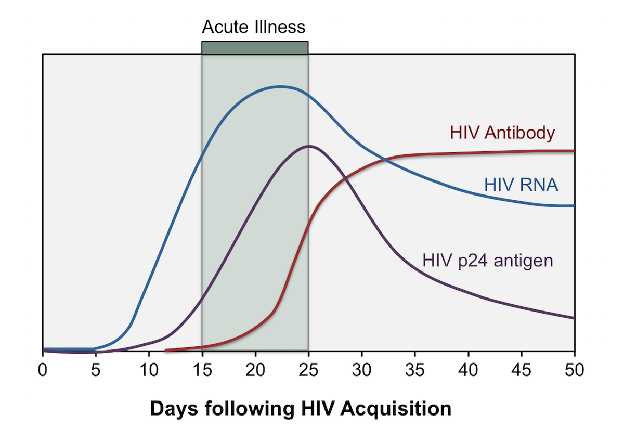
Serum Markers in Early HIV Infection

Slide 27
Types of HIV Tests
Rapid Tests
  Test for HIV antibodies
  Results in 30 minutes
  Test may not be positive for 3-6 weeks after exposure to HIV
4th Generation Testing
  Tests for antigens and antibodies
  Very accurate
  Allows for earlier diagnosis (2-3 weeks after infection)
  If positive, must be followed by a confirmatory test
  Must perform test to differentiate HIV-1 from HIV-2
Notes:
There are two main types of the HIV virus HIV -1 and HIV- 2. Of the approximately 37.9 million people in the world who have HIV, approximately 1 to 2 million have HIV-2. HIV-2 is seen most commonly in West Africa, France, Spain, Portugal, Brazil, India, Angola and Mozambique. Management of HIV-2 may require different medications than HIV-1; treatment with an expert skilled in HIV is usually recommended. Individuals may be infected with both HIV-1 and HIV-2.

Slide 28
CDC Revised Recommendations 2006 for HIV Testing
Routine, voluntary HIV screening for persons aged 13-64 in all health care settings, not based on risk factors.
Screen persons at known risk at least once a year.
Screen all pregnant women each pregnancy.
Separate signed consent or counseling should not be required.

Slide 29
HIV:
Chronic Infection

Slide 30
How does HIV affect the body?
HIV depletes the number of T cells (CD4 cells) in the host and destroys the body’s natural immunity.
HIV can directly affect cell function of some organs.
  Brain, kidney, neuropathy (impaired nerve sensation in hands and feet).
Chronic inflammation from immune system being ramped up. This may ↑ the risk of heart disease and stroke.

Slide 31
Once acquired, HIV is a lifelong infection
There is no cure for HIV, but the infection can be controlled with daily medications.
With treatment, the life expectancy of people with HIV is nearly the same as those who do not have HIV.
Without treatment, most people living with HIV infection will go on to develop AIDS.

Slide 32
Blood tests to monitor HIV infection
T cells (CD4 cells)
Viral Load
Type of white blood cell.
Normal is 500-1500.
Protects from certain infections.
Monitored every 6-12 months.
Measures amount of virus in the bloodstream.
Also called RNA test.
Monitored every 3-6 months.
Ideal value is ‘undetectable’.
Notes:
Undetectable does not mean that there is no virus in the body. It means that the amount of virus circulating in the bloodstream is so low that a commercial lab can’t detect any virus.

Slide 33
Acquired Immunodeficiency Syndrome
(AIDS)
People with HIV go on to develop AIDS if their immune system becomes very compromised and has an impaired ability to fight infections.

Slide 34
Criteria for Diagnosis of AIDS:
CD4 count falls to 200 or below (or < 14%).
or
Patient develops an indicator condition such as tuberculosis, pneumocystis pneumonia, Kaposi’s sarcoma, disseminated fungal infection, lymphoma, invasive cervical cancer, recurrent pneumonias, wasting syndrome.

Slide 35
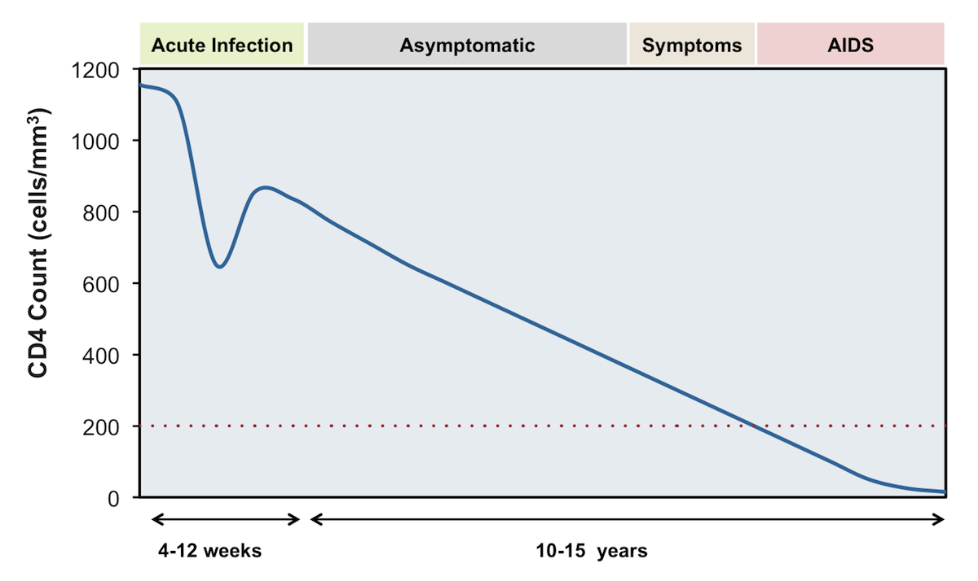
Natural History of Untreated HIV Infection

Slide 36
Common Illnesses in people with HIV
Sinus infections
Bronchitis
Bacterial infections
Diarrhea
Fatigue
Weight loss
Folliculitis
Seborrhea
Vaginal infections

Slide 37

Illnesses That Can Occur in Patients with HIV
BRAIN
EYES
Toxoplasmosis
Cryptococcal meningitis
Progressive multifocal leukoencephalopathy
Encephalopathy
Cytomegalovirus
MOUTH/THROAT
Candidiasis
GUT
LUNGS
Cytomegalovirus
Cryptosporidiosis
Mycobacterium avian complex
Salmonella septicemia (recurrent)
Isosporiasis
Pneumocystis carinii/jiroveci
pneumonia (PCP)
Pneumonia (recurrent)
Tuberculosis (TB)
Histoplasmosis
SKIN
GENITALS
Kaposi’s sarcoma
Herpes simplex (severe)
Genital Herpes
Vaginal Candidiasis
Cervical cancer (invasive)
OTHER
Lymphoma
Wasting disease
Coccidioidomycosis
Notes:
Information adapted from the U.S. Department of Health and Human Services' HIV and Its Treatment: What You Should Know (December 2009) accessed at http://www.aidsinfo.nih.gov/contentfiles/understandinghivprevention_fs_en.pdf on Oct. 20, 2010.

Slide 38
Treatment & Wellness Care for the Person with HIV

Slide 39
Initial Clinic Visits
Educate about HIV disease progression, transmission, treatment options.
Discuss safe sex & risk reduction. Avoid exposure to different strains of HIV that have different sensitivity patterns to HIV meds.
Identify other chronic health conditions, including psychiatric illness.
Start antiretroviral meds ASAP.
Notes:
You may hear the term “rapid initiation of ART”. This means starting medications to control HIV as soon as possible.

Slide 40
Initial Lab Tests
CD4 Count (T cells)
Viral Load
Genotype
Complete Blood Count
Baseline Chemistries
Hepatitis A, B and C testing
Syphilis, Chlamydia and Gonorrhea tests
Tuberculosis screening with QuantiFERON Gold or T-SPOT tests.
Notes:
Quantiferon Gold and T-SPOT are blood tests used to screen for tuberculosis. They are more reliable than the PPD skin test.

Slide 41
Genotype Test
Analyzes for mutations in the HIV virus that can affect its sensitivity to anti-retroviral medications.
HIV virus without mutations is called wild-type.
A genotype test should be done at time of diagnosis.
Repeat genotype if antiretroviral meds are not working (treatment failure).

Slide 42
Anti-retroviral Medications
Highly active anti-retroviral therapy.
Acronyms: HAART or ART.
Controls infection; does not eradicate it.
Goals:
  Slow viral replication.
  Stop disease progression and keep person as healthy as possible.
  Maintain or increase CD4 count.
  Prevent opportunistic infections.
  Prevent transmission of HIV to others.

Slide 43
Who Should Be on Anti-Retrovirals?
DHHS Adult and Adolescent ARV Guidelines recommend initiation of antiretroviral therapy for all persons with HIV to reduce morbidity and mortality associated with HIV infection and to prevent HIV transmission to others.
In addition, antiretroviral therapy should be started immediately, or as soon as possible, after the HIV diagnosis is confirmed.

Slide 44
Anti-retroviral Medications
5 FDA approved categories of anti-retrovirals:
  HIV entry inhibitors
  Nucleoside reverse transcriptase inhibitors (NRTIs)
  Non-nucleoside reverse transcriptase inhibitors (NNRTIs)
  Integrase strand inhibitors (INSTIs)
  Protease inhibitors (PIs)

Slide 45
Recommended Initial ART Regimens
The choice of the initial antiretroviral regimen depends on multiple patient factors, including medical and psychiatric comorbidities, patient preferences, and drug interactions.
In the Adult and Adolescent ARV Guidelines, the Recommended Initial Regimens for Most People with HIV consists of an INSTI anchor drug plus a 2-drug NRTI backbone. Other effective regimen options are available for use in certain clinical situations.
Notes:
Comorbidities are other illnesses that a person may have in addition to HIV.
Refer to the DHHS guidelines (at HIV.gov) on antiretroviral medications to find out additional information about appropriate medications to use to treat HIV.

Slide 46
Single Tablet Regimens
Genvoya
Biktarvy
Delstrigo
Juluca
Stribild
Triumeq
Atripla
Complera
Odefsey
Symtuza
Notes:
Single tablet regimens combine several different anti-retroviral medications into one pill. This makes it much easier for people to take ARTs.

Slide 47
Monthly Injection ART
On Jan 21, 2021 the FDA approved Cabenuva (cabotegravir and rilpivirine, injectable formulation) to use once a month as a complete treatment regimen for HIV.
Indicated for patients whose HIV is well controlled with an oral ART regimen.
Must take one month of oral cabotegravir and rilpivirine before starting injections to ensure tolerability of medications.

Slide 48
Use of Viral Load to Guide HIV Treatment Decisions
Viral Load (RNA) monitoring
  2-4 weeks (not more than 8 weeks) after start or change of ART, then every 4-8 weeks until suppressed to <200 copies/mL.
  Every 3-4 months with stable patients; may consider every 6 months for stable, adherent patients with VL suppression >2 years.
  Isolated “blips” may occur (transient low-level RNA, typically <400 copies/mL); these are not thought to predict virologic failure.

Slide 49
Virologic Failure
Defined as a HIV RNA level of >200 copies/ml confirmed on multiple test dates.
Assess patient’s ability to take medication as prescribed.
Requires an assessment of multiple issues: HIV meds, non-HIV meds, other medical problems, social issues.
Order a genotype.
Change medications as indicated by tolerability and genotype.

Slide 50
Wellness Care
Proper nutrition; maintain ideal body weight.
Keep immunizations up to date.
Annual tuberculosis screening for most patients.
Avoid alcohol and substance misuse.
Annual lipid tests and assessment for risk of heart disease and strokes.
Annual screening for syphilis and other STIs according to risk factors.
Annual screening for Hepatitis C in certain patients.
Screen for osteoporosis

Slide 51
Concurrent Illnesses In People with hiV

Slide 52
Examples of Concurrent Illnesses
Diabetes Mellitus
Hypertension
Hyperlipidemia
Heart Disease
Stroke
Hepatitis
Substance Use Disorders

Slide 53
Hepatitis C
RNA virus.
Can cause hepatitis, cirrhosis, liver failure, hepatocellular carcinoma.
Transmitted via:
  Exposure to blood products (i.e. sharing street drug paraphernalia).
  Organ transplantation.
  Condomless sex.
  Perinatal (mother to newborn).

Slide 54
Hepatitis C con’t
15 to 30% of people with HIV may also have hepatitis C.
As compared to people without HIV, individuals with HIV may have a more aggressive and rapid course of infection with hepatitis C.
There are a number of anti-viral medications that treat hepatitis C.
  Can cure hepatitis C.
  Can be prescribed for people with HIV.
  Drug – drug interactions with ARTs can occur.
Re-infection can occur. Test yearly in high risk individuals.

Slide 55
Psychiatric Illnesses in HIV Patients
Major depression
Bipolar Illness
Schizophrenia
Panic Disorder
Anxiety Disorder
↑ risk for suicide
Posttraumatic Stress Disorder
Notes:
Guide for HIV/AIDS Clinical Care, Section 8, pages 557-596
April 2014
US Department of Health and Human Services, Health Resources and Service Administration, HIV/AIDS Bureau

Slide 56
Ending the HIV EPIDemic

Slide 57
Methods to Reduce New Infections
Needle Exchange Programs Cincy: The Exchange.
PrEP
nPEP
Treatment as Prevention U=U.
Reducing mother to baby transmission.

Slide 58
PrEP
Pre-exposure Prophylaxis. Medication to prevent HIV infection.
Who is eligible? Those at risk for HIV: sex partner is known HIV +; multiple sex partners; trading sex for housing, food or drugs; substance abuse disorder.
Check Hepatitis B test and kidney function.
Daily oral emtricibaine + tenofovir disoproxil fumarate or
Daily oral emtricitabine + tenofovir alafenamide or
Injection cabotegravir every 8 weeks.
Patients should be have appointments every 3 months to repeat HIV test and assess ability to take medication as prescribed. Test for sexually transmitted infections as appropriate.

Slide 59
Post-Exposure Prophylaxis
(nPEP)
Typically administered when there is a defined exposure like unprotected sex or rape.
Rapid HIV test must be negative.
Must give ART meds within 72 hours of exposure.
28 days of antiretroviral meds. Examples:
  tenofovir disoproxil fumarate + emtricitabine + dolutegravir OR
  Tenofovir disoproxil fumarate + emtricitabine + raltegravir
Repeat HIV testing at 4-6 weeks and again at 3 months.

Slide 60
Treatment as Prevention U=U
Individuals with undetectable viral loads are much less likely to transmit HIV to their sex partners or people with whom they share needles with.
A few of the research studies showing validity of U = U:
  HPTN-052
  PARTNER-1 & PARTNER -2 studies
  Opposites Attract
Undetectable = Untransmittable
U=U Campaign
https://www.preventionaccess.org/undetectable

Slide 61
Reducing Mother to Child HIV Transmission
Test all pregnant women for HIV.
Repeat testing in 3rd trimester if woman is at high risk for HIV
Pregnant women should be antiretroviral medications; ensure that the viral load is undectable.
Undetectable viral load reduces transmission risk from about 25 % to about 1%.
HIV exposed neonates should receive antiretroviral medication(s) from an infectious diseases expert and have medical follow-up.

Slide 62
Resources

Slide 63
Early Intervention Program (EIP)
Rapid HIV testing site in the Emergency Department at UCMC.
Testing is usually available 24/7.
EIP offers HIV risk reduction education.
Information materials about sexual and behavioral health.
Linkage to HIV care and case management if HIV test is positive.
513-584-0720

Slide 64
Caracole
Non-profit AIDS service organization for clients in southwest Ohio, northern Kentucky and southeast Indiana.
Case Management.
Housing: housing stipends as well as on site housing.
HIV prevention:
  HIV testing.
  Needle exchange & harm reduction.
  Education about safer sex.

Slide 65
OHIV.org 800-332-2437
Private & anonymous info about HIV, STIs, sexual health, testing, HIV prevention (PAPI program).
Anyone in Ohio may call or access program online.
Phone hotline, online chat, webpage with lists of resources.
Health professionals may use the hotline to find resources, testing sites and general care information.

Slide 66
Opioid Response Network
Free local training and education to professionals addressing the public health crisis of opioid use disorder.
Staffed by American Academy of Addiction Psychiatry experts and other national professional organizations with expertise in the prevention, treatment and recovery of opioid use disorders.
Send request to Opioid Response Network

Slide 67
AETC National Clinical Consultation Center
HIV Management, COVID-19 800-933-3413
PEPline (post HIV exposure) 888-448-4911
Perinatal HIV Hotline 888-448-8765
PrEPline (HIV prevention) 855-448-7737
Clinical Substance Use Consultation 855-300-3595
Hepatitis C 844-497-4636

Slide 68
Medical Case Management Curriculum
Online self learning course for case managers
Offered by Southeast AETC
Purpose is to improve case managers’ health literacy and optimize client-centered communication through improved understanding of the unique structural barriers faced by people with HIV.
https://www.seaetc.com/medical-case-management-mcm-curriculum/

Slide 69
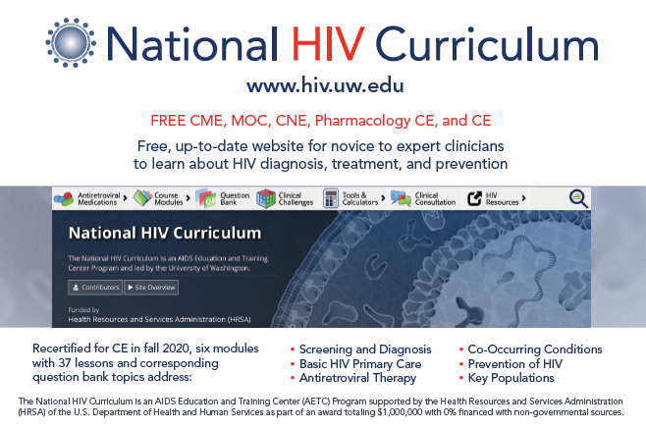
Notes:
Postcard Front

Slide 70
QUESTIONS?

Slide 71
Source Material
cdc.gov
odh.ohio.gov
National HIV Curriculum www.hiv.uw.edu
https://www.preventionaccess.org/undetectable
Aidsinfo.nih.gov
Slides about stigma are provided courtesy of: Tusday Dudley, M.Ed., Program Director, MATEC Missouri.

Slide 72
Contact Information
Mary Beth Donica donicamy@uc.edu 513-584-2422

