Slide 1
Oral Manifestations of Sexually Transmitted Infections in PWH
C Mark Nichols, DDS (mnichols@avenue360.org)
Dental Director, South Central AETC
Director of Dental Services, Avenue 360 Health and Wellness
Notes:
Version date_ 11 2020

Slide 2
Conflicts of Interest
C. Mark Nichols, DDS has no financial conflicts of interest to disclose.
Evidence-based, off-label use of some medications are referenced in this presentation.
This project is supported by the Health Resources and Services Administration (HRSA) of the U.S. Department of Health and Human Services (HHS). Under grant number U1OHA33225 (South Central AIDS Education and Training Center). It was awarded to the University of New Mexico. No percentage of this project was financed with non-governmental sources. This information or content and conclusions are those of the authors and should not be construed as the official position or policy of, nor should any endorsements be inferred by HRSA, HHS, or the U.S. Government

Slide 3
Disclaimers
The opinions expressed in this presentation are those of the speaker and not necessarily those of the University of Texas School of Dentistry.
The opinions expressed in this course should not be construed as advice for the care of specific patients.

Slide 4
Avenue 360 Health and Wellness
Federally Qualified Health Center, Joint Commission Certified
Primary Medical Care
Psychiatric and Mental Health Care
Pediatric Medical Care
Drug Addiction Treatment
Housing Assistance
General Dentistry
Adult Day Treatment
Residential Hospice and Respite Care

Slide 5
Learning Objectives
Review the categories of oral sexually transmitted infections (STIs).
Identify oral manifestations of STIs.
Discuss the difference of oral STIs in people with HIV (PWH).
Photos included in this slide set are from C.Mark Nichols, DDS unless otherwise specified.

Slide 6
Oral Sexually Transmitted Infections in HIV
Human Papilloma Virus
Herpes Simplex Virus
Molluscum contagiosum
Syphilis
Gonorrhea
Chlamydia

Slide 7
Higher prevalence of Oral HPV in PWH
Prevalence of any oral HPV for adults 18-69yo increasing
2009-2010: any HPV: 6.9% (men 10.1%, women 3.6%); HPV-16: 1%
2011–2014: any HPV: 7.3%; high-risk HPV: 4.0%
2013–2014: any HPV: 45.2% men, 39.9% women; high-risk 25.1% men, 20.4% women
High risk HIV-negative adults has a prevalence of 25% (men 28%, women 18%); HPV 16 – 5.3% ⁽²⁰⁰⁹⁻¹⁰⁾
Adult PWH prevalence of 40% (men 45%, women 35%); HPV 16 – 6.1% ⁽²⁰⁰⁹⁻¹⁰⁾
McQuillan et al, NCHS Data Brief, No. 208, 2017, CDC.gov “Oral Human Papillomavirus Infection: Hazard of Intimacy” Schlecht JAMA 2012 ,Letter to the editor that summarizes Gillison et al, JAMA 2012
Notes:
Prevalence of any and high-risk genital HPV higher among non-Hispanic black than both non-Hispanic white and Hispanic men and women

Slide 8
HPV in Oral Cavity and Peri-Oral Region
Condyloma acuminatum – HPV 6,11 *
Verruca vulgaris – HPV 1,2,4,7
Verruca plana - HPV 3,10,28,41
Multifocal epithelial hyperplasia – HPV 13,32 *
HPV induced dysplasia – HPV 16,18 *
*Sexual transmission: oral-genital, oral-oral, genital-genital

Slide 9
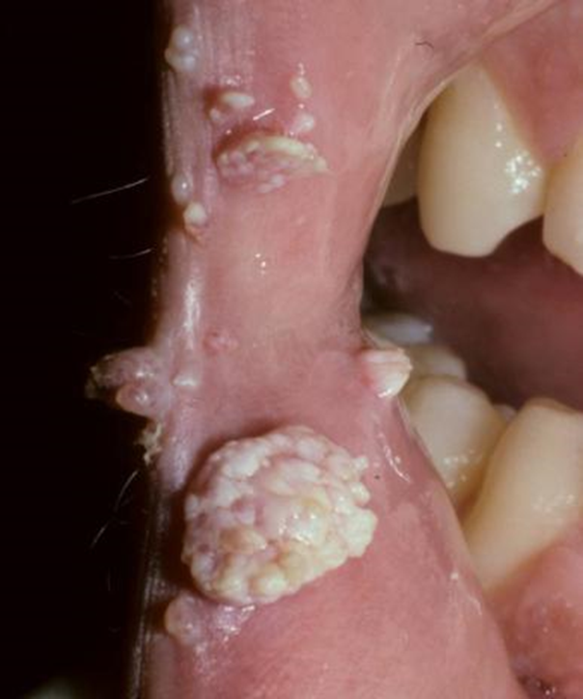
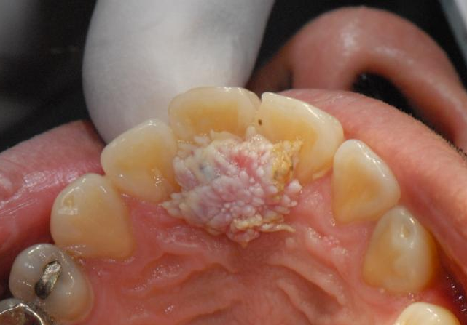
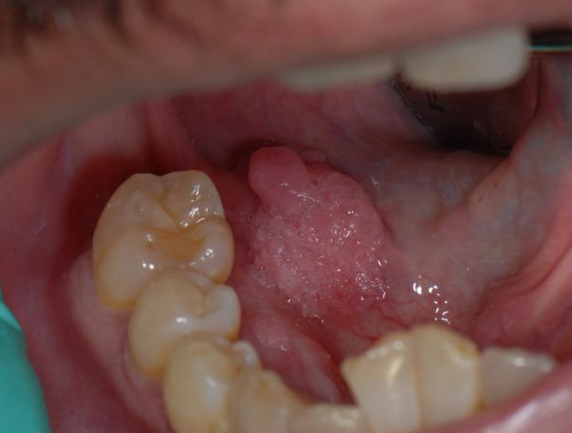
Condyloma acuminatum
Solitary or multiple lesions on the oral mucosa or vermillion border with a finger-like projections or cauliflower surface
Etiology: HPV 6,11; usually sexual transmission
Dx: clinical but biopsy preferred
Tx: excision
Dx=diagnosis, Tx=treatment

Slide 10
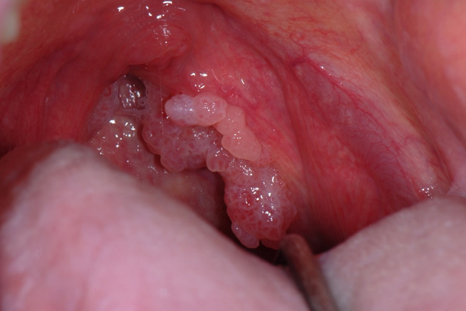
Case History: Growth on Tonsil
56yo MSM with HIV
Meds: ART, warfarin, carvedilol
CD4: 498 (Stage 2)
HIV PCR: <20 (controlled)
CBC: WNL
DX: condyloma acuminatum
ART= antiretroviral therapy; WNL= within normal limits
Notes:
Patient case 2017

Slide 11
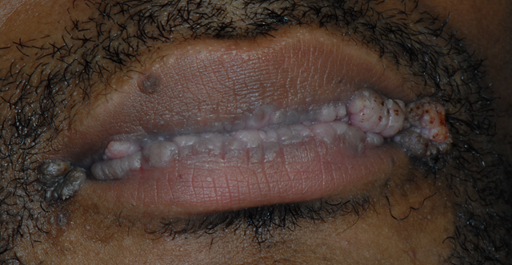
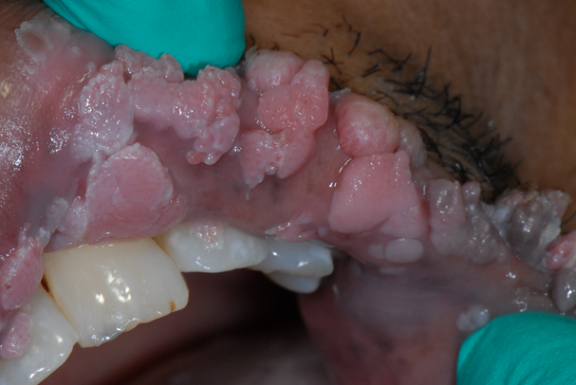
Case History: Growths on lips
26yo MSM with HIV
Meds: ART x 1 year
CD4: 100 (Stage 3)
HIV PCR: 1.4 million (uncontrolled)
HPV-18
Anal cancer
Notes:
Patient case 2020

Slide 12
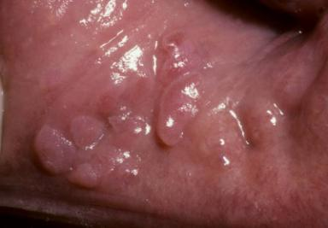
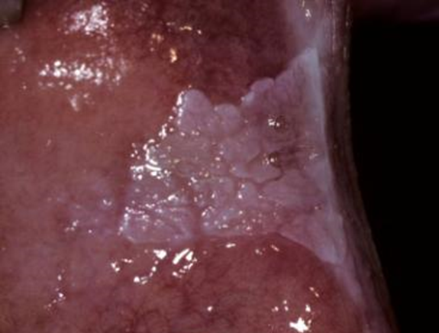
Multifocal Epithelial Hyperplasia (MEH; FEH, Heck’s Disease)
Raised or slightly nodular lesion on oral mucosa with stippled surface
Color can vary from normal to white
Usually multiple lesions but can be solitary; most often appear where tissue is easily traumatized by teeth
Etiology: HPV 13,32; often CD4 <300
Dx: clinical, biopsy preferred
Tx: excision, keratolytic agents, alpha-interferon
Notes:
biopsy preferred for at least one lesion

Slide 13
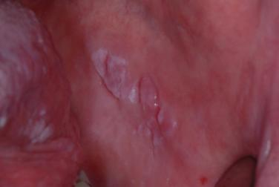
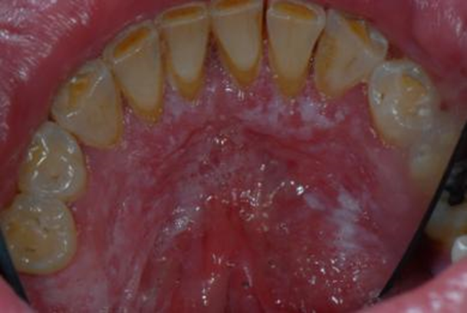
Case History: HPV-16 Induced Severe Dysplasia
41yo MSM
Meds: ART
CBC wnl
CD4: 247 (Stage 2)
HIV PCR 553 (uncontrolled)
Smokes tobacco
Bowenoid papulosis
Notes:
Patient case 2016

Slide 14
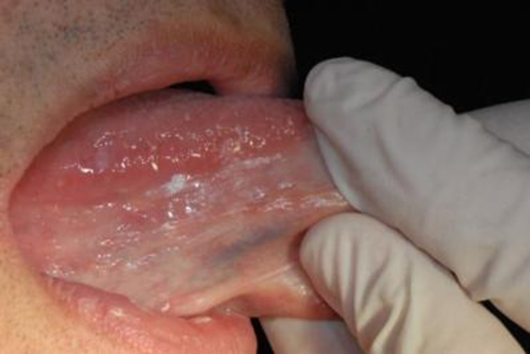
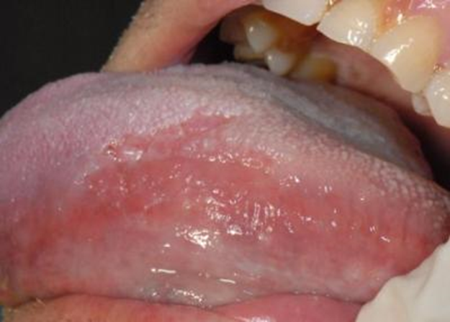
Case History: Invasive Squamous Cell Carcinoma
59yo MSM
Meds: ART >10 years; darunavir, ritonavir, etravirine, TMP/SMX, gemfibrozil, insulin, fluconazole
CD4 111 (Stage 3)
HIV < 20 (controlled)
Severe neuropathy
Wasting disease
Diabetes
Notes:
Patient case 2010
ART= etravirine (NNRTI), darunavir/ritonavir (PI)

Slide 15
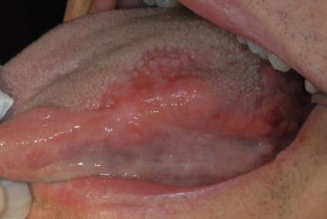
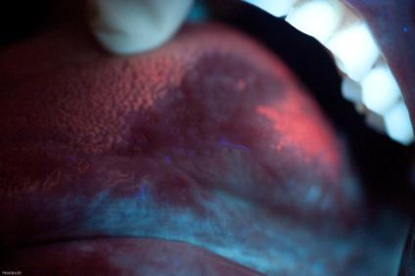
Case History 2: Invasive Squamous Cell Carcinoma
OraRisk HPV – 84 (unknown risk)
Notes:
Patient case 2010

Slide 16
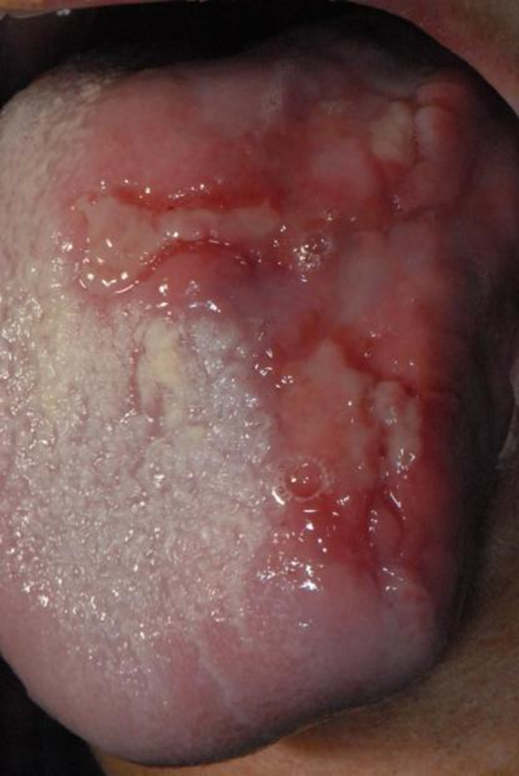
Case History 3: Invasive Squamous Cell Carcinoma
Progression at 7 months and development of severe anal cancer
Notes:
Patient case 2012
Patient died

Slide 17
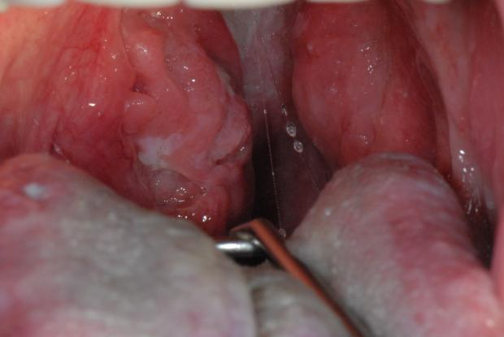
Case History 4: Invasive Squamous Cell Carcinoma
Tonsillar HPV-induced squamous cell carcinoma
OraRisk HPV - 16
Notes:
Patient case 2012
Patient died

Slide 18
Herpes Simplex Virus (HSV)
HSV is among the most prevalent STI
Most infections are subclinical; recurrent, painful lesions
Most genital HSV infections in U.S. are caused by HSV-2, while HSV-1 infections are typically orolabial and acquired during childhood
Prevalence of genital HSV-1 appears to be increasing among young adults
Decline in orolabial HSV-1 infections
Increasingly common oral sex behavior
CDC.gov
Notes:
This has been attributed, in part, to the decline in orolabial HSV-1 infections, because those who lack HSV-1 antibodies at sexual debut are more susceptible to genital HSV-1 infection. Increasingly common oral sex behavior among adolescents and young adults also has been suggested as a contributing actor

Slide 19
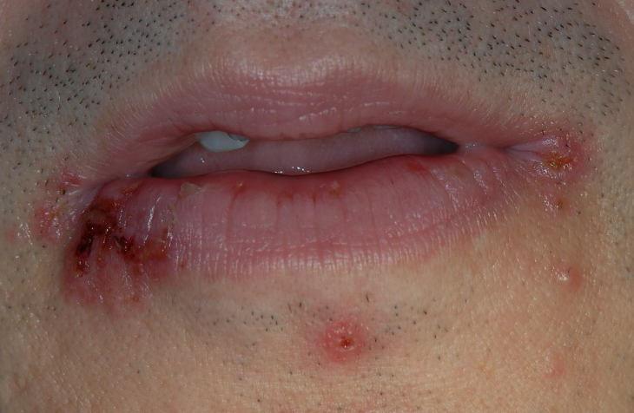
HSV Lesions - Labialis
Multiple vesicular lesions with slight crusting surface, usually appearing on vermillion border or perioral area
Painful; proceed by prodromal period of tingling sensations
Etiology: HSV-1 > HSV-2
Dx: clinical or cytology
Tx: may resolved spontaneously; if CD4 low, antivirals may be indicated; acyclovir, famciclovir, valacyclovir
Oral manipulation should be postponed until lesions resolve

Slide 20
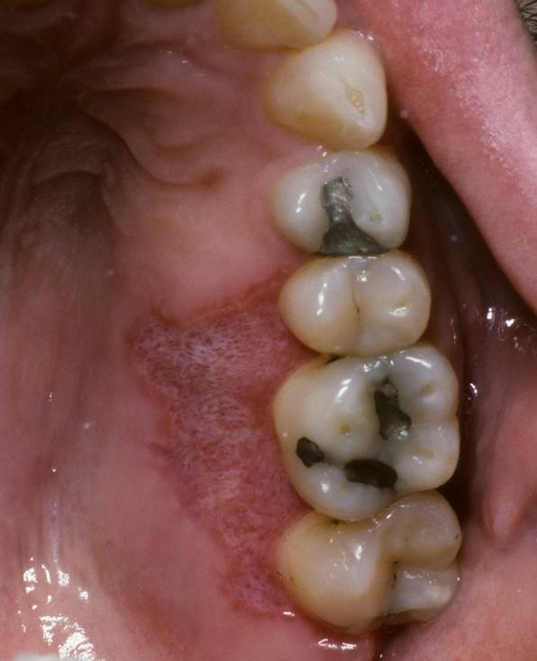
HSV Lesions - Intraoral
Ulcerations with irregular margins on keratinized tissue, typically on palatal or attached gingival tissue
Extremely painful
CD4 usually <200
Etiology: HSV
Dx: clinical or biopsy
Tx: acyclovir, famciclovir, valacyclovir

Slide 21
Molluscum Contagiosum - Poxvirus
Molluscum contagiosum lesion classification:
1. commonly seen skin lesions found largely on the faces, trunks, and limbs of children
2. sexually transmitted lesions found on the abdomen, inner thighs, and genitals of sexually active adults
3. diffuse and recalcitrant eruptions of patients with Stage 3 HIV (AIDS) or other immunosuppressive disorders
PWH can develop “giant” lesions (≥15 mm in diameter), larger numbers of lesions, and lesions that are more resistant to standard therapy
CDC.gov
Notes:
PWH= people with HIV
Other immunocompromising conditions (e.g., solid organ transplant recipients)

Slide 22
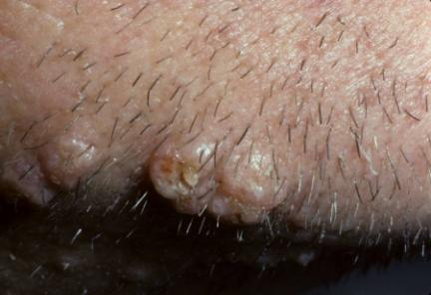
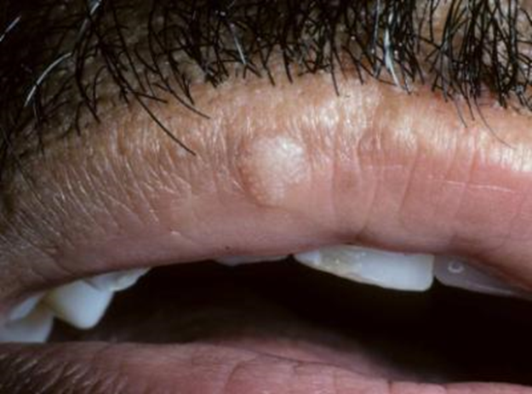
Molluscum contagiosum
Multiple raised or nodular lesions with a white core usually seen on vermillion border or skin
Etiology: Poxvirus and direct skin contact; Patient can auto inoculate from other sites (i.e. genital)

Slide 23
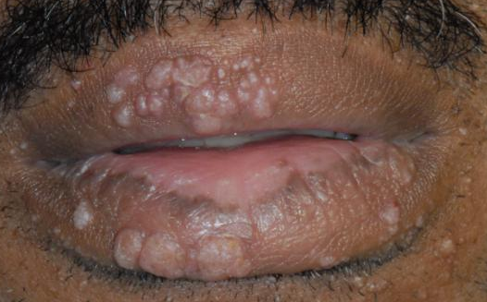
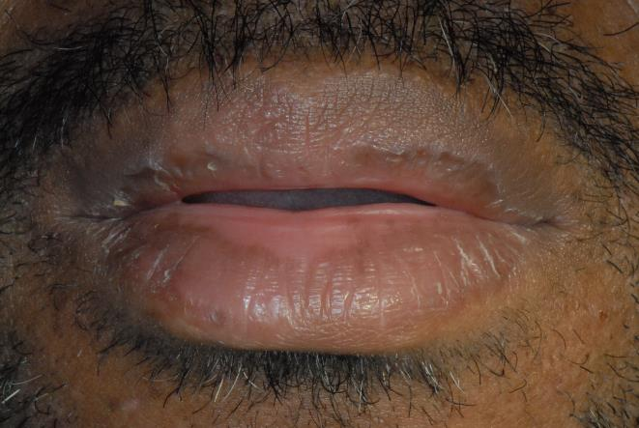
Molluscum contagiosum
Dx: clinical, biopsy preferred
Tx: enucleation or topical tretinoin gel, systemic acitretin

Slide 24
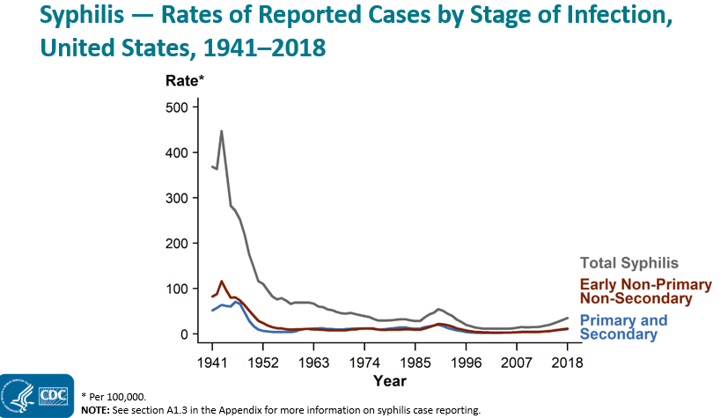
Syphilis: Treponema pallidum
Cases are on the rise
https://www.cdc.gov/std/syphilis/stats.htm
Notes:
Line graph showing United States rates of reported total syphilis, primary and secondary syphilis, and early non-primary non-secondary syphilis dating back to 1941, when syphilis reporting began; current increases in syphilis can be seen in the context of historically high syphilis rates from the 1940s. In 2018, 115,045 total cases of syphilis representing all stages of disease were reported in the United States; this is the highest number of total syphilis cases recorded since 1991. The 2018 case count for total syphilis reflects a 13.3% increase from 2017 when there were 101,584 cases. Reports of primary and secondary syphilis and early non-primary non-secondary syphilis cases—incident stages of infection—increased as well during 2017–2018.

Slide 25
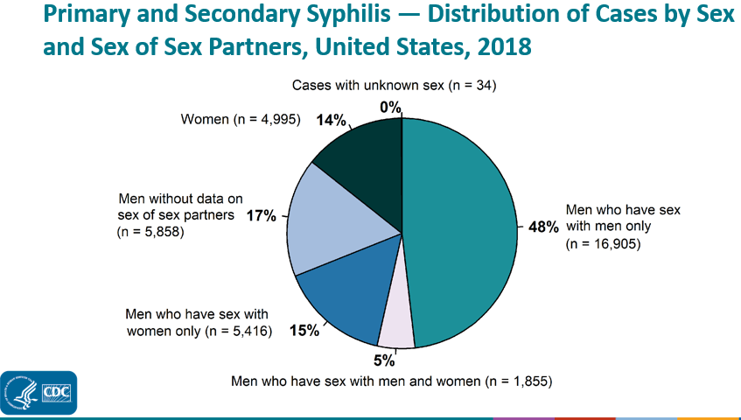
Syphilis: Treponema pallidum
Highest rates in MSM
Highest rates in men: 25-29yo
Highest rates in women: 20-24yo
https://www.cdc.gov/std/syphilis/stats.htm
Notes:
Pie graph showing the distribution of primary and secondary syphilis cases by sex and sex of sex partners in the United States in 2018. Men accounted for 85.7 % of reported primary and secondary syphilis cases. Of 35,063 reported primary and secondary syphilis cases in 2018, 18,760 (53.5%) were among men who have sex with men, including 16,905 (48.2%) cases among men who had sex with men only and 1,855 (5.3%) cases among men who have sex with both men and women. Overall, 5,416 (15.4%) cases were among men who have sex with women only, 4,995 (14.2%) were among women, 5,858 (17%) were among men without information about sex of sex partners, and 34 (0.1%) were cases reported with unknown sex. Among the 24,176 male cases with information on sex of sex partners, 77.6% occurred among men who have sex with men.
The highest rates were observed among men aged 25–29 years with 55.7 cases per 100,000 males, men aged 30–34 years with 45.8 cases per 100,000 males, and men aged 20–24 years with 44.6 cases per 100,000 males. The highest rates among females were among those aged 20–24 years with 10.0 cases per 100,000 females and those aged 25–29 years with 9.4 cases per 100,000 females.

Slide 26
Syphilis Stages
Syphilis is a complex STI that has a highly variable clinical course (“The great imitator”)
Early Syphilis: Primary Syphilis, Secondary Syphilis
Latent Syphilis: no symptoms; may last for years; symptoms may never return, or the disease may progress to the third (tertiary) stage
Tertiary Syphilis: develops years later in 15-30% without treatment
Congenital Syphilis: babies infected through placenta or during birth
Neurosyphilis: invasion of neuro system; can occur at any stage
cdc.gov
Notes:
Tertiary syphilis: disease may damage your brain, nerves, eyes, heart, blood vessels, liver, bones and joints. These problems may occur many years after the original, untreated infection.
Neurosyphilis: At any stage, syphilis can spread and, among other damage, cause damage to the brain and nervous system (neurosyphilis) and the eye (ocular syphilis), 8th nerve (otosyphilis).
Congenital syphilis: Babies born to women who have syphilis can become infected through the placenta or during birth. Most newborns with congenital syphilis have no symptoms, although some experience a rash on the palms of their hands and the soles of their feet. Later signs and symptoms may include deafness, teeth deformities and saddle nose — where the bridge of the nose collapses.
However, babies born with syphilis can also be born too early, be born dead (stillborn) or die after birth.

Slide 27
Syphilis and HIV
PWH tend to have more than one chancre, a larger and deeper primary lesion, higher rate of asymptomatic primary syphilis, more aggressive secondary syphilis and increase rate of early neurological involvement
Syphilis and HIV: a dangerous combination ,Lynn, Lightman Lancet Inf Dis. 2004
Case series of syphilis and HIV co-infections ,Wahab et al, Pak J Med Sci 2013

Slide 28
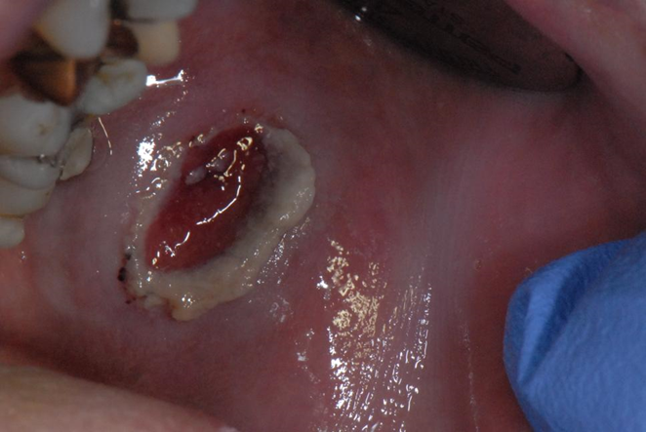
Primary Syphilis
One or more ulcerative lesions (chancre)
Usually appear at site of initial exposure (penile, oral, rectal, vaginal) about three weeks after exposure
Usually painless
Will spontaneously heal in 3-6wks
Dx: clinical
Tx: penicillin IM
cdc.gov; MayoClinic.org
Notes:
Bicillin-LA 2.4million units IM x 1

Slide 29
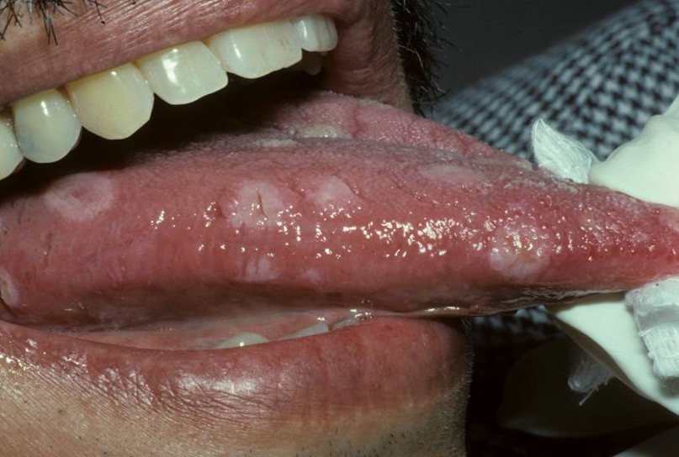
Secondary Syphilis
Localized or diffuse muco- cutaneous lesions; generalized lymphadenopathy
Can include mucous patches, condyloma lata
Usually appears 3-6wks after primary lesions resolves
These signs and symptoms may disappear within a few weeks or repeatedly come and go for as long as a year
Dx: serology; Tx: penicillin IM
cdc.gov; MayoClinic.org
Notes:
rash — such as non-pruritic macular, maculopapular, papular, or pustular lesions; alopecia
Primary ulcerative lesion may still be present
White serpengenous patches on tongue or palate, may have a wart like appearance. Asymptomatic. Also known as condyloma lata or mucous patches.
Etiology – chronic infection of Treponema pallidum. May have anal lesions.
Bicillin-LA 2.4million units IM x 1

Slide 30
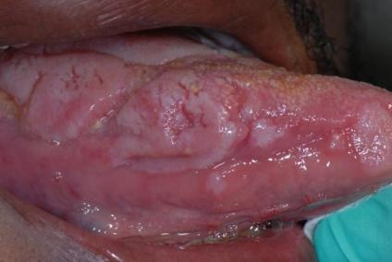
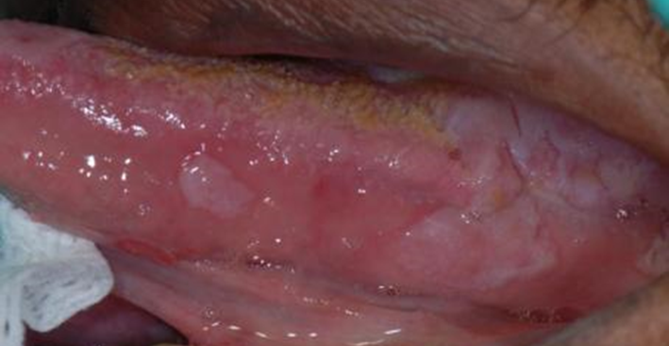
Case History – Swollen Tongue
44yo MSM c/o 2wk tongue enlargement; has started biting it occasionally
Meds: ART
CBC wnl
CD4 552 (Stage 1)
HIV PCR <48 (controlled)
White serpengenous patches
Notes:
Patient case 2013

Slide 31
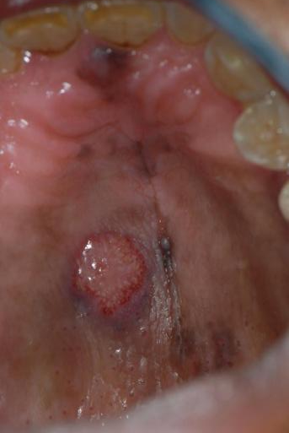
Case History – Swollen Tongue
DDX: HPV, sarcoidosis, amylodosis, dysplasia, SCC
Pt reported recurrence of “anal HPV” that coincided with enlargement of tongue
HPV DNA – 83 high risk
Biopsy dx: condyloma lata, secondary syphilis
Notes:
Patient case 2013

Slide 32
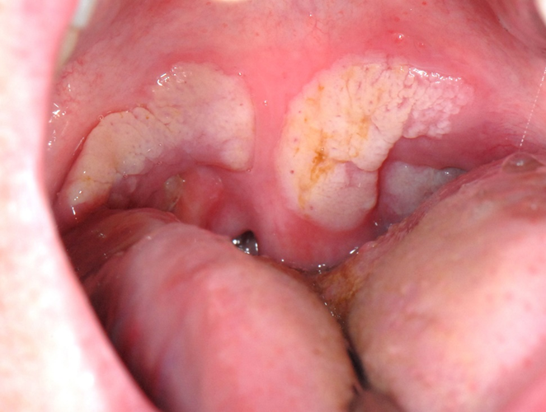
Case History – Secondary Syphilis
30yo MSM
CD4: 563 (Stage 1)
HIV PCR < 40 (controlled)
Non painful white adherent plaques on soft palate, duration unknown
Bx: reactive hyperplasia with heavy concentration of spirochetes
DX: condyloma lata; RPR:1:128
TX: penicillin IM
Notes:
CBC wnl
referral to PCP
Penicillin G benzathine (Bicillin-LA) 2.4million units IM x1

Slide 33
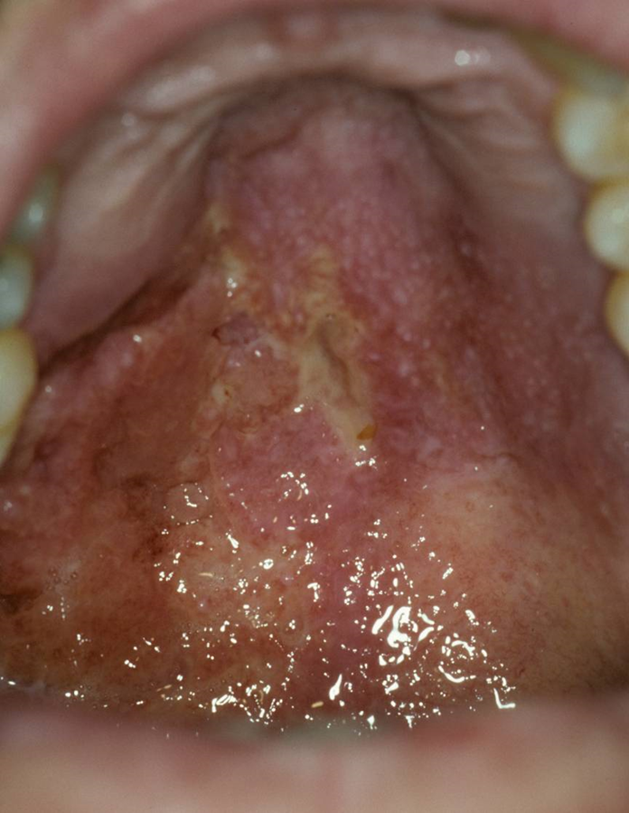
Tertiary Syphilis
Gumma in hard palate
Extremely painful
Granulomatous with ulceration
Notes:
Penicillin G benzathine (Bicillin-LA) 2.4million units IM x 3; although clinical findings may be permenant

Slide 34
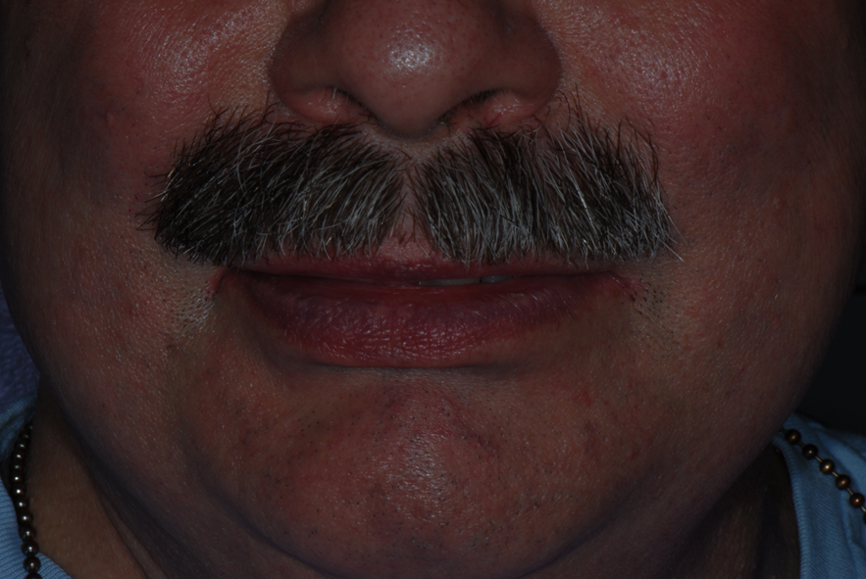
Case History - Neurosyphilis
Almost complete paralysis of the muscles of the upper face.
Appeared years after the initial diagnosis of primary syphilis
Appears to be permanent.
In photo, patient is trying to elevate his upper lip.
Notes:
Dx: serologies; lumbar puncture
Tx: penicillin IV x 10-14d

Slide 35
Neisseria gonorrhoeae
Gonorrhea is the second most commonly reported communicable disease
Causes infections in the genitals, rectum, and throat
Can be acquired by having anal, vaginal, or oral sex with someone who has gonorrhea
cdc.gov
Notes:
In U.S., an estimated 820,000 new N.gonorrhoeae infections occur each year
Urethral infections caused by N. gonorrhoeae among men can produce symptoms that cause them to seek curative treatment soon enough to prevent sequelae, but often not soon enough to prevent transmission to others
Among women, gonococcal infections are commonly asymptomatic or might not produce recognizable symptoms until complications (e.g., PID) have occurred

Slide 36
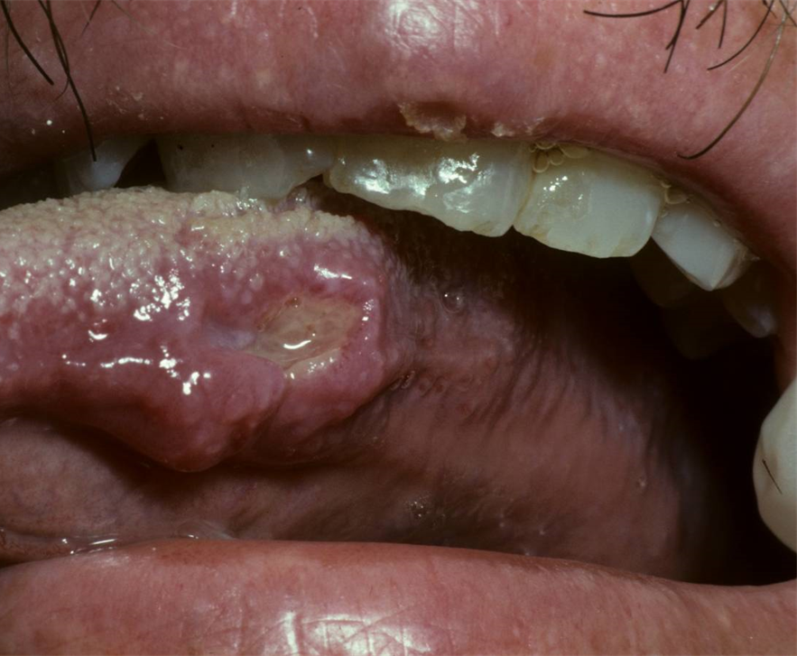
Case History – gonorrhea
Intracellular Gram-negative diplococci in biopsy
Also had red maculopapular lesions in pharynx
Lesions may be severe in immunocompromised patients
Dx: NAAT, gram-stain/culture
Tx: Ceftriaxone + azithromycin
Notes:
NAAT= nucleic acid amplification test

Slide 37
Chlamydia trachomatis
Chlamydia, caused by infection with Chlamydia trachomatis; most common notifiable disease in U.S.
Can cause a pharyngitis but oral lesions have never been identified in my practice
Dx: NAAT
Tx: azithromycin or doxycycline
cdc.gov
Notes:
It is among the most prevalent of all STDs, and since 1994, has comprised the largest proportion of all STDs reported to CDC.
NAAT= nucleic acid amplification test

Slide 38
References
CDC.org
MayoClinic.org
Oral Pathology, Clinical Pathologic Correlations, Regezi& Sciubba, 2nd
Differential Diagnosis of Oral Lesions, Wood & Goaz, 4th
Prevalence of Oral HPV Infection in the United State, 2009-2010, Gillison et al, JAMA 2012
Oral Human Papillomavirus Infection Hazard of Intimacy Schlecht, JAMA 2012 (Letter to the editor)
Syphilis and HIV: a dangerous combination ,Lynn, Lightman Lancet Inf Dis. 2004
Case series of syphilis and HIV co-infections ,Wahab et al, Pak J Med Sci 2013

Slide 39
Resources
Clinical Consultation Center http://nccc.ucsf.edu/
HIV Management
Perinatal HIV
HIV PrEP
HIV PEP line
HCV Management
Substance Use Management
Present case on ECHO http://echo.unm.edu hivecho@salud.unm.edu
Additional trainings scaetcecho@salud.unm.edu
AETC National HIV Curriculum https://aidsetc.org/nhc
AETC National HIV-HCV Curriculum https://aidsetc.org/hivhcv
Hepatitis C Online https://www.hepatitisc.uw.edu/
AETC National Coordinating Resource Center https://targethiv.org/library/aetc-national-coordinating-resource-center-0
HIV Clinical Guidelines https://clinicalinfo.hiv.gov/en/guidelines
www.scaetc.org
Notes:
Find an HIV TeleECHO clinic in your area: https://echo.unm.edu/locations-2/echo-hubs-superhubs-united-states/
AETC National HIV Curriculum: 6 core modules for self study; regularly updated; CME, CNE

