Slide 1
Management of Treatment-Experienced Patients
Guidelines for the Use of Antiretroviral Agents in Adults and Adolescents
June 2021

Slide 2
About This Presentation
These slides were developed using the Guidelines updated in June 2021.
The intended audience is clinicians involved in the care of patients with HIV.
Because the field of HIV care is rapidly changing, users are cautioned that the information in this presentation may become out of date quickly.
It is intended that these slides be used as prepared, without changes in either content or attribution. Users are asked to honor this intent.

Slide 3
Guidelines for the Use of Antiretroviral Agents in HIV-1-Infected Adults and Adolescents
Developed by the Department of Health and Human Services (DHHS) Panel on Antiretroviral Guidelines for Adults and Adolescents – A Working Group of the Office of AIDS Research Advisory Council (OARAC)

Slide 4
Outline
Definitions
Causes of virologic failure (VF)
Management of VF
Clinical scenarios
Discontinuation or interruption of ART
Poor CD4 recovery and persistent inflammation despite viral suppression

Slide 5
Treatment-Experienced Patients
The recommended initial ARV regimens should achieve and maintain HIV suppression to below the lower level of detection (LLOD) of HIV RNA assays
Virologic rebound or failure of virologic suppression often results in resistance mutations to one or more of the ARVs in the regimen
Assessment and management of patients with extensive ART resistance is complex: expert consultation is recommended

Slide 6
Virologic Response, Definitions (1)
Viral suppression
Virologic suppression (VS):
Confirmed HIV RNA below LLOD (e.g., <50 copies/mL)
Virologic failure (VF):
Inability to achieve or maintain HIV RNA <200 copies/mL
Graphic: National HIV Curriculum, hiv.uw.edu

Slide 7
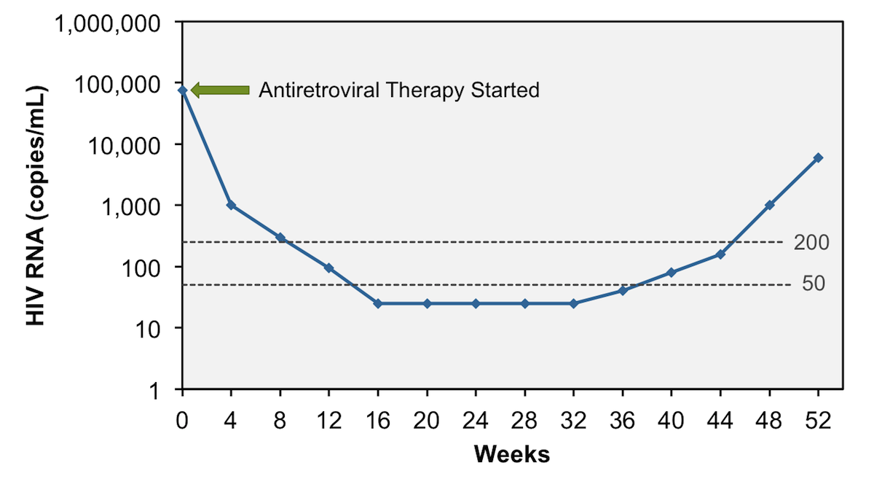
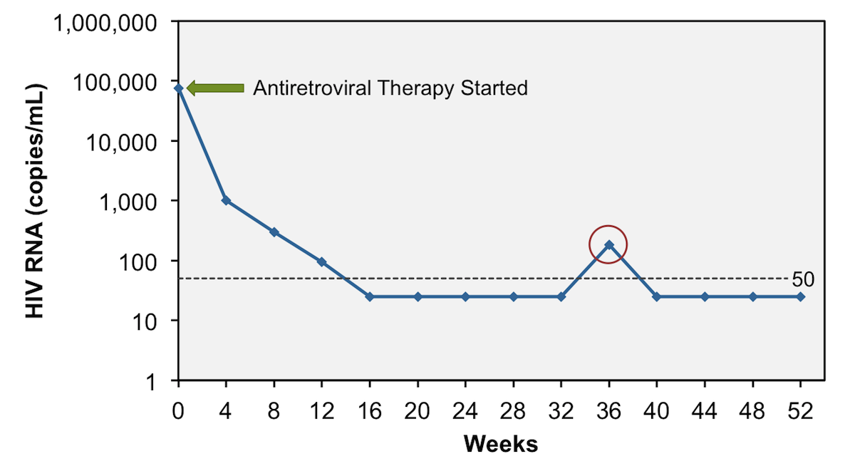
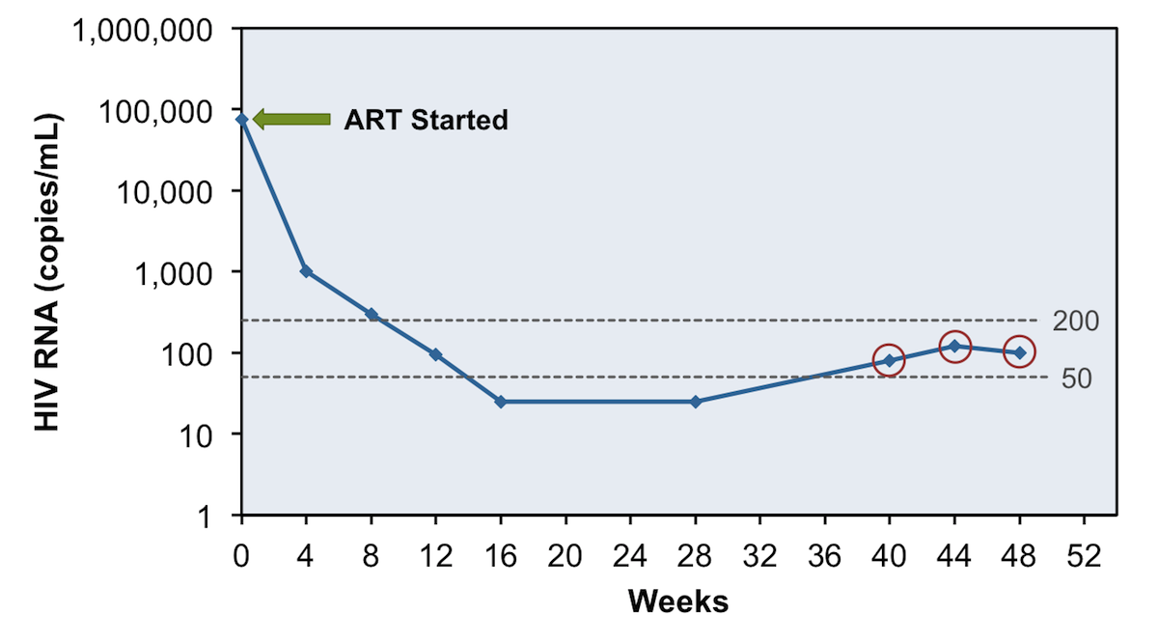
Virologic Response, Definitions (2)
Virologic rebound
Incomplete virologic response:
Lack of VS to <200 copies/mL after 24 weeks on ART
Virologic rebound:
Confirmed HIV RNA ≥200 copies/mL after VS
Virologic blip:
An isolated detectable HIV RNA level followed by a return to VS
Low-level viremia:
Detectable HIV RNA <200 copies/mL
Virologic blip
Low-level viremia
Graphics: National HIV Curriculum, hiv.uw.edu

Slide 8
Causes of Virologic Failure (VF) (1)
Most common: suboptimal adherence, ARV intolerance; also transmitted drug resistance
Patient/adherence-related factors
Comorbidities that affect adherence (e.g., substance abuse, psychiatric or neurocognitive issues)
Unstable housing
Missed clinic appointments
Interruptions in access to ART
Cost/affordability of ARVs
Adverse drug effects
High pill burden, dosing frequency

Slide 9
Causes of Virologic Failure (VF) (2)
HIV-related factors
Transmitted or acquired resistance mutations
Prior treatment failure
Higher pretreatment HIV RNA (depending on the ART regimen)
ARV regimen-related factors
Pharmacokinetic problems
Suboptimal ARV potency
Low genetic barrier to resistance
Prior exposure to nonsuppressive regimens
Food requirements
Drug-drug interactions with concomitant medications
Prescription errors

Slide 10
Managing Patients with VF (1)
Carefully assess causes of VF; management will vary according to cause
Review HIV RNA, CD4 count, ART history, prior and current ARV resistance test results
Resistance is cumulative; consider all past resistance
Resistance test should be done while patient is taking the failing regimen, or within 4 weeks of treatment discontinuation
If >4 weeks since ARV discontinuation, resistance test may provide useful information, but it may not detect previously selected mutations

Slide 11
Managing Patients with VF (2)
Goal of treatment: virologic suppression (HIV RNA <LLOD)
Select regimen based on ARV history, resistance testing, and/or novel mechanism of action
New regimen should contain at least 2 fully active agents
2 fully active ARVs may be sufficient if at least one has high resistance barrier (eg, DTG or boosted DRV)
If no fully active ARV with high resistance barrier is possible, 3 fully active ARVs are very important

Slide 12
Managing Patients with VF (2)
Some ARVs may have partial activity even if resistance mutations are present (e.g., some NRTIs and PIs)
1 active drug should not be added to a failing regimen (resistance likely to develop quickly)
If HIV/HBV coinfection – continue HBV-active agents, to avoid HBV flare
Consult with experts

Slide 13
Persons of Childbearing Potential: INSTIs Considerations
Perform pregnancy test before ART start
DTG:
DTG-based ART regimens are recommended options, but discuss benefits and risks to inform decision-making
Small (0.19%) and not statistically significant increased rate of neural tube defects (NTDs) in infants exposed to DTG at conception
Other INSTIs:
BIC: should not be used in pregnancy - insufficient data
CAB: should not be used in pregnancy – no data
EVG/c: should not be used in pregnancy: low EVG levels in 2nd and 3rd trimesters
RAL: no evidence of increased fetal malformations; included in recommended options in pregnancy

Slide 14
Managing VF: Level of Viremia (1)
For all:
Confirm VL, assess/address adherence, possible drug-drug and drug-food interactions
VL >LLOD - <200:
ART change not usually required. Development of resistance unlikely. No consensus re management. Check VL q 3 months.
VL ≥200 - <1,000:
Drug resistance likely (esp. if VL >500). Manage as for VL ≥1000.

Slide 15
Managing VF: Level of Viremia (2)
VL ≥1000 and no ARV resistance mutations identified:
Usually caused by suboptimal adherence: assess and address; consider changes, simplification
VL ≥1000 and ARV resistance mutations identified:
Modify regimen ASAP, to avoid more resistance mutations and higher viral loads

Slide 16
Managing VF, Clinical Scenarios: Failure of 1st ART Regimen - INSTI + 2 NRTIs
Resistance considerations | ART options
If resistance to 3TC/FTC but no INSTI resistance | Boosted PI + 2 NRTIs (at least 1 fully active) DTG + 2 NRTIs (include at least 1 fully active) Boosted PI + INSTI
If EVG or RAL resistance but susceptibility to DTG +/- 3TC/FTC resistance | Boosted PI + 2 NRTIs (at least 1 fully active) DTG BID (if HIV is sensitive to DTG) + 2 NRTIs (at least 1 fully active) DTG BID (or possibly BIC*) + boosted PI
*BIC: no data in patients with VF and EVG or RAL resistance mutations; “its use cannot be formally recommended” in these settings.

Slide 17
Managing VF, Clinical Scenarios: Failure of 1st ART Regimen (2) - NNRTI + 2 NRTIs
Resistance considerations | ART options
Most likely: resistance to NNRTI +/- 3TC/FTC (M184V/I) Add’l NRTI mutations may be present | DTG + 2 NRTIs (at least 1 fully active) Boosted PI + 2 NRTIs (at least 1 fully active) Boosted PI + INSTI

Slide 18
Managing VF, Clinical Scenarios: Failure of 1st ART Regimen (3) - Boosted PI + 2 NRTIs
Resistance considerations | ART options
Most likely: no resistance, or resistance only to 3TC/FTC (M184V/I) | Continue same regimen Another boosted PI + 2 NRTIs (at least 1 fully active) DTG* + 2 NRTIs (at least 1 fully active) Another boosted PI + INSTI
*Could consider BIC in place of DTG. If only 1 NRTI is active, DTG preferred to BIC. No data on use of BIC in this setting of VF.

Slide 19
Managing VF, Clinical Scenarios: Failure of 2nd (or subsequent) ART Regimen – ARV resistance but active ARV options
Resistance considerations | ART options
Consider past and current resistance test results and ART history to design new ART regimen | At least 2 fully active ARVs Can use partially active ARVs if no other options Consider ARVs with different mechanisms of action

Slide 20
Managing VF, Clinical Scenarios: Failure of 2nd (or subsequent) ART Regimen (2) – Multiple or extensive resistance and few ARV options
Resistance considerations | ART options
Consider past and current resistance test results and ART history to design new ART regimen Consider tropism test (if MVC is being considered) Consult experts | Identify all active or partially active ARVs Consider ARVs with different mechanisms of action Consider investigational ARVs: clinical trial or expanded access program ART discontinuation is NOT recommended

Slide 21
Managing VF, Clinical Scenarios: Suspected ARV Resistance but Limited/Incomplete ARV and Resistance History - Unknown
Resistance considerations | ART options
Obtain records, if possible Resistance testing: may identify mutations (if patient off ART, mutations may not be detected) | Consider restarting previous regimen and obtain VL and resistance test after 2-4 weeks Consider regimen with ARVs with high genetic barriers to resistance (eg, DTG and/or boosted DRV) with close VL monitoring and resistance testing if inadequate viral suppression

Slide 22
Discontinuation or Interruption of ART (1)
Treatment interruption should be avoided, if possible: may cause rapid increase in HIV RNA, immune decompensation, clinical progression
Unplanned ART interruption may occur, and sometimes may be necessary

Slide 23
Discontinuation or Interruption of ART (2)
Short-Term Interruptions (days-weeks)
Unanticipated:
Severe toxicity or inability to take oral medication:
Stop all ARV components simultaneously
Planned:
All ARVs have similar half-lives:
Stop all simultaneously
ARVs have different half-lives:
Some NNRTIs have long half-lives; may stop NNRTI first and stop other ARVs 2-4 weeks later, or replace NNRTI with boosted PI for 4 weeks, then stop all

Slide 24
Discontinuation or Interruption of ART (3)
Planned Long-Term Interruptions
Not recommended outside controlled clinical trials
If ART must be discontinued, patients should understand risks (re personal health and re HIV transmission)
Follow closely: clinical and laboratory monitoring

Slide 25
Poor CD4 Recovery and Persistent Inflammation Despite Viral Suppression
Morbidity and mortality are higher in HIV-infected individuals than in the general population, even with viral suppression
E.g., cardiovascular disease, many non-AIDS cancers and infections, COPD, osteoporosis, diabetes, liver disease, kidney disease, thromboembolic disease, neurocognitive dysfunction, frailty
Likely related to poor CD4 recovery, persistent immune activation, and inflammation, as well as health-related behaviors and ARV toxicity

Slide 26
Poor CD4 Recovery Despite VS
Low CD4 (especially <200 cells/µL, but also up to at least 500 cells/µL) despite viral suppression on ART: associated with risk of illness and mortality
Lower pretreatment CD4 counts associated with suboptimal CD4 recovery – early ART initiation may enhance CD4 recovery

Slide 27
Poor CD4 Recovery Despite VS: Management
Evaluate for underlying causes
Malignancy, coinfections (e.g., HCV), medical conditions
Medications that may decrease CD4 cells (e.g., cancer chemotherapy, interferon)
No consensus on management of patients without evident causes
Changing or intensifying the ARV regimen has not been shown to be beneficial, is not recommended
IL-2: no benefit, not recommended
Other immune-based therapies are being studied

Slide 28
Persistent Immune Activation and Inflammation Despite VS (1)
Immune activation and inflammation improve with suppression of HIV through ART, but do not return to normal
Systemic immune activation and inflammation may be independent mediators of risk of morbidity and mortality in patients with viral suppression on ART
Poor CD4 recovery on ART (e.g., CD4 <350 cells/µL) associated with greater immune system activation and inflammation

Slide 29
Persistent Immune Activation and Inflammation Despite VS (2)
Causes not completely clear: likely include HIV persistence, coinfections, microbial translocation
No proven interventions
ART intensification or modification: not consistently effective in studies
Anti-inflammatory medications and others are being studied
Clinical monitoring with immune activation or inflammatory markers is not currently recommended
Focus on maintaining viral suppression with ART, reducing risk factors (e.g., smoking cessation, diet, exercise), managing comorbidities (e.g., hypertension, hyperlipidemia, diabetes)

Slide 30
Websites to Access the Guidelines
AETC National Coordinating Resource Center https://aidsetc.org
Clinical Info https://clinicalinfo.gov

Slide 31
About This Slide Set
This presentation was prepared by Susa Coffey, MD, for the AETC National Resource Center in March 2020. and updated in June 2021.
See the AETC NCRC website for the most current version:
https://aidsetc.org

