Slide 1
PrEP: A Hard Pill to Swallow
Understanding Black MSM and their relationship to PrEP

Slide 2
Disclaimer
This presentation was supported by the Health Resources and Services Administration (HRSA) of the U.S. Department of Health and Human Services (HHS) as part of an award totaling $3,994,961 with no percentage financed with nongovernmental sources. The contents are those of the author and do not necessarily represent the official views of, nor an endorsement, by HRSA, HHS or the U.S. Government.

Slide 3
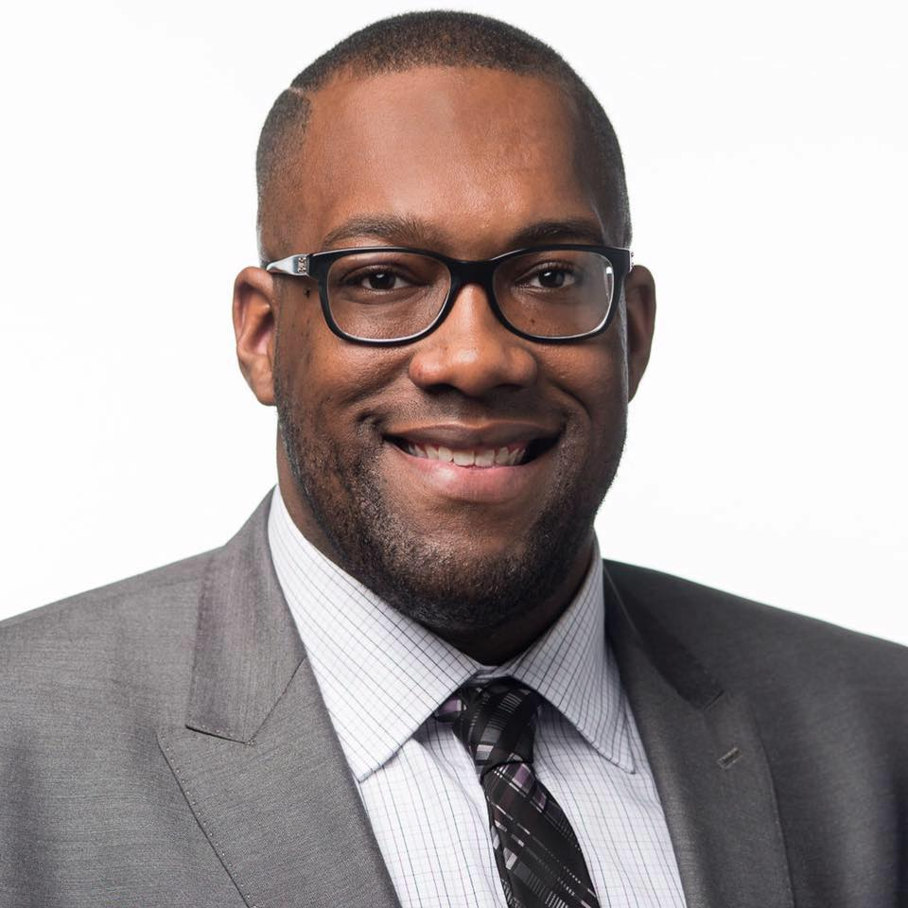
Presenters
Tyrell Manning
He/Him/His
Early Intervention Outreach Services Specialist
Williams & Associates, Inc.
D. Rashaan Gilmore
He/Him/His
Founder + President
BlaqOut

Slide 4
Learning Objectives
Understand the impact of HIV amongst Black men who have sex with men (BMSM)
Identify strategies and best practices for recruiting and engaging BMSM with pre-exposure prophylaxis (PrEP)
Discuss perceived ideas about Black MSM and PrEP uptake
Understand PrEP messaging to Black MSM

Slide 5
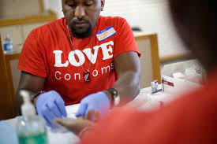
HIV & BMSM

Slide 6
(Gant, et al., 2020)
Notes:
Gant, Z., Johnson, S. D., Li, J., Wang, S., Hawkins, D., Chong, M., ... & Hernandez, A. (2020). Diagnoses of HIV infection in the United States and dependent areas (updated), 2018.

Slide 7
(Gant, et al., 2020)

Slide 8
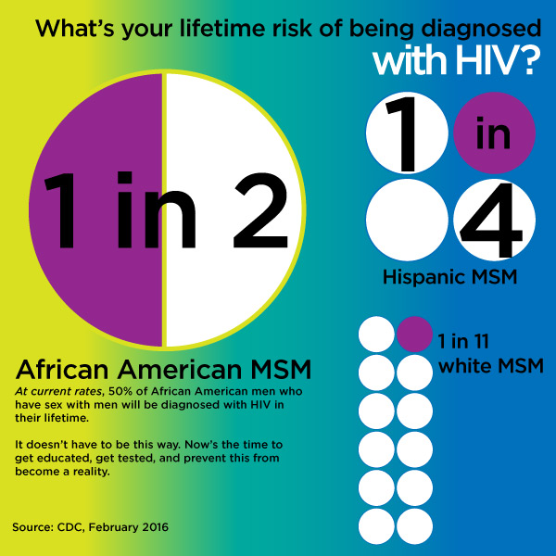
BMSM still bear a disproportionate burden of new HIV infections.
(HVCS, 2016)
Notes:
HVCS. (2016, Feb 29). CDC Releases Report on Lifetime Risk of HIV Diagnosis. Retrieved from https://www.hudsonvalleycs.org/cdc-releases-report-on-lifetime-risk-of-hiv-diagnosis/

Slide 9
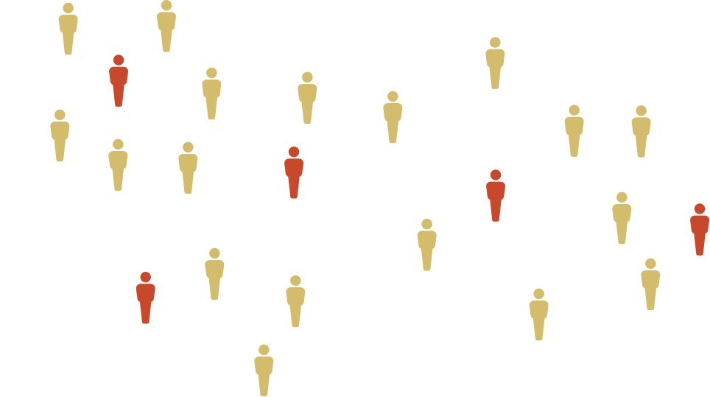
Why are BSM disproportionately impacted by HIV?
Notes:
Compared to their white counterparts, Black MSM have fewer sexual partners and less condomless aex we well as lesser/equal drug use. Yet high rates of HIV.

Slide 10
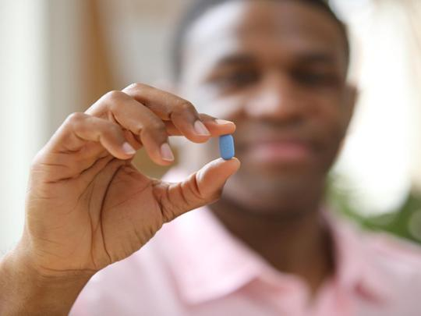
What about PrEP?

Slide 11
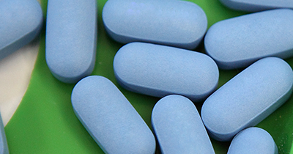
PrEP: A Quick Recap
Pre-exposure prophylaxis (PrEP) is an HIV biomedical prevention tool
Approved in 2012 by the FDA (Truvada)
Approved in 2019 (Descovy)
Taken by HIV-negative individuals once daily to help them maintain their negative status
PrEP is 99% effective when used daily (sexual transmission)
PrEP is 74% effective when used daily (IDU transmission)
(CDC, 2020)
Notes:
CDC. (2020, May 13). Pre-Exposure Prophylaxis (PrEP). Retrieved from https://www.cdc.gov/hiv/risk/prep/index.html

Slide 12
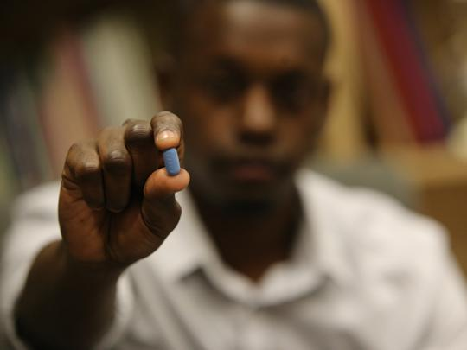
BMSM’s Relationship with PrEP

Slide 13
CDC Data Reports...
“40 percent of white gay and bisexual men used PrEP in 2017, while only 30 percent of their Latino counterparts and 26 percent of their African-American counterparts did so…” Fitzsimons, T. (2019, March 8)
“Eighty-six percent of African-Americans know about it, as do 87 percent of Latinos and 95 percent of whites.” Fitzsimons, T. (2019, March 8)
(Fitzsimons, 2019)
Notes:
Fitzsimons, T. (2019, March 8). PrEP use jumps to 35 percent among gay and bi men at risk of HIV. NBC News. Retrieved from https://www.nbcnews.com/feature/nbc-out/prep-use-jumps-35-percent-among-gay-bi-men-risk-n980516?icid=related

Slide 14
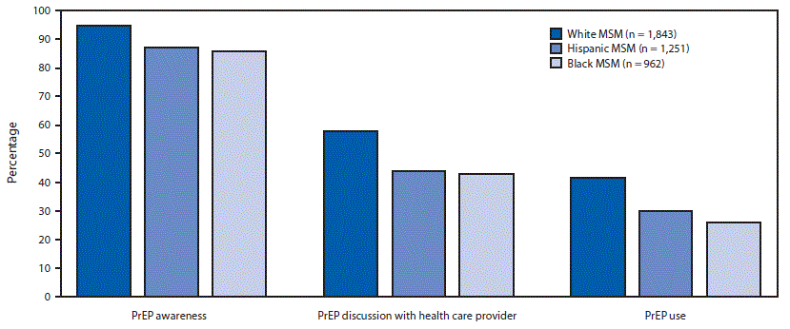
FIGURE. Pre-exposure prophylaxis (PrEP) awareness,* discussion,† and use,§ by race/ethnicity, among men who have sex with men (MSM) with a likely indication for PrEP use (N = 4,056) — 23 urban areas, 2017
(Kanny, et al., 2019)
Notes:
Kanny, D., Jeffries IV, W. L., Chapin-Bardales, J., Denning, P., Cha, S., Finlayson, T., ... & National HIV Behavioral Surveillance Study Group. (2019). Racial/ethnic disparities in HIV preexposure prophylaxis among men who have sex with men—23 urban areas, 2017. Morbidity and Mortality Weekly Report, 68(37), 801.

Slide 15
Why aren't BMSM taking PrEP?
Stigma/Shame
Bias
Medical mistrust/mishandling
Lack of PrEP savvy/sex-positive providers
Low income
Un/Under-Insured
Socioeconomic challenges
They Don't want to
(Reuters, 2019)
Notes:
Reuters. (2019, Sept 26). Unequal HIV prevention pill use puts minority men at higher risk. NBC News. Retrieved from https://www.nbcnews.com/feature/nbc-out/unequal-hiv-prevention-pill-use-puts-minority-men-higher-risk-n1059016

Slide 16
“It’s important to note that the
goal shouldn’t be to make PrEP use
equal for African American, Hispanic,
and white MSM”, Kirby, T. (2020)
Prioritize Equity!
(Kirby, 2020)
Notes:
Kirby, T. (2020). PrEP use falling short in African American and Hispanic MSM. The Lancet HIV, 7(2). https://doi.org/10.1016/s2352-3018(20)30005-9

Slide 17
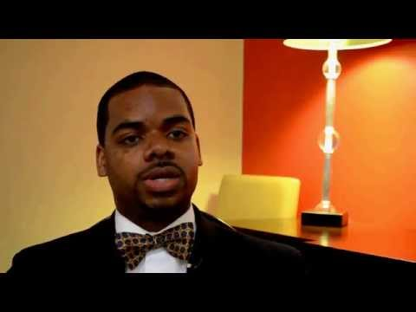
HIV Prevention Trials Network Study 073 (2019)
(Griffiths, 2019; Wheeler, et al., 2019)
Notes:
Griffiths, D. (2019, Feb 25). Gay Men, Substance Use, and Harm Reduction: It's Time to Act. The Body Pro. Retrieved from https://www.thebodypro.com/article/study-shows-bmsm-demonstrate-high-prep-adherence
Wheeler, D. P., Fields, S. D., Beauchamp, G., Chen, Y. Q., Emel, L. M., Hightow‐Weidman, L., ... & Wilton, L. (2019). Pre‐exposure prophylaxis initiation and adherence among Black men who have sex with men (MSM) in three US cities: results from the HPTN 073 study. Journal of the International AIDS Society, 22(2), e25223.

Slide 18
Culturally Competent Supportive Services
"When you present folks with choice, information, and opportunity, they are able to synthesize that information and to make choices that reflect their needs, wants, desires, and health in the way they have the autonomy to do unlike other places," Lisa Hightow-Weidman, M.D., M.P.H.
(The Body Pro, 2019)
Notes:
The Body Pro. (2019, Feb 27). Black Gay and Bisexual Men Demonstrate High PrEP Adherence in Hotly Anticipated Study. Retrieved from https://www.thebodypro.com/article/study-shows-bmsm-demonstrate-high-prep-adherence.

Slide 19
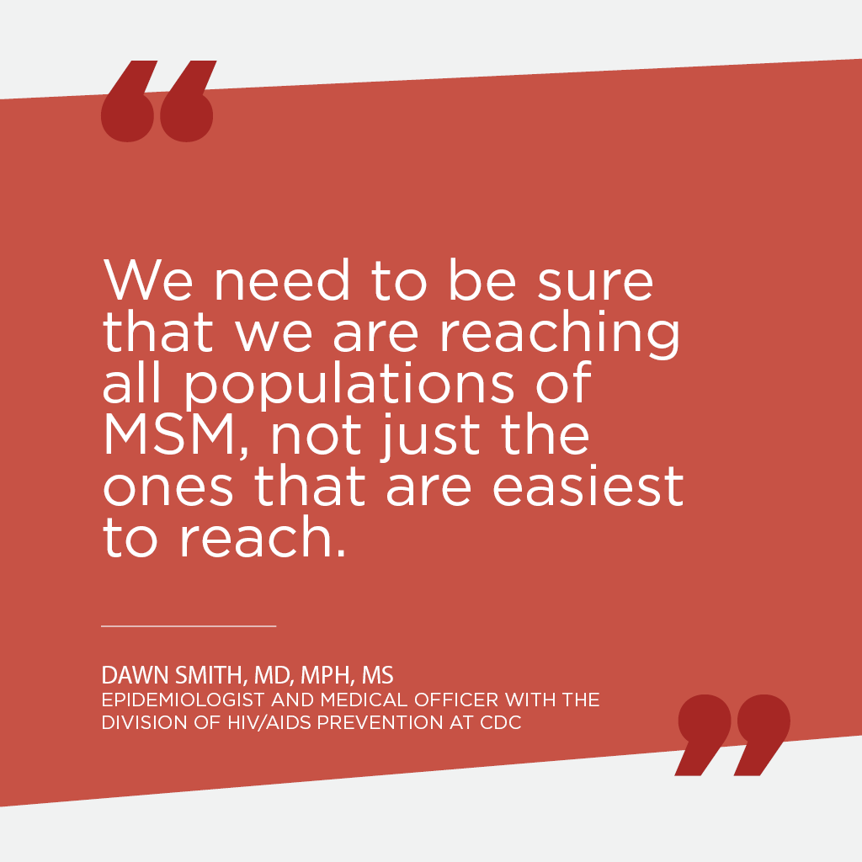
Equity-Based PrEP Promotion
Who’s in the images that are hanging in your clinic?
Who is featured in your pamphlets and brochures?
How are you approaching conversations about PrEP?
Who are you using to promote?
Are you compensating them?
Who is leading planning and strategizing around reaching BMSM?

Slide 20
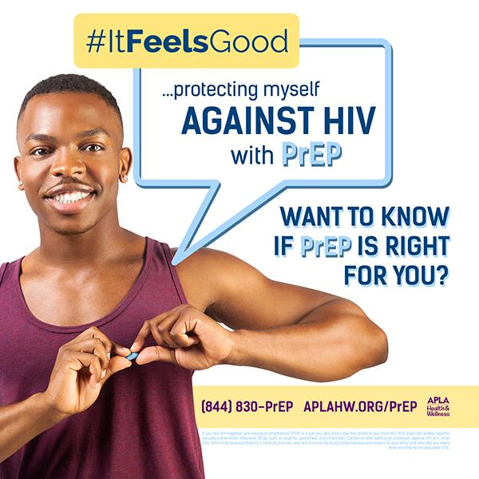
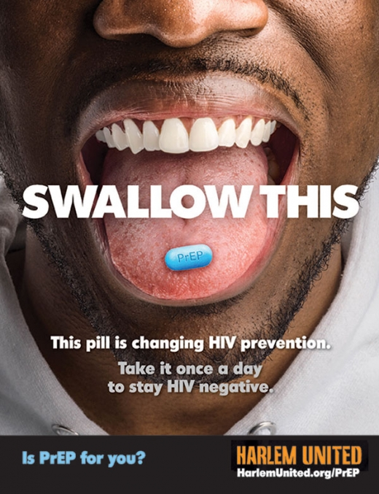
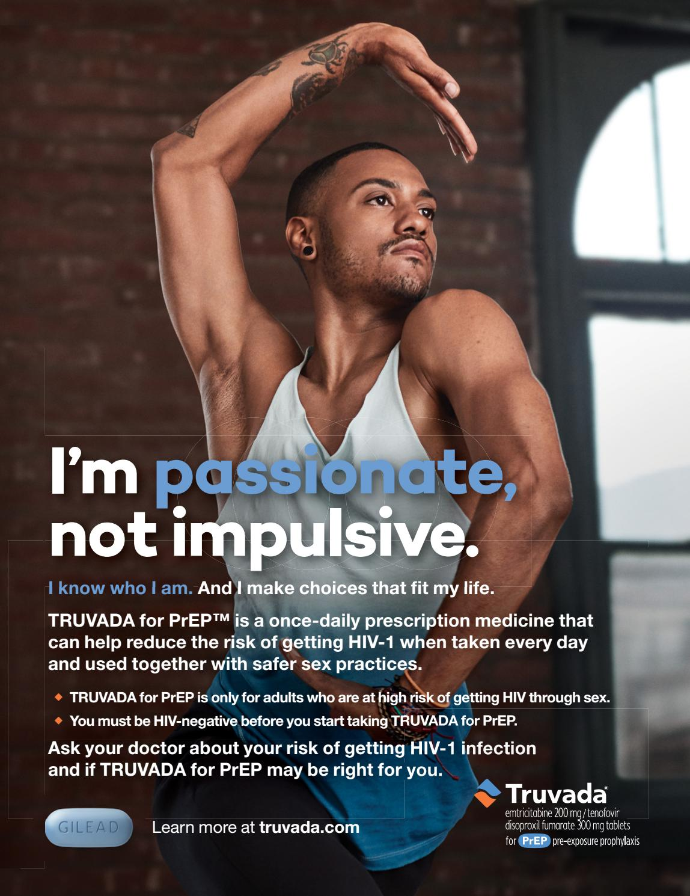
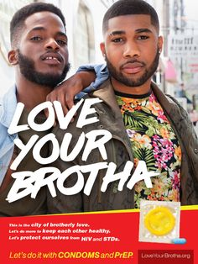
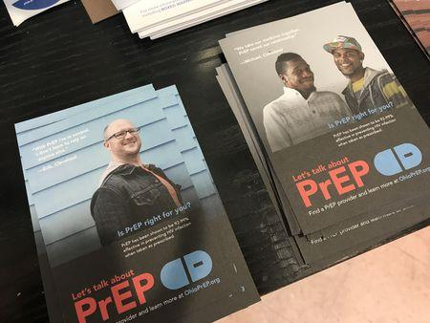
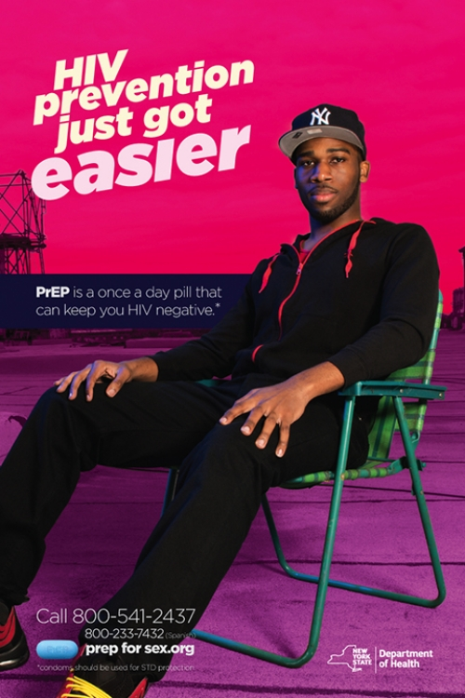
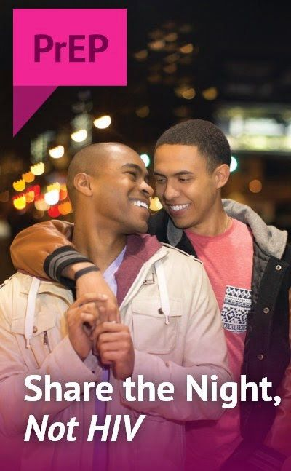
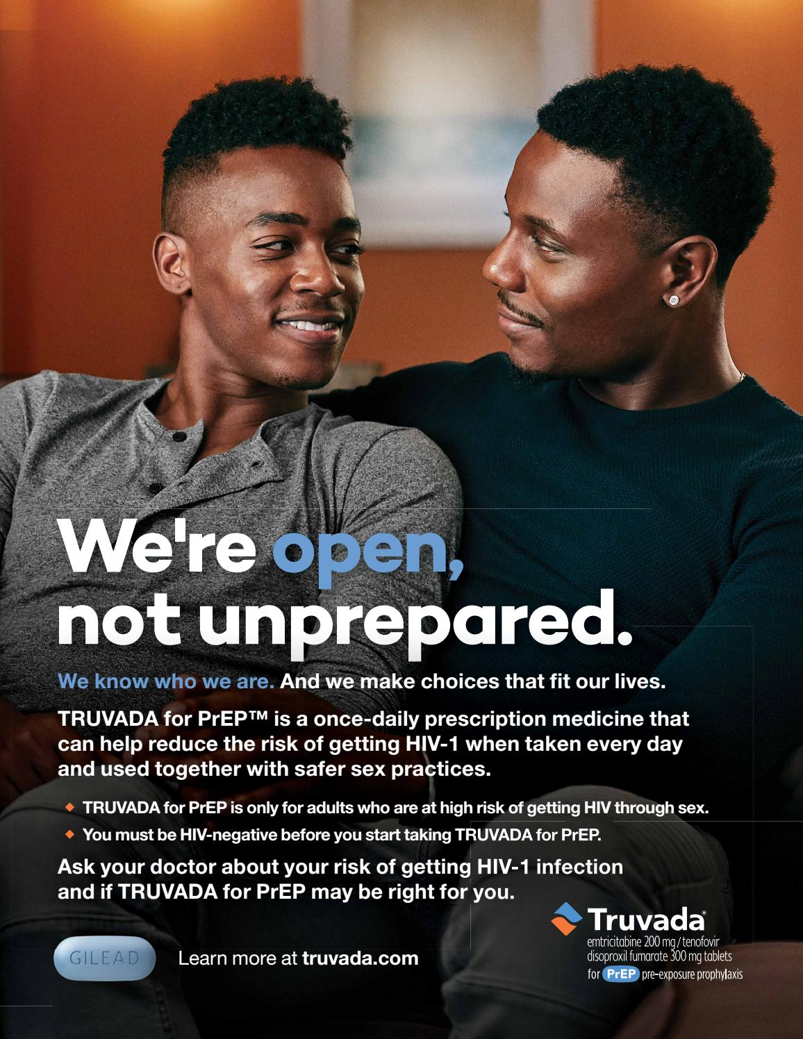
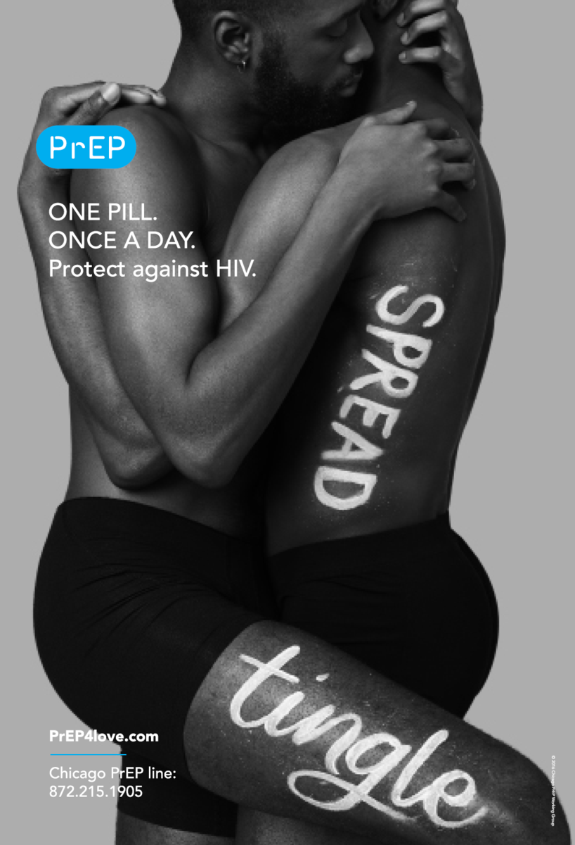
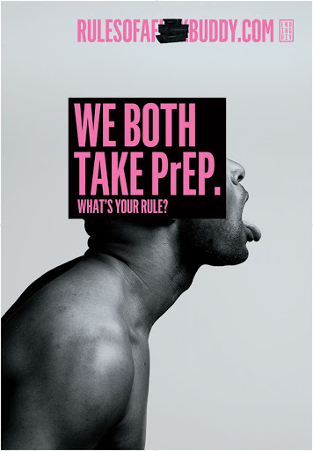
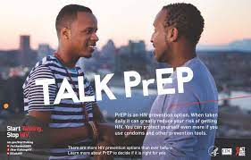
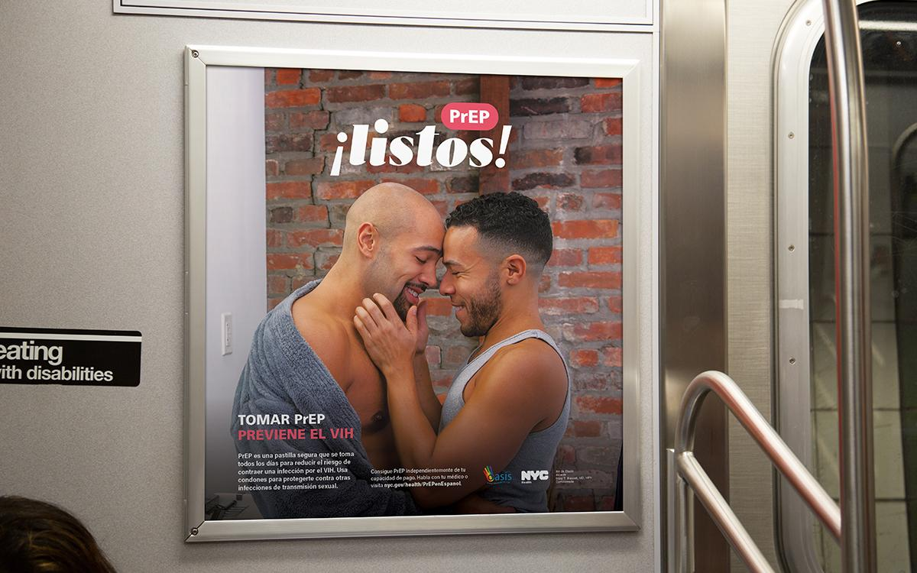

Slide 21
Examine
Assumptions
Bias
Stigma
Language
Expectations
“We are much more than a hard-to-reach population, walking risk factors for HIV or vectors of disease transmission,” he said. “We are proud black men.” - Dr. David Malebranche
(Boerner, 2016; Rodriguez, 2018)
Notes:
Boerner, H. (2016, Dec 30). Confronting Implicit Bias to Transform Sexual Health and Medical Care. The Body Pro. Retrieved from https://www.thebodypro.com/article/confronting-implicit-bias-to-transform-sexual-heal
Rodriguez, M. (2018, Jul 27). Watch This Top HIV Researcher Break Down How Medical Racism and Bias Hurt Black Gay Men. Into More. Retrieved from https://www.intomore.com/impact/watch-this-top-hiv-researcher-break-down-how-medical-racism-and-bias-hurt-black-gay-men/

Slide 22
Questions

Slide 23
References
The Body Pro. (2019, Feb 27). Black Gay and Bisexual Men Demonstrate High PrEP Adherence in Hotly Anticipated Study. Retrieved from https://www.thebodypro.com/article/study-shows-bmsm-demonstrate-high-prep-adherence
Boerner, H. (2016, Dec 30). Confronting Implicit Bias to Transform Sexual Health and Medical Care. The Body Pro. Retrieved from https://www.thebodypro.com/article/confronting-implicit-bias-to-transform-sexual-heal
Fitzsimons, T. (2019, March 8). PrEP use jumps to 35 percent among gay and bi men at risk of HIV. NBC News. Retrieved from https://www.nbcnews.com/feature/nbc-out/prep-use-jumps-35-percent-among-gay-bi-men-risk-n980516?icid=related
Gant, Z., Johnson, S. D., Li, J., Wang, S., Hawkins, D., Chong, M., ... & Hernandez, A. (2020). Diagnoses of HIV infection in the United States and dependent areas (updated), 2018.
HVCS. (2016, Feb 29). CDC Releases Report on Lifetime Risk of HIV Diagnosis. Retrieved from https://www.hudsonvalleycs.org/cdc-releases-report-on-lifetime-risk-of-hiv-diagnosis/
Kanny, D., Jeffries IV, W. L., Chapin-Bardales, J., Denning, P., Cha, S., Finlayson, T., ... & National HIV Behavioral Surveillance Study Group. (2019). Racial/ethnic disparities in HIV preexposure prophylaxis among men who have sex with men—23 urban areas, 2017. Morbidity and Mortality Weekly Report, 68(37), 801.
Kirby, T. (2020). PrEP use falling short in African American and Hispanic MSM. The Lancet HIV, 7(2). https://doi.org/10.1016/s2352-3018(20)30005-9
Reuters. (2019, Sept 26). Unequal HIV prevention pill use puts minority men at higher risk. NBC News. Retrieved from https://www.nbcnews.com/feature/nbc-out/unequal-hiv-prevention-pill-use-puts-minority-men-higher-risk-n1059016
Wheeler, D. P., Fields, S. D., Beauchamp, G., Chen, Y. Q., Emel, L. M., Hightow‐Weidman, L., ... & Wilton, L. (2019). Pre‐exposure prophylaxis initiation and adherence among Black men who have sex with men (MSM) in three US cities: results from the HPTN 073 study. Journal of the International AIDS Society, 22(2), e25223.

