Slide 1
Project ECHO® - UNM
HIV TeleECHO Clinic
Treatment of HCV Genotype 3 in Patients with Cirrhosis
September 14, 2021
Karla Thornton, MD, MPH
Professor, Division of Infectious Diseases
University of New Mexico Health Sciences Center
Senior Associate Director
Project ECHO
Notes:
Version_ MM YYYY

Slide 2
Conflict of Interest Disclosure Statement
Speaker has nothing to disclose.
This presentation was reviewed by UNMHSC and SCAETC faculty to ensure it meets Continuing Education guidelines.
This project is supported by the Health Resources and Services Administration (HRSA) of the U.S. Department of Health and Human Services (HHS). Under grant number U1OHA33225 (South Central AIDS Education and Training Center). It was awarded to the University of New Mexico. No percentage of this project was financed with non-governmental sources. This information or content and conclusions are those of the authors and should not be construed as the official position or policy of, nor should any endorsements be inferred by HRSA, HHS, or the U.S. Government.

Slide 3
Learning Objectives
Recognize the difference between HCV genotype 3 and other genotypes
Identify appropriate treatment options for patients with HCV genotype 3 and cirrhosis
Notes:
https://www.hcvguidelines.org/

Slide 4
HCV Genotype 3 (GT3)
In U.S., prevalence of GT3 approximately 10%
GT3 infection more common in younger patients (4% in patients born before 1946 - 18% in those born after 1976)
Higher proportion of GT3 among people who inject drugs (PWID)
Faster rates of fibrosis progression
Increased risk of cirrhosis
Higher prevalence of severe steatosis
Higher incidence of hepatocellular carcinoma
https://www.hepatitisc.uw.edu/go/treatment-infection/treatment-genotype-3/core-concept/all
Notes:
Abstract
Data show that viral genotype 1 may increase the risk of cirrhosis and hepatocellular carcinoma (HCC) compared to genotype 2 in patients with chronic hepatitis C virus (HCV) infection. However, the effect of HCV genotype 3 on cirrhosis and HCC risk is uncertain. We identified patients with active HCV infection, confirmed by positive polymerase chain reaction (PCR) and a known HCV genotype, from the VA HCV Clinical Case Registry between 2000 and 2009. We examined the effect of HCV genotype on the risk of cirrhosis and HCC in a Cox proportional hazards model adjusting for patients' age, period of service (World War I/II, Vietnam era, post-Vietnam era), race, gender, human immunodeficiency virus (HIV) infection, alcohol use, diabetes, body mass index, and antiviral treatment receipt. Of the 110,484 patients with active HCV viremia, 88,348 (79.9%) had genotype 1, 13,077 (11.8%) genotype 2, 8,337 (7.5%) genotype 3, and 1,082 (0.9%) patients had genotype 4 infection. Despite being younger, patients with genotype 3 had a higher risk of developing cirrhosis (unadjusted hazard ratio [HR] = 1.40, 95% confidence interval [CI] = 1.32-1.50) and HCC (unadjusted HR = 1.66, 95% CI = 1.48-1.85) than HCV genotype 1 patients. After adjustment for prespecified demographic, clinical, and antiviral treatment factors, the risk of cirrhosis and HCC was 31% (adjusted HR = 1.31, 95% CI = 1.22-1.39) and 80% (adjusted HR = 1.80, 95% CI = 1.61-2.03) higher in patients with genotype 3 compared to genotype 1 infected patients.
Conclusion: HCV genotype 3 is associated with a significantly increased risk of developing cirrhosis and HCC compared to HCV genotype 1. This association is independent of patients' age, diabetes, body mass index, or antiviral treatment

Slide 5
HCV GT3 Treatment
In direct-acting antiviral (DAA) era, GT3 relatively difficult to cure compared with other genotypes in patients with cirrhosis
For treatment-naïve adults with compensated cirrhosis, two regimens recommended:
  glecaprevir-pibrentasvir for 8 weeks (in persons without HIV)
  sofosbuvir-velpatasvir for 12 weeks
If considering sofosbuvir-velpatasvir:
  Baseline NS5A genotype 3 resistance testing required
  Ribavirin should be added if the Y93H resistance-associated substitution (RAS) is detected
https://www.hepatitisc.uw.edu/go/treatment-infection/treatment-genotype-3/core-concept/all

Slide 6
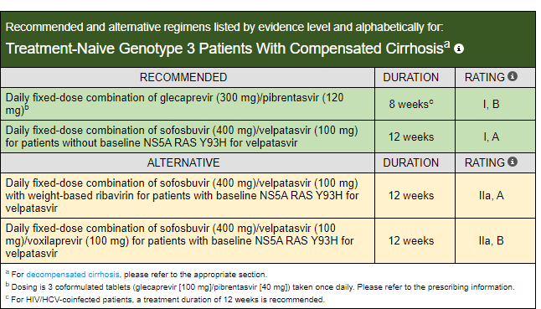
AASLD/IDSA HCV Guidelines:
Treatment Naive Genotype 3 With Compensated Cirrhosis
https://www.hcvguidelines.org/treatment-naive/gt3/compensated-cirrhosis

Slide 7
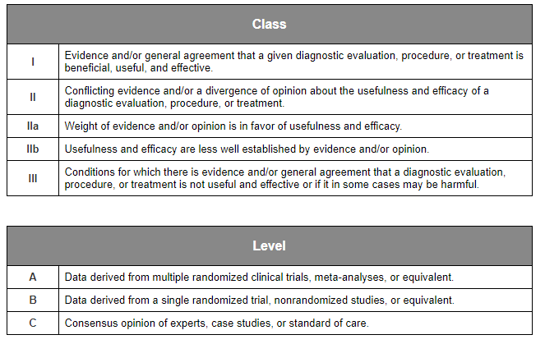
Rating System Used to Rate Level of Evidence and Strength of Recommendation
https://www.hcvguidelines.org/contents/methods/table-2

Slide 8
Glecaprevir-Pibrentasvir in HCV GT 3, +/- Cirrhosis
SURVEYOR-II (Part 3)
Phase 3
Treatment-Naïve and Treatment-Experienced
Source: Wyles D, et al. Hepatology. 2018;67:514-23.

Slide 9
Glecaprevir-Pibrentasvir in HCV GT 3, with Cirrhosis and Prior Treatment
SURVEYOR-II (Part 3): Study Design
0
0
8
12
16
24
28
Week
Week
20
GT 3, Treatment-Naive
With cirrhosis
GLE-PIB
(n = 40)
SVR12
GT3, Treatment-Experienced
Without cirrhosis
GLE-PIB
(n = 22)
SVR12
GT 3, Treatment-Experienced
Without cirrhosis
GLE-PIB
(n = 22)
SVR12
GT 3, Treatment-Experienced
With cirrhosis
GLE-PIB
(n = 47)
SVR12
Drug Dosing: Glecaprevir-pibrentasvir (100/40 mg) fixed dose combination; three pills once daily
Source: Wyles D, et al. Hepatology. 2018;67:514-23.

Slide 10
Glecaprevir-Pibrentasvir in HCV GT 3, with Cirrhosis and Prior Treatment
SURVEYOR-II (Part 3): Results
39/40
20/22
21/22
45/47
Abbreviations: TN = Treatment Naïve; TE = Treatment Experienced
Source: Wyles D, et al. Hepatology. 2018;67:514-23.

Slide 11
Glecaprevir-Pibrentasvir in GT 1-6 and Compensated Cirrhosis
EXPEDITION-8
Phase 3
Cirrhosis
Treatment-Naïve and Treatment-Experienced
Source: Brown RS, et al. J Hepatol. 2020;72:441-8.

Slide 12
Glecaprevir-Pibrentasvir in GT 1-6 & Compensated Cirrhosis
EXPEDITION-8: Treatment Protocol
Week
0
4
8
12
20
24
32
HCV RNA
GT 1-6
Compensated Cirrhosis
*Glecaprevir-
Pibrentasvir
(n = 343)
SVR12
*Drug Dosing: Glecaprevir-pibrentasvir (100/40 mg) fixed-dose combination; 3 pills once daily
Source: Brown RS, et al. J Hepatol. 2020;72:441-8.

Slide 13
Glecaprevir-Pibrentasvir in GT 1-6 & Compensated Cirrhosis
EXPEDITION-8: Method to Determine Cirrhosis Eligibility
Method Used to Determine Cirrhosis Eligibility | Patients (%) (n = 343)
Histology (Metavir F4 or equivalent | 32 (9.3)
Fibroscan ≥14.6 kPa (no histology data available) | 285 (83.1)
FibroTest ≥0.75 and APRI >2 (no histology or FibroScan data available) | 26 (7.6)
Source: Brown RS, et al. J Hepatol. 2020;72:441-8.

Slide 14
Glecaprevir-Pibrentasvir in GT 1-6 & Compensated Cirrhosis
EXPEDITION-8: Results (Intent-to-Treat)
Sustained Virologic Response Rates (SVR): ITT Analysis
325/343
226/231
26/26
60/63
13/13
1/1
9/9
Source: Brown RS, et al. J Hepatol. 2020;72:441-8.

Slide 15
Sofosbuvir-Velpatasvir in Genotype 3
ASTRAL-3*
Phase 3
Treatment Naïve & Experienced
*Published in tandem with ASTRAL-2 Trial
Source: Foster GR, et al. N Engl J Med. 2015;373:2608-17.

Slide 16
Sofosbuvir-Velpatasvir in HCV Genotype 3
ASTRAL-3: Study Design
Week
0
12
24
36
Treatment-naïve or Treatment-experienced
GT 3
(n = 552)
n = 277
SOF-VEL
SVR12
n = 275
SOF + RBV
SVR12
*Randomization stratified by treatment experience and cirrhosis status.
Abbreviations: SOF-VEL = sofosbuvir-velpatasvir; RBV = ribavirin
Drug Dosing
Sofosbuvir-velpatasvir (400/100 mg): fixed-dose combination; one pill once daily
Sofosbuvir: 400 mg once daily
Ribavirin (weight-based and divided bid): 1000 mg/day if <75 kg or 1200 mg/day if ≥75 kg
Source: Foster GR, et al. N Engl J Med. 2015;373:2608-17.

Slide 17
Sofosbuvir-Velpatasvir in HCV Genotype 3
ASTRAL-3: Results
SVR12 Results by Treatment Experience and Cirrhosis Status
160/163
141/156
40/43
33/45
31/34
22/31
33/37
22/38
Treatment Naïve
Treatment-Experienced
Source: Foster GR, et al. N Engl J Med. 2015;373:2608-17.

Slide 18
Sofosbuvir-Velpatasvir in HCV Genotype 3
ASTRAL-3: Resistance
Baseline Resistance-Associated Variants (RAVs)
Response to Treatment (SVR12)
(n = 231)
(n = 43)
225/231
38/43*
*SVR12 in 84% (21/25) of patients with Y93H
Source: Foster GR, et al. N Engl J Med. 2015;373:2608-17.

Slide 19
Summary
Infection with HCV GT 3 is an independent risk factor for cirrhosis, hepatocellular carcinoma (HCC) and liver related death
Patients with GT3 and cirrhosis are the most difficult to cure
The two preferred regimens from AASLD/IDSA for GT3 patient with cirrhosis are:
  glecaprevir-pibrentasvir for 8 weeks (in persons without HIV)
  sofosbuvir-velpatasvir for 12 weeks (in persons without a baseline Y93H RAS)
https://www.hcvguidelines.org/treatment-naive/gt3/compensated-cirrhosis

Slide 20
References
Gordon SC, et al; CHeCS investigators. Race, Age, and Geography Impact Hepatitis C Genotype Distribution in the United States. J Clin Gastroenterol. 2019 Jan;53(1):40-50
McMahon BJ, et al. Infection With Hepatitis C Virus Genotype 3 Is an Independent Risk Factor for End-Stage Liver Disease, Hepatocellular Carcinoma, and Liver-Related Death. Clin Gastroenterol Hepatol. 2017 Mar;15(3):431-437.
Kanwal F, et al.. HCV genotype 3 is associated with an increased risk of cirrhosis and hepatocellular cancer in a national sample of U.S. Veterans with HCV. Hepatology. 2014 Jul;60(1):98-105. doi: 10.1002/hep.27095. Epub 2014 May 27.
Bochud PY; Swiss Hepatitis C Cohort Study Group. Genotype 3 is associated with accelerated fibrosis progression in chronic hepatitis C. J Hepatol. 2009 Oct;51(4):655-66.
AASLD/IDSA HCV Guidance: https://www.hcvguidelines.org/
HCV Online: https://www.hepatitisc.uw.edu/

Slide 21
Resources
National Clinician Consultation Center http://nccc.ucsf.edu/
  HIV Management
  Perinatal HIV
  HIV PrEP
  HIV PEP line
  HCV Management
  Substance Use Management
Present case on ECHO http://echo.unm.edu hivecho@salud.unm.edu
AETC National HIV Curriculum https://aidsetc.org/nhc
AETC National Coordinating Resource Center https://targethiv.org/library/aetc-national-coordinating-resource-center-0
Additional trainings scaetcecho@salud.unm.edu
www.scaetc.org
Notes:
Find additional TeleECHO sessions in your area: https://echo.unm.edu/locations-2/echo-hubs-superhubs-united-states/
https://hsc.unm.edu/echo/get-involved/join-an-echo/
IDEA Platform: Infectious Diseases Education & Assessment. https://idea.medicine.uw.edu/
AETC National HIV Curriculum: 6 core modules for self study; regularly updated; CME, CNE
Hepatitis C Online Curriculum: https://www.hepatitisc.uw.edu/
Hepatitis B Online Curriculum: https://www.hepatitisb.uw.edu/
National STD Curriculum: https://www.std.uw.edu/

