Slide 1

How to make an efficient and highly effective HIV telemedicine clinic
Desert Expertise:
DIY; How to make an Efficient and Highly Effective HIV Telemedicine Clinic
Stephen A. Klotz, Cesar Egurrola, and Lawrence York

Slide 2

Disclaimer
This project is supported by the Health Resources and Services Administration (HRSA) of the U.S. Department of Health and Human Services (HHS) as part of an award totaling $3,278,366. The contents are those of the author(s) and do not necessarily represent the official views of, nor an endorsement, by HRSA, HHS or the U.S. Government.
The views and opinions expressed in this presentation are not necessarily those of the Pacific AIDS Education and Training Centers (PAETC), the Regents of the University of California or its San Francisco campus (UCSF or collectively, University) nor of our funder the Health Resources and Services Administration (HRSA).Neither PAETC, University, HRSA nor any of their officers, board members, agents, employees, students or volunteers make any warranty, express or implied, including the warranties of merchantability and fitness for a particular purpose; nor assume any legal liability or responsibility for the accuracy, completeness or usefulness of information [,apparatus, product] or process assessed or described; nor represent that its use would not infringe privately owned rights.

Slide 3

Improving Access to Quality Medical Care Webinar Series
Presented by
Southwest Telehealth Resource Center, Arizona Telemedicine Program & Pacific AIDS Education & Training Arizona and Petersen Clinics, Tucson, AZ

Slide 4

Webinar Tips & Notes
When you joined the webinar your phone &/or computer microphone was muted
Time is reserved at the end for Q&A, please use the Chat function to ask questions. Questions will be answered at the end of the presentation
Please fill out the post-webinar survey
Webinar is being recorded
Recordings will be posted on the ATP website
    Link to ATP website to view webinar recordings

Slide 5
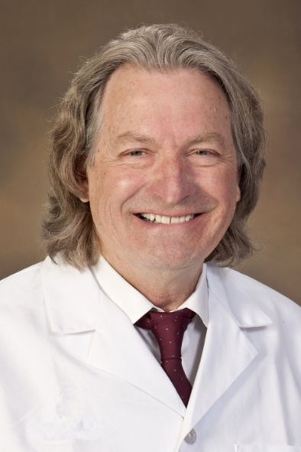
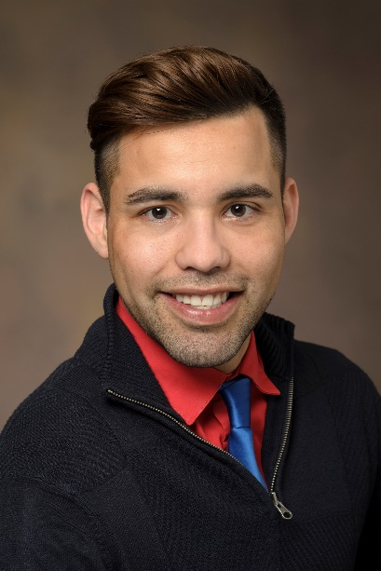
Desert Expertise: DIY; How to make an Efficient and Highly Effective HIV Telemedicine Clinic
Stephen Klotz, MD
Professor of Medicine and Community and Family Medicine
Cesar Egurrola
Program Coordinator
Larry York, PharmD
Clinical Infectious Diseases Pharmacist

Slide 6




Objectives of Webinar
1 DESCRIBE A SUCCESSFUL HIV TELEMEDICINE CLINIC 14 YEARS IN THE MAKING
2 DESCRIBE THE PRINCIPAL PARTICIPANTS IN THE TELEMEDICINE CLINIC
3 DESCRIBE HOW PATIENTS GET MEDICATIONS REFILLED AND LABORATORY TESTS PERFORMED
4 DESCRIBE PATIENT REACTION TO A TELEMEDICINE CLINIC

Slide 7




Quick-start Menu
HIV PHYSICIAN
HIV CLINICAL COORDINATOR
HIV PHARMACIST
EMR OPEN AND READY TO GO
HIPAA COMPLIANT ZOOM OR SIMILAR CONNECTION HANDLED BY CLINICAL COORDINATOR
LINK PATIENT BY PHONE OR VIDEO CONFERENCE

Slide 8



Conduct of Clinic for Returning Patients
Clinic coordinator controls all connections and brings the patient on the screen or telephone
Physician greets patient and asks general health questions followed by a review of any recent labs or x-rays and when the next visit is to occur (5 minutes)
Pharmacist goes over medication list; renews ART and determines compliance and explains how to take ART; orders vaccines if needed (5 minutes)
Clinic coordinator asks questions about mental health and sexual practices; orders labs as needed; reviews patient’s contact information; makes next appointment (5 minutes)

Slide 9
Physician’s Goals
Determine if stable living conditions exist for the patient
Every patient on ART
Every patient undetectable for HIV-1 RNA
Depending upon patient’s age, preventive health measures are suggested
Schedule follow-up appointment with telemedicine as needed (usual visit time for compliant patient, 1/year)

Slide 10
Pharmacist’s role
Prior to Telemedicine Visit:
Returning patient: update medication list
New patient: Review any documents available for a new patient, update medications/vaccines
During Telemedicine Visit:
If returning patient: assess adherence and risk of drug/drug interactions, identify vaccination needs
If new patient: additional time spent reviewing all relevant labs, answering all questions, setting up medication pick-up
Last Item: Order Review

Slide 11
Prior to Visit
Complete medication and lab review
Anticipate vaccination needs
If timely or possible, check with pharmacy to assess fill history
Ultimate Goals:
  Optimize visit
  Support diagnostic stewardship

Slide 12
Prior to Visit – Medication Review
Compare medication to potential lab changes
  Focus on SCr, LFTs
  May also consider lipid panel, weight, CBC depending on medications
Assess need for opportunistic infection prophylaxis
  CD4 absolute count and percentage, HIV RNA
Evaluate need for chronic HBV coverage
  DHHS guidelines recommend dual coverage for those coinfected with HIV/HBV

Slide 13
During Visit – Medication Review
Evaluate adherence
  If < 95%, identify strategies to improve adherence
  May refer to pharmacy-run adherence clinic for additional counseling as needed
Identify new medications and OTC/herbal supplements
  Some supplements including multivitamins may affect commonly used ARV regimens

Slide 14
During Visit – Common Drug Interactions
PPIs/H2RAs/antacids
  Major interactions/contraindications with rilpivirine regimens
    Odefsey, Juluca
Steroids including inhaled and intranasal
  Major interaction with boosted regimens (ritonavir, cobicistat)
    Recommend beclomethasone or flunisolide
Birth control/gender-affirming therapies
  Often have major interactions with boosted regimens (ritonavir, cobicistat)
    IUDs, injectable agents generally fine with common first line regimens

Slide 15
During Visit - Adherence
Generally recommend use of a phone alarm or app
Offer free pillboxes, keychain pill holders
Pharmacy-managed treatment adherence clinics offered

Slide 16
During Visit – Vaccination Review
Pneumococcal, tetanus/diphtheria/pertussis, meningococcal
  Easy to overlook later doses/boosters due to lengthy timing
Check hepatitis A and B serologies
  DHHS guidelines recommend confirming immunity after at least HBV vaccine
HPV, shingles, seasonal influenza as needed

Slide 17
During Visit – Rapid ART
Obtain medication or arrange for drop off prior to visit
  Hand deliver to patient for first dose
Once physician visit has concluded, answer all remaining questions
  Often in-depth discussion about HIV, expectations, next steps

Slide 18
After Visit
Obtain prior authorizations as needed for medications
Follow up in 2-3 days with rapid ART patients to review results, answer questions

Slide 19
Pharmacist’s Goals
Ensure all patients can easily access medication
Ensure medication is appropriate in regard to comorbidities and past resistance
Address barriers to adherence
Identify and mitigate any possible drug/drug interactions
Administer necessary vaccinations
Review orders to ensure accuracy

Slide 20
Telemedicine
Clinic Director
Background- 14 years in the making
HIPAA compliant virtual consult platform
Research other Telehealth programs- “Frankenstein” approach
Clinic Buy-in
Patient Buy-In

Slide 21
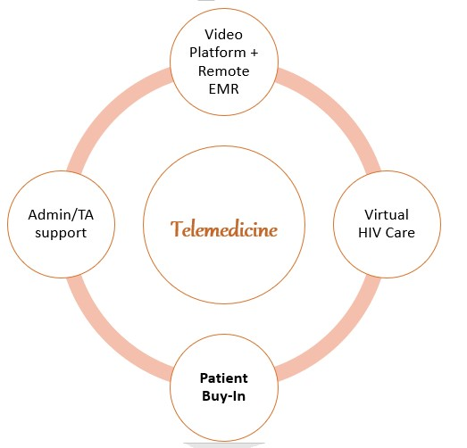
Successful Telemedicine Components

Slide 22
Telemedicine Clinic Structure
Patients are scheduled for virtual consult
Link to phone number or to Zoom provided to patients a week prior to appointment
Reminder call day of (or before) appointment
Follow up appointment and care plan determined during consult

Slide 23
Clinical Coordinator’s role
Prior to Telemedicine Visit:
Determine visit type
Provide instructions for access to virtual consult
Assure patient’s necessary clinical data is available
During Telemedicine Visit:
Complete Ryan White healthcare access assessment
Order follow-up lab work as directed by physician or pharmacists
Summarize follow-up care plan
After Telemedicine Visit
Emails patient follow-up plan
Assures patients are linked to any referral services determined during clinical assessment
Serve as point of contact between appointments

Slide 24
Prior to Visit
Determine visit type (Video/Phone call) and provide instructions for access to virtual consult
  Provide TA to patients, as needed
Assure patient has lab orders to complete prior to visit; remind patients as needed
Collect clinical data from outside sources; provide to care team for review prior to appointment
For high-acuity patients: coordinate care with other entities
  ASO Case Managers
  BH Care Managers

Slide 25
During Visit
”Check-in” patients once they connect to consult; check patients out
  Call patients who do not connect
Make sure clinic flow is running smoothly
  Keep track of time
  Inform other patients if consult is running late
Complete HRSA required patient assessments focusing on Behavioral Health, Sexual Health and access to social services needed to supplement HIV care
Order follow up lab work as directed by Physician or Pharmacists
Summarize follow up care plan for care team and patient; assure patient has a clear understanding of next steps
  Determine date of next appointment if possible

Slide 26
After Visit – Follow Up Plan
Email patient’s follow up plan, lab orders and next appointment information
  Including STI Swab Kits when necessary
Ensures patients are linked to any referral services determined during clinical assessment
Ensure follow up lab work or orders are completed in accordance to patient’s care plan
  For patients seen yearly, collects lab results 6mo after appointment
  Schedule follow up appointment if not already scheduled

Slide 27
Ongoing
Clinical Coordination
Serve as point of contact between appointments
Order HIV related lab work and schedule patient appointments, as needed
Works closely with care team to assure patient’s HIV care needs are being met
Coordinate care with outside entities and providers as needed

Slide 28
Clinical Coordinator’s Goals
Ensure all patients can easily access HIV medical care
Ensure patients in need of behavioral health, substance use, or social services are connected to resources they need
Link collaborating agencies and providers to assure patient’s needs are being met
Ensure patients have a clear understanding of their care plan
Serve as a patient advocate, as needed to successfully navigate their medical care

Slide 29
Describe the principal participants in the Telemedicine Clinic
In our experience, a successful and efficient HIV Telemedicine Clinic needs to have 3 different clinical participants:
Clinical Coordinator to get patients to their consult
Clinical Pharmacist to maximize adherence and understanding around ARV
Physician to oversee and lead patient’s care

Slide 30
Q &A
Q & A
Thank you!

