Slide 1
Post-Exposure Prophylaxis (PEP)
Larry York, PharmD, BCIDP, BCPS, AAHIVP
Sascha Bianchi, MPH
Some slides adapted from John Leander Po, MD, PhD

Slide 2
Disclaimer
“This presentation is supported by the Health Resources and Services Administration (HRSA) of the U.S. Department of Health and Human Services (HHS) as part of an award totaling $3,278,366. The contents are those of the author(s) and do not necessarily represent the official views of, nor an endorsement, by HRSA, HHS or the U.S. Government.”
The views and opinions expressed in this presentation are not necessarily those of the Pacific AIDS Education and Training Centers (PAETC), the Regents of the University of California or its San Francisco campus (UCSF or collectively, University) nor of our funder the Health Resources and Services Administration (HRSA). Neither PAETC, University, HRSA nor any of their officers, board members, agents, employees, students or volunteers make any warranty, express or implied, including the warranties of merchantability and fitness for a particular purpose; nor assume any legal liability or responsibility for the accuracy, completeness or usefulness of information [,apparatus, product] or process assessed or described; nor represent that its use would not infringe privately owned rights.

Slide 3
Objectives
By the end of this discussion, you will be able to understand and discuss:
1. The research related to Post-Exposure Prophylaxis for HIV
2. How to initiate and manage PEP care
3. The PEP delivery methods via telemedicine

Slide 4
What is PEP?
Regimen to reduce risk of contracting HIV if exposed
“Plan B” of HIV
  72 hour window of efficacy from moment of possible exposure
Typically consists of Truvada 200/300 mg plus another agent
  Unlike PrEP, PEP is a complete antiretroviral regimen against HIV

Slide 5
HIV Acquisition Risk Groups

Slide 6

HIV Occupational PEP (oPEP)
Exposures common
57 documented cases of health care workers contracting HIV from exposures as of 2010;
  No new documented cases since 1999
  143 other possible cases (1981-2010)
Area of considerable concern but little data
Source:
https://www.cdc.gov/hai/organisms/hiv/surveillance-occupationally-acquired-hiv-aids.html

Slide 7
HIV Non-Occupational PEP (nPEP)
Includes all exposures outside of a healthcare setting
Underutilized resource to potentially prevent HIV spread
More difficult to obtain medicine

Slide 8
Which fluids are potentially infectious for HIV?
blood?
saliva?
sweat?
feces?
semen?
vaginal secretions?
cerebrospinal fluid?
breastmilk?
synovial fluid?
pleural fluid?
peritoneal fluid?
pericardial fluid?
amniotic fluid?
pus?
urine?
vomitus?

Slide 9
Which fluids are potentially infectious for HIV?
blood
saliva
sweat
feces
semen
vaginal secretions
cerebrospinal fluid
breastmilk
synovial fluid
pleural fluid
peritoneal fluid
pericardial fluid
amniotic fluid
pus
urine
vomitus

Slide 10
Exposure Risks (average, per episode, involving HIV-infected source patient)
Exposure | Risk
Percutaneous (blood)¹ | 0.3%
Mucocutaneous (blood)² | 0.09%
Receptive anal intercourse³ | 1 - 2%
Insertive anal intercourse⁴ | 0.06%
Receptive vaginal intercourse⁵ | 0.1 – 0.2%
Insertive vaginal intercourse⁶ | 0.03 – 0.14%
Receptive oral (male)⁷ | 0.06%
Female-female orogenital⁸ | 4 case reports
IDU needle sharing⁹ | 0.67%
Vertical (no prophylaxis)¹⁰ | 24%
Notes:
1. Bell DM. Am J Med 1997;102(suppl 5B):9--15.
2. Ippolito G et al. Arch Int Med 1993;153:1451--8.
3. Am J Epidemiology 1999;150:306-11.
4. Am J Epidemiology 1999;150:306-11.
5. MMWR 47;RR-17, 1998.
6. NEJM 336(15):1072-8. (rates in Europe & U.S.)
7. Am J Epidemiology 1999;150:306-11.
8. Rothenberg RB et al. AIDS 1998;12:2095-2105.
9. MMWR 47;RR-17, 1998.
10. ACTG 076

Slide 11
Other Risk Factors to Consider
Viral load of source patient
Considerations for needlesticks:
  Glove use
  50% decrease in volume of blood transmitted
  Hollow bore vs solid bore
    Large diameter needles weakly associated with increased risk
    Drying conditions
    Tenfold drop in infectivity every 9 hours
Notes:
Efficacy of gloves in reducing blood volumes transferred during simulated needlestick injury.
Mast ST, Woolwine JD, Gerberding JL.
Department of Medicine and Infectious Diseases, University of California, San Francisco.
This study was designed to evaluate factors that affect blood volumes transferred to skin during simulated needlestick injuries in an in vitro paper prefilter model and an ex vivo porcine tissue model. The effect of needle type and size, penetration depth, and glove use on the volume of radiolabeled blood transferred was determined in each model. Blood volumes ranged from 0.47 +/- 0.26 microL (30-gauge needle, 0.5-cm depth, in vitro model) to 5.88 +/- 1.45 microL (18-gauge needle, 2.0-cm depth, in vitro model). Needle size and penetration depth were significantly associated with transfer volume. Glove material reduced the transferred blood volume by 46%-86% in both models. Transfer volumes were within the same order of magnitude for all conditions. Hence, virus titer in the source blood may be a better predictor of needlestick infectivity than is exposure volume. Regardless, gloves may exert some protective effect and should be worn whenever needles are handled.

Slide 12
HIV Testing and Acute HIV

Slide 13
Laboratory Markers of HIV Infection

Slide 14
4th generation HIV-1/2 immunoassay
(+)
(-)
Negative for HIV-1 and HIV-2 antibodies and p24 Ag
HIV-1/HIV-2 antibody differentiation immunoassay
HIV-1 (+)
HIV-2 (-)
HIV-1 antibodies detected
HIV-1 (-)
HIV-2 (+)
HIV-2 antibodies detected
HIV-1 (+)
HIV-2 (+)
HIV antibodies detected*
HIV-1 (-) or indeterminate
HIV-2 (-)
NAT
*Additional testing required to rule out dual infection
NAT (+) Acute HIV-1 infection
NAT (-) Negative for HIV-1

Slide 15
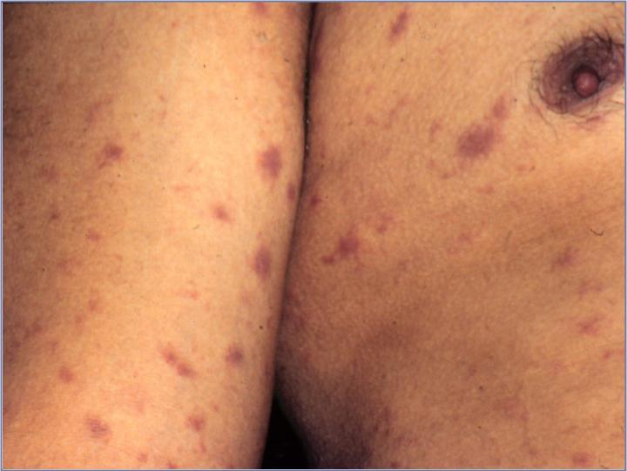
Acute Retroviral Syndrome Signs/Symptoms
Fever
Malaise
Myalgia
Rash
Headache
Sore throat
Lymphadenopathy

Slide 16
Acute Retroviral Syndrome Presentation
Most patients who contract HIV are symptomatic with seroconversion¹
Flu-like or mono-like illness often accompanied by a rash²
Onset typically 2-6 weeks following exposure, but high variability¹
Treatment of acute HIV with antiretroviral therapy may have significant long-term benefit³
1. Schacker T et al. Ann Int Med 1996;125:257-64.
2. Kahn JO, Walker BD. N Engl J Med. 1998;339:33-39.
3. Walker B. State of the Art Lecture and Summary. 8th CROI, Session #37.

Slide 17
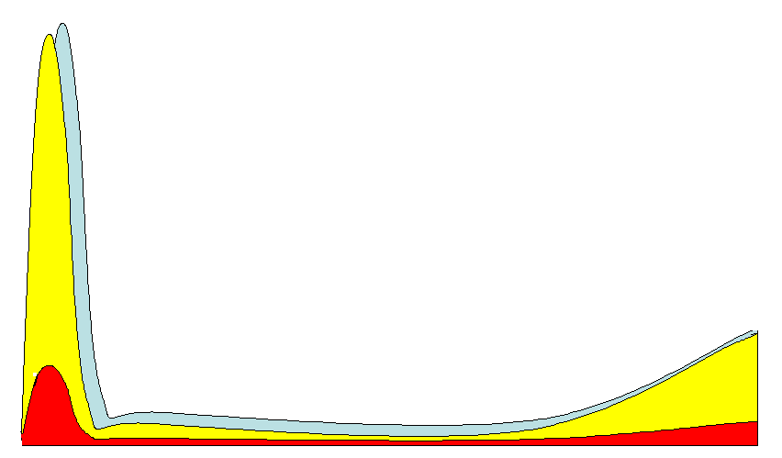
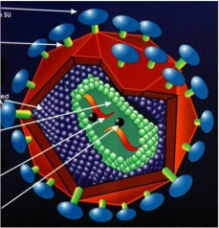
Increased Risk of Sexual Transmission of HIV
5
1/30-
1/200
Virus 75-750 times more infectious
4
HIV RNA in Semen
(Log₁₀ copies/ml)
1/100-
1/1000
1/1000 -
1/10,000
1/500 -
1/2000
3
2
Acute Infection
6 wks
AIDS
Asymptomatic
Infection
HIV Progression
Cohen & Pilcher, J Infect Dis. 2005

Slide 18
PEP Antiretrovirals and their Management

Slide 19
Key Points of PEP Regimens
Duration is always 28 days
COMPLETE regimen against HIV
Timing is critical
  Begin AS SOON AS POSSIBLE

Slide 20
Preferred PEP Regimens
Integrase-based regimens preferred:
  Truvada 200/300 mg + Isentress (raltegravir) 400 mg twice daily
  Truvada 200/300 mg + Tivicay (dolutegravir) 50 mg once daily
Total duration is always 28 days

Slide 21
Truvada (FTC/TDF)
Single pill containing two medications
  Emtricitabine (FTC) 200 mg
  Tenofovir disoproxil (TDF) 300 mg
Can be taken with or without food
Both agents have renal adjustments
  These adjustments have NOT been studied for PEP

Slide 22
Side Effects of Truvada
May experience nausea, bloating upon initiation
  Usually resolves within 2-3 weeks
Headache
Increased risk of decreased renal function
  Uncommon but known adverse effect from TDF
  Renal function usually returns to normal if TDF stopped
Increased risk of decreased bone mineral density

Slide 23
When NOT to use Truvada
Do not begin Truvada if CrCl < 60 mL/min
If CrCl declines to < 50 mL/min, alternative recommended
  Definite recommended point for renal dose adjustments

Slide 24
Truvada and Chronic HBV
FTC and TDF both active against HBV
  Sudden withdrawal may lead to acute HBV flares
Critical to know HBV status of PEP patient to assess risk
  May consider continuing Truvada or TDF beyond 4 week period
  Assess by reviewing HBsAb, HBcAb, HBsAg

Slide 25
Critical Issues in PEP Treatment
Timing is key
  Efficacy decreases continuously after initial exposure
  Beyond 72 hours, PEP generally no longer recommended
Treatment duration is 4 weeks
If source patient has known HIV resistance:
  Optimize regimen to treat the resistant virus

Slide 26
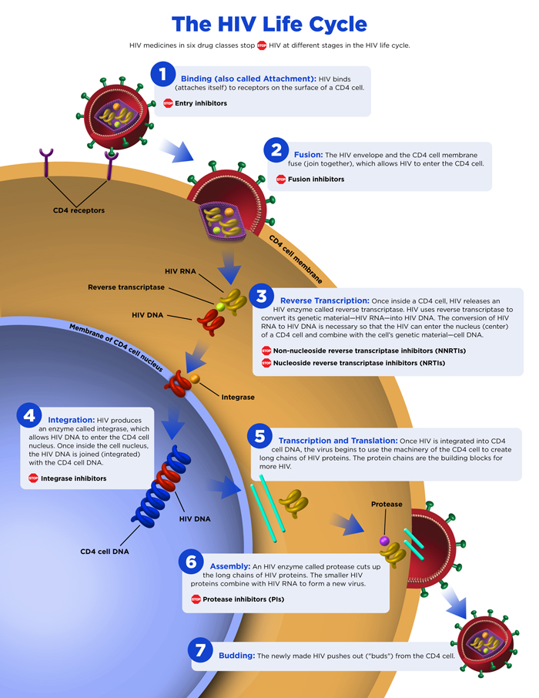
NRTIs
Nucleoside/Nucleotide Reverse Transcriptase Inhibitors
Indirectly inhibits enzyme required to copy viral RNA to DNA.

Slide 27
INSTIs
Integrase Inhibitors
Inhibits strand transfer of viral DNA to host cell DNA by the integrase enzyme.

Slide 28
Side Effects of INSTI-Based PEP
Increased incidence of headaches
Sleep disturbance
  Insomnia more prevalent in drug studies

Slide 29
Isentress (RAL)
Advantages
Disadvantages
  Well-tolerated
  Data for use in pregnancy
  Very low risk of drug interactions
  Twice-daily dosing
  Lower barrier to HIV resistance

Slide 30
Tivicay (DTG)
Advantages
Disadvantages
  Well-tolerated
  Once-daily dosing
  Very high barrier to HIV resistance
  Neural tube defects?

Slide 31
Dolutegravir and Neural Tube Defects?
Recent study from Botswana suggested this connection
  Has not been observed in studies or through US pregnancy registry
Incidence of NTDs comparatively higher in Botswana
More recent data from this study did not find a statistically significant increase in neural tube defects

Slide 32
Drug Interactions of INSTI-Based PEP
RAL and DTG can chelate polyvalent cations and lose efficacy
  Give 2 hours before or 6 hours after Ca/Mg/Fe/Al/Zn supplements
Not recommended with select anticonvulsants
  Phenytoin, phenobarbital, carbamazepine diminish INSTI levels
DTG can increase metformin levels
  Monitor closely
  Consider metformin 1,000 mg/day max during duration

Slide 33
Alternative PEP Regimens
For renal dysfunction/kidney disease (CrCl < 60 mL/min):
  Dose-adjusted lamivudine and zidovudine 300 mg twice daily
    Combivir includes both lamivudine and zidovudine at full dose
  Preferred 3rd agent (raltegravir, dolutegravir)
For alternative to raltegravir or dolutegravir:
  Darunavir 800 mg daily + ritonavir 100 mg daily
    If pregnant, darunavir 600 mg + ritonavir 100 mg both twice daily
Consult with specialist for further regimens
  Particularly if source patient has known resistance

Slide 34
Zidovudine
Advantages
Disadvantages
  Well-studied against HIV
  Twice-daily dosing
  Numerous adverse effects
  Tolerability concerns

Slide 35
PIs
Protease Inhibitors
Inhibits protease, the enzyme that cuts HIV protein into smaller strands used to assemble a new virus.

Slide 36
PIs
Protease Inhibitors
Inhibits protease, the enzyme that cuts HIV protein into smaller strands used to assemble a new virus.

Slide 37
Prezista (darunavir) + Norvir (ritonavir)
Advantages
Disadvantages
  Very high barrier to HIV resistance
  Better tolerated than other PIs
  At least two pills once daily
  Numerous drug interactions
  Metabolic/liver/lipid effects

Slide 38
Occupational PEP Testing
Baseline:
  HIV screening
  Renal and hepatic function tests
  Complete blood count (CBC)
Repeat renal/hepatic testing and CBC 2 weeks post-exposure
Repeat HIV testing at 6 weeks, 12 weeks, and 6 months
  If 4th gen testing used, can retest at 6 weeks and 4 months

Slide 39
HBV/HCV Retesting
Warranted at 4-6 months if source patient known or suspected to have either HBV or HCV
Only retest HBV if susceptible at baseline
  Include HBsAb, HBcAb, HBsAg to fully assess status
HCV/HIV coinfection may delay HIV antibody response
  If concerned, recheck both at 4-6 months

Slide 40
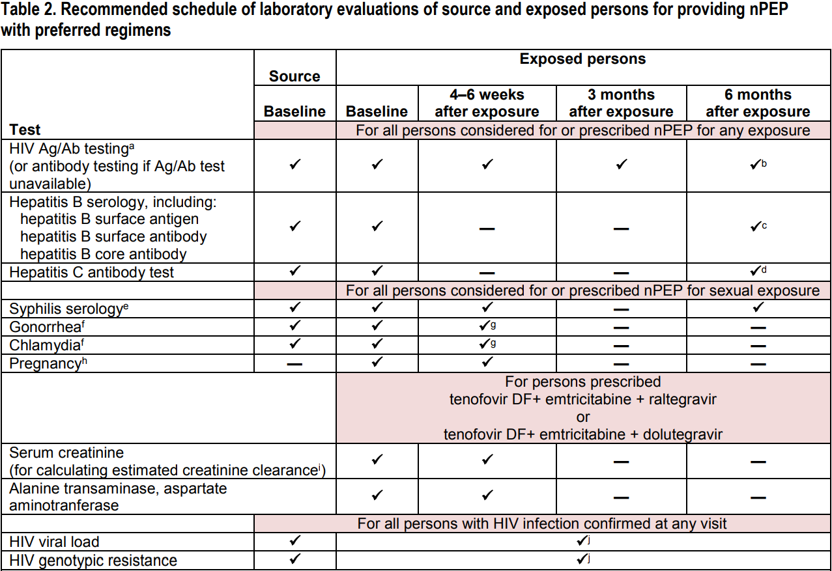
Non-Occupational PEP Testing
Source:
https://www.cdc.gov/hiv/pdf/programresources/cdc-hiv-npep-guidelines.pdf

Slide 41
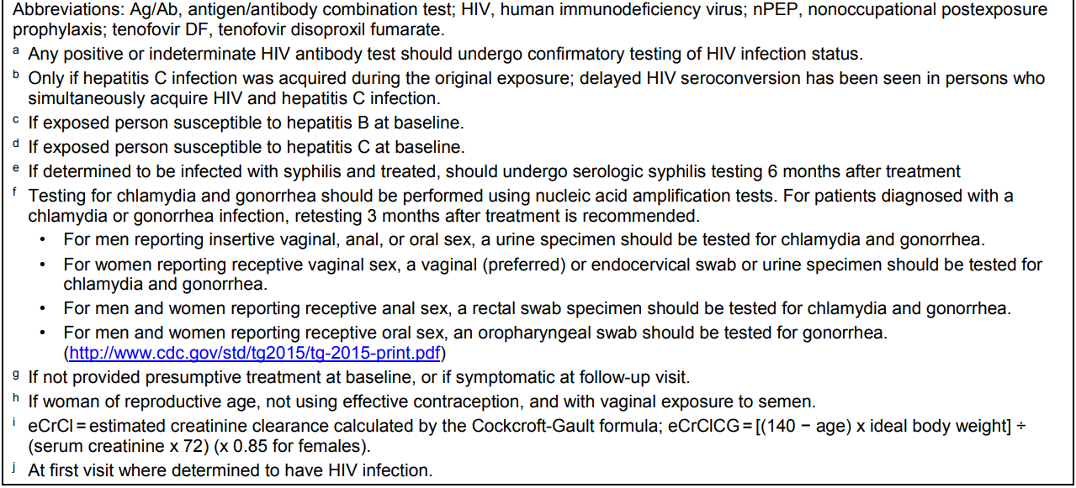
nPEP Testing Footnotes
Source:
https://www.cdc.gov/hiv/pdf/programresources/cdc-hiv-npep-guidelines.pdf

Slide 42
Counseling at time of exposure and follow-up appointments
Use condoms
Avoid blood or tissue donations
Avoid pregnancy & breastfeeding (if possible)
Possible drug side effects
Possible drug interactions
Importance of adherence to PEP regimen
Consider re-evaluation of exposed health care professional (HCP) 72 hours post-exposure, especially after additional information about the exposure or SP becomes available.

Slide 43
PEP in Pregnancy
Considerations similar to those of non-pregnant exposed persons.
  The pregnant exposed person and her fetus are at risk for HIV acquisition.
  Most PEP regimens, benefits outweigh the risk of infant (and maternal) exposure to ARVs.
  Based on limited data, use of ARVs in pregnancy does not appear to increase the risk of birth defects compared to the general population.
  Toxicities from currently recommended PEP medications are not thought to be significantly increased in pregnancy.
Notes:
http://nccc.ucsf.edu/clinical-resources/pep-resources/pep-quick-guide/

Slide 44
PEP and Lactation
Breastfeeding is not a contraindication for PEP.
The decision to take PEP and/or continue breastfeeding is complex and individualized, and expert consultation is recommended
Considerations:
  Acute HIV in a breastfeeding mother greatly increases the risk of HIV transmission to her infant.
  Pump and discard
  Pumping and storing while waiting on SP’s HIV test results
  Limited data on PEP medications in breastmilk
Notes:
o Tenofovir DF and emtricitabine (TDF and FTC, components of Truvada™) and protease inhibitors can be detected in breastmilk only in very limited amounts
o Lamivudine (3TC, Epivir®) can penetrate the breastmilk in significant amounts
o Raltegravir (RAL, Isentress®)—unknown extent of breastmilk penetration

Slide 45
Conclusion
PEP a valuable resource that may be underutilized
  Well-tolerated agents available for use
  Efficiency in prescribing and taking PEP critical to success

Slide 46
Cheat Sheet Part 1
Preferred regimens:
  Truvada 200/300 mg daily + Tivicay 50 mg daily
  Or
  Truvada 200/300 mg daily + Isentress 400 mg BID
CrCl < 60 mL/min regimens:
  Combivir 150/300 mg BID + an above INSTI
    May administer zidovudine and dose-adjusted lamivudine separately in place of Combivir
    Full-dose lamivudine safe down to as low as CrCl > 30 mL/min

Slide 47
Cheat Sheet Part 2
If pregnant:
  Truvada 200/300 mg daily + Isentress 400 mg BID
  Truvada 200/300 mg daily + Tivicay 50 mg daily
If INSTI-intolerant:
  Truvada 200/300 mg daily + Prezista 800 mg daily + Norvir 100 mg daily
If INSTI-intolerant and pregnant:
  Truvada 200/300 mg daily + Prezista 600 mg BID + Norvir 100 mg BID

Slide 48
PEP: Special Cases
Known or suspected resistance of the source virus to antiretroviral agents
Delayed exposure report (after 72 hours)
Exposed person has serious illness (eg, renal disease)

Slide 49
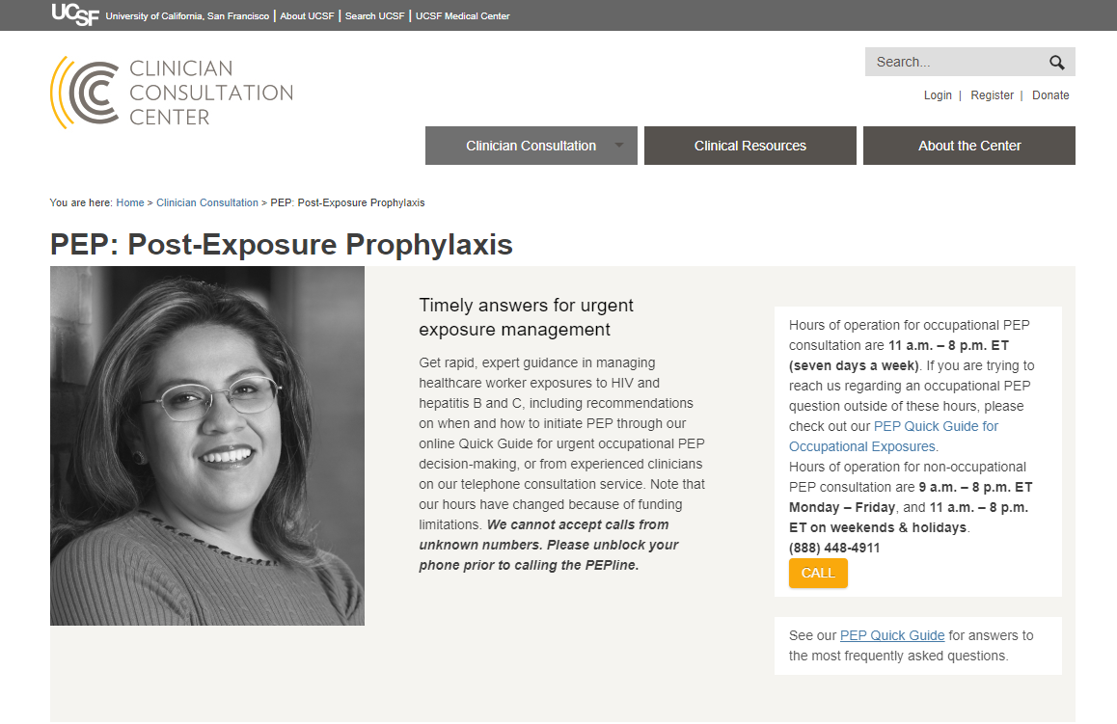
nccc.ucsf.edu

Slide 50
PEP Patient Navigation in the era of Covid-19

Slide 51





PEP Navigation Process Overview
Evaluating Provider
Initiate PEP within 72 hours.
Conduct baseline testing.
Ensure patient can access at least 3 days of medication.
PEP
Clinic
Ensure patient accesses remainder of medication.
Follow-up within 1 week.
Follow-up at 4-6 weeks.
Notes:
Evaluating provider and PEP clinic may be the same. Or evaluating provider may be ED, urgent care, PCP, Health Department etc
If possible (ED, Urgent care), initiate first dose, buys patient some time
If possible. draw labs, easier to ensure it happens in a timely manner. No need to wait for results
Get meds and follow up. Discuss in detail on next slides

Slide 52
Ensure patient can access at least 3 days of medication while setting up remainder
Preplanned billing options in case of insurance issues
Trusted pharmacies that have training on PEP
Complete PAs, if needed, enroll in manufacturers' assistance

Slide 53
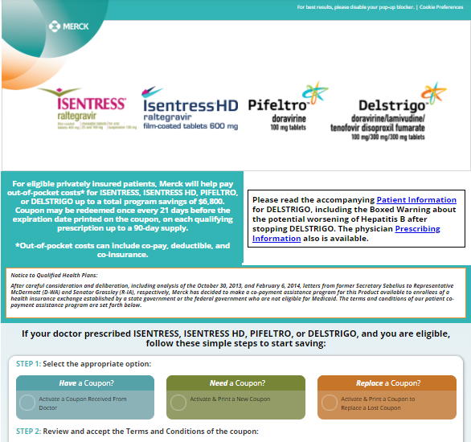
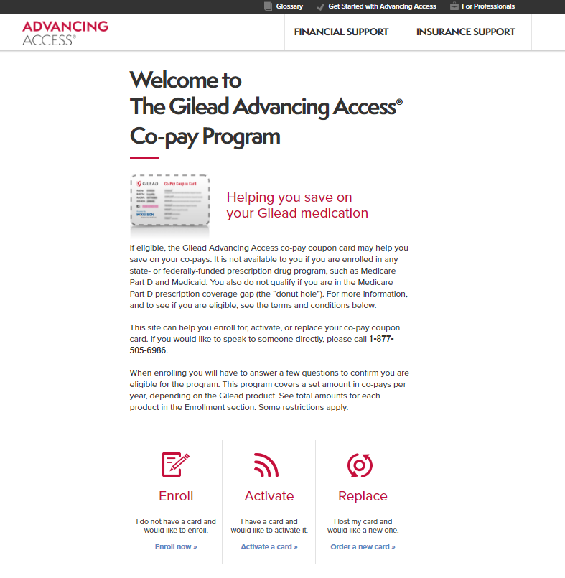
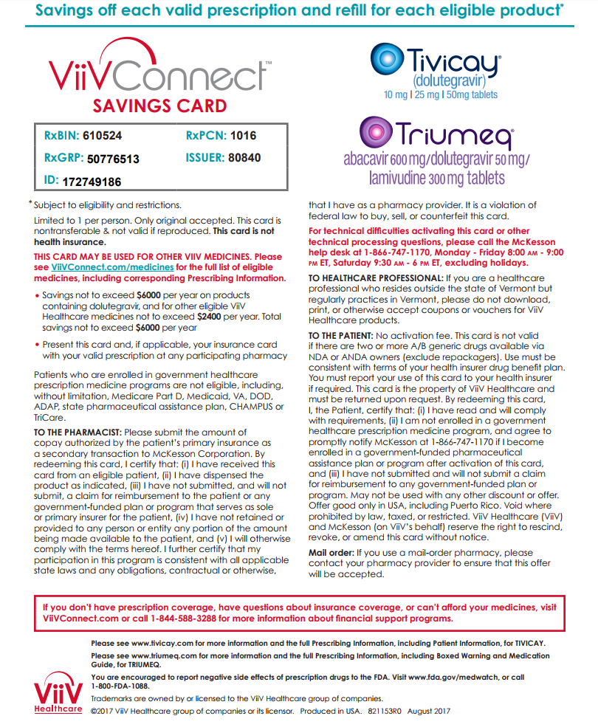


Copay Assistance/Free Medications Available!
https://www.gileadadvancingaccess.com/
https://www.viivconnect.com/patient-assistance-program/
https://www.isentress.com/#
https://www.patientadvocate.org/
https://www.panfoundation.org/

Slide 54



Intake via Telemedicine
Have a pre-planned process for collecting important information and communicating it with provider
Have an assigned person that the patient/pharmacy can reach when problems arise
Important messages should be repeated often due to trauma associated with PEP

Slide 55
Follow-up within 1 week
Providers who understand the urgency and are willing to double book
Multiple options for patients, video visit, phone visit, in-person
Complete any missing baseline labs
Ensure patients have access to full 28 days of medication

Slide 56
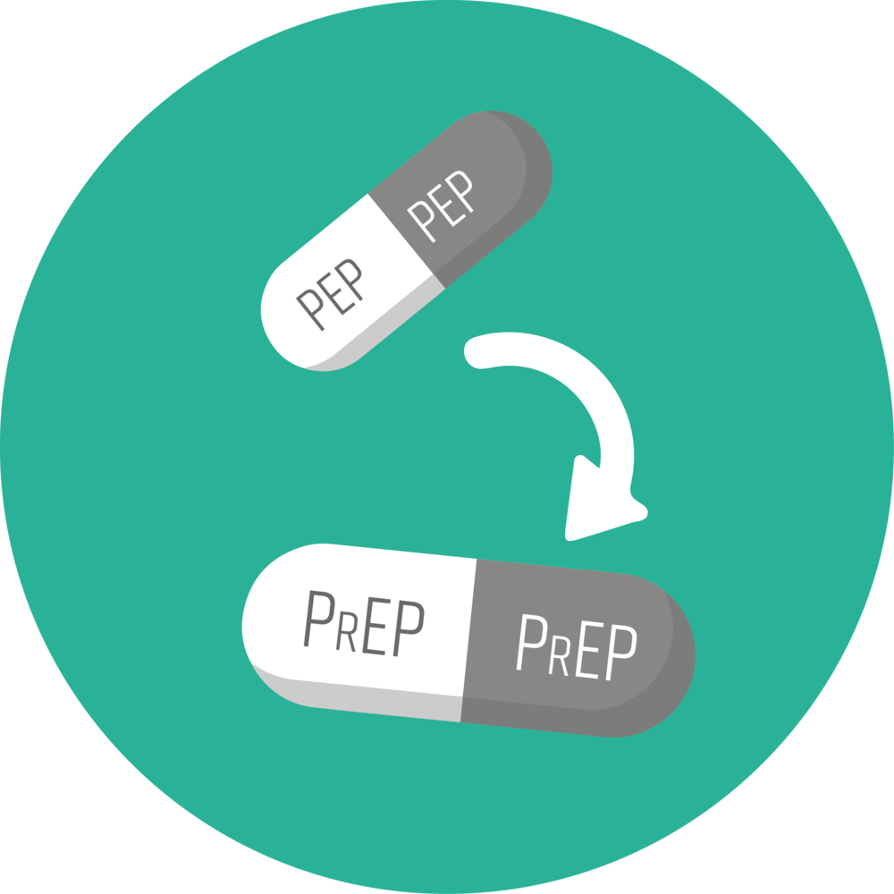
Follow-up
Follow-up at 4-6 weeks
Complete follow-up labs
Transition to PrEP if patient desires
Labs completed on day 25, PrEP started immediately on day 29

Slide 57
Additional Considerations in the Era of COVID-19
Emergency rooms are overwhelmed
  Preferable to directly see patients same day
Schedule lab visits later in the day to avoid crowds
Have mental health linkages to care on hand
Work with pharmacies able to deliver medication

Slide 58
Virtual Visits
Patient Access:
Telemedicine Coordination:
Telephone needed for phone consults
Smartphone or computer with working camera needed for video consults
Confirm patient’s appointment type
Coordinate necessary lab work and access to virtual consults
Make sure patient has a clear understanding of follow-up plan, provide in writing if possible
Make sure patient has access to all necessary testing, including STI swabs

Slide 59
Telemedicine Best Practices
Tips for Coordinators:
Tips for Providers:
-Have a back-up plan if technology fails
-Determine what information is necessary
-Call patient ahead of time to practice using telehealth systems
-Determine what information is necessary
-Many additional services can be provided without requiring a face-to-face visit including vaccinations, STI treatments, emergency contraception

Slide 60
Conclusion
The practice of PEP is straightforward
  Supporting PEP management, however, can take considerable work
Telemedicine a perfect avenue to deliver PEP care
Research still ongoing in simplifying PEP management

Slide 61
THANK YOU

