Slide 1

HIV in the Era of Covid-19: PrEP
(Pre-exposure Prophylaxis)
The Theory, Practice and Results
Larry York, PharmD
HIV Pharmacist
Cesar Egurrola, BS
Clinical Operations/QI Manager
Stephen Klotz, MD
HIV Physician, Moderator
University of Arizona Petersen Clinics
Supported in part by the Arizona AIDS Education Training Center and UA Telemedicine

Slide 2
Disclaimer
“This presentation is supported by the Health Resources and Services Administration (HRSA) of the U.S. Department of Health and Human Services (HHS) as part of an award totaling $3,278,366. The contents are those of the author(s) and do not necessarily represent the official views of, nor an endorsement, by HRSA, HHS or the U.S. Government.”
The views and opinions expressed in this presentation are not necessarily those of the Pacific AIDS Education and Training Centers (PAETC), the Regents of the University of California or its San Francisco campus (UCSF or collectively, University) nor of our funder the Health Resources and Services Administration (HRSA). Neither PAETC, University, HRSA nor any of their officers, board members, agents, employees, students or volunteers make any warranty, express or implied, including the warranties of merchantability and fitness for a particular purpose; nor assume any legal liability or responsibility for the accuracy, completeness or usefulness of information [,apparatus, product] or process assessed or described; nor represent that its use would not infringe privately owned rights.

Slide 3

What is PrEP?
One pill once a day to reduce risk of contracting HIV
> 90% protective against sexually acquiring HIV
Reduces HIV acquisition risk in intravenous drug users (IVDU)
Currently only two agents approved for PrEP

Slide 4
What are we trying to accomplish? A Case Study
Herman, a 54-year-old man (HIV-negative) comes into the hospital unable to talk normally. He is the longtime partner of Bill, a 35-year-old man who is HIV-positive, compliant with anti-retroviral therapy and whose HIV-1 RNA (viral loads) are nearly always non-detectable.
Bill was hospitalized for 10 for diabetes mellitus, neuropathy and renal failure. He came to clinic weeks later; his HIV-1 viral load was >3,000 copies of RNA.
Herman was hospitalized 1 month later slurring his speech and could move his tongue only to the right. The HIV-1 RNA was >1,000,000 copies and the platelets <30,000/dL.
Herman was treated with plasmapheresis and ART. He is doing well and compliant with ART.

Slide 5

Another Case Study
Roger is a 56-year-old man (MSM) who has ”come out” two months ago. He was an insurance executive with a good income and no sexual activity with women or men for years. In the past he occasionally had HIV tests and they were all negative. (The testing was done at his place of work.)
He had one male partner 3 weeks ago and was primarily the partner on the bottom. He now complains of fever, skin rash and a sore throat.
On physical examination he has oral-pharyngeal thrush, tender lymphadenopathy and a macular rash on the extremities and abdomen.
The HIV-1 RNA was >2,000,000 copies and the RPR was negative.
He was started on ART and has done well.

Slide 6
Truvada (FTC/TDF)
Single pill containing two medications
  Emtricitabine (FTC) 200 mg
  Tenofovir disoproxil (TDF) 300 mg
One tablet once a day
  No more than 90-day prescription provided
Can be taken with or without food
Take missed doses as soon as remembered
  If close to next dose, wait until then and take 1 tablet

Slide 7
Descovy (FTC/TAF)
Single pill containing two medications
  Emtricitabine (FTC) 200 mg
  Tenofovir alafenamide (TAF) 25 mg
Same instructions for use as Truvada
ONLY studied in MSM and transgender women
  Not recommended for use in cisgender women or for IVDU

Slide 8
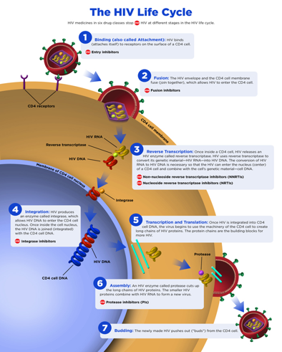
NRTIs
Nucleoside/Nucleotide Reverse Transcriptase Inhibitors
Indirectly inhibits enzyme required to copy viral RNA to DNA.

Slide 9
Side Effects of PrEP
May experience nausea, bloating upon initiation
Usually resolves within 2-3 weeks
Headache
Uncommon but known adverse effect from TDF
Increased risk of decreased renal function
Renal function usually returns to normal if PrEP stopped
Increased risk of decreased bone mineral density

Slide 10
Tenofovir Disoproxil Drug Issues
Primarily known for its potential renal issues
Risk of renal dysfunction may be multifactorial
  Age
  Addition of other nephrotoxic agents
May also lead to decreased bone mineral density
  Possibly 1-3% greater loss with TDF
  Calcium/vitamin D supplementation may help

Slide 11
Tenofovir Alafenamide Drug Issues
Same concerns as TDF but appears to be lower risk
  Improved renal/bone adverse effect profile
Not as well studied for PrEP
  Only recently approved
  Effects of missing doses less clear than with TDF regimen

Slide 12
Descovy for PrEP
DISCOVER study looked at MSM and transgender women
  Found to be equivalent to Truvada
Major concerns again relate to female use
  A previous PK study with TAF found poor tissue levels
    11-fold lower in cervicovaginal fluid
Uncertain how important adherence is for use

Slide 13
When PrEP is NOT Recommended
Do not begin Truvada if CrCl < 60 mL/min
If CrCl declines to < 50 mL/min, stop Truvada
  FTC and TDF have recommended dose adjustments
  Renally-adjusted doses were not studied for PrEP
Descovy should be stopped if CrCl < 30 mL/min
  An option for PrEP in patients with mild-moderate CKD

Slide 14

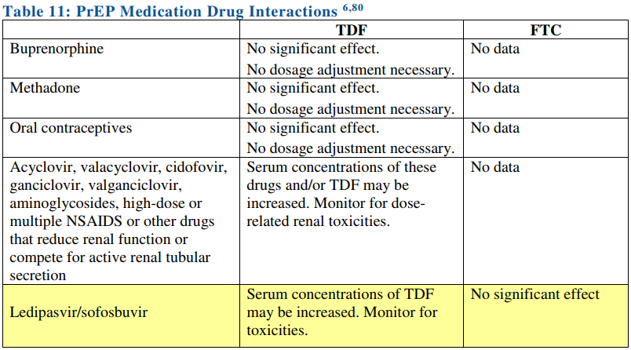
PrEP (Truvada) Drug Interactions

Slide 15
PrEP (Descovy) Drug Interactions
Descovy more likely to have interactions than Truvada
TAF more susceptible to p-glycoprotein effects
  Efficacy may be compromised with select agents
Avoid use with:
  Barbiturates
  Carbamazepine/oxcarbazepine
  Phenytoin
  Rifamycins
  St John’s Wort

Slide 16
PrEP Activity
Truvada deposits at varying rates into different tissues
Estimate ~7 days for maximal rectal tissue levels
Estimate ~20 days for maximal vaginal tissue/blood levels
This data is not yet known for Descovy

Slide 17
On-Demand PrEP (Truvada)
Recent evidence supports this potential approach
  2 tablets 2-24 hours before sexual encounter
  1 tablet 24 hours after sexual encounter
  1 tablet 48 hours after sexual encounter
Missing doses here may not be as forgiving
Reliant on anticipation of a sexual encounter
Not officially recommended as of yet

Slide 18
Vaginal Exposures and Adherence
Far less clear how levels are affected in this tissue
DOES appear to be much more susceptible to missed doses
Would avoid on-demand PrEP in this group

Slide 19
Indications - MSM

Slide 20
Indications - Heterosexuals

Slide 21
Indications - IVDU

Slide 22
Patient Visits
Typically PrEP patients are seen every 3 months
Visits should be focused around:
  Risk reduction counseling
  Assessment of HIV status/signs and symptoms of acute infection
  STI screening as recommended or needed
  Medication adherence counseling

Slide 23
Virtual
Visits
Patients Access:
Telephone needed for phone consults
Smartphone or Computer with working camera needed for video consults
Telemedicine Coordination:
- Confirm patient’s appointment type
-Coordinate necessary lab work and access to virtual consults
-Make sure patient has a clear understanding of follow up plan, provide in writing if possible
-Make sure patient has access to all necessary testing, including STI swabs

Slide 24
Baseline Testing
HIV screening test
Estimated creatinine clearance
Hepatitis B serologies (HBsAb, HBcAb, HBsAg)
  Follow up with HBV DNA if HBsAg is positive
Hepatitis C screening
Bacterial STI testing

Slide 25
Every 3 Month Monitoring
HIV testing (preferably 4th generation)
Pregnancy testing for women who may become pregnant
Bacterial STI testing if signs/symptoms present
Bacterial STI testing for asymptomatic MSM patients
  If history of STI or multiple partners

Slide 26
Every 6 Month Monitoring
Monitor estimated creatinine clearance
Bacterial STI testing for all sexually active patients

Slide 27
HIV 4th Generation Screening Test
Preferred test, quickest identification on HIV
Can detect a new infection 10-14 days after exposure
May affect decision to initiate PrEP
  If unprotected encounter within 2-week period, may repeat test

Slide 28
Patient Snapshot by Race/Ethnicity
Phase 1 – 01/01/2014-09/30/2016
Phase 2 – 10/01/2016-12/31/2018
Notes:
Jai
Include current data and trends from 2013-2018.
Include information on reactivity rate and PrEP cascade for attrition.
Demographics of PrEP patients
Seroconversion prior to starting PrEP
PrEP care cascade
STI positivity rate (once and multiple)
Extra-genital testing
Rates for folks who are still engaged in care
Phase 1 – January 1, 2014-September 30, 2016
Phase 2 – October 1, 2016-December 2018.

Slide 29
Patient Snapshot by Age Category
Phase 1 – 01/01/2014-09/30/2016
Phase 2 – 10/01/2016-12/31/2018
Notes:
Jai
Include current data and trends from 2013-2018.
Include information on reactivity rate and PrEP cascade for attrition.
Demographics of PrEP patients
Seroconversion prior to starting PrEP
PrEP care cascade
STI positivity rate (once and multiple)
Extra-genital testing
Rates for folks who are still engaged in care

Slide 30
Patient Snapshot by Gender
Phase 1 – 01/01/2014-09/30/2016
Phase 2 – 10/01/2016-12/31/2018
Notes:
Jai

Slide 31
Patient Snapshot by Sexual Orientation
Phase 1 – 01/01/2014-09/30/2016
Phase 2 – 10/01/2016-12/31/2018
Notes:
Jai

Slide 32
Patient Snapshot by Risk Group
Phase 1 – 01/01/2014-09/30/2016
Phase 2 – 10/01/2016-12/31/2018
Notes:
Jai

Slide 33
Clinical PrEP Cascade
Retention Baseline
2014-2018 seroconversion prior to initiation: 5
Notes:
Jai
Interested – Number of patients in the Database (Intakes completed)
Linked – Number of patients with an initial appointment
Initiated – Number of patients started with PrEP
Retained – Number of patients attending Q1 visit (of those who initiated)
Adherence – Number of patients attending Q4 visit (of those who initiated)
Does not include all patients who have been referred for PrEP, if included we would see a greater attrition rate.

Slide 34
STI Positivity Rate
HIV Positivity Rate for those maintained in care: 0%
Notes:
Jai
Rates of testing remained the same over time for STI (urine) and RPR testing.
Rates of swab testing remained the same over time ~22% of those engaged in care.

Slide 35
Increased Risk of STI Acquisition?
A recent meta-analysis suggests increased STIs with PrEP
Unclear association as even newer data refutes this
Arguably, STI rates have increased for all MSM despite PrEP
  However, PrEP clearly has reduced the rate of HIV acquisition

Slide 36
U=U: Need for PrEP?
Undetectable = Untransmittable
Recent CDC initiative to raise awareness
  If HIV RNA < 200 copies/mL, do not sexually transmit HIV
If patient in a monogamous, sero-discordant relationship:
  PrEP may not be warranted
  Discussion with patient regarding desire for use

Slide 37
Paying for PrEP
AWP per tablet = $70.32
If high copays:
  Gilead offers a copay card good for several thousand dollars/year
If insurance will not cover or a PA appeal is denied:
  Gilead may pay for medication

Slide 38
THANK YOU!

