Slide 1
Destigmatizing HIV/AIDS
Alison J. Szarko, M.A.
Pronouns: she/her Doctoral Student, UNR Behavior Analysis Program
Graduate Research & Teaching Assistant, UNR Med
Student Representative, ABAI ACT SIG
Dr. Shanna Strauss, MD, MSc
Pronouns: she/her Emergency Medicine Resident, Brown University
June 8, 2021
Notes:
Shay -

Slide 2
Disclaimer
“This presentation is supported by the Health Resources and Services Administration (HRSA) of the U.S. Department of Health and Human Services (HHS) as part of an award totaling $3,278,366. The contents are those of the author(s) and do not necessarily represent the official views of, nor an endorsement, by HRSA, HHS or the U.S. Government.”
The views and opinions expressed in this presentation are not necessarily those of the Pacific AIDS Education and Training Centers (PAETC), the Regents of the University of California or its San Francisco campus (UCSF or collectively, University) nor of our funder the Human Services and Resources Administration (HRSA). Neither PAETC, University, HRSA nor any of their officers, board members, agents, employees, students or volunteers make any warranty, express or implied, including the warranties of merchantability and fitness for a particular purpose; nor assume any legal liability or responsibility for the accuracy, completeness or usefulness of information [,apparatus, product] or process assessed or described; nor represent that its use would not infringe privately owned rights.
Notes:
Ali -

Slide 3
Learning Objectives
At the completion of this presentation, participants will be able to:
Utilize Acceptance and Commitment Training (ACT) to align actions with values
Personalize strategies to uncover personal implicit biases that interfere with value-based actions
Use Cultural Humility to destigmatize HIV/AIDs within one’s life
Notes:
Shay -

Slide 4
Polling Question #1
Q: Who has heard of Cultural Humility (CH) and Acceptance and Commitment Training (ACT)?
Yes I have heard of Cultural Humility (CH), but not ACT
Yes I have heard of Acceptance and Commitment Training (ACT), but not CH
Yes I have heard of Both ACT and CH
No I have not heard of either ACT or CH
Notes:
Shay -

Slide 5
Cultural Humility VS Cultural Competence:
A lifelong process of critical self-reflection and self-critique
Redressing the power imbalances in the patient-provider dynamic
Developing mutually beneficial partnerships with communities on behalf of individuals and defined populations
Advocating and maintaining institutional accountability that parallels the three principles above
Jann Murray-Garcia, MD, MPH
Melanie Tervalon, MD, MPH
Tervalon M, Murray-Garcia J: “Cultural humility versus cultural competence: a critical distinction in defining physician training outcomes in multicultural education, “Journal of Health Care for the Poor and Underserved 1998; 9(2):117-124
Slide courtesy of Leanna Lewis, LCSW
Notes:
Shay - In the 1990’s two black women physicians, Dr. Jann Murry Garcia and Dr. Melanie Tervalon created a framework for culture change at Oakland Children’s Hospital. From this experience they published the tenets of Cultural humility in 1998 in the Journal of Health Care for the Poor and Underserved. This work went on to evolve our constructs for cultural competency. Cultural competency implied that there was a finite amount of information we could memorize and master; thus perpetuating stereotypes, bias, and “isms” (like racism, sexism, fascism, anti-semitism, ageism, sizeism, ableism)
Although Cultural Competency was a step in the direction of our goals for Diversity and Inclusion we are now taking another step forward with Cultural Humility. These paradigms will continue to evolve overtime, and because of the evidence supporting Cultural Humility as the most advanced framework for actualizing timely and effective cultural change we are presenting it to you as the starting point from which we recommend beginning your evolution into dismantling stigma.
Cultural Humility is based on 4 fundamental pillars =
a lifelong process of critical self-reflection and self-critique
Redressing the power imbalance in the patient-provider dynamic
Developing mutually beneficial partnership with communities on behalf of individuals and defined populations
Advocating and maintaining institutional accountability that parallels the three principles above
The continuing theme throughout all of these pillars is the humility to accept ourselves and others as we strive towards common goals.
It is important to note that we are talking about behaviors that are not objectively unacceptable, for example a witnessed battery (someone punching someone else) is an objectively unacceptable behavior. We recommend that objectively unacceptable behaviors be managed with transformative justice.
In cultural humility we are talking about interactions where we are learning about each other, experiencing subjectively unappreciated behaviors (or what we might colloquially call faux pas), and the systemic bias that drive our behaviors. In these scenarios Cultural Humility gives us the framework to evolve our relationships and our institutions.

Slide 6
Reflection
Q: What kind of patient makes you want to run an HIV/AIDS test?
Q2: What kind of patient or patient encounter would make you feel uncomfortable in suggesting an HIV/AIDS test?
Notes:
Shay - We will ask the participants to write down their thoughts.
Then we will have them share in a word cloud the descriptors of patients that make them feel comfortable or uncomfortable
Then we will run through the hexaflex in slides 12-17 about each of these patients and patient scenarios.

Slide 7
The CH approach to destigmatization
Source: https://www.apositivelife.com/living-with-hiv/faces-of-hiv-diagnoses/
Notes:
Shay - We don’t know what we don’t know. All these faces are people living with HIV and AIDS. Not everyone who has tested + for HIV/AIDS looks like the stereotype we are taught about in medical school.
The CH approach is that we take the time to humble ourselves with other people and open ourselves to the opportunity to know someone as an individual. This means when we walk into a room we leave our assumptions behind, we ask questions, and we apologize for making mistakes along the way. There are no rules, you don’t have to memorize how to talk to certain people, the whole idea is that we do not group/categorize/sterotype. Instead we allow the person in front of us to be an individual.
As physicians we know the risk factors and presenting signs/symptoms of HIV/AIDS - and although this is great for multiple choice exams this distilled perspective of HIV/AIDS leads us to stereotype, judge, and mistreat people we know have HIV/AIDS. It also leads us to not test people who have HIV/AIDS and do look like they would be at risk. Without universal and standardized HIV/AIDS testing of all patients we are left trying to figure out who has HIV/AIDS based on brief clinical encounters. This is complicated by the fact that we are afraid that our patient may have a negative perspective/associations of HIV/AIDS and thus we are afraid that we will ruin our physician-patient relationship by suggesting our patient get HIV/AIDS testing. Additionally, HIV/AIDS is a scary disease and if we compartmentalize it as a disease that only infects IV drug users and promiscuous people we feel safer, like we can’t get it. When we are faced with a patient who reminds us of ourselves or our patients it is scary to even consider it as something for which they should be tested.
Destigmatizing HIV/AIDS is hard work - it takes individual growth, organizational culture change, and patient education. The first step is embracing the discomfort of getting out of our comfort zone and this takes practice. We find that ACT is a framework that allows for the individual to personalize their approach to CH at their own pace and with the assistance of robustly studied approaches to behavior change.

Slide 8
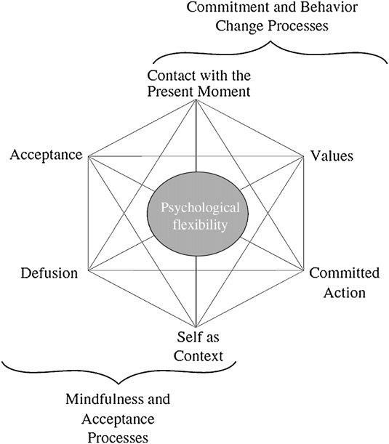
Why ACT?
Evidence-based
Effective for:
Improving academic performance
Managing burnout
Managing bias / stigmatization toward patients
Anxiety
Depression
Suicidal ideations
Substance abuse
Customizable (process-based)
Teaches psychological flexibility
The ability to adapt and continue to move in the direction of your values, even in the presence of stressors
Chase, et al. (2013); Palilunas, et al., (2018); Hayes, et al., (2004); Kanter, et al. (2020); Coto-Lesmes, et al., (2020); Ducasse, et al., (2018); Osaji, et al. (2020)
Notes:
Ali - Chase, J. A., Houmanfar, R., Hayes, S. C., Ward, T. A., Vilardaga, J. P., & Follette, V. (2013). Values are not just goals: Online ACT-based values training adds to goal setting in improving undergraduate college student performance. Journal of Contextual Behavioral Science, 2(3-4), 79-84. doi:10.1016/j.jcbs.2013.08.002
Paliliunas, D., Belisle, J., & Dixon, M.R. (2018). A randomized control trial to evaluate the use of acceptance and commitment therapy (ACT) to increase academic performance and psychological flexibility in graduate students. Behavior Analysis in Practice, 11, 241-253. DOI: 10.1007/s40617-018-0252-x
Hayes, S. C., Bissett, R., Roget, N., Padilla, M., Kohlenberg, B. S., Fisher, G., . . . Niccolls, R. (2004). The impact of acceptance and commitment training and multicultural training on the stigmatizing attitudes and professional burnout of substance abuse counselors. Behavior Therapy, 35(4), 821-835. doi:10.1016/S0005-7894(04)80022-4
Kanter, J. W., Rosen, D. C., Manbeck, K. E., Branstetter, H. M. L., Kuczynski, A. M., Corey, M. D., . . . Williams, M. T. (2020). Addressing microaggressions in racially charged patient-provider interactions: A pilot randomized trial. BMC Medical Education, 20(1), 88-88. doi:10.1186/s12909-020-02004-9
Coto-Lesmes, R., Fernández-Rodríguez, C., & González-Fernández, S. (2020). Acceptance and commitment therapy in group format for anxiety and depression. A systematic review. Journal of Affective Disorders, 263, 107–120.
DOI: 10.1016/j.jad.2019.11.154
Ducasse, D., Jaussent, I., Arpon-Brand, V., Vienot, M., Laglaoui, C., Béziat, S., Calati, R., Carrière, I., Guillaume, S., Courtet, P., & Olié, E. (2018). Acceptance and commitment therapy for the management of suicidal patients: A randomized controlled trial. Psychotherapy and Psychosomatics, 87, 211-222. DOI: 10.1159/000488715
Osaji, J., Ojimba, C., & Ahmed, S. (2020). The Use of acceptance and commitment therapy in substance use disorders: A review of literature. Journal of Clinical Medicine Research, 12(10), 629-633.
DOI: 10.14740/jocmr4311

Slide 9
ACT in the Context of Cultural Humility
The purpose of ACT
Teach psychological flexibility, comprised of the following core skill set:
Present Moment Contact
Acceptance
Defusion
Perspective Taking
Values Clarification
Committed Action
ACT empowers you as an individual to implement meaningful, values-based change both personally and at the organizational level - even in the presence of unavoidable, uncomfortable stressors.
Notes:
Ali -

Slide 10
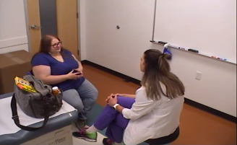
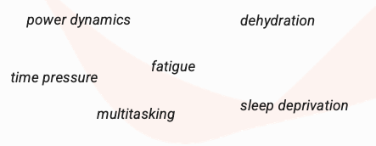
ACT in Context at UNR Med
Notes:
Shay - We currently teach medical students ACT and CH because healthcare is stressful and the current medical education system is set up in a way that often dehumanizes our patients.
Dehumanization is taught as a necessary component in surgery, anatomy lab, codes, etc. because we must do something that would be objectively harmful to someone outside of that context (the OR, anatomy lab, life/death). However, when we default into dehumanizing our patients as a coping mechanism we lose our connection with our patients and we stop seeing them as individuals. We stop treating them with respect and begin to act out of alignment with the physician’s oath we all take.
In order for us to appropriately evaluate our patients we must be willing to test them for HIV/AIDS and talk about difficult topics such as HIV/AIDS.
In this bottom right photo you see me talking to a patient-actor in a simulation, this encounter was a simulation to talk about difficult topics such as obesity and opioid addiction. Practicing these difficult conversations in safe environments such as simulations is helpful because we are given the opportunity to make mistakes and start over without penalty. We get to work through how we respond in those uncomfortable moments. Another way to do this is through visualization. When I was a professional athlete I would use visualization daily to mentally work through a race - the start line anxiety, the mid-race fatigue, seeing another competitor pass me - when you practice your response on the couch it is easier to respond in line with your values.

Slide 11
Values Clarification
Reverse engineering values - looking at why you do what you do
Example:
Wearing a mask during COVID is a form of Cultural Humility
Notes:
Shay - You can think of your values as the overarching life direction you would like to move in the direction of at any given point in time. Values are different from committed actions or goals - because they are not necessarily achievable. They are qualities of being and doing that we choose to live in alignment with on a moment-to-moment basis. For example, one may value Health, so they choose to live in alignment with their value of health by choosing to eat a salad for lunch, rather than choosing a fast-food option. Eating one salad one time is no guarantee an individual will be optimally healthy and there is never a point in life where one can say they’ve mastered “Health” and no longer has to take any action in service of said value.
Some other ways to think about values are...

Slide 12
Acceptance
Diving In
“This won’t be easy and it will be worth it.”
Notes:
Ali -

Slide 13
Present Moment Contact
Breathing exercises
Meditation
Notice 5 things
Getting back to the present moment (recognizing when you are on the thought train)
Notes:
Shay -

Slide 14
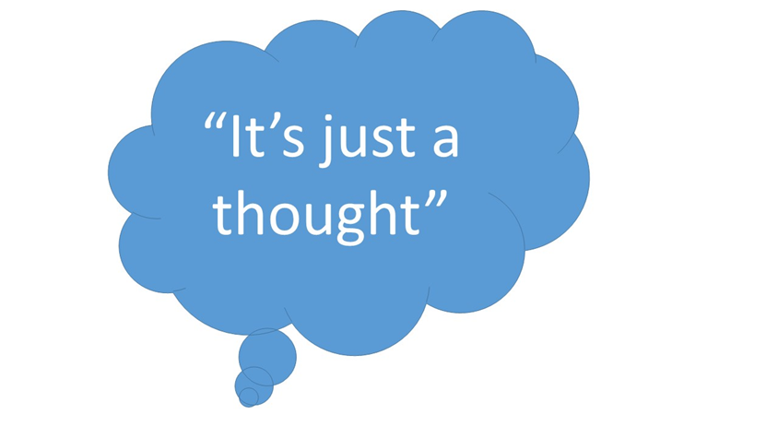
Defusion
The “I Can’t” Game
Label It
“I’m having the thought…”
“I’m having the feeling of…”
Write it Out
Notes:
Ali -

Slide 15
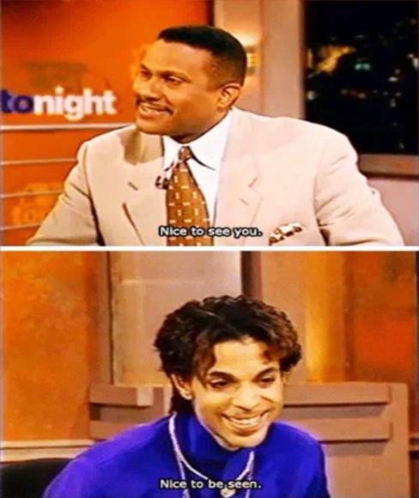
Perspective Taking
Self-as-Context & Others-as-Context
The other person’s shoes.
Active Listening
“Am I listening? Or am I just waiting for my turn to talk?”
Let it breathe.
Notes:
Shay -

Slide 16
Committed Action
Smalls Steps > Giant Leaps
Start small.
Habit Formation > Isolated Events
SMART Goals
specific
measurable
achievable / accountable
realistic
time-framed
The Goldilocks Method
Graph It or Track It
Notes:
Ali -

Slide 17
CH Activity
Notes:
We can do this if we can have people get into breakout rooms so they are paired up.

Slide 18
Thank you!
“When I dare to be powerful,
to use my strength in the service of my vision,
then it becomes less and less important whether I am afraid.”
-Audre Lorde
Shanna Strauss, M.D. - shannastrauss@med.unr.edu
Alison J. Szarko, M.A. - aszarko@nevada.unr.edu
18
Notes:
Ali - Closing thoughts.

