Slide 1
Power of Perceptions: Sticking It To Stigma
Authored by:
Angie Geren, APP, Cht
June 8th, 2021

Slide 2
Disclaimer
“This program is supported by the Health Resources and Services Administration (HRSA) of the U.S. Department of Health and Human Services (HHS) as part of an award totaling $3,278,366. The contents are those of the author(s) and do not necessarily represent the official views of, nor an endorsement, by HRSA, HHS or the U.S. Government.”
The views and opinions expressed in this presentation are not necessarily those of the Pacific AIDS Education and Training Centers (PAETC), the Regents of the University of California or its San Francisco campus (UCSF or collectively, University) nor of our funder the Human Services and Resources Administration (HRSA). Neither PAETC, University, HRSA nor any of their officers, board members, agents, employees, students or volunteers make any warranty, express or implied, including the warranties of merchantability and fitness for a particular purpose; nor assume any legal liability or responsibility for the accuracy, completeness or usefulness of information [,apparatus, product] or process assessed or described; nor represent that its use would not infringe privately owned rights.

Slide 3
Disclosures
All presenters of this continuing medical education activity have indicated that neither they nor their spouse/legally recognized domestic partner has any financial relationships with commercial interests related to the content of this activity.

Slide 4
Learning Objectives
Identify types of stigma
Identify the harm stigma causes
Identify tools to decrease stigma and increase connection with clients/patients

Slide 5
Working with communities to address the opioid crisis.
SAMHSA’s State Targeted Response Technical Assistance (STR-TA) Consortium assists STR grantees and other organizations, by providing the resources and technical assistance needed to address the opioid crisis.
Technical assistance is available to support the evidence-based prevention, treatment, and recovery of opioid use disorders.
Funding for this initiative was made possible (in part) by grant no. 6H79TI080816 from SAMHSA. The views expressed in written conference materials or publications and by speakers and moderators do not necessarily reflect the official policies of the Department of Health and Human Services; nor does mention of trade names, commercial practices, or organizations imply endorsement by the U.S. Government.
Notes:
More info on next slide

Slide 6
Working with communities to address the opioid crisis.
The STR-TA Consortium provides local, experienced consultants to communities and organizations to help address the opioid public health crisis.
The STR-TA Consortium accepts requests for education and training resources.
Each state/territory has a designated team, led by a regional Technology Transfer Specialist (TTS) who is an expert in implementing evidence-based practices.
Funding for this initiative was made possible (in part) by grant no. 6H79TI080816 from SAMHSA. The views expressed in written conference materials or publications and by speakers and moderators do not necessarily reflect the official policies of the Department of Health and Human Services; nor does mention of trade names, commercial practices, or organizations imply endorsement by the U.S. Government.

Slide 7
Contact the STR-TA Consortium
To ask questions or submit a technical assistance request:
Visit www.opioidresponsenetwork.org
Email str-ta@aaap.org
Call 401-270-5900
Funding for this initiative was made possible (in part) by grant no. 6H79TI080816 from SAMHSA. The views expressed in written conference materials or publications and by speakers and moderators do not necessarily reflect the official policies of the Department of Health and Human Services; nor does mention of trade names, commercial practices, or organizations imply endorsement by the U.S. Government.
Notes:
Next slide is the anonymous questions we want folks to tackle.

Slide 8
Consider the following statement
Notes:
Okay gang, before we jump into the training and presentation, I wanted to get you all thinking about the issues as they relate to stigma and substance use. Using these questions in front of you, I want you to consider each statement and how you would truthfully respond to each one. Again, you don’t have to share any of this out loud, this is NOT a test, and there are no right or wrong answers here.
I’m going to give everyone 5 minutes here to carefully read through the questions and formulate your own response, based on the four options; strongly agree, agree, disagree, or strongly disagree. Again, no need to write your answers down or say them out loud, and at the end of 5 minutes, I’ll come back with some very general questions.
Questions:
a. How did it feel to think about the statements?
b. Were there any statements that you got stuck on, or had a harder time with?
c. Were there statements that didn’t make sense to you?
d. Were there statements that were more (or less) meaningful for you?
Explain that this exercise was done to get people thinking about some of the ideas that will shape our discussion today, and about some of the values that can be pushed and pulled when it comes to discussions around drug use and health care. Thank the group for their participation and let them know we’ll revisit these questions very very briefly near the end of the training.

Slide 9
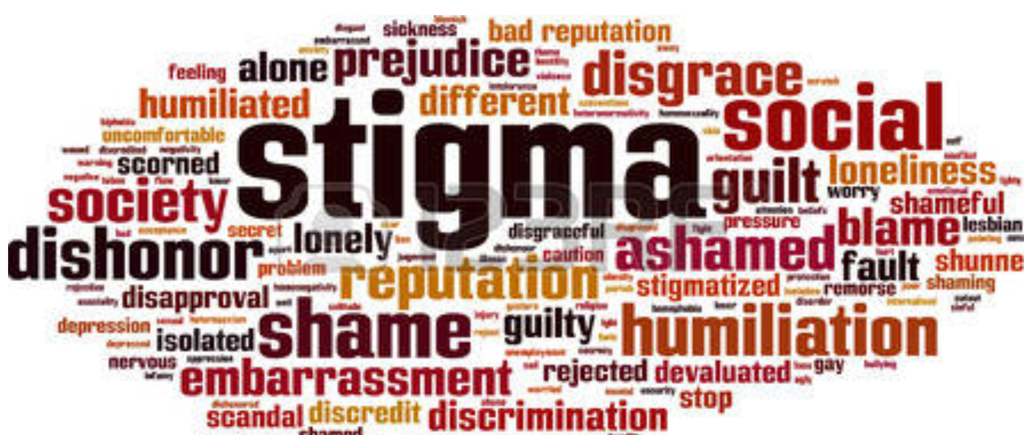
We’re Swimming In Stigma
Stigma is defined as a mark of disgrace or infamy, a stain of reproach, as on one's reputation (SAMHSA, 2018)
Stigma remains the biggest barrier to addiction treatment faced by patients/clients (naabt.org)
Notes:
Okay, let’s get this show on the road, whaddya say?
Folks, it’s no secret that we’re pretty much swimming in stigma. What is stigma you ask? Samhsa’s definition for Stigma is a mark of disgrace or infamy, a stain or reproach, as on one's reputation, and refers to attitudes and beliefs that lead people to reject, avoid, or fear those they perceive as being different.”
Stigma remains the biggest barrier to addiction treatment faced by patients/clients (naabt.org) and the terminology – the words used to describe addiction - has contributed to the stigma. Substance use disorders carry a high burden of stigma, so if you want folks to get into treatment, ya may not want to stigmatize the treatment or the effort…. Jis sayin here, folks.
Just the, fear of judgment alone means that people with substance use disorders are less likely to seek help, and more likely to drop out of treatment programs in which they do enroll.
Lots of derogatory, stigmatizing terms were popular and used throughout the “War on Drugs” in an effort to dissuade people from misusing substances. Education took a backseat, mainly because little was known about the science of addiction.
Changing the language reduces the stigma and will benefit everyone. It will allow patients to more easily regain their self esteem, allow lawmakers to appropriate funding, allow doctors to treat without disapproval of their peers, allow insurers to cover treatment, and help the public understand this is a medical condition as real as any other” (naabt.org). The National Alliance of Advocates for Buprenorphine Treatment
Many of us are already focusing on stigma reduction through person first language. We’ll talk more about this shortly, and there are some good resources available online as well.

Slide 10
3 Types of Stigma
“Public stigma” encompasses the attitudes and feelings expressed by many in the general public toward persons living with mental health or SUD challenges or their family members.
“Institutional (structural) stigma” occurs when negative attitudes and behaviors about mental illness or SUD, including social, emotional, and behavioral problems, are incorporated into the policies, practices, and cultures of organizations and social systems, such as education, health care, and employment.
“Self-stigma” occurs when individuals internalize the disrespectful images that society, a community, or a peer group perpetuate, which may lead many individuals to refrain from seeking treatment for their mental health or SUD conditions.”
Notes:
DON’T read the slide
There are 3 types of stigma (actually 4, but these are the primary ones): public, institutional and self stigma
Public stigma – memes and signs that suggest moral failures, comments in print and online media, using images of ppl overdosed in their cars, etc.
Institutional or structural stigma - Structural stigma is discrimination present in the health care system manifested in the implementation of policies and uses language that leads to lower quality of care, limited and fragmented access to behavioral health treatment and other services, and overuse of coercive approaches to care. Usually this bias targets specific, easily stereotyped and generalizable attributes, such as race, gender, nationality, sexual orientation and age. Though direct discrimination is illegal by United States law, many believe that indirect discrimination is still pervasive in many social institutions and daily social practices. The recent transgender ban in the military is an example.
Self stigma’’s description here is adequate and the big take away here is both that this type of stigma may keep people from seeking services for their mh or sud challenges, it also causes a loss of hope, self esteem and confidence, creating a vicious circle of coping with substance misuse to combat the pain of the stigma, which leads to ever more self stigma and substance misuse or an exacerbation of mh problems.

Slide 11
How Does Stigma Affect Family Members & Others?
This is called courtesy stigma. It means sometimes family members & those associated with persons with mental illness or SUD experience avoidance by others because of stigma.
Some say mental health and addiction services receive less funding because of the type of service they provide, and there is often less support money.
Communities lose the positive resources those with mental illness/SUD could provide. Stigma perpetuates fears about mental illness and addiction.
Notes:
READ the slide
Cadca conference and world café session re SUD docs in str talking about the stigma within their med community for specializing in addiction.

Slide 12
The Backbone of Stigma
Lack of trust in intimate settings
Possible contact with vulnerable group
Potential for self harm
MI/SUD being antithetical to power or authority
Unsure how to interact with person with MI/SUD
Source: https://www.ncbi.nlm.nih.gov/books/NBK384923/
Notes:
Don’t read slide
In the 2006 Global Context Study , levels of recognition, acceptance of neurobiological causes of mental illness and substance use, and treatment endorsement were similarly high; however, a core of five prejudice items persisted, and these are considered the backbone of stigma.
The persistence of core prejudice factors help explain why increased public knowledge has not decreased public stigma.. So what are those 5 backbones of stigma?
Lack of trust in intimate settings – do you want cousin John, who has the severe crack addiction, in the same room with Grandma’s pocketbook?
Possible contact with vulnerable group – Do you want John in the same room as Grandma? Or with a vulnerable child? Or your 14 year old daughter or granddaughter?
Potential for self harm – who do I call when my new renter John lights his hair on fire at 3 in the morning?
MI/SUD being opposed to power or authority – if we tell John he needs to leave, will he obey, or will he turn violent? Or goes quiet, or just ignores you?
Unsure how to interact with person with MI/SUD – What do I even say, and worse, what do I do if things get weird or scary?

Slide 13
Stigma Roulette For SUD
Stigma from within
Blame self, feel hopeless
Stigma from recovery community
Medications vs. “abstinence”
Stigma from clinicians
Belief that treatment is ineffective
Stigma from outside
Choice (moral failing) vs. disease
Notes:
Don’t read slide
People with addiction face many different types of stigma. They face stigma from within– they may blame themselves or feel hopeless.
They can face stigma even within the recovery community. This is particularly true for people on medication treatments for their illness. So while we would never shame someone with diabetes for being on insulin, people with addiction who are on lifesaving medications are often shamed.
They can face stigma from the people who are supposed to be treating them., There is a long held belief in pockets of the medical system and among some clinicians that treatment is ineffective or that people don’t get better. Finally, ppl with addictions face huge stigma from the general public, who see it as a moral failing because they erroneously believe that addiction is a choice not a disease.

Slide 14
How does Stigma Impact Individuals?

Slide 15
Stigma Complicates Illness
Internalized Stigma Outcomes
Depression
Decreased Hope
Worsening Symptoms
Less Likely to Seek Help
Less Likely to Self-Advocate
Ibid.
Notes:
Don’t read slide
Stigma not only inhibits help seeking, it may weaken the impact of help when it is eventually accessed.
Let me provide some Examples of stigma:
People with SUD and those on Medication Assisted Treatment may not be accepted to post-acute care facilities. “In other words, if someone is on MAT, are they really in recovery? Is that what we are projecting in our language and actions? OR, are we supportive of those pathways of recovery as well as 12 step or faith-based approaches? MAT involves taking evidence –based medications like methadone (Methadone) buprenorphine (Suboxone), or naltrexone, for example. These medications work to prevent withdrawal and reduce cravings for opioid drugs. People with Opioid Use Disorder can take these evidence based medications and it will help stabilize and over a longer span, will help heal the them as well.”
Still, the stigma is pervasive and people on MAT may not be offered organ transplantation
People mandated to treatment as a condition of probation who have a positive drug screen despite complying with treatment can be violated and returned to jail or prison. And can I just tell you, as a person who was incarcerated in state prison for a nonviolent cannabis drug crime in a state by the way, where that is no longer even a crime, that the strongest heroin I ever did…. I obtained in prison. If we’re pinning our hopes on rehabilitation and recovery within the criminal justice system, we’re in serious trouble.
Substance use disorder is among the most stigmatized conditions in the US and around the world. People do not want to work with, be related to, or even see people with a substance use disorder in public.
Many believe that people with a substance use disorder can or should be denied housing, employment, social services, and health care.
Some health care providers treat patients who have substance use disorders differently.
Clinicians have lower expectations for health outcomes for patients with substance use disorders; this in turn can affect whether the provider believes the patient is deserving of treatment.
Some health care providers, falsely believing that substance use disorders are within a person’s control, cite feelings of frustration and resentment when treating patients with substance use disorders
This unconscious and often unintentional bias is real, and many researchers suggest that unconscious bias occurs automatically as the brain makes quick judgments based on past experiences and background.
As a result of unconscious biases, certain people benefit and other people are penalized.
Two quick examples can help us quickly understand this:
Resumes are a pretty consistent source of unconscious bias. One particular study gave a group of managers a set of resumes. Some of them were exact duplicates where only the names had been changed. Resumes with the Anglo sounding names received substantially more callbacks that those with diverse names of other origins.
Need help programming your smart phone? The best choice is a Generation Y-er or your child, not the Baby Boomer, right? This could be an accurate assumption, but it’s not always the case.
https://www.samhsa.gov/capt/sites/default/files/resources/sud-stigma-tool.pdf
The Impact of stigma is just pernicious, folks, it:
Erodes confidence that substance use disorder is a valid and treatable health condition
Barrier to jobs, housing, relationships
Deters public from wanting to pay for treatment, allows insurers to restrict coverage
Stops people from seeking help
Impacts clinical care and treatment decisions
“Regardless of where it comes from the impact of stigma is real and huge and negative. Stigma keeps people from understanding that addiction is a valid and treatable medical condition. It can serve as a barrier to jobs, housing, relationships. On a policy level it allows practices like how insurance companies can restrict coverage. And most importantly it keeps people from acknowledging that they have a problem and from seeking help.”

Slide 16
Factors that Influence Stigma and Consequences
Blame
People with substance use disorders are generally considered to be more responsible for their conditions than people with depression, schizophrenia, or other psychiatric disorders (Crisp et al., 2000, 2005; Lloyd, 2013; Schomerus et al., 2011).
Belief that a substance misuser's illness is a result of the person's own behavior can also influence attitudes about the value and appropriateness of publicly funded alcohol and drug treatment and services (Olsen et al., 2003).
(SAMHSA, 2018)
Notes:
Read the slide

Slide 17
Stereotypes of Dangerousness
People with substance use disorders are considered even more dangerous and unpredictable than those with schizophrenia or depression (Schomerus et al., 2011).
In a survey conducted in the United States (Link et al., 1997), a vast majority of respondents considered it likely for a cocaine- or alcohol-dependent person to hurt others.
Notes:
Read the slide
And this isn’t just for the SUD community; think about what is typically said whenever there is a mass or workplace shooting about the shooter. Almost ALWAYS very quickly begins to comment on the person’s “mental health.”

Slide 18
Media Portrayals
Much of the evidence on the media's influence on stigma change is negative in direction (Pugh et al., 2015).
The media play a crucial role in stoking fear and intensifying the perceived dangers of persons with substance use disorders (Lloyd, 2013).
Similarly, media portrayals of people with mental illness are often violent, which promotes associations of mental illness with dangerousness and crime (Diefenbach and West, 2007; Klin and Lemish, 2008; Wahl et al., 2002).
Furthermore, the media often depict treatment as unhelpful (Sartorius et al., 2010; Schulze, 2007) and portray pessimistic views of illness management and the possibility of recovery (Schulze, 2007).
Notes:
Read the slide
Another content analysis in 2004 of U.S. news coverage of mental health issues found that, in 39 percent of stories, an association was made between persons with mental illness and dangerousness (Corrigan et al., 2005a). Treatment was mentioned in 26 percent of stories but only 16 percent of the stories included recovery as an outcome.
Not so Fun Fact: Results from the 2006 General Social Survey found an increase in the public's knowledge of mental disorders and treatment since their previous 1996 survey, but stigma levels for people with mental illness did not decrease over that time (Pescosolido et al., 2010). This tells us that it requires more than just knowledge about the disorders and treatment for them. Language matters!

Slide 19
More Consequences of Stigma
Substance use disorder is among the most stigmatized conditions in the US and around the world. People do not want to work with, be related to, or even see people with a substance use disorder in public.
Many believe that people with a substance use disorder can or should be denied housing, employment, social services, and health care.
Some health care providers treat patients who have substance use disorders differently.
Clinicians have lower expectations for health outcomes for patients with substance use disorders; this in turn can affect whether the provider believes the patient is deserving of treatment.
Some health care providers, falsely believing that substance use disorders are within a person’s control, cite feelings of frustration and resentment when treating patients with substance use disorders
Notes:
Read the slide
In a recent study of Americans conducted by Johns Hopkins University, only 22% of people surveyed were willing to work closely with someone suffering from drug addiction, yet 62% were willing to work closely with someone suffering from mental illness.

Slide 20
How Trauma Contributes to Stigma
Trauma-initiated Loss of control (trauma triggering) in a MH or SUD setting reinforces a biased belief system created by someone (or many) who previously stigmatized the individual, their behavior, and/or their community in the past
Responses lacking trauma awareness may create feelings of marginalization, oppression, and victimization in the individual compromising self-worth, dignity, and hope
Notes:
Read slide

Slide 21
How Trauma Contributes to Stigma
Things a provider or person may do that are not trauma-informed and may increase stigma:
Not using empowering recovery-oriented language
Limiting choices of those individuals who attend your program
One size fits all mentality when it comes to:
Programming
Punitive measures (punishments, banning, etc)
Ideas on recovery or what it means to be in recovery
Notes:
Read slide

Slide 22
Actions Have Power…
When establishing rules or making program decisions, important to understand you may be unintentionally stigmatizing the very people you serve
Be aware that sometimes what feels like a simple programming decision may actually negatively impact someone or a group so severely that you lose the critical opportunity to establish a trusting relationship with the individual

Slide 23
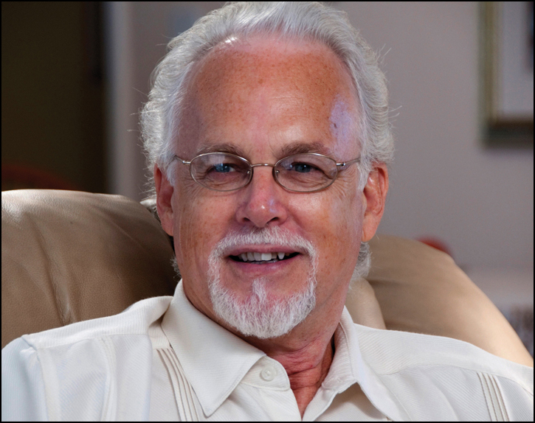
Words have Power…
“Words have immense power to wound or heal…The right words catalyze personal transformation and offer invitations to citizenship and community service. The wrong words stigmatize and dis-empower.”
- William White, Author and Recovery Advocate
Notes:
If you are not familiar with William White and you are interested in learning more about recovery advocacy, recovery messaging, and just really cool recovery stuff in general, you should check out his blog at William White Papers.org
Bill’s like the Godfather of Recovery for many of us, and this quote from him drives home a point I’ve made throughout this presentation; words matter. Read quote
So ”What is the message we want to be sending our clients/patients? Or their families and friends? Are we using inviting language, positive, supportive? Or can they tell how we feel about addiction just by speaking with us for 5 mins.?”
Using the terms substance abuse or substance abusers contributes to the social and professional stigma attached to substance use disorders and may inhibit help-seeking and may negatively impact the rendering of appropriate services.
On example is a study referred to as the Smoking Gun study. (N =728) Smoking Gun refers to the Kelly studies. In one randomized study, health care workers at two conferences (n = 728) completed a survey with case studies describing the subject as either a substance abuser or as having a substance use disorder. In the case study, the subject was having difficulty complying with court orders. The study asked the health care workers to recommend options ranging from the therapeutic to the punitive. Those workers with the substance abuser case studies were significantly more likely to recommend punitive measures .

Slide 24
Non-Stigmatizing Language
"By using accurate, non-stigmatizing language, we can help break the stigma surrounding this disease so people can more easily access treatment, reach recovery, and live healthier lives."
Michael Botticelli, Former Director White House ONDCP
Notes:
This is Michael boticelli, The first National Drug Czar who is also in recovery, and his parting message as he exited ONDCP was to draw attention to the pernicious impact of stigma.
https://obamawhitehouse.archives.gov/blog/2017/01/13/changing-language-addiction
Read slide

Slide 25
Why Does Care Look so Different?
WHO study of 18 most stigmatized social problems in 14 countries:
Drug addiction ranked number 1
Alcohol addiction ranked number 4
Stigma associated with poor mental and physical health among people who use drugs
Stigma among top reasons people don’t access treatment
Notes:
Don’t read slide
“We know stigma is a huge issue in addiction because it is the number one reason why people who need treatment don’t access it. We also know from studies across the world that drug addiction is the single most stigmatized condition on earth– more than having HIV or being a criminal.”

Slide 26
Eliminating Stigma
Notes:
So we’ve talked a bit about stigma and how to identify it, and now let’s take a look at how we might begin eliminating it.
Intro Jerria here, and turn it over through slide 28. Jerria presents slides, at slide 28, Jerria finishes and shares spoken word.

Slide 27
What if….
What if we treated other diseases the way we treat substance use disorder?
Notes:
Jerria
Don’t Read Slide
I want to take a step back for a second and ask you all….What if we treated other chronic disease like we treat addiction?

Slide 28
What if….
You go to the hospital with chest pain and are diagnosed as having a heart attack…
Told it’s “your fault” because of your “choices”
Denied treatment because you “did it to yourself”
Given a list of cardiologists and cath labs to call
Only given aspirin if you agree to go to counseling
Kicked out of the hospital for more chest pain
Notes:
Jerria
Don’t read slide
Imagine if you went to the hospital with chest pain and were found to be having a heart attack. What if the doctors and nurses told you it was your fault because of the diet you “chose” or the fact that you don’t exercise or smoke? What if they refused to give you treatment because you had “done this to yourself.” What if instead of immediate care you were given a list of phone numbers for cardiologists to call and sent on your way? What if instead of being given life saving medication you were told you could only get medication if you agreed to also go to nutrition counseling? Or what if you were kicked out of care for having a symptom of your disease? This all sounds outrageous when you apply it to heart disease and yet this is what people with addiction face every single day. They are blamed for their disease, denied treatment, told to find care themselves, denied lifesaving medications like methadone, Suboxone or naltrexone, and kicked out of care for having a symptom of their disease- namely using.

Slide 29
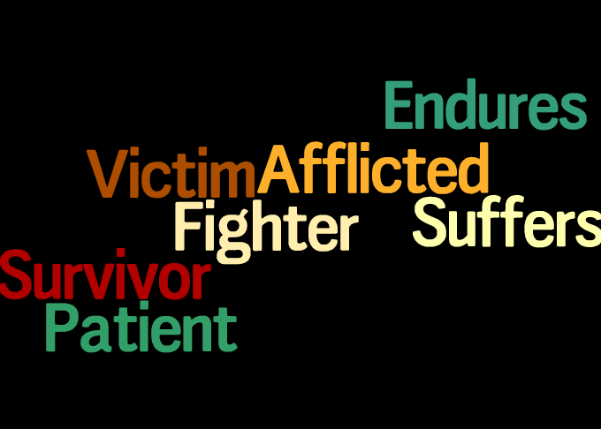
Language Used for People with Other Illnesses
Notes:
Jerria
Don’t read slide
So It’s not just the care and treatment that is different. Even the language we use is different for addiction as compared to other diseases. Think about the language we use for most illnesses, it is a language that communicates compassion and patient-centeredness. We talk about cancer survivors and suffering or enduring chronic disease.
The language we use for addiction is quite different. We call patients substance ABUSERS and talk about how their urine is dirty with drugs. We wouldn’t call someone with diabetes a sugar abuser or someone who is overweight a food abuser and yet with addiction that term has been normalized.”

Slide 30
Change Language to Improve Care
Avoid: “dirty,” “clean,” “abuse,” and “abuser”
Use Person-First language instead
Consider changing: Medication Assisted Treatment
Medications for addiction treatment are life-saving similar to insulin for diabetes, which is not called “insulin assisted treatment” despite importance of behavioral interventions with diabetes care
“Medically-supervised withdrawal" also more accurate and less stigmatizing than ”detox“ or “taper”
Notes:
So how do we change the language to improve the care? Let’s look at some brief examples of what to say and what not to say, and we’re going to do a lot more of this work shortly, but for now, we want to focus on changing the language we use – remember that stigma is the number one reason people don’t come in for treatment – so if we want to improve the care, we need to change the language we’re using!
READ THE SLIDE

Slide 31
Person First Language Examples
http://mainequalitycounts.org/wp-content/uploads/2018/10/QC-Substance-Use-Conversation-Guide.pdf
Notes:
Jerria
We have these person first language examples here, and you have them as well in the download pods. The reason I wanted you to see this one is because it separates the terminology examples into person centered, neutral and objective, opportunity focused language.
Use and encourage language that promotes self-esteem and self-efficacy such as person-first language like “person with substance use disorder” instead of “addict” or “alcoholic.”
Health care teams that use empowering language can diminish the “why try” effect of self-stigma and encourage engagement in peer supports and education to increase social and
coping skills.
Before we move on from this slide, it’s important to realize that many people with substance use disorder often use stigmatizing language to describe themselves. Steven shared a story with me about a recent social media interaction he had around this and I’m hoping he can share that again with all of you. Steven?

Slide 32
Language Audit
Perform a “language audit” of existing materials for language that may be stigmatizing, then replace with more inclusive language.
Example: Using the search and replace function for electronic documents, search for “addict” and replace with “person with a substance use disorder,” or search for “abuse” and replace with “use” or “misuse.”
Make sure to review both internal documents (e.g., mission statements, policies) as well as external ones (e.g., brochures, patient forms).
SAMHSA/CAPT, 2017
Notes:
Jerria
Don’t read slide
Remember back when we first began this presentation, Steven talked about institutional, or Structural stigma. You’ll remember that this type of stigma is discrimination present in the health care system in the implementation of policies and language; leading to lower quality of care, ,limited and fragmented access to behavioral health treatment and other services, and overuse of coercive approaches to care.
As you may be realizing at this point, eliminating stigma is going to require some work –and one of the ways to start is to perform a language audit:
Now Read the slide then read the remaining text below.
SAMHSA’s Center for the Application of Prevention Technologies has a pretty great toolkit for doing this, it’s called Words Matter: How Language Choice Can Reduce Stigma and it is available in the downloads pod here in the room.
Before I turn this back over to Steven, I want to share one more thing with all of you…. (Jerria feel free to either give a little explanation about this or just launch right in to the Spoken Word you’ve created. I’ll have Melissa pull up the word doc “Spoken Word” I created from your email in the room while you’re sharing so folks can follow along if they’d like)

Slide 33
Words Matter
They say your words become
Your actions and your actions
Your habit
So I encourage myself
Respect
I demand it
Change starts within
how can you stigmatize me
Then call me friend?
I'm not the person
That I used to be
Now that I know my struggle
Is a SUD…
Don't know what that is?
Look it up please
Maybe you’ll understand
It's not a habit its a disease
all I needed was the
proper treatment
From my family, friends, and doctors
Support I could believe in
Don't need nobody calling
Me names
Preconceived notions
And silly mind games
I define who I am
God knows what ill be
Understand that my past
Is Not my destiny
May not be there yet
But im on my way
Shout out to every person in recovery
It's gonna be okay
Notes:
Jerria
Turns it back to Steven when finished

Slide 34
Stigma and OUD
Notes:
Okay, I love this video. You can clearly tell the speaker here, Ms Loukas is passionate and knowledgeable about stigma and recovery. Remember too that stigma is pernicious and can be insidious, often hiding in plain sight.
Play video: https://youtu.be/X-EzP2QcZcU
Also on: https://pcssnow.org/education-training/training-courses/stigma-and-oud/
There are actually two “ouch” stigma moments for me in this video, there was the “psych meds” comment, and then the “wet shelter” comment, both of which sure conjures up some gnarly negative images for many. Now, I’m not here to disparage Ms. Loukas at all. Rather, I’m trying to point out to all of us that even the most passionate advocates can step right into a big ol pile of stigma without even realizing it. I will certainly be guilty of it myself again, but I keep finding it and rooting it out when I come across it within me. It’s what I must do and now I’m asking you to do it too because language and words matter folks, yes?

Slide 35
Evidence-Based Interventions
Stigma Elimination Through Contact
Peer storytelling
Stigma Elimination Through Education
Peers educating on the science of addiction and recovery
Stigma Elimination Through Language
All of us using non-stigmatizing, person first, recovery-oriented language
Holding each other accountable by creating teachable moments/learning opportunities when we use stigmatizing language.
Notes:
Don’t read slide
We are mentioning these three evidence-based stigma reduction interventions because we know they work and have the evidence to support it, and we encourage you to reach out to the Opioid Response Network for more intensive training via:
Recovery Community Messaging Training which teaches folks how to more impactfully tell their stories. This training also discusses the use of accurate and non-stigmatizing language.
The Science of Addiction & Recovery which provides information about substance use disorder in an accessible format.
While these trainings are all good and they definitely work, perhaps the most important thing we can do to help change attitudes and behaviors is to
HAVING SOMEONE WITH LIVED EXPERIENCE PROVIDE EDUCATION. We know that when those of us with lived experience speak, it HAS TWICE THE IMPACT ON ATTITUDE CHANGE AND INTENDED BEHAVIORS that trainings without that voice experience. Frequently, contact-based interventions – those lived experience stories - are combined with education where factual information is presented. People with lived experience support and personalize the information by relating it to their own life experiences.

Slide 36
What Can YOU Do?
Treat addiction with science-based strategies
Speak out against stigma & discrimination
Keep hope alive
Treat affected individuals with dignity
Partner with peer recovery specialists
Be mindful of language
Notes:
“So what can you all do? First you can do just what you are doing today– learn more about addiction and speak out! For everyone who knows someone with addiction, you can keep hope alive and help them know that addiction is treatable and that they will get better. I hope everyone will be mindful of the language they use and remembers always to treat people with dignity and respect. Please, spread the message that treatment works and most people do get better in their recovery journey.”
Use appropriate language in formal and informal conversations when discussing SUDs to decrease stigma by:
Removing labels
Using “person first” language

Slide 37
Role of Providers/Policy Makers
Reduce
Reduce stigma surrounding substance misuse.
Challenge
Challenge providers and communities to be aware of unintentional bias.
Use
Use appropriate language in conversations when discussing SUDs to decrease stigma by:
Removing labels & using “person first” language
Notes:
Read the slide
Let me just say a quick word about the unintentional or “unconscious bias”
Many researchers suggest that unconscious bias occurs automatically as the brain makes quick judgments based on past experiences and background. As a result of unconscious biases, certain people benefit and other people are penalized.
Two quick examples to help us quickly understand this:
Resumes are a pretty consistent source of unconscious bias. One particular study gave a group of managers a set of resumes. Some of them were exact duplicates where only the names had been changed. Resumes with the Anglo sounding names received substantially more callbacks that those with diverse names of other origins.
Need help programming your smart phone? The best choice is a Generation Y-er or your child, not the Baby Boomer, right? This could be an accurate assumption, but it’s not always the case.

Slide 38
Reminders
Substance Use Disorder (SUD) is a chronic disease. . . as are diabetes, depression and hypertension
Substance use falls along a continuum
Use ranges from abstinence/low-risk to chronic dependence and encompasses all stages in between
Relapse and lapse are a part of the disease process
As many other chronic diseases can be managed, SUD can also be managed through appropriate treatment -- even during pregnancy
Successful treatment for SUD means the person is in recovery; it does not mean they are “cured”
Notes:
Read the slide (2 more reminder slides are coming)
Remember too that “There are 2 main factors that influence stigma: cause and controllability. Stigma decreases when people understand that the individual is not responsible for causing his/her problem when he or she is unable to control it.” Education and changing terminology used will influence perceptions.
Source. Kelly, J.F., Walkerman, S.E., & Saitz, R. (2015, January). Stop talking 'dirty': clinicians, language, and quality of care for the leading cause of preventable death in the United States. The American Journal of Medicine, 128(1), 8-9.
Source: Buchman, D.Z., Leece, P., & Orkin, A. (2017, Winter). The epidemic as stigma: the bioethics of opioids. Journal of Law, Medicine, & Ethics, 45(4), 607-611.

Slide 39
Reminders (continued)
Embrace
Embrace positive change: Treatment for substance use disorders has historically been viewed as binary, with addiction and abstinence as a person’s only two options
Don’t create
Don’t create a dichotomy of “someone is using or not using.” There are many positive changes a person can make to reduce negative consequences
Don’t convey
Don’t convey the impression that abstinence is the only goal
Don’t assume
Don’t assume there is only one “right” way to address substance misuse
Notes:
Read the slide
Source. Kelly, J.F., Walkerman, S.E., & Saitz, R. (2015, January). Stop talking 'dirty': clinicians, language, and quality of care for the leading cause of preventable death in the United States. The American Journal of Medicine, 128(1), 8-9.
Source: Buchman, D.Z., Leece, P., & Orkin, A. (2017, Winter). The epidemic as stigma: the bioethics of opioids. Journal of Law, Medicine, & Ethics, 45(4), 607-611.

Slide 40
Reminder: Words Matter
Source: https://news.harvard.edu/gazette/story/2017/08/revising-the-language-of-addiction/
Notes:
Read slide
Jerria, we’ve been talked about stigma generally, but I want you to share what you’ve experienced when working with youths and young adults because I know it’s a little different, as are the tactics you are using to help them understand stigmatizing language and words.

Slide 41
Recommended Reading
Ending Discrimination Against People with Mental and Substance Use Disorders: The Evidence for Stigma Change
https://www.ncbi.nlm.nih.gov/books/NBK384923/
Notes:
Personal Slide coming next
Ending Discrimination Against People with Mental and Substance Use Disorders: The Evidence for Stigma Change.
Show details Committee on the Science of Changing Behavioral Health Social Norms; Board on Behavioral, Cognitive, and Sensory Sciences; Division of Behavioral and Social Sciences and Education; National Academies of Sciences, Engineering, and Medicine.
Washington (DC): National Academies Press (US); 2016 Aug 3.
National Center for Biotechnology Information
National library of medicine
National institute of Health

Slide 42
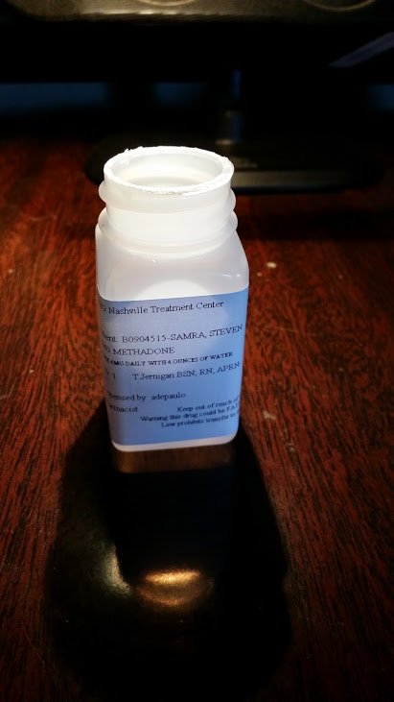
Wearing My Past On My Sleeve
MAT: 2000/2014
Detoxed 2/13/2014
Folsom Prison, drug conviction: 1996
Long Beach, CA: 1999
Waiting to die: opioid/cocaine addiction
Notes:
I typically would have shown this slide at the beginning of this presentation so everyone in the room knew that I had the lived experience that validates why I’m in front of you today.
But the reason I waited until the very end of this presentation to share a small snippet of my recovery story is because I know the pervasive impact of stigma personally, both in the context of addiction challenges and as a speaker/presenter.
I’ve said repeatedly during this presentation that Stigma may also keep ppl from seeking treatment. I was one of those people, and I’ll tell you why. 12 step story
I’ve been opioid medication free for 5 years now, and I stand in front of every one of you today wearing my past and my recovery on my sleeve, because if any of you had met me in 1998, you likely would have simply stepped over me laying in the gutter and would have never given me another thought. I’m in front of all of you today to tell you recovery is real, medication assisted treatment works, and with the right supports, those of us with substance use histories not only recover, we go on to do GREAT things in and for our communities, our brothers and sisters still struggling with addiction, and for the families that thought they lost us forever. And those of us serious about our recovery also recognize when they might be headed for trouble, and none of us is immune. After almost 6 years of struggle to control not addiction symptoms but mental health symptoms, I recently returned to MAT and within 48 hours, my entire life “returned to a stable normal” and it’s been consistently positive ever since. My resumption of MAT ensures that I will remain in a loving relationship, enjoy a fantastic job and the fruits of my labors, and I get to continue sharing to, and learning from, folks like you every day. To say I’m blessed is an understatement, but no more so than any one of you in this room.
Okay, let’s try something different and before we jump into some interactive work, let me just check back in with all of you on that slide I shared at the very start of this presentation – the one with these questions….bring up the next slide.

Slide 43
Consider the following statements
Notes:
I just want to check back in with all of you on these questions and I don’t need you to respond unless you would like to, but I’m hoping that after we did today’s training, some of you may have different feelings about these questions. Again, no need to respond here unless any of you want to share a thought or two, happy to listen.
Okay folks, let’s stop here and switch gears.

Slide 44
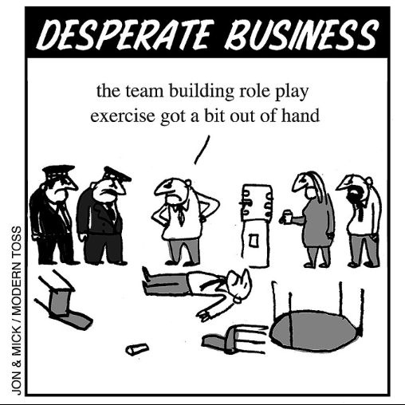
Q & A and Interactive Activities Time!
Notes:
Okay, I want to give everyone a couple of minutes here to ask questions or share any comments, concerns, etc. We’re going to tackle some group activities for the remaining time we have today, and I want to try and address any questions that may have arisen from the training. I’ll give everyone another shot at QA before we part ways today, so there’ll be another chance.

Slide 45
Who’s Still Standing?
Notes:
Show folks how to raise and lower hand in AC room.
1st Scenario:
You have just applied for a new job at a new organization.
It’s your dream job and you were very excited to hear you have been shortlisted
for interview. In the interview the discussion moves on to ask about the gap in
your work history where you had to take time out from work due to your mental health
problem. Remain standing if you feel you are able to be open about your mental health
problem and explain to the panel your gap in employment.
Sit down if you decide to make up another reason.
2nd scenario:
You are on a first date.
Everything is going well, you have just finished your starters and waiting for
main course to be served. You’ve decided that you would quite like to see your
date again as things seem to be going so well. The conversation moves onto
mental health and you discuss a TV programme that has recently been on about
this.
Remain standing if you feel you are able to be open about your mental health
problem and let the other person know about your experience and connection
to the programme.
Sit down if you say nothing at all.
3rd Scenario:
You are at a family wedding.
The speeches have just finished and you are chatting with extended family
(Grandparents, Uncles, Aunties, Cousins) that you have not seen for a while.
The conversation moves onto your current health and one of your family
members asks how you have been?
Remain standing if you feel you are able to be open about your mental health
problem and talk to them about some of the difficulties you have recently had.
Sit down if you decide to brush it off and just say I’m fine.

Slide 46
The Glass Half Empty, The Glass Half Full?
Notes:
Melissa to pull up the first three pages of the Person First Language w Questions document
(Last two pages have answers and we want to give that to them AFTER they complete this assignment, so we just need the first 3 pages of the Person First Language w Questions to be able to be pulled up in the room).
Steven to read through pg 1, then scroll down to first page and have folks begin responding, either in the chat or through the phone.
This should take about 30 minutes total.
At conclusion, ask for any final questions of the group.
Remind them that they can now download this full document from the pod

Slide 47
Presenter Contact Info
Angie Geren angie@arizonarecovers.org

Slide 48
References
Addiction-stigma(2017). Retrieved from http://www.drugabuse.com.
Adlaf, E.M., Hamilton, H.A., Wu, F., & Noh, S. (2009). Adolescent stigma towards drug addiction: Effects of age and drug use behavior. Addictive Behaviors, 34(), 360-364.
Brown, S.A. (2011). Standardized measures for substance use stigma. Drug and Alcohol Dependence, 116(), 137-141.
Browne, T., Priester, M., Clone, S., & Iachini, A., DeHart, D., & Hock, R. (2015). Barriers and facilitators to substance use treatment in the rural south: A qualitative study. The Journal of Rural Health, 32(), 92-101.
Buchman, D.Z., Leece, P., & Orkin, A. (2017, Winter). The epidemic as stigma: the bioethics of opioids. Journal of Law, Medicine, & Ethics, 45(4), 607-611.
Johns Hopkins HUB. (October 1, 2014). Drug addiction viewed more negatively than mental illness, Johns Hopkins study shows.
Kelly, J.F., Walkerman, S.E. & Saitz, R. (2015, January). Stop talking 'dirty': clinicians, language, and quality of care for the leading cause of preventable death in the United States. The American Journal of Medicine, 128(1), 8-9.
Kramlich, D., Kronk, R., Marcellus, L., Colbert, A., & Jakub, K. (2018). Rural Postpartum Women With Substance Use Disorders. Qualitative Health Research, (), 1-13.
Walsh, C., (2017). Revising the Language of Addiction. Retrieved from: https://news.harvard.edu/gazette/story/2017/08/revising-the-language-of-addiction/

