Slide 1
Department of Health and Human Services
Helping people. It’s who we are and what we do.

Slide 2
IN PARTNERSHIP WITH…
2

Slide 3
Nevada’s office of suicide prevention NOSP state plan
Nevada’s Office of Suicide Prevention NOSP State Plan
Introduction to Zero Suicide Quick Refresher
Gatekeeper: Overview training in
Suicide Prevention
3

Slide 4
Disclaimer
The views and opinions expressed in this presentation are not necessarily those of the Pacific AIDS Education and Training Centers (PAETC), the Regents of the University of California or its San Francisco campus (UCSF or collectively, University) nor of our funder the Health Resources and Services Administration (HRSA). Neither PAETC, University, HRSA, nor any of their officers, board members, agents, employees, students or volunteers make any warranty, express or implied, including the warranties of merchantability and fitness for a particular purpose; nor assume any legal liability or responsibility for the accuracy, completeness or usefulness of information [apparatus, product] or process assessed or described; nor represent that its use would not infringe privately owned rights.
paetc.org
4

Slide 5
Disclosures
All presenters of this continuing medical education activity have indicated that neither they nor their spouse/legally recognized domestic partner has any financial relationships with commercial interests related to the content of this activity.

Slide 6
Objectives
NOSP “New Normal”
Zero Suicide – Nevada’s Approach
Terminology / Change in terminology
Data
Facts
What to look for
Risk Factors
Warning Signs/ Invitations
Show you care
Ask about suicide
What to do - Get help
Community Resources and Trainings
Postvention
Q and A
5

Slide 7
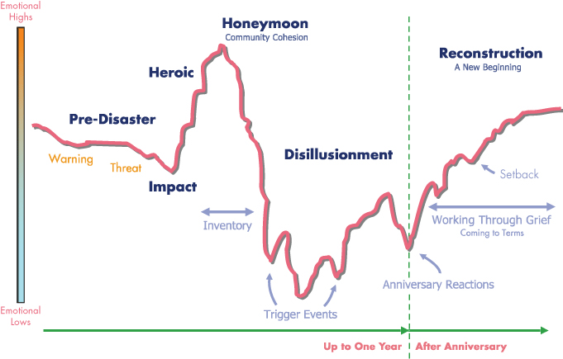
Emotional highs and lows
6

Slide 8
NOSP State Plan Goals 2021-2025
Goals:
Increase Suicide Surveillance Data, Research and Evaluation
Inspire and Empower Every Person to Play a Role in Prevention
Address Upstream Factors that Impact Suicide
Support Adoption of Evidence-Based and Best Practices for Safer-Suicide-Care
7

Slide 9
NOSP Goals 2021-2025 (cont)
Enhance Crisis Care
Suicide Prevention and Early Detection
Ensure Lethal Means
Statewide Adoption of a Suicide Postvention Programs
988
July 16th, 2022
National Mental Health 3-digit number
Sustainability / Legislation
Project Aware
DOE
8

Slide 10
ZERO SUICIDE
9

Slide 11
Zero Suicide Initiative
Suicide prevention is a core responsibility of HEALTH
Apply new knowledge about suicide & focuses on treating it directly
A systematic clinical approach in health systems, not “the heroic efforts of crisis staff and individual clinicians.”
Shift from fragmented suicide care toward a holistic and comprehensive approach to patient safety and quality improvement within healthcare systems.
Zero Suicide | Crisis Now Model | OPENBeds | CSSNV
Bringing community partners together – community team effort
System-wide approaches have worked to prevent suicide: United States Air Force Depression Care (18 Months zero suicides) (et al., 2009)
10

Slide 12
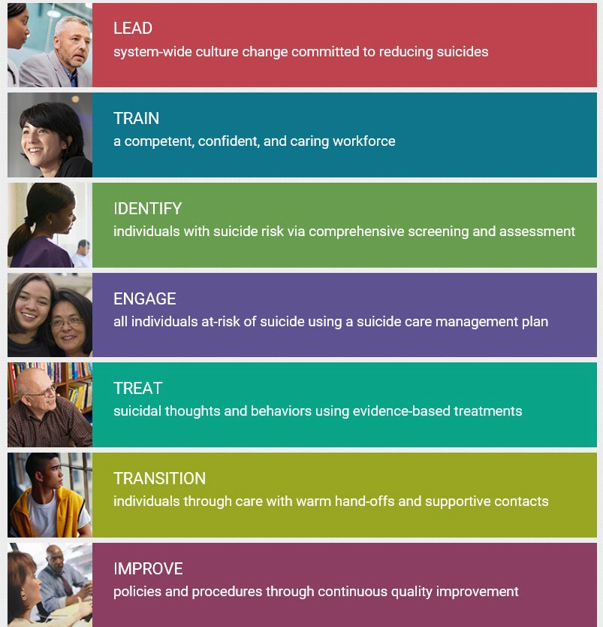
Zero suicide

Slide 13
Where is Nevada?
LEADERSHIP / IMPROVE
ZS Coordinator – continuously meeting and greeting key leaders throughout our state
ZS Workforce Survey – continuously launching via SurveyMonkey platform; with new providers throughout the state (north, south, rural and frontier)
Data is provided to individual partners: break down department and job classification; data can be provided by county and city if needed (survey is filled out correctly and enough responses are received). The data confirms Nevada’s workforce is untrained in suicide prevention
Champion Leadership Teams for Zero Suicide Learning Series. Must complete registration tasks
Working towards 2nd Zero Suicide Learning Series Sessions…..
Project Coordinator working on a statewide ZS website/toolkit: State resources, assessment tools/instructions, information, and more… Completed Summer 2021|Zero Suicide Nevada Website
Adapt Zero Suicide | Crisis Now Model
12

Slide 14
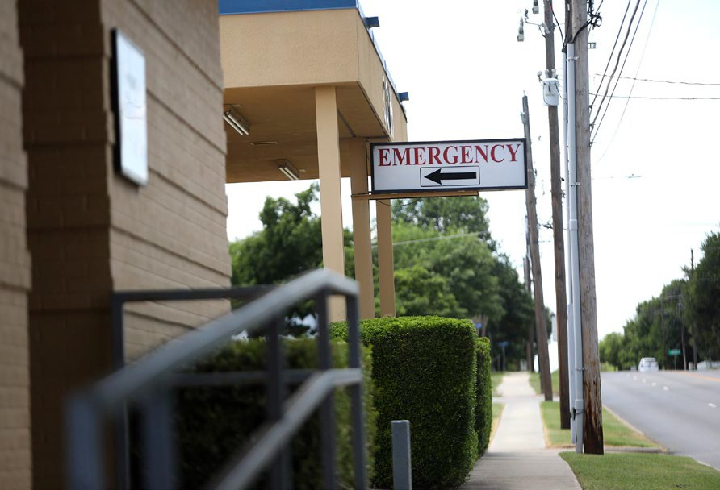
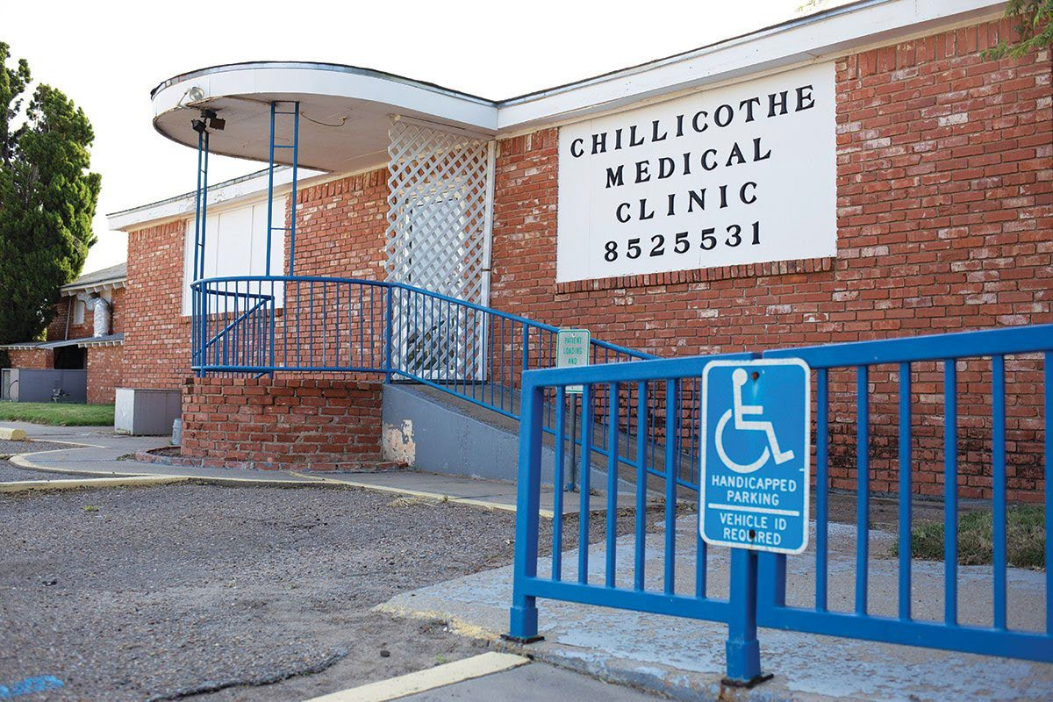
Teams….
Battle Mountain
Dignity
NNAMHS
Pershing
Rural Clinics
Saint Mary’s
South Lyon Medical
Southern Nevada Public Health
Tahoe-Forest
UMC
Humboldt General
13

Slide 15
Where we are Going…
Appling for grant and | Preparing for Second | Statewide trainings | Supports from Joint | Supports “Crisis Now | Working on Zero | Watch our statistics go
searching for funding | Zero Suicide Learning | and support for | Commission, Action | Model” | Suicide legislation: | down
Series Sessions / CASAT
implementing Zero Suicide into health and behavioral health systems
Alliance for Suicide Prevention, Suicide Prevention Resource Center, EDC
Nevada’s OSP Strategic Plan 2021-
2025
VA has adopted new BDR
14

Slide 16
Questions….
This Photo by Unknown Author is licensed under CC BY
15

Slide 17
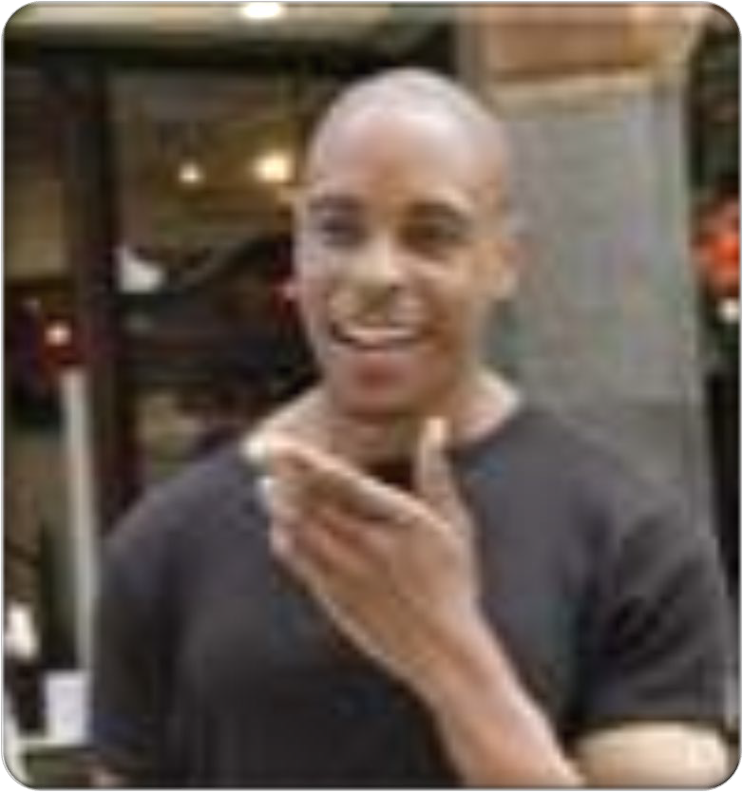
Pieces of the Puzzle
All need to be educated
Willing to talk more openly about suicide
Common Language for identifying
Understand your role In prevention
16

Slide 18
National 2019 Numbers
Lost: 47,511 lives | 130.2 lives per day
Males: 37,256 | 102.1 per day
Females: 10,255 | 28.1 Per day
Lost: 23,941 firearms | 50.4%
Lost: 6,125 Poisoning | 12.9%
Lost: 506 drowning | 0.2%
Lost: 13,563 suffocation/hanging | 28.5%
Lost: 921 to cutting/Piercing | 1.9%
10th leading cause of death overall
2nd leading cause of death for 15 – 24-year old’s
WISQARS 2020/AAS2020 https://www.suicidology.org

Slide 19
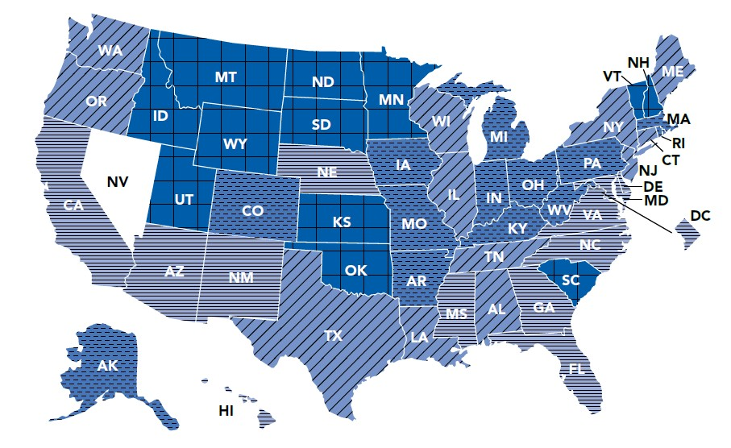
State 2019 Numbers
7th in the nation
Lost: 657 Lives
Lost: 367 Firearms
Lost: 144 | 65+ older | 1st in the nation
1st leading cause of death for 11-19 years of age
2nd leading cause of death for 20-49 years of age
WISQARS 2020
18

Slide 20
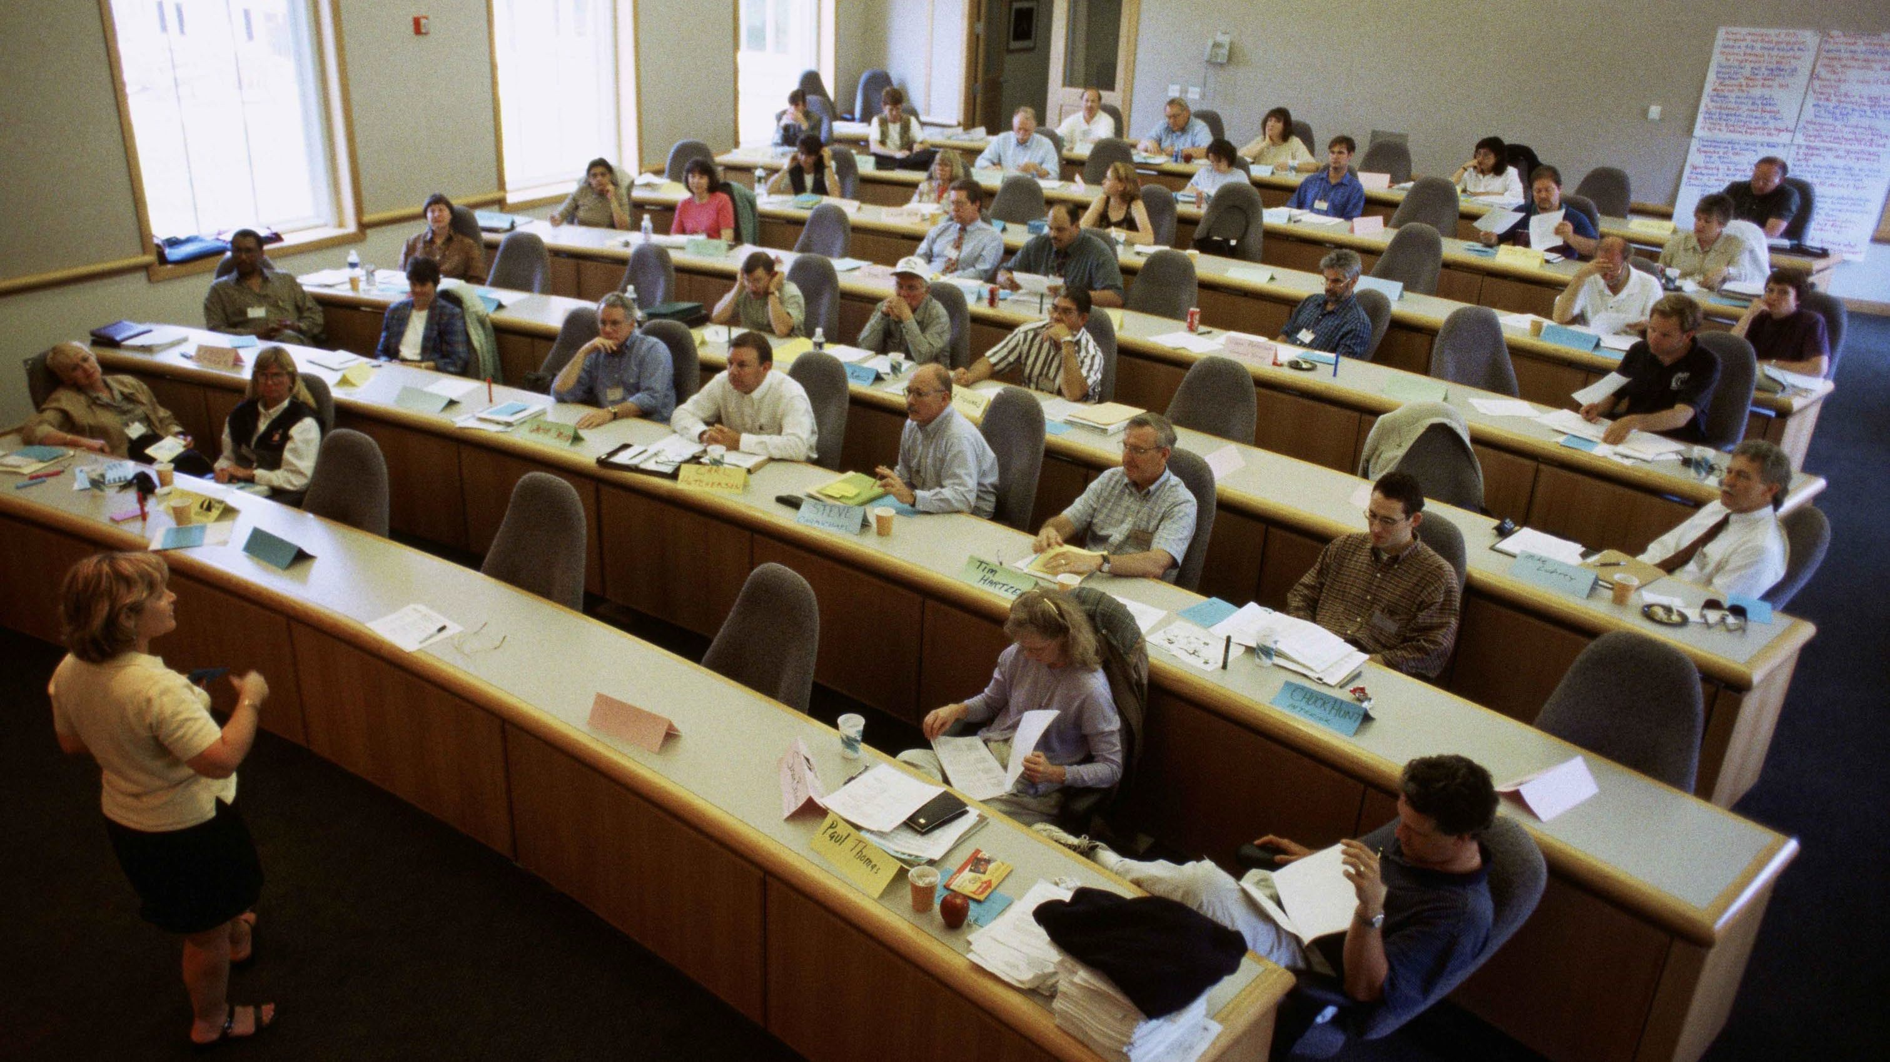
Scope of Suicide Among College Students
Estimated to be 2nd leading cause of death
1100 suicides per year, 75% male
1.5%report suicide attempt in past year
10% report suicidal ideation in past year
50% of college students report suicidal ideation at some point in life
<20% of college students who die by suicide received campus-based services
Suicide rates higher among seniors and grad students

Slide 21
Suicide in our HIV population??
Lack of research; thus data
Treatments Working
General Population rates
What are you seeing daily?
Help us understand?
20

Slide 22
Gender, and culture disparities
Dis

Slide 23
Gender Disparities
Suicide among males is 4x’s higher than among females.
Male deaths represent 79% of all US suicides.
Firearms are the most used method of suicide among males. Females are more likely than males to have suicidal thoughts. Females experience depression at roughly 2x’s the rate of men. Females attempt suicide 3x’s as often as males.
Poisoning is the most common method of suicide for females.
Suicide rates among the elderly are highest for those who are divorced or widowed.
(CDC, SMH)
22

Slide 24
Sexual Orientation and Gender Identity (SOGI)
Lesbian, gay, and bisexual kids are 3x more likely than straight kids to attempt suicide at some point in their lives.
Medically serious attempts at suicide are 4x more likely among LGBTQ youth than other young people.
African American, Latino, Native American, and Asian American people who are lesbian, gay, or bisexual attempt suicide at especially high rates.
41% of trans adults said they had attempted suicide, in one study. The same study found that 61% of trans people who were victims of physical assault had attempted suicide.
Lesbian, gay, and bisexual young people who come from families that reject or do not accept them are over 8x more likely to attempt suicide than those whose families accept them.
Each time an LGBTQ person is a victim of physical or verbal harassment or abuse, they become 2.5x more likely to hurt themselves.
23

Slide 25
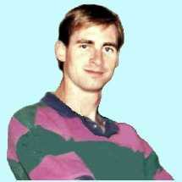
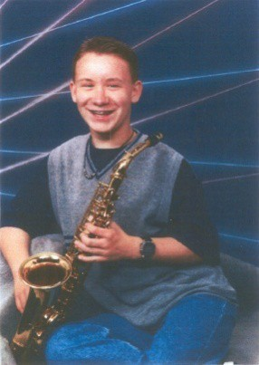
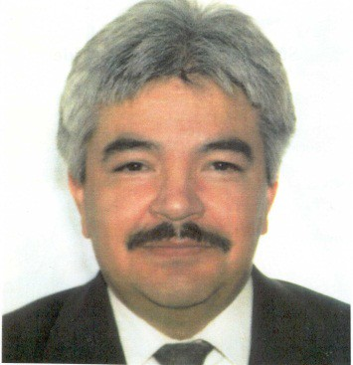
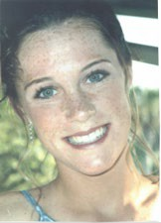
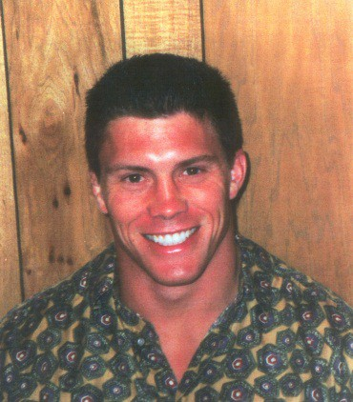
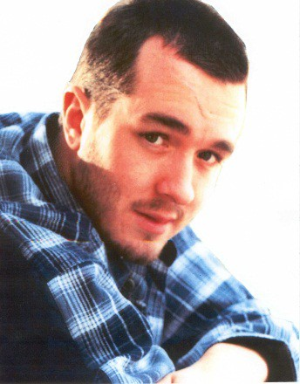
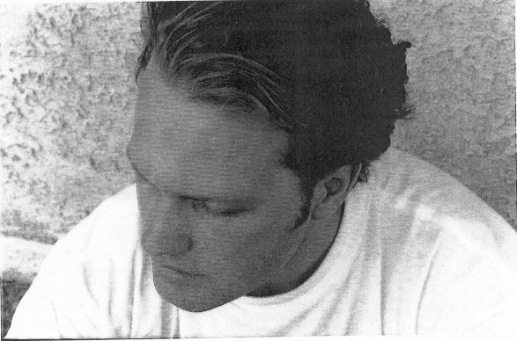
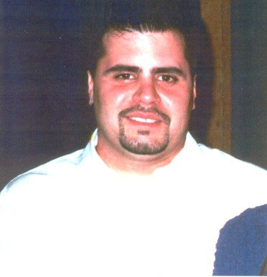
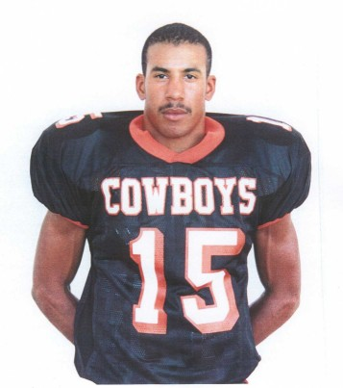
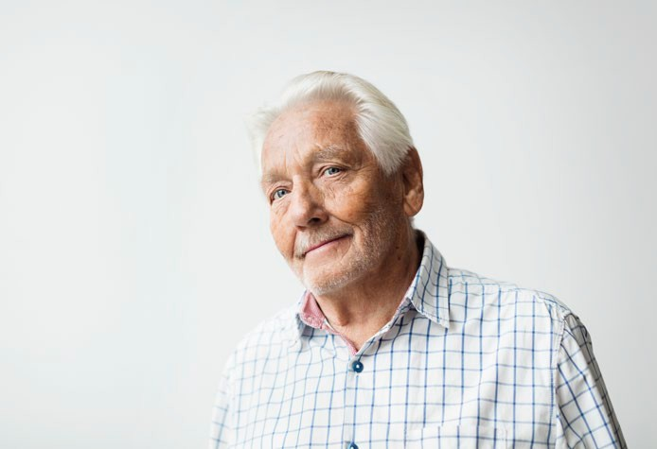
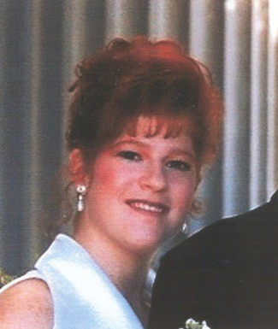
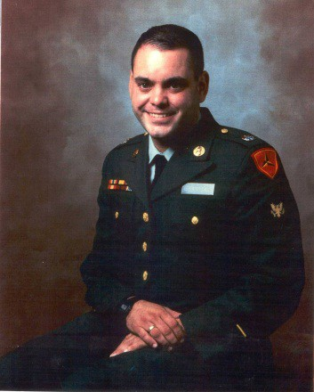
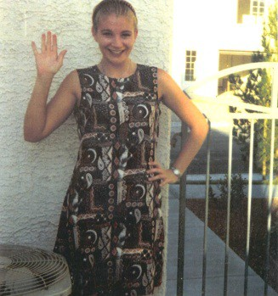
Not Just Statistics…..
24

Slide 26
Suicide Touches Everyone
135 People Effected for Every Death and Effects Linger Across Generations Because of the Silence that Often Follows
25

Slide 27
Facts You Need to Know About Suicide
There is strong evidence that sexual orientation and Gender identity impact Youth of increased risk for suicide.
Any concerned, caring friend can be a “gatekeeper” and may very well make the difference between life and death.
Not every death is preventable.
Used with permission from the Maine Resource Book for Gatekeepers
26

Slide 28
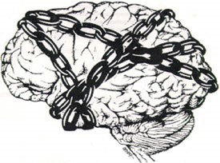
It’s biggest cause: a heritable, treatable medical illness called depression
It’s Biggest Cause: a Heritable, Treatable Medical Illness Called Depression
Depression is a treatable medical illness caused by changes in brain chemistry
27

Slide 29
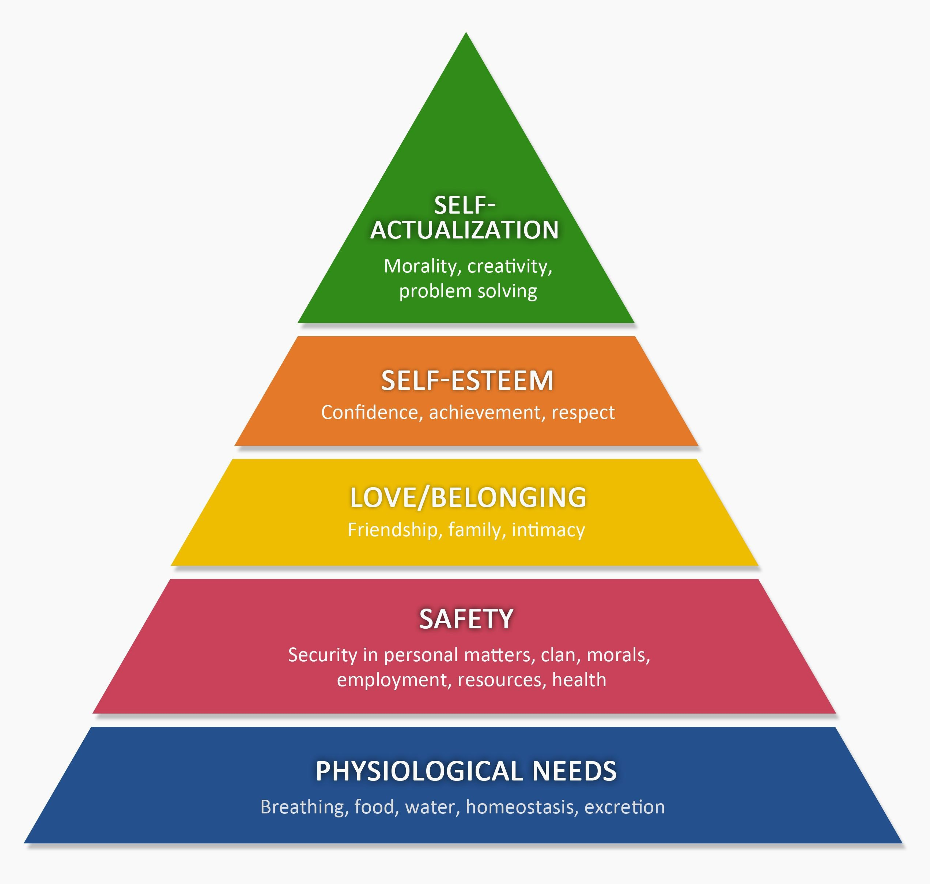
Pyramid
28

Slide 30
Changing OUR Talk
29

Slide 31
Prevention/Intervention Steps
KNOW WHAT TO LOOK FOR
KNOW WHAT TO DO
KNOW HOW TO HELP
30

Slide 32
What to Look For

Slide 33
RECOGNIZING RISK FACTORS
Risk factors are identified as stressful life events, situations, and/or conditions that may increase the likelihood that one will attempt or complete suicide
Source: US Public Health Services, The Surgeon General’s Call to Action to Prevent Suicide, Department of Health and Human Services, 1999
32

Slide 34
Risk Factors for Suicide
33

Slide 35
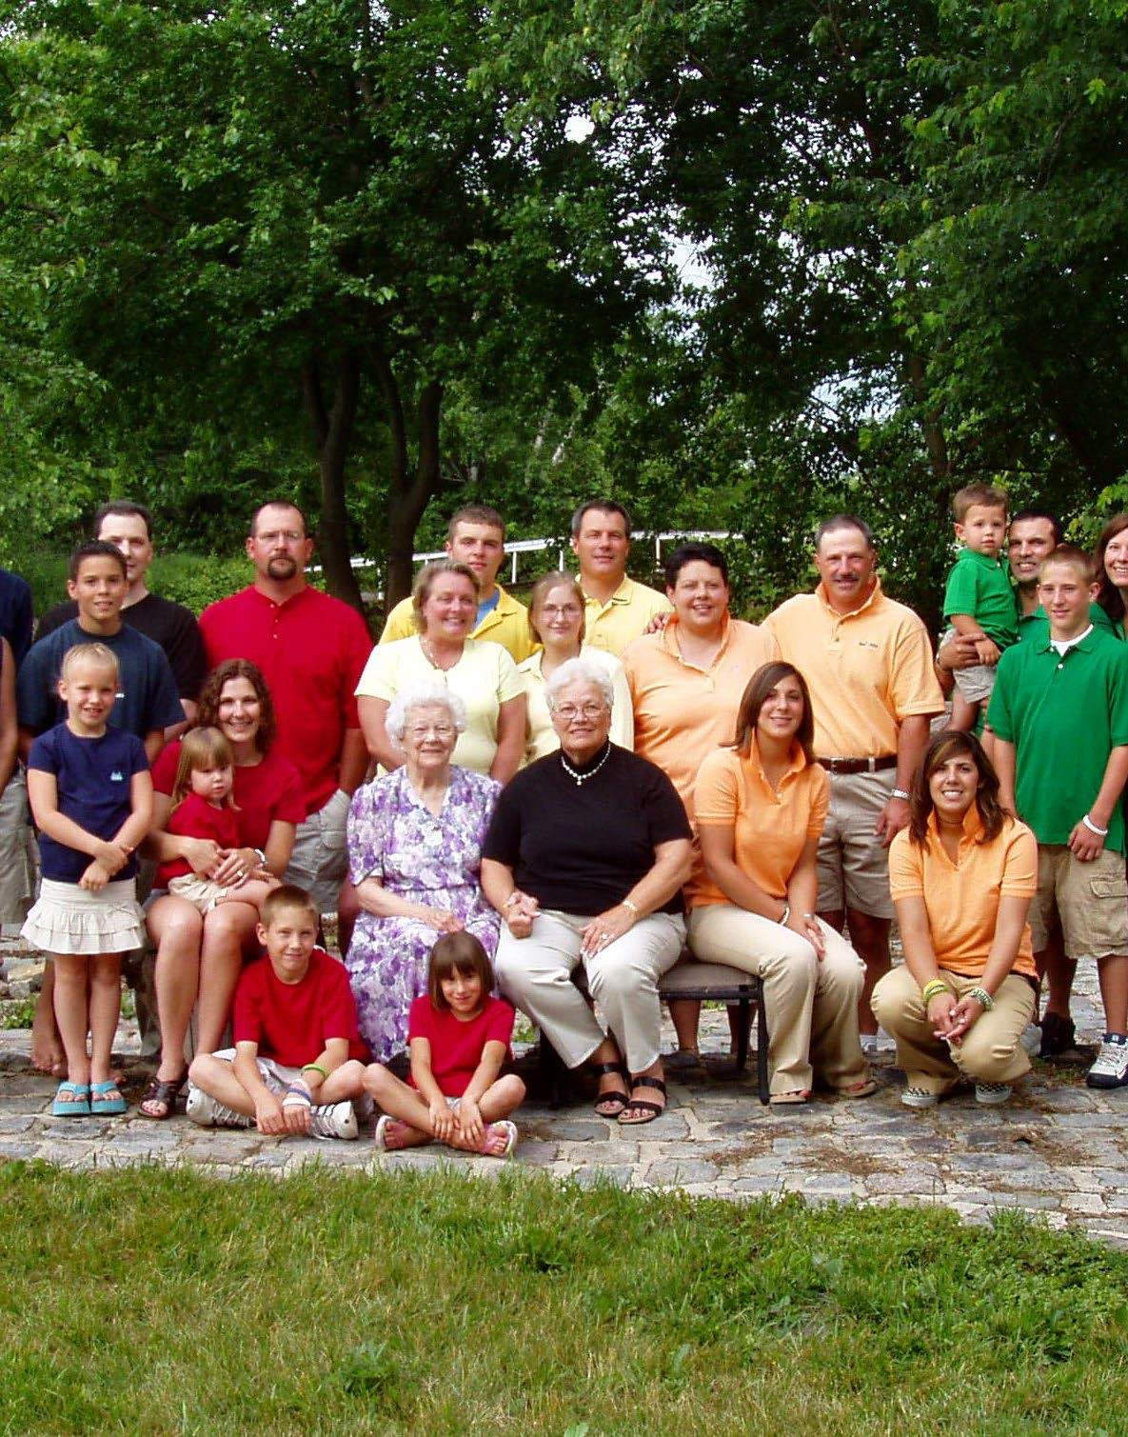
Key Risk Factors By Age
OLDER ADULTS: DEATH OF A LOVED ONE, PHYSICAL ILLNESS, UNCONTROLLABLE PAIN, FEAR OF BURDENING FAMILY MEMBERS, SOCIAL ISOLATION, MAJOR CHANGES IN SOCIAL ROLES
MIDDLE AGE: RELATIONSHIP PROBLEMS, LEGAL PROBLEMS, FINANCIAL HARDSHIP, SUBSTANCE ABUSE AND JOB STRESS
YOUTH: CONTAGION, SUBSTANCE ABUSE, IMPULSIVE AGGRESSIVE PERSONALITY DISORDERS, STRESSFUL LIFE EVENTS, FAMILY FACTORS
34

Slide 36
Invitations / Warning SIGNS
35

Slide 37
RECOGNIZING Invitations / WARNING SIGNS
Invitations / Warning signs are changes in a person’s behavior, feelings, and beliefs about oneself for a period of two weeks or longer that are considered to be maladaptive or out-of-character for the individual
Source: American Association of Suicidology 2006 Get the facts and take action.
36

Slide 38
Identifying Verbal Clues
Direct:
“I wish I were dead!” “I’m going to end it all.” “I’m going to kill myself.”
Indirect:
“Who cares if I’m dead anyway?”
“I won’t be around much longer.”
“I don’t want to be a burden.”
37

Slide 39
Invitations / Warning Signs for Elderly Patients
Stockpiling medications
Buying a gun
Giving away possessions
Taking sudden interest in religion Failing to care for themselves Withdrawing
Failure to thrive, even after appropriate medical treatment Scheduling medical appointment for vague symptoms
Source: Suicide Prevention Resource Center website www.sprc.org
38

Slide 40
Invitations / Warning Signs for Adolescents
Volatile mood swings
Evidence of unhealthy relationship
Sudden deterioration in personal appearance
Self-harm
Fixation with death or violence
Eating disorders
Gender identity issues
Depression
Bullying
Source: Suicide Prevention Resource Center website
www.sprc.org
39

Slide 41
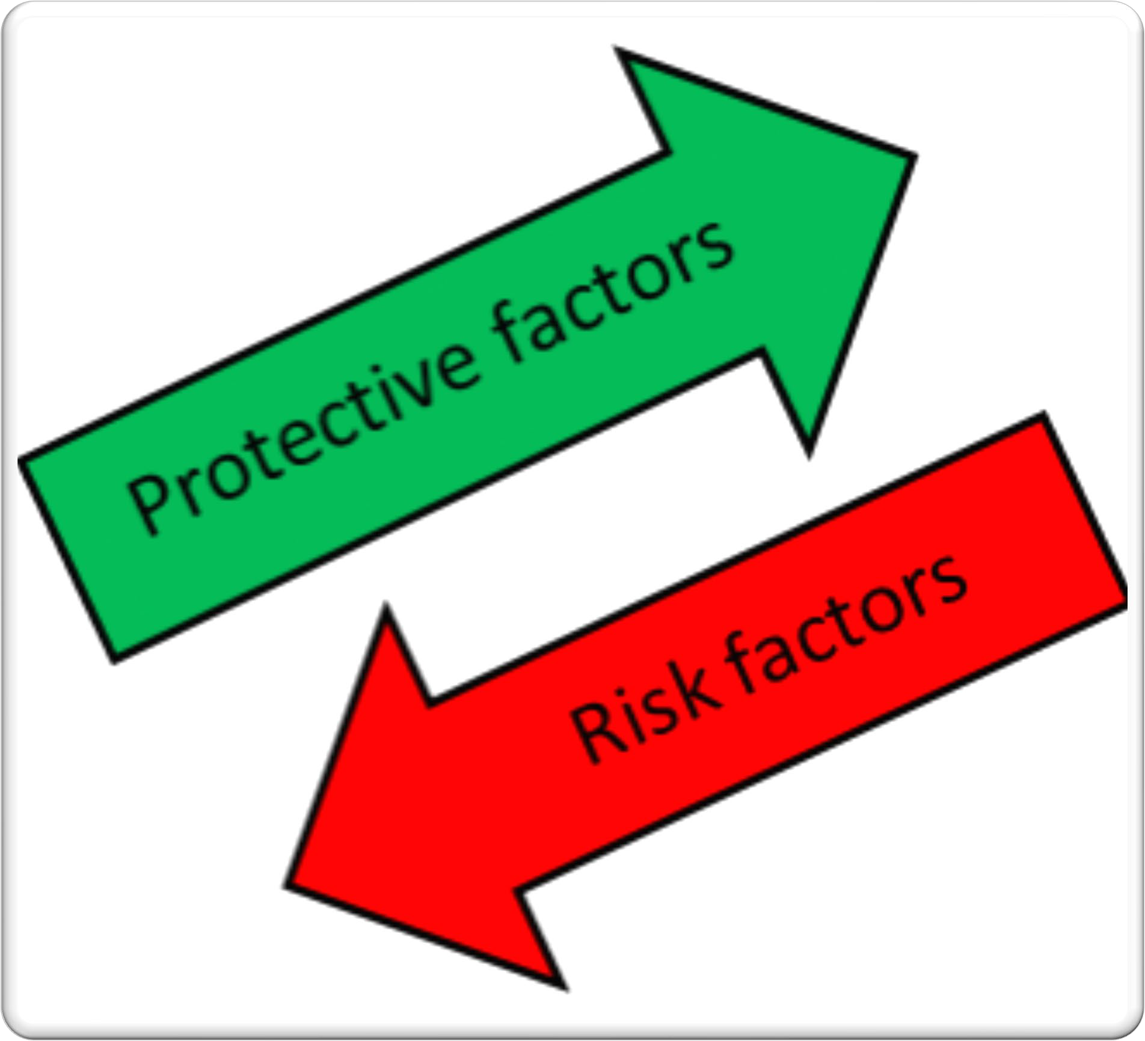
Protective Factors
Coping Strategies
Support: available & accessible
Positive school experiences/Part of a close school community
Safe environment at school (especially for lesbian, gay, bisexual, and transgender
youth)
A respect for all cultures
Restricted access to firearms: guns locked or unloaded,
ammunition stored or locked
Receiving effective mental
health care
40

Slide 42
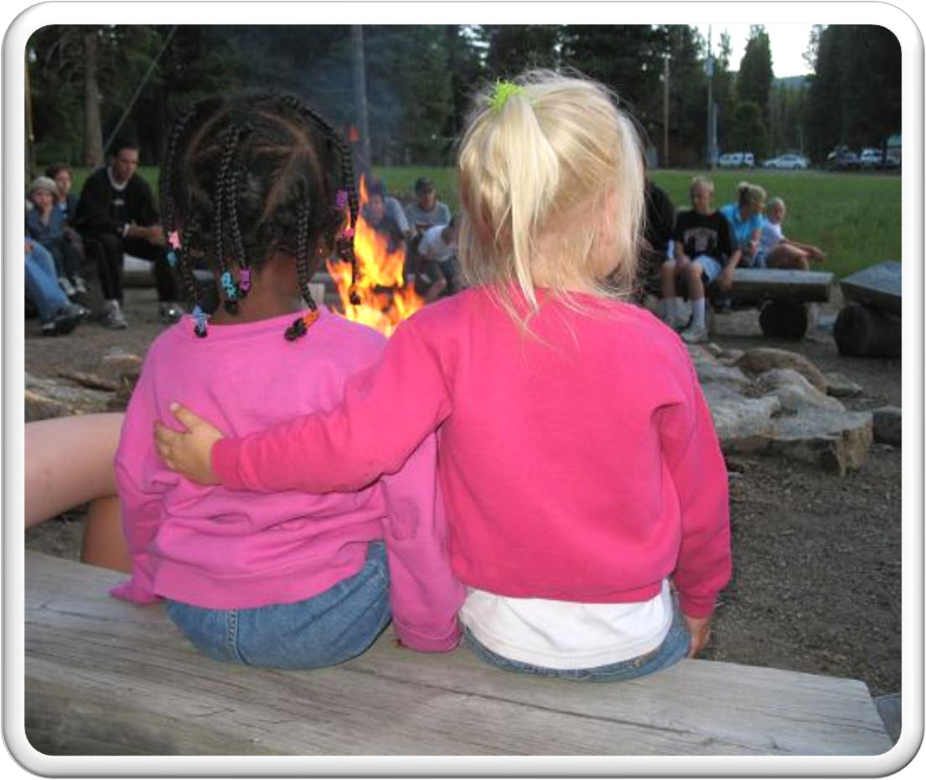
Protective Factors
Self-Esteem
Sense of connectedness to family/ school / community
Personal Control
Sense of purpose / meaning to life
Resilience: ongoing or continuing sense of hope in the face of adversity
41

Slide 43
What To Do
SHOW YOU CARE
ASK ABOUT SUICIDE
3. GET HELP
Adapted with permission from the
Washington Youth Suicide Prevention Program http://www.yspp.org
42

Slide 44
First Preventative Step

Slide 45
What To Do

Slide 46
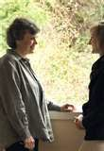
SECOND
Prevention Step….
ASK ABOUT SUICIDE!
Be direct
But Non-Confrontational
45

Slide 47
What to do…
Ask The Question
Share your concern with what you have recognized
Don't be afraid to ask whether the person is considering suicide
Do not try to argue someone out of suicide.
Avoid pleading and preaching
46

Slide 48
What To Do
Adapted with permission from the Washington Youth Suicide Prevention Program http://www.yspp.org
47

Slide 49
Community resources
48

Slide 50
911

Slide 51
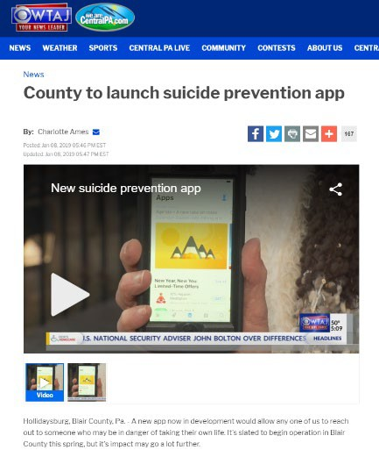
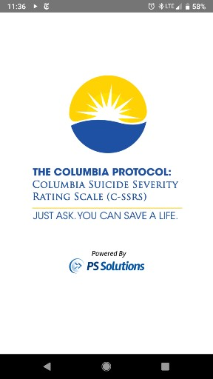
Finding People Where They Live with the C-SSRS Mobile App:
With Individualized Community Crisis Information
Now available on the app store!
(Search “Columbia protocol”)
50

Slide 52
University of Nevada, Reno Counseling Services
Make an appointment
Scheduling an initial consultation
In order to best serve our students, Counseling Services operates on a same-day scheduling basis. Please contact our office at (775) 784- 4648 to schedule a same-day initial consultation.
Urgent Care appointments
If students have urgent psychological concerns, they have an opportunity to meet with a clinician during our Urgent Care hours. The hours for this service vary.
Please contact Counseling Services at (775) 784-4648 for information. Due to the nature of this service, students may experience a wait time to see a counselor.

Slide 53
Nevada healthcare warmline
Feeling anxious, stressed, or overwhelmed by COVID-19??
Work in health care in Nevada?
Want someone to talk to, help with stress, or find a community resource?
NEVADA HEALTHCARE WARMLINE
Call the Nevada HealthCARES Warmline!
FREE, confidential support line for Nevada’s healthcare workers
Calls are anonymous
Monday-Friday from 8:00 am to 8:00 pm We’re here to listen at 1-833-434-0385
A collaboration between:
Nevada Department of Health and Human Services and the UNLV School of Medicine Contact Sara Hunt at
sara.hunt@unlv.edu
52

Slide 54
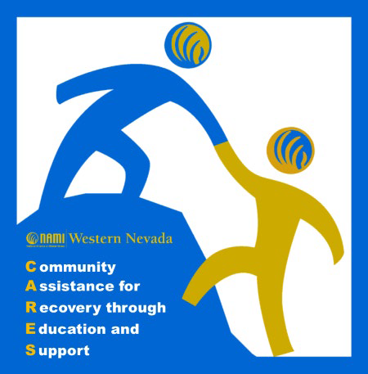
NAMI Western Nevada WARMLine
The Warmline is a stigma-free, non-crisis, phone service you can call or text at 775-241-4212 to speak one-on-one with a NAMI WNV CARES operator. The Warmline is staffed by trained peers in recovery, who provide support to peers by telephone.
NAMI WNV is working with NOSP on a referral CARING CONTACTS Program
53

Slide 55
Mobile Crisis Units Rural (702) 486-7865
Reno (775) 688-1670
RURAL CLINICS IMMEDIATE MENTAL HEALTH CARE TEAM 1 (877) 283-2437
54

Slide 56
State Resources for Seniors
NV CAN 211: https://www.nevada211.org/
Care Connections: https://nevadaadrc.com/
HELLO Project: https://hellostartsnow.org/
Nevada Senior Resources: https://www.seniorresource.com/nevada.htm
Senior Bridges: https://www.nnmc.com/services/senior-bridges- behavioral-health
Washoe County Senior services: https://www.washoecounty.us/seniorsrv/
Nevada Senior Guide: https://www.washoecounty.us/seniorsrv/
New to Reno: https://www.washoecounty.us/seniorsrv
▪
mhealth TOOLS: TSWF_T2_v4 (defeet.org)
55

Slide 57
Suicide Prevention
Resources
American Foundation for Suicide Prevention (AFSP)
www.afsp.org
American Association of Suicidology (AAS)
www.suicidology.org
Suicide Prevention Resource Center (SPRC)
www.sprc.org
Suicide Prevention Action Network (SPAN USA)
www.spanusa.org
Nevada State Suicide Prevention web site
www.suicideprevention.nv.gov
Surviving Suicide (survivor support) web site
www.survivingsuicide.com
Nevada Coalition for Suicide Prevention
www.nvsuicideprevention.org
Nevada Intervention Connection
https://ncsp.academy.reliaslearning.com/suicide-prevention-training-
ncsp.aspx
ZERO Suicide Website
Homepage | Zero Suicide (edc.org)
56

Slide 58
Office of Suicide Prevention Training Opportunities
Suicide Prevention Training: Introduction (15 – 30 minutes)
Suicide Prevention 101 (1 - 1 ¼ hours)
Gatekeeper (2 hours)
ASIST: (Applied Suicide Intervention Skills Training) two day workshop
SafeTALK: (Suicide Alertness) 2 - 4 hours
Youth Mental Health First Aid (8 hours)
Other Options – provided through the OSP
CAMS Online (various)
TMCC and CASAT online trainings (various)
Zero Suicide Website
CALM – Counseling on Access to Lethal Means
This Photo by Unknown Author is licensed under CC BY-SA-NC
57

Slide 59
Remember in Summary
Suicide thinking is irrational
Tunnel vision
Almost all are ambivalent
Suicidal behavior is an act of communication
There is no typical suicide victim
There are no absolute reasons for suicide
There are no all-inclusive predictive lists of warning signs or a definitive method for determining if someone is or is not suicidal
Suicide is always multi-dimensional
Most people don’t want to die – they want to end their pain
58

Slide 60
POSTVENTION -
The provision of crisis intervention, support and assistance for two groups of people. For those who have lost a loved one to suicide
and those who have experienced their own suicide attempt.
Support the survivor bereavement experience
Support the healing/recovery process after an attempt
Encourage safe and effective public messaging and media reporting of suicide
Prevent further suicides / become educated and trained
POSTVENTION IS PREVENTION!
59

Slide 61
Suicide loss survivor
Anyone whose life has been impacted by a suicide death
Family, friends, co-workers, classmates, therapists, physicians, nurses etc.. who are left behind to pick up the pieces after the shattering experience of a suicide death
Suicide Loss
Survivor
A suicide survivor not only suffers the grief and trauma of losing a loved one to suicide, but are also themselves at higher risk for suicide and emotional problems
60

Slide 62
Suicide Grief
61

Slide 63
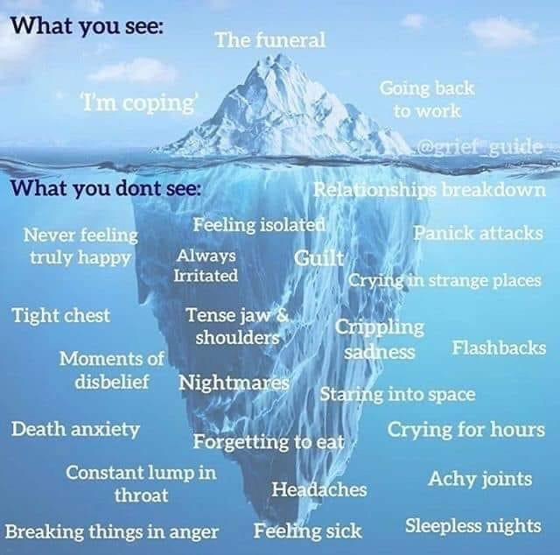
What you see, what you don’t see
62

Slide 64
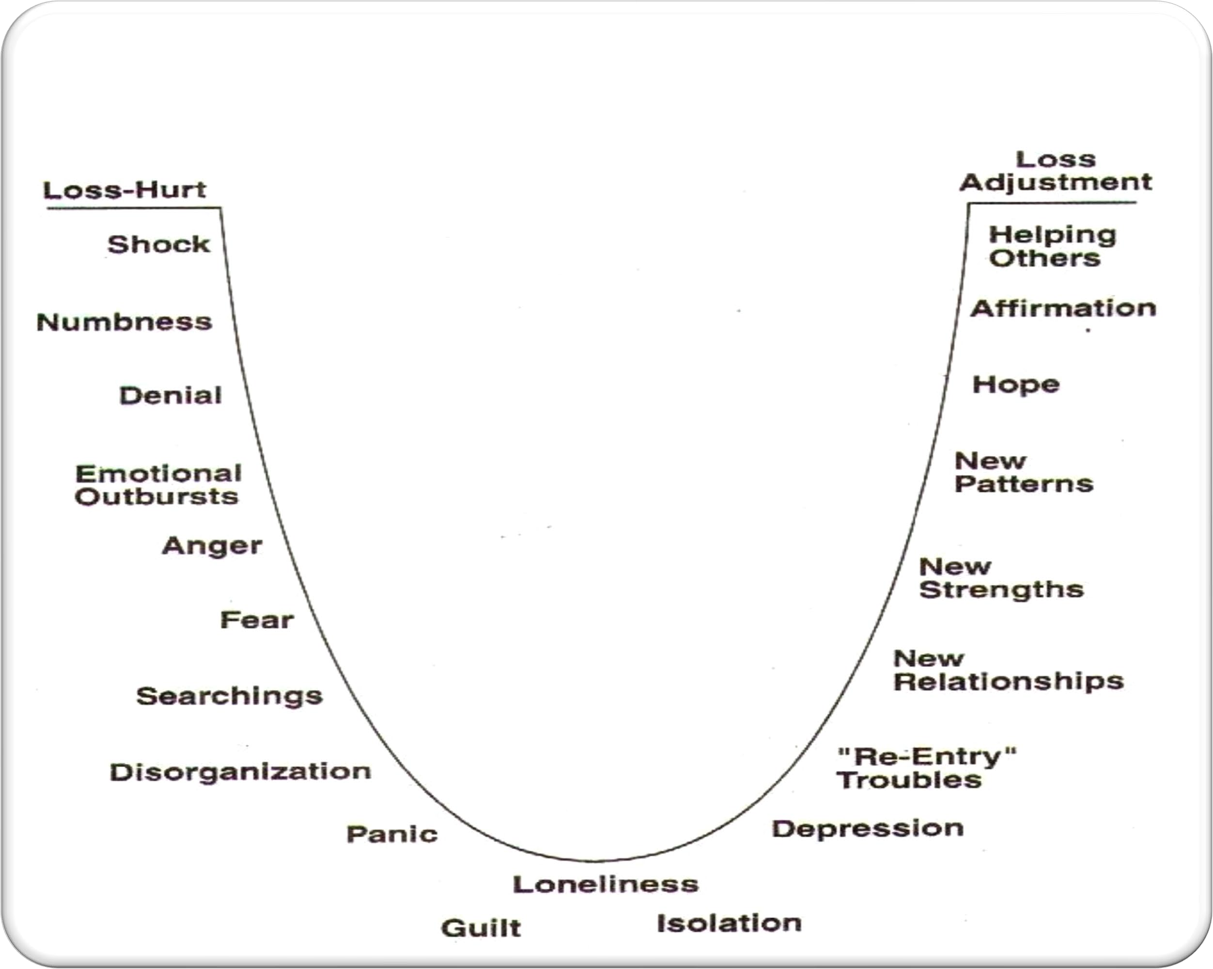
STAGES OF GRIEF
63

Slide 65
SUICIDE LOSS
64

Slide 66
Some Common Loss Survivor Responses
Struggle to make sense of it
Unanswered questions
ANGER
Guilt over failed responsibilities
Isolation caused by self- imposed shame
Blame
Shock, disbelief, fear, awkwardness
Stigma
Difficulty accepting the death was by suicide
Feelings of rejection and abandonment
Often “hyper vigilant”- afraid of another loss or death
PTSD
Suicide isn’t something we feel we can talk about
Judgement
65

Slide 67
Secondary losses
66

Slide 68
Helping loss survivors
Listen without judging
Accept the intensity of the individual’s grief
Communicate with compassion – not cliché
Provide information on suicide and grief
Be there
Have patience
Let them know they’re not alone
Offer assistance, and expect that your help may be refused
Be sensitive to difficult times
Listen as often as needed
Helping
Loss Survivors
67

Slide 69
Attempt Survivor
Anyone whose life has been impacted by a crisis followed by an attempt to end their life by suicide.
“I am tired of hiding, tired of misspent and knotted energies, tired of the hypocrisy, and tired of acting as though I have something to hide.”
– Kay Redfield Jamison An Unquiet Mind, 1995
68

Slide 70
Attempt Data
In 2018, 10.7 million people in the U.S. seriously considered suicide
3.3 million made a suicide plan
1.4 million made a suicide attempt
Data from the National Survey on Drug Use and Health (2018)
In 2018 17.2% of
students surveyed seriously considered suicide
13.6 % made a suicide plan
7.4% made a suicide attempt
Youth Risk Behavior Surveillance System (2017)
69

Slide 71
How to help attempt survivors
All activities designed to help attempt survivors, or anyone who has been suicidal, should be consistent with one or more of the following Core Values:
Foster hope and help people find meaning and purpose in life
Preserve dignity and counter stigma, shame, and discrimination
Connect people to peer supports
Promote community connectedness
Engage and support family and friends
Respect and support cultural, ethnic, and/or spiritual beliefs and traditions
Promote choice and collaboration in care
Provide timely access to care and support
Check-in on those you love
70

Slide 72
Graphic
71

Slide 73
Survivor of suicide loss support groups
Reno
Crisis Support Services
of Nevada
Phone: (775) 784-8085
Las Vegas Arms of Support (800) 649-0925
Canyon Ridge Christian Church
Phone: (702) 656-7141
Douglas County/South Lake Tahoe
Suicide Prevention Network
Phone: (775) 783-1510
Survivor of
Military & Veteran Survivors of
Loved Ones to Suicide Phone: (702) 738-9247
Suicide Loss Support Groups
Elko
Survivors of Suicide Loss of
Northeastern Nevada Phone: (775) 397-1911
Henderson
Surviving Suicide Loss Phone: (702) 501-5984.
Barbara Greenspun Women's Care Phone: (702) 501-5984
Winnemucca Survivors of Suicide Phone: (775) 623-9003
72

Slide 74
Conclusion
Preventing suicide is like the many fragments of a puzzle
We need to work together – until the pieces of the puzzle come together
“We cannot change the past, but together we can shape a different future.”
Dr. David Satcher, Former US Surgeon General
73

Slide 75
Questions?
This Photo by Unknown Author is licensed under CC BY-ND
74

Slide 76
Nevada’s office of suicide prevention
Nevada’s Office of Suicide Prevention
Suicide Prevention Coordinator
Misty Vaughan Allen, MA 4600 Kietzke Lane, B-114
Reno, NV 89502
Phone: (775)684-2236, Email: mvallen@health.nv.gov
Zero Suicide, Project Coordinator (OSP/CASAT)
Cherylyn Wood
4600 Kietzke Lane, B-114
Reno, NV 89502
Phone: (775)684-2242,
Email: ccwood@health.nv.gov
Suicide Prevention Training and Outreach Facilitator
Janett Massolo
4600 Kietzke Lane, B-114
Reno, NV 89502
Phone: (775)684-2238, Email: jmassolo@health.nv.gov
Suicide Prevention Training and Outreach Facilitator
Richard Egan
3811 W. Charleston Ave. # 210 Las Vegas, NV 89102
Phone: (702)486-8225,
Email: Regan@health.nv.gov
Suicide Prevention Office Manager
Angela Friedman
4600 Kietzke Lane, B-114
Reno, NV 89502
Phone: (775)684-2237,
Email: angelafriedman@health.nv.gov
75

Slide 77
References:
Zero Suicide https://zerosuicide.sprc.org/
Henry Ford Institute https://www.henryford.com/services/behavioral- health/zero-suicide
Google Images
Texas Zero Sucide
Arizona https://magellanhealthinsights.com/category/suicide- prevention/
ZEST – https://sites.utexas.edu/zest/
NYC Zero Suicide – https://www.omh.ny.gov/omhweb/dqm/bqi/suicideasaneverevent.pdf
76

