Slide 1
HIV Rapid Antiretroviral Therapy (ART)/ Preexposure Prophylaxis (PrEP)
Lori Fantry, MD, MPH
Professor of Clinical Medicine
University of Arizona

Slide 2
Disclaimer
“This presentation is supported by the Health Resources and Services Administration (HRSA) of the U.S. Department of Health and Human Services (HHS) as part of an award totaling $3,278,366. The contents are those of the author(s) and do not necessarily represent the official views of, nor an endorsement, by HRSA, HHS or the U.S. Government.”
The views and opinions expressed in this presentation are not necessarily those of the Pacific AIDS Education and Training Centers (PAETC), the Regents of the University of California or its San Francisco campus (UCSF or collectively, University) nor of our funder the Health Resources and Services Administration (HRSA). Neither PAETC, University, HRSA nor any of their officers, board members, agents, employees, students or volunteers make any warranty, express or implied, including the warranties of merchantability and fitness for a particular purpose; nor assume any legal liability or responsibility for the accuracy, completeness or usefulness of information [,apparatus, product] or process assessed or described; nor represent that its use would not infringe privately owned rights.

Slide 3
Learning Objectives
By the end of this presentation, you will be able to:
Discuss how rapid initiation of HIV treatment results in improved patient outcomes and reduced HIV transmission
Discuss current recommendations for monitoring patients on PrEP to ensure efficacy, safety, and prevention of HIV and other sexually transmitted infections (STIs)
Compare and contrast FDA approved regimens for PrEP to improve clinical outcomes

Slide 4
Ending the HIV Epidemic Starts with Testing
Link to the CDC's HIV testing information

Slide 5
Plan A: Treat All Treat Fast
Reduce the time in which a person with HIV
can get an HIV associated condition
Reduce the time of infectivity

Slide 6
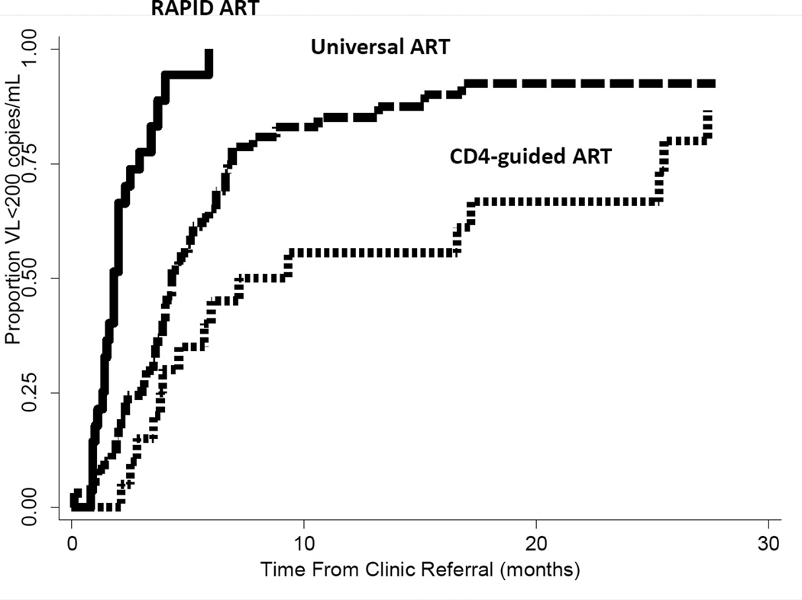
Proportion of Viral Load <200 copies/mL over time from clinical referral in Months
Christopher D. Pilcher et al. The Effect of Same-Day Observed Initiation of Antiretroviral Therapy on HIV Viral Load
and Treatment Outcomes in a U.S. Public Health Setting. J Acquir Immune Defic Syndr. 2017 Jan 1; 74(1): 44–51.

Slide 7
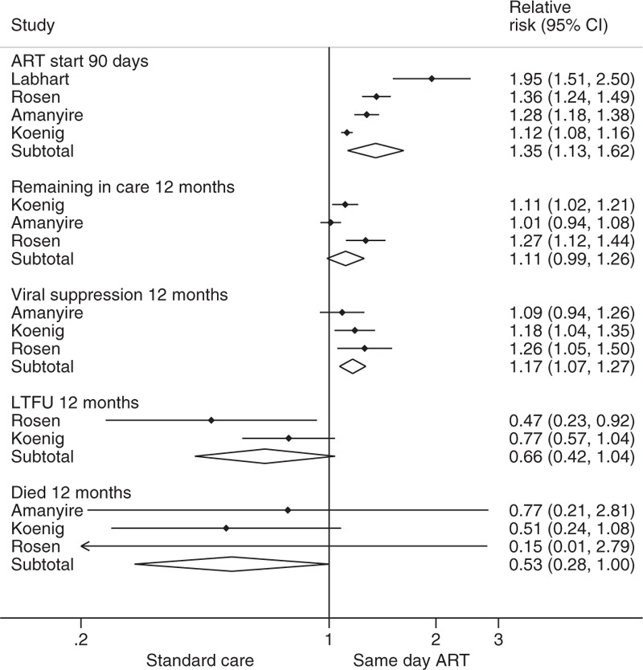
Relative Risk (95% CI) for Standard Care versus Same Day ART

Slide 8
Remaining in Care
No evidence that Rapid ART start resulted in > likelihood of remaining in care (two cohorts: RR 0.97, 95% CI 0.79–1.18; low-quality evidence).
Study reported ↑ risk of lost to follow-up at 3 months (RR 1.97, 95% CI 1.21–3.20)
Ford N, Migone C, Calmy A, et al. Benefits and risks of rapid initiation of antiretroviral therapy. AIDS. 2018;32(1):17-23. doi:10.1097/QAD.0000000000001671

Slide 9
What would make you delay ART?
Cryptococcal meningitis
Kaposi’s sarcoma
Undetectable viral load
CD4 cell count 700
Pneumocystis jiroveci pneumonia

Slide 10
Only 51% of persons living with HIV are virally suppressed
Plan B: PrEP

Slide 11
What is PrEP?
PrEP = preexposure prophylaxis
Antiretroviral therapy (ART) given to an individual without HIV
99% efficacy when taken as prescribed

Slide 12
Tenofovir disoproxil fumarate (TDF)/emtricitabine (FTC) (Truvada®)
FDA approved 7/16/12
Indicated for all with high risk of HIV infection

Slide 13
Tenofovir alafenamide (TAF)/FTC (Descovy®)
FDA approved 10/3/19
Indicated for
Men
Transgender women
Not for cisgender women
https://www.wellrx.com/descovy/drug-images/

Slide 14
Possible PrEP Candidates People at ongoing, substantial risk of acquiring HIV infection
Adult or adolescents ≥ 35 kg (77 pounds)
Partner’s HIV status unknown
Men who have sex with men (MSM)
Persons who inject drugs (PWID) who share equipment
Persons with STIs
Person’s partner has HIV risk factors
Female partners of MSM
Partners of PWID
Candidates for PrEP are people at ongoing, substantial risk of acquiring HIV infection.
Link to CDC's HIV PrEP Guidelines for 2017
Notes:
Candidates for PrEP are people at ongoing, substantial risk of acquiring HIV infection. The next few slides will show several groups to consider as candidates for PrEP.

Slide 15
People with STIs within 6 months
MSM
Gonorrhea
Chlamydia
Syphilis
Heterosexuals
Gonorrhea
Syphilis

Slide 16
Partner living with HIV
Partner not taking ART
OR
HIV-infected partner VL >200 copies/ml
If not recommending PrEP, must have recent viral load documenting VL <200 copies/ml

Slide 17
Pregnancy
PrEP not contraindicated
Risk benefit changes
Risk to fetus if woman taking PrEP
https://unsplash.com/s/photos/pregnant-woman

Slide 18
Case Study: Michele
Michele is a 23-year-old women who presents to Planned Parenthood for an HIV test. She has no complaints. She had chlamydia 4 months prior to the visit.
PMH: 2014 Gonorrhea
SH:
Sexually active with 6 men in the past year. HIV, IDU, and sex with men status unknown
Uses condoms 40% of the time
Smokes ½ ppd
Drinks alcohol occasionally
No illicit drugs.

Slide 19
What would you recommend for Michele?
HIV screening
STI screening
Birth control
Daily TDF/FTC
All of the above

Slide 20
You decided to start Michele on PrEP. What tests will you order next?
HIV test
Liver Function tests
Creatine clearance
All the above
A and C

Slide 21
Testing prior to PrEP:
HIV testing
Hepatitis B antigen
Hepatitis B surface antibody
Hepatitis B core antibody
Hepatitis C serology
Estimated creatinine (eCrCl)
Syphilis (RPR)
Gonorrhea/chlamydia
MSM any site of contact (urine, oral, rectal)
Gonorrhea
Heterosexual men urine
Women vaginal preferred over urine
Pregnancy Testing

Slide 22
HIV Testing
Within 7 days of starting
Repeat if longer
Repeat if suspect acute HIV
May do viral load but false + with viral loads < 3000 copies/mL

Slide 23
Acute HIV definition of acute
Fever (75%)
Fatigue
Myalgia
Skin rash
Headache
Pharyngitis
Cervical adenopathy
Arthralgia
Night sweats
Diarrhea (27%)
Clinical presentation and diagnosis of primary HIV-1 infection by Daar ES, Pilcher, CD and Hecht FM (2008)
Notes:
These are the most common symptoms of acute HIV, with fever being the most common (75%), and diarrhea the least common on the list (27%).

Slide 24
Hepatitis B Testing
TDF/FTC and TAF/FTC also used to treat hepatitis B virus (HBV)
Follow up with hepatitis B experienced provider
If HBV patient started on TDF/FTC or TDF/FTC and discontinues
May → “flare” of hepatitis
Notes:
When an uninfected person takes Truvada before an exposure, the drugs accumulate in cells that are susceptible to infection – so any virus that does enter the body never has a chance to make any copies; replication is blocked from the very start.

Slide 25
PrEP Initiation Visit - Labs
Evaluate for recent exposure to HIV or acute HIV
Review labs
Counsel
Risk behavior reduction
Adherence
Prescribe
eCrCl ≥ 60 ml/min TDF/FTC (Truvada®)
eCrCl ≥ 30 ml/min TAF/FTC (Descovy®)

Slide 26
TAF/FTC and TDF/FTC and Short-Term Side Effects (lasts 1 month)
TAF
Headache
Nausea (with or without vomiting)
Fatigue
Unintentional weight gain
TDF
Headache
Nausea (with or without vomiting)
Flatulence
Unintentional weight loss

Slide 27
TDF/FTC Long Term Side Effects
Nephrotoxicity
Small decreased eCrCl may occur
Clinically insignificant
Rarely progressive
Usually reversible
Loss of bone mineral density
Small decrease in bone mass within the first 6 months
≥ 25% of patients on long-term TDF
Rarely progressive
Usually reversible
Incidence of fractures no different than placebo

Slide 28
Long Term Side Effects of PrEP on Renal Function by Age Group

Slide 29
How often should individuals on PrEP be tested for HIV?
Every 30 days
Every 3 months
Every 6 months
Once a year

Slide 30
Follow up at least every 3 months
HIV (antibody and antigen)
Gonorrhea/chlamydia
MSM any site of contact (urine, oral, rectal)
Gonorrhea
Heterosexual men urine
Women vaginal preferred over urine
RPR
Pregnancy testing
Counseling

Slide 31
At least every 6 months
Monitor Creatinine Clearance
More frequent if HTN, diabetes, and other risk factors
Continue PrEP even if
Decrease eCrCl if remains ≥60 ml/min and not steadily declining
If eCrCl < 60 ml/min, change to TAF/FTC
If steady decline, change to TAF/FTC

Slide 32
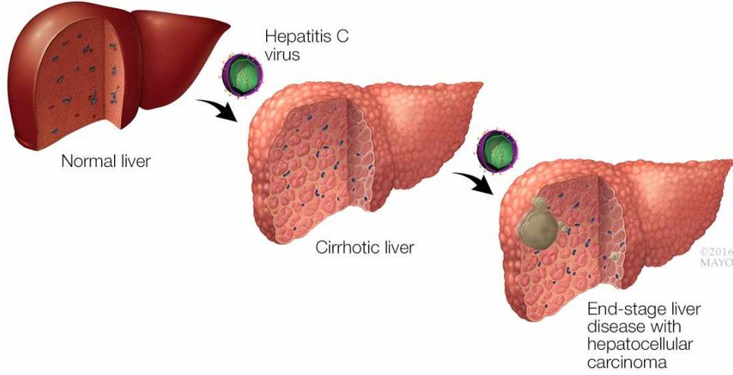
At least annually
Hepatitis C testing

Slide 33
On-Demand = Intermittent = Non-daily = Event Driven PrEP

Slide 34
On-Demand PrEP
Effective prevention for gay and bisexual men
No data on heterosexual men or women
Some health departments in Canada and US offer guidance
NOT part of CDC’s guidelines.
CDC still recommends daily dosing

Slide 35
Future directions of PrEP
Cabotegravir LA (injectable) every 2 months
Islatravir po every 28 days
Islatravir implant yearly
Combine with hormonal contraceptive
Vaginal insert with TAF and elvitegravir
Macaques (Dobard CROI 2020)
Broadly neutralizing antibodies
Dapivirine Vaginal Ring

Slide 36
Case Study: Paul
Paul is a 30-year-old man with no medical problems presents to the Maricopa County Health Department for an HIV test. He complains of some burning with urination. He had chlamydia 4 months prior to the visit.
SH:
Sexually active with men and women
4 partners in the past year. Unknown HIV status
Uses condoms 60% of the time
Does not smoke
Drinks alcohol occasionally
No illicit drugs.

Slide 37
What would you recommend for Paul?
Monthly islatravir
Daily TDF/FTC
On-Demand TDF/FTC
Daily TAF/FTC

Slide 38
Challenges
18.1% of US population at risk for HIV on PrEP
Knowledge of PrEP among patients is lowest in
African Americans
Women
Hispanics
Uptake lowest in
African Americans
Hispanics
Women (4% of women at risk on PrEP)
Retention low in all groups

Slide 39
Solutions
Increase knowledge among African Americans, Hispanics, and women
Increase patient access with more health care sites providing PrEP
Availability at health care sites including those that provide care to groups at risk with low uptake
Increase provider PrEP awareness
76% of primary care providers aware of PrEP
28% of primary care providers familiar with PrEP prescribing
Link to PubMed article: PrEP Awareness, Familiarity, Comfort, and Prescribing Experience among US Primary Care Providers and HIV Specialists by Petroll et. al. (2018)

Slide 40
When in Doubt, Get Help!
Contact UA ID
520-626-6887
National Clinician Consultation Center, University of California San Francisco

Slide 41
References
Link to CDC site: PrEP (Updated 11/3/20) https://www.cdc.gov/hiv/basics/prep.html
Link to Low Risk of Proximal Tubular Dysfunction Associated With Emtricitabine-Tenofovir Disoproxil Fumarate Preexposure Prophylaxis in Men and Women by Mugwanya et. al. (2016)
Link to Effects of Emtricitabine/Tenofovir on Bone Mineral Density in HIV-Negative Persons in a Randomized, Double-Blind, Placebo-Controlled Trial by Mulligan et. al. (2015)
Link to Panel on Antiretroviral Guidelines for the use of antiretroviral agents in HIV-1-infected adults and adolescents. Antiretroviral Guidelines for the use of antiretroviral agents in HIV-1-infected adults and adolescents. http://www.aidsinfo.nih.gov/ContentFiles/AdultandAdolescentGL.pdf. Accessed 12/28/19

Slide 42
Additional References
Link to: How safe is TDF/FTC as PrEP? A systematic review and meta-analysis of the risk of adverse events in 13 randomised trials of PrEP by Pilkington et. al. (2018)
Link to: Changes in Kidney Function Associated With Daily Tenofovir Disoproxil Fumarate/Emtricitabine for HIV Preexposure Prophylaxis Use in the United States Demonstration Project by Tang et. al. (2018)
Link to CDC site: Preexposure prophylaxis for the prevention of HIV infection in the United States - 2017 update, a clinical practice guideline

