Slide 1
Pain Management in Individuals with Substance Use Disorders
Jared W. Klein, MD, MPH
Assistant Professor
Division of General Internal Medicine
University of Washington School of Medicine
March 2, 2021

Slide 2
Panel Discussants
James Darnton, MD
Clinical Instructor
Division of General Internal Medicine
University of Washington School of Medicine
Jocelyn James, MD
Assistant Professor
Division of General Internal Medicine
University of Washington School of Medicine

Slide 3
No conflicts of interest or relationships to disclose
We will discuss off-label use of medications

Slide 4
Outline
Chronic pain in patients taking medications for opioid use disorder (MOUD)
Acute pain in patients taking MOUD
Acute pain in patients with active OUD but not taking MOUD
Pain in patients with OUD in prolonged remission
Discussion / Q&A

Slide 5
Definitions
Acute Pain
Weeks 0-6
Sub-acute Pain
Weeks 6-12
Chronic Pain
Weeks 12+

Slide 6
Definitions, cont.
Moderate-Severe Pain
Surgery
Fractures
Mild-Moderate Pain
Musculoskeletal
Odontogenic
Burns
Headaches
Focus on function

Slide 7
Case 1
52-year-old individual on methadone maintenance (110 mg/day) is seen in clinic for chronic low back pain.
Pain has been present for over 15 years since a work-related injury. Has completed several courses of physical therapy, most recently was 2 years ago.
Currently on permanent disability due to back pain and depression. Also has hypertension and chronic hepatitis C.
Medications include: methadone (as above), sertraline 100 mg/day, acetaminophen (up to 2000 mg/day), HCTZ 25 mg daily.

Slide 8
Case 1, cont.
How would you manage this patient’s chronic pain?
Ask to split the methadone into 2 equal doses
Start ibuprofen 600 mg TID
Start oxycodone 5 mg QID PRN pain
Start gabapentin 300 mg TID
Another physical therapy referral

Slide 9
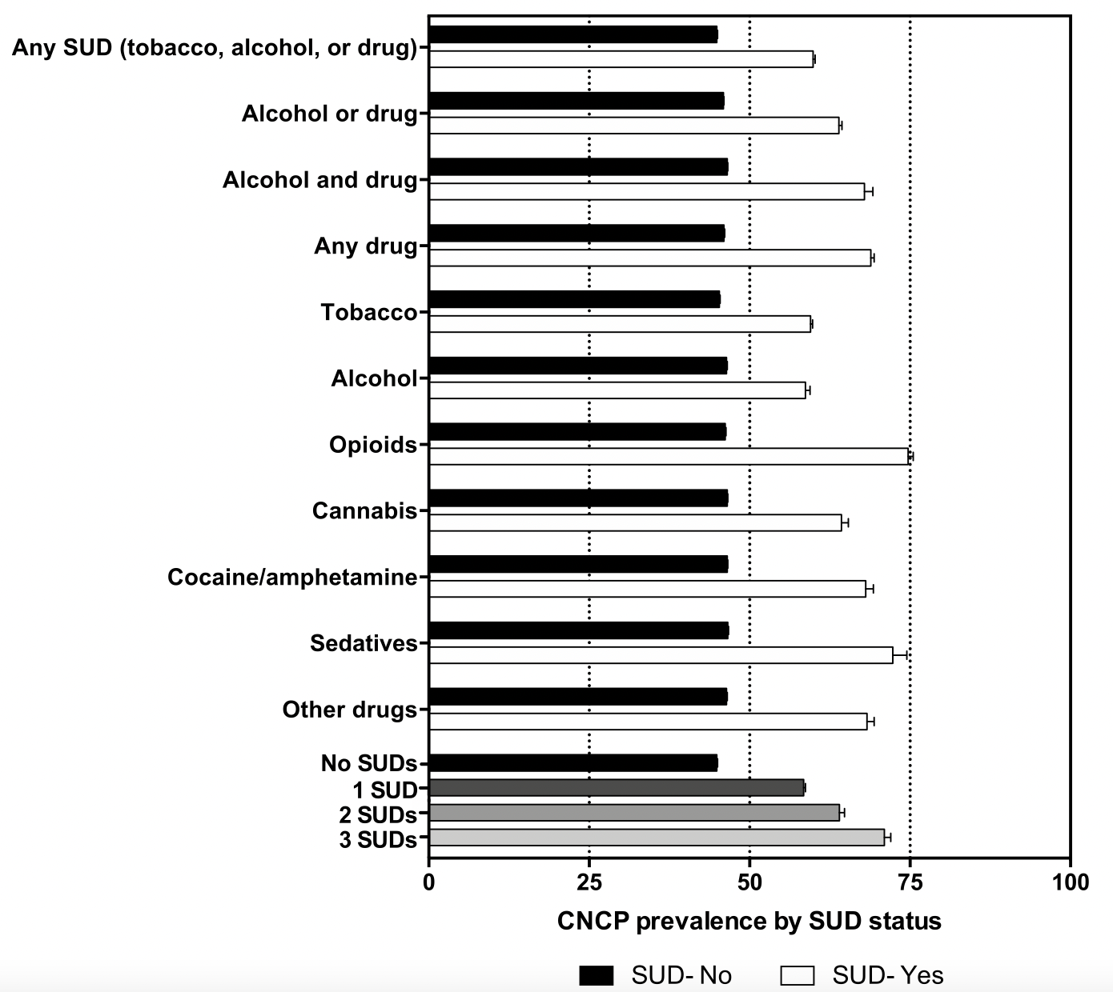
Chronic pain is common
%
%
%
%
%
Drug Alcohol Depend. 2020 Apr 1;209:107902
Notes:
Cross-sectional study of 950,000 patients at academic health system (Duke) from 2013-2018, examined rates of chronic non-cancer pain (CNCP) by SUD status, approximately 11% had any SUD, about 1.3% had OUD

Slide 10
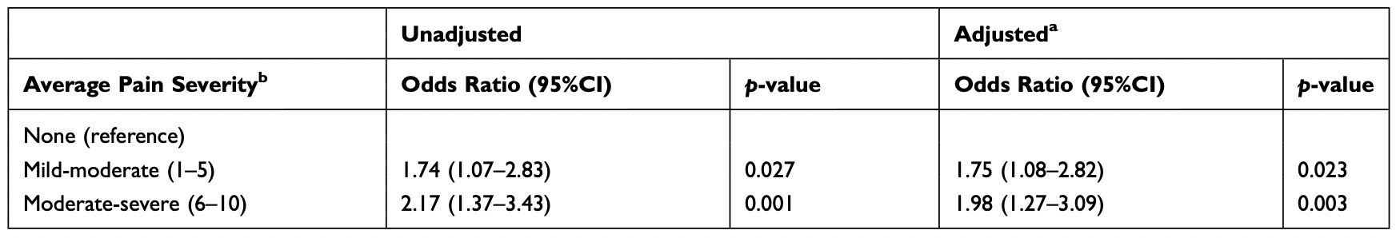
OUD + pain = worse outcomes?
PWUD with pain more likely to have difficulty accessing addiction treatment than those without pain
  Dose-response trend (more pain = more difficulty accessing treatment)
  Robust after adjusting for potential confounders
Lower retention and increased likelihood of ongoing non-prescribed opioid use in patients with OUD who have pain
Journal of Pain Research 2020:13
Notes:
Study of 1300 people who use drugs in Vancouver BC
Adjusted for age, ethnicity, homelessness, incarceration, violence, mental illness, overdose, heroin use, prescription opioid use, methamphetamine use, and heavy alcohol use.

Slide 11
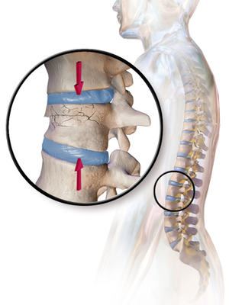
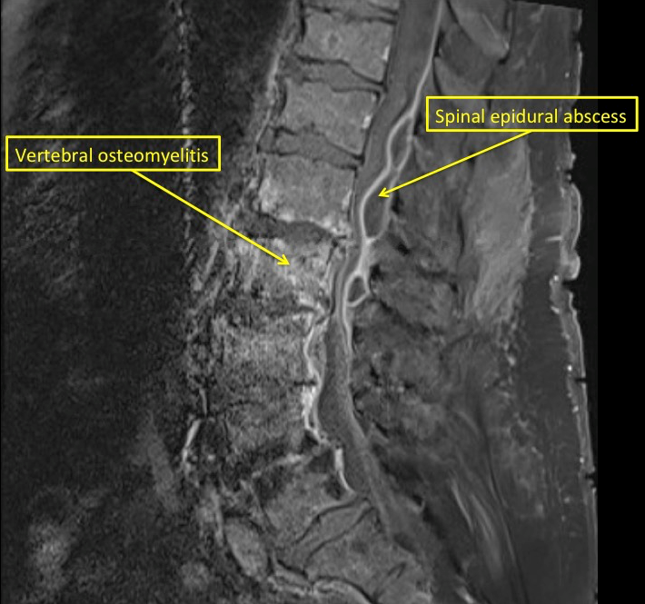
Critical to evaluate for underlying causes
Source: www.aans.org
Notes:
Evaluation may include careful physical exam, judicious ordering of diagnostic tests
Both from American Association of Neurological Surgeons, aans.org

Slide 12
Multimodal pain treatment is the foundation
ALWAYS institute multimodal pain treatment strategies
Non-opioid medications | Non-pharmacologic approaches
Acetaminophen | Comfort measures (repositioning, ice/heat)
NSAIDs | Physical modalities (PT, splinting, TENS)
Adjuvant agents (gabapentinoids, SNRIs) | Behavioral strategies (mindfulness, CBT)
Topicals | Manual therapies (acupuncture, massage)

Slide 13
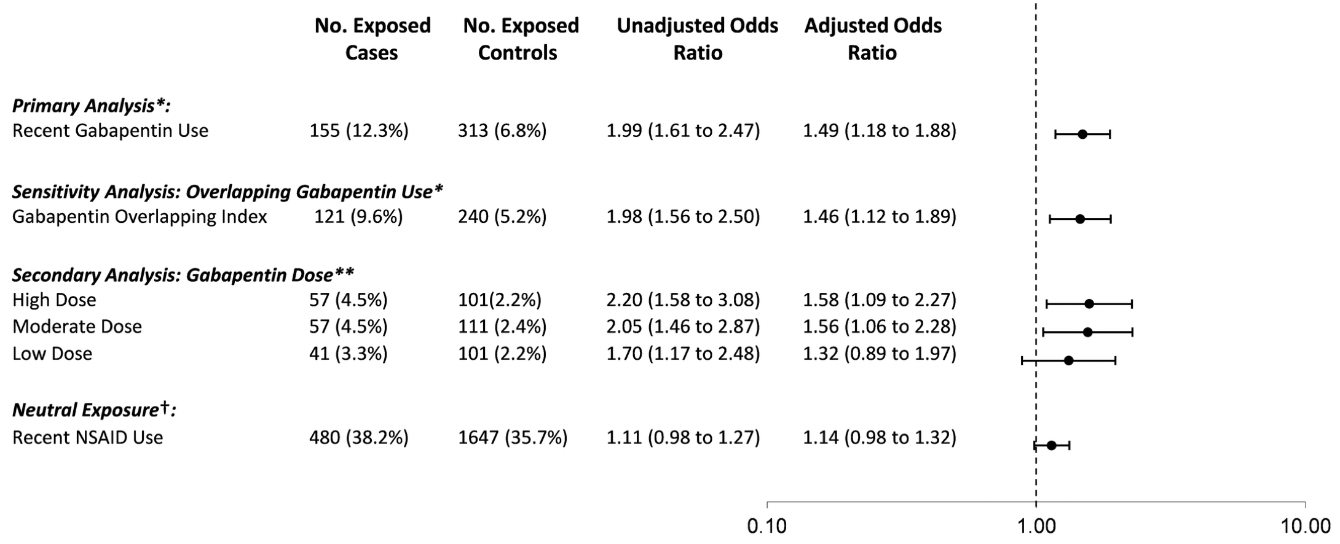
Gabapentin in patients with OUD
Self-reported gabapentin & pregabalin misuse¹
  15-22% among patients with OUD (vs 1% general population)
Association between combination gabapentin-opioid prescription and overdose, especially at high dose²
¹Addiction. 2016 Jul;111(7):1160-74.
²PLoS Med. 2017 Oct 3;14(10).
Notes:
Emerging evidence of unhealthy gabapentin use
Study of self-reported gabapentin misuse in patients with OUD compared to general population
Case-control study of fatal opioid overdoses in Ontario from 1997-2013. After adjusting for confounders, odds of fatal overdose were 1.5 times higher in patients co-prescribed opioids and gabapentin, possible dose-response association

Slide 14
Depression is common, likely undertreated
The 16% of Americans with mental illness receive >half of all opioid Rx ¹
50%
Most studies demonstrate at least half of patients with OUD have depression
¹J Am Board Fam Med. 2017 Jul-Aug;30(4):407-417.
²J Gen Intern Med. 2020 May 29.

Slide 15
Treating depression in pts with OUD + pain
OK to use SSRIs – safe and modestly effective
Possible preference for SNRIs
  Modulate pain experience in the CNS by boosting levels of serotonin and norepinephrine
  Duloxetine FDA approved for fibromyalgia, chronic low back pain and knee osteoarthritis
Use TCAs with caution in patients on methadone
Counseling should be offered and encouraged!

Slide 16
Adjust MOUD, when possible
Methadone and buprenorphine have short (~6 hours) duration of effect for pain control
Increase dose or split dose of MOUD
  For patients on methadone who have take-home doses, they could consider splitting take-home dose BID
  For patients on buprenorphine, consider dosing BID-TID
not always possible for patients dosed daily at opioid treatment program!

Slide 17
Generally avoid full opioid agonists
Full opioid agonists carry risk of over-sedation/overdose, diversion and disrupting recovery
Exceptions for palliative care situations or end-stage diseases with substantial functional impairment
If prescribe full opioid agonists:
  Ensure adequate shared decision-making about risks
  Institute close monitoring (urine toxicology, PMP checks)
  Establish functional endpoints
  Coordinate with opioid treatment program, if applicable

Slide 18
Case 1, revisited
How would you manage this patient’s chronic pain?
Ask to split the methadone into 2 equal doses
Start ibuprofen 600 mg TID
Start oxycodone 5 mg QID PRN pain
Start gabapentin 300 mg TID
Another physical therapy referral

Slide 19
Case 2
26-year-old individual on buprenorphine presents with right maxillary dental pain
Dentist said they need a root canal, which is scheduled for next week
Has been stable on buprenorphine for 18 months
Housed, lives with partner and 2 young children

Slide 20
Case 2, cont.
How would you manage this patient’s buprenorphine?
Stop buprenorphine 5 days before the procedure
Stop buprenorphine the day before the procedure
Increase buprenorphine dose after the procedure
Continue buprenorphine and add oxycodone

Slide 21
Risky time for patients with OUD
Acute pain
Anticipate conflict over opioids¹
anxiety
Physicians
Patients with OUD
Fear of deception
Inconsistency
Avoidance
Mistreatment
Stigmatization
¹ J Gen Intern Med. 2002 May;17(5):327-33.

Slide 22
Continue MOUD whenever possible
Methadone easier to combine with full opioid agonists
  No preferred full opioid agonist
  Should coordinate with opioid treatment program
Increasing evidence that full opioid agonists can be effectively added to buprenorphine to manage acute pain
  Theoretical preference for higher affinity full opioid agonists (e.g. hydromorphone, fentanyl)
Naltrexone should be discontinued for moderate-severe acute pain requiring full opioid agonists
Disrupting MOUD may destabilize recovery without improvements in acute pain management

Slide 23
Multimodal pain treatment is still critical
ALWAYS institute multimodal pain treatment strategies
If available, consider involving anesthesia/pain medicine colleagues with complex cases for advanced techniques (regional blocks, ketamine, lidocaine infusions, etc.)
Non-opioid medications | Non-pharmacologic approaches
Acetaminophen | Comfort measures
NSAIDs | Physical modalities
Adjuvant agents | Behavioral strategies
Topicals | Manual approaches

Slide 24
Adequately treat acute pain
Anticipate tolerance
  Consider 50% increase above usual opioid dose
  Monitor closely for oversedation or undertreatment
Opioid use disorder is a chronic disease
  Do not expect to worsen OUD by using opioids
  Do not expect to cure OUD by withholding opioids
Institute safety measures
  Small quantities
  Frequent refills
  Ensure naloxone available
  Secure storage location

Slide 25
Case 2, revisited
How would you manage her buprenorphine?
Stop buprenorphine 5 days before the procedure
Stop buprenorphine the day before the procedure
Increase buprenorphine dose after the procedure
Continue buprenorphine and add oxycodone

Slide 26
Case 3
32-year-old individual is admitted to the hospital with large deltoid abscess with surrounding cellulitis
Started on IV vancomycin and taken to the OR for operative drainage
11-year history of opioid use, including daily heroin use for the past 6 years
Previously on methadone 5 years ago but left treatment after about 6 months

Slide 27
Case 3, cont.
How would you manage this patient’s withdrawal symptoms?
Oxycodone 10 mg Q8 Hours
Methadone 10 mg TID
Loperamide, ibuprofen, clonidine
Hydromorphone PCA (patient-controlled analgesia)

Slide 28
Hospitalized patients with OUD: Key Principles
Treat acute condition
Manage withdrawal symptoms
Address pain issues
Initiate substance use treatment
Notes:
Maintain focus on treating the acute medical/surgical issue.
To do this, it is necessary to aggressively manage withdrawal and pain.
Opportunity to initiate and link with SUD treatment, but this is not necessary if patient hesitant.
Important to ensure entire care team is on the same page, transparent discussions are key.

Slide 29
Methadone for opioid withdrawal
Start with 20 mg
  Reassess q2-3 hours, give additional 5-10 mg until withdrawal signs abate
  Do not exceed 40 mg in first 24 hours
Next day, give total in one daily dose (may split dose for acute pain)
Monitor QTc, sedation and respiratory depression
Taper versus maintained dose
No methadone Rx at discharge!!!

Slide 30
Buprenorphine for opioid withdrawal
OK to use buprenorphine for withdrawal
  Bup-nx 4-1 mg SL QID (or 8-2 mg SL BID)
  Low threshold to increase to 8-2 mg SL TID for pain
Use may be limited by concurrent full opioid agonist use and severe acute pain
Generally defer induction if anticipate need for full agonists in the near future (e.g. impending major surgery)
Decision re: methadone versus buprenorphine
  Logistics
  Patient preference

Slide 31
Harm reduction and safety measures
Opioid-specific measures
  Use with others
  Carry naloxone
  Test for fentanyl
  Use a test dose first
Advice around other depressants (benzos, alcohol)
  Cut back or avoid use while taking opioids
  Explore interest in treatment for other SUD
As always, institute routine safety measures when prescribing
  Small quantities with more frequent refills
  Ensure naloxone available
  Secure storage location

Slide 32






Be aware of opioid prescribing limits
7 days for non-op,
14 days for operative
≤7-day supply
No specific limits
≤7-day supply
<7-day supply
≤7-day supply

Slide 33
Case 3, revisited
How would you manage this patient’s withdrawal symptoms?
Oxycodone 10 mg Q8 Hours
Methadone 10 mg TID
Loperamide, ibuprofen, clonidine
Hydromorphone PCA (patient-controlled analgesia)

Slide 34
Case 4
48-year-old individual presents to clinic with right knee pain.
Exam and MRI are consistent with meniscal tear and the surgeon advised arthroscopic repair.
Has a history of opioid use disorder in prolonged remission, last use was over 10 years ago. Took buprenorphine-naloxone for 3 years, then gradually tapered off.
Currently employed as a preschool teacher. Has a good relationship with their adult children.

Slide 35
Case 4, cont.
What advice would you give about peri-operative pain control?
The risk of return to use by taking opioids post-operatively is increased.
The risk of return to use by taking opioids post-operatively is similar to the general population.
Higher doses of opioids might be necessary for adequate pain control given the history of opioid use disorder.
The patient should reconnect with a sponsor or counselor if not already

Slide 36
Limited data for patients in prolonged recovery
Risk of return to use
  Mostly anecdotes and case reports
  Plausible given stress, anxiety and opioid exposure
Potential protective factors
  Longer duration of recovery
  Higher engagement with recovery support (sponsor, mutual support groups, etc.)
  More stability of home and work environments
  Better adherence to mental health treatment, if applicable
Pain Med. 2018 Oct 1;19(10):1908-1915.

Slide 37
Recommendations for acute pain among patients in prolonged recovery
Clear, open communication
about risks
No longer physically dependent on opioids
Proactive plan
  Maximize non-opioid, multimodal analgesia
  Enhance recovery supports
  Avoid former drug of choice, if possible
  Consider preemptively restarting MOUD, if patient amenable
Prim Care Companion J Clin Psychiatry. 2002 Aug;4(4):125-131.
Notes:
Communication:
What is the patient’s perspective? How worried are they?
Any recent experience with opioids during recovery?

Slide 38
Case 4, revisited
What advice would you give about peri-operative pain control?
The risk of return to use by taking opioids post-operatively is increased.
The risk of return to use by taking opioids post-operatively is similar to the general population.
Higher doses of opioids might be necessary for adequate pain control given the history of opioid use disorder.
The patient should reconnect with a sponsor or counselor if not already

Slide 39
Panel Discussion
What challenges have you experienced in treating patients with OUD who present with acute or chronic pain?
What are your practices for managing MOUD around the time of planned or unplanned pain episodes?
What suggestions do you have for supporting patients with OUD in prolonged remission who are having pain issues?

Slide 40
References
John WS, Wu LT. Chronic non-cancer pain among adults with substance use disorders: Prevalence, characteristics, and association with opioid overdose and healthcare utilization. Drug Alcohol Depend. 2020 Apr 1;209:107902.
Davis MA, Lin LA, Liu H, Sites BD. Prescription Opioid Use among Adults with Mental Health Disorders in the United States. J Am Board Fam Med. 2017 Jul-Aug;30(4):407-417.
Voon P, Wang L, Nosova E, Hayashi K, Milloy MJ, Wood E, Kerr T. Greater Pain Severity is Associated with Inability to Access Addiction Treatment Among a Cohort of People Who Use Drugs. J Pain Res. 2020 Oct 1;13:2443-2449.
Smith RV, Havens JR, Walsh SL. Gabapentin misuse, abuse and diversion: a systematic review. Addiction. 2016 Jul;111(7):1160-74.
Gomes T, Juurlink DN, Antoniou T, Mamdani MM, Paterson JM, van den Brink W. Gabapentin, opioids, and the risk of opioid-related death: A population-based nested case-control study. PLoS Med. 2017 Oct 3;14(10):e1002396.

Slide 41
References, cont.
Merrill JO, Rhodes LA, Deyo RA, Marlatt GA, Bradley KA. Mutual mistrust in the medical care of drug users: the keys to the "narc" cabinet. J Gen Intern Med. 2002 May;17(5):327-33.
Myers J, Compton P. Addressing the Potential for Perioperative Relapse in Those Recovering from Opioid Use Disorder. Pain Med. 2018 Oct 1;19(10):1908-1915.
Prater CD, Zylstra RG, Miller KE. Successful Pain Management for the Recovering Addicted Patient. Prim Care Companion J Clin Psychiatry. 2002 Aug;4(4):125-131.

