Slide 1
Substance Use and Mortality:
How the COVID-19 pandemic is affecting PWH & Communities of Color
Jermaine D. Jones PhD
Associate Professor of Clinical Neurobiology
Columbia University Irving Medical Center &
New York State Psychiatric Institute

Slide 2
Disclosures
“This program is supported by the Health Resources and Services Administration (HRSA) of the U.S. Department of Health and Human Services (HHS) as part of an award totaling $3,845,677 with zero percentage financed with nongovernmental sources. The contents are those of the author(s) and do not necessarily represent the official views of, nor an endorsement, by HRSA, HHS or the U.S. Government.”

Slide 3
Disclosures continued
In the past three years, Dr. Jones has received compensation in the form of partial salary support from studies supported by Cerecor Inc. and BioXcel Therapeutics, has served as a consultant to Alkermes, is the recipient of an investigator-initiated grant from Merck Pharmaceuticals, and received honoraria from the World Health Organization.

Slide 4
Objectives
Review pre-COVID-19 rates of substance use disorders (SUD) and overdose deaths.
Review pre-COVID-19 rates of HIV prevalence and prevention efforts.
Understand the impact of the COVID-19 pandemic on the HIV and Substance Use Disorder epidemics.
Understand the unique impact of these three conditions on communities of color, and race's role in the confluence among the three.

Slide 5
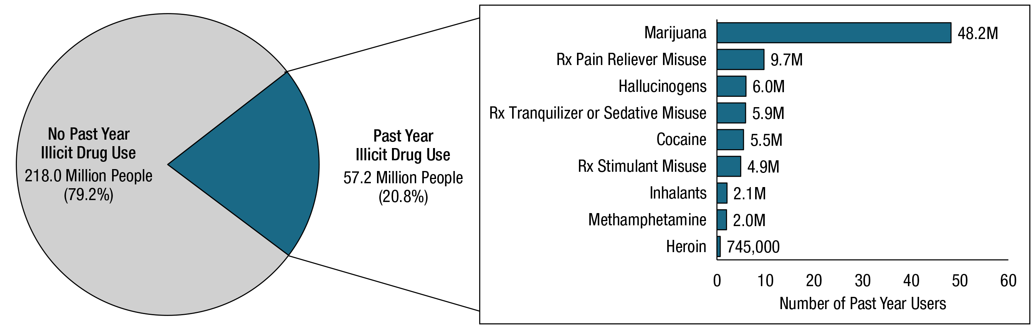
Pre-Pandemic:
Substance Use and Use Disorder
Past Year Substance Use among People Aged 12 or Older
National Survey of Drug Use and Health 2019

Slide 6
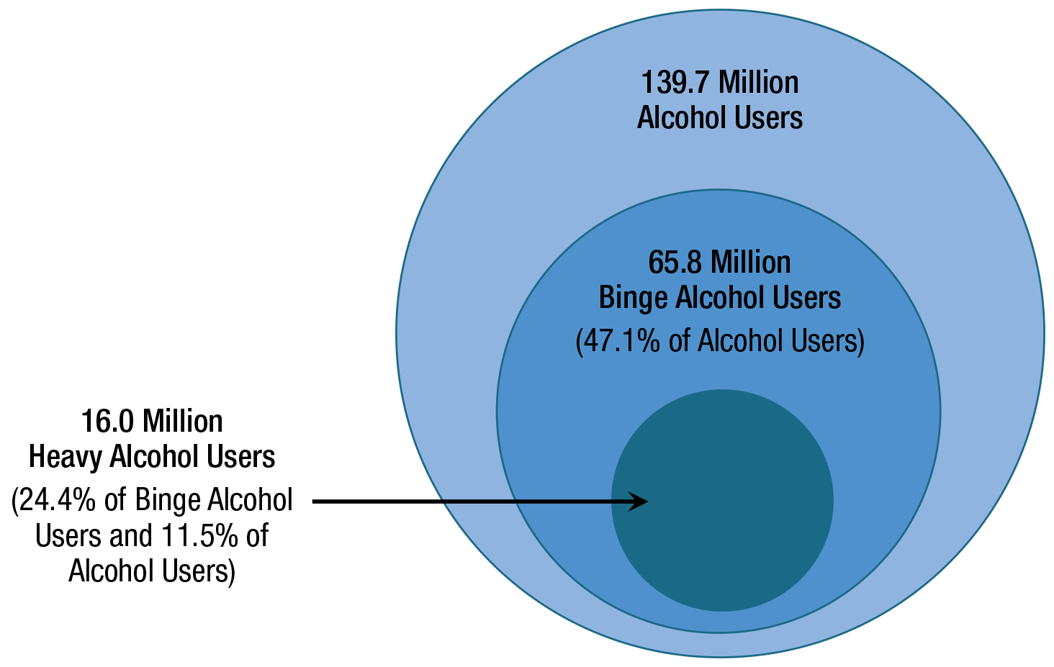
Alcohol Use among People Aged 12 or Older: 2019
FFR1.06
National Survey of Drug Use and Health, 2019
6

Slide 7
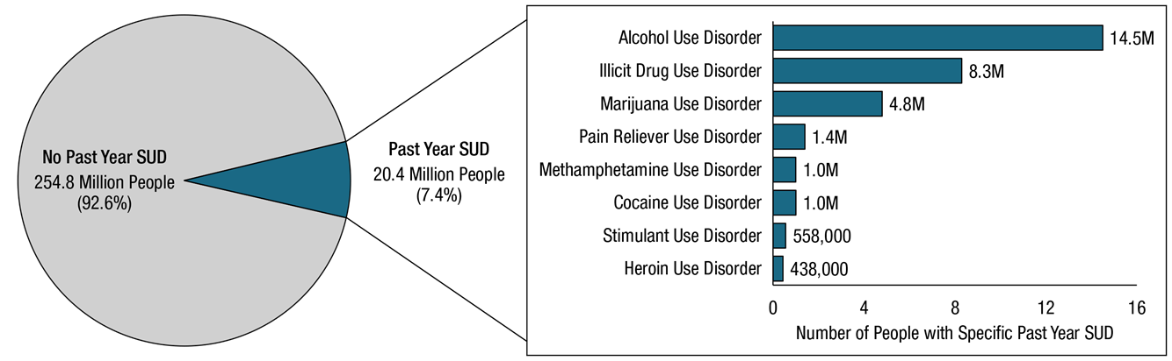
Pre-Pandemic:
Substance Use and Use Disorder
Past Year Substance Use Disorder among People Aged 12 or Older
National Survey of Drug Use and Health, 2019

Slide 8
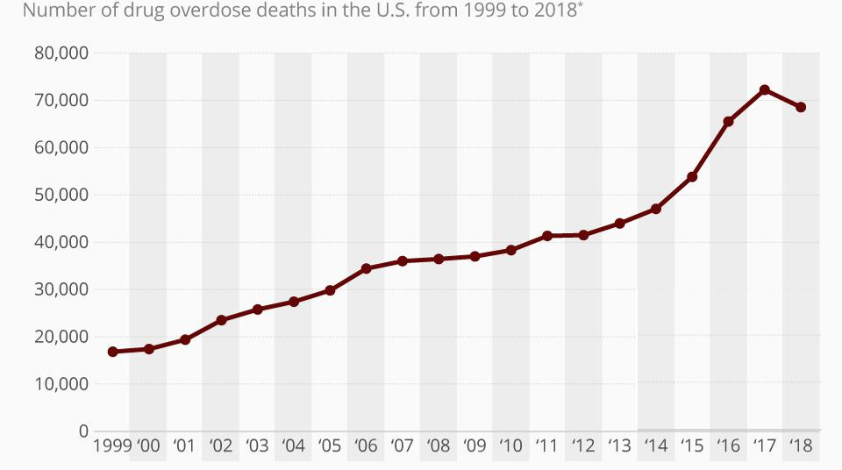
Pre-Pandemic: Overdose
Drug Overdose Deaths in the U.S. From 1999-2018
Source: CDC.GOV

Slide 9
Racial Disparities in Treatment
Treatment Initiation and Engagement by Race/Ethnicity (Acevedo et al., 2018).

Slide 10
Racial Disparities, Drug Use Criminalization
Source: U.S. National Research Council (2014: 61).

Slide 11
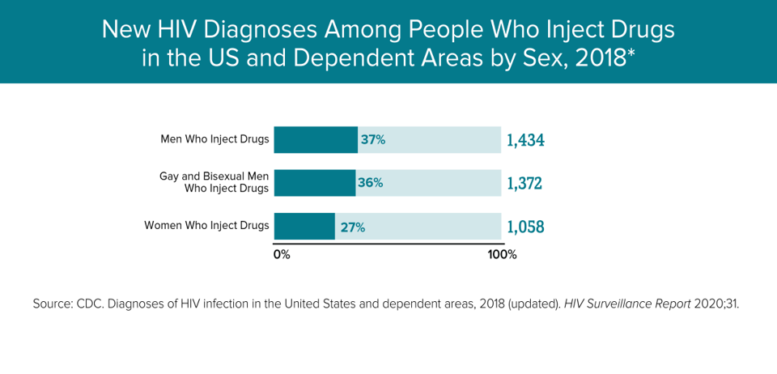
Pre-Pandemic: HIV Rates

Slide 12
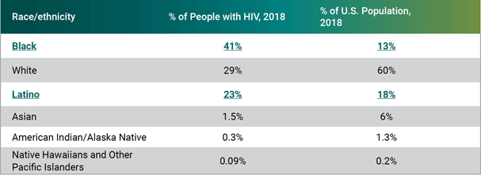
Racial Disparities & HIV
Source: https://www.hiv.gov/hiv-basics/overview/data-and-trends/impact-on-racial-and-ethnic-minorities

Slide 13
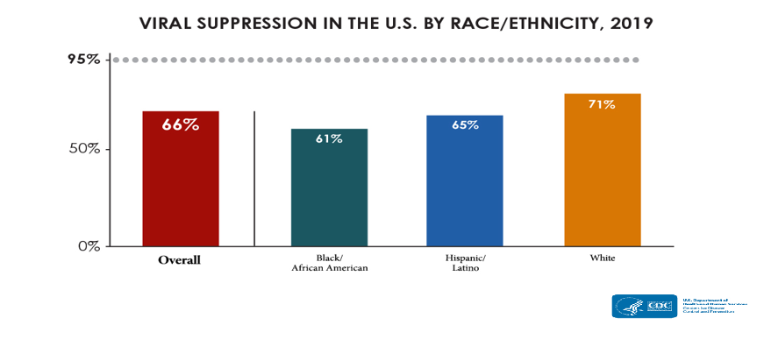
Racial Disparities & HIV
Notes:
Grey Line is the Target Goal for 2030

Slide 14
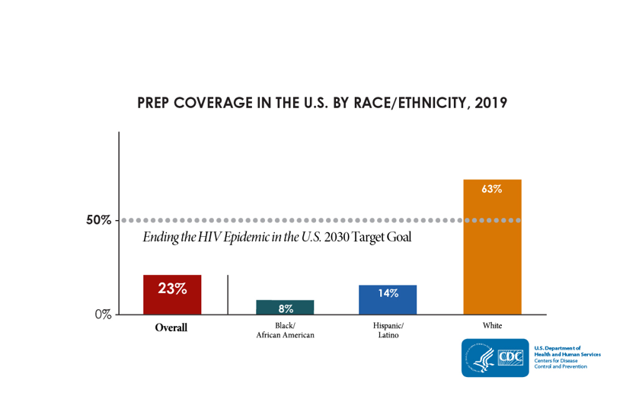
Racial Disparities & HIV
Notes:
23% of Individuals Eligible for PrEP were covered in 2019

Slide 15
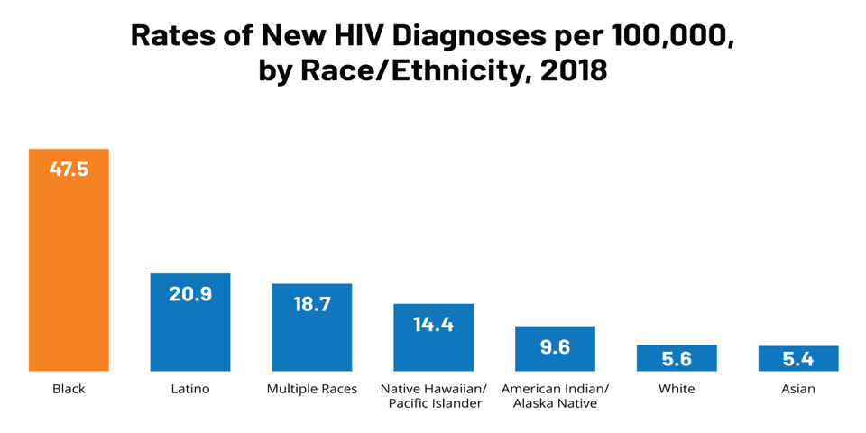
Racial Disparities & HIV
https://www.kff.org/hivaids/fact-sheet/black-americans-and-hivaids-the-basics/
Notes:
Average rate in the U.S is about 13.6/100,000

Slide 16

The Global Pandemic
Coronavirus disease 2019 (COVID-19) is caused by severe acute respiratory syndrome coronavirus 2 (SARS-CoV-2).
Symptoms of COVID-19 often include fever, cough, headache, fatigue, breathing difficulties, and loss of smell and taste.
Symptoms may begin one to fourteen days after exposure to the virus.
Of those people who develop symptoms:
  81% develop mild to moderate symptoms (up to mild pneumonia)
  14% develop severe symptoms (dyspnea, hypoxia, or more than 50% lung involvement on imaging), and
  5% suffer critical symptoms (respiratory failure, shock, or multi-organ dysfunction).
Notes:
The World Health Organization first called COVID-19 a pandemic on March 11th, 2020.

Slide 17
A Decentralized Strategy
  Quarantines
  Mask Mandates
  Shut Downs
  Test and Trace
Notes:
+159 new daily cases (As of NOV 23rd 2021)

Slide 18
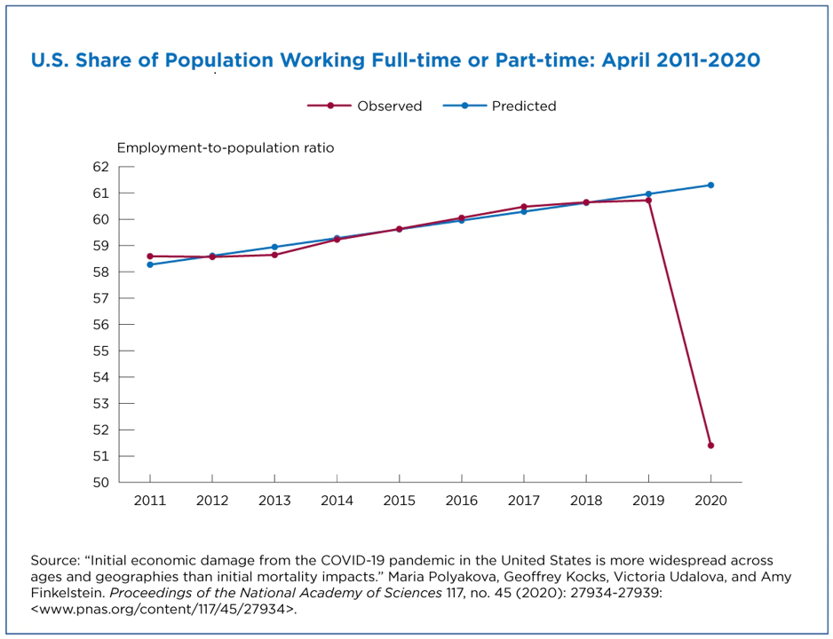
Financial Impact
Notes:
The decline in the employment-to-population ratio in the United States in April 2020 was significant. Historical trends predicted a 61.3% ratio but it turned out to be 51.5%. This additional national decline was 9.9 per 100 individuals in April 2020 (Figure 1). That means there were fewer people employed than was expected before the pandemic.
employment displacement decreased with age. It was largest among the younger age group (ages 25 to 44). These individuals make up only 39% of the U.S. population ages 25 and older but accounted for about half of the people 25 and older who lost their jobs nationwide.

Slide 19
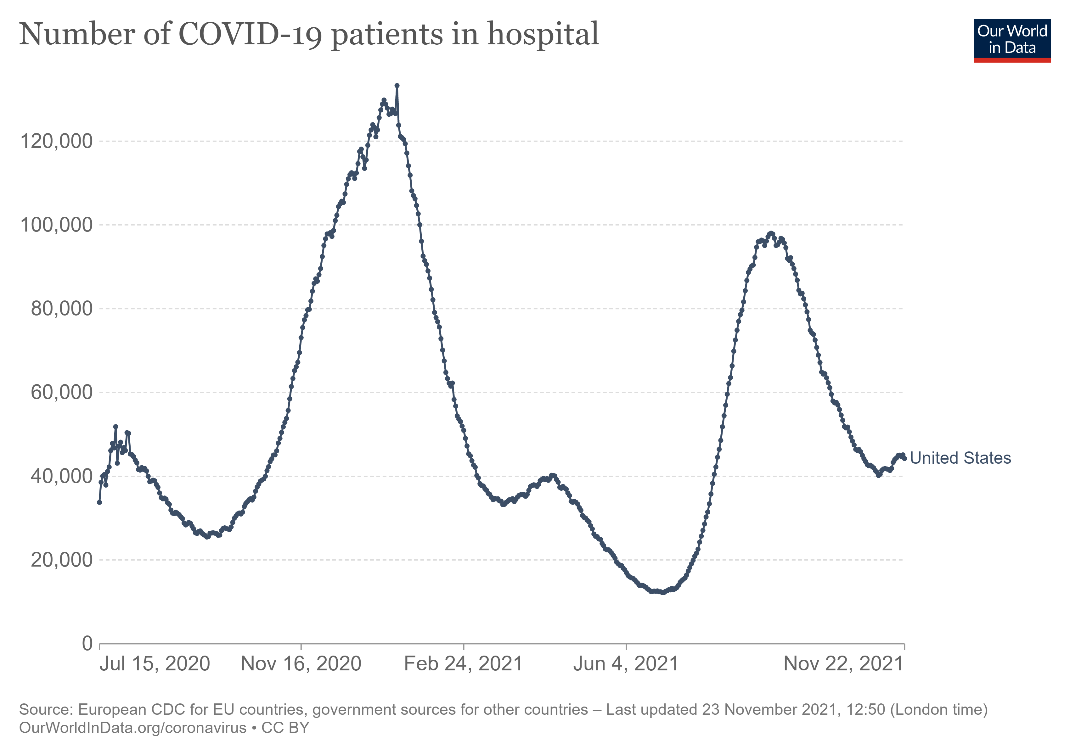
Hospitalizations

Slide 20
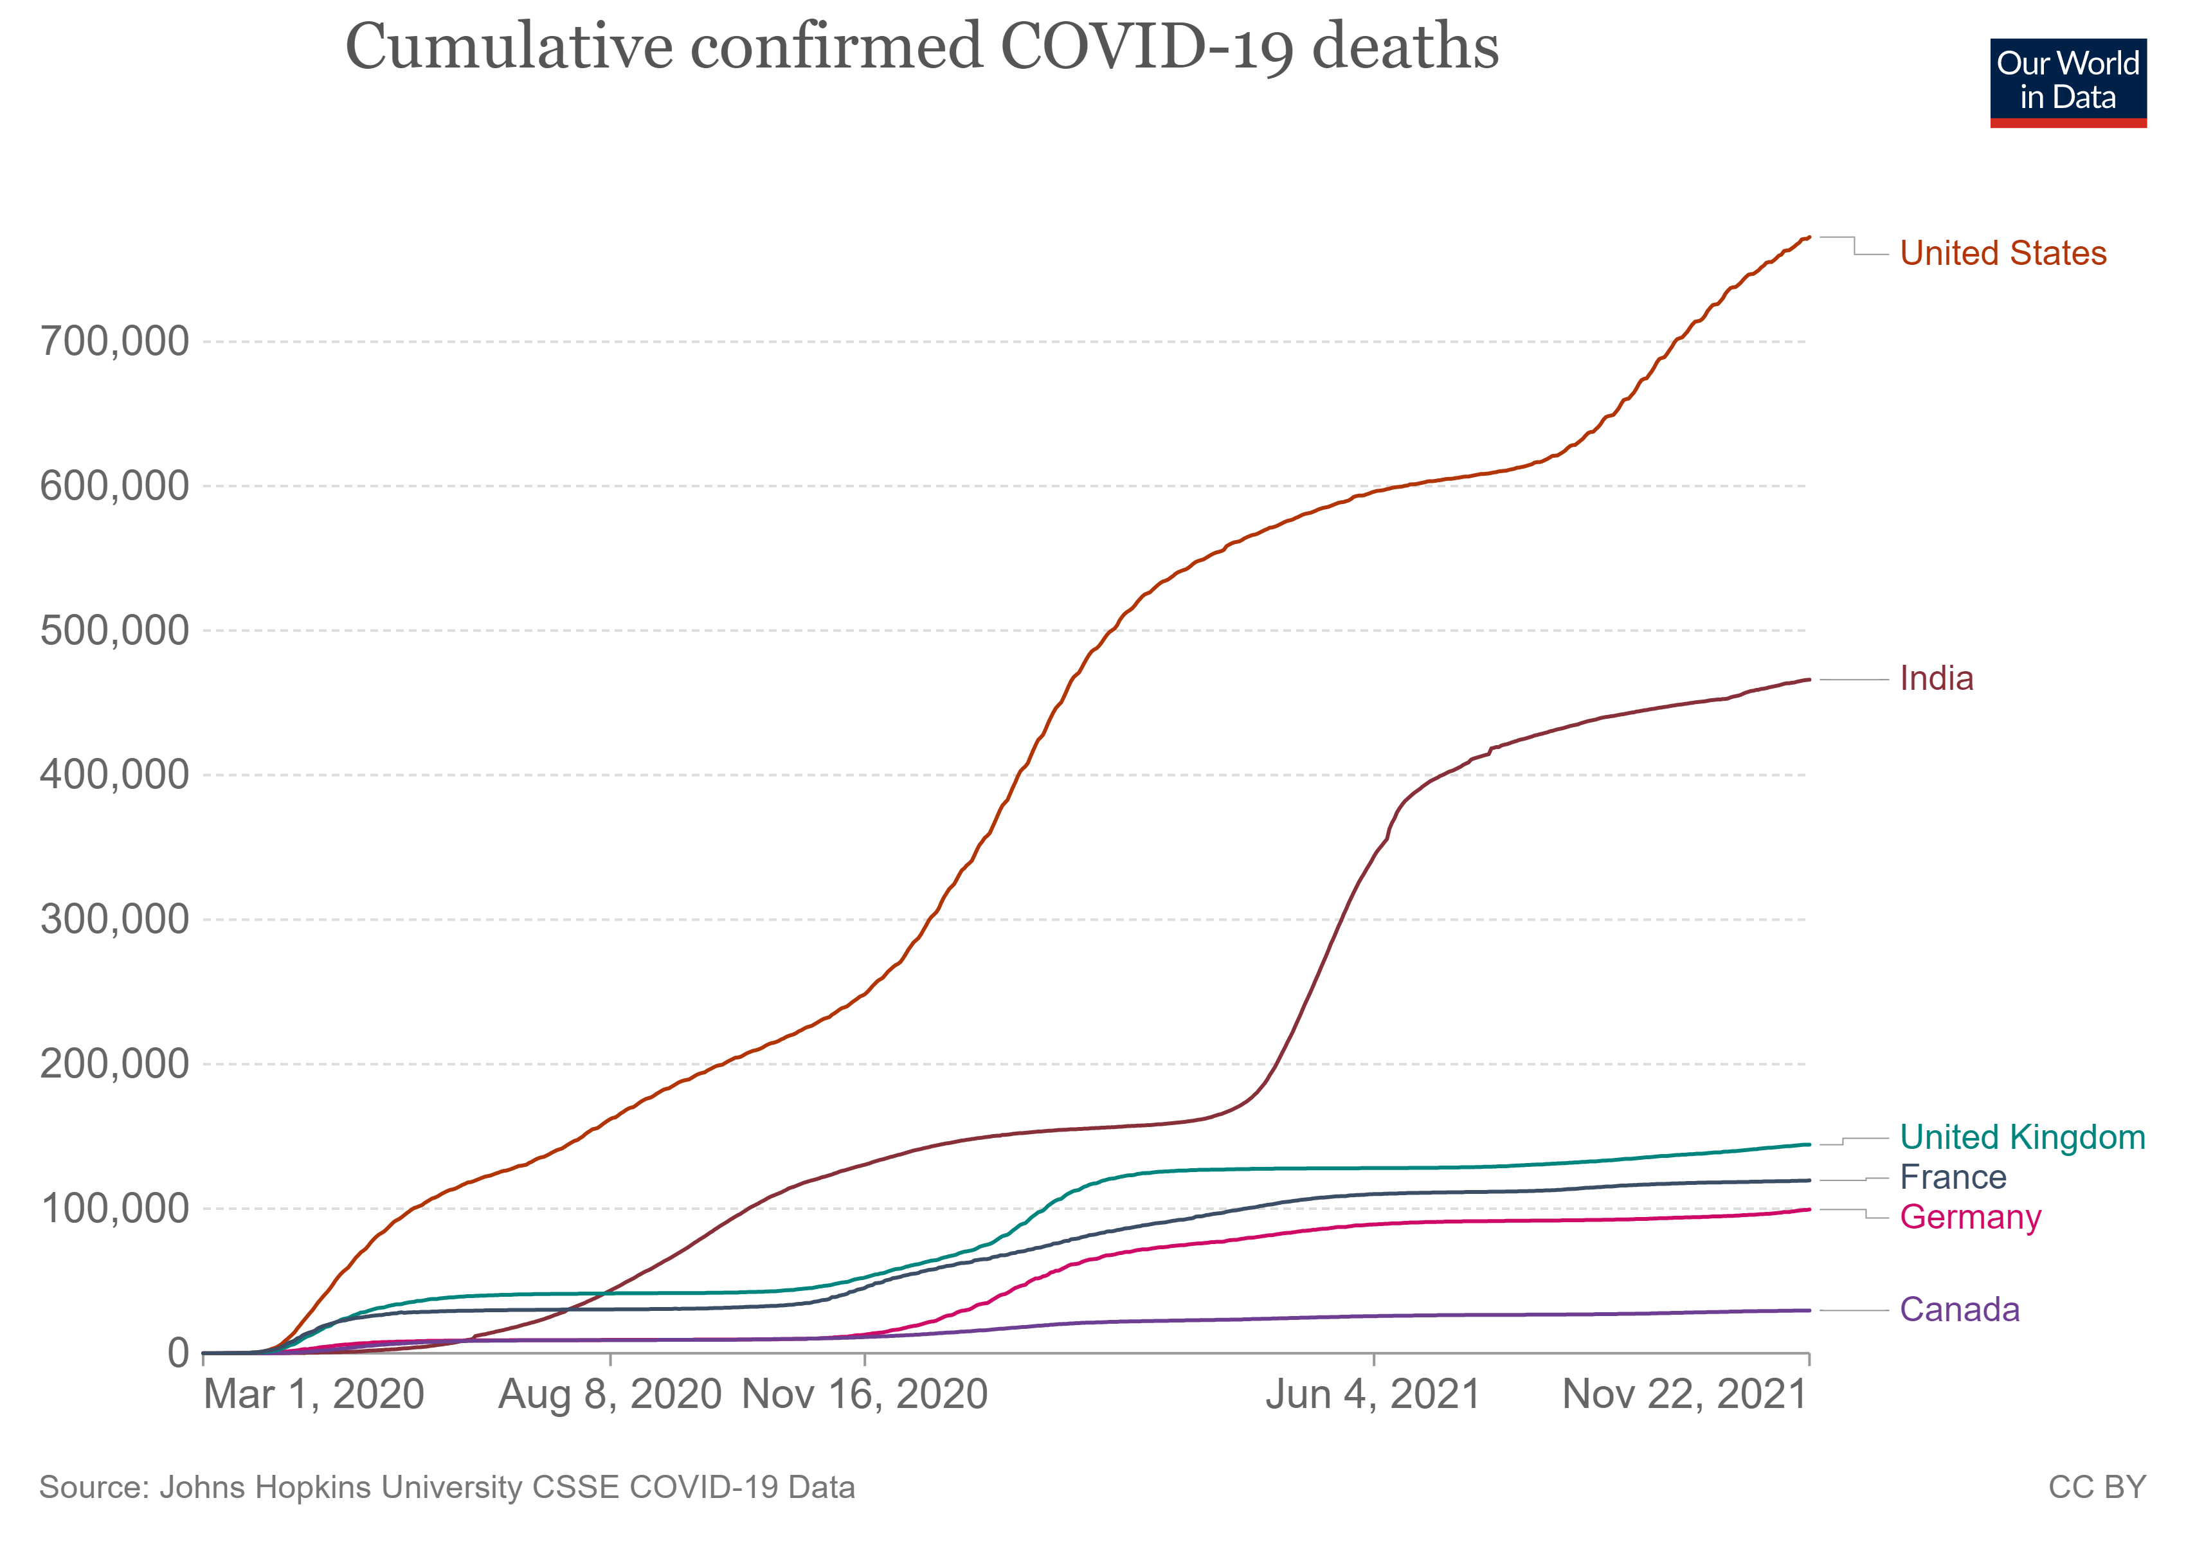
Deaths

Slide 21
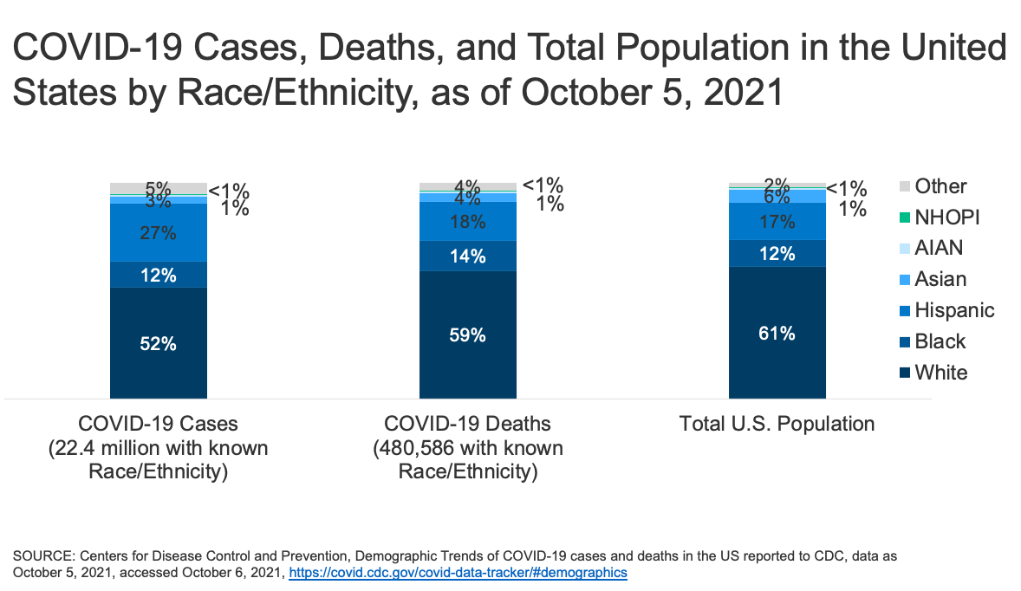
Deaths
Notes:
Compared to white, non-Hispanic Americans, Black Americans are 2.6 times more likely to contract COVID-19, 4.7 times more likely to be hospitalized as a result of contracting the virus, and 2.1 times more likely to die from COVID-19–related health issues (CDC 2020b). While non-Hispanic white people are dying in the largest numbers (CDC 2020a), Black and Hispanic people are dying at much higher rates relative to their share of the U.S. population
Inequities in infectious disease outcomes are the byproduct of decades of government policies that have systematically disadvantaged Black, Hispanic, and Native American communities (Cowger et al. 2020). For example, as a result of policies that have helped to determine the location, quality, and residential density for people of color, Black and Hispanic people are clustered in the same high-density, urban locations that were most affected in the first months of the pandemic (Cowger et al. 2020; Hardy and Logan 2020).

Slide 22
COVID Among People Who Use Drugs (PWUDs)
An analysis of electronic health records from more than 73 million patients found that while people with Substance Use Disorders (SUDs) made up only 10.3% of the sample, they accounted for 15.6% of COVID-19 diagnosis.
People with SUDs were more likely to experience severe COVID-19 outcomes including hospitalization (41% versus 30%) and death (9.6% versus 6.6%).
Notes:
Jalal H, Buchanich JM, Roberts MS, Balmert LC, Zhang K, Burke DS. Changing dynamics of the drug overdose epidemic in the United States from 1979 through 2016. Science. 2018;361(6408):eaau1184. doi:10.1126/science.aau1184

Slide 23
What Steps Were Taken to Protect PWUDs?
Prior to the pandemic, only 27% of specialty addiction treatment facilities in the United States reported having telehealth capabilities.
Among individuals with private insurance and Medicare, telehealth was used in 0.1% of addiction treatment visits.
Notes:
The COVID-19 pandemic caused addiction treatment providers to rapidly pivot from primarily delivering in-person addiction treatment to providing telehealth treatment.
The widespread and rapid adoption of telehealth for substance use disorder treatment services under the COVID-19 pandemic emergency order invigorated a reassessment of telehealth’s role in addiction treatment. More research is needed on the effectiveness of telehealth-delivered addiction treatment. Telehealth may serve to improve addiction treatment access, initiation, and retention.

Slide 24
What Steps Were Taken to Protect PWUDs?
Substance Abuse and Mental Health Services Administration allowed for buprenorphine initiation without an in-person assessment.
  A similar exception was not made for methadone.
Patients undergoing intake at a new provider who were already taking methadone could undergo an intake assessment via telehealth.
Virtual overdose education and naloxone by mail.
Notes:
Be sure to mention differences in the scheduling of the two drugs (Bup and Methadone).
In North America, new regulations allow for pharmacists to adjust opioid substitution therapy doses, and several countries, including Australia, have relaxed restrictions regarding take-home doses Bach P, Robinson S, Sutherland C, Brar R. Innovative strategies to support physical distancing among individuals with active addiction. Lancet Psychiatry 2020; 7:731–733.

Slide 25
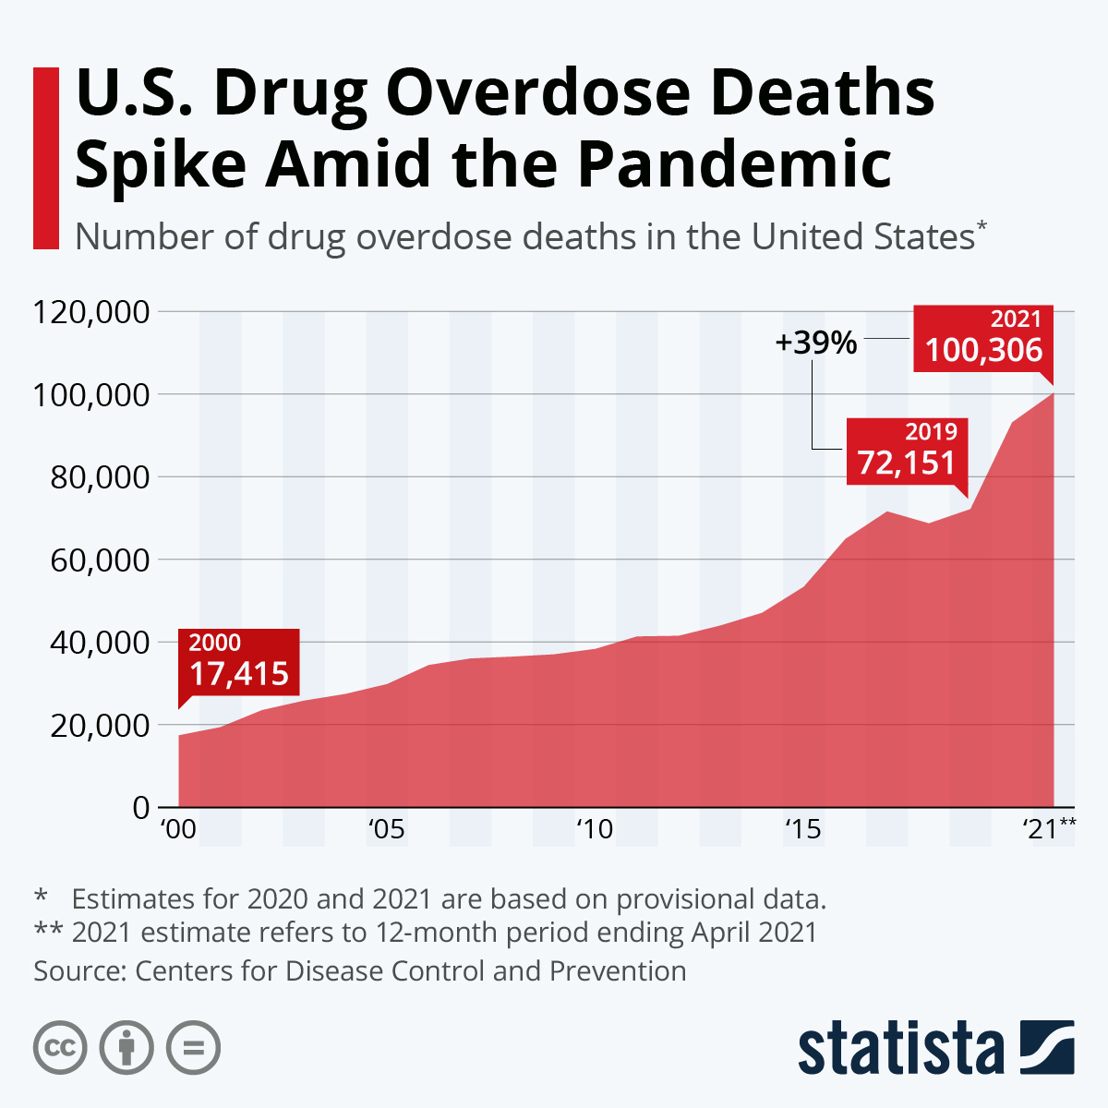
Overdose After the Pandemic
Notes:
The early months of the pandemic saw an 18% increase nationwide in overdoses compared with those same months in 2019. The trend has continued throughout 2020.
There may be increased risk of opioid overdose arising from (a) erratic access to methadone or buprenorphine dosing, (b) erratic access to illicit
heroin supplies and (c) increased access to takeaway doses of methadone/buprenorphine necessitating expansion of take-home naloxone supplies, particularly where treatment services are providing increased take-away doses of OAT.
COVID-19 itself has potential to increase overdose risk among people with SUD with chronic lung disease, previously identified as a risk factor for overdose mortality [16], and methamphetamine use may place people at increased risk of pulmonary hypertension [17], a risk factor for COVID-19 complications.

Slide 26
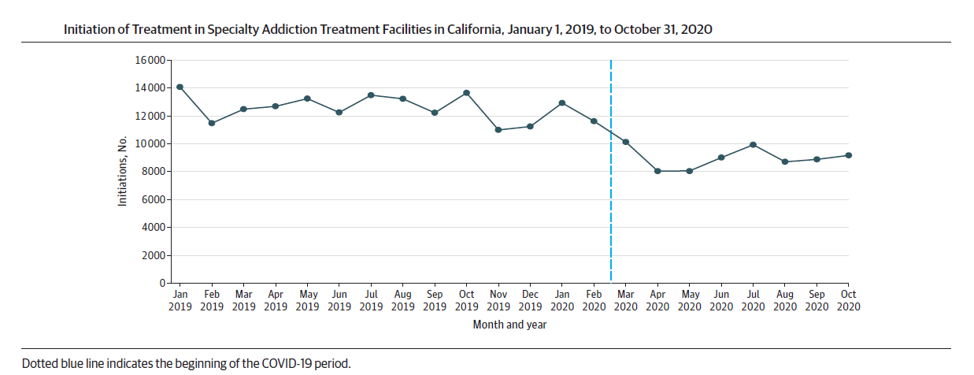
What Happened?
Mark et al., 2021
Notes:
Mark TL, Gibbons B, Barnosky A, Padwa H, Joshi V. Changes in Admissions to Specialty Addiction Treatment Facilities in California During the COVID-19 Pandemic. JAMA Netw Open. 2021;4(7):e2117029.
This cohort study found that the COVID-19 pandemic was associated with a 28% decline in addiction treatment initiations through October 2020.

Slide 27
What Happened?
Persistent stress of COVID-19 may have led to increased demand for mental health services.
According to the Centers for Disease Control and Prevention, 13% of Americans reported starting or increasing substance use as a way of coping with stress or emotions related to COVID-19.
Unemployment and economic hardships likely increased levels of poverty, marginalization, and social exclusion.
Diminished health exaggerated mortality rates (up to 15 times higher for injecting drug users than for the general population (Costa-Storti et al., 2020).
Notes:
Negative effects of the confinement measures likely exacerbated existing socioeconomic problems. And while the impact of the confinement measures is likely to be more immediate, the effects of the COVID-19 recession will undoubtedly endure over a longer time period and continue to negatively impact on the lives of HRDU. Rising unemployment and economic hardship have the clear potential to increase levels of poverty, marginalization, and social exclusion. In practical terms, reduced personal income will mean less money for food, housing and health care. Poor and diminished health status in turn potentially impact on an already exaggerated mortality rates (up to 15 times higher for injecting drug users than for the general population) [I think these are global stats, not US specific (Costa Storti et al., 2020).
Preexisting psychiatric symptoms may be exacerbated due to fear and worry about being infected, social isolation and the lack of connectivity,
distressing medical symptoms and death
Disruptions in the drug supply may have also lead to poorer quality drugs, (i.e., increased adulteration of drugs with fentanyl).

Slide 28
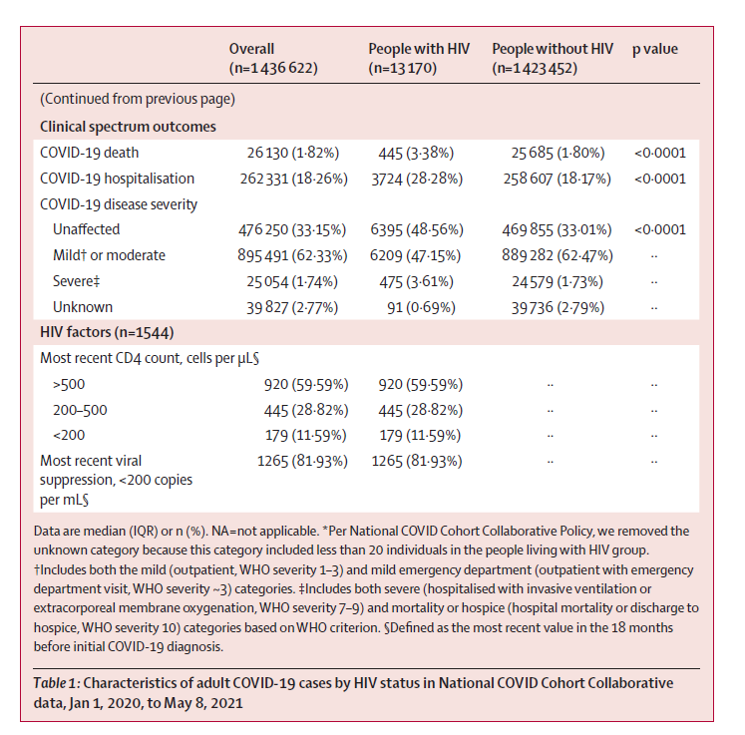
COVID-19 Among People with HIV
Yang et al., 2021
Notes:
In the harmonised N3C data release set from Jan 1, 2020, to May 8, 2021, there were 1 436 622 adult COVID-19 cases, of these, 13 170 individuals had HIV infection. A total of 26 130 COVID-19 related deaths occurred, with 445 among people with HIV. After adjusting for all the covariates, people with HIV had higher odds of COVID-19 death (adjusted odds ratio 1·29, 95% CI 1·16–1·44) and hospitalisation (1·20, 1·15–1·26), but lower odds of mild or moderate COVID-19 (0·61, 0·59–0·64) than people without HIV. Interaction terms revealed that the elevated odds were higher among older age groups, male, Black, African American, Hispanic, or Latinx adults. A lower CD4 cell count (<200 cells per μL) was associated with all the adverse COVID-19 outcomes, while viral suppression was only associated with reduced hospitalisation.

Slide 29
What Steps Were/Should Be Taken to Protect People with HIV
Mobile Clinics
Co-Located Health Care Services
Self-Administered Tests And Medications
Patient Assistance Programs
Notes:
Mobile Clinics
Rather than relying on telehealth, mobile clinics should go into communities to deliver PrEP and ART outside of the standard workday. PrEP and ART services have much to learn from innovations in the substance use field. Mobile clinics have successfully been used for substance use treatment and are often seen as attractive, accessible, and acceptable to high-risk and hard-to-reach individuals.y
Co-Located Health Care Services
In addition to mobile clinics, PrEP and ART services should be co-located alongside other health care services. These could include substance use services such as needle exchanges and syringe dispensaries, which remain crucial for the health of injection drug users during the COVID-19 pandemic.
Self-Administered Tests And Medications
Another innovation would be to allow people to receive PrEP pill packets in larger quantities and to self-administer HIV tests, requiring patients to go to clinics less frequently. Self-administered HIV tests have been found to increase testing frequency and to not increase sexual risk-taking behaviors.
Patient Assistance Programs
High copayments, a lack of insurance, and high costs for PrEP have consistently been cited as barriers to initiating and sustaining PrEP. While many patient assistance programs exist (for example, drug manufacturer Gilead’s patient assistance program), many are unaware of them or are still unable to cover laboratory or medical visit costs when these costs are not covered by patient assistance. Therefore, it is critical, especially given the co-occurring economic crisis that COVID-19 has sprung, to eliminate copays for PrEP

Slide 30
What Steps Should Be Taken To Protect PWUD
Providing depot buprenorphine (e.g., weekly and monthly formulations) rather than daily supervised sublingual buprenorphine dosing or methadone dosing.
Providing additional take-away (non-supervised) doses of both buprenorphine and methadone.
Ensuring people who use drugs continue to have access to clean injecting equipment and other harm-reduction services.
  Providing bulk syringes and other sterile injecting equipment.
Where face-to-face services cannot be provided, vending machines are an efficient method to maintain service delivery around the clock with reduced staffing requirements.
Current harm should be updated to reduce the spread of COVID-19:
  e.g. sharing of equipment such as glass pipes, joints/cigarettes, cash, and straws for ‘snorting’ drugs.
  encourage good hand hygiene by providing hand sanitizer.

Slide 31
Conclusions
COVID-19 has highlighted demonstrated disparate effects due to structural inequities.
While HIV itself may not alter one’s risk for acquiring COVID-19, people living with HIV often face multiple comorbidities that heighten the risk for severe illness from COVID-19.
People living with HIV are also at risk for discontinuing anti-retroviral therapy (ART) during the pandemic.
  Those that discontinue ART are more likely to develop severe HIV disease, which may put them at risk of developing severe COVID-19.
  People who are immune-suppressed are also at increased risk for SARS-CoV2 infection.
Notes:
While HIV itself may not alter one’s risk for acquiring COVID-19, people living with HIV often face multiple comorbidities (for example, older age, cardiovascular disease, pulmonary disease) and social determinants of health (for example, housing insecurity, food insecurity) that heighten the risk for severe illness from COVID-19.

Slide 32
Conclusions
The prevalence of COVID-19 continues to be high in prisons and jails.
  PWUD are more likely to be criminal justice-system involved.
The pandemic has fast tracked the opportunity for upscaling the use of digital health interventions.
Telehealth has the potential to overcome many barriers preventing access to, and provision of healthcare services for substance use disorders.
Notes:
Telehealth= computerized, web and telephone-based medicine,

Slide 33



Acknowledgements
Sandra Comer
Shanthi Mogali
Jeanne Manubay
Felipe Castillo
Claudia Tindall
Janet Murray
Laura Brandt
Vincent Woolfolk
Suky Martinez
Nicholas Allwood
Freymon Perez
Rebecca Abbot
Lauren Noble
CJ Levin

