Slide 1
Treatment as Prevention
Undetectable=Untransmittable
A Strategy for HIV Prevention
Rob Phoenix, APRN, FNP-C
Huntridge Family Clinic, Las Vegas,
Nevada; PAETC-NV Faculty
Roseman University of Health Science, College of Nursing, MSN Adjunct
2/24/22

Slide 2
Disclaimer
“This program supported by the Health Resources and Services Administration (HRSA) of the U.S. Department of Health and Human Services (HHS) as part of an award totaling $3,278,366. The contents are those of the author(s) and do not necessarily represent the official views of, nor an endorsement, by HRSA, HHS or the U.S. Government.”
The views and opinions expressed in this presentation are not necessarily those of the Pacific AIDS Education and Training Centers (PAETC), the Regents of the University of California or its San Francisco campus (UCSF or collectively, University) nor of our funder the Human Services and Resources Administration (HRSA). Neither PAETC, University, HRSA nor any of their officers, board members, agents, employees, students or volunteers make any warranty, express or implied, including the warranties of merchantability and fitness for a particular purpose; nor assume any legal liability or responsibility for the accuracy, completeness or usefulness of information [,apparatus, product] or process assessed or described; nor represent that its use would not infringe privately owned rights.

Slide 3
Disclosures
Presenter name: John Phoenix,
Gilead Sciences speaker bureau and consultant
ViiV consultant role
Janssen, consultant role
Napo Pharmaceutical, speaker bureau
Lupin pharmaceutical, consultant
Synexis, consultant
Autumn Update Planning committee 2021

Slide 4
Learning Objectives
At the completion of this presentation, participants will:
Discuss individuals at risk for HIV and who could benefit from HIV prevention services
Discuss options for HIV prevention for persons at risk of HIV
Identify priority populations for HIV prevention services
Provide patient education around HIV prevention services such as TaSP, U=U and medication options

Slide 5
Which of the following are HIV prevention strategies
U=U
TaSP
Medications (emtrictabine/tdf, or emtrictabine/taf)
Condoms
Testing, knowing partner status
All the above
other

Slide 6
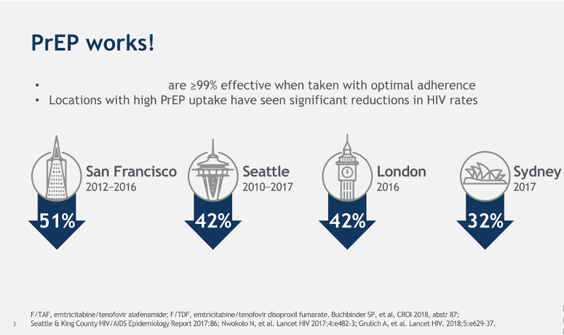
PrEP Works
Notes:
Randomized controlled trials have demonstrated the safety and efficacy of HIV PrEP in preventing HIV transmission. This slide summarizes the population-level effectiveness of scaling up PrEP access on decreasing new cases of HIV in major cities in the world.¹⁻⁴ These data together show that PrEP is highly effective both on an individual and population scale.

Slide 7
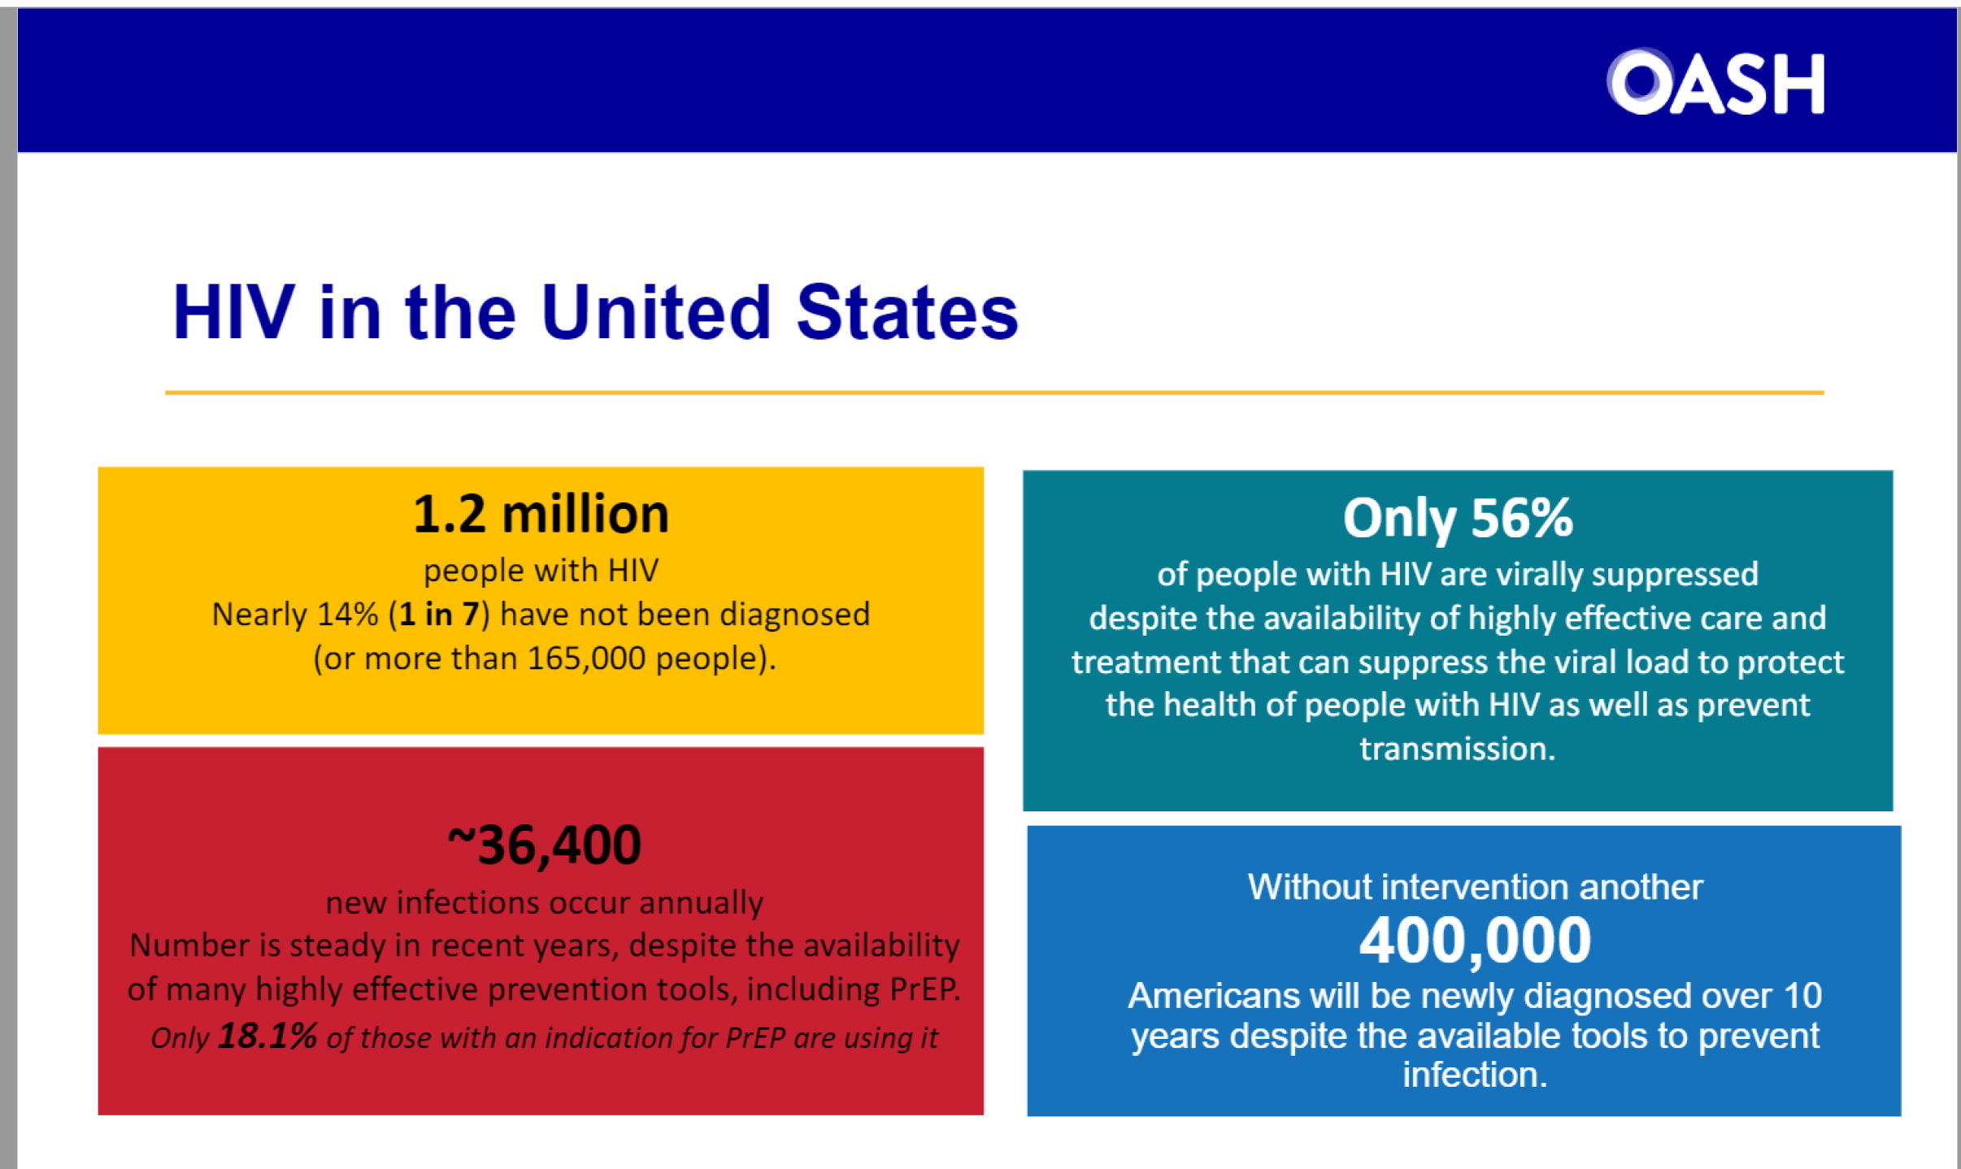
HIV in the US
(OASH, 2021)

Slide 8
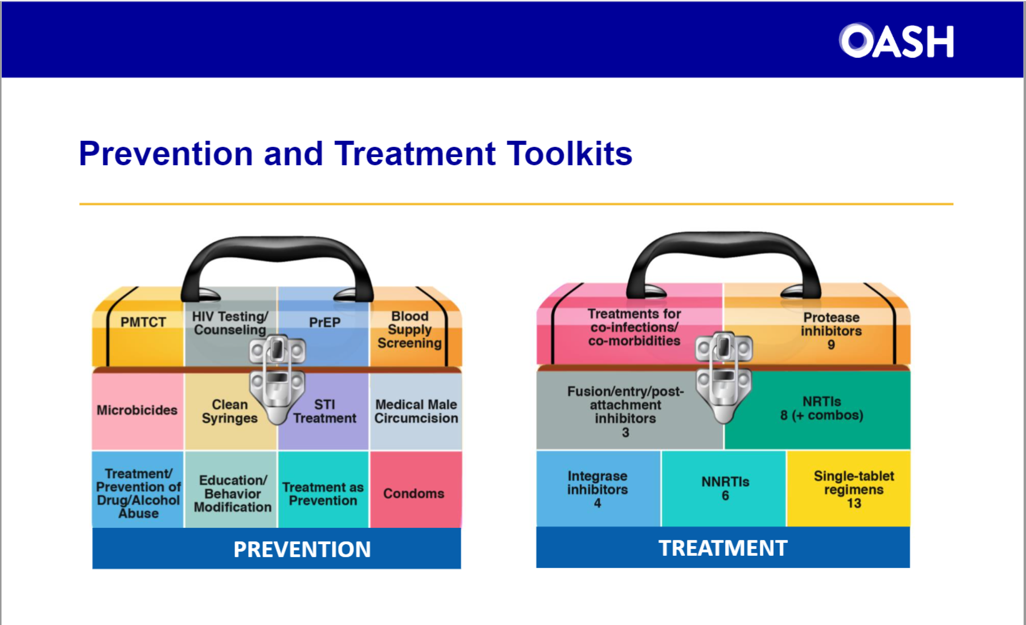
Toolkits
(OASH, 2021)

Slide 9
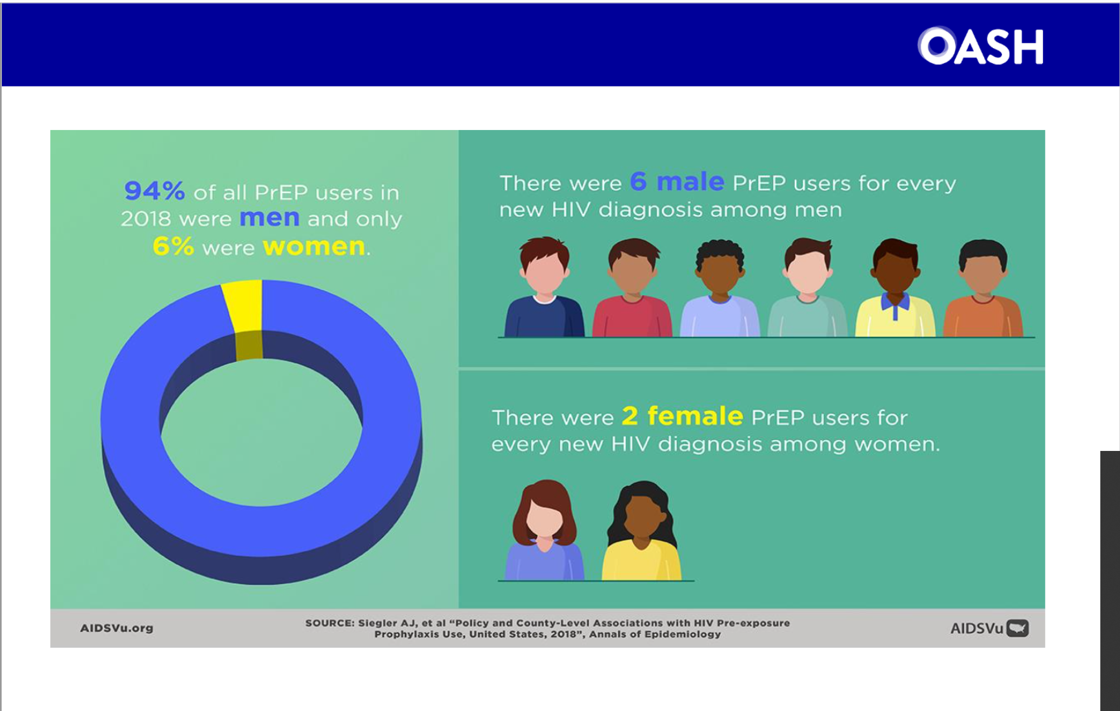
PrEP Users
(OASH, 2021)

Slide 10
HIV prevention
The CDC estimates Over 1.1 million people at risk of HIV
The CDC estimates that only10% of people who are eligible for PrEP have ever taken an HIV prevention medication
Nevada AETC/UNR survey in 2020 found 1 in 5 Nevadans unaware of their HIV status
40% of new HIV infections are transmitted by people undiagnosed and unaware they have HIV (CDC, 2019)
CDC Ready Set PrEP <25 people in Nevada
CDC Vitals Signs November 2015.
UNR PAETC EHE 2020

Slide 11
In your current role at your clinic, what is your role in HIV prevention?
PrEP navigator
Prescriber (MD/DO/NP/PA/Pharmacist)
Office staff (RN, LPN, MA)
Case manager/Peer navigator
Our clinic doesn’t currently offer PrEP

Slide 12
Have you heard of TaSP and U=U
TaSP yes, but not U=U
U=U yes, but not TaSP
Both TaSP and U=U
Neither

Slide 13
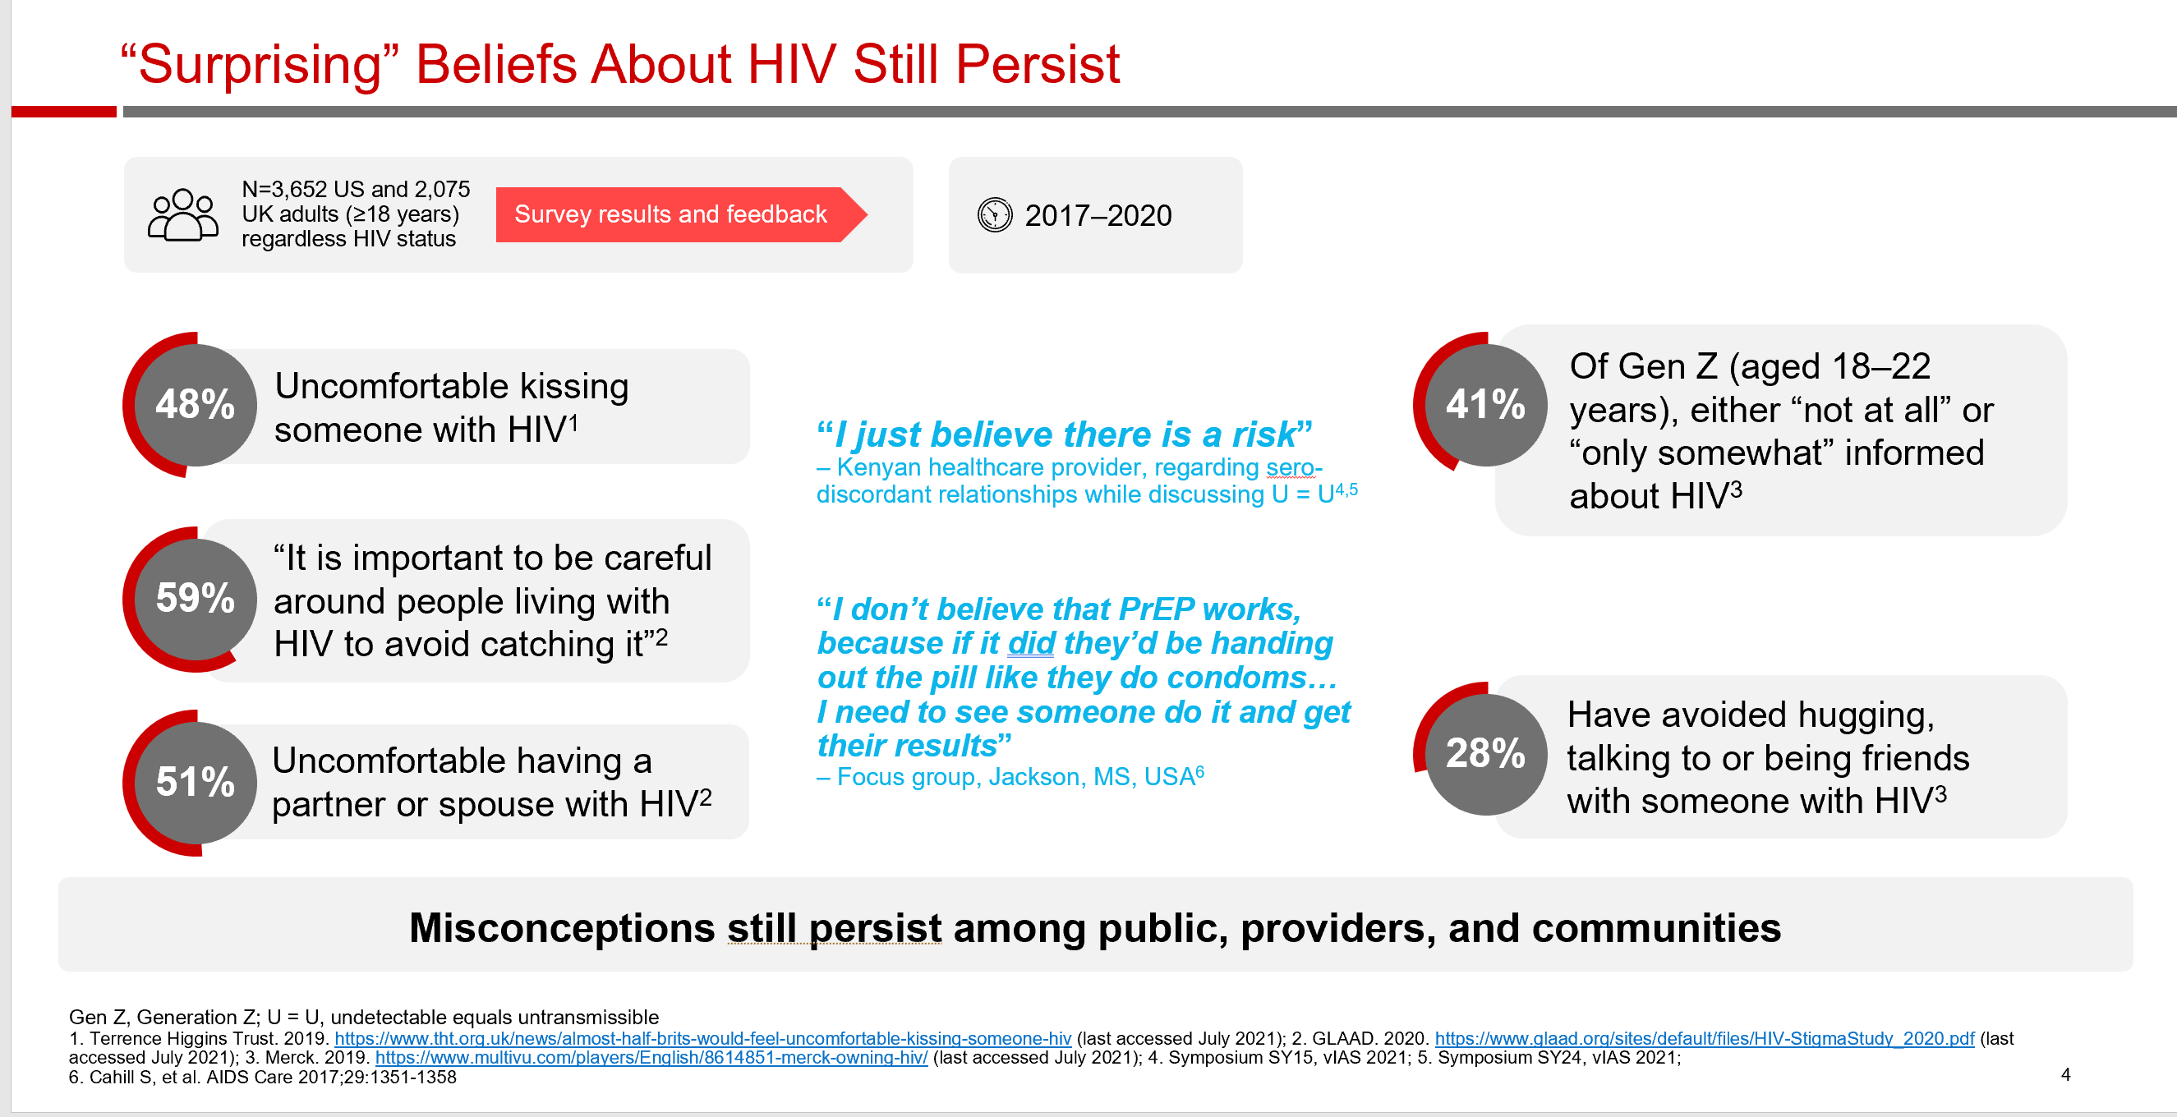
US and UK surveys

Slide 14
Are primary care and ED providers required to have discussion about STI testing/risk with patients?
Yes
No
Don’t know

Slide 15
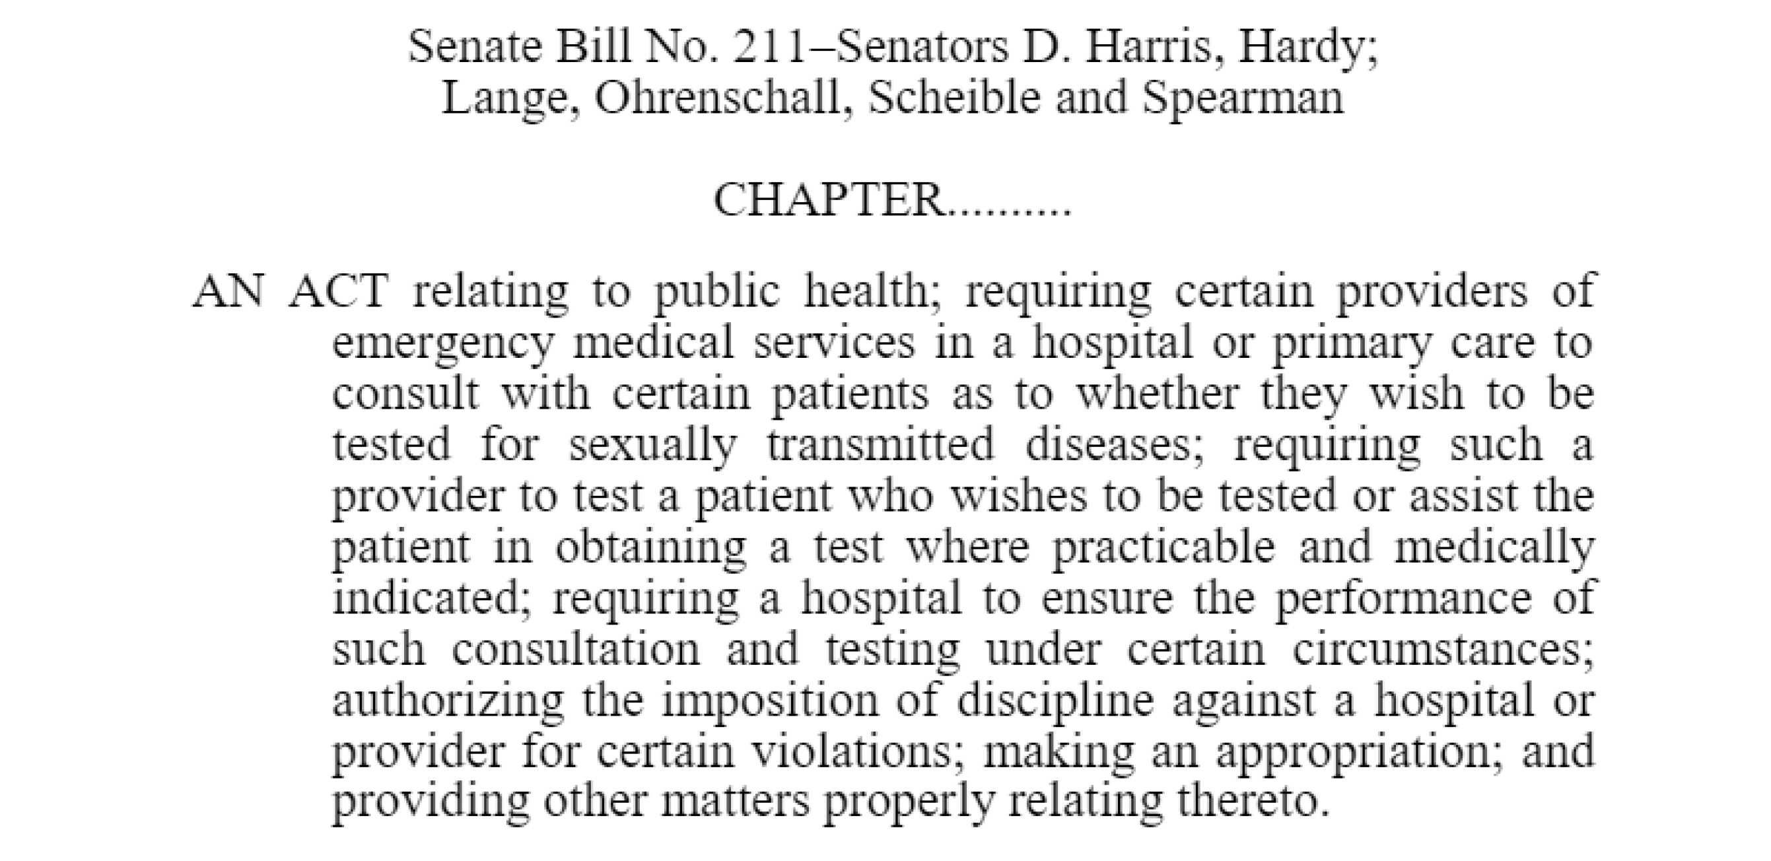
SB 211

Slide 16
Did you know that SB211 was a thing?
Yes
No

Slide 17
Who can prescribe PrEP medications?
MD/DO/NP/PA
Pharmacist
both

Slide 18
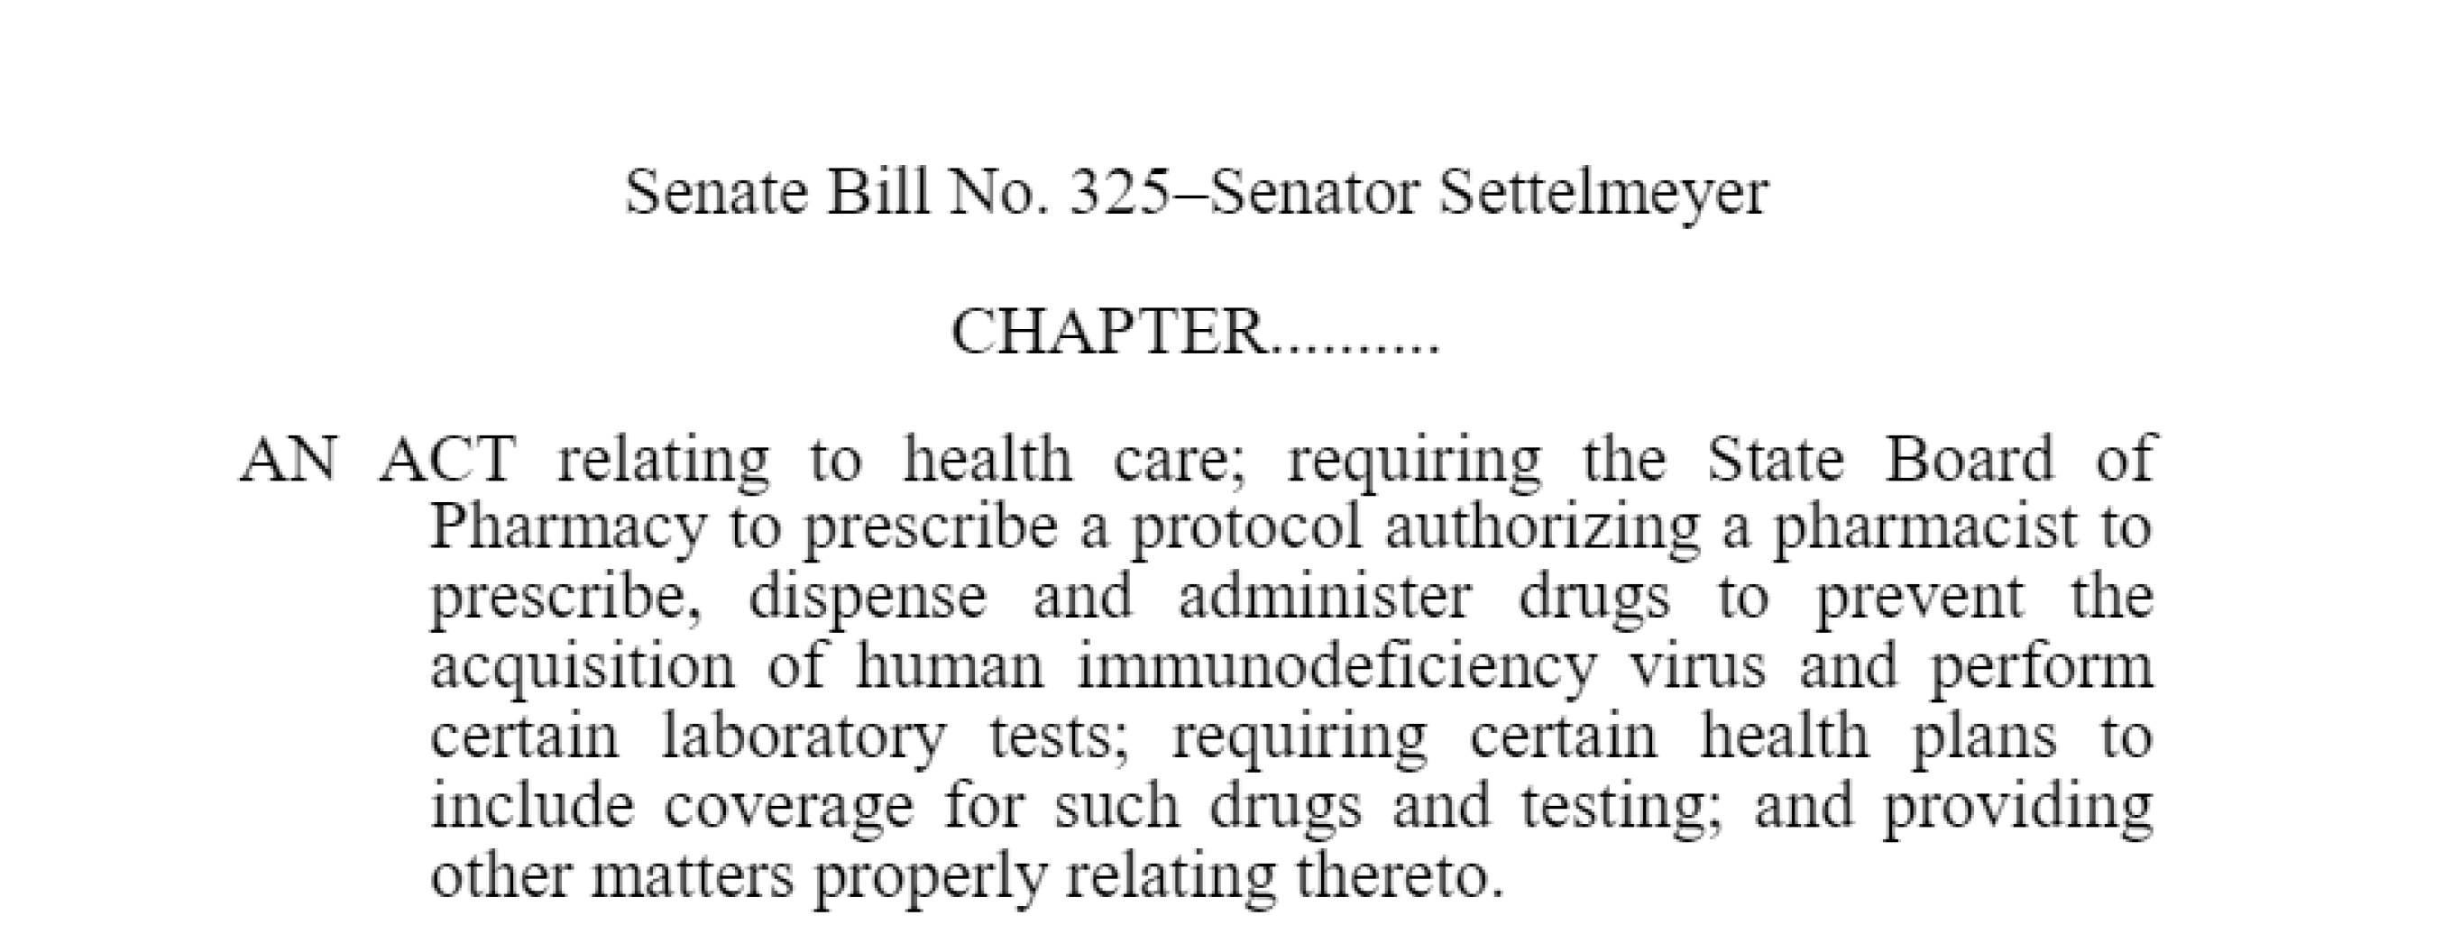
SB325

Slide 19
Had you heard about SB325 before today?
Yes
No

Slide 20
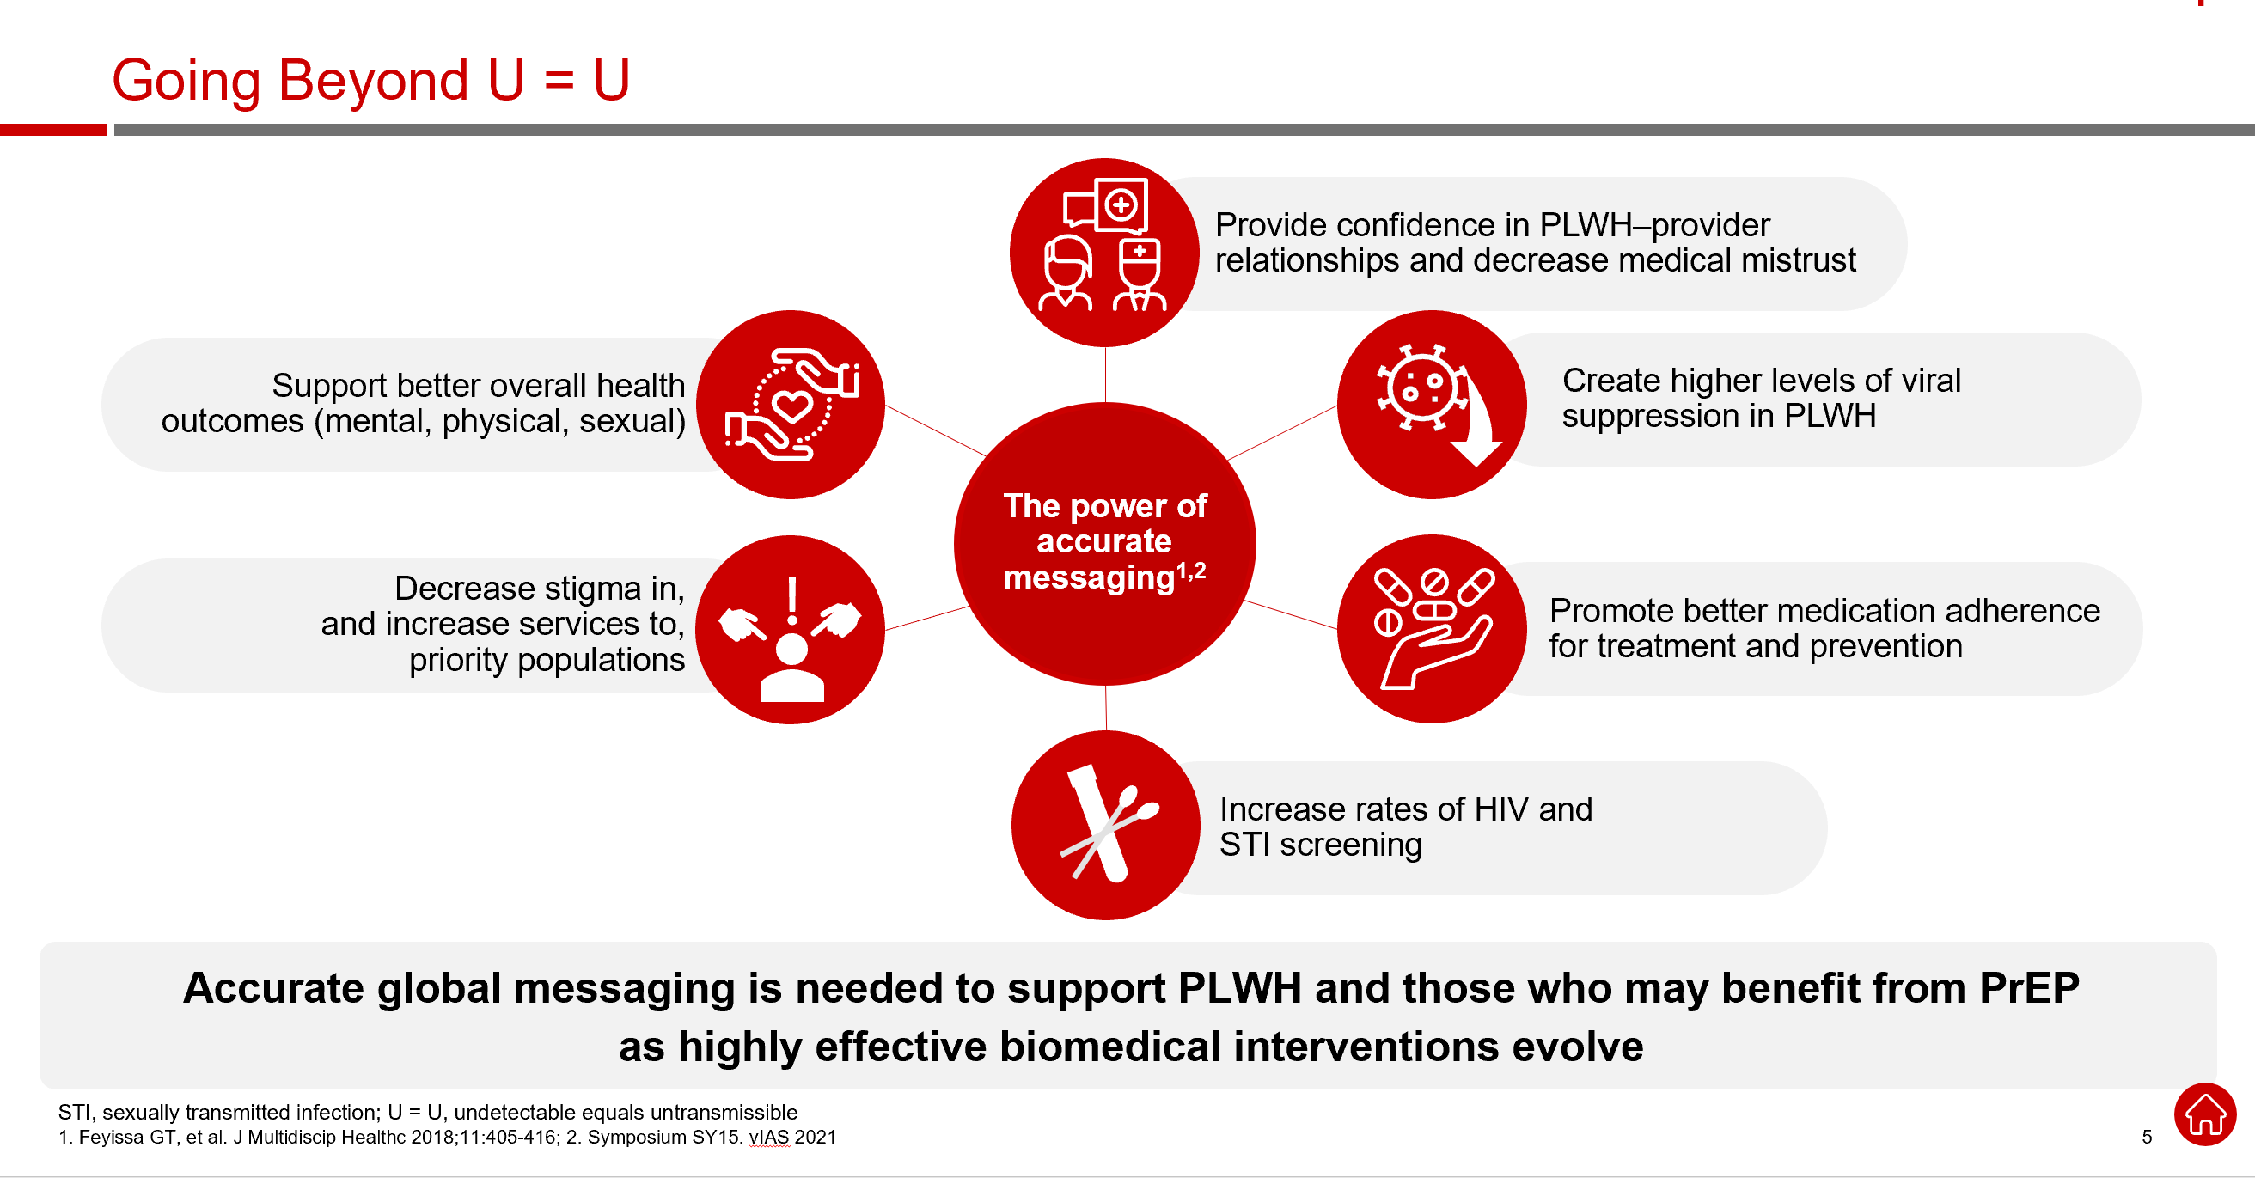
U=U

Slide 21
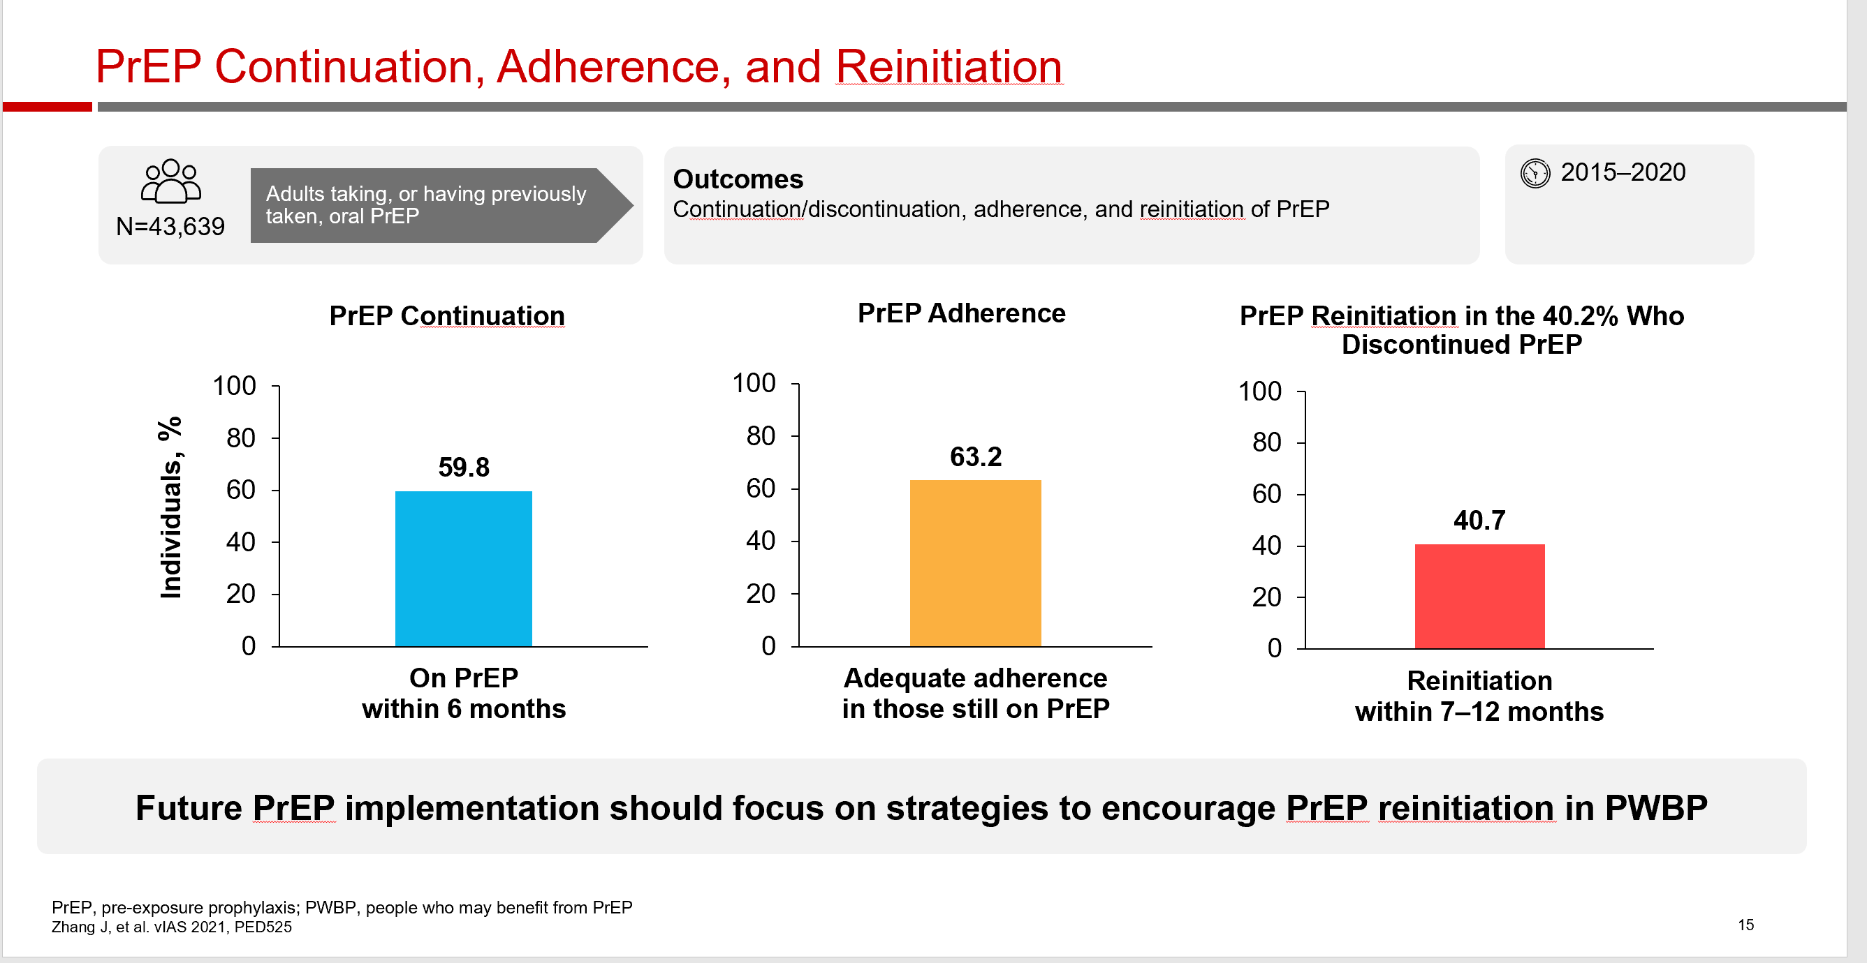
PrEP continuation, adherence and Re-initiation
People who may benefit from PrEP (PWBP)

Slide 22
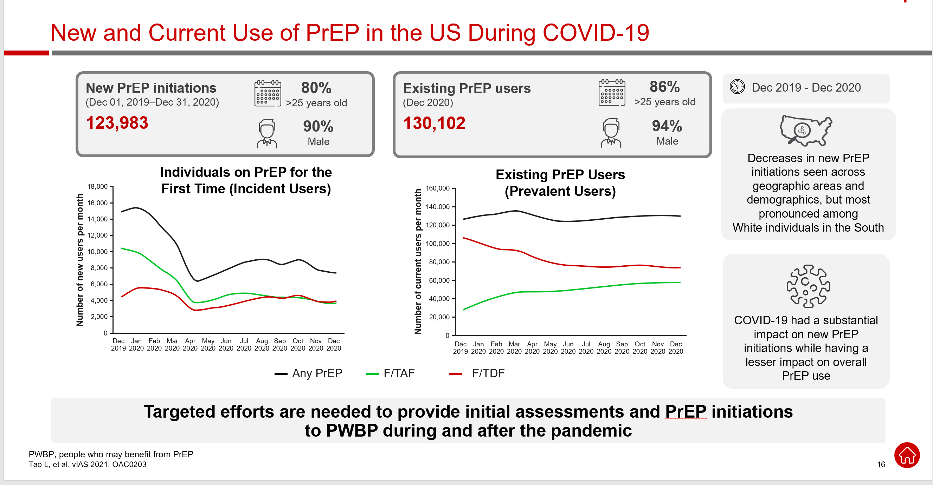
New & Current use of PrEP in the US during COVID-19

Slide 23
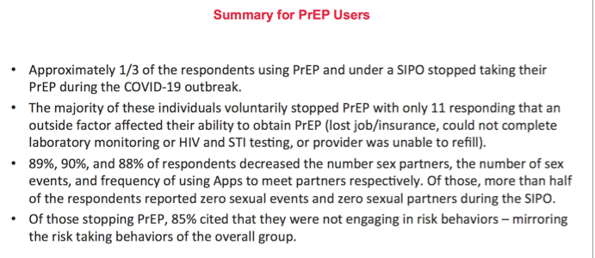
Patients & PrEP during COVID
AIDS 2020: 23rd International AIDS Conference Virtual, July 6-10, 2020

Slide 24
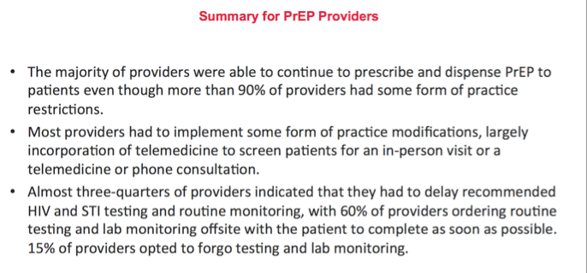
Providers & PrEP during COVID
AIDS 2020: 23rd International AIDS Conference Virtual, July 6-10, 2020

Slide 25
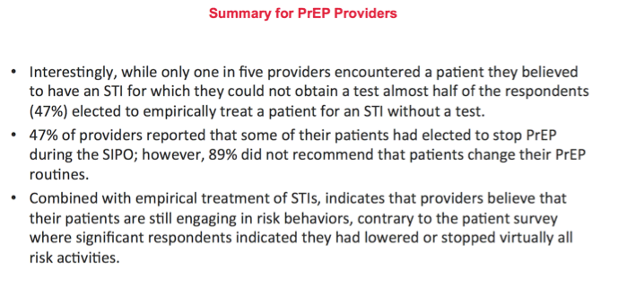
Providers & PrEP
AIDS 2020: 23rd International AIDS Conference Virtual, July 6-10, 2020

Slide 26
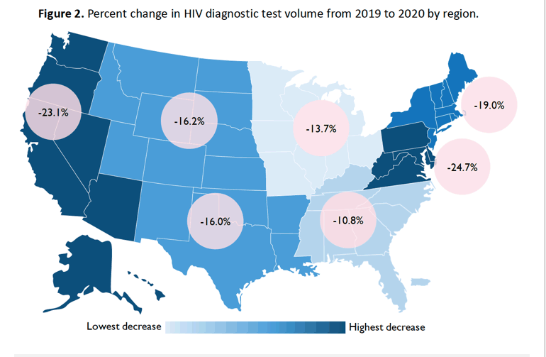
HIV testing rate changes
11th IAS Conference on HIV Science 18-21 July 2021

Slide 27
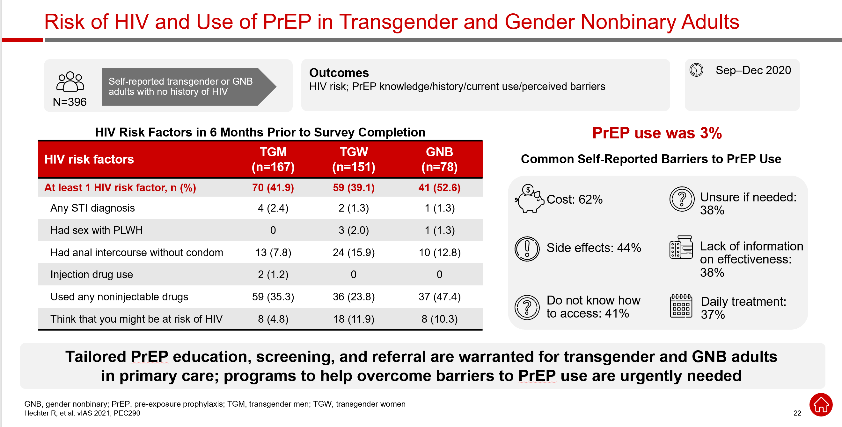
Risk of HIV and use of PrEP
Survey, Kaiser Southern California (US)

Slide 28
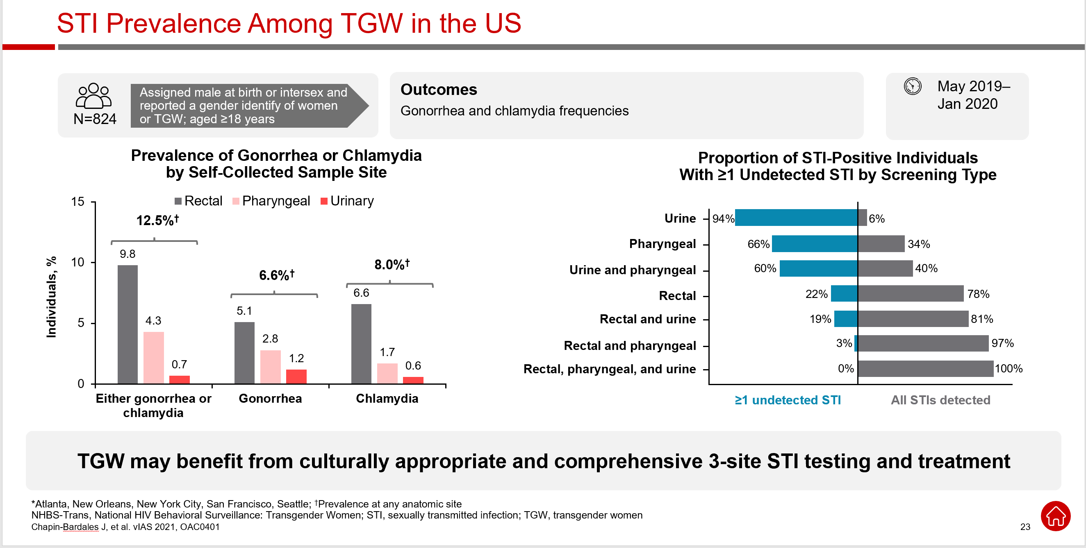
NHBS-Trans 2019–2020, Respondent-Driven Sampling in 5 cities* (US)

Slide 29
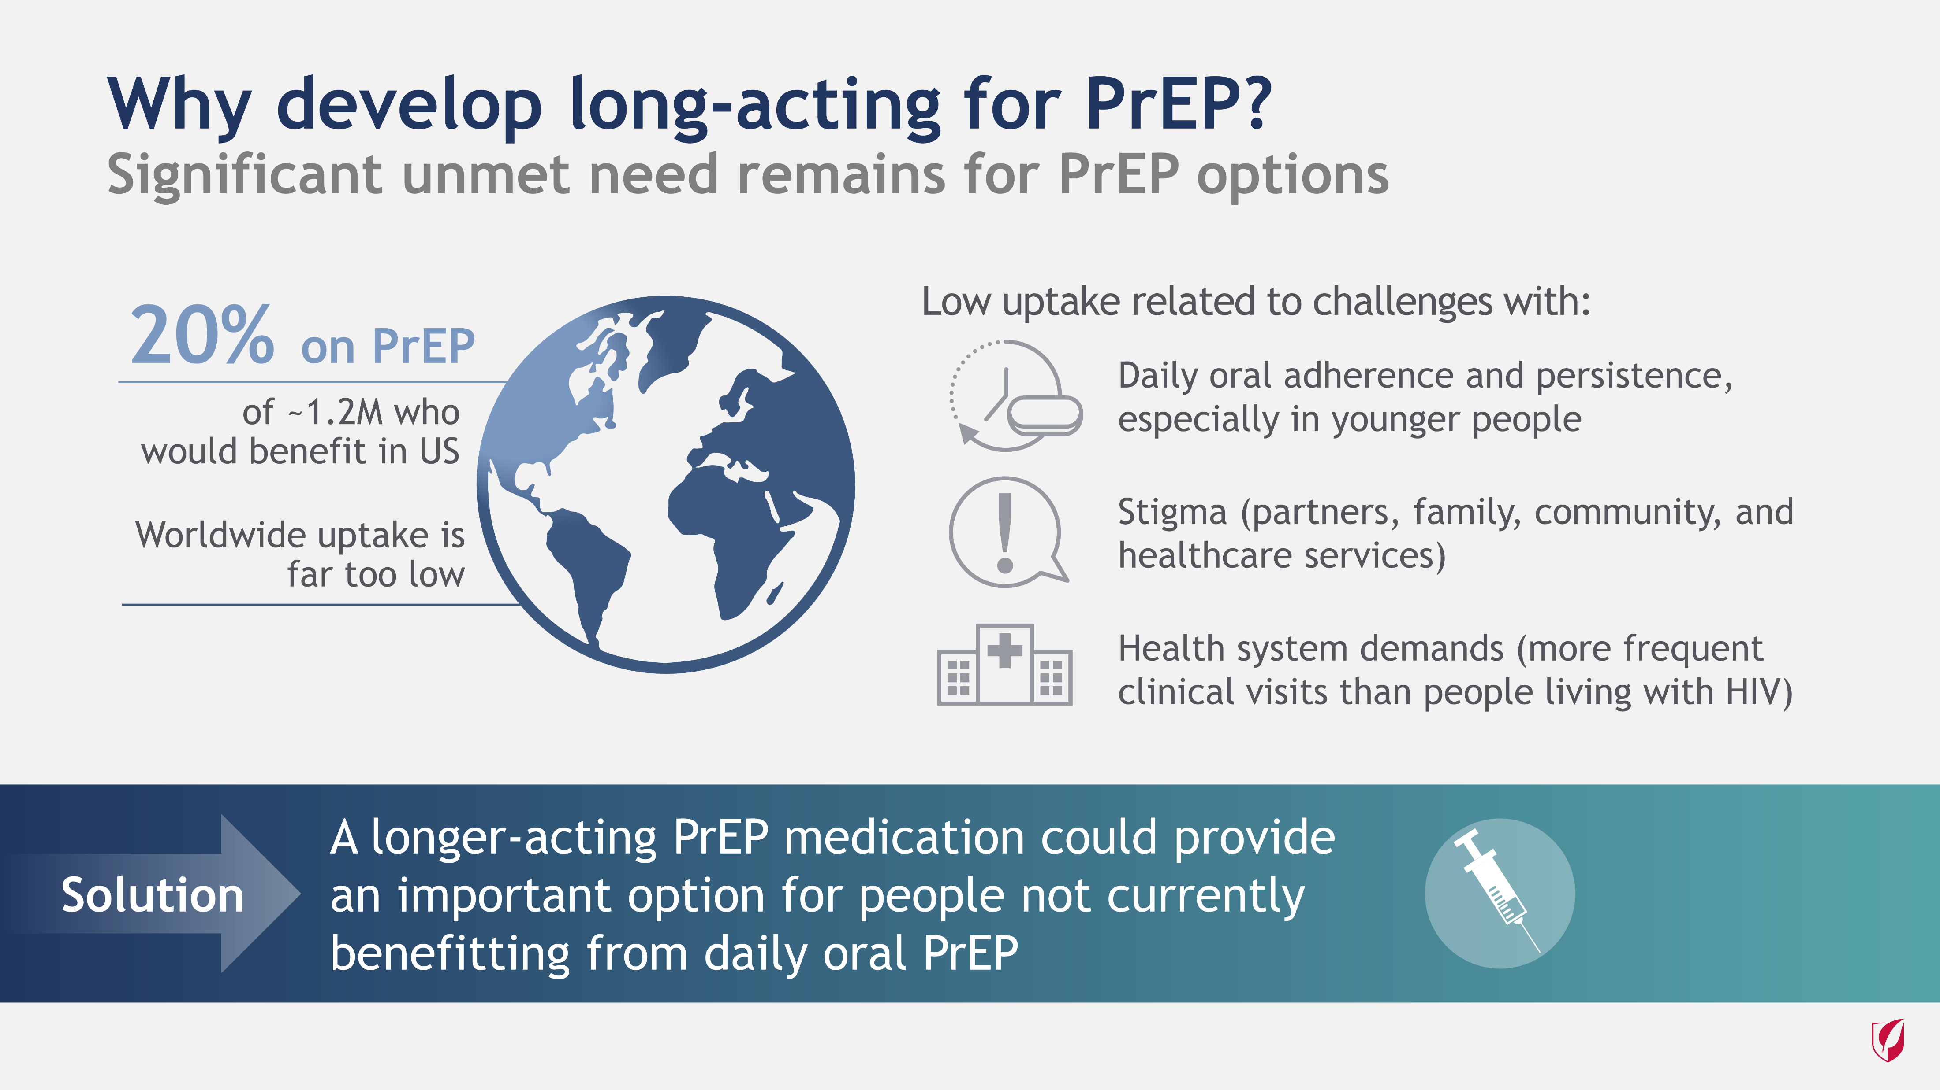
Long Acting PrEP
Notes:
Despite the demonstrated efficacy of PrEP, there remains a significant unmet medical need for new PrEP options. Both in the United States and globally, only a small proportion of people who might benefit from PrEP are using it. The reasons for suboptimal PrEP uptake are numerous and include challenges of adherence to daily oral dosing, stigma associated with taking PrEP, and requirement for frequent healthcare interactions. Notably, the uptake in PrEP has been particularly low among historically underrepresented and disproportionately affected populations, such as transgender women and people of color. Long-acting PrEP could address some of these challenges, potentially reaching more people who would benefit from PrEP.

Slide 30
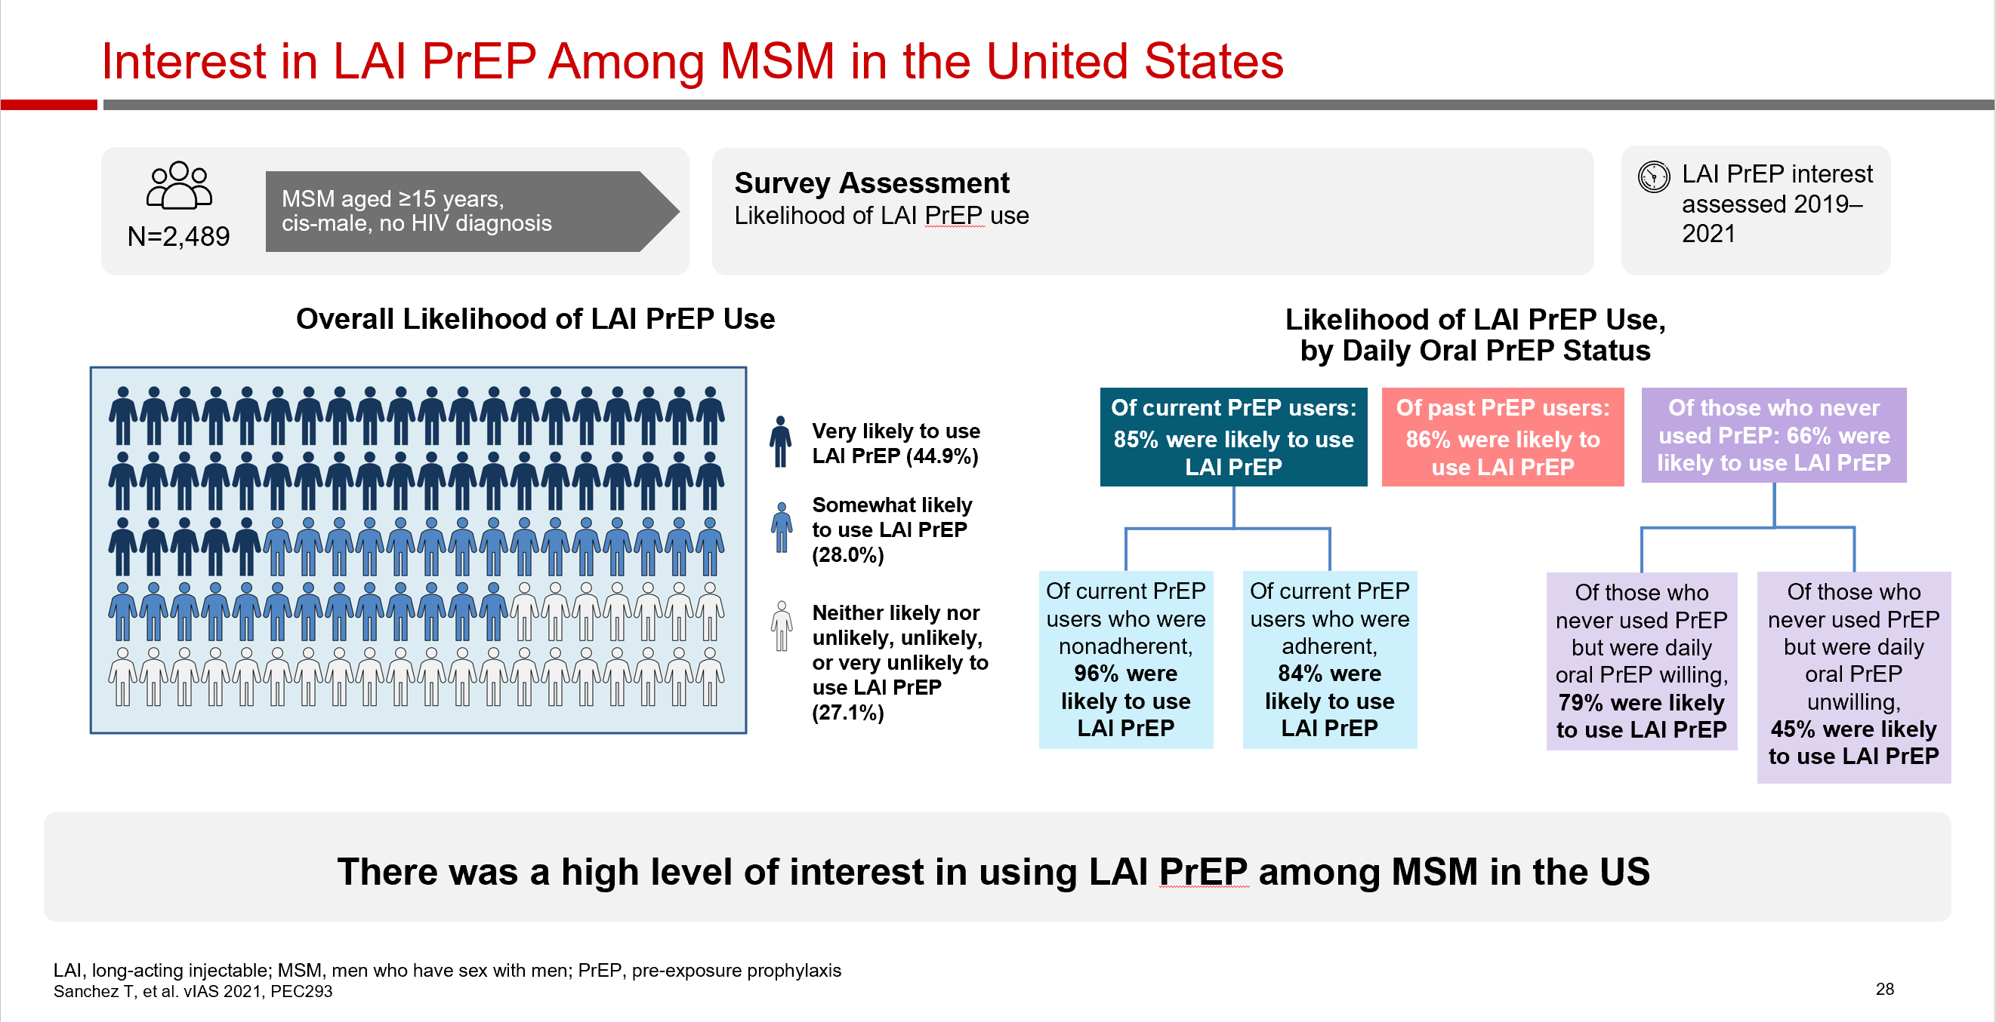
Long Acting Injectable
American Men’s Internet Survey (US)

Slide 31
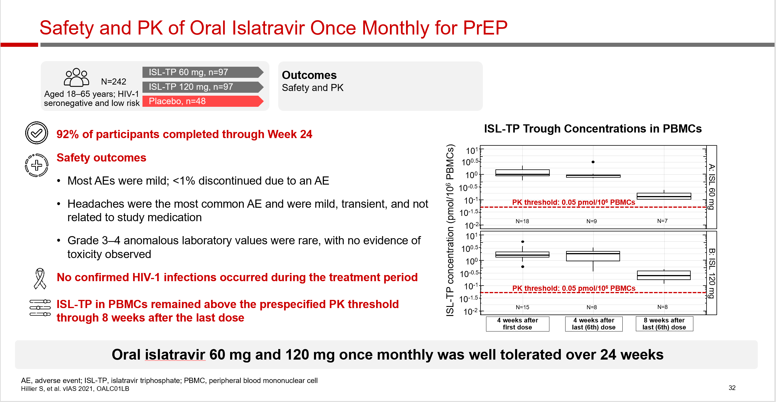
Week 24 Analysis of Phase 2a, Randomized, Double-Blind Trial of Islatravir

Slide 32
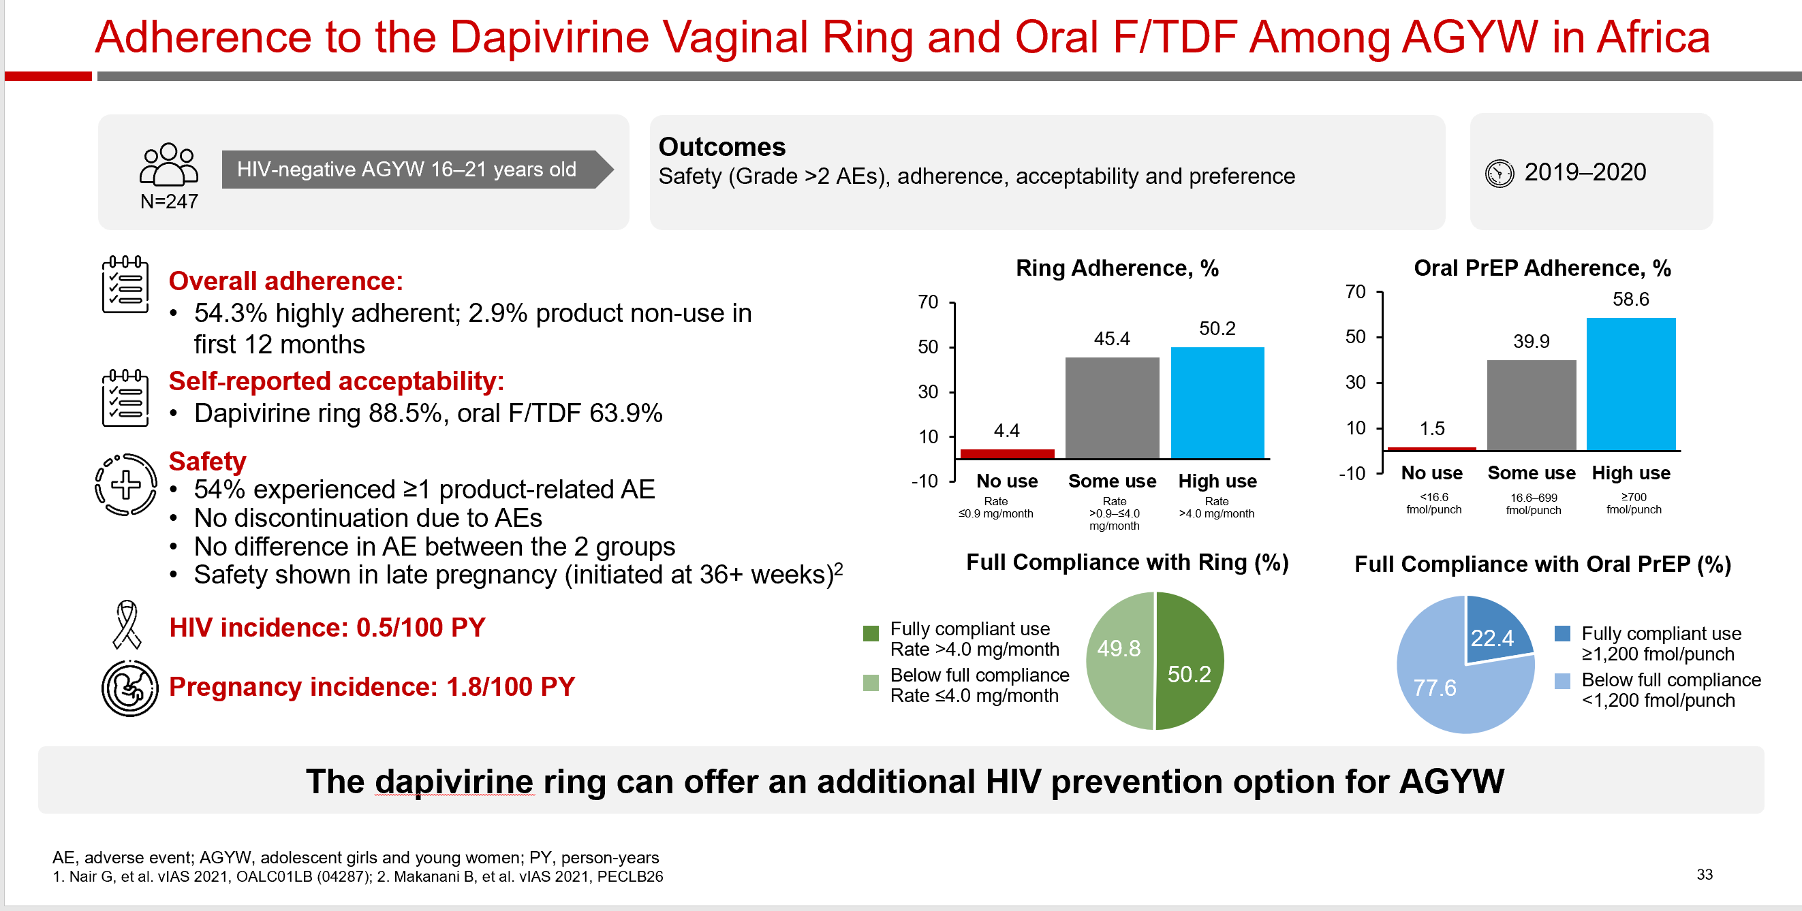
MTN-034/REACH: Randomized, Open-label, Crossover Study
(South Africa, Uganda, Zimbabwe

Slide 33
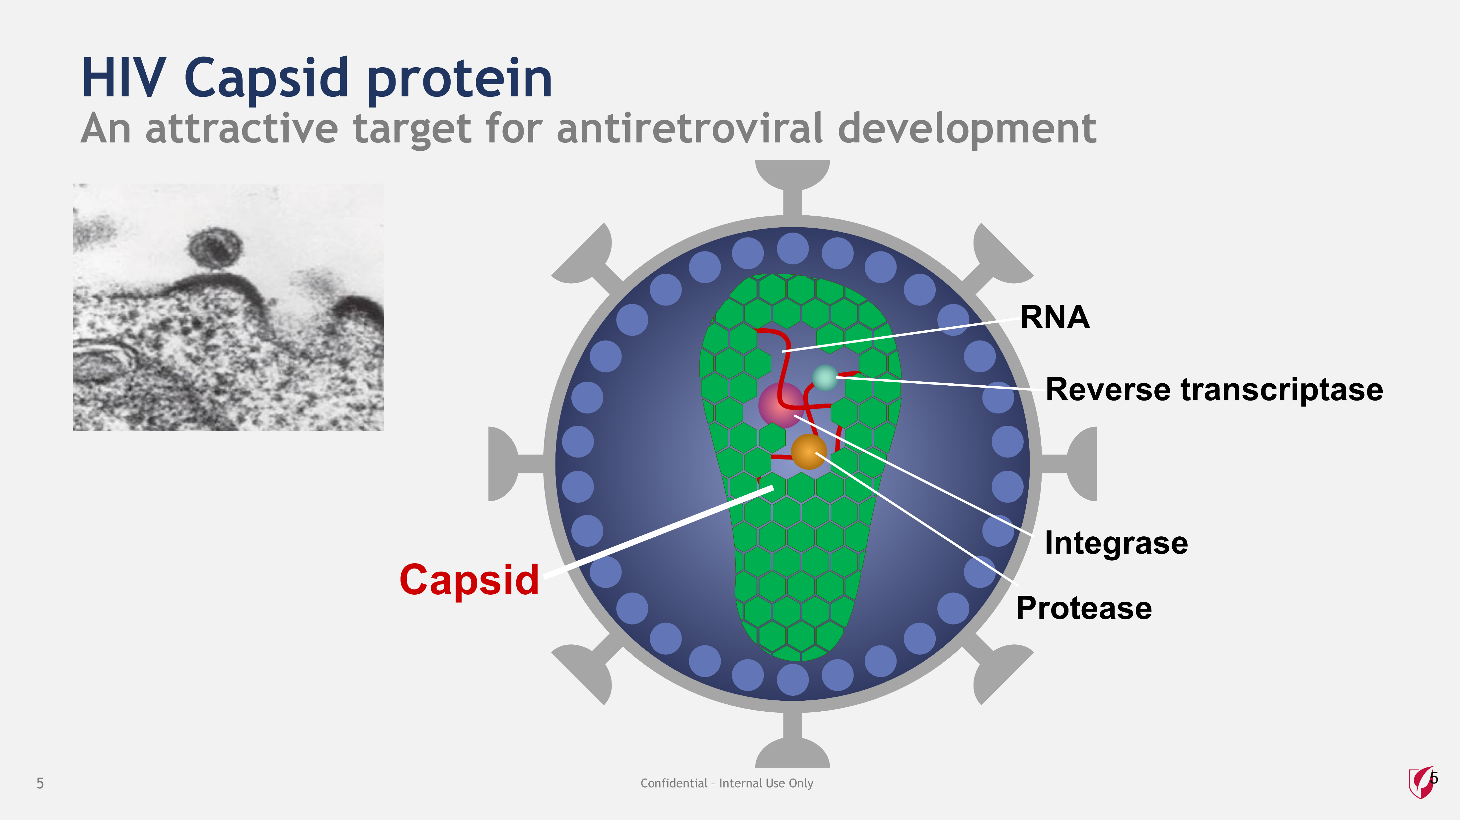
HIV Capsid Protein
Notes:
The HIV capsid protein, shown here in green, makes up the core of the HIV virion and shields the viral genome

Slide 34
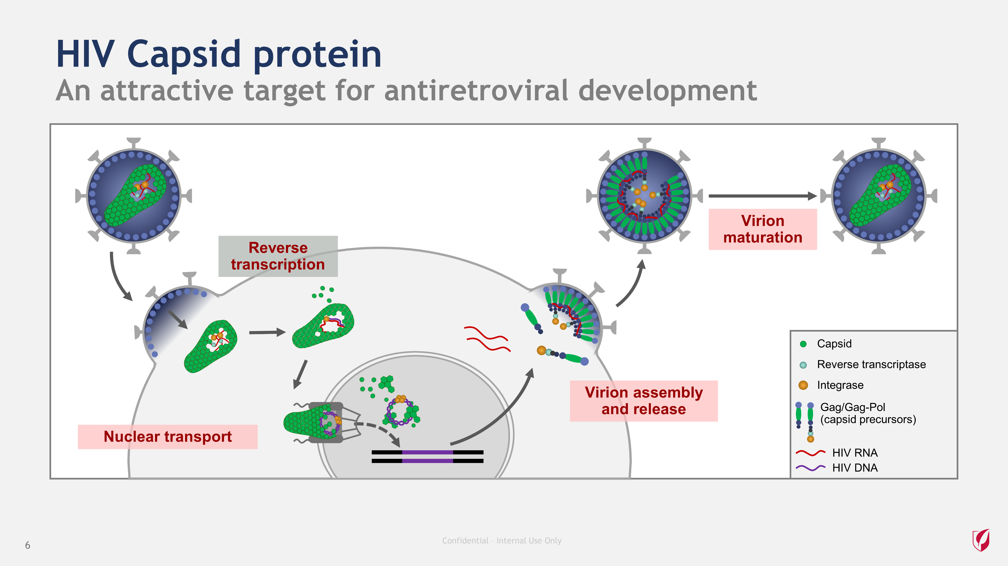
HIV Capsid Protein Cont.
Notes:
The HIV capsid protein is an attractive target for antiretroviral development because it is not merely a structural protein; it is actively involved in several steps of the viral replication cycle. Capsid chaperones the viral pre-integration complex into the host cell nucleus, making capsid necessary for HIV integration to occur. Capsid is also essential for the assembly of new viral particles at the host cell surface and maturation of released viral participles into infectious virions.

Slide 35
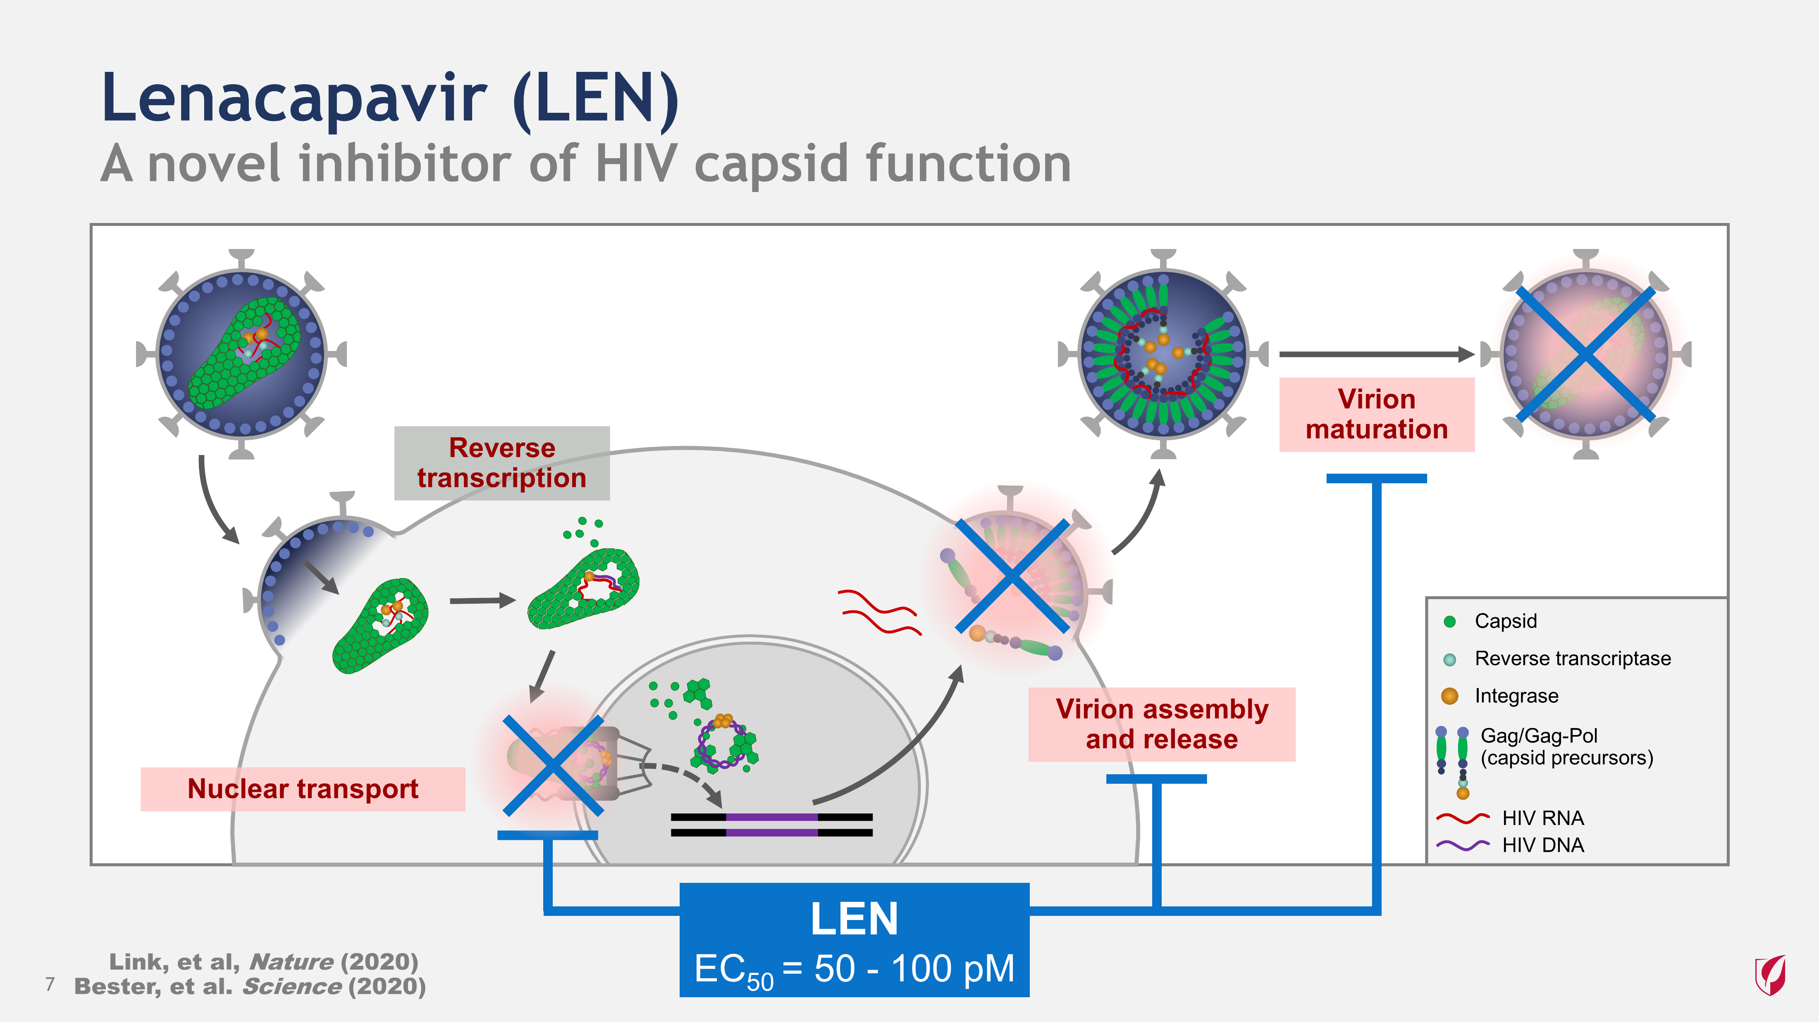
Lenacapavir
Notes:
In vitro studies have demonstrated that LEN inhibits multiple capsid-dependent steps in HIV replication. This makes LEN unique in that it acts both as a pre- and post-integration inhibitor of HIV replication. Importantly, LEN’s potency is very high (50-100 pM depending on cell type). LEN is about 10 times more potent than rilpivirine and efavirenz and about 20 times more potent than bictegravir and cabotegravir.

Slide 36
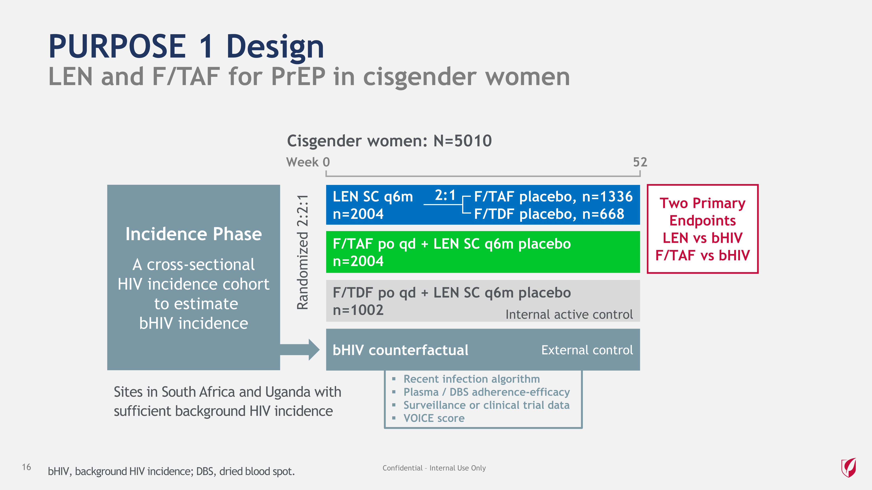
Purpose 1 Design
Notes:
PURPOSE 1 will evaluate LEN and F/TAF for PrEP in adolescent girls and young women (AGYW). The study will enroll approximately 5010 AGYW ages 16-25 in high HIV incidence areas in South Africa and Uganda. The study will have two primary endpoints, both of which will be compared to a counterfactual estimate of the background HIV incidence rate (bHIV). The first primary endpoint will be the HIV incidence rate in participants taking LEN. The second primary endpoint will be the HIV incidence rate in participants taking F/TAF; this endpoint will satisfy the FDA post-marketing commitment to study F/TAF for PrEP in cisgender women. The study will include pre-specified secondary analyses comparing LEN and F/TAF to F/TDF, allowing for efficacy comparisons between the study drugs and the active control.
To determine the counterfactual HIV incidence rate, the study includes an Incidence Phase, which is a specialized screening phase where HIV testing and HIV recency assays will be performed. The data collected from the Incidence Phase will be used in a recent infection testing algorithm (RITA) to calculate the background HIV incidence rate, and the primary endpoint will compare the HIV incidence rates in participants taking LEN or F/TAF to the background incidence rate. The study will also perform additional incidence rate measurements to corroborate the RITA-derived rate, including adherence-efficacy assessments, comparison to clinical trial and surveillance-derived incidence rates, and risk score derived incidence rate estimates such as the VOICE score.
Participants who are found to be HIV negative and meet other eligibility criteria in the Incidence Phase will be eligible for participation in the Randomized Blinded Phase. Participants who chose to partake in the Randomized Blinded Phase will be randomized in a blinded fashion 2:2:1 to receive 6-monthly subcutaneous LEN, daily oral F/TAF, or daily oral F/TDF (included as an active internal control). Each participant will also receive a placebo injection or pill, such that each participant receives one pill and one injection. The Randomized Blinded Phase of the study will continue until all participants have reached at least 52 weeks of follow-up, at which time the primary analysis will be conducted and the study arms will be unblinded. If LEN is shown to be safe and efficacious, there will be an optional open-label LEN extension.

Slide 37
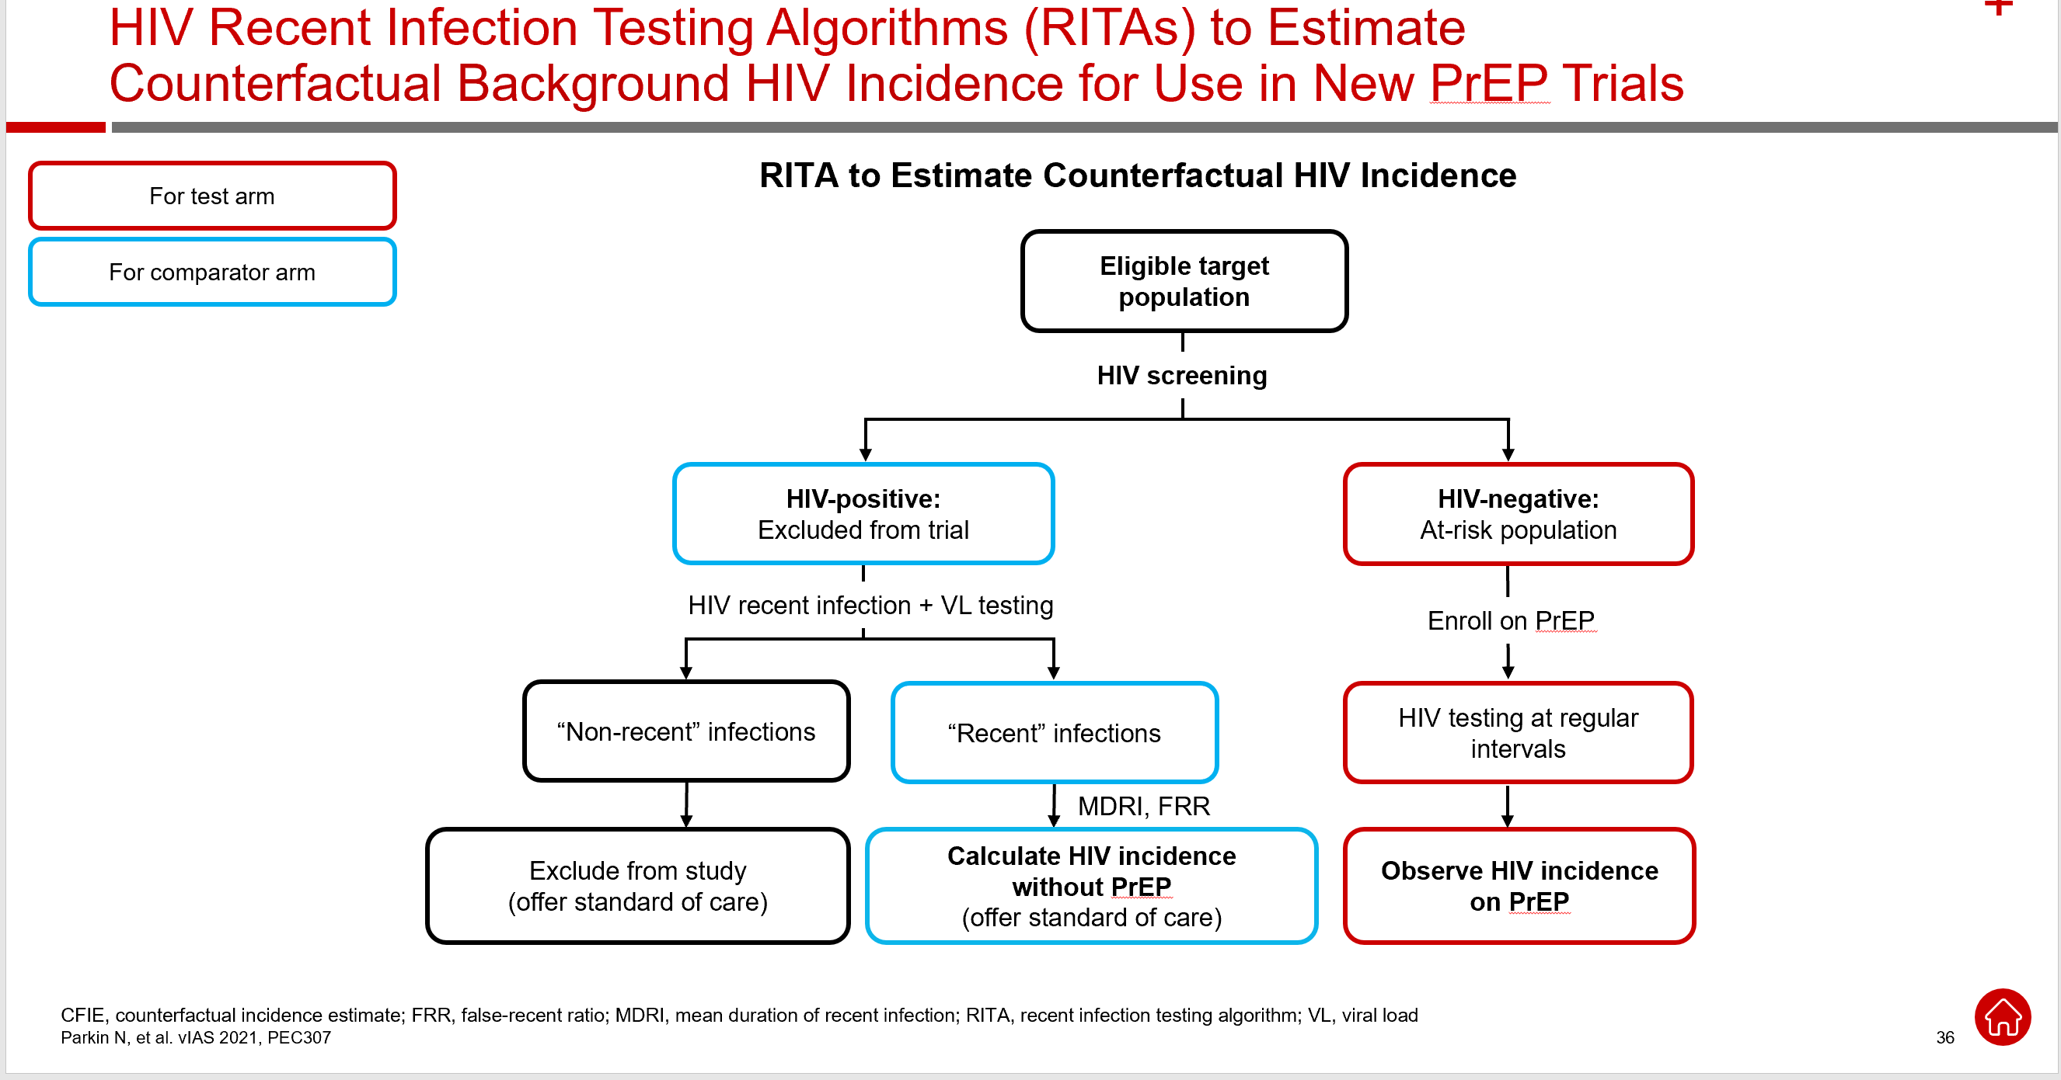
HIV RITAs and CFIE, New PrEP Trials

Slide 38
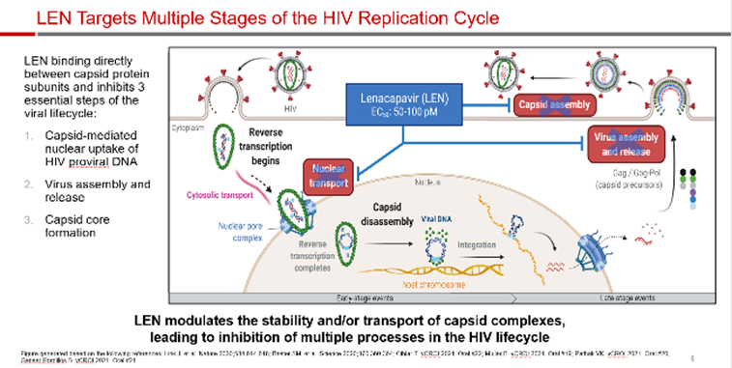
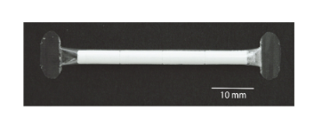
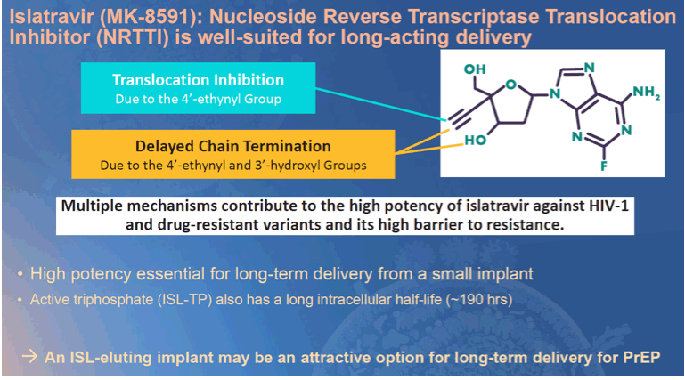
New agents
Implantable cabotegravir
Conference on Retroviruses and Opportunistic Infections Will be Virtual Boston USA March 6-10, 2021

Slide 39
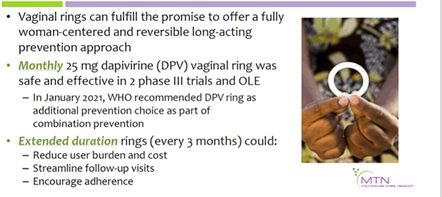
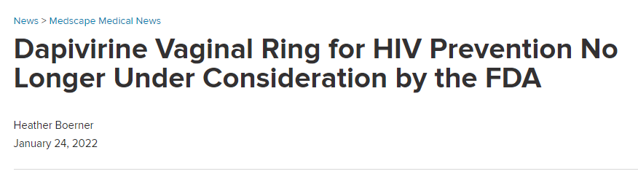
New agents cont
Conference on Retroviruses and Opportunistic Infections Will be Virtual Boston USA March 6-10, 2021
Boerner, 2022
Notes:
In December, the ring's maker, the International Partnership for Microbicides (IPM), pulled its application for FDA approval for the pre-exposure prophylaxis (PrEP) ring. However, in initial studies, the ring was found to be just 27% effective overall. Later studies, where scientists divided women by how much drug was missing from the ring — a proxy for use — found that higher use was associated with higher protection (as much as 54%). By comparison, Truvada has been found to be up to 99% effective when used daily, though it can take up to 21 days to be available in the vagina in high enough concentrations to protect women from vaginal exposure. And the HIV prevention shot was found to be 90% more effective than that in a recent trial of the two methods conducted by the HIV Prevention Trials Network.

Slide 40
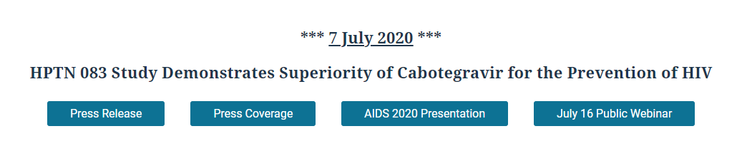
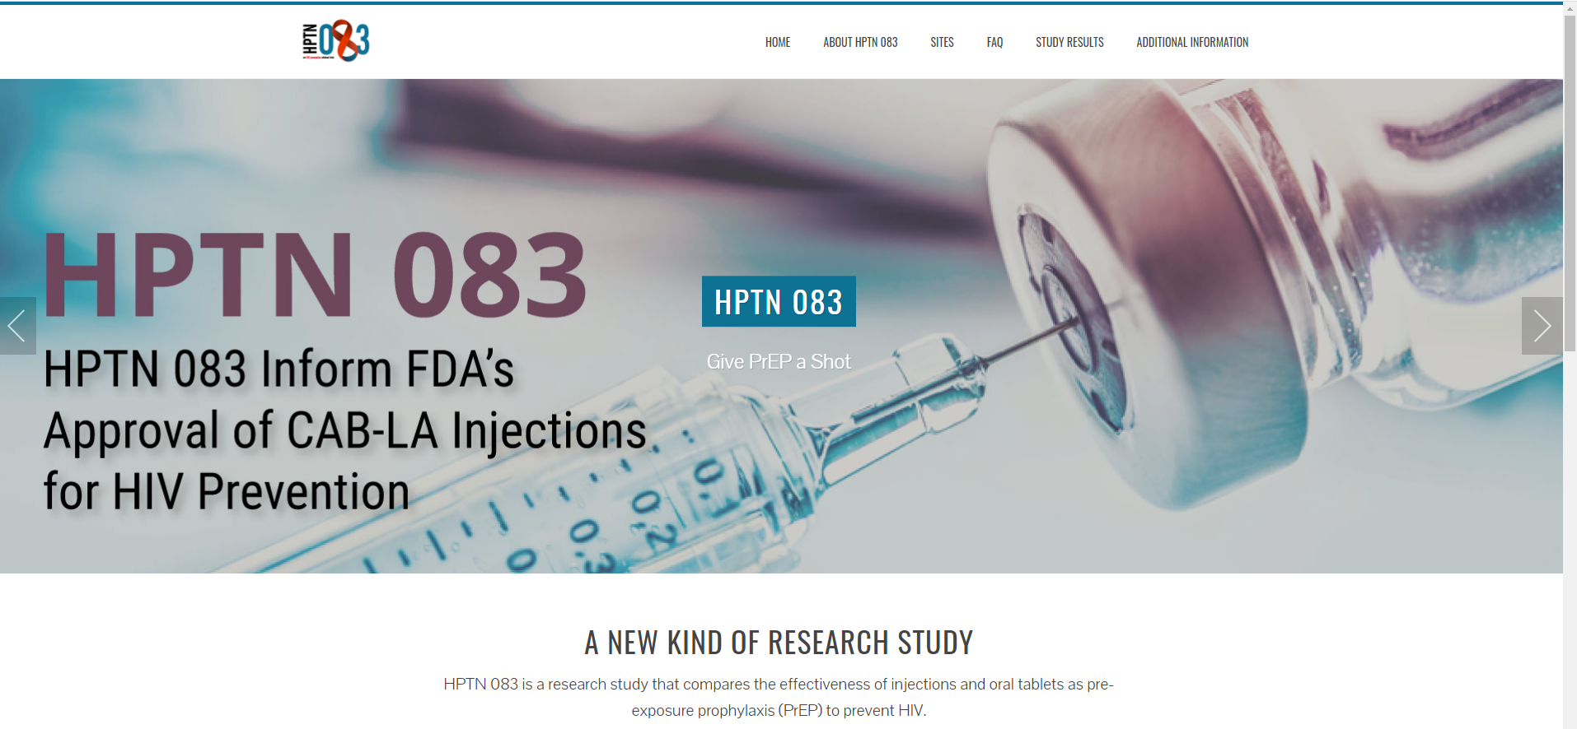
Cabotegravir for HIV Prevention
(HPTN083, 2017)
Notes:
On May 14, 2020 a Data and Safety Monitoring Board (DSMB) reviewed HPTN 083 study data and recommended that the blinded part of the study be stopped early for successfully meeting its specified objectives. The study results showed that CAB LA, administered every eight weeks, provided high efficacy compared to TDF/FTC. A total of 50 incident HIV infections occurred in HPTN 083, with 38 incident HIV infections in the TDF/FTC arm (incidence rate 1.21%) and 12 incident HIV infections in the CAB arm (incidence rate 0.38%): in other words, approximately three times the number of incident HIV infections were in the TDF/FTC arm than in the CAB arm. The study sponsor, the U.S. National Institute of Allergy and Infectious Diseases (NIAID), approved the decision to stop the blinded part of the study.
After a more extensive analysis of the interim study data, the regimen containing CAB LA was found to be statistically superior to daily oral TDF/FTC for PrEP among the cisgender men and transgender women who have sex with men enrolled in HPTN 083. A total of 52 incident HIV infections occurred, with 13 incident infections in the CAB arm (incidence rate 0.41%) and 39 incident infections in the TDF/FTC arm (incidence rate 1.22%). The hazard ratio for the CAB versus TDF/FTC arms is 0.34 (95% CI 0.18-0.62), corresponding to a 66% reduction in incident HIV infections in study participants given CAB compared to TDF/FTC. These results were presented at AIDS 2020.

Slide 41
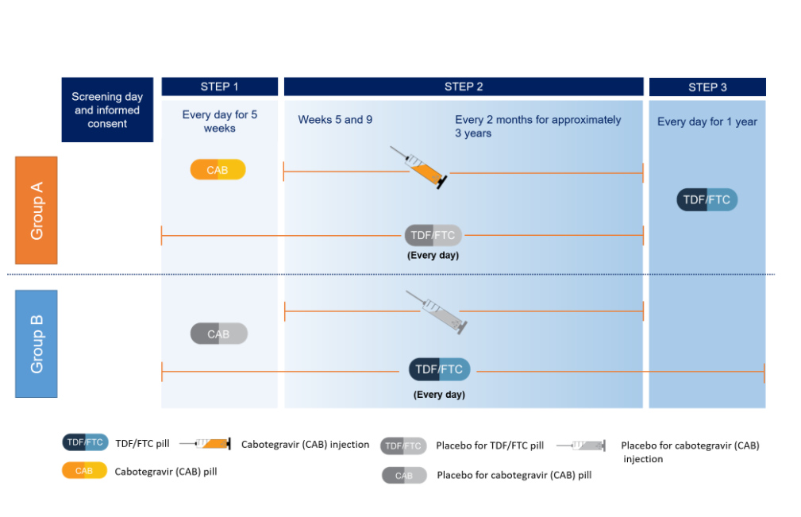
HPTN 083
(HPTN083, 2017)

Slide 42
PrEP for Injection Now Approved
(ViiV Healtcare, n.d.)

Slide 43
PrEP challenges
At the end of 2018, just 7% of women who could benefit from HIV prevention drugs were taking them,
New CDC guidelines recommend clinicians talk to every sexually active adult and adolescent about HIV prevention medications at least once, and prescribe it to anyone who asks for it, whether or not they understand their patients' HIV risks.
However, research continues to show that clinicians struggle with willingness to prescribe PrEP to Black women
the American College of Obstetrics and Gynecology's committee opinion on managing women using HIV prevention drugs has not been updated to reflect the new guidelines
Boerner, 2022

Slide 44
How motivated to change related to HIV prevention are you after today’s presentation?
Not at all
Somewhat motivated
Very motivated
Very motivated but not sure I can make a difference in my agency
Very motivated and I will work to make a change in my agency

Slide 45
References
Brawley, S. (2020, July 6–10). Impact of COVID-19 related shelter in place orders on PrEP access, usage and HIV risk factors in the United States [conference presentation]. International AIDS Conference, Virtual, Virtual. https://natap.org/2020/IAC/IAC_35.htm
Curanovic, D., Camarillo, J., Petropoulos, C., & Walworth, C. (2021, July 18–21). Decline in HIV testing and changes in positivity rates during the COVID 19 pandemic. 11th IAS Conference on HIV Science, Virtual. chrome-extension://oemmndcbldboiebfnladdacbdfmadadm/https://www.natap.org/2021/IAS/IAS2021DeclineHIVestingfinal.pdf
Karunakaran, D., Simpson, S. M., Su, J. T., Bryndza-Tfaily, E., Hope, T. J., Veazey, R., Dobek, G., Qiu, J., Watrous, D., Sung, S., Chacon, J. E., & Kiser, P. F. (2021). Design and testing of a cabotegravir implant for hiv prevention. Journal of Controlled Release, 330, 658–668. Retrieved October 3, 2021, from https://doi.org/10.1016/j.jconrel.2020.12.024

