Slide 1
Pre-Exposure Prophylaxis for hiv
Sean Kelly, MD
Vanderbilt Division of Infectious Diseases

Slide 2
Objectives
Background of PrEP
Importance of PrEP in the Southeast
Provider and patient barriers to PrEP
PrEP eligibility
PrEP prescribing
Counseling
Adverse effects
Lab monitoring

Slide 3
Secondary Objectives
Increase your confidence in providing PrEP!
Provide PrEP!

Slide 4
What is PrEP

Slide 5
PrEP is primary prevention
It is intended to PREVENT the onset of a disease in those who are AT RISK
It is a concept, fulfilled by medication that has been FDA-approved for this purpose

Slide 6
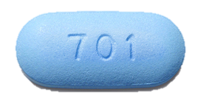
TDF/FTC
Fixed dose combination of tenofovir disoproxil fumarate (TDF) 300mg/emtricitabine (FTC) 200mg
FDA-approved for use as PrEP for adults on June 6, 2012
FDA-approved for use as PrEP for adolescents on May 15, 2018
Generic TDF/FTC approved June 2017
Became available September 2020

Slide 7
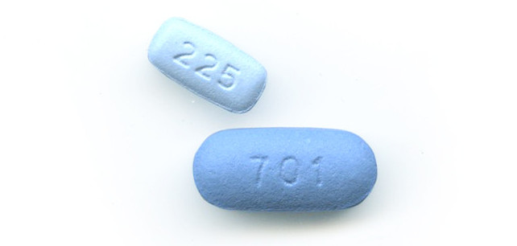
TAF/FTC
Similar to TDF/FTC
TDF/FTC = tenofovir disoproxil fumarate + emtricitabine
TAF/FTC= tenofovir alafenamide + emtricitabine
Approved for PrEP October 2, 2019 for non-vaginal sex
TAF achieves high intracellular concentrations, but lower (>10-fold) plasma and tissue concentrations than TDF
Lower risk of BMD loss and reduced creatinine clearance
Can be used in chronic kidney disease (CrCl >30 mL/min)

Slide 8
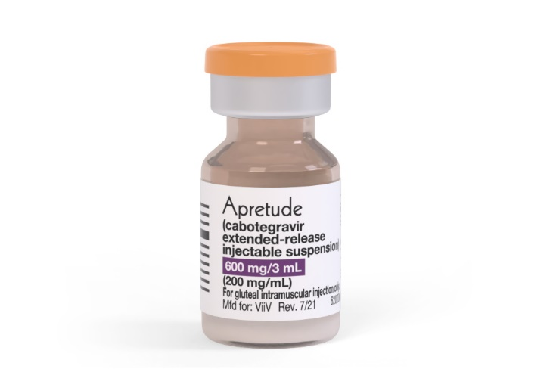
LA cabotegravir
Long-active injectable
Optional oral lead-in
2 doses 1 month apart, then every 2 months
Consecutive doses can be given 7 days before or after target date
Approved 12/20/21
Demonstrated superiority to TDF/FTC
Injection site reactions are common
Since LA cabotegravir is not yet widely used, this talk will focus on oral PrEP
https://gskpro.com/content/dam/global/hcpportal/en_US/Prescribing_Information/Apretude/pdf/APRETUDE-PI-PIL-IFU.PDF

Slide 9
Which should I use???
TDF/FTC
TAF/FTC
Pros | Cons | Pros | Cons
More data on efficacy, PK, dosing strategies… | Low risk of renal dysfunction | Lower risk of renal dysfunction | Fewer data, less experience
More experience | Reversible bone mineral density loss | Lower risk of bone mineral density loss | Can’t be used for vaginal sex yet
Covered by all insurance | Larger pill size | Smaller pill size | Less insurance coverage
Can be used for vaginal and anal sex | Can’t be used if eGFR <60 | Faster time to therapeutic level | No data on 2-1-1 dosing
More brand recognition |  | Can be used if eGFR >30 | Weight gain?
Generic available |  |  | Not cost effective
Walensky RP, Horn T, McCann NC, Freedberg KA, Paltiel AD. Comparative Pricing of Branded Tenofovir Alafenamide-Emtricitabine Relative to Generic Tenofovir Disoproxil Fumarate-Emtricitabine for HIV Preexposure Prophylaxis: A Cost-Effectiveness Analysis. Ann Intern Med. 2020;172(9):583-590. doi:10.7326/M19-3478

Slide 10
Primary Prevention
 | HIV | Myocardial infarction or Stroke
Assess risk | Take a sexual history | Take a past medical, family, social history, check cholesterol and screen for diabetes, calculate 10-year ASCVD risk by 2013 ACC/AHA guidelines
Laboratory evaluation | Serum creatinine, HIV screen | Comprehensive metabolic panel, cholesterol profile, hemoglobin a1c
Further risk reduction | Condom use, sexual health and substance use counseling, STI screening | Lifestyle and diet modification counseling, treat comorbid conditions (hypertension, diabetes), smoking cessation
Medication options | TDF/FTC TAF/FTC | Atorvastatin Rosuvastatin Pravastatin Pitavastatin Simvastatin Fluvastatin | Aspirin
PrEP IS EASY

Slide 11
PrEP is a PROGRAM
Not only HIV prevention
Involves comprehensive sexual healthcare
Screening and treatment for STIs
Hepatitis A and B vaccination
Counseling on STI prevention strategies

Slide 12
STIs Facilitate HIV Transmission
Disruption of mucosal integrity
Increase HIV target cells in genital tract due to immune reaction to infection
STIs promote HIV shedding in the genital tract
Presence of ulcerative STI increases likelihood of HIV acquisition up to 5-fold!
https://www.cdc.gov/std/hiv/stds-and-hiv-fact-sheet-press.pdf

Slide 13
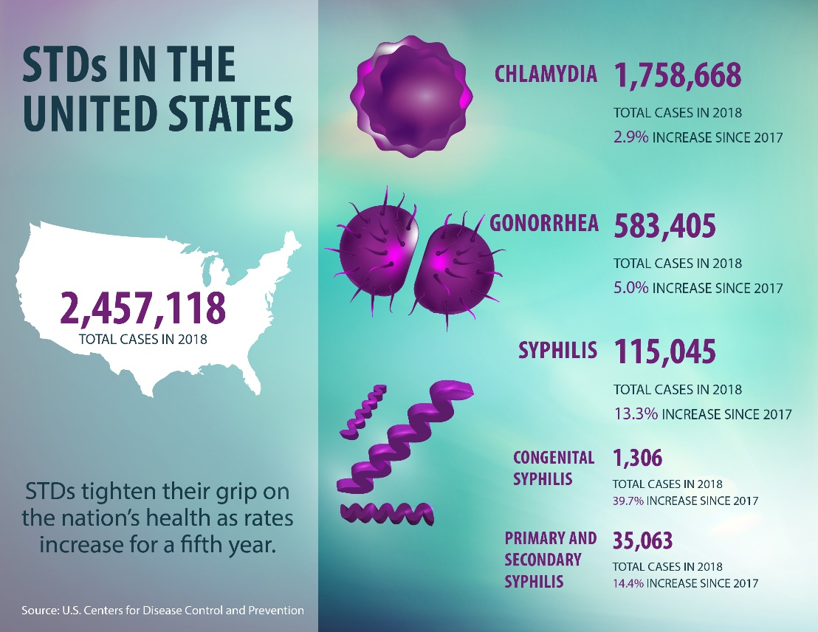
Be afraid!
PrEP does NOT protect against bacterial and other STIs
These are at record highs!

Slide 14
PrEP efficacy studies summary
Study | Population | Dosing | Risk Reduction
iPrEX | MSM | Daily | 44% (92% with ideal adherence)
TDF2 | Heterosexual men and women | Daily | 62.2% (100% in open-label extension with regular follow-up)
Partners | Sero-discordant heterosexual couples | Daily | 75% (90% with ideal adherence)
Bangkok Tenofovir Study Group | Intravenous drug users | Daily | 48.9% (74% with ideal adherence)
IPERGAY | MSM | On-demand | 86%

Slide 15
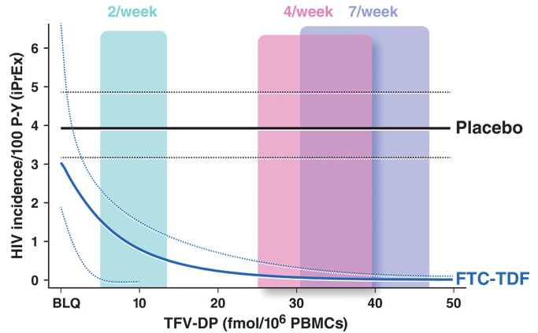
Dosing matters
Using drug concentrations in iPrEX and STRAND, pharmacokinetic models predict:
76% risk reduction with 2 doses/week
96% with 4 doses/week
99% with 7 doses/week.
Anderson PL, Glidden DV, Liu A, Buchbinder S, Lama JR, Guanira JV, et al. Sci Transl Med. 2012;4: 151ra125.
Notes:
Pharmacokinetic studies indicate decreasing efficacy of TDF/FTC as PrEP with less than daily dosing; among MSM, taking four doses per week is associated with 96% efficacy, while taking two doses per week is associated with 76% efficacy

Slide 16
Why PrEP Matters

Slide 17
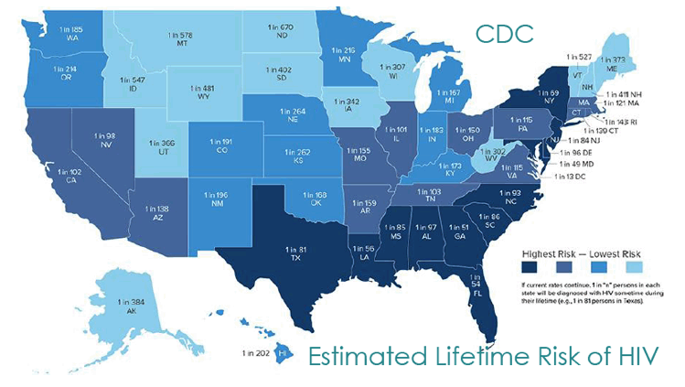
The Southeast remains the region with the highest HIV incidence, which can be markedly reduced with widespread use of pre-exposure prophylaxis (PrEP) among high-risk individuals.

Slide 18
HIV Risk by Race/Ethnicity and MSM
White women
1 in 880
White men
1 in 132
Hispanic women
1 in 227
Hispanic men
1 in 48
Black women
1 in 48
Black men
1 in 20
White MSM
1 in 11
Hispanic MSM
1 in 4
Black MSM
1 in 2
CDC, 23 Feb 2016: http://www.cdc.gov/nchhstp/newsroom/2016/croi-press-release-risk.html
Notes:
Young, African-American men who have sex with men, and who live in the South have the highest lifetime risk for HIV in USA

Slide 19
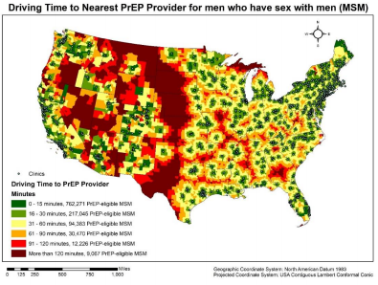
PrEP Deserts
Most MSM with reduced geographic access to PrEP providers (“PrEP deserts”) reside in the South.
Over 50% of MSM in the South must drive >60 minutes to a PrEP provider.
PrEP deserts are generally non-urban areas.
Weiss K, et al. Access to PrEP clinics among US MSM: documenting PrEP deserts. Conference on Retroviruses and Opportunistic Infections, Abstract 1006; March 4–7, 2018, Boston, Massachusetts

Slide 20
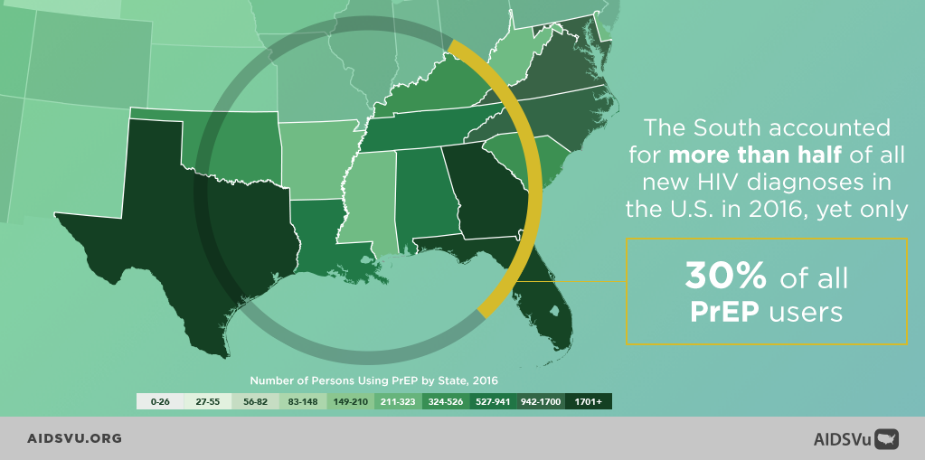
PrEP use

Slide 21
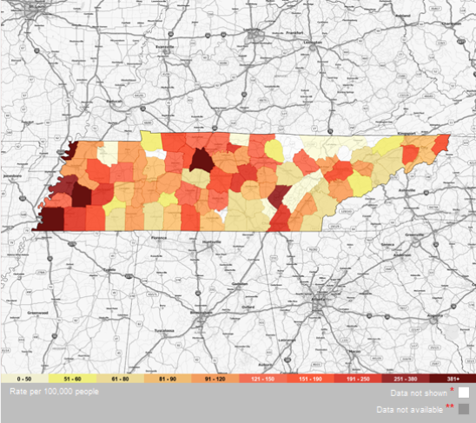
Tennessee HIV risk and location of PrEP providers
https://aidsvu.org/state/tennessee/
https://getpreptn.com/get-prep/#map_top

Slide 22
Barriers to PrEP

Slide 23
PrEP sounds amazing!
So why aren’t we using it?

Slide 24
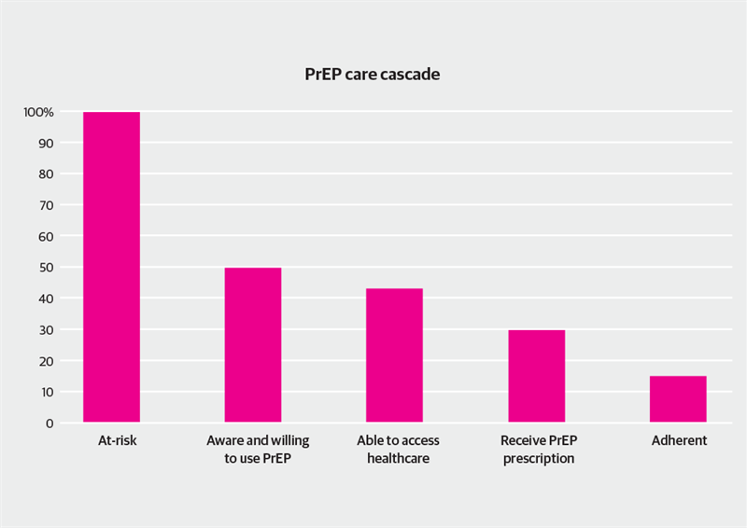
PrEP barriers
https://www.aidsmap.com. Sept 9, 2016 [Accessed April 9, 2018]

Slide 25
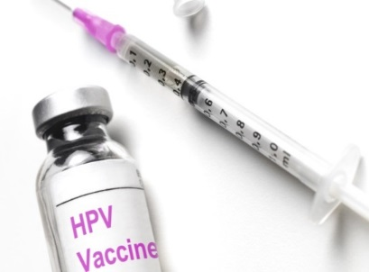
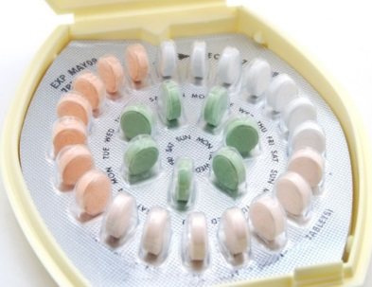
Stigma
A preventative measure against the consequences of sexual activity
… condones sexual activity
… promotes sexual activity
… causes sexual activity

Slide 26
Sexual risk compensation
PrEP users will engage in higher risk sex than they previously had.
This increased unsafe sex will undermine prevention efforts.
Higher rates of bacterial STIs diagnosed among PrEP users may falsely support this.
PrEP users are screened for bacterial STIs frequently due to follow-up requirements.
On a population level, sexual risk compensation is a fallacy.

Slide 27
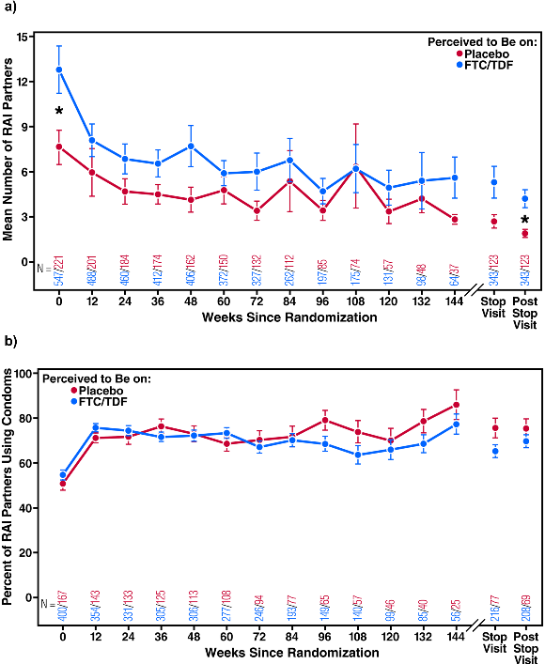
Sexual Risk Compensation
iPrex
PROUD
For patients believing they were on PrEP, the number of receptive anal intercourse partners decreased.
Pre-exposure prophylaxis to prevent the acquisition of HIV-1 infection
UK randomized, open-label study
275 MSM to start TDF/FTC immediately
269 MSM to start TDF/FTC after 1 year
86% HIV risk reduction
No difference between groups in STI incidence
Syphilis incidence also decreased in both study arms
For patients believing they were on PrEP, condom use increased.
Julia L. Marcus, David V. Glidden, Kenneth H. Mayer, Albert Y. Liu, Susan P. Buchbinder, K. Rivet Amico, Vanessa McMahan, Esper Georges Kallas, Orlando Montoya-Herrera, Jose Pilotto, Robert M. Grant. PLoS One. 2013 Dec
McCormack S, et al. Lancet. 2016 Jan 2; 387(10013): 53–60.
18;8(12):e81997

Slide 28
Actually…
Pre-Contemplation
Contemplation
Planning
Action
Maintenance
Active commitment to health
Confidence in sexual health
Stronger relationships
Fewer sexual partners
Further risk reduction

Slide 29
As a society, we treat HIV-related health care activities differently.
As healthcare providers, we need to accept our responsibility to protect our patients.

Slide 30
PrEP barriers - Providers
Insufficient evidence of efficacy
Inexperience with Truvada/lack of knowledge
PrEP is cost-prohibitive
PrEP is not a primary care activity (“not me”)
Unfamiliarity with PrEP candidates; inability to assess high HIV risk
Sexual risk compensation (that use of PrEP will lead to increased high-risk behavior)
Discomfort using a drug with potential adverse effects in an otherwise healthy person (primary prevention vs. treatment)
Patients perceived as non-adherent, and risk HIV resistance mutation development
Personal ideology
Blumenthal J, et al. AIDS Behav 2015,19:802-810.
Karris MY, et al. Clin Infect Dis 2014,58:704-712.
Sharma M, et al. PLoS One 2014,9:e105283.
Hakre S, et al. Medicine (Baltimore) 2016,95:e4511.
Clement ME, et al. AIDS Care 2017:1-6.
Martin J, et al. Abstract # 1447. IDWeek, San Diego, October 4-8, 2017.
Imp B, et al. Abstract # 879, IDWeek, San Diego, October 4-8, 2017.
Blackstock OJ, eta al. J Gen Intern Med 2017,32:62-70.

Slide 31
PrEP eligibility

Slide 32
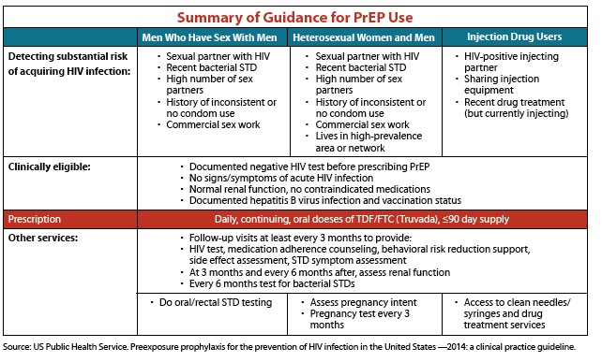
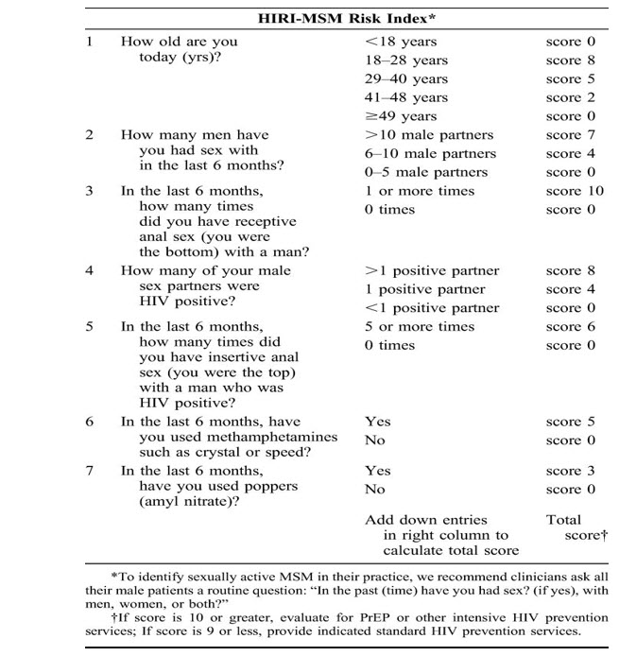
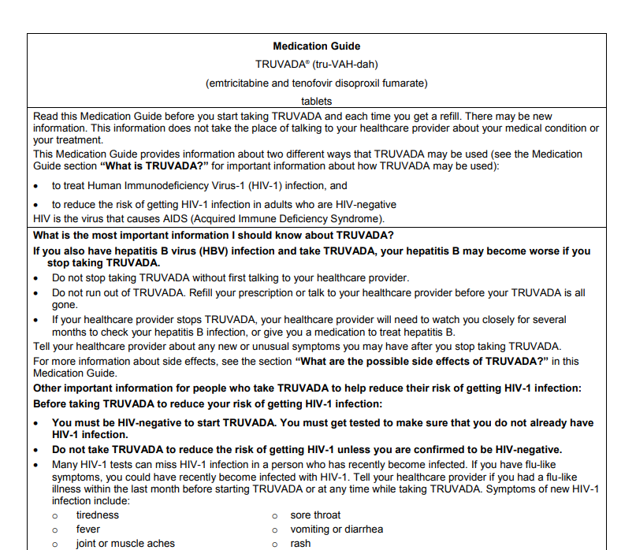
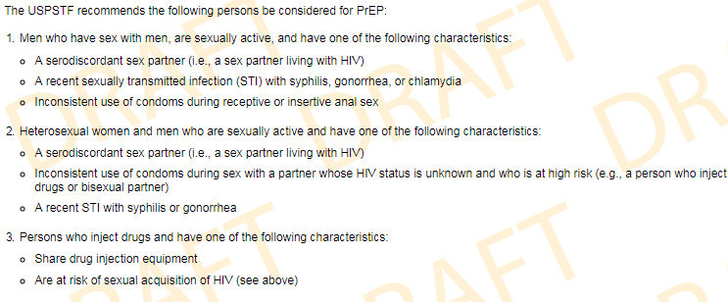
PrEP eligibility
Anyone with high risk for HIV acquisition, as determined by the patient’s and/or provider’s assessment, in which the risk of PrEP does not outweigh the benefit.
https://www.cdc.gov/hiv/pdf/prepguidelines2014.pdf
http://www.gilead.com/~/media/Files/pdfs/medicines/hiv/truvada/truvada_medication_guide.pdf
Notes:
Gilead package insert:
When considering TRUVADA for HIV-1 PrEP, factors that help to identify individuals at risk may include: • has partner(s) known to be HIV-1 infected, or • engages in sexual activity within a high prevalence area or social network and has additional risk factors for HIV-1 acquisition, such as: • inconsistent or no condom use • diagnosis of sexually transmitted infections • exchange of sex for commodities (such as money, food, shelter, or drugs) • use of illicit drugs or alcohol dependence • incarceration • partner(s) of unknown HIV-1 status with any of the factors listed above

Slide 33
Recommendation comparisons
300 high risk young, black MSM (age 16-29) in Chicago
33 HIV acquisitions over 3 years
52% met CDC eligibility for PrEP
85% met HIRI-MSM eligibility for PrEP
94% met drug company eligibility for PrEP
CDC guidelines: Low sensitivity, specificity (52%)
Drug company guidelines: High sensitivity, low specificity (15%)
Lancki N et al. AIDS, 2018

Slide 34
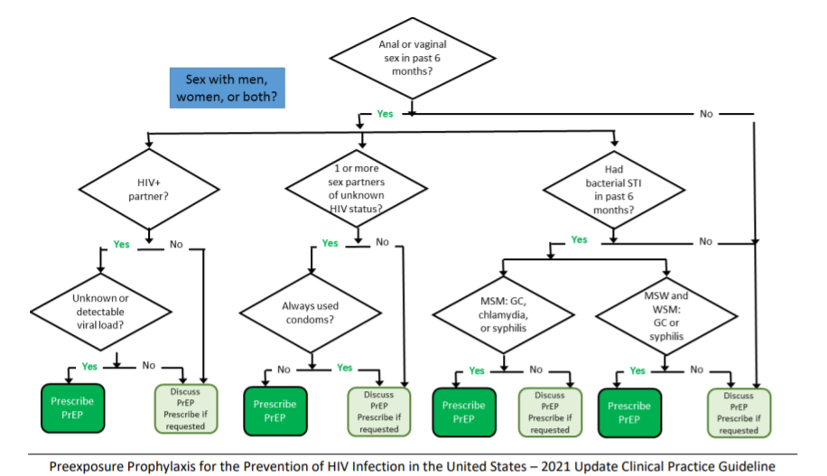
Discuss with everyone!
https://www.cdc.gov/hiv/pdf/risk/prep/cdc-hiv-prep-guidelines-2021.pdf

Slide 35
What about U=U?

Slide 36
U=U
Those who have an undetectable viral load have effectively no risk of transmitting the virus.
This is a consensus of HIV experts worldwide, CDC, NIH, IDSA/HIVMA, common knowledge in the medical community.
Combined data from 4 studies (HPTN 052, OPPOSITES ATTRACT, PARTNER and PARTNER2)
Among sero-discordant couples where the partner living with HIV had a durably undetectable viral load:
zero transmission among over a hundred thousand condomless sex acts
Results similar in both male-female and male-male partnerships

Slide 37
U=U
Is PrEP necessary in this situation?
Consider durable viral suppression
Contributing factors include adherence, history of virologic failure, follow-up interval of the HIV-positive person
Consider non-monogamous sex
In U=U studies, HIV transmissions DID occur, but were linked to sex between HIV-negative participant and HIV-positive individual not involved in the study
Always weigh risks and benefits

Slide 38
Special considerations (TDF/FTC and TAF/FTC)
Pregnant or breastfeeding women
Pregnancy Category B (No known risk)
Minimally secreted in breastmilk, not contraindicated in breastfeeding
Chronic HBV
TDF/TAF and FTC are active against HBV
Abrupt withdrawal could cause HBV flare
Stopping requires careful monitoring and observation
Chronic Renal Failure (CrCl <60mL/min)
Don’t use TDF/FTC; safety has not been adequately determined
Can use TAF/FTC for CrCl >30mL/min

Slide 39
PrEP medication counseling

Slide 40
PrEP Medication Counseling
Dosing
One tab daily, with or without food
Adherence, and its relationship to efficacy
Time to effectiveness
7-10 days for men, 21 days for women
Barrier protection especially needed during that time
Adverse effects
Nausea, vomiting, diarrhea, loss of appetite, weight loss
Fatigue, headache
Requirements for monitoring
Refill process
“Call when you have 7-10 days left”

Slide 41
Adverse Events (TDF/FTC)
Small (2%) but significant decline in estimated creatinine clearance was observed in the TDF/FTC group after taking the drug for, on average, 81 weeks
iPrEX, 2013

Slide 42
Adverse Events (TDF/FTC)
BUT THIS CAN RECOVER!
Bone mineral density recovered after 6 months of stopping TDF/FTC in both young and older adults.
Significant decline in T scores and z scores for BMD at the forearm, hip, and lumbar spine in participants who received TDF/FTC, as compared with those who received placebo
TDF2 Study Group, 2012
Grant RM, et al. Recovery of bone mineral density after stopping oral HIV pre-exposure prophylaxis. CROI 2016 Feb 20-24 Boston
Notes:
Among 109 participants in the TDF–FTC group and 112 in the placebo group in whom bone mineral density was measured, there was a decline in T scores and z scores for bone mineral density at the forearm, hip, and lumbar spine in participants who received TDF–FTC, as compared with those who received placebo (P=0.004 for both T scores and z scores at the forearm and P<0.001 for both scores at the hip and lumbar spine)

Slide 43
PrEP laboratory monitoring

Slide 44
HIV screening
At baseline, 4th generation HIV Ag/Ab combination assay
During PrEP maintenance, HIV Ag/Ab AND HIV RNA PCR are now recommended
Incident HIV infections during PrEP use may exhibit lower viral replication and longer time to antibody production (seroconversion)
Routine HIV RNA PCR may not be readily available or affordable
Providers should use tests that are available to them to continue PrEP provision
Donnell D, et al. The effect of oral preexposure prophylaxis on the progression of HIV-1 seroconversion. AIDS. 2017;31(14):2007. 78.
Marzinke MA, et al. Characterization of human immunodeficiency virus (HIV) infection in cisgender men and transgender women who have sex with men receiving injectable cabotegravir for HIV prevention: HPTN 083. Infect Ds. 2021;

Slide 45
A year of oral PrEP
Encounter | To do
Month 0 | Screen for HIV Confirm HBV and HCV status Check serum creatinine Screen for STIs Counseling Prescribe
Month 3 | Screen for HIV Counseling Prescribe
Month 6 | Screen for HIV Screen for STIs Counseling Prescribe
Month 9 | Screen for HIV Counseling Prescribe
Month 12 | Screen for HIV Screen for STIs Check serum creatinine Counseling Prescribe
Labs*:
HIV screen: 5
Serum creatinine: 2**
STI screen: 3
*Lipids Q12 months if taking TAF/FTC
**Serum creatinine should be done Q6 months if age ≥50 years or who have an CrCl <90 mL/min at initiation
Prescriptions/Refill authorizations: 5
Discussions: 5+
https://www.cdc.gov/hiv/pdf/risk/prep/cdc-hiv-prep-guidelines-2021.pdf

Slide 46
2-1-1 Dosing – TDF/FTC ONLY!
24 hours
24 hours
TDF/FTC
TDF/FTC
TDF/FTC
TDF/FTC
2-24 hours
24 hours
24 hours
24 hours
24 hours
Off-label dosing to consider
Continue 1 pill/day until 48 hours from event
If <7 days between last pill and new event, resume one pill/24 hours (no need to double-dose)
https://www.cdc.gov/hiv/pdf/risk/prep/cdc-hiv-prep-guidelines-2021.pdf
Notes:
TDF-FTC was given as a fixed-dose combination of 300 mg of TDF and 200 mg of FTC per pill. Participants were instructed to take a loading dose of two pills of TDF-FTC or placebo with food 2 to 24 hours before sex, followed by a third pill 24 hours after the first drug intake and a fourth pill 24 hours later.
In case of multiple consecutive episodes of sexual intercourse, participants were instructed to take one pill per day until the last sexual intercourse and then to take the two postexposure pills.
When resuming preexposure prophylaxis, participants were instructed to take a loading dose of two pills unless the last drug intake was less than 1 week earlier, in which case they were instructed to take only one pill.

Slide 47
Dosing matters
Using drug concentrations in iPrEX and STRAND, pharmacokinetic models predict:
76% risk reduction with 2 doses/week
96% with 4 doses/week
99% with 7 doses/week.
Anderson PL, Glidden DV, Liu A, Buchbinder S, Lama JR, Guanira JV, et al. Sci Transl Med. 2012;4: 151ra125.
Notes:
Pharmacokinetic studies indicate decreasing efficacy of TDF/FTC as PrEP with less than daily dosing; among MSM, taking four doses per week is associated with 96% efficacy, while taking two doses per week is associated with 76% efficacy

Slide 48
Financial aspects of PrEP

Slide 49
PrEP coverage
Most insurance plans cover TDF/FTC, most cover TAF/FTC (though fewer cover brand medication)
Variable copays
Medicare/Medicaid cover PrEP
Gilead Advancing Access Program – Copay Assistance
$7,200/calendar year of copay assistance
No income limitation, federal beneficiaries excluded
Gilead Advancing Access Program – Medication Access
Full drug coverage if income <500% federal poverty level
Primary option for uninsured patients

Slide 50
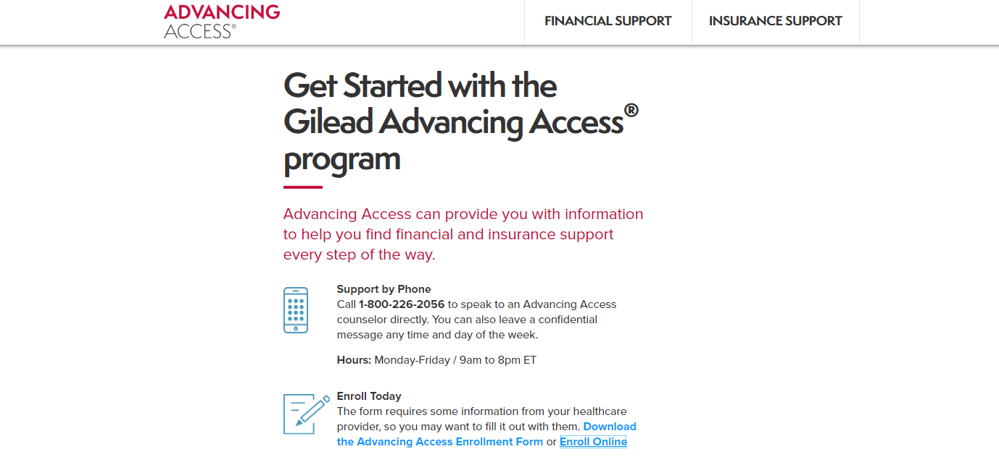
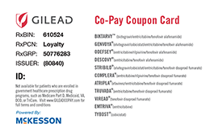
Copay Assistance

Slide 51
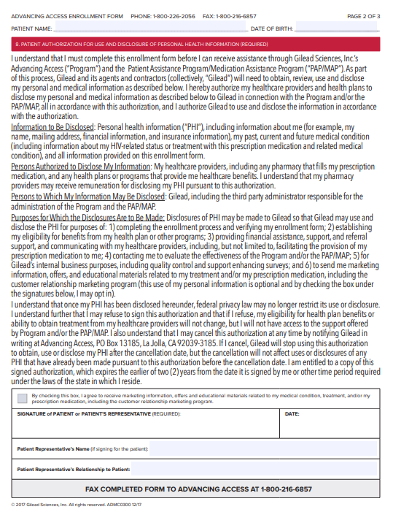
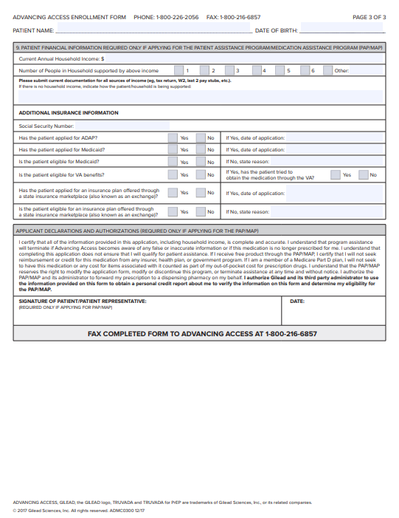
Medication Assistance Program

Slide 52
Ready, Set, PrEP
US Dept. of Health and Human Services Program
No-cost PrEP provider if the patient:
Tests negative for HIV;
Has a valid prescription
Does not have health insurance coverage for outpatient prescription drugs
Does not cover costs of visits or labs
Easy to apply:
Online: GetYourPrEP.com
By phone: 855.447.8410

Slide 53
STOP PrEP
The patient doesn’t want it
Behavior or life situations have changed that lower risk for HIV infection
Intolerable adverse events/toxicities
HIV-infection

Slide 54
PrEP Locator
https://preplocator.org
Notes:
PrEP providers have to register themselves (and the organization will call the clinic to confirm it provides PrEP, so make sure person answering the phone is aware!)

Slide 55
Conclusion
PrEP is a component of primary care
PrEP is an extremely effective preventive strategy for both HIV and STIs
Understand PrEP prescribing guidelines
There are some adverse effects, but PrEP is generally very well-tolerated
PrEP requires an ongoing patient-doctor relationship
Ask for help! sean.g.kelly@vumc.org
PrEP

Slide 56
Questions?

