Slide 1
PrEP & nPEP: 2021 CDC & MDHHS Clinical Guideline Update
MATEC Michigan
February 24, 2022

Slide 2
MATEC Statement on Equity and Inclusion
MATEC has a strong commitment to fair, respectful and unbiased representation of humankind. We strive to be anti-racist, gender affirming and honor all people in an authentic way. This is our goal in all of our work, including this presentation.
Our commitment to you is that we take this stance seriously and invite you to do the same. We ask that if you find something offensive, off-putting, or inaccurate to please let us know.
We continue to grow and evolve and welcome you on our journey.

Slide 3
Land Acknowledgement
Wayne State University rests on Waawiyaataanong, also referred to as Detroit, the ancestral and contemporary homeland of the Three Fires Confederacy. These sovereign lands were granted by the Ojibwe, Odawa, Potawatomi, and Wyandot nations, in 1807, through the Treaty of Detroit. Wayne State University affirms Indigenous sovereignty and honors all tribes with a connection to Detroit. With our Native neighbors, WSU can advance educational equity and promote a better future for the earth and all people.

Slide 4
Disclaimer
This program is partially supported by the Health Resources and Services Administration (HRSA) of the U.S. Department of Health and Human Services (HHS) as part of an award totaling $4,198,345 with zero percentage financed with nongovernmental sources. The contents are those of the author(s) and do not necessarily represent the official views of, nor an endorsement, by HRSA, HHS or the U.S. Government.
Funding for the AIDS Research and Education Center in the School of Medicine at Wayne State University is provided in part by Michigan Department of Health and Human Services (MDHHS) Division of
Communicable Diseases.

Slide 5
MATEC Michigan
The Michigan site of the Midwest AIDS Education and Training Center (MATEC) is located in Detroit at Wayne State University School of Medicine, Division of Infectious Diseases.
MATEC Michigan’s mission is to increase the number of health care professionals who provide excellent quality HIV care and prevention services to our state’s underserved and vulnerable populations.

Slide 6
Disclosure
No one with the ability to control content of this activity has a relevant financial relationship to disclose with an ineligible company.
None of the planners or speakers for this educational activity have relevant financial relationships to disclose with ineligible companies whose primary business is producing, marketing, selling, re-selling, or distributing healthcare products used by or on patients

Slide 7
Continuing Medical Education
The Wayne State University School of Medicine is accredited by the Accreditation Council for Continuing Medical Education to provide continuing medical education for physicians.
The Wayne State University School of Medicine designates this live activity for a maximum of 2.5 AMA PRA Category 1 Credit(s)™. Physicians should claim only the credit commensurate with the extent of their participation in the activity.

Slide 8
Continuing Nursing Education
Detroit Medical Center is approved as a provider of nursing continuing professional development by Ohio Nurses Association, an accredited approver by the American Nurses Credentialing Center’s Commission on Accreditation. (OBN-001-91)
Detroit Medical Center designates this live activity for 2.5 Contact Hours.
Criteria for awarding contact hours requires attendance for the entire session.

Slide 9
Program Evaluation
Upon program completion, you will be asked to complete a short evaluation.
We value your feedback and consider your responses carefully when developing future programs.
Thank you for joining us today

Slide 10
Post-Exposure Prophylaxis
MATEC Michigan
February 24, 2022

Slide 11
Learning Objectives
Assess indications for post-exposure prophylaxis
Assess sexual assault considerations
Apply the 2021 CDC STD Treatment Guideline update to post-exposure treatment
Assess the 2021 MDHHS non-occupational post-exposure treatment guidelines
Review post-exposure prophylaxis for HIV, STI, Hepatitis B, HPV, and pregnancy

Slide 12
Resources

Slide 13
Resources
Sexual Assault and Abuse and STIs - STI Treatment Guidelines (cdc.gov)
MDHHS nPEP Guidance 2021 (michigan.gov)
National HIV Curriculum (uw.edu)
voices4 - Sexual Assault & Abuse (michigan.gov)
SOM - Find Services In Your Area (michigan.gov)

Slide 14
Sexual Assault Considerations

Slide 15
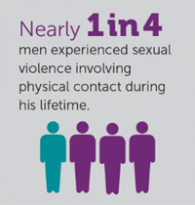
Sexual Assault of Adolescents & Adults

Slide 16
“Examinations of survivors of sexual assault should be conducted by an experienced clinician in a way that minimizes further trauma to the person. The decision to obtain genital or other specimens for STI diagnosis should be made on an individual basis.”
Sexual Assault and Abuse and STIs - STI Treatment Guidelines (cdc.gov)

Slide 17
STI Prophylaxis
Follow-up is often poor
Testing and privacy
Trauma-informed care
Any identified infections may not be related to the assault
Infections are often asymptomatic

Slide 18
Initial Evaluation
Chlamydia & Gonorrhea
At any site of penetration or attempted penetration
NAAT preferred
Men who have sex with men – screen any anatomic site of exposure in last 12 months, regardless of type of sexual contact during assault
Consider anoscopy
Serum for HIV, syphilis, Hepatitis B, Hepatitis C

Slide 19
Lab Tests
HIV Ab/Ag
Chlamydia
Gonorrhea
Trichomoniasis
Syphilis
Hepatitis B
Hepatitis C
Serum creatinine
AST/ALT
Urine pregnancy

Slide 20
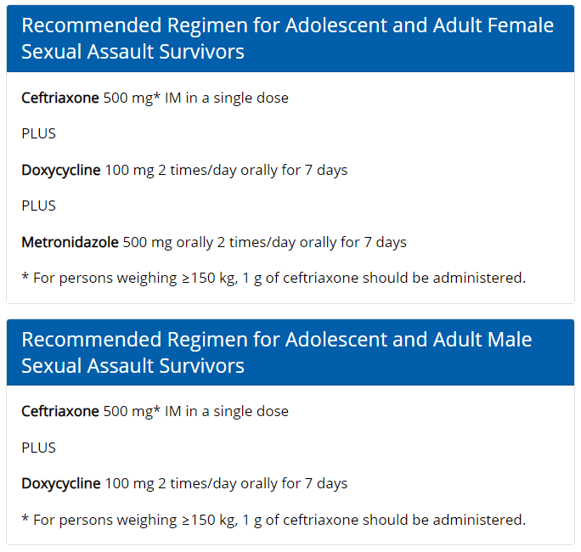
20
https://www.cdc.gov/std/treatment-guidelines/sexual-assault-adults.htm

Slide 21
Hepatitis B
Transmission
Sexual activity
Injection drug use
Risk factors
Similar to those of STIs
Vaccination should be offered as part of routine prevention services in STI treatment facilities

Slide 22
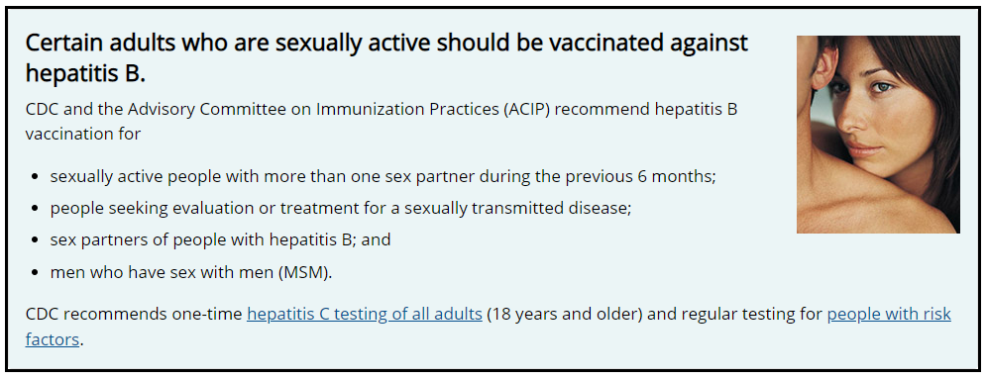
22
https://www.cdc.gov/hepatitis/populations/stds.htm

Slide 23
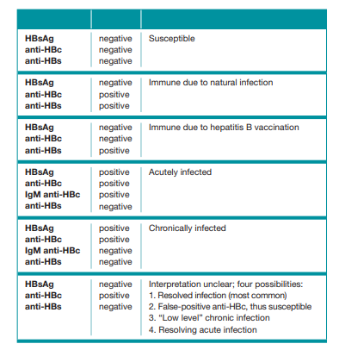
23
https://www.cdc.gov/hepatitis/hbv/pdfs/SerologicChartv8.pdf

Slide 24
Hepatitis B Post-exposure Prophylaxis
If hepatitis B status of assailant is unknown AND
Survivor not previously vaccinated
Post-exposure HBV vaccination indicated
If assailant is known to be HBsAg positive AND
Survivor not previously vaccinated
Post-exposure HBV vaccination AND Hepatitis B Immune globulin (HBIG) are indicated
Survivor previously vaccinated but no record of postvaccination testing
Administer single HBV booster dose

Slide 25
Hepatitis B Post-exposure Prophylaxis
Administer first dose of vaccine at time of initial examination
Heplisav-B
2 dose series administered at least 4 weeks apart
Engerix-B, Recombivax HB
3 dose series administered at 0, 1, and 6 months
Twinrix (combination HAV and HBV)
3 dose series administered at 0, 1, and 6 months

Slide 26
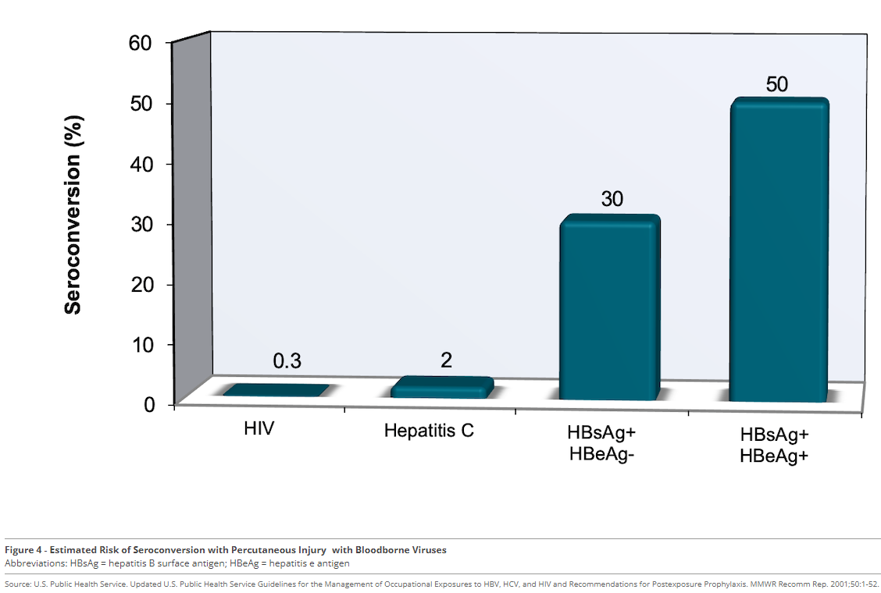
26
https://www.hepatitisb.uw.edu/go/prevention-hbv/postexposure-prophylaxis-following-occupational-exposure-to-hepatitis-b-virus/core-concept/all

Slide 27
Human Papillomavirus Vaccination
Survivors of any gender ages 9-26 without history of previous vaccination, or with history of incomplete series
Administer first dose at initial examination
If <15 years old
2 dose schedule (initial examination and 6-12 months later)
If ages 15-26
3 dose schedule (initial examination, 1-2 months, 6 months)
If older than 26, shared decision making

Slide 28
HIV non-Occupational Post-Exposure Prophylaxis (nPEP)

Slide 29
HIV Risk Assessment
HIV risk per individual sex act is relatively low*
Vaginal intercourse 0.08%
Receptive anal intercourse 1.38%
Oral sex considered negligible
*Based on data from consensual sex acts
Specific circumstances increase risk:
Bleeding, trauma, site of exposure, viral load of assailant, presence of STI or genital lesions in assailant or survivor

Slide 30
nPEP Considerations
Likelihood of assailant having HIV
Determination not often possible
Any characteristics that increase risk for HIV
Receptive anal sex
Injection drug use
Local epidemiology
Ejaculation
Exposure of mucous membranes
Time lapsed since event <72 hours
Risks & benefits
Severe adverse reactions are rare

Slide 31
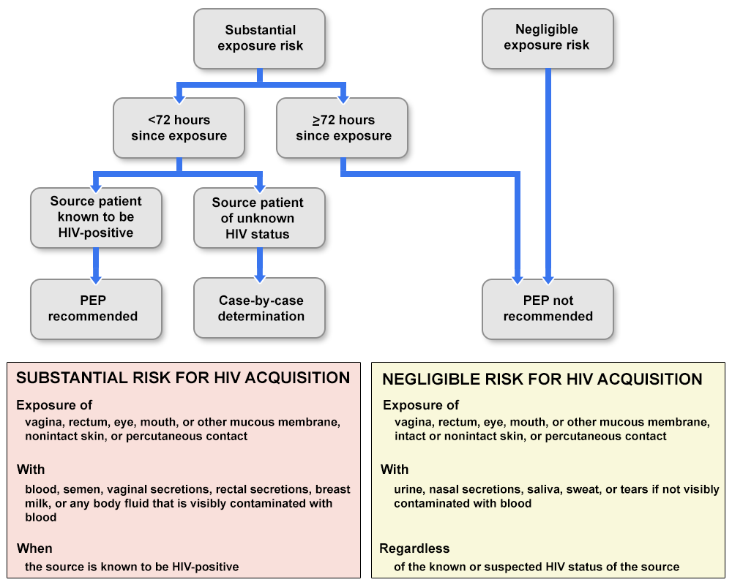
31
FIGURE 1. Algorithm for evaluation and treatment of possible nonoccupational HIV exposures
Sexual Assault and Abuse and STIs - STI Treatment Guidelines (cdc.gov)

Slide 32
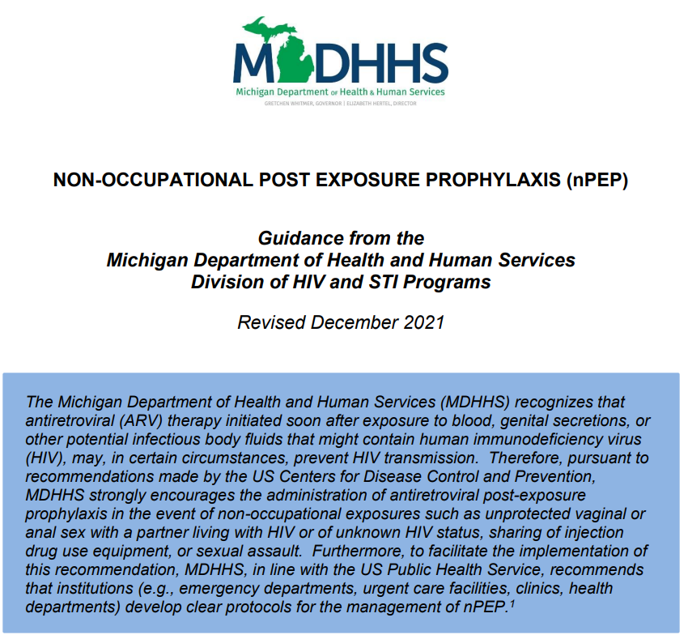
32

Slide 33
nPEP Considerations
Reduces risk for acquiring HIV
Does not eliminate
Use is not limited to sexual assault scenarios
Shared injection drug use equipment
Consensual, condomless vaginal or anal sex with a partner with HIV or with an unknown HIV status
Most effective as soon as possible after exposure. Effectiveness drastically reduced >72 hours

Slide 34
Preferred nPEP Regimens for Adults
Tenofovir disoproxil fumarate 300mg with Emtricitabine 200mg (Truvada) by mouth once daily AND Raltegravir 400 mg (Isentress) by mouth twice daily
OR
Tenofovir disoproxil fumarate 300mg with Emtricitabine 200mg (Truvada) by mouth once daily AND Dolutegravir 50 mg (Tivicay) by mouth once daily
Duration of Therapy: 28 days

Slide 35
MDHHS 2021 Update
Dolutegravir is recommended for pregnant or birthing persons
NYSDOH AI PEP to Prevent HIV Infection (hivguidelines.org)
Resources for Care Providers - AIDS Institute Clinical Guidelines (hivguidelines.org)

Slide 36
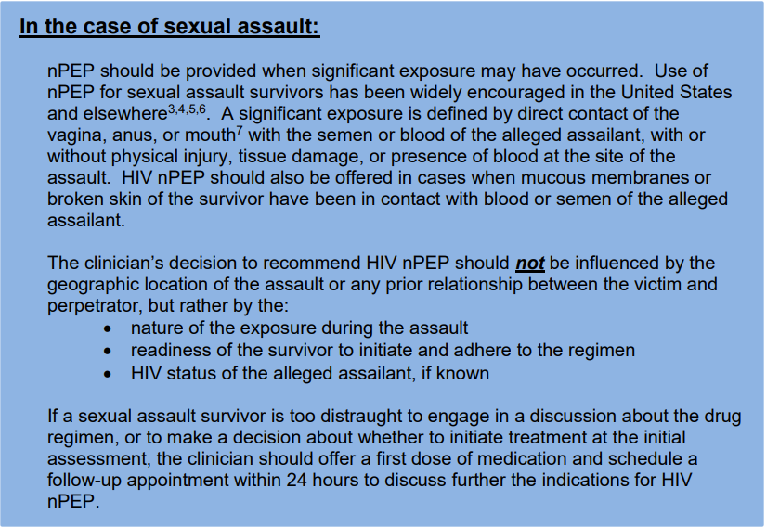
36
MDHHS nPEP Guidance (michigan.gov)

Slide 37
Medication Access
Identify process to ensure prompt access to medication
Starter-pack 5-7 days
Relationship with pharmacies
HIV Specialty pharmacy
MedCart
Hospital pharmacy
Gilead Advancing Access® program
ViiV Healthcare ViiVConnect Savings Card (myviivcard.com)
1-844-588-3288
Log in to Merck Connect

Slide 38
Baseline Labs
HIV Ab/Ag testing
Rapid or expedited point of care testing when possible
Patient does not need test result prior to dispensing nPEP regimen
Declining HIV test should not preclude initiation of nPEP
Serum creatinine
AST, ALT

Slide 39
Patient Counseling
Individualized HIV risk assessment
Side effects of nPEP regimen
Duration of therapy
Baseline labs and follow-up schedule
Medication adherence
Plan to access 28-day supply
Caution in known impaired renal function
Consult with Infectious Disease Specialist

Slide 40
Side Effects
Nausea
Vomiting
Diarrhea
Headache
Fatigue
Side effects are common, but usually mild and reversible when medication discontinued

Slide 41
Adherence & Administration
Effectiveness decreases when doses are missed
Take for full 28 days
Unless determined no HIV exposure occurred

Slide 42
nPEP Follow-up
If assailant, sex partner, of needle-sharing partner found to be HIV negative, nPEP should be discontinued
Consider PrEP initiation
HIV Ab/Ag testing at 4-6 weeks and 3 months after exposure
May need to schedule early follow-up for ongoing counseling

Slide 43
Summary

Slide 44
Questions

Slide 45
Program Evaluation
MATEC Michigan thanks you for your participation in today’s program
We appreciate all feedback and look forward to incorporating your suggestions into future programming
Link in the chat box
Scan the QR Code
Link in your email

Slide 46
Continuing Medical Education
February 24, 2022 PrEP & nPEP: 2021 CDC & MDHHS Clinical Guideline Update
Activity Code: 190253
Using your designated phone number in our CME Tracker System please visit:
WWW.CME.MED.WAYNE.EDU
Click on “Activity Check-in”
Enter Cellphone Number and Activity Code (above)
You have 7 days from the start of the conference to claim credit.
Landlines will not work with system. Cell phone is required
If you are unable to claim credit, please update your CME account.
Contact CME for questions: dcme@med.wayne.edu
or ea6178@wayne.edu

Slide 47
Continuing Nursing Education
A record of your attendance today has been made
A certificate awarding contact hours for today’s program will be sent to the email you used during registration
Please contact MATECMichigan@gmail.com with any continuing education questions

Slide 48
MATEC Michigan
2727 Second Avenue
Suite 138
Detroit, Michigan 48201
Phone: 313-962-2000
Urgent Consultation: 313-408-3483
Fax: 313-962-4444
Email: MATECMichigan@gmail.com

Slide 49
Speaker Resources
Pediatric Exposures in Michigan
Contact Elizabeth Secord, MD, Wayne Pediatrics
esecord@med.wayne.edu
Consultation Line (24/7) : 248-840-4785
MDHHS / Henry Ford HIV Consultation Line
313-575-0332
MATEC Michigan
24/7 Consultation line: 313-480-3483
National PEPline
PEP: Post-Exposure Prophylaxis | National Clinician Consultation Center (ucsf.edu)
1-888-448-4911

Slide 50
MATEC Resources
Clinical Consultation Center http://nccc.ucsf.edu/
HIV Management
Perinatal HIV
HIV PrEP
HIV PEP line
HCV Management
Substance Use Management
AETC National HIV Curriculum
https://aidsetc.org/nhc
AETC National HIV-HCV Curriculum https://aidsetc.org/hivhcv
Hepatitis C Online https://www.hepatitisc.uw.edu
AETC National Coordinating Resource Center https://aidsetc.org/
Additional Trainings https://matec.info

