Slide 1
Sexually Transmitted Infections
MATEC Michigan
Program Date

Slide 2
MATEC Statement on Equity and Inclusion
MATEC has a strong commitment to fair, respectful and unbiased representation of humankind. We strive to be anti-racist, gender affirming and honor all people in an authentic way. This is our goal in all of our work, including this presentation.
Our commitment to you is that we take this stance seriously and invite you to do the same. We ask that if you find something offensive, off-putting, or inaccurate to please let us know.
We continue to grow and evolve and welcome you on our journey.

Slide 3
Land Acknowledgement
Wayne State University rests on Waawiyaataanong, also referred to as Detroit, the ancestral and contemporary homeland of the Three Fires Confederacy. These sovereign lands were granted by the Ojibwe, Odawa, Potawatomi, and Wyandot nations, in 1807, through the Treaty of Detroit. Wayne State University affirms Indigenous sovereignty and honors all tribes with a connection to Detroit. With our Native neighbors, WSU can advance educational equity and promote a better future for the earth and all people.

Slide 4
Disclaimer
This program is supported by the Health Resources and Services Administration (HRSA) of the U.S. Department of Health and Human Services (HHS) as part of an award totaling $4,198,345 with zero percentage financed with nongovernmental sources. The contents are those of the author(s) and do not necessarily represent the official views of, nor an endorsement, by HRSA, HHS or the U.S. Government.
Funding for the AIDS Research and Education Center in the School of Medicine at Wayne State University is provided in part by Michigan Department of Health and Human Services (MDHHS) Division of
Communicable Diseases.

Slide 5
MATEC Michigan
The Michigan site of the Midwest AIDS Education and Training Center (MATEC) is located in Detroit at Wayne State University School of Medicine, Division of Infectious Diseases.
MATEC Michigan’s mission is to increase the number of health care professionals who provide excellent quality HIV care and prevention services to our state’s underserved and vulnerable populations.

Slide 6
Disclosure
No one with the ability to control content of this activity has a relevant financial relationship to disclose with an ineligible company.

Slide 7
Continuing Medical Education
The Wayne State University School of Medicine is accredited by the Accreditation Council for Continuing Medical Education to provide continuing medical education for physicians.
The Wayne State University School of Medicine designates this live activity for a maximum of 2.5 AMA PRA Category 1 Credit(s)™. Physicians should claim only the credit commensurate with the extent of their participation in the activity.

Slide 8
Continuing Nursing Education
Detroit Medical Center is approved as a provider of nursing continuing professional development by Ohio Nurses Association, an accredited approver by the American Nurses Credentialing Center’s Commission on Accreditation. (OBN-001-91)
Detroit Medical Center designates this live activity for ___ Contact Hours.
Criteria for awarding contact hours requires attendance for the entire session.

Slide 9
Program Evaluation
Upon program completion, you will be asked to complete a short evaluation.
All responses are carefully read and are crucial for continued program improvement.
Thank you for joining us today

Slide 10
Learning Objectives
Epidemiology of HIV/STIs in Michigan and Nationally
Review available HIV/STI informational resources
Screening guidelines

Slide 11
Epidemiology

Slide 12
Factors Associated With STI Acquisition
Previously diagnosed STI, or co-existing STI
Partner with an STI
New sex partner
Multiple sex partners, or partner with multiple partners
Inconsistent condom use
History of incarceration in self or in partner
Transactional sex
Lifetime number of sexual partners
Age of sexual debut

Slide 13
Chlamydia

Slide 14
Chlamydia
Most common reportable STI in the United States
Chlamydia trachomatis (C. trachomatis)
Transmission
Sexual activity
Mother-to-child at birth
Rates highest in sexually active young women
Treated & cured with oral antibiotic medication

Slide 15
Chlamydia Symptoms in Women
Cervicitis
Abdominal discomfort, spotting
Mucopurulent endocervical discharge
Friable cervix
Urethritis
Dysuria
Urinary frequency
Pelvic inflammatory disease
Lower abdominal pain
Cervical motion tenderness
Uterine or adnexal tenderness

Slide 16
Chlamydia Symptoms in Men
Urethritis
Dysuria
Urethral discharge
Epididymitis
Unilateral scrotal pain
Swelling of scrotum
Tenderness

Slide 17
Chlamydia Symptoms in Women or Men
Oropharyngeal Infection
Usually asymptomatic
Acute tonsillitis, acute pharyngitis, abnormal pharyngeal sensation
Conjunctivitis
Autoinoculation
Discomfort in one eye
Eye redness
Rectal Infection
Usually asymptomatic
Proctitis or proctocolitis
Rectal pain, mucoid or bloody discharge, fever, tenesmus

Slide 18
Chlamydia
Complications
Pelvic inflammatory disease
Chronic pelvic pain
Fallopian tube scarring
Infertility
Increased risk for HIV acquisition and HIV transmission

Slide 19
Chlamydia Diagnosis
Urine
First void urine
Throat swab
Rectal swab
Vaginal swab
Cervical swab

Slide 20
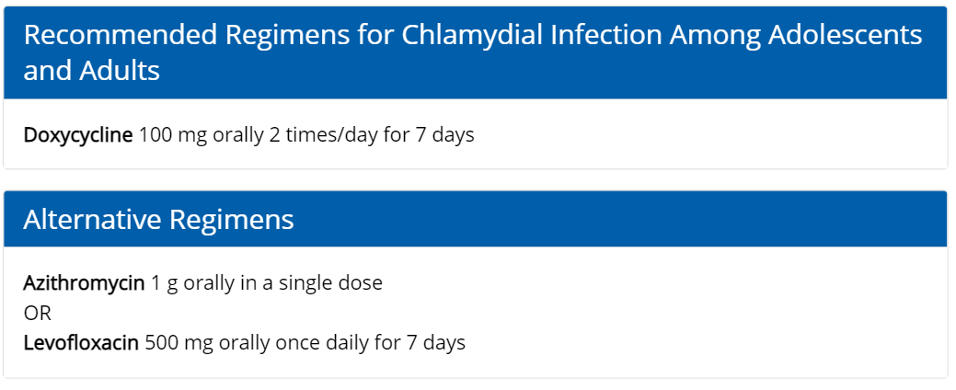
Chlamydia Treatment
https://www.cdc.gov/std/treatment-guidelines/chlamydia.htm

Slide 21
Chlamydia Follow-up
Patient & Partner Counseling
Abstain from sex for 7 days if singe-dose therapy
Abstain from sex for duration of 7-day therapy
Abstain until symptoms resolve beyond 7-day period
Partners in last 60 days should be treated
Most recent partner if last sex >60 days ago

Slide 22
Chlamydia Follow-up
Test of cure
Not standard of care
Should not be repeated <4 weeks after treatment
Repeat testing in 3 months
Re-infection is very common
Increases risk for complications
Treatment failure is rare

Slide 23
Gonorrhea

Slide 24
Gonorrhea
Second most common reportable STI in the United States
Neisseria gonorrhoeae
Transmission
Sexual activity
Mother-to-child at birth
Rates highest in sexually active young people, rates are higher in men
Treated & cured with oral antibiotic medication
Concern for antibiotic resistant infection

Slide 25
Gonorrhea Symptoms in Women
Cervicitis
Vaginal & cervical discharge
Friable cervix
Anorectal infection
Uncommon
Bartholin Gland infection
Fluid-filled cyst on one side of labia
May form painful abscess
Pelvic inflammatory disease
Lower abdominal pain
Cervical motion tenderness
Uterine or adnexal tenderness
Fever
Intermenstrual bleeding

Slide 26
Gonorrhea Symptoms in Men
Urethritis
Dysuria
Urethral discharge
Purulent
Epididymitis
Unilateral scrotal pain
Swelling of scrotum
Tenderness
Anorectal infection
Asymptomatic
Proctitis
Anal irritation, painful defecation, constipation, rectal bleeding, rectal discharge, pruritus, tenesmus

Slide 27
Gonorrhea Symptoms in Women or Men
Oropharyngeal Infection
Usually asymptomatic
Mild sore throat
Pharyngitis, tonsillitis, fever, cervical adenitis
Conjunctivitis
Autoinoculation
Mild, non-purulent conjunctivitis
Progresses to redness, copious discharge, edema, ulcerative keratitis
Disseminated Gonococcal Infection
Uncommon, can be life-threatening
Skin lesions
Arthralgia, Arthritis
Tenosynovitis
Hepatitis
Myocarditis, endocarditis
Meningitis

Slide 28
Gonorrhea Diagnosis
Urine
First void urine
Throat swab
Rectal swab
Vaginal swab
Cervical swab
Gram’s stain
Culture

Slide 29
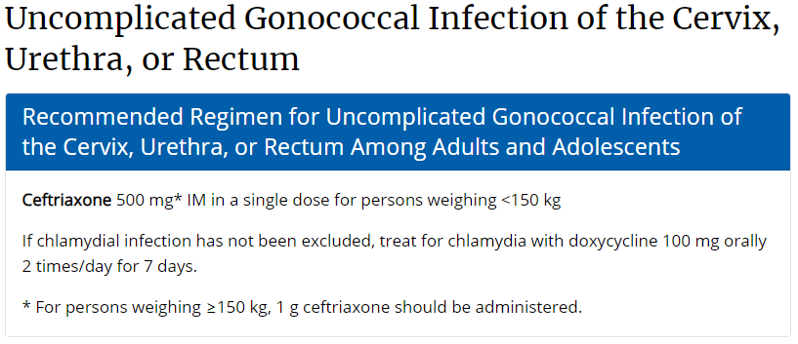
Gonorrhea Treatment
https://www.cdc.gov/std/treatment-guidelines/gonorrhea-adults.htm

Slide 30
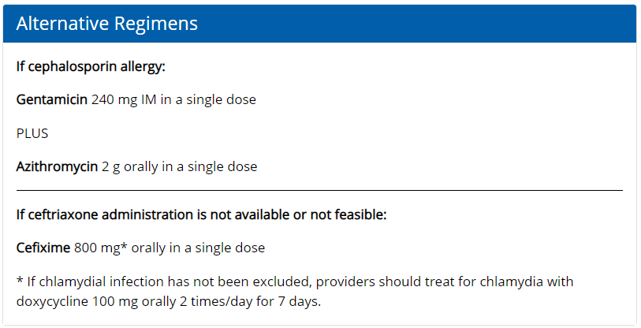
Gonorrhea Treatment
https://www.cdc.gov/std/treatment-guidelines/gonorrhea-adults.htm

Slide 31
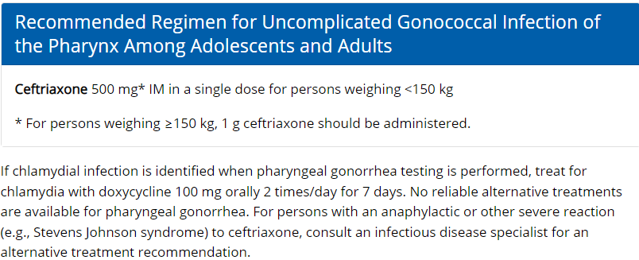
Gonorrhea Treatment
https://www.cdc.gov/std/treatment-guidelines/gonorrhea-adults.htm

Slide 32
Gonorrhea Follow-up
Patient & Partner Counseling
Abstain from sex for 7 days if singe-dose therapy
Abstain from sex for duration of 7-day therapy
Abstain until symptoms resolve beyond 7-day period
Partners in last 60 days should be treated
Most recent partner if last sex >60 days ago

Slide 33
Gonorrhea Follow-up
Test of cure
Not standard of care for cervix, urethra, or rectum
Recommend for pharyngeal infection 7-14 days following treatment
Repeat testing in 3 months
Re-infection is very common
Increases risk for complications
Treatment failure is rare but antibiotic resistance is rising

Slide 34
Syphilis

Slide 35
Syphilis
Cases have been increasing, particularly congenital infections
Treponema pallidum
Transmission
Sexual activity
Mother-to-child during pregnancy
The Great Imitator
Public health impact

Slide 36
Primary Syphilis
Primary lesion “chancre”
Appears 10-90 days after acquisition
Usually 2-3 weeks
May be multiple, may be painful
Usually singular and painless
Regional lymphadenopathy
Highly infectious
Heal spontaneously in about 3-8 weeks even without treatment
If untreated, may progress

Slide 37
Secondary Syphilis
Reflects dissemination
4-10 weeks after primary symptoms
May overlap primary
Generalized body rash
Lymphadenopathy
Systemic Symptoms
Mucous Patches
Condyloma lata
Alopecia
Visceral organ involvement

Slide 38
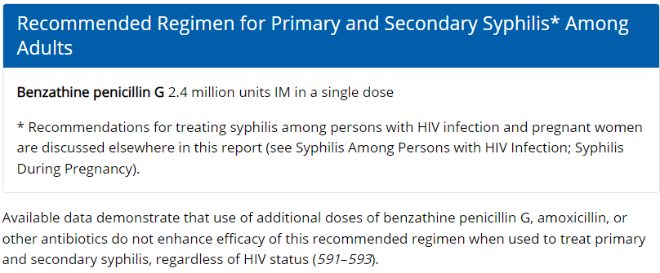
Syphilis Treatment

Slide 39
Early Latent Syphilis
< 1 year duration
No clinical evidence of syphilis AND one of the following:
Documented seroconversion in the previous 12 months
Sustained fourfold or greater rise in nontreponemal titer in the previous 12 months
Unequivocal symptoms of primary or secondary symptoms in last 12 months
Contact in the last 12 month with a partner diagnosed with primary, secondary, or early latent syphilis
Only possible exposure occurred in the previous 12 months

Slide 40
Late Latent Syphilis
> 1 year duration
No clinical evidence of syphilis
Reactive nontreponemal and treponemal test with no prior diagnosis of syphilis
Do not meet criteria for early latent syphilis

Slide 41
Latent Syphilis Treatment
https://www.cdc.gov/std/treatment-guidelines/latent-syphilis.htm

Slide 42
Tertiary Syphilis
Rare
If left untreated, 30% of syphilis cases will progress to tertiary stage 2-50 years after original infection
Manifestations
Gummatous lesions
Cardiovascular
Late neurosyphilis
General paresis
Tabes dorsalis
Psychiatric manifestations

Slide 43
Tertiary Syphilis Treatment

Slide 44
Neurosyphilis
Can occur at any stage of syphilis
Otic & ocular involvement may occur
Early Neurosyphilis
Meningeal syphilis
Weeks to months after initial infection.
Resembles aseptic meningitis
Fever, headache, stiff neck
Cranial nerve abnormalities
Meningovascular syphilis
Usually 5-12 years after, but can occur sooner
Stroke-like symptoms and seizures

Slide 45
Neurosyphilis
Late Neurosyphilis
Typically 15 years or more after initial infection
Rarely seen
General paresis
Tabes dorsalis
Dementia

Slide 46
Ocular Syphilis
Syphilis can affect any part of the eye
With or without neurosyphilis
Most common
Anterior, posterior or panuveitis
Can also include
Lid involvement
Episcleritis, Vitritis
Papillitis, Interstitial keratitis
Retinitis, Optic neuritis
Any patient with syphilis with ocular complaints should have full cranial nerve evaluation and immediate referral to
ophthalmologist for full evaluation

Slide 47
Otosyphilis
Can occur at any stage
Manifestations
Hearing loss
Tinnitus
Vertigo
Sensorineural
One or both ears
If suspected, should evaluate for neurosyphilis & ocular manifestations
Immediate referral to otolaryngologist

Slide 48
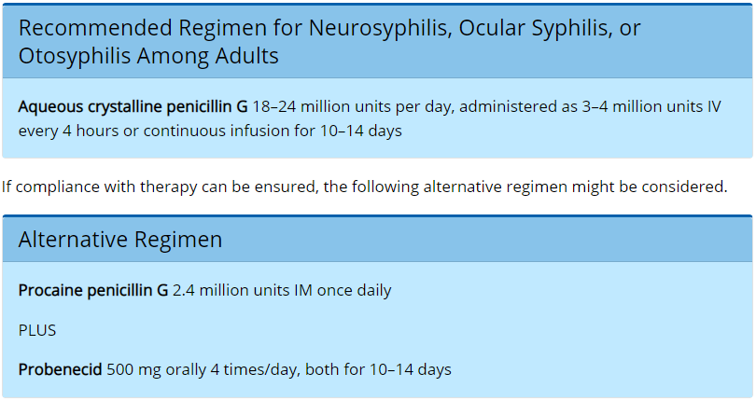
Neurosyphilis Treatment
https://www.cdc.gov/std/treatment-guidelines/neurosyphilis.htm

Slide 49
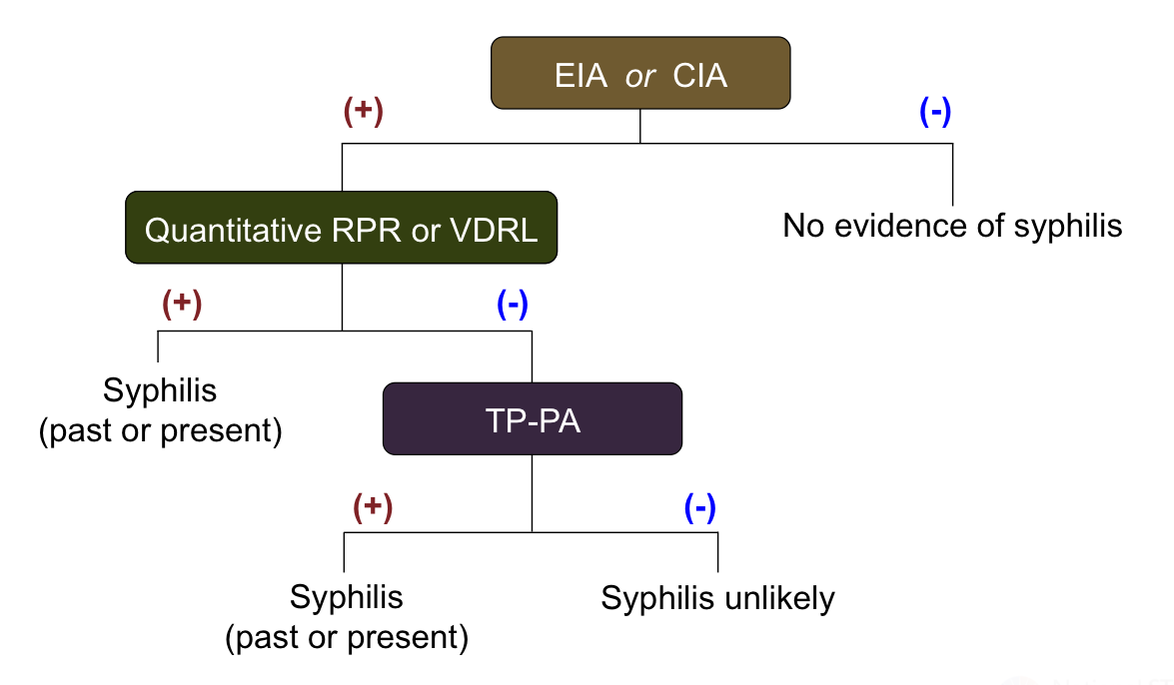
Syphilis Diagnosis
Figure 24 - Syphilis Serologic Screening—Reverse Sequence Algorithm The reverse serologic screening algorithm uses an initial treponemal test for screening, followed by a nontreponemal test confirmation. A specimen with reactive EIA/CIA results should be tested reflexively with a quantitative nontreponemal test (RPR or VDRL). Abbreviations: EIA = enzyme immunoassay; CIA = chemiluminescence immunoassays; RPR = rapid plasma reagin; VDRL = Venereal Disease Research Laboratory; TP-PA = Treponema pallidum particle agglutination
https://www.std.uw.edu/custom/self-study/syphilis/5

Slide 50
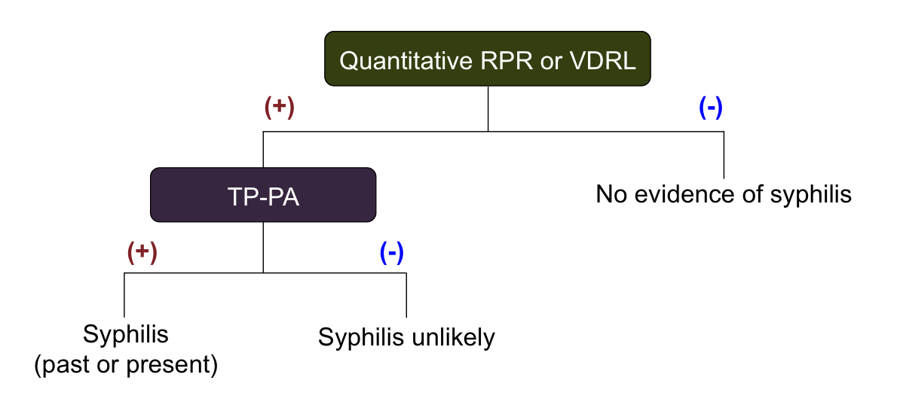
Syphilis Diagnosis
Figure 23 - Syphilis Serologic Screening—Traditional Sequence Algorithm The traditional (standard) serologic screening sequence algorithm uses a quantitative nontreponemal test (RPR or VDRL) for screening followed by a treponemal test for confirmation of positive screening tests. Abbreviations: RPR = rapid plasma reagin; VDRL = Venereal Disease Research Laboratory; TP-PA = Treponema pallidum particle agglutination.
https://www.std.uw.edu/custom/self-study/syphilis/5

Slide 51
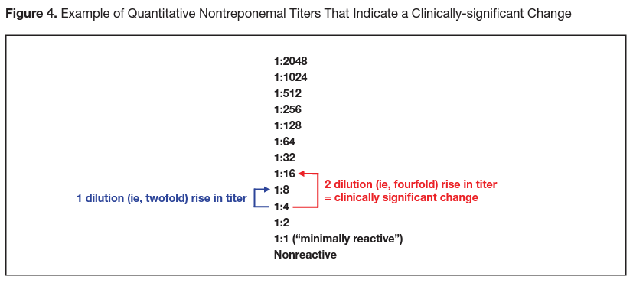
Syphilis Diagnosis
https://www.nycptc.org/x/Syphilis_Monograph_2019_NYC_PTC_NYC_DOHMH.pdf

Slide 52
Syphilis Follow-up
Primary & Secondary Syphilis
Monitor serology 6 months and 12 months after treatment
Latent Syphilis
Monitor serology 6, 12, and 24 months
Neurosyphilis
Monitor serology based on above
Serologic RPR usually correlates with CSF, follow-up lumbar puncture usually not indicated

Slide 53
Syphilis Follow-up
Abstain from sex for 7 days following treatment completion AND
All lesions have resolved AND
Partners have been treated

Slide 54
Partner Management
Primary, secondary, early latent
Partners in the previous 90 days
Treat partners presumptively for early syphilis, regardless of test results and symptom status
If last sexual activity was > 90 days ago
Most recent partner should be offered presumptive treatment, but can choose to test first if can reliably follow-up
Late latent syphilis
If high titer at diagnosis (greater than 1:32) and in area with high rates of syphilis,
partner treatment may be appropriate

Slide 55
Partner Management
Some partners may be at risk for infection and should be notified for evaluation
Primary syphilis
Partners in the previous 90 days + duration of primary syphilis symptoms
Secondary syphilis
Partners in the previous 6 months + duration of secondary symptoms
Early latent syphilis
Partners in the previous 1 year

Slide 56
Herpes Simplex Virus (HSV)

Slide 57
Genital Herpes
Top cause of genital ulcer disease worldwide
Herpes simplex virus
Predominately HSV-2, less often HSV-1
Transmission
Sexual activity
Mother-to-child at birth
Asymptomatic infections are common, many cases are unrecognized and undiagnosed

Slide 58
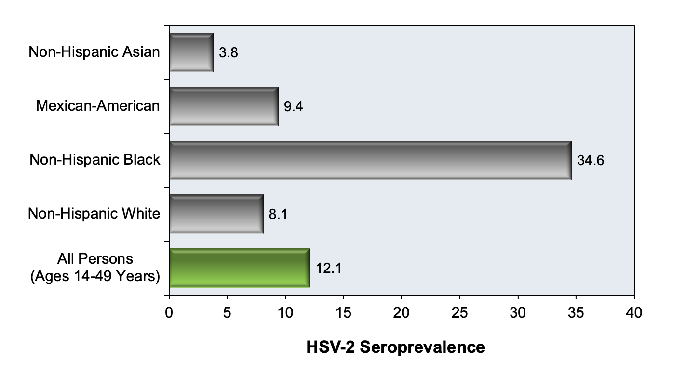
Epidemiology
In 2018, estimated18.6 million people ages 18-49 living with genital HSV-2 infections in the United States
Not a reportable condition, data likely underrepresents true prevalence
https://www.std.uw.edu/custom/self-study/genital-herpes/2

Slide 59
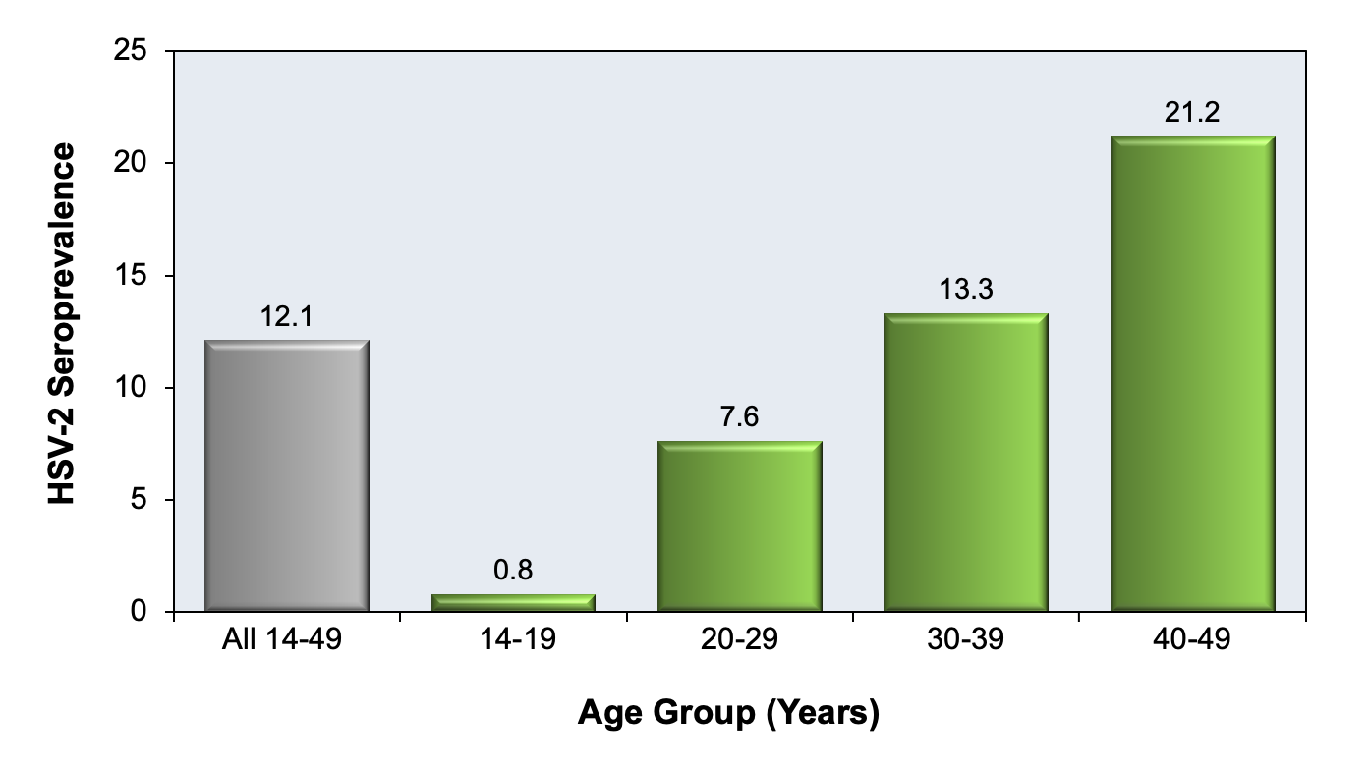
Epidemiology
Figure 3 - HSV-2 Seroprevalence in United States, by Age Group, 2015-2016 NHANES These data are from the 2015-2016 National Health and Nutrition
Examination Survey (NHANES) and are for persons 14-49 years of age.
https://www.std.uw.edu/custom/self-study/genital-herpes/2

Slide 60
Genital Herpes Transmission
Virus enters through susceptible mucosal surface or broken skin
Resides in nerve cells, ganglia serve as reservoir
Cycles of latency and reactivation
Viral shedding

Slide 61
Viral Shedding
Viral shedding episodes can last from a few hours to >24 hours in duration
Often asymptomatic
Usually shorter duration than clinical episode shedding
Triggers immune response, recruitment of CD4 T cells to genital mucosa
Decreases over time
Most transmissions thought to occur during asymptomatic shedding

Slide 62
Genital Herpes Transmission
Antiviral suppressive therapy reduces HSV-2 shedding 70-80%
Genital HSV-1 shedding is less frequent
Transmission during asymptomatic viral shedding, often by individual unaware of their own status

Slide 63
Primary Genital Infection
First infection with either HSV-1 or HSV-2, no prior history of either
Often asymptomatic or subclinical and unrecognized
Without treatment, typically resolves within 3 weeks
Antibodies develop within 12 weeks

Slide 64
Primary Genital Infection
Severe, multiple genital ulcers, pain, itching, vaginal or urethral discharge, tender inguinal lymphadenopathy
Progression from pustule to wet ulcer to dry crust over 2-3 weeks
Cervicitis
Proctitis
Systemic Symptoms
Fever, myalgia, headache, aseptic meningitis, autonomic nervous system dysfunction (urinary retention)

Slide 65
Recurrent Genital Infection
Mild, localized
Resolve in 3-5 days after initial symptoms
May experience prodromal symptoms
Tingling, burning, nerve pain
12-24 hours prior to symptom onset
Recurrences are more frequent in first year following initial infection and decrease over time
HSV-1 recurrences are less common and less frequent

Slide 66
Genital Herpes Diagnosis
Clinical diagnosis can be challenging
Should be confirmed with laboratory testing
Virologic testing
Nucleic Acid Amplification NAAT
Viral culture
Serologic testing
Type-common
Type-specific (preferred)

Slide 67
Virologic Testing
NAAT
Preferred
Can differentiate HSV-1 and HSV-2
High sensitivity and specificity
Viral culture
Former gold standard
Highly specific, but sensitivity declines as lesions resolve
Less accurate with recurrent infection

Slide 68
Type-specific Serologic Testing
HSV-2 infections are almost always sexually acquired, almost always indicates anogenital infection
Reverse not true for HSV-1 and oral infection
Antibodies develop several weeks after infect
Persist indefinitely
False negative tests occur
Early in infection
False positive can occur
Particularly with positive low index value

Slide 69
Type-specific Serologic Testing
Two-step testing is recommended
Initial positive serologic tests should be confirmed by a second serologic test with different technology
Negative initial tests do not need to be confirmed
Unless early infection suspected

Slide 70
Type-specific Serologic Testing
First test
Enzyme-linked or chemiluminescence-linked immunoassay.
Often HerpeSelect HSV-2 ELISA
Significant false-positive rates (particularly with low index). Poor specificity
Confirmatory test
Biokit HSV-2 Rapid Assay ELISA
Western blot
Should not use Herpeselect immunoblot to follow the HerpeSelect ELISA (same antigen is used)

Slide 71
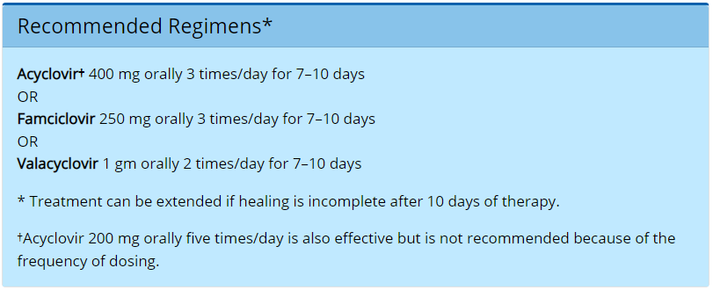
First Clinical Episode
https://www.cdc.gov/std/treatment-guidelines/herpes.htm

Slide 72
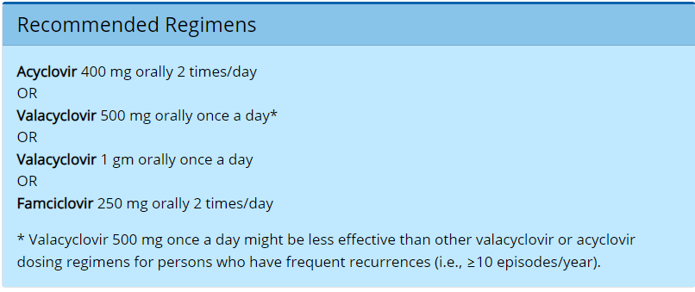
Recurrent Episode: Suppressive Therapy
https://www.cdc.gov/std/treatment-guidelines/herpes.htm

Slide 73
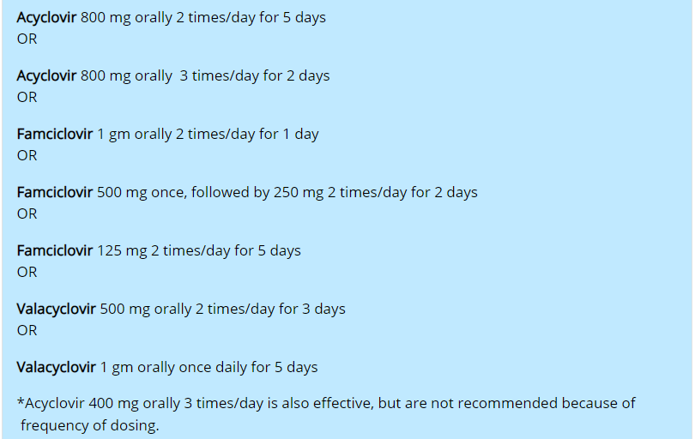
Recurrent Episode: Episodic Genital HSV-2
https://www.cdc.gov/std/treatment-guidelines/herpes.htm

Slide 74
Genital Herpes Counseling
Although the psychological effect of a serologic diagnosis of HSV-2 infection in a person with asymptomatic or unrecognized genital herpes appears minimal and transient, certain persons with HSV infection might express anxiety concerning genital herpes that does not reflect the actual clinical severity of their disease; the psychological effect of HSV infection can be substantial.
https://www.cdc.gov/std/treatment-guidelines/herpes.htm

Slide 75
Components of Counseling
Natural history of infection
Asymptomatic viral shedding, transmission, recurrence
Suppressive vs. episodic therapy
Role of suppressive therapy in reducing transmission
Informing sex partners
Abstaining from sex during clinical episodes
Male condoms reduce, but do not eliminate, risk for transmission
Role of type-specific serologic screening of partners
Neonatal transmission risks
HIV considerations

Slide 76
Human Papillomavirus (HPV)

Slide 77
Human Papillomavirus (HPV)
Most common genital infection in the United States
Most infections are transient, asymptomatic, no clinical consequences
Infection can cause anogenital warts, oropharyngeal cancers, and urogenital cancers
Cervical cancer most common in women
Oropharyngeal cancer most common in men
HPV vaccine is effective in preventing urogenital cancers and anogenital warts
Most infections are unrecognized and resolve spontaneously
Common among adolescents & adults

Slide 78
Human Papillomavirus (HPV)
Sexual transmission rate is high
Often transmitted by asymptomatic partner or partner with subclinical infection
Rare transmission from mother to newborn during delivery
May result in respiratory papillomatosis in children

Slide 79
Epidemiologic Trends
Before vaccine introduction
Estimated 79 million infected
14 million new infections/year
Within 10 years following vaccine introduction, prevalence of HPV types 6, 11, 16, and 18 has decreased:
86% among females age 14 through 19 years
71% among females age 20 through 24 years

Slide 80
HPV Classification
High-Risk Types
Types 16 or 18
Types 31, 33, 45, 52, 58
High-Risk HPV Types
Oncogenic
Low-grade or high-grade cervical cellular changes
Cancer of the cervix
Some high-risk types also associated with cancers of the oropharynx, penis, anus, vagina, and vulva
Low-Risk HPV Types
Non-oncogenic
Low-grade cellular changes
Can cause genital warts
Low-Risk Types
Types 16 or 18

Slide 81
Patient Counseling: Natural History
Anogenital warts
Will develop in 15-64% of people with types 6 or 11
Warts develop 3-6 months after exposure for women, may take up to 11 months for men
Cervical HPV
Slow progression to cervical cancer, potentially decades
Anal HPV
Median duration varies by type
Oropharyngeal HPV
Not well understood
More than 90% of cases resolve spontaneously within 3 years

Slide 82
Symptoms: Anogenital Warts
Four types
Condylomata acuminata
Smooth papules
Flat papules
Keratotic warts
Location
Areas that experience friction
Vulva, introitus, perineum, perianal area, vaginal canal, cervix
Intra-anal, penis, urethral meatus, scrotum
Mostly cosmetic concerns
Dyspareunia, pruritus, bleeding
Vaginal warts usually asymptomatic but have potential for
Vaginal bleeding, discharge, obstruction of birth canal
Warts of urethral meatus
Hematuria, altered urine stream

Slide 83
Symptoms: Cervical Dysplasia & Cancer
Dysplasia and early cancers not often apparent on physical examination without assistance such as wit colposcopy
Rely on Pap test or colposcopy for identification

Slide 84
Symptoms: Anal Dysplasia & Cancer
Similar in nature to cervical dysplasia
Diagnosis often requires high-resolution anoscopy and biopsy
Often asymptomatic
May experience pain, bleeding, pruritus
Often normal physical examination
Exam may reveal lesions

Slide 85
HPV Diagnosis: Anogenital Warts
Clinical diagnosis, can confirm with biopsy if
Diagnosis uncertain, atypical lesion presentation, immunocompromise, recalcitrant to therapy, worsening with therapy

Slide 86
HPV Diagnosis: Cervical Dysplasia & Cancer
Pap test collects cervical cells which are examined microscopically for abnormal morphology
Liquid-based Pap test can be performed at any time during menstrual cycle
Liquid-based cytology also indicated with cervical friability
Purulent discharge should be removed with saline swab
Genital warts are not an indication to perform Pap more often
Sequence of testing does not influence
results

Slide 87
HPV Diagnosis: Anal Cancer
Digital anorectal exam (DARE)
Consider yearly for persons with HIV and for people reporting receptive anal sex
Should be performed after collection of anal cytology specimen, if collecting
Anal Pap/cytology
Nothing inserted in anus for 24 hours prior
Swab should be rayon or polyester and moistened with tap water
High-Resolution Anoscopy
Colposcope to examine anal canal & perianal region
Application of acetic acid & iodine solution to visual lesions
Requires specialized training
Biopsy can be collected

Slide 88
88
https://www.cdc.gov/std/treatment-guidelines/anogenital-warts.htm

Slide 89
89
https://www.cdc.gov/std/treatment-guidelines/anogenital-warts.htm

Slide 90
Management of Abnormal Cervical Cytology
Refer to the 2019 ASCCP Risk-Based Management Consensus Guidelines for Abnormal Cervical Cancer Screening Tests and Cancer Precursors
Recommendations are patient on individualized risk assessment
Colposcopy can be deferred in some
Emphasis on observation
https://www.asccp.org/Default.aspx

Slide 91
Management of Anal High-Grade Squamous Intraepithelial Lesions
Shared decision making
Provider-applied
Laser electrocautery, infrared coagulation
Patient applied
Imiquimod
Recurrence rates are high
May spontaneously regress without treatment
Limited data

Slide 92
Trichomoniasis

Slide 93
Trichomoniasis
Most common curable STI in the world
not a reportable condition in the U.S.
Trichomonas vaginalis (T. vaginalis)
Protozoan parasite
Transmission
Sexual activity
Men who have sex with men are at low risk
Transmission rates among women who have sex with women is substantial

Slide 94
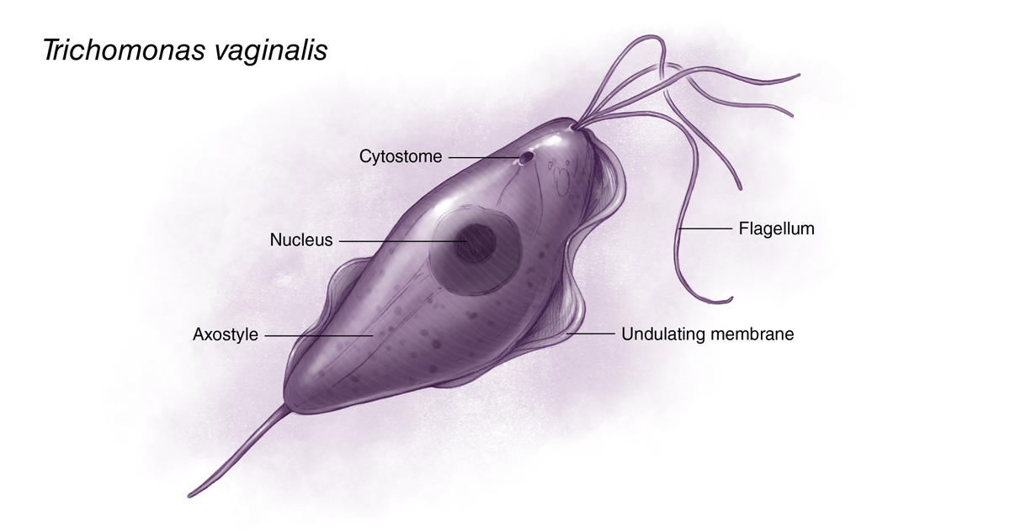
Trichomoniasis
Figure 9 - Trichomonas vaginalis Trichomonas vaginalis is a pear-shaped flagellated protozoan parasitic organism that is approximately 10 by 7 micrometers. The organism achieves a quivering motion via the anterior flagella and the undulating membrane. After attaching to vaginal epithelial cells, the organism takes on a more ameboid-like appearance.
https://www.std.uw.edu/custom/self-study/vaginitis/4

Slide 95
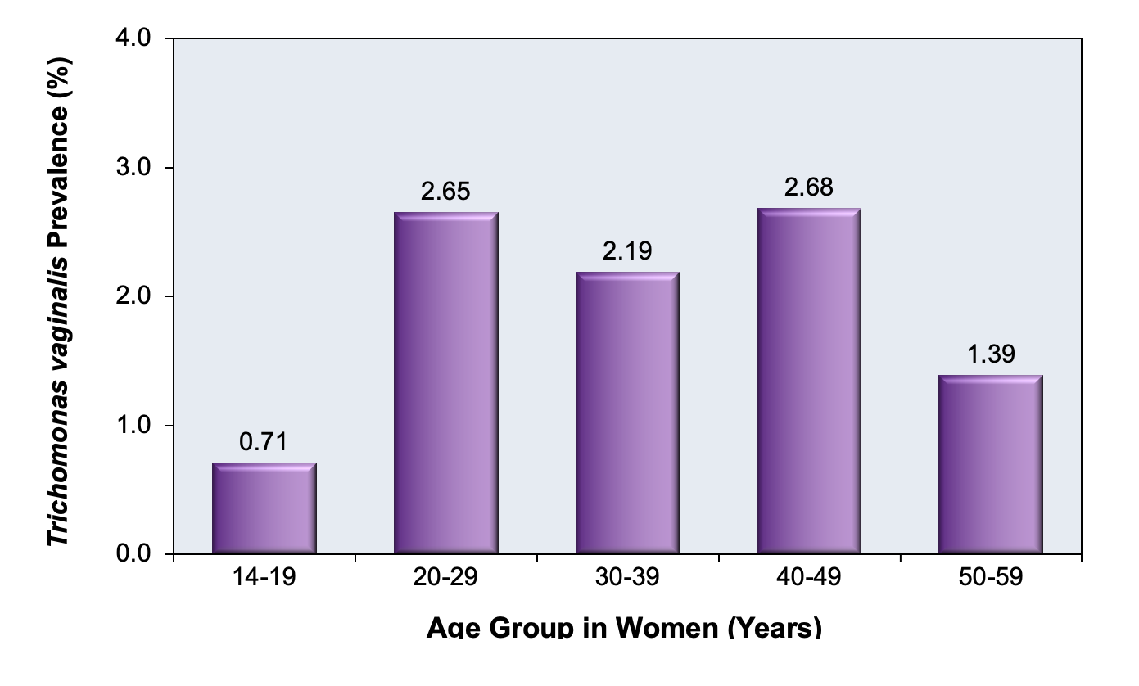
Trichomoniasis
Figure 8 - Prevalence of Trichomonas vaginalis Among Civilian, Noninstitutionalized Females Aged 14 to 59 Years: United States, 2013 to 2016
https://www.std.uw.edu/custom/self-study/vaginitis/4

Slide 96
Trichomoniasis Symptoms
Women
Frothy gray or green vaginal discharge
Pruritus
Many cases are asymptomatic
“Strawberry cervix”
Cervical punctate hemorrhages
Men
Often asymptomatic
Causes 11-13% of nongonococcal urethritis
May cause impaired sperm motility

Slide 97
Trichomoniasis Diagnosis
Wet mount microscopy
Inexpensive, simple
Sensitivity is 44-68%
Culture
Former gold standard
NAAT
Current gold standard
Sensitivity & specificity rates >98%
Point-of-Care Testing
Results in 10-40 minutes

Slide 98
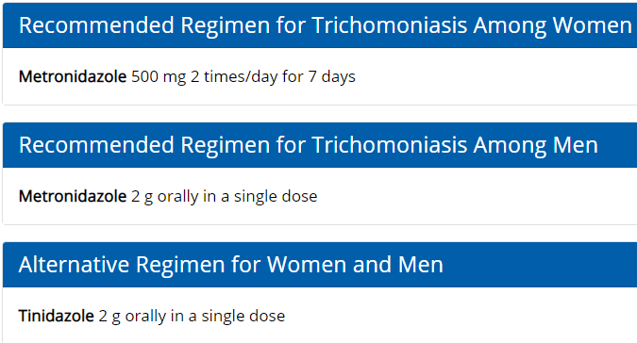
Trichomoniasis Treatment
https://www.cdc.gov/std/treatment-guidelines/trichomoniasis.htm

Slide 99
Trichomoniasis Follow-up
Patient & Partner Counseling
Abstain from sex for 7 days if singe-dose therapy
Abstain from sex for duration of 7-day therapy
Abstain until symptoms resolve beyond 7-day period
Partners in last 60 days should be treated
Most recent partner if last sex >60 days ago

Slide 100
Trichomoniasis Follow-up
Test of cure
Not indicated
Repeat testing in 3 months
Re-infection is very common in women
Increases risk for complications
Treatment failure is rare
No evidence to support retesting in men

Slide 101
Bacterial Vaginosis

Slide 102
Bacterial Vaginosis
Alteration in vaginal microbiome
Loss of the protective Lactobacillus species
Leads to increase in facultative and strict anaerobic bacteria
G. vaginalis, A. vaginae, Megasphaera type I
Increases risk for other STI and pregnancy complications
Most common of vaginal discharge in the United States and worldwide

Slide 103
Associated Factors
Factors Associated With Higher Risk
Increased number of male partners
Female sex partners
Douching
Genital HSV-2 infection
Factors Associated With Lower risk
Condom use
Male circumcision
Oral contraceptive pill

Slide 104
Bacterial Vaginosis Symptoms
More than half of cases are asymptomatic
Vaginal odor
Often described as fishy, unpleasant
More prominent after sex and around menstruation
Vaginal discharge
Often off-white, thin, homogenous
Not typically associated with dysuria, burning, pruritus, dyspareunia, inflammation or swelling

Slide 105
Considerations
Self-esteem
Sexual relationships
Quality of life

Slide 106
Diagnosis: Amsel Criteria
Clinical diagnosis
Sensitivity 37-70%, specificity 94-99%
Presence of three of four criteria:
Vaginal pH greater than 4.5
Presence of “clue cells” in at least 20% of vaginal epithelial cells under saline microscopy
Positive amine “whiff” test. Fishy odor with or without addition of 10% KOH
Homogenous, non-viscous, milky-white discharge adherent to vaginal walls

Slide 107
Diagnosis: Gram’s Stain with Nugent Scoring
Traditional gold standard, time-consuming, requires training and expertise
Based on concentration of Lactobacillus, Bacteroides, Gardnerella, and Mobiluncus
Nugent score 0-3: Normal. Lactobacillus-dominant
Nugent score 4-6: Intermediate microbiota. Emergence of G. vaginalis
Nugent sore 7-10: Consistent with bacterial vaginosis

Slide 108
Diagnosis
Point-of-care assays
Results in 10-30 minutes
NAAT
Can be patient-collected or provider-collected
Results in usually 24 hours

Slide 109
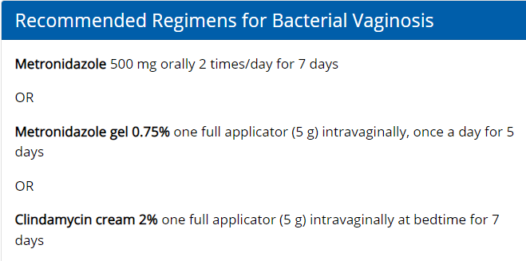
Bacterial Vaginosis Treatment
https://www.cdc.gov/std/treatment-guidelines/bv.htm

Slide 110
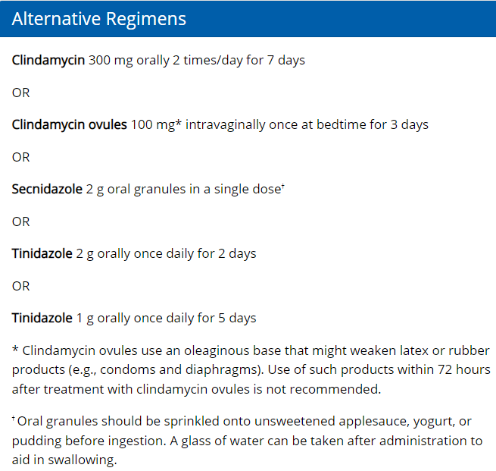
Bacterial Vaginosis Treatment
https://www.cdc.gov/std/treatment-guidelines/bv.htm

Slide 111
Bacterial Vaginosis Follow-up
Male partner treatment is not indicated
Female partners often have concurrent infection but management considerations not well studied
Recurrent & persistent infection common
Long-term regimens can be considered

Slide 112
Screening Guidelines

Slide 113
Chlamydia
Women
Under age 25 and sexually active
Age 25 and older, sexually active, increased risk
New partner, more than one partner, partner with concurrent partners, partner with STI, transactional sex
Consider rectal chlamydial testing based on reported sexual behaviors, exposure
Shared decision making

Slide 114
Chlamydia
Men Who Have Sex With Men
At least annually
Sites of contact (urethra, rectum) regardless of condom use
Every 3-6 months if at increased risk
Using PrEP, has HIV infection, partners have concurrent sex partners

Slide 115
Gonorrhea
Women
Under age 25 and sexually active
Age 25 and older, sexually active, increased risk
New partner, more than one partner, partner with concurrent partners, partner with STI, transactional sex
Consider pharyngeal & rectal screening based on reported sexual behaviors, exposure
Shared decision making

Slide 116
Gonorrhea
Men Who Have Sex With Men
At least annually
Sites of contact (urethra, pharynx, rectum) regardless of condom use
Every 3-6 months if at increased risk
Using PrEP, has HIV infection, partners have concurrent sex partners

Slide 117
Chlamydia & Gonorrhea
Transgender & Gender Diverse Persons
Screen based on
Anatomy
Age
Reported sexual behaviors and exposure

Slide 118
Chlamydia & Gonorrhea
Men Who Have Sex With Women
No set screening guideline
Consider screening, particularly young men, in high prevalence clinical settings
STI clinic, adolescent clinic, corrections

Slide 119
Chlamydia & Gonorrhea
Persons with HIV
Screen at first HIV evaluation and at least annually thereafter
More frequent screening based on individual risk and local epidemiology

Slide 120
Syphilis
Women & Men Who Have sex with Women
Screen asymptomatic individuals at increased risk
Incarceration history, transactional sex history, high prevalence regions, race/ethnicity, men under the age of 29

Slide 121
Syphilis
Men Who Have Sex with Men
At least annually when sexually active
Every 3-6 months if increased risk

Slide 122
Syphilis
Transgender and Gender Diverse People
At least annually
Based on sexual behaviors and exposure

Slide 123
Syphilis
Persons with HIV
Screen at first HIV evaluation
At least annually thereafter
More frequent screening depending on individual risk and local epidemiology

Slide 124
Herpes
Type-specific HSV serology can be considered for individuals presenting for an STI evaluation
Particularly for individuals with multiple partners or partner known to have HSV infection

Slide 125
Human Papillomavirus (HPV)
Women ages 21-29
Every 3 years with cytology (Pap test)
Women ages 30-65
Every 3 years with cytology (Pap test), or
Every 5 years with combination cytology and HPV testing

Slide 126
Human Papillomavirus (HPV)
Women with HIV
Screen within 1 year of sexual activity
Repeat 6 months later
Once 3 consecutive normal Pap test, screen every 3 years

Slide 127
Human Papillomavirus (HPV)
Men Who Have Sex with Men
Consider annual digital rectal exam
Insufficient data to recommend routine anal cancer screening with cytology (anal Pap)
If performing, ensure access to follow-up
High-resolution anoscopy

Slide 128
Human Papillomavirus (HPV)
Transgender and Gender Diverse People
Screen based on anatomy
People with a cervix should be screened according to cervical cancer screening guidelines

Slide 129
Trichomoniasis
Women
Screen in high-prevalence setting
STI clinic, corrections
Screen women at high risk for infection
Multiple partners, transactional sex, substance use, history of STI, history of incarceration
Women with HIV
Screen sexually active women at entry into care and at least annually thereafter

Slide 130
HIV
Women & Men Who Have Sex with Women
Everyone aged 13-64 at least once, opt-out
Anyone seeking evaluation and treatment for STIs

Slide 131
HIV
Men Who Have Sex with Men
At least annually if
HIV status not known or is negative and patient or partner has had more than one sex partner since most recent HIV test
Consider screening every 3-6 months

Slide 132
HIV
Transgender and Gender Diverse Person
Everyone aged 13-64 at least once, opt-out
Frequency of repeat screenings should be based on individualized assessment of risk

Slide 133
Pregnancy Considerations

Slide 134
Risk Factors
New sexual partner
More than one sexual partner
Partner with concurrent partners
Partner with an STI
Transactional sex
Incarceration history of self or partner
History of STI
Community prevalence rates
Substance use

Slide 135
Chlamydia in Pregnancy
Azithromycin has been deemed safe and effective
Doxycycline is contraindicated during 2nd and 3rd trimesters
Amoxicillin 500mg orally 3 times/day for 7 days is an alternative treatment in pregnancy
Test of cure 4 weeks after treatment

Slide 136
Gonorrhea in Pregnancy
Treat with single dose ceftriaxone
Treat for chlamydia if co-infection not yet ruled out
If cephalosporin allergy, consult with infectious disease expert
Gentamicin use cautioned in pregnancy
Risk for neonatal birth defects, nephrotoxicity, or ototoxicity

Slide 137
Screening Guidelines
Chlamydia & Gonorrhea
All women under the age of 25
Women > 25 if at increased risk
Repeat testing in 3rd trimester
Test of cure 4 weeks after chlamydia treatment
Re-test 3 months after treatment for gonorrhea or chlamydia

Slide 138
Syphilis in Pregnancy
Can lead to stillbirth
Any fetal death after 20 weeks’ gestation should trigger syphilis testing
No mother or neonate should leave hospital without maternal serologic status documented at least once in pregnancy
Risk for antepartum fetal infection or congenital syphilis is related to stage of syphilis during pregnancy
Primary and secondary syphilis are highest risk

Slide 139
Syphilis in Pregnancy
Pregnant women without a history of syphilis treatment should have stage determined
Treat with penicillin regimen appropriate for the stage of syphilis
Penicillin G is only known effective treatment for fetal infection & preventing congenital syphilis
When treating for late latent syphilis, optimal dosing interval is 7 days.
> 9 days between doses is not acceptable and will trigger need to restart treatment series

Slide 140
Syphilis in Pregnancy
Pregnant women without a history of syphilis treatment should have stage determined
Treat with penicillin regimen appropriate for the stage of syphilis
Penicillin G is only known effective treatment for fetal infection & preventing congenital syphilis
When treating for late latent syphilis, optimal dosing interval is 7 days.
> 9 days between doses is not acceptable and will trigger need to restart treatment series

Slide 141
Screening Guidelines: Syphilis
Every pregnant person at first prenatal visit
Traditional or Reverse Algorithm
Retest at 28 weeks gestation AND again at delivery if high risk for infection

Slide 142
Screening Guidelines: Herpes
No routine screening guidelines for asymptomatic pregnant women
Type-specific serology may be considered to identify women at risk for acquiring genital herpes during pregnancy

Slide 143
Screening Guidelines: HPV
Same screening intervals as the nonpregnant population

Slide 144
Screening Guidelines: HIV
Screen at first prenatal visit via opt-out testing
Retest in third trimester if at high risk
Rapid testing at delivery if no prenatal care or not previously screened during pregnancy

Slide 145
Questions

Slide 146
Program Evaluation
MATEC Michigan thanks you for your participation in today’s program
We appreciate all feedback and look forward to incorporating your suggestions into future programming
Link in the chat box
Scan the QR Code
Link in your email
QR CODE

Slide 147
Continuing Medical Education
<Program Date> <Your Event Name Here>
Activity Code: <your activity code here>
Using your designated phone number in our CME Tracker System please visit:
WWW.CME.MED.WAYNE.EDU
Click on “Activity Check-in”
Enter Cellphone Number and Activity Code (above)
You have 7 days from the start of the conference to claim credit.
Landlines will not work with system. Cell phone is required
If you are unable to claim credit, please update your CME account.
Contact CME for questions: dcme@med.wayne.edu
or ea6178@wayne.edu

Slide 148
Continuing Nursing Education
A record of your attendance today has been made
A certificate awarding contact hours for today’s program will be sent to the email you used during registration
Please contact MATECMichigan@gmail.com with any continuing education questions

Slide 149
MATEC Michigan
2727 Second Avenue
Suite 138
Detroit, Michigan 48201
Phone: 313-962-2000
Urgent Consultation: 313-408-3483
Fax: 313-962-4444
Email: MATECMichigan@gmail.com

Slide 150
References
We prefer you to add your references throughout your presentation on the slides
Use this slide for any additional references

Slide 151
Speaker Resources
If you have any resources, feel free to add them here

Slide 152
MATEC Resources
Clinical Consultation Center http://nccc.ucsf.edu/
HIV Management
Perinatal HIV
HIV PrEP
HIV PEP line
HCV Management
Substance Use Management
AETC National HIV Curriculum
https://aidsetc.org/nhc
AETC National HIV-HCV Curriculum https://aidsetc.org/hivhcv
Hepatitis C Online https://www.hepatitisc.uw.edu
AETC National Coordinating Resource Center https://aidsetc.org/
Additional Trainings https://matec.info

