Slide 1
HIV Screening & Linkage
Michelle Iandiorio, MD
Clinical Director, SCAETC
Professor, UNMHSC Dept of Internal Med, Div of ID
Notes:
Version date_12 2021
Target audience:
Outreach testers
PrEP navigators
Case managers
Medical assistants
Nurses

Slide 2
Conflict of Interest Disclosure Statement
Speaker’s organization has received grant support from Merck Research Laboratories for clinical trials on which she serves as an investigator.
This project is supported by funds from the Bureau of Primary Care.
This project is supported by the Health Resources and Services Administration (HRSA) of the U.S. Department of Health and Human Services (HHS). Under grant number U1OHA33225 (South Central AIDS Education and Training Center). It was awarded to the University of New Mexico. No percentage of this project was financed with non-governmental sources. This information or content and conclusions are those of the authors and should not be construed as the official position or policy of, nor should any endorsements be inferred by HRSA, HHS, or the U.S. Government.

Slide 3
Learning Objectives
Recognize the need for HIV screening, prevention, and treatment.
Identify HIV screening guidelines and explain why HIV screening is routine best practice.
Correctly interpret HIV screening and monitoring tests.
Explain status neutral linkage to care.
Notes:
Go over the meaning of results types offered by VAC Education through DSHS labs.
HIV Ag-Ab Multiplex _test
HIV ½ Supplemental Assay Interpretation _ Test
NAAT Testing
ELISA Testing
Difference between Antigen and Antibody HIV testing
Difference between HIV 1 and HIV 2
VAC will create a sample packet of HIV testing results that come back with odd results; to create a guide book showing staff examples of those testing results.

Slide 4
There have been improvements in reduction of new HIV diagnoses…
Annual number of new diagnoses decreased 8% from 2015 to 2019 in U.S. (36,000)
  Majority of new diagnoses in men with male sex partners
From 2010 to 2019, HIV diagnoses decreased among youth overall
  2019 HIV infections decreased among 13-24yo by 46%
https://www.cdc.gov/hiv/statistics/overview/ataglance.html
Notes:
Trend in new infections from 2010 to 2019
40,000 ISH to 36,000 ISH. Slide Sets | Resource Library | HIV/AIDS | CDC: www.cdc.gov
Goal with EHE is 2025 – approximately 8000 to 9000 new infections; 2030 - <3000 new infections
2018 HIV Surveillance Report
The annual number of new diagnoses decreased 9% from 2010 to 2016 in the 50 states and the District of Columbia.
In 2018, gay, bisexual, and other men who have sex with men accounted for 69% of all new HIV diagnoses in the United States and 6 dependent areas. In the same year, heterosexuals made up 24% of all HIV diagnoses
From 2010 to 2017, HIV diagnoses decreased 10% among youth overall in the 50 states and the District of Columbia.
In 2018, youth aged 13 to 24ª made up 21% (men: 92% MSM; women: 85% WSM, 12% IDU)
2019 surveillance report
The annual number of HIV infections in 2019, compared with 2010, increased among persons aged 25–34 years (35%), but decreased among persons aged 13–24 (−46%) and 45–54 years (−36%).
The annual number of HIV infections in 2019, compared with 2010, decreased among persons with infection attributed to heterosexual contact (−24%). The annual numbers remained stable among persons with infection attributed to injection drug use (IDU), male-to-male sexual contact (MMSC), and MMSC and IDU.

Slide 5
… But Disparities Still Exist
New HIV diagnoses in Native American population increased 22% between 2015 to 2019 (31% in Native American men with male sex partners)
From 2010 to 2016, HIV diagnoses increased 6% among Latinx
The most affected subpopulation is African American/Black gay and bisexual men
https://www.cdc.gov/hiv/statistics/overview/ataglance.html
MSM=men who have sex with men
https://www.cdc.gov/hiv/statistics/overview/ataglance.html
Notes:
2018 HIV Surveillance Report
The most affected subpopulation is African American gay and bisexual men (42% of new HIV diagnoses in 2018 with accounted for 13% of the US population⁾
Rates of Diagnoses of HIV Infection among Adults and Adolescents, by Age at Diagnosis, 2008–2012—U.S. 50,000 new patients infected with HIV/yr. http://www.cdc.gov/hiv/library/reports/surveillance/
37,600 new patients infected with HIV/yr in the U.S.²⁰¹⁴
Highest increases in youth (13-25), MSM, racial minorities
Implies the need for alternatives/additions to condoms
Additional statistics about disparities
2 out of every 5 patients newly diagnosed with HIV are youth
African American MSM have 5x the national average of new HIV diagnoses. African Americans make up 12% of US population but 44% of new HIV diagnoses.
One of every 2 women newly infected with HIV is African American.
New HIV diagnoses in Native American population increased 19% between 2005 to 2014 & 63% in MSM
Transgender patients have 3x the national average of new HIV diagnoses
Hispanics make up 18% of US population but 25% of new HIV diagnoses.
2019 Surveillance report
In 2019, the largest percentage of HIV infections were attributed to MMSC (66%), followed by heterosexual contact (22%).
In 2019, Black/African American persons made up approximately 12% of the population of the United States but accounted for 41% of HIV infections. White persons made up 62% of the population of the United States but accounted for 25% of HIV infections. Hispanic/Latino persons made up 17% of the population of the United States but accounted for 29% of HIV infections.
The estimated HIV incidence for American Indian/Alaskan Native persons should be used with caution because the RSE is 30%–50% .

Slide 6
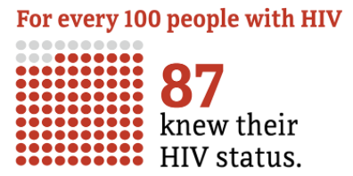
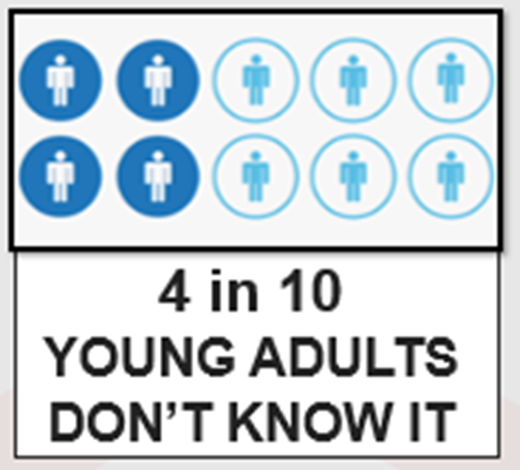
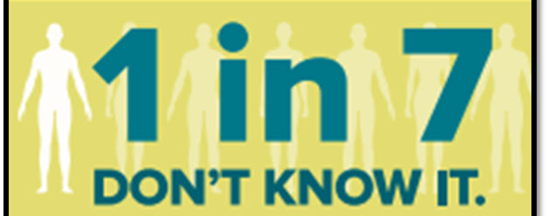
Not all People with HIV know their status
1,059,784 PWH 2019
http://www.cdc.gov/hiv/statistics/overview/ataglance.html
Notes:
PWH= people with HIV
13% don’t know their status (1 in 7.5 don’t know it)
36,801 new hiv dx in US and dependent areas in 2019.
Of those, 69% gay and bisexual men, 23% heterosexual, 7% IDU
Number highest among 25-34yo
Transgender people: 2% MTF, 1% FTM
86% male
Rates of Diagnoses of HIV Infection among Adults and Adolescents, by Age at Diagnosis, 2008–2012—U.S. 50,000 new patients infected with HIV/yr.
CDC. MMWR 2015;64:657-662 (2012 data).
Estimated 1 in 8 HIV-infected women in the U.S. do not know their status
-13% general US population- 44% of 13-24yo do not know
http://www.cdc.gov/hiv/library/reports/surveillance/
NM: We have roughly 3,300 persons living with HIV. And average 131 new infections per year. 119 in 2012 – 142 in 2013 – 129 in 2014, 133 in 2015 – 134 in 2016
CDC. MMWR 2015;64:657-662 (2012 data).
Estimated 1 in 8 HIV-infected women in the U.S. do not know their status
-13% general US population- 44% of 13-24yo do not know
http://www.cdc.gov/hiv/library/reports/surveillance/

Slide 7
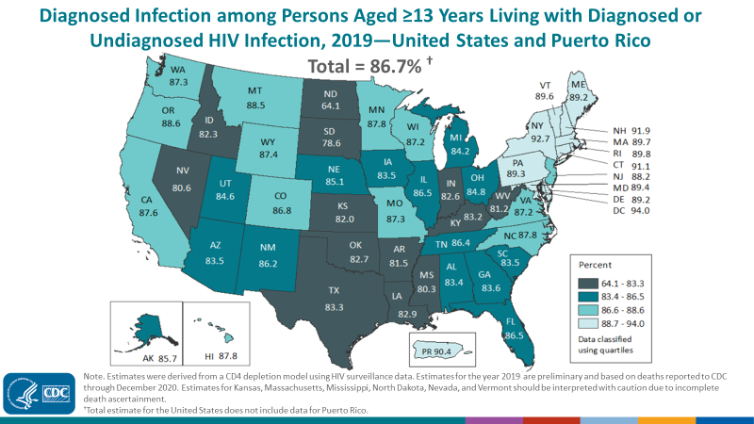
Undiagnosed HIV (2019)
In U.S., 13% don’t know their status
In Texas, 17% don’t know their status
Notes:
Estimated 13% of people in the US living with HIV infection are unaware of their diagnosis
Darker the color, the fewer the people with HIV have been diagnosed
HIV Screening is Important for Prevention & Treatment of HIV.
Those who don’t know their status thought to account for 30-50% of new infections (Marks, et al. 2006)

Slide 8
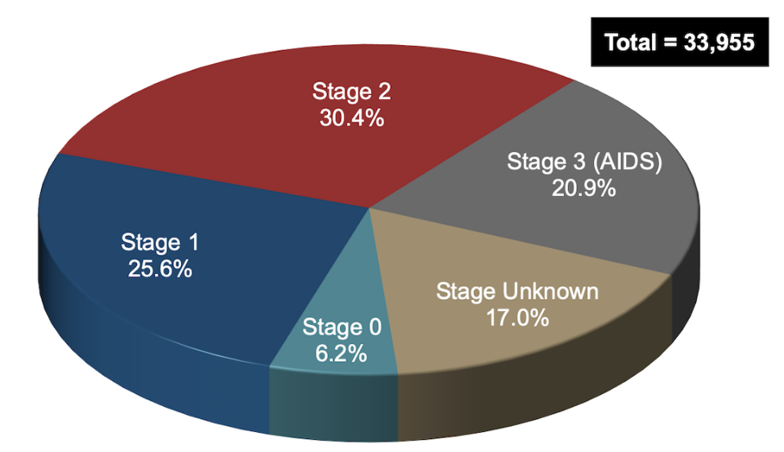
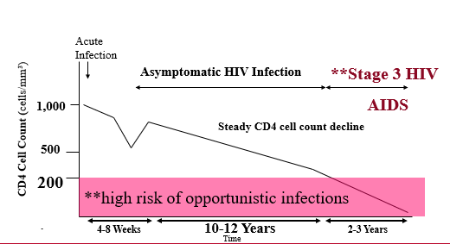
Late-stage diagnosis is associated with more morbidity and potential increased transmission
Late-stage diagnosis (2017)
Natural history of HIV: steady decline in CD4 count
Centers for Disease Control and Prevention. Monitoring selected national HIV prevention and care objectives by using HIV surveillance data—United States and 6 U.S. dependent areas, 2017. HIV Surveillance Supplemental Report. 2019;24(No. 3):1-74. Published June 2019
Notes:
2017 data
This means that patients have had undiagnosed HIV infections for about 10 years.
Stage 3 HIV: CD4<200 or CD4<14% or any CD4 with active opportunistic infection or malignancy
HIV Screening is Important for Treatment of HIV
21% new HIV diagnoses in the U.S. already have advanced disease (21% stage 3, 51% stage 2+3)
People who know they are infected can start HIV treatment
HIV treatment (HAART/ART) results in viral suppression and markedly reduced transmission¹⁻³
Studies show the benefit of ART on all people with HIV (PWH)^{4,5}
1. Cohen MS, et al. NEJM 2011;365:493-505. 2. Skarbinski J, et al. JAMA Intern Med 2015;175:588-96. 3. Rodger AJ et al. JAMA 2016;316(2):1-11. 4. Smith et al. JAIDS 2013; 63S2:S187-99. 5. Kitahata MM, et al. NEJM 2009;360:1815-26.

Slide 9
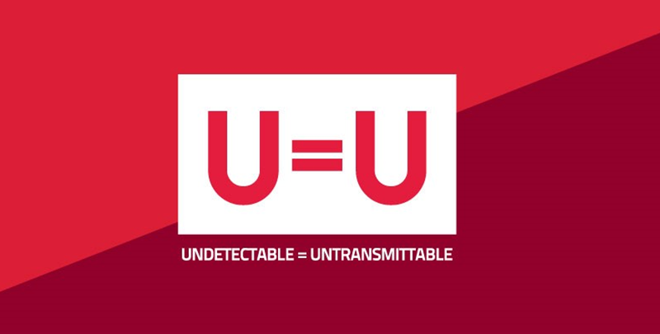
HIV Treatment is Prevention
Cohen, et al. NEJM 2011; 365: 493-505. Skarbinski J, et al. JAMA Intern Med 2015;175:588-96.
Bavinton BR, et al. Lancet HIV. 2018. IAS 2018 Conferencehttp://programme.aids2018.org/Abstract/Abstract/13470

Slide 10
HIV Screening Guidelines
CDC 2006
Test all pregnant women
Test all pts 13-64 yo
Test all pts with TB, STD
Test high risk patients at least annually
USPTF 2013
Test all 15-65 yo
Test <15 & >65 yo if at risk
Test all pregnant women
Grade A recommendation
Branson BM, et al. MMWR 2006. Moyer, Virginia et al. Annals of Internal Medicine. 2013.
Notes:
Branson BM, et al. MMWR Recomm Rep. 2006;55(RR-14):1-17.
Thought that those who don’t know their status account for 50% of new infections (Marks, et al. 2006)
Verbal consent for testing (written consent no longer needed)
https://www.uspreventiveservicestaskforce.org/uspstf/document/RecommendationStatementFinal/prevention-of-human-immunodeficiency-virus-hiv-infection-pre-exposure-prophylaxis

Slide 11
Status Neutral HIV Screening & Linkage to Care
Making HIV screening part of routine care helps ensure patients are screened, despite presumed risk, and helps reduce stigma
If HIV screen nonreactive/negative but significant risk, linkage to HIV prevention (i.e. PEP, PrEP)
If HIV screen reactive/positive, linkage to HIV treatment (antiretroviral therapy and holistic care)
Notes:
HIV Screening is Important for Prevention
Knowing they have HIV allows people to
Protect others from becoming infected
Make safer decisions about sex, needle use, & their health care
PWH who know their status avoid behaviors that spread infection
Those at high risk but test negative can utilize prevention strategies
Coates, et al JAMA 1987;258:1889. Doll et al. Health Psychol 1990;9:253-65. Fox, et al. AIDS 1987;1:241-6. Gibson, et al. AIDS and Behavior 1999;3:3-12. Rietmeijer, et al. AIDS 1996; 10:291-8. van Griensven et al. Am J Epidemiol

Slide 12
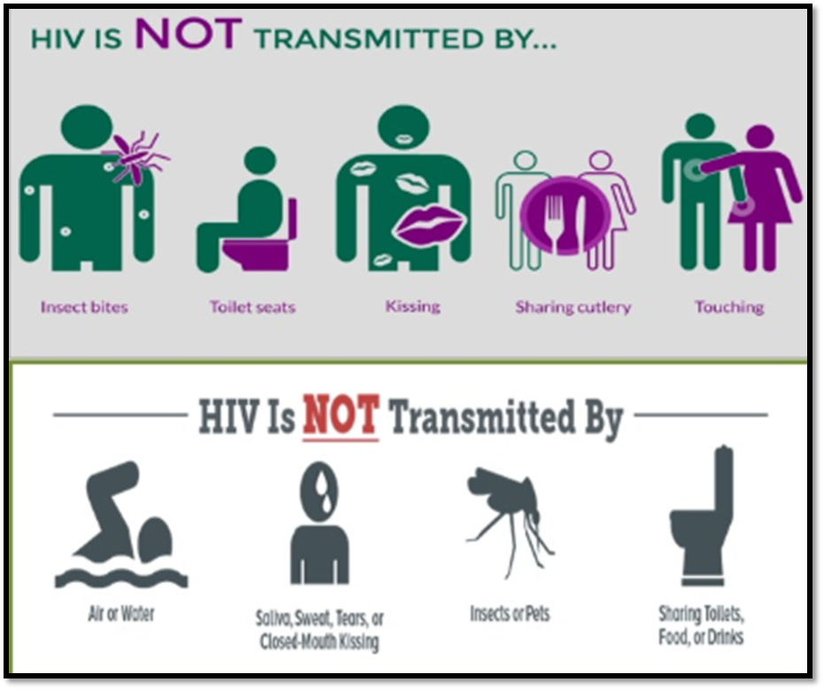
HIV Transmission Risk
Not infectious:
Urine, saliva, sweat, tears, nasal secretions, sputum, vomitus, stool
https://www.cdc.gov/hiv/risk/estimates/riskbehaviors.html
Image: https://healthylife.werindia.com/your-road-to-healthy-life/hiv-is-not-transmitted-by
Notes:
Status neutral approach.
Screen all patients for HIV and all those with history sexual activity for STIs.
Inform all patients about HIV transmission risk – for their own use, to help spread reliable information to communities, to reduce spread of misinformation, to reduce stigma

Slide 13
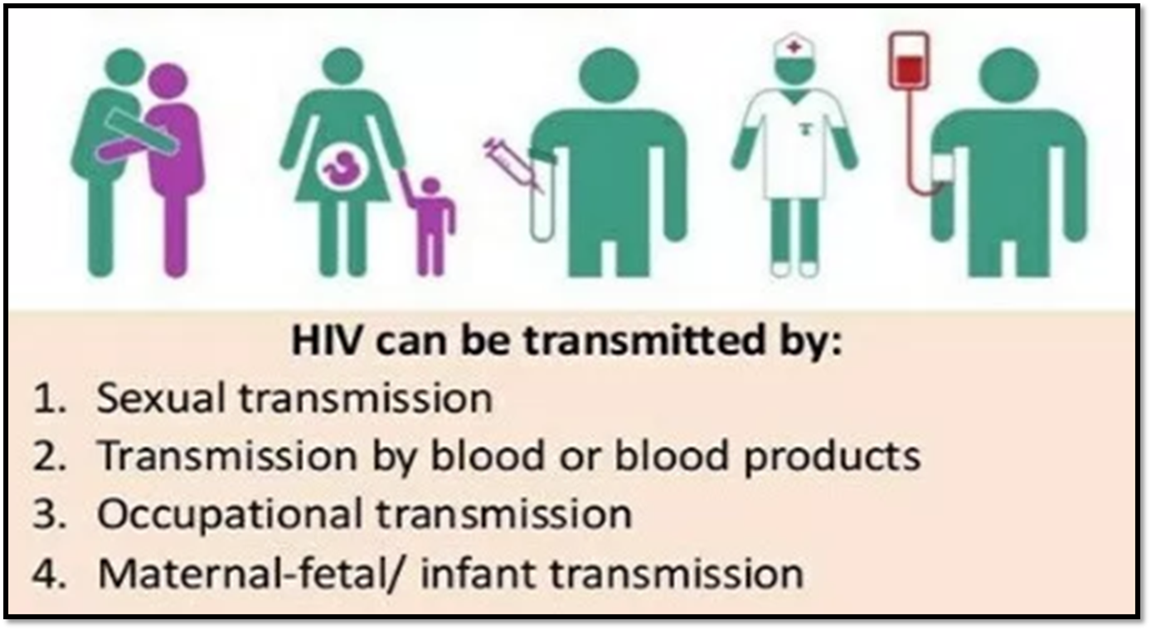
HIV Transmission Risk
Potentially infectious fluids: blood, breast milk, tissue, semen, vaginal secretions, visibly bloody fluids
Exposure across mucosal surface, open wound, or injection
https://www.cdc.gov/hiv/risk/estimates/riskbehaviors.html
Notes:
Potentially infectious fluids also include visibly bloody fluids, other bodily fluids (cerebral spinal fluid, synovial fluid, pleural fluid, pericardial fluid, amniotic fluid)

Slide 14
HIV Transmission Risk
Higher risk
Receptive anal sex
  Per episode: 0.3 - 3%
Needle sharing
  Per episode: 0.67%
Lower risk
Oral sex
  Per episode: 0.06%
Insertive sex
  Per episode 0.03 – 0.14%
1. Bell DM. Am J Med 1997;102(suppl5B):9--15. 2. Ippolito G et al. Arch Int Med 1993;153:1451--8. 3. Am J Epi 1999; 150:306-11.4. Am J Epi 1999;150:306-11.5. MMWR 47;RR-17, 1998.6. NEJM 336(15):1072-8. 7. Am J Epi 1999;150:306-11.8. Rothenberg RB et al. AIDS 1998;12:2095-2105.9. MMWR 47;RR-17, 1998.10. ACTG 076.
Notes:
Risk reduction approach
Empower patients to make risk assessment and behavior decisions for themselves based on scientific information

Slide 15
HIV Treatment in Birthing Parent
Prevents Vertical Transmission
25%
Without ART
40% if breastfeeding off ART
<1%
Birthing parent takes perinatal ART
Labor ART +/- IV zidovudine (AZT)
Neonate oral zidovudine (AZT)
ART=antiretroviral therapy; HIV treatment
Notes:
Higher rate in Asia and Africa (25-40%): other medical conditions, prolonged breastfeeding
1999 study of 57 woman who had viral loads <1000 at delivery, none had hiv infected babies (irrespective if on haart or not)
Plasma viremia is significant risk: rate of vertical transmission 3.4 gold higher per log of plasma viremia.
Give AZT even if resistance: crosses placenta readily, reduces genital viral load

Slide 16
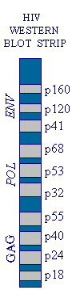
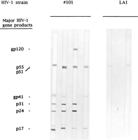
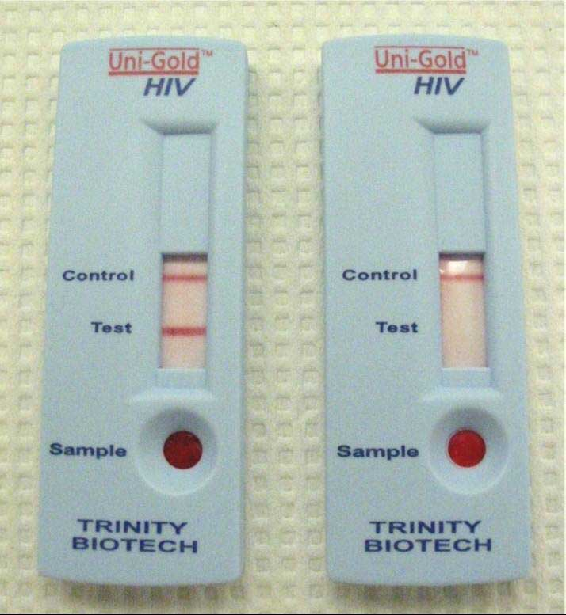
HIV Testing
Rapid Testing
  HIV Ab Elisa Screen
  High sensitivity
  False-positive possible
3rd Generation Screening
  HIV Ab Elisa followed by automatic WB confirmation
Confirmatory Testing
  Western blot
  High specificity
Notes:
Rapid testing used by NMDOH: Uni-Gold (100% sensitive, finger stick, results in 10 minutes)
HIV Ab cost at Tricore (2/2011) $20.00
Rapid screening available through DOH. Not yet approved at UNM or TriCore.
There are many reasons for a false-positive ELISA result. Some of the more common reasons for a false positive are:
Contamination: In a laboratory, samples may be placed in the wrong testing well; wells containing negative samples may be contaminated from adjacent positive wells; plate washers may malfunction.
treated blood and blood abnormalities have been implicated in false positive reactions.False positive reactions have been reported in 19% of people with hemophilia, 13% of alcoholic patients with hepatitis, and 4% of hemodialysis patients.
Pregnancy. If this is not her first pregnancy, a woman may react positively when she is, in fact, negative.
History of injection drug use.Cross-reactivity with other retroviruses.
Q. What is the expected false-positive rate for an HIV antibody ELISA?A. The false-positive rate is 1 to 5 per 100,000 assays.
The term "indeterminate" relative to HIV testing usually refers to the HIV antibody Western blot assay. The HIV antibody Western blot assay is used on two or more specimens found to be reactive by an HIV antibody ELISA screening assay. (6) Persons who are not at high risk for HIV infection and do not have symptoms, and yet continue to test indeterminate, usually have a very low probability of being infected with HIV. (7) There are many possible reasons for an indeterminate HIV antibody Western blot assay. Some of these reasons might be:Prior blood transfusions, even with non-HIV-1 infected bloodPrior or current infection with syphilis.Prior or current infection with malaria parasites.Autoimmune disease (e.g. diabetes, Grave's disease, etc.).Infection with other human retroviruses (e.g., HIV-2, HTLV I/II).Association with "large animals." Animal trainers and veterinarians are sometimes exposed to viruses which do not cause human disease but may interfere with HIV antibody tests.Second or subsequent pregnancies in women.

Slide 17
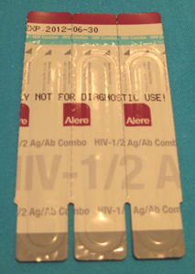
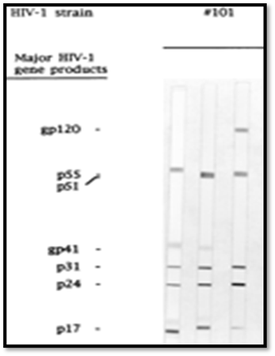
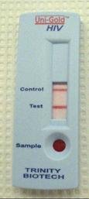
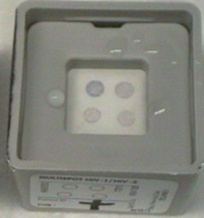
HIV Screening
4th Generation
3rd Generation
Antigens bind HIV antibodies from patient sample
Allows detection in early seroconversion
6-8 week window period
Antigens bind HIV Abs from patient sample & monoclonal Abs detect p24 antigen
Allows detection prior to seroconversion
Detect between 12-26d from exposure
Notes:
P24 antigen can appear in just 12-26 days after infection; Examples listed above are CLIA-waived, FDA-approved rapid HIV tests
Tests that are categorized as CLIA-waived can be performed outside of a laboratory setting. Testing programs must register and obtain a CLIA certificate of waiver before engaging in testing outside the laboratory setting. Waived tests can be performed by anyone who has been trained in their use, but typically no special credentialing is required.
Alere Specificity** 99.23% (Antibody) 99.66% (Antigen). ** Seronegative plasma or serum conducted in 9 clinical trail sites: Belgium, Uganda, Senegal, UK, Thailand, France, Ethiopia, South Africa, and Colombia. Other viral or bacterial infections included ( HBV, HCV, HTLV, CMV, Toxo IgG, Syphilis, HSV 1 / 2, EBV, Flu vaccinated patients and Chlamydia IgG/IgM. Cancer Patients. Potentially Interfering Substances including: IV drug users, multiparus pregnancy, rheumatoid factor, alcoholic cirrhosis, autoimmune (ANA), high cholesterol, lipemic, high bilirubin, hemolyzed, and anti mouse IgG.
Sensitivity ***100% *** HIV-1 non B subtypes include A, C, D, F, G, H, J, K, and CRF01_AE, CRF02_AG, CRF06_cpx, CRF09_cpx, CRF11_cpx, CRF35_AD, and BD
Information Provided by Alere: http://www.alere.com/za/en/product-details/determine-1-2-ag-ab-combo.html
Alere 1-2 weeks prior to other rapid tests & 1-3d before 3rd gen lab tests but 3-4d after 4th gen lab tests. An international study suggests that there is lower specificity for the antigen component of the test (98.3%) than for the antibody component (99.2%).
Multispot detects HIV-1 earlier than WB
5 studies documented discrepancy
Usually “indeterminate” on WB
Specificity: 99-99.93% (product insert)
“Intermediate “
HIV-1: only one envelop gp41 protein is bound (HIV-2: gp36)
The use of Western blot misclassifies majority of HIV-2 infections.
Western blot positive for HIV-1 46-85% of specimens from persons with HIV-2
Incorrect/delayed diagnosis
Monospot: correctly classifies the majority of both HIV-1 and HIV-2 antibody-positive infections, including subset misclassified by Western blot
Ramos et al. Journal of Clinical Virology, 2013

Slide 18
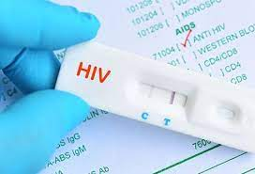
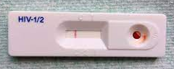
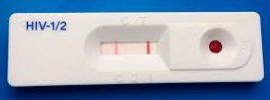
HIV Screening Tests
Nonreactive
Reactive

Slide 19
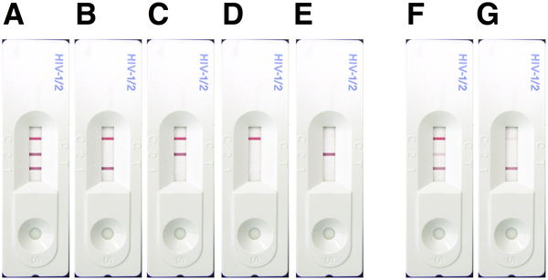
HIV Screening Tests
Possible results for the three-line SD Bioline HIV rapid diagnostic test (RDT) that presents indicator lines for control, HIV-2 and HIV-1
control
Faint lines count
HIV-2
HIV-1
https://journals.plos.org/plosone/article?id=10.1371/journal.pone.0018294
Notes:
Chiu YHC, Ong J, Walker S, Kumalawati J, Gartinah T, et al. (2011) Photographed Rapid HIV Test Results Pilot Novel Quality Assessment and Training Schemes. PLOS ONE 6(3): e18294. https://doi.org/10.1371/journal.pone.0018294
https://journals.plos.org/plosone/article?id=10.1371/journal.pone.0018294
Figure 4. Possible results for the three-line SD Bioline HIV rapid diagnostic test (RDT) that presents indicator lines for control, HIV-2 and HIV-1.
HIV-1/2 positive (A), HIV-1 positive results (B, F & G), HIV-2 positive (C), HIV negative (D) and Invalid (E) results. A-E were considered "obvious" because the manufacturers' instruction illustrated these types of result. F & G are both HIV-1 positive and considered "difficult" because the correct interpretation required comparison of intensities for the middle and bottom lines (F), or the ability to see and interpret a faint line (top line, G).
https://doi.org/10.1371/journal.pone.0018294.g004

Slide 20
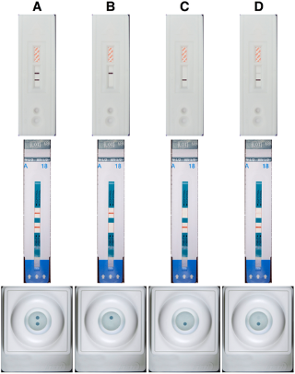
HIV Screening Tests
Advance Quality
Determine
Reactive
Nonreactive
Invalid
Faint lines count
Insti
https://journals.plos.org/plosone/article?id=10.1371/journal.pone.0018294
Notes:
Chiu YHC, Ong J, Walker S, Kumalawati J, Gartinah T, et al. (2011) Photographed Rapid HIV Test Results Pilot Novel Quality Assessment and Training Schemes. PLOS ONE 6(3): e18294. https://doi.org/10.1371/journal.pone.0018294
https://journals.plos.org/plosone/article?id=10.1371/journal.pone.0018294
Figure 3. Possible types of result for two-line/dot HIV rapid diagnostic tests (RDTs).
RDTs from top to bottom are: Advance Quality, Determine and Insti. Typical results for reactive (A), non-reactive (B) and invalid sample results (C) as shown in manufacturers' instruction were considered "obvious". The results labeled D were considered "difficult" because of the presence of only a faint line/dot and because both lines/dots are not the same intensity.
https://doi.org/10.1371/journal.pone.0018294.g003

Slide 21
Acute Retroviral Syndrome
Symptomatic acute HIV infection
Typically occurs 2-4 weeks after infection
Nonspecific flu-like illness for 3-14 days
Diagnosis = 3rd or 4th Gen Screening test negative or indeterminate with HIV RNA high
Highly infectious during this time

Slide 22
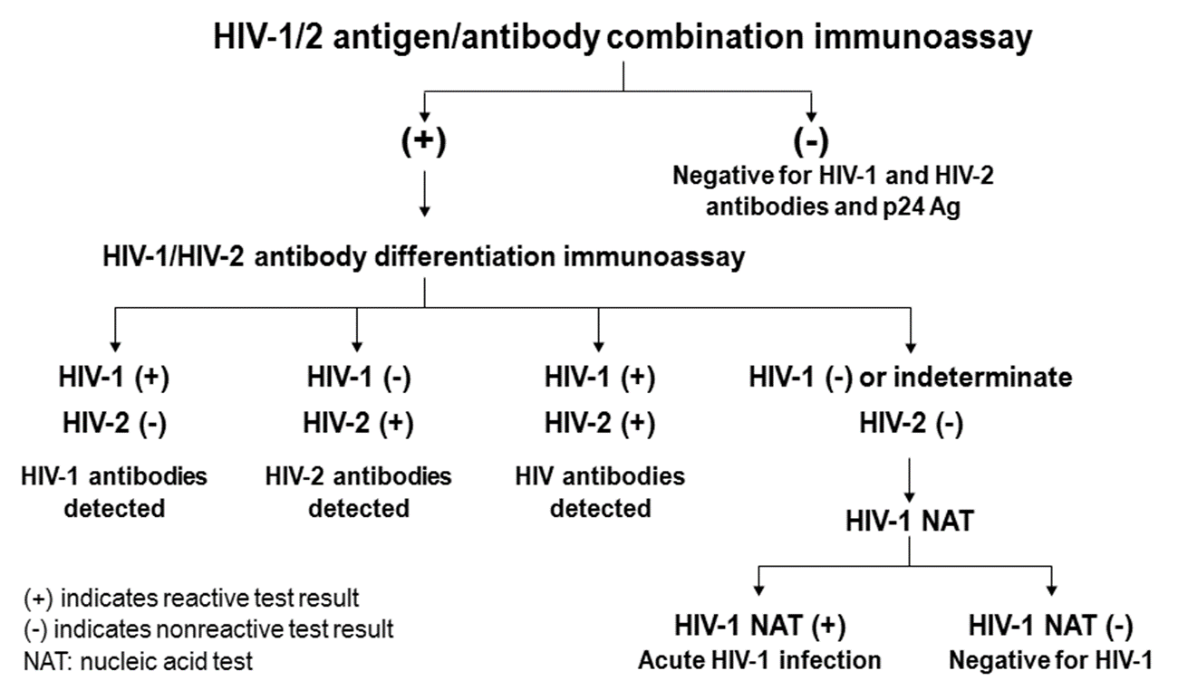
Algorithm for HIV Screening
If concern for acute infection
Serum HIV Viral Load
MMWR 6/2013.
Notes:
Testing begins with a combination immunoassay that detects HIV-1 and HIV-2 antibodies and HIV-1 p24 antigen.
All reactive specimens on this initial assay undergo supplemental testing with an immunoassay that differentiates HIV-1 from HIV-2 antibodies.
Specimens that are reactive on the initial immunoassay and nonreactive or indeterminate on the antibody differentiation assay proceed to HIV-1 nucleic acid testing (NAT) for resolution.
The results of this algorithm may be used to identify persons likely to benefit from treatment, to reassure persons who are uninfected, and for reporting evidence of HIV infection to public health authorities.
Advantages to algorithm:
More accurate lab diagnosis of acute HIV-1 infection & HIV-2 infection
Equally accurate lab diagnosis of establishing HIV-1 infection
Fewer indeterminate results
Faster turnaround time for most test results

Slide 23
PEP vs PrEP
HIV PEP = post-exposure prophylaxis​
Given after high-risk exposure to reduce risk of HIV infection​
Start within 72 hours of exposure​
28-day course of daily 3-drug regimen​
HIV PrEP = pre-exposure prophylaxis​
Daily regimen given before exposure to reduce risk of HIV infection​
Oral daily 2-drug regimen or long acting injectable medication
https://www.cdc.gov/hiv/pdf/programresources/cdc-hiv-npep-guidelines.pdf ​
https://www.cdc.gov/hiv/pdf/risk/prep/cdc-hiv-prep-guidelines-2021.pdf

Slide 24
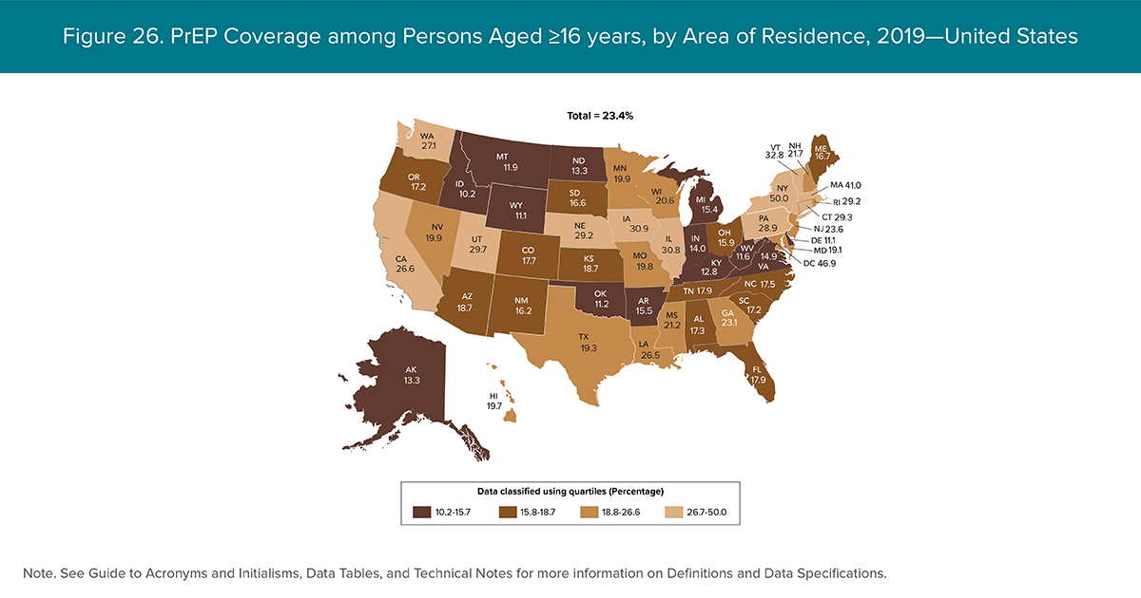
PrEP Coverage
Nationally, 23% of the people who are considered at considerable risk of HIV infections are receiving pre-exposure prophylaxis
Notes:
CDC. Monitoring selected national HIV prevention and care objectives by using HIV surveillance data—United States and 6 dependent areas, 2019. HIV Surveillance Supplemental Report 2021
Nationally, rates of PrEP use are around 23%, which is to say that 23% of the people who are considered at considerable risk of HIV infections are receiving pre-exposure prophylaxis

Slide 25
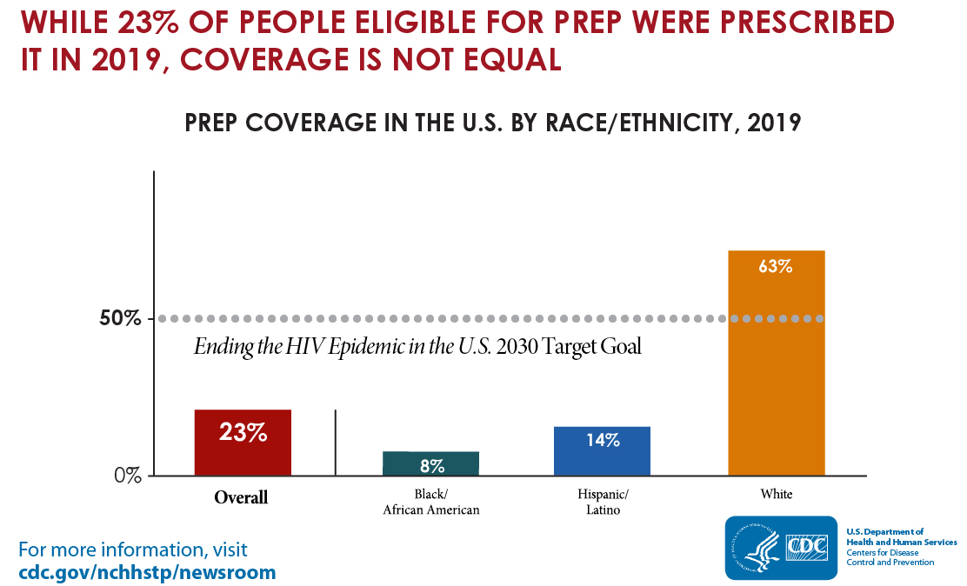
Notes:
People of color comprise a disproportionate number of new HIV infections in the US, yet have limited uptake of PrEP
PrEP has been most widely adopted by college educated, middle-aged, white gay men
Many LGBTQ+ community centers across the US are based in neighborhoods most popular for white gay men
If we look at it from a gender perspective, Men have at least 3x higher PrEP coverage than woman
Black heterosexual woman have higher rates of HIV acquisition than other women
CDC, 2016
Though 20% of the US population, Latinx people account for ¼ of new cases of HIV. Most of those diagnosed are men
Awareness of PrEP is low among Latinx individuals at risk, particularly MSM, posing challenges to adoption
Stigma or fear of being judged for one’s behaviors may serve as a barrier to PrEP adoption, as well as linguistic and economic access to resources in some regions

Slide 26
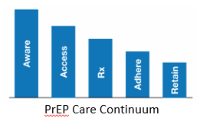
Need for PrEP to reach more people at risk
Continued disparities among certain populations with new HIV infections and lack of access to HIV PrEP
Interventions to improve metrics at each step of PrEP care Continuum could reduce disparities
Jenness, S et al. CROI2018. Abstract 1149
Notes:
-Jenness, S et al. CROI2018. The PrEP care continuum and HIV racial disparities among MSM. Abstract 1149. Mathematical model of HIV transmission for MSM to include race-stratefied transitions through PrEP continuing from awareness to access to rx to adherence to retention.
https://www.cdc.gov/mmwr/volumes/68/wr/pdfs/mm6827-H.pdf

Slide 27
HIV Clinical Assessment
CD4 count
HIV Viral load
Used to stage disease
Stage 1: asymptomatic, CD4>500
Stage 2: CD4 200-500
Stage 3: CD4<200, <14%, opportunistic disease or malignancy
Used to monitor ARV therapy
Well controlled: viral load undetectable
Suboptimal or uncontrolled: viral load detectable
(HIV RNA quantitative PCR)

Slide 28



HIV Clinical Assessment
CD4 count
HIV Viral load
Notes:
Discuss CD4 count and CD4 percentage (CD3+CD4+)and what they mean
What do the results look like
Example: Total WBC 5.8, N59%, L15%, M11% E8%, B2%, variant lymph 5%
N#3.4, L#1.2, M#.6, E#.5B0.1

Slide 29
When to Start HIV Treatment
ASAP in all people with HIV as long as the patient is ready (A1 recommendation)
Must start conditions
  Opportunistic infection, Tuberculosis
  HIV-Associated Nephropathy, Co-infection with HBV or HCV
  Pregnant women
https://aidsinfo.nih.gov/news/1592/statement-from-adult-arv-guideline-panel---start-and-temprano-trials
Notes:
ART is recommended for treatment:
“ART is recommended for all HIV-infected individuals, regardless of CD4 T lymphocyte cell count, to reduce the morbidity and mortality associated with HIV infection.” (A1)
ART is recommended for prevention:
“ART also is recommended for HIV-infected individuals to prevent HIV transmission.” (A1)
ART should be initiated as soon as possible
On a case-by-case basis, ART may be deferred because of clinical and/or psychological factors
Patients should understand that indefinite treatment is required; ART does not cure HIV
Address strategies to optimize adherence

Slide 30
Resources
National Clinician Consultation Center http://nccc.ucsf.edu/
  HIV Management
  Perinatal HIV
  HIV PrEP
  HIV PEP line
  HCV Management
  Substance Use Management
Present case on ECHO https://echo.unm.edu/locations-2/echo-hubs-superhubs-united-states/
AETC National HIV Curriculum https://aidsetc.org/nhc
AETC National Coordinating Resource Center https://targethiv.org/library/aetc-national-coordinating-resource-center-0
Additional trainings scaetcecho@salud.unm.edu
www.scaetc.org
Notes:
Find an HIV-related topic TeleECHO in your area: https://echo.unm.edu/locations-2/echo-hubs-superhubs-united-states/
IDEA Platform: Infectious Diseases Education & Assessment. https://idea.medicine.uw.edu/
AETC National HIV Curriculum: 6 core modules for self study; regularly updated; CME, CNE
Hepatitis C Online Curriculum: https://www.hepatitisc.uw.edu/
Hepatitis B Online Curriculum: https://www.hepatitisb.uw.edu/
National STD Curriculum: https://www.std.uw.edu/

